Slide 1
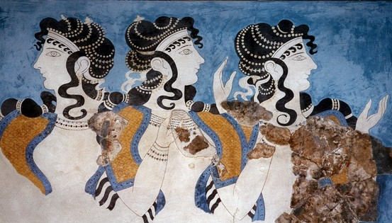

Slide 2
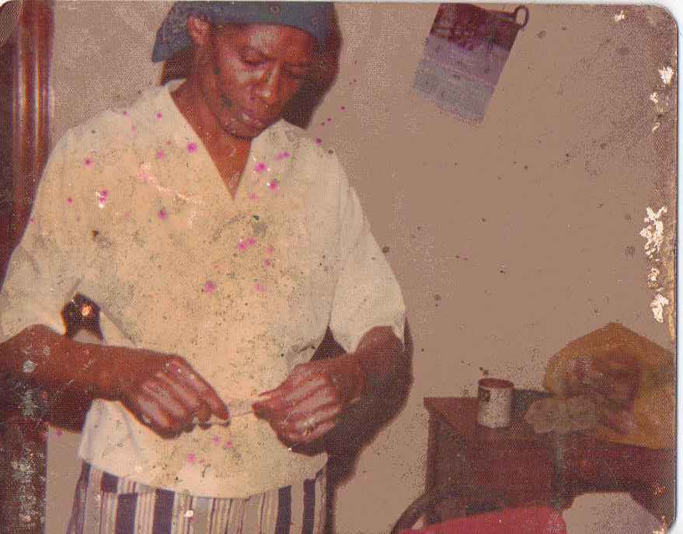

Slide 3
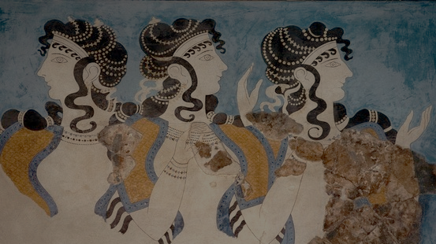
Faithful: Translating the classics
Emily Wilson
Professor of Classical Studies
Chair of the Program in Comparative Literature
& Literary Theory
University of Pennsylvania

Slide 4
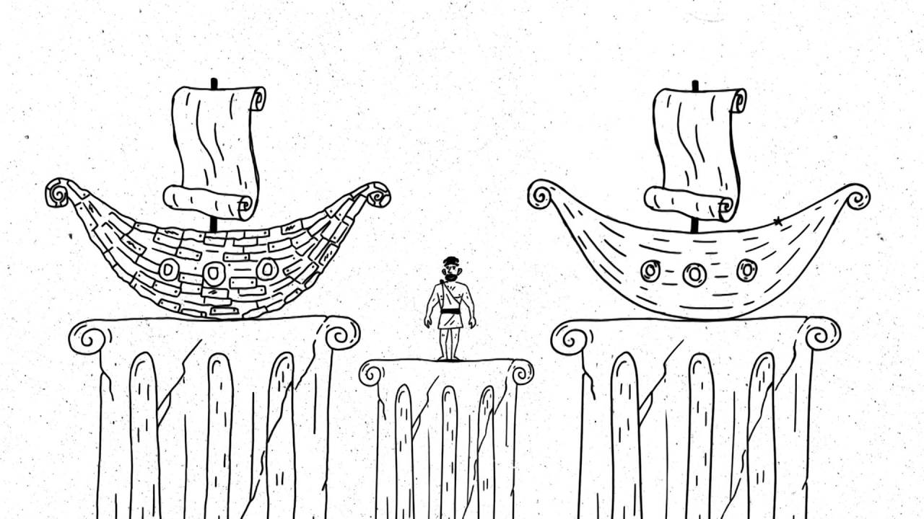
The Ship of Theseus Paradox: if Theseus replaces every element of his original ship in the course of his journey, does he come home in the same ship, or a different one?
The Translator’s Equivalence Dilemma: Translators replace every word and syllable of the original text with entirely different ones, and also move it to an entirely different cultural context. What might it mean to do perform this impossible task responsibly?

Slide 5
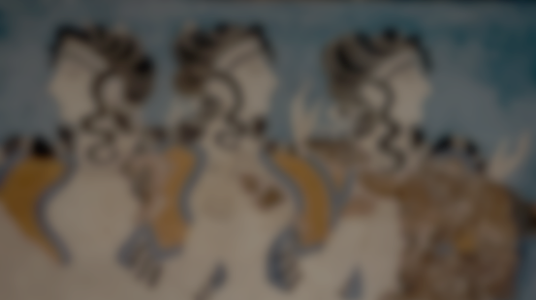
Foreignizing is “an ethnodeviant pressure on [target-language cultural] values to register the linguistic and cultural difference of the foreign text, sending the reader abroad.”
  (Lawrence Venuti)
  cf. Antoine Berman, “Trials of the Foreign”
But this doesn’t work if the reader already assumes the text will be “foreign” in particular ways—e.g. archaic, primitive, bombastic, pre-critical, “heroic”, conservative, etc.

Slide 6
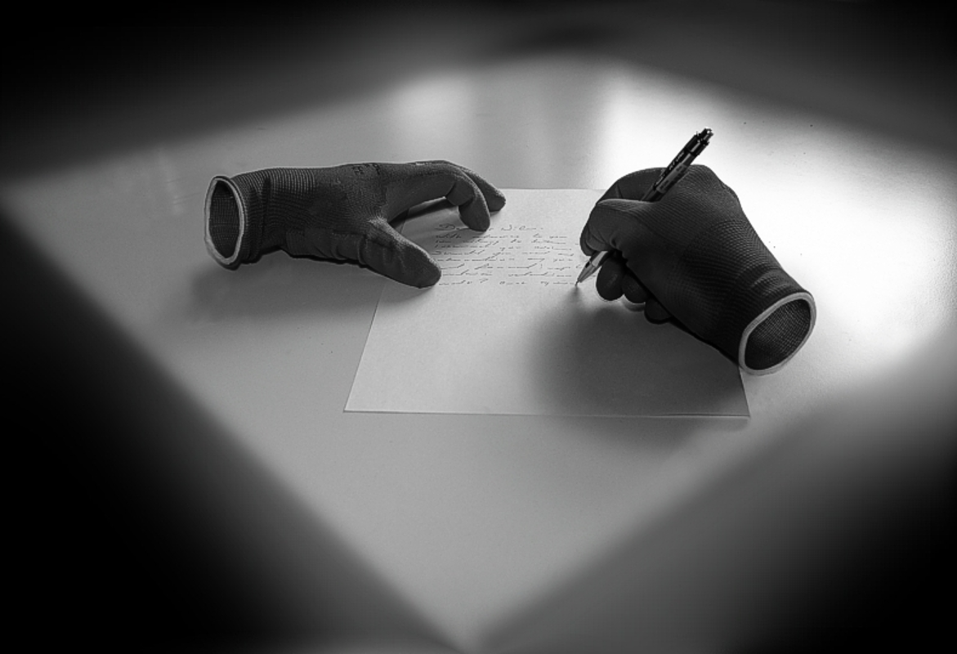

Slide 7
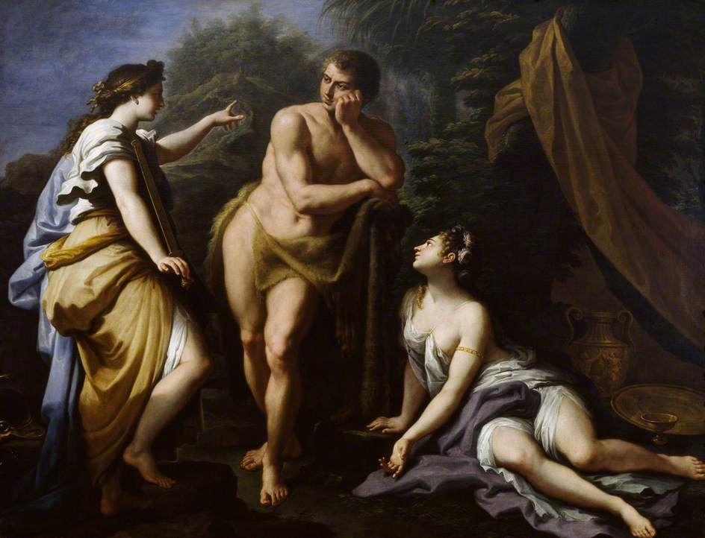
Heracles at the crossroads, with Virtue and Pleasure (Paolo de Matteis):
THIS IS THE WRONG IMAGE FOR TRANSLATION

Slide 8
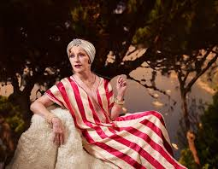
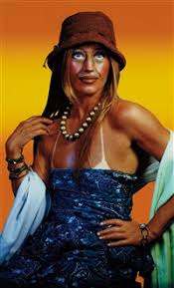
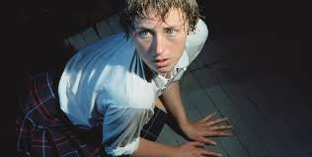
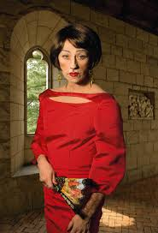
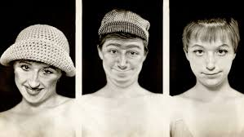
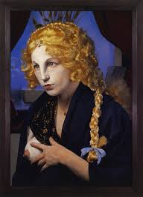
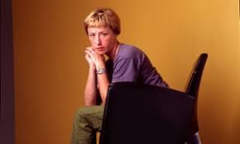
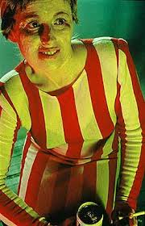
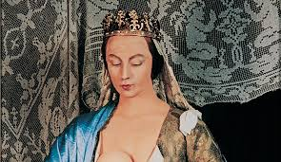
Cindy Sherman: Many true portraits

Slide 9
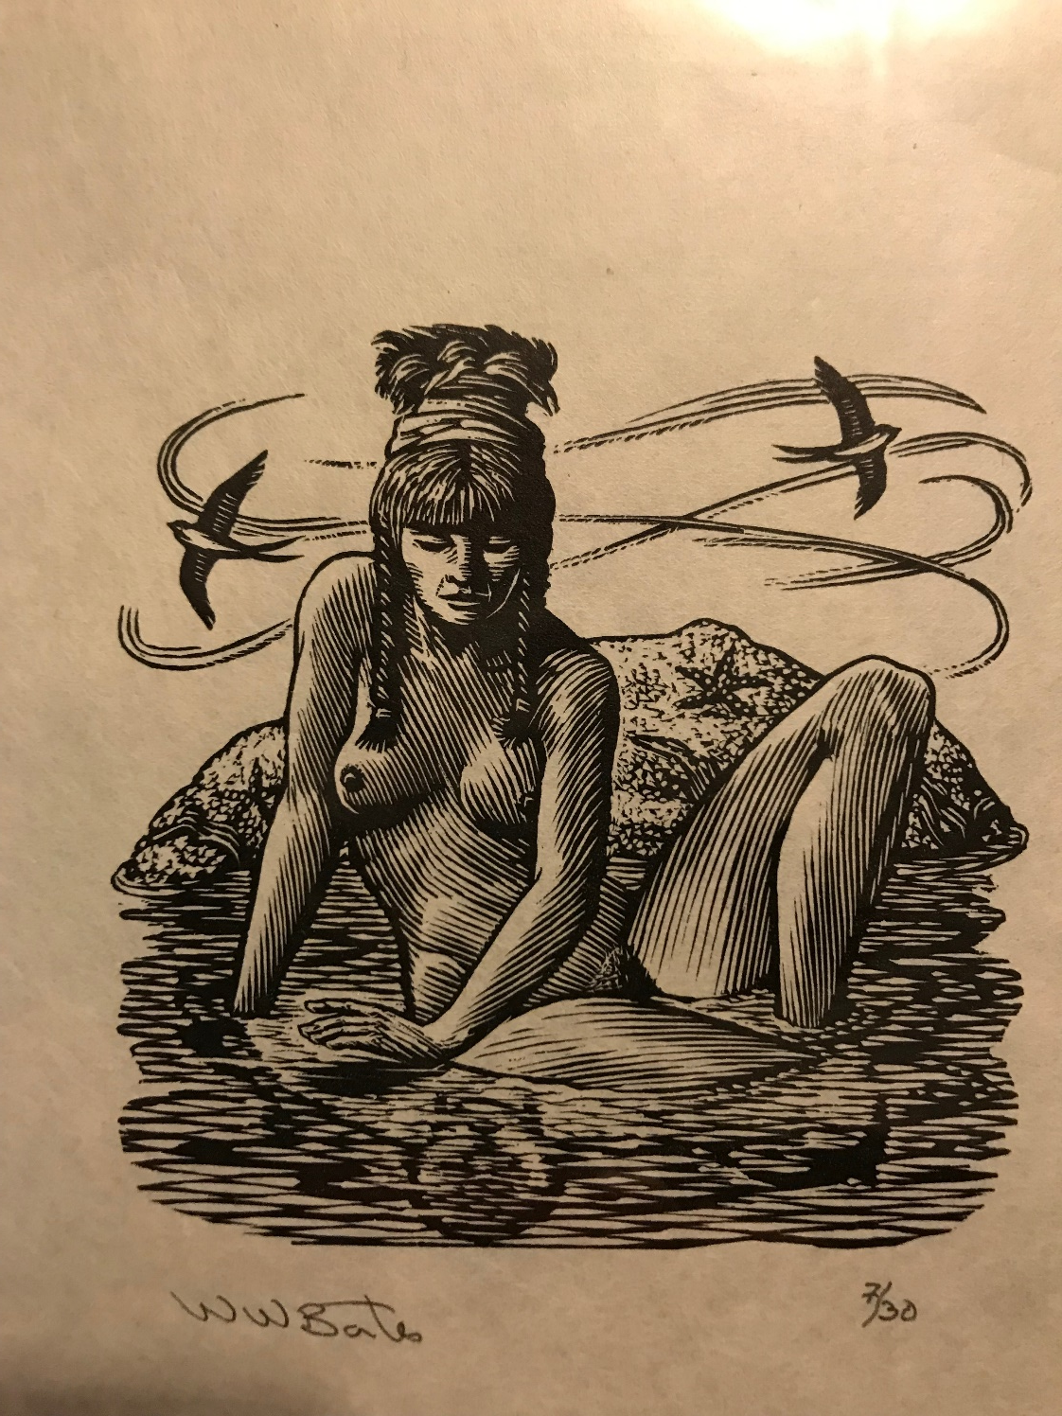
Engraving of Calypso
by Wesley Bates

Slide 10
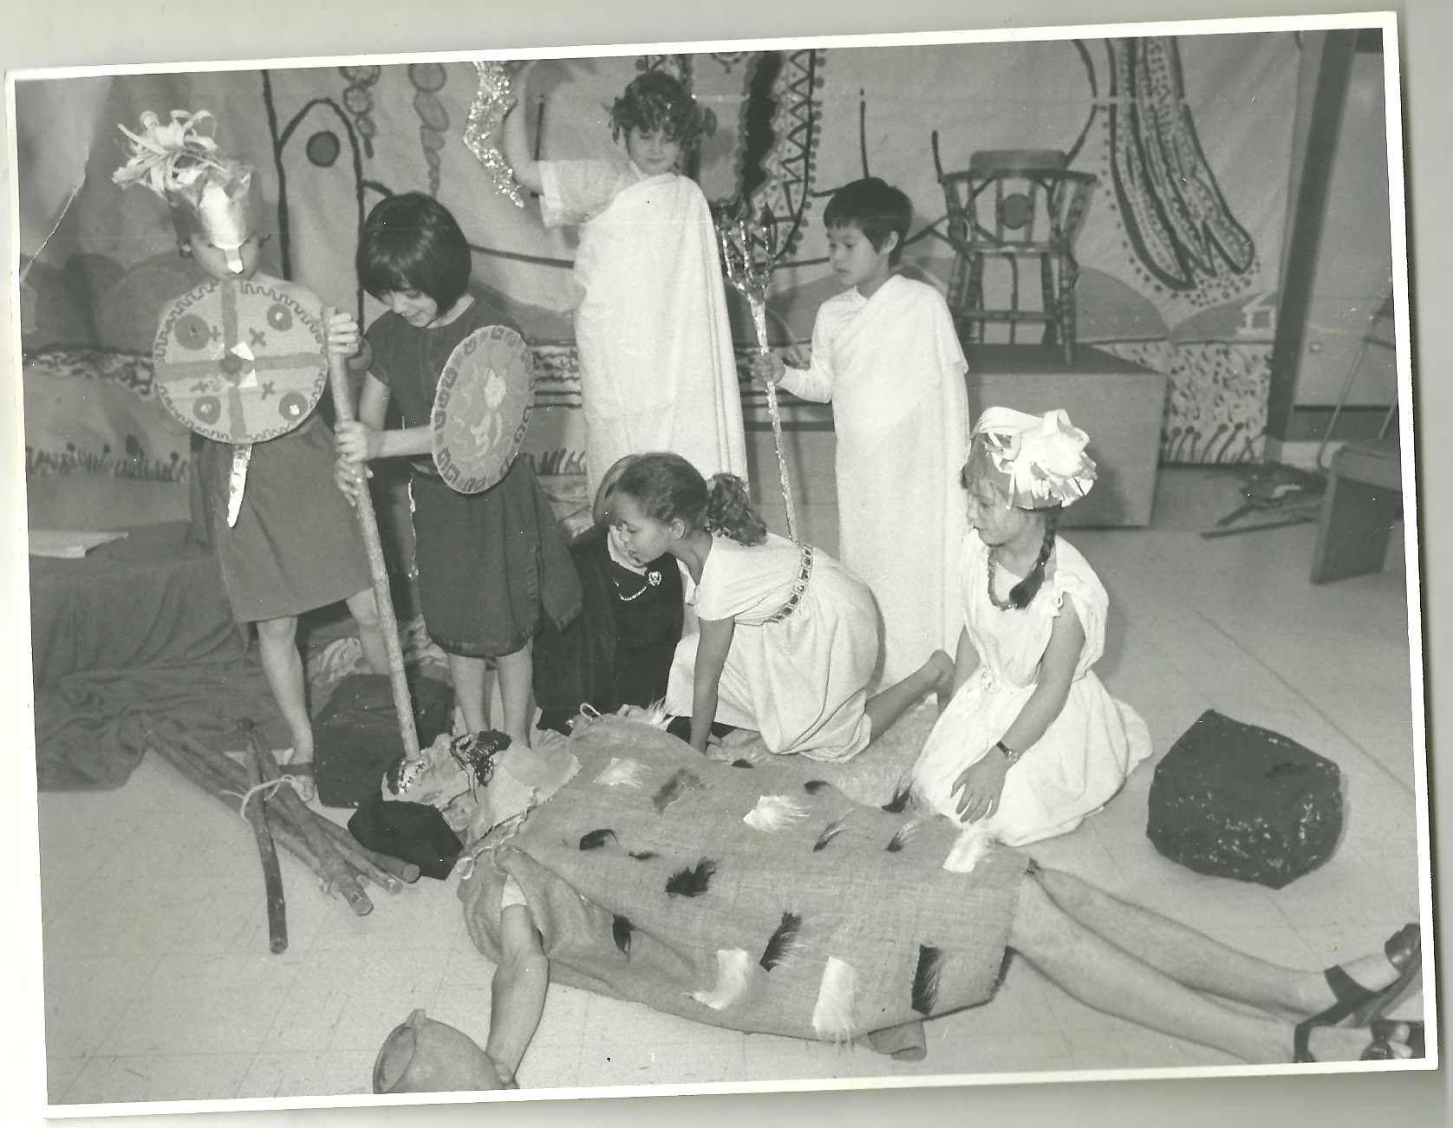
St. Barnabas, Oxford, Elementary School Production of The Odyssey, 1980.

Slide 11
ἄνδρα μοι ἔννεπε, μοῦσα, πολύτροπον
The man, O Muse, inform, that many a way
Wound with his wisdom to his wished stay...
Chapman, 1615
The man for wisdom’s various arts renown’d
Long exercised in woes, O Muse, resound!
Pope, 1725

Slide 12
Hexameters and Hexameter-ish
ἄνδρα μοι / ἔννεπε, /μοῦσα, πο/λύτροπον, /ὃς μάλα/ πολλὰ
πλάγχθη, ἐ/πεὶ Τροί/ης ἱε/ρὸν πτολί/εθρον ἔπ/ερσεν...
Homer (hexameter)
Tell me, /Muse, of the / man of many ways, who was driven [unmetrical]
far journeys, after he had sacked Troy’s sacred citadel. [unmetrical]
Lattimore (a bit hexameter-ish)
Tell me, / Muse, of the / man versa/tile and re/sourceful, who / wandered
many a / sea-mile / after he / ransacked / Troy’s holy / city.
Merrill (hexameter)
The man—Muse / tell me ab/out that res/ourceful / man who / wandered (?)
far and / wide when he’d / sacked Troy’s / sacred / citadel (? five beats?)
Green, hexameter-ish

Slide 13
No Meter, But Laid Out As If Verse
Sing in me, Muse, and through me tell the story
of that man skilled in all ways of contending,
the wanderer, harried for years on end,
after he plundered the stronghold
on the proud height of Troy.
Robert Fitzgerald, 1961
Sing to me of the man, Muse, the man of twists and turns
driven time and again off course, once he had plundered
the hallowed heights of Troy.
Robert Fagles, 1996
Speak, Memory.
Of the cunning hero,
the wanderer, blown off course time and again
after he plundered Troy’s sacred heights.
Stanley Lombardo, 2000

Slide 14
Tell me / about / a compl/icat /ed man.
Muse, tell / me how / he wand/ered and / was lost
when he / had wrecked / the hol/y town / of Troy...
Wilson, 2017
iamb: u- (da-DUM)
pentameter: five feet

Slide 15
How can one replicate not only the dictionary-definitions of the words of the original, but the literary and emotional effect?
It’s not “faithful” to turn a great & beautiful & musical poem into ugly, contorted, un-rhythmical, clunky English
Essential elements in the effect of Homer:
  pace
  rhythm
  clarity / simplicity
  magic
  pleasure
  emotion
  psychological depth
  Multiple POVs

Slide 16
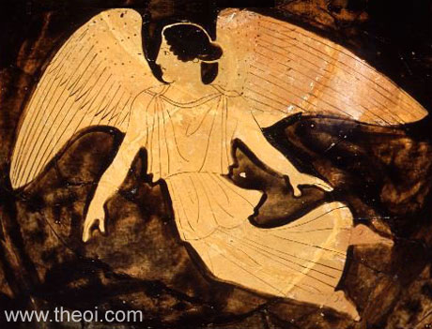
ἦμος δ᾽ ἠριγένεια φάνη ῥοδοδάκτυλος Ἠώς...
The early Dawn was born; her fingers bloomed...
When newborn Dawn appeared with rosy fingers...
When rosy-fingered Dawn came bright and early...
Soon Dawn was born, her fingers bright with roses....
When Dawn appeared, her fingers bright with flowers...
When early Dawn appeared and touched the sky / with blossom..
When vernal Dawn first touched the sky with flowers...
Soon Dawn appeared and touched the sky with roses.
When early Dawn shone forth with rosy fingers...
But when the rosy hands of Dawn appeared..
Early the Dawn appeared, pink fingers blooming
When early Dawn revealed her rose-red hands
Then when rose-fingered Dawn came, bright and early
....Then the roses of Dawn's fingers / appeared again
When Dawn came, / born early, with her fingertips like petals,
...When rose-fingered Dawn / appeared
Then Dawn was born again; her fingers bloomed
Eos the dawn, Athenian red-figure lebes gamikos C5th B.C., University of Mississippi Museum

Slide 17
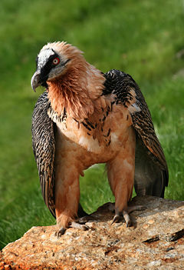
Weird words:
pep talk
stuck up
ossifrage
sauntered
complicated
scalawag
canapés
mercurial
corn-rows
Ossifrage
https://leesbird.com/bb/ossifrage/

Slide 18
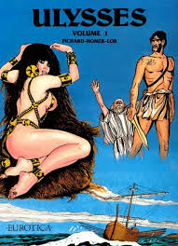
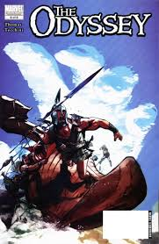
Ulysses: 001
Nbm Pub Co (1 Jun. 1994)
Marvel Illustrated: The Odyssey #6
Marvel Comics (April 2009)

Slide 19
Tell me about a complicated man.
Muse, tell me how he wandered and was lost
when he had wrecked the holy town of Troy,
and where he went, and who he met, the pain
he suffered on the sea, and how he worked
to save his life and bring his men back home.
He failed, and for their own mistakes, they died:
they ate the Sun God’s cattle, and the god
kept them from home. Now goddess, child of Zeus,
tell the old story for our modern times.

Slide 20
The Hanging of the Slave Women: Greek text
τοῖσι δὲ Τηλέμαχος πεπνυμένος ἦρχ᾽ ἀγορεύειν:
‘μὴ μὲν δὴ καθαρῷ θανάτῳ ἀπὸ θυμὸν ἑλοίμην
τάων, αἳ δὴ ἐμῇ κεφαλῇ κατ᾽ ὀνείδεα χεῦαν
μητέρι θ᾽ ἡμετέρῃ παρά τε μνηστῆρσιν ἴαυον.’
ὣς ἄρ᾽ ἔφη, καὶ πεῖσμα νεὸς κυανοπρῴροιο
κίονος ἐξάψας μεγάλης περίβαλλε θόλοιο,
ὑψόσ᾽ ἐπεντανύσας, μή τις ποσὶν οὖδας ἵκοιτο.
ὡς δ᾽ ὅτ᾽ ἂν ἢ κίχλαι τανυσίπτεροι ἠὲ πέλειαι
ἕρκει ἐνιπλήξωσι, τό θ᾽ ἑστήκῃ ἐνὶ θάμνῳ,
αὖλιν ἐσιέμεναι, στυγερὸς δ᾽ ὑπεδέξατο κοῖτος,
ὣς αἵ γ᾽ ἑξείης κεφαλὰς ἔχον, ἀμφὶ δὲ πάσαις
δειρῇσι βρόχοι ἦσαν, ὅπως οἴκτιστα θάνοιεν.
ἤσπαιρον δὲ πόδεσσι μίνυνθά περ οὔ τι μάλα δήν.

Slide 21
What is the murderer like?
Greek: Τηλέμαχος πεπνυμένος
Lattimore: thoughtful Telemachus
Fitzgerald: Telémakhos, who knew his mind, said curtly..
Fagles: ... and stern Telemachus
Lombardo: Telemachus,/ in his cool-headed way
Green: Sagacious Telemachus
Wilson: Telemachus then took initiative

Slide 22
Are the victims human? Does Telemachus think they deserved it?
Greek : τάων, αἳ … παρά τε μνηστῆρσιν ἴαυον
Lattimore: “these creatures”
Fitzgerald: I would not give the clean death of a beast
to trulls … you sluts
Fagles: You sluts—the suitors' whores!"
Lombardo: —the suitors' sluts
Green: extensive footnote on this passage focuses entirely on the mechanics of hanging a 1200lb weight of humans on a single rope.
Wilson: “these girls … lay beside the suitors”

Slide 23
Does the simile dehumanize the victims, or the opposite?
Fitzgerald: [hung] like larks in springès triggered in a thicket / where the birds think to nest—a cruel nesting
Fagles: flying in / for a cozy nest but a grizly bed receives them
Lombardo: And the bed that receives them is far from welcome.
Green: flying back / To their roosts, and hateful the bed that now welcomes them
Wilson: to fly / home to their nests, but someone set a trap— / they crash into a net, a bitter bed-time

Slide 24
The moving feet: are they party girls’ feet, or birds’ feet, or the feet of dying human beings?
Fitzgerald: Their feet danced for a little, but not long.
Fagles: they kicked up heels for a little—not for long.
Lombardo: Their feet fluttered /For a little while, but not for long.
Wilson: They gasped, / feet twitching for a while, but not for long

Slide 25
Poem includes different perspectives on the various murders
Athena: kleos—GLORY
Odysseus: dike—PAY-BACK
Telemachus: aidos—SHAME
Women: nostos- UNFULFILLED HOMECOMING
Narrator: oiktos—PITY

Slide 26
The Hanging of the Slave Women: Wilson
Telemachus then took initiative,
insisting, “I refuse to grant these girls
a clean death, since they poured down shame on me
and Mother, when they lay beside the suitors.”
At that, he wound a piece of sailor’s rope
round the rotunda and round the mighty pillar,
stretched up so high no foot could touch the ground.
As doves or thrushes spread their wings to fly
home to their nests, but someone set a trap –
they crash into a net, a bitter bed-time; 470
just so the girls, their heads all in a row,
were strung up with the noose around their necks
to make their death an agony. They gasped,
feet twitching for a while, but not for long.

Slide 27
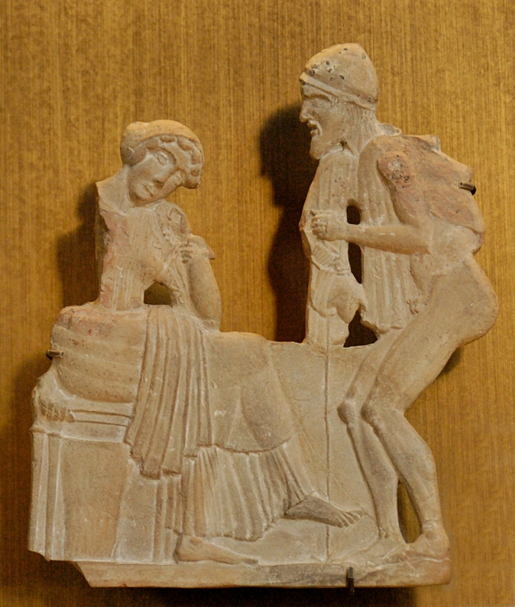
Penelope and Odysseus
Whose gaze is privileged, if either? How are they different?
Musée du Louvre
Ulysse et Pénélope
around 450 BC

Slide 28
Translators serve many mistresses
The original text
The original language.
The original historical & literary context.
The new text (the translation).
The English language.
Translators’ own cultural contexts & readership.

