Slide 1


“Why do birds sing?”
Lauren Riters
Professor of Biology
Notes:
To Download PowerPoint in order to use in your own slides, Please select “File” - “Download” - “Microsoft PowerPoint (.pptx)”

Slide 2
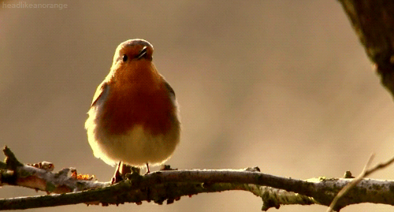
Why do birds sing?
Lauren V. Riters
Department of Biology
University of Wisconsin Madison
WiffleGif
European robin
Notes:
Thanks…I appreciate the opportunity today to present. Thank you to Lisa Brooks and the Naturalist Group for inviting me to give this talk to the Monona Community Senior Center.
Thank you for the kind introduction -- I am Lauren Riters and I have been a professor in Biology at the University of Wisconsin for over 24 years now. And the focus of research in my lab is on how hormones environmental and social factors regulate birdsong… and if you are a birder you will groan because most of my research is on starlings which are not popular (drive out native songbirds, agricultural pests – Aldo Leopold saw them as symptoms of a sick environment) but they are really great singers. So I’ll mention some of my research on starlings but today I’ll talk more broadly about what biologists have discovered about WHY BIRDS SING.
The center is pretty much on the lake next to Port Washington South Beach Park, AND someone reported a flamingo! In September of 2023; which includes Old Coal Dock Park ands Port Washington Avian Sanctuary.
From eBird -- Can expect to see a lot of non songbirds gulls and ducks and cormorants, loons, herons ----https://ebird.org/hotspot/L2059749/bird-list?yr=cur&hs_sortBy=count Can expect cardinals and sparrows robins jays etc… AND during migration you might see other songbirds including warblers and redstarts and cedar waxwings.
https://ozaukeepress.com/content/flamingos-make-history-port Natural beauty can sometimes be found in unlikely places. That’s what I learned on a hike along Port Washington’s waterfront. An area that was once a place used by ships to unload coal for a power plant has a decidedly different energy today - it’s a Wisconsin nature sanctuary that’s teeming with life, home to birds, butterflies and wildflowers. It’s called the Port Washington Avian Sanctuary, and it’s a hidden gem worth seeking out. Port Washington Avian Sanctuary, a nearly five-acre habitat that’s teeming with wildlife. It’s located on what was once the “South Dock.” The old soot-covered dock has been completely transformed. Established in 2011 as part of a mitigation project associated with the Port Washington Generating Station, the sanctuary is home to a variety of habitats, including deep and shallow marshes, wet meadows, and prairies. It’s hard to imagine this park in Port Washington as a coal dock. It’s become a key stop-off point for migratory birds traveling up the Lake Michigan shore.

Slide 3
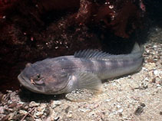
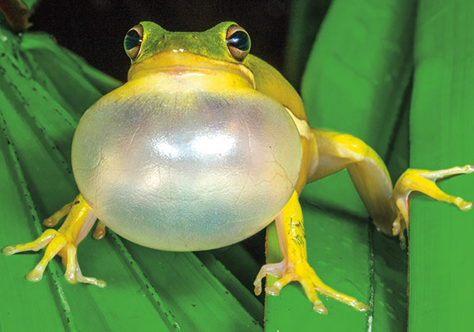
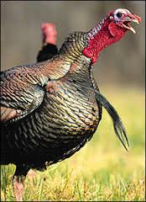
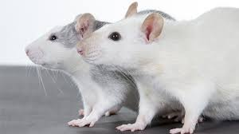
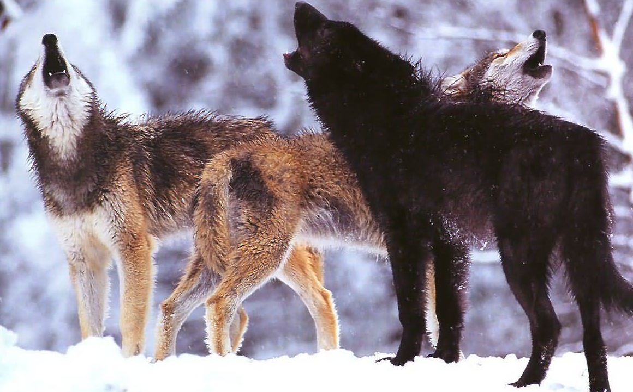

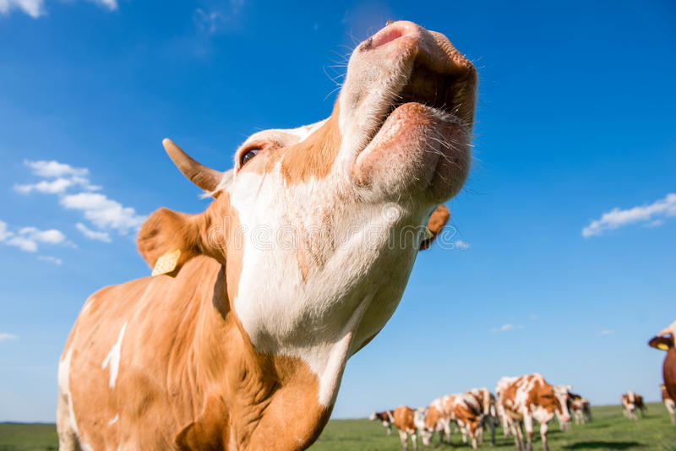
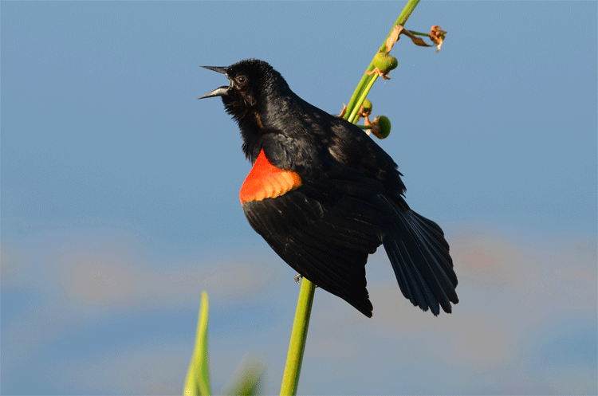
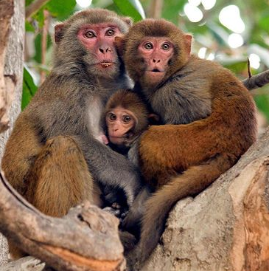
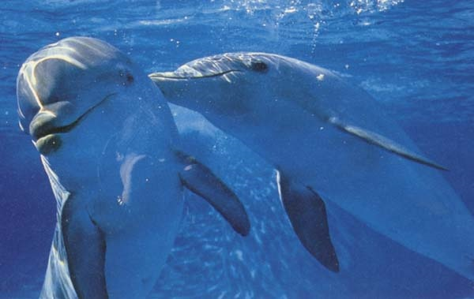
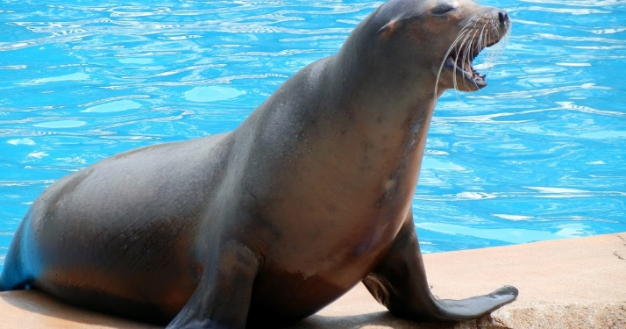

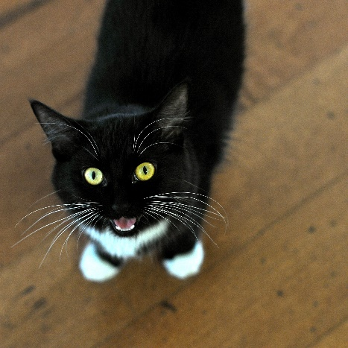
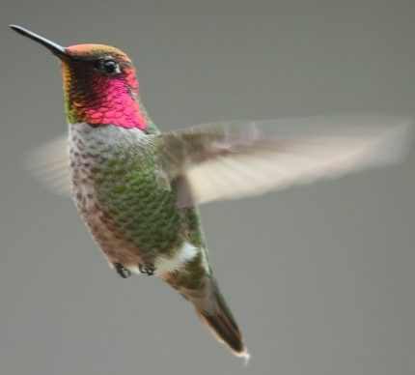
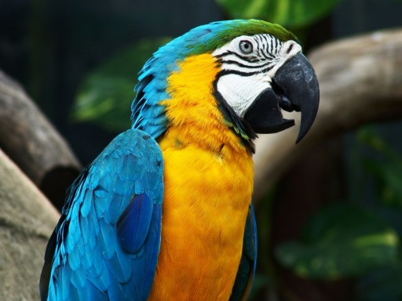
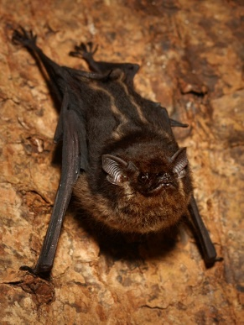
Vocal communication is critical for social success across animal species.
Notes:
Vocal communication across animal species is critical for success soc intxns … we are all familiar with vocal behavior in many animals…frogs croak, rats squeak, cows moo etc….For most species vocal behavior is unlearned…..an animal does not need be taught to produce its species-typical vocalizations. But that is not the case for all animals.

Slide 4
Vocal learning is rare across the animal kingdom.
Notes:
Although it is really rare, some animals must learn at least some of their vocalizations from tutors, from adults or peers…..Vocal learning is found in only a few animals….you see it in elephants, songbirds (which We’ll talk about today) – related birds like parrots,humingbirds, and also dolphins and whales, seals bats and of course humans
Different ORDERS (taxonomic categories)
Order Passeriform (perching bird) only oscines…= about 4500 songbirds and 10,000 bird species 3 toes forward one back
So not all birds learn to vocalize…chickens hawks owls…
Hummingbirds order apodiforme, family – Trochilidae – unique iwing structure, small feet that aren’t for walking – this order includes swifts (not swallows- which are passeriforme)
Parrots order Psittaciformes – family Psittacidae – 2 toes forward, prehensile tongue, curved beak
Songbirds are order Passeriformes – in the oscine suborder
Kingdom (animal) phylum (chordata) class (aves) order family genus species

Slide 5
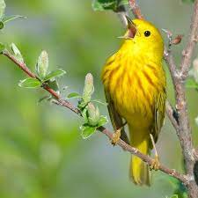
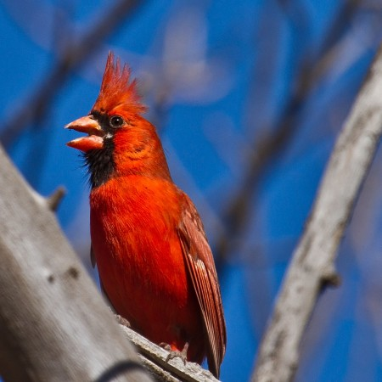
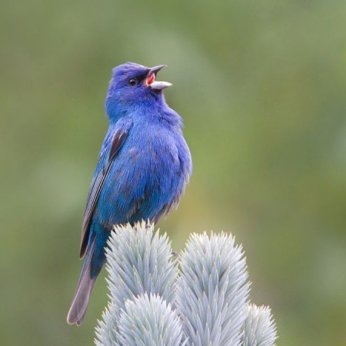
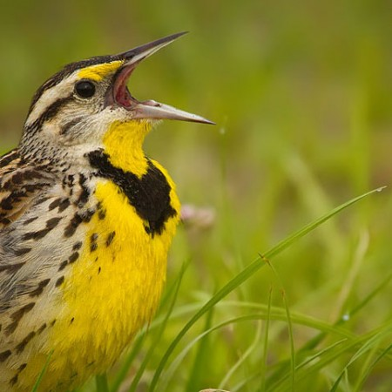

Songbirds learn species-specific songs.
Yellow warbler
Northern cardinal
Indigo bunting
Eastern meadowlark
?
?
songbird photos: allaboutbirds.org
Notes:
See https://xeno-canto.org/species/Setophaga-aestiva to try to embed songs
When it comes to vocal learning and vocal production songbirds are in a league of their own. Songbirds which I’m showing you here... make up about half of the world’s 10,000 bird species. IN fall millions of these birds migrate south and if you are out and about you may hear some song but in spring when the birds return and are preparing to breed the skies are full of bird song AND if you have an ear for birdsong or an App…Merlin Bird ID. So if you were to hear the song of a cardinal it would be very distinct.. And a meadowlark different from cardinal
CAN I make so can’t see screen guess who is singing on cardinal – can any one name who is singing?
Each bird sings its own species typical song --

Slide 6
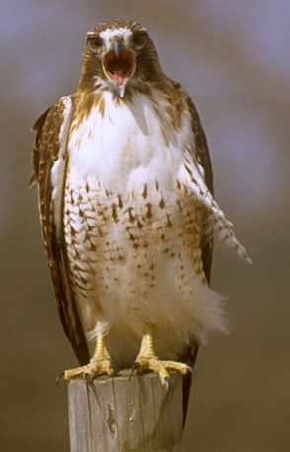
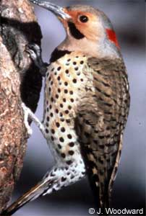
Many birds call. Songbirds sing and call.
Yellow warbler
Northern cardinal
Indigo bunting
Eastern meadowlark
Not songbirds →
photos: allaboutbirds.org, ozaukeepress.com
Notes:
We are going to focus on songbirds and songs but songbirds also “call” as do non songbirds….what is the difference between a song and call?
A distinction is made between songs and calls…Generally song is the more melodious, complex vocalization…with specific functions….linked to things an individual is advertising – it is linked to health ..a male trying to tell female he’s attractive or to communicate to another male that he’s threatening…calls are often not learned simpler…things not advertising quality…an example would be an alarm call. Not true for all birds…chickadees…# of dees at end how threatening the stimulus is….and short fee bee is the song..

Slide 7
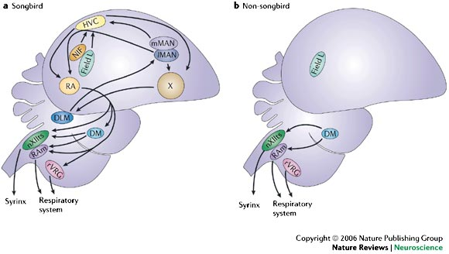
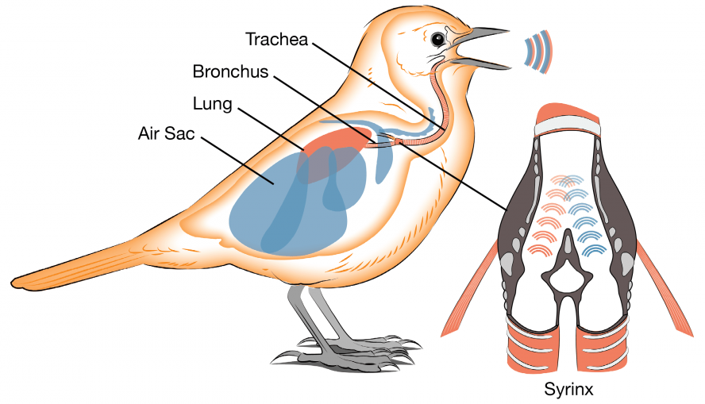
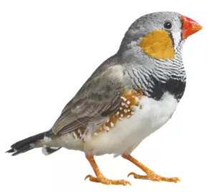
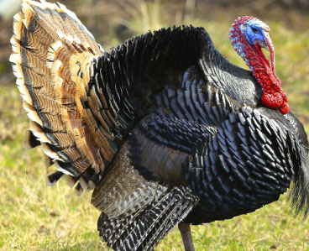
Songbirds have a “song control system” in the brain.
And a syrinx
Bolhuis and Gahr 2006
Notes:
Songbirds have evolved a specialized brain system to learn and produce song….ONLY songbirds have this system in the brain….(and vocal learners like hummingbirds and parrots have something similar)…birds that sing more in spring…this system gets larger and brain new brain cells show up here during the breeding season when males sing courtship song – so adult animals can grown new brain cells – give us all hope. Other birds don’t have these brain areas.
Songbirds produce song with a specialized organ called a syrinx…it can produce 2 sounds at once. (other birds do have a syrinx) – we have a larynx we can’t do this
How does the Northern Cardinal (Cardinalis cardinalis) span a wider range of pitches than a piano in just a tenth of a second? Remarkably, the secret to the Northern Cardinal’s vocal prowess has been measured in the lab.¹ It turns out that these vocal gymnastics are made possible by a seamless switch between sides of the syrinx partway through the cardinal’s most dramatically sweeping notes.

Slide 8
Why do songbirds sing?
Yellow warbler
Northern cardinal
Indigo bunting
Eastern meadowlark
Notes:
Song must be really important…evolved such an elaborate brain system….SO WHY? Why do birds sing?
Next…show list
Song sparrow

Slide 9
Outline: Why do birds sing?
Learning / practice
To attract a mate
To repel a competitor
Because it feels good
Notes:
There are many reasons birds sing. I’ll go through 4 today…starting with song practice and ending with the possibility that they sing because it is rewarding…because it feels good.

Slide 10
Outline: Why do birds sing?
Learning / practice

Slide 11
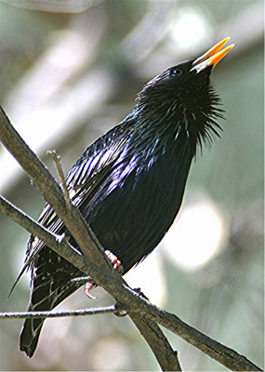
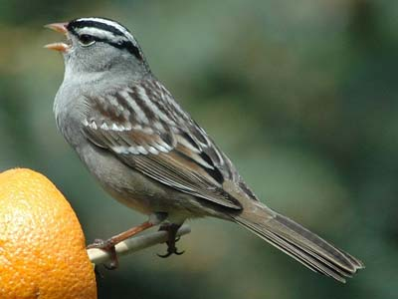
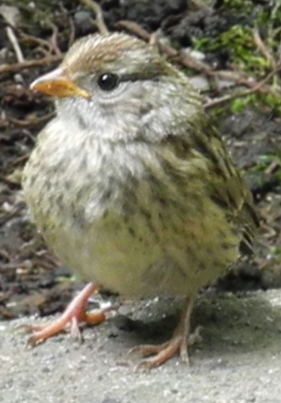
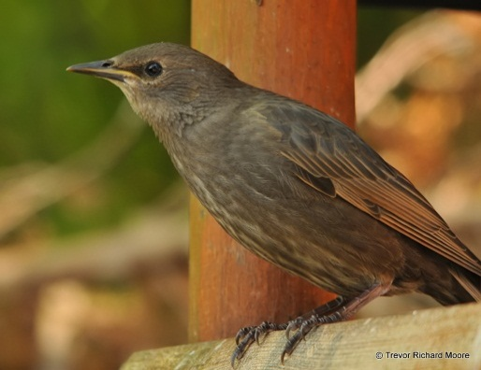
Why do birds sing?
Learning / practice
-songbirds learn songs from adult tutors
White-crowned sparrow
European starling
Sensitive period learners
Open ended learners
In many species males and females sing
Notes:
Many songbirds begin learning their songs while still in the nest, during a phase known as the critical period, when nestlings listen to the adults singing around them (just like human infants). Then following fledging – leave the nest, young birds attempt to match the songs of their parents they go through basically a babbling period (also like human infants) (if you have a good ear for bird song you can sometimes hear these not quite perfect sloppy songs), practicing until they have matched their parents’ song. For some species that is IT….they will sing the song they learned during a sensitive period…lasting 15-50 days and then as an adult…and they will not learn new songs. Other species can continue to learn songs throughout their lives…such as starlings. Some songbirds, do’n just learn from parents…some birs such as starlings (the ones I study) as well as catbirds, thrashers, and mockingbirds, blue jays learn to mimic other species—frogs, dogs, other birds, human speech and even car alarms. Finally, males are famous for singing to attract females (we’ll talk about that soon) but females of many species also sing…eg cardinals both males and females sing a lot.
Window 15 – 50 days (depend on species and sex)
Female White-crowned sparrows yes a little
Female starlings yes
Female cardinals yes – sensitive period but males period is longer than females possible because he disperses and must be able to learn dialect in his geographical region to be successful.
Female robins? Read no but then saw yes in winter

Slide 12
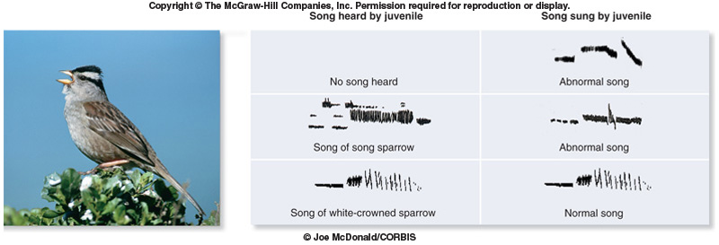
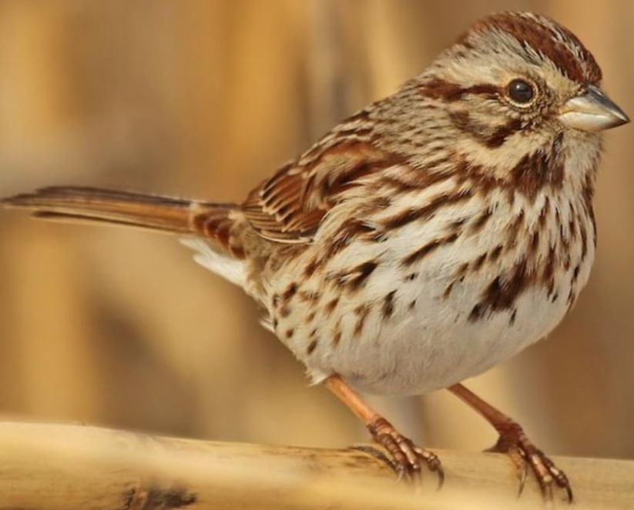
Song is learned but birds are predisposed to learn the song of their own species.
Group
White-crowned
sparrow
1
No song heard
Abnormal song
2
Song sparrow song
Abnormal song
Song
sparrow
3
White-crowned sparrow song
Normal song
Campbell Biology
Notes:
So biologists figured out that song is learned and they were curious….if song is learned could we get a bird to learn the song of another species? For example, could you get a white-crowned sparrow for example to sing song sparrow song?
So here is an example of the kind of study biologists run to ask this question….
in this study….
Song is learned but MOST birds can’t just learn anything.

Slide 13
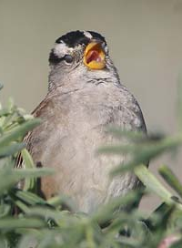
Birds learn local song dialects.
Mountain white-crowned
sparrow
Females prefer to mate with males singing local dialects
MacDougall-Shackleton x2 2001
Notes:
The next question was…if song is learned….could birds develop accents? Like humans that live in Oklahoma or Boston or here in Wisconsin? Are there regional dialects? Yes. Biologists have found that bird song varies geographically…so here is an example of a study of mountain white-crowned sparrows in the Sierra Nevada mountains…GO THROUGH FIG.
It turns out that females prefer to mate with males that sing local dialects….AND males have actually been found to CHANGE song to match female preferences…..
FIG. 1. Locations of sample sites throughout the Sierra Nevada. Ovals indicate dialect regions; sites within an oval are characterized
by a common dialect. Numbers indicate sample sizes for each site; sites with fewer than five males sampled were excluded from the analysis.

Slide 14
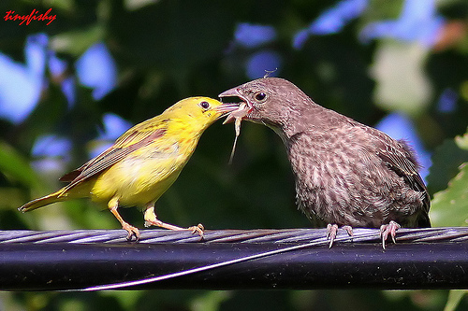
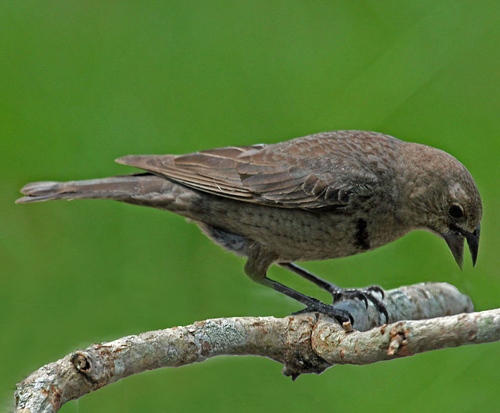
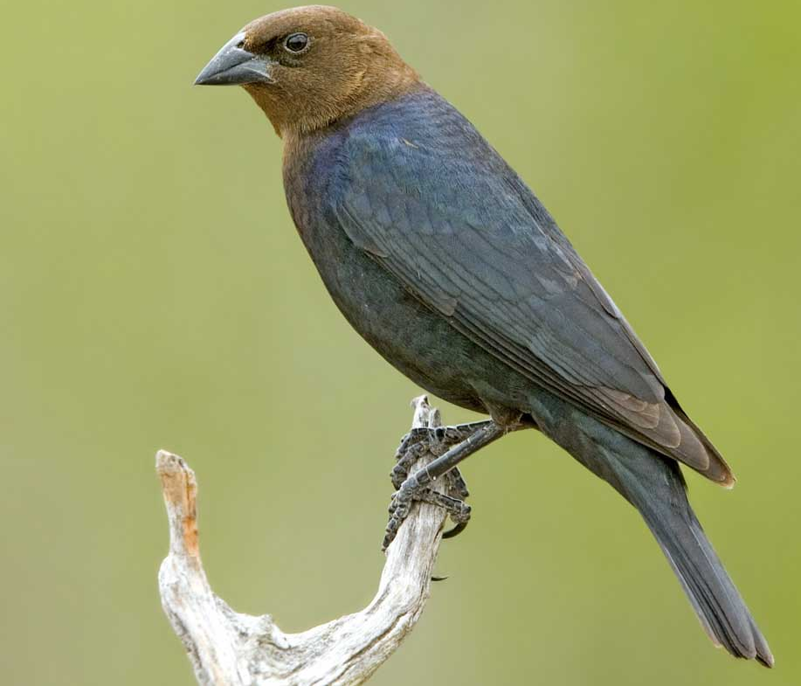
Female responses can shape male song.
Brown-headed cowbirds
Presidio
Females (from Indiana)
Males (from South Dakota)
When housed with IN females, males learned IN song.
Notes:
So this has been shown in cowbirds…and before I tell you about that study…let me introduce cowbirds…these are brood parasites…they do not raise their own young. The female lays her eggs in the nests of other birds! Now this makes it really tricky for cowbirds to learn cowbird song…they are raised by other birds (here is a yellow warbler feeding a cowbird chick). It turns out that the young birds learn song when they join other flocks of cowbirds.
It has also been found that females (who don’t sing) also shape singing….UPDATE UPDATE UPDATE A group of biologists put males from South Dakota with females from Indiana, and assumed that, with time, the females from Indiana would develop a preference for South Dakota song. But over time, males from SD changed their singing behavior to more closely match female preferences….so it turned out the female ignored SD song but responded any time a male produced something like IN song…so she trained the males to alter songs.
Non-Vocal Shaping of Avian Song Development: Parallels to HumanSpeech DevelopmentAndrew P. King*, Meredith J. West* & Michael H. Goldstein
COOL cowbirds stuff from Woodland Dunes talk below!
-- Also, one of the viewers on Tuesday evening shared a couple of interesting articles about cowbirds. They suggest that young cowbirds leave the host nest at night and roost with other cowbirds and this may be how cowbirds learn to become cowbirds. Cool stuff! The links are below.
https://northernwoodlands.org/outside_story/article/cowbirds#:~:text=Most%20female%20cowbirds%20will%20have,their%20young%20within%20their%20range
https://www.audubon.org/news/how-does-cowbird-learn-be-cowbird
Cultural transmission of vocal traditions in cowbirds (Molothrus ater) influences courtship patterns and mate preferences
https://pubmed.ncbi.nlm.nih.gov/11459168/

Slide 15
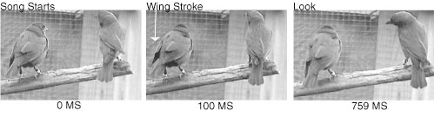
Female cowbird wing strokes shape male song.
West and King lab
Notes:
And it turns out that what she is doing is very subtle and very quick and we can’t really see it. She flips her wing.
…they use a wing stroke (as brief as 200 ms). The female is the architect of the male brain.
Songs eliciting wing strokes
developed into effective courtship signals, as measured by subsequent playback
testing of the songs effectiveness at eliciting copulatory postures in females in
breeding condition. Songs associated with wing strokes were significantly more
potent than songs produced in the same singing bout but unaccompanied by a
wing stroke.
They’re selecting an attentive, good male that can read a female.”
Julie Gros-Louis · David J. White · Andrew P. King Meredith J. West

Slide 16
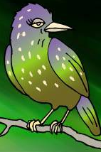
Outline: Why do birds sing?
Learning / practice
To attract a mate
Notes:
So much about song… at least for males is all about reproducing…he sings to attract a female, he sings to keep other males away from his female and he sings even when it’s not the breeding season in a flock to practice song that he will later use to try to attract a female

Slide 17
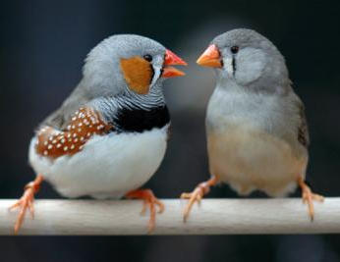
Birds time courtship song and mating so that chicks hatch when resources are available.
Zebra finches
European starling
Opportunistic breeders
Seasonal breeders
Notes:
Birds time reproduction so that chicks hatch when resources are available….some birds are opportunistic breeders…Many birds around here are seasonal….it would be foolish to lay eggs in the middle of a Wisconsin winter…there would be no insects or seeds to feed the chicks…so around here most birds are seasonal breeders. Environmental, hormonal, and social factors stimulate courtship song.

Slide 18
Courtship song is stimulated by day length and testosterone.
testosterone
European starling
Seasonal breeders
Notes:
Daylength is the best predictor for when conditions are right to breed….days are predictably long in spring and short in winter….in songbirds here in Wisconsin…in fall and winter gonads are small and males do not sing to females…but in spring as daylength increases this information goes right through the skull (not through the eyes…if you put a little dark cap on the birds this won’t happen)…the daylength is sensed by the brain and this causes the gonads to grow and produce hormones (testosterone for the males). The testosterone acts on those brain regions that I mentioned are involved in song and on areas that regulate motivation an NOW when a males sees a female he will break into song….
Just as there is a seasonal cycle to bird song there is also a daily cycle, with the most intense period being at first light, the so called 'dawn chorus'. Why sing so intensely at dawn though? It is not known but song travels well through the clear early morning air so that may be part of it.

Slide 19
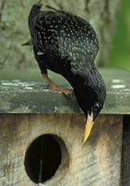
Song attracts and stimulates females.
estradiol
Females are choosy
(males can be too).
Notes:
Ok so males are singing in spring…what about females? Many females do sing and that is gaining research interest but most research on females so far relates to female responses to male song. Females listen to male song and use it to evaluate male quality to decide whether or not to mate with a male…here is a female starling checking out a nest box from which a male is singing. It turns out that hearing song can stimulate female ovaries and so can contact with a nest site….. In some species, male song causes females to go into a mating posture……BUT not just any song will stimulate a female… (THOUGH males can be choosy too…not as well studied but is also gaining research interest)

Slide 20

Females use song to select mates.
Females generally prefer males that sing…
Local song dialects
Long, complex songs
High song rates
Why?
Notes:
Females are choosy and it’s thought that they are choosy b/c they have more to lose if they pick a loser male…they have to invest in egg production. SO what are females looking for?
Generally….
Why? How do females benefit by choosing a male that sings high rates of long complex local song?

Slide 21
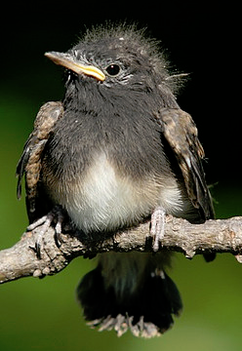
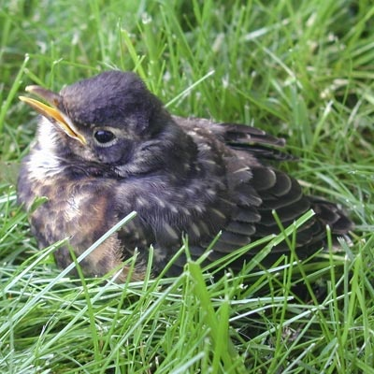
Song tells females about a male’s early condition.
Developmental stress interferes with song learning
Notes:
Song tells females about a males’ early condition. Baby robin … or costs to learning song…
young males in good condition learn songs more accurately than males in poor condition and that females use learning accuracy as an honest signal of male developmental history
Nutritional/developmental stress hypothesis – undernutrition or heavy parasite load leads to poor song development – overally stress early in life results in production of less attractive song in adulthood – early stress causes lest accurate copying of songs

Slide 22
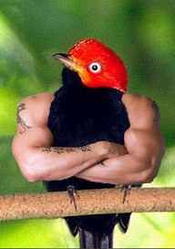
Song tells females about a male’s current condition.
Singing is costly
Thus only high-quality males can produce high quality songs
Low quality males cannot “cheat” and sing high quality songs; song honestly indicates male quality
From forums.somethingawful.com
Notes:
Song is thought to tell her something about current male quality. Singing is costly…energetically and it makes males vulnerable to predators and when they sing they are no doing other things like eating. Because singing is costly only high-quality males without parasites, that are well fed and otherwise strong and healthy can sing…so low quality males can’t produce high quality song. THUS by choosing a male that sings high rates of long complex local song a female is selecting a high quality male to help raise her offspring.
From forums.somethingawful.com

Slide 23
Outline: Why do birds sing?
Learning / practice
To attract a mate
To repel a competitor

Slide 24
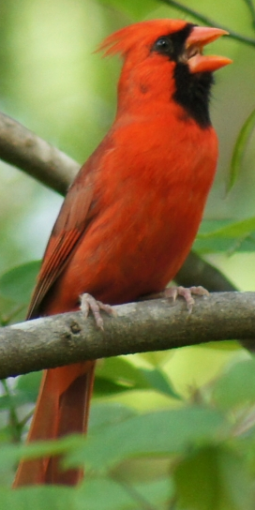
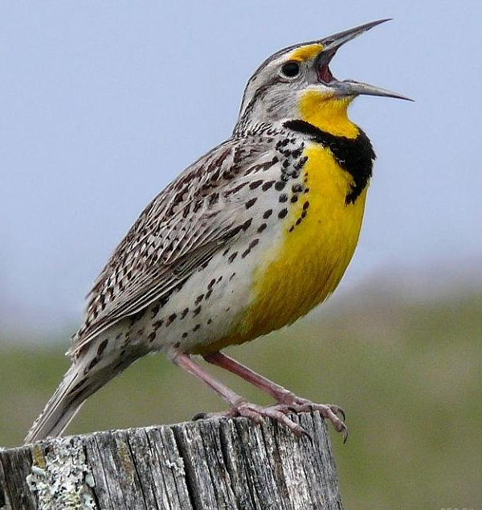
Males sing to defend territories from other males.
Meadowlark
Red-winged blackbird
Cardinal
For many species the same song that attracts a female also repels a competitor
(note: not just a male thing – e.g., female cardinals and starlings also sing at high rates to repel competitors)
Notes:
The same song that attracts a female repels other males rwbbs will attack you…!
Some famous territorial birds around here…
Meadowlark – polygamous defends territory like rr bbs – often has 2 mates, sometimes 3
Cardinal (males and FEMALES do this) – usually one mate (often pair for life but not always)
Red winged black bird often has 5 mates can be up to 15
Sing when a male enters the territory
This song is used to defend territories…may not directly attract females…though females pay attentino (I’ll show you inupcoming slide)
THO’ in some species there are separate territory and mate attraction songs -- Catchpole 1982 says structure of song may differ when singgin to attract mate or defend territory and its seems tob e true for eg with chestnut sided warbler..

Slide 25
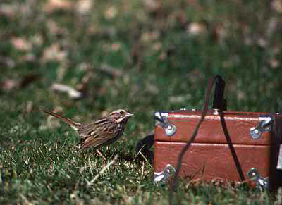
When biologists play song in a territory, the territory holder sings and approaches the speaker.
Song sparrow threatening a speaker
If a biologist plays song in an empty territory, it is more likely to remain empty.
Notes:
If play song in a territory the territory holder sings and approaches speaker
If temporarily mute a bird he loses his territory
If play song from an empty territory it is less likely to be taken over

Slide 26
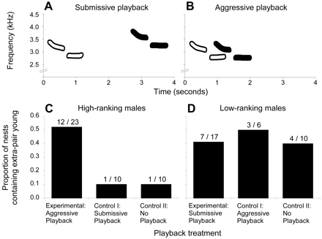
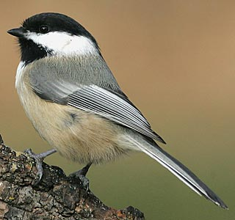
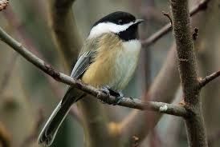
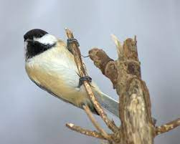
Females eavesdrop on male singing competitions.
High ranking males that received an “aggressive response” lost paternity.
Mennill et al., 2002
Notes:
Territorial song is not used to attract females but females do use it to make mating decisions……
Male Chickadees do this countersinging thing where high ranking males are never interrupted…they sing feee beee and are NOT interrupted and female will actively attempt to mate with these males…low ranking males are interrupted and they do not get to mate with as many females….so in this study scientists decided to see what happened when they interrupted a high ranking male. -- -it’s a sordid tale….SCANDALOUS!
Study by Mennill
White traces = real singer
Black traces = simulated intruder
At the start of the breeding season, when male-male song contests are common and females actively solicit copulations, we used interactive song playback to engage territorial male chickadees in countersinging interactions with a simulated intruder
High-ranking males that lost song contests with a simulated intruder lost paternity in their nests (Fig. 1C); high-ranking males that received playback simulating an aggressive intruder showed a significantly greater level of paternity loss than high-ranking males that received playback simulating a submissive intruder…The genetics told the sordid tale, Mennill says. "After a high-ranking guy lost a competition because I matched and overlapped his song, his female engaged in extrapair copulations." To Mennill, this proves that the females are eavesdropping on the guy-to-guy discussion
So when the lady heard her guy humiliated by the computerized song, about half of her future young wound up having a different dad, Mennill reports. "She's accustomed to hearing him win every song contest, but after hearing him lose, she changes her reproductive strategy.“
Indeed, it took only six minutes a day, on two successive days, for the songs to change the female's mind, says Mennill. Apparently "the kind of information available through eavesdropping has a lot of importance relative to reproductive strategies.
Thus, females paired to high-ranking playback subjects adopted a mixed reproductive strategy after hearing brief song contests in which their mate fared poorly. This change in female reproductive decisions after short playback sessions suggests that information available through eavesdropping plays an important role in female assessment of male quality.

Slide 27
Outline: Why do birds sing?
Learning / practice
To attract a mate
To repel a competitor
Because it feels good

Slide 28
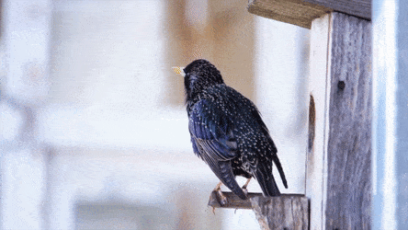
The factors that reward song differ depending on context.
Gyfcat.com
Notes:
Here it is clear what reinforces song….if a rival departs or if a male attracts a female….BUT in some cases why birds sing and what rewards song is not as clear.

Slide 29




Some birds keep singing outside the breeding season for no apparent reason.
Facilitated by flockmates, lack of predators (low stress)
Photo: Richard Smedley Barely B
Fall
-Song learning, practice
-Flock cohesion
-Not related to courtship or territory
-Not immediately functional
Notes:
This type of singing is critical but appears to be “non-functional” in an immediate sense.

Slide 30
There are few behaviors animals perform at high rates for no apparent reason.
“Play is a repeated, seemingly non-functional behavior differing from more adaptive versions structurally, contextually, or developmentally...”
Burghardt, 2014 Anim. Behav. and Cogn.
Is flock song a form of play behavior?
That is, do birds sing for “fun”?
Notes:
With the notable exception of play behavior, which is defined here in a recent paper by Gordon Burghardt as a …. Similarly song practice is a repeated seemingly non-functional behavior differing from ….So could song practice be a form of play behavior?
Play is a repeated, seemingly non-functional behavior differing from more adaptive versions structurally, contextually, or developmentally, and initiated when the animal is in a relaxed, unstimulating, or low stress setting.
This leads to the idea that perhaps birds sing because it feels good… because whey do we play? Because it feels good…it’s fun!

Slide 31





Notes:
To put this into a broader context. Do birds play? There are famous examples of bird play (birds engaging in behavior for no apparent adaptive purpose)-- parrots and magpies and crows…ducks, birds of prey. It has been estimated that only 1% of the 10,000 birds species play…. But could it be that affiliative flock may be a prevalent form of play exhibited by an estimated 4500+ species of oscine songbirds. Fall song when they are practicing….
Red kite playing with tennis ball
Magpie
Kea (New Zealand parrot) even have a play call…play it back and they start to play
Sledding crow in Russia https://j.gifs.com/yDQrbd.gif

Slide 32



Is flock song play? For a behavior to be considered play it must be…
1) No obvious, immediate function
2) Spontaneous or rewarding
3) Modified from other contexts in which the same behavior might occur
4) Performed repeatedly but not rigidly
5) Initiated when free from stress
?
?
“not fully functional”
?

Slide 33

Starlings sing less rigid, “sloppier” songs in fall.
Spring
Fall
n=12
n=12
n=12
n=12
Female songbirds tend to prefer and males to avoid longer or more stereotyped songs.
Alger et al., 2016
Notes:
Accompanying differneces in song function and motivational state, we have found differences in structural features of song.
Given differences in the function of song in these 2 contexts, we wondered if song might be structurally distinct. SJA study….yes.
Marcel Eens has shown that song bout length in starling is best predictor of male mating success in starlings and in multiple other songbirds females prefer and males are replled…so this means that males are adjusting song structure to promote social cohesion in fall (make it sloppier and less threatening) and to attract females and repel males in spring
There is evidence that songbirds in flocks modify structural aspects of song to promote social tolerance. For example, analyses of recordings of song produced by male songbirds (e.g., zebra finches, starlings, xx sparrows smith bren) demonstrate that song produced in gregarious flocks is shorter, less stereotyped, and contains fewer notes than song produced in the context of female-directed mate attraction (). Females prefer to mate with males singing long, stereotyped, complex songs, and these features of song tend to repel male competitors (). Thus, social tolerance may be promoted in flocks through the de-emphasis of song features that induce sexual and agonistic responses.
We report this here in starlings but this has been reported in multiple other songbirds as well.
Canaries, song sparrows, zebra finches and other species as well.
Complex vocal signals, such as birdsong, contain acoustic elements that differ in both order and duration. These elements may convey socially relevant meaning, both independently and through their interactions, yet statistical methods that combine order and duration data to extract meaning have not, to our knowledge, been fully developed. Here we design novel semi-Markov methods, Bayesian estimation and classification trees to extract order and duration information from behavioural sequences and apply these methods to songs produced by male European starlings, Sturnus vulgaris, in two social contexts in which the function of song differs: a spring (breeding) and autumn (nonbreeding) context. Additionally, previous data indicate that damage to the medial preoptic nucleus (POM), a brain area known to regulate male sexually motivated behaviour, affects structural aspects of starling song such that males in a sexually relevant context (i.e. spring) sing shorter songs than appropriate for this context. We further test the utility of our statistical approach by comparing attributes of song structure in POM-lesioned males to song produced by control spring and autumn males. Spring and autumn songs were statistically separable based on the duration and order of phrase types. Males produced more structurally complex aspects of song in spring than in autumn. Spring song was also longer and more stereotyped than autumn song, both attributes used by females to select mates. Songs produced by POM-lesioned males in some cases fell between measures of spring and autumn songs but differed most from songs produced by autumn males. Overall, these statistical methods can effectively extract biologically meaningful information contained in many behavioural sequences given sufficient sample sizes and replication numbers.
KEYWORDS:

Slide 34
Is flock song play? For a behavior to be considered play it must be…
1) No obvious, immediate function
2) Spontaneous or rewarding
3) Modified from other contexts in which the same behavior might occur
4) Performed repeatedly but not rigidly
5) Initiated when free from stress
?
?
“not fully functional”
?
Notes:
Check
Now what about this neural regulation? Conserved…evolutionary sense…birds and mammals diverged from a common ancestor over 300 million years ago and it it thought that brain regions that regulated social behavior in this reptilian ancestor are similar to brain regions that continue to regulate social behavior…

Slide 35

How do you ask a bird if it “feels good” to sing?
1
Behavioral measures (30 min)
Fall
Fall condition
Notes:
We would predict that males singing fall but not spring song would develop a song-associated place preference. To test this…
Highlight that in fall we predict song is intrinsically rewarded and in spring we expect that song is extrinsically rewarded
Wqith the idea that fall song is practice it is intrinsically rewarding if it is play behaivor, but spring song is extrinsically rewarding (rewarded by mating)
WAS THIS 30 min? Yes it was
Singing, prurrp calls, preening, feeding and drinking

Slide 36


2
Conditioning (30 min)
=
Conditioned place preference (CPP)
apparatus

Slide 37
3
Test (next day)
=
Conditioned place preference (CPP)
apparatus
Notes:
The next day birds are allowed to move freely between the two compartments of the CPP apparatus. If the song-paired compartment is preferred, we consider song-induced CPP to have occurred. The idea is that the neural state induced by singing is the unconditioned stimulus. When this neural state is paired with a distinct compartment of the CPP apparatus, this compartment becomes associated with the state induced by the singing behavior. Thus, if song induces a pleasurable or rewarding neural state, then males should develop a CPP.

Slide 38

3
Test (next day)
=
Conditioned place preference (CPP)
apparatus
If singing feels good, birds should spend more time on the green side
Notes:
The next day birds are allowed to move freely between the two compartments of the CPP apparatus. If the song-paired compartment is preferred, we consider song-induced CPP to have occurred. The idea is that the neural state induced by singing is the unconditioned stimulus. When this neural state is paired with a distinct compartment of the CPP apparatus, this compartment becomes associated with the state induced by the singing behavior. Thus, if song induces a pleasurable or rewarding neural state, then males should develop a CPP.

Slide 39

Only starlings singing fall song developed a place preference.
Fall
Song rate
If singing feels good, birds should spend more time on the green side
Riters and Stevenson 2012

Slide 40
Is flock song play? For a behavior to be considered play it must be…
1) No obvious, immediate function
2) Spontaneous or rewarding
3) Modified from other contexts in which the same behavior might occur
4) Performed repeatedly but not rigidly
5) Initiated when free from stress
?
“not fully functional”
Notes:
Check
Now what about this neural regulation? Conserved…evolutionary sense…birds and mammals diverged from a common ancestor over 300 million years ago and it it thought that brain regions that regulated social behavior in this reptilian ancestor are similar to brain regions that continue to regulate social behavior…

Slide 41

Why do birds sing?
“…the songs of birds serve mainly as an attraction during the season of love…”
“…male birds … continue singing for their own amusement after the season for courtship is over”
--Charles Darwin (1874)
Notes:
I thought my hypotheses were entirely novel but it turns out what I propose is something suggested over 150 years ago by Darwin…….we offer mechanisms in support of something Darwin proposed 150 years ago…

Slide 42
Why do birds sing?
Learning / practice
To attract a mate
To repel a competitor
Because it feels good

Slide 43



Questions?
Thank you!
https://xeno-canto.org/ to hear (and upload) song recordings
Go to BirdCast.info to track migration (during migration seasons)
Use the Merlin App to id birds
Notes:
Shima enaga – long tailed bush tit from japan

Slide 44
Questions?
Feel free to contact badgertalks@uwmad.wisc.edu
Sign up to learn about more talks near you at badgertalks.wisc.edu
Thank you!

