Slide 1




From Evansville to Giverny and Back Again:
The Life and Art of Theodore Robinson
Janine Yorimoto Boldt
Collection Reinstallation Project Associate

Slide 2
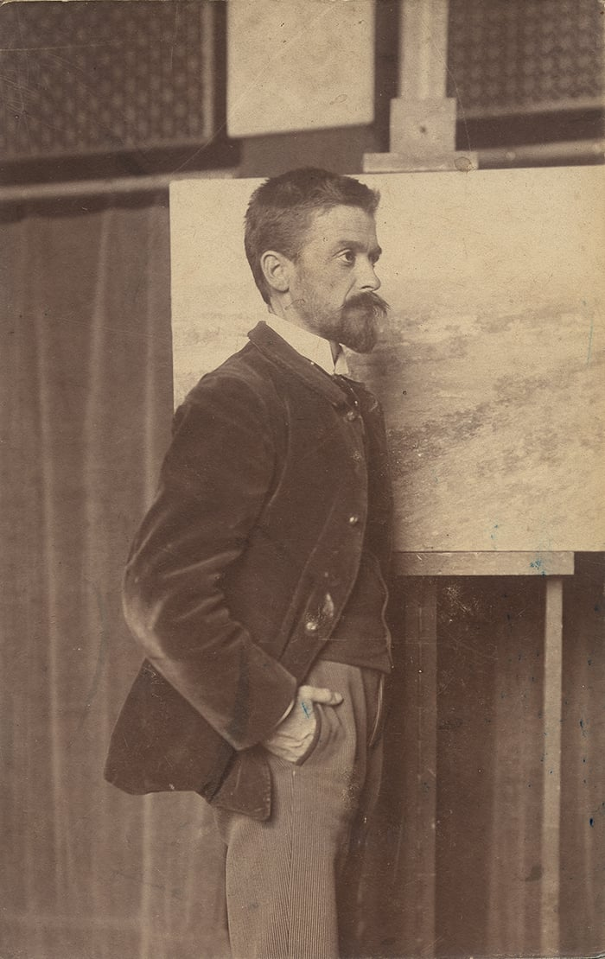
Theodore Robinson
1882

Slide 3
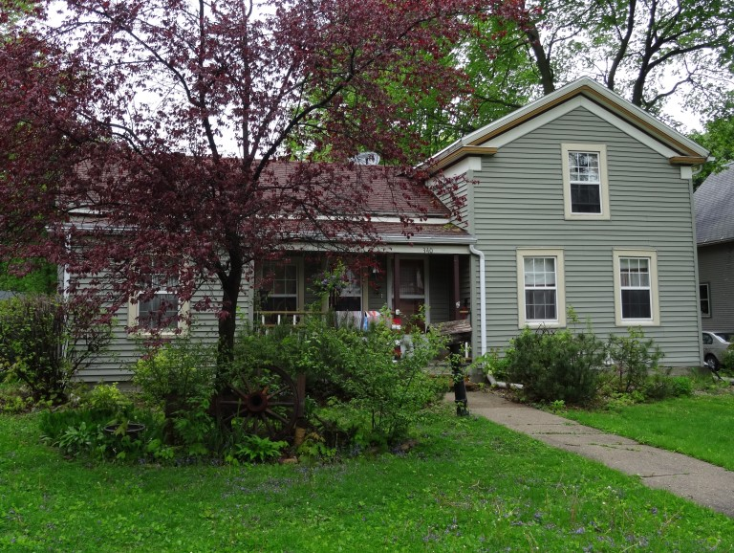
Theodore Robinson’s house, built by Rev. Elijah Robinson, 1857

Slide 4
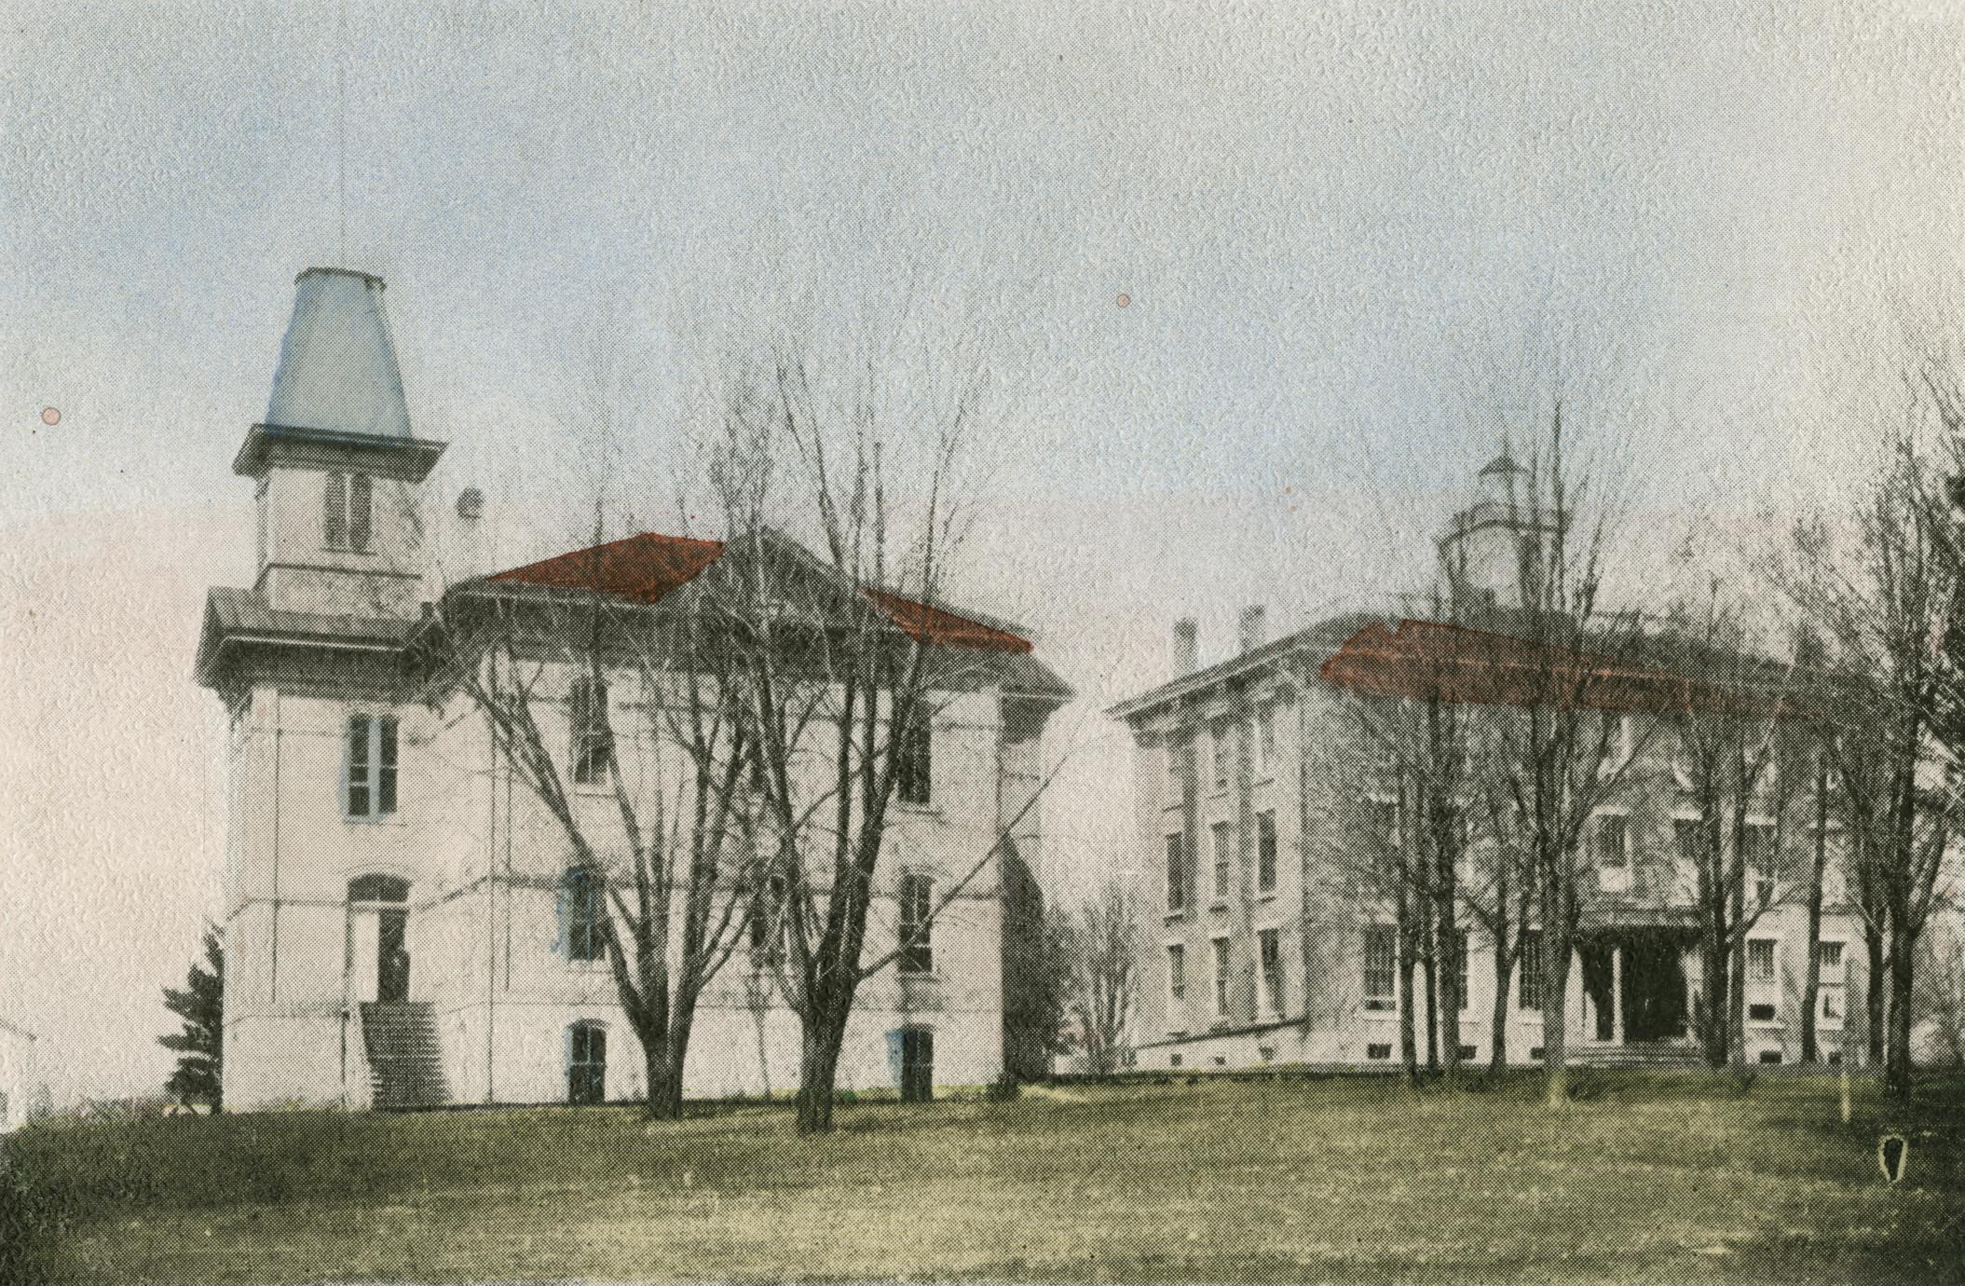
Evansville Seminary, ca. 1900

Slide 5
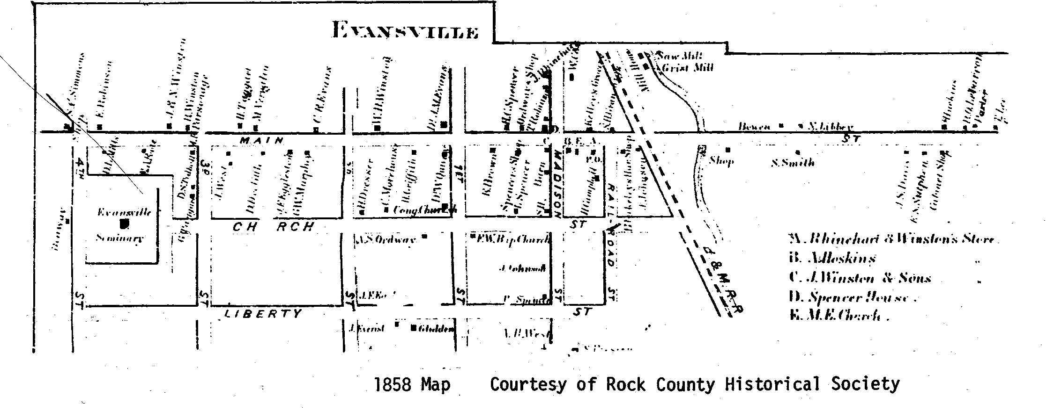

Slide 6
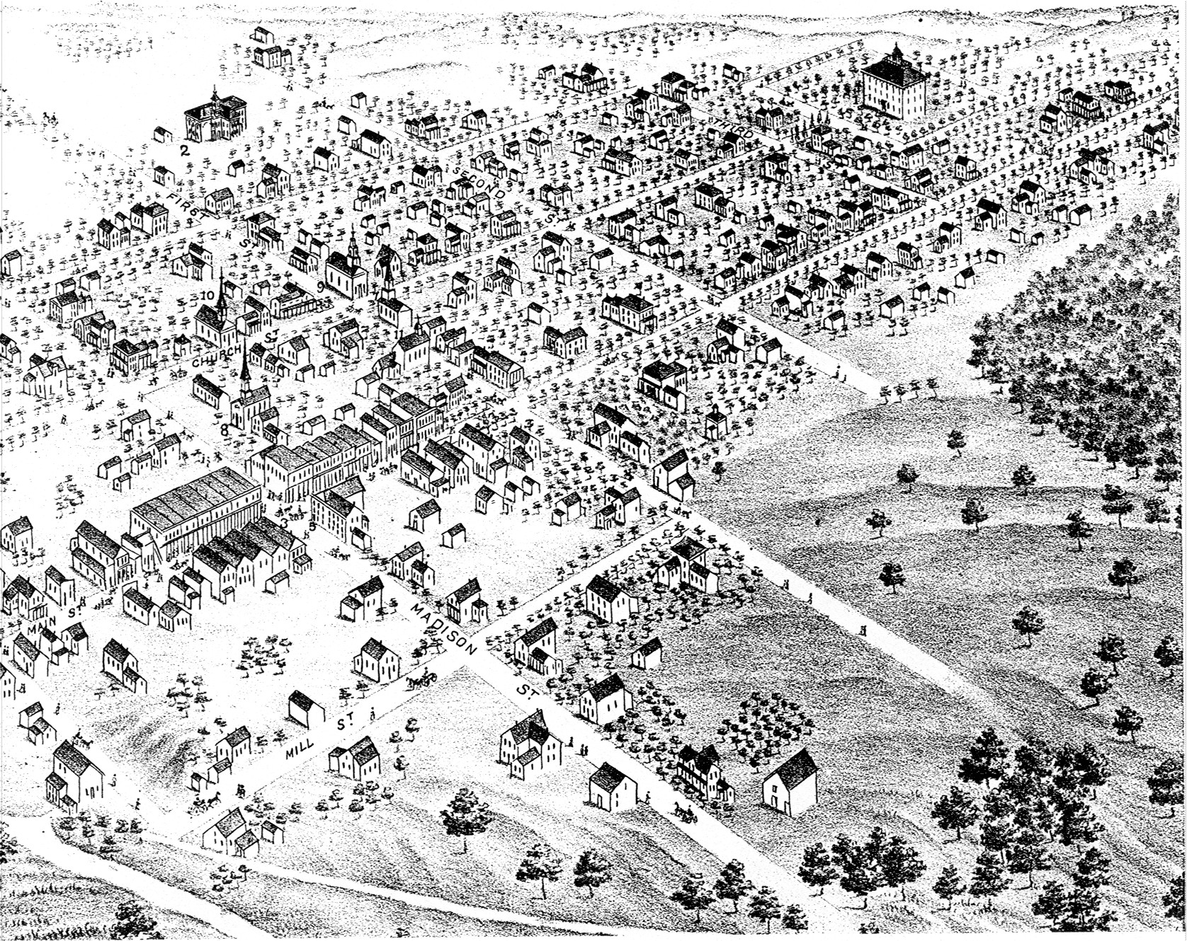
1871 View of Evansville

Slide 7
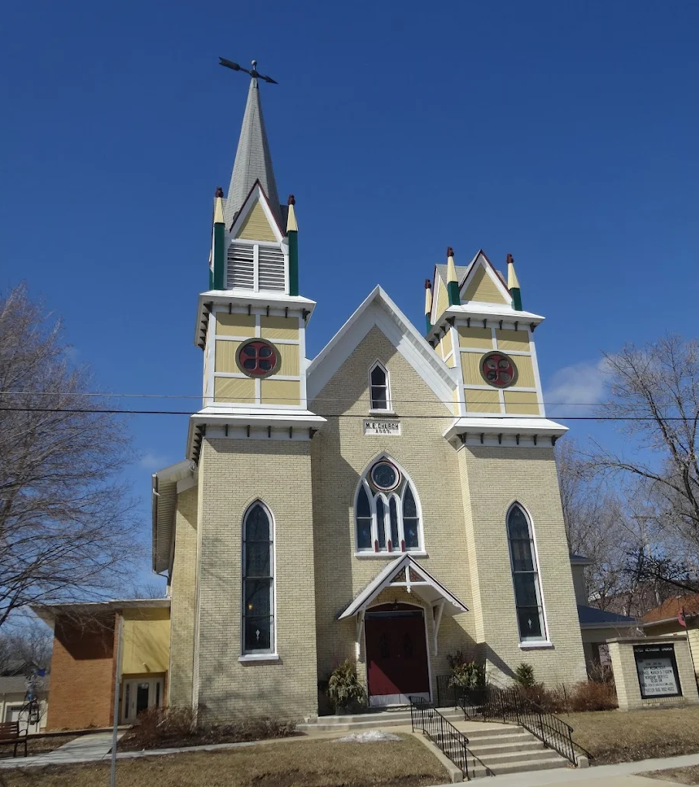
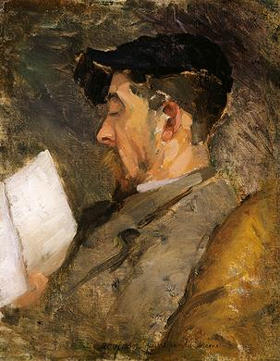
Self-Portrait
ca. 1884-1887
The Metropolitan Museum of Art
Evansville Methodist Church, built 1867

Slide 8
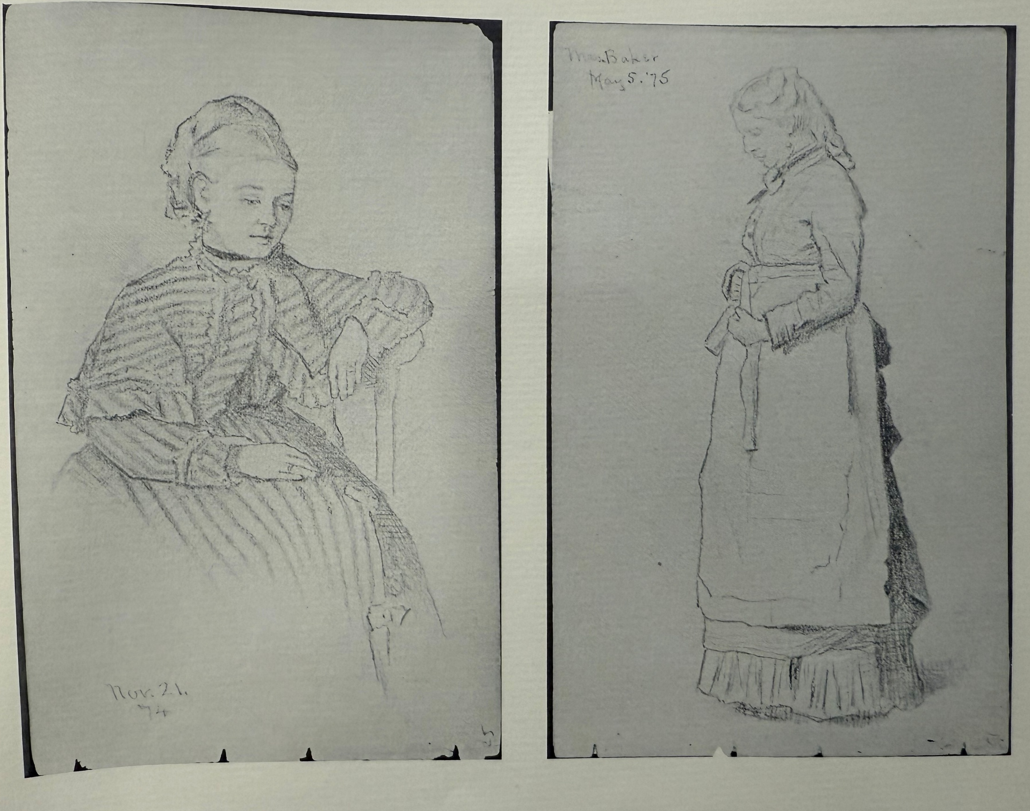
“All who have seen Theodore’s pencil sketches the past year or two, are convinced that he has selected a congenial profession. There is not a young man of better habits, purer morals, or one whom Evansville would delight to honor in any calling more than Theodore Robinson.”
Evansville Review, November 16, 1870
Pages from sketchbook dated 1874 and 1875

Slide 9
“We all part regrettingly with Theodore, or our young artist, as we have been pleased to call him”
Evansville Review, July 31, 1872

Slide 10
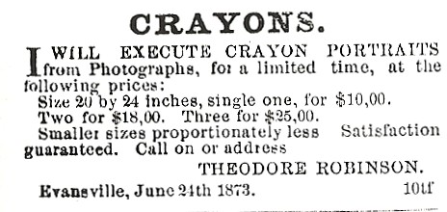
Evansville Review, 1873

Slide 11
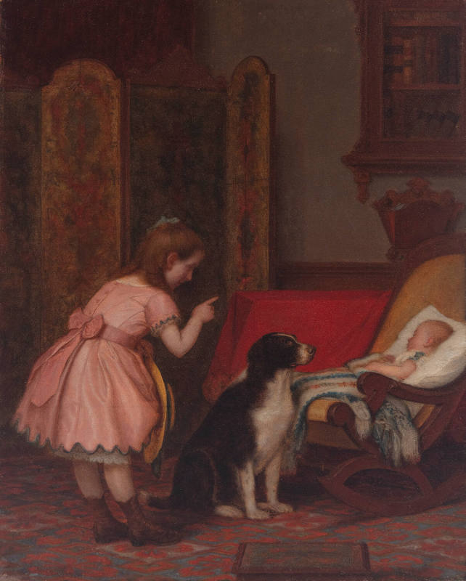
Lemuel Everett Wilmarth
Left in Charge
1874
National Academy of Design

Slide 12
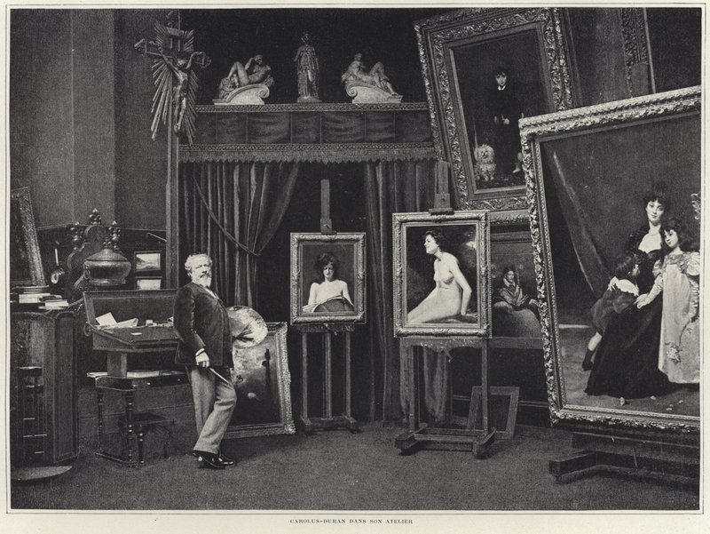
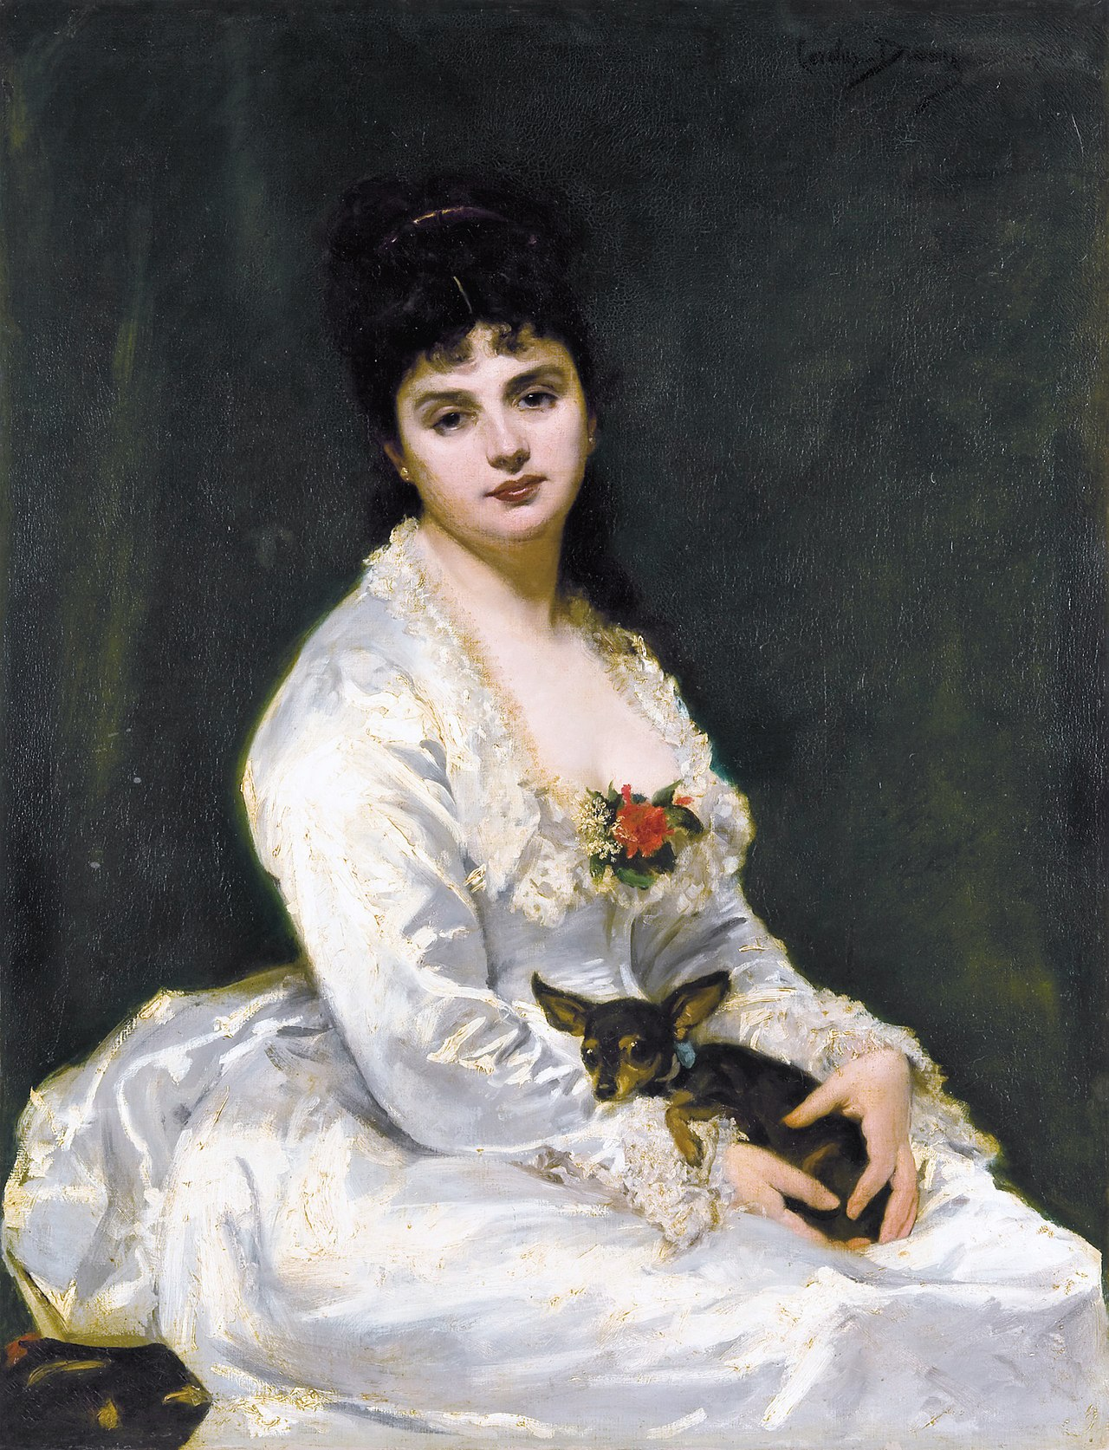
Carolus-Duran
Madame Henry Fouquier
1876
Wikimedia/Sotheby’s
Carolus-Duran in his studio

Slide 13
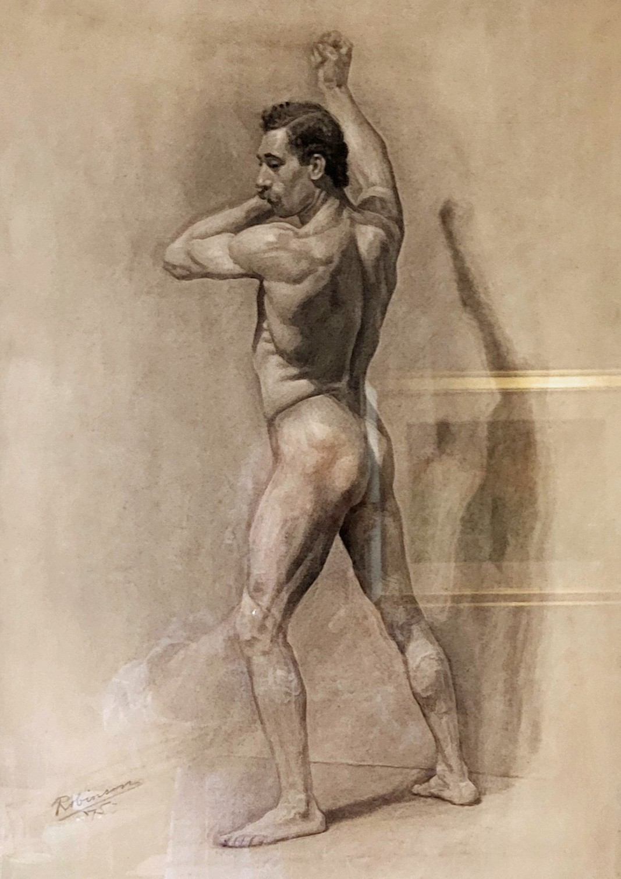
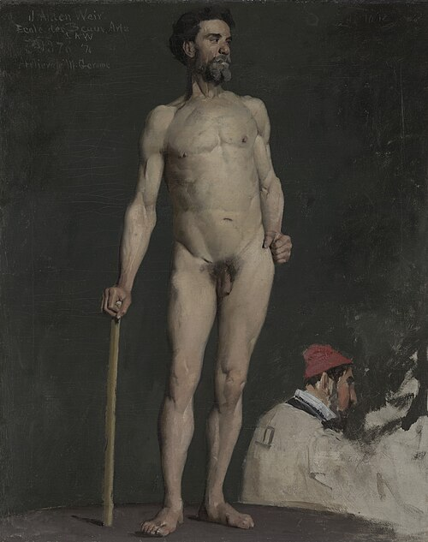
Julian Alden Weir
Study of a Male Nude
1876
Yale University Art Gallery
Nude study
1875
Creekside Place

Slide 14
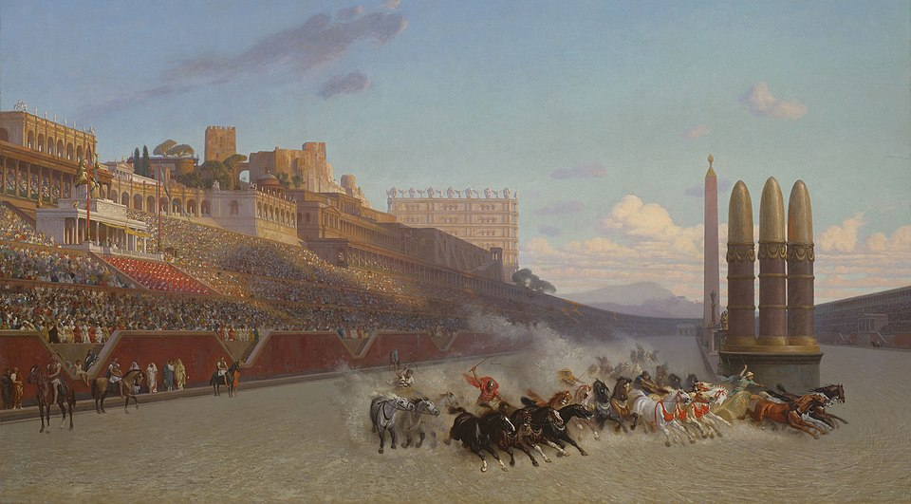
Jean-Léon Gérôme
The Chariot Race
1876
Art Institute of Chicago

Slide 15
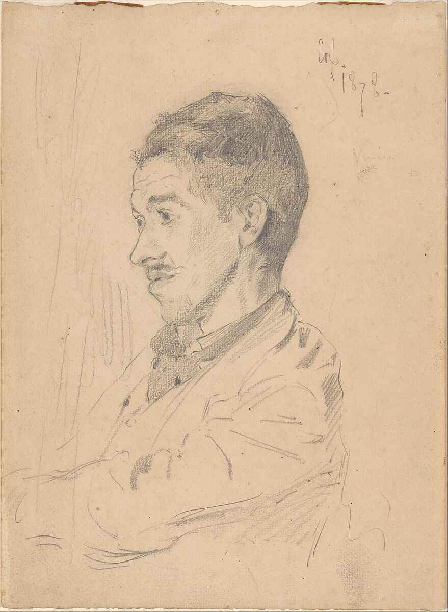
“Life here is very pleasant after Paris…were it not for the marvelous facilities for study in every branch of knowledge, the incomparable collections and museums, and the opportunities for instruction…Paris as a place of residence has few attractions, except for one who would live in a whirl of dissipation or excitement.”
Kenyon Cox
Theodore Robinson
1878
The Metropolitan Museum of Art

Slide 16
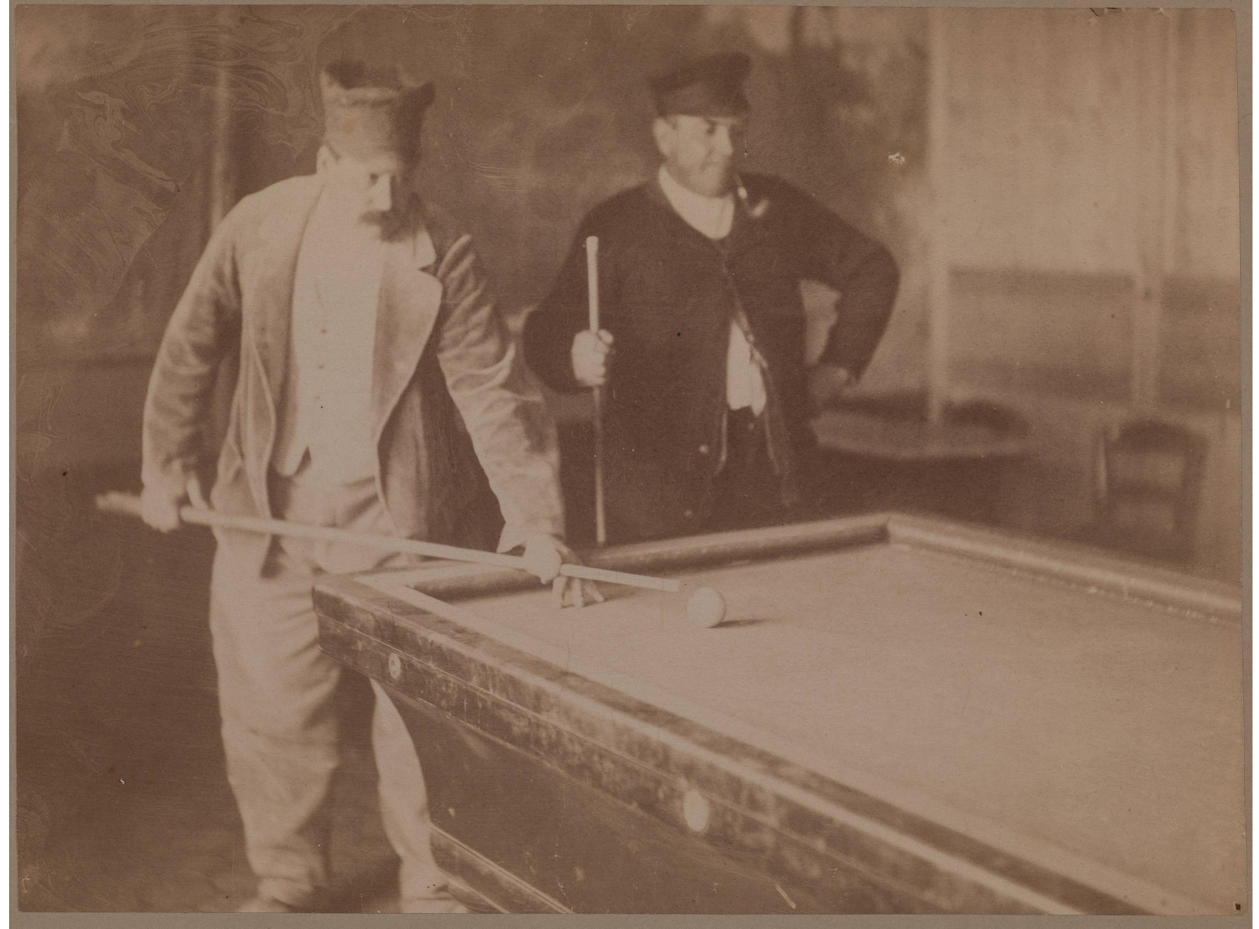
“The billiard room of this village is detrimental to the morals of the youth of this village and should be closed."
Two Men Playing Billiards
Unknown date
Terra Foundation for American Art

Slide 17
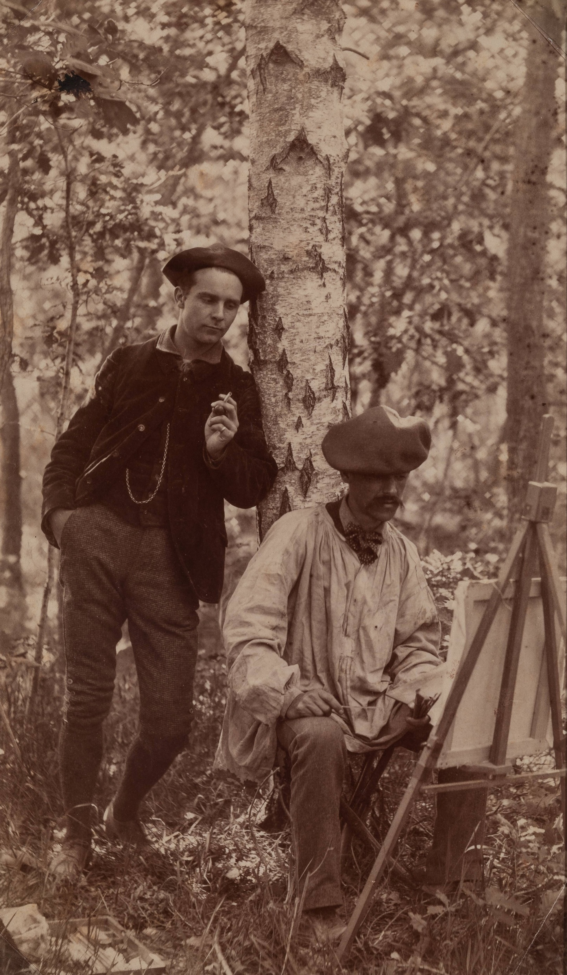
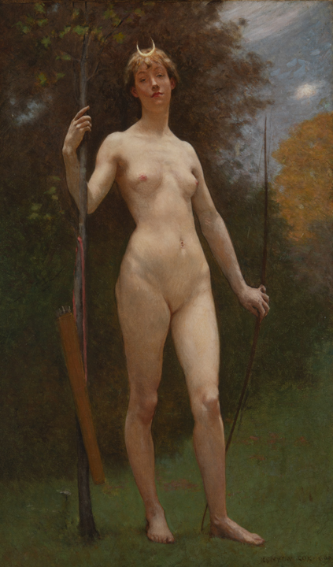
Kenyon Cox
Diana
n.d.
Chazen Museum of Art
Gift in memory of Harold G. Laun
Theodore Robinson (seated) with Kenyon Cox
Terra Foundation for American Art
Gift of Ira Spanierman

Slide 18
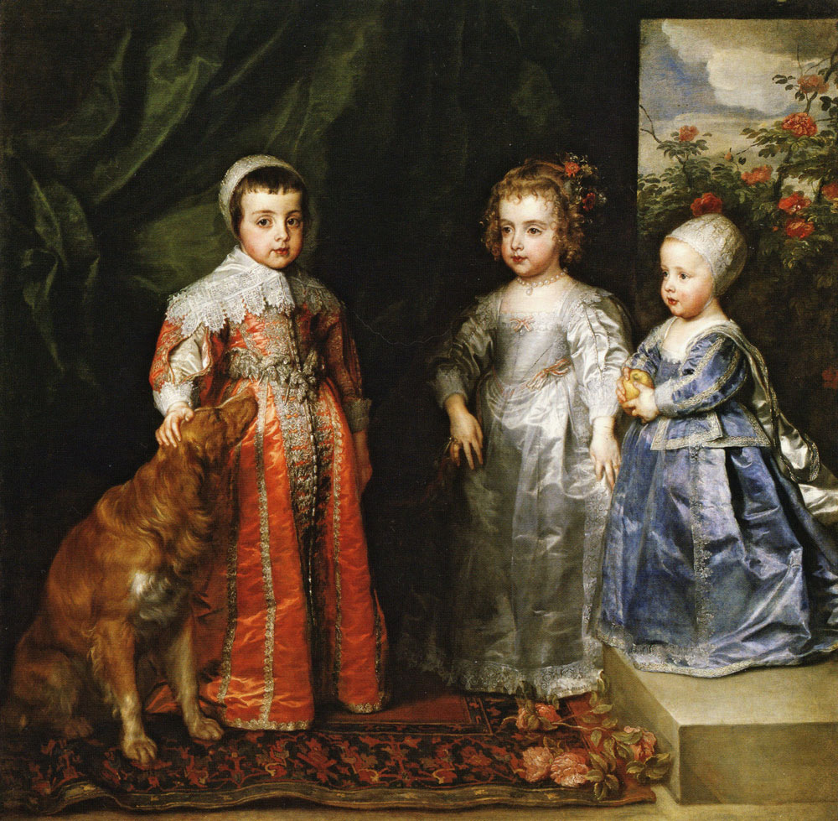
“the most charming Vandyck I have seen.”
Anthony van Dyck
The Three Eldest Children of Charles I
1635
Galleria Sabauda, Turin

Slide 19
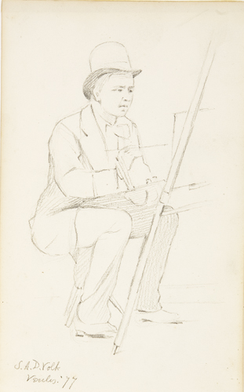
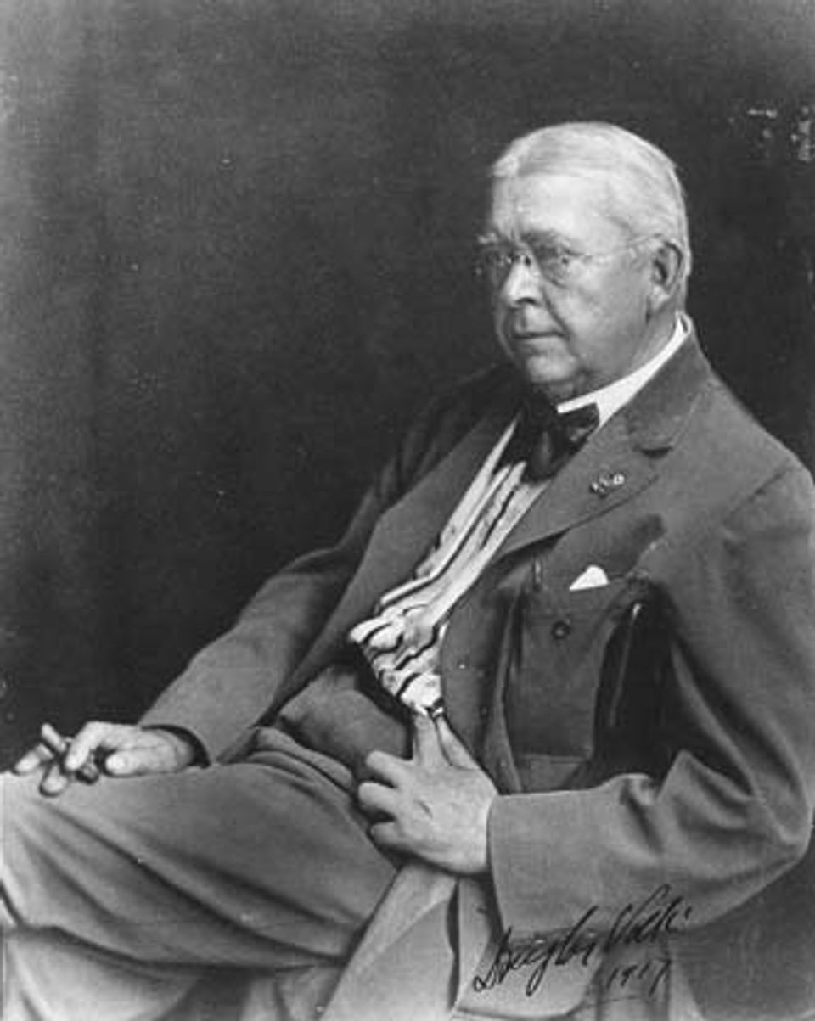
Douglas (S. A. D.) Volk
1917
Smithsonian American Art Museum
Portrait of S. A. D. Volk
1877
Chazen Museum of Art
Gift of John Wilde

Slide 20
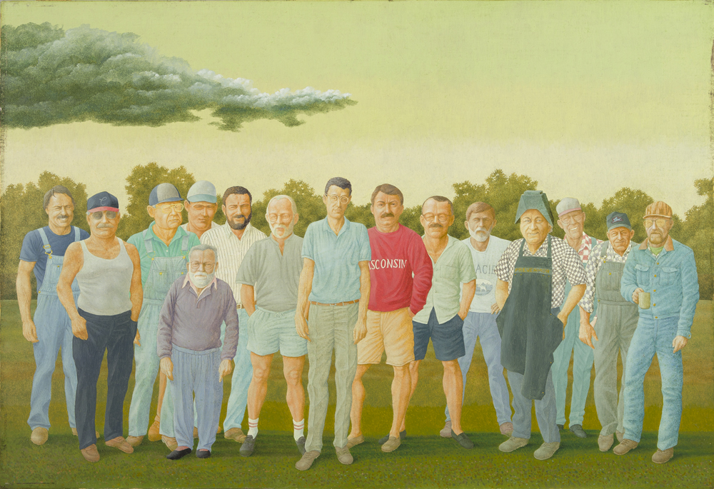
John Wilde
15 Cooksvillians
1995
Chazen Museum of Art,
Gift of Leslie and Johanna Garfield
Portrait of S. A. D. Volk
1877
Chazen Museum of Art
Gift of John Wilde

Slide 21
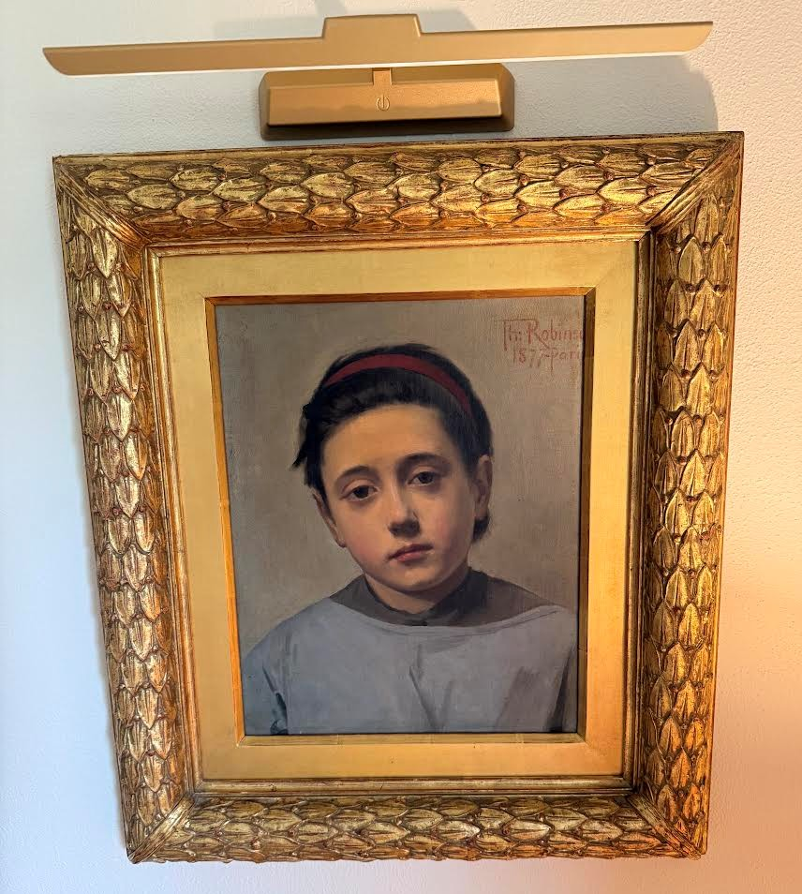
“My picture is accepted and I tremble with joy”
Portrait of Mimi
1877
Private collection

Slide 22
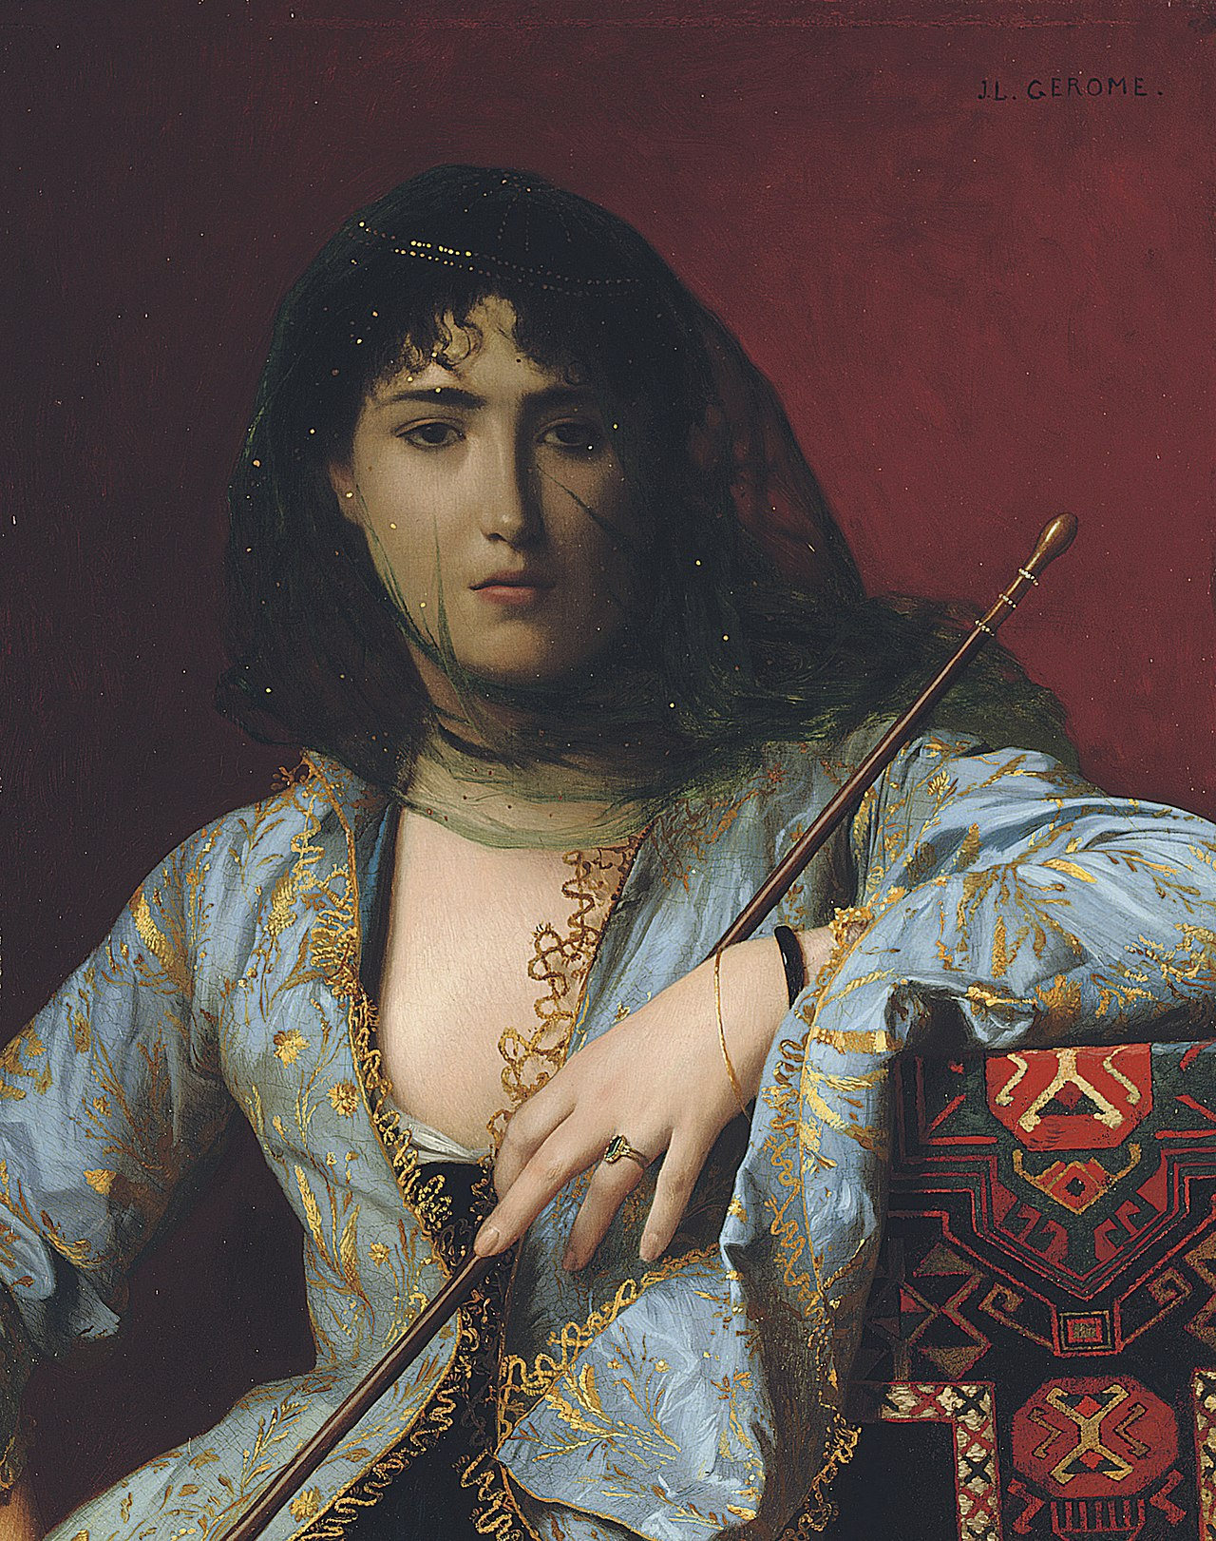
Carolus-Duran
Madame Henry Fouquier
1876
Wikimedia/Sotheby’s
Portrait of Mimi
1877
Private collection
Jean-Léon Gérôme
Femme circassienne voilée
1876
Qatar Museums

Slide 23
“He is too truthful, and let me say it as a friend, he does not flatter people enough. His pictures are exact resemblances. His greatest hindrance to success is his faithfulness to nature. A little more flattery of the subject would largely increase his popularity”
“It seems to us that this “faithfulness to nature” is the very failing which should be cultivated”
Portrait of Mimi
1877
Private collection

Slide 24
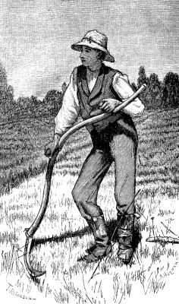
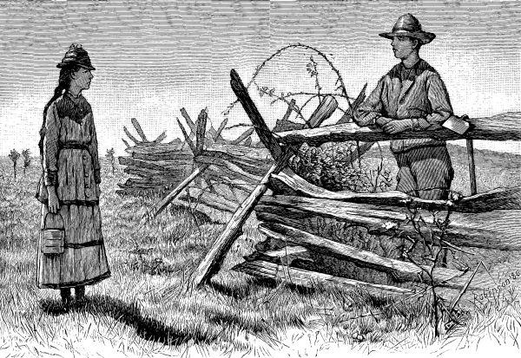
Engravings for Harper’s Young People, 1880.
Left: Noon-time in the Meadow for “How John Goodnow Got His Own Way”
Right: Hetty and Jim for “Hetty”

Slide 25
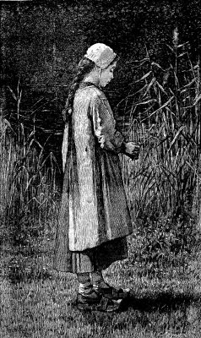
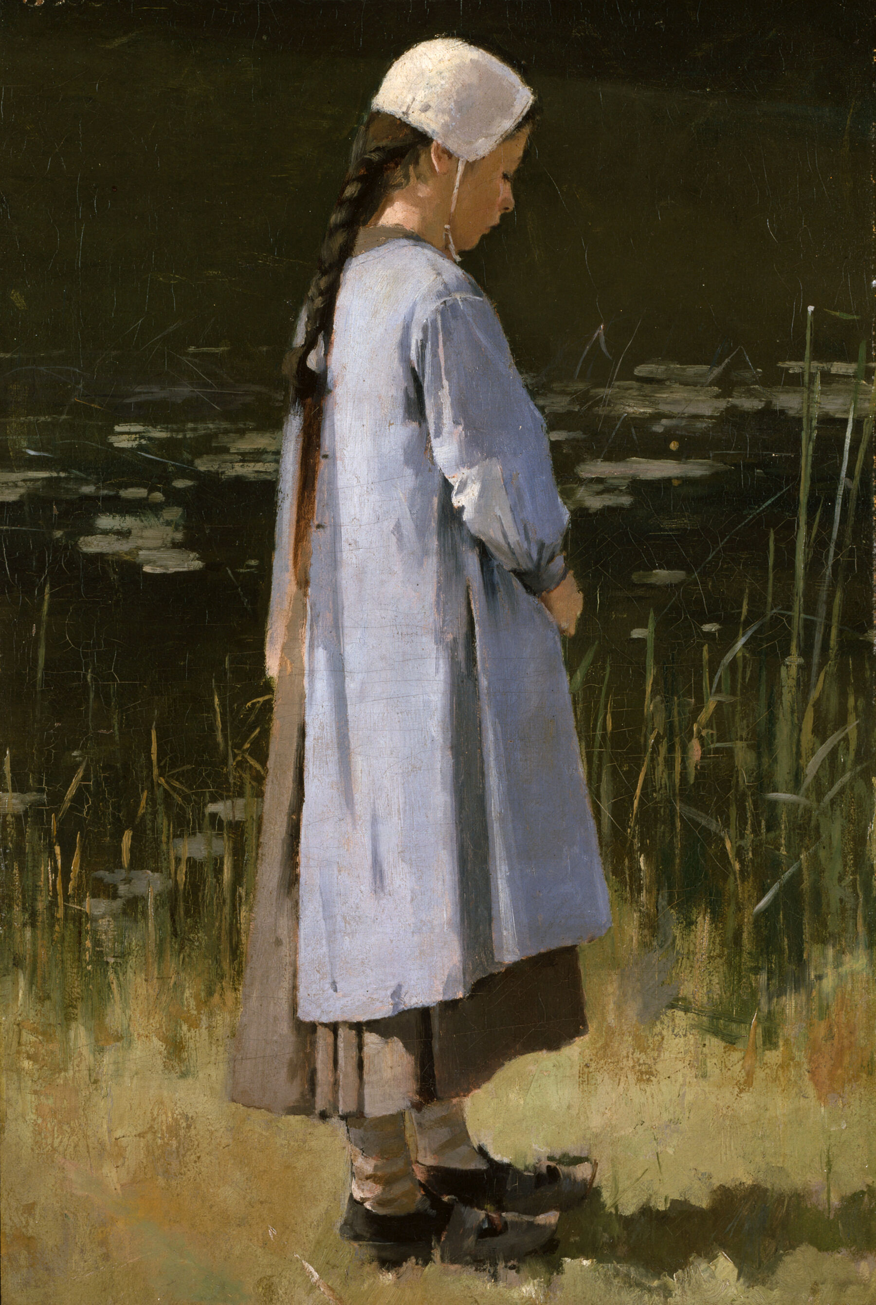
Suzette
1880
Engraving for “Viola’s Sketch” in the magazine Harper’s Young People
Angelus
ca. 1879
Colby College Museum of Art

Slide 26
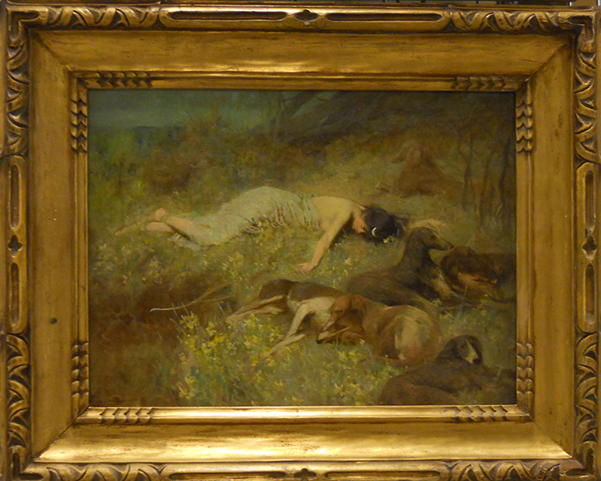
“to extricate Robinson from his surroundings where…he was fast relapsing into a vegetable state”
Will Hicok Low
The Garden of Diana
n.d.
Chazen Museum of Art, Gift of D. Frederick Baker from the Baker/Pisano Collection

Slide 27
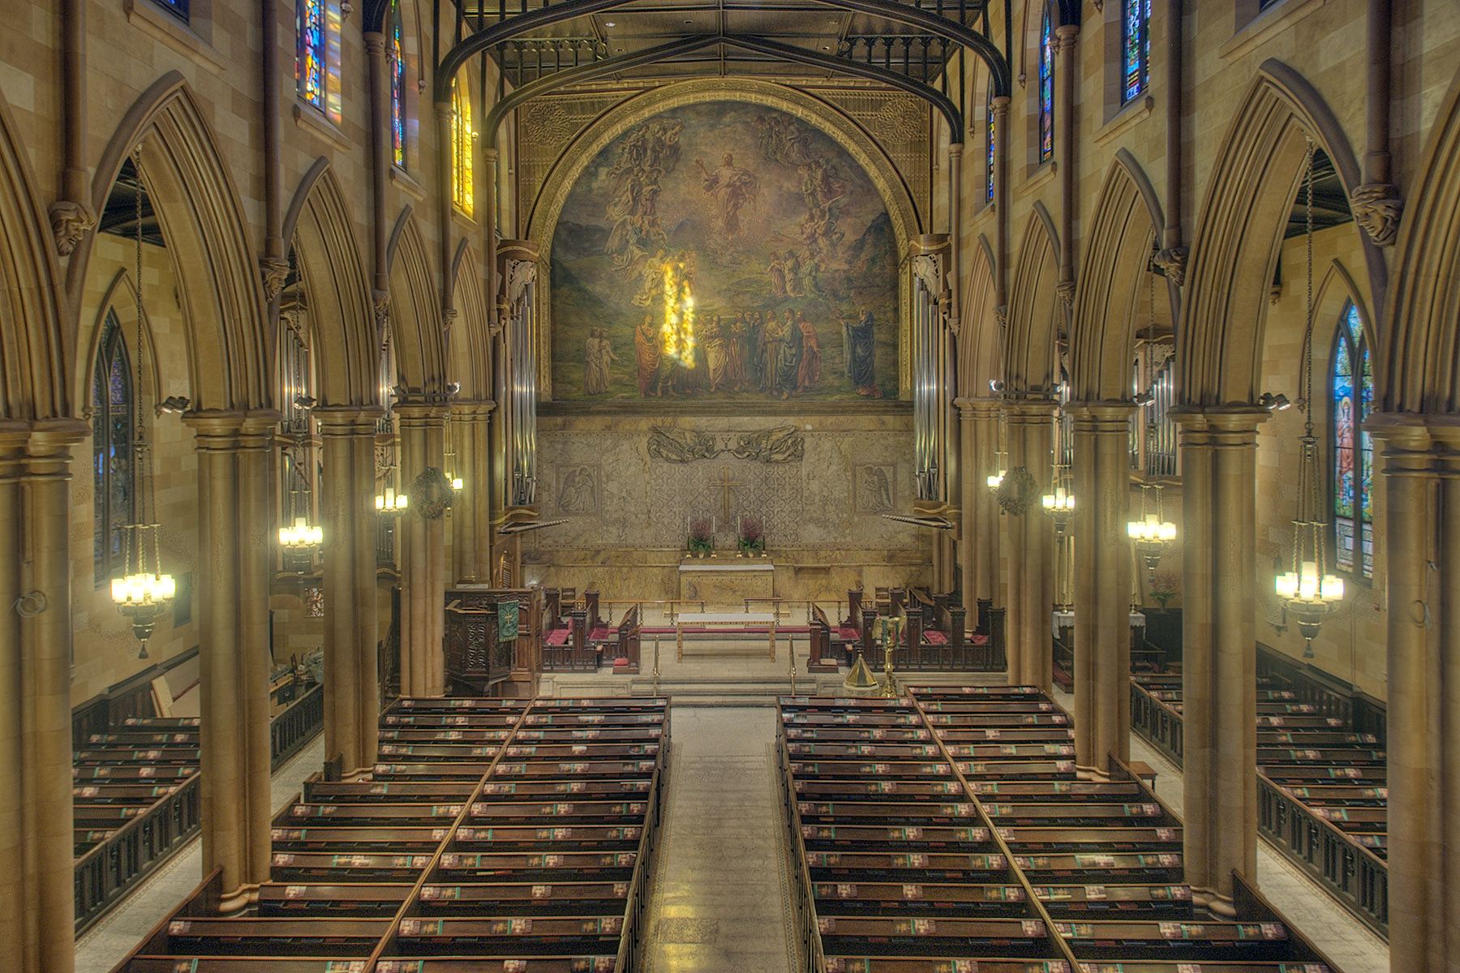

Slide 28
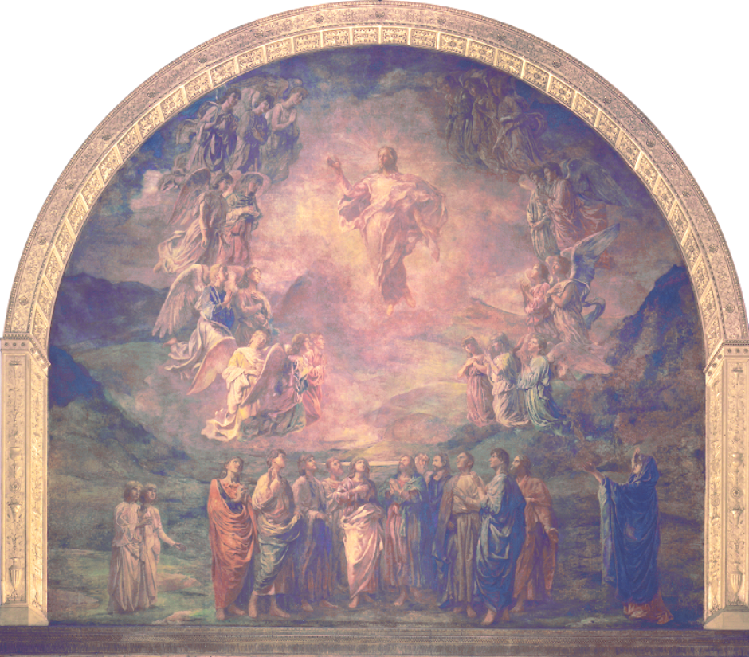

Slide 29
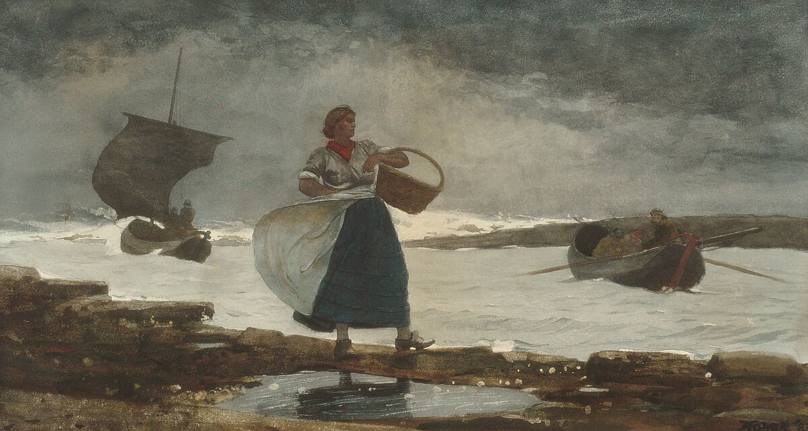
“Since I began to draw years ago, my ideal was Winslow Homer that is, country life and work, mostly out-of-door”
Winslow Homer
Inside the Bar
1883
The Metropolitan Museum of Art

Slide 30
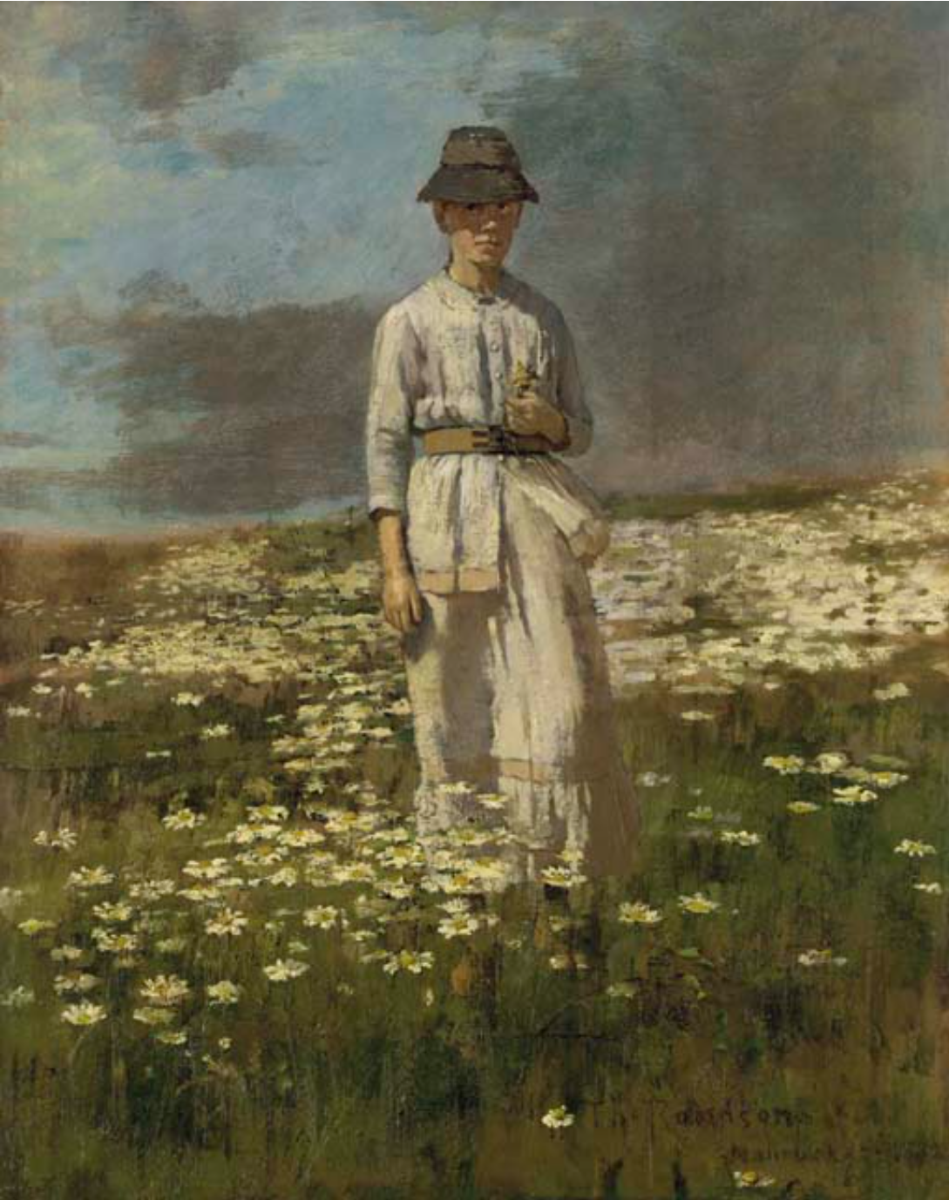
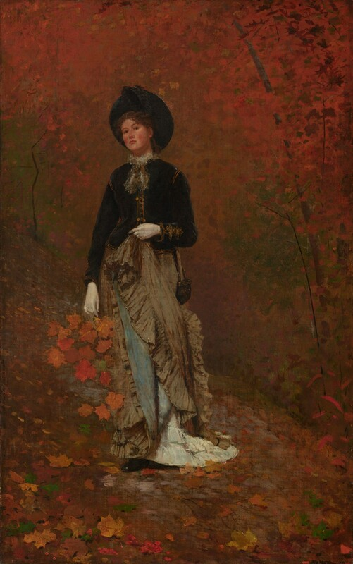
Winslow Homer
In Autumn Woods
1877
National Gallery of Art
Daisy Field, Nantucket
1882
Private collection (photo from Christie’s)

Slide 31
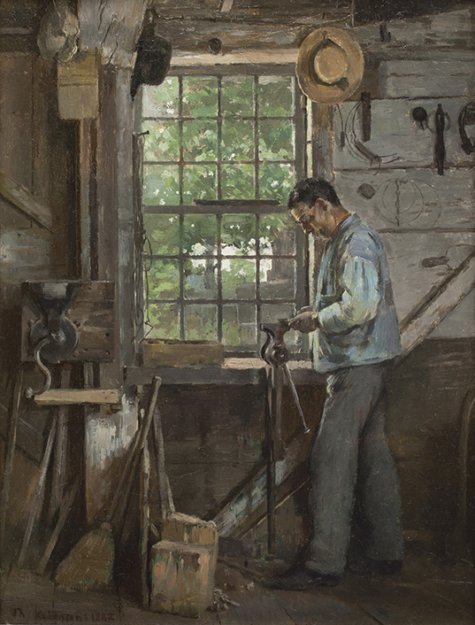
“I have nearly gotten rid of the desire to do “American” things—mostly because American life is so unpaintable.”
Man in a Workshop
1882
Chazen Museum of Art
Gift of Mr. and Mrs. Robert J. Bullard

Slide 32
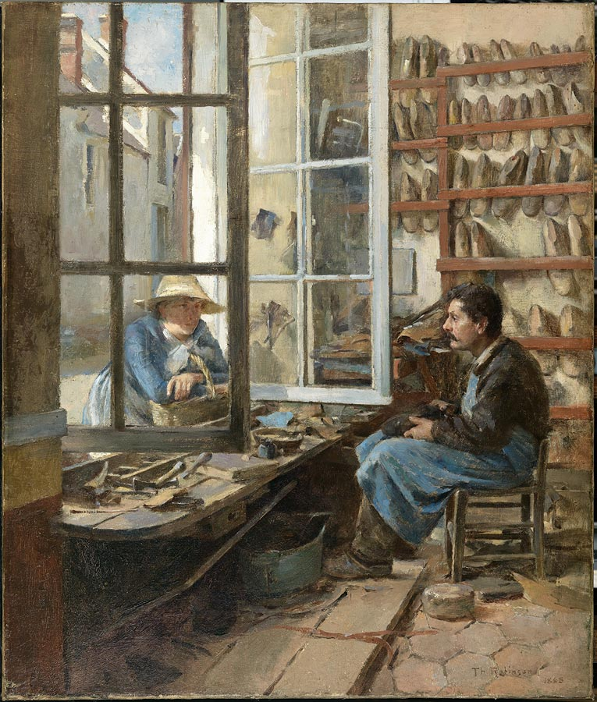
A Cobbler of Old Paris
1885
Smith College Museum of Art

Slide 33
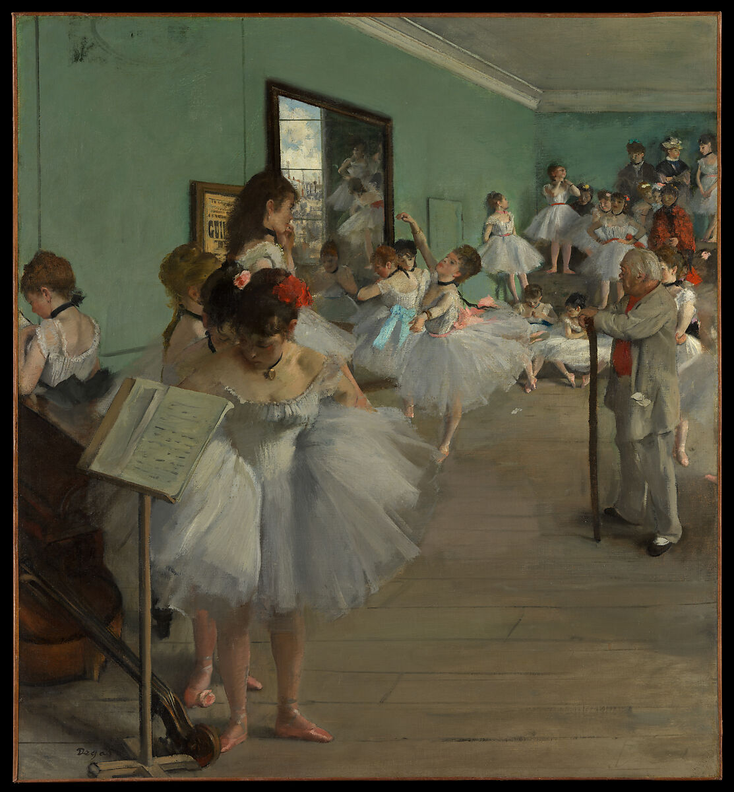
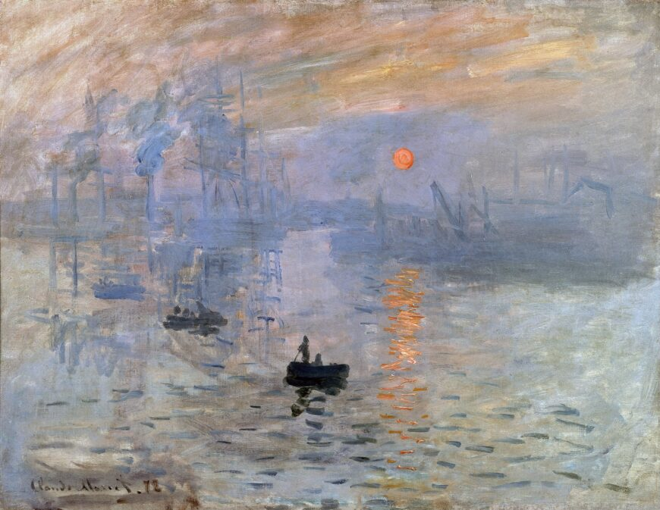
Edgar Degas
The Dance Class
1874
The Metropolitan Museum of Art
Claude Monet
Impression, Sunrise
1872
Musée Marmottan

Slide 34
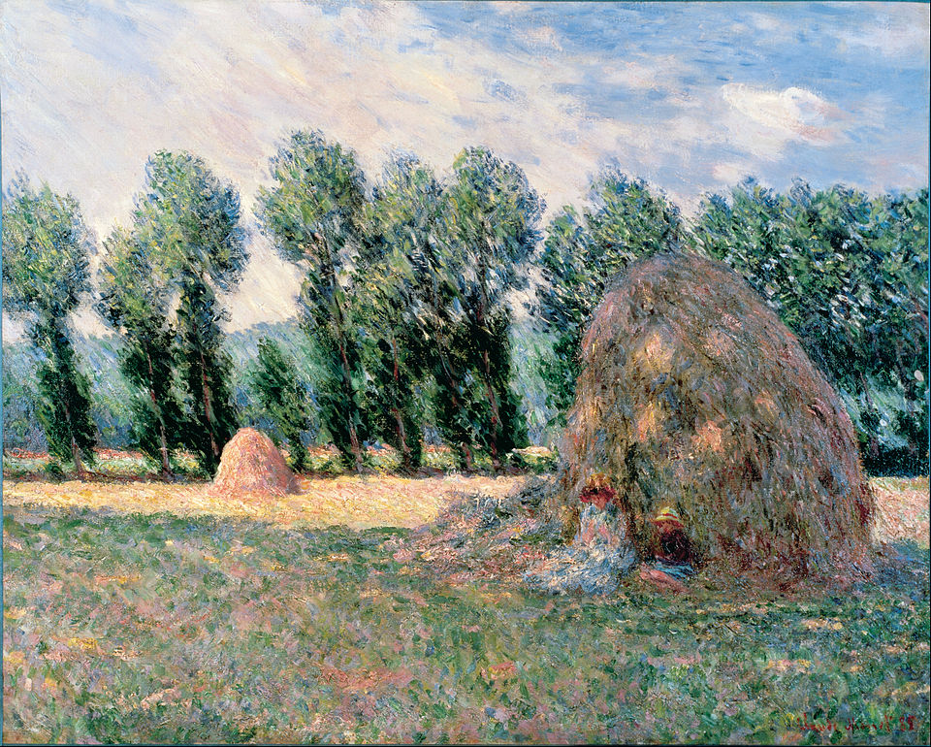
Claude Monet
Haystacks
1885
Ohara Museum of Art

Slide 35
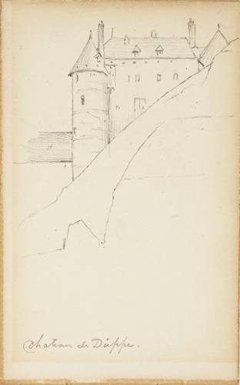
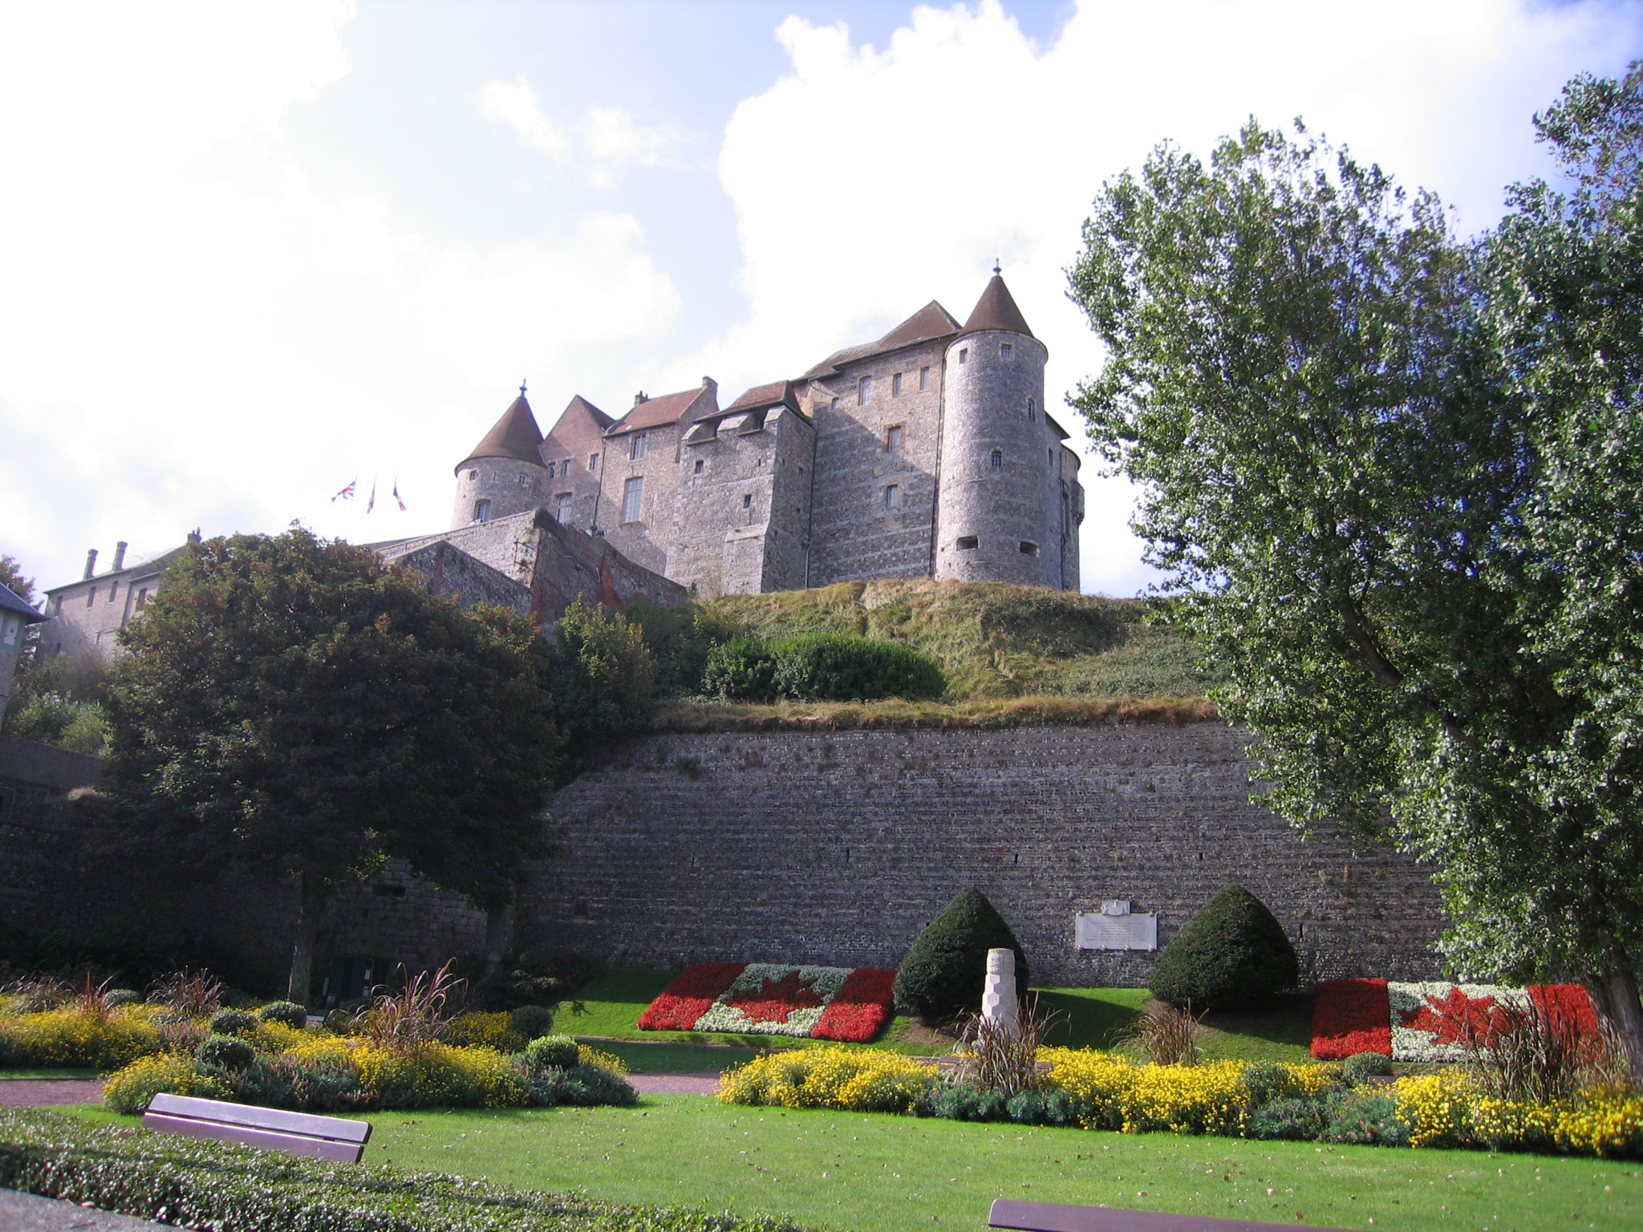
Château de Dieppe
1880s
Chazen Museum of Art
Gift of Vere and Marge DeVault in memory of John Antes
Modern photograph of Château de Dieppe, Wikimedia

Slide 36
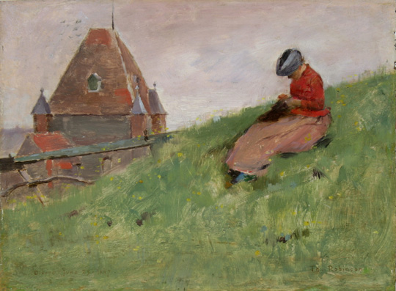
On the Cliff (Girl Sewing)
1887
Chazen Museum of Art
Juli Plant Grainger Fund purchase

Slide 37
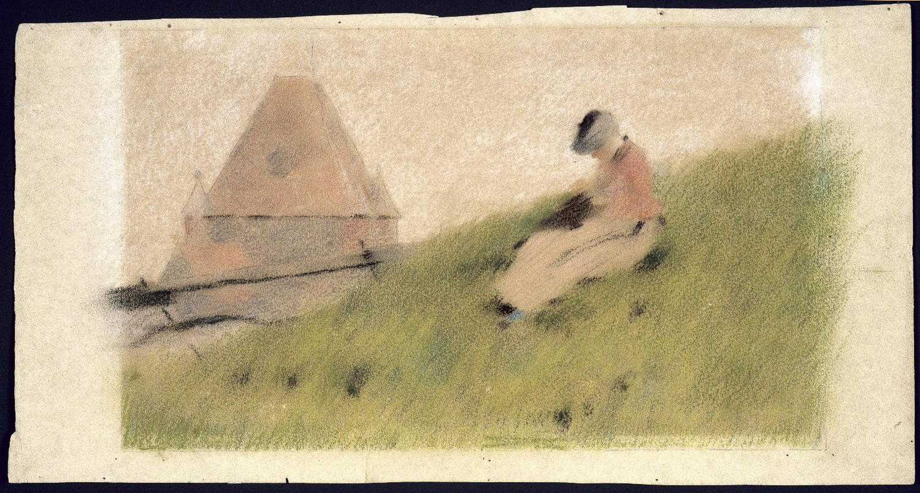
On the Cliff (Girl Sewing)
1887
Chazen Museum of Art
Juli Plant Grainger Fund purchase
On the Cliff (pastel with underdrawing)
ca. 1887
Brooklyn Museum of Art

Slide 38
On the Cliff (Girl Sewing)
1887
Chazen Museum of Art
Juli Plant Grainger Fund purchase
Daisy Field, Nantucket
1882
Private collection (photo from Christie’s)

Slide 39
On the Cliff (Girl Sewing)
1887
Chazen Museum of Art
Juli Plant Grainger Fund purchase

Slide 40
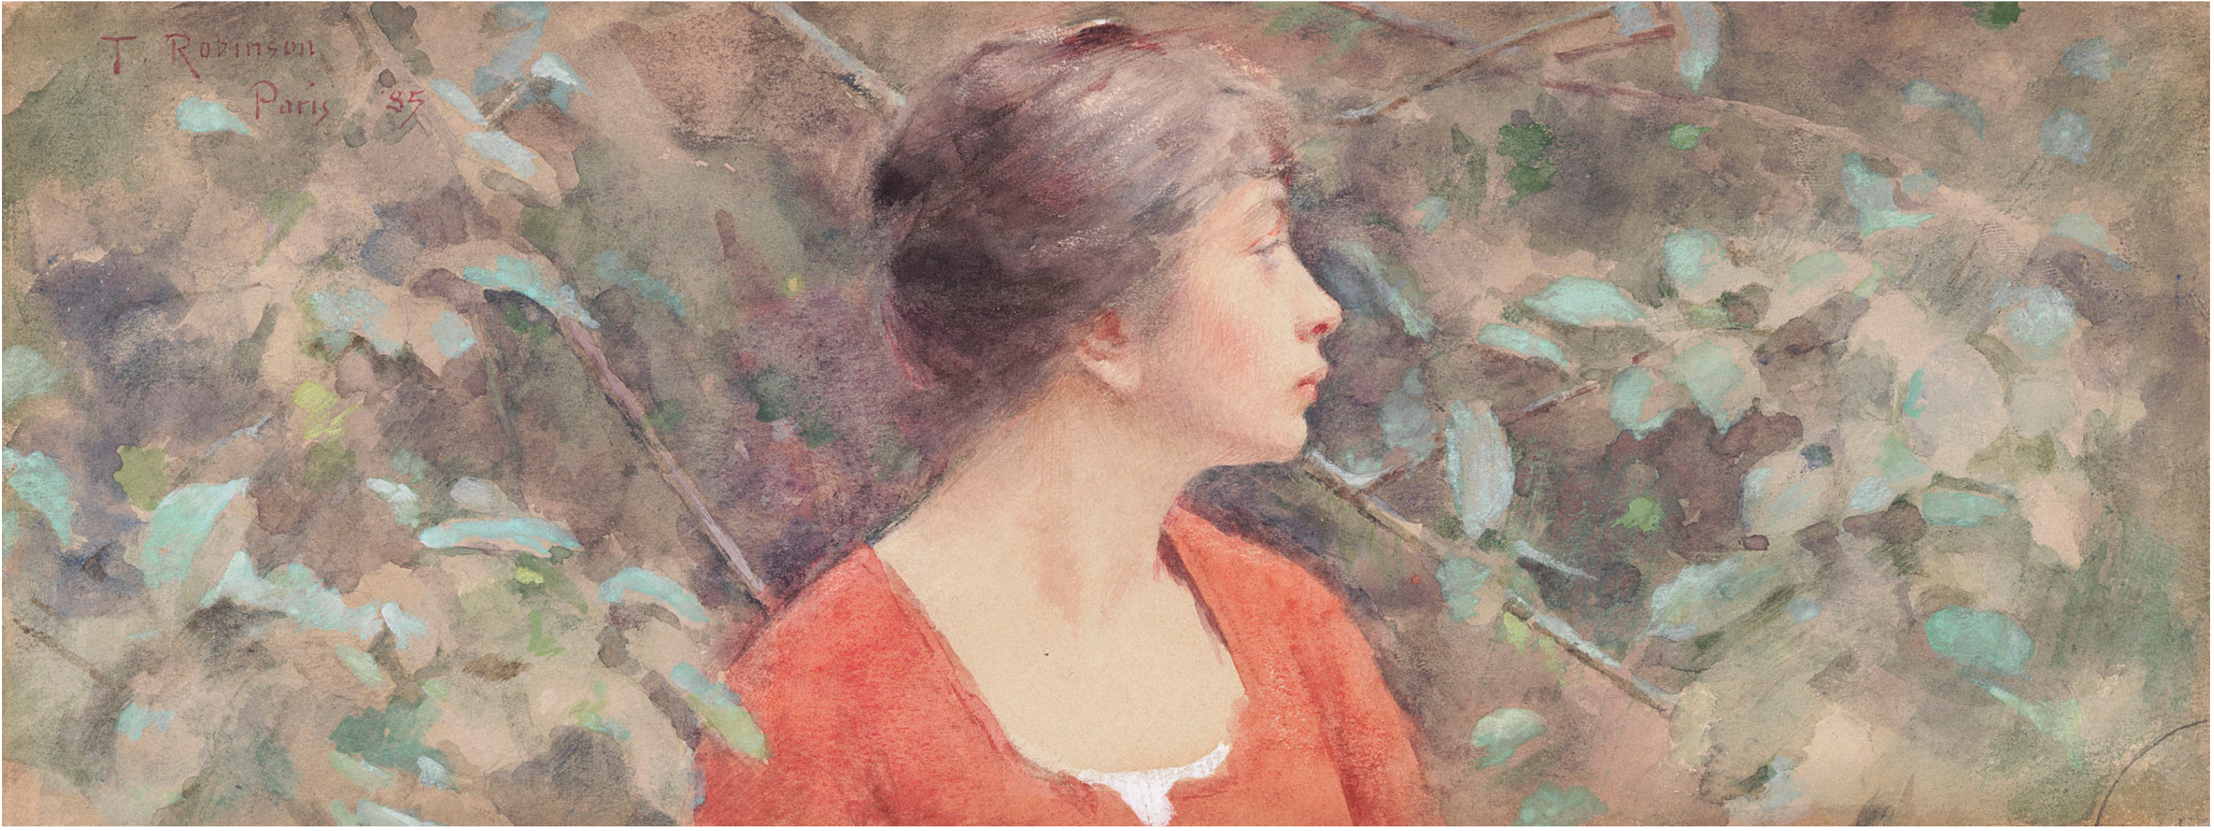
Lady in Red Dress (Marie)
1885
Photo from Christie’s

Slide 41
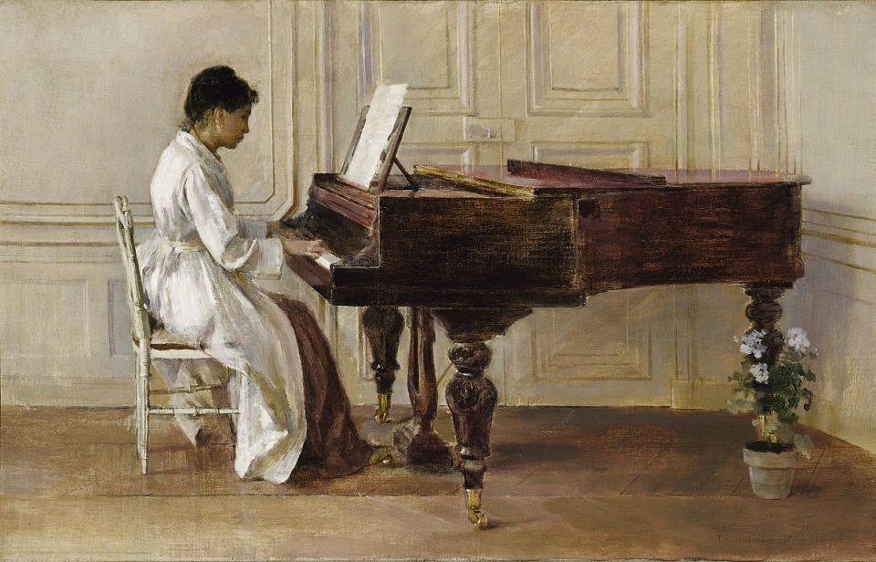
At the Piano
1887
Smithsonian American Art Museum

Slide 42
On the Cliff (Girl Sewing)
1887
Chazen Museum of Art
Juli Plant Grainger Fund purchase
At the Piano
1887
Smithsonian American Art Museum

Slide 43
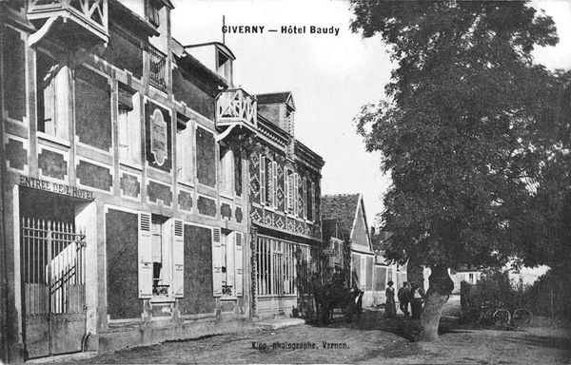
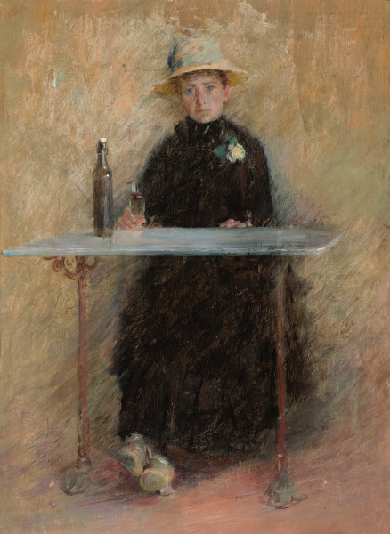
Portrait of Madame Baudy
1888
Virginia Museum of Fine Arts

Slide 44
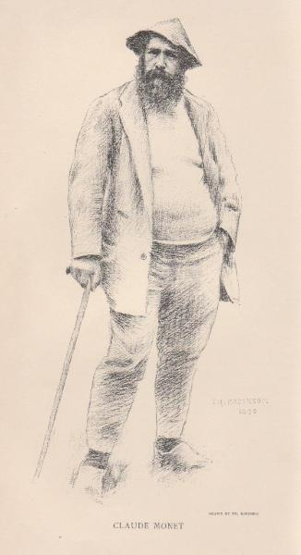
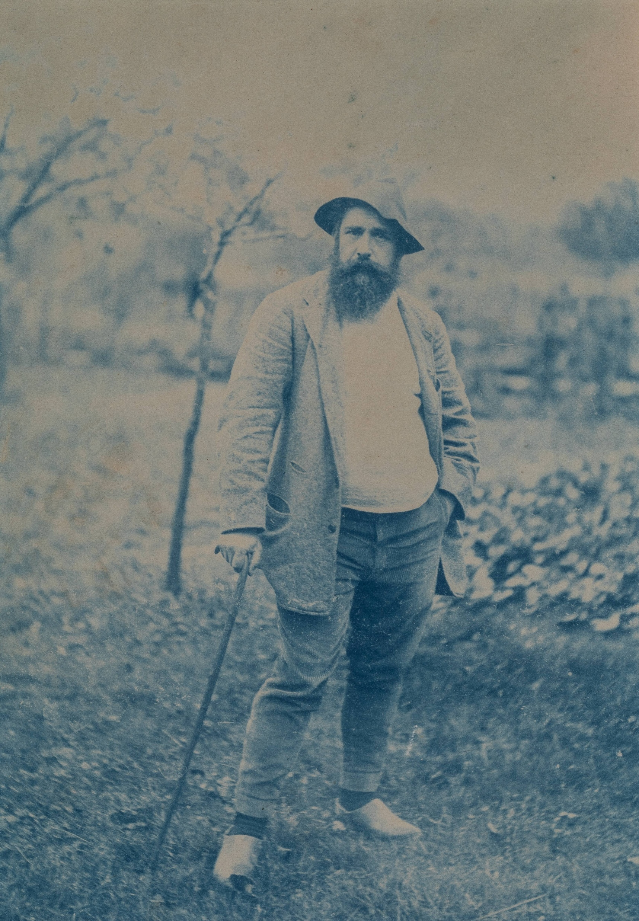
Portrait of Monet
Cyanotype
Ca. 1880-1890
Terra Foundation for American Art
Claude Monet
Illustration from Century Magazine, 1892

Slide 45
“the most aggressive, forceful painter, the one whose work is influencing the epoch the most...there is always a delightful sense of movement, vibration, and light”
Claude Monet
Illustration from Century Magazine, 1892

Slide 46

La Vachère
1888
Baltimore Museum of Art

Slide 47

Bird’s Eye View, Giverny
1889
The Metropolitan Museum of Art

Slide 48

Blossoms at Giverny
1891
Terra Foundation for American Art

Slide 49


Slide 50

“a fleeting impression of full fruit boughs, floods of sunshine, and two figures, a child and a girl in light garments”
Blossoms at Giverny
1891
Terra Foundation for American Art
In the Orchard
1891
Princeton University Art Museum

Slide 51


Afternoon Shadows
1891
RISD Museum
Afternoon Shadows
1891
Harn Museum of Art

Slide 52


Claude Monet
Haystack, Morning Snow Effect
1891
Museum of Fine Arts, Boston
Claude Monet
Haystack, Snow Effect, Overcast Day
1891
Art Institute of Chicago

Slide 53


John Leslie Breck
Studies of an Autum Day
1891
Terra Foundation for American Art
John Leslie Breck
Studies of an Autum Day
1891
Terra Foundation for American Art

Slide 54




Cyanotypes
ca.1890
Terra Foundation for American Art
At the Fountain
1890
Canajoharie Library and Art Gallery
Watering Pots
1890
Brooklyn Museum of Art

Slide 55


Two in a Boat
ca. 1891
Albumen print
Terra Foundation for American Art
Two in a Boat
1891
The Phillips Collection

Slide 56
“I’ve got to go back to what is my country. I am only beginning to see its beauties and possibilities and to feel that affection for a country, so indispensable to paint it well”

Slide 57

“delightful sense of movement, vibration, and light”
The Wedding March
1892
Terra Foundation for American Art

Slide 58


E. J. M. Betty
1894
Private collection
Union Square, New York
1895
New Britain Museum of American Art

Slide 59

Low Tide, Riverside Yacht Club
1894
The Metropolitan Museum of Art

Slide 60
“My Japanese print points in a direction I must try and take: an aim for refinement and a kind of precision seen in the best old as well as modern work.”
“The Japanese work ought to open one’s eyes to certain things in nature, before almost invisible and a new enjoyment, their infinite variety of compositions, their extraordinary combination of the convention and the reality.”
Low Tide, Riverside Yacht Club
1894
The Metropolitan Museum of Art

Slide 61

Utagawa Hiroshige
Fireworks at Ryogoku, from the series Famous Places in Edo
ca. 1845
Chazen Museum of Art, Bequest of John H. Van Vleck
Low Tide, Riverside Yacht Club
1894
The Metropolitan Museum of Art

Slide 62

Claude Monet
La Japonaise
1876
Museum of Fine Arts, Boston

Slide 63

Frank Lloyd Wright
Drafting studio at Taliesin
Frank Lloyd Wright Foundation

Slide 64
Utagawa Hiroshige
Fireworks at Ryogoku, from the series Famous Places in Edo
ca. 1845
Chazen Museum of Art, Bequest of John H. Van Vleck
Low Tide, Riverside Yacht Club
1894
The Metropolitan Museum of Art

Slide 65

Mary Cassatt
In the Loge
1878
Museum of Fine Arts, Boston

Slide 66

World’s Columbian Exposition
1894
Crystal Bridges Museum of American Art

Slide 67

“This year I got back among the hills I knew when a boy…I am just now beginning to paint subjects that touch me…What I am trying to do this year is to express the love I have for the scenes of my native town.”
West River Valley, Vermont
1895
Private collection

Slide 68

“He was also a Wisconsin man, at least he had spent his youth and early manhood in a small village a few miles below Madison, and still retained a love for the suave and grassy hills and fields of that region.”
J. Alden Weir
Theodore Robinson
ca. 1887-1893
Smithsonian American Art Museum

Slide 69


Slide 70
From Evansville to Giverny and Back Again:
The Life and Art of Theodore Robinson
Janine Yorimoto Boldt
Collection Reinstallation Project Associate

