Slide 1
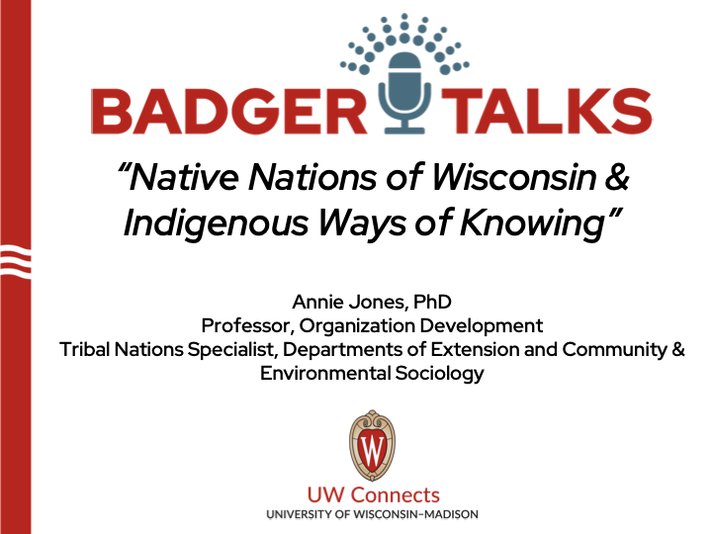

Uncovering the Secrets
of Wisconsin’s History
Annie Jones, PhD
Professor, Organization Development
Tribal Nations Specialist, Departments of Extension and Community & Environmental Sociology
Notes:
To Download PowerPoint in order to use in your own slides, Please select “File” - “Download” - “Microsoft PowerPoint (.pptx)”

Slide 2
Purpose
Introduce Wisconsin’s Tribal Nations
Explore ways to incorporate Indigenous or community ways of knowing in your work

Slide 3
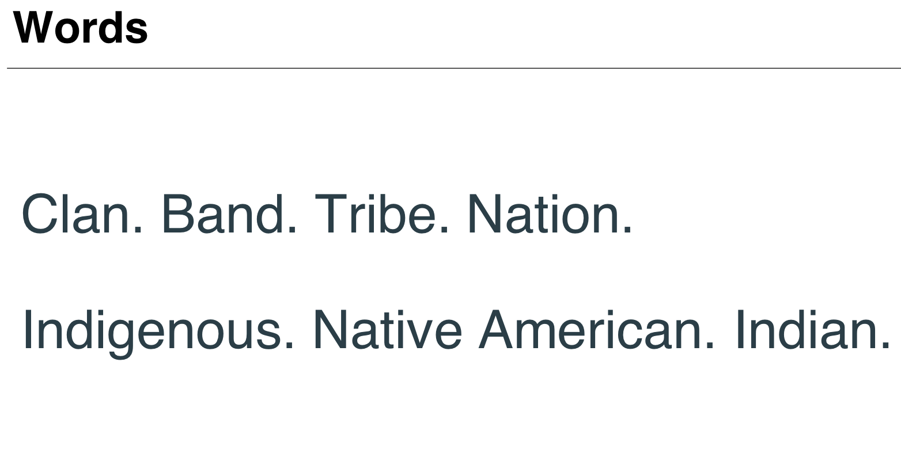

Slide 4
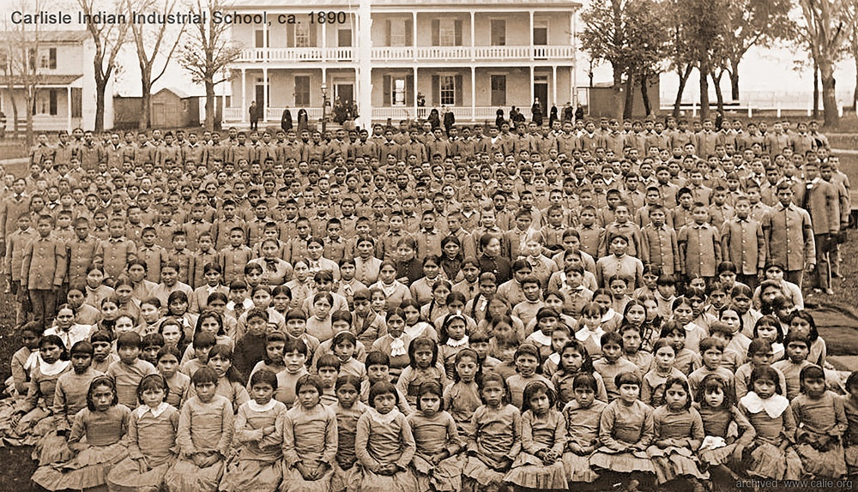

Slide 5
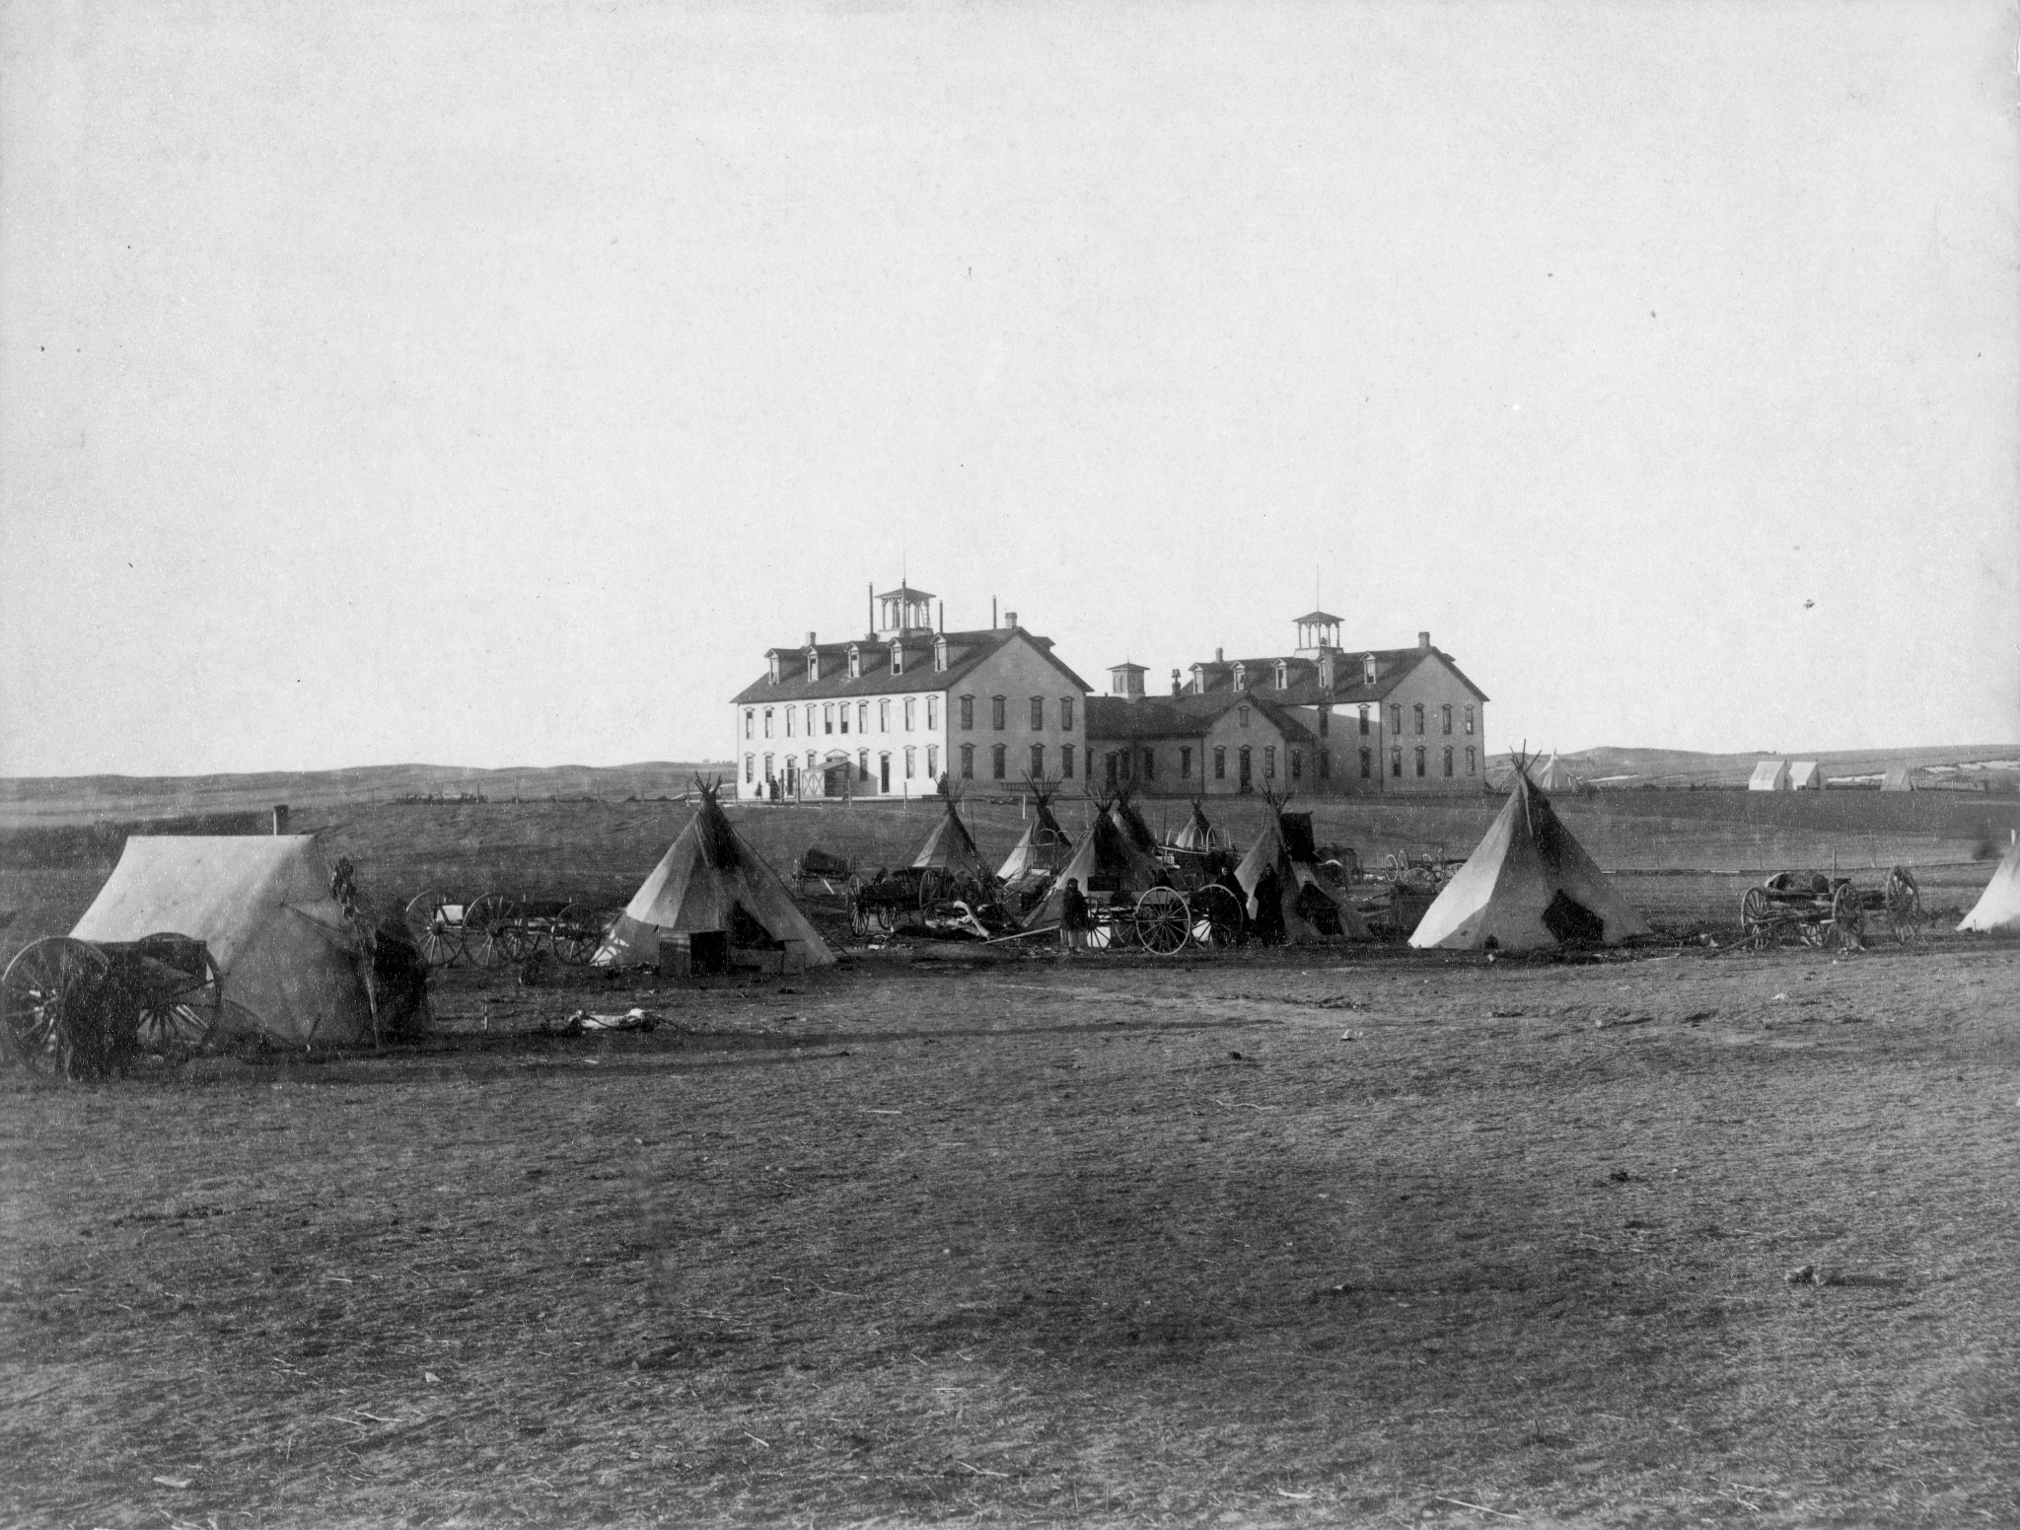

Slide 6
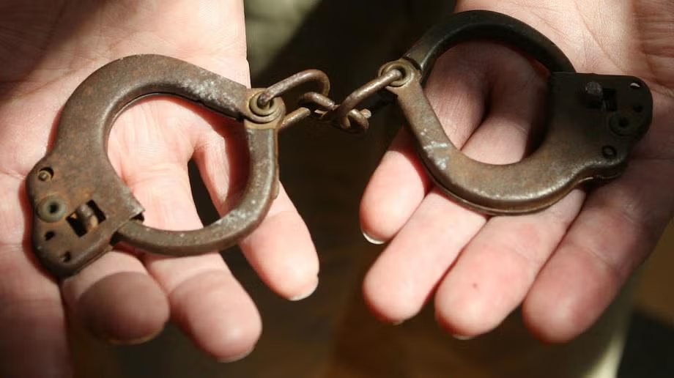
Photo courtesy of Mary Annette Pember

Slide 7
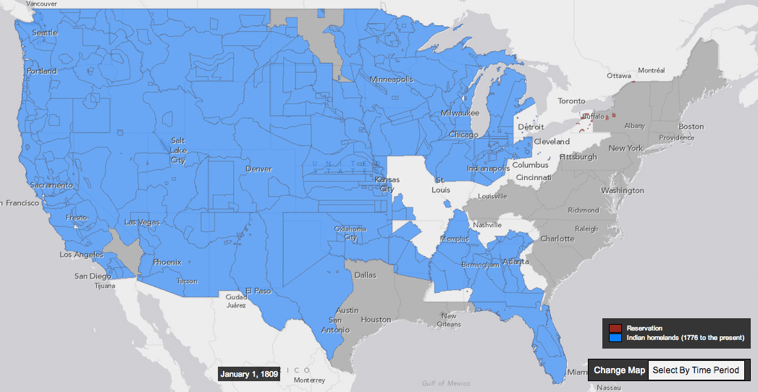
Land Dispossession - 79 years (1809-1888):
The Making of Modern Native Nations

Slide 8
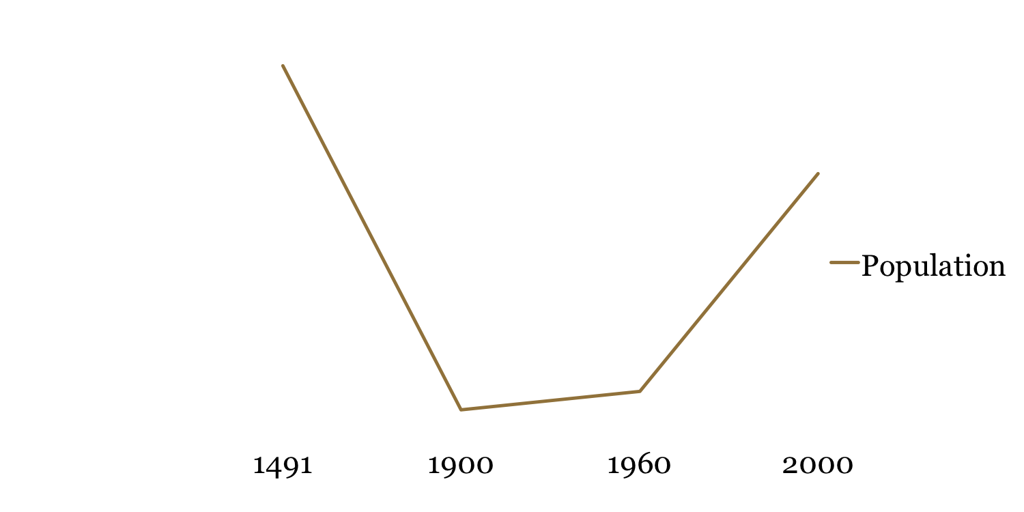
Indigenous Population in US vertical lines | show when the US attempted to eradicate all Native American languages & cultures from planet Earth.
~6,000,000 🡪 237,000 🡪 4,300,000

Slide 9
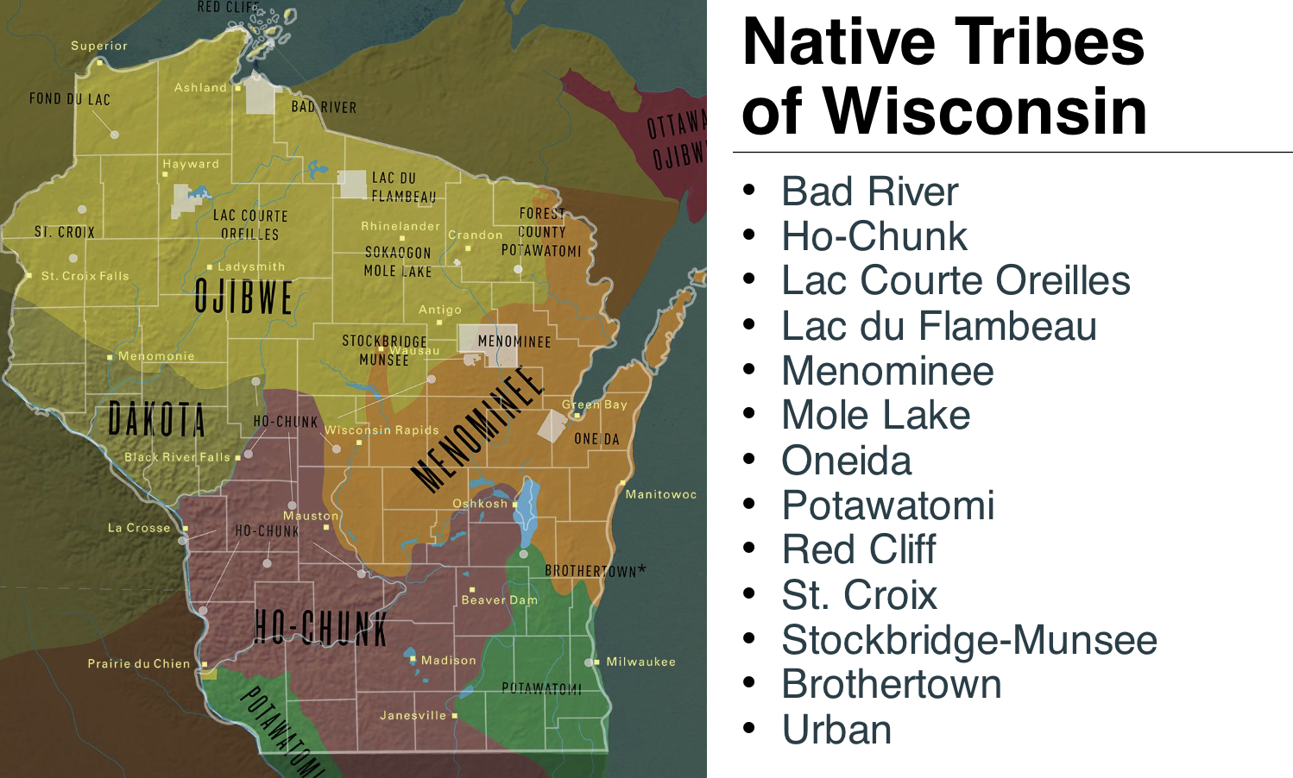

Slide 10
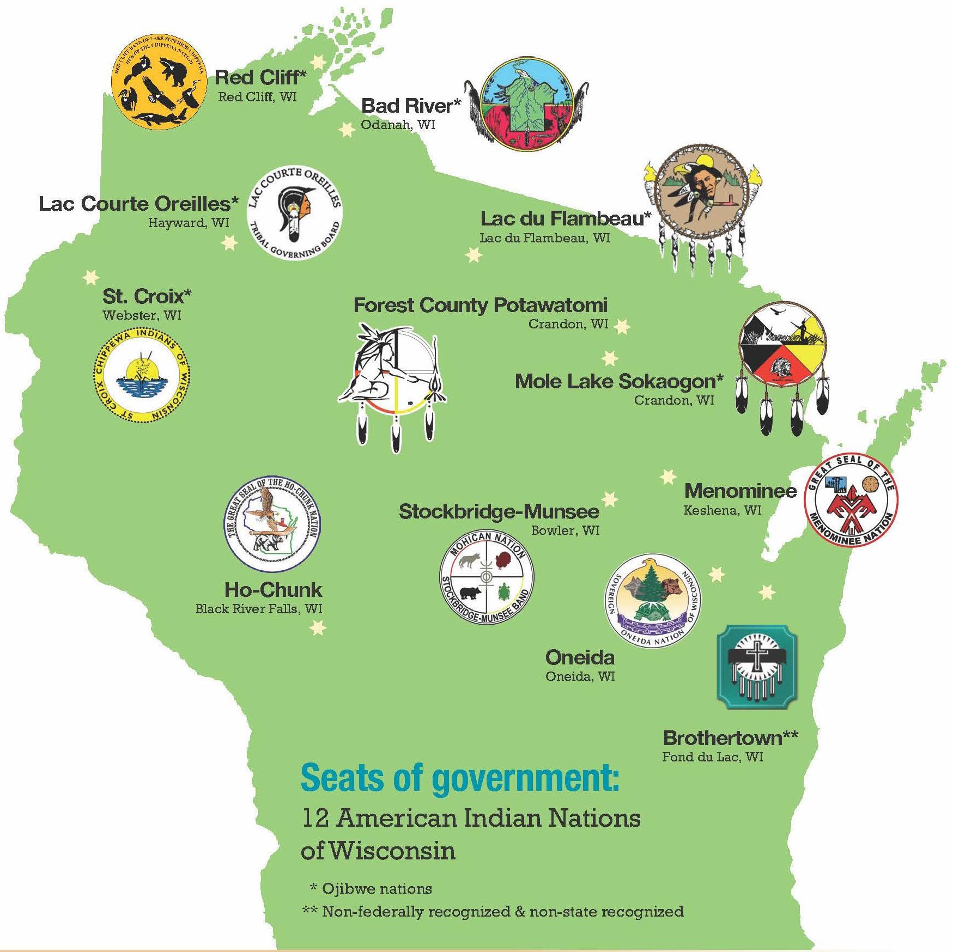
12 Native Nations.
6 Indigenous languages.
3 Indigenous language families.
Algonquian Language Family:
Menominee, Potawatomi,
Ojibwe.
Siouan Language Family:
Ho-Chunk.
Iroquoian Language Family:
Oneida,
Stockbridge-Munsee,
Brothertown.
Notes:
Quiz leads us to who were are today and the former treaty lands of the Great Lakes

Slide 11
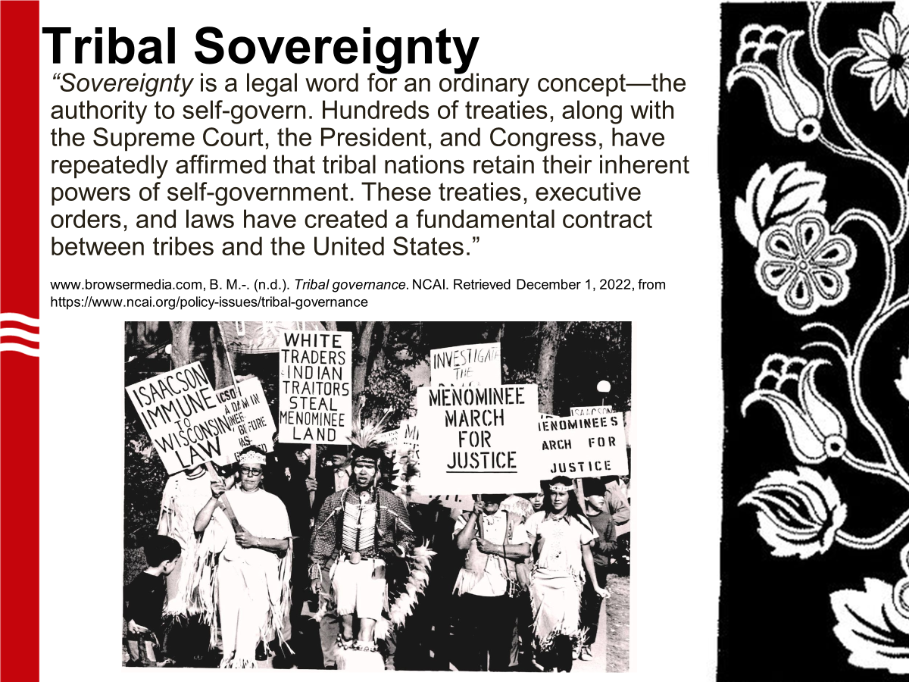

Slide 12
Wisconsinite Culture:
Ways of Knowing
When I think of Wisconsin, some phrases that come to mind are…

Slide 13
Ways of Knowing in Your Community
How would you describe
the culture of the place where you were raised?
Where you reside now?

Slide 14


Humans have lived in what is now known as Wisconsin for at least 13,500 years (Kenosha/Racine). What would Wisconsin culture be like after 10,000 years of statehood?
13,500-year timeline

Slide 15
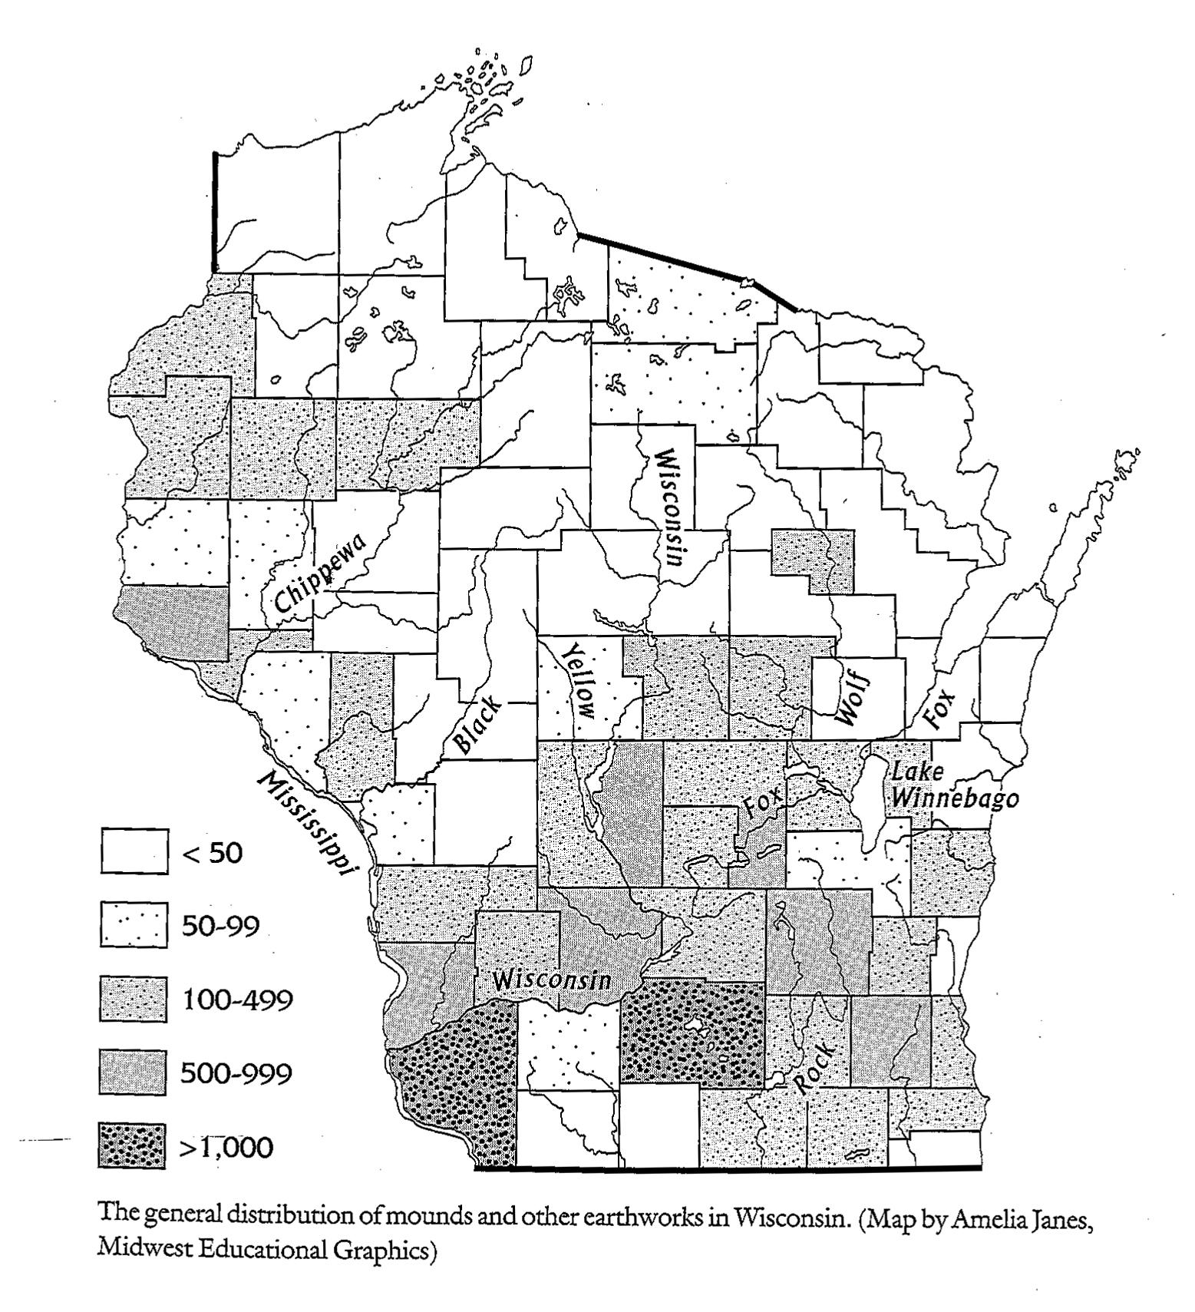
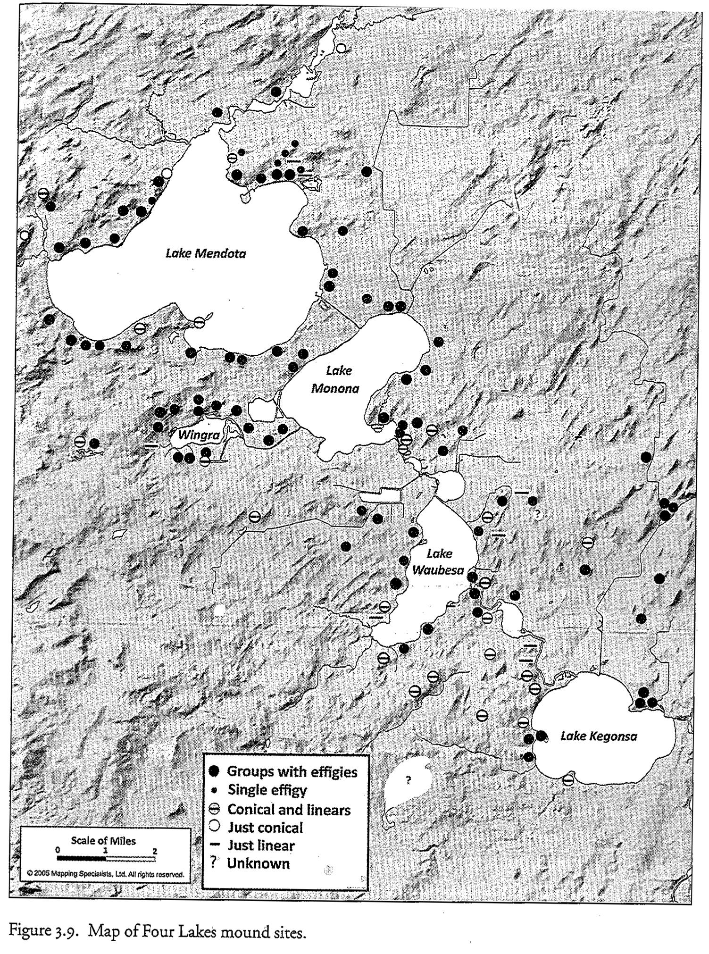
Linear, Conical, and Effigy Mound System covering 20,000+ square miles.
~20,000 mounds originally
~1,200 mounds in Four Lakes

Slide 16
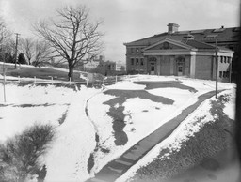
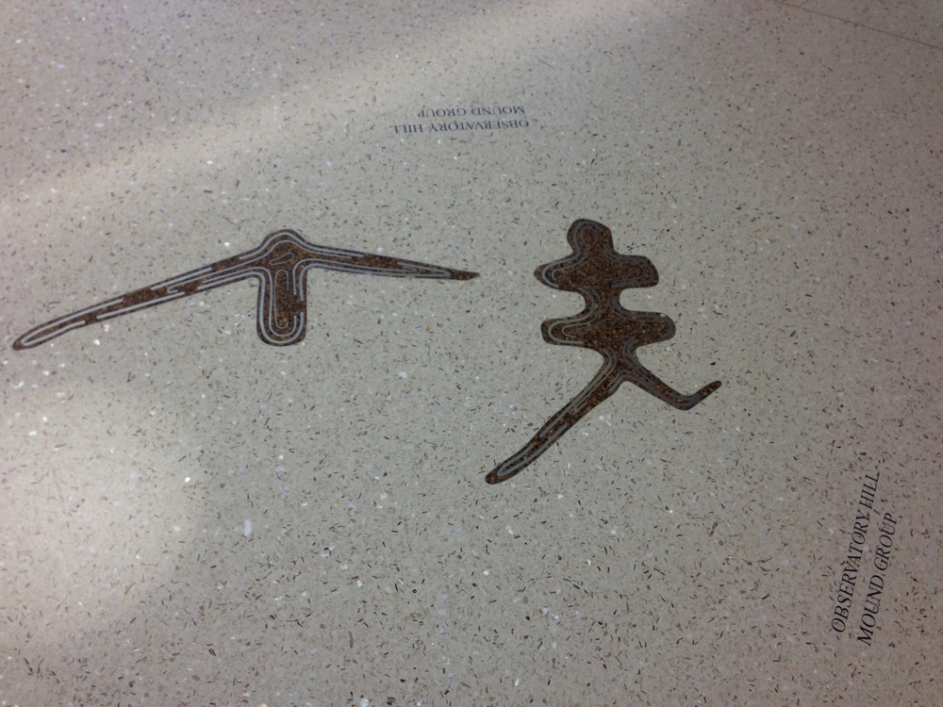
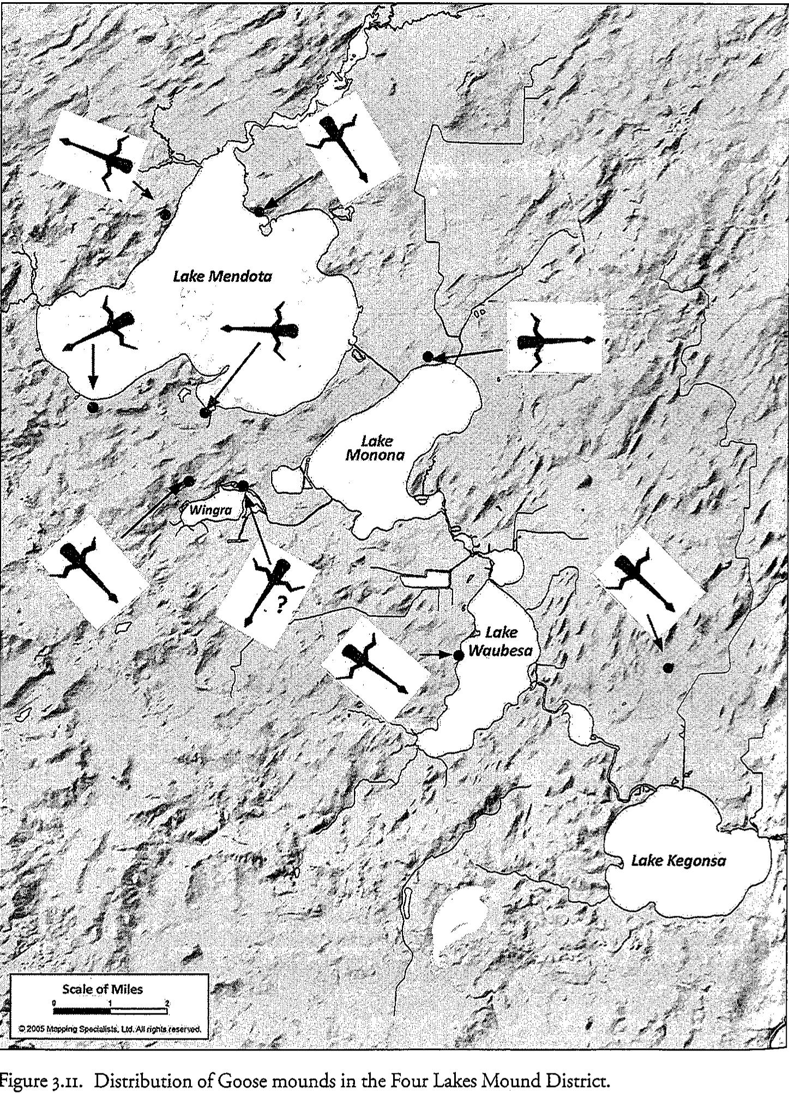
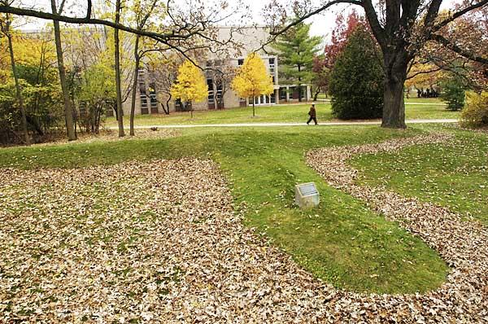
Unique Double Tailed Water Spirit (Nationally Registered Historic Landmark) &
Signature Effigy of Teejop, only found in Teejop, the Bent Winged Goose.

Slide 17


Slide 18
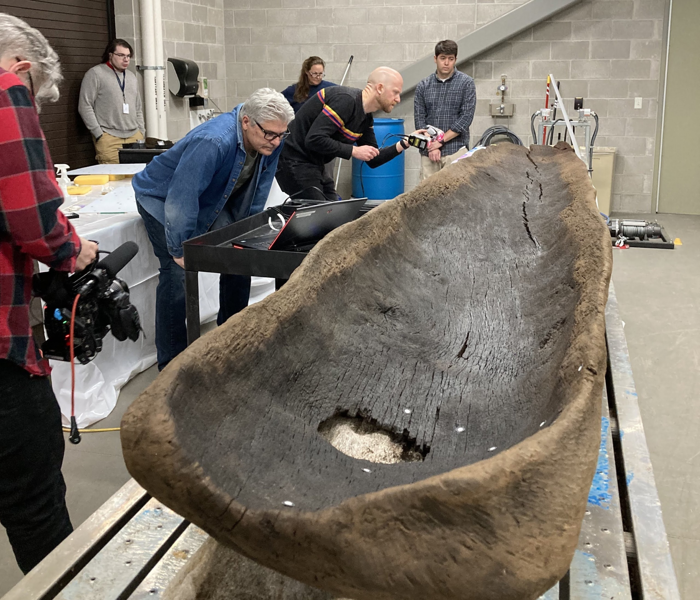

Slide 19
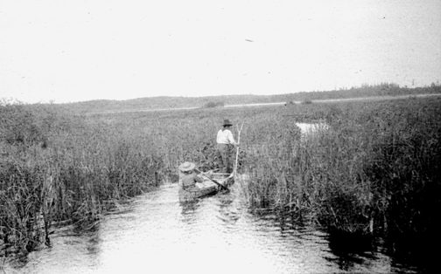

Slide 20
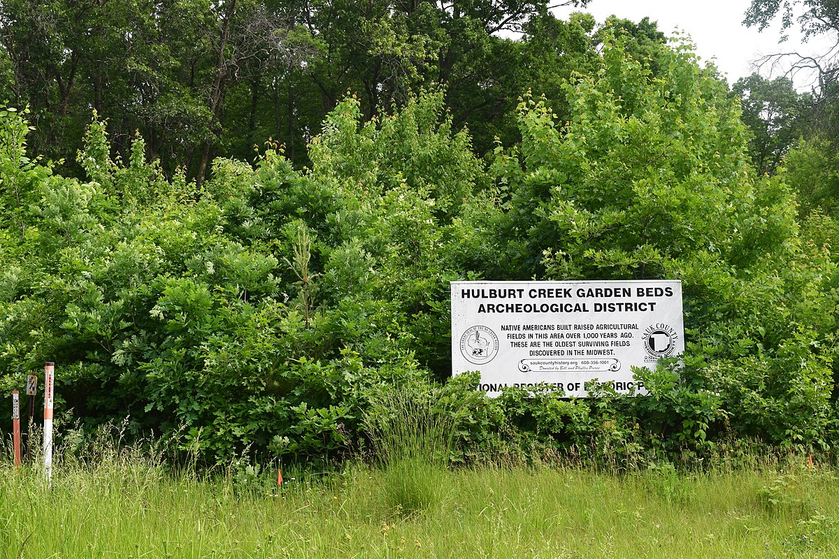

Slide 21
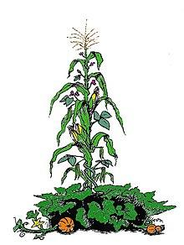
Three Sisters: Corn, climbing beans and squash
https://en.wikipedia.org/wiki/Three_Sisters_(agriculture)

Slide 22
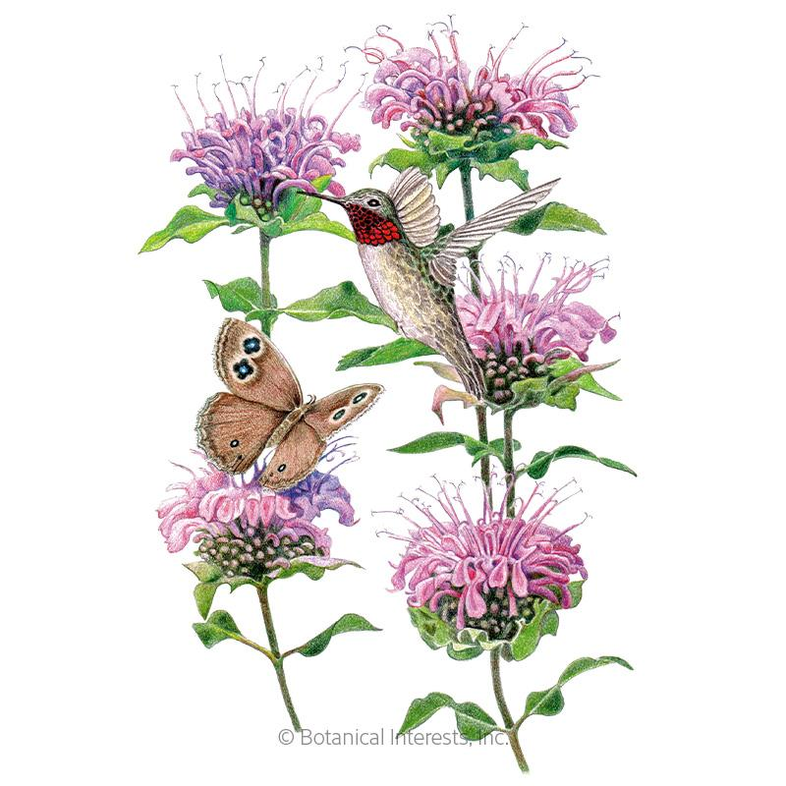
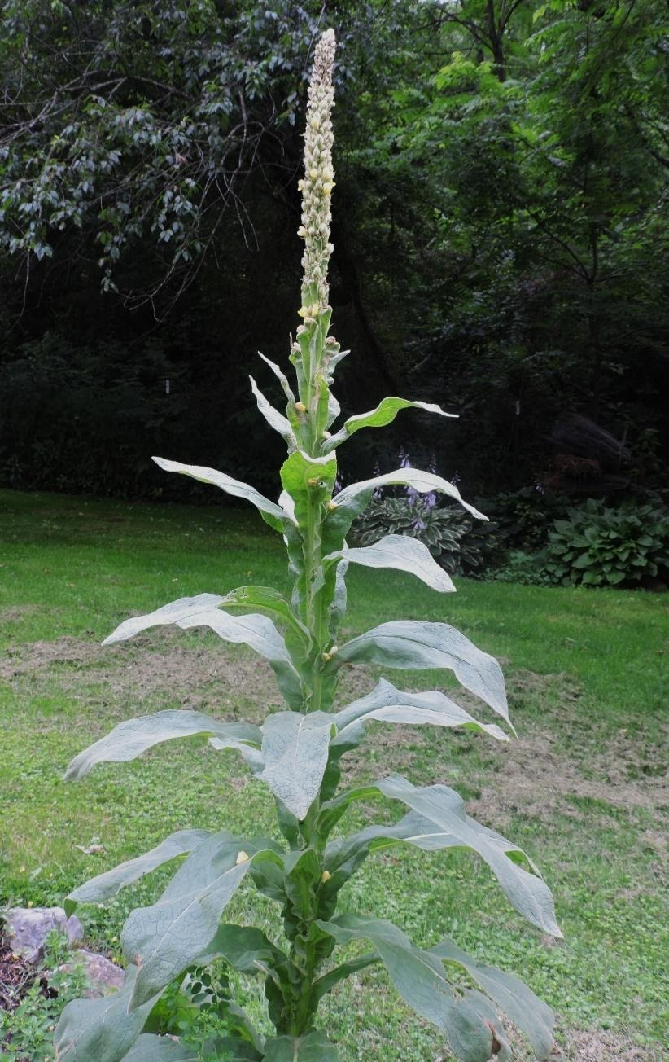
Maskīhkiwapoh: Tea
Bergamot
Mullein
https://www.botanicalinterests.com/product/Wild-Bergamot-Seeds
https://wildfoods4wildlife.com/monographs/mullein/

Slide 23
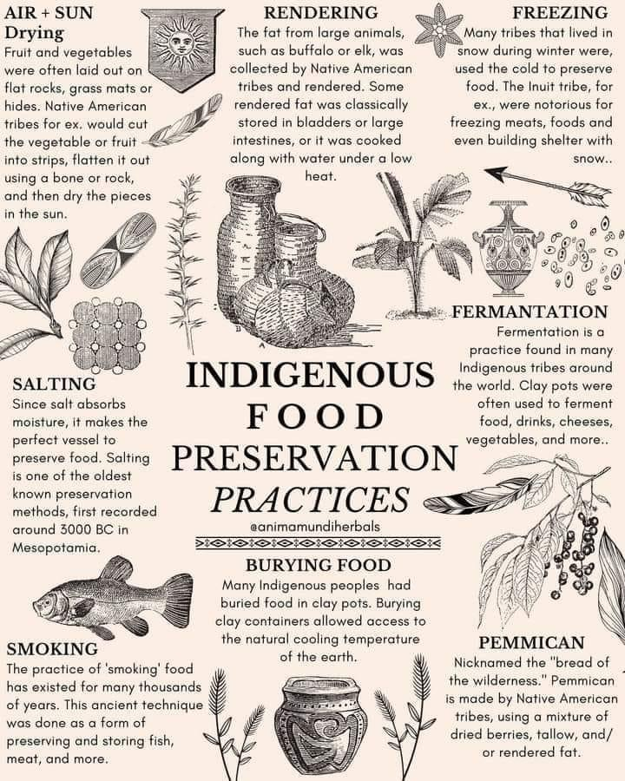

Slide 24
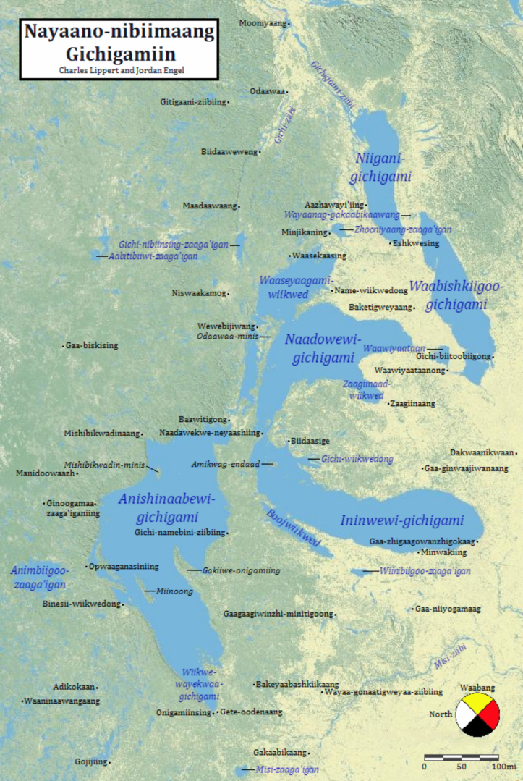
Indigenous V. Pre-colonial Orientations

Slide 25
Incorporating Indigenous Ways of Knowing into Your Work
Community ways of knowing are important elements of working with Native American (and all) audiences – we start where they are
Take the time needed to build relationships - “People don’t care how much you know, until they know how much you care”
Co-creation and inclusion in all phases of our work, especially including planning and evaluation - we work hand-in-hand
Adapt materials to be culturally relevant, or better yet, lead from culture
Tribal consultation!

Slide 26
By leading with Indigenous Ways of Knowing, we persist!
Food Sovereignty
Language Revitalization
Climate resilience
Youth development

Slide 27
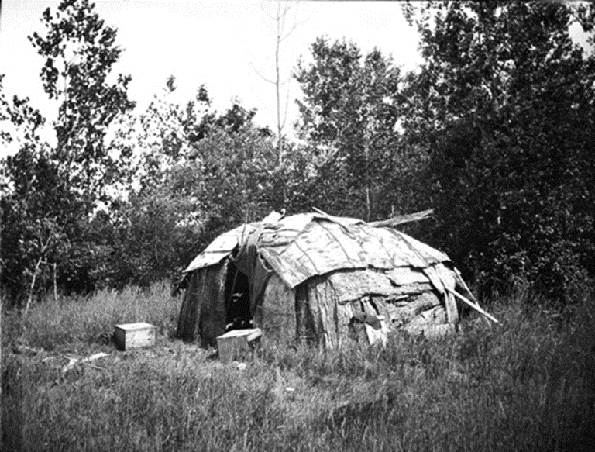
The Power of Circles
“Everything an Indian does is in a circle, and that is because the power of the World always works in circles, and everything tries to be round…”
Chief Black Elk

Slide 28
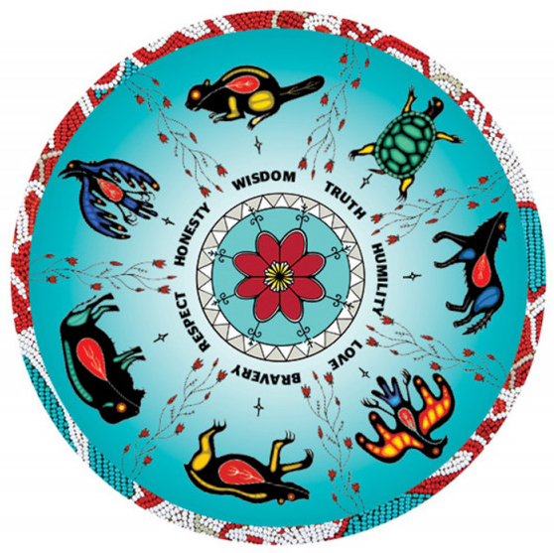
Seven Grandparent Teachings

Slide 29
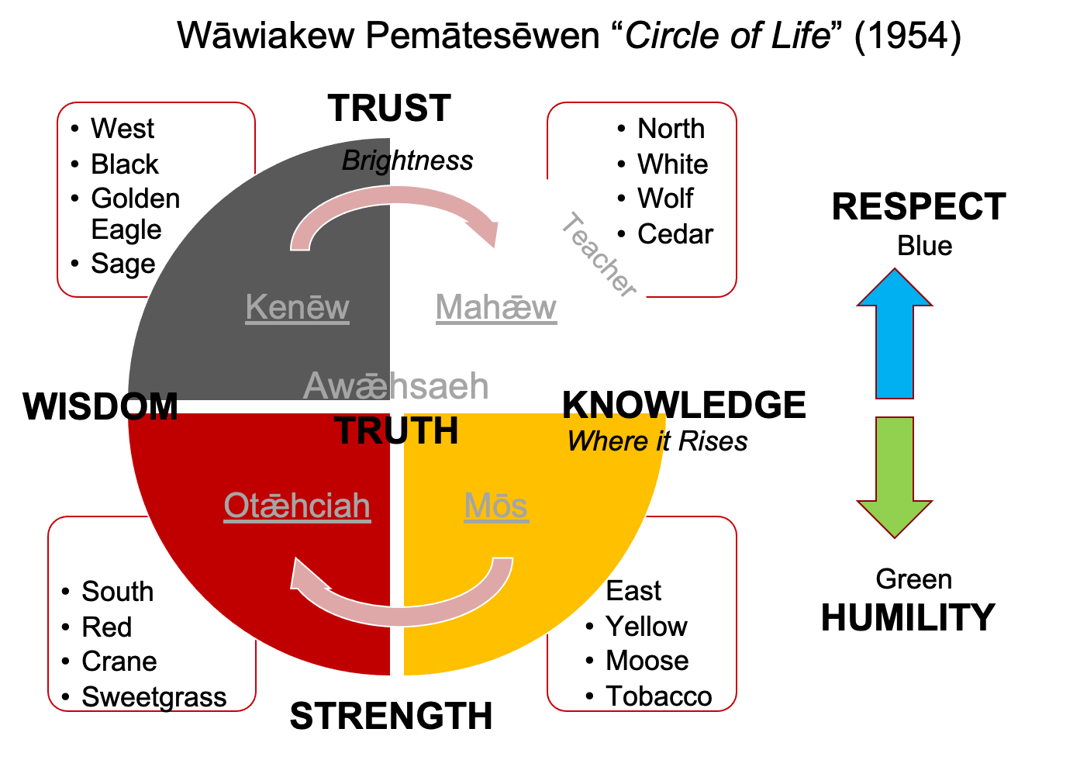

Slide 30
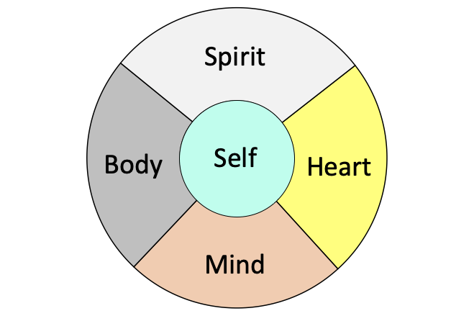
Medicine Wheel

Slide 31
Lessons of the Medicine Wheel
Repeating cycles and patterns
Everything is interconnected
Whomever is in the circle belongs in the circle
Change is an all-inclusive experience incorporating our use of self, spirit, heart, body and mind
We must use all of our gifts in order to be successful

Slide 32
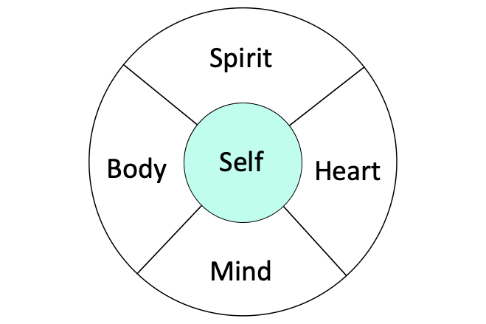
Self – Intention
What’s on your mind? How would you like to focus your attention today?
Which of your personal values can serve as “gifts” for addressing this issue?

Slide 33
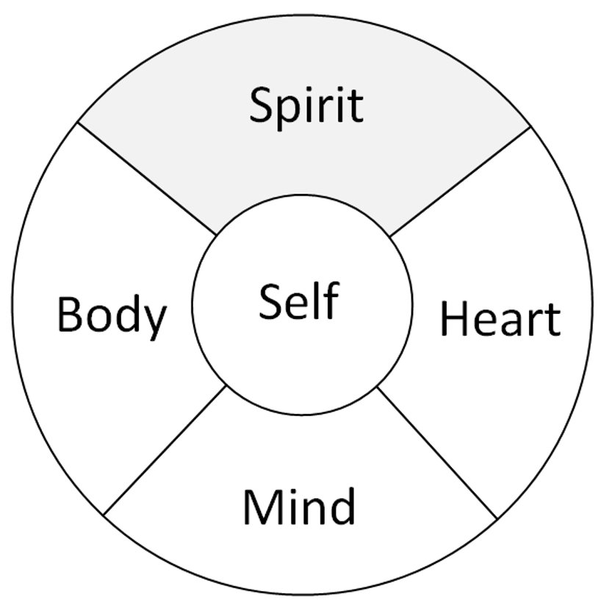
Spirit
What is the “higher calling” for addressing this issue?

Slide 34
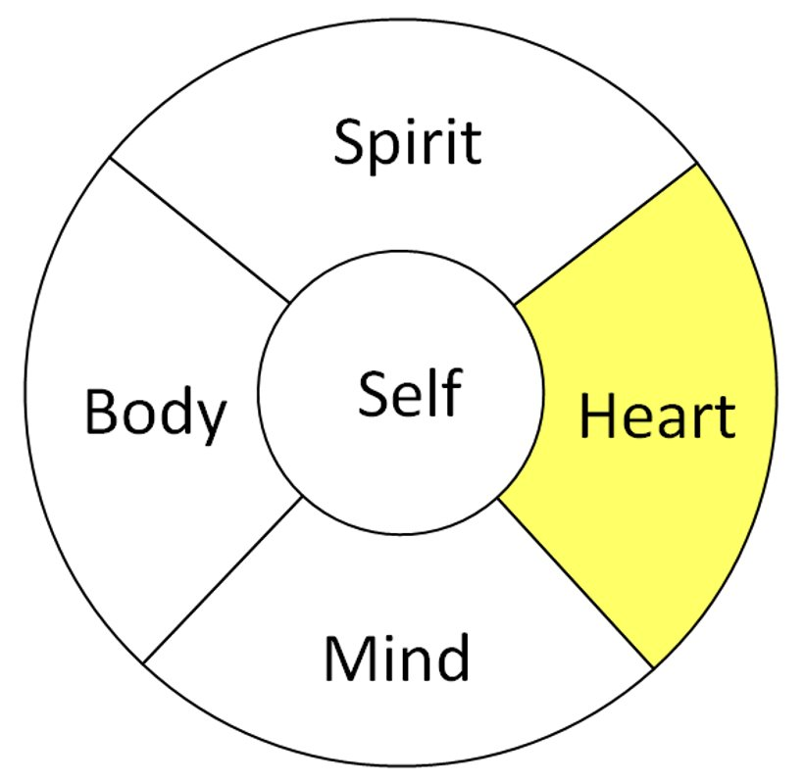
Heart
Knowing that we know our purpose:
What gets in the way of achieving that purpose?
What helps?

Slide 35
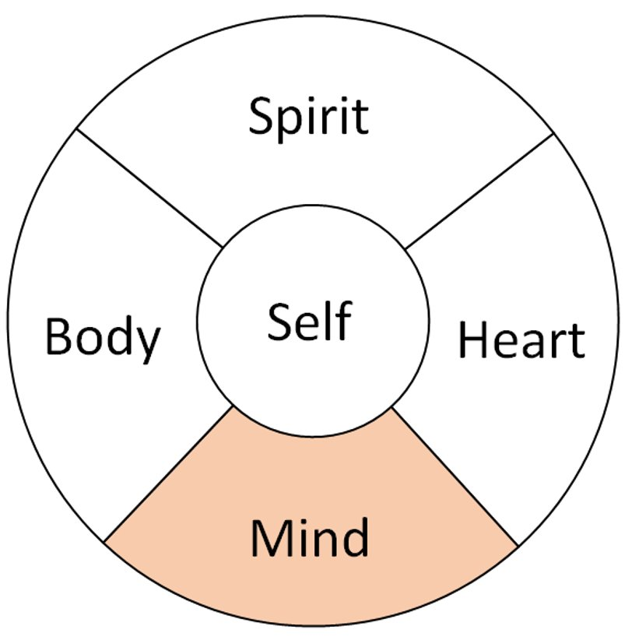
Mind
Now that you know the purpose, what gets in the way and what helps – what are one or two things that you can personally do that would make the most difference as you move forward?

Slide 36
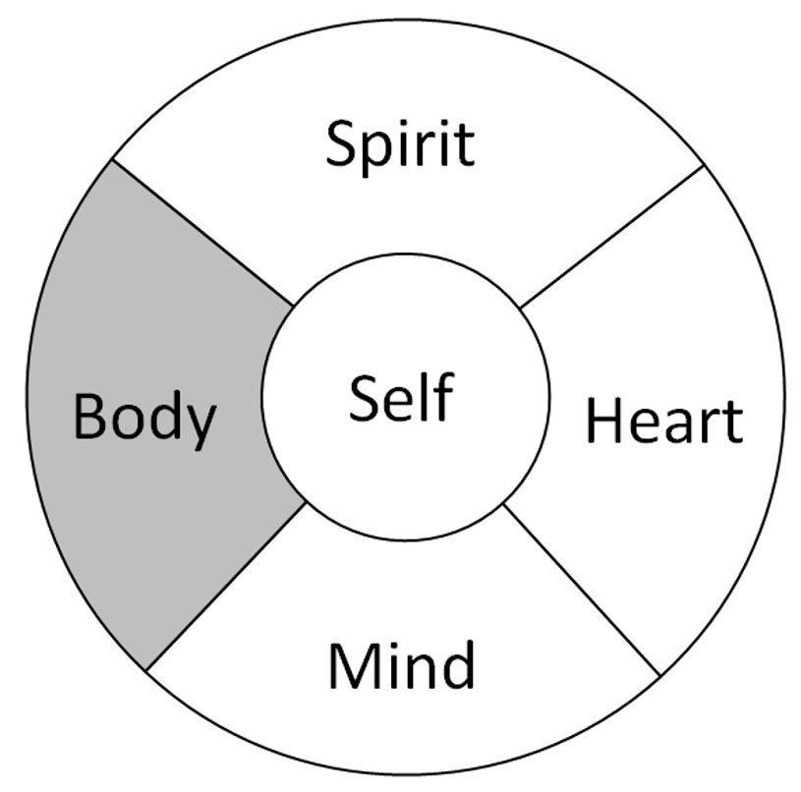
Body
What action steps will you implement?
Know, Use, Own?

Slide 37

For Calling the Spirit Back
By Joy Harjo
Performed by Marena Fox Baker

Slide 38
