Slide 1
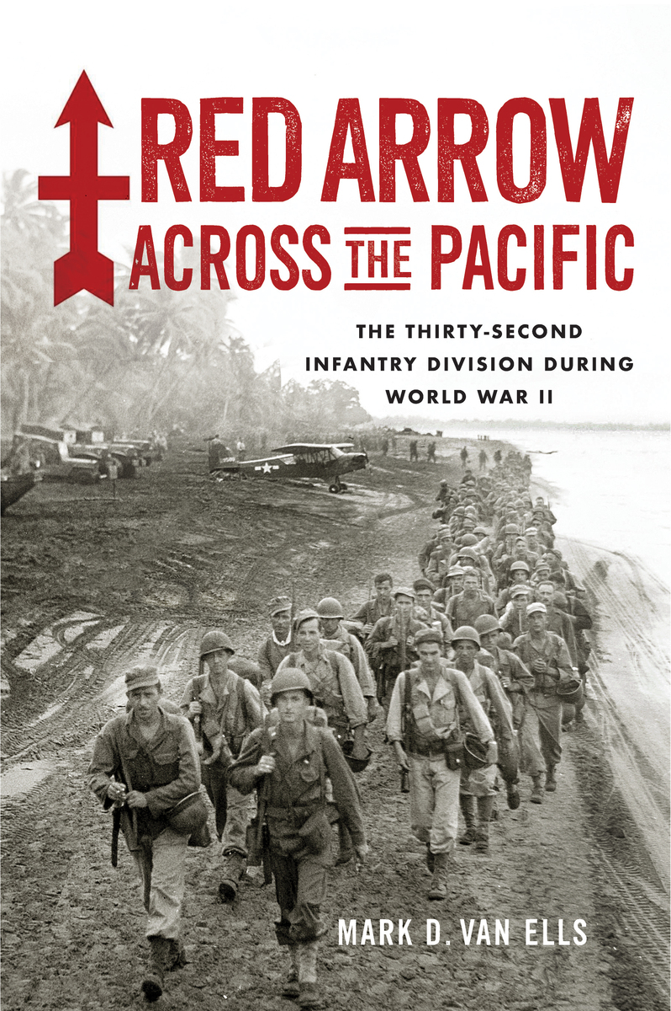
The 32nd Infantry Division during World War II
HISTORY SANDWICHED IN LECTURE SERIES
MADISON, WI
JULY 8, 2025

Slide 2


Slide 3
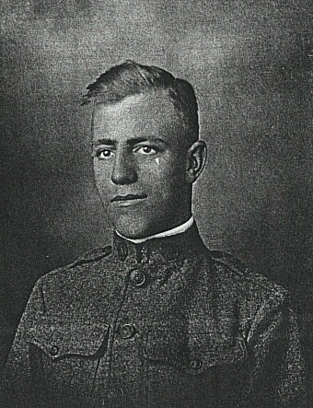
Personal Connections
Right:
Andrew V. Van Ells, Supply Co., 127th Infantry Regiment
Port Washington, WI

Slide 4

The 32nd “Red Arrow” Division
Created in 1917
Made up of National Guard units from Wisconsin and Michigan
Impressive record during World War I
Pierced every German line it encountered
Between the wars

Slide 5
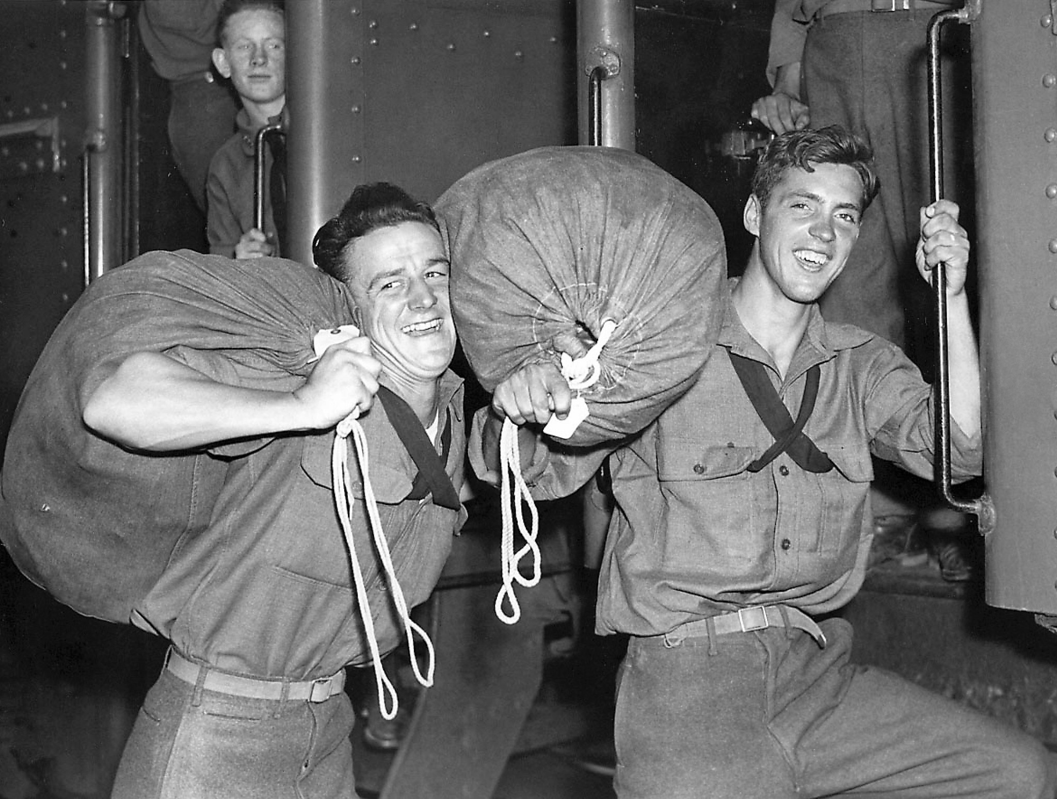
Mobilization, October 1940

Slide 6
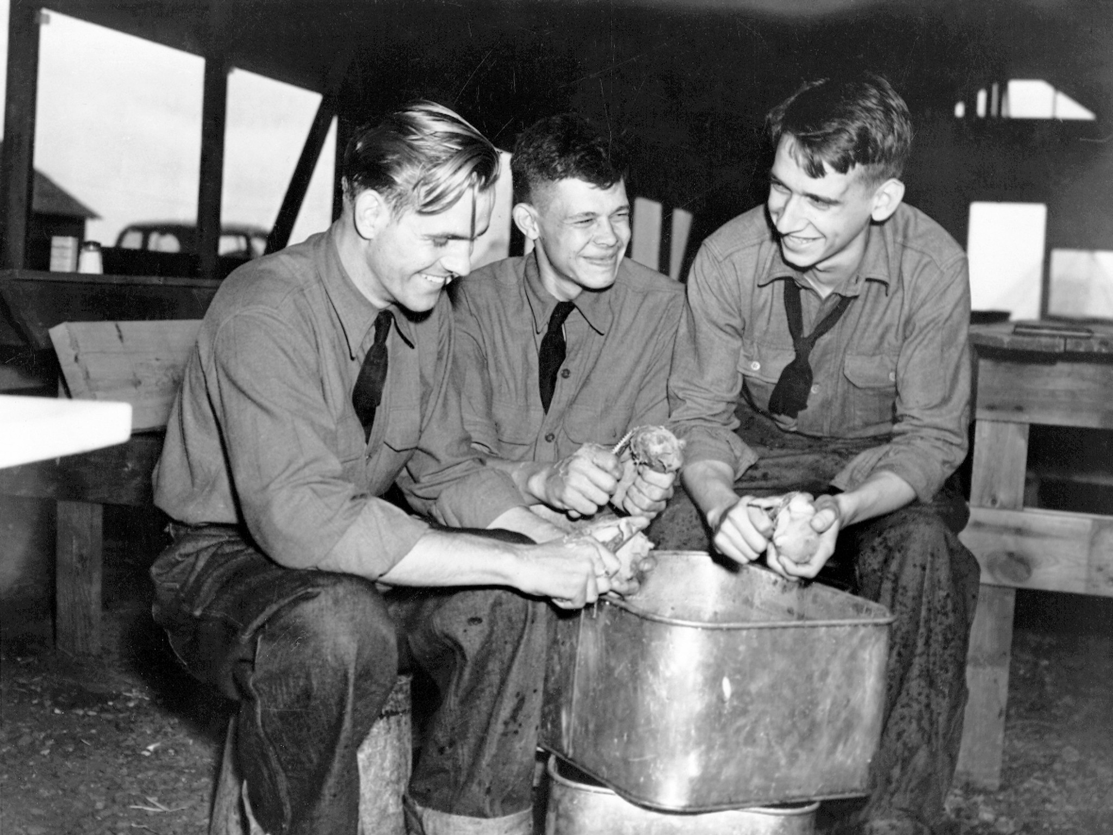
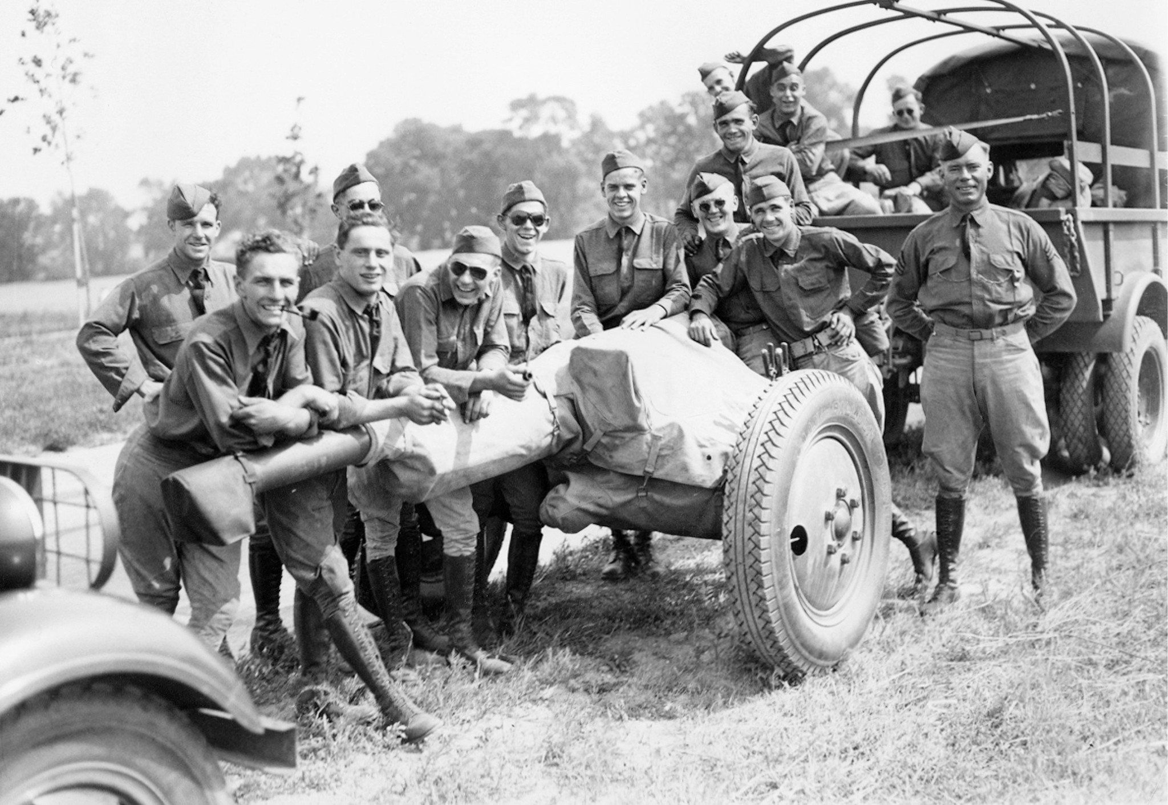
Training in Louisiana

Slide 7
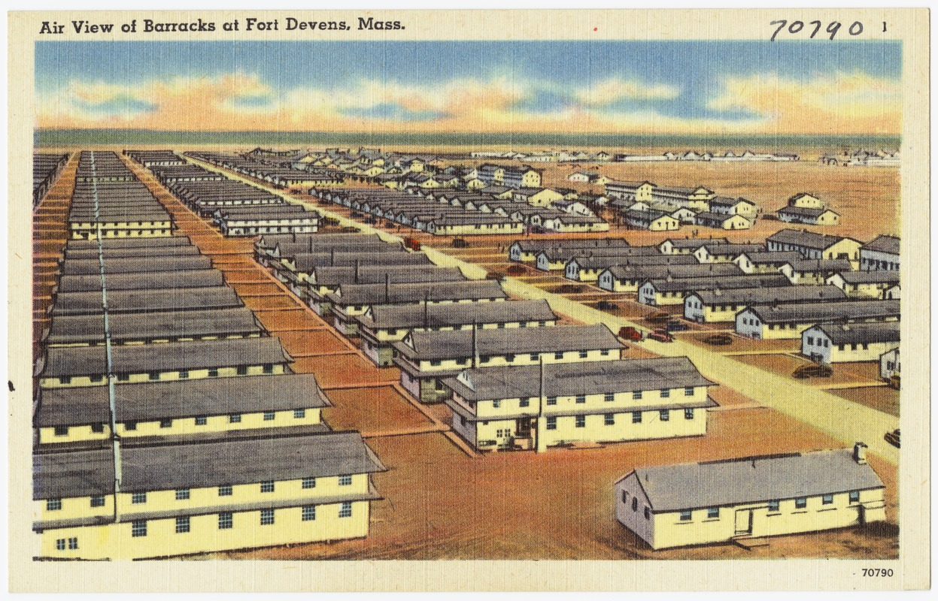
A division on the move

Slide 8
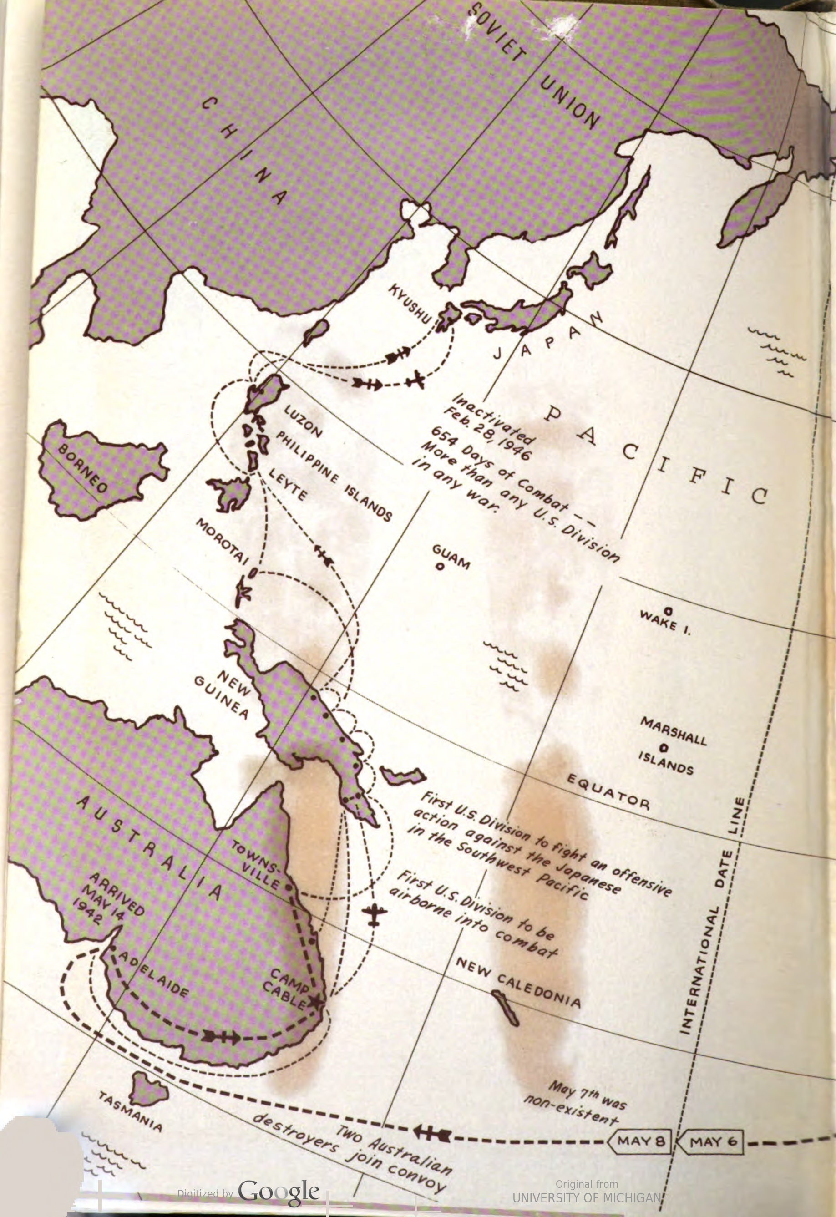
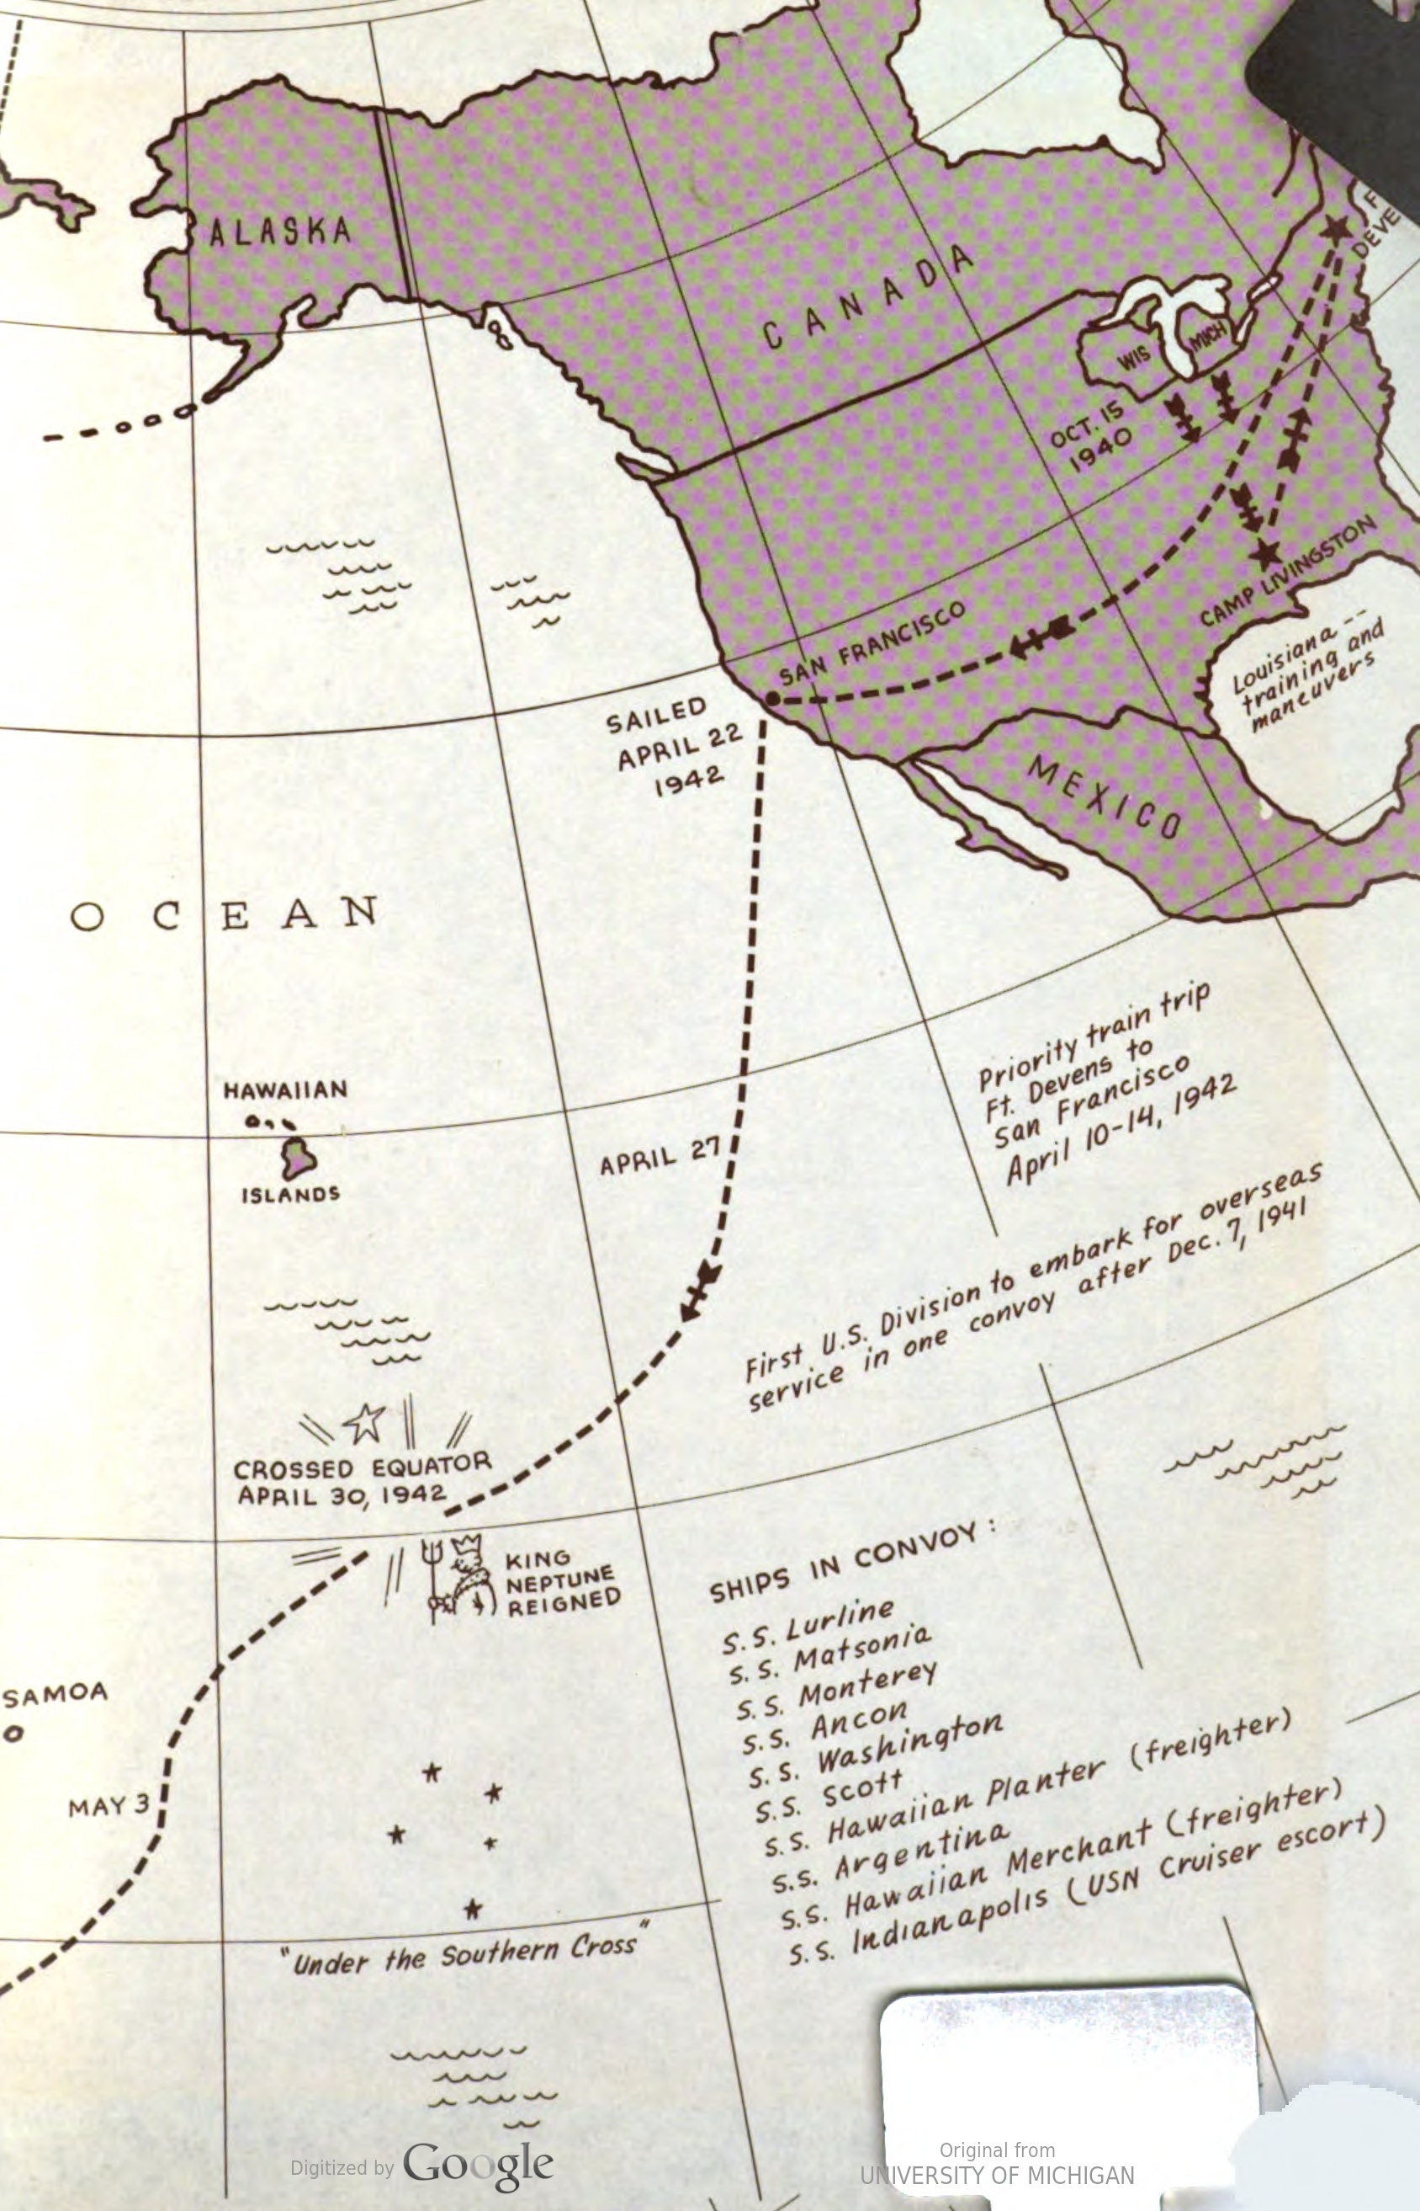

Slide 9
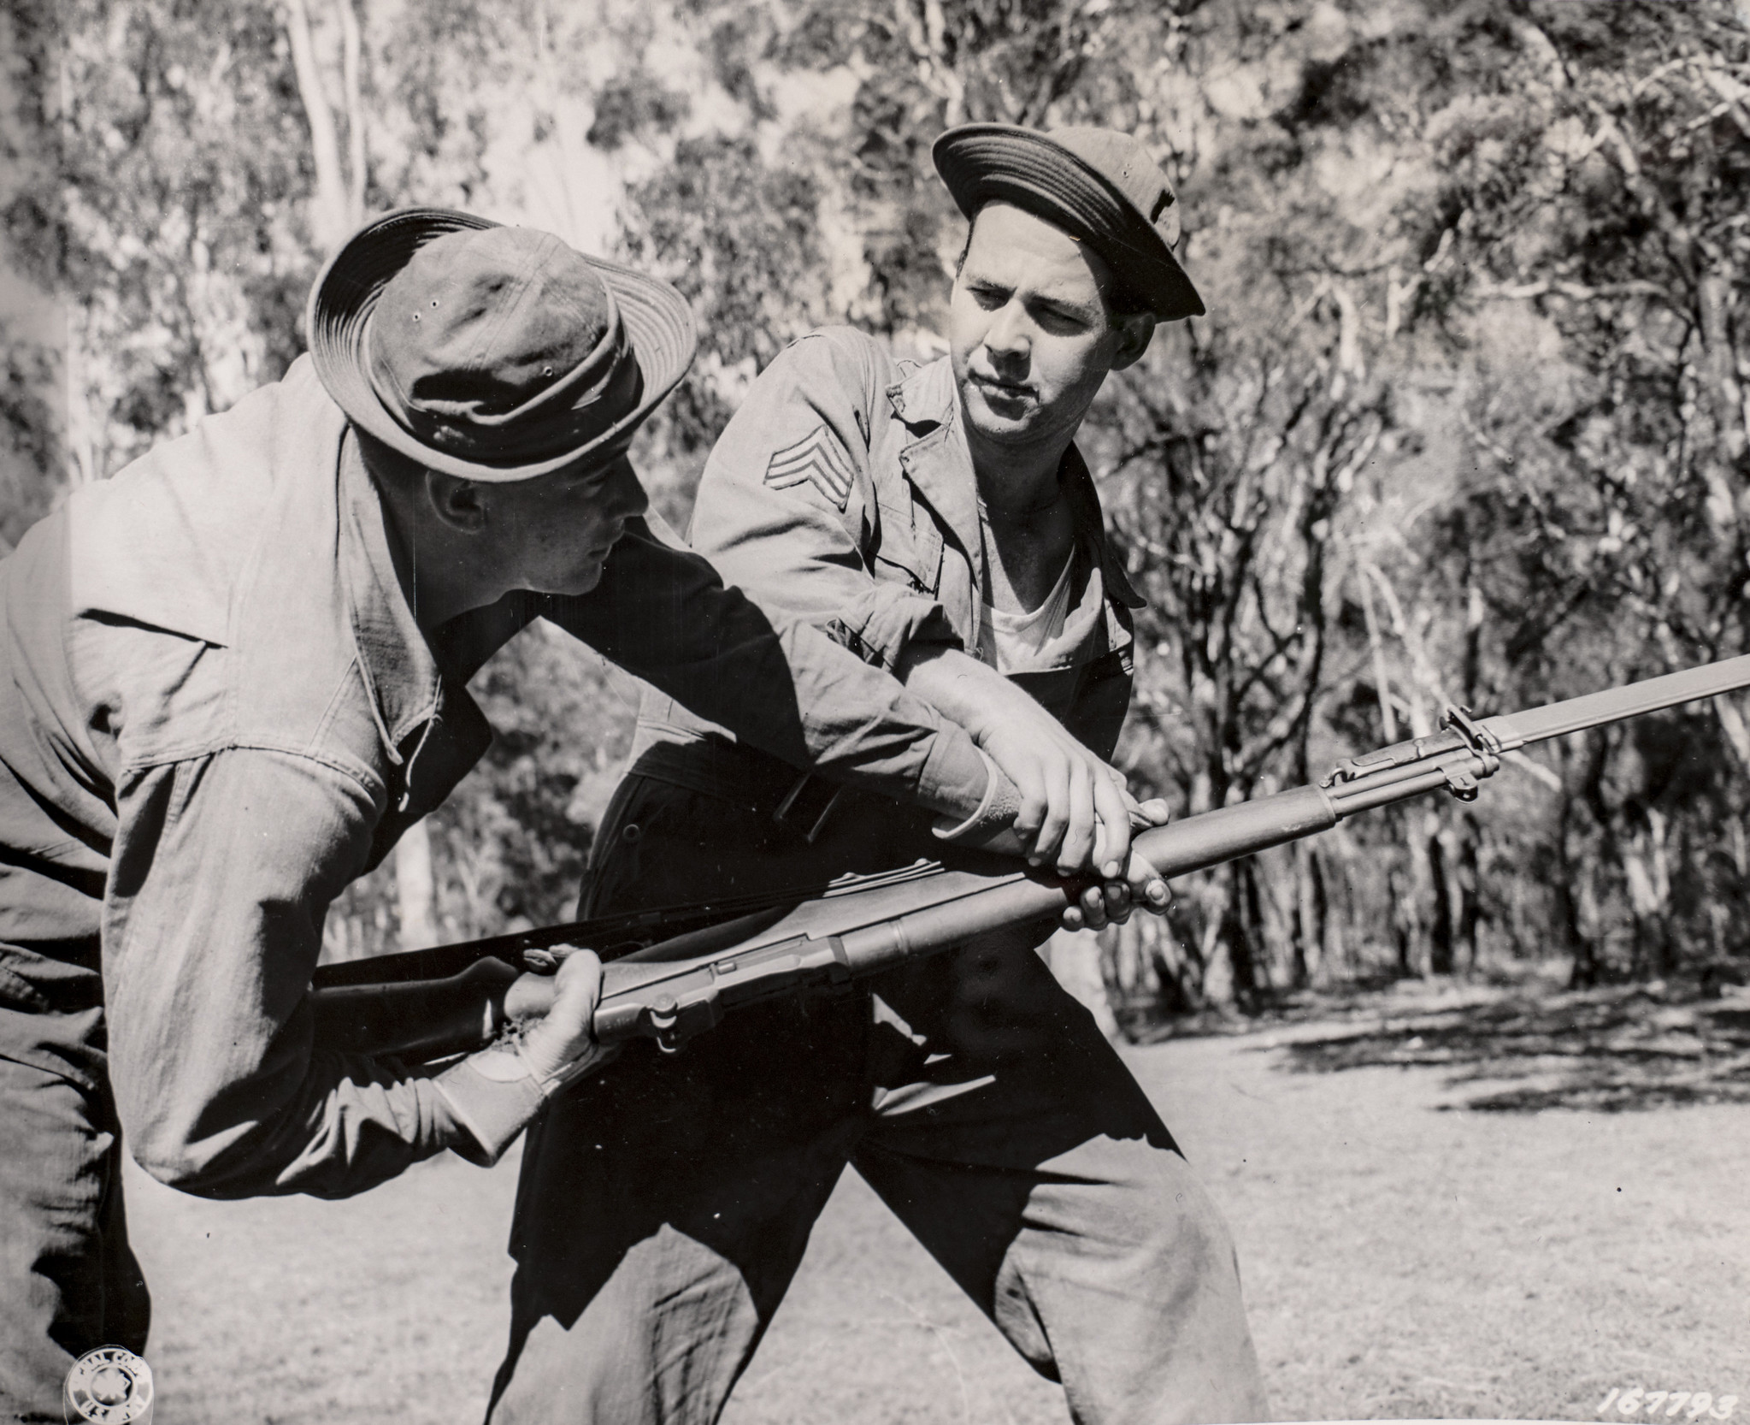
Training in Australia

Slide 10
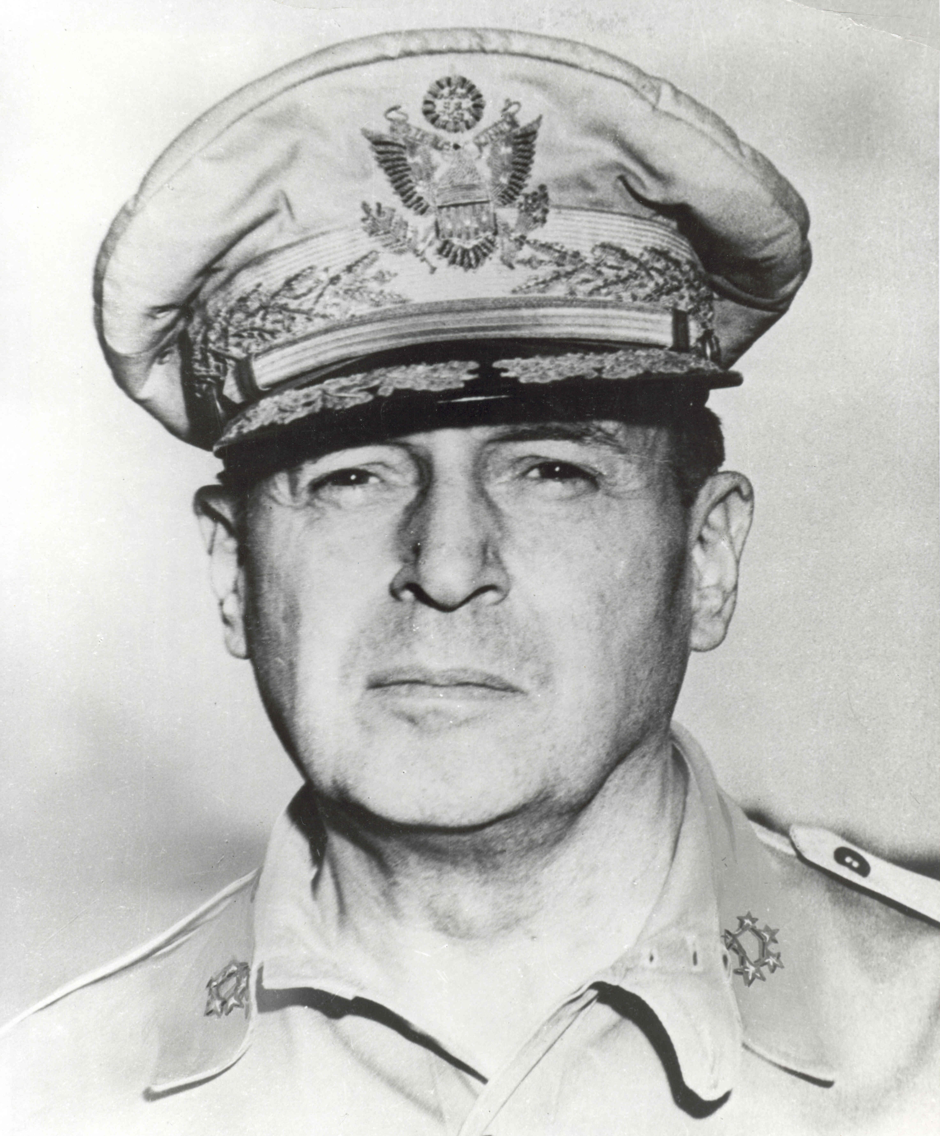
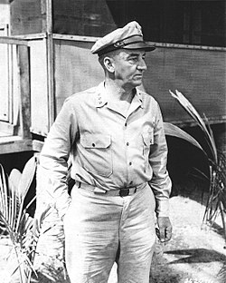
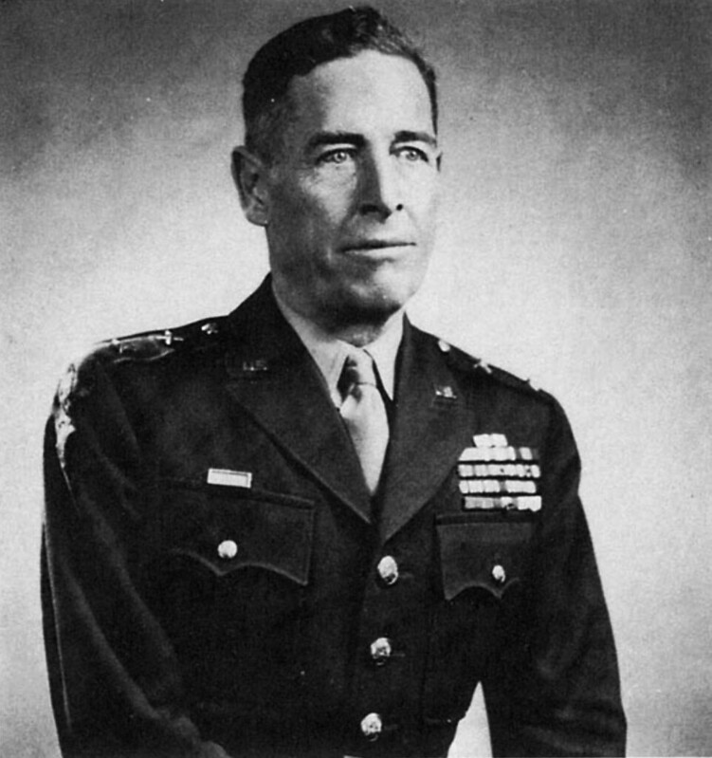
The US Leadership Team
Douglas MacArthur
Supreme Commander, SWPA
Robert Eichelberger
Commander, I Corps
Edwin Forrest Harding
Commander, 32nd Infantry Division

Slide 11
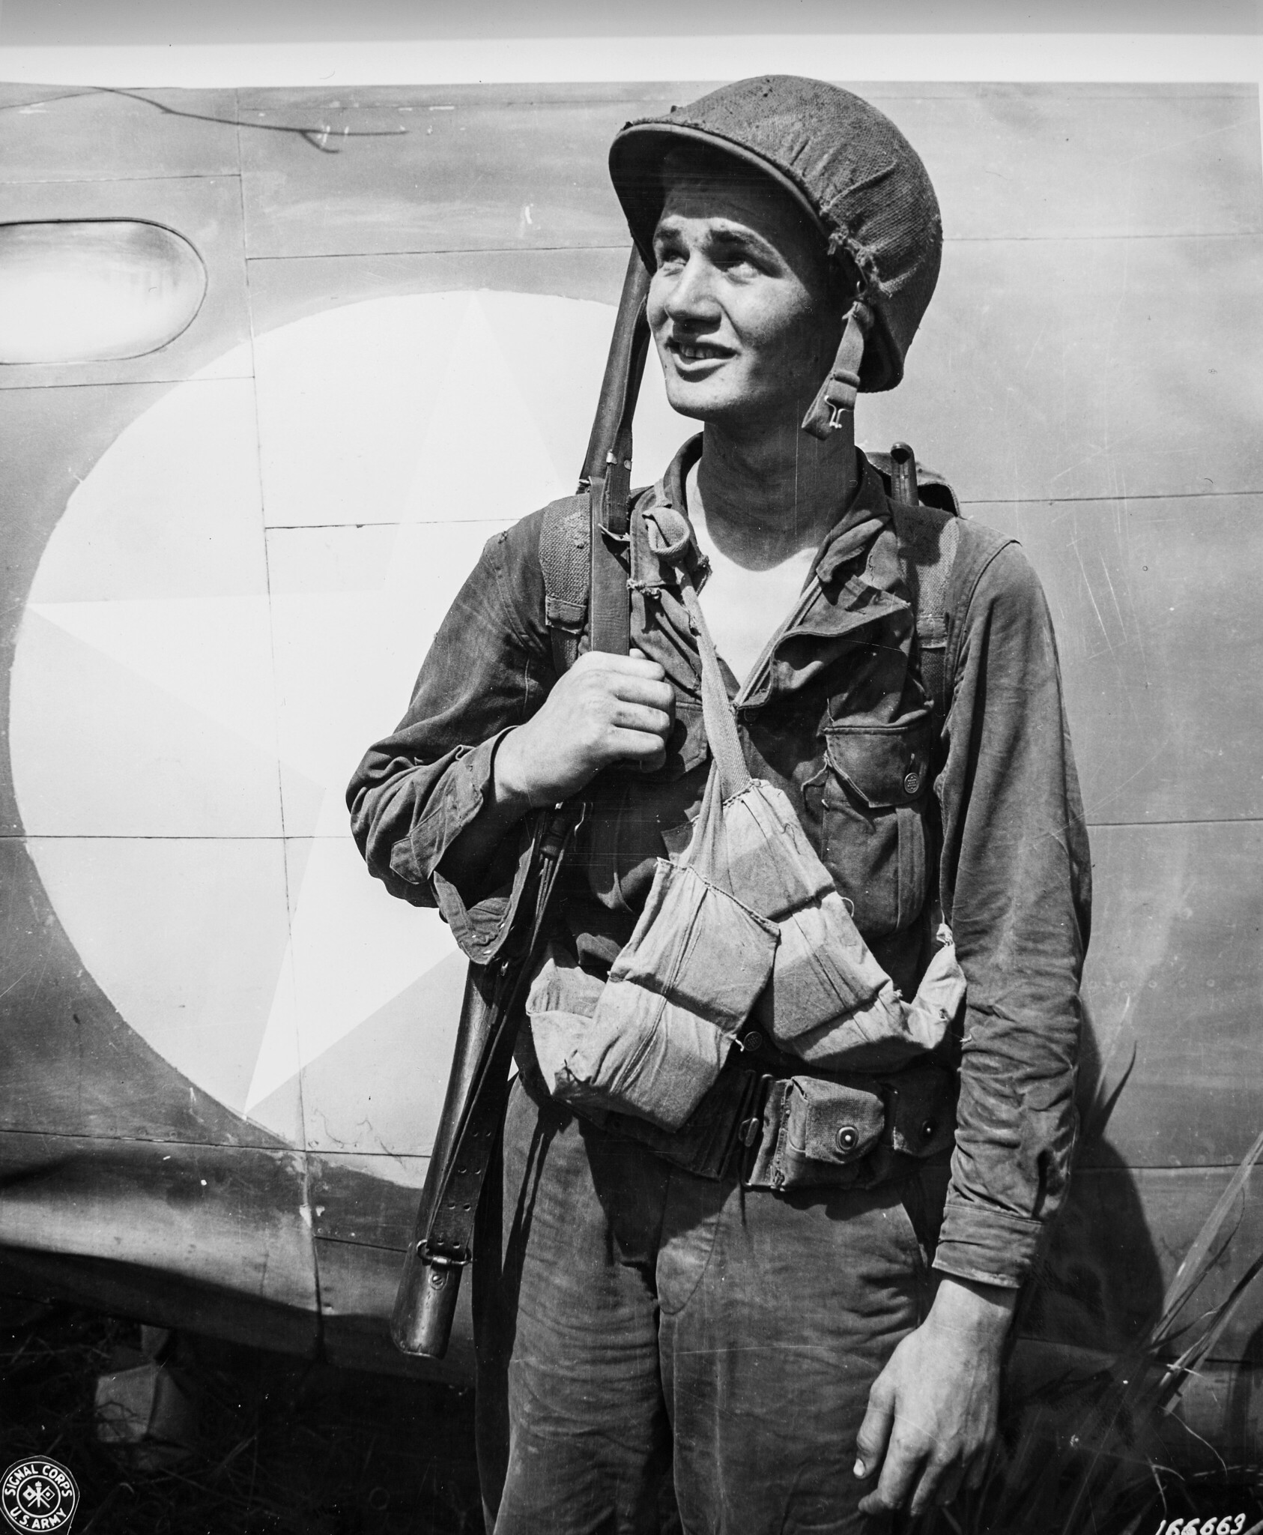
The Red Arrow on the Eve of Battle
Inadequate training
Inadequate equipment
Almost constantly on the move
Questionable leadership
Poor intelligence
Little naval support
Confident – but inexperienced

Slide 12
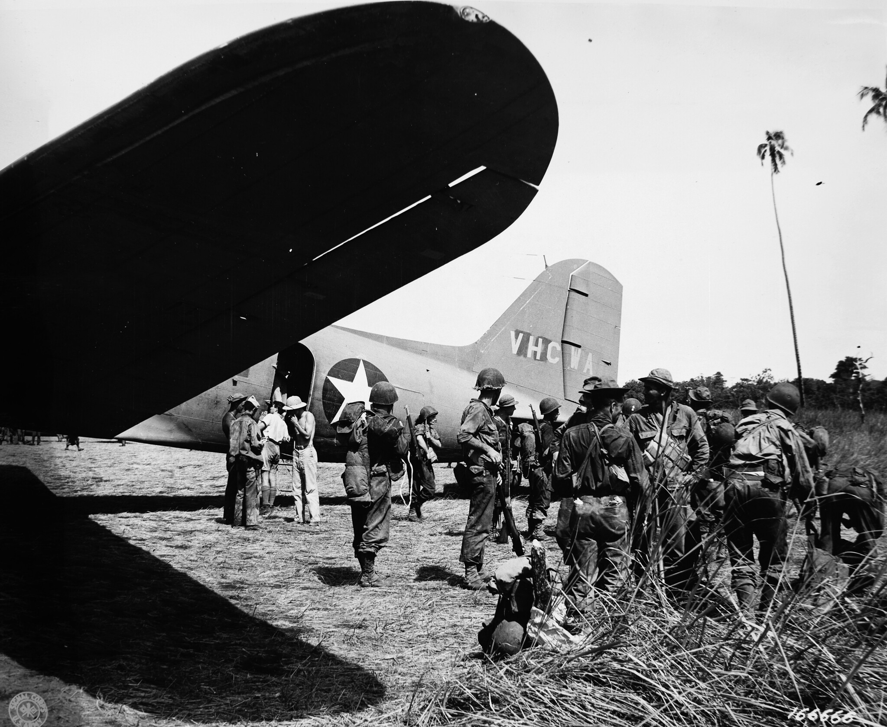
Arrival in New Guinea

Slide 13
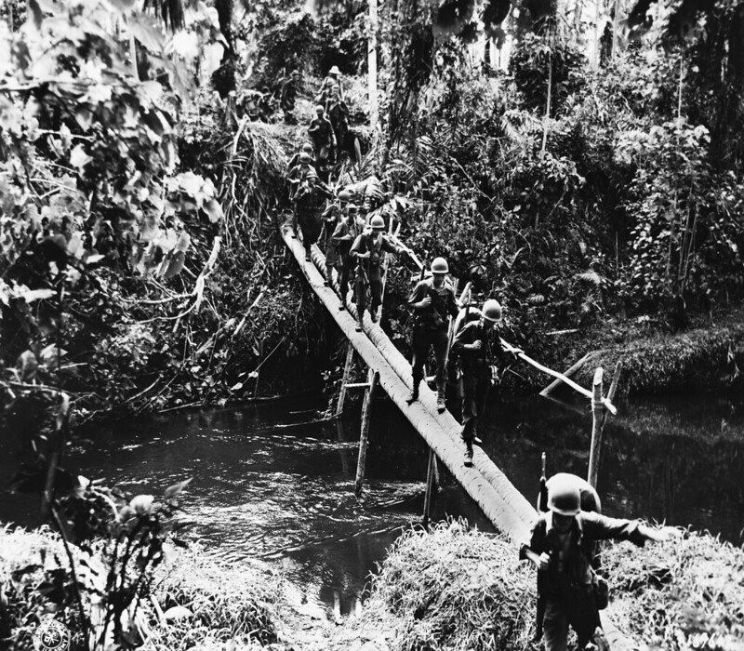
An Unfamiliar Environment

Slide 14
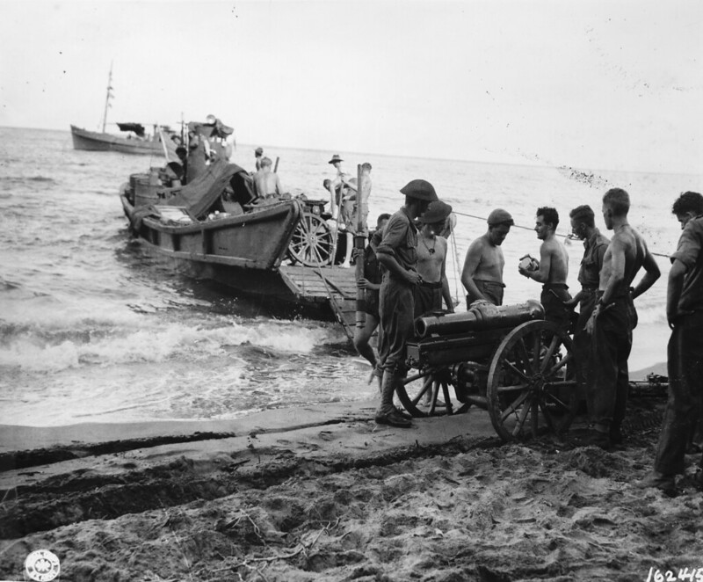
A Logistical Nightmare

Slide 15
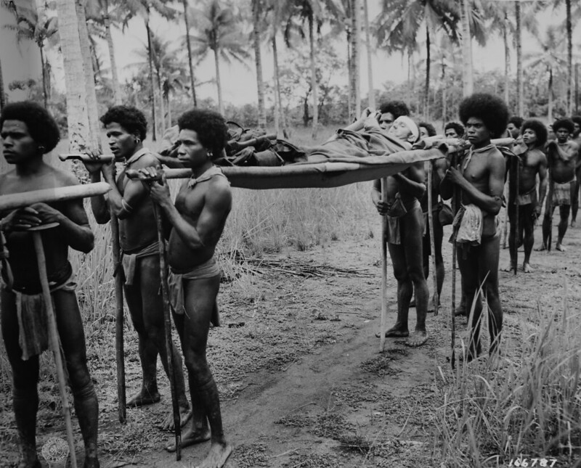
Papua New Guineans

Slide 16
Buna: The Approach

Slide 17
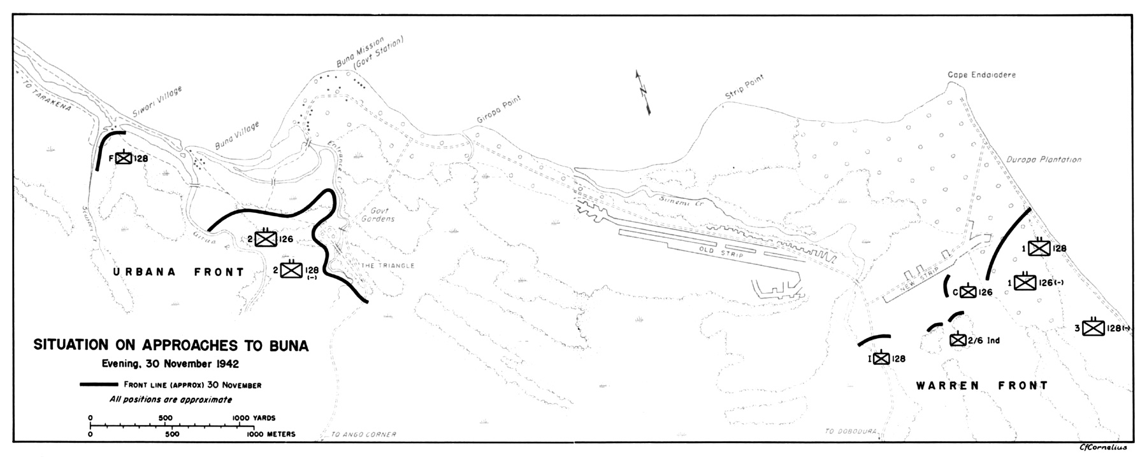
Baptism of Fire

Slide 18
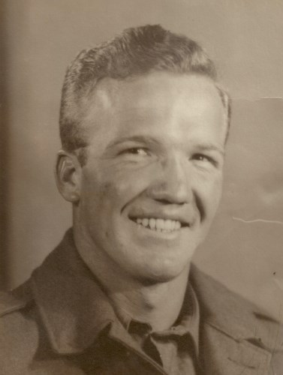
“Men fell all around, many mortally wounded; some with legs riddled with bullets sank to the ground crying and moaning. The guns kept firing, and many of those who had fallen were hit again, killing them.” Roy Campbell Co. B., 128th Infantry Regiment

Slide 19
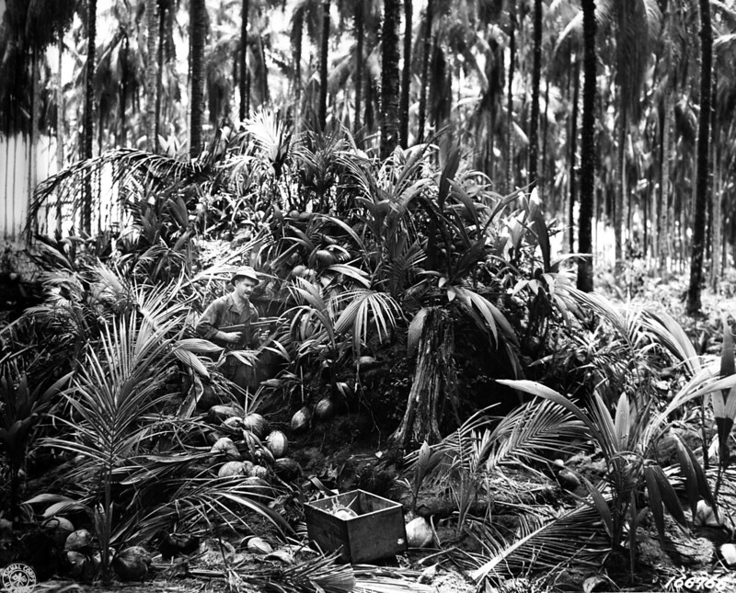

Slide 20
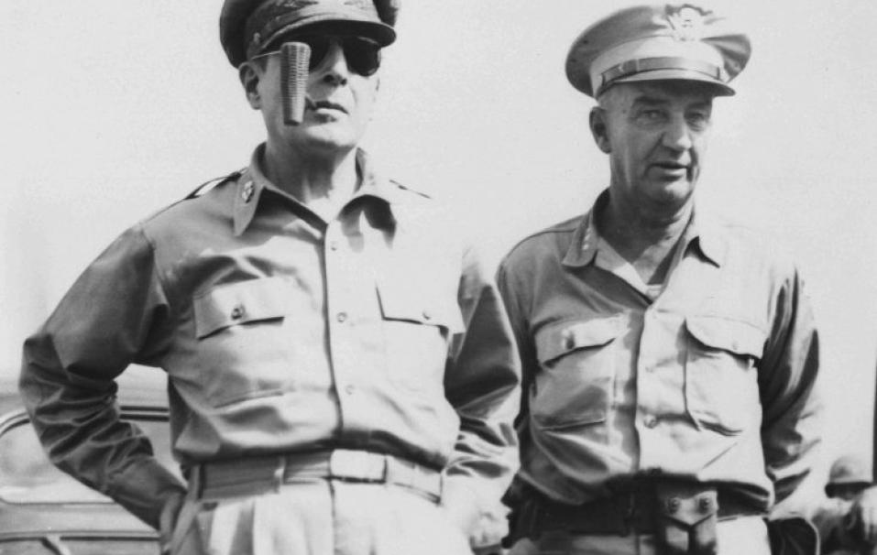
“Take Buna or don’t come back alive” MacArthur to Eichelberger November 30, 1942

Slide 21
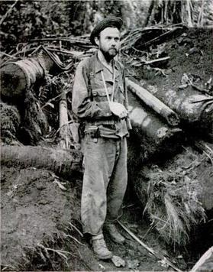
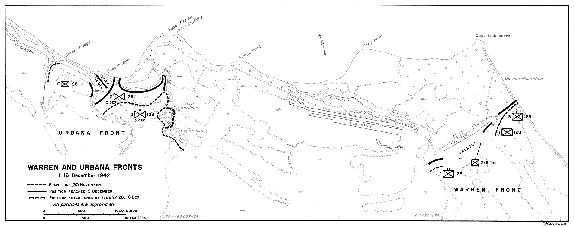
Herman Bottcher

Slide 22
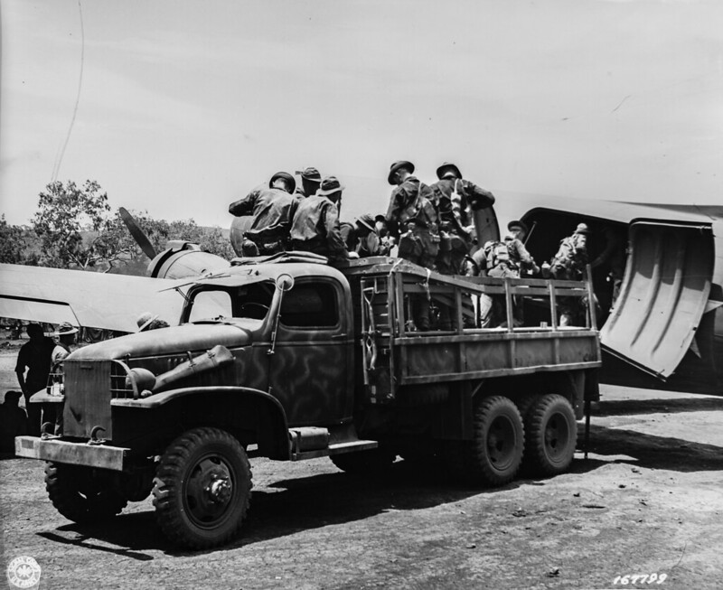
Arrival of the 127th Infantry Regiment

Slide 23
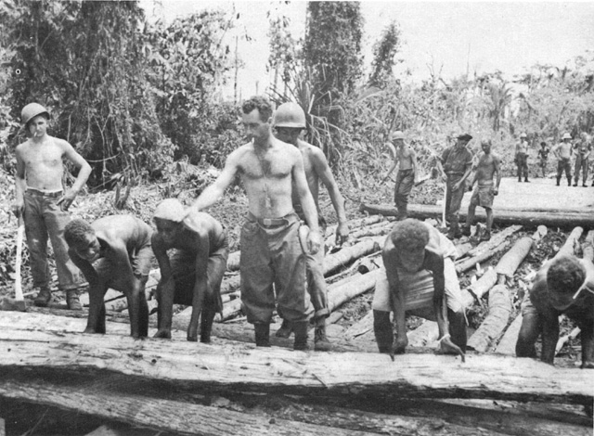
Improving Logistics

Slide 24
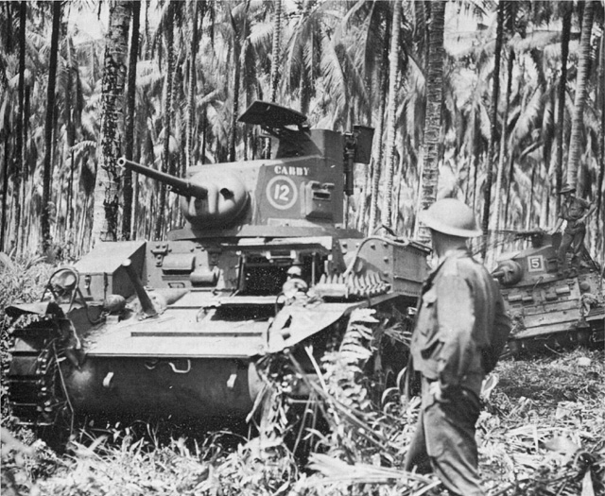
Arrival of Australian Tanks December 18, 1942

Slide 25
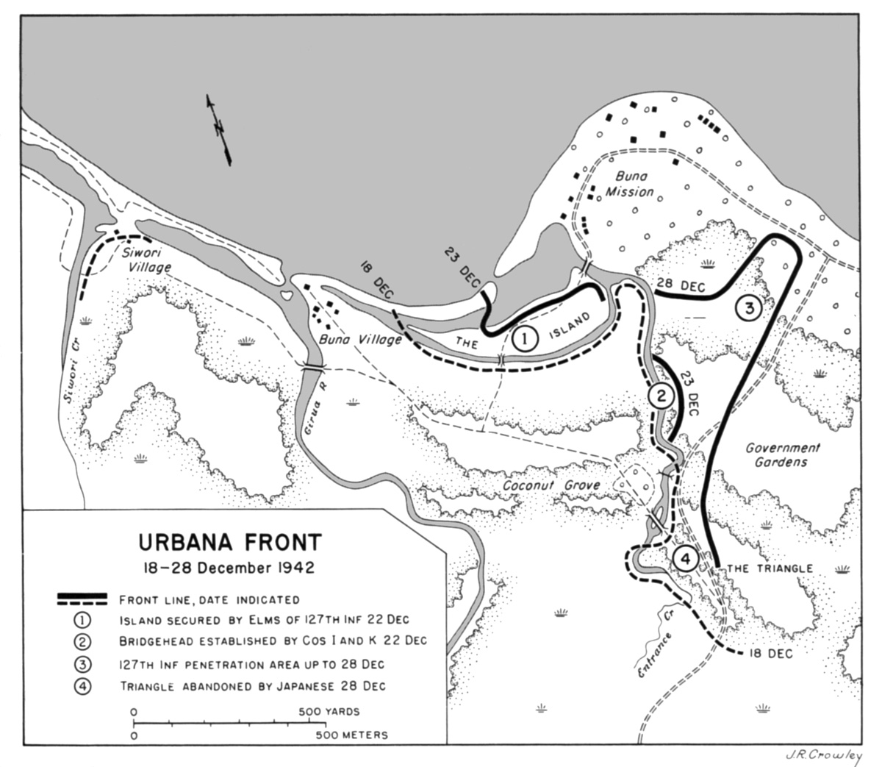
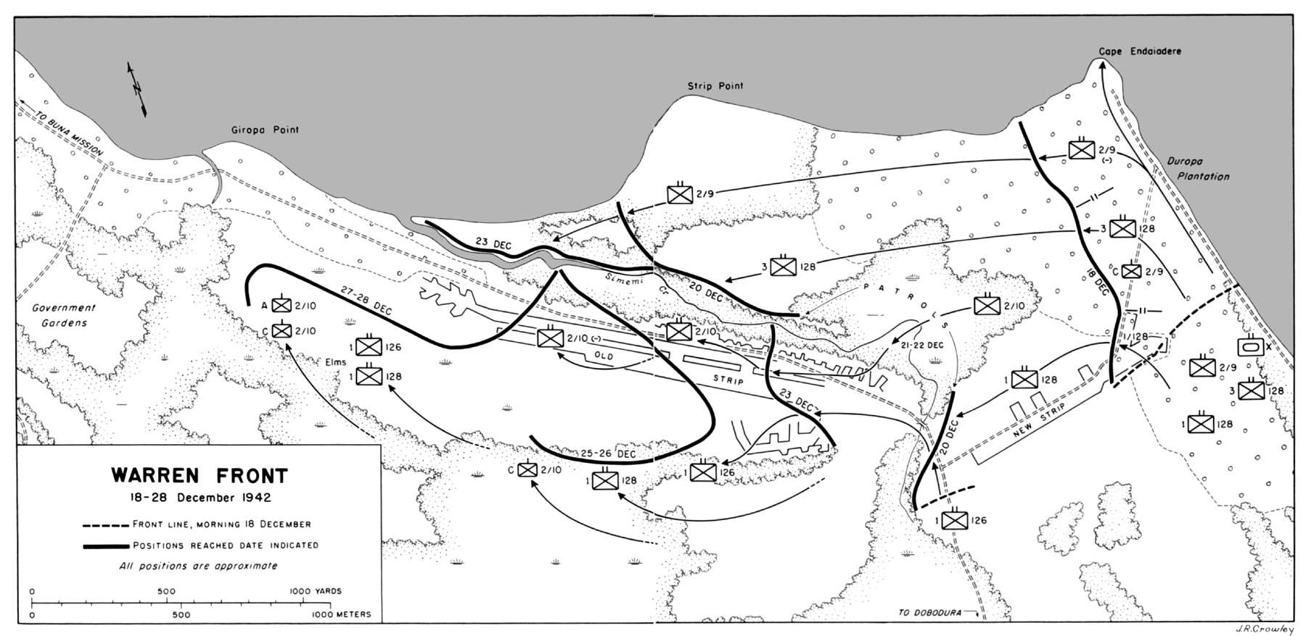
Breakthroughs

Slide 26
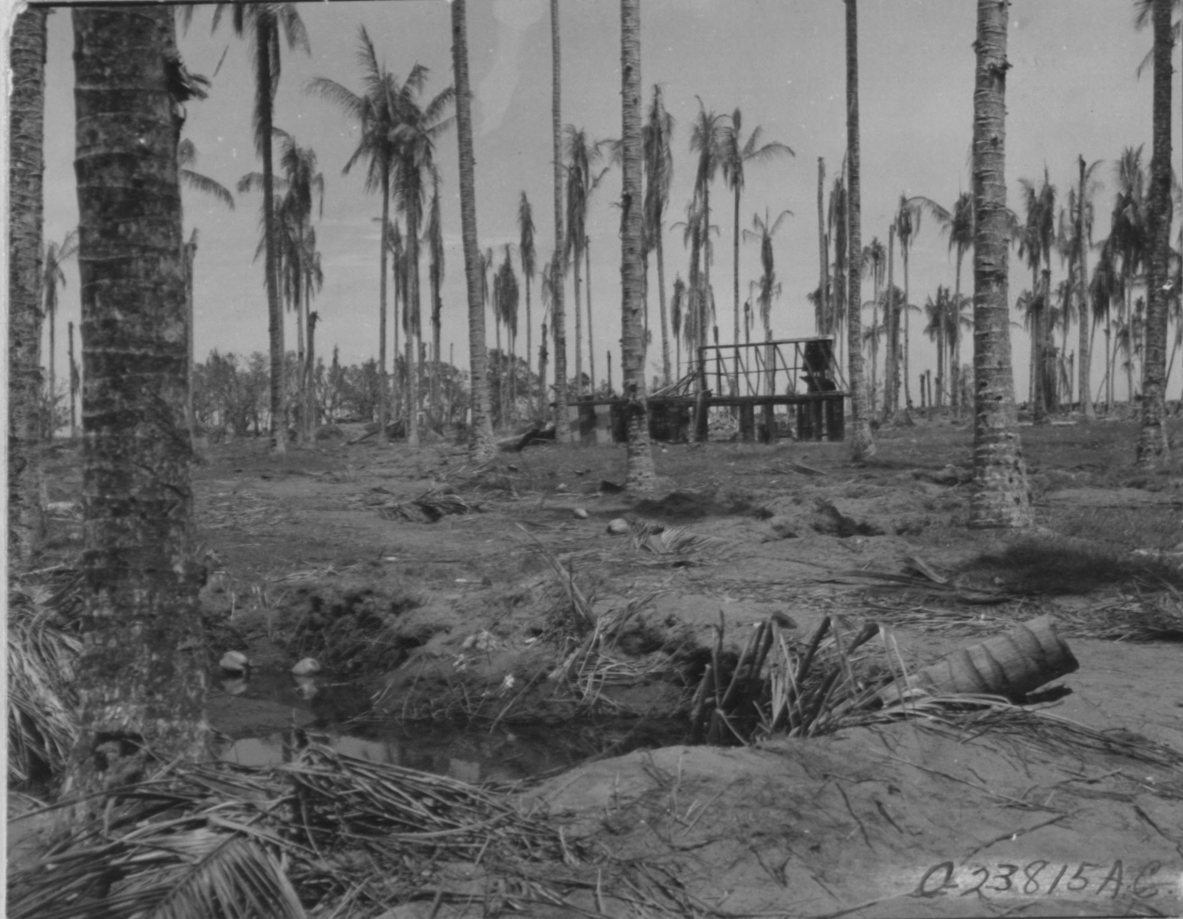
Fall of Buna Mission January 2, 1943

Slide 27
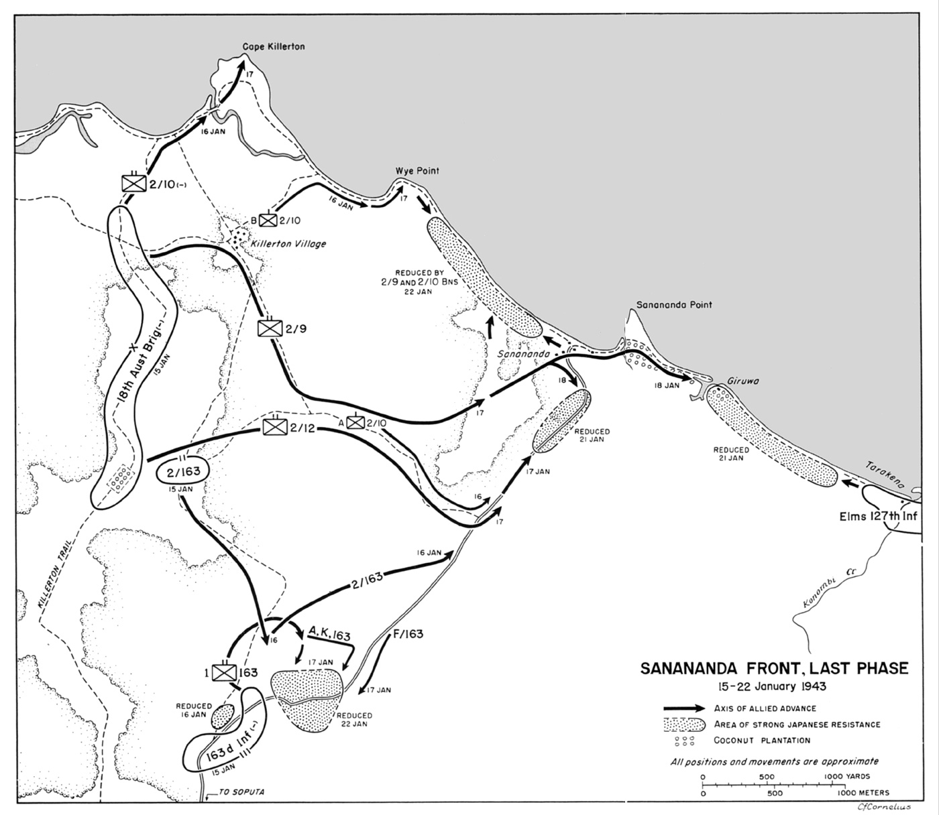
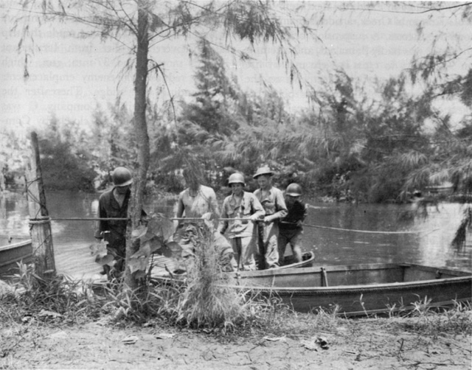
The Final Offensive

Slide 28
“A great deal has been said and whispered about the 32nd Division and much of it makes no sense. The 32nd which ‘failed’ at Buna was the same 32nd that won the victory there. No one else did.” Robert Eichelberger

Slide 29
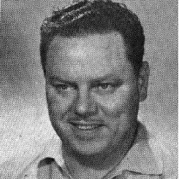
“We fought the [Japanese]. We fought the jungle, the rain and mud, the insects, swamps and diseases – and we won.” James E. Myers Co. K, 128th Infantry Regiment

Slide 30
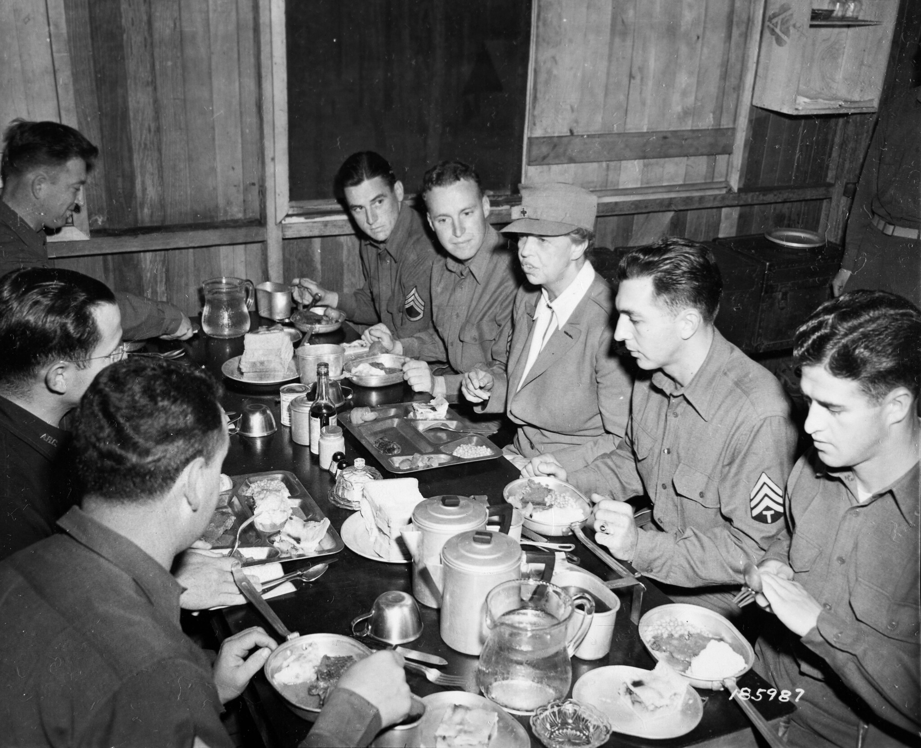
Rest and reorganization
A new commander – General William H. Gill
Intensified training
Replacements
National press
A visit from the First Lady
Rotations home begin March 1944

Slide 31
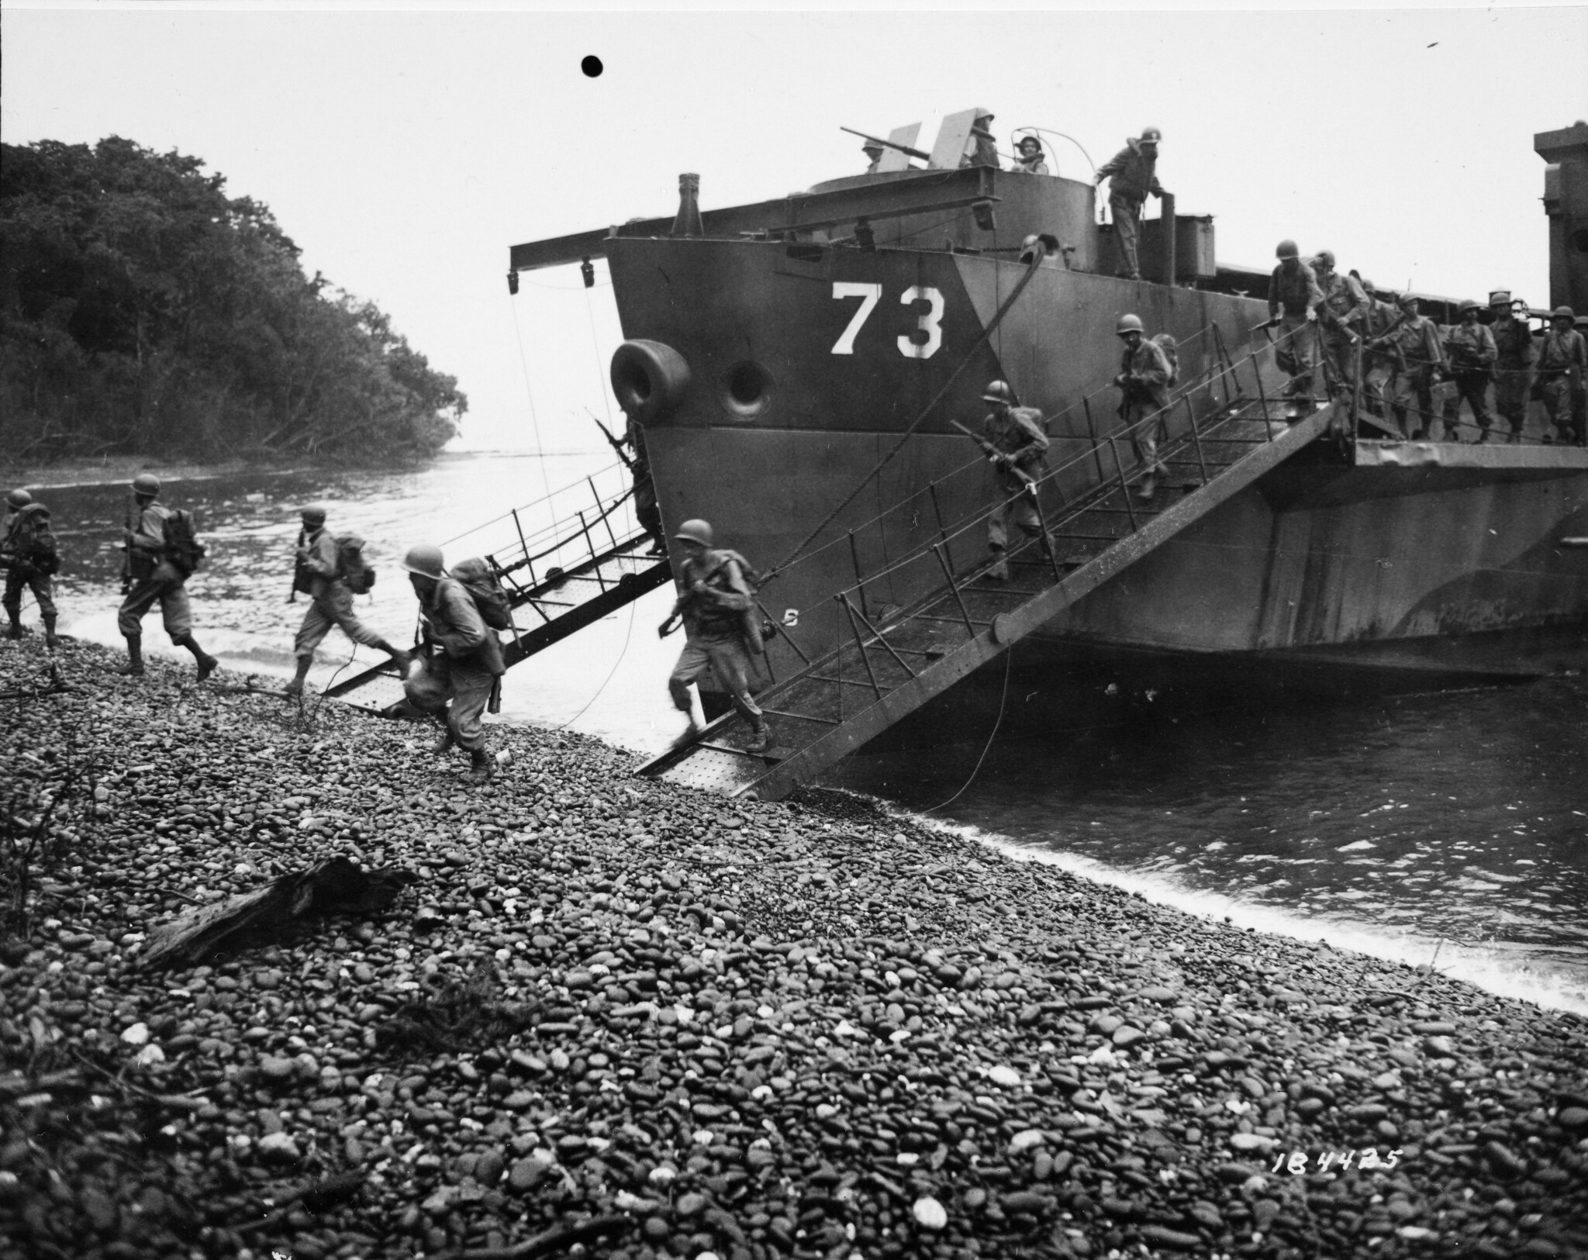
Leapfrogging: Saidor

Slide 32
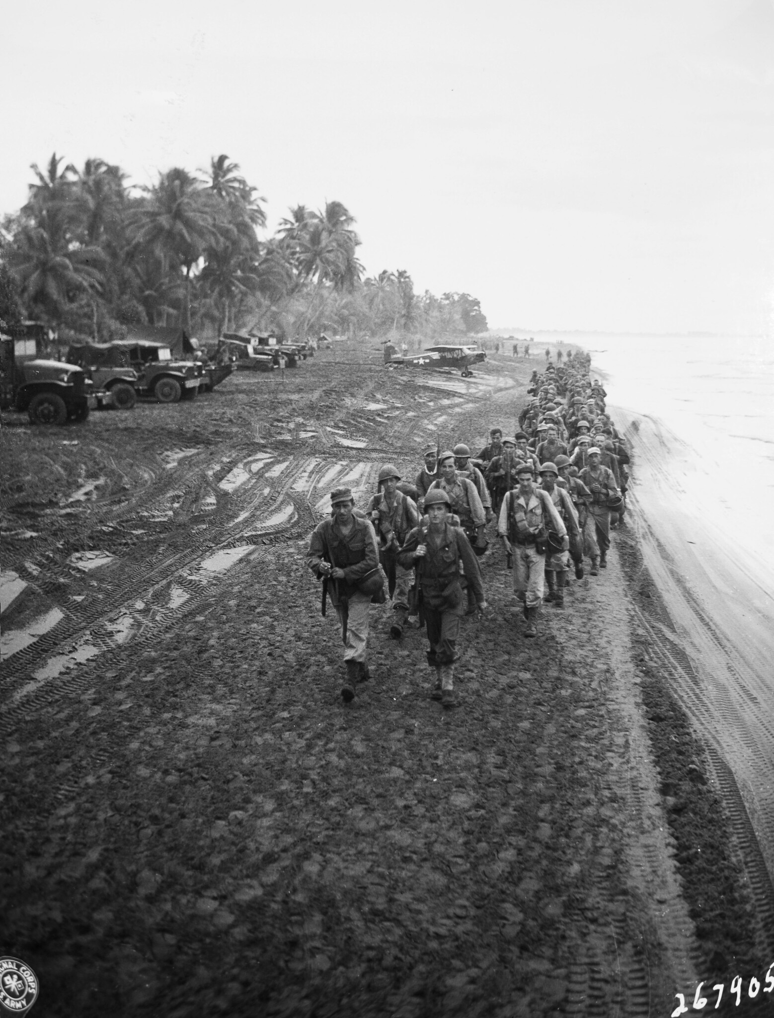
Leapfrogging: Aitape

Slide 33
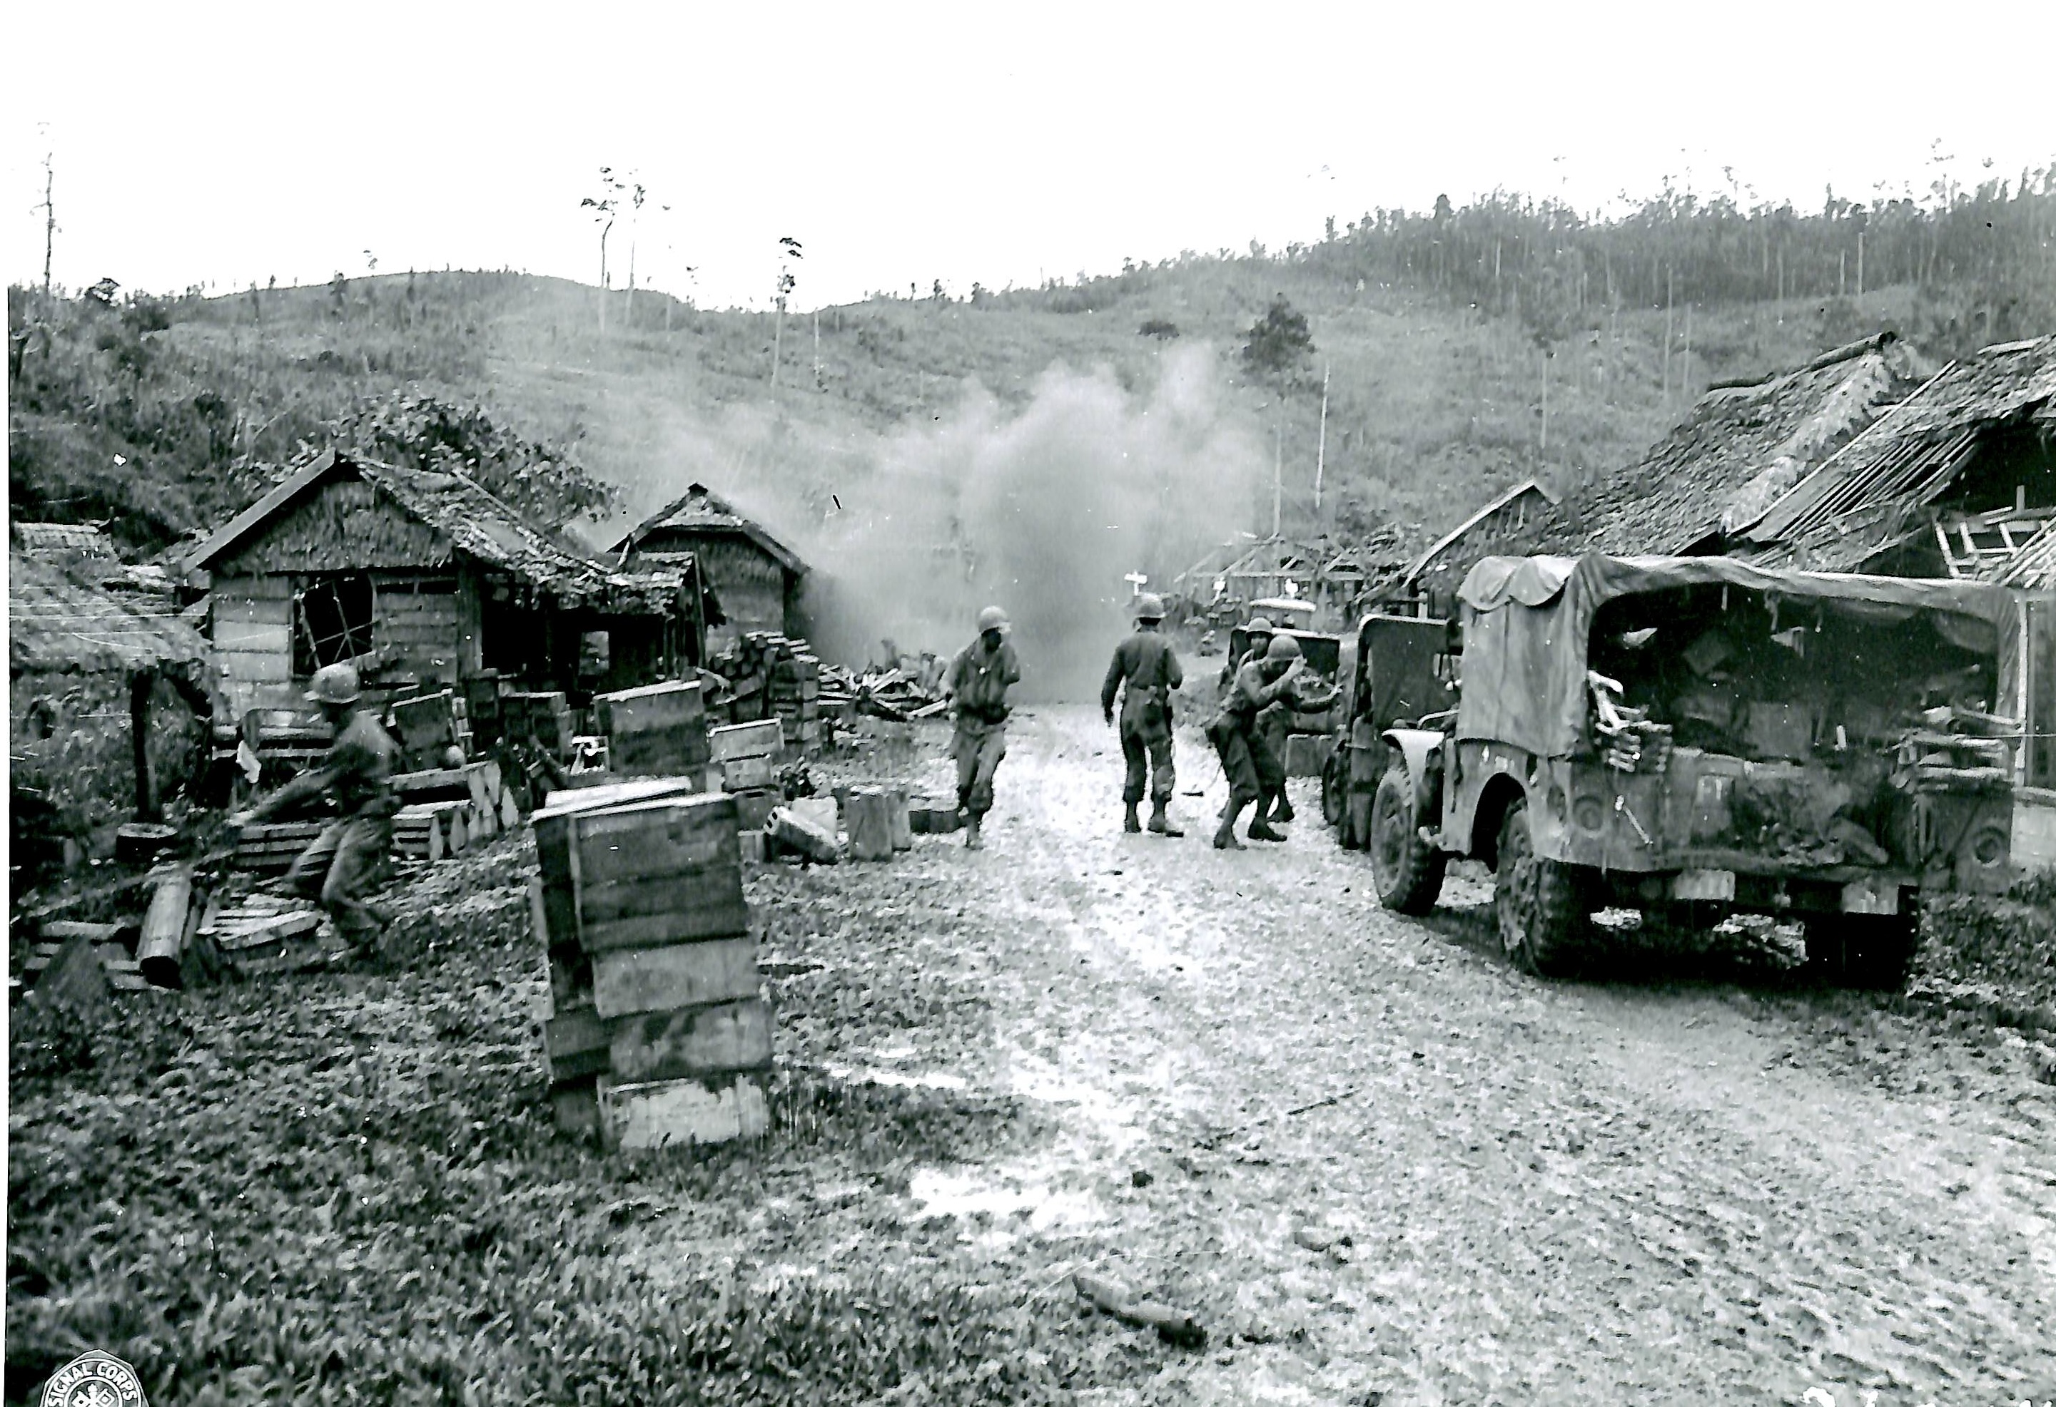
Leyte

Slide 34
“Big Chief stated 32d had never been any good.” Robert Eichelberger

Slide 35
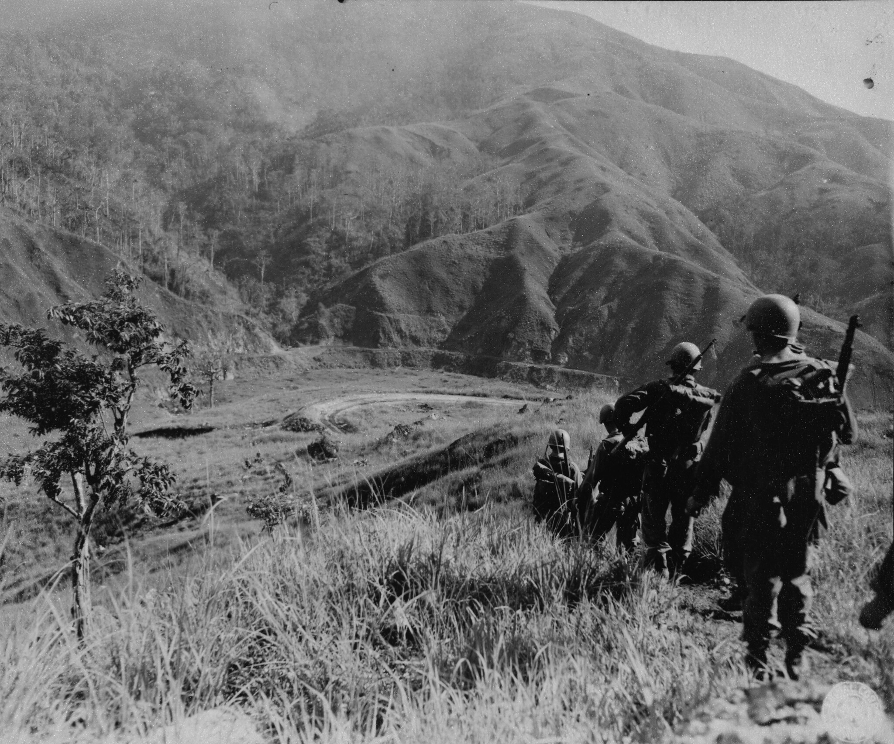
Luzon and the Villa Verde Trail

Slide 36
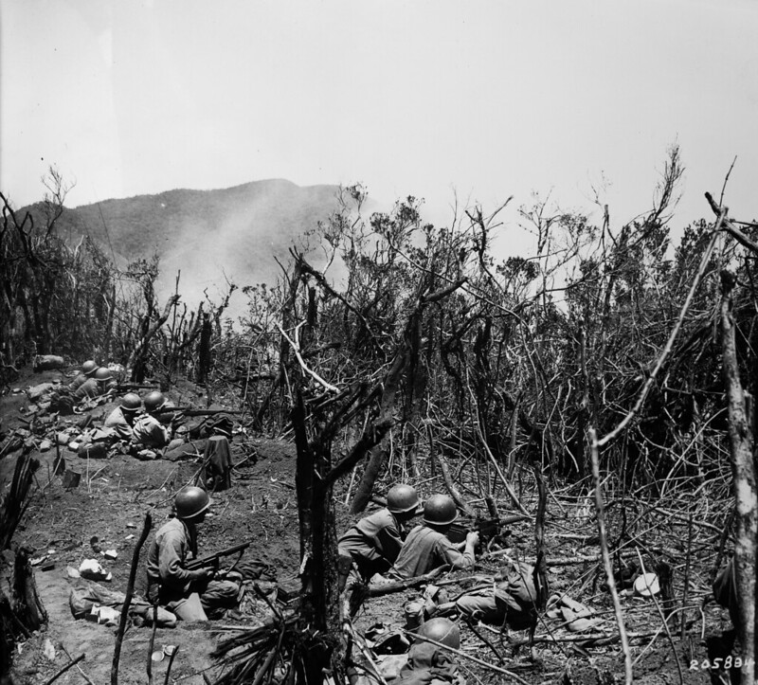
A fight for every hill

Slide 37
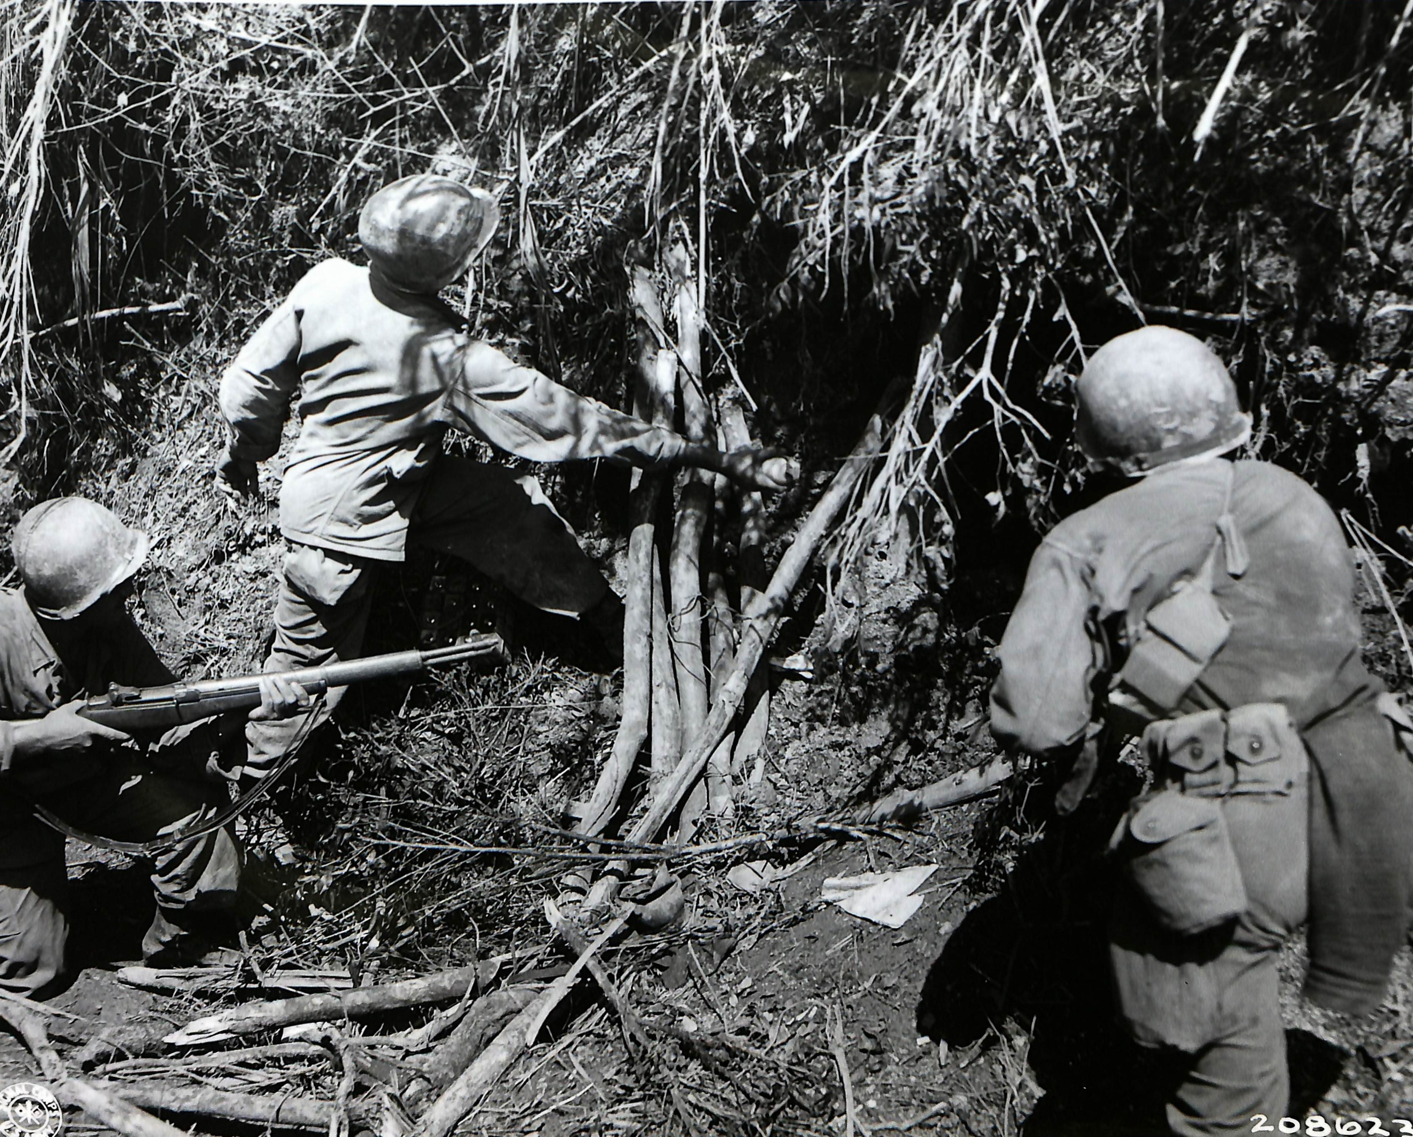
Eliminate every cave and bunker

Slide 38
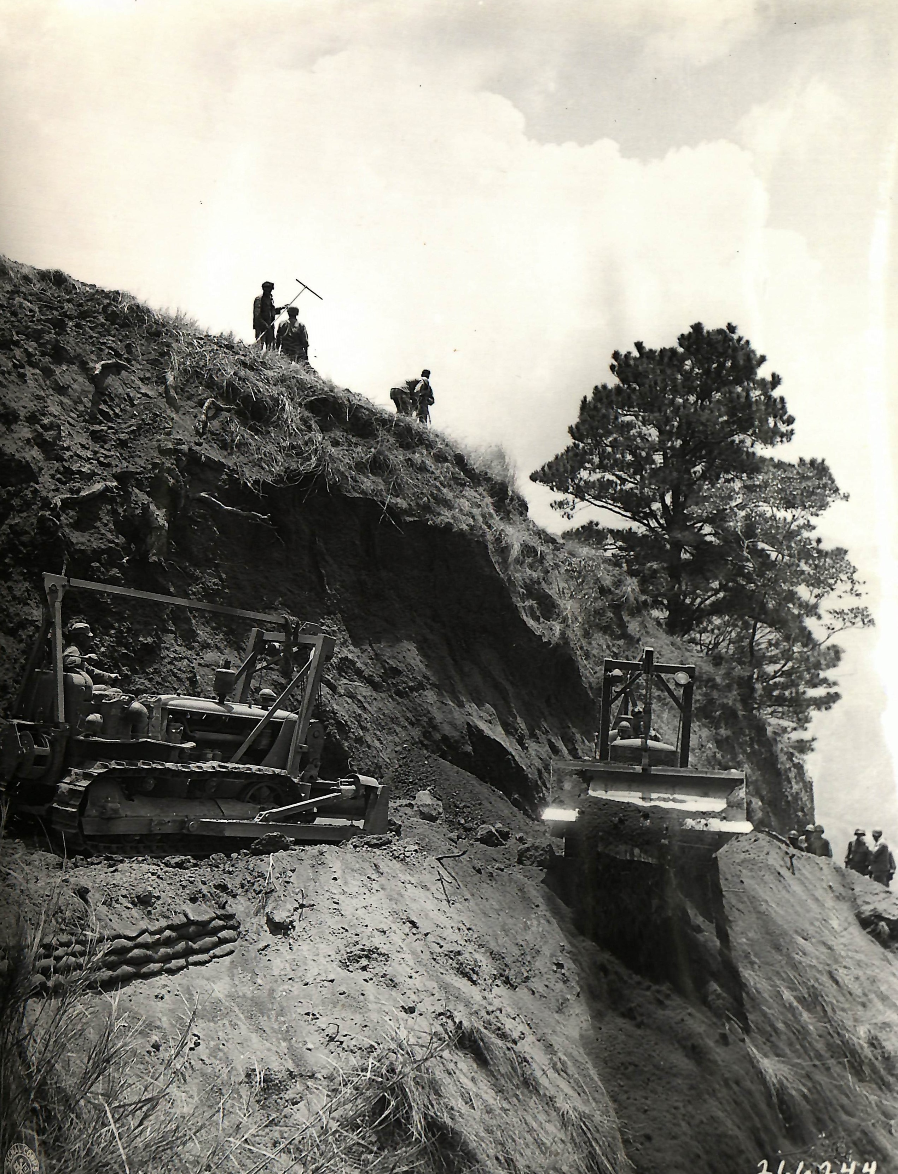
The 114th Engineers

Slide 39
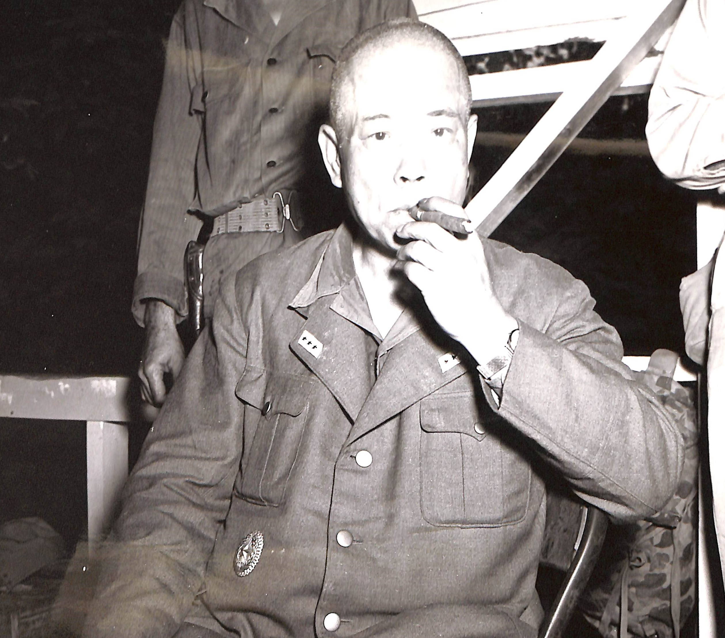
Northern Luzon

Slide 40
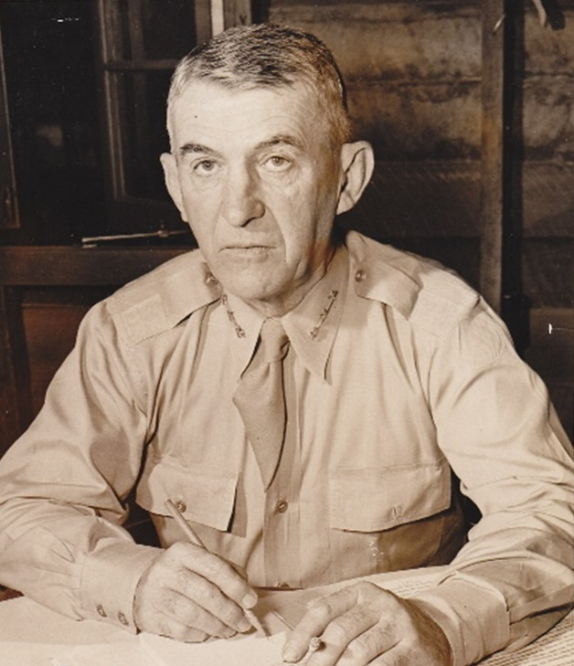
“General Yamashita indicated that he considered the 32nd Division the best his troops encountered both on Leyte and Luzon.” General Walter Krueger Commander, US Sixth Army

Slide 41
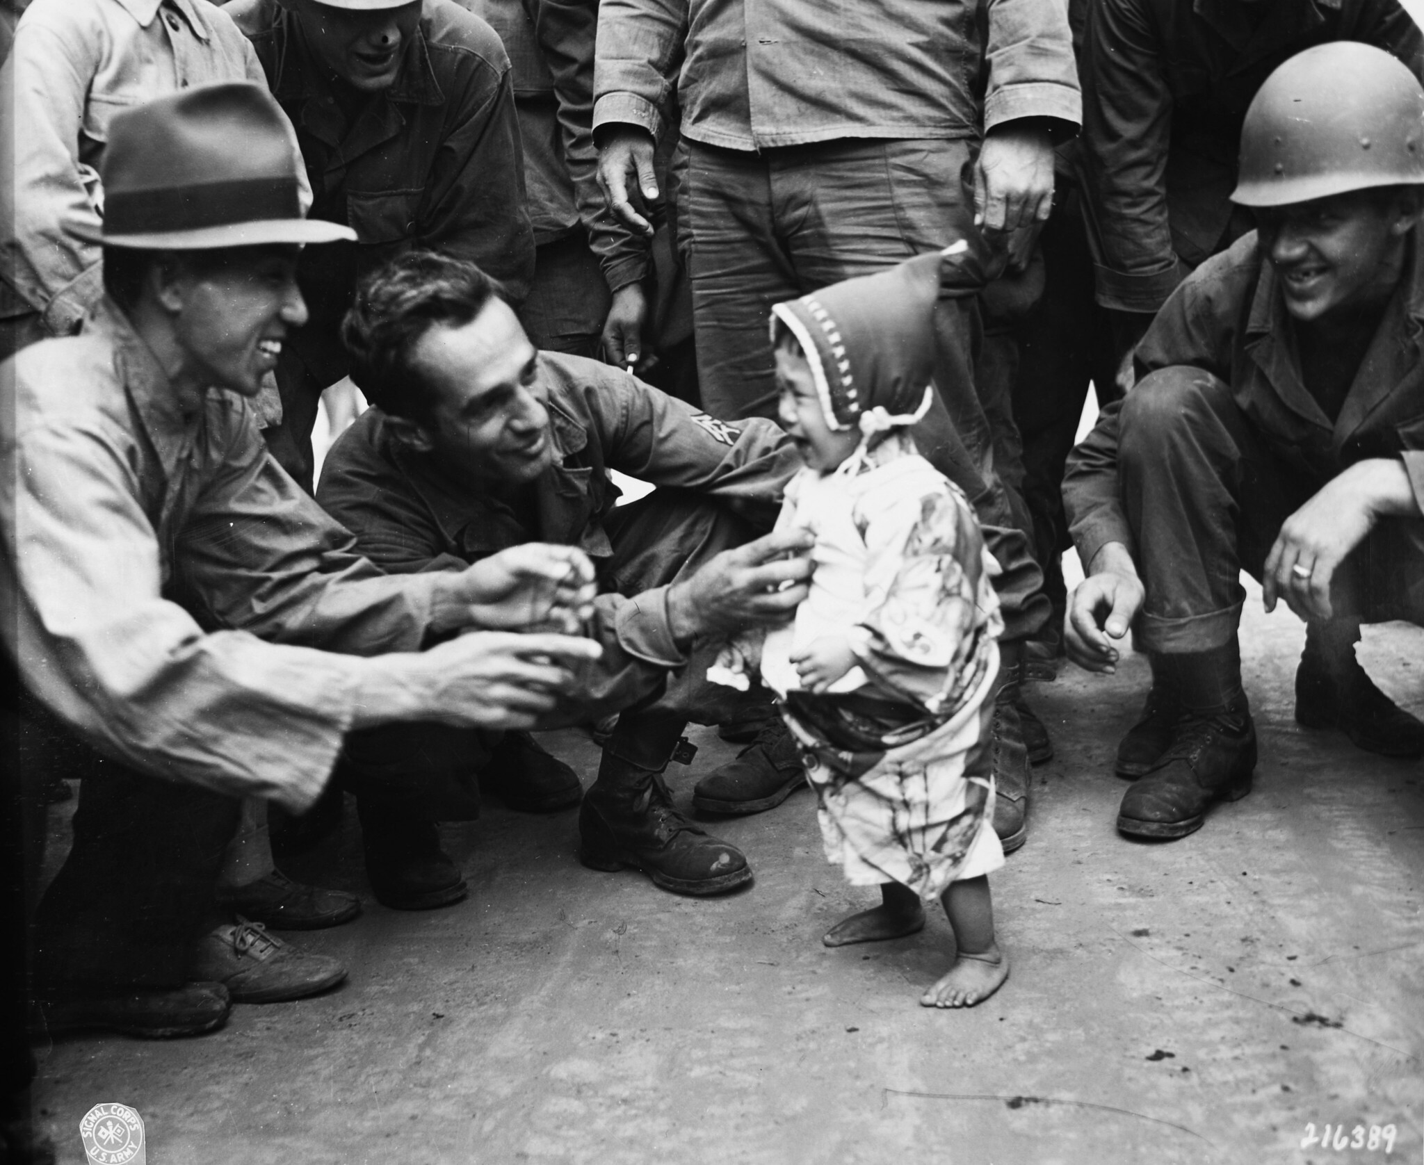
Occupation of Japan

Slide 42
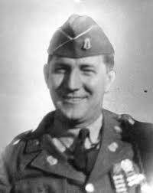
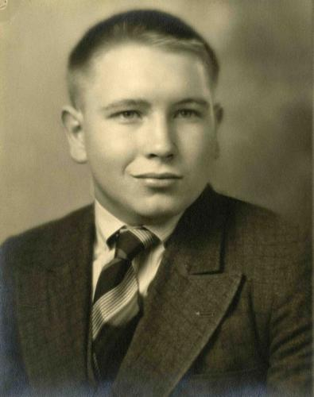
Eleven Congressional Medals of Honor
Elmer Burr
Kenneth Gruennert

Slide 43
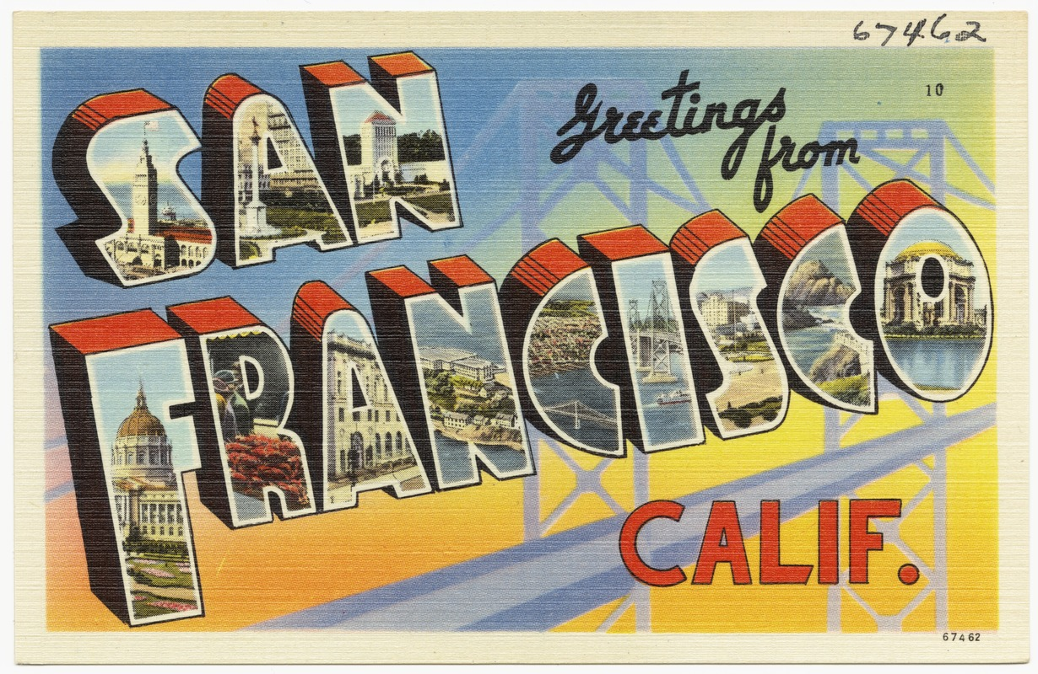
The Cultural Experience of War
Meeting new people
Seeing new places
Souvenirs
Some unseemly behaviors

Slide 44
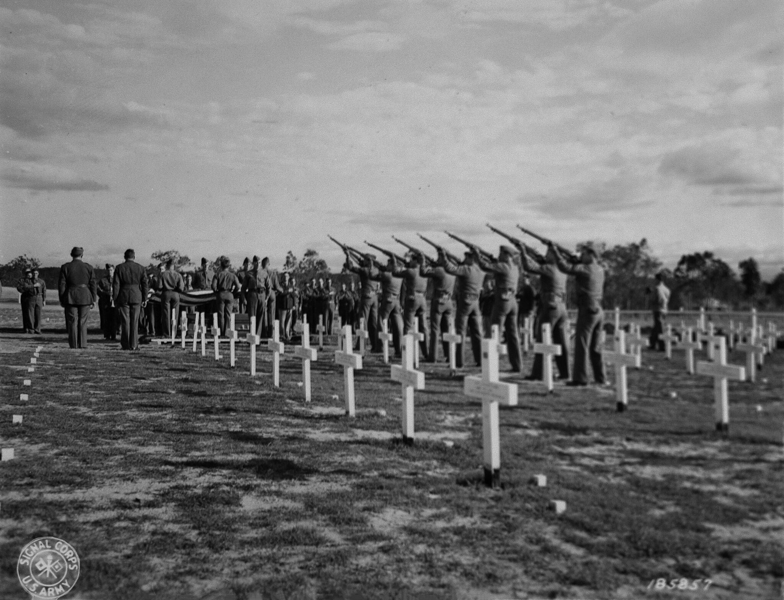
The human toll on the Red Arrow
Killed on action: 1,613 (highest for any US Army division in the Pacific)
Battle-related deaths: 2,002 (second most in the Pacific)
Wounded 5,627 (third most in the Pacific)
Casualty rate at Buna 90%

Slide 45
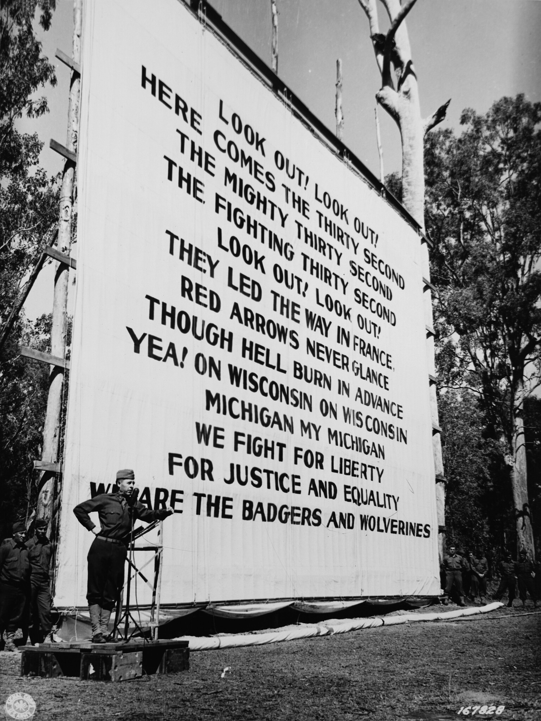
Some Red Arrow firsts and superlatives
654 days in combat – more than any other US Army division
First US Army division to fly into a combat zone
First US troops to use a flamethrower in combat
First US Army division to meet and defeat the Japanese in battle

Slide 46
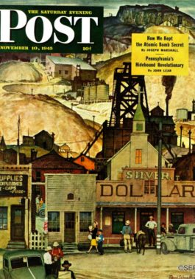
They’re quick to take issue, by force if necessary, with anyone who challenges the Red Arrow’s impressive array of claims to top Pacific battle honors.... Barroom brawls are on record as a result of conflicting claims.” Charles Murdock Public Affairs Office, 32nd Infantry Division Saturday Evening Post, 10 November 1945

Slide 47
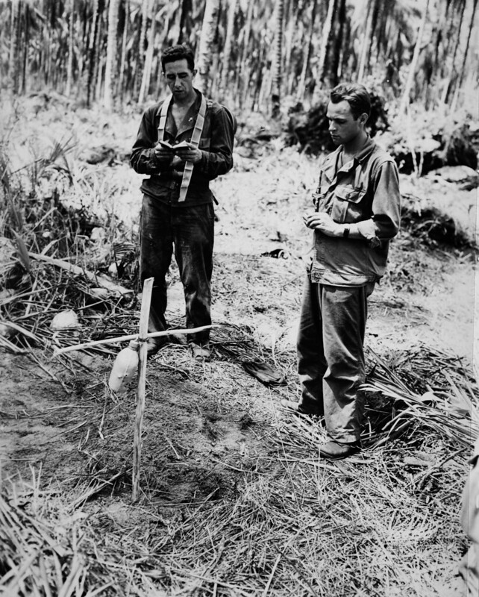
The “Good War” and the “Greatest Generation”
World War II has become a mythologized, almost sacred event in American culture
Such sentimentality obscures the harsh realities of war
In particular, it obscures the sacrifice and hardships the soldier faced and endured

Slide 48

“Red Arrowmen came from all walks of life: farmers, factory workers, shopkeepers, pencil-pushing bureaucrats, conservative Christians, communists, the scions of elite families” Red Arrow across the Pacific, p. 3.

Slide 49



The Book
Red Arrow across the Pacific: The Thirty-second Infantry Division during World War II Paperback, $40, 512 pages, 68 b&w photos, 8 maps Wisconsin Historical Society Press
Available from the Wisconsin Historical Society https://shop.wisconsinhistory.org/

Slide 50


Thank You!
My website:
markdvanells.com
Photo credits: Boston Public Library; National Archives; Library of Congress; SecondHandSongs.com; Wikipedia; Wisconsin National Guard.

