Slide 1

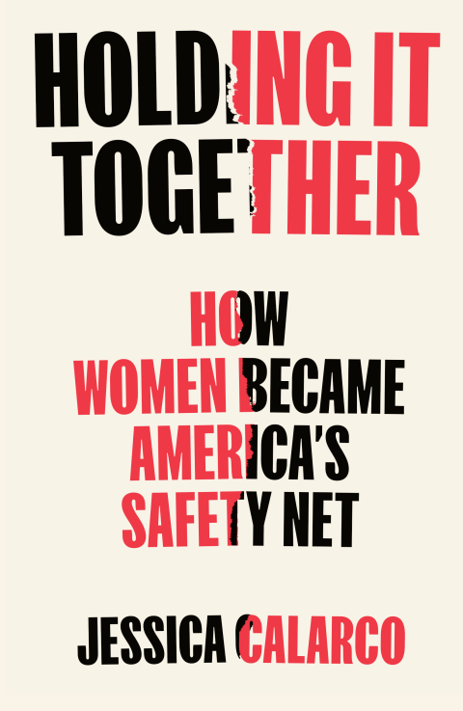
Jessica Calarco
Professor of Sociology
University of Wisconsin-Madison
Socials: @JessicaCalarco

Slide 2


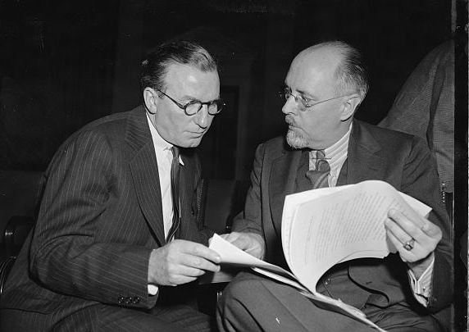
Promoting The
Illusion Of A
DIY Society
the National Association of Manufacturers imported and promoted neoliberal theory
they aimed to avoid taxes by persuading Americans we don’t need a sturdy social safety net
Billboard sponsored by National Association of Manufacturers, 1937; https://www.loc.gov/pictures/resource/ppmsca.15609/
National Association of Manufacturers asks Congress to remove taxes to stimulate business; 1939; https://www.loc.gov/pictures/item/2016875746/

Slide 3

A DIY Society
Our DIY Society
the vision
the reality
we don’t need to invest in
care, because people can
take care of themselves
some people need help to take care of themselves, but others rarely have the time to help

Slide 4


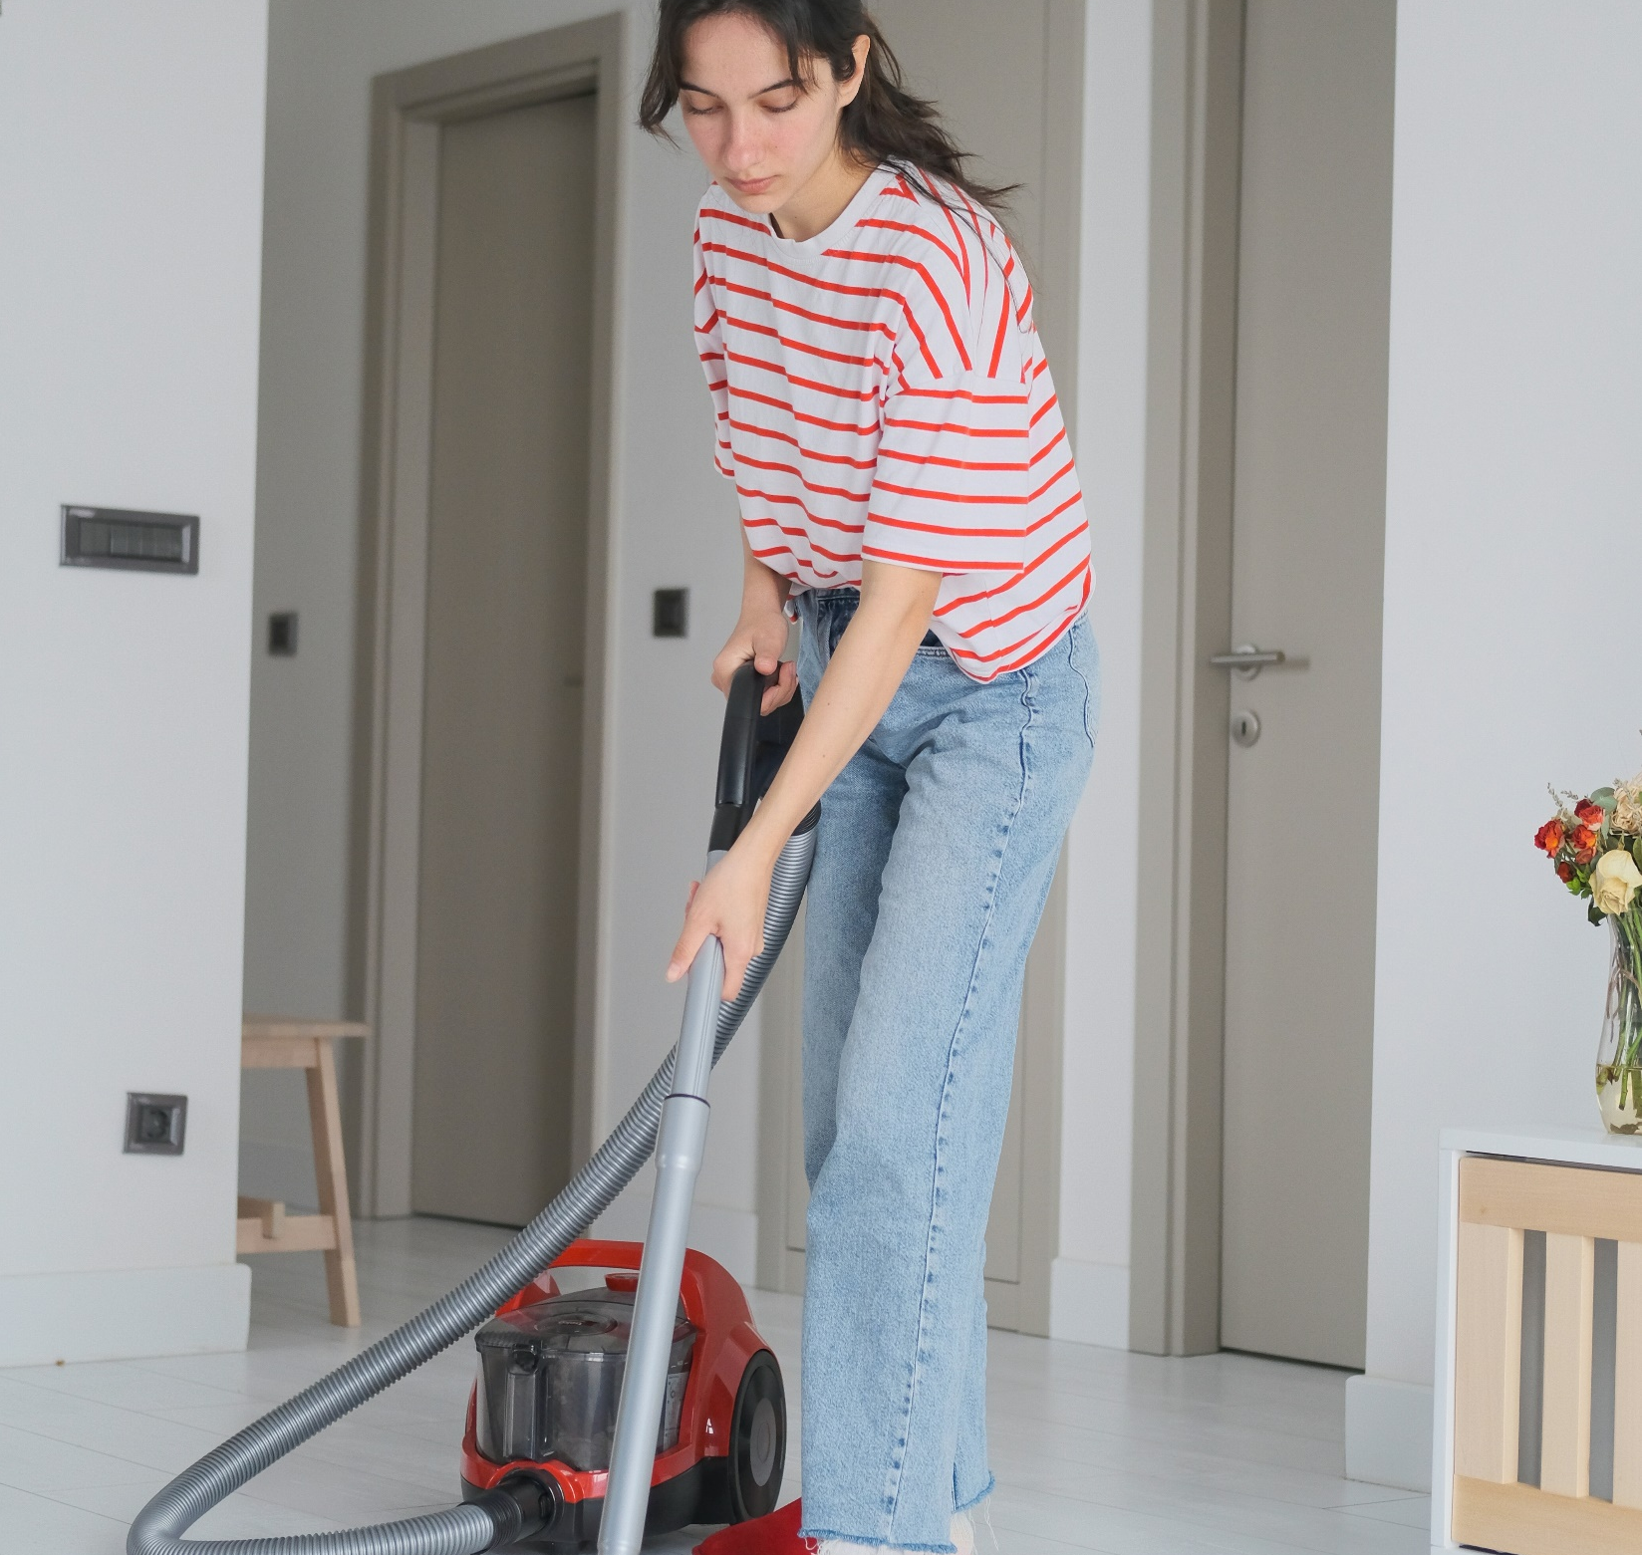
Maintaining the diy illusion
women hold 94% of childcare jobs
women hold 88% of home healthcare jobs
women do ~2x as much
unpaid care as men
Notes:
Now, we might expect the US to collapse under all that precarity
And yet, we haven’t collapsed
Because, while other countries have social safety nets
The US has women holding us together, instead
…
Women, for example, do almost twice as much unpaid care as men do – caring for the children and the sick and the elderly in their families and communities
Women, disproportionately women of color, also hold the vast majority of jobs in the care sector—jobs in fields like childcare and home health care—which are among the lowest-paid jobs in the economy as a whole
https://nwlc.org/wp-content/uploads/2023/05/child-care-workers-5.25.23v3.pdf
https://www.bls.gov/spotlight/2023/healthcare-occupations-in-2022/

Slide 5

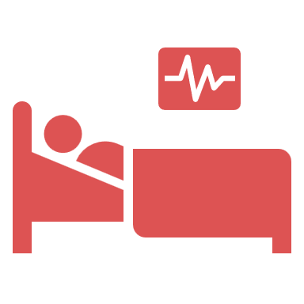



Holding It Together is Tearing Women Apart
maternal
employment
maternal
mortality
postpartum
depression
motherhood
penalties
child
poverty
USA
72%
21/100K
18%
$.63/$1
20.4%
Sweden
83%
5/100K
12%
$.93/$1
8.8%
*women with
children ages 0-14
*rate per
100,000 births
*first year
post birth
*average earnings of mothers vs fathers
*children
under 18
Notes:
Maternal Employment:
https://blog.dol.gov/2024/05/06/mothers-employment-has-surpassed-pre-pandemic-levels-but-the-child-care-crisis-persists#:~:text=While%20maternal%20employment%20has%20recovered,that%20of%20fathers%20(92.0%25).
https://www.oecd.org/content/dam/oecd/en/data/datasets/family-database/lmf1_2_maternal_employment.pdf
Maternal Mortality:
https://data.worldbank.org/indicator/SH.STA.MMRT?locations=OE&most_recent_value_desc=true
Postpartum Depression:
https://www.ncbi.nlm.nih.gov/pmc/articles/PMC8528847/
Motherhood Wage Gap:
https://www.aauw.org/issues/equity/motherhood/
https://www.ifau.se/globalassets/pdf/se/2024/wp-2024-12-the-child-penalty-in-sweden-evidence-trends-and-child-gender.pdf
Child Poverty Rates:
https://www.oecd-ilibrary.org/poverty-among-children_5ksjbg72xgnw.pdf

Slide 6
Data
2018–2019
Spring 2020
Fall ‘20-Spring ‘21
Fall ‘21-Spring ‘22
SNAP Prenatal Surveys
(N=250 Indiana women)
PPS Surveys/Interviews
(Wave 1)
(SNAP moms)
PPS Surveys/Interviews
(Wave 2)
(SNAP moms/partners)
PPS Surveys/Interviews
(Wave 3)
(SNAP moms/partners/friends)
SNAP Follow-Up Surveys/Interviews
(6M, 12M, 18M postpartum)
Ipsos Survey
(N=2,018 US parents)
Qualtrics Survey
(N=2,009 US parents)
2019–2021
Fall 2020
Fall 2021
SNAP: Social Networks and Parenting Study
PPS: Pandemic Parenting Study
Notes:
To show you what I mean here, let me share some stories from the 250 women my research team and I have been following since 2018
We’ve conducted hundreds of hours of interviews with these women, and we’ve also conducted two national surveys, each with more than 2,000 families across the US

Slide 7

We force
women to care for
little or no pay by…
gaslighting them into thinking “good choices” will save them
limiting the choices they can make, including for their bodies
leaving them nowhere to turn for support and nowhere to hide
Notes:
Now, people like JD Vance like to claim that women are just “happiest” caring for others
But the reality is that we often force women into unpaid and underpaid caregiving roles, including by limiting their reproductive freedom, subjecting them to punitive policies, and limiting their access to support

Slide 8
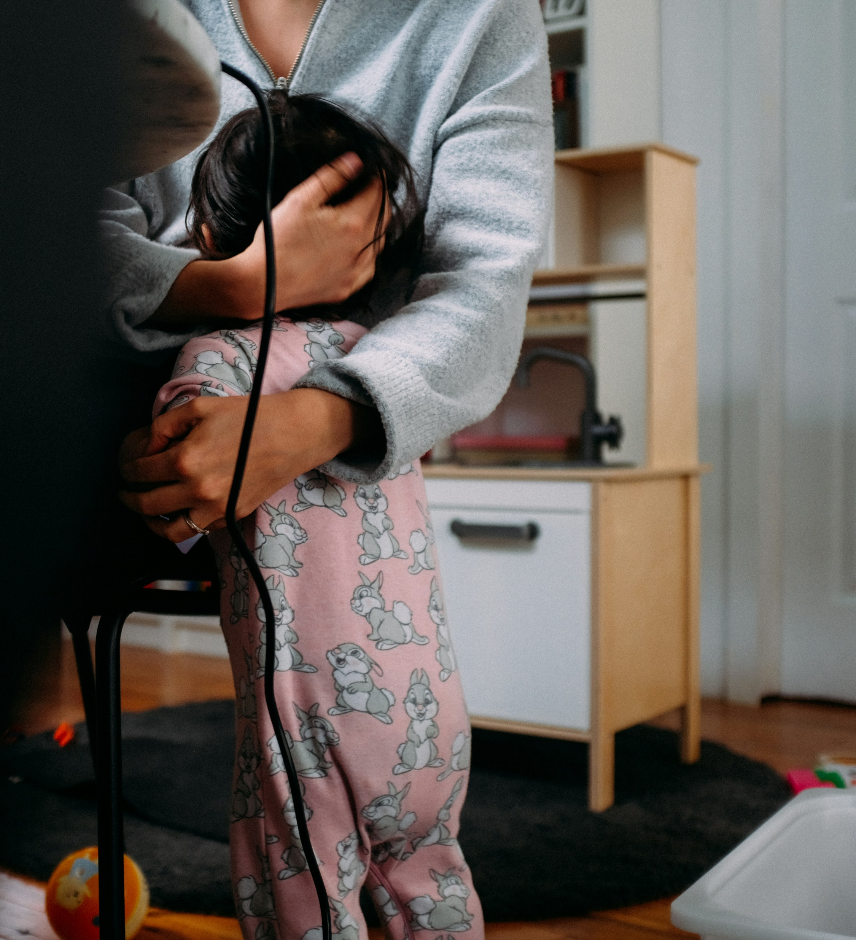
Other countries have social safety nets.
The US has women.
we trap women in motherhood
(and other unpaid caregiving roles)
we leave them with nowhere
to turn and nowhere to hide
we force them to settle for less-than-ideal partners and less-than-ideal jobs
Notes:
Now, Brooke’s story illustrates why so many young women are concerned about attacks on reproductive freedom
Because forcing a woman to have a baby is the fastest way to push her into economic precarity and leave her with little choice but to settle for a less-than-ideal partner or take a less-than-ideal job
…
Put differently, Brooke’s story shows how the US forces women to fill in the gaps in our economy and our social safety net
One key way we do so is by trapping them in motherhood or other unpaid caregiving roles—leaving them responsible for the children or the sick or the elderly, and then leaving them with nowhere to turn for support and nowhere to hide when others ask them to hold even more
Which forces them to settle for less-than-ideal partners and less-than-ideal jobs

Slide 9

Some women are especially vulnerable
systematic under-investment in low-income communities
and communities of
color leaves women
with nowhere to turn
and nowhere to hide
Notes:
This system is particularly effective for trapping women from low- and middle-income families, and, disproportionately for Black and Latina moms
…
Consider a mom I’ll call Patricia
When the pandemic closed schools and childcare centers, Patricia took over care for her kids because she was already working remotely as a customer service agent, while her husband Rodney couldn’t do his construction job from home
That double duty was hard on Patricia. She talked about feeling guilty for not giving her kids more attention, saying, “When it’s time to clock out, I need to not clock out mentally as a mother, too.”
Given that guilt, Patricia decided to switch to part-time work. She figured it would give her more energy to focus on the kids’ needs.
And she hoped it would give her more time to rest, which she needed, because she had unexpectedly become pregnant with twins.
What ended up happening, though, was that Patricia’s mom started asking her for rides to the doctor, and friends started asking for rides the store.
Patricia wanted to say no, but she said yes instead, because her community has limited public transit, because she was one of the only people in her network with a car, and because she worried she might need support herself someday.
Unfortunately, that someday came when Patricia and Rodney divorced just before the twins were born, which forced Patricia to lean on the same people who leaned on her.
…
Our attempts to DIY society have been particularly damning for women like Patricia
Because of how we’ve underinvested in their families and their communities
And because, unlike more privileged women who can afford to outsource some of their own caregiving responsibilities, they’re often forced to hold it together on their own

Slide 10

Yet, even relatively privileged women are drowning
because we’ve given them
more responsibility than they
can manage (or outsource)
because men rarely step up to
do more, even when they could
Notes:
At the same, even privileged women are drowning
Because our DIY model has left all but the wealthiest families with more responsibility than they can manage
And because what’s left over after outsourcing usually falls to women, even when men could do more to fill in the gaps
…
Take a mom I’ll call Virginia
She makes $75K a year as a college professor, which is more than what her husband makes as a middle school teacher.
Yet, Virginia is still the default parent—the one who manages the mental load of parenting and stays home when the kids get sick and can’t go to childcare.
Virginia is also part of the sandwich generation, caring for her mom with Alzheimer’s, even though her brother also lives nearby
All that responsibility affects Virginia’s mental health and her relationships.
And she’s worried she might not be able to do enough research to get tenure, because she’s constantly getting pulled away to deal with crises at home.
…
When I asked Virginia what might make things better, she told me:
“I need the child tax credit to come back. I need a financial cushion. I need time and reliable care for my children. I need consistency. I need institutions to step up and do what they’re supposed to do to be humane.”

Slide 11

So, why aren’t more Americans demanding a stronger safety net?
we’ve stigmatized government assistance
eroding respect for the dignity of those stuggling
we’ve underfunded existing government programs
eroding our trust in government to meet our needs
we’ve promoted myths that delude and divide
eroding collective efforts to demand a safety net
Notes:
Virginia’s lament also raises the question:
Why aren’t more Americans demanding a stronger social safety net with universal support?
Why, for example, did we all just shrug and say “better luck next time” when Joe Manchin and Kyrsten Sinema and the Republicans killed Build Back Better’s efforts to put in place policies like:
Expanded child tax credits,
Guaranteed paid family leave,
Universal preschool and affordable childcare,
Free community college tuition,
More funding for schools, childcare centers, and eldercare facilities, and
A higher federal minimum wage
…
As I show in the book, the lack of collective urgency around efforts to pass those policies stems from the fact that we’ve:
Stigmatized government assistance in ways that erode our willingness to see everyone as deserving of life with dignity,
And from the fact that we’ve:
Underfunded existing government programs to the point where even those who benefit from them are forced to look elsewhere for support, which erodes our trust in the ability of government to get things done
It might surprise you to learn, for example, that Brooke, who we met in the beginning, isn’t a Democrat—she’s a conservative-leaning Independent
And she’s skeptical of efforts to expand the social safety net, at least in part, because of how she’s been treated for needing government support
Given the shortage of affordable housing, Brooke had to move herself and her son into a shelter while she waited for a spot to open up
And Brooke also had to turn to a Christian crisis pregnancy center for assistance, because she wasn’t allowed to use her food stamps to pay for diapers and wipes, and because the center gave them out for free
That support, however, came with pressure to join the church, and pressure to find a husband who would support her, rather than continuing to rely on programs like welfare and food stamps so she could raise her son on her own

Slide 12

The myth of meritocracy
goads women into judging others for needing support
72% of US moms agree that “most people who
want to get ahead can make it if they work hard”*
moms who agree are 50% more likely than other moms to also agree that people are poor “because they have not worked as hard as most other people”*
*data from a 2022 Qualtrics poll of ~2,000 US parents of children under 18, weighted to align with CPS data
Notes:
In a similar way, conservative and religious organizations also persuade women to judge others for needing government support
Take, for example, a white, evangelical Christian, Republican stay-at-home mom that I’ll call April. April’s husband Mateo, who is Latino, is a pastor at their church, and makes about $30,000 a year
Their income is low enough that they qualify for Medicaid
Yet, April insists that they could get by without it.
And she also insisted that they didn’t need the economic relief payments during the pandemic, even though they cashed the checks
…
April even went so far as to criticize other mothers who did need that Covid relief money, saying they were probably making poor financial choices, like spending money on manicures or hiring babysitters so they could have time for themselves.
April said “I’d never do those things,” adding that she always made “frugal” choices and that her family’s faith and hard work would see them through (even when she also admitted to eating only her son’s sandwich crusts for lunch)
…
The reality, though, is that April and her family are able to get by on such a low income because they’ve had a huge amount of family support and community support and even a lot of government support behind the scenes
April and Mateo, for example, were able to finish college without any debt, because they went to their state public university, and because their parents—all four of whom are college-educated professionals—were able to cover the remainder of the costs so April and Mateo didn’t have to take out any loans
And April and Mateo don’t have to worry much about housing costs, because their families gave them downpayment money as a wedding present to help them buy a house, meaning that they only have to pay a few hundred dollars a month in mortgage and utility payments—far below what they’d have to pay for rent
…
Ultimately, then, while April would benefit very directly from a stronger safety net, she strongly opposes policies like:
Guaranteed paid family leave
National health insurance
Free college, and
Universal affordable childcare

Slide 13

The myth of Mars and Venus lets men feel like “good guys” while enjoying patriarchy’s perks
52% of US dads agree children are better off if
their mother is home and does not work for pay*
dads who agree are about twice as likely as other
dads to oppose tax-funded universal childcare
*data from a 2022 Qualtrics poll of ~2,000 US parents of children under 18, weighted to align with CPS data
Notes:
Now, you might be thinking—where are the men here?
Couldn’t they just be doing more to help women at home?
But, the precarity of our DIY society, coupled with persistent gender pay gaps and motherhood penalties, incentivizes men to focus their energy on paid work and leave the care work to women, instead
…
At the same, men whose wives are doing more of the care work don’t want to think of themselves as “bad guys”
And what I find in my research is that men’s desire to see themselves as “good guys,” makes them susceptible to conservative messaging, which says it’s best for women and families and society if men focus paid work while women focus on care
…
Consider, Dennis. He’s White, he’s a moderate political Independent, and he makes $90,000 a year as an IT manager
When they first had kids, Dennis’s wife Bethany was working full-time as a social worker, earning $30,000 a year
Given their combined salaries, they could afford to pay for full-time childcare
But Dennis persuaded Bethany that they didn’t need to spend all that money, because Bethany could work from home three days a week while caring for the baby, and because Dennis’s mom could watch the baby the other two days a week
Bethany agreed, but that arrangement ended up taking a serious toll on her mental health, because it meant essentially trying to do two simultaneous full-time jobs
In the wake of that stress, Dennis could have suggested paying for full-time childcare or even stepped up to do more himself at home
Instead, Dennis used the stress that Bethany was facing to persuade her that the best option would just be to quit her job and stay home full-time with the kids
…
In the wake of that decision, Bethany, like Kara, struggled with the isolation and the loss of identity that came from being a stay-at-home mom, and she wanted to go back to paid work
But Dennis kept trying to convince Bethany that she and the kids are much happier at home
In the process, Dennis also convinced himself that it was okay to accept what he called the “perks” of having a stay-at-home wife—like not having to help with laundry or school stuff for the kids
And Dennis also convinced himself that even though policies like universal childcare are what he called “good as a concept,” they’re not, in his view, really worth the cost, since his kids already get great care from Bethany at home

Slide 14

The supermom myth gaslights women into believing they shouldn’t need
or want support from anyone
44% of US moms agree that it’s their responsibility
to give their kids “the best possible chance of
success, even if that makes it harder for other
people’s children to be successful”*
moms who agree are 30% more likely than other moms
to also agree that it’s best for kids if moms stay home
*data from a 2022 Qualtrics poll of ~2,000 US parents of children under 18, weighted to align with CPS data
Notes:
In a similar way, conservative religious organizations also appeal to women who get pushed out of the workforce because of the high cost of childcare
Take, for example, a stay-at-home mom I’ll call Kara. She’s a moderate Republican and she’s multiracial White and Asian American
Before she had kids, Kara worked as a mental health counselor, but her job paid so little, and childcare cost so much, that she and her husband would have lost money if Kara kept working for pay
At first, Kara struggled with the isolation and the loss of identity that came from being a stay-at-home mom.
But then a friend urged her to join an Evangelical Christian moms group, which not only became Kara’s primary source of support but also reframed her thinking around motherhood
They taught Kara that it would be selfish of her to ask for more help from her husband or from the government
And that she should be grateful to sacrifice herself for her kids
…
She explained that, during moments when she felt overwhelmed, or resentful toward her husband for not doing more to help at home, she reminded herself: “I’m learning that I need to be less selfish. Learning to be thankful. When I feel really burnt out, to be like, ‘Well. This is what God has given me. I can do it cheerfully. He’ll give me the strength to get through it, and he’ll give me rest when I need it.’”

Slide 15

To Persuade The Skeptics
ensure that the safety net is funded to provide meaningful support
focus on universal programs that eliminate the stigma of support
help people see how billionaires and big corporations have…
deluded us into believing we don’t need or deserve public support
divided us to keep us from coming together to demand support

Slide 16
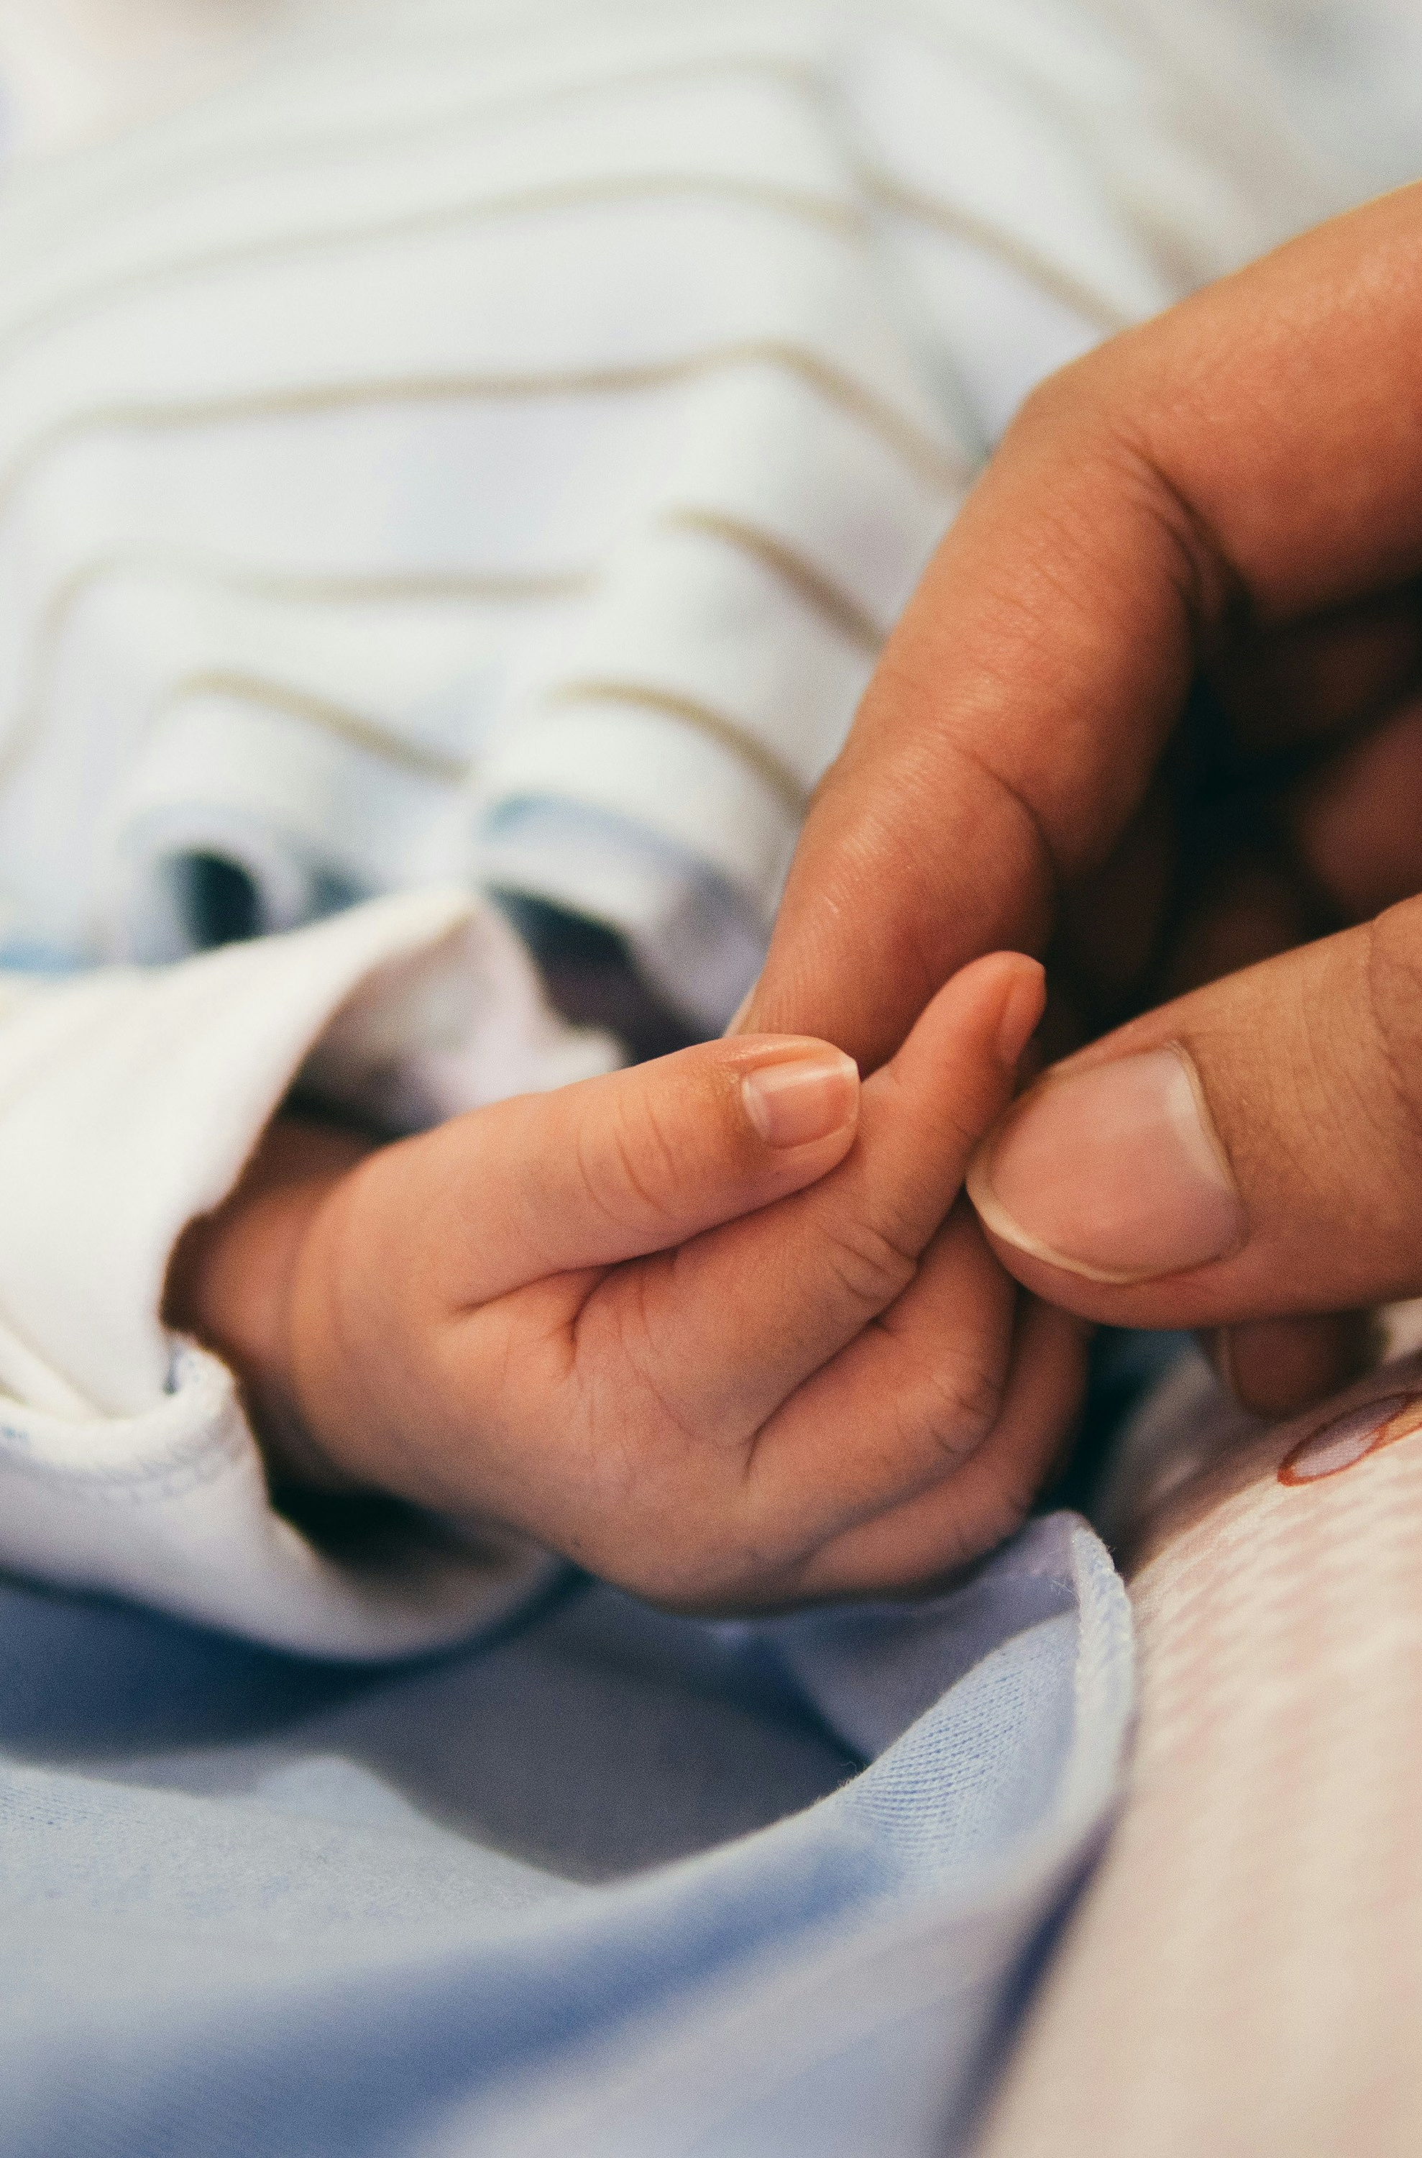
The net we need would allow all people to…
live with dignity
(e.g., affordable housing, healthcare, eldercare)
reach opportunity
(e.g., affordable childcare, college)
contribute a shared project of care
(e.g., 35hr work weeks, family leave, PTO)
Notes:
Essentially, Virginia is saying we need a stronger safety net. One that
Allows people to live with dignity
Gives people a leg up in reaching opportunities
Gives people the time to contribute to a shared project of care

Slide 17

Better Policies Are Possible Here
and in fact, we’ve done this before,
like with the Lanham Act Childcare Centers built by Congress in WWII
Children having lunch with a trained assistant at a childcare center in Connecticut, 1942
https://www.wwiimemorialfriends.org/blog/the-lanham-act-and-universal-childcare-during-world-war-ii

Slide 18
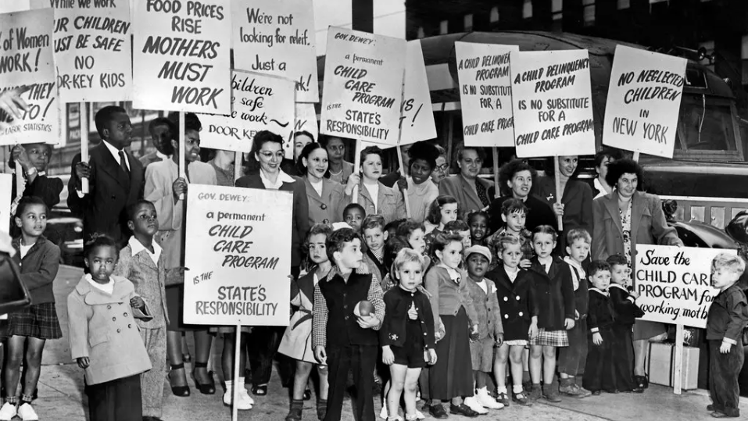
exploitation isn’t sustainable
together, we can demand the dignity
and support we all need and deserve
if we don’t let billionaires call the shots
Photo from the New York Times, depicting a protest in New York City in 1947, which the city’s welfare commissioner dismissed as “hysterical”
https://www.nytimes.com/2019/10/02/us/paid-childcare-working-mothers-wwii.html

Slide 19
Thank you!
Jessica Calarco
Professor of Sociology
University of Wisconsin-Madison
Socials: @jessicacalarco
Notes:
I’ll stop there, to leave time for Q&A
But thanks again to Joyce for hosting tonight’s events
And thanks to you all for being here!

Slide 20
With Thanks To
Elaine Hernandez
Amelia Knopf
Emily Meanwell
Andy Halpern-Manners
Amelia Hawbaker
Cara Davies
Katie Beardall
Melissa Garcia
Hui Chen
Elizabeth Anderson
Grayson Bodenheimer
Caroline Brooks
Max Coleman
Emily Ekl
Benjamin Hartmann
Monica Heilman
Yingjian Liang
Nora Weber
Chavonté Wright
Natalia Fuentes-Rohwer
Katie Orick
Leo Banks
Kinsey Bromm
Rachel Desmarais
Elsie Gasaway
Shanita Hunt
Alisha Kirchoff
Callie Cleckner
Ellis Frieh
Krystina Millar
Megan Bolton
Shelley Rao
Tabi Wilbur
Lisa Aten
Paula Cotner
Julia Mobley
Susan Risen
Brea Perry
Bethan Roberts
Fred Cate
Indiana University, Department of Sociology and Office of the Vice Provost for Research
Indiana Clinical and Translational Sciences Institute, ICTSI NIH/NCRR Grant No. UL1TR001108

