Slide 1
HOW WISCONSIN BECAME THE CHEESE STATE
Dean Sommer, Cheese Technologist

Slide 2
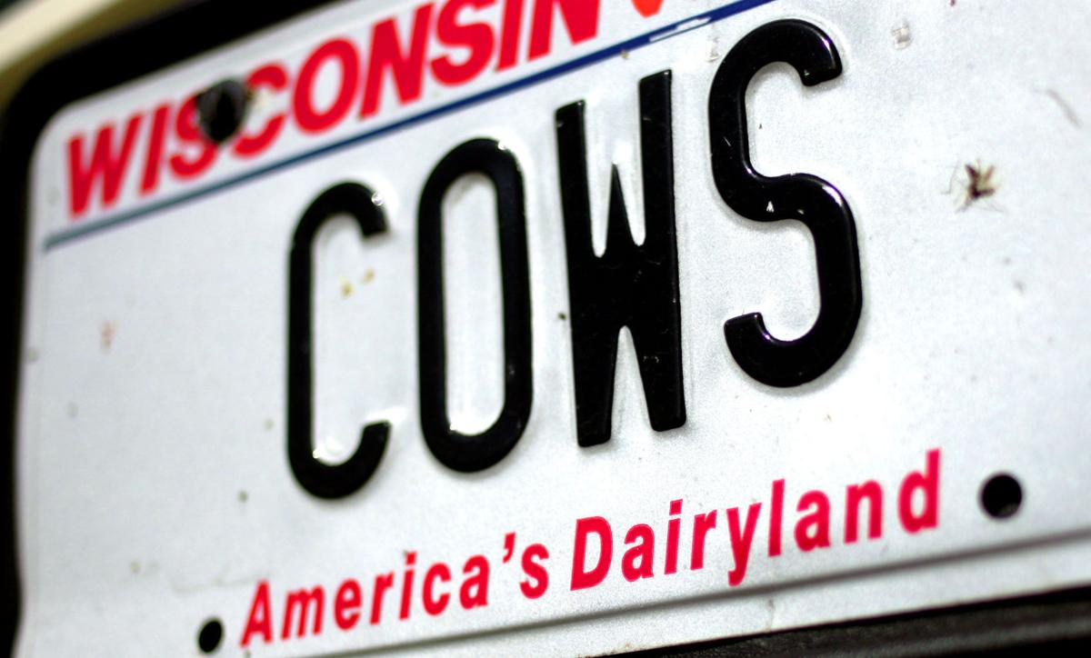

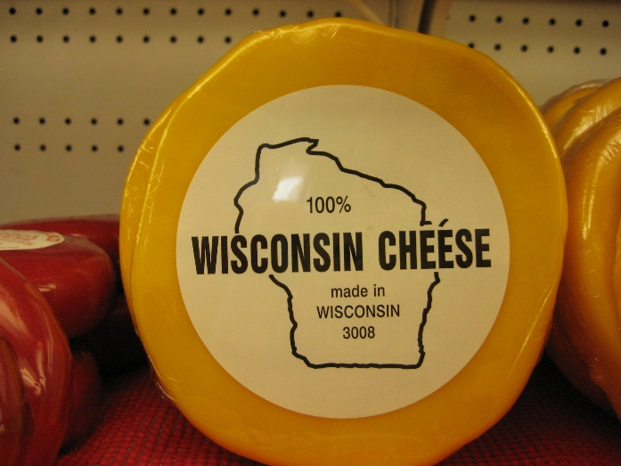
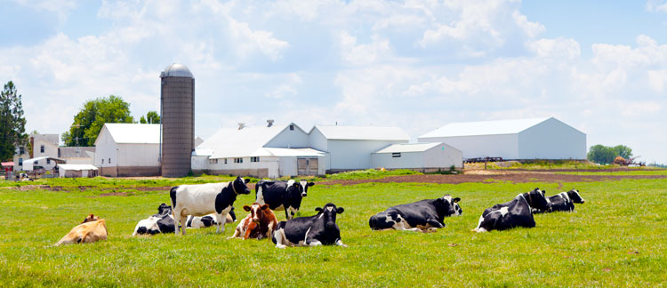
Wisconsin: America’s Dairyland
Source: Madison.com
Source: Sportinal
Source: CNN
Source: Hoard’s Dairyman

Slide 3
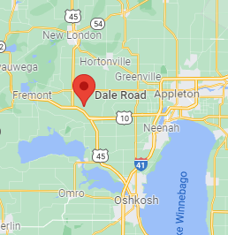

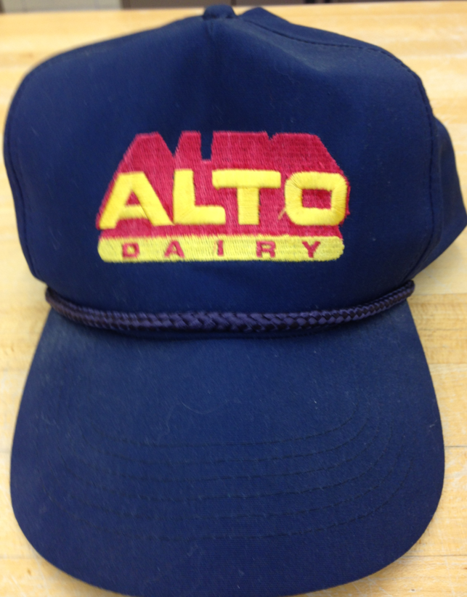
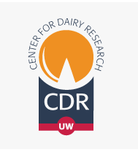

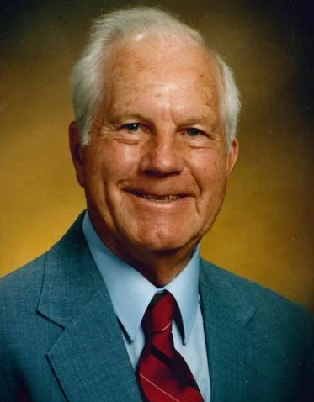
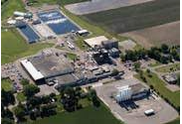
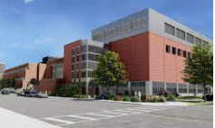

Dean’s Dairy History

Slide 4
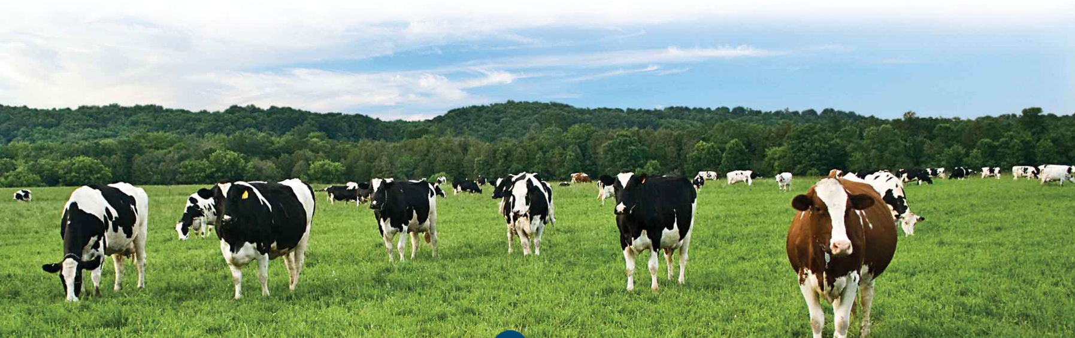
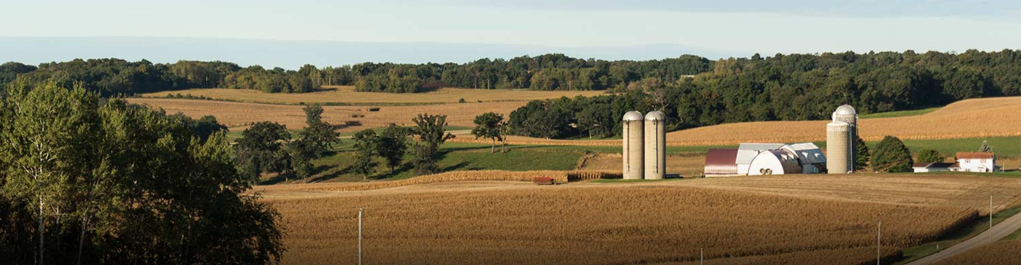
US DAIRY: WHY WISCONSIN?

Slide 5
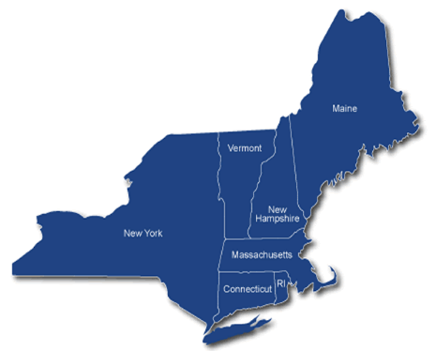
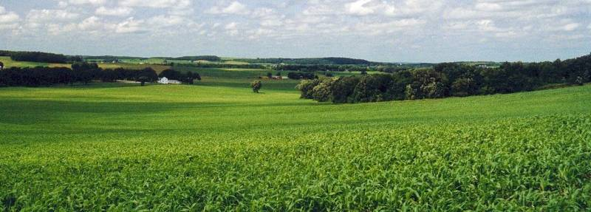
Wisconsin Ag Historical Beginnings
Began with the migration of Yankee farmers from the Northeast in the 1840s.
In the 1860s, Wisconsin, the leader in the production of wheat, saw the crop devastated by insects. This led to an influx of dairy farmers.
Wisconsin soils, topography and climate were well adapted for dairy farming.

Slide 6
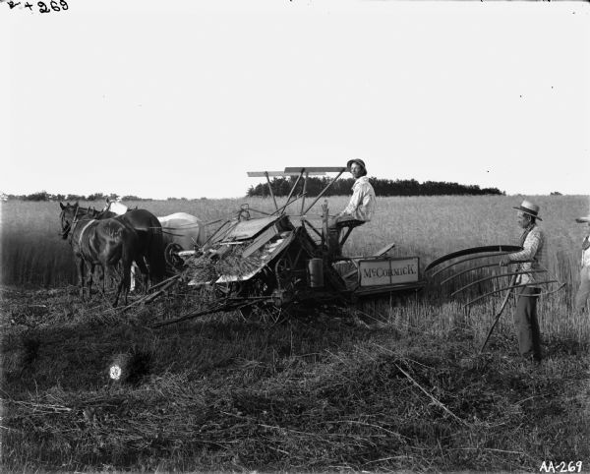
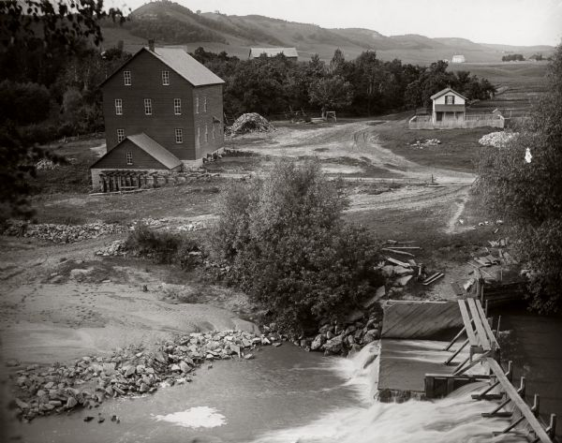
Wisconsin early years 1840-1880
Yankees and wheat
Credit: WI Historical Society

Slide 7
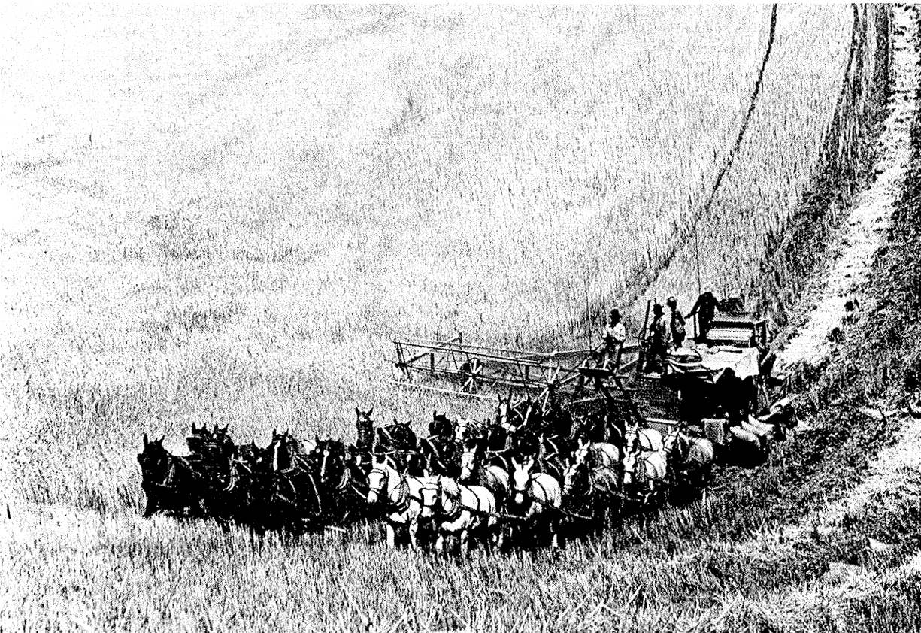
Wisconsin was known as the breadbasket of the US
Credit: My Land, My Home, My Wisconsin, Robert & Maryo Gard

Slide 8
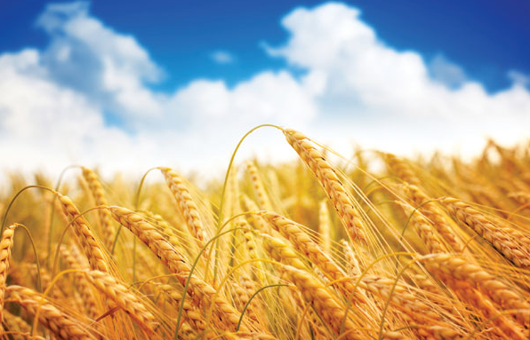
Why wheat?
Important cash crop
Small initial capital investment
Fairly easy to grow
High rate of financial return
Farm cheaply, deliver a product many people need
Ref. www.wisconsinhistory.org

Slide 9
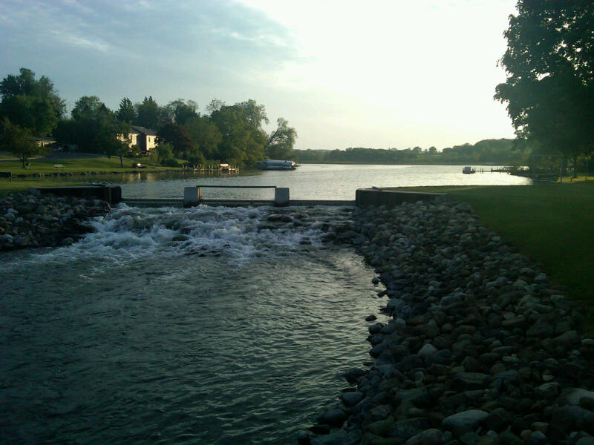
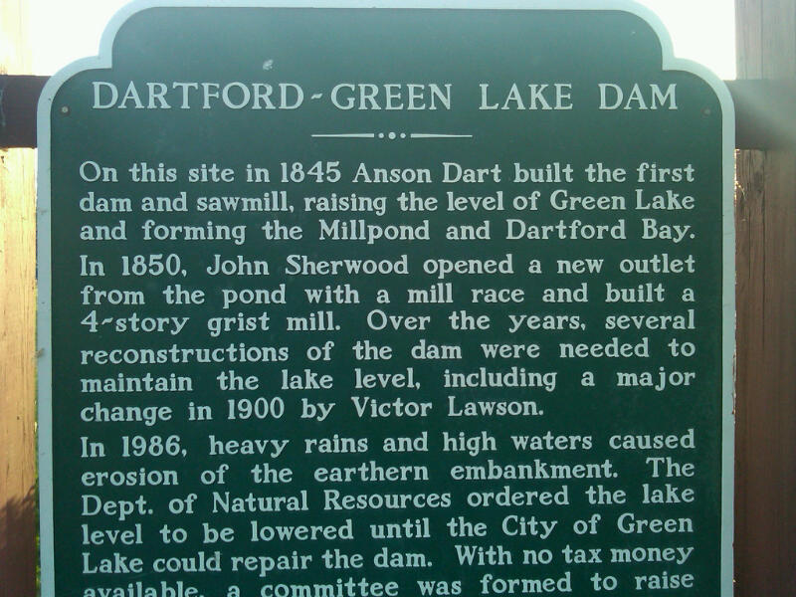
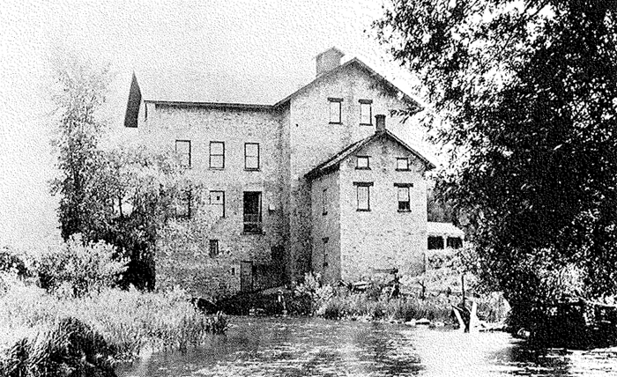
Picture of Green Lake memories p92
Credit: Green Lake Memories

Slide 10
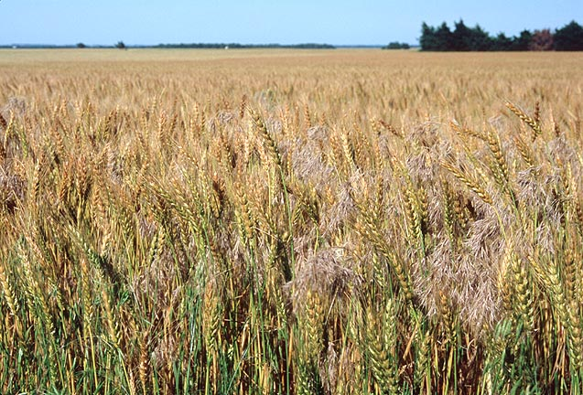


The Decline of Wisconsin’s Wheat Industry
Ravages of insects
  Chinch bugs
Depletion of the soil
  Nitrogen
Credit: My Land, My Home, My Wisconsin, Robert & Maryo Gard

Slide 11
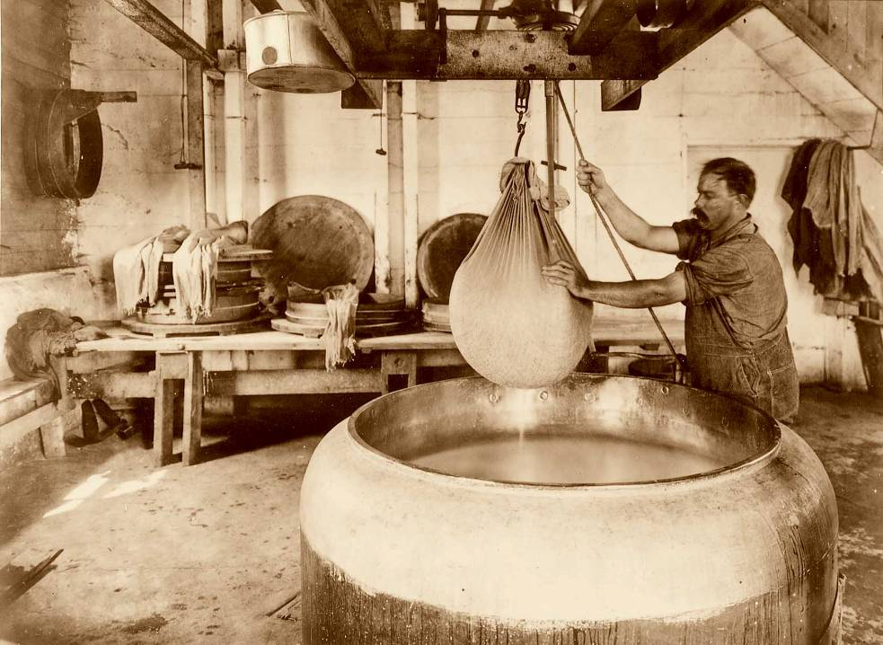
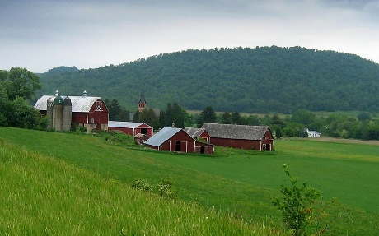
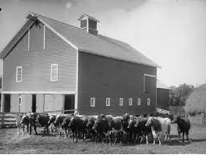
Wisconsin Cheese Historical Beginnings
The 1860s also saw a large immigration of Europeans to Wisconsin.
  Swiss, German, Norwegian, Swedish, Danish, French, Italian and Dutch populations
  Traditions and skills
  were imported as well
  from their homelands
Credit: My Land, My Home, My Wisconsin, Robert & Maryo Gard

Slide 12
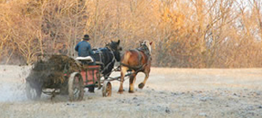
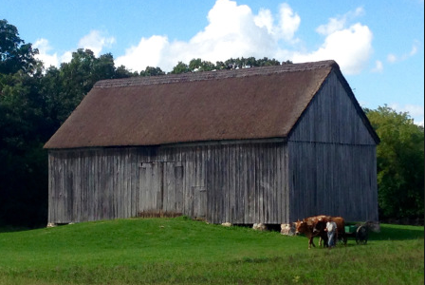
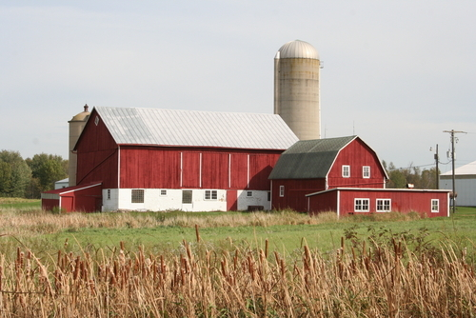
New European Settlers:
Built barns for their livestock
Greater animal care
Recognized the importance of fertilizer (manure)
Credit: My Land, My Home, My Wisconsin, Robert & Maryo Gard

Slide 13
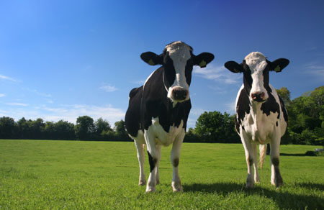
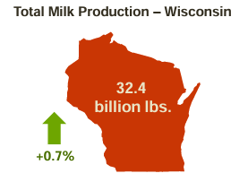

Dairy Cows in Wisconsin
1867 – 245,000
1912 – 1,460,000
1945 –2,585,000 (ave. milk output/cow/lactation 6,330 lb)
2018 –1,280,000 (ave. milk output/cow/lactation 24,002 lb)
2024 –1,269,000 (ave. milk output/cow/lactation 25,493 lb)
Credit: My Land, My Home, My Wisconsin, Robert & Maryo Gard
Notes:
Today – 1,280,000 BUT production higher now

Slide 14
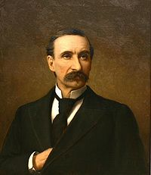
The Father of Wisconsin Dairying
William Dempster Hoard
Born in Stockbridge, NY in 1836
Migrated to Wisconsin in 1857
Lived in Fort Atkinson, Jefferson County
Ref. The Rise of Dairy Industry in WI
Credit: WI Historical Society

Slide 15
William Dempster Hoard
Saw the decline in wheat yields
Wondered how to promote Wisconsin farm prosperity
Remembered lessons from New York State
Vision of Wisconsin as prosperous milk producing region
“Substitute the cow for the plow”
Ref. The Rise of Dairy Industry in WI
Credit: WI Historical Society

Slide 16
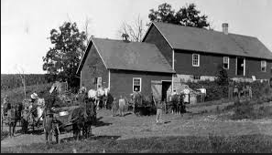
Beginning American Cheese Plants
Depending on definitions, when did the first cheese “factory” appear?
In 1841, Anne Pickett made cheese making history when she established Wisconsin’s first cheese factory by adding milk from neighbors’ cows to her own production.

Slide 17
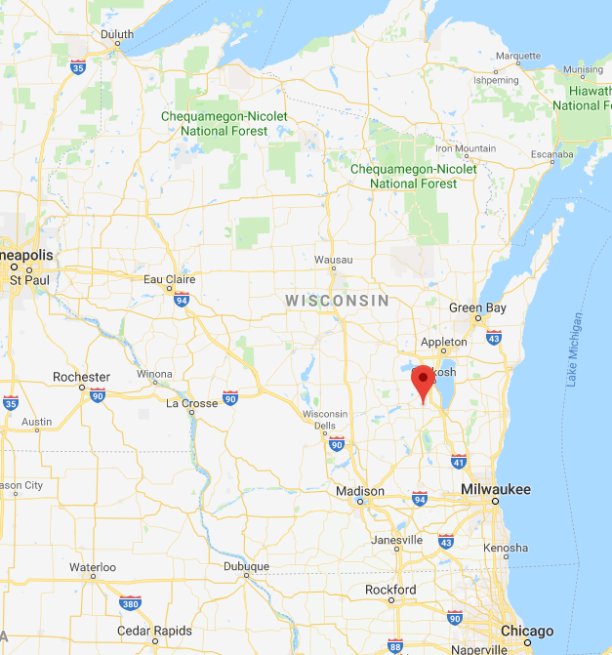
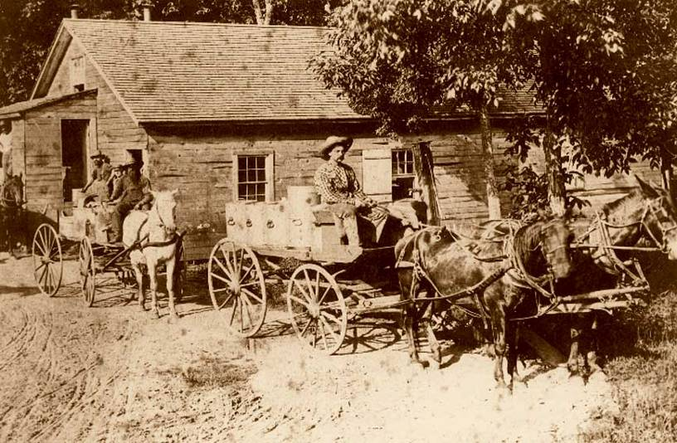
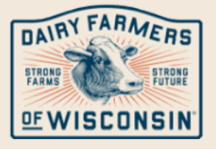
Beginning American Cheese Plants
In 1864, Chester Hazen established a new factory concept:
  It was built “away” from the farmstead
  Started with 100 cows
  By 1865, “200 cows”
  By 1870, “1000 cows”
  Started shipping WI cheese outside the state

Slide 18
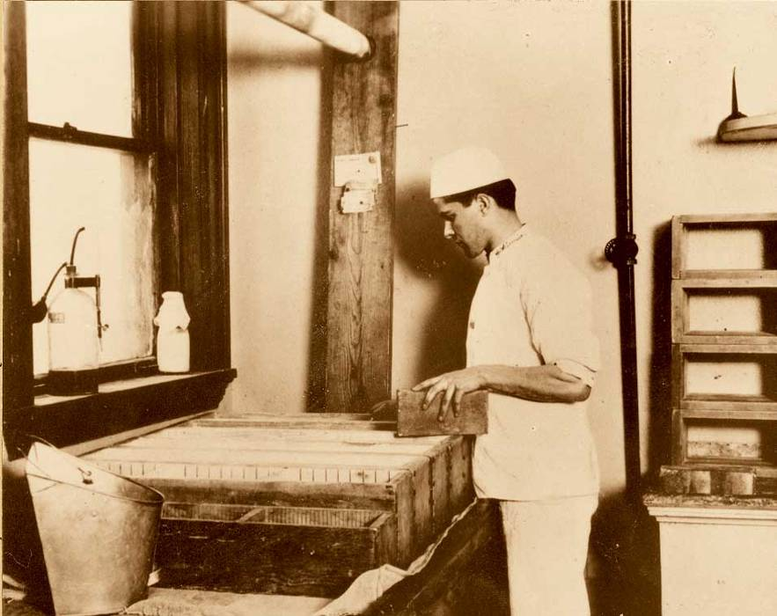
Wisconsin Cheese Originals
Around 1877, Brick cheese was first produced near Watertown, WI by John Jossi
  Named after the shape as well as originally using bricks to press the moisture from the cheese
  “Married man’s Limburger”

Slide 19
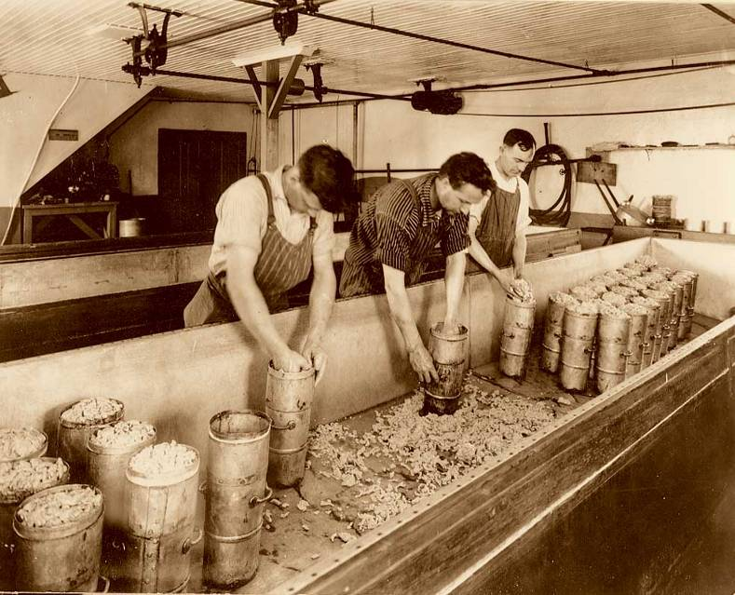
Wisconsin Cheese Originals
In 1885, Colby cheese was first produced in the town of Colby, WI by Joseph Steinwand
  “Cheddar cheese make” with the addition of a curd washing step
  Produced an open textured variety

Slide 20
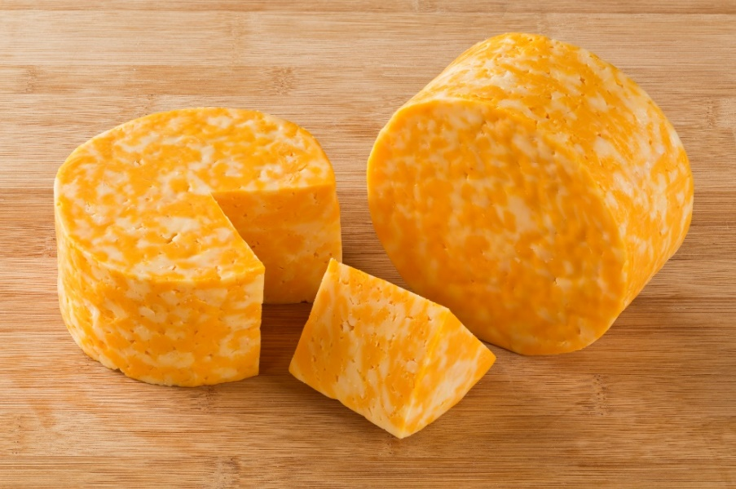
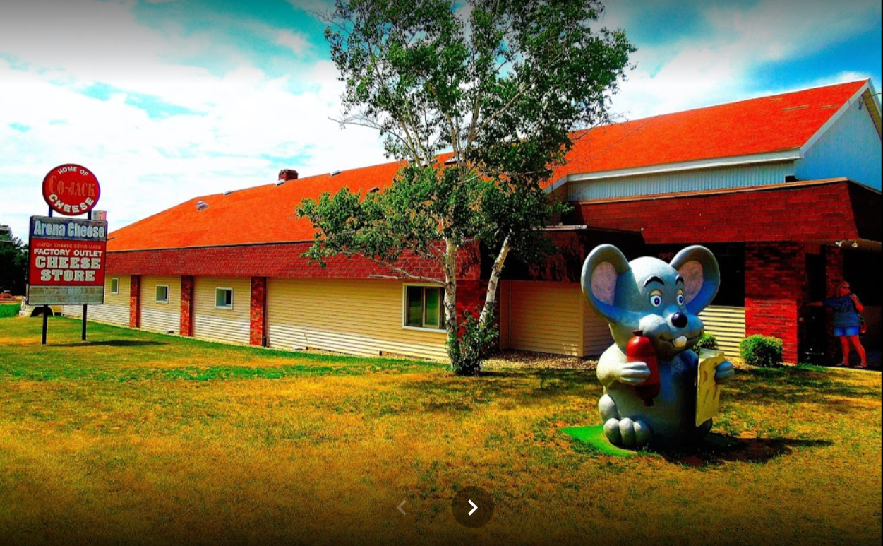
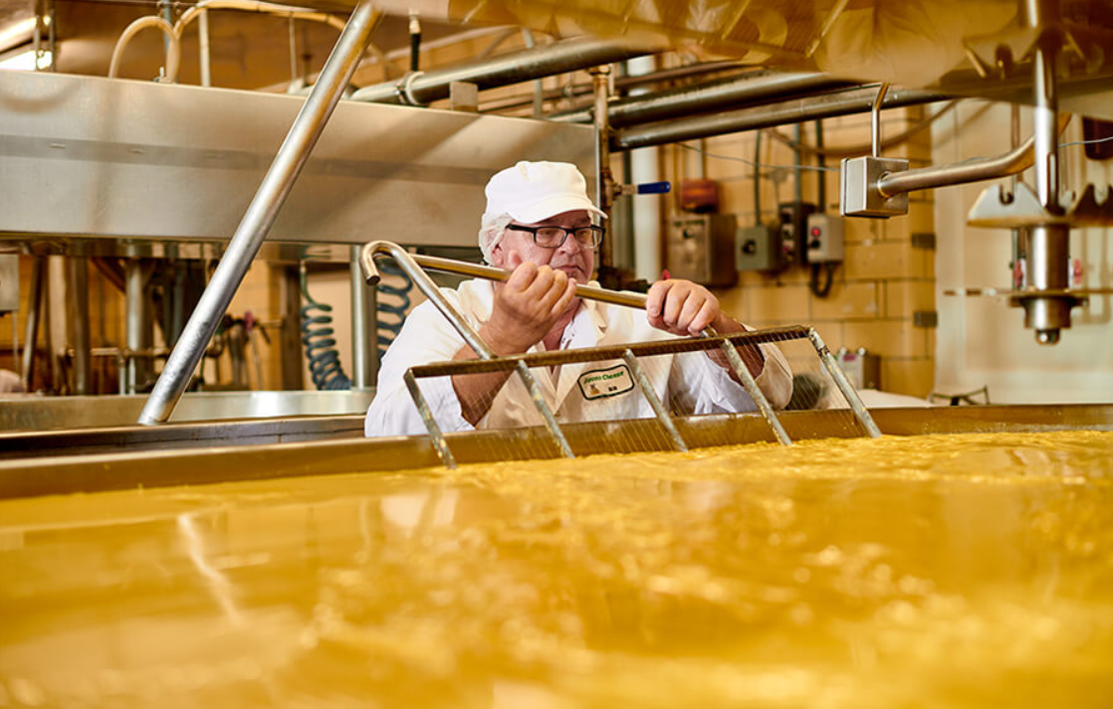
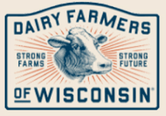
1979: CoJack (Colby Jack) cheese developed by Arena Cheese in Arena, WI
Wisconsin Cheese Originals
Notes:
Arena – made jack & Colby – little pile of each – combined and made one long horn and gave away at bar across the street and the rest is history…
Millions of lbs per year

Slide 21
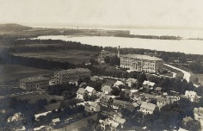
The Role of UW-Madison
Credit: WI Historical Society

Slide 22
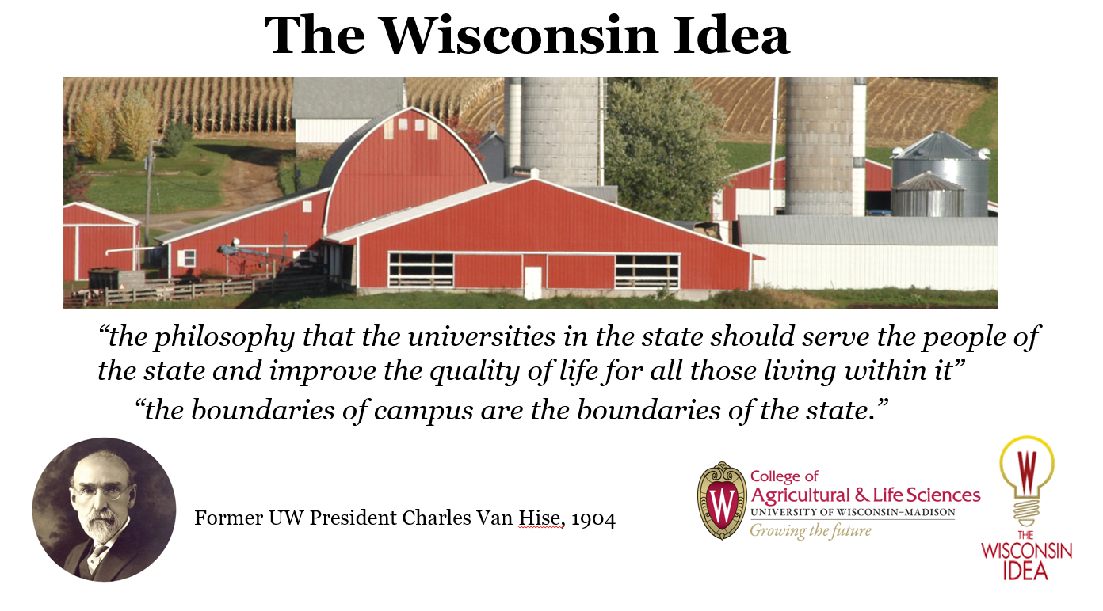

Slide 23

The dominate dairy/cheese state of 1850-1910 was?

Slide 24
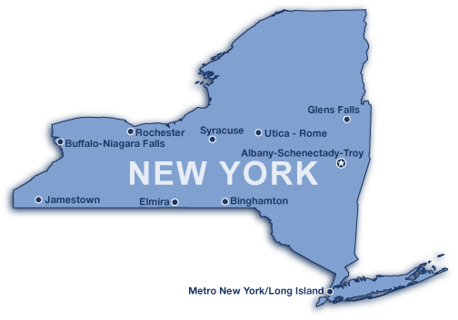

Slide 25
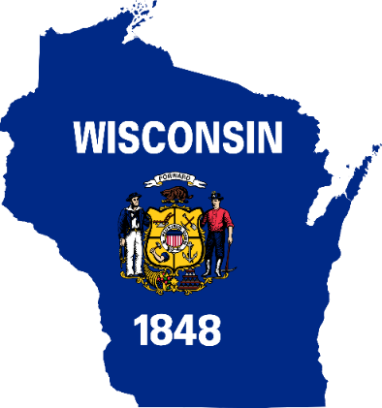
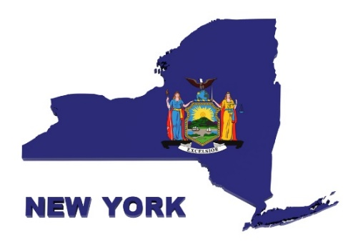

Many of the early, influential dairy leaders in Wisconsin’s dairy development years came from New York
  W.D. Hoard (Hoard’s Dairyman; Guernsey herd;)
  Hiram Smith (Pres., WI Dairyman’s Assoc., UW Regent, instrumental in organizing WI State Experimental Stations)
  W.A. Henry (First Prof. Ag., Dean of UW College of Ag.)
  Stephen Babcock (1st Agricultural Chemist at UW)
  Walter Price (Dairy product & Cheese expert UW ‘29-60’s)

Slide 26
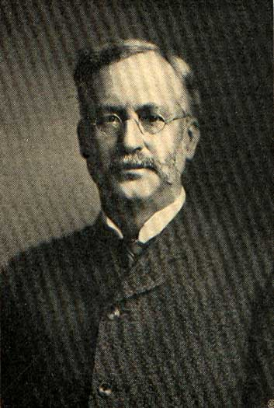
Important Dairy Milestones at UW-Madison
1880 – W.A. Henry came from Cornell
  1st Professor of Agriculture
1883 – UW experimental farm opened
1889 – UW-College of Agriculture formed

Slide 27
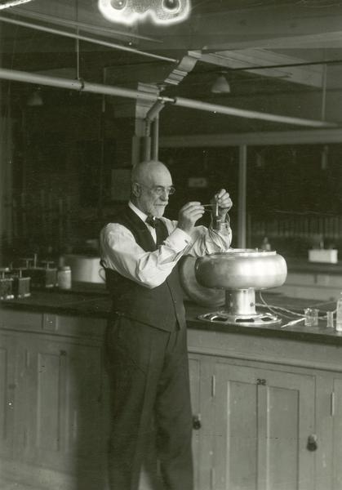
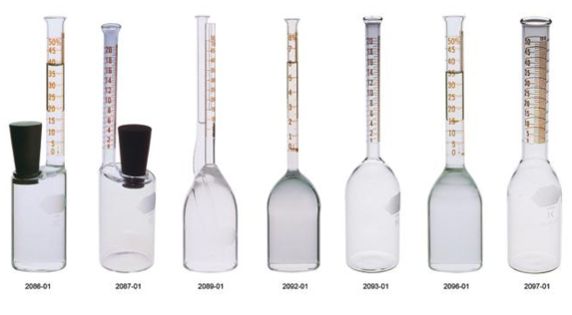
Important dates contd.
1885 – Beginning of Farmer Institutes/Cooperative Extension
1885 – 1st Farm Short Course held
1888 – Stephen Babcock, Cornell, hired as Professor of Agricultural Chemistry
1890 – Babcock milk fat test developed
Credit: WI Historical Society

Slide 28
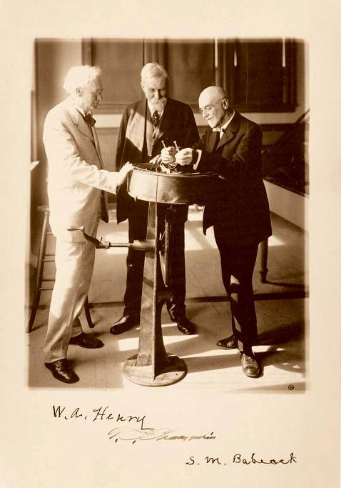
Wisconsin Cheese Timeline
Dr. Stephen Babcock created the
Babcock Butterfat Test in 1890:
  Used to determine fat content
  of milk.
  Changes "value determination"
  of milk.
  Was a pivotal moment in the U.S.
  dairy industry
  - The Thomas Edison of Dairy

Slide 29
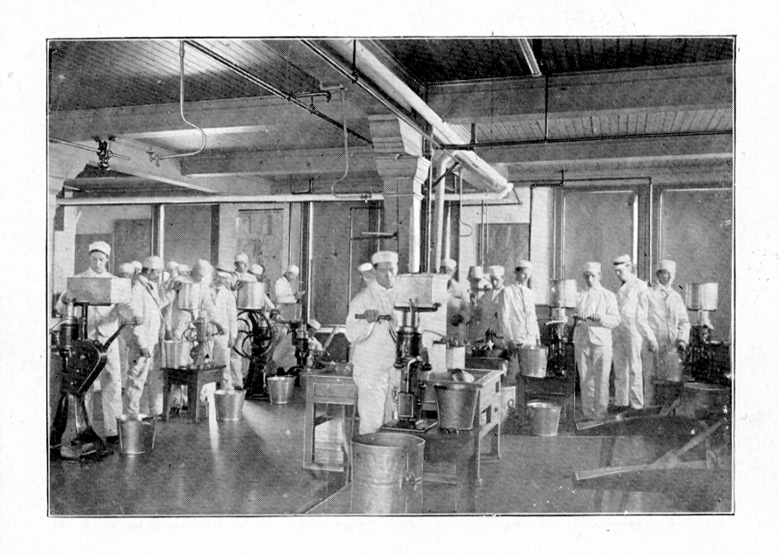


In the Early Years
Late 1800s, early 1900s--Resident 2-week training course in dairy manufacturing

Slide 30

Wisconsin Cheese Timeline
In 1910, Wisconsin becomes the leader in cheese production as refrigerated (ice) railcars allowed cheese to be shipped to New York and east coast
In 1915, Wisconsin becomes the leading dairy state.
Starting in 1916, Wisconsin cheesemakers were required to have a license to make cheese.
By 1921, Wisconsin had
instituted mandatory
grading of all major
cheese varieties.

Slide 31


Slide 32


Wisconsin Cheese Timeline
By 1922, Wisconsin had more than 2,800 cheese factories dotting the landscape.

Slide 33

Cheese Plants in Wisconsin

Slide 34


Slide 35


Slide 36



Technology Improvements
These production changes at the farm resulted in expansion at the cheese plant level as well.
  In 1972, Wisconsin tops 1 billion pounds of cheese
  By 1992, Wisconsin surpasses 2 billion pounds
  In 2022, Wisconsin makes 3.5 billion pounds

Slide 37





Center for Dairy Research

Slide 38


UW- The Modern Cheese Era
  WI Center for Dairy Research
…to turn knowledge and expertise into the dairy industry’s success by bridging cutting edge research with practical education and outreach.
Largely funded by dairy farmers!

Slide 39




CDR Cheese Timeline
In 1976, Wisconsin establishes the Walter V. Price Cheese Research Institute.
This led to the creation of the Wisconsin Center for Dairy Research in 1986.
The Wisconsin Master Cheesemaker® Program begins in 1994. Today we have ~90 “Masters”.
Class of 2010

Slide 40





What do we do?

Slide 41



Cheesemakers

Slide 42

























Working with State Cheesemakers

Slide 43





















Working With End Users
Notes:
IPAP

Slide 44





THE $45.6 BILLION WISCONSIN DAIRY INDUSTRY

Slide 45

Specialty Cheese

Slide 46


What is Specialty Cheese?
Cheese of limited production
Particular attention paid to natural flavor and texture profiles
  High quality, command a premium price
May be made from all types of milk (cow, sheep, goat)
May include a variety of flavorings
Wisconsin specialty cheese production has increased by more than 600% since 1994
Source: Wisconsin Agricultural Statistics Service
Notes:
Limited production – NOT commodity, high quality, premium price

Slide 47


Slide 48


Slide 49


Slide 50


Slide 51


Slide 52



What are Specialty Cheeses?
The unique artisan story
  Quality/craftsmanship
  Cheesemaker
  Family
  The land
  Comaraderie

Slide 53


Slide 54



CDR and Specialty Cheese Development
Notes:
CDR does a LOT of specialty cheese development

Slide 55



Specialty Cheese Makers Hit the Big Time

Slide 56



Uplands Cheese
Pleasant Ridge Reserve
Best of Show at the 2001, 2005, and 2010 American Cheese Society Conference
U.S. Champion at the 2003 U.S. Championship Cheese Contest
2007 Gallo Gold Medal Award for Best Artisanal Dairy Product

Slide 57




Seymour Blue/Great Lakes Cheese/Emmi Roth Cheese

Slide 58





Slide 59

Juustoleipa

Slide 60




CRAVE BROS CHEESE

Slide 61





Red Barn Family Farms
2023 Cupola 1st Runner-up Best of Show U.S. Championship Cheese Contest

Slide 62



ROELLI CHEESE WINS ACS 2016 Little Mountain

Slide 63






Slide 64







Products other than cheese…

Slide 65


Positioning for the Future

Slide 66
Why did Wisconsin become so successful at Dairying?
Soil, climate, natural rainfall
Immigrants with a passion for dairy and great skills in cheesemaking and dairy farming, this tradition has been carried on……
Partnerships
  Outstanding dairy farmers
  University (training and practical research)
  Industry/associations/infrastructure (focus on quality, improvement, growth)
  State (supported research and regulations to improve quality/safety, wanted to grow this sector)
Creativity and entrepreneurship (can do….)

Slide 67


MAKE FRIENDS WITH CHEESE!

