Slide 1





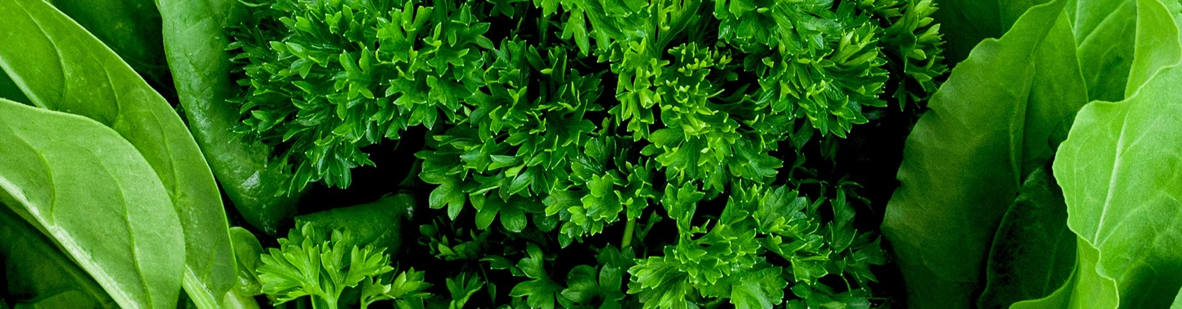
www.happyleafled.com
Indoor Gardening for
Food and Fun
Victor Zaderej, Happy Leaf LED
zaderej@alum.mit.edu
hello@happyleafled.com
Notes:
1. HOPING-NOT ONLY SHOW-EASY and FUN-INDOOR GARDENER-GET EXCITED JOINING ME HOBBY
2. Originally from Fort Wayne Indiana
3. I work in the electronics industry
4. Studied engineering at MIT
5. I became an indoor gardener about 13 years ago and I will share with you what I have learned

Slide 2

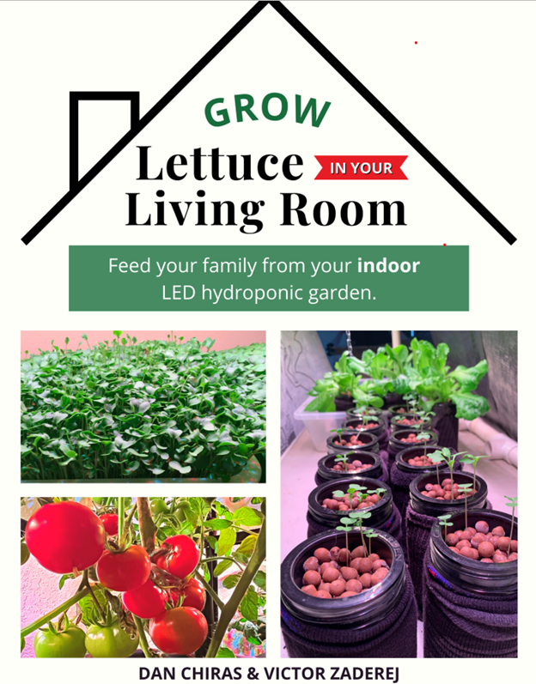
This presentation is based on a book I co-authored with Dan Chiras, Grow Lettuce in Your Living Room.
We also have a great library of videos on YouTube that demonstrate many of the topics I’m covering.
www.happyleafled.com
Notes:
Grow Lettuce in Your Living Room will be referenced throughout this PPT if you would like more detail on how to grow your own food at home.

Slide 3




What food can you grow indoors?
START HERE: Endless varieties of leafy lettuce greens and herbs
(e.g., basil, dill, arugula, thyme, rosemary, etc.)
OR, START WITH MICROGREENS: Endless varieties/flavors of this superfood. Fast and easy to grow.
NEXT LEVEL GREENS AND VEGGIES: Spinach, kale, Bok choy, collard greens, radishes, carrots, eggplant, peppers, beets, tomatoes, cucumbers
CHALLENGING, YET POSSIBLE: Edible flowers, fruit trees, strawberries
Notes:
We advise folks to start with the easiest crops,
Typically, leafy greens or microgreens
They can experiment with just about any type of green imaginable
Move on to vegetables and even fruit.

Slide 4
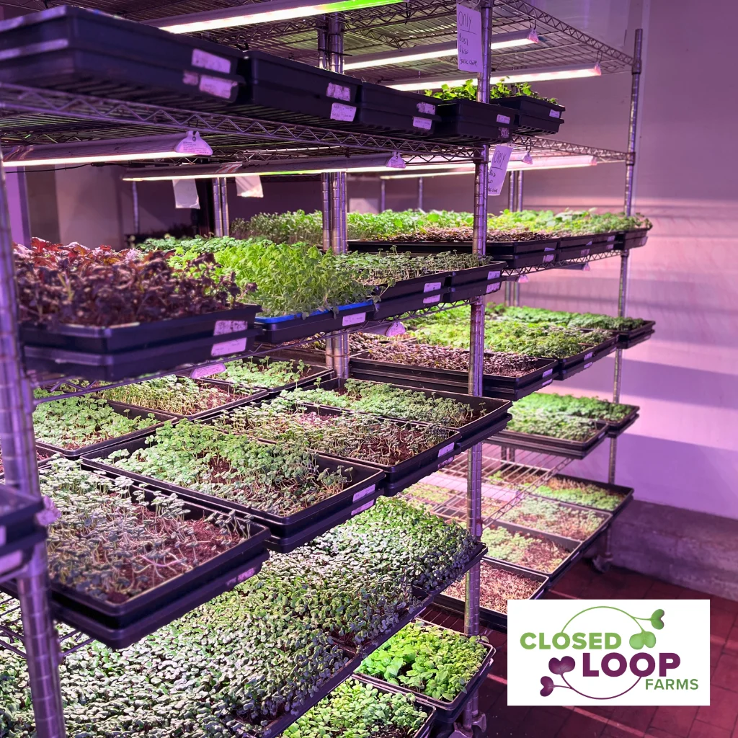

Why Grow Your Food Indoors?
Healthy Food
(No pesticides or herbicides)
No food recalls
(E.coli or Salmonella)
01
05
Fresh and Tasty
(Grow what is wanted and needed)
A more sustainable future
(90% less water, no packaging/shipping)
02
06
Grown Locally
(In your own home)
Save money (90% less expensive than purchasing in a store)
03
07
Food Security/Shortages
(Remember COVID shelves)
Fun!
(You will really appreciate indoor gardening during the winter!)
04
08
www.happyleafled.com

Slide 5
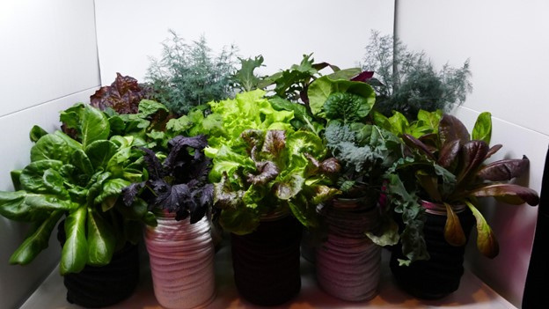
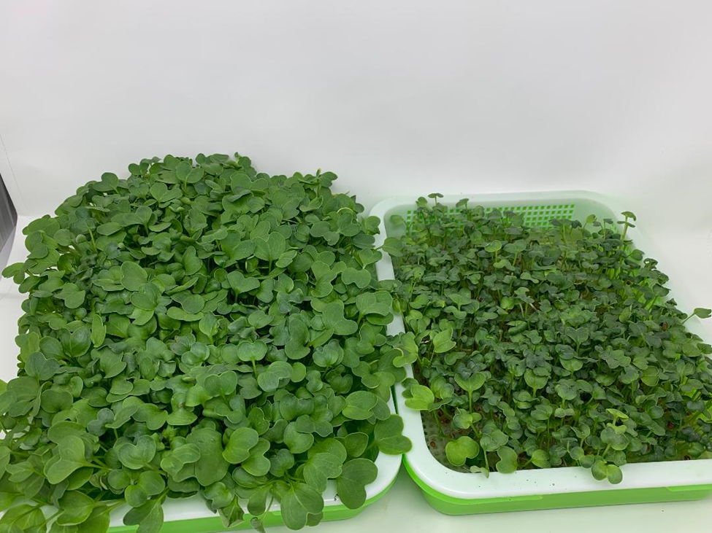
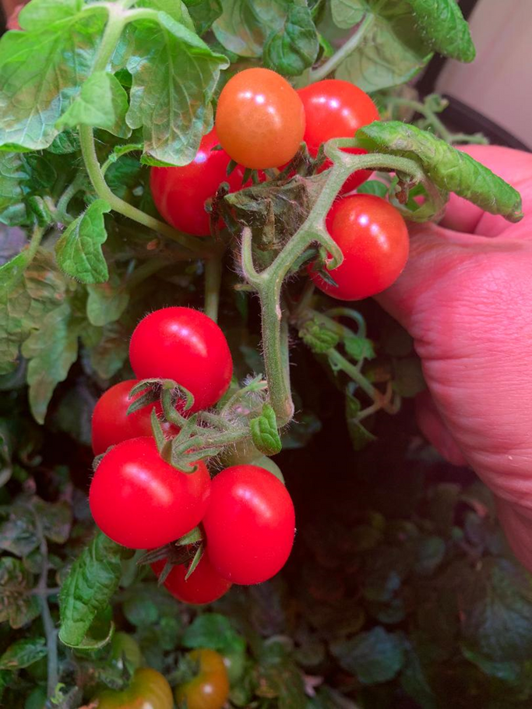
What can you grow?
Leafy Greens
Microgreens
Tomatoes
www.happyleafled.com
Notes:
We've honed in on certain methods that work for different types of plants,
I'll share those with you.

Slide 6
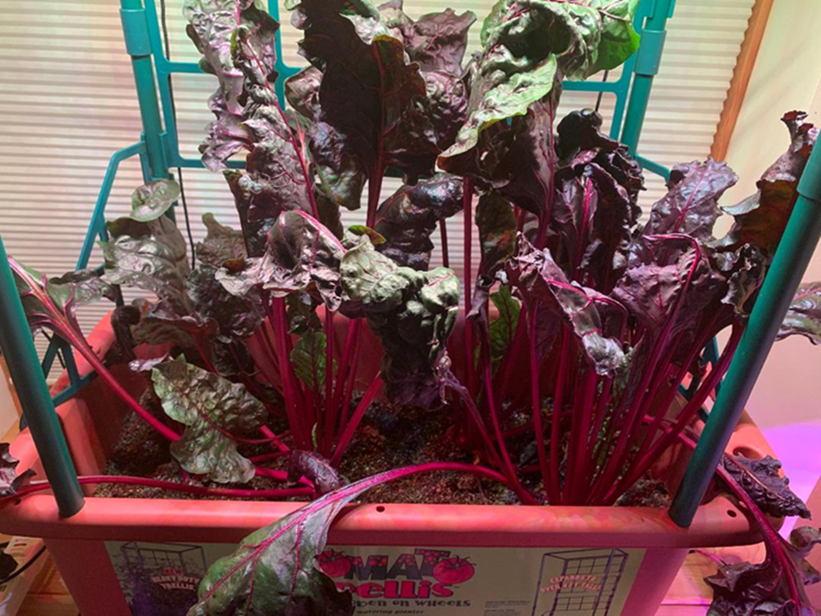
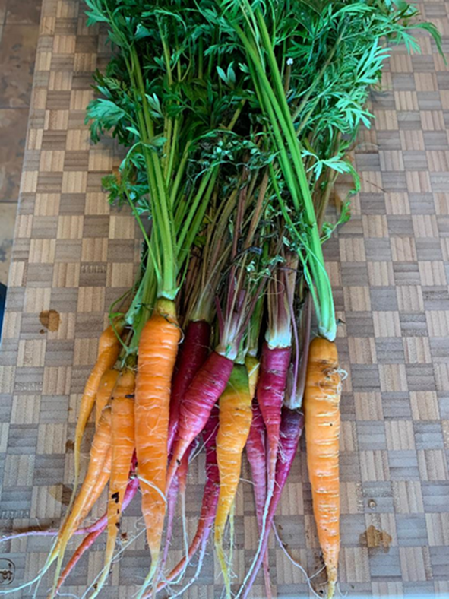
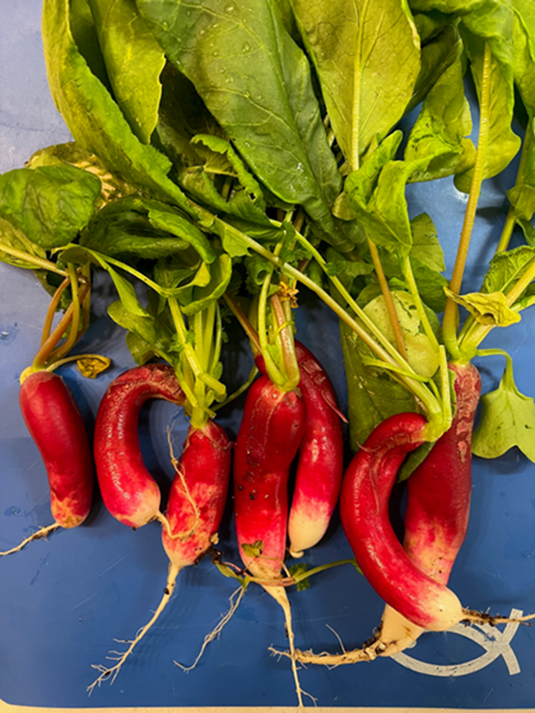
All grown indoors
Beets
Carrots
Radishes
www.happyleafled.com

Slide 7
Transform Your Indoor Gardening Experience
Guide: Strategies for indoor passive hydroponic gardening.
Four Approaches: Four methods for passive hydroponic garden.
Cost-Effective: Advice on sourcing materials and managing costs.
Expert Insights: Dan Chiras, author on sustainable living (43 books)
Vic Zaderej, Lighting designer and indoor gardener
LED Grow Lights: What is needed for a grow light that will enable
indoor gardening
www.happyleafled.com
Notes:
This page is about the Book

Slide 8
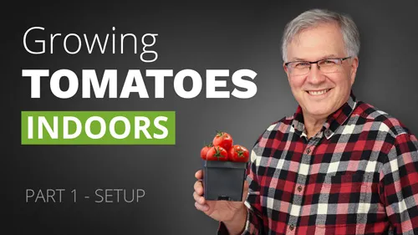
My indoor
gardening story
www.happyleafled.com
Notes:
1. I have been a gardener for 35 years
2. Started growing lettuce and herbs indoors under LED grow lights I developed at Molex in 2012
3. Friends and relatives would ask where they could purchase the lights
4. Started Happy Leaf in 2014 to educate how to grow food indoors
5. Manufacture the best and most cost-effective grow lights in the US.
5. We design and make our lights in Northern Illinois.
We live in a Net Zero Passive Solar Home in Northern Illinois

Slide 9
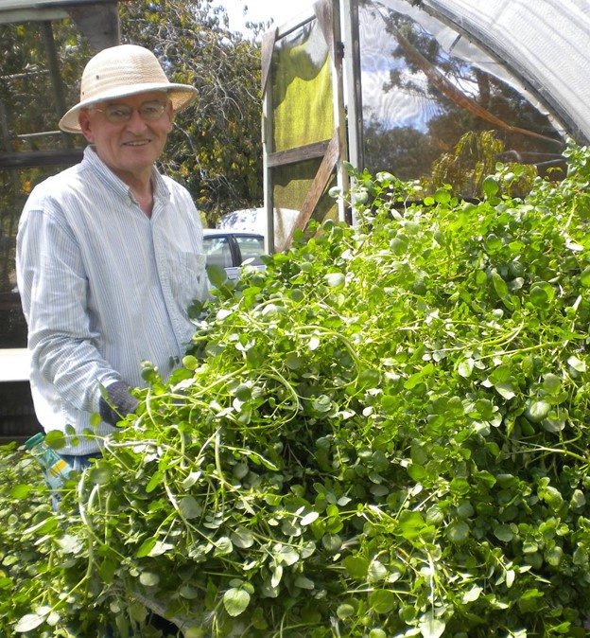
Indoor gardening
meets
Dr. Kratky
www.happyleafled.com
Notes:
1. Like others, assumed it was not possible to grow food indoors.
2. After the fall harvest, clean out garden beds, can and freeze, store the root crops, wait for spring
3. High efficiency LEDs and research Purdue and MI State changed my mind.
4. Passive hydroponics by Dr. Bernie Kratky has made what we discuss in this presentation possible.

Slide 10

I am not a gardener! Can I really do this?
www.happyleafled.com
Notes:
1. No prior experience is needed! We guarantee this.
2. There is a slight learning curve but we will start you off with the quickest and easiest veggies
3. We will show you exactly what you need and where to purchase everything.
4. We will walk you through a step-by-step process on how to set everything up.
5. We will show you how to harvest your indoor garden and some recipes we like.

Slide 11
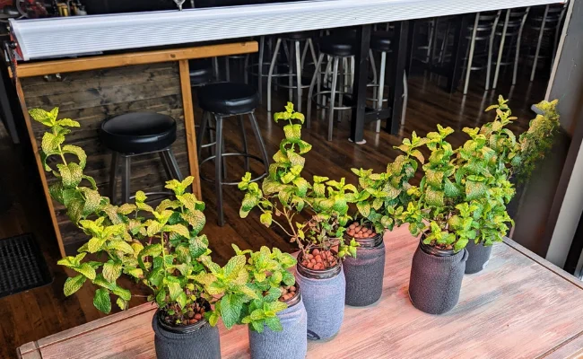
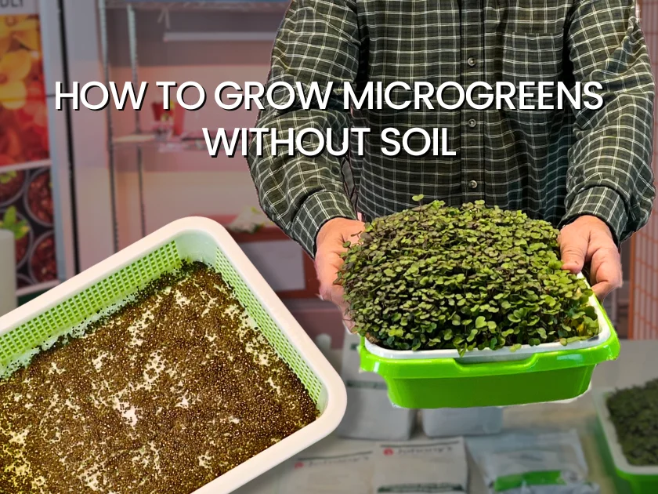
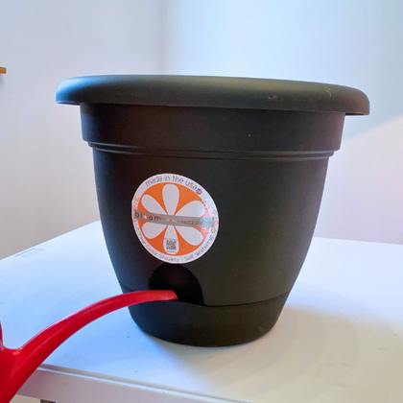
Three indoor growing methods
Kratky Jars
Microgreen Trays
Self-Watering Pots
www.happyleafled.com
Notes:
1. Kratky Jars- A passive hydroponics developed by Dr. Bernie Kratky University of Hawaii in the 1990s
2. Microgreens- highly nutritious- kale, broccoli, cabbage, arugula, basil, radishes in two weeks
3. Self watering container gardening root crops, tomatoes, cucumbers, spinach, kale all year long.

Slide 12
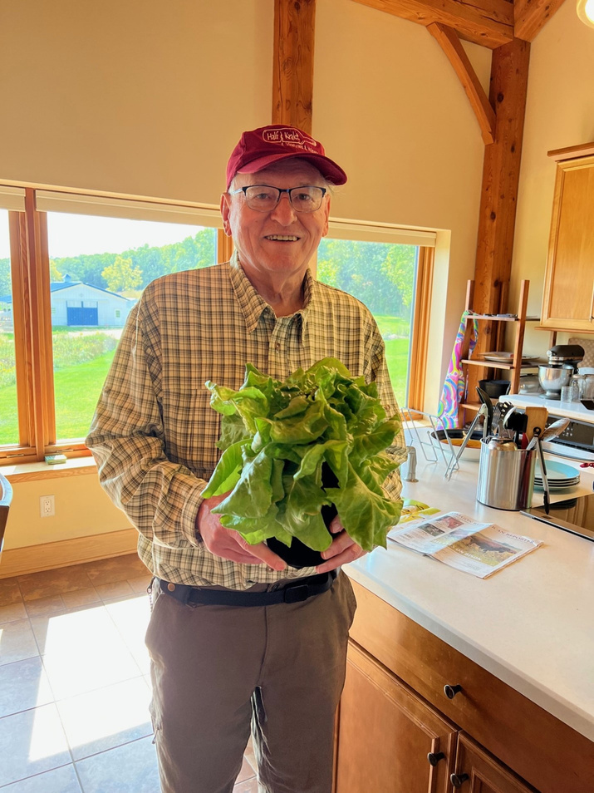
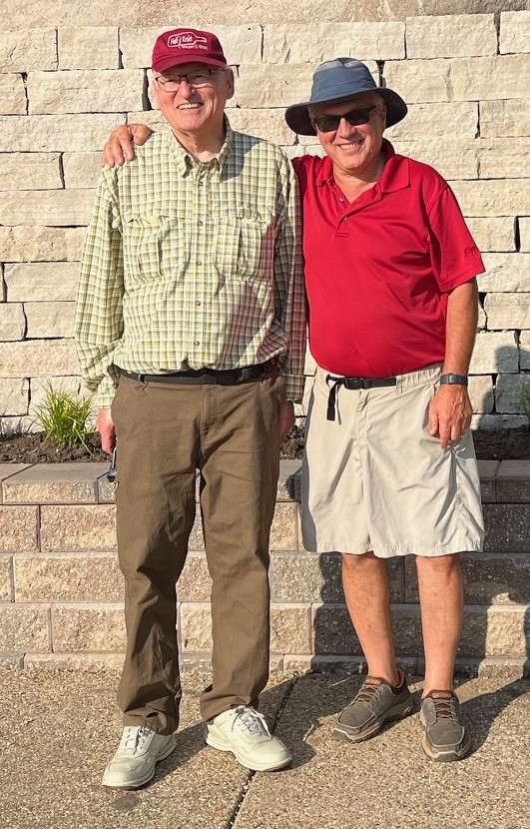
Kratky Jars
“I am absolutely delighted that some home growers are using these simple hydroponic methods and that the revolution with LED lighting will increase inclement season home gardening.”
Aloha, Bernie Kratky
www.happyleafled.com
Notes:
1. The Kratky method was developed by Dr. Bernie Kratky in 1990s when on sabbatical in Taiwan.
2. Used for commercial scale growing in Hawaii
3. We modified his process to grow in large mouth canning jars.
4. Bernie has become a close friend, and we communicate regularly.

Slide 13
What can you grow in Kratky Jars?
  Endless varieties of lettuces and herbs (basil, dill, parsley, thyme, chives, sage, rosemary, mint, etc)
  Arugula
  Bok Choi *
  Kale *
  Chard *
www.happyleafled.com
Notes:
1. The sky's the limit with herbs and lettuces.
2. We have grown bok choi, kale and chard in the Kratky jars
3. But we also like growing these plants with one of the other methods I'll discuss.

Slide 14
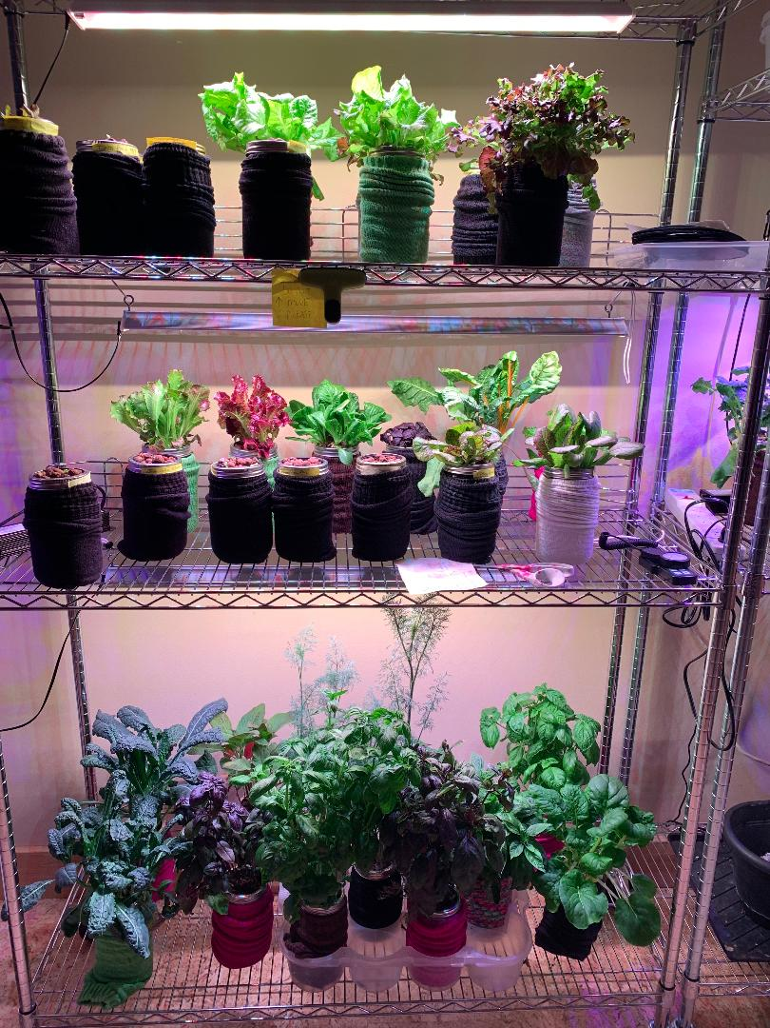
Advantages of growing in one-quart canning jars
www.happyleafled.com
Notes:
1. Most of us have large mouth canning jars or we can easily purchase some.
2. We can plant something different in every jar.
3. We can harvest an individual jar whenever we would like and start again.
4. We can succession plant so that we always have fresh veggies available.
5. Three-inch net pots fit perfectly into a large mouth canning jar so no drilling or cutting required.
6. Individual jars only weigh about 2 lb so they can be easily moved.

Slide 15

Advantages of growing in one-quart canning jars
www.happyleafled.com
Notes:
1. The one-time cost of a jar, net pot, and the clay pellets is typically less than $3.
2. Everything is reusable so washing out the jar to start again is quick and easy.
3. A dark sock can be used to block light from the jar to prevent algae growth.
4. It is very easy to check the water level in the jar by lowering the sock.
5. It is really cool to be able to grow your food in a canning jar!

Slide 16
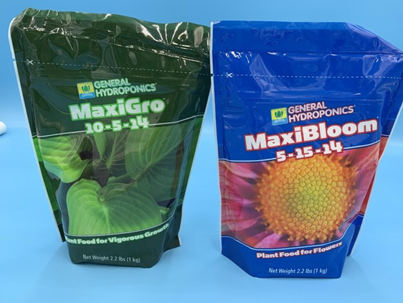
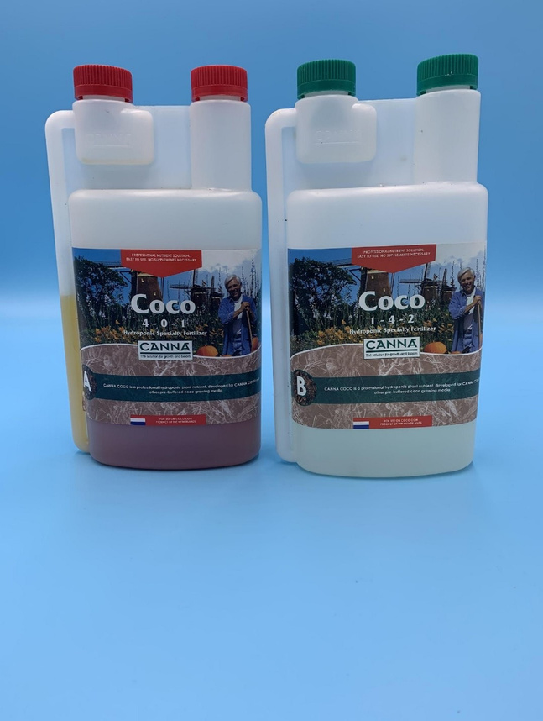
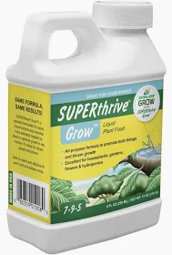
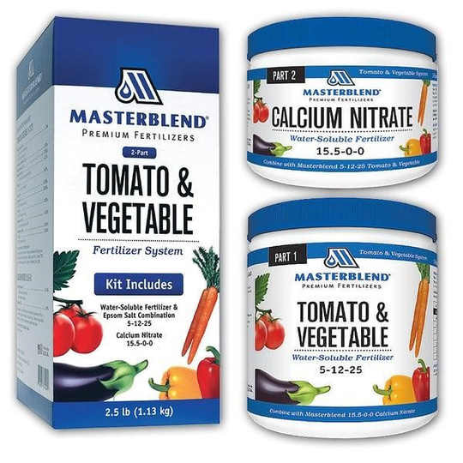
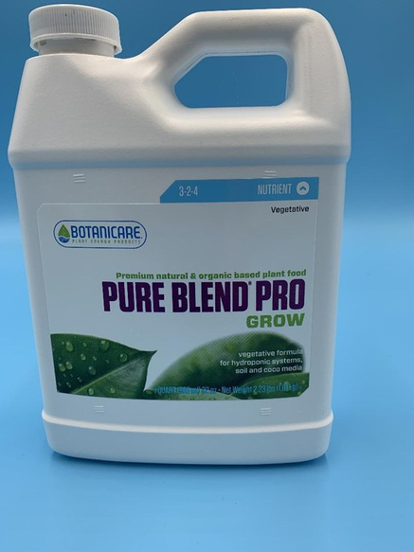
Nutrient options
www.happyleafled.com
Notes:
General Hydroponics MaxiGro is the nutrient we recommend you start with.
One part and very easy to use. MaxiBloom is used for fruiting plants.
3. Super Thrive, aka, Dyna-gro
4. Botanicare Pure Blend Pro is a liquid making it more expensive, but considered an Organic option.
5. Masterblend is a great option for vegging and flowering but comes in two or three parts.
6. Canna Coco is a liquid and comes in two parts but is imported from Holland.

Slide 17
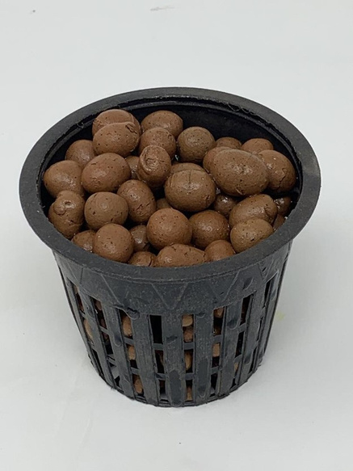
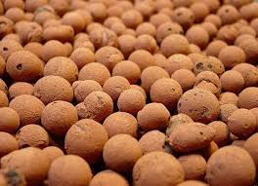
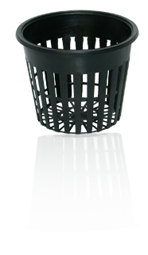
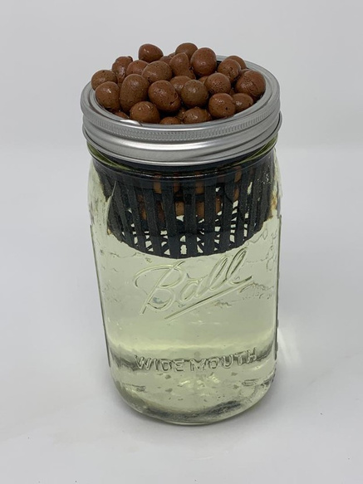
What is that?
www.happyleafled.com
Re-usable fired clay pellets
AKA
clay pebbles
leca
hydroton balls
3 Inch Net Cup
Notes:
1. The medium we prefer is called hydroponic clay pebbles, but they go by a lot of different names. 2. They are re-usable.
3. Eliminate the population of indoor insects.
4. It's generally cleaner to work with these than dirt.
5. It is possible to use rock wool instead of clay pebbles
6. Net cups are easily cleaned and re-used and they come in a variety of sizes, not just the 3" that we use in 1 quart canning jars.
7. You can get a net cup for a 5 gallon bucket.

Slide 18
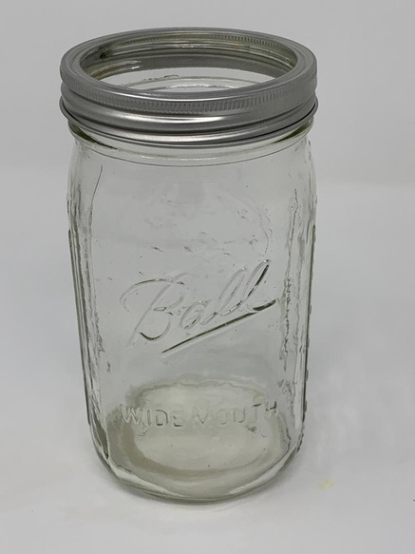
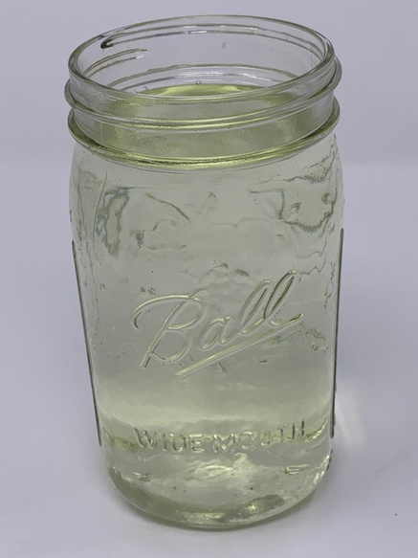
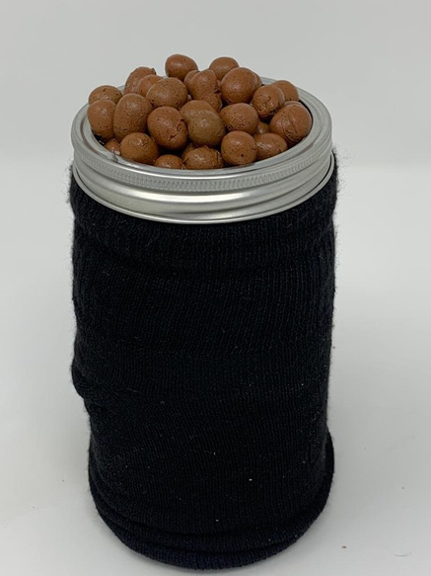
Planting Kratky jars
www.happyleafled.com
Mix one gallon of water with the appropriate amount of nutrients and mix well.
Fill four large mouth canning jars with nutrient solution to the glass ring near the top.
Take a 3-inch diameter net pot and fill it with rinsed hydroponic clay pellets.
Place the filled net pot into the canning jar and screw on the jar band.
Remove one layer of clay pellets and place 4-6 seeds on the moist pellets.
Pull a dark sock over the canning jar to prevent light from entering the root area.
Notes:
1. Mix one gallon of water with the appropriate amount of nutrients and mix well.
2. Fill four large mouth canning jars with nutrient solution to the glass ring near the top.
3. Take a 3 inch diameter net pot and fill it with rinsed hydroponic clay pellets.
4. Place the filled net pot into the canning jar and screw on the jar band.
5. Remove one layer of clay pellets and place 4-6 seeds on the moist pellets.
6. Pull a dark sock over the canning jar to prevent light from entering the root area.
7. Place up to 24 jars (3 deep by 8 wide) 6-8 inches below one 33 inch Procyon 2.0 light.
The timer for the light should be set to 14-18 hours per day.
You can now leave for vacation for the next 3 to 4 weeks.
See the next page for your expected progress.
See pages 33 and 34.

Slide 19
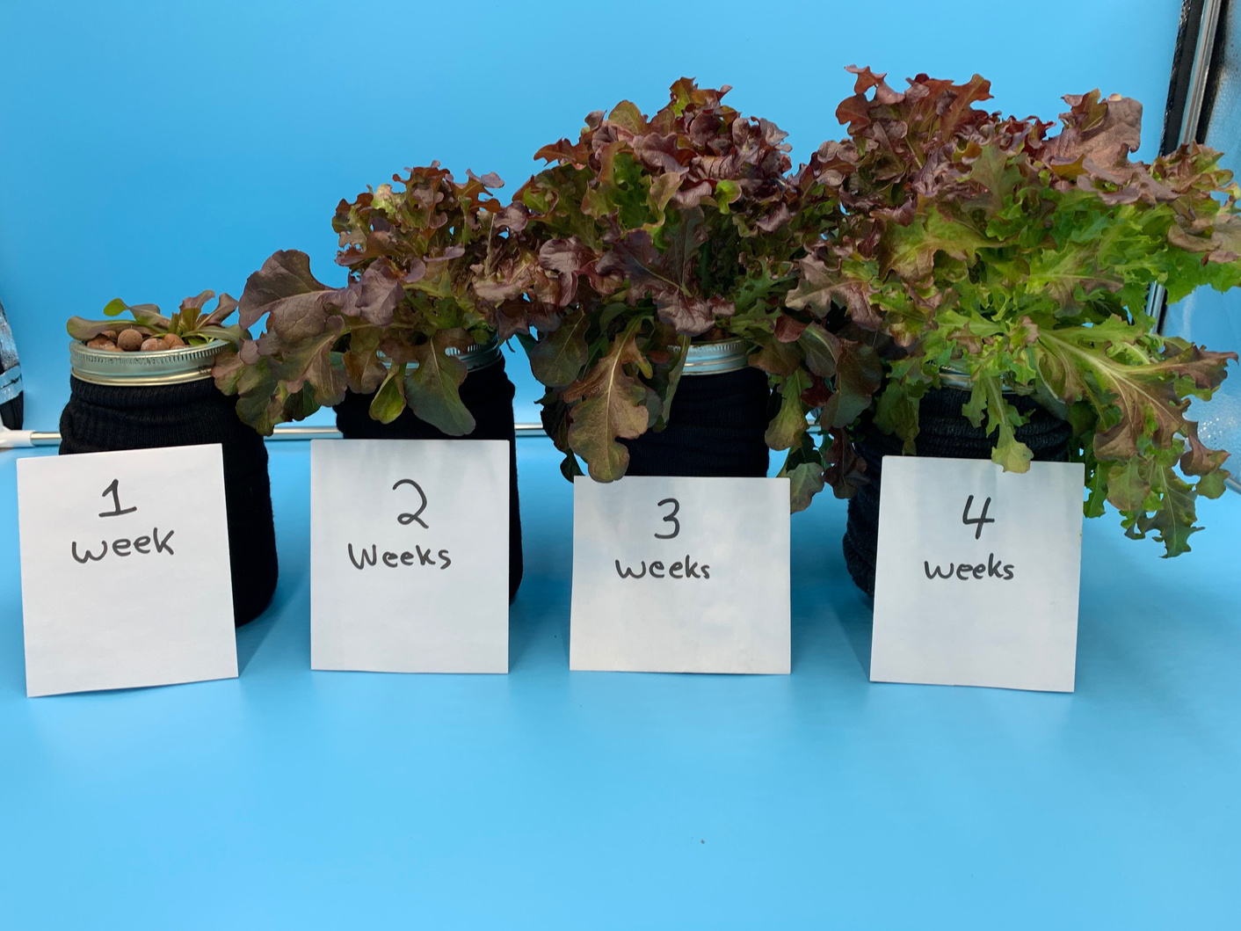
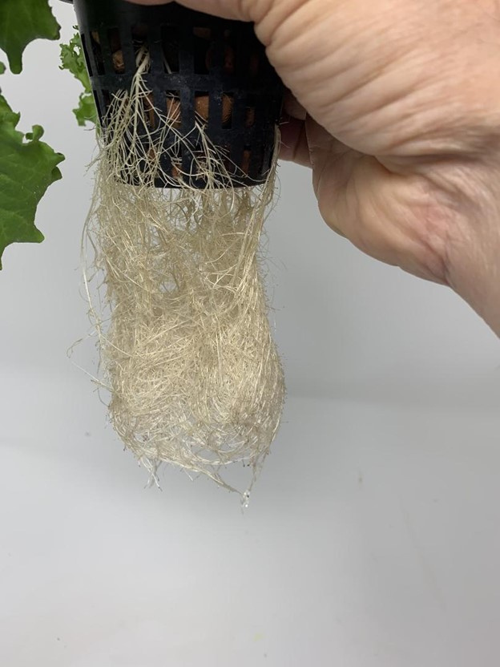
Expected results
www.happyleafled.com
These are the roots that drop into the jar to absorb water and nutrients.
****Never add water above the bottom of the net pot or the plant will die. *************
Notes:
1. Four weeks of lettuce growth under a Happy Leaf 2.0 light.
2. The lettuce can be harvested by removing leaves or cutting the entire top off just before eating.
3. Some lettuces can be cut several times before they become bitter and need to be restarted.
4. Cleaning the jars, pellets, and net pots is easy.
5. Run through a dishwasher cycle in a bag or boil to clean the clay pellets.

Slide 20
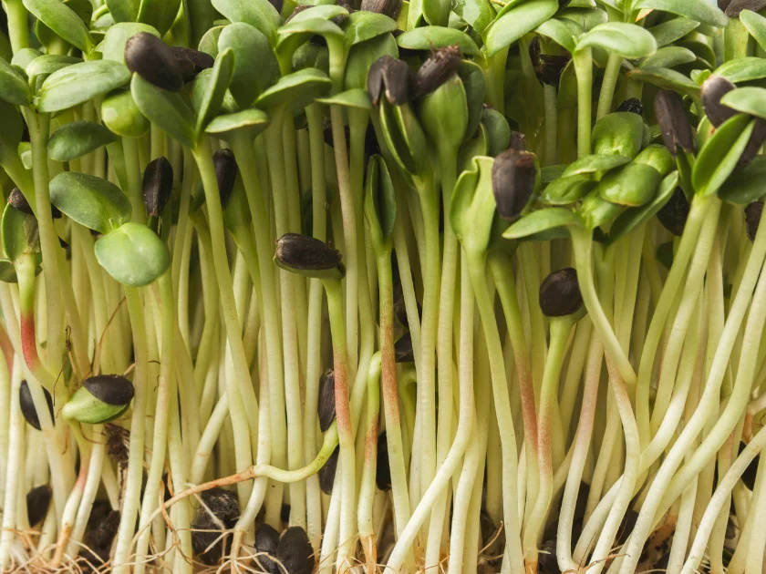
Microgreens at home
Notes:
1. Why Grow Microgreens at Home?
2. Highly nutritious (5-10 times more nutrient dense)
3. Easy to grow
4. Over 50 varieties
5. Grow very quickly
6. Available year-round
7. Can be grown in small spaces
8. Expensive to buy but inexpensive to grow
9. Quick planting and clean up
10. Taste great
11. A great business opportunity for entrepreneurs (A tray of microgreens may sell for $25 and costs $1 to grow)

Slide 21
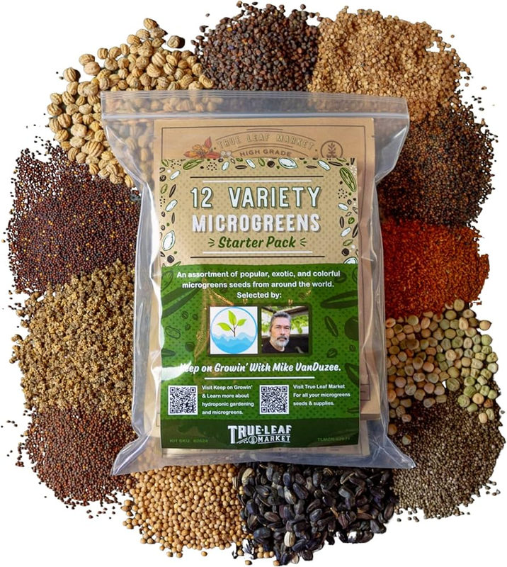
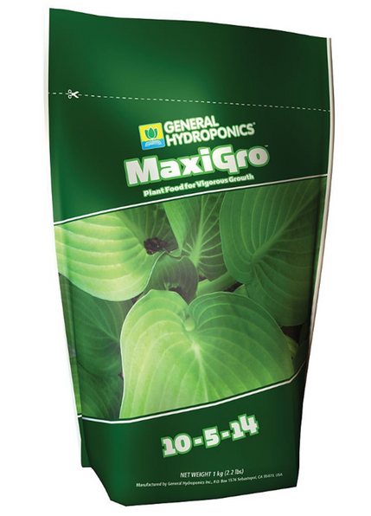
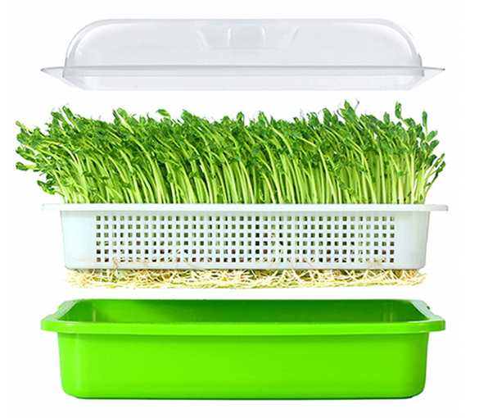
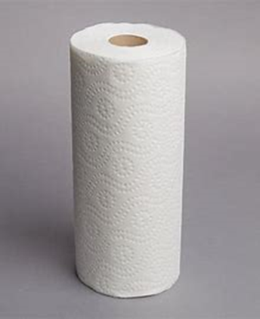
Grow microgreens at home
www.happyleafled.com
A microgreen tray with a lid.
(Amazon)
Nutrients
(Amazon or Happy Leaf)
Paper Towel
Seeds

Slide 22
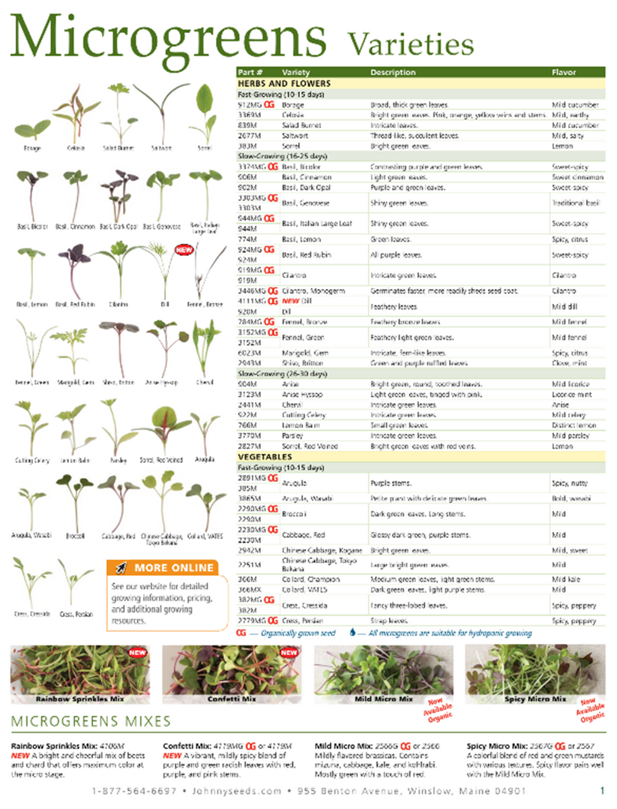
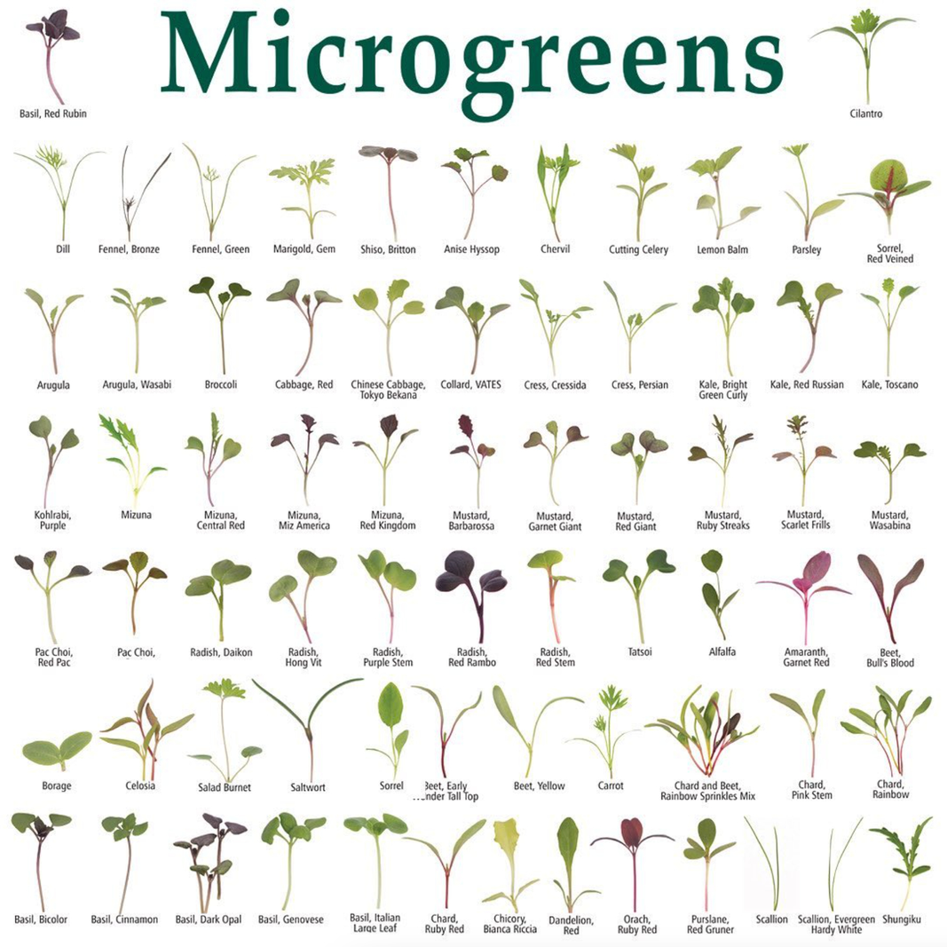
Seeds!
www.happyleafled.com
Notes:
1. We have found Johnny’s Selected Seeds to be one of the best place to purchase seeds for microgreens. They have a large variety, and you can purchase in bulk very cost effectively.
2. We have also been impressed with seeds that came from True Leaf Market.

Slide 23
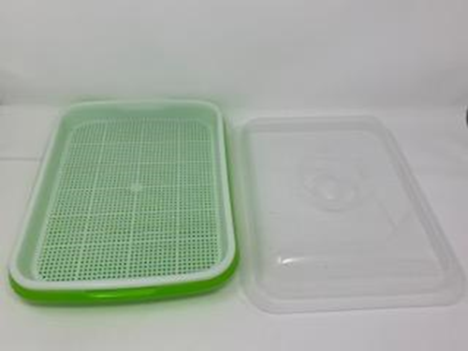
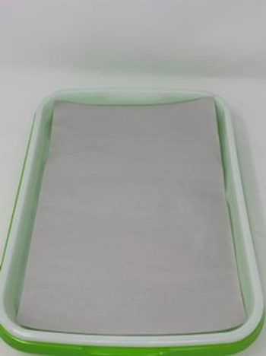
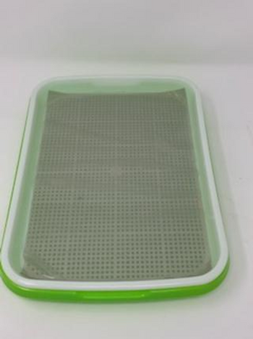
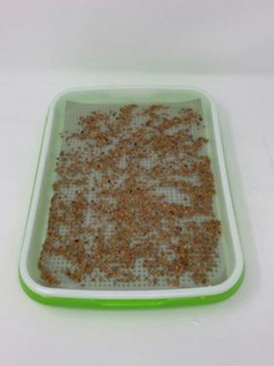
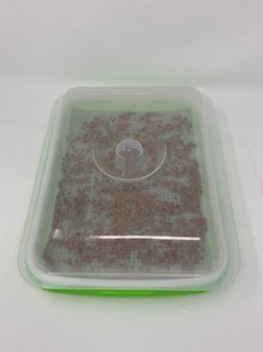
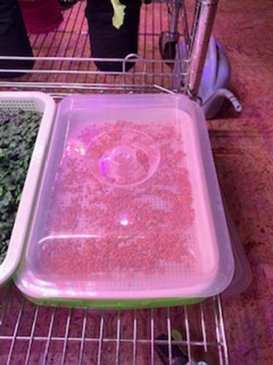
Planting microgreens
Place tray on a flat surface
Place the paper towel inside
Fill tray with nutrient water to top of paper
Sprinkle seeds onto paper towel
Cover tray with lid
Place tray 8-14" under a high quality light
Notes:
1. light can be on for 24 hours per day but I normally use a 16-hour cycle.
2. In 2 to 4 days, the seeds will have germinated so the cover needs to be removed.
3. You may notice white fuzz on the seeds. This is normal. These are the roots being formed.
4. In 7 to 14 days, the fast-growing varieties of microgreens will be ready to be harvested.
5. Harvest when ready to eat and the rest can be left to grow for a few more days.
6. Add nutrient water when water level drops. Lift white tray to check on the water.
7. To harvest, use scissors. Hold the top of the microgreens and cut near the bottom.
8. Think of it as a haircut.

Slide 24
Growing microgreens
www.happyleafled.com
Kale microgreens Radish microgreens
Notes:
1. Trays of kale and radish microgreens were planted 10 days ago.
2. Kale is ready to be harvested and the radish will be in several days.
3. Other fast-growing varieties include broccoli, cabbage, and kohlrabi.

Slide 25
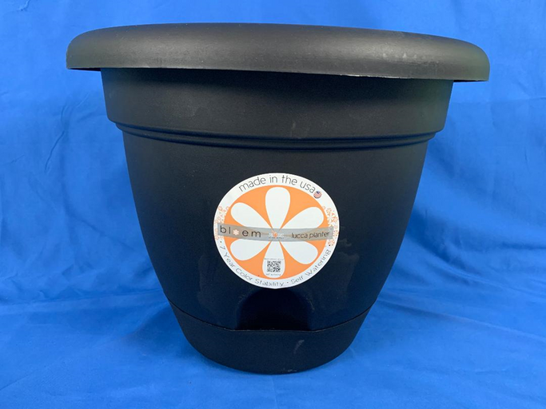
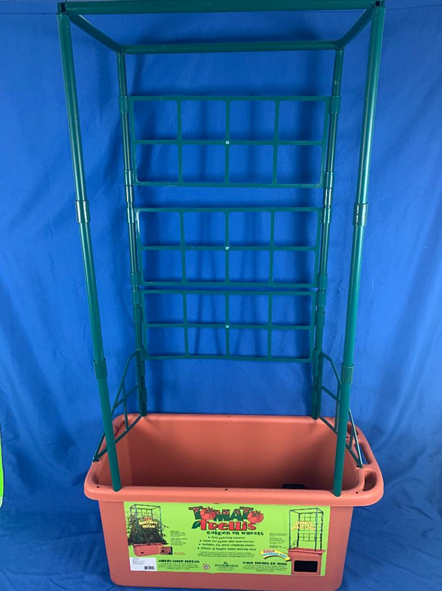
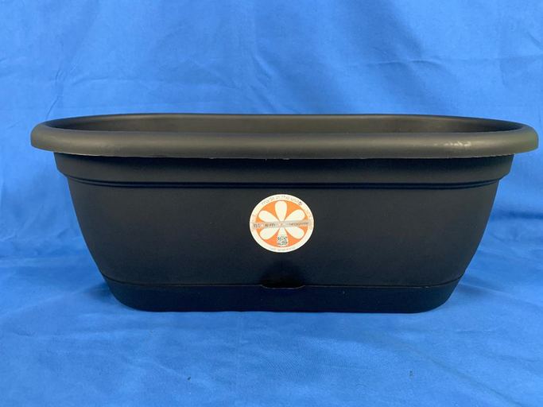
Growing root plants, tomatoes, peppers, spinach, kale, and cucumbers!
Tomato Trellis from Hydrofarm
Lucca containers from Bloem
Notes:
1. We call the method to grow these items Passive Hydroponics in Self-Watering Containers.
2. Here are some examples of the containers.
3. Nutrient water is added to these containers into the reservoir at the bottom.

Slide 26
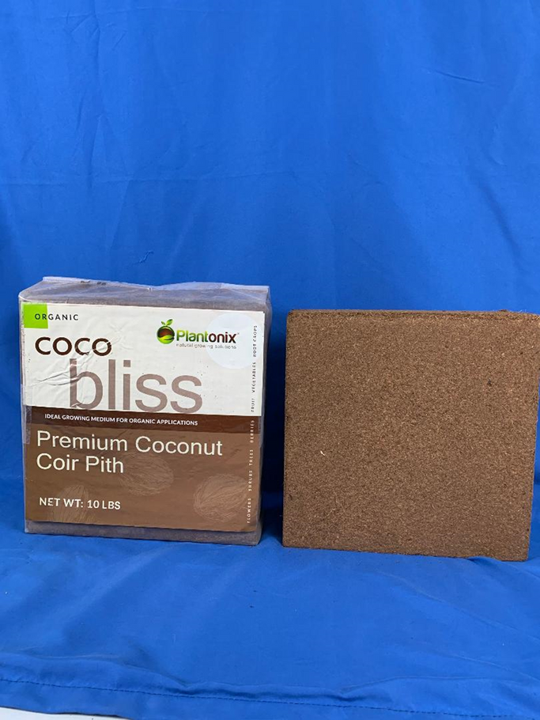
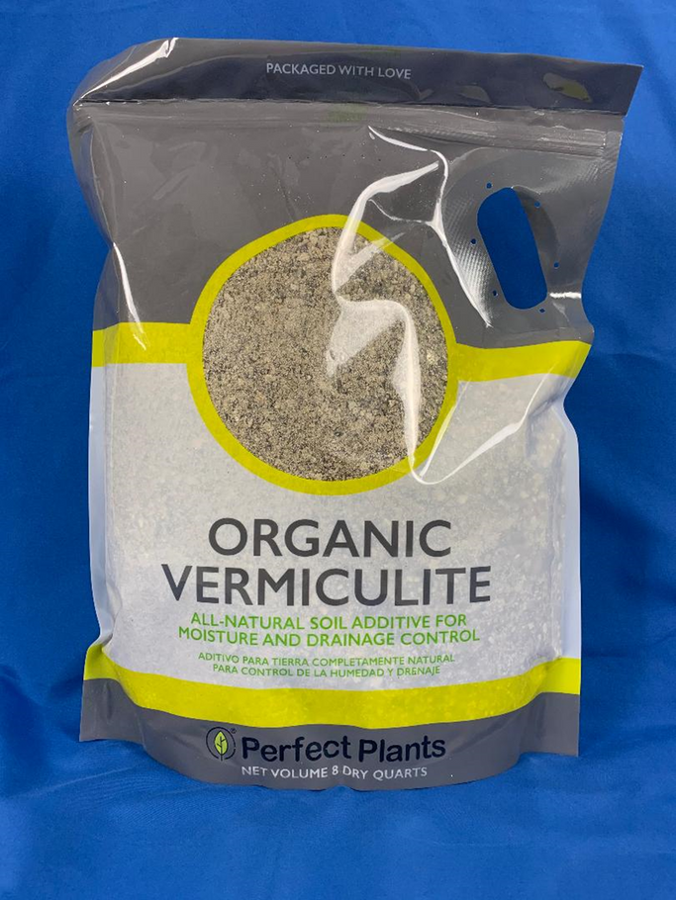
Grow media for self-watering containers
Use a mix of 70% Coco Coir and 30% Vermiculite for self-watering containers.
www.happyleafled.com
Notes:
1. Use a mix of 70% Coco Coir and 30% Vermiculite for self-watering containers.

Slide 27
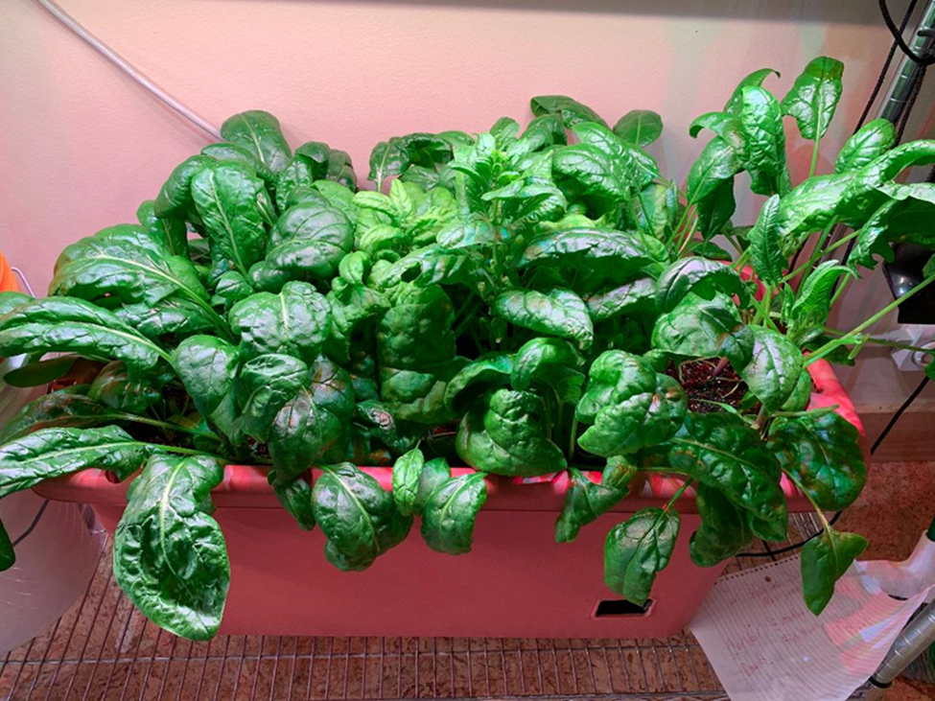

Harvests from self-watering containers
Spinach
www.happyleafled.com
Notes:
1. Spinach grown in a Tomato Trellis container and our first harvest of Corvair spinach.

Slide 28
Harvests from self-watering containers
Beets
Carrots
Radishes
www.happyleafled.com

Slide 29


Harvests from self-watering containers
Poblano Peppers
Kosara Hybrid Cucumber from Totally Tomatoes
www.happyleafled.com

Slide 30


Harvests from self-watering containers
Tomato Options for Indoor Gardening:
Little Red Robin (Totally Tomatoes -These are grown on the Space Station)
Tiny Tim (RDR Seeds)
Sweet N Neat (Totally Tomatoes)
www.happyleafled.com

Slide 31


An indoor garden In your home
www.happyleafled.com
Notes:
1. You only need a 2x4 foot space in your home.
2. This is a bakers rack at the Ogle County Health Department in Illinois.
3. Racks can be purchased on Amazon for about $100)
4. Three of the selves are spaced 16 inches apart for growing microgreens.
5. One of the shelves is spaced 22 inches up to grow lettuce and herbs.
6. The Procyon 2.0 looks like a 3000K light so they can be used to light your kitchen or living room.
7. To the right is the lettuce 4 weeks later.

Slide 32

All three grow methods
require effective light
Plant on left grown under shop light (48w)
Plant on right grown under Happy Leaf Procyon 2.0 (46W)
(4 weeks of growth)
South-facing windows and shop lights will not produce the results we are talking about
Notes:
LED shop lights and white LED Grow Lights are not options for growing to maturity
The lettuce on the left is grown under a 48 W shop light.
The lettuce on the left is grown under a 46 W Procyon 2.0 light in 4 weeks.

Slide 33

www.happyleafled.com
Notes:
1. Three Factors that are Most Important in a High-Quality Grow Light:
2. How much useful light does the fixture emit? (PAR-Photosynthetically Active Radiation- Energy)
3. What is the quality/spectrum/color of the light? (Research done by universities.)
4. What is the efficacy/efficiency of the light? (How much PAR energy per watt?)

Slide 34

Plants “see” light differently than we do!
PAR
(Plants)
Lumens
(Humans)
www.happyleafled.com
Notes:
1. Lumens are a measure of brightness of light for human eyes but as you can see above, measuring light in Lumens does not include the light colors (Red and Blue) that the plants need the most.
2. A measure of PAR energy includes all of the useful light so if you see a Grow Light that even mentions Lumens as a level of brightness, stay away from it.

Slide 35

The PAR energy plants need to grow
www.happyleafled.com
Notes:
The level of PAR energy needed by the plants at their various stages of growth varies.
This topic requires more detail and is discussed in much more detail in Chapter 7.

Slide 36

Why spectrum or the ratio of red to blue to green light is so important for robust plant growth
Typical White LED
Optimal
www.happyleafled.com
Notes:
1. This figure was published by Prof. Erik Runkle’s research team at Michigan State.
2. All of these plants were grown under the same intensity of PAR energy but they are all different.
3. The optimal spectrum is about 70% Red, 20% Green, and 10% Blue light.

Slide 37


Look for a spectral graph that includes 60 to 70% red light!
This is a Typical Spectrum used by most low cost LED grow lights. This is called a phosphor converted white spectrum with a ratio of RGB in the 25%:50%:25% range.
This is the Optimal Spectrum shown on the previous slide. This spectrum will produce 2.5 times bigger plants than a typical spectrum like the one shown on the right for the same amount of energy. The optimal ratio of Red to Green to Blue (RGB) is 70%:20%:10%.
Notes:
The optimal spectrum shown on the right was determined by professors at Purdue and MI State
Plants grown under this spectrum will be bigger, healthier, and more nutritious.
The spectrum on the left uses white LEDs which are not a good option for plant growth.

Slide 38

Grow light efficiency
www.happyleafled.com
Notes:
Efficiency is very important for commercial growers because energy costs are high.
May not be as important for home growers unless you are off the grid.
A good efficiency/efficacy is 2.5 micromoles of photons per Joule or higher.
Keep this in mind if you plan to become a commercial grower
We are currently developing a pulsed LED light than can reduce energy use by 25%

Slide 39

Minimum requirement
specs and features of an effective grow light
  PAR Reading = >200 PPFD
  Blue light of 10-15%
  Spectral graph includes 60- 70% red light
  Minimize energy use
  PAR map- how much area
  Accessible customer service
  5 year warranty
www.happyleafled.com
Notes:
An effective grow light will make a difference in how quickly your plants grow, how large they grow, and their nutritional content.

Slide 40

How to select the right grow light for indoor gardening
www.happyleafled.com
Notes:
You would like to be sure you are getting the latest technology for plant growth.
We have been in business 10 years and we are now shipping the 10th generation of lights.
Variety of options to support or hang the lights.
We have eyebolts that allow you to hang it almost anywhere.
You would like to be able to grow anything from microgreens to tomatoes with your light. (We show you how this can be done and will ensure you are successful.)
You would like for your light to be designed and manufactured in the US. (We design and build our lights in Northern Illinois. We do import the power supply but that is because no one in the US makes them.)

Slide 41

Seed starting is a super-power for sustainable living
  Big Money Savings!
  More control over timing and availability of plants
www.happyleafled.com
Notes:
You can grow what you want quickly and very affordably
Buy the seeds for the type of plants you enjoy eating and store them in a cool dry area
Many types of seeds will last for years when properly stored

Slide 42

Quality lighting makes a big difference
Quality lighting can make a big difference for seed starting
  Faster growth
  Healthier plants
www.happyleafled.com
Notes:
1. Yes, some folks are able to get seeds started in a south-facing window
2. In the Winter and early spring the days are too short and cloudy
3. Giving plants optimal light is the game changer for healthy seedlings.

Slide 43

Start saying good-bye to fluorescents
Contain mercury - disposal issues
Very limited capabilities
They need to placed close to the plants
www.happyleafled.com
Notes:
1. Fluorescents have very limited capabilities for growing plants.
2. They typically only reach a PAR level around 100.
3. You have to keep the light very close to the plant to keep them from getting leggy.
4. Contain Mercury
5. 3-4 times less efficient than high quality LEDs
6. Cannot tune the light to optimal colors for plant growth

Slide 44
Seed sources/storing seeds
Store in paper envelopes.
Room temperature and/or in a refrigerator is optimal. Heat will permanently dry out seeds
Protect seeds from humidity!
Jung Seeds/Totally Tomatoes (WI)
Seed Savers Exchange (IA)
Johnny’s Seeds (ME)
Baker Creek Seeds (MO)
NE Seed (CT)
www.happyleafled.com
Notes:
1. There are numerous sources to buy seeds from. Here a few that we purchase seeds from regularly.
2. We recently learned about Row 7 Seeds, and are eager to start experimenting with their varieties.
3. We know one of the original founders of this company and trust the quality of what they offer.
4. We keep our seeds in a refrigerator and find many of them germinate many years later.
5. Baker Creed Heirloom Seed Company suggests making sure the humidity percentage plus the temperature of a specific spot doesn't exceed 100.

Slide 45

Read your seed packets!
Notes:
Yes, the type is often pretty small, but the details on a seed package are well worth your attention for successful production.

Slide 46



Media options/nutrients
This organic seed starter potting mix includes nutrients and is sterilized.
Coco coir and vermiculite does not have nutrients, so they need to be added. But this mixture is safe in terms of sterilization
Notes:
1. Beyond potting mixes or seed starting mixes, there are other options such as coco coir and vermiculite, peat moss or peat pellets.
2. It is critical to be aware of what level of nutrition the media offers for your seeds.
3. When using potting soil and seed starting mixes, make sure they are sterile to prevent bugs
4. Nutrients are not needed for germination, but after germination, young plants need nutrients
5. We prefer a coco coir and vermiculite and we water with the same nutrient mix that we use for the other methods we discussed

Slide 47

Moisture/watering
Humidity domes can be used to improve germination.
www.happyleafled.com
Notes:
1. Humidity domes are useful, but not mandatory.
2. Be sure to remove the dome after germination
3. Keeping the seed and plant moist but not oversaturated is a somewhat delicate balancing act.
4. I like to use a spray bottle to keep the soil moist from the top until seeds have germinated
5. The number one mistake people tend to make is over watering
6. Make sure the container you use for seed starting has good drainage
7. Place the container on a boot tray to hold excess water away from the plant while also keeping the soil most from the bottom

Slide 48

Moisture
Over-watering
Beware of “Damping off”
www.happyleafled.com
Notes:
1. Damping off is a term for the sudden death of a new plant caused by a handful of fungal diseases
2. Mold can cause damping off so be sure to sanitize your planting area
3. Prevent damping off by allowing the grow medium to dry out between watering
4. A non-toxic biological fungicide can help protect seedlings

Slide 49

Temperature/Humidity
Lettuce will germinate at 40 F
Carrots prefer 55 - 65 F
Tomatoes and peppers like 70 F
Eggplants require 80 - 90 F
The ideal humidity range is between 40 and 60% AFTER germination.
www.happyleafled.com
Notes:
1. Different seeds/plants will germinate at different temperatures.

Slide 50

Heat Mats for Tomatoes, Peppers, and Eggplant
70 - 80 F is ideal for seed starting
Lower than 70 F will need a heat mat.
www.happyleafled.com
Notes:
1. Heat mats can be used to germinate plants like tomatoes, peppers, and eggplant that require temperatures above 70 F

Slide 51

When to start seeds?
Seed packets typically estimate timing based on using fluorescent lighting.
High quality LEDs will shorten the time- period needed to start plants by several weeks.
www.happyleafled.com
Notes:
1. Look at the last frost date in your area. For Northern Illinois, it is right around May 15th.
2. Note that the information on seed packets is typically based on using fluorescent light,
3. If you are using Happy Leaf lighting, you will need to shorten your timeframe.
4. With a Happy Leaf Procyon 2.0, you can start about 5 weeks before the last frost date.

Slide 52
Summary
You can grow your own food at home all year long!
Simple passive hydroponic methods make it easy and fun!
We guarantee anyone who wants to, can enjoy fresh veggies grown at home!
The key is high quality LED lighting!
The initial investment is very reasonable for a lifetime of “Food and Fun”
www.happyleafled.com
Notes:
1. You can grow your own food at home cost effectively if you have the right methods and grow lights!
2. Simple passive hydroponic methods that allow you to grow microgreens, leafy greens, herbs, spinach, kale, and root plants at home.
3. We guarantee anyone can grow their own food at home.
4. The initial cost is reasonable and the payback is very fast.
5. Visit our YouTube channel at HappyLeafLED for How to Videos.
6. Visit our website at www.HappyLeafLED.com and follow us.
7. Follow us on Facebook at HappyLeafLED

Slide 53

Questions
www.happyleafled.com
Notes:
1. You can grow your own food at home cost effectively if you have the right methods and grow lights!
2. Simple passive hydroponic methods that allow you to grow microgreens, leafy greens, herbs, spinach, kale, and root plants at home.
3. We guarantee anyone can grow their own food at home.
4. The initial cost is reasonable and the payback is very fast.
5. Visit our YouTube channel at HappyLeafLED for How to Videos.
6. Visit our website at www.HappyLeafLED.com and follow us.
7. Follow us on Facebook at HappyLeafLED

Slide 54
www.happyleafled.com
Thank You!
Victor Zaderej, Happy Leaf LED
zaderej@alum.mit.edu
hello@happyleafled.com

