Slide 1
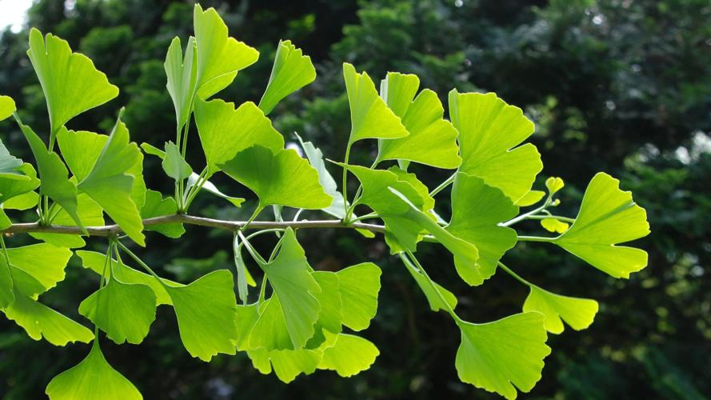
I’m Cutting You Off!
Plant Pruning Basics
Cora Borgens
Notes:
Hello all and welcome to “I’m Cutting You Off! Plant Pruning Basics” We will cover a lot today, but please don’t be overwhelmed, (one of these / this session) will be recorded, so you will get a chance to go back and look at it afterward. Please hold all questions until the end, I’ll leave as much time as I can to go over them, or I will be available after the presentation as well.

Slide 2

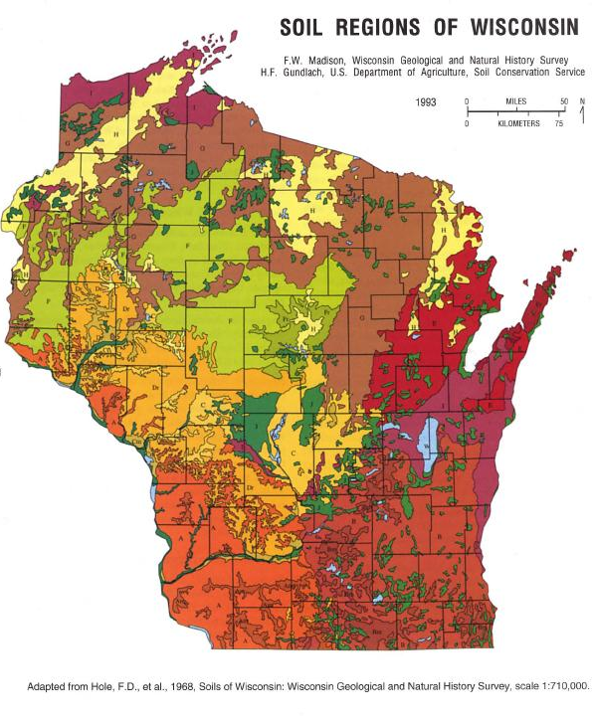


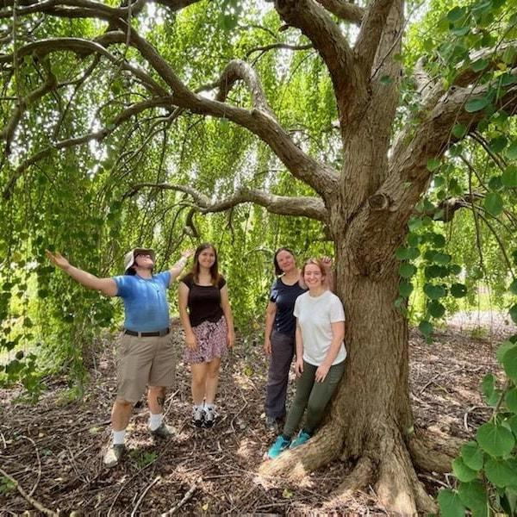
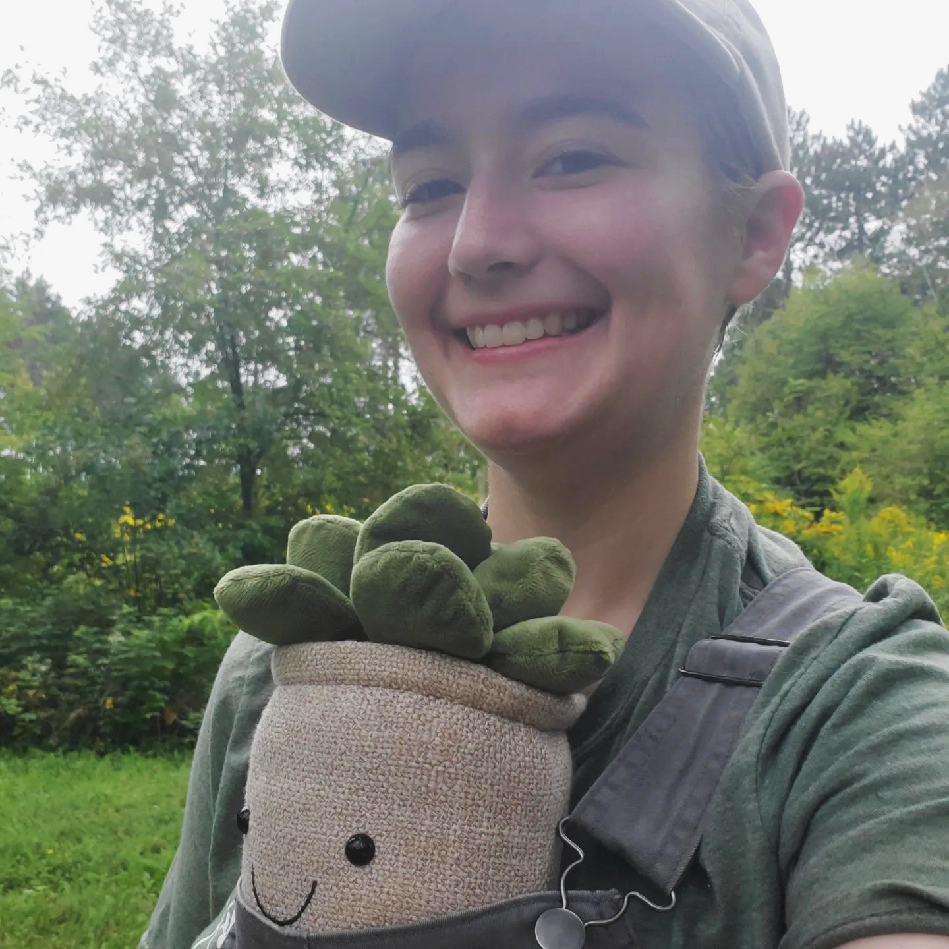


About Me…
Notes:
To start us off, Hi! My name is Cora, and I graduated from Washington State University with a degree in Integrated Plant Sciences, and I have to give kudos to my professor and school mom, Carol Kawula, whose teachings were the foundation for this presentation.
While in school, I also had the opportunity to intern at the Sarah P. Duke gardens in Durham, North Carolina which solidified my desire to work in botanic gardens, specifically.
My first job out of college brought me to Wisconsin and almost didn’t keep me here, but I found such an amazing community I couldn’t bring myself to leave.
I currently work in the medical field, but am working on the side in science communication and freelance horticulture. I’m a cat mom to two furry scoundrels and knit prolifically in every minute of my spare time.

Slide 3
Outline
Why Pruning
Pruning Equipment
Plant Anatomy
Tree Injury & Compartmentalization
Pruning Cuts
Plant Growth Patterns & Pruning
Pruning Conifers
Practice example & Questions
Notes:
Some topics we will cover today;
Why pruning matters
Different types of pruning equipment and basic info about when to use them
Plant anatomy- We’ll look into how plants grow so we can best understand how to prune them
Tree injury and compartmentalization- another facet of plant anatomy that gets its own section due to how important it is
How exactly to make your pruning cuts
Plant growth types and pruning- because how the plant grows will affect how you want to prune it
And finally, a short section on pruning conifers, because they can be a little more tricky to prune nicely

Slide 4
WHY PRUNING?
Pruning. Def. The removal or reduction of parts of a plant for a variety of reasons
Notes:
Starting off our first section: why pruning?
The definition of pruning is the removal or reduction of parts of a plant for a variety of reasons

Slide 5
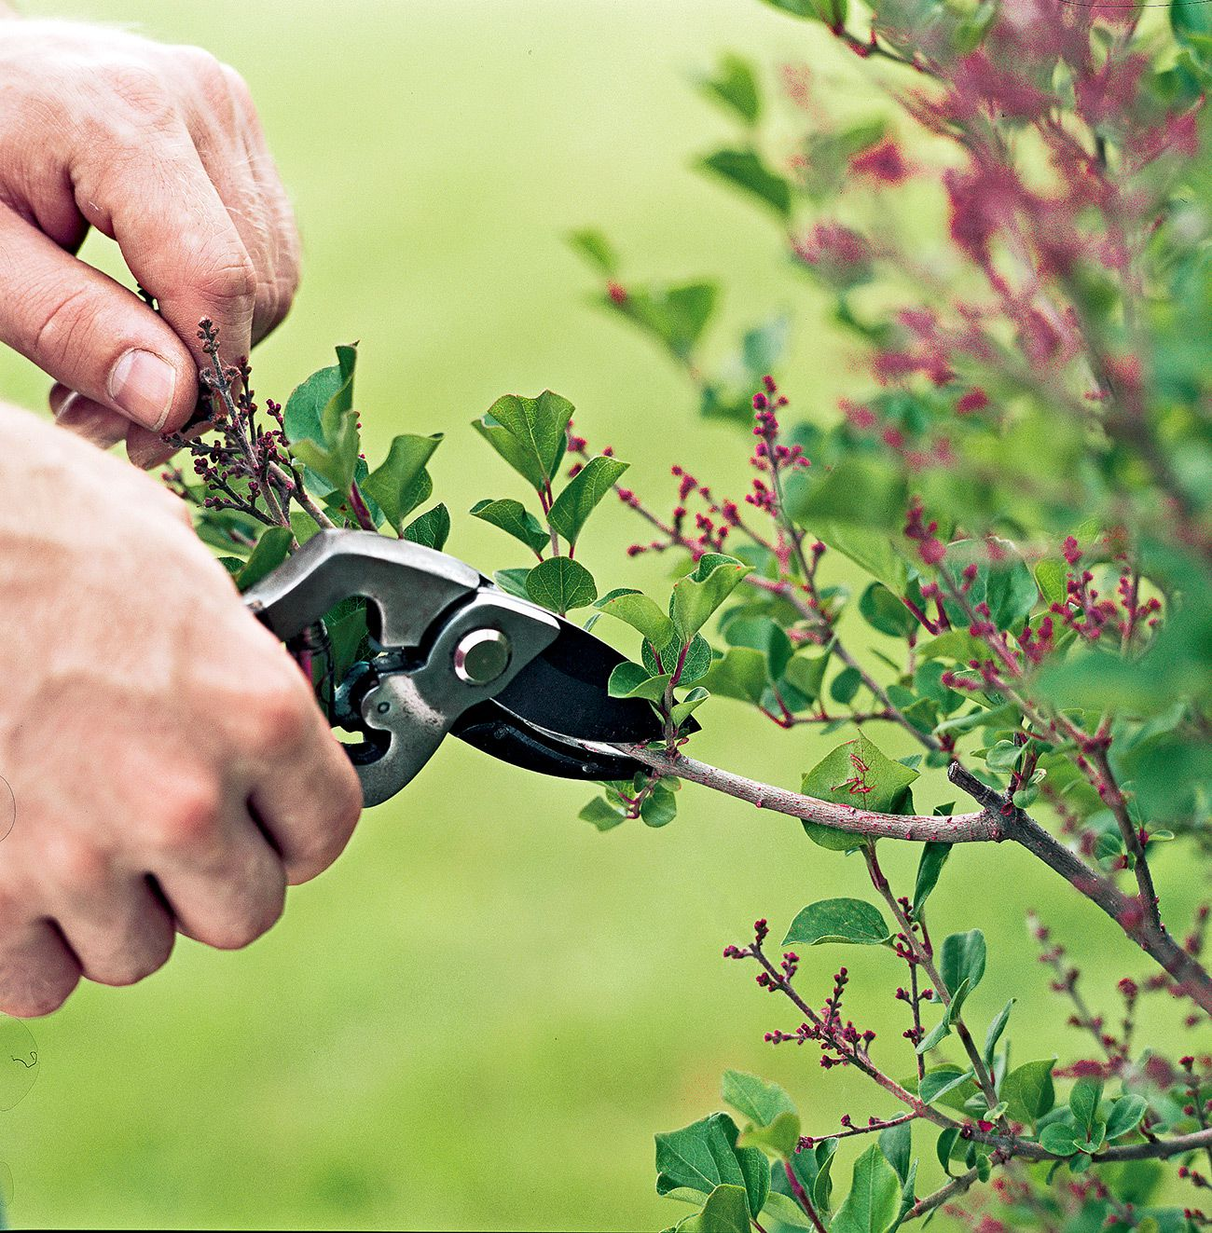
Why Prune?
WHY PRUNING?
Size / Form
Notes:
Pruning to enhance or restrict size or form

Slide 6
Why Prune?
WHY PRUNING?
Size / Form
Health / Rejuvenation
Notes:
Pruning to prolong future health of a plant or to renovate old plant growth

Slide 7
Why Prune?
WHY PRUNING?
Size / Form
Health / Rejuvenation
Training
Notes:
Pruning to train a plant (usually trees) for future growth

Slide 8
Why Prune?
WHY PRUNING?
Size / Form
Health / Rejuvenation
Training
Flowering/Fruiting
Notes:
Pruning to enhance flowering or fruiting of a plant

Slide 9
Why Prune?
WHY PRUNING?
Size / Form
Health / Rejuvenation
Training
Flowering/Fruiting
Safety
Notes:
Pruning to ensure safety in the landscape

Slide 10
Why Prune?
WHY PRUNING?
Size / Form
Health / Rejuvenation
Training
Flowering/Fruiting
Safety
Purpose
Notes:
Pruning to help a plant serve a specific purpose in the landscape (shade, privacy, air flow)

Slide 11
Why Prune?
WHY PRUNING?
Desired Pruning outcome with most Landscape plants :
For a plant to NOT look like someone touched it!
Notes:
The desired outcome for most landscape plants is to have the plant NOT look like you touched it at all

Slide 12
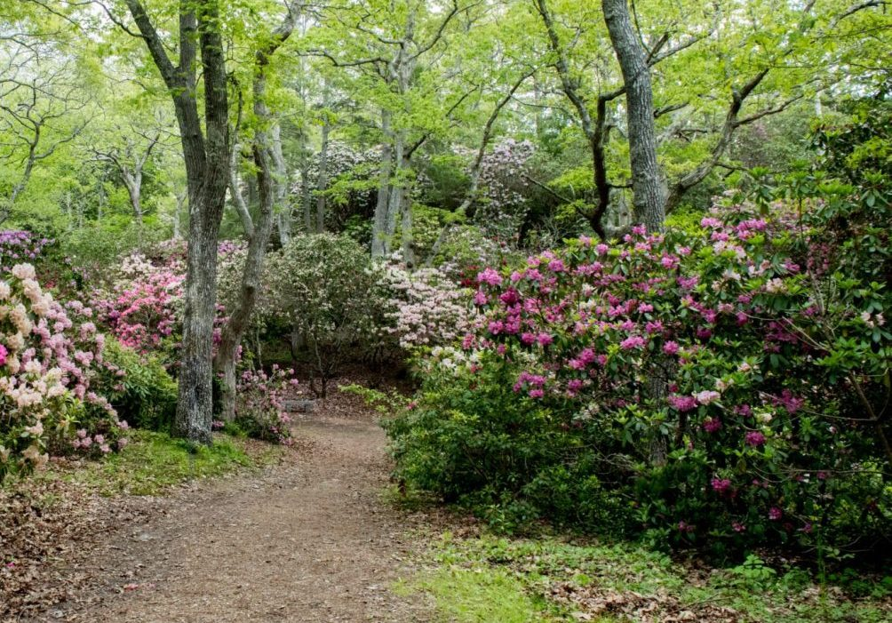
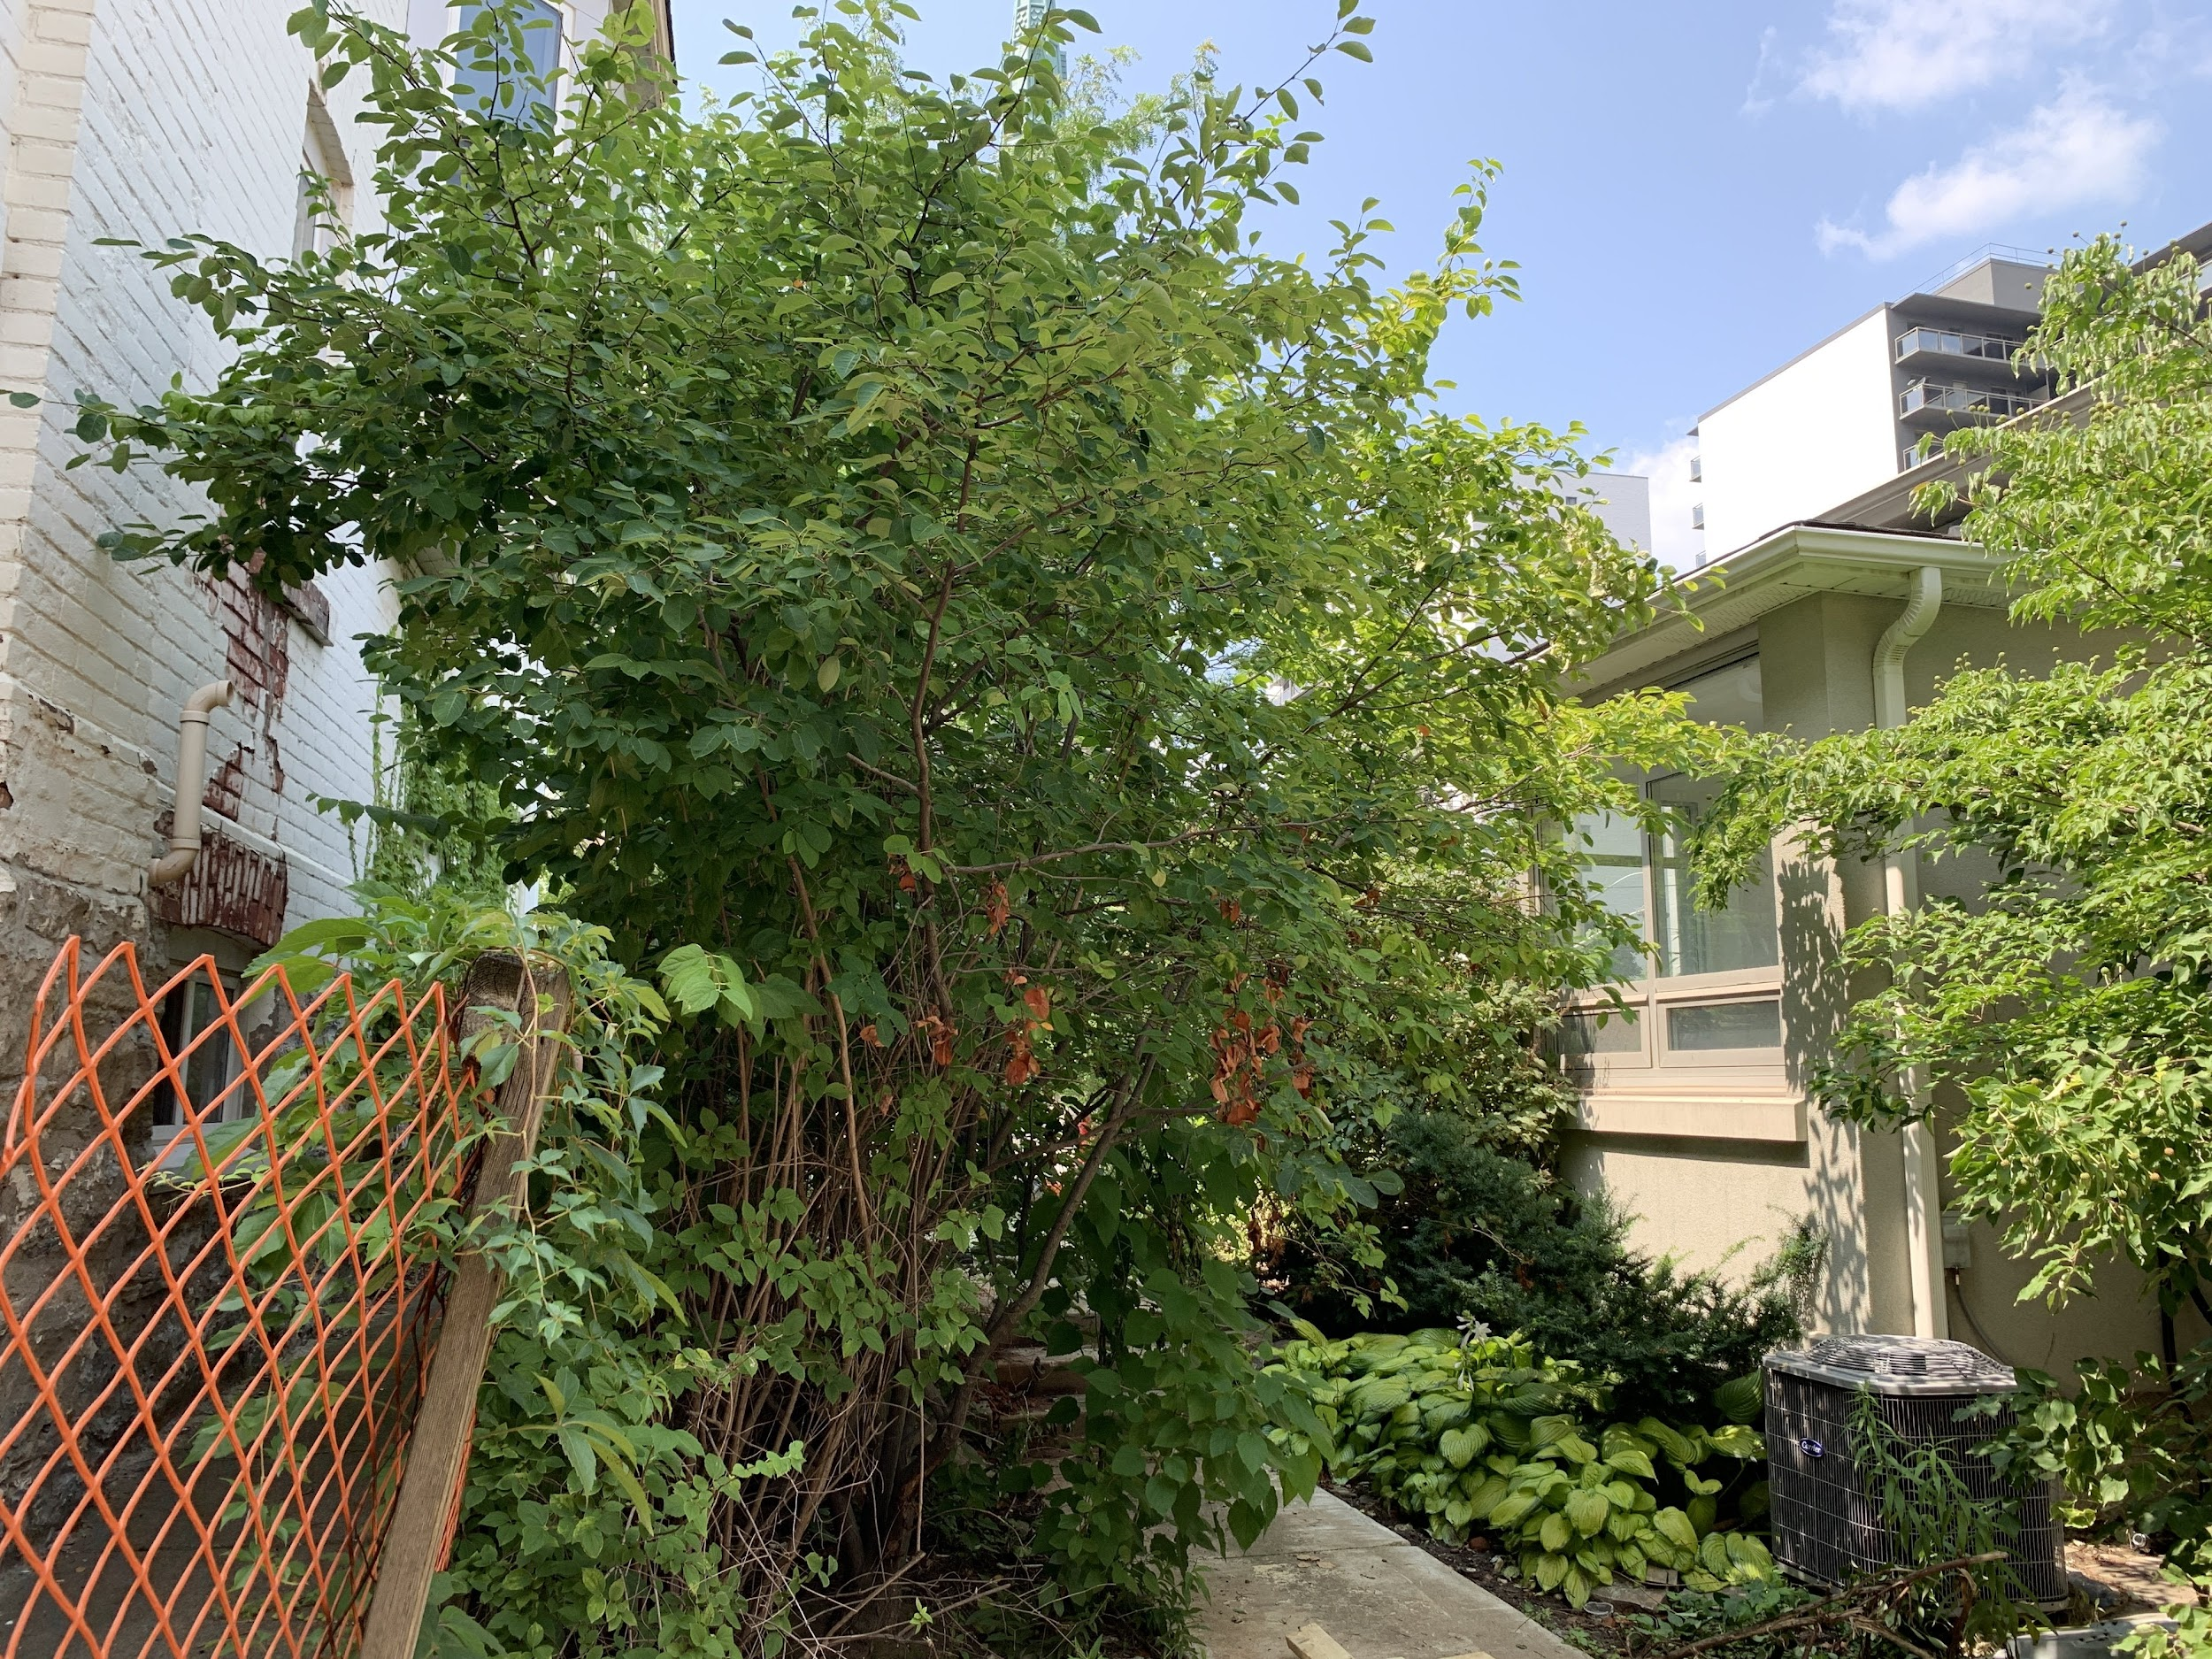
“Right Plant in the Right Place”
WHY PRUNING?
Design goal: Maximum plant size to fit desired volume
Notes:
Another goal for landscape plants is to initially plant the right plant in the right space- so that the maximum plant size fits in the desired volume, however, pruning can help us to contain plants to a size appropriate to their situation.
For example, on the left, the shrubs look to be fully grown and yet are not overgrowing the path. On the right is an example where the shrub has gotten too large and is encroaching the walkway, and now becomes a hazard to your eyeballs.

Slide 13
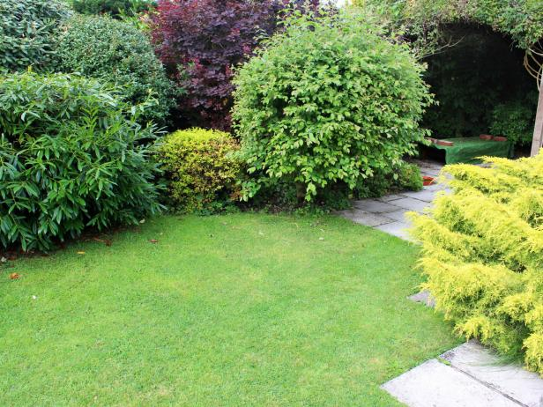
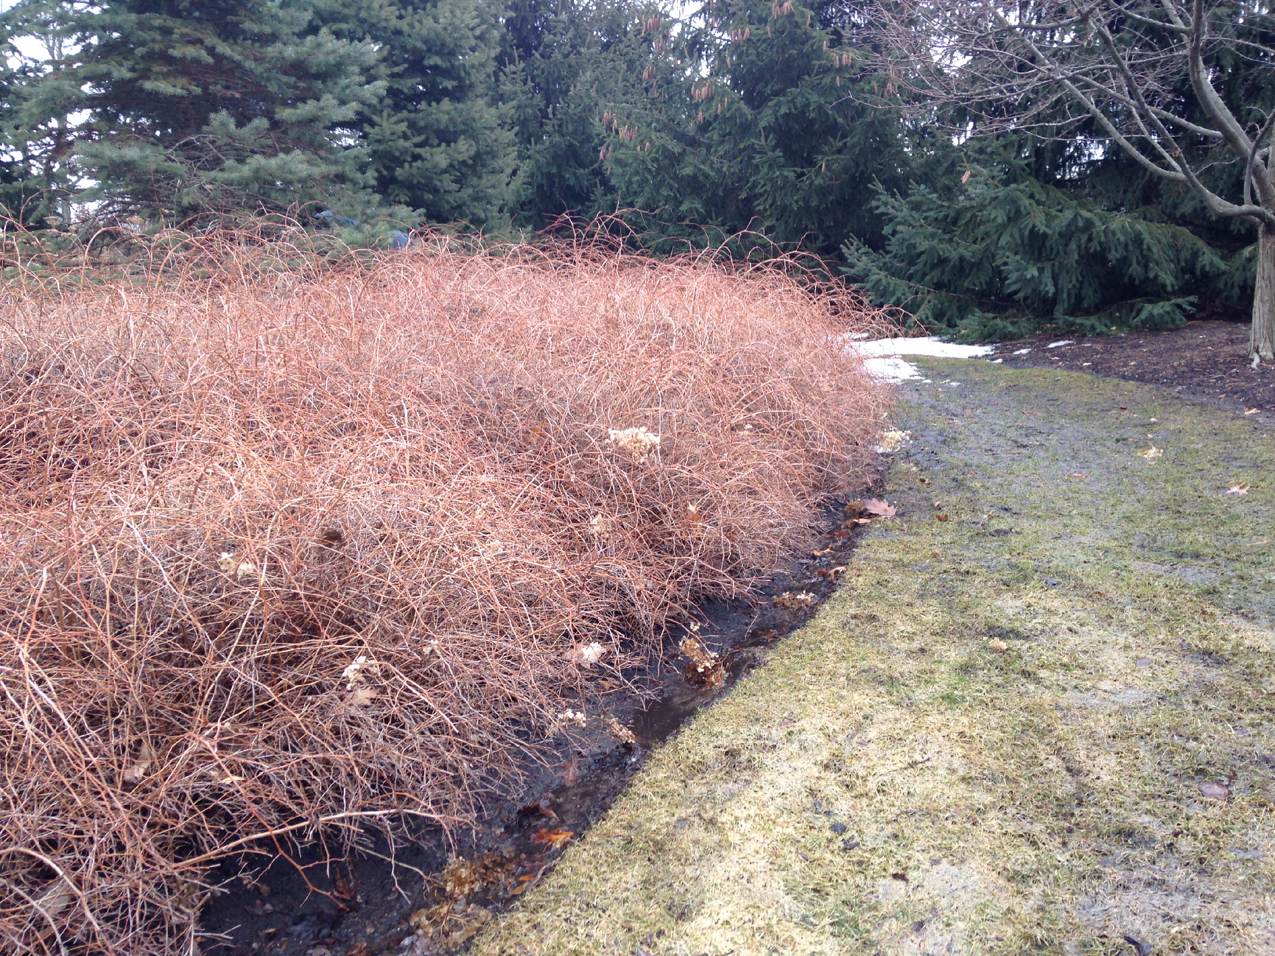
Pruning can be done when plants are actively growing or dormant
WHY PRUNING?
Notes:
Pruning can occur when plants are actively growing, or when a plant is dormant. Some plants react better to pruning while dormant, and others, while actively growing.

Slide 14
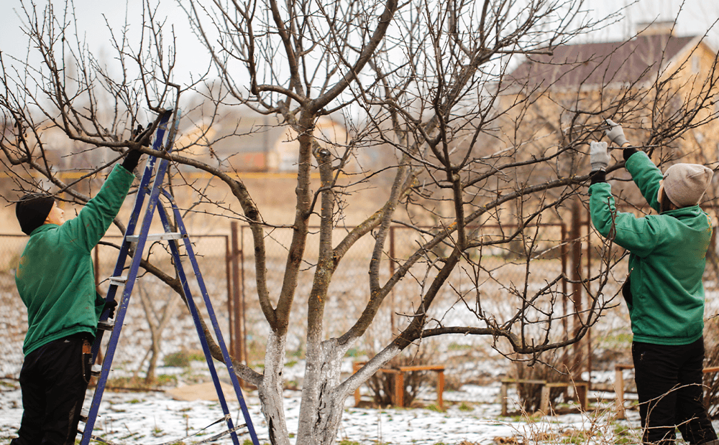
Winter Pruning:
WHY PRUNING?
Dormant Season
Benefits:
Rapid wound closing
Easy to see issues
Less busy
Notes:
Pruning in the dormant season has some benefits; pruning in late winter or early spring means the plant is usually ‘geared up’ to start growing soon anyway, and will seal off wounds as soon as it starts pushing out new material.
Wintertime often means a lot less leaves for deciduous plants, which makes it really easy to see branch structures and any problems that might be hidden when the plant is fully leafed-out
And finally, winter is usually less busy, for you and landscaping professionals (though many here switch to snow removal in the winter months). Regardless, this makes it a good time to take a look at what pruning needs your plants might have

Slide 15
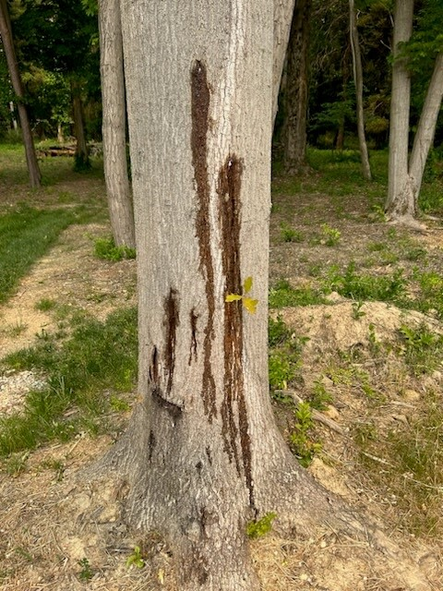
Winter Pruning:
WHY PRUNING?
Things to Watch For:
Don’t prune if temperatures are below freezing
Prune “bleeders” in summer months
Notes:
Things to watch out for with winter pruning; you want to make sure you’re not pruning if temperatures are below freezing- this could cause damage to plant tissues, making it harder for the plant to recover
Some plants are known as ‘bleeders’- and sap will leak out of a pruning cut after it is made. Not to worry though, this does not harm the plant, it just looks kind of unsettling.
Examples of trees that are bleeders include birch, elm, dogwood, walnuts, and maples! Maples are where we get maple syrup. We collect maple syrup in early spring when the sap starts flowing. Ergo, if you prune a maple at this time, it might start “bleeding”!

Slide 16
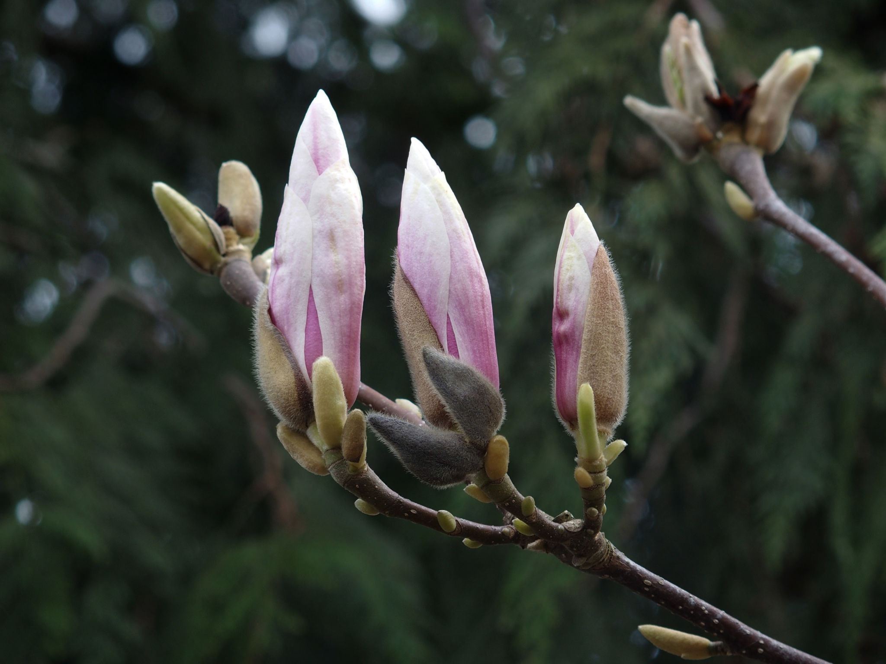
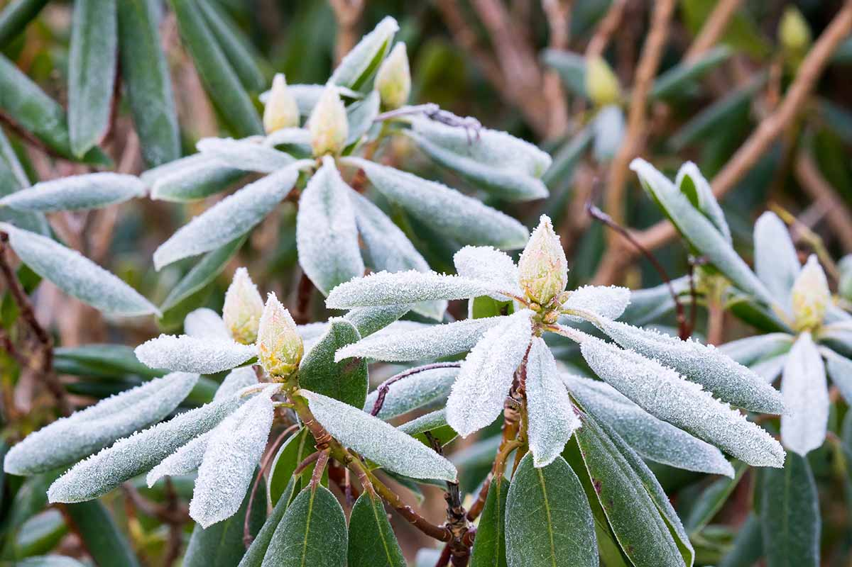
Winter Pruning:
WHY PRUNING?
Things to Watch For: Early Spring Bloomers/ Fruiting plants
Notes:
Another thing to watch out for is your early spring bloomers; things like lilacs, some hydrangeas, crab apple, magnolias, and rhododendrons/azaleas
These plants set their buds at the END of the growing season, and the buds sit dormant all winter. If you prune these plants in the winter, you will remove these early buds and miss out on your beautiful flowers.
Thus, you want to wait to prune these plants until AFTER they are done blooming
The same goes for any plant you want to harvest fruit from- fruit comes from flowers, so don’t remove the flowers early if you want to harvest fruit

Slide 17
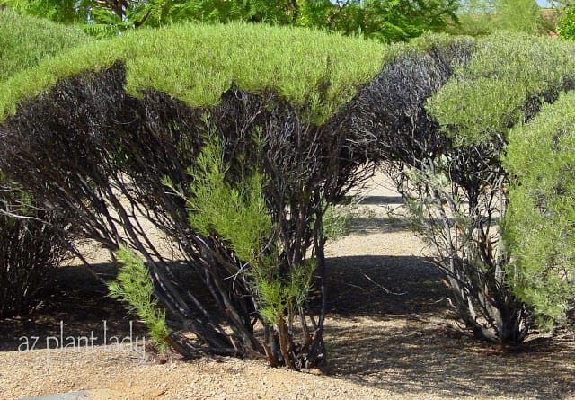
Pruning & Landscape Management
WHY PRUNING?
Pruning is the most frequently misunderstood practice
Notes:
Pruning is the most commonly misunderstood practice for landscape management.

Slide 18
Pruning & Landscape Management
WHY PRUNING?
Pruning is the most frequently misunderstood practice
Requires an understanding of:
Natural habit
Biology
Function in the landscape
Notes:
You have to have knowledge of a plant’s natural habit- how the plant naturally wants to grow and spread- it’s easier to ‘go with the flow’ than to fight it into the shape you want
As we saw in the last slide, you need to know the biology of the plant, when it blooms and sets fruit and how buds are arranged on the stems, which we will go over a little later in the presentation.
Finally, you need to understand what role a plant is playing in the environment; is it a privacy screen? Then you don’t want to prune too aggressively; you want nice, dense growth. Is it a specimen plant? Then you want to prune it to show off it’s structure or flowers.

Slide 19
Pruning Equipment
Using the right tools to make the cut
Notes:
Moving on to Pruning Equipment- using the right tools to make the cut

Slide 20
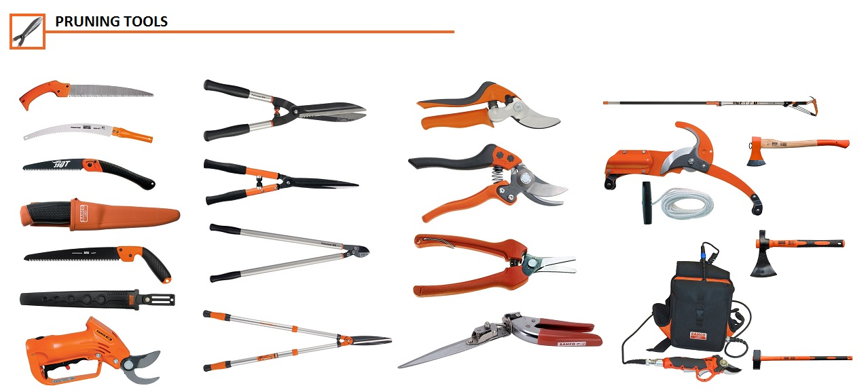
Pruning Equipment overview
Pruning Equipment
Important to have the proper equipment for the job
Buy the Best Equipment You can Afford/ Will Use
Notes:
A quick overview; It’s important to have the right tool for the job- this will reduce chances of injury to you OR the plant
You want to buy the best equipment that you can afford OR that you will reasonably use. Better quality means it will last you a long time (theoretically), but there’s no sense going out and buying an expensive piece of equipment for only one landscaping job. There are lots of tool rentals available for larger equipment through your local hardware stores.
For example, I really need to rip up my front yard and get some more organic matter in the soil, but I don’t anticipate having to do this more than once, so I’ll rent a tiller when I’m ready to tackle this project, rather than spending hundreds of dollars to buy the equipment.

Slide 21
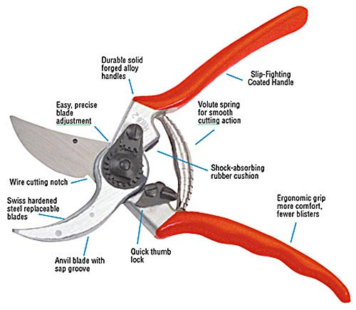
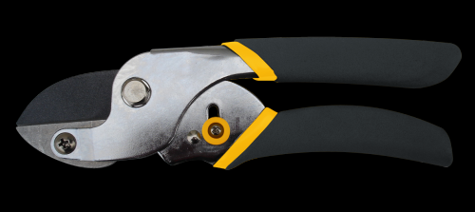
Hand Pruners/Shears/Clippers
Pruning Equipment
Most frequently used tool for annuals, perennials, small branches
Two types
Bypass
Anvil
Notes:
Your most common pruning tool is going to be your hand pruners/shears/clippers/whatever you want to call them. I would recommend buying a good-quality pair of these.
You use these to prune smaller-diameter branches and stems, anything larger means you’ll have a hard time making a clean cut OR you could risk damaging your pruners. Believe me, I have bent blades by not heeding this advice.
There are a couple different types of hand pruners, most commonly you’ll use bypass pruners which have an overlapping, scissor-like action to cleanly cut through live plant material.
The other type is an anvil, or snap-cut action, which is used for dead wood only, that is likely to ‘snap’ when you apply pressure.

Slide 22
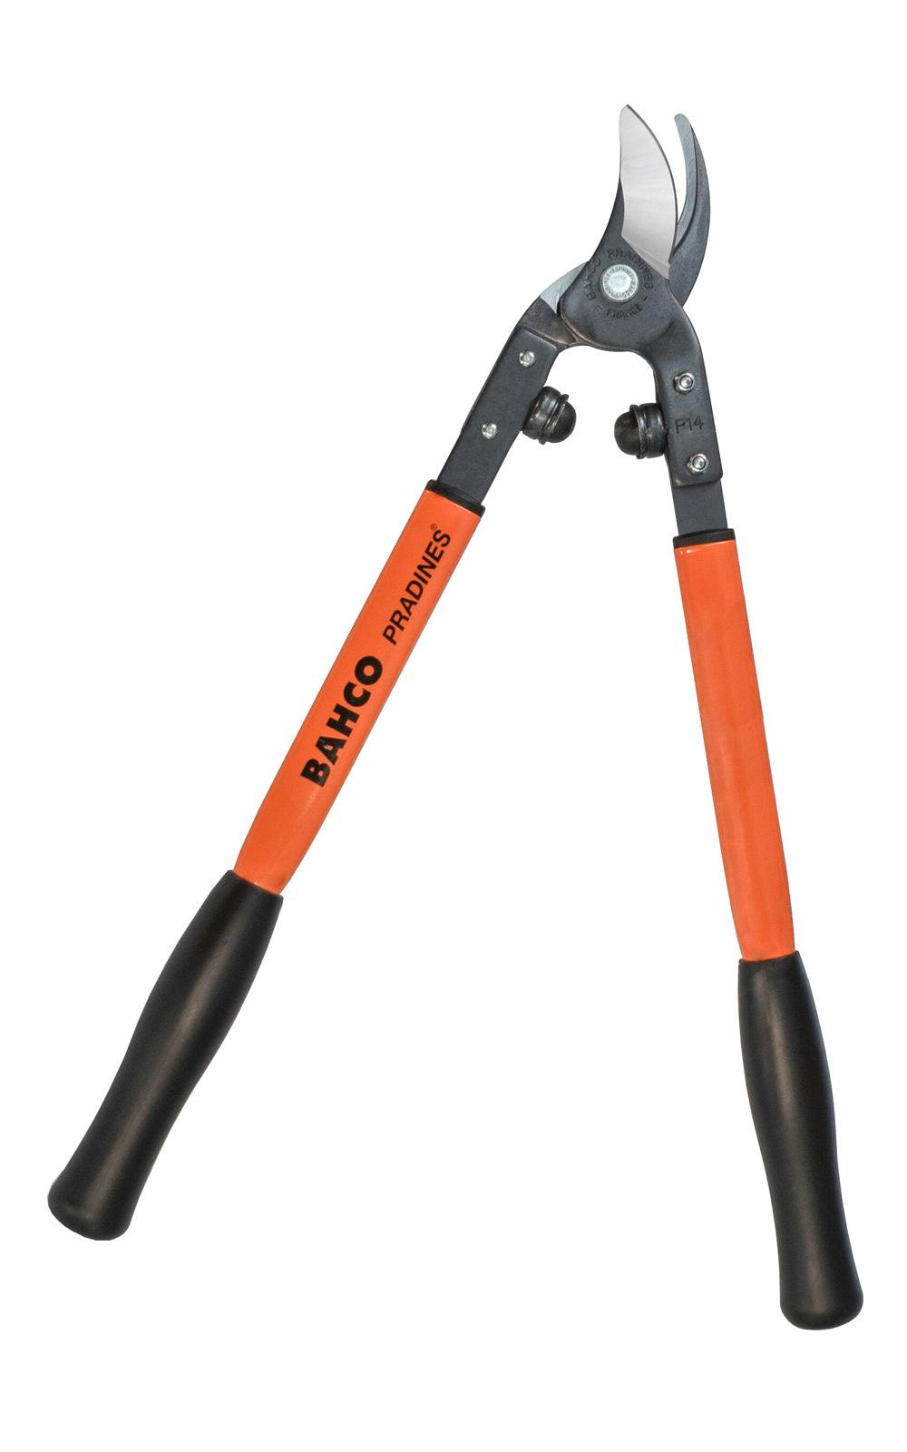
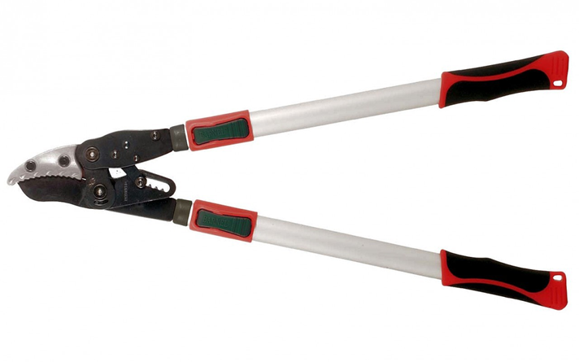
Loppers: (2 handed Pruners)
Pruning Equipment
Larger sized stems
Look for “bumpers”, cushioning mechanism near the blades
Look for a removable bolt so blade can be replaced
Also comes in Bypass, Anvil, or Ratchet
Notes:
Loppers are larger, two-handed pruners that allow you to cut larger branches/stems and give you a little more reach for branches above head, or deeper into a dense shrub.
You still want to be aware of blade size to make sure you are cutting stems that fit properly into those blades, allowing you to make a clean cut
It’s good to look for a pair that has ‘bumpers’ that allow for cushioning when making cuts (easier on the tool and your joints), and a removable bolt so you can replace the blades when needed.
These also come in bypass or anvil type, and sometimes ratchet, or gear-driven, which ‘snaps’ into place as you close the blades, allowing you to use less effort to cut larger branches.

Slide 23
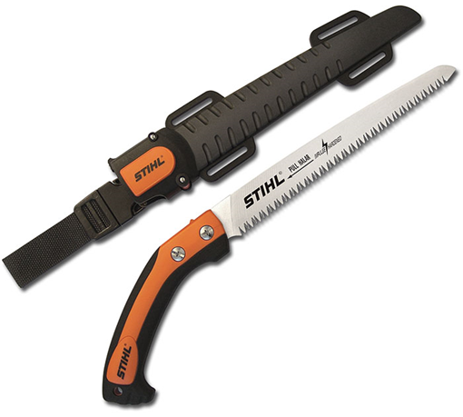
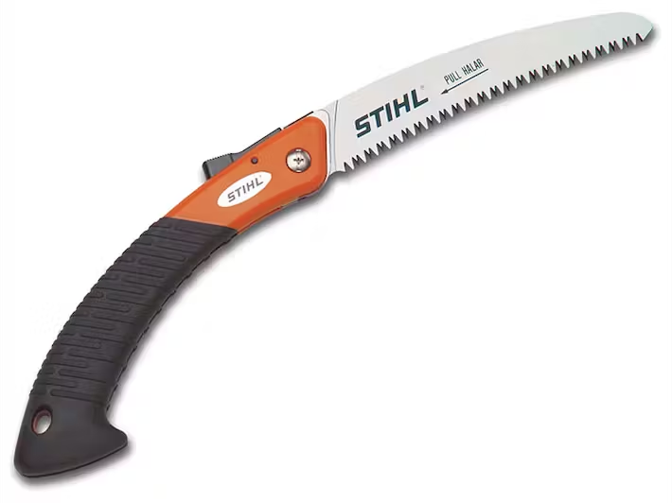
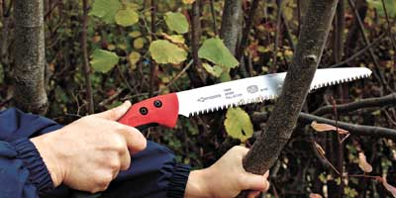
Hand Pruning Saws:
Pruning Equipment
Branches 2” diameter or more
Easy to maneuver in tight branch crotches
Come in static or foldable designs
Notes:
Hand pruning saws allow you to cut even larger branches, usually 2’’ diameter or more. They are easier to maneuver in tight branch crotches or in shrubs that have lots of large stems very close together.
Some blades have a curved design meant to cut on the ‘pull’ stroke
They come either as a static (non-foldable) blade, or a foldable design with a locking mechanism when it’s closed. Make sure this locking mechanism works, so you don’t cause injury. Again, I’m speaking from experience.

Slide 24
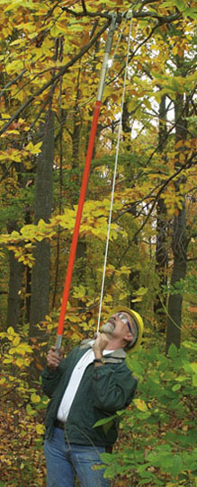
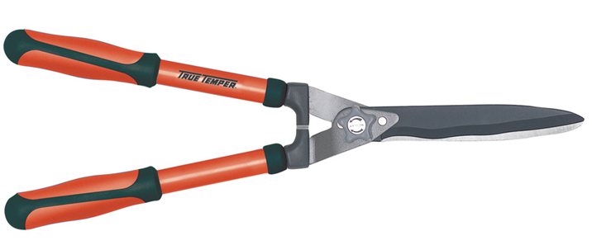
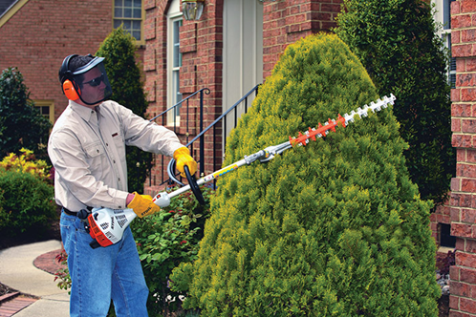
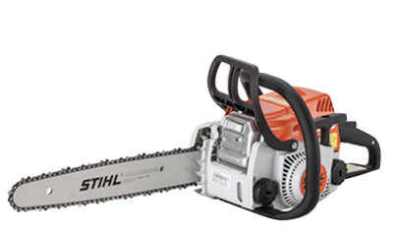
Other Tools…
Pruning Equipment
Hedge Trimmers
Pole Pruners
Chainsaws
Notes:
Other tools you might encounter include hedge trimmers, which are only meant for small stems at the tips of hedge-type shrubs. These can be hand-operated or powered.
Pole pruners allow for stems sizes 1.5-2” in diameter, similar to loppers, but are on much longer poles for reaching higher up into tree canopies. These can be hand operated with a pull rope, or powered.
Finally, the classic chainsaw. These are for 3” or larger diameter branches, and are most often used for large pruning jobs or the removal of entire trees/shrubs. Safety note: NEVER use a chainsaw while standing on a ladder, and if you own a chainsaw, consider buying a pair of chaps, protective pants to prevent serious injury to your legs

Slide 25
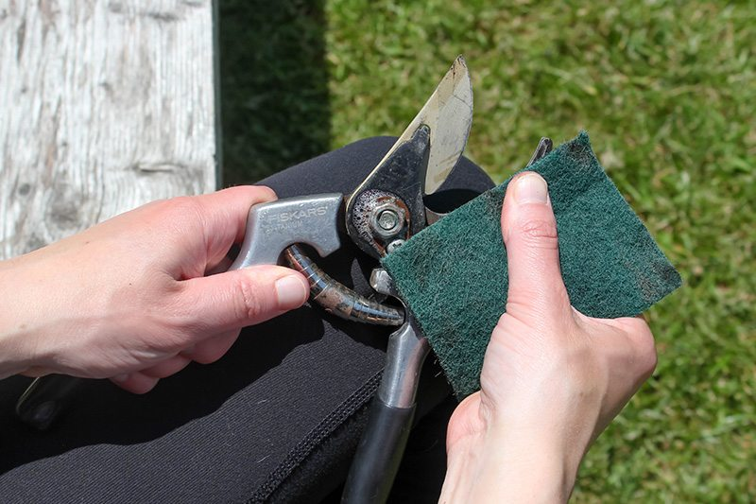
Caring for Pruning Equipment
Pruning Equipment
Maintain
Clean
Sharpen
Oil
Storage
Replace blades
Notes:
Maintenance is an important part of extending the life and efficacy of your tools.
Make sure to clean your tools after every pruning project, removing any dirt or sap that could gum up or dull the blades
Sharpen the blades when needed (usually once a season- winter is a GREAT time to do this)
Oil your blades as needed to make sure they open and close smoothly AND before you store them for the winter to prevent rusting
Always store in a dry location, again to avoid rusting
Replace your blades if they get any serious nicks or the blades become bent out of shape.

Slide 26
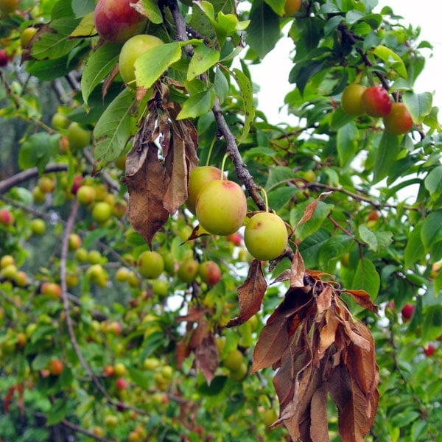
Caring for Pruning Equipment
Pruning Equipment
Sterilize
IF worried about disease transfer
Alcohol (90% Isopropyl) or bleach solution (10%)
If using bleach, rinse with water after sanitizing
Notes:
Sterilization is most likely not going to be an issue, as this is more common in agricultural or research practices, but can be useful if you have a disease concern with certain plants.
Bacterial or fungal diseases will often spread through plant tissues or saps, so you want to sterilize between EACH plant that may be a vector, or a source of disease transfer.
Strong isopropyl (rubbing) alcohol or a 10% bleach solution- that’s one part bleach to 9 parts water- is usually enough to kill anything that could transfer.
If using bleach, rinse your tools with regular water after, or the bleach will start to corrode the metal

Slide 27
Plant Anatomy
Understanding how plants grow helps you to prune properly
Notes:
Plant anatomy: understanding how plants grow will help you to prune them properly

Slide 28
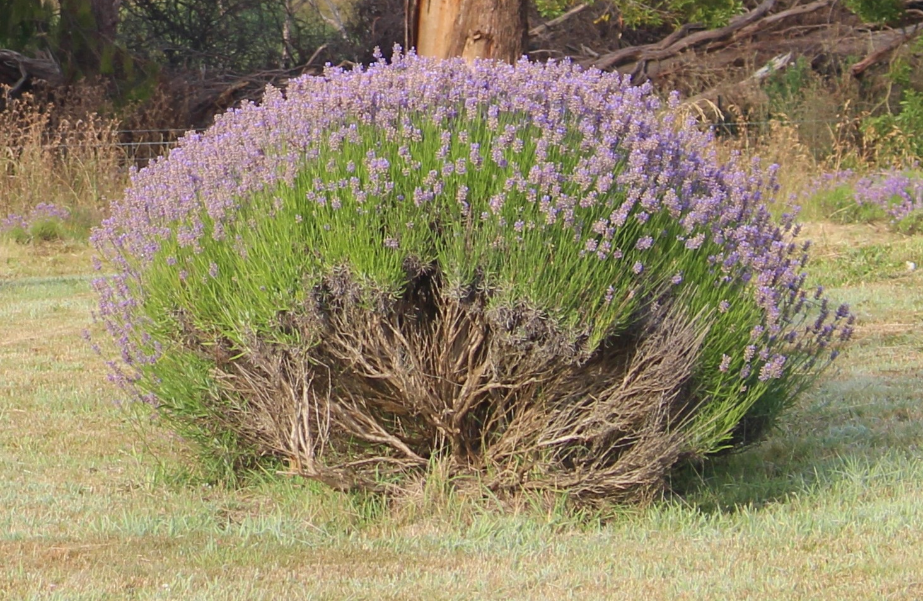
Two Types of Growth:
Plant Anatomy
Primary Growth
Herbaceous
Growth in length/height
Growth from shoot tips
Notes:
There are two types of growth with plants. The first is primary growth; green, herbaceous growth. This is growth in length or height of stems, coming from the tips of the shoots. Primary growth occurs in the primary, or first, growing season- so plants such as annuals will only have herbaceous growth.

Slide 29
Two Types of Growth:
Plant Anatomy
Secondary Growth
Woody growth
Growth in width/diameter
Notes:
Secondary growth is when plants develop wood. This growth is also associated with growth in diameter or width of stems. This always occurs after primary growth. Biennials and perennials (plants with more than one growing season) will exhibit secondary growth.

Slide 30
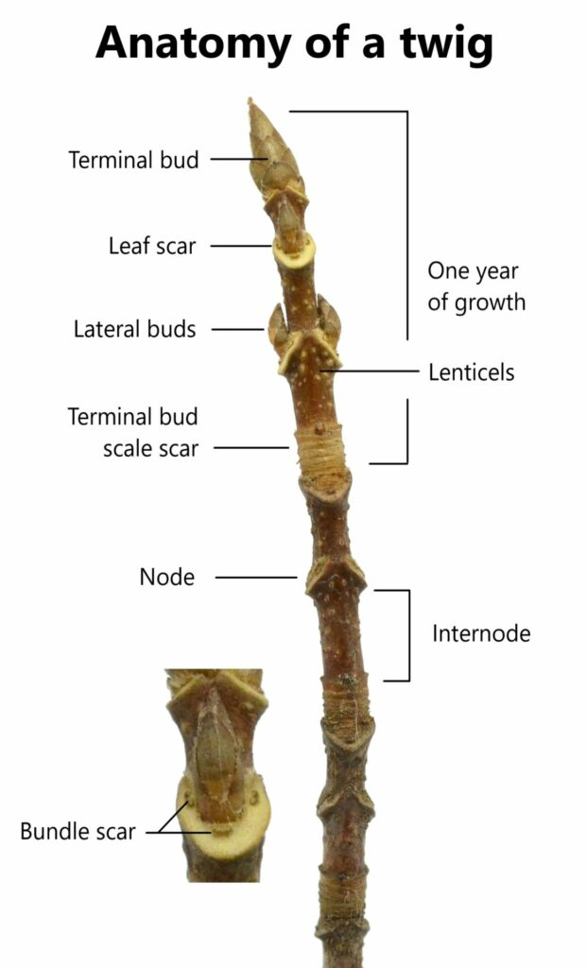
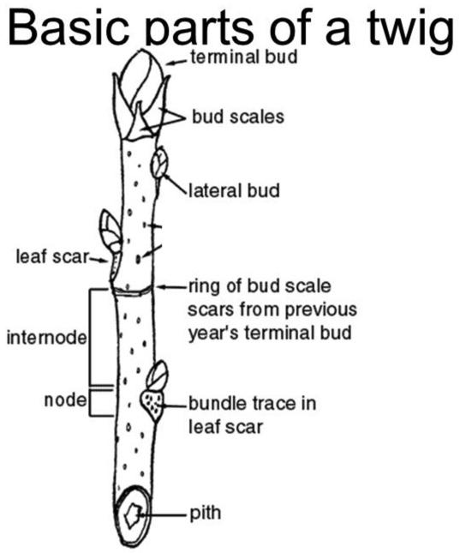
Plant Anatomy
Notes:
No test for this portion, this is just to demonstrate some of the anatomy of stems.
The only parts I want you to pay attention to are the buds- the terminal buds (sometimes there can be multiple) are at the tip of the stem, whereas lateral buds are anything further down from the terminal bud.
There are also bud scale scars, which are scars left from terminal buds of the previous year. The distance between the scars and the current terminal bud indicates how much growth occurred between each year

Slide 31
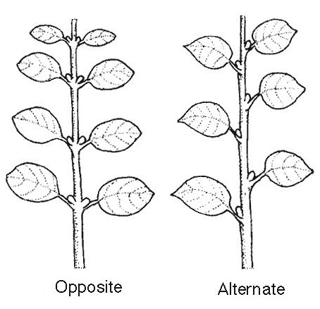
Bud Arrangement
Plant Anatomy
Notes:
Where buds are located on a stem also indicate the type of stem arrangement a plant will have: alternate or opposite being the most common.
Opposite means the buds are directly opposite each other on the stem- the resulting stems would then be opposite each other.
Alternate arrangement means the buds/stems will alternate which side of the stem they are on.

Slide 32
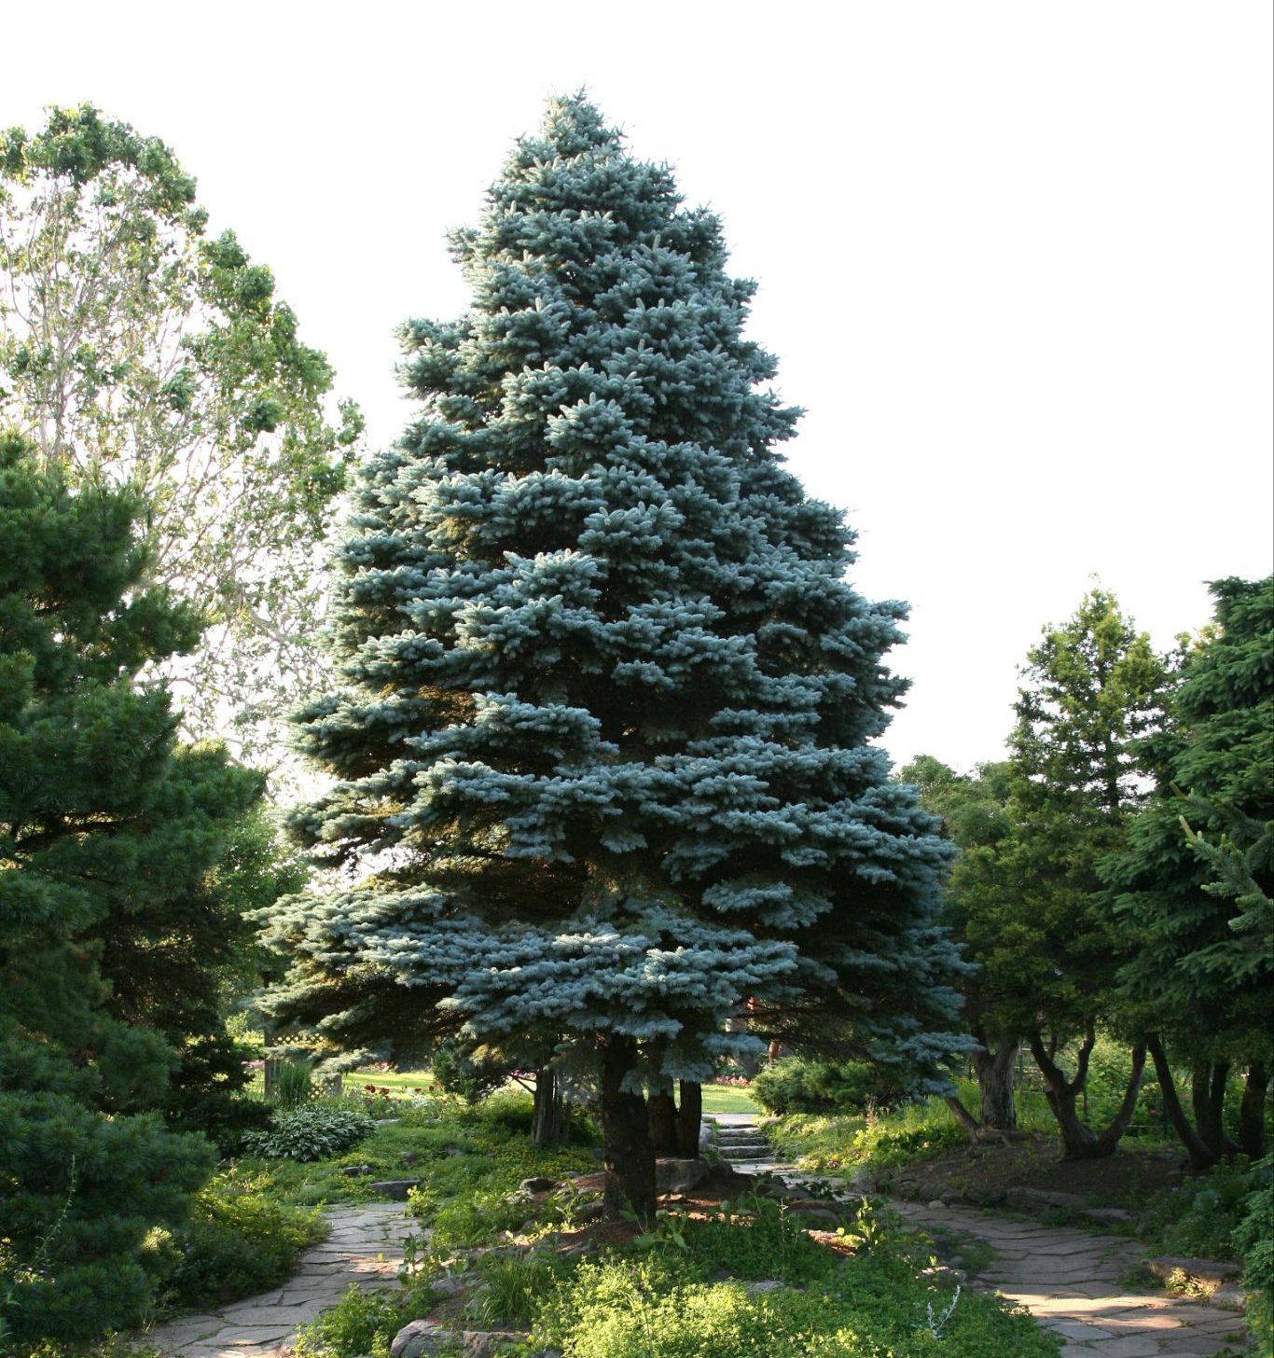
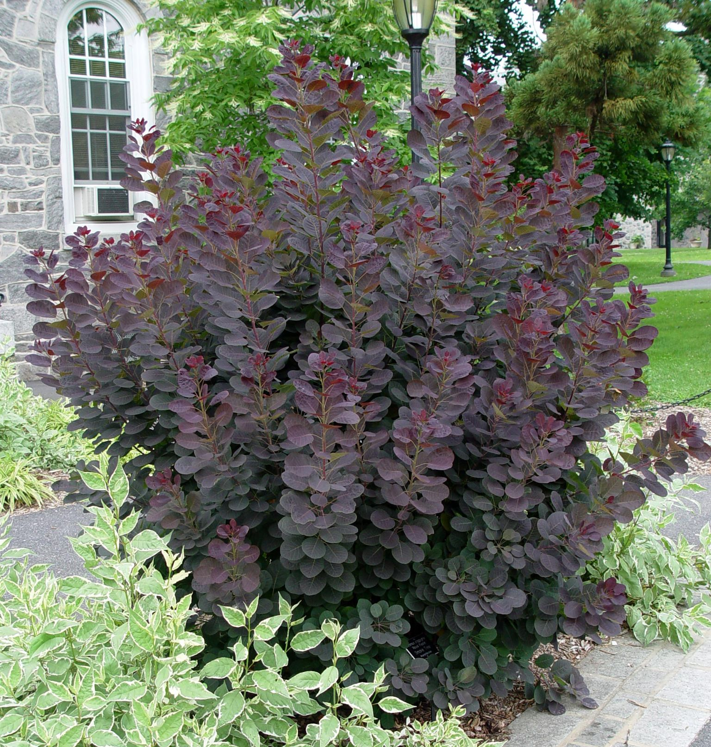
Apical control and dominance
Plant Anatomy
Terminal (upward) growth stops lateral (outward) growth from occurring
Notes:
Apical control and apical dominance are functions directing how a plant grows.
Both are terms for how terminal growth (upward, from the terminal bud) will stop lateral growth (outward, from lateral buds) from occurring.
If apical dominance is broken, it will signal multiple lateral buds to start growing. If apical control is broken, one of the lateral stems will try to take the place of the previous main leader, but the plant’s form will be noticeably altered.

Slide 33
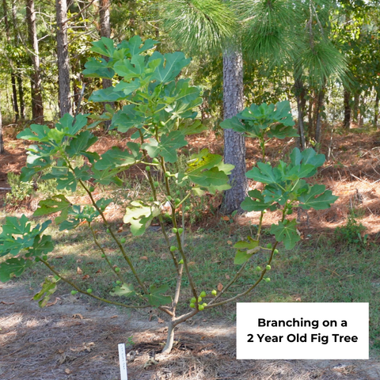
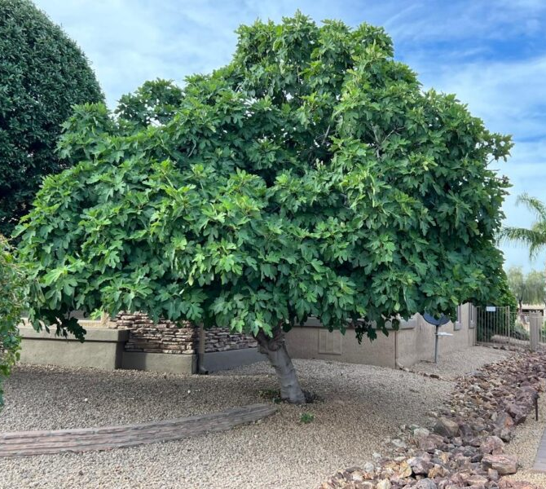
How do trees grow?
Plant Anatomy
Notes:
So how do trees grow?

Slide 34
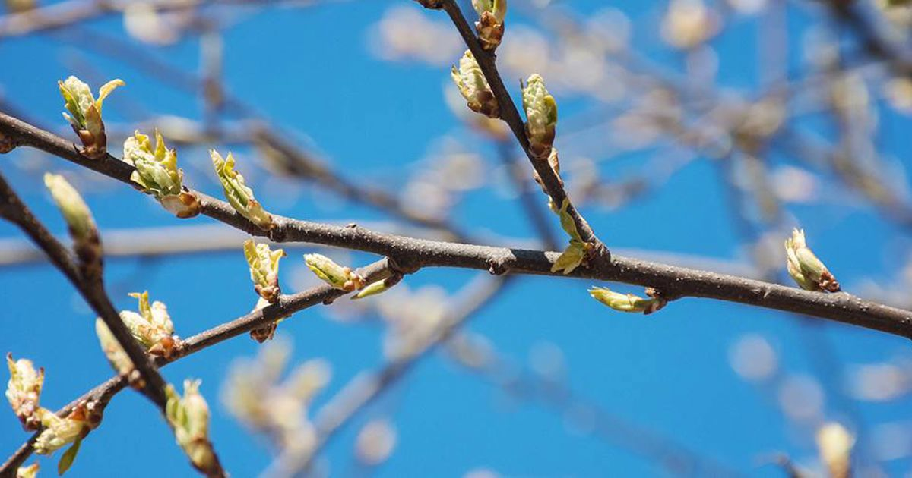
Every branch starts out as a bud…
Plant Anatomy
Notes:
Every branch starts out as a bud…

Slide 35
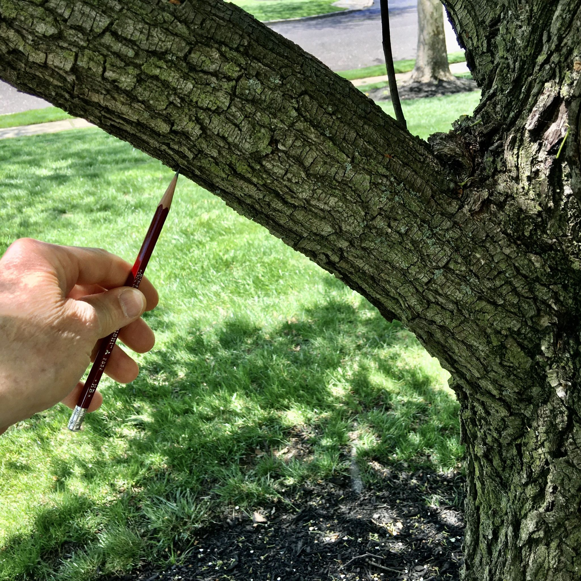
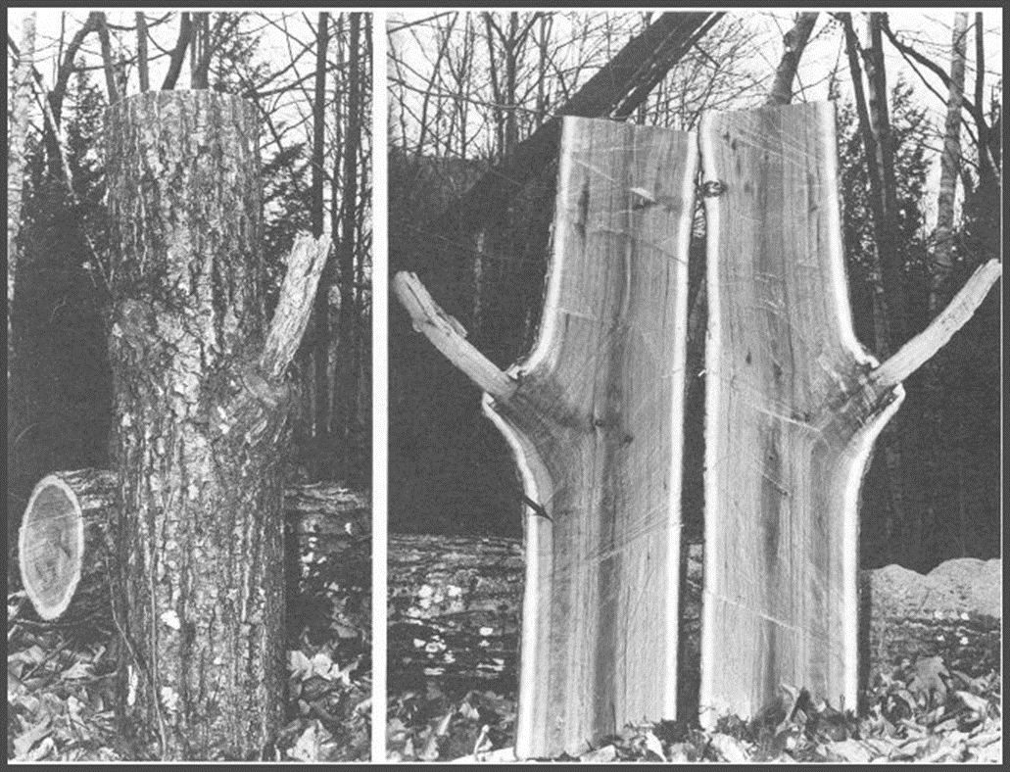
Branch grows outward and increases in diameter along with the trunk…
Plant Anatomy
Branch wood is “locked” inside trunk wood
Notes:
As the branch grows outward, it increases in diameter along with the trunk increasing in width. Wood layers overlap in this process, which “locks” the branch inside the trunk

Slide 36
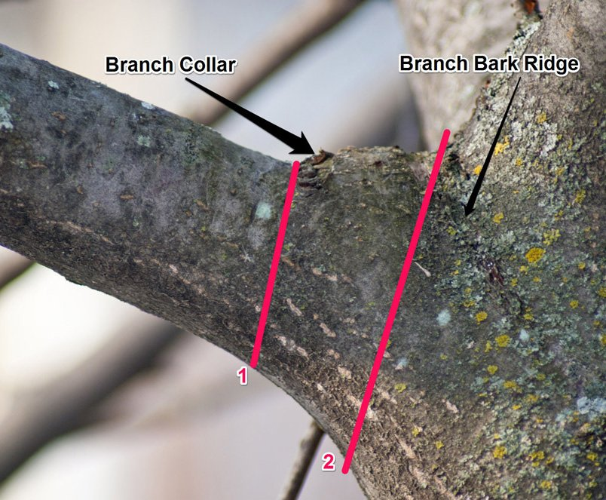
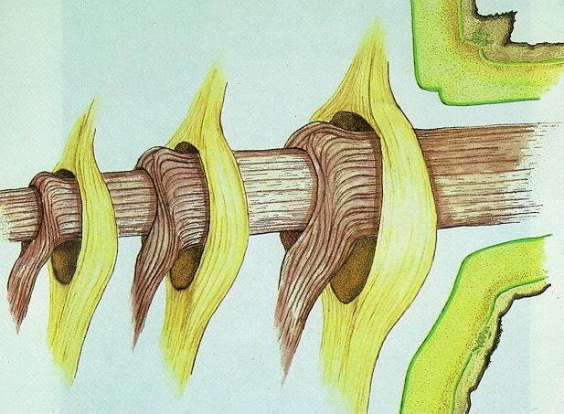
Branch collar
Plant Anatomy
Overlapping trunk and branch wood create the branch collar
Notes:
These overlapping layers of branch wood and trunk wood create a formation of a branch collar. Some species of trees don’t have a very distinct branch collar, but usually there is some degree of visible swelling where this occurs.

Slide 37
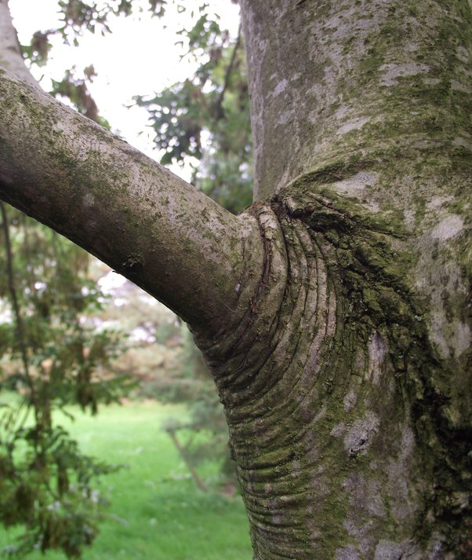
Plant Anatomy
Branch attachment strength
Branch diameter should be less than ½ of trunk diameter
Notes:
What do you look for to know if a branch is strong? We’ll look at how that branch has formed in relation to the tree’s trunk. Firstly, the diameter of any branch should be less than half that of the trunk diameter.

Slide 38
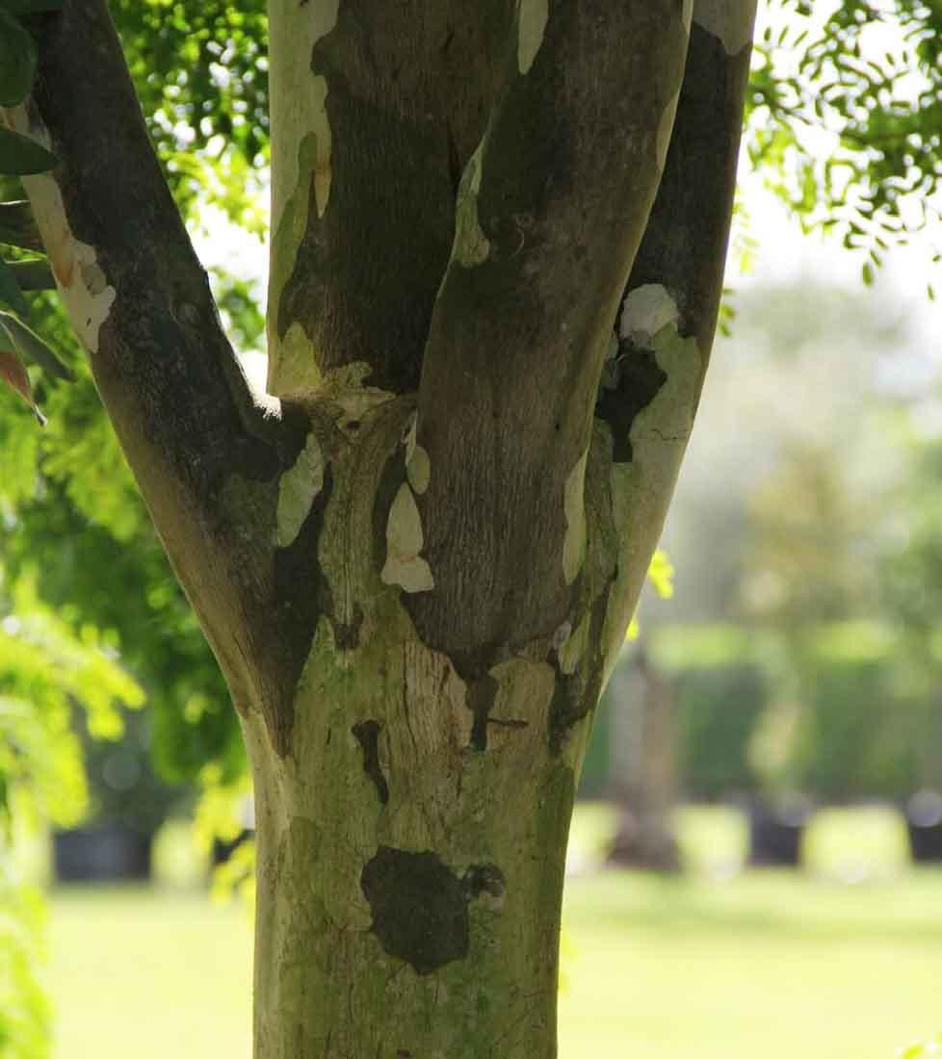
Plant Anatomy
Branch attachment strength
2. There should only be one branch at one location on the trunk
Notes:
Secondly, there should only be one branch at a given location on the trunk. In this image, you can see at least three branches all at the same height on the trunk. As these branches grow larger, they can start to interfere and rub against each other, causing wounds where the wood could start to decay.

Slide 39
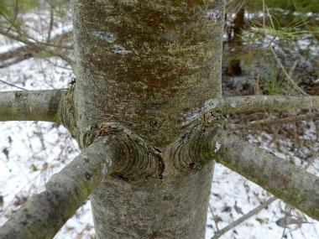
Plant Anatomy
Branch attachment strength
Branch attachment can be slightly different with some plants
Notes:
However, branch attachment can be slightly different depending on tree species.
This image is of a white pine, and these branches have adequate spacing even though they’re at the same height on the trunk. As these branches grow larger and larger, so does the trunk. These branches are spaced far enough apart that they won’t interfere with each other.
When pruning, it’s helpful to imagine how the plant is going to grow in the future- and what potential issues could be fixed now, when it’s easier on you and the plant.

Slide 40
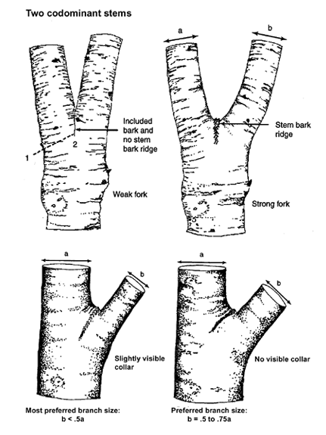
Codominant Stems
Plant Anatomy
Trunk becomes 2 branches or trunks of about the same size
Notes:
Codominant stems occur when two branches or trunks become about the same size, instead of the tree having one main leader or main stem. These will form a ‘fork’ or a ‘y’ shape.
This creates a weak union between the branches. Instead of the smaller stem interlocking with the bark of the larger stem, they will continue to grow separately, without that interlocking support.

Slide 41
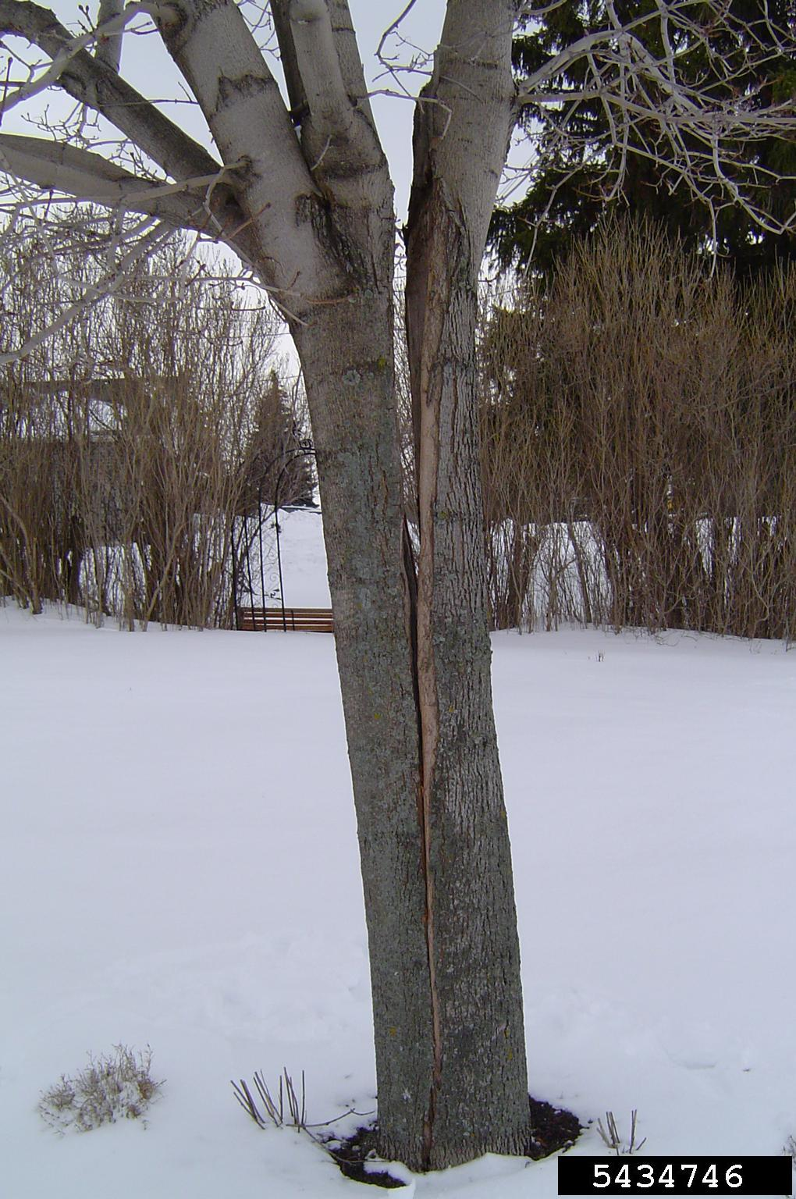
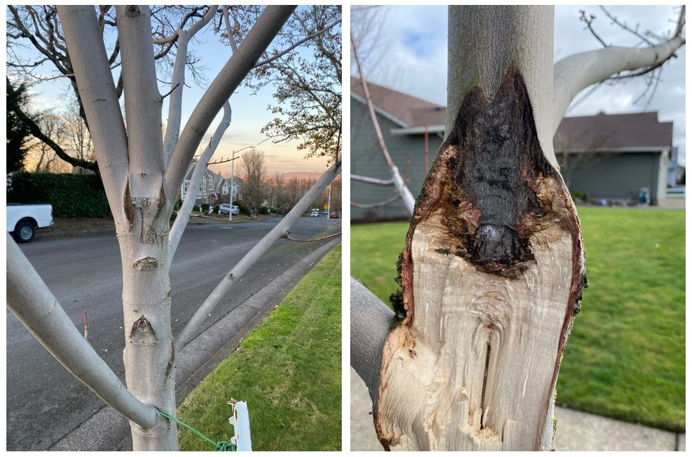
Codominant Stems
Plant Anatomy
Often, codominance becomes a problem
Notes:
Usually, codominant stems will become a problem and should be caught early to avoid the trunk splitting in the future.

Slide 42
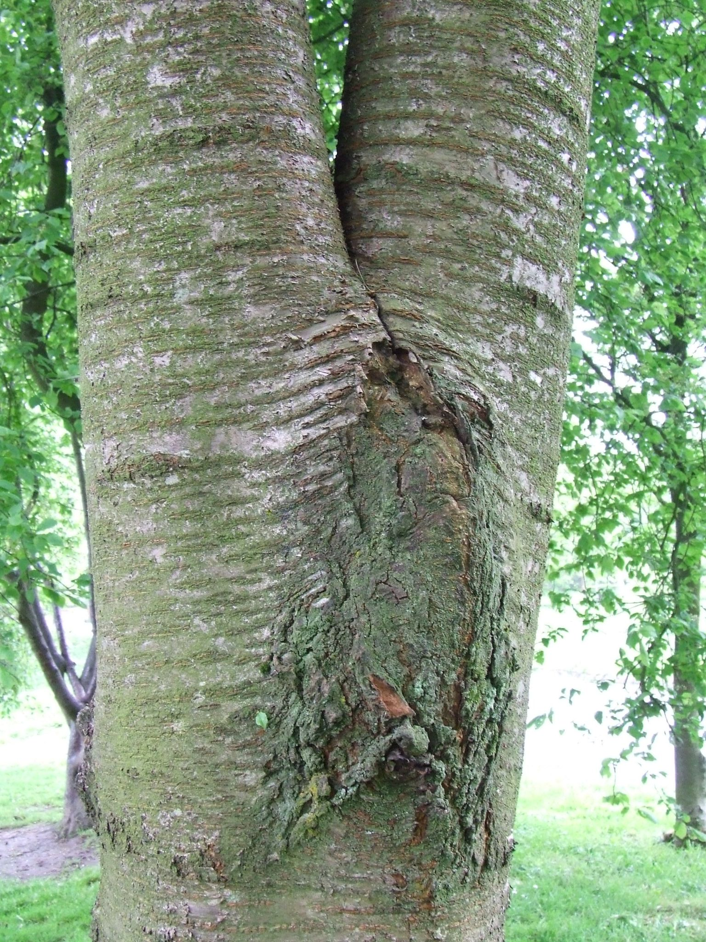
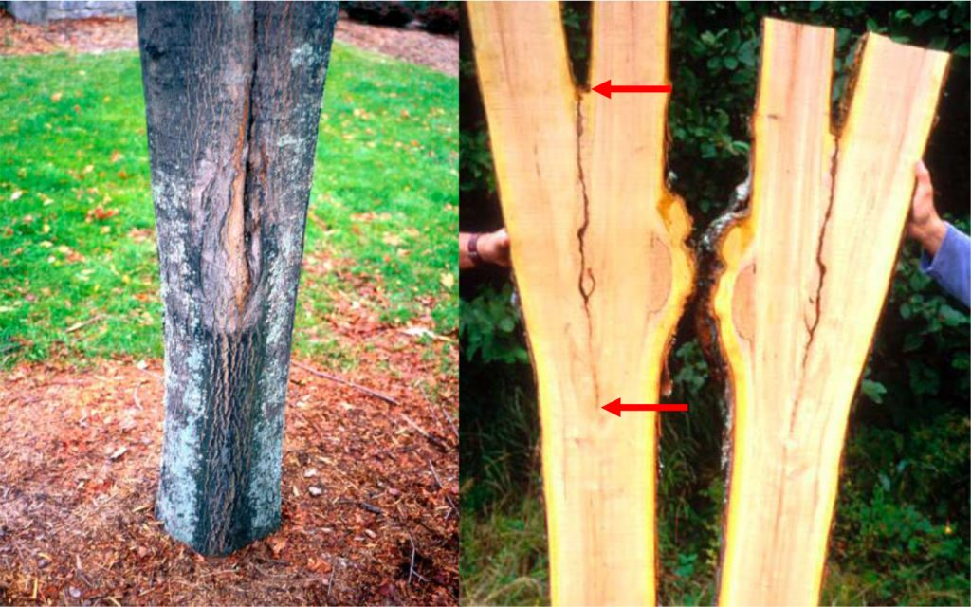
Included & Excluded Bark
Plant Anatomy
Codominance can indicate included bark
Notes:
Codominance could indicate that there is included bark. Because the wood layers of these two stems will never overlap, bark can get caught between the two layers, leaving areas where bacteria and fungi can get in and start to decay the wood
Included bark can also occur when we have too many branches too close together at the same spot on the trunk- as they grow, their bark can get trapped in between them.

Slide 43
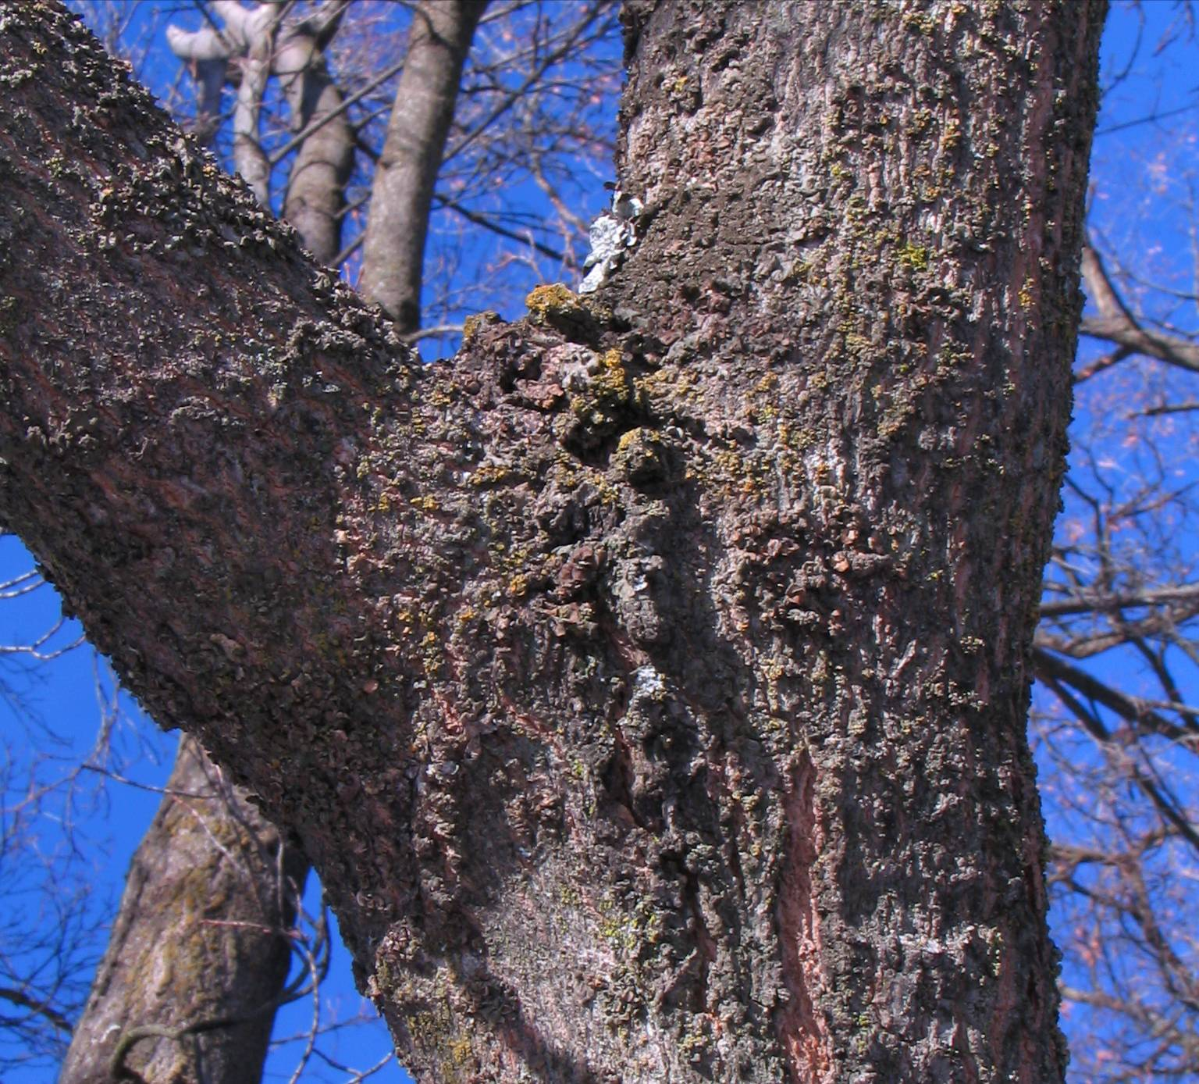
Included & Excluded Bark
Plant Anatomy
Excluded bark means the bark is pushing
out & away from the trunk
Notes:
Excluded bark occurs when branch wood and trunk wood properly overlap, and appears to push out and away from the union, rather than curling inwards.
This is usually indicative of a strong branch attachment.
The branch-bark ridge occurs just above the branch collar.

Slide 44

Water Sprouts & Suckers (Epicormic growth)
Plant Anatomy
Vertical shoots formed on stems/branches (Water sprouts)
OR
From the base of plant (Suckers)
Notes:
Epicormic growth is when a plant starts growing a thin, whip-like brach, usually pointing near-vertical. If it’s formed from stems or branches, they are called water sprouts, if formed from the base of the plant, they are called suckers.
These stems are always weakly attached due to their vertical growth. With proper care, they can become stronger. These can sometimes indicate stress in a plant but can also occur more commonly on plants that grow quickly or aggressively. These stems can be pruned any time of the year

Slide 45

The Structure of a Tree
Plant Anatomy
Desired for Maximum Stability:
Trunk has a single main leader
Notes:
Trees are a prominent part of any landscape, and we want them to be stable and healthy for many years. Pruning for proper structure starting earlier in a tree’s lifespan will help ensure they last a long time.
Desired characteristics for maximum stability include; Having a single main leader running most of the way through the tree.

Slide 46

The Structure of a Tree
Plant Anatomy
Desired for Maximum Stability:
Trunk has a flared base (root flare)
Notes:
Roots provide the highest amount of stability for a tree, and are also important for oxygen exchange.
A strong tree will have a nice flare at the base without roots circling the trunk.
Circling roots are caused by a tree being planted too deep in the soil, or covered with too much mulch. If you’ve seen or heard of mulch volcanoes, this is the result.

Slide 47

The Structure of a Tree
Plant Anatomy
Desired for Maximum Stability:
Trunk has a flared base (root flare)
Trunk is not girdled by roots
Notes:
Circling roots provide less stability and can cause extra stress to the trunk due to cutting off circulation as the trunk grows- this is known as girdling.

Slide 48

The Structure of a Tree
Plant Anatomy
Desired for Maximum Stability:
Trunk is tapered from the ground up
Notes:
Trunk taper means the trunk caliper (width) is larger at the base of the tree and decreases as you move upwards.
Proper trunk taper develops from the tree moving in the wind, allowing the base to strengthen, and from having adequate amounts of sunlight.
Trees in a dense forest can grow too quickly when trying to reach high in the canopy to get sun, making their trunk wood weaker.

Slide 49

The Structure of a Tree
Plant Anatomy
Desired for Maximum Stability:
Trunk is tapered from the ground up
Don’t stake too long
Notes:
Leaving a newly planted tree staked for longer than 1 year can prevent it from developing trunk taper.

Slide 50


The Structure of a Tree
Plant Anatomy
Desired for Maximum Stability:
Scaffolded (evenly distributed) branches
Notes:
Proper branch scaffolding means weight is evenly distributed across a tree.
Scaffolding occurs both in the vertical aspect (moving up the trunk) and in a radial aspect (from a top-down, or bottom-up view).
This is also what we’re looking for when we talk about branch attachment and making sure branches are evenly distributed on a trunk.

Slide 51


The Structure of a Tree
Plant Anatomy
Desired for Maximum Stability:
Scaffolded branches
Notes:
If weight is unevenly distributed, the tree could be more prone to splitting or leaning.
The picture on the right shows a tree that has been ‘lion-tailed’ where all lower and ‘interior’ branches have been removed, leaving weight unevenly distributed farther away from the trunk, leading to those branches breaking off.
Again, scaffolding branches is a structural feature you want to establish early in a tree’s life, because these problems will be harder to fix later.

Slide 52

Plant Anatomy
Main leader
Good flare
Good taper
Scaffolded branches
Notes:
Let’s go through an example step-by-step. Do we have a strong main leader?

Slide 53
Plant Anatomy
Main leader
Good flare
Good taper
Scaffolded branches
Notes:
Yes, there is a very clear leader directing this tree’s growth. How about root flare?

Slide 54
Plant Anatomy
Main leader
Good flare
Good taper
Scaffolded branches
Notes:
This tree also has good root flare giving it support from the base. Good trunk taper?

Slide 55
Plant Anatomy
Main leader
Good flare
Good taper
Scaffolded branches
Notes:
It’s a little harder to see, but this tree has a good trunk taper, indicating it had time to ‘grow at its own pace’ and will be strong against wind from multiple directions.
And how about scaffolding?

Slide 56
Plant Anatomy
Main leader
Good flare
Good taper
Scaffolded branches
Notes:
This tree has some well-scaffolded branches. Overall, the branches and canopy growth are evenly distributed across the tree.

Slide 57
Tree Injury & Compartmentalization
Animals “Heal”, Trees “Seal”
Notes:
Pruning causes a wound to the plant. It’s important to know how plants deal with these wounds, especially for longer-lived organisms like trees, which is why we’ll focus on it for this next section.

Slide 58

Trees are some of the largest and longest-lived organisms we know of…
Tree Compartmentalization
Notes:
Trees are some of the longest-lived and largest organisms we know of. Evolutionarily, they predate us by millions of years- 350-420 millions years ago compared to the miniscule 6 million of the oldest human ancestors.

Slide 59


Despite this, there is no wound healing process available to trees
Tree Compartmentalization
Notes:
Despite this, trees have no wound healing process.
To heal means to take damaged tissue and have it function again. Trees cannot do this, they can only ‘seal off’ injuries and grow new, functioning tissue around these damaged areas.
Wildfires can leave scarring that is visible in tree rings even hundreds of years later- this is an important part of dendrochronology, or using tree rings to date things.

Slide 60

How does a tree react to damage? CODIT
Tree Compartmentalization
Tree creates boundaries around the injury (compartmentalization)
Tree grows new wood around injury
“Compartmentalization Of Decay In Trees”
Coined by Alex Shigo, USDA FS
Notes:
So how does a tree ‘seal off’ wounds?
Trees have a process of creating boundaries around a wound, horizontally, radially, and vertically inside the trunk.
This helps resist loss of normal wood function (strength and transporting water/nutrients) and helps resist the spread of bacteria and fungi that cause decay.
The tree will then grow new wood that will eventually close over top of these boundaries.
This process is called CODIT, or Compartmentalization Of Decay In Trees, coined by Alex Shigo of the USDA Forest Service

Slide 61


Branch protection zone
Tree Compartmentalization
Forms in the base of a branch
Composed of chemicals that resist microorganisms
Notes:
Branch protection zones form in the base of a branch, where it attaches to the trunk. These zones have higher concentrations of chemicals that help resist spread of organisms from the branch into the trunk

Slide 62


Branch protection zone
Tree Compartmentalization
Branch wood inside the collar may decay, but trunk wood is usually unaffected
From: Richard C. Murray, The Tree Biology Notebook
Notes:
So, if a branch is wounded and starts to decay, these zones will help quarantine that from the trunk itself.
This can also work in the other direction; in the upper picture, you can see where a trunk has hollowed out, leaving the base of branches in the branch protection zone.
In the lower picture, you can clearly see where the branch collar is- healthy trunk wood surrounding the decayed wood of the branch.
This is why it’s really important not to harm the branch collar when making pruning cuts.

Slide 63
Pruning Cuts
Making the Right Cut Matters
Notes:
Now we’ll talk about how to actually *make* pruning cuts

Slide 64

Two Main types of Pruning Cuts:
Pruning Cuts
Thinning Cut
Notes:
There are two primary cuts we use for pruning. A thinning cut and a heading cut. A thinning cut is taking off a lateral branch where it joins a larger branch or the trunk, which then directs growth to the main branch.

Slide 65
Two Main types of Pruning Cuts:
Pruning Cuts
Thinning Cut
Heading Cut
Notes:
A heading cut means interrupting a main branch, often inducing new branches to grow.

Slide 66


Heading Cuts:
Pruning Cuts
Growth effect is localized to specific stem
Notes:
Heading cuts localize growth to each specific stem

Slide 67
Heading Cuts:
Pruning Cuts
Growth effect is localized to specific stem
Forces lateral buds to grow (most plants)
Notes:
On most plants, the heading cuts will ‘force’ or induce lateral buds to grow

Slide 68
Heading Cuts:
Pruning Cuts
Growth effect is localized to specific stem
Forces lateral buds to grow (most plants)
Lush, vigorous growth results BUT new stems may be weakly attached
Notes:
This can create lush, vigorous growth, but the tradeoff is that these new stems may be weakly attached

Slide 69
Heading Cuts:
Pruning Cuts
Growth effect is localized to specific stem
Forces lateral buds to grow (most plants)
Lush, vigorous growth results BUT new stems may be weakly attached
Good for increasing fullness in a shrub
Notes:
Heading cuts are good for increasing the ‘fullness’ of a shrub, as shown in the diagram on the right

Slide 70

Use Heading Cuts When…
Pruning Cuts
Shearing hedges
Forcing buds at specific locations
Small branches (finger thickness or less)
Notes:
Heading cuts are primarily what you use when shearing hedges
You can use heading cuts when you want to force more buds at specific locations on a plant
You want to use heading cuts on small stems- finger thickness or less. This has to do with wound healing and the resulting growth- the larger the stem diameter, the more aggressively the plant will grow sprout from lateral buds

Slide 71

Use Heading Cuts When…
Pruning Cuts
Rejuvenation of certain shrubs
Increasing flower production on plants that produce flowers at terminal ends
Notes:
Heading cuts can help when you need to do a rejuvenation pruning- cutting all stems of a shrub to promote new, primary growth all over the plant.
This can also be used to increase the amount of flower buds on plants that form their buds at the ends of stems- cutting one stem will prompt two more to grow, so now you have two flower buds at the end of these stems.

Slide 72

How to Make a Heading Cut
Pruning Cuts
Make a heading cut slightly ABOVE where buds are located on a stem
Alternate bud arrangement
Opposite bud arrangement
Notes:
How to make a heading cut. You want to cut slightly above a bud or set of buds on a stem.
Too long, and the chunk left above the bud will decay, with that decay possibly moving down the stem. Too low, and you could accidentally cut the bud and hamper the resulting growth.
For alternate bud arrangement, cut at an angle, usually about 45 degree, to allow water to roll off the stem. For opposite bud arrangement, cut straight across

Slide 73

Do NOT use Heading Cuts on Trees!
Pruning Cuts
Tree “Topping”
Removing the tops of branches or trunk
Notes:
Do NOT use heading cuts on tree tops. Tree topping is when you remove an entire upper portion of a tree

Slide 74
Do NOT use Heading Cuts on Trees!
Pruning Cuts
Consequences:
Branch or trunk rot
Stressed tree health
Ruined natural form of tree
Notes:
Tree topping can include a greatly increased risk of branch or trunk rot- there’s no branch protection zone to stop infection moving downward.
This also stresses the tree’s health as it is missing a lot of canopy that would return energy to the plant, and it has to spend a lot of energy to grow new stems.
These stems will also have a very different form- very vertical like watersprouts- and the tree can NEVER regain its original form.

Slide 75

Do NOT use Heading Cuts on Trees!
Pruning Cuts
Consequences:
Poor growth
New growth prone to breakage, dangerous if left to develop
Notes:
These new, very vertical stems are always poorly attached and can easily break off easily, which could be dangerous if they’re allowed to grow larger and get heavy.

Slide 76


Thinning cuts
Pruning Cuts
Removing a branch back to a larger branch or the trunk
Notes:
Now over to thinning cuts. Thinning cuts involve removing the end of a branch BACK to the branch it splits from or from the trunk itself. There are many benefits to this.

Slide 77


Thinning Cut Results
Pruning Cuts
Growth effect is distributed over the entire plant
Notes:
Thinning cuts mean the resulting growth is more evenly distributed over the whole plant because…

Slide 78
Thinning Cut Results
Pruning Cuts
Growth effect is distributed over the entire plant
Directs energy/growth to existing branches
Notes:
Thinning cuts direct energy/growth to existing branches. The plant wants to keep growing from it’s main stems/terminal buds

Slide 79
Thinning Cut Results
Pruning Cuts
Growth effect is distributed over the entire plant
Directs energy/growth to existing branches
Growth maintains natural pattern
Notes:
This all helps to maintain the natural growth pattern of the plant, rather than inducing other stems to grow where they normally would not.

Slide 80

Proper vs. ‘Flush’ cut
Pruning Cuts
A proper thinning cut is just outside the branch collar
Notes:
A proper thinning cut is just outside, or further away from the trunk, to the branch collar. A flush cut is when a cut occurs parallel to the trunk, cutting through the branch collar.

Slide 81

Proper vs. ‘Flush’ cut
Pruning Cuts
A flush cut will destroy the branch protection zone
Very slow sealing
No barrier between branch wood and trunk
Notes:
A flush cut destroys the branch protection zone, resulting in very slow wound sealing- it takes a lot longer for the trunk wood to seal over this scar.
A flush cut also DESTROYS the branch protection zone- there is no extra barrier stopping bacteria and fungi from starting to decay the trunk wood, which could potentially compromise the whole tree (over the course of many years)

Slide 82

Pruning Cuts
Notes:
Another diagram to show cutting outside the branch collar and demonstrating a three-point cut, a way to safely prune large branches

Slide 83

Correct thinning cut for large branches: 3-point cut
Pruning Cuts
Reasons for using 3-point cuts:
Prevents bark from tearing off into the trunk, compromising Branch Protection Zone
Notes:
A three point helps keep the weight of the branch from tearing wood down into the branch collar, again compromising the branch protection zone.
This area of torn wood is susceptible to decay and will take much longer for the tree to seal over than a clean cut.
Do you see what else is wrong with this picture? They also cut through the branch collar in addition to the branch weight tearing into it.

Slide 84

Correct thinning cut for large branches: 3-point cut
Pruning Cuts
Cut 1: Undercut 1/3 of the branch, a few inches away from the trunk
Notes:
The first part of your three point cut is to move a couple inches out from the branch collar and cut from the BOTTOM, about ⅓ of the way through the stem.
This relieves the weight of the rest of the branch, preventing it from tearing. You’ll usually notice your saw getting pinched in the wood as the branch weight shifts down.

Slide 85
Correct thinning cut for large branches: 3-point cut
Pruning Cuts
Cut 2: Saw downward beyond Cut 1 (toward branch tip)
Notes:
For the second cut, you’ll move a little bit out from the first cut, towards the branch tip, and cut downward until you cut through OR, until the branch snaps off by itself, which will usually happen with a heavier branch.

Slide 86
Correct thinning cut for large branches: 3-point cut
Pruning Cuts
Cut 3: Once weight of branch is gone, make final pruning cut outside of the branch collar
Notes:
Your third cut is to go just outside the branch collar and remove the stub left over. This leaves you with a nice, clean cut. Easier on you AND the plant. And very satisfying when you’re finished with it.

Slide 87
Plant Growth & Pruning
The Growth Pattern of a Plant Affects How to Prune
Notes:
Plant growth and pruning. Knowing the natural growth pattern of a plant will help you know how you want to prune it.

Slide 88

When Pruning Anything:
Plant Growth & Pruning
Prune in small doses
Get the big picture
Notes:
When pruning anything, prune in small doses. Take a few branches, stand back, get a good look at the plant, then go in for more. You can’t put anything back on once it’s taken off.

Slide 89



Remove the 3 D’s
Plant Growth & Pruning
Remove any:
Dead
Damaged
Diseased
Parts of the plant
Notes:
Always remove the 3 D’s; dead, damaged, or diseased parts of the plant

Slide 90


Remove the 3 D’s
Plant Growth & Pruning
Also remove any:
Crossing/rubbing branches
Water Sprouts & suckers
Notes:
Also remove any crossing or rubbing branches (that have damage or will cause damage) and any water sprouts or suckers.

Slide 91

Plant Growth & Pruning
Notes:
A good diagram of the first things you want to prune when looking at a woody plant

Slide 92



Plant Growth Types
Plant Growth & Pruning
Notes:
We have three main growth types in woody plants…

Slide 93
Plant Growth Types
Plant Growth & Pruning
Terminal
Notes:
Our terminal growers, like most trees

Slide 94
Plant Growth Types
Plant Growth & Pruning
Terminal
Basal
Notes:
Basal growers, like most shrubs

Slide 95
Plant Growth Types
Plant Growth & Pruning
Terminal
Basal
Intermediate
Notes:
And intermediate growers, which can lean more tree-like or more shrub-like, depending on the plant and how you want to prune it.

Slide 96


Terminal Growers - Trees
Plant Growth & Pruning
Usually have a single trunk
Largest buds at terminal tips
Growth is most prolific at terminal tips
Notes:
Terminal growers usually have one main trunk, their largest buds at the terminal tips of the stems, and growth tends to be strongest from those terminal buds

Slide 97

Terminal Growers - Trees
Plant Growth & Pruning
Most pruning work starts at young age
Almost all trees are terminal growers
Notes:
Pruning terminal growers usually starts at a young age. And again, most trees are terminal growers

Slide 98

Terminal Growers: Pruning Steps
Plant Growth & Pruning
Remove dead, damaged, diseased, wood “3 D’s”
Remove wrongly placed, interfering, or rubbing limbs
Prune to shape
Only use proper “thinning cuts”
Don’t prune more than 1/3 of the total branches
Notes:
When pruning terminal growers, first remove any dead, damaged, or diseased parts of the plant
Then look for any wrongly placed, interfering, or rubbing limbs.
Prune to shape, establishing one main leader and choose branches to keep to established good scaffolding
Only use thinning cuts- cut every stem back to a larger branch or the trunk
Don’t prune more than ¼ to ⅓ of the total growth. Pruning removes leaves, which generate energy for the plant. Removing too much canopy will hamper its ability to recover from pruning

Slide 99

Plant Growth & Pruning
Notes:
Another diagram to help illustrate things to look for when pruning trees

Slide 100

Basal Growers - Shrubs
Plant Growth & Pruning
Multiple trunks or basal stems
Largest buds on mid portion of the stem
Flower on lateral portions of the stem
Notes:
Basal growers have multiple trunks or basal stems, the largest buds are usually along the middle portion of the stem, and flowers usually occur on lateral portions of the stem

Slide 101

Basal Growers - Shrubs
Plant Growth & Pruning
Prune to enhance blooming or fruiting
Prune to keep from getting too crowded
Basal Growers include Forsythia, Boxwood, Spirea
Notes:
You usually prune basal growers to enhance blooming/fruiting
Prune out old stems to keep the plant from getting too crowded and starting to get damage/decay in center
Common basal growers include forsythia, boxwoods, and some spirea species

Slide 102

Basal growers – Pruning Steps
Plant Growth & Pruning
3 D’s- remove dead, damaged, or diseased wood
Remove ⅓ of the oldest stems at ground level
Stand back and cut any un-appealing stems (thinning cuts)
Continue in random pattern until ¼ to ⅓ of the plant stems are removed
Notes:
To prune basal growers, still start with the 3 D’s.
Then remove about ⅓ of the oldest stems, cutting them just above the ground.
Then, stand back and cut any unappealing stems using thinning cuts. Maybe one portion is sticking up higher than other parts of the plant, maybe one stem is growing crooked, etc.
Continue taking away stems in a random pattern until ¼ to ⅓ of all the plant stems are removed

Slide 103


Basal growers – Shearing
Plant Growth & Pruning
Shearing (heading cuts) work for basal growers
Flower along stems, not at ends
Notes:
Shearing works for basal growers due to having multiple basal stems and flowering along the lateral stems- so using heading cutswon’t remove all of your flower buds

Slide 104
Basal growers – Shearing
Plant Growth & Pruning
Results:
Increased “twigginess”
Some flowers removed
Shrub loses natural form
May become more prone to insect and disease problems
Labor-intensive
Notes:
The result is increased “twigginess” of the stems and fullness of the shrub
However, you still remove some of the flowers, the shrub will lose its natural form, it may be more prone to insect or disease problems, and it is a very labor-intensive practice that needs to be repeated several times a growing season.
Personally, I like a more natural form to all my plants, like in the lower picture

Slide 105

Intermediate Growers
Plant Growth & Pruning
Growth is partly terminal / partly basal
Can have multiple stems
Largest bud on terminal tip
Notes:
Intermediate growers are just that- an intermediate type of growth between basal and terminal. These plants will usually have multiple stems coming from the base of the plant, but will also have their largest buds (and flowers) at the terminal ends of the stems.

Slide 106

Intermediate Growers
Plant Growth & Pruning
Prune to enhance flowering and fruiting
Prune to keep form
tree v. shrub
Intermediate growers include Lilacs, Rhododendrons, some Viburnum and Hydrangea species
Notes:
Prune to enhance flowering or fruiting, and prune to keep form- either as a tree (by removing extra basal stems) or as a shrub (using thinning cuts for even growth all over the plant)
Common plants that are intermediate growers include lilacs, rhododendron/azaleas, and some viburnum and hydrangea species.

Slide 107

Intermediate Growers- Pruning Steps
Plant Growth & Pruning
1. 3 D’s- remove dead, damaged, or diseased wood
2. Remove
some older branches at ground level
OR
All extra stems except main leader
Notes:
For pruning intermediate growers, first start with your 3 D’s. Then, choose which shape you want to keep- pruning some basal branches but still leaving a few, or pruning away any extra suckers to maintain one main stem.

Slide 108

Intermediate Growers- Pruning Steps
Plant Growth & Pruning
3. Heading Cuts on growing shoots to force branching
4. Remove old seed and fruit heads
5. Thinning cuts to remove unappealing stems
Notes:
Use heading cuts to force more branching in areas you want flowers, and deadhead to remove old seed/fruit parts. Use thinning cuts to remove any unappealing stems

Slide 109

Intermediate Growers- Pruning Steps
Plant Growth & Pruning
Vining plants can also be pruned like an intermediate grower
Notes:
Vining plants can also be pruned like an intermediate grower, and have different methods depending on the type of vine and what season they flower in

Slide 110

“Rejuvenation Pruning”
Plant Growth & Pruning
Cutting a plant completely to the ground
Multi-stem Shrubs that have not been pruned for years, are overgrown, leggy, not flowering, or not showing bark color
Notes:
Rejuvenation pruning is when you use heading cuts on ALL stems and completely cut a plant back. This is helpful for older, more overgrown shrubs or shrubs that have features mainly on first-season growth, so you want to remove all older growth.
A common example would be a Red Osier dogwood- the lovely red stem color comes from younger stems and they gradually turn brown with more than a year or two of growth, so they benefit from the occasional rejuvenation pruning.

Slide 111

“Rejuvenation Pruning”
Plant Growth & Pruning
Basal or intermediate growers
Does NOT work with all plants
Notes:
Rejuvenation pruning can be used for basal, intermediate growers, or vining plants. Not all plants will recover from this type of pruning, so make sure to do a little research first

Slide 112

Annuals - Deadheading
Plant Growth & Pruning
Cutting off spent flower heads/stalks, sometimes to prevent fruiting
Plant saves energy, can promote more flowers
Notes:
Pruning for annual plants usually involves deadheading.
This is when you remove spent flower heads or flowering stalks, usually before they try to set seed. Making seeds is extremely energy-intensive, so stopping the plant from doing this can induce more flowering and/or stop an annual from dying after it sets seed.
Basil is a plant notorious for dying once it sets seed.

Slide 113

Annuals - Cutting Back*
Plant Growth & Pruning
Cutting/clearing away most/all dead plant material fall, winter, or spring
Notes:
Cutting back is when you clear away most or all of dead plant material after the growing season. Again for annuals or herbaceous perennials.
However, removing green leaves, even if most are dead, will be removing any extra energy the plant can regain that season.
This is one reason I recommend waiting until after winter to cut back or unless ALL of the leaves are withered.

Slide 114

Annuals - Cutting Back*
Plant Growth & Pruning
Slow Down on Spring Cleaning!
Provides habitat for native invertebrates & pollinators
Helps protect plants from harsh winter temperatures
Notes:
Additionally, clearing away plant material before winter can rob you of some important ecosystem functions; dead leaves and plant material provides habitat for native invertebrates and pollinators, and helps give your plants some insulation against our harsh winter temperatures.
Wait to clean out plant material until the insects wake from their winter slumber :)

Slide 115
Pruning Conifers
Conifers have different pruning needs than other woody plants
Notes:
Conifers can be a little more tricky to prune, so we’ll give them a little more attention now

Slide 116

MOST CONIFERS GROW BEST IN FULL SUN
Pruning Conifers:
When conifers become shaded, the foliage dies.
Notes:
Most conifers grow best in full sun, and their foliage can die off when deeply shaded- you’ll find the inner branches of some conifers will have brown or dead needles.
An exception to this- conifers that do handle shade well- are yews and hemlocks

Slide 117

BE CAREFUL WITH CONIFERS!
Pruning Conifers:
Most conifers have little to NO capacity to regrow from old wood
Notes:
You have to be more careful pruning conifers because most species have little to no ability to start growing from old wood. Again, an exception to this are Yews

Slide 118


Pruning Conifers:
Terminal leader has been
cut or damaged
Notes:
Many conifers also have extremely strong apical control, and can look very strange after cutting the main leader.
The picture on the left is a tree with the main leader recently cut, on the right is an example where damage occurred to the main leader several years earlier. The form is mostly the same on the right, but remember that these resulting branches may be more prone to breakage.

Slide 119

Pruning Conifers:
Try to hide pruning cuts behind other branches
Notes:
Because most conifers don’t sprout new growth well after pruning into older wood, pruning in this example would leave this raw wood visible. Try to strategically hide these raw areas behind other branches or foliage

Slide 120

Pruning Conifers:
https://youtu.be/YOCftESUjhI
Notes:
This is not an embedded video, but is a great primer into pruning conifers with examples of manipulating the growth of the plant while still keeping it natural-looking.

Slide 121

Pruning Pines
Pruning Conifers:
Buds are only on terminal tips & current season’s growth
Will not grow back from old wood
Plant may be kept small by pruning if started when plant is young
Notes:
Starting with pine trees; Pines come in packets- their needles are bundled into a papery sheath called a fascicle.
Pines only grow from terminal buds, and from undeveloped buds located on the stem where there are needles. Pruning below that, on older wood, will not have any resulting growth

Slide 122


Pruning Pines
Pruning Conifers:
Prune in spring when ‘candles’ are expanding
Prune ⅓ to ½ total candle
Thinning cuts & 3 D’s
Notes:
The method for pruning pines is to ideally prune in the spring, when you see the ‘candleing’- this is the newly emerging growth for the season.
To limit the amount of growth, prune a third to a half of the candle’s height. This leaves enough for the plant to produce enough energy and keep growing. You can, of course, still take off entire stems (using thinning cuts) and you should still remove the 3 D’s

Slide 123

Pruning Fir/ Spruce/ True Cedars
Pruning Conifers:
Buds are also at tips & current season’s growth
If you reach hard, woody stem, you’ve gone too far
Prune when dormant
Notes:
Firs, Spruce, and True cedars have pointier needles, and are not bundled. These plants also produce buds at the tips of the stems, and along stems from the current growing season (anywhere where the stem is not woody and hard)
Pruning these trees is a little easier when they are dormant, as you will be able to see where the current season’s growth is and prune based on that.

Slide 124


Pruning Fir/ Spruce/ True Cedars
Pruning Conifers:
Still prune for good tree structure & the 3 D’s
Notes:
Still prune for good structure and remove the three D’s.
The tree on the left is showing some competing leaders, so it’s best to prune those right away to establish a good form

Slide 125

Pruning Junipers/ Arborvitae/ Red Cedars/ False Cypress
Pruning Conifers:
Only produces buds where green leaves are present
Prune in late spring / early summer to shape
Notes:
Junipers, arborvitaes, red cedars, and false cypress are your conifers with scaly or awl-shaped leaves.
These plants only produce buds where green leaves are present.
Pruning in late spring or early summer is ideal because you can see where the new growth is and the plant can still grow from what material is left behind in the ‘green’ area

Slide 126

Pruning Junipers/ Arborvitae/ Red Cedars/ False Cypress
Pruning Conifers:
Shearing - difficult
Constant shearing will create dead center with thin shell of green
Only shear when actively growing
Notes:
Shearing is common with some of these species, however, it can cause some problems.
Shearing even a LITTLE bit too far and removing all of the actively-growing leaves means you will be left with a brown spot.
Over time, shearing creates a very thin shell of green leaves over a dead center. This is why it’s crucial to prune (or shear) these when they are actively growing so you don’t remove too much material.

Slide 127


Pruning Hemlocks & Yews
Pruning Conifers:
Good latent bud potential along stem for several years
May be sheared into hedges during active or dormant periods
Easiest types of conifers to keep small or hedged
Notes:
Hemlocks and yews have soft, flat needles.
They also have very good latent bud potential- meaning they have dormant buds that can sprout from old wood.
These can be much more easily sheared, and shearing can be done in both active or dormant periods of the plant.
These are the easiest conifers to keep small or hedged. In the first picture, you can see how much new growth is being taken off, but there is still a good amount of leaves underneath (thanks to shade tolerance), and areas that are not very leafy can still grow some more (thanks to latent buds)

Slide 128
Let’s Practice!

Slide 129

Notes:
Here is our tree- or part of it anyway

Slide 130
Notes:
The first thing I see in this picture is a branch that’s verging on codominant. The width of this stem is more than half that of the main trunk

Slide 131
Notes:
In the red circle, you can see an area that may have been excluded bark at one point, but as the tree has grown, there is now going to be included bark

Slide 132
Notes:
Even though it’s a pretty big chunk of wood to take off, I would cut this entire branch. However, because it’s such a big portion of the tree, I would not do any other pruning unless it’s for dead or damaged material

Slide 133
Notes:
This image also has a good example of a crossing branch, that if left to grow, would start rubbing against the trunk. This branch could easily be cut where the yellow line is

Slide 134

Questions?
horti.cora@gmail.com

