Slide 1
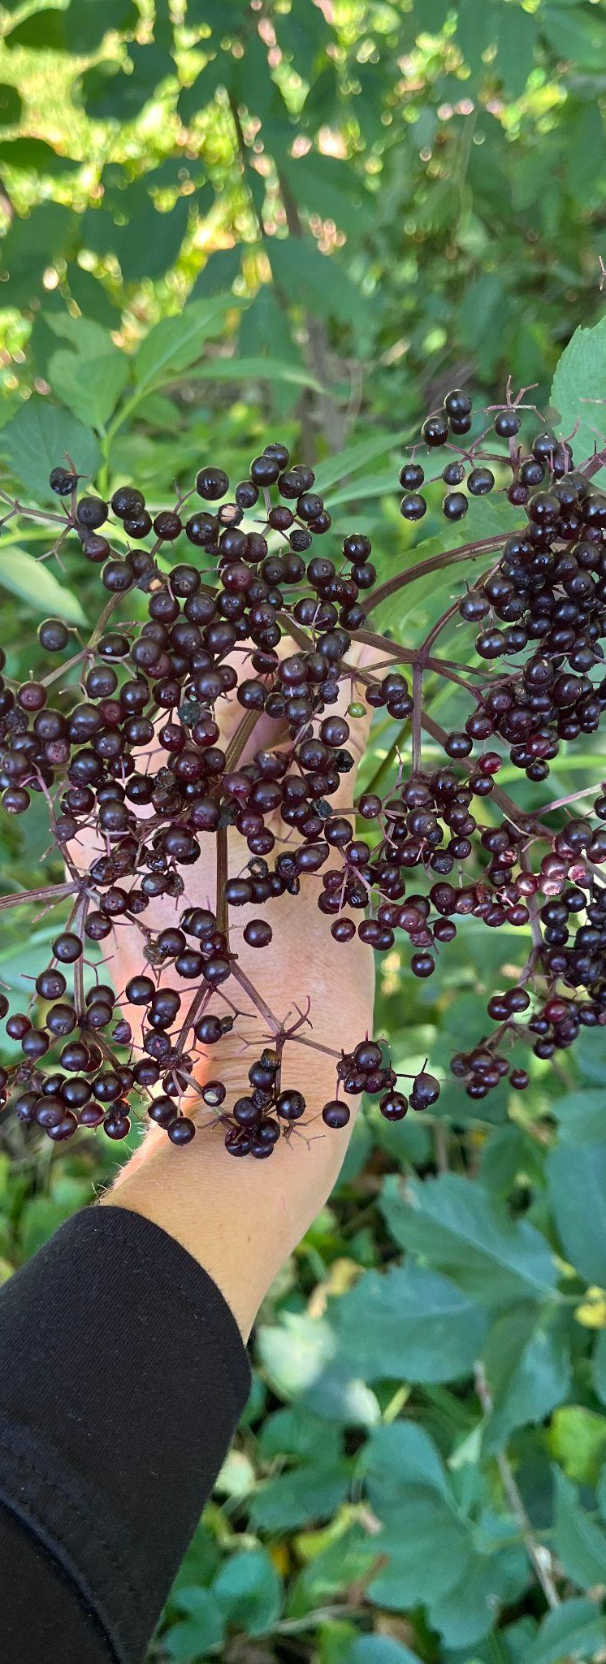
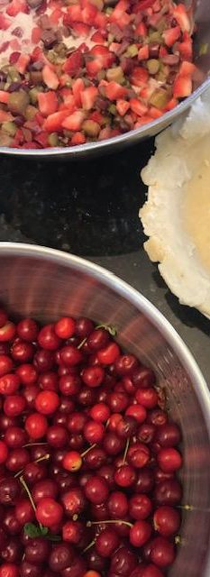
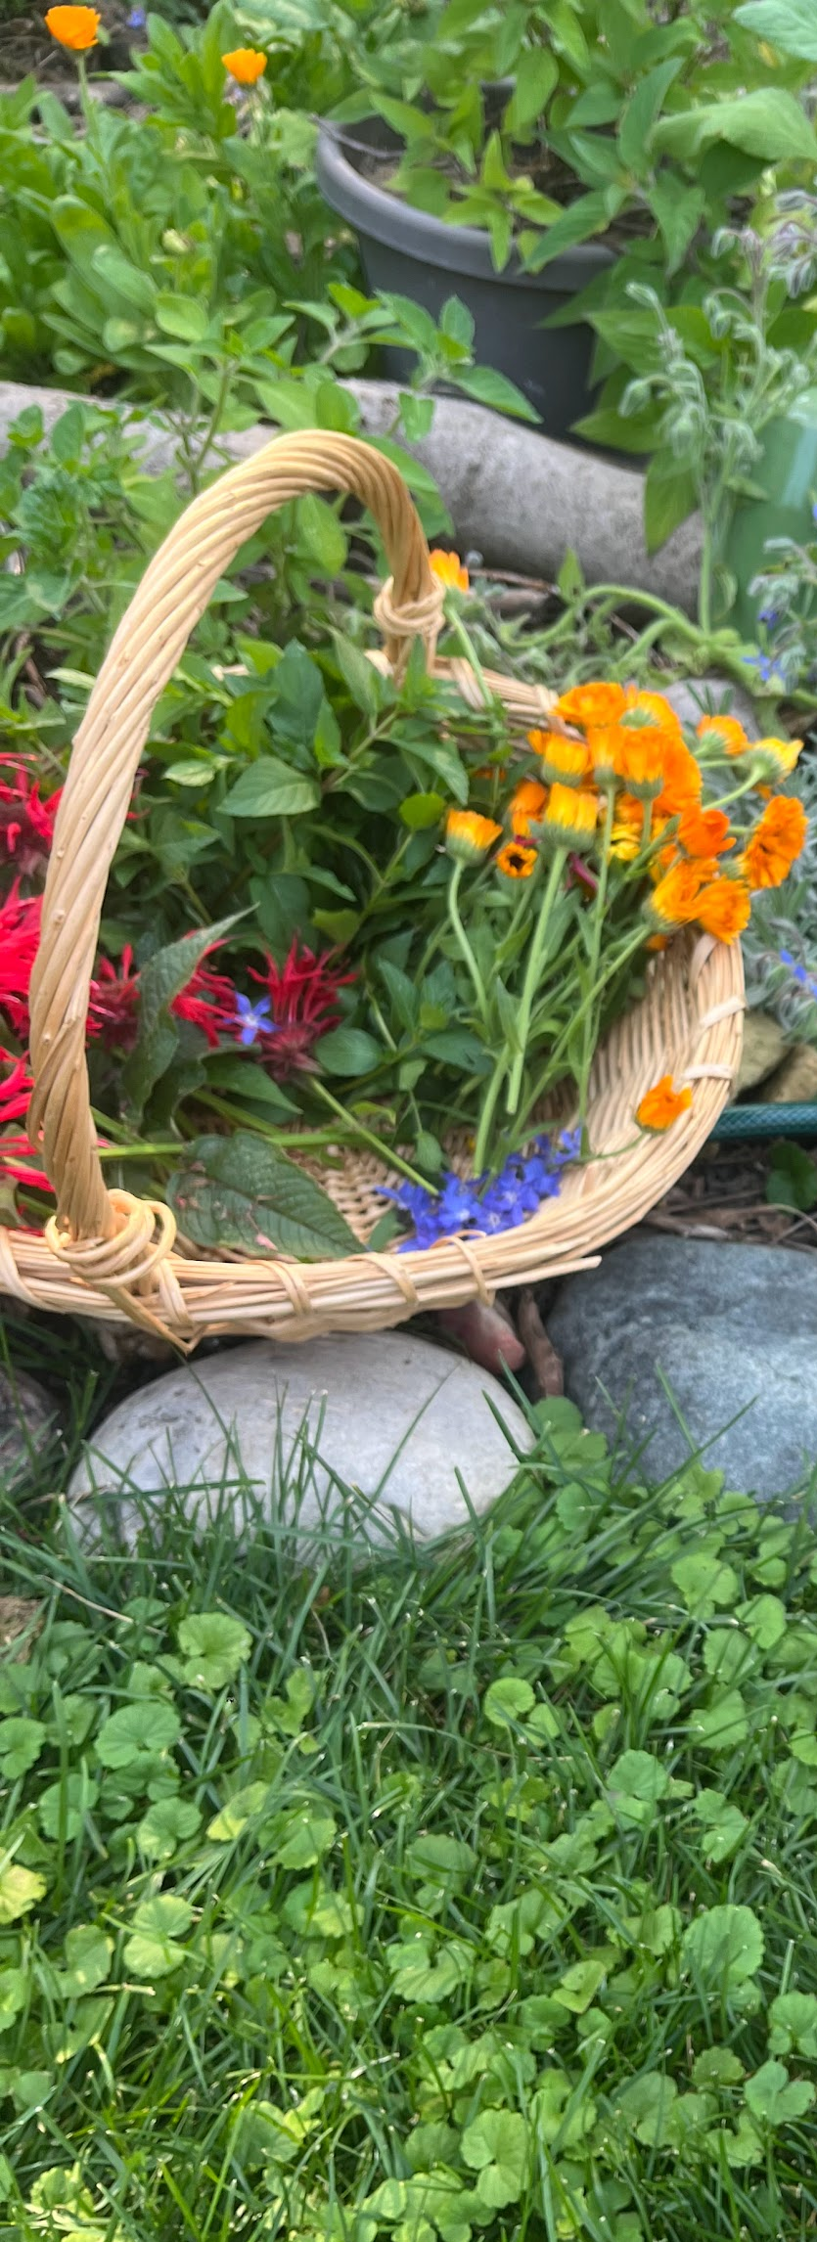



The Art of Food Forest Design
Rachel Belida
Eco & Edible Landscape Designer
Daily Harvest Designs
2025 Garden & Green Living Expo
Connect
with me!

Slide 2
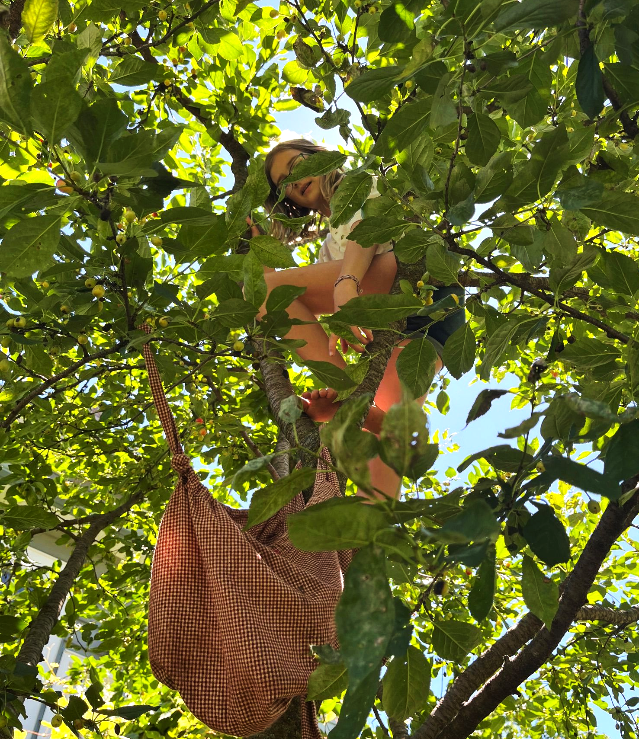
Overview
Introduction
What is a Food Forest?
7 Layers
Benefits
Sample Designs
Food Forest Plants
Common Questions
Q&A

Slide 3
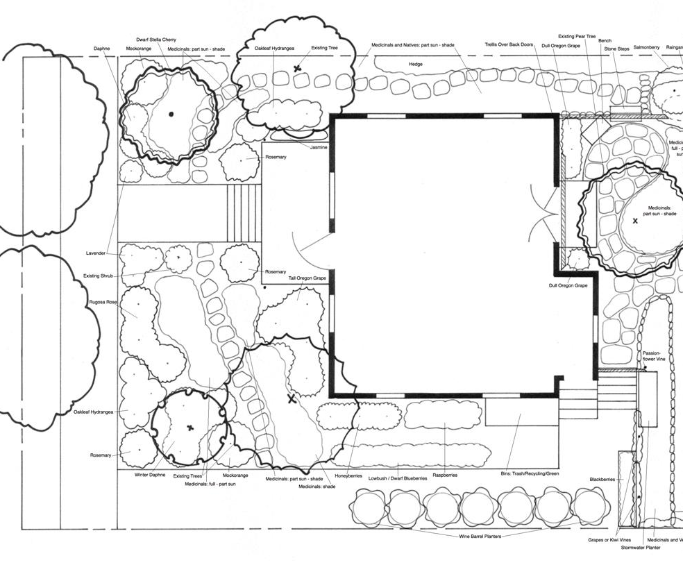
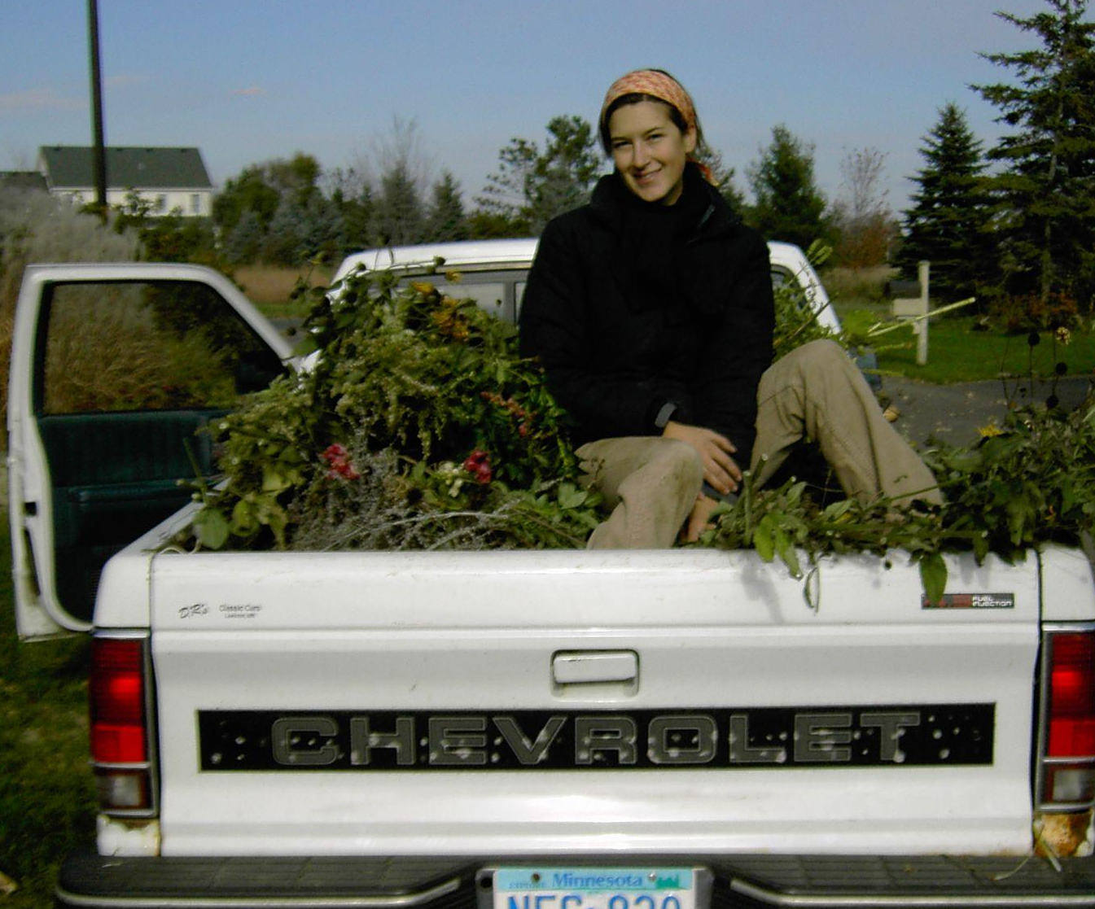
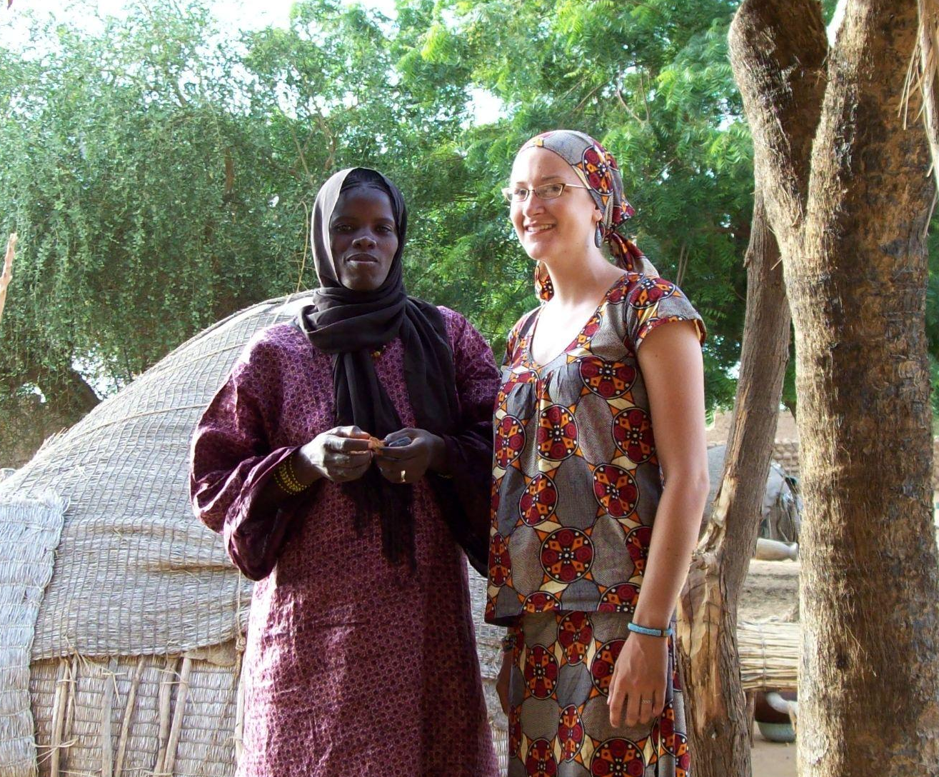
Rachel’s Journey
BS Horticulture & Landscape Design
Dirty Knees Gardening
Peace Corps in Mali, West Africa
Notes:
background and experiences that inform my garden style and approach + Magna + permaculture discovery (system of design that focuses on relationships between things rather than each separate part)

Slide 4
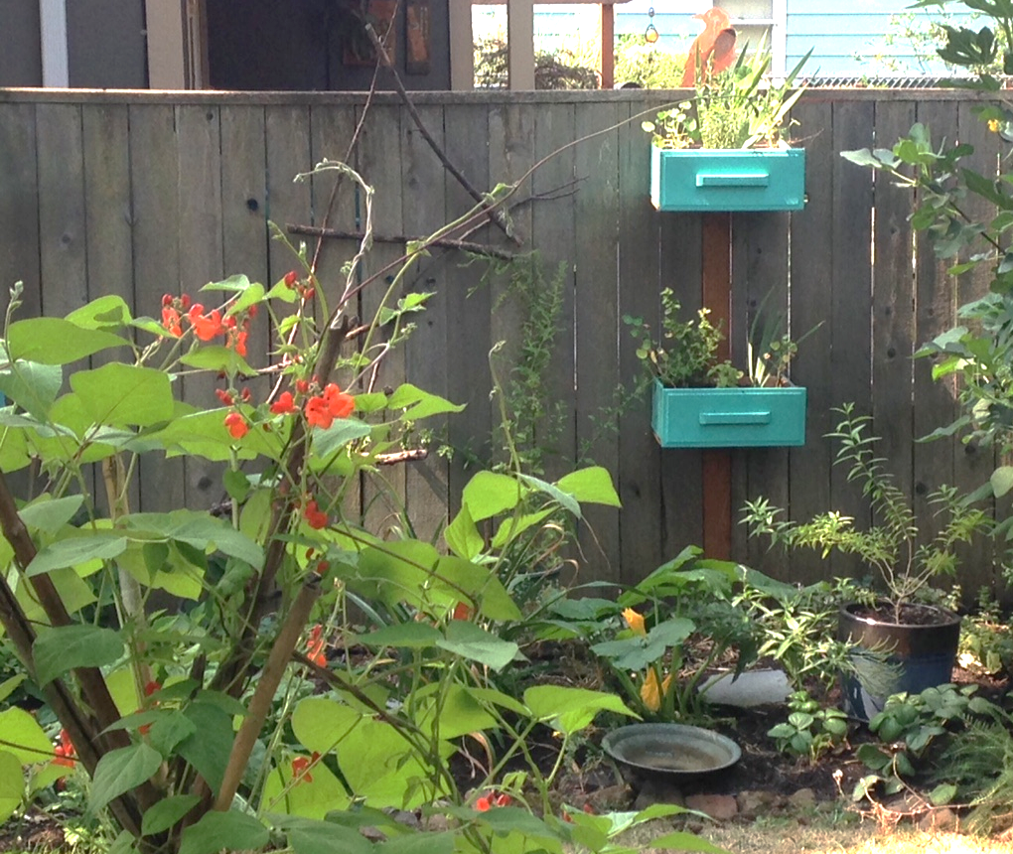
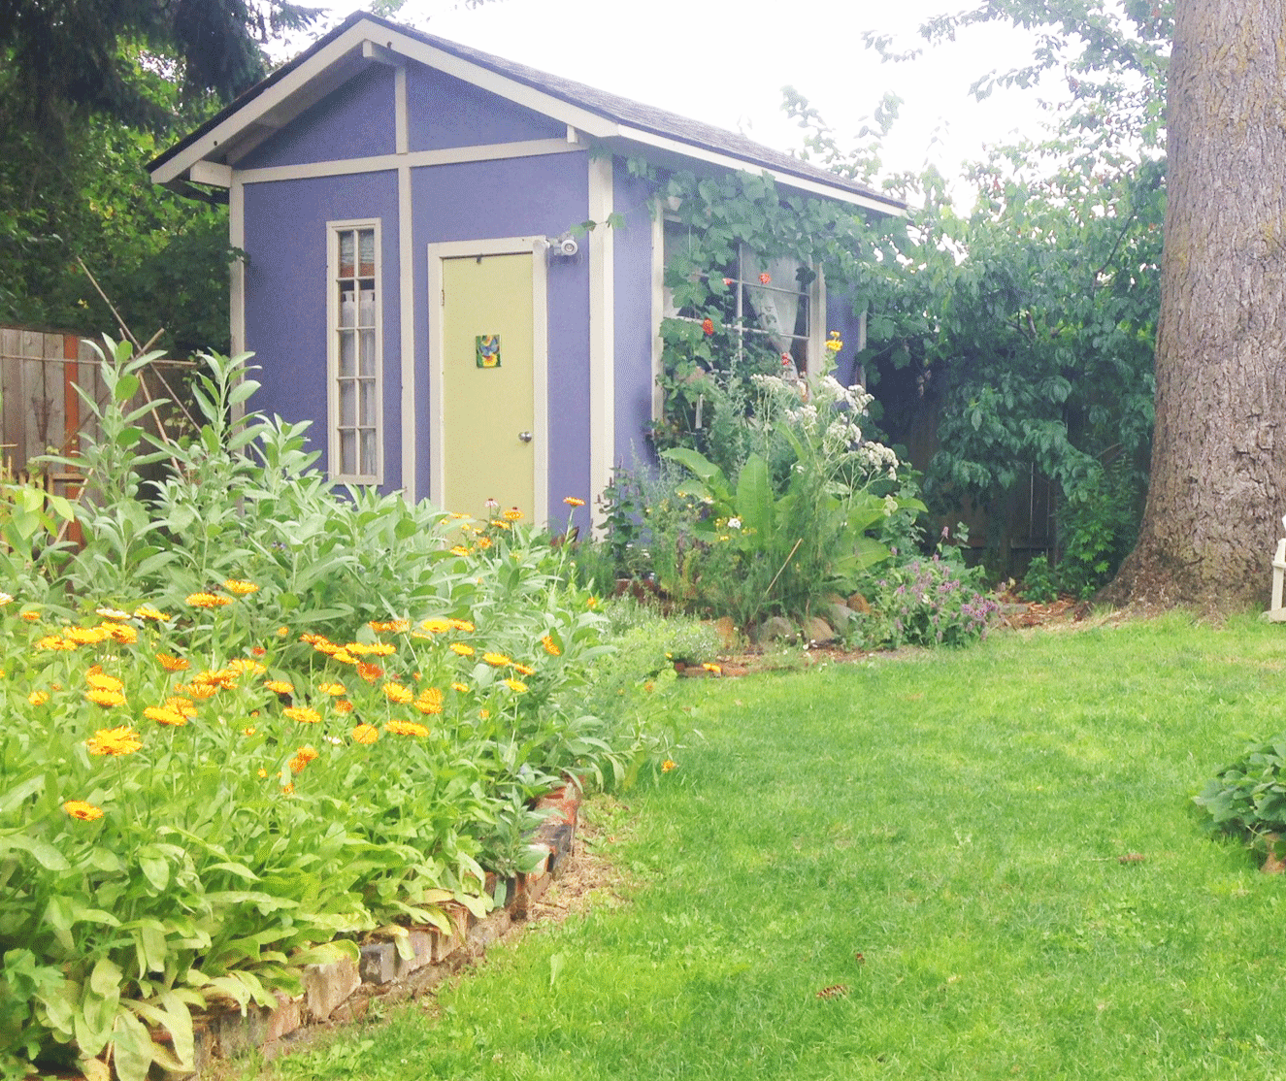
Rachel’s Journey
Permaculture & Herbal Medicine
Edible Landscape Design

Slide 5
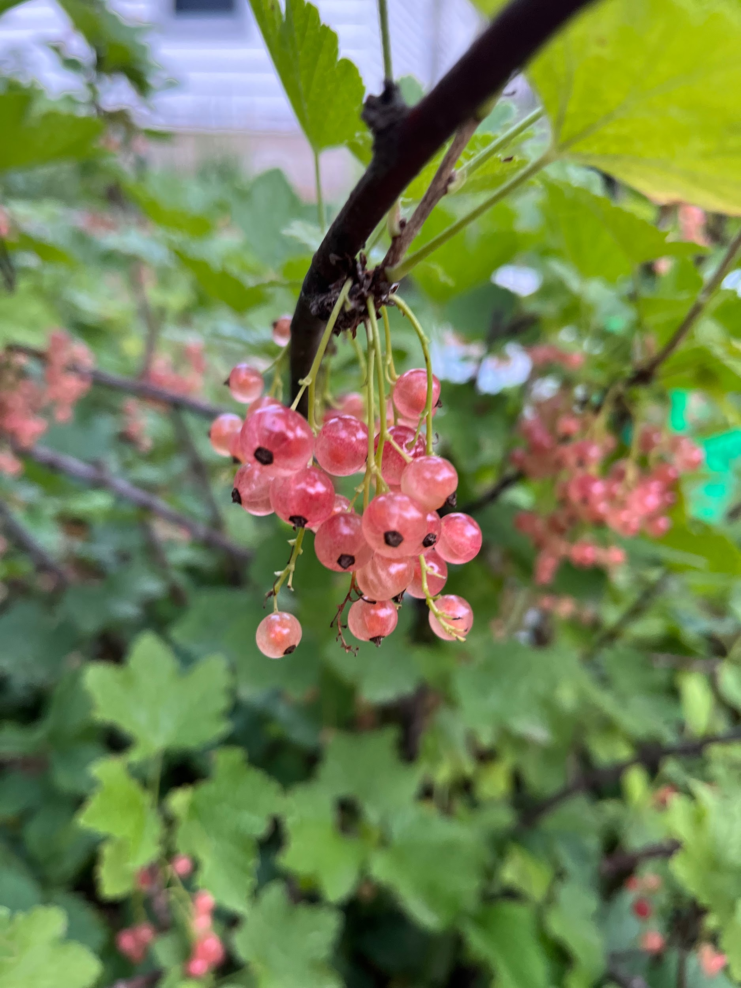
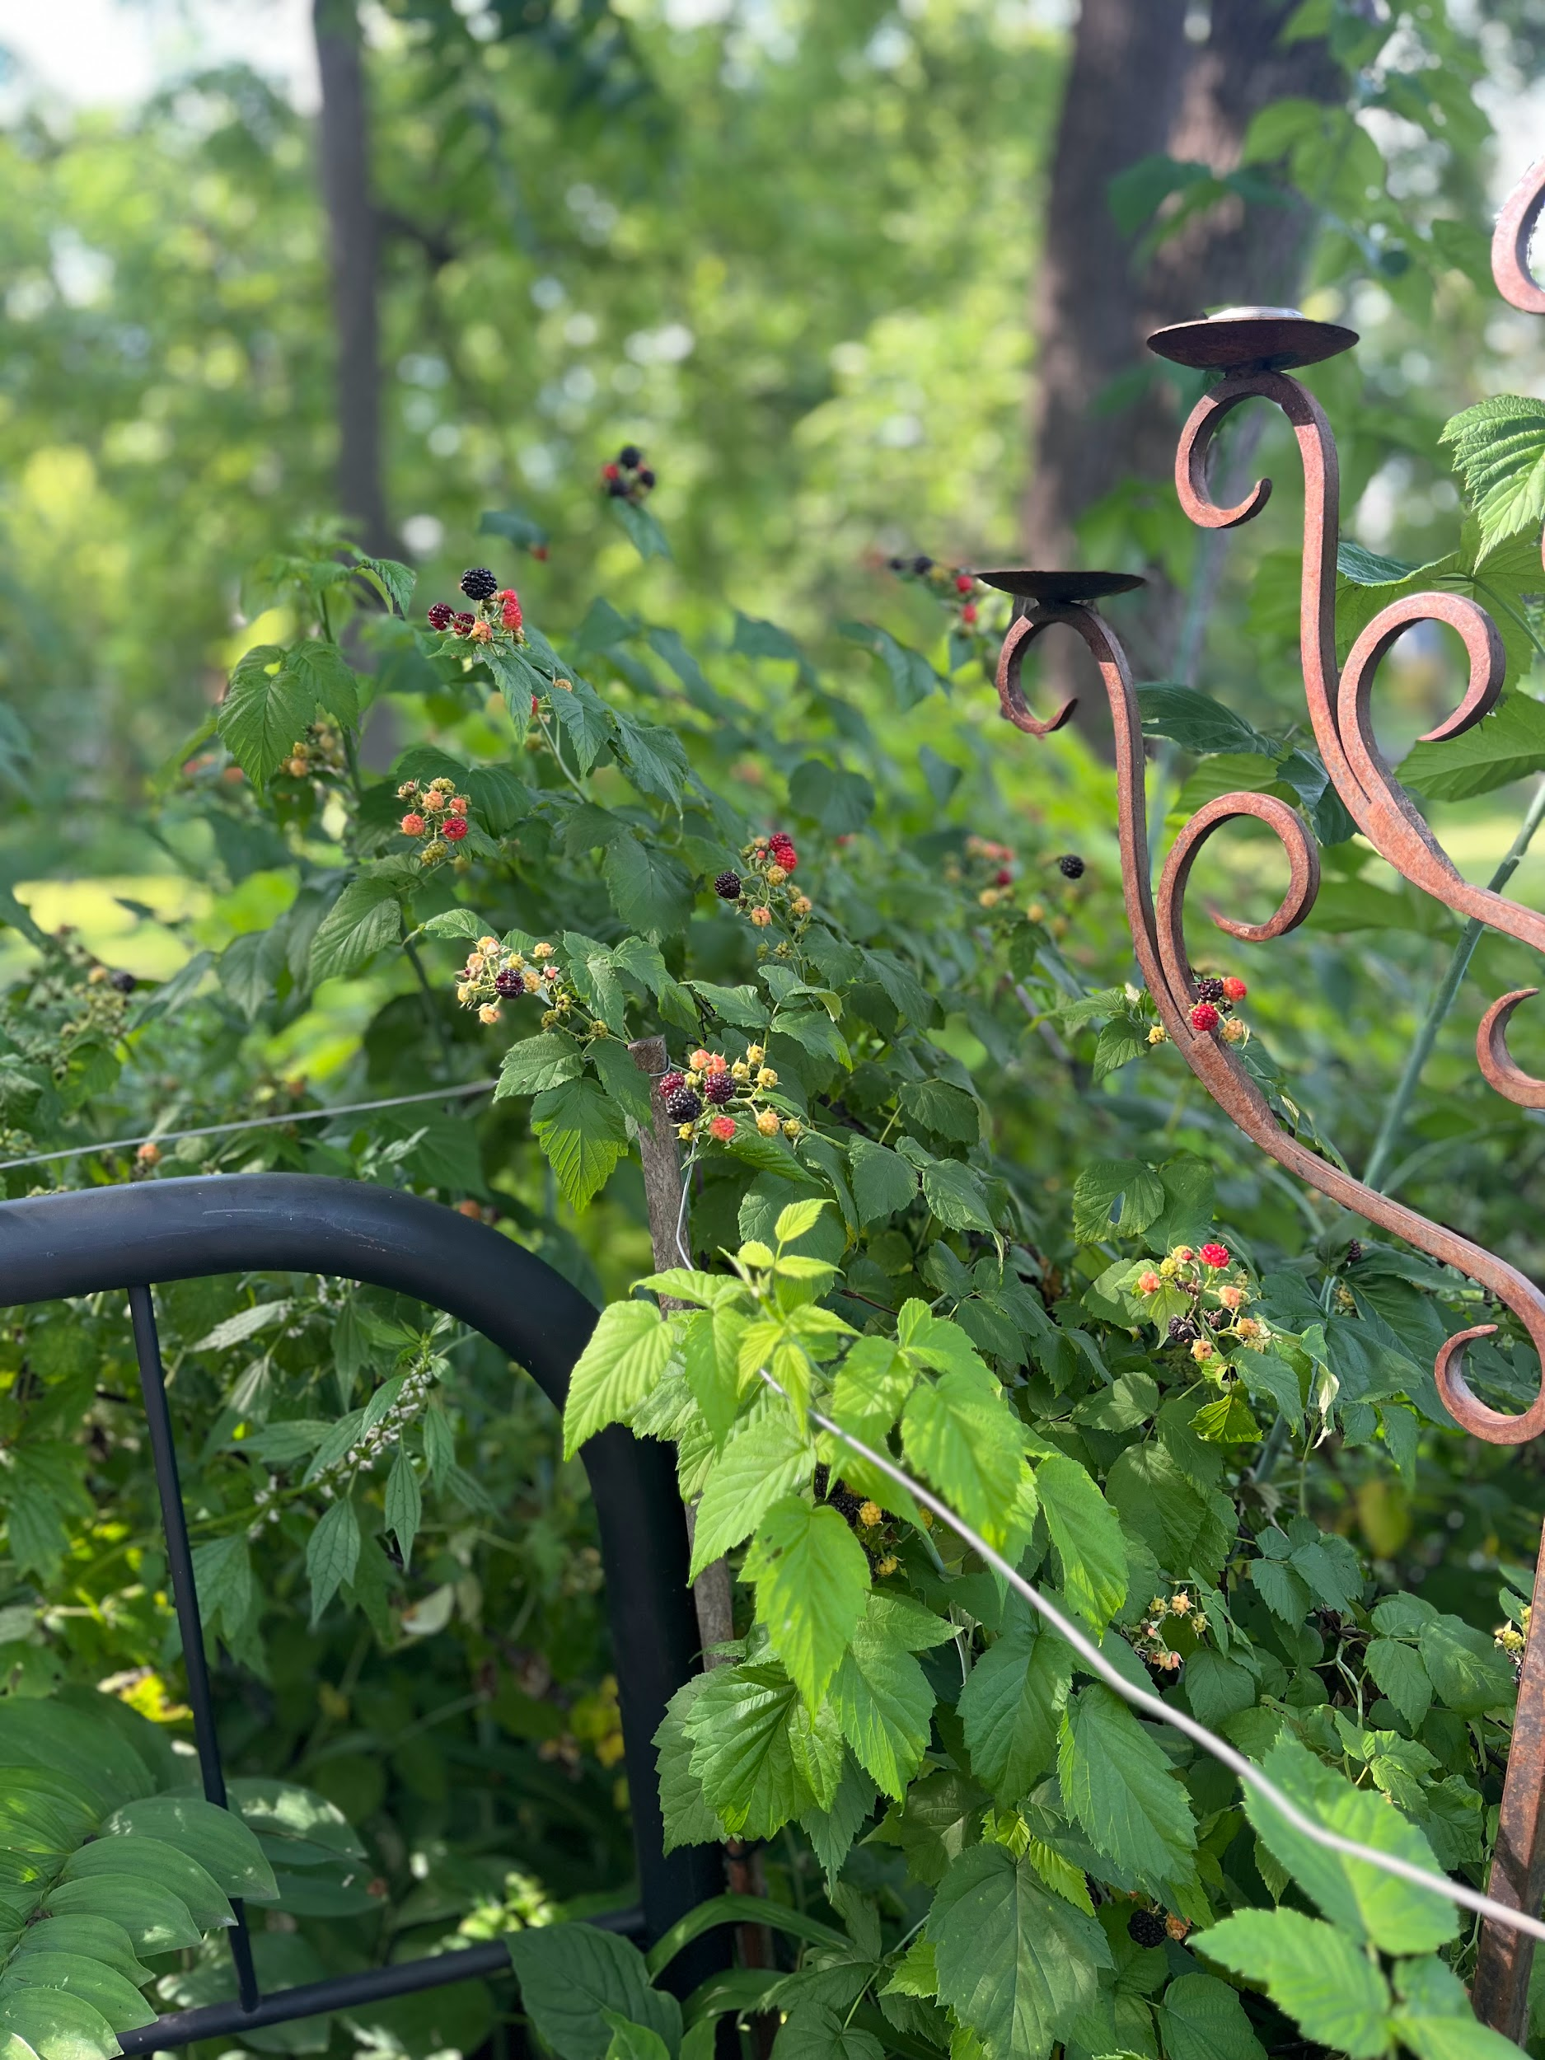
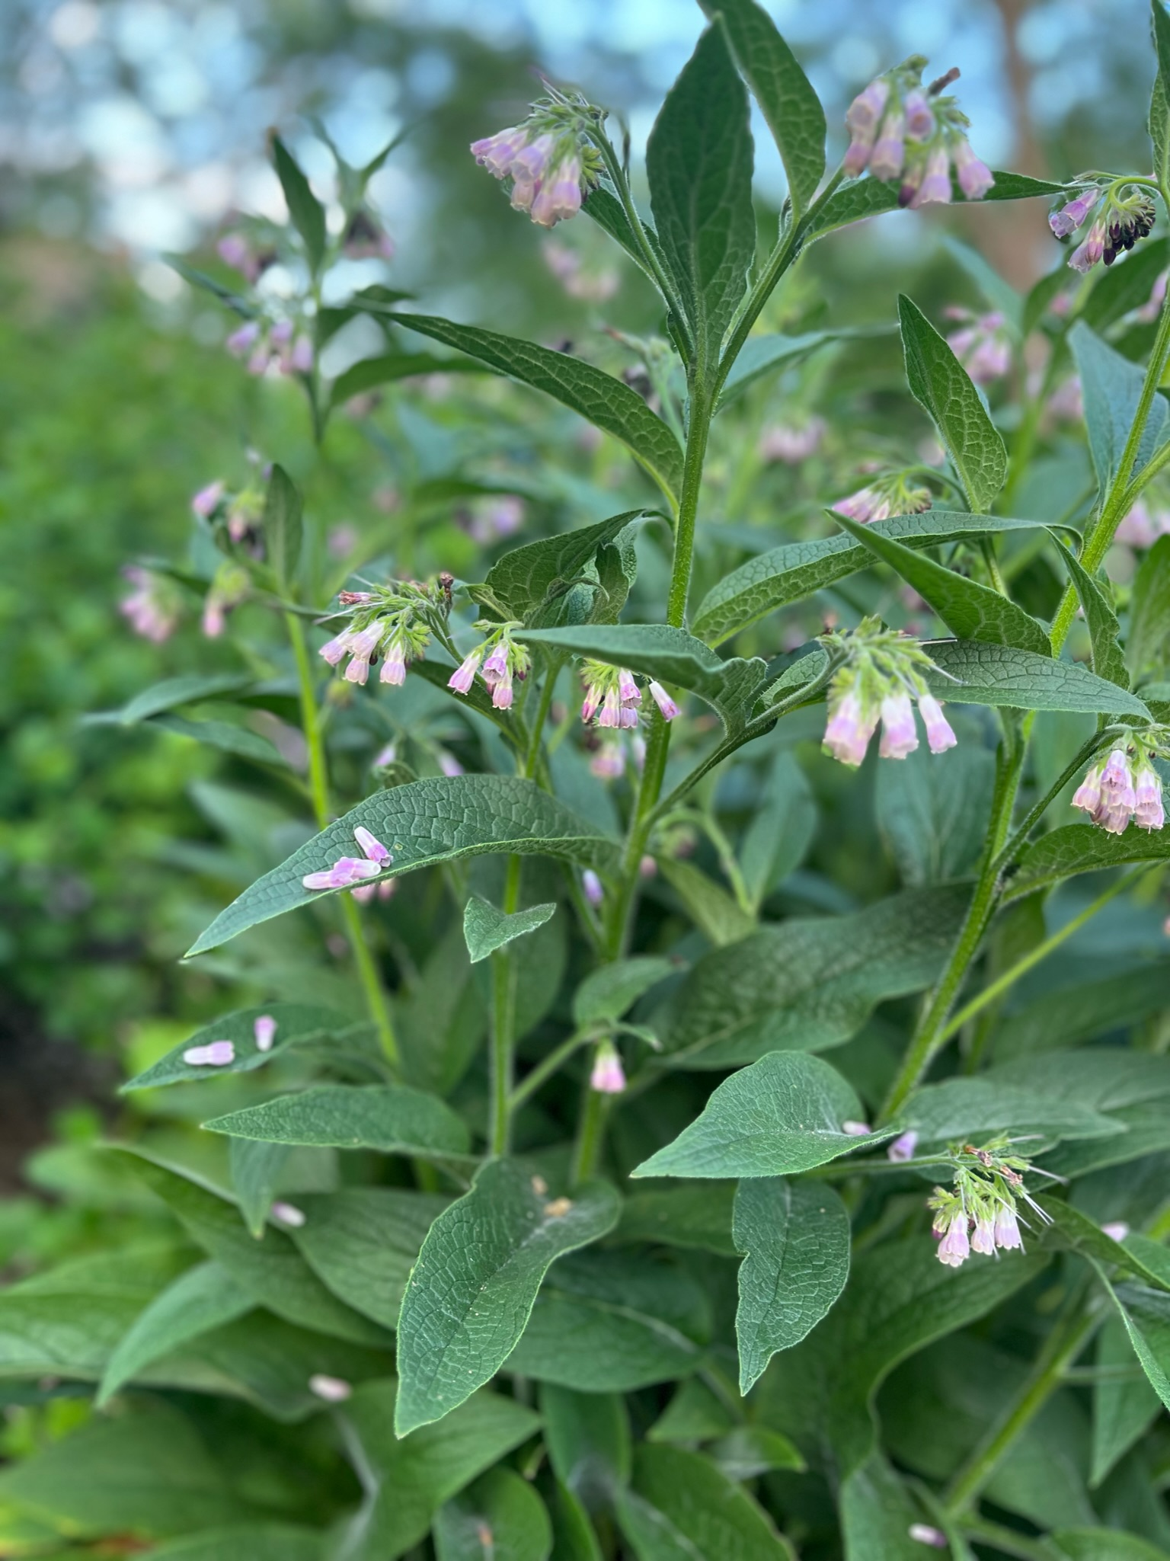
What is a Food Forest?

Slide 6
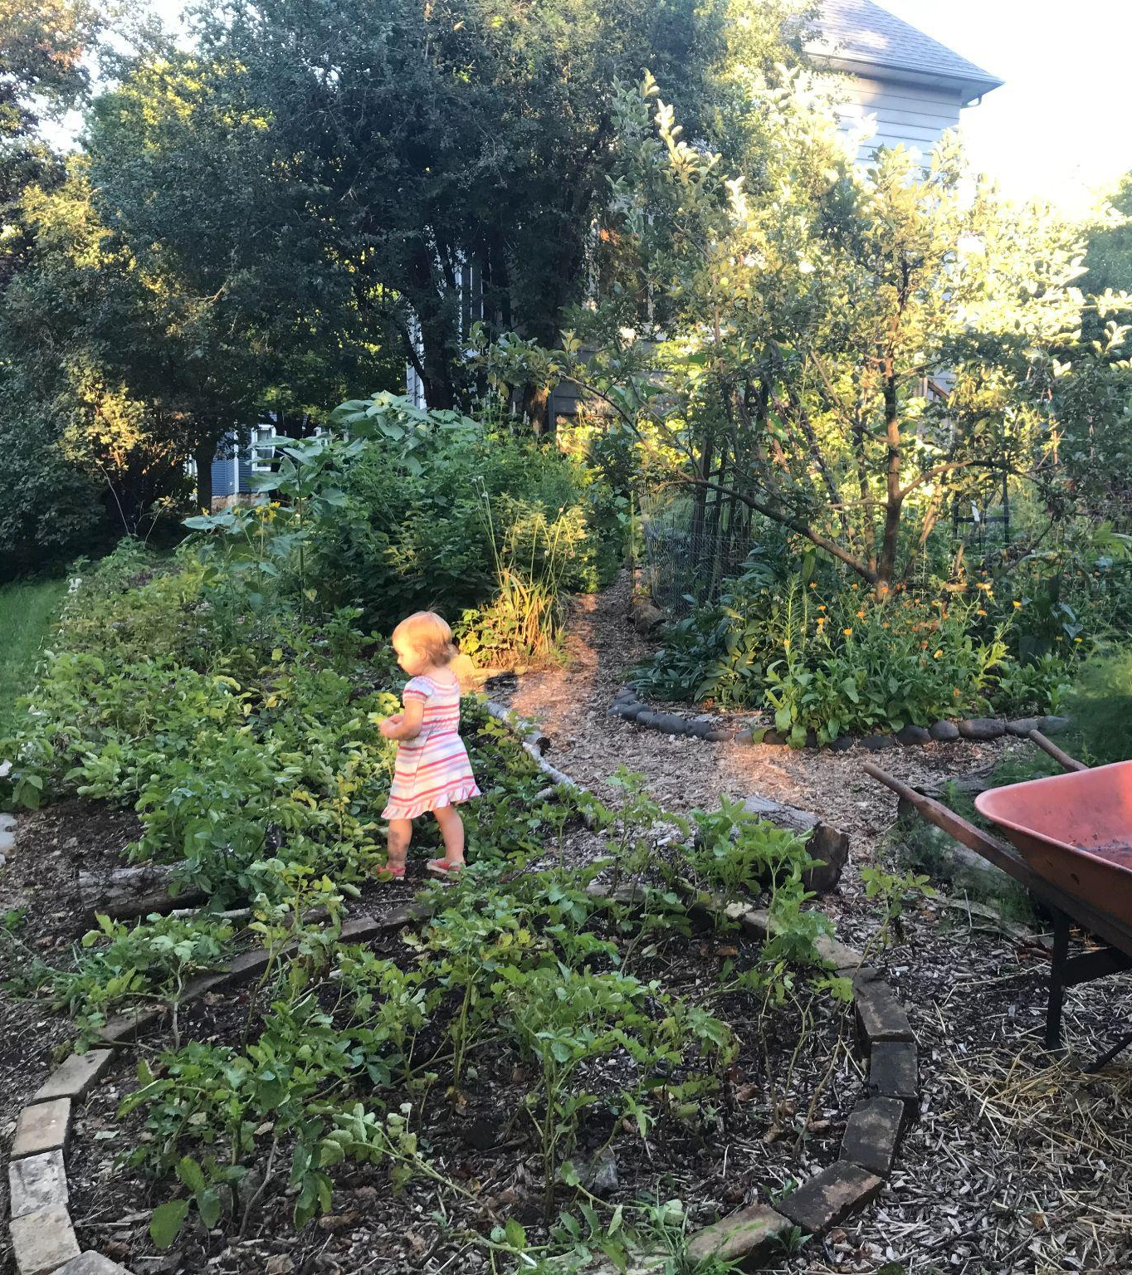
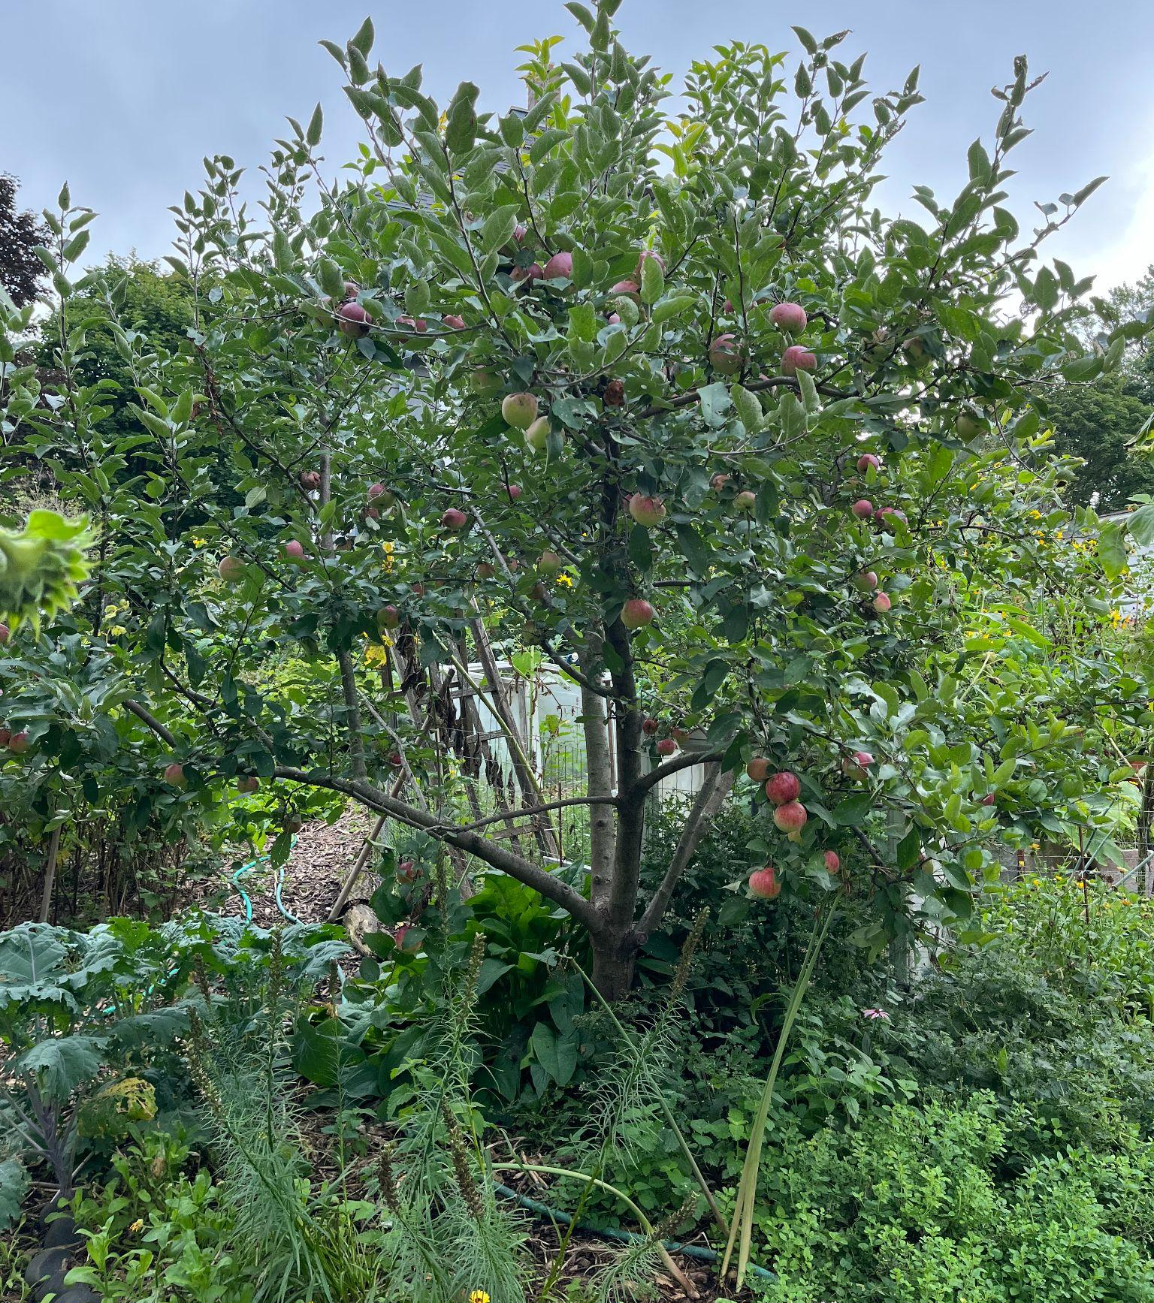
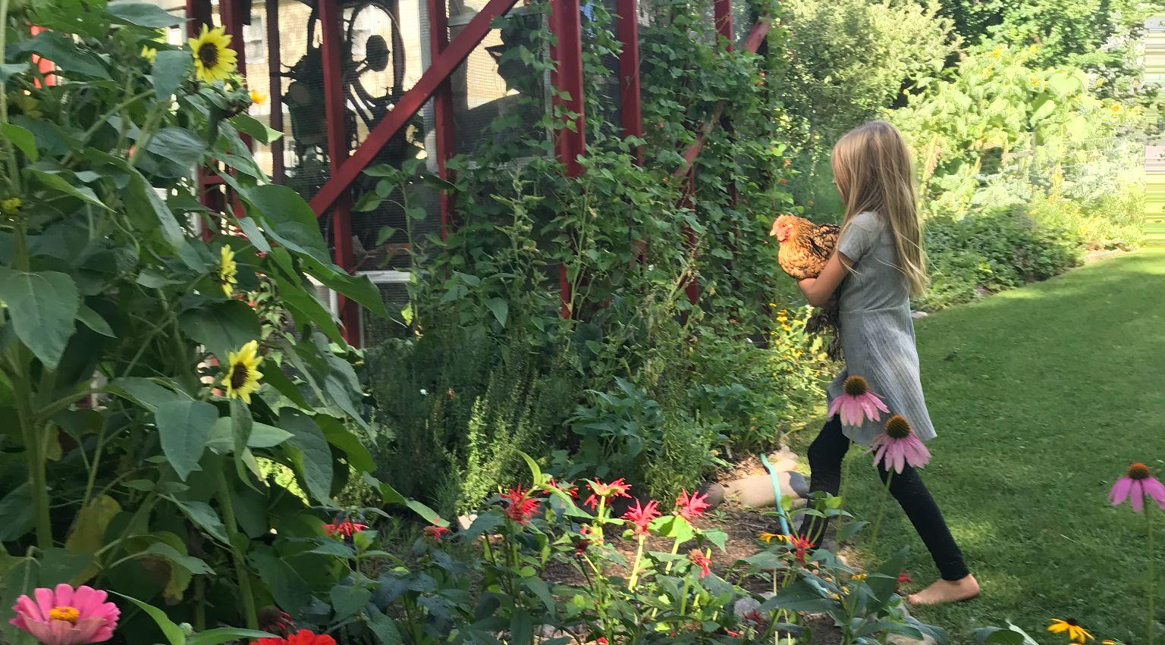
A food forest mimics how nature works in an actual forest - while growing food.
2022
2020
2021

Slide 7
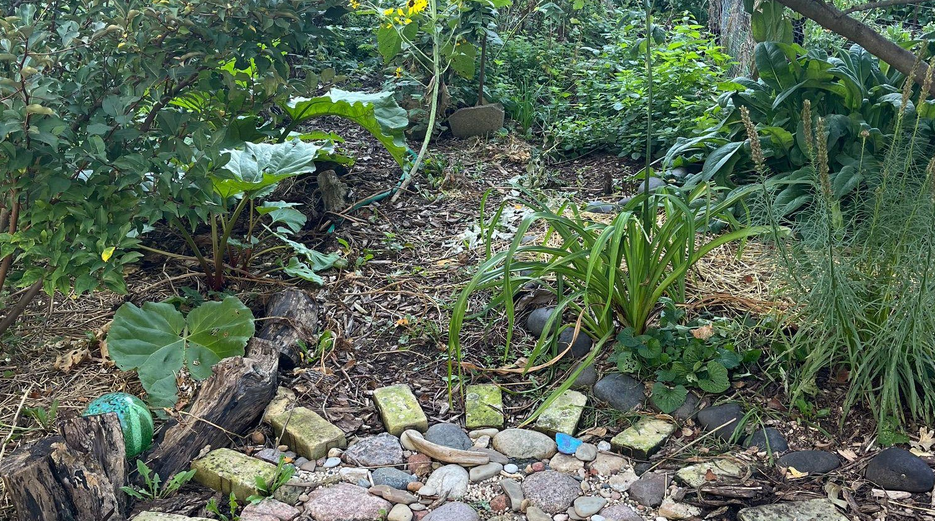
A food forest is a layered garden that creates a self-sustaining ecosystem. It has seven layers, from roots to tall trees, allowing various plants to grow together. This design boosts biodiversity and strengthens the ecosystem. By including edible plants, a food forest supports sustainable food production and creates a healthy environment for many plants and animals.

Slide 8
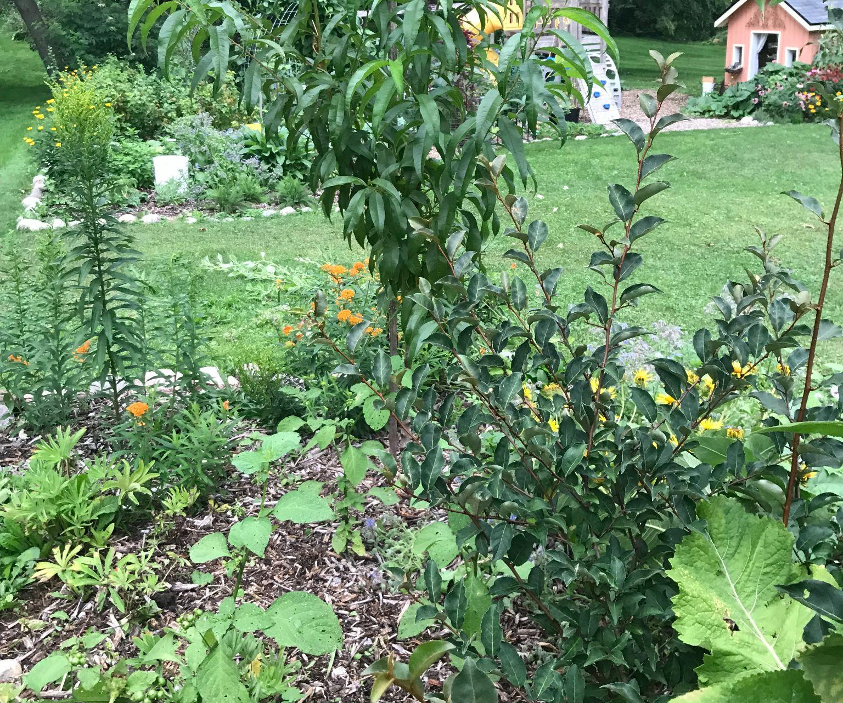
In a forest, humans are not needed to constantly tend and care for plants.
partly self-sustaining =
less work!
What does this mean for you?
2021

Slide 9
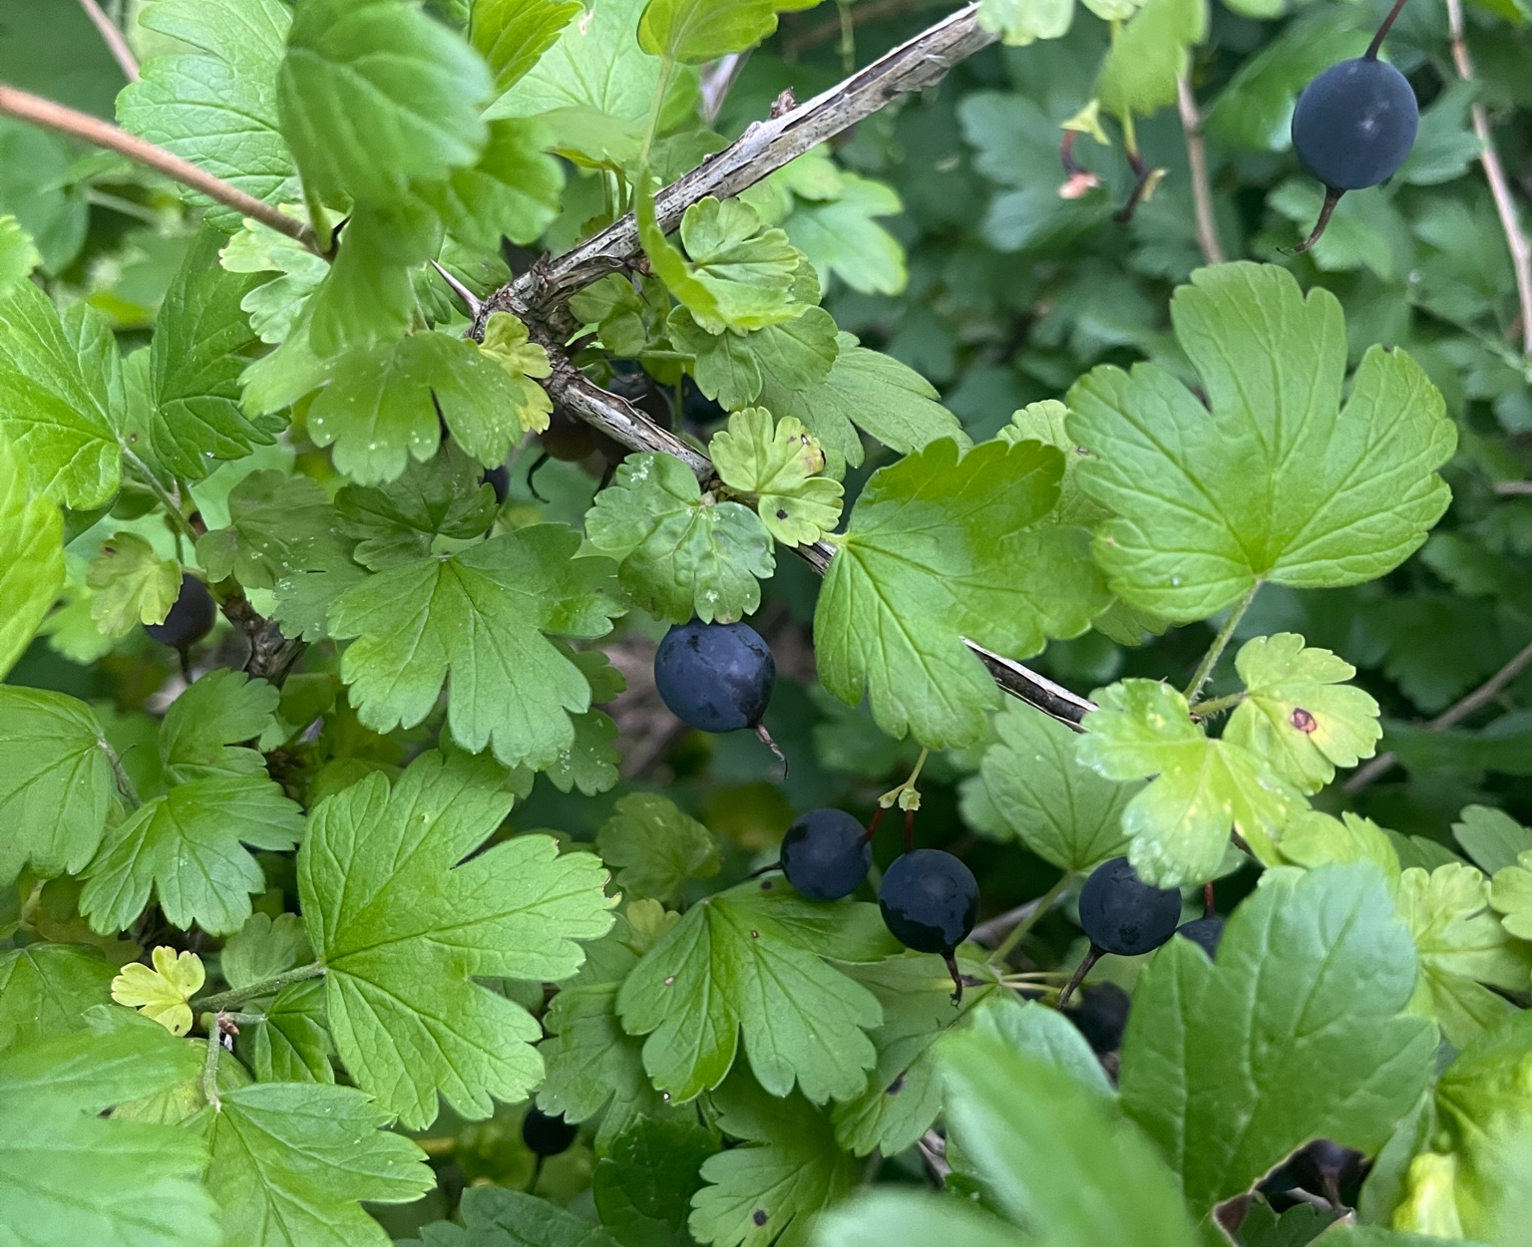
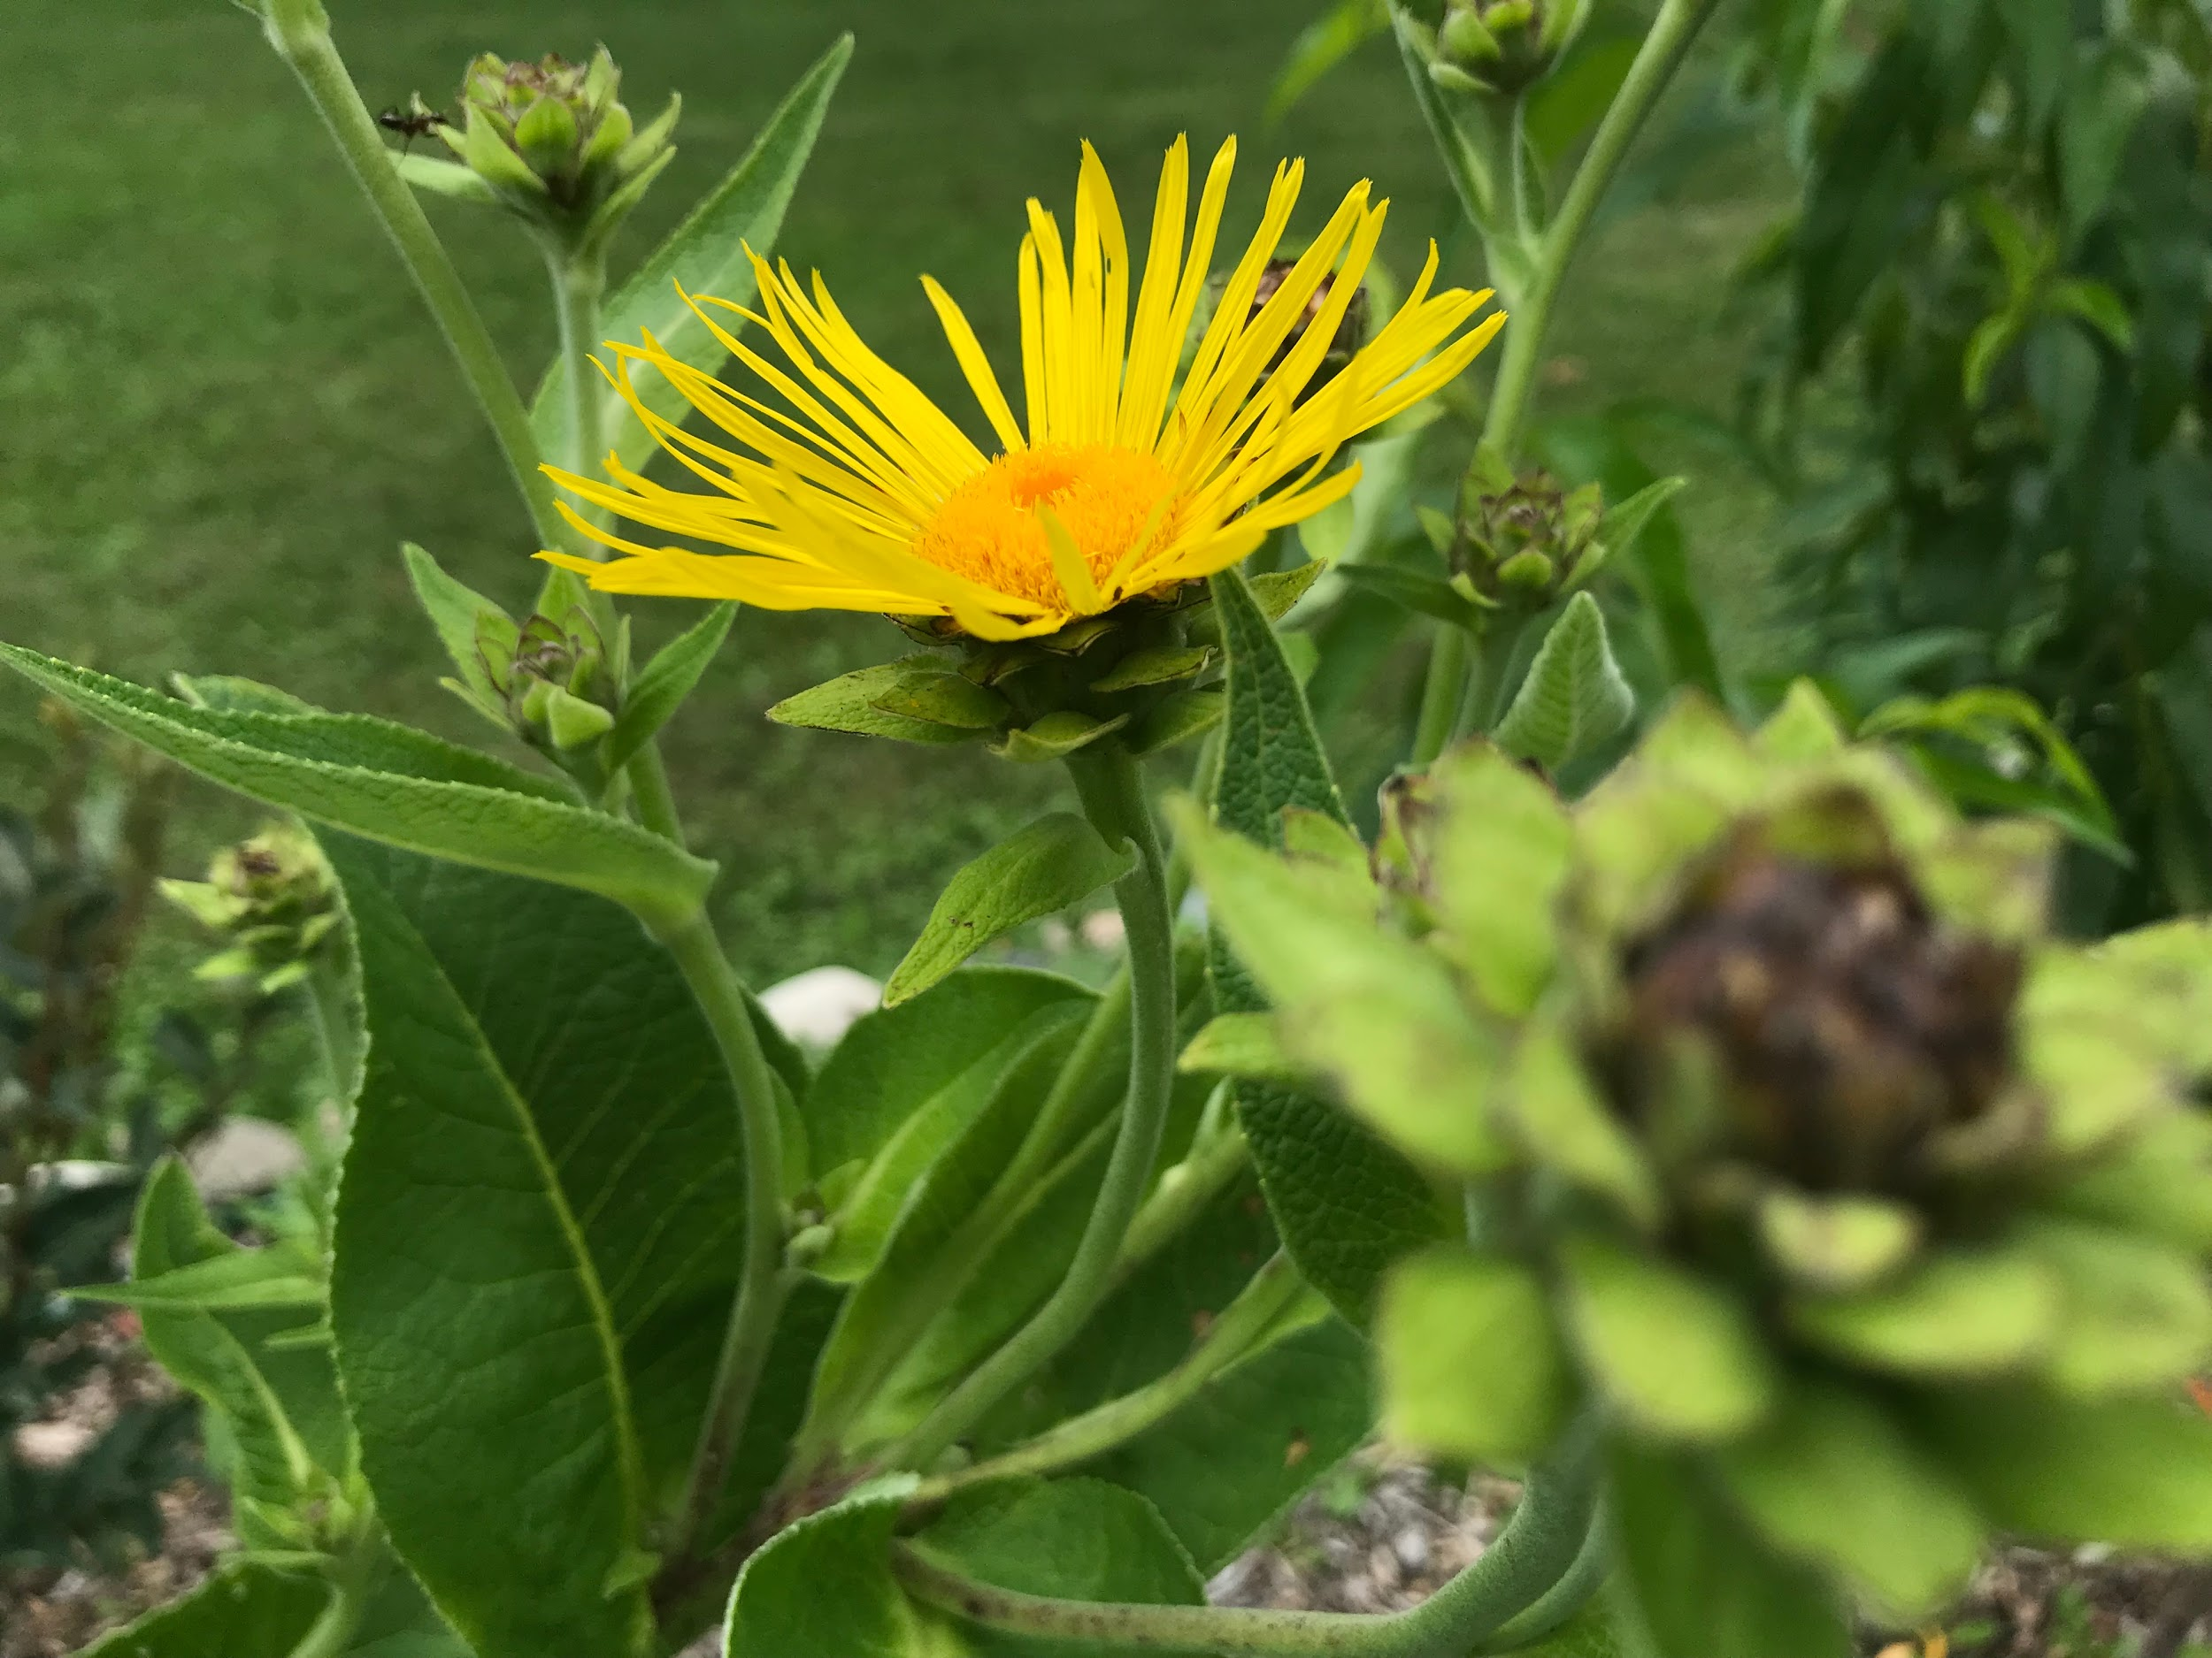
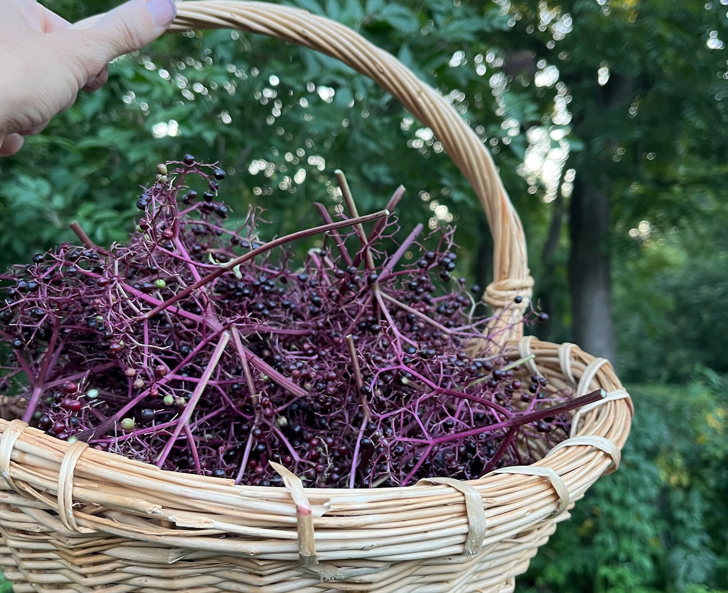
7 Layers of a Food Forest
Notes:
Expected harvests & Functions of each layer

Slide 10
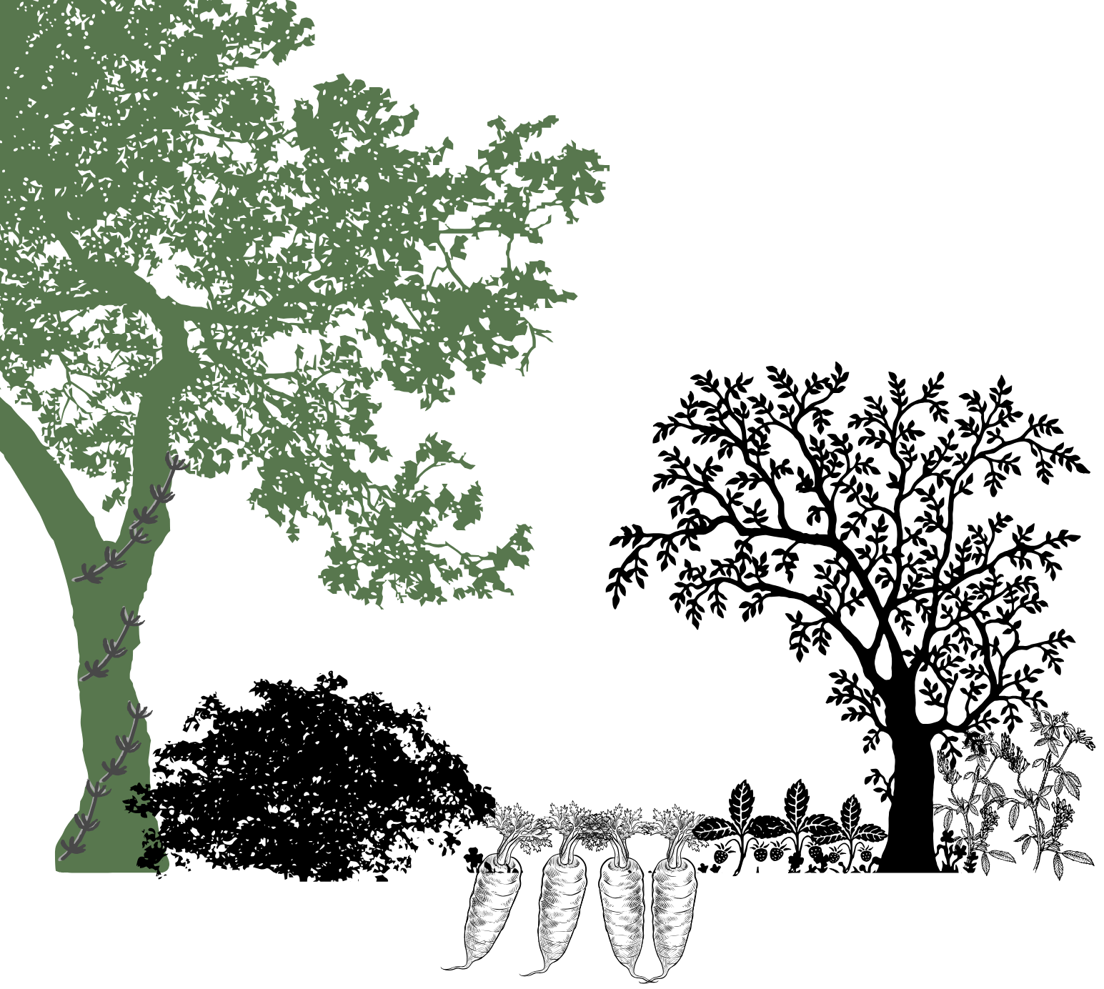
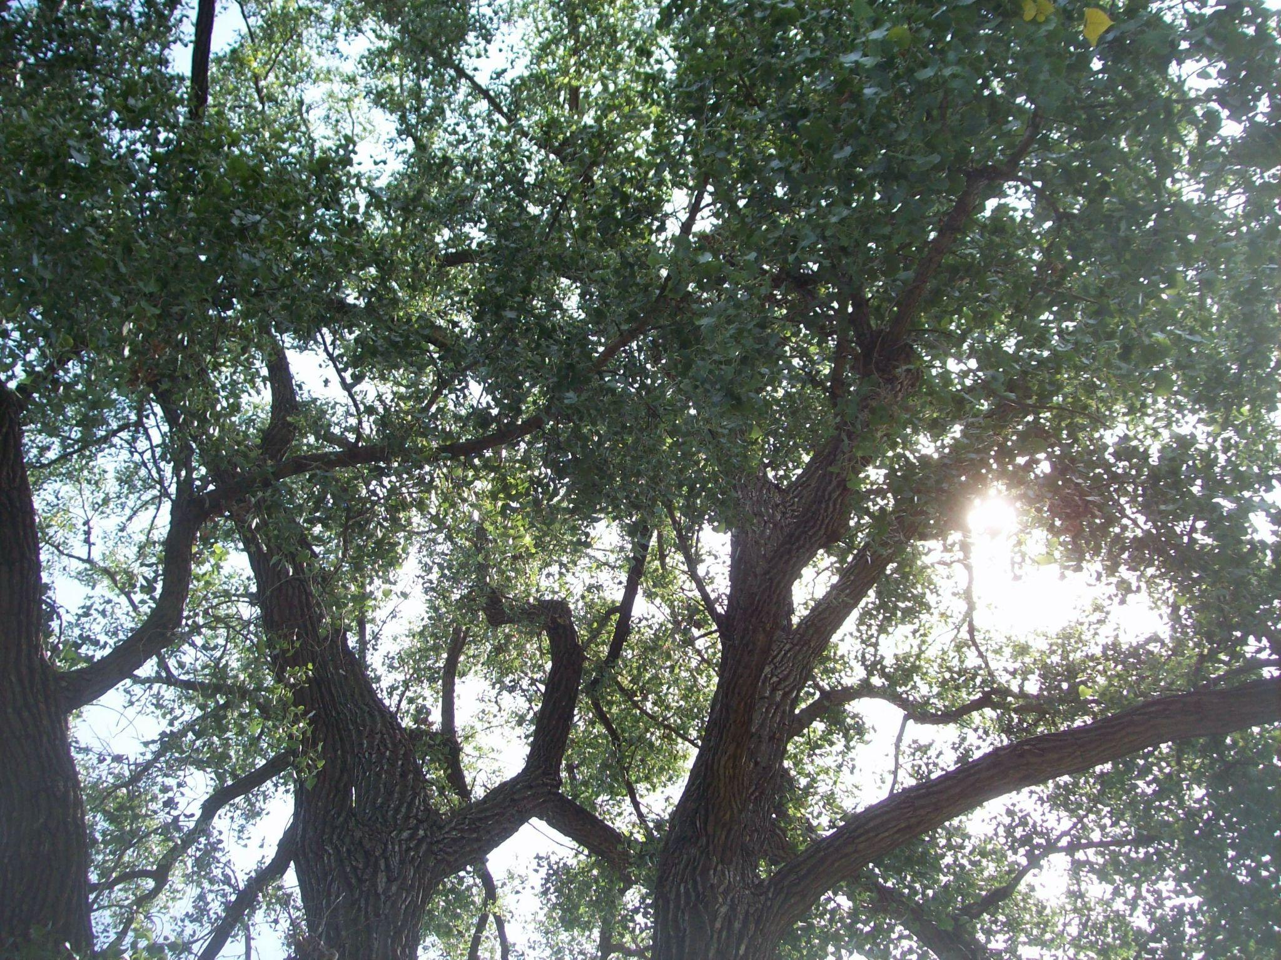
Canopy / Overstory tall trees, 30’+
food (nuts, sap for syrup, fruit) & medicine
recreation & relaxation
shade & oxygen
air quality & climate improvement
conserve water & preserve soil
support wildlife
Notes:
Forest functions & harvests - can skip this layer

Slide 11
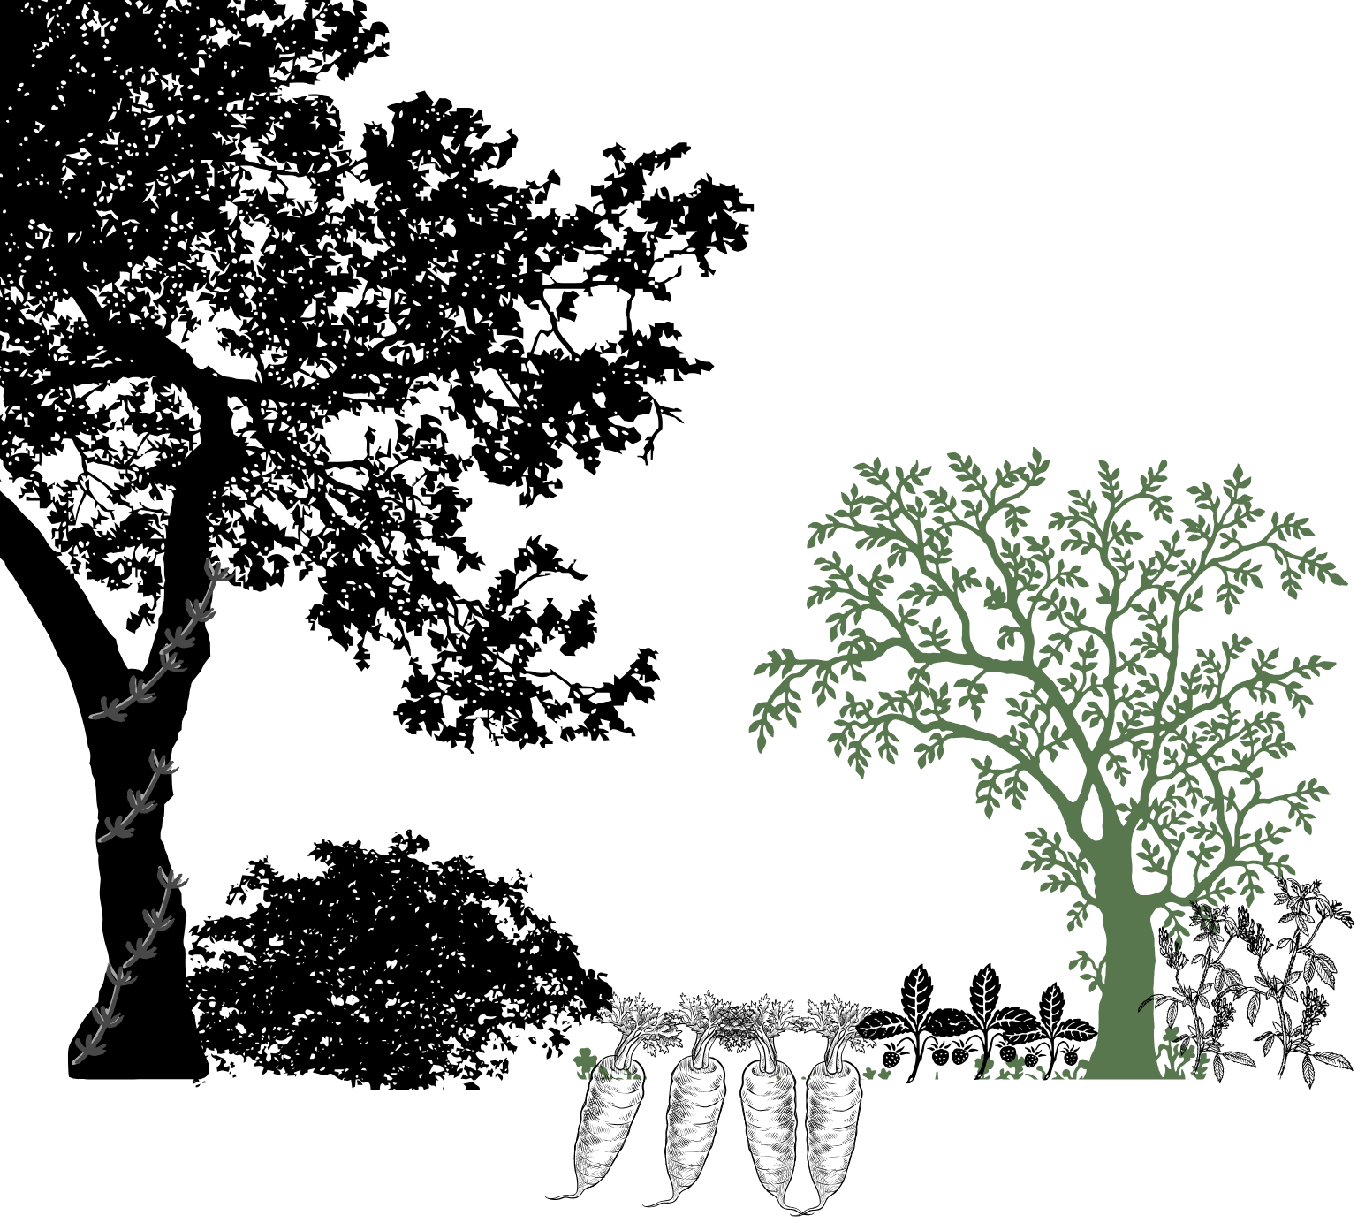

Understory sm. trees & lg. shrubs, 10-30’
food (nuts, fruit) & medicine
recreation (climbing / forts)
shade & oxygen
species diversity
nutrient cycling
protect seedling regeneration
Notes:
Forest functions & harvests

Slide 12
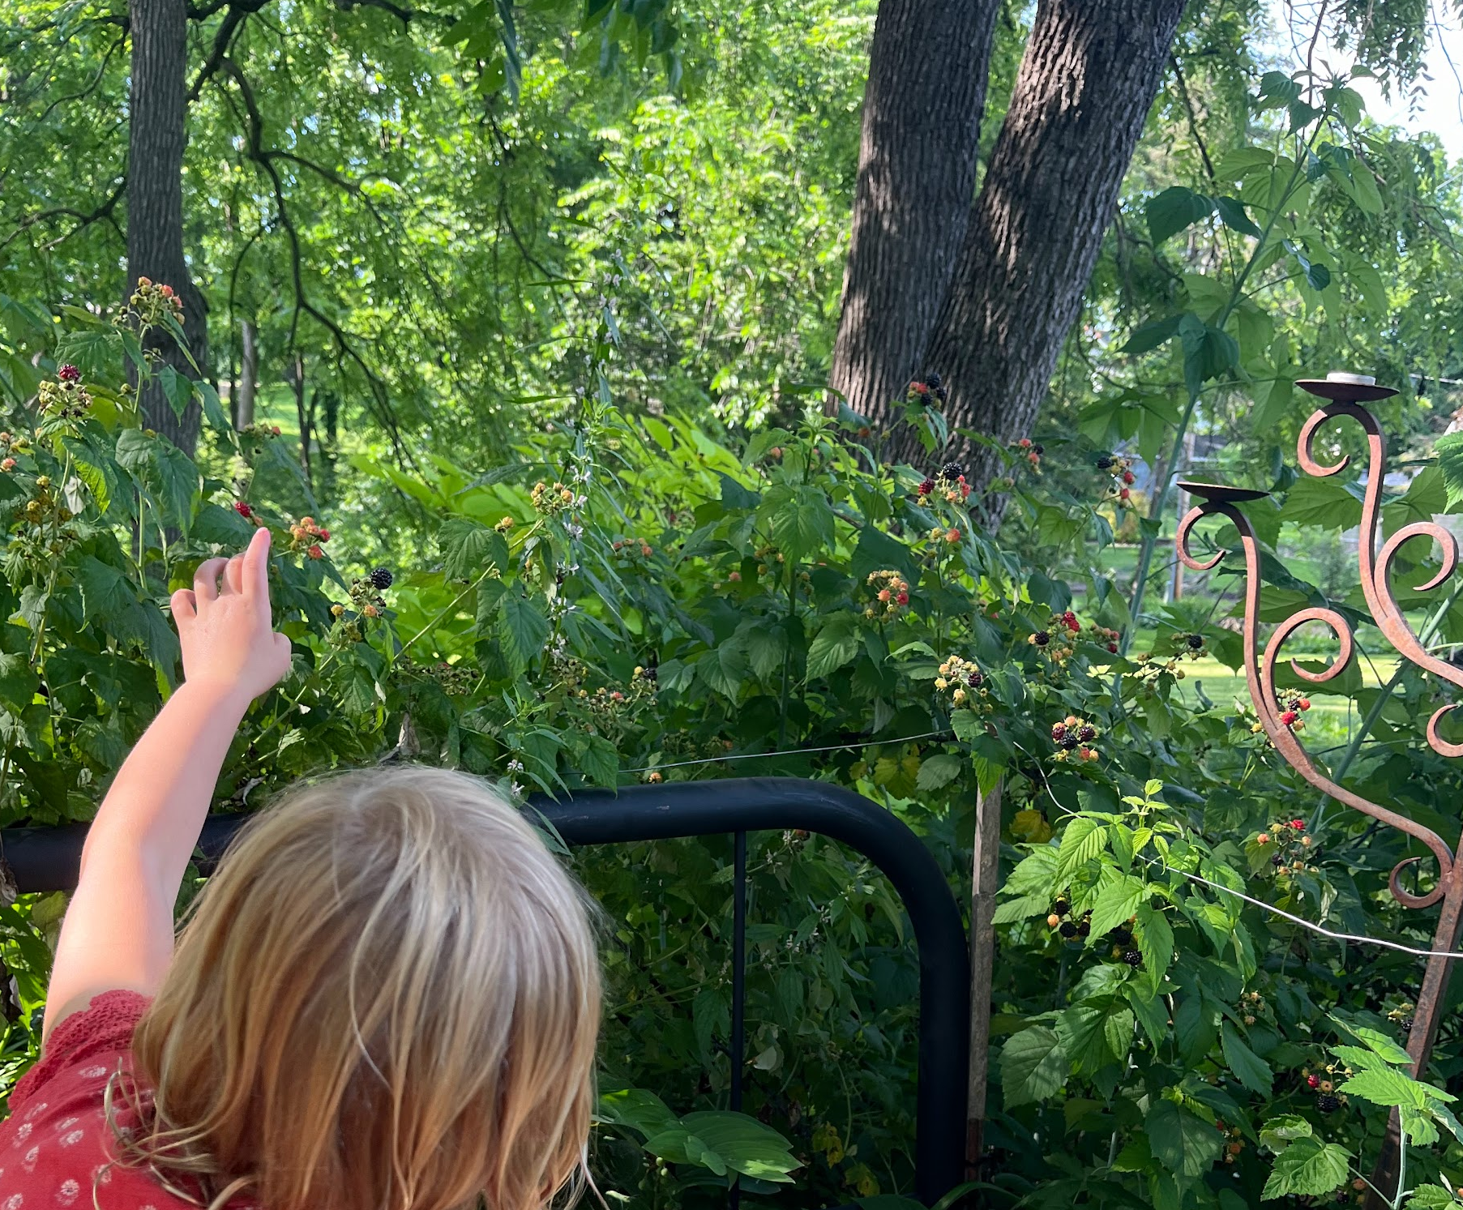
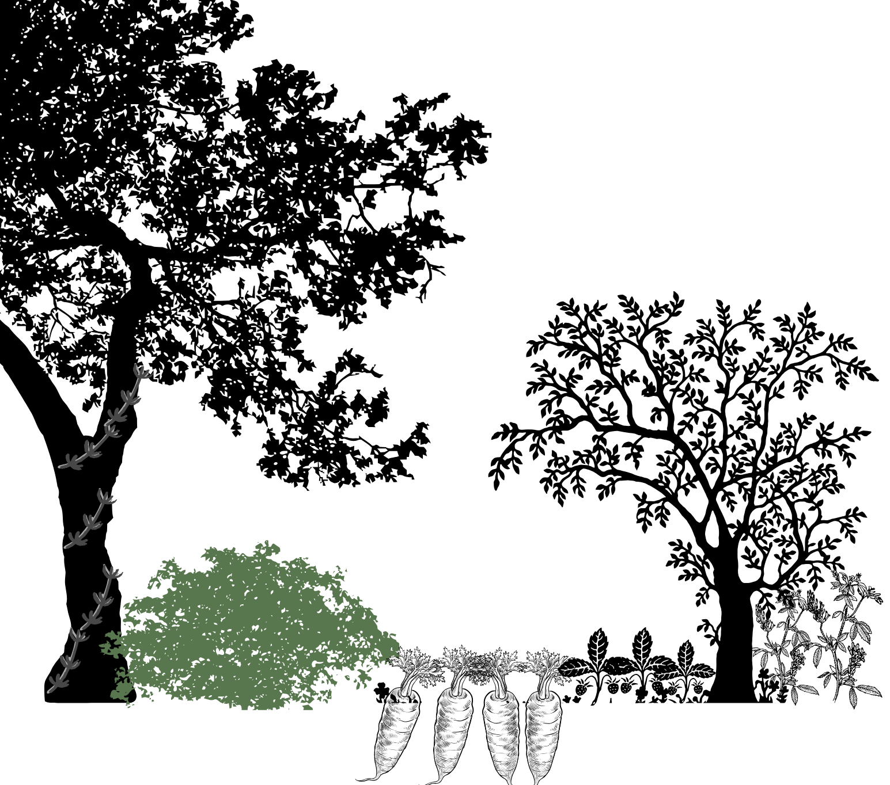
Shrubs woody plants, up to 10’
food (nuts, fruit) & medicine
species diversity
nutrient cycling
protect seedling regeneration
Notes:
Forest functions & harvests

Slide 13
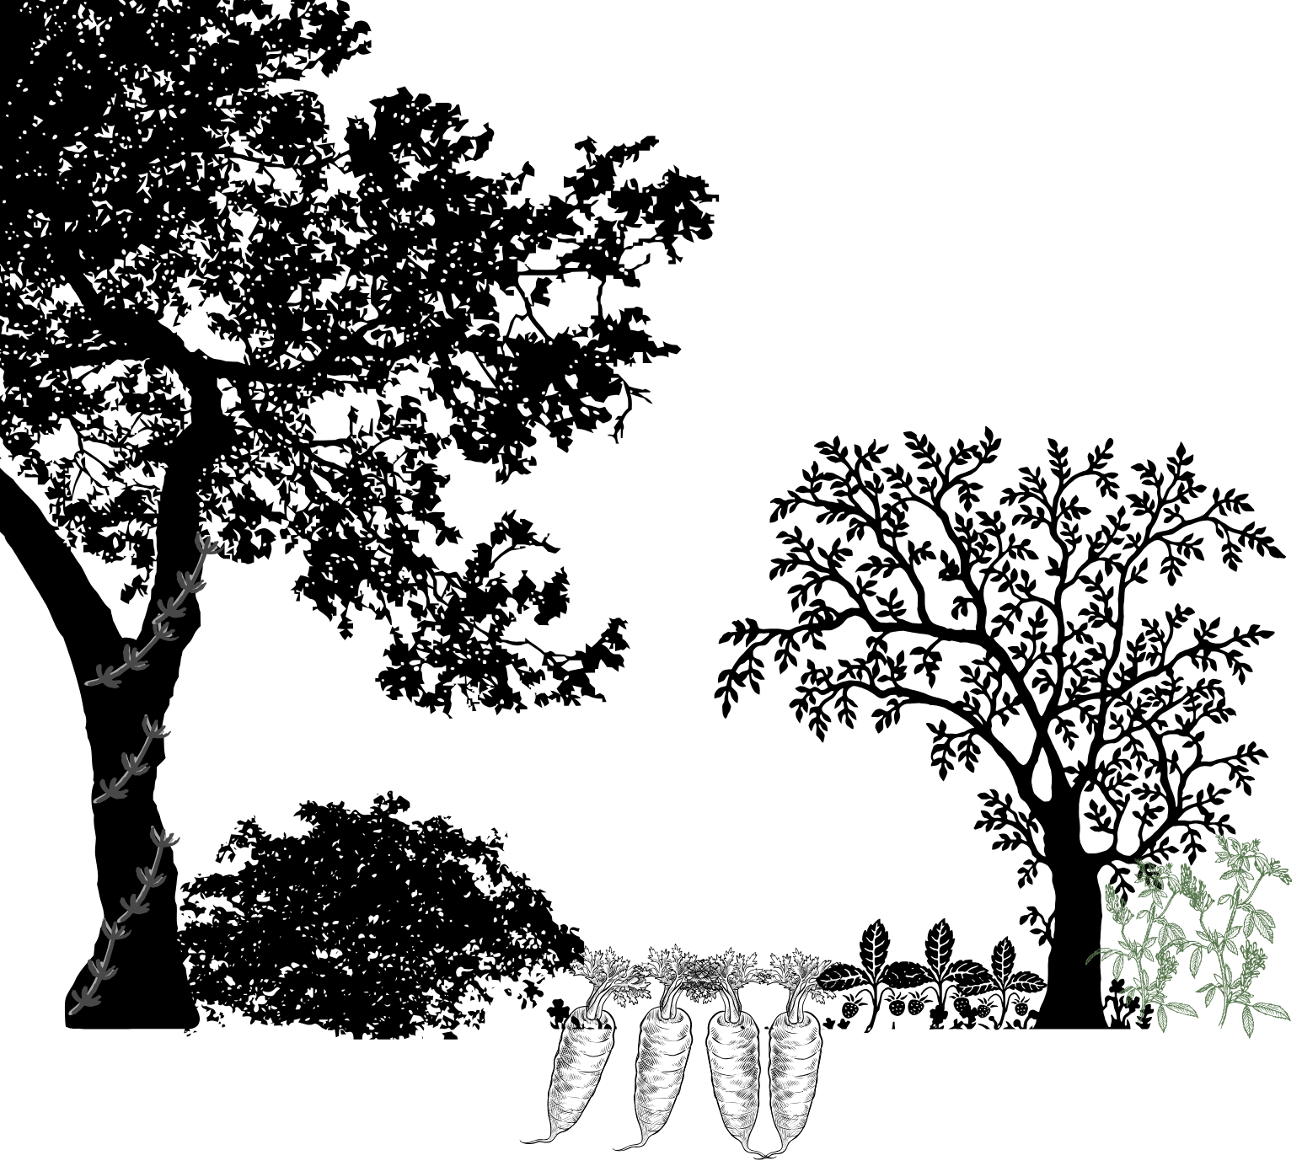
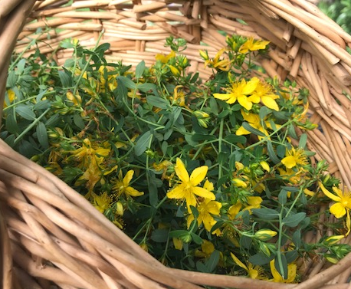
Herbaceous non-woody herbs & flowers
food (edible flowers, tea, culinary herbs, greens) & medicine
fun (crafts, flower pressing, natural dyes, etc.)
repel, confuse, distract pests
ecosystem health & fertility
nitrogen fixation & dynamic accumulation
Notes:
Forest functions & harvests

Slide 14
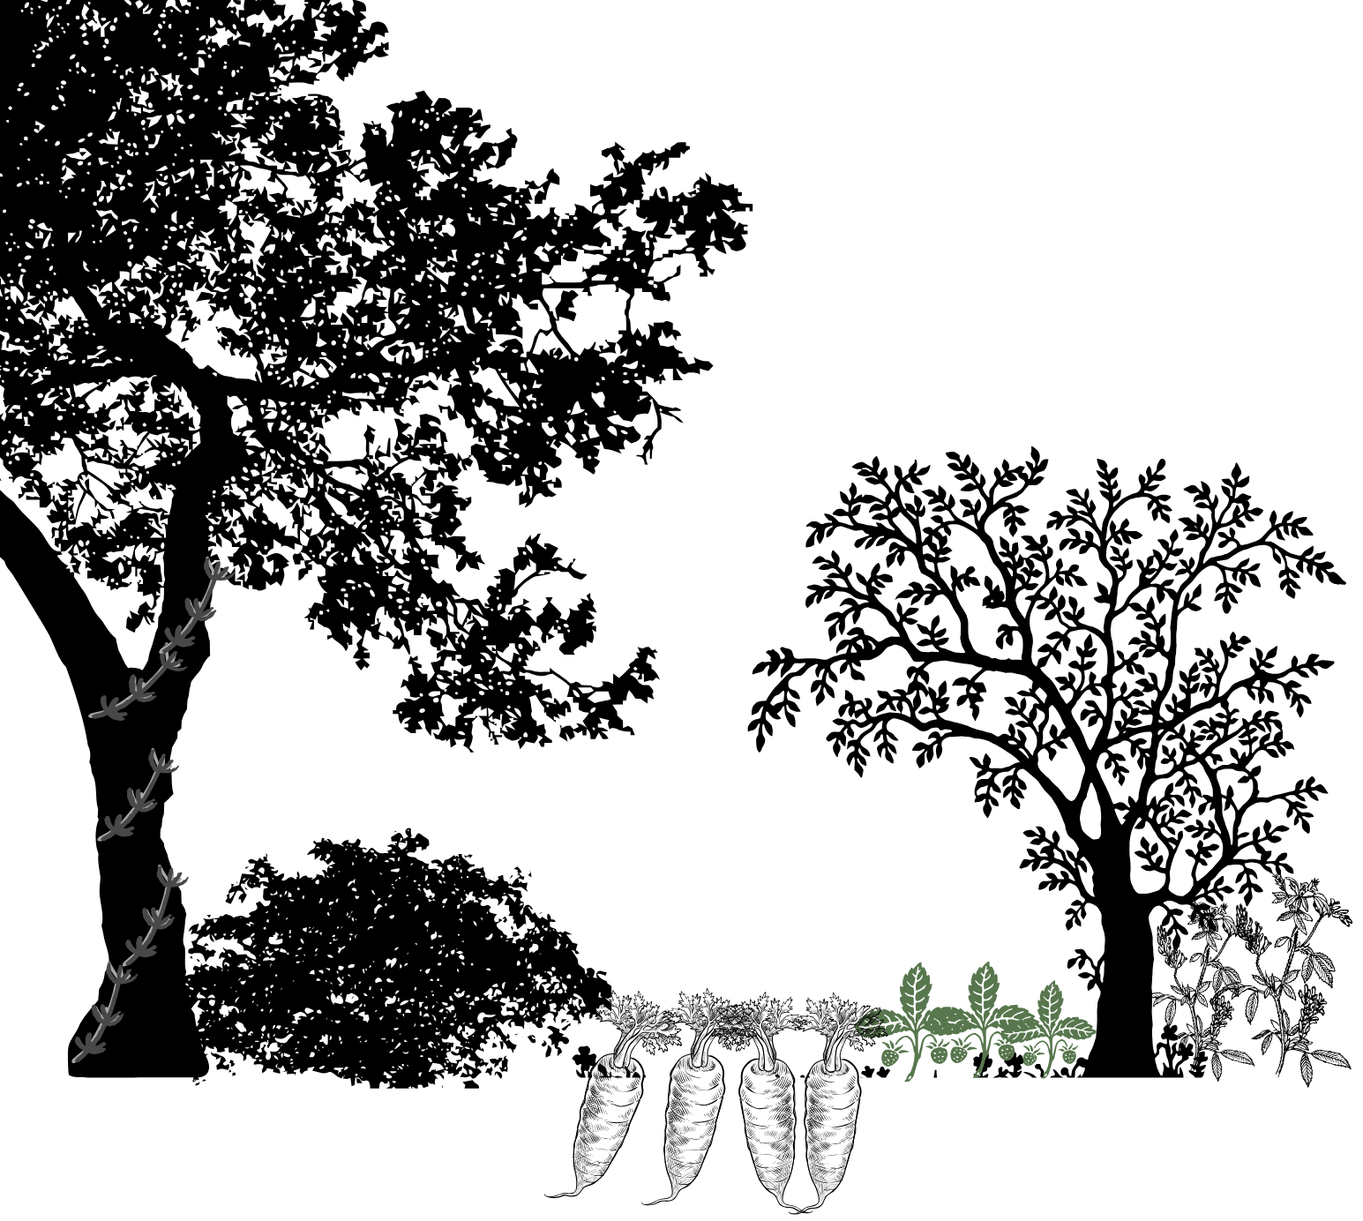
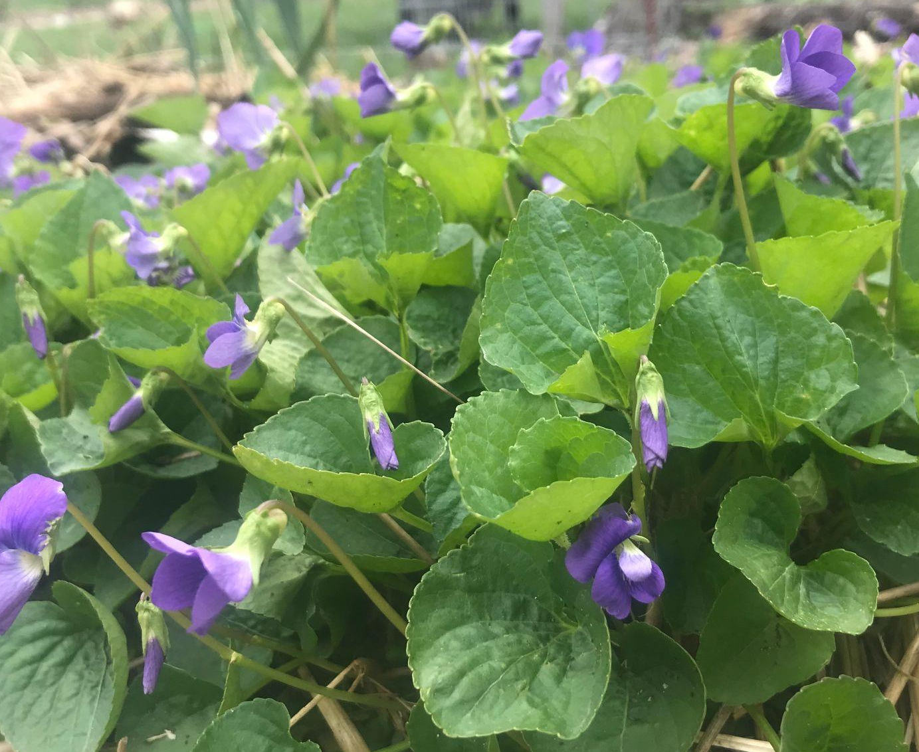
Groundcovers low & spreading
food (fruit, edible flowers, greens, herbs) & medicine
stabilize soil & hold moisture
refuge for small wildlife
prevents unwanted plants
Notes:
Forest functions & harvests

Slide 15
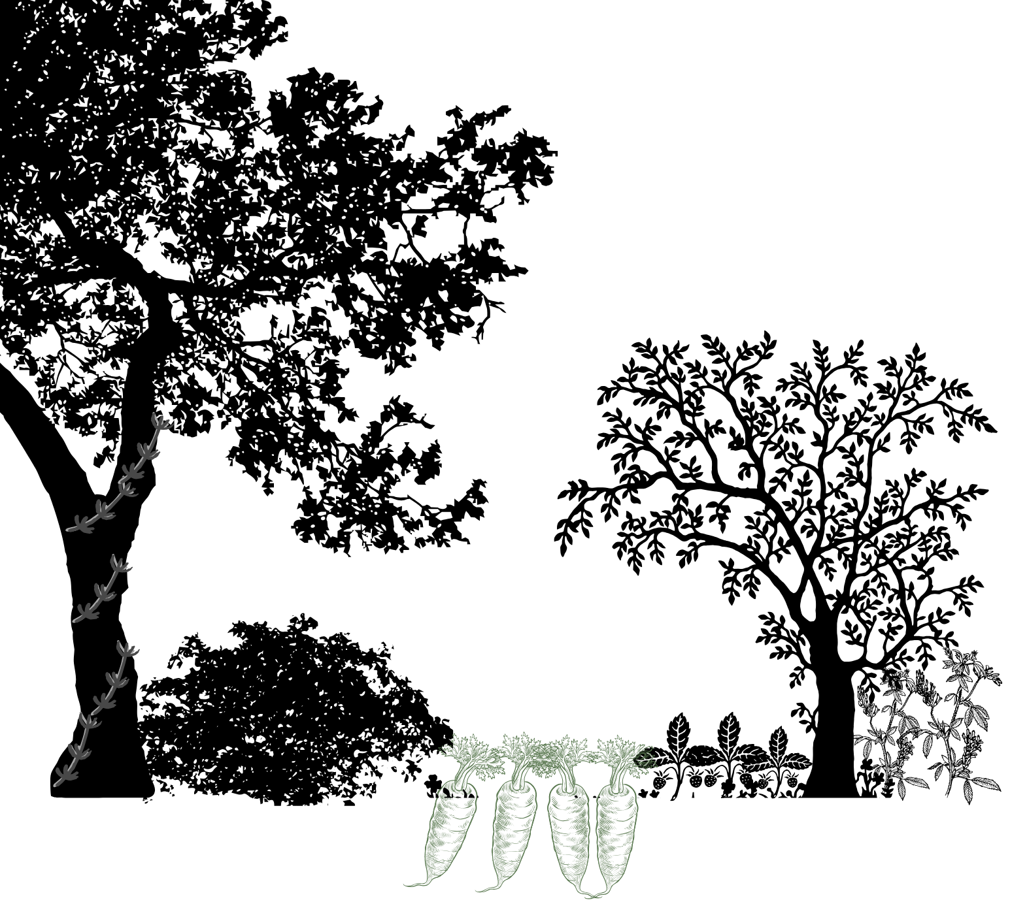
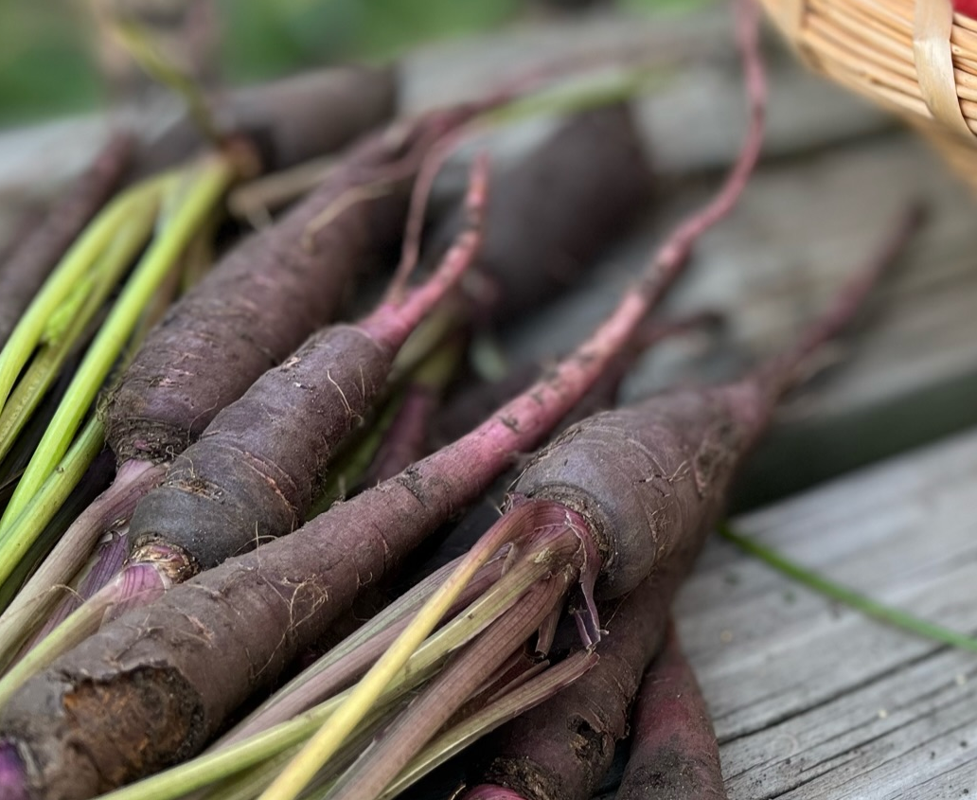
Roots below-ground harvests
food (root vegetables) & medicine
build soil structure
soil stability & water-holding
uplift of water & nutrients
Notes:
Forest functions & harvests

Slide 16
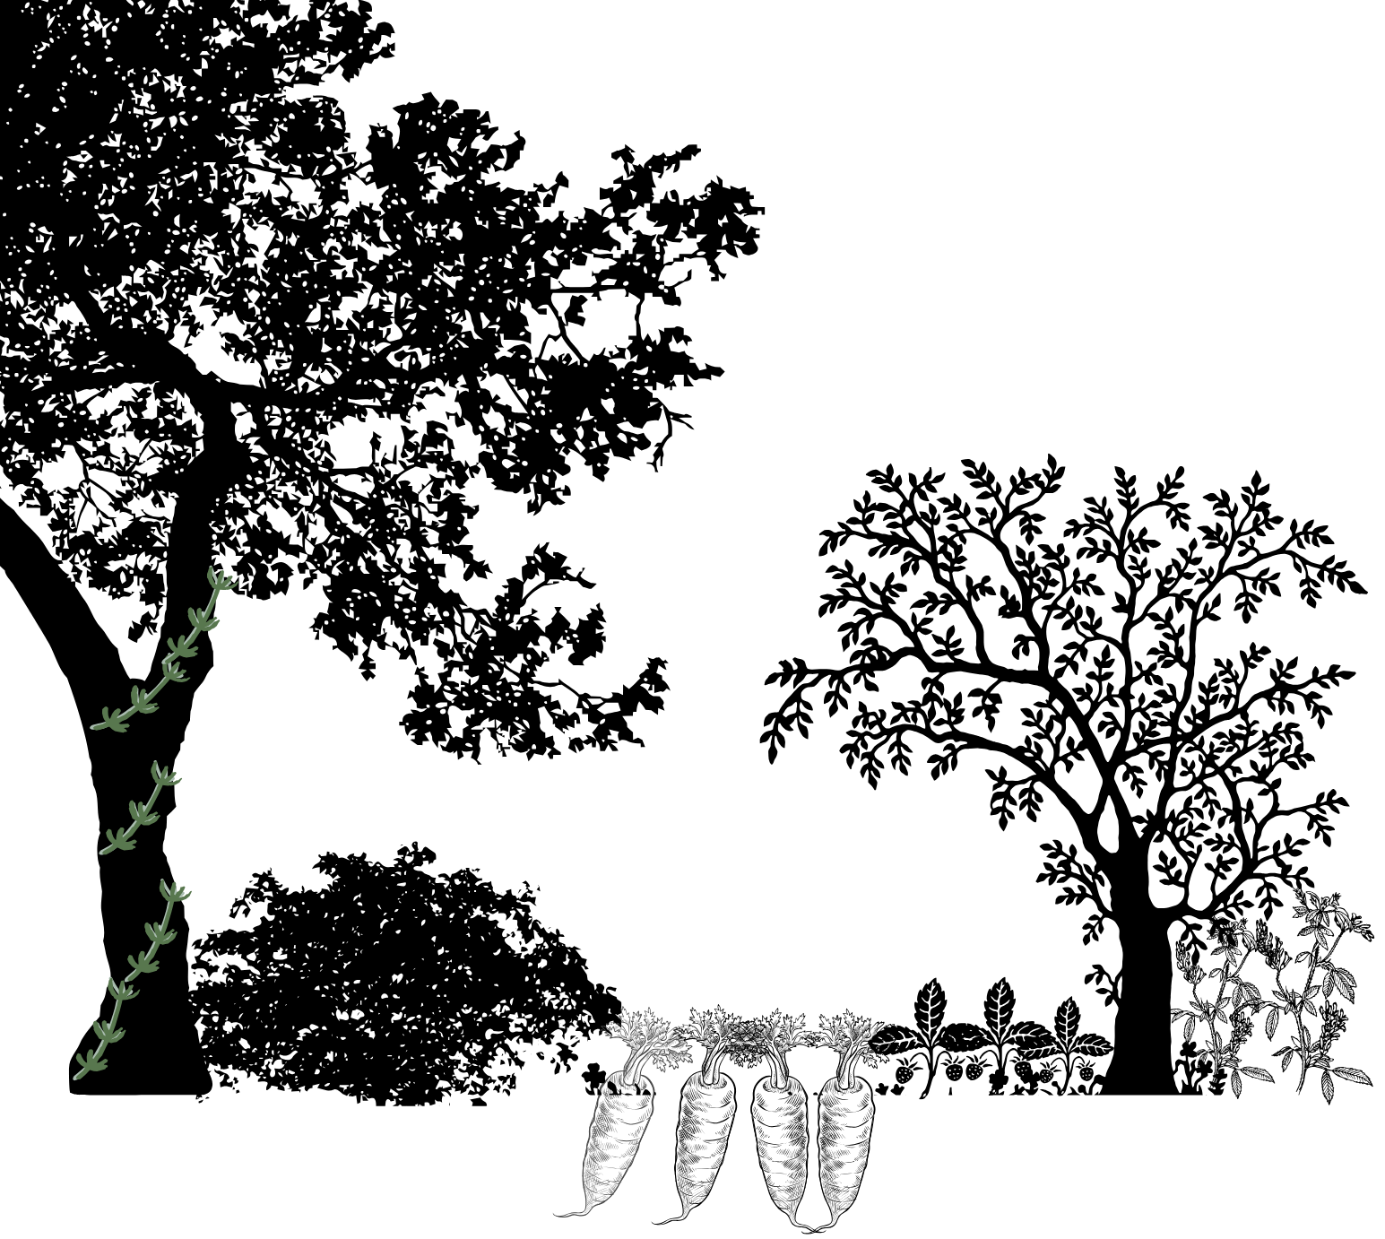
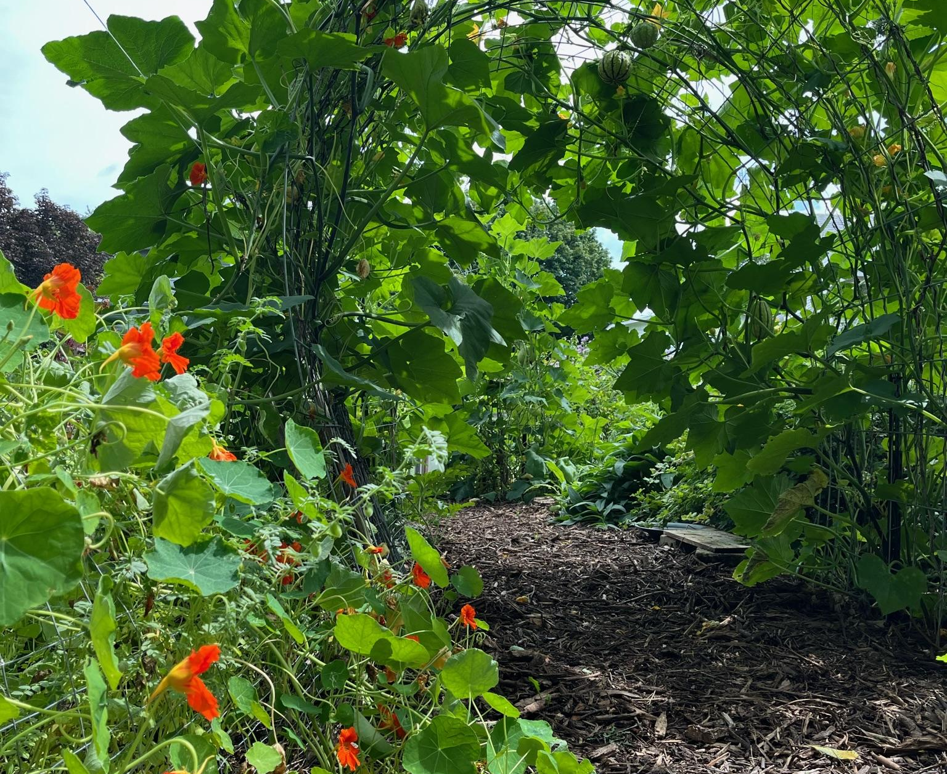
Vines climbers
food (vegetables, staple crops - dry beans and squash, fruit, edible flowers) & medicine
craft materials
species diversity
photosynthesis & production
Notes:
Forest functions & harvests

Slide 17
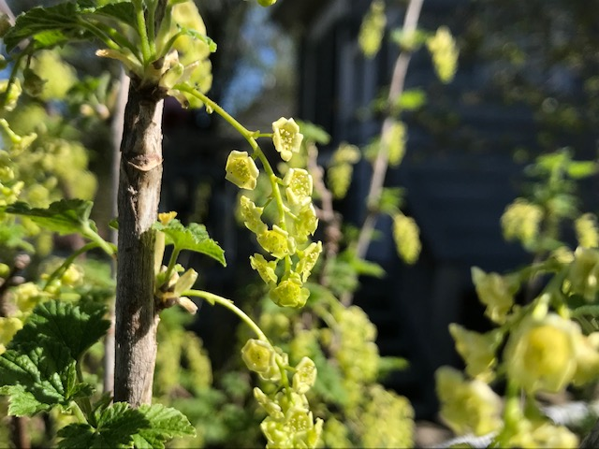
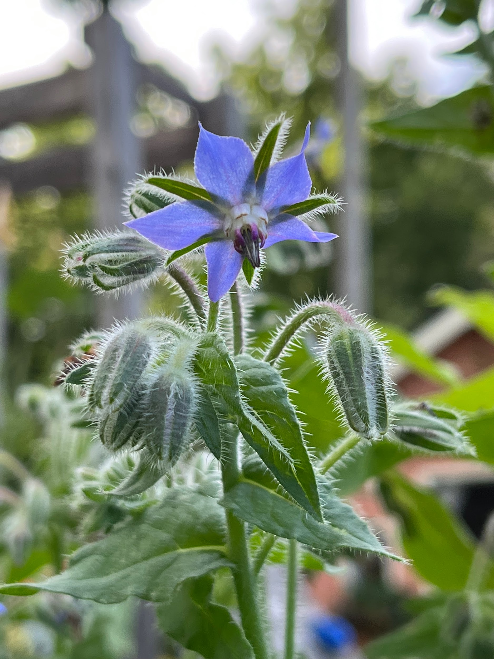
Food Forest Benefits

Slide 18
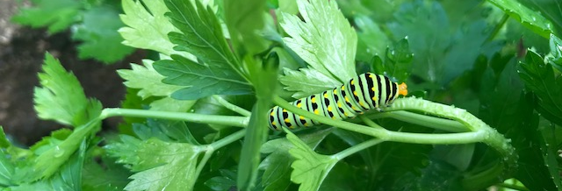
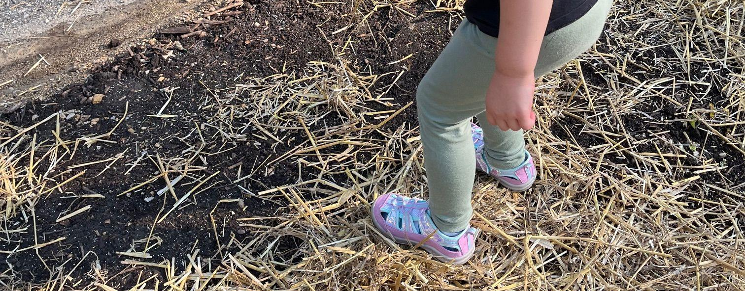
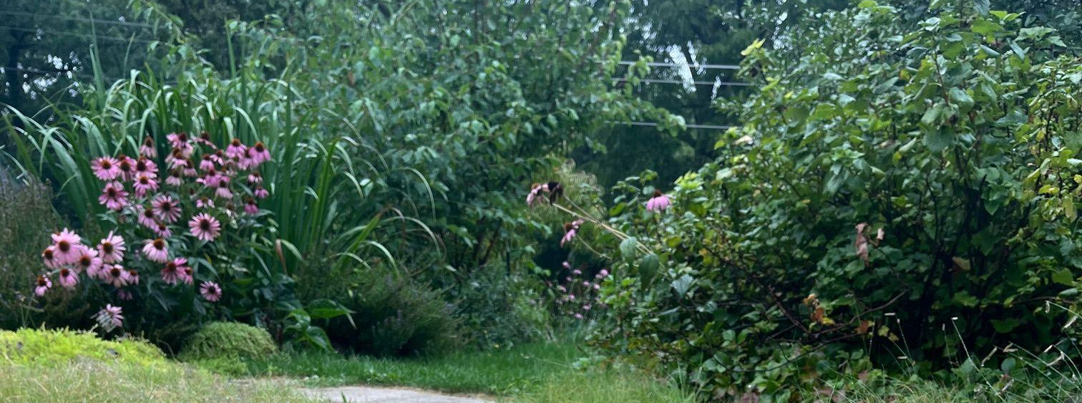
Biodiversity
Soil Health
Maintenance
diversity of plants = rich habitat
healthier ecosystem = less interventions
perennial plants = little soil disruption
nutrient cycling
soil life thrives
diverse plantings = self-sustaining
Notes:
Goal = variety to balance and self-regulate

Slide 19
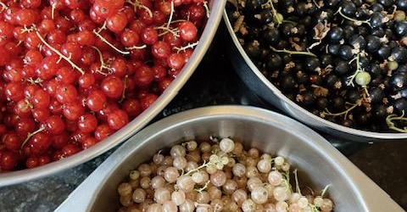
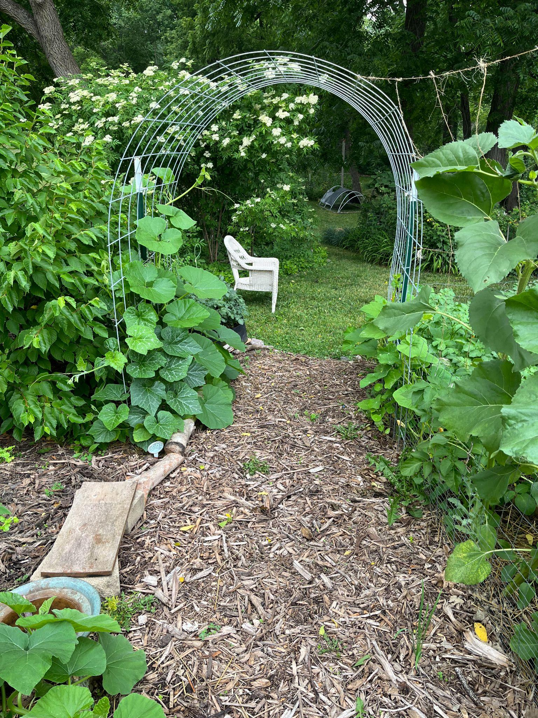
Food Security
Aesthetics
perennial food focus
diverse harvests & varied, seasonal diet
often an excess of food
structure and visual interest
inviting environments where beauty and utility coexist
greener, more resilient urban spaces

Slide 20
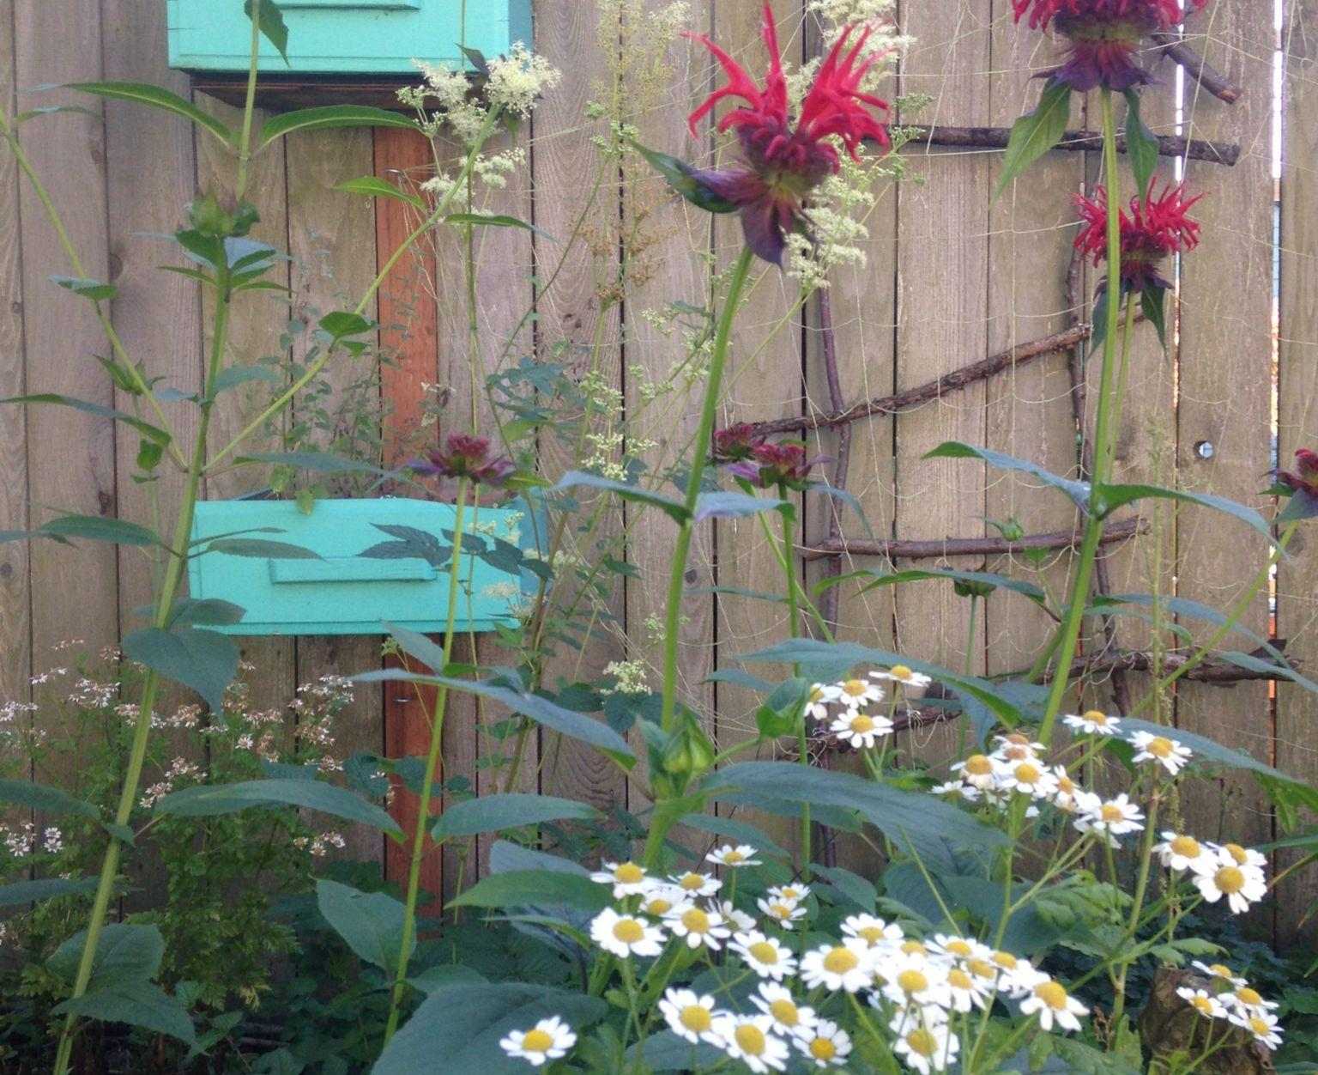
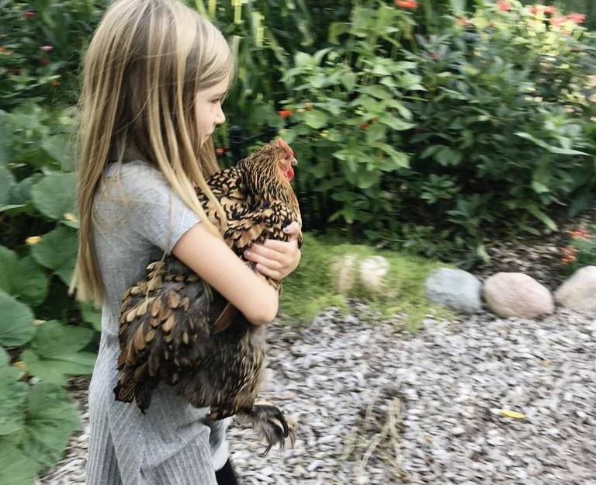
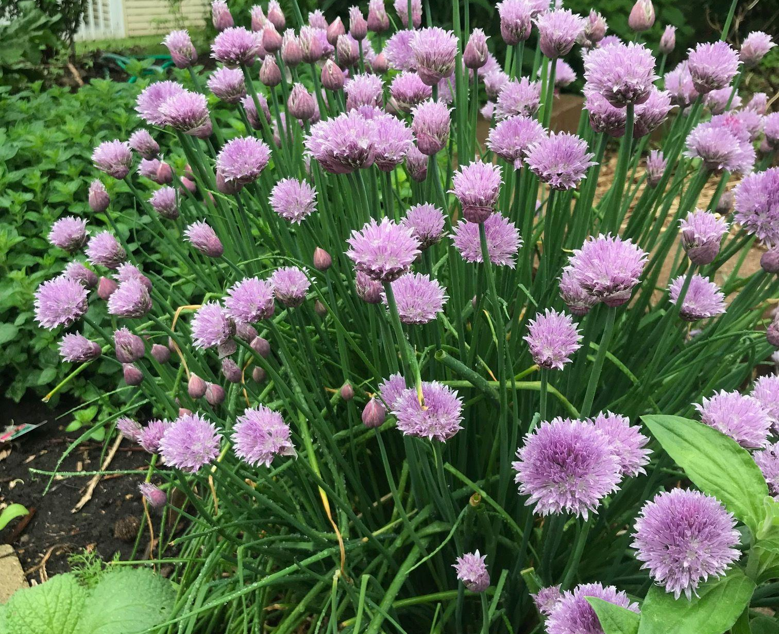
3 Sample Designs

Slide 21
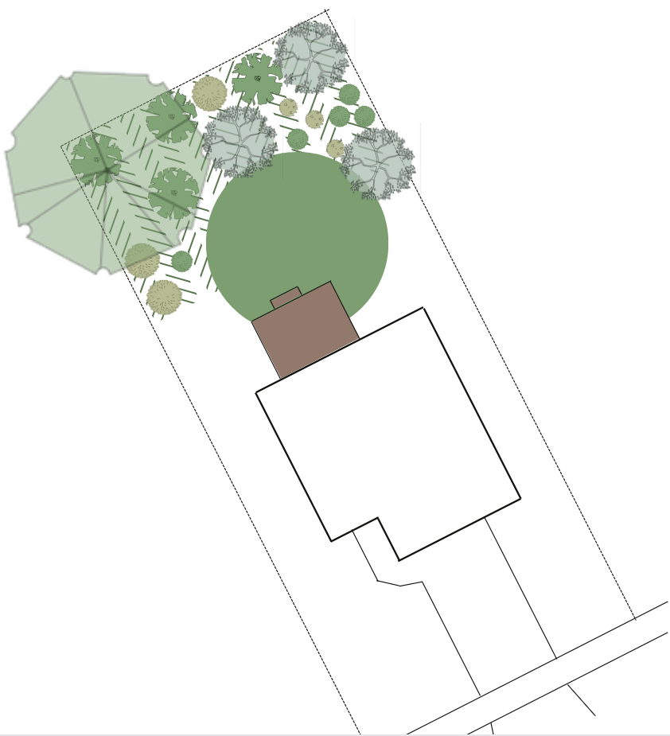
#1 Food Forest Border
Planting that separates spaces, blocks/highlights views, adds privacy, or directs traffic
possible locations:
  property line (side, front, or back)
  between two outdoor areas
possible functions:
  “wall” for an outdoor room
  barrier that directs traffic
  block or highlight views

Slide 22
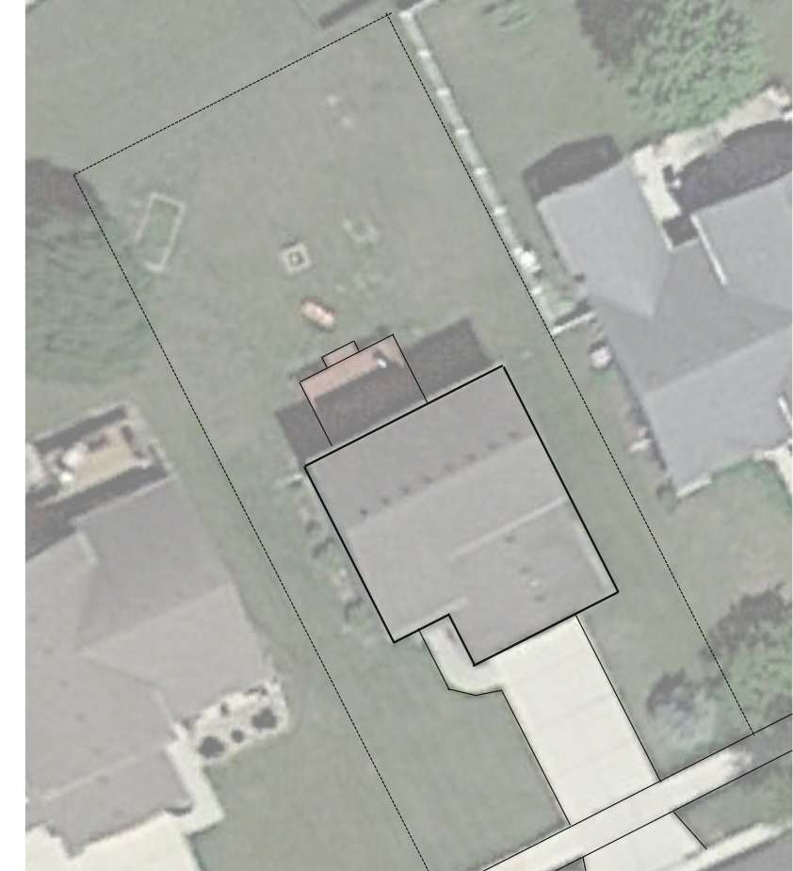
Sample
Food Forest Border
3 design ideas:
back border, “landscaped” look
back border, “natural” look
side yard border

Slide 23
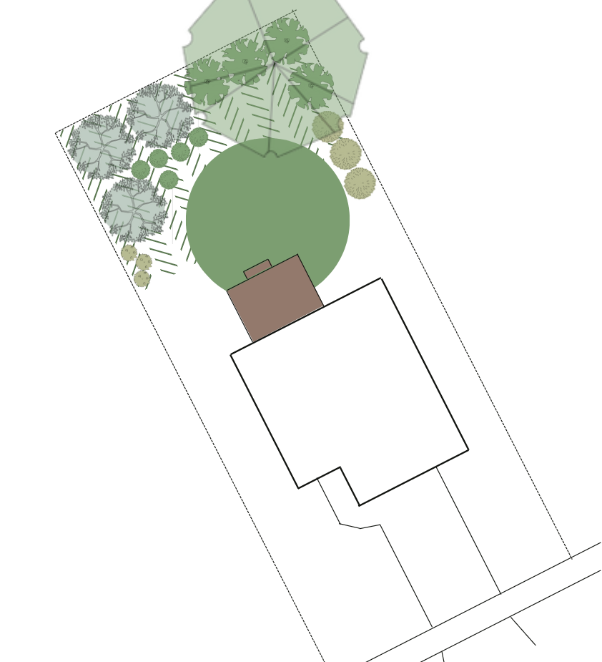
understory
canopy
Sample
Food Forest Border
shrubs
A. back border, “landscaped” look:
block views
adds height & structure
perennial foods
increases privacy
great backdrop for remaining space
organized
blends into neighborhood vibe
reduced lawn size
herbs, ground-covers & roots

Slide 24
canopy
shrubs
Sample
Food Forest Border
understory
B. back border, “natural” look:
block views
adds height & structure
perennial foods
increases privacy
great backdrop for remaining space
natural, “wild” appearance
reduced lawn size
herbs, ground-covers & roots

Slide 25
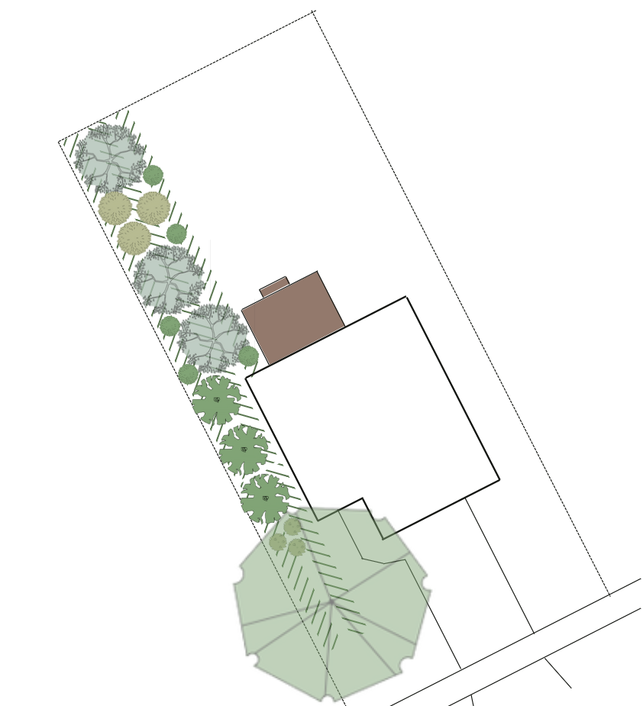
understory
Sample
Food Forest Border
herbs, groundcovers & roots
C. side yard border:
block views
adds height & structure
perennial foods
increases privacy
afternoon shade
reduced lawn size
shrubs
canopy

Slide 26
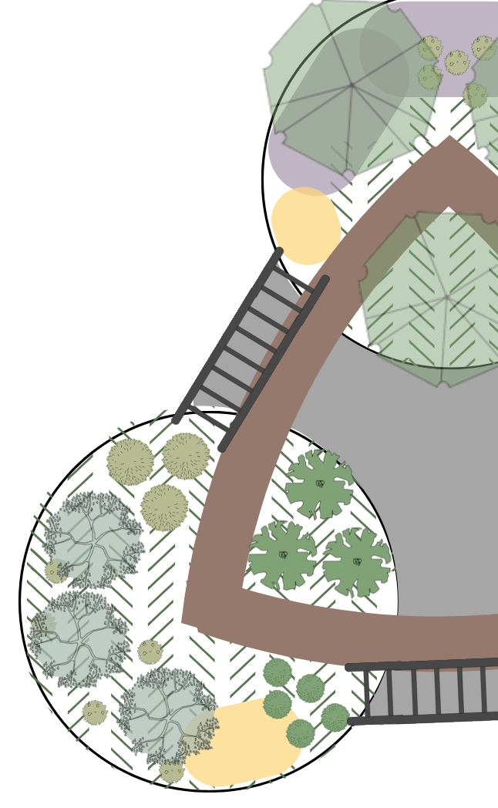
#2 Freestanding Food Forest
Stand-alone forest located in an open area
possible locations:
  sunny spot in lawn
  entry garden
possible functions:
  visual interest
  draw someone outside
  block or highlight views
  garden to visit on way to another location

Slide 27
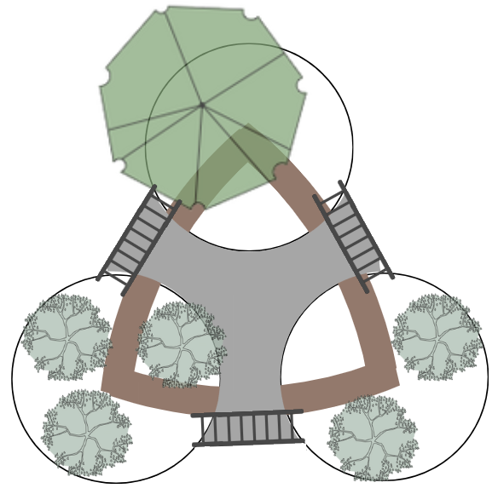
canopy
Sample
Freestanding Food Forest
structural interest
3 entryway arbors (black)
main paths (gray)
secondary paths (brown)
canopy trees
understory trees
repetitive circular gardens
understory

Slide 28
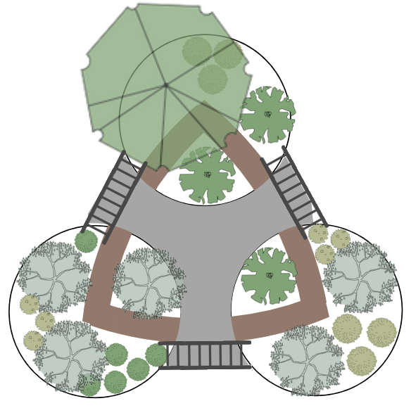
canopy
Sample
Freestanding Food Forest
vines
shrub layer
additional structure
year-round interest
food
vines on arbors
understory
shrubs

Slide 29

canopy
Sample
Freestanding Food Forest
herbs, ground-covers & roots
native plants
lower layers
fill in between woody plants
increase biodiversity
food and medicine
natives and pollinator attraction
vines
understory
shrubs
pollinator plants

Slide 30

#3 Food Forest Landscape
ornamental garden design principles but prioritizing edible plants and a perennial, layered garden
possible locations:
  any residential, commercial, or public property
  entry garden, foundation planting, general landscape
possible functions:
  visual interest
  block or highlight views
  water management, soil stabilization and soil building, erosion control, beauty, function

Slide 31

Sample
Food Forest-Inspired Residential Landscape Design

Slide 32

understory
canopy
Goals:
block views
add height & structure
perennial foods
add privacy
add shade
shrubs

Slide 33

gathering space
canopy
under-story
Goals:
flow/movement
veg garden
entryway
gathering space
shrubs
entryway
veg garden

Slide 34

gathering space
canopy
under-story
Goals:
add privacy
increase food production
visual interest
division of space
shrubs
more
shrubs
entryway
veg garden

Slide 35

gathering space
canopy
under-story
Goals:
increase plant diversity
more food/med
cover soil
reduce erosion
herbs, ground-covers & roots
shrubs
more
shrubs
entryway
veg garden

Slide 36
understory
gathering
canopy
Goals:
add pollinator plants
add native plants
low maintenance
herbs, ground-covers & roots
shrubs
more
shrubs
veg garden
entryway
pollinator
plants
native
plants

Slide 37
Food Forest Plants

Slide 38




Canopy Tree Ideas (30’+)
Am. Persimmon 35-60’ x 25-35’
Standard Fruit Trees 25-30’ x 25-30’
Beech 50-80’ x 40-80’
Buartnut 25-30’ x 25-30’
Chinese Chestnut 40-60’ x 40-60’
Oaks (some Quercus sp.)
Serviceberry 25-30’ x 25-30’
Walnut (Black 50-60’ x 25-30’, English 25-30’ x 25-30’, Heartnut 25-30’ x 25-30’)
Wild Black Cherry 50-60’ x 20-30’

Slide 39



Understory Tree Ideas (10-30’)
Fruit Tree, Semi-Dwarf 12-15’ x 12-15’
(Apple, Apricot, Cherry - sweet / pie, Nectarine, Peach, Pear, Plum)
Crabapple 12-20’ x 15-20
Elderberry, Blue 10-12’ x 10-12’
Fig, Chicago Hardy 10-15’ x 12-15’
Filbert (C. avellana) 10-12’ x 10-12’
Hawthorn 10-25’ x 10-25’
Mulberry, Dwarf 10-15’ x 15-20’
Pawpaw 12-15’ x 12-15’
Quince, Fruiting 10-12’ x 10-12’

Slide 40


Shrub Ideas (2-10’)
Aronia/Chokeberry 6-12’ x 6-12’, f/pt
Blackberries 4-6’ x 3-6’, f/pt
Bush Cherries 7-15’ x 7-15’, f/pt
Currants 3-5’ x 3-5’, f/pt
Elderberry, Black/Am. 5-12’ x 4-12’, f/pt
Goji 3-6’ x 3-10’, f/pt
Gooseberry 2-5’ x 3-6’, f/pt
Goumi 6-10’ x 6-10’, f/pt
Hazelnut, Am. (C. americana) 6-15’ x 10’, f/pt
Honeyberry 3-8’ x 3-8’, f/pt
Lavender 2-3’ x 2-4’, f
currants
goumi berry
lavender & chives

Slide 41



raspberry flowers
honeyberry bush
Shrub Ideas (2-10’), continued
Quince, Dwarf / Flowering 6-10’ x 6-10’, f/pt
Raspberry 3-6’ x 3-5’ / suckering, f/pt
Rose (various) 2-6’ x 2-6’, f/pt
Serviceberry, Roundleaf / ‘Regent’ / Alder-Leaved 3-15’ x 4-12’, f/pt
Sage 2-3’ x 2-3’, f/pt
Seaberry 6-12’ x 6-12’, f
Viburnum, High. Cran. 8-15’ x 10-15’, f/pt
Winterberry 3-12’ x 3-12’, f/pt
common sage

Slide 42


asparagus
Herbaceous (12”+)
Anise Hyssop 24-48” x 12-24”
Artichoke, Jerusalem 72-120” x 36-60”
Asparagus 60” x 24-36”
Astragalus 24-36” x 24-36”
Bach. Button / Cornflower 12-36” x 12-24”
Basil (various) 12-24” x 12-24”
Bee Balm 18-24” x 24-36”
Bergamot, Wild 36-48” x 12-24”
Black Cohosh 48-72” x 24-48”
Borage 12-36” x 12-24”
borage
bee balm

Slide 43


comfrey
cutting celery
Herbaceous (12”+), continued
Calendula 12-24” x 12-24”
Catnip 24-36” x 24-36”
Cutting Celery 18” x 12-18”
Chives 12-20” x 12-20”
Comfrey 12-36” x 12-30”
Daylilies 8-24” x 24-48”
Ferns 12-36” x 12-36”
Elecampane 36-72” x 24-36”
Fennel 48-60” x 18-36”
Feverfew 24” x 18-24”
elecampane

Slide 44



Lemon balm
Herbaceous (12”+), continued
Ginseng, Am. 6-18” x 6-18”
Goat’s Beard 48-70” x 48-70”
Good King Henry 24-36” x 12”
Hollyhock 72-96” x 12-24”
Horehound 36” x 18”
Horseradish 36” x 36”
Joe Pye Weed 48-72” x 18-48”
Lemon Balm 24-36” x 24-36”
Lovage 36-72” x 24-36”
horehound
assorted herbs

Slide 45




rhubarb & chives
Herbaceous (12”+), continued
Marshmallow 48-60” x 24”
Motherwort 24-36” x 18-36”
Mugwort 24-48” x 36-72”
Mullein 60-72” x 24”
Onion, Egyptian Walking 12-24” x 6-12”
Ramps / Wild Leek 8” x 4-8”
Rhubarb 24-36” x 24-36”
Salad Burnet 12” x 12-18”
motherwort
salad burnet

Slide 46


stinging nettle
Herbaceous (12”+), continued
Skullcap 8-24” x 8-24”
Sorrel, Red/Green 12-30” x 12-24”
Spearmint 24” x 36”
St. John’s Wort 12-36” x 12-24”
Stinging Nettle 8-36” x 6-12”
Sunchoke / Jer. Artich. 96-144” x 24”
Sweetgrass 18” x 24”+
Valerian 36-72” x 24-48”
Yarrow 12-18” x 12-18”
yarrow
red-veined sorrel

Slide 47



mint
calendula
Groundcovers (low + spreading)
Aronia, Low Scape Mound 12-24” x 24-36”
Blueberry, Lowbush 12” x 36”
Calendula 12-24” x 12-24”
California Poppy 6-18” x 6-18”
Chamomile, Roman 4-8” x 6-12”
Chickweed 4-6” x 20”
Corn Salad / Mache 6-12” x 6-8”
Cranberry 12” x 36-48”
Lingonberry 12” x 12-36”
Mint (various) 12-24” x 12-24”
chickweed

Slide 48



sweet woodruff
thyme
thyme
Groundcovers (low + spreading)
Nasturtium 12” x 12-36”
Onion, Egyptian Walking 12-24” x 6-12”
Oregano (various) 12-36” x 18-24”
Peppermint 12-24” x 12-24”+
Raspberry, Arctic 6” x spreading
Strawberry (various) 4-12” x 12-24”
Sweet Woodruff 8-12” x 24”
Thyme, Woolly 3” x 12”
Violet (various) 6-8” x 6-8”
Wintergreen 6” x 12-24”
violets

Slide 49



onions
Roots
Burdock 72” x 36-48”
Dandelion
Elecampane
Garlic 24-30” x 6-10”
Ramps 8” x 4-8”
Mountain Yam 9’ x 5’
Ginger 36” x 15”
Mashua 6.5’ x 6.5’
Potato 12” x 12”
potatoes
carrots

Slide 50





grapes
Vines
Clematis 5-7’ x 3-5’
Climbing Yam 8-10’ x 8-10’
Grapes (table, wine) 15-20’ x 15-20’
Hops 12’ x 12’
Kiwi (Arctic Beauty 10-20’ x 6-10’, Hardy 10-20’ x 10-15’)
Magnolia Vine 8-15’ x 8-15’
Nasturtium 12” x 12-36”
Passionflower 6-8’ x 3-6’
Veggies (Pole Beans, Peas, Scarlet Runner Beans, Squash, etc.)
scarlet runner beans
passionflower

Slide 51


Common Questions

Slide 52

How long will a food forest take to get established?
Large nut trees: 4+ years
Fruit & small nut trees: 2+ years
Berry bushes: 1+ years
Perennial veggies: same year+
Annual herbs & veggies: now
Common
Q’s

Slide 53

How big does a food forest need to be?
Any size!
Small urban lot to several acres
Common
Q’s

Slide 54

How much food will a food forest produce?
Study in Scotland: “Sustainable food production in a temperate climate – a case study analysis of the nutritional yield in a peri-urban food forest”
https://www.sciencedirect.com/science/article/abs/pii/S1618866718304151
Common
Q’s

Slide 55
Study in Scotland:
How much food will a food forest produce?
Plot size: 0.08 hectare (ha) food forest, then scaled up to 1 ha (1 hectare = 2.47105 acres)
Carbs for 7m or 9f
Fat for 4m or 5f
Protein for 3m or 4f
If more legumes & nut trees included = protein and fat for addl. people
m = male, f = female
https://www.sciencedirect.com/science/article/abs/pii/S1618866718304151
Common
Q’s

Slide 56
How much food will a food forest produce?
Average residential property size in WI = 14,810 sq. ft. (~ ⅓ acre). If 5,000 sq. ft. food forest, then:
Carbs for 0.94m or 1.2f
Fat for 0.54m or 0.67f
Protein for 0.40m or 0.53f
If more legumes & nut trees included = additional protein and fat
m = male, f = female
https://www.sciencedirect.com/science/article/abs/pii/S1618866718304151
Common
Q’s

Slide 57

How much sun does a food forest need?
At least 6 hours of sunlight per day, especially if growing fruit trees.
Q & A
Common
Q’s

Slide 58

What are challenges to planting & maintaining a food forest?
Need land & time
Takes time to establish / long term
Requires money up front
Delayed harvests
Irrigation until established
Common
Q’s

Slide 59

Final Thoughts
My hope is that you gained a better understanding of food forests and their benefits beyond just food production.
I invite you to plant your own food forest, work with your community to install a public food forest, or simply share your knowledge and excitement with others.
Let’s embrace this opportunity to cultivate a greener future.

Slide 60
Thank you! Questions?

Slide 61



Thank you!
Questions?
Scan for
more
Rachel Belida
Eco & Edible Landscape Designer
Daily Harvest Designs
2025 Garden & Green Living Expo

