Slide 1
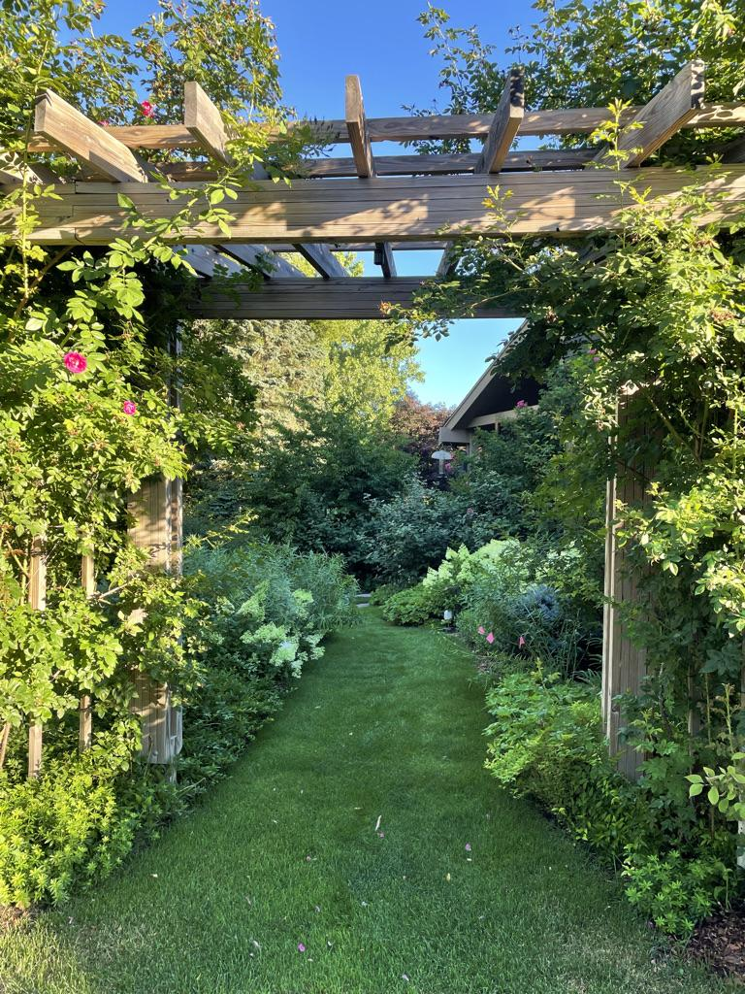
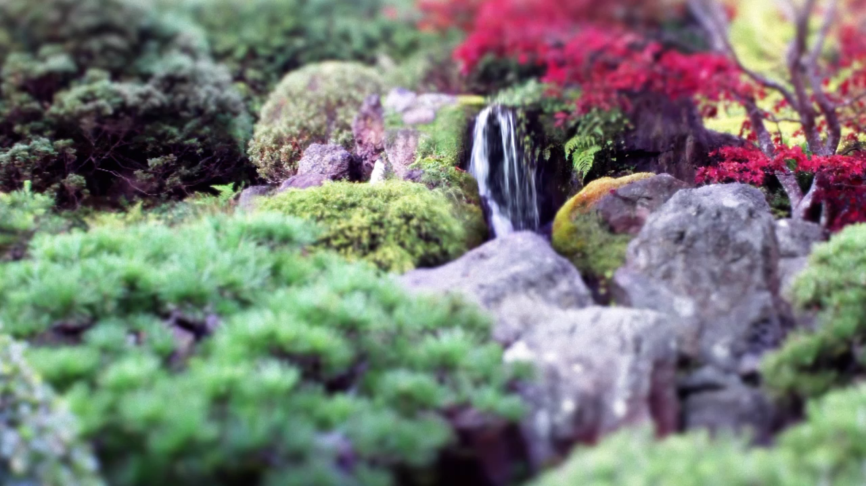
The Buckthorn Diaries:
-
The Improvisational Garden
How to turn the garden you have into the sustainable garden you love.
Patrick Smith
Notes:
Hello everyone, my name is Patrick Smith and I’m here today to share my gardening journey over the last 9 years, from complete gardening novice to someone who dares call themselves a gardener!
You see, I believe that the stories we tell about our gardens- our successes, our failures, our challenges and even our happy accidents- are most powerful when they are most personal. Thus, the Buckthorn Diaries, the story my life in my garden. And, for this chapter , what I am calling Improvisational Gardening….

Slide 2
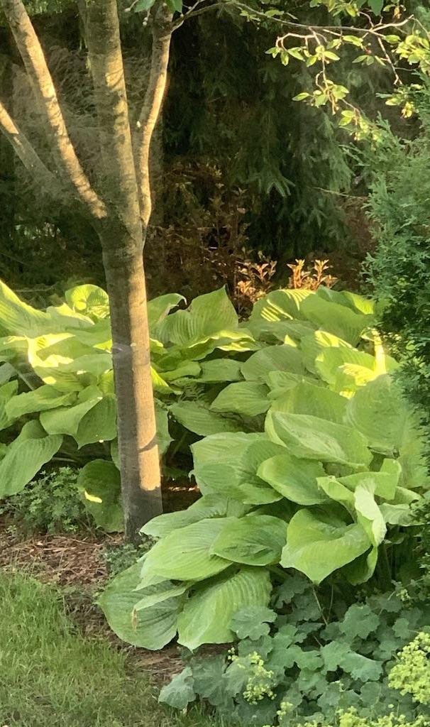
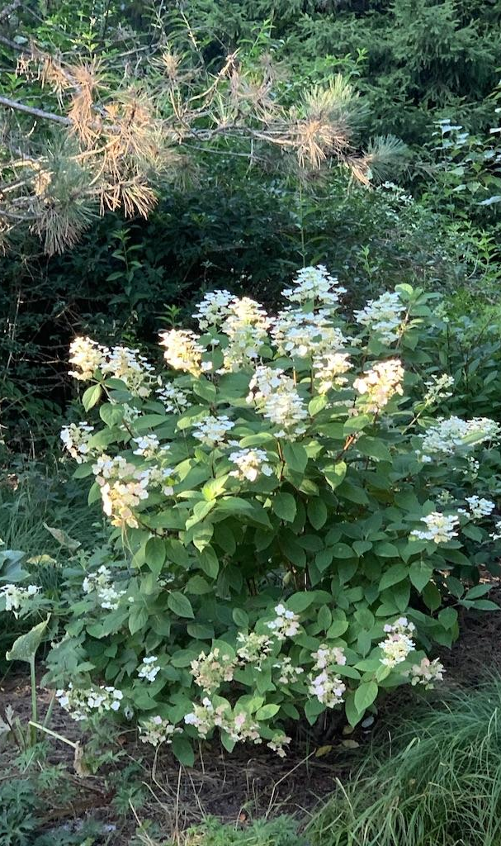
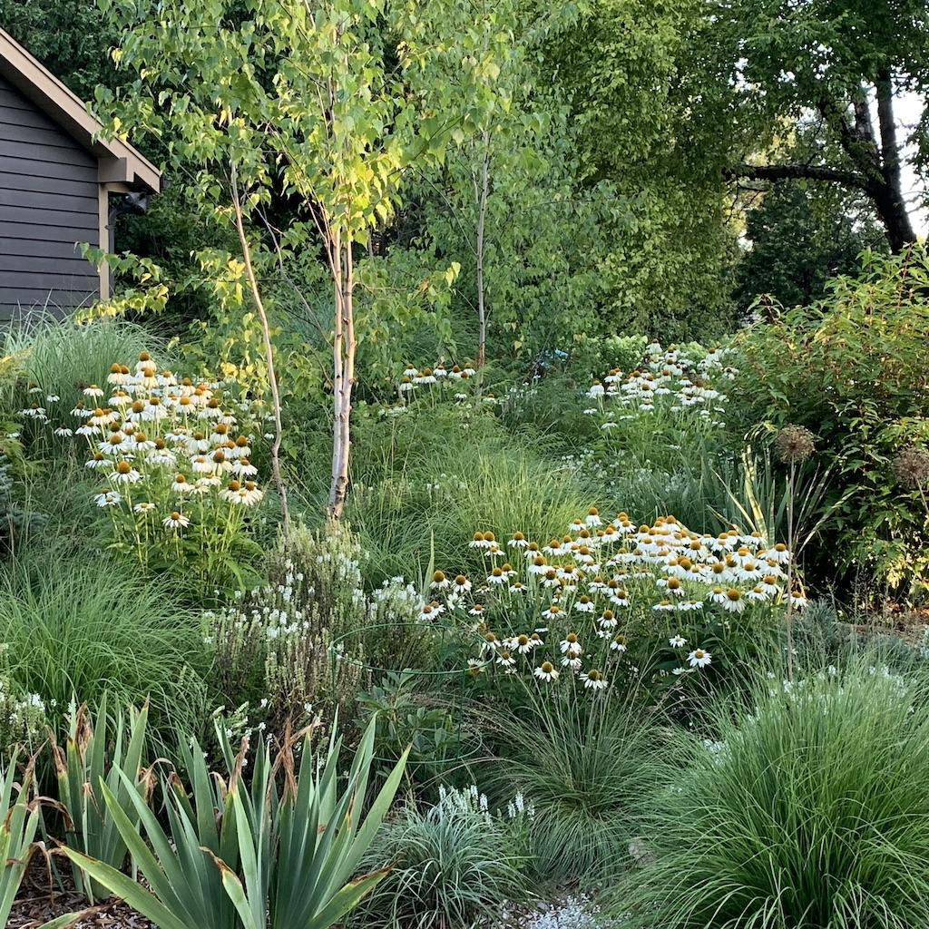
Notes:
...but what do I mean by that? Think of a trumpeter riffing a solo in jazz, or a cook going to the fridge and coming up with something delicious from whatever she finds there. Think of a speaker who lost their notes and gives the speech anyway, and it turns out even better than planned. These are all examples of improvisation and I think that most gardens can use a healthy dose of this kind of thinking.

Slide 3
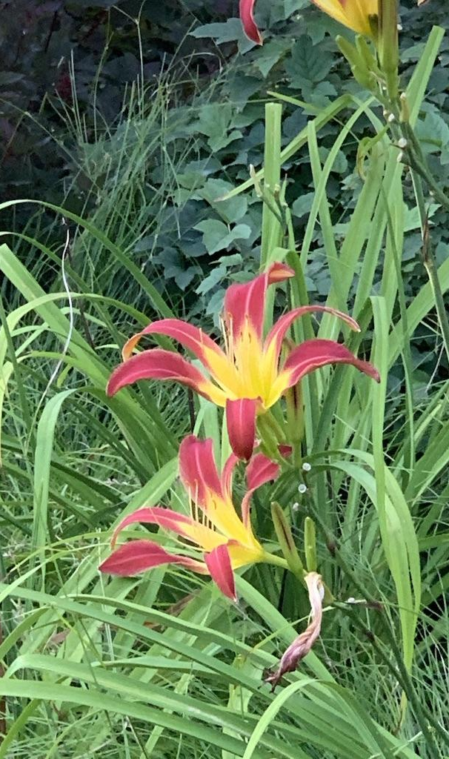
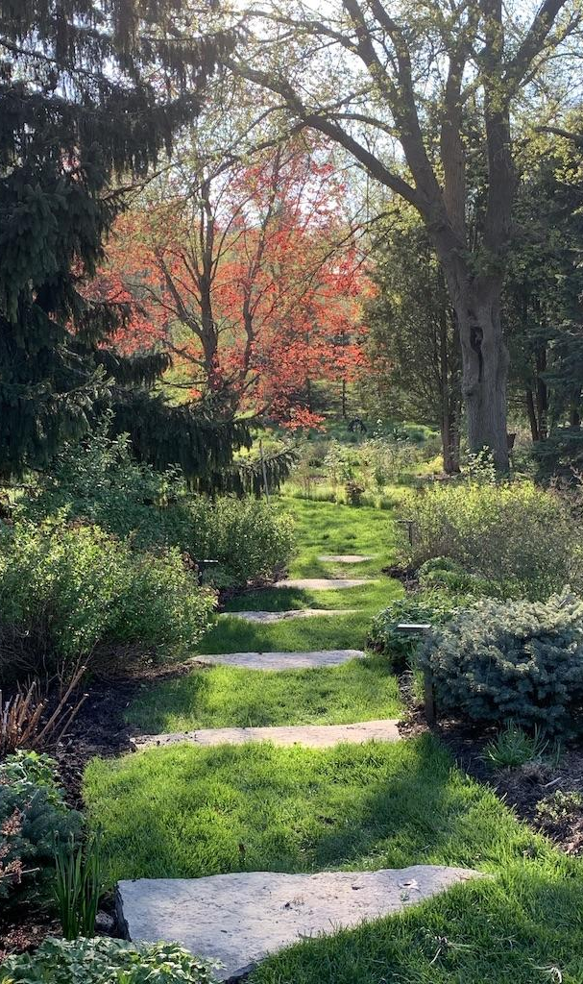
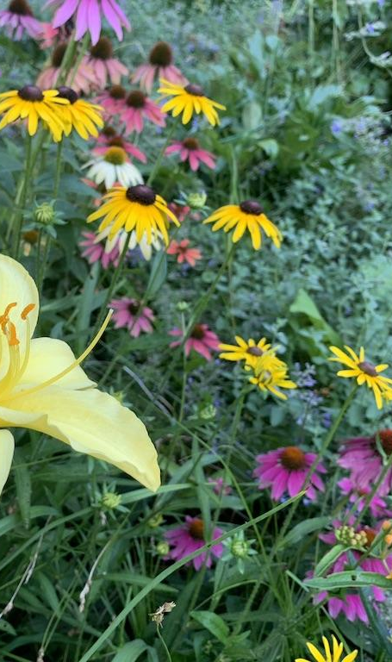
Notes:
It is like doing improv comedy (which I do) where no matter what happens on stage your response is “Yes, and …” In a similar way you take what Mother Nature gives you in your garden, and say Yes, there is shade here AND I will do this or Yes, I have clay soil AND I will plant these. It’s what happens AFTER you realize that trying to control all the elements is futile, that perfection is boring and that staying in the present moment is LIVING.

Slide 4
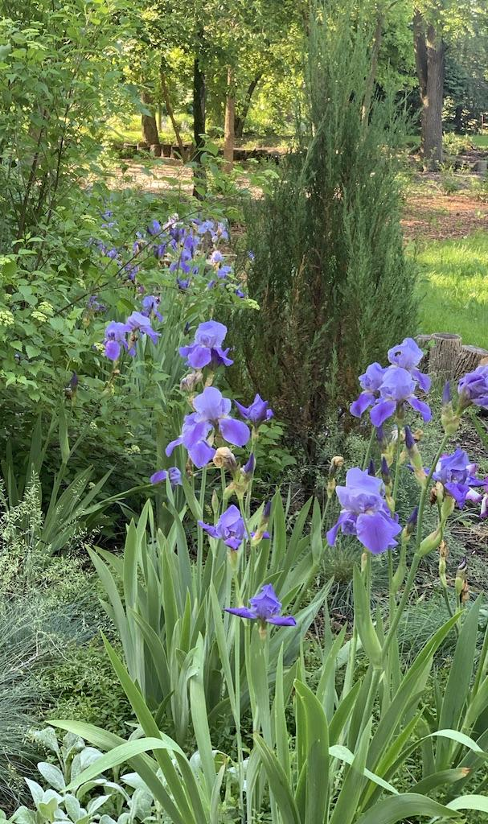
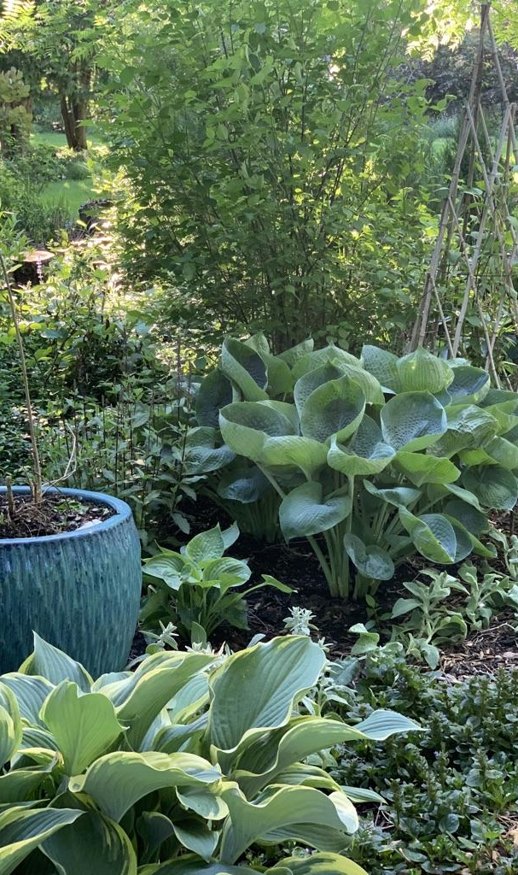
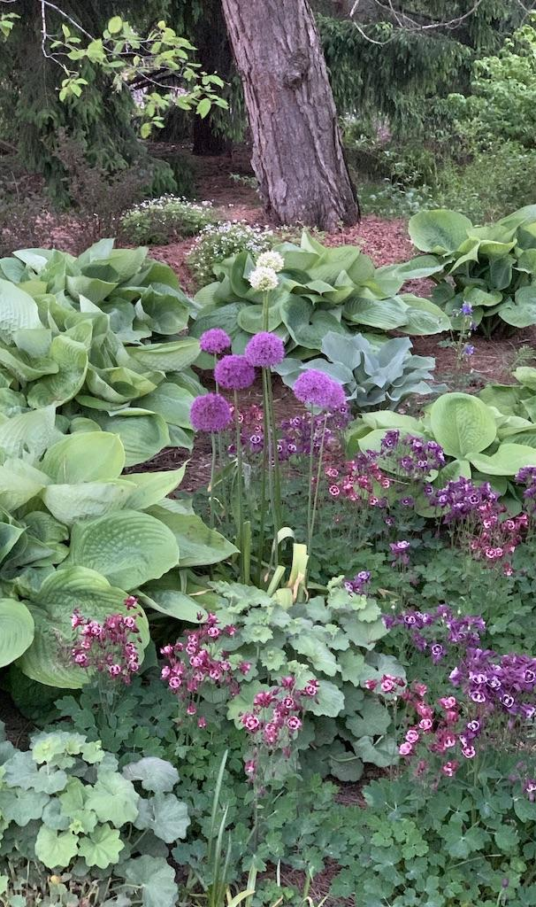
Notes:
Ultimately, it all comes together in a way that not only reflects the time, the place, the environment and the plant community, BUT ALSO in a way that is the ultimate reflection of YOU. Your taste, your history, your strengths and the way you LIVE. What could be more beautiful?

Slide 5
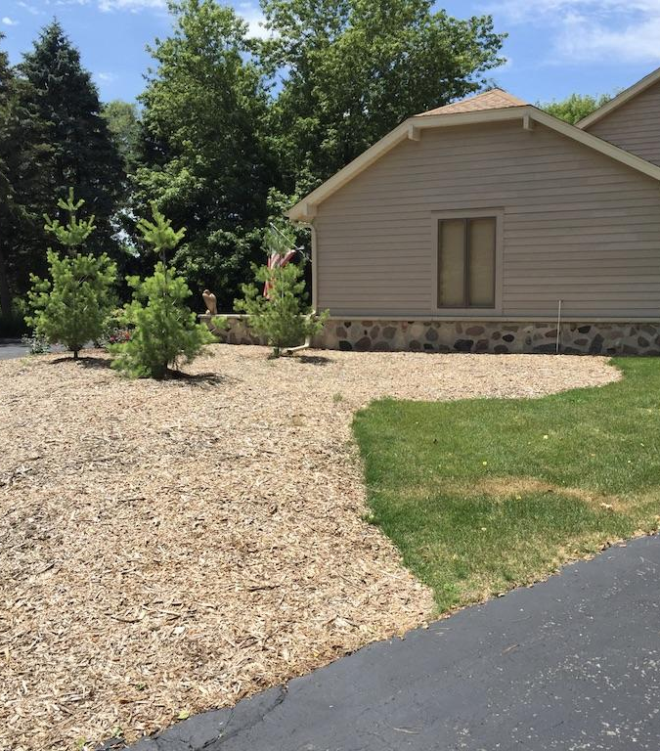
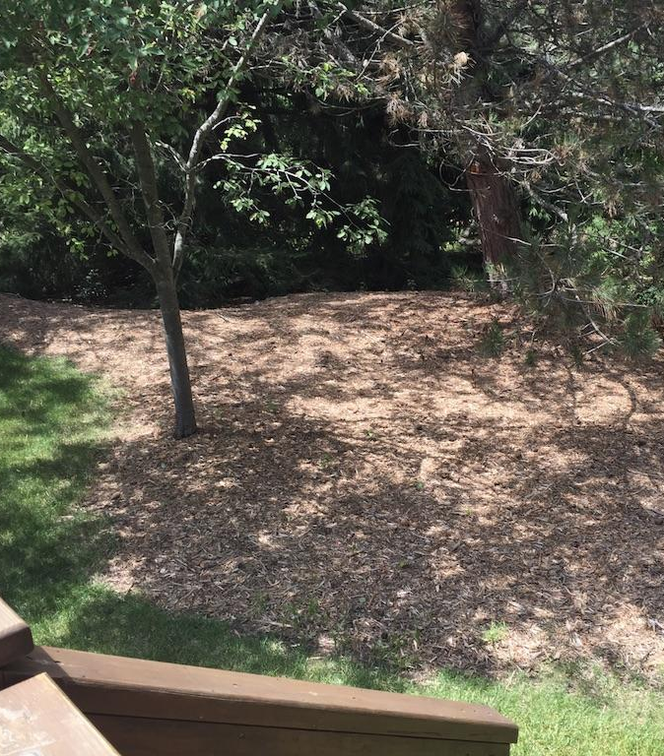
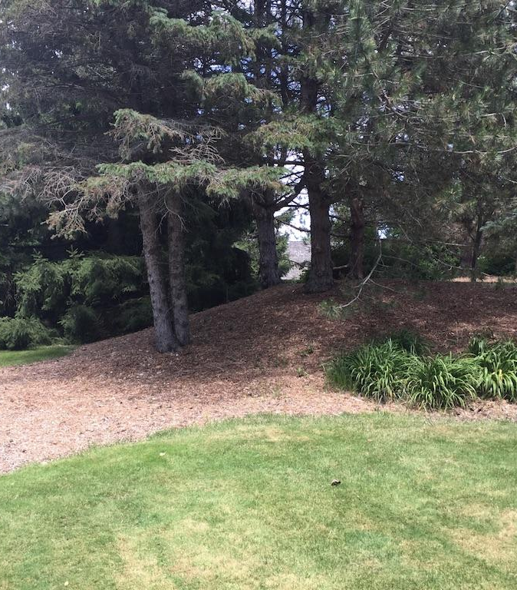
“Humble Beginnings ”
2015 City Life to Five Acres
Lawn + Trees + Woods
Notes:
HOWEVER, I begin my Improvisational Gardening story, as most gardening stories do, with humble beginnings…..with “what’s left in the fridge”. We bought our house and moved in on Sept 30, 2015. We were looking for a break from our many years of city living. We wanted more nature! We wanted more space and more dogs. ALL of that seemed possible here.
We just thought- lawn looks good. Mature trees are good. The “woods” in the back, good. We thought it would be fun to plant a vegetable garden and grow some perennials, other than that we knew nothing.

Slide 6
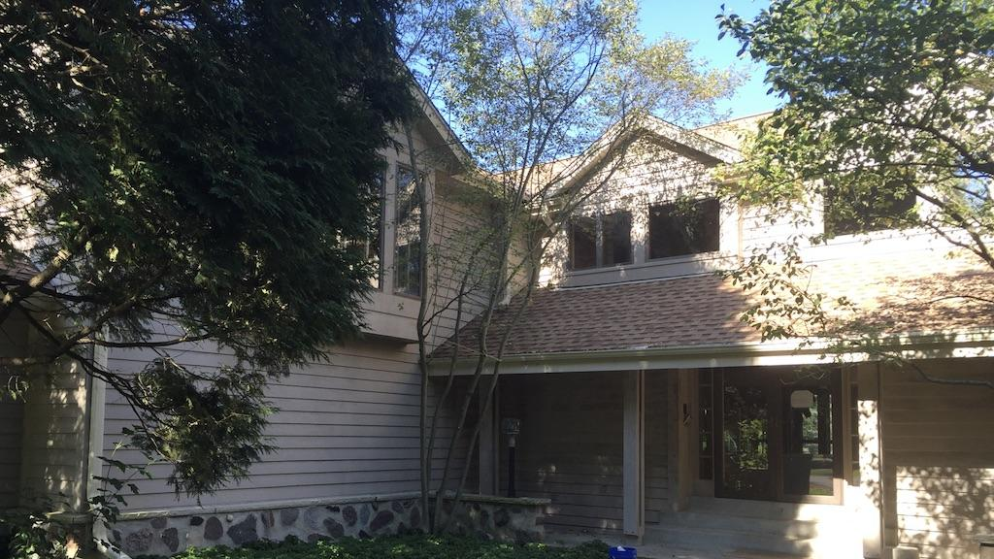
The “Mullet House” Transformation
Business in the Front & Party in the Back
Notes:
Initially my response was- it was really beige, bland and boring in the front (think county park) and kind of wild in the back- so I thought “Mullet House” as in, “business in the front, party in the back”.
I thought I would run with that theme on the property. The vision was essentially to have a more ordered public front that leads to a more carefree and wilder private back.
A million other ideas have come and gone over the years, I have stayed shockingly true to this original “vision”, rather than a particular style.

Slide 7
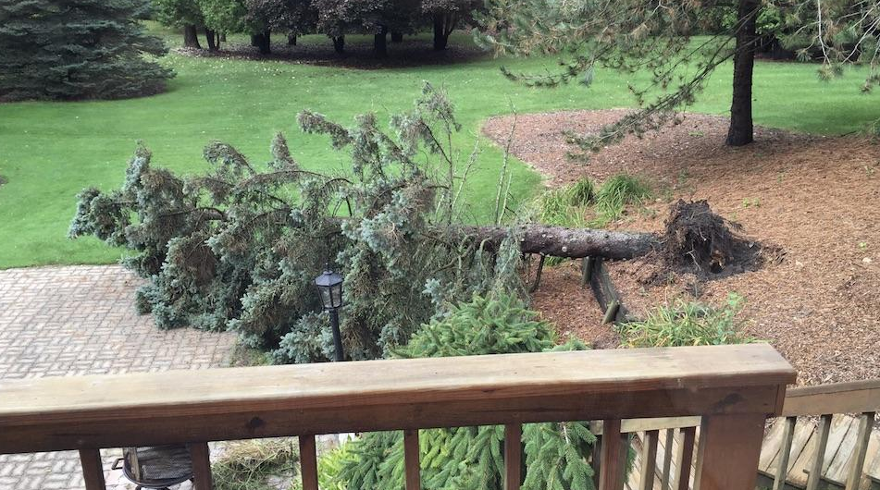
This is your wake up call!
Notes:
Our “first wake up call” came the next morning- our very first “view” of the back property that morning was of a 40 foot spruce tree that lay sprawling across the entire width of the back patio, as if it had just given up hope in the middle of the night. We took that as a cry for help from the property and knew we had to get to work!
In hindsight, we were comically .naive. Cue the tiny violin!

Slide 8
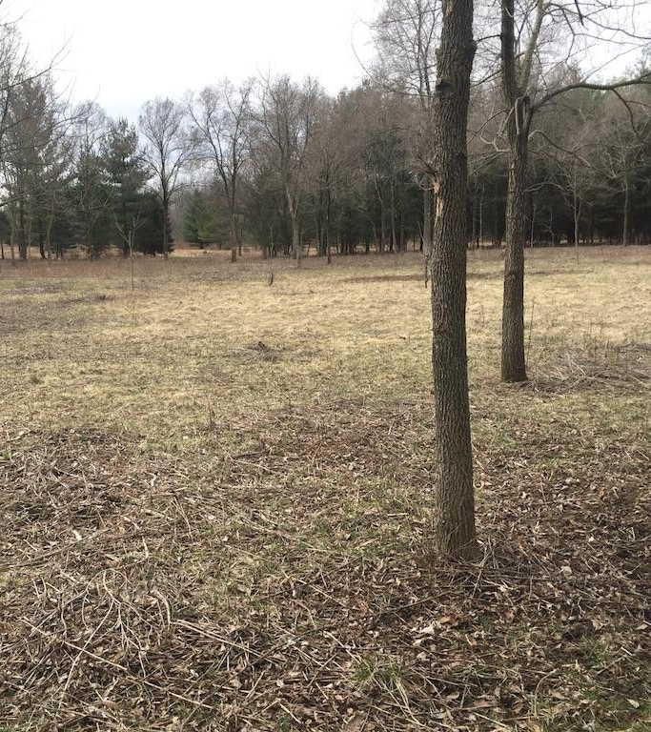
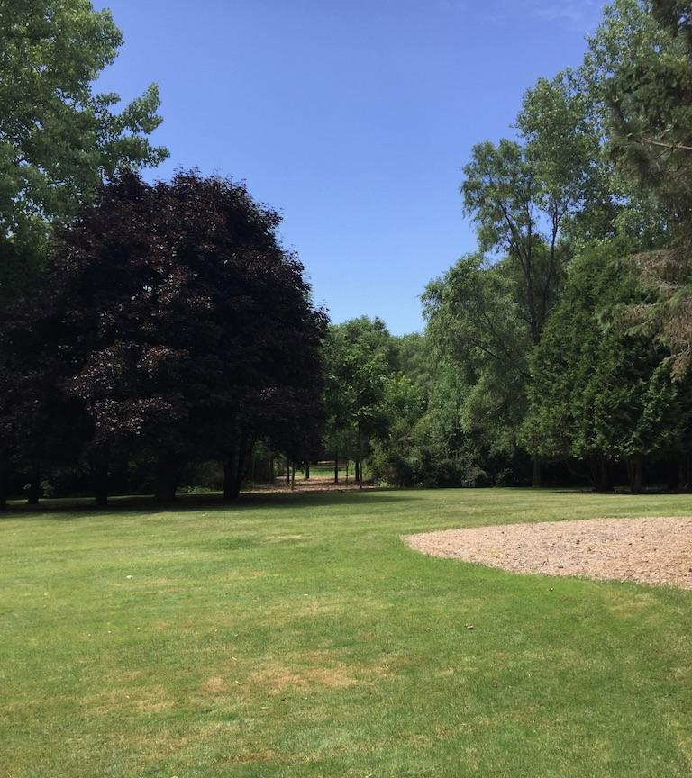
A whole lot of Nothin’
Notes:
We started to see what was really there….a whole lot of nothin’

Slide 9
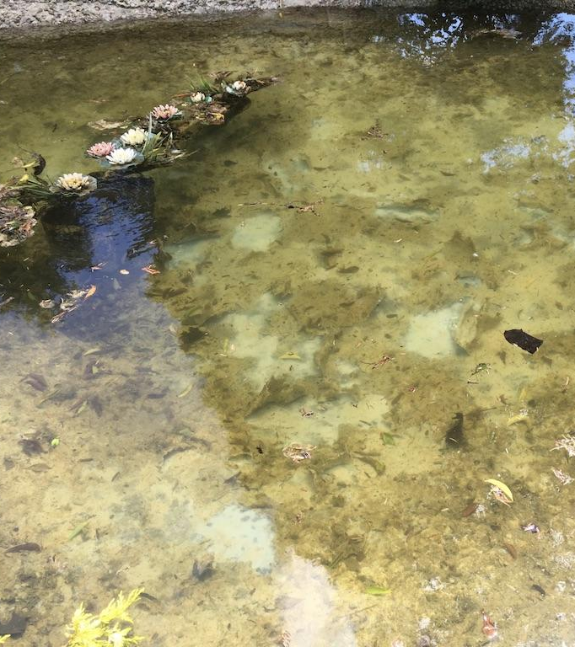
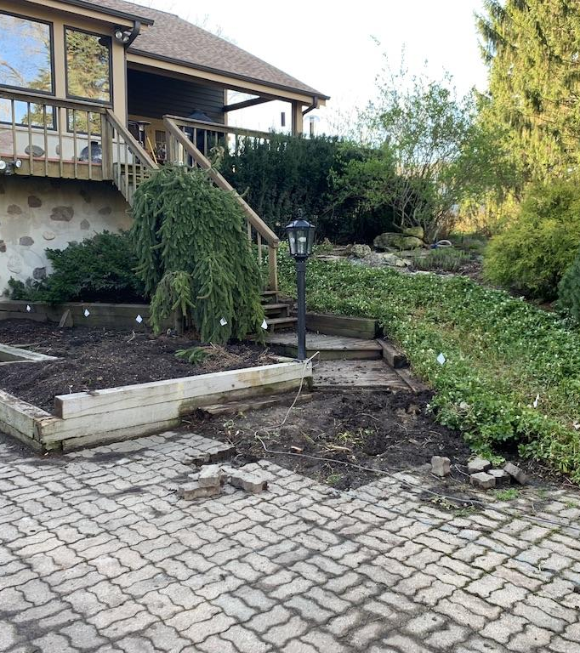
Old, Tired and
Worse for the Wear
Notes:
And what WAS there was old, tired and worse for the wear!
(yes, those are plastic lotus floating in the “water feature”)

Slide 10
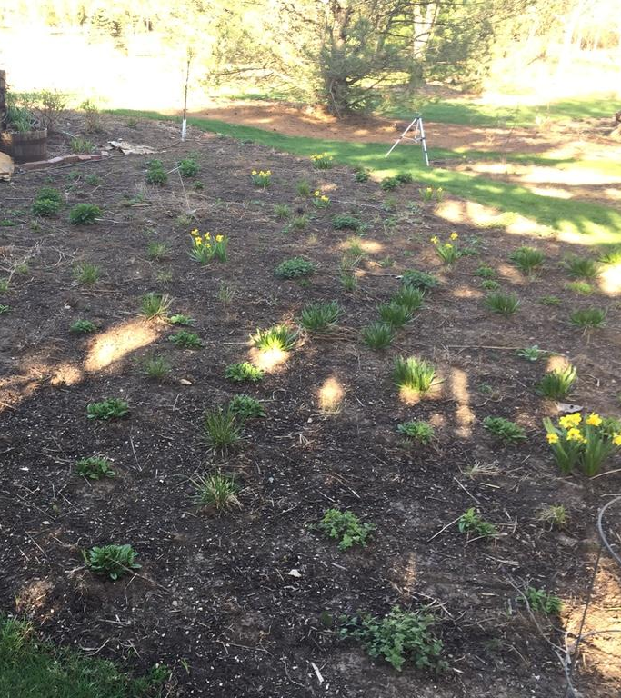
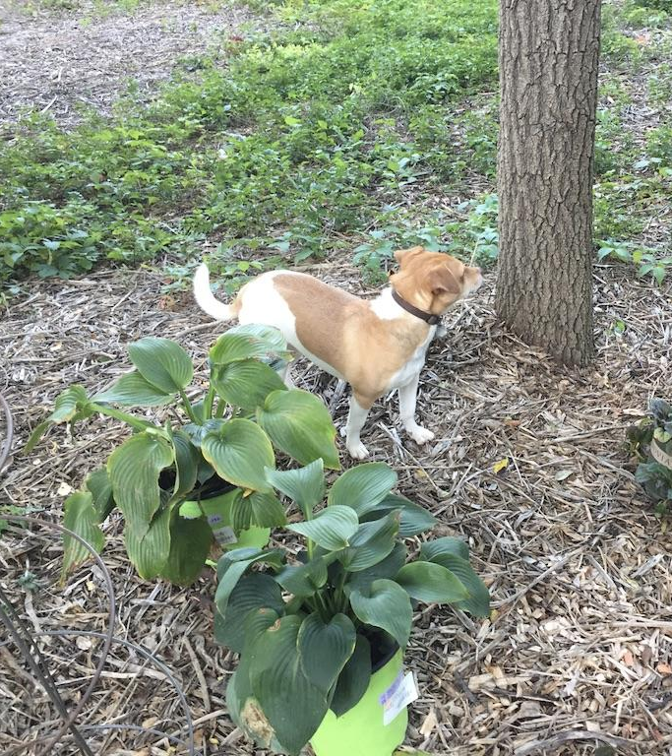
The Moment of Truth:
My journey as a real gardener…
Notes:
The truth is, I immediately started planting perennials that first fall and for the first year, really. They were what I thought I knew. I was blindly optimistic.
It wasn’t until I was in the middle of reading my latest gardening brook that I began to ealize that I was waaaaay in over my head that I asked Roy Diblik, of Northwind Perennial Farm, to come and check things out. (if time, story about finding Roy in a book). It changed my whole perspective and my priorities. On that first visit he very gently asked, “You do know you bought 5 acres of invasive plants, right?”.
There it was. He said out loud what we had begun to suspect: We basically bought 4 acres of invasive plants and 1 acre of diseased trees, with a lot of grass and wood chips in between.
I almost burst into tears. And so began my real journey as a gardener.

Slide 11
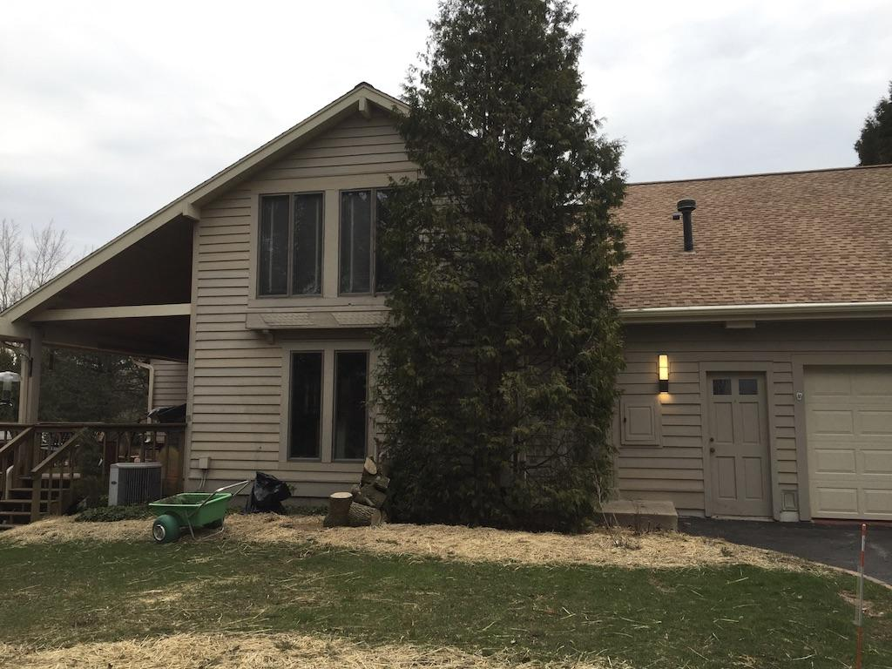
And so it began – Goodbye…
BUCKTHORN!
Honeysuckle
Diseased and dying trees
Notes:
From that moment we knew we had to remove the groves buckthorn and invasive honeysuckle, along with the diseased and dying trees- out went diseased ash, spruce and pines, and away went two mature trees that were splitting in half. And we said goodbye to the arborvitae that looked like they were eating the house alive. Note: back door to house in there somewhere.
It sounds easy, but it was difficult, expensive and traumatic. Many of the trees that were part of the very reason we bought the house were gone, and a bit of our excitement with them.

Slide 12
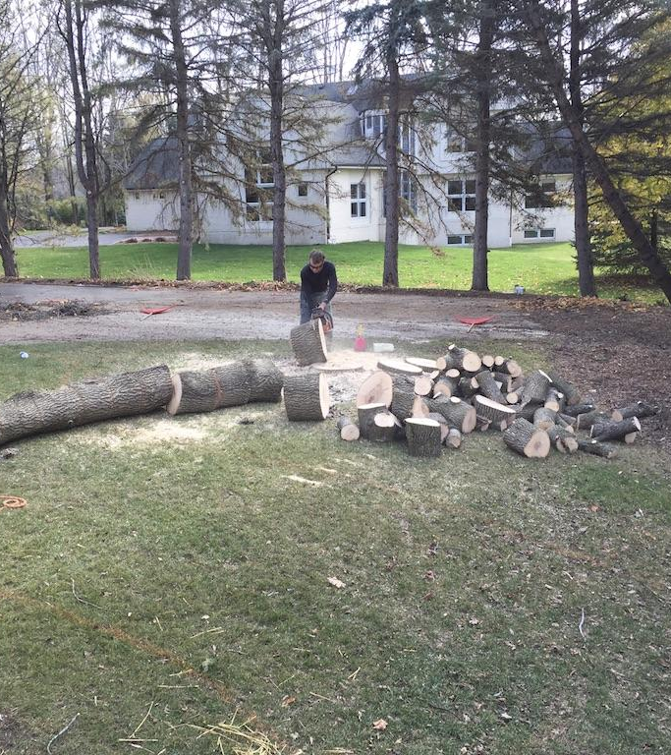
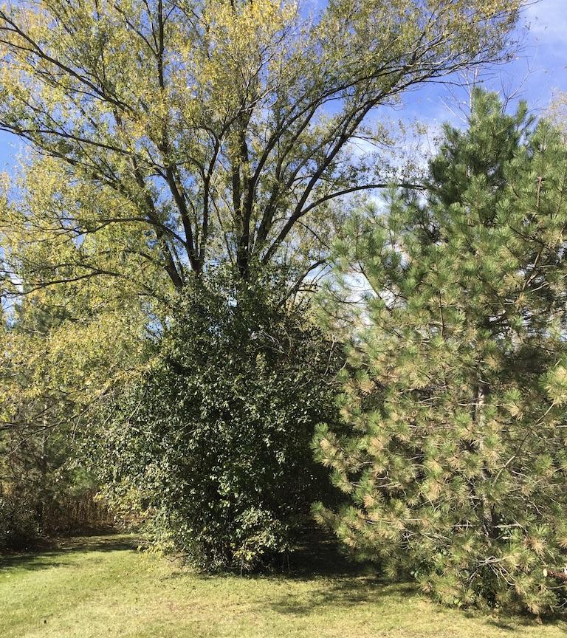
When does it end?
It doesn’t!
Notes:
Long term, however, it emboldened me! But that took years.
After the “first wave” of tackling dead trees and woody invasives came the herbaceous invasives- dames rocket, poison ivy, garlic mustard, creeping Charlie, bindweed, bishop’s weed, purple nightshade…you name it, we had it! And still do….I learned that there would be no end, that there would always be subsequent "waves" of plant deaths and new invasives, and that I would always have to make room in my schedule to address this.

Slide 13
Yes, and: Accepting Reality and Taking Stock
Who/What do I know?
What do I have? What do I need to learn?
When? Starting NOW
Where can I get help, inspiration, education?
WHY am I doing this?
Notes:
During that whole period of essentially ”erasing the chalkboard” to create a blank slate, I began to really take stock, accept reality and ask myself the harder questions. As I did, I began to realize that not only is inspiration all around, but that I had access to all sorts of mentors and memories, travels and talents, that I could access on my gardening journey. This inspirational journey- the learning, the looking inward- is the essence of improv and became the birth of my "improvisational gardening" approach.

Slide 14
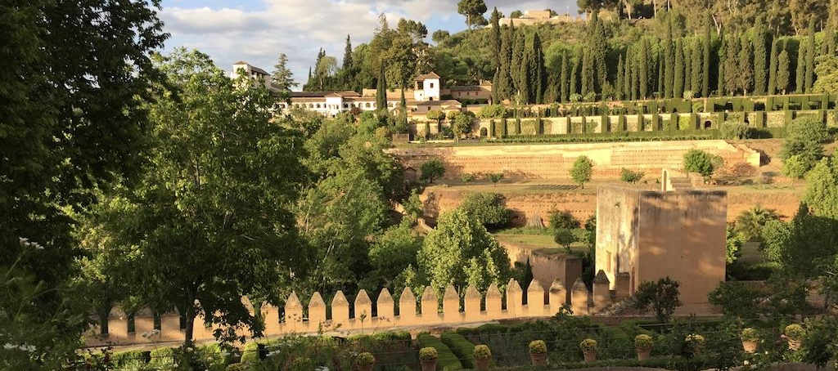
Garden Inspirations
Notes:
I’ve been inspired by so many PLACES. I’ve had the great, good fortune to travel around the world and literally every place has been a source of inspiration.

Slide 15
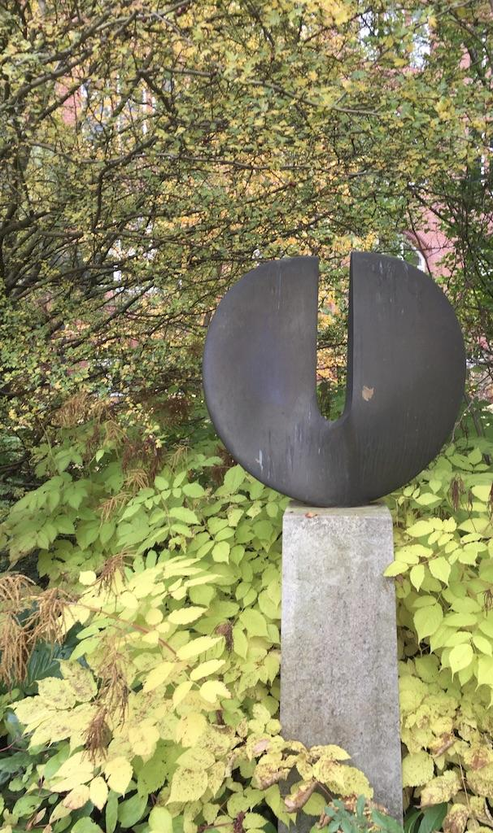
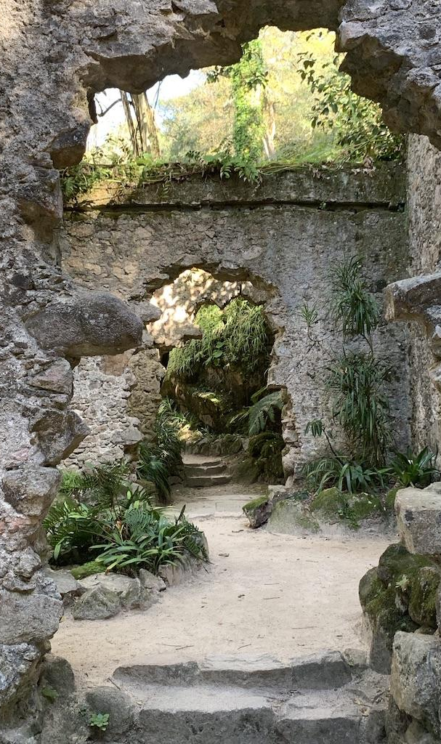
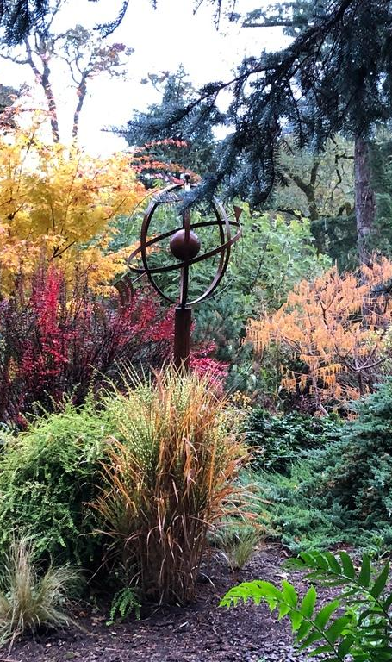
.
Notes:
Places I’ve called home: Stilwell, Ks. Seattle, Kansas City, Atlanta, Columbus, OH. Chicago, New York City, Nashville. Many of the plants I’ve chosen for my garden are subtle and not so subtle reminders of each.

Slide 16
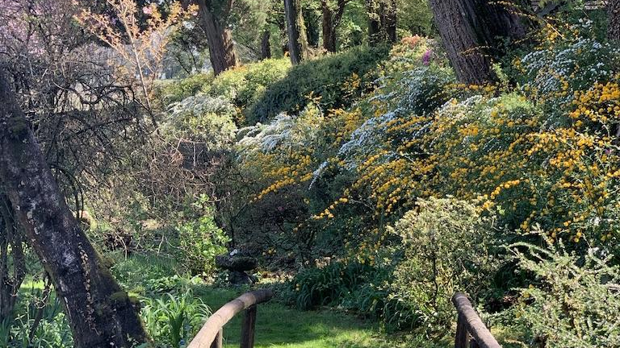
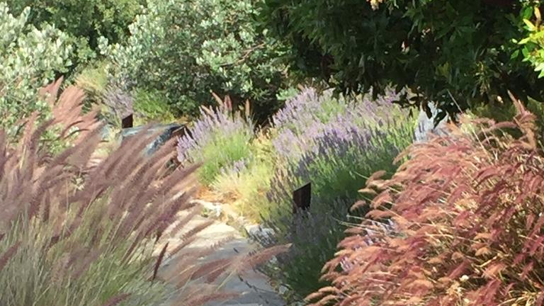
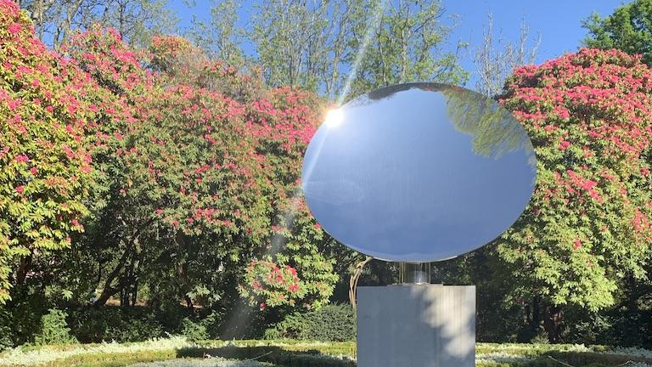
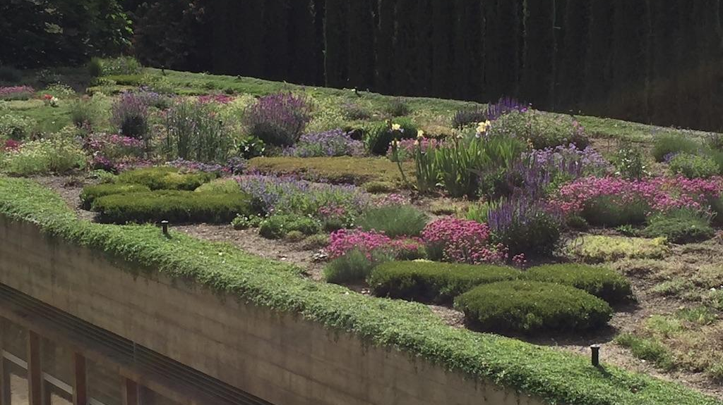
Notes:
I am inspired on an ongoing basis by any new person, plant or place I encounter! As Diana Vreeland so famously said, “The eye has to travel!”.

Slide 17
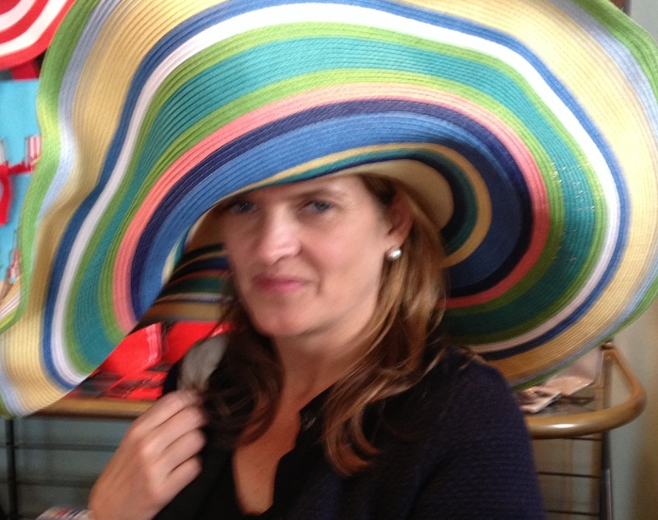
My Background
32 Years in Fashion Retail
How to create, collate and edit
How to build and trust a process
Seasonality/Styles and Trends
Coordinating each item into outfits and wardrobes
How to SEE!
Notes:
My work background is a whole other story. Tapping into this knowledge created another major shift in my gardening journey.
I spent most of my career in product development and design and it has informed my process and approach to virtually everything, and now I began to see how it could apply to gardening:
How you create, collate, and edit. How you build and trust a process. How you build an outfit and then a wardrobe. Seasonality. Style vs. trend. What role does every element play in the whole- an article of clothing, accessories, grooming. Appropriateness. Setting. Knowing when to break the rules. Items, categories, collections, themes, branding.
I went back through years of photos taken during my retail career and found endless inspiration that I could apply to my garden. Here are just a few…..

Slide 18
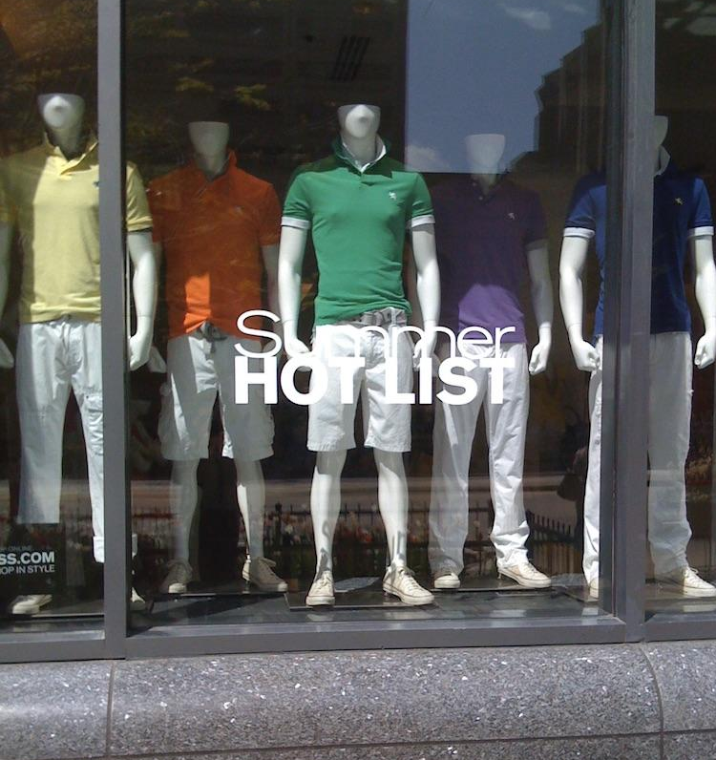
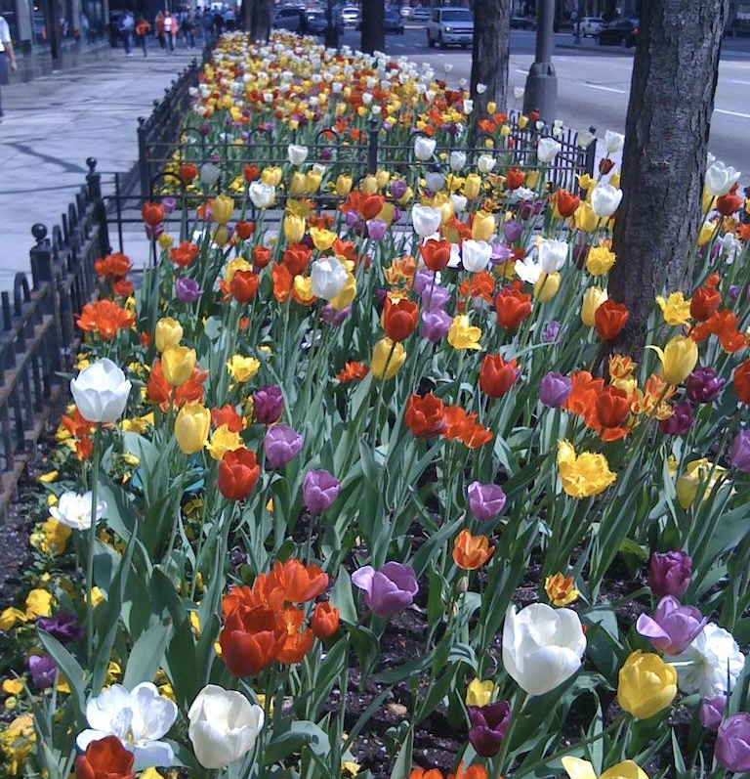
Notes:
A shopping trip inspired a connection to a spring planting in Chicago...

Slide 19
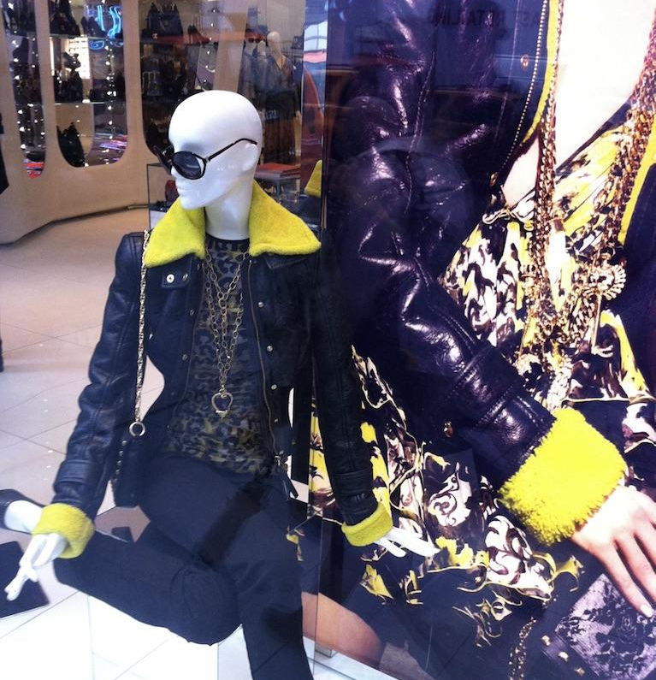
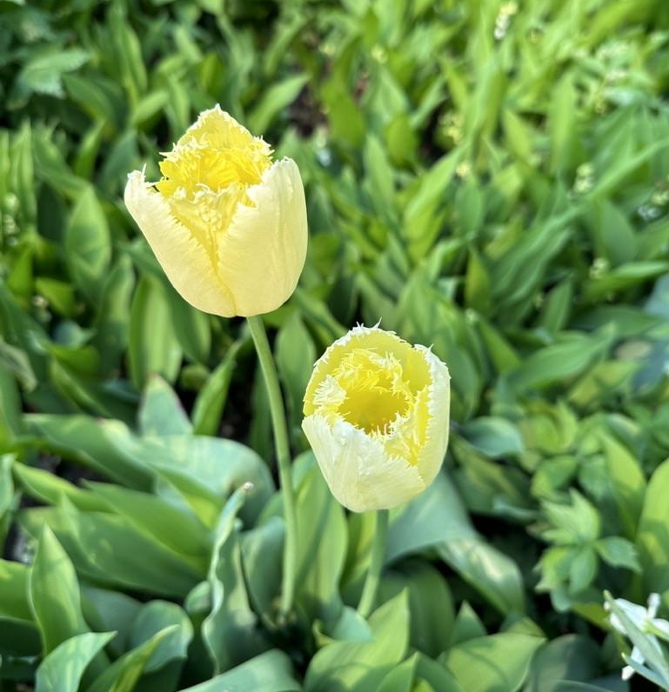
Notes:
A women's jacket in Berlin inspired this planting of Crispa tulips in our front entry bed...

Slide 20
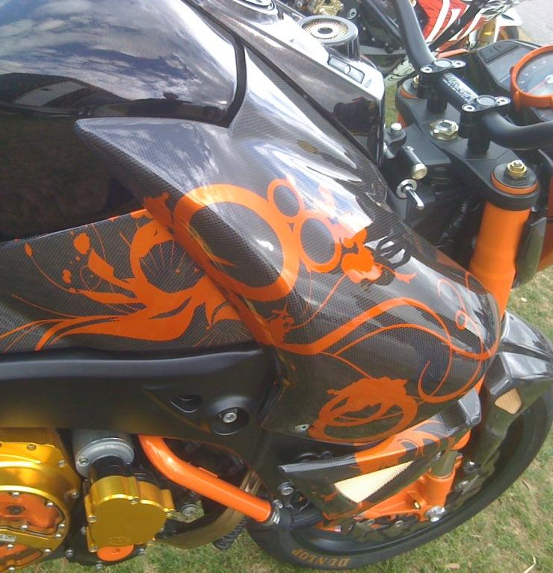
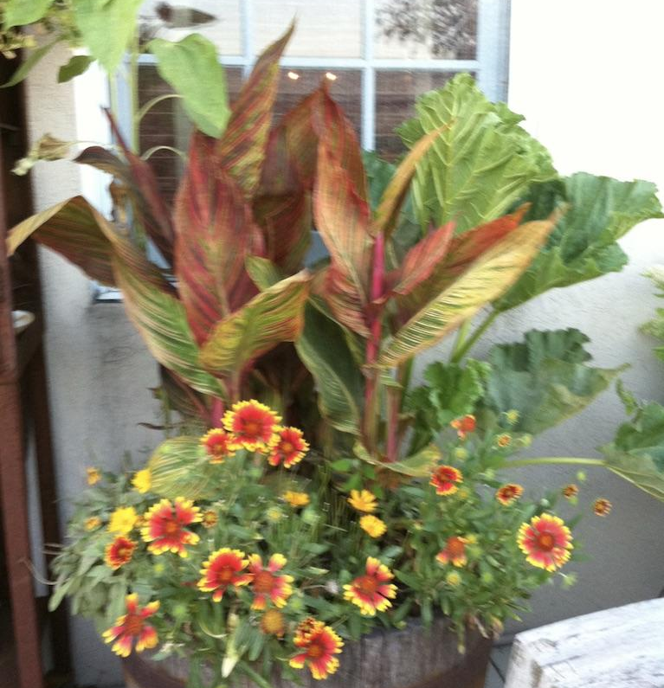
Notes:
This custom paint job seen at a motorcycle rally in Brazil inspired this planter palette back home.

Slide 21

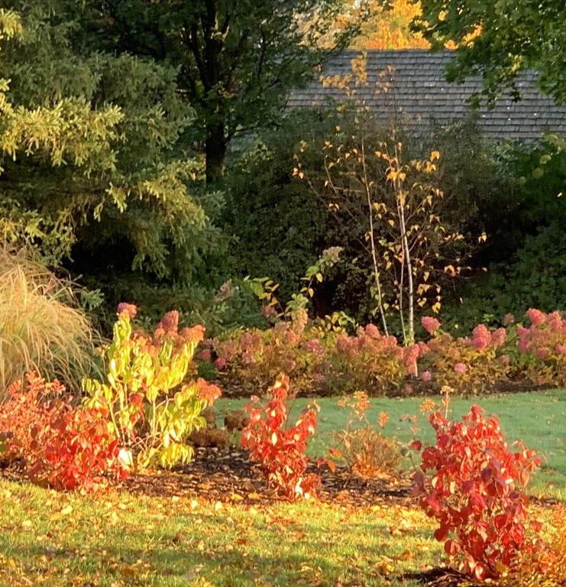
Notes:
A work of art spotted in Puerto Vallarta inspired this fall color palette in our front yard.

Slide 22
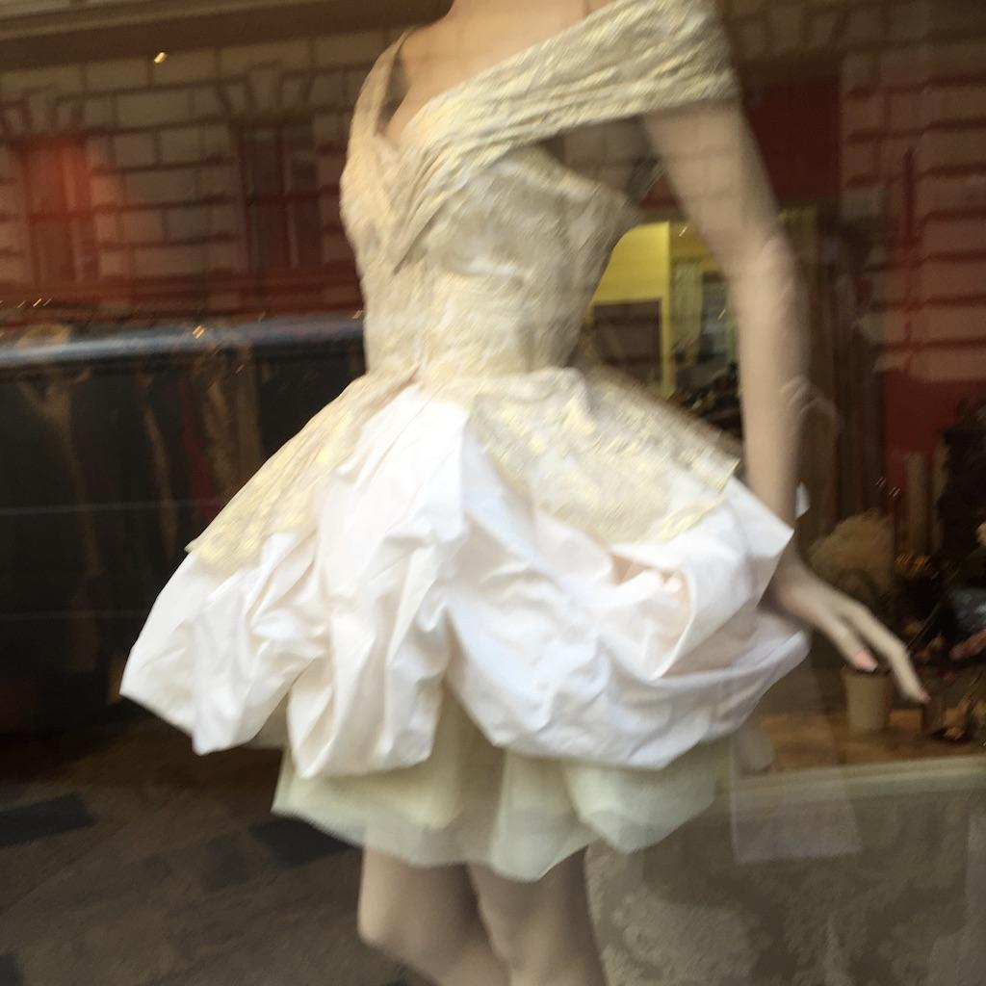
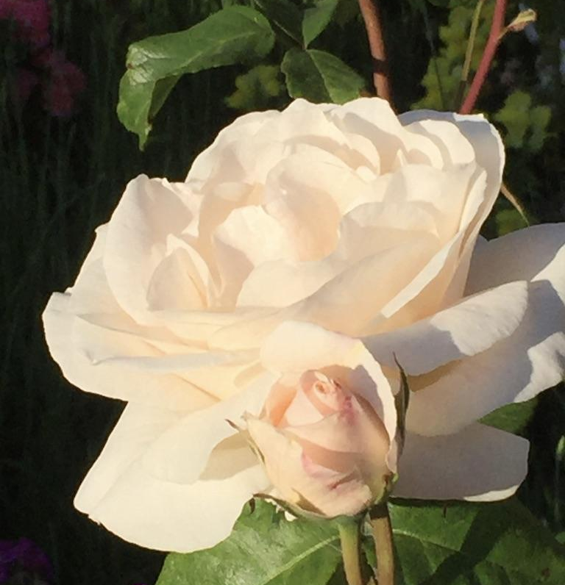
Notes:
Finally, how this window display in Vienna reminded me of my grandmother's roses that inspired me to plant these John F. Kennedy roses in her honor. The irony of these images is that NATURE likely inspired THE ART that inspired my garden! Truly a full circle moment.
Every lesson I have learned in Fashion Merchandising has a parallel application in the garden.

Slide 23
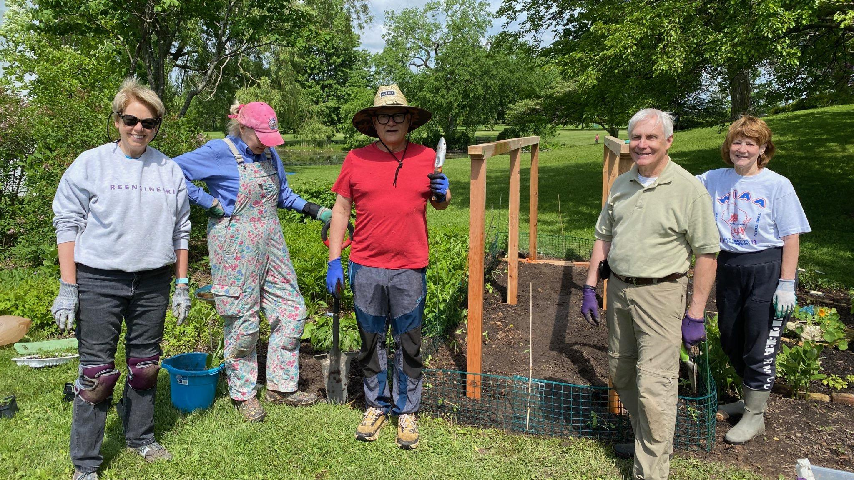
SEWMG
Foundational Class
Continuous Education
Volunteerism
Science based information
Notes:
Education: I eventually found my way to taking classes through the UWM Extension Master Gardener program. This was so critical! To actually engage in science and evidence based learning and gardening changed a lot for me! Not to mention finding a group of like-minded individuals, and also to be challenged by some not as like minded individuals. I LOVED the continuing education part of the program as well as the VOLUNTEER component. and I would remiss if I didn’t give a big shout out to my volunteer partners in crime at Lynden Sculpture garden, some of whom are here today!

Slide 24
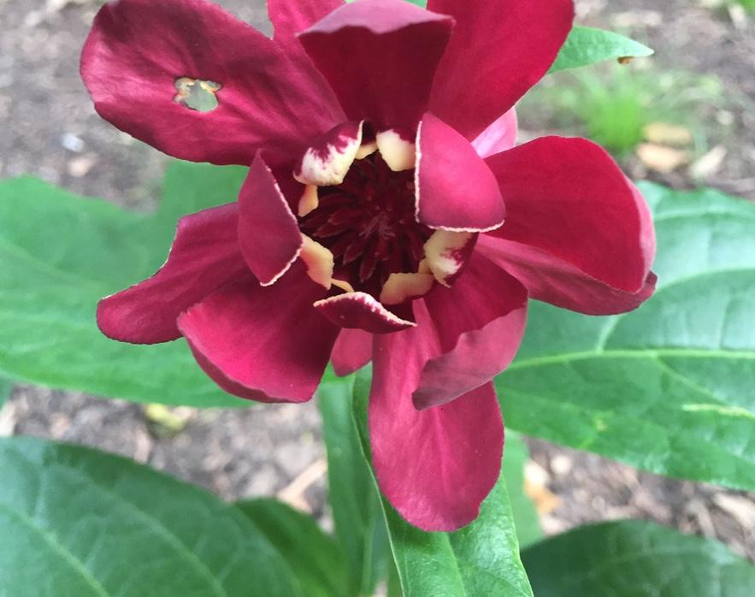
Garden Mentors:
Family
Grandma and Grandpa Smith: garden as sustenance.
Grandma Schnoebelen: gardening for beauty.
My Father: garden as sanctuary.
Notes:
I began to think of my earliest memories of "garden"
My Grandma Smith: she seemed to be able to grow anything. There was such a joyful disorder. It was like a weird combination of a Rockwell and a Wyeth painting.
My Grandma Schnoebelen: Everything was so planful and carefully maintained. Intimidating, but beautiful and aspirational. The only roses I have in my garden are because of her.
My father: He seemed to be most at ease in the garden- what a respite it must have been for a father of 9!! It was likely the only place he felt was in control.

Slide 25
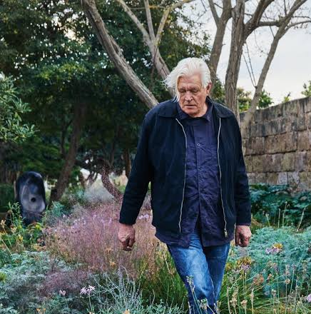
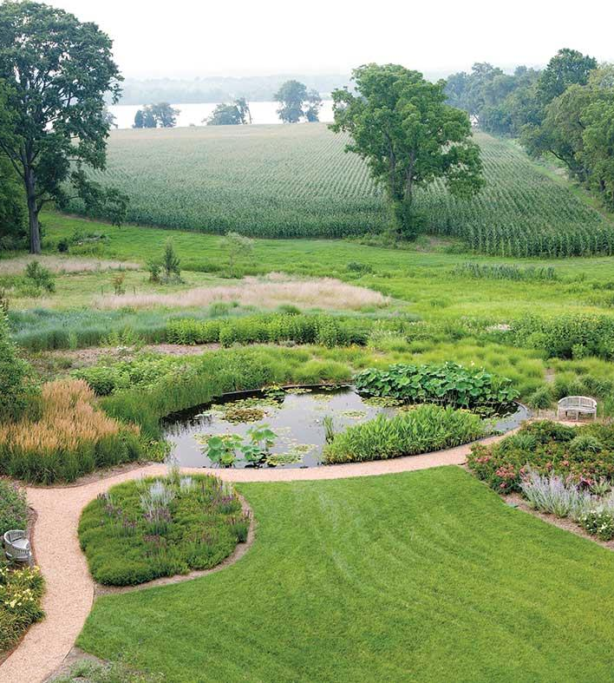
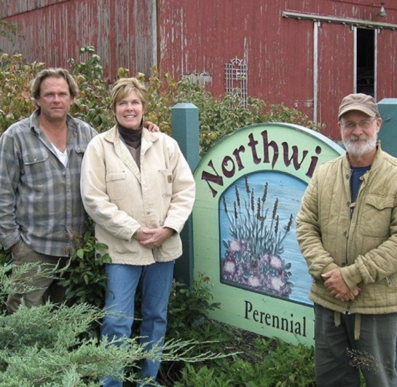
The New
Perennialists
Piet Oudolf
Oehme van Sweden
Roy Diblik, Northwind Perennial Farm
Notes:
When I started taking inspiration from other gardeners, it started with perennials, or who I am calling The New Perennialists. Roy Diblik, Northwind Perennial Farm: Roy is the Yoda of Gardening! I love his concept of plant communities and of starting with 3-5 plants in a small area to really learn how they grow. He introduced me to sedges, which he calls living mulch. I am obsessed.
Ohm/Van Sweden and their use of Grasses- such appeal to a boy from Kansas, where everything is relentlessly horizontal. A callback to riding through the Flint Hills Tallgrass Prairie.
Piet Oudolf for the depth and complexity of his naturalistic plantings, for the idea that a garden is beautiful in every season, and that brown is a color, too.

Slide 26
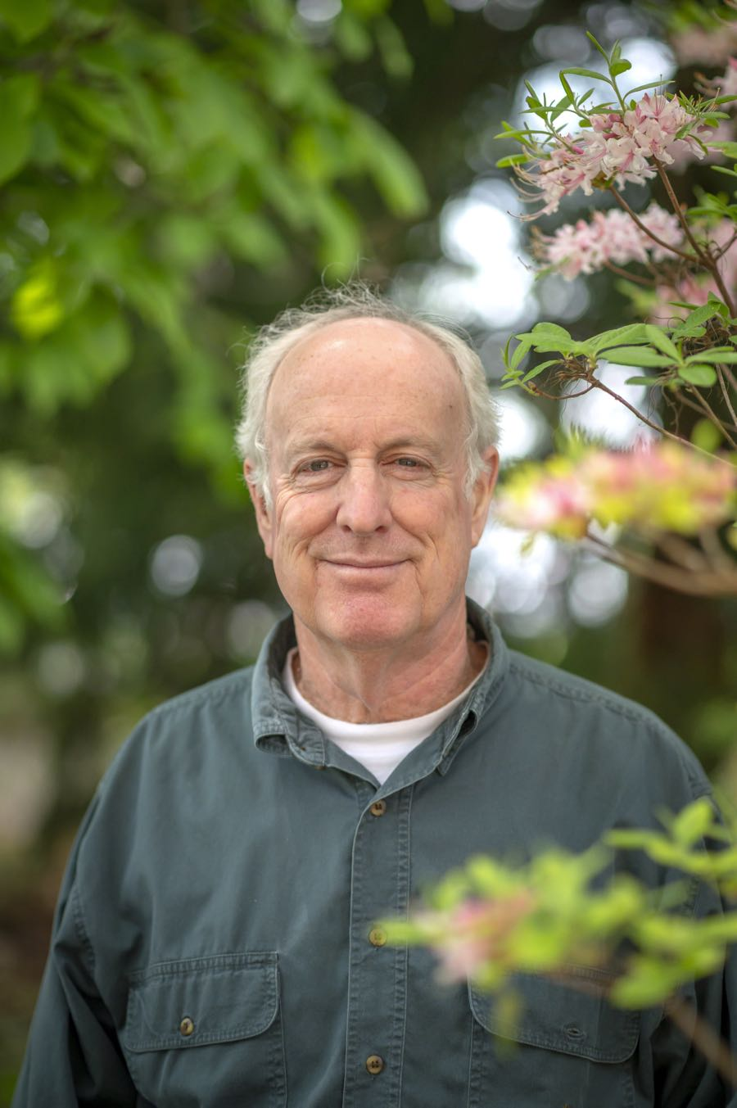
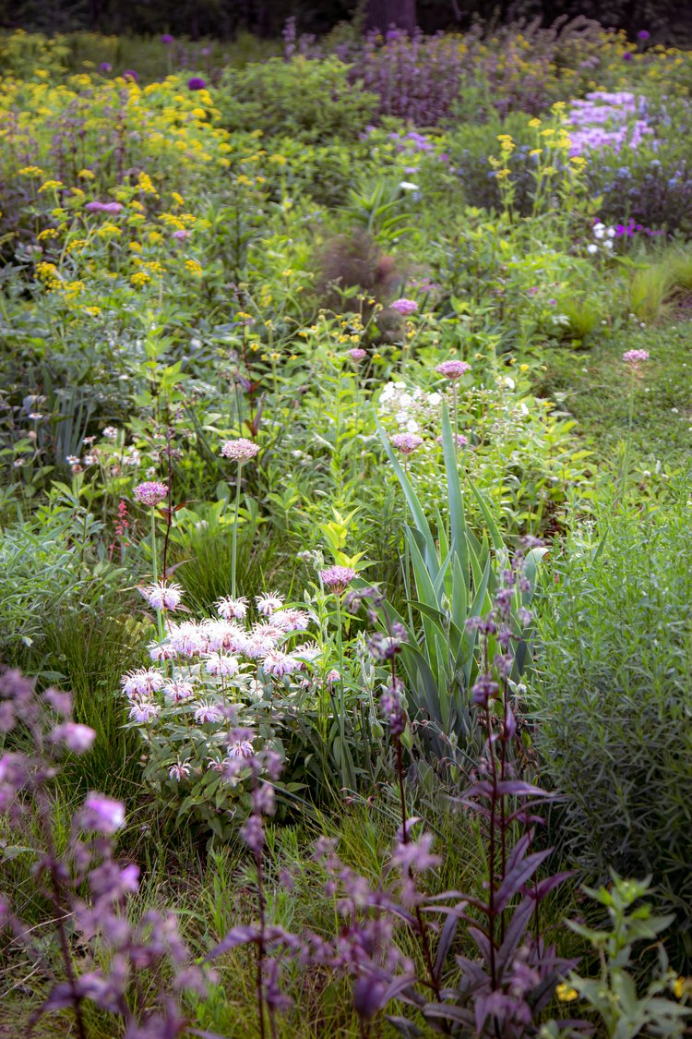

The New Naturalists
Doug Tallamy, The Professor
Kelly D. Norris, The Artist
Benjamin Vogt, The Activist
Notes:
My latest inspiration has come from a group of gardeners I call THE NEW NATURALISTS.. Here are three gardeners that really represent the dynamic and diverse approaches to what gardening is all about, RIGHT NOW. I came to the sustainability party a bit late. I’ve got a lot of catching up to do, and in real time. But that is the very essence of IMPROVISATION, isn’t it? Staying in the present and not getting stuck in the past
Doug Tallamy- The Scholar. Homegrown National Park. Keystone Plants. Bringing Nature Home.
Kelly Norris- The Artist. New Naturalism. Just Keep Planting.
Benjamin Voght- The Activist. A New Garden Ethic. Unlawn America. Prairie Up.
Learning from these gardeners helped me accept the reality that...

Slide 27
We are in the Era of Environmental Gardening
Worldwide biodiversity crisis.
Worldwide climate crisis.
Horticulture and Ecology begin to merge.
A lot of what we do/have learned is counterintuitive to how Nature actually works.
Notes:
We are living in the era of enviromental gardening:
Lost 3 b. birds since 1970, 40%. At risk to lose 1 million more species. Insect populations are collapsing.
The shift has begun from
- Pretty for the sake of pretty to Responsible Beauty.
Inert to Dynamic
Control and Domination to Partnership and Community
-Property Ownership to Land Stewardship
I have been gardening for less than 10 years and I have already gardened through one zone change. In my lifetime, there have been 3 zone changes. We have to be forward looking and incorporate as many best sustainable practices in our yards if we want to have a viable future.

Slide 28


Sustainability Defined
Forward thinking.
Works with Nature, not against it.
Values ecosystem support.
Minimal impact on the earth.
- American Horticultural Society
Notes:
Here is where I began to make the connection between Improv and Sustainability and the things they share in common. And while they may seem very different, with different terms, they share some common goals regarding
-being present/in the present.
-working with and not against.
-accepting reality.
-less control and more partnership
- accepting the unexpected.

Slide 29


Sustainability Entails
Soil health.
Water efficiency.
Supports pollinators.
Plant selection.
Materials and tools.
Notes:
Soil Health: healthy soil produces healthy plants. Healthy soil is full of organisms that turn organic matter and minerals into plant nutrients. Do you test your soil? Do you compost? Do you use fertilizers? What type? So much of this is about working with/yes, and. What you DON’T DO- disturb the soil, try to change it too much. Mother nature has a solution to almost every condition.
Water Efficiency: Water can be in short supply or rain can be unpredictable. How do you practice water conservation? How is your garden waterwise?
Supporting wildlife and pollinators: wilderness is disappearing, supporting a natural ecosystem is something that home gardeners can do to combat loss of plant and animal species. How are you attracting pollinators? How are you creating wildlife habitats? How do you attract beneficial insects?
Plant Selection: native plants are adapted to the local climate and soil conditions where they naturally occur. The require less watering and fertilization.
Materials & Tools: gas-powered mowers and power tools can cause noise and air pollution. Hardscaping like concrete are impermeable and contribute to water waste. Some mulches and lumber can be toxic and harmful to soils. How do you choose environmentally friendly tools and hardscaping materials? How to you reuse and recycle and find alternatives to plastic? Do you use pesticides and herbicides? How and how often do you use them?

Slide 30


Nature Driven Decision Making
Plant more plants.
Prioritize Keystone plants.
Plant them closer together. They are social and live in community, leaning on each other, supporting each other.
No plant evolved to grow in bark mulch (they actually grow through last year’s debris).
Embrace natural processes.
Gardening is disturbance. Weeds are early colonizers and first responders that arrive after a disturbance. Plant native annuals to minimize weeds.
Notes:
When we start to observe/learn how nature actually works we start to embrace natural processes.

Slide 31

Sustainability, at its essence, is the pledge to be conscious stewards of the world we inhabit.
Notes:
Everything by design, nothing by default. Stewardship, not ownership. Dynamic, not static. Integrated, not isolated. Responsible beauty, not just pretty. Collaboration, not control.

Slide 32


The Way Forward:
Let’s get to work!
Notes:
As I realized how to bring all these inspirations and experiences and tools from my career, I went to work with a clearer idea of what I wanted to accomplish and a newfound purpose!

Slide 33

My Goals as a Gardener:
Responsible Beauty.
Celebrate Native Plants
Botanical Diversity/Community
Cultivate Curiosity
Leave the Land Healthier
Notes:
I started to trust myself realize what I wanted out of gardening….
Create beauty- useful, responsible, life sustaining beauty. Always with a sense of humor. Stewardship vs. Ownership
More natives. Especially trees and shrubs. Less grass.
Diversity. I love massing plants, but too much of any one thing causes problems! As I found out with Ninebark (powdery mildew), and Arrowwood Viburnums (Viburnum leaf beetle).
Be curious. Take chances. Make mistakes.
Edit based on knowledge. The amur maple really need to go.
Leave things a little better than I found them.

Slide 34

My Garden Style
Naturalistic
Aspirational
Sustainable
Experimental
IMPROVISATIONAL
Notes:
Optimistically- Naturalistic.
Aspirational.
The place where minimalism and maximalism meet.
Realistically- Cleans up well. Not bad on a good day. Wildly optimistic.
More ideas than sense.
Finally- IMPROVISATIONAL. of the moment.

Slide 35

Planting Themes
Joy & Abundance
Plant Communities
Transition to Natives
Happy Accidents
Notes:
JOY and ABUNDANCE!
I really want things to be what they want to be, grow where they want to grow. Even when I plant new beds or create new paths, I try to think of how the water flows, where the sun falls, how one wanders through an area. And I use hardscape as little as necessary, or to solve a real problem, or hide an eyesore. I want each plant to be ITSELF- be big if it’s big. Spill if it spills. Wander if it wanders. Which means minimal pruning for shrubs and trees.
Finding plant combinations that seem like good neighbors/communities. And, once in a while, I just get a wild thought and try stuff. I create many areas for pure experimentation.
I also like when Mother Nature has a good idea-
I love a happy accident! Finding a balance between cultivars and natives is a new endeavor Overall, I literally try to make it seem as if everything is both coming together AND falling in to disarray at the same time, as in nature!

Slide 36

Notes:
Abundance personified. On the verge of too much...

Slide 37

Notes:
Good neighbors- meadow plants in community. directly from the “appropriate plants” list by Roy Diblik

Slide 38

Notes:
This is a great moment of cultivars transitioning into more natives. There is no one right way, except to get started. Even since this was taken I have removed ninebark cultivars and added more native shrubs.

Slide 39


Notes:
Happy accidents:
I thought I got rid of these old lilies, but they were tough as nails and came back. Now I love the moment when they and the Hydrangea are in full flower. I call it the creamsicle border.
This experimental area of greens doesn’t technically “work”, design wise, but every time I see it out my bedroom window I am instantly calmed.

Slide 40

My Planting Priorities
Native Trees and Shrubs for Structure and Legacy
Perennials-more natives
Sedges! Mother Nature’s mulch
🚫 Turfgrass- lose at least 50%
🚫 Annuals- except natives, pots, filler.
Notes:
My priorities became very straightforward .
Trees and shrubs are the true structure of any garden, but especially a large one! and as I age Trees and Shrubs become even more important.
Perennials have been the focus of my garden, with natives and nativars becoming more important over time.
There can never be enough sedges, and other native groundcovers.
Only turfgrass as necessary.
I don’t have a lot of use for annuals, except native annuals,as potted plants and temporary problem solvers. I have to draw the line somewhere!
Ultimately, though, my garden reflects where I am in my life, right now!

Slide 41

My Planting Palette
Tonalities
  White/Green/Silver
  Yellow/Orange/Red
  Blue/Lavender/Purple
  Green in all its glory
Notes:
I love tonalities: white/green/silver, yellow/orange/red, blue/lavender/purple.
Maybe it is growing up in Kansas where you see lots of browns in the landscape, lots of tonalities. I am drawn to them.
Tonalities are a palette cleanser. In a fashion collection, you serve up tonalities to soothe the eye between more colorful collections, and give a collection a sense of order. Tonalities also give you wiggle room to experiment with different plants to see how they blend in with a grouping. Even if the plant doesn’t work, it will work to a degree because it fits in with the tones, which tricks the eye into liking the effect.
Another type of tonality is warms vs. cools.
It is harder to pull off contrast and boldness in a garden. You have to work at that more and if you are not careful you can end up with a “hot mess”.

Slide 42



White is Always Right
Notes:
Shots from the “business in the front” part of the front yard. White even makes a wilder arrangement of plants look planful and soothing.

Slide 43



Notes:
Bold colors can seem too “hot” sometimes, but I love the crackle of energy and boldness they give!

Slide 44



Am I Blue?
Notes:
The BLUE ALLEE- my biggest garden ”conceit” or folly, that stemmed from taking my LEAST FAVORITE color and going bonkers with it….

Slide 45


The Power of Green
Notes:
The power of green. Period. The end.

Slide 46

Concentric Circles Approach
The house as my bullseye
Worked outward in concentric circles
Notes:
To some degree, the property prioritized for me the first few years- death, disease, invasives, etc. Also, there were just some eyesores that had to be addressed right away due to their visibility and/or high level of use. So it started as sheer practicality.
After that, I tended to start in the area around the house and then work outward in concentric circles. I am still on that journey and it will never end.
situations.
As I get deeper into the process, I also want to create more infrastructure for critters besides just a food supply: more bird houses and baths, some owl and bat houses, etc.

Slide 47

My Garden Building Rule of Thirds
1/3 Planned Approach
1/3 Reacting
1/3 Creativity and Improvisation
Notes:
So much was about how I “fit” the gardening/landscaping into an already full budget of home remodeling that would take years. I’d say it was about 1/3 planned, 1/3 reacting to what was happening in the garden in real time and 1/3 where I was at creatively and was willing to work on. This parallels the idea of the three ”layers” of a garden- groundcover, focal plants, trees and shrubs. I overplant the groundcover layer, I plant a broader mix of focal plants and then adjust annually.
However, some of the areas of the front of the property were far more planful and “designed”, but still had to evolve over time as I found the right plant materials and as I simply learned more about gardening and how to apply it to my particular situation.
Flexibility was the key given my constraints of budget, amount of help and ability to find plant material that I could afford.

Slide 48

Beds + Names
The Granny Garden
The Sunset Landing
The Golden Meadow
The Island of Misfit Toys
The Hydrangea Haven
The Secret Stumpery
The Blue Allee
And on and on…
Notes:
I’m a sucker for a theme. I name every bed and often there is a color story related to each bed: The Granny Garden, The Blue Allee, The Sunset Landing, The Golden Meadow, The Dappled Path, The Fernery, The Island of Misfit Plants, The Hydrangea Haven, The Bodacious Bearded Border. It just goes on and on….

Slide 49

Notes:
The Pollinator Garden in Late Spring/Early summer. Unrecognizable 6 weeks later!
Weather: 3/5 years of record rain wiped out all the salvia.

Slide 50

Notes:
Unrecognizable 6 weeks later. Now more Queen of the Prairie, Joe Pye weed and Milkweed. SO BE IT!

Slide 51
Notes:
The Transitional Triangle- White keeps it from looking too wild.

Slide 52

Notes:
Just a small part of the The Hydrangea Haven then encircles the front yard now. I used to think of them as too “granny”, old fashioned and bosomy. Now they’ve become a bit of an obsession. AND I am experimenting with more native hyrdrangea arborescens and quercifolia.

Slide 53

Plant Selection
NPR = Never Pay Retail
A plug for plugs!
Don’t Buy Pretty (buy healthy)
Stay True to the Vision: Pocket Plant List
Keystone Natives: whenever possible
Notes:
I have a few “guidelines” for buying plants:
NPR- Never pay retail. I have to buy too many plants to afford retail. I look for both seasonal sales as well as clearance or overstock sales. I am not afraid to “substitute” a similar plant for the “ideal” if there is enough discount and/or quantity. I am also not afraid to go anywhere- from a sidewalk plant sale to a big box store to specialty nurseries and more! You never know where you might find something. However, jumping worms…..is it worth the risk?
-a plug for plugs. often more cost effective, so you can buy more. grow just as fast as larger size plants. Izel and Agrecol sell to retail consumers, but at higher quantities.
-check those roots! i take most plants out of their pots before I buy. 1- root health critical, 2- big box stores a real challenge.
-Stay true to the vision. So far, I have honored my original overall idea/color story. If a plant is on sale and it fits in to the vision, it will likely be purchased. If not, hard pass!
plants with me always when I am scouting sales or visiting new nurseries to keep me focused.
I look for natives now more than ever, but they are more expensive and harder to find, on sale or otherwise. This is changing a bit, but not fast enough for me. Therefore, I focus on Keystone plants, since they have an outsize impact on the garden.
However, I am not afraid to break all these rules, if the situation presents itself. I am at the point now that I trust my instincts enough to take advantage of a good “find”.

Slide 54

My Gardening Mottos
The eye has to travel.
Without a gardener, there is no garden.
Live with it. Learn from it. Build on it.
How you do anything is how you do everything.
The future is a place we are making.
Notes:
My words to live by. I love a good turn of phrase!
Diana Vreeland
Gardening is disturbance. Make it good!
Smith family motto.
Buddhist phrase I learned.
My own motto. if you are not making the future, right now, the future will have its way with you….

Slide 55

Improvisation to Transformation
Top Five Tips
How to turn the garden you have into the garden you love
  Always say “Yes, and ….” Work with what Mother Nature gives you.
  Add new information. Make sure your garden reflects you.
  Be present. Don’t block/deny. Embrace the reality of your site/ability/budget/plants.
  Understand the location and relationship. LEARN about your plants/property.
  You look good if you make your partner look good. Your partner is nature.
Notes:
These are literally 5 of the ”rules of Improv” and how to think about them as they apply to your garden.

Slide 56

Sustainable Improvisation
Top Five Tips
How to turn the garden you have into the sustainable garden you love
  Reduce your lawn. Less wall-to-wall carpet, more area rugs.
  Remove invasive plant species.
  Rethink pretty: Responsible Beauty. Replace outliers.
  Plant for pollinators. Identify and Plant Keystone plants.
  Start planting. Just keep planting. Plant generously.
Notes:
There are dozens of other tips, but these 5 resonate with me, and are straightforward and simple.

Slide 57
Good Neighbor Gardening
Top Five Design Tips
How to turn the garden you have into the garden your neighbors love
  Limit your plant palette by square footage.
  Use borders and ground covers for “visual control”, “orderly frames”.
  Only 1-3 plants in bloom at any one time. No more.
  No plants taller than 3-4’ and placed in middle or back.
  Repeat, repeat, repeat. Masses and drifts to please the eye.
Notes:
Simple ways to keep your naturalistic garden from becoming a “hot mess”.

Slide 58

“Perhaps the gardener is not someone who makes forms last over time, but over time, if possible, ensures that enchantment survives.”
- Gilles Clement in The Planetary Garden
Notes:
A Beautiful disturbance.

Slide 59

Stay CURIOUS And Always Have FUN!
C. Patrick Smith, llc
Follow me on Instagram @cpatrickpatrick
and Blue Sky
@cpatrickpatrick.bsky.social
Want to book The Improvisational Gardener? Reach me at:
414-704-0028
cpatricks@gmail.com

Slide 60

See you in the garden!
Buckthorn Acres is Located on 5 acres in River Hills, Wisconsin.
It is home to 2 humans, 2 dogs, countless chipmunks and squirrels, turkeys, raccoons, opossums, deer, coyote, the occasional snapping turtle, at least 21 species of birds and counting, not to mention all the creepies and crawlies, winged wonders and flying pollinators.
All are welcome.
Follow me on Instagram @cpatrickpatrick
New website coming soon: www.warmmodernhome.com

Slide 61


