Slide 1
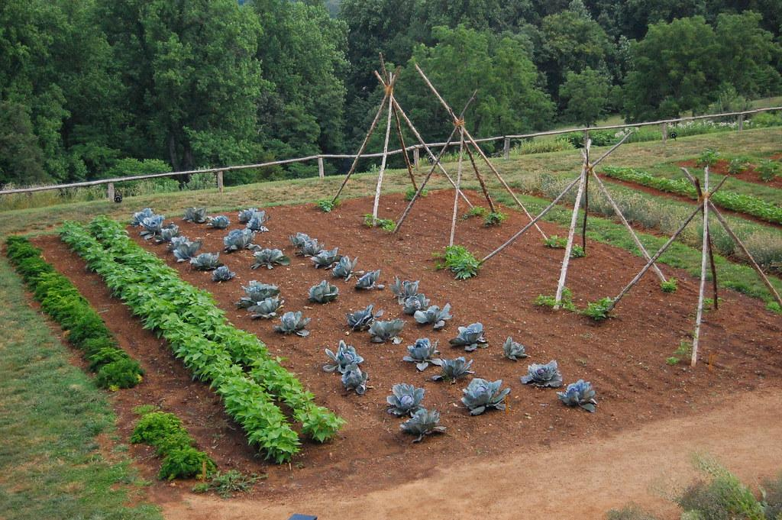
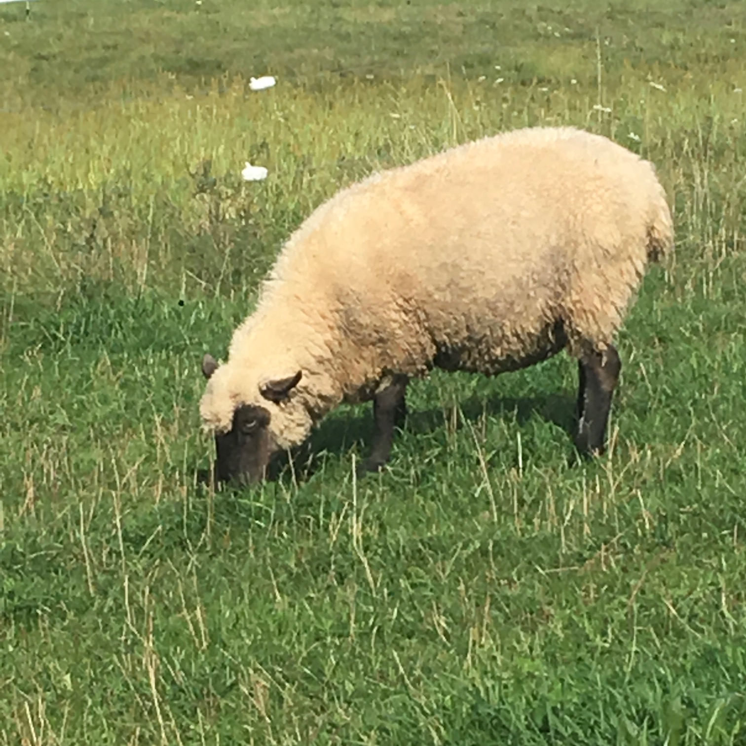
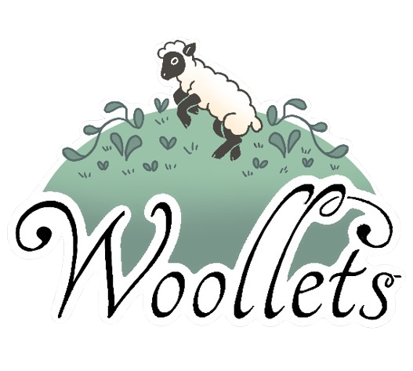
Wonderful Wool:
For Your Plants and Your Planet!
Photo: Google Image

Slide 2

“... human legacy of environmental damage to the water, air and ground of this world is not one thing, but nearly too many to count; nevertheless we still must each face the environmental challenges, doing what each of us can in our way to help preserve our environment.”
-Unknown
Photo: Google Image
Notes:
E 2 “... human legacy of environmental damage to the water, air and ground of this world is not one thing, but nearly too many to count; nevertheless we still must each face the environmental challenges, doing what each of us can in our way to help preserve our environment.”

Slide 3
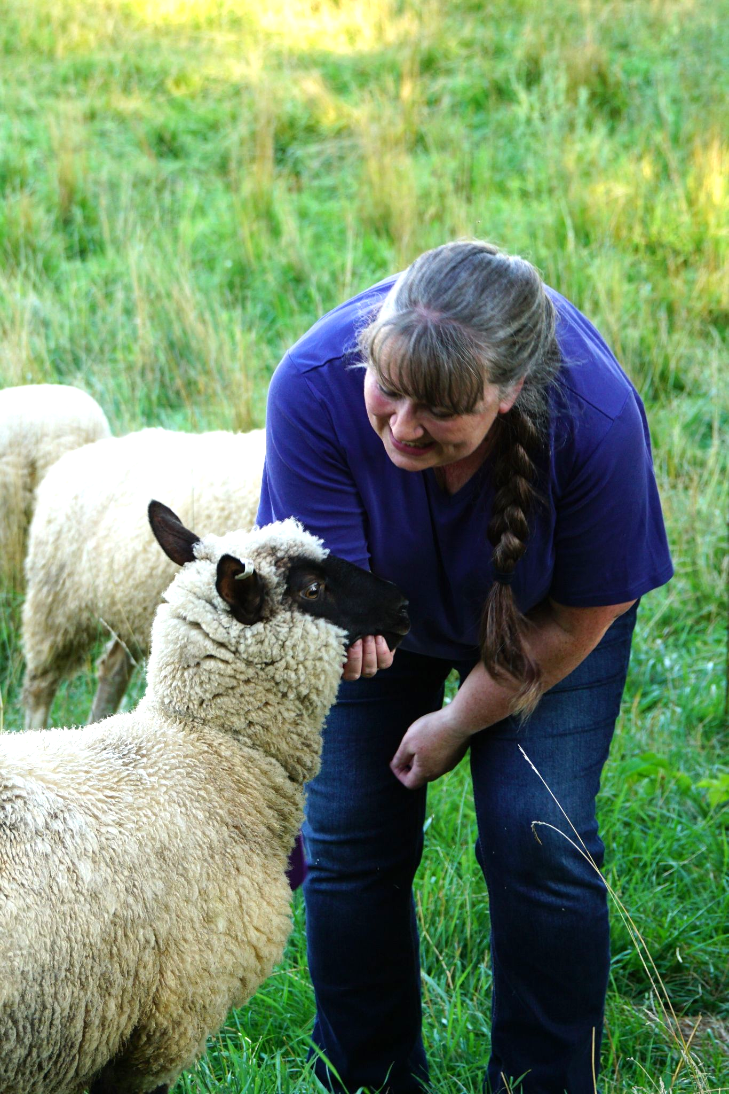

Karen Mayhew
Elaine Becker
Notes:
K 3
Karen Mayhew - I’m a 4th gen farmer, a shepherd, and I’ll be finishing Master Gardener Certification next month. My day job is at our local US Post Office, I grew up on a big market vegetable and chicken farm and now I farm sheep with my family. Our small family farm is 25 acres with a Farm Stay in our barn, miscellaneous chickens, goats, rabbits, cats and a flock of 50 heritage breed sheep. 50 sheep produce a lot of wool and I am always looking for new creative ways to use all that fiber. I spin and knit but still, A lot of that wool goes in my gardens. This is my business partner.
I am Elaine Becker. I am an educator and librarian by day. I received a BS in environmental science from Indiana University and am currently becoming a Master Naturalist. Growing up my family had extremely large gardens. I grew up watching and helping my folks grow and preserve our garden vegetables and was raised in a house full of gardening magazines. Many summer days and evenings we kids would be picking beans, weeding, mulching or helping to preserve the vegetables. I’m an environmentalist, a plant lover, geeky prairie lover, and want the very best for our environment.
Company Narrative
We two women have been friends for over 20 years. This past year, we started a new company together, Woollets. We are a 2 woman show, if you will. Woollets was born out of a desire to do better for the environment. As a sheep farmer, I saw thousands of pounds of wool being thrown into landfills because shepherds no longer had a viable market. The biggest wool buyer in the Midwest closed its doors in 2023, and they were only paying 1-2 cents per pound. I wanted to find a new outlet for all that wool to provide good revenue to Wisconsin farm families.
Elaine saw a need to help save the peat bogs from overharvesting and was more focused on the aspect of being a good steward of the earth. We wanted to create a product from what is seen as waste, diverting it from landfills, simultaneously creating a market for shepherds.

Slide 4
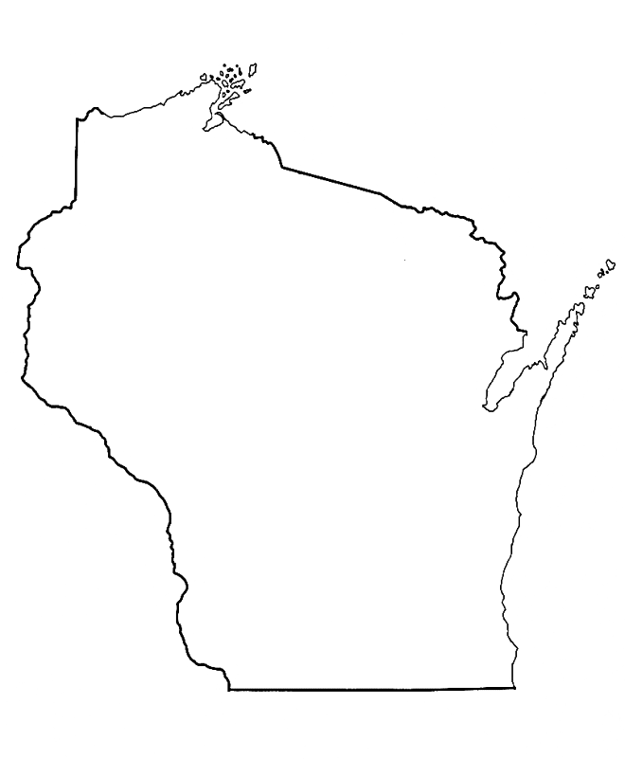
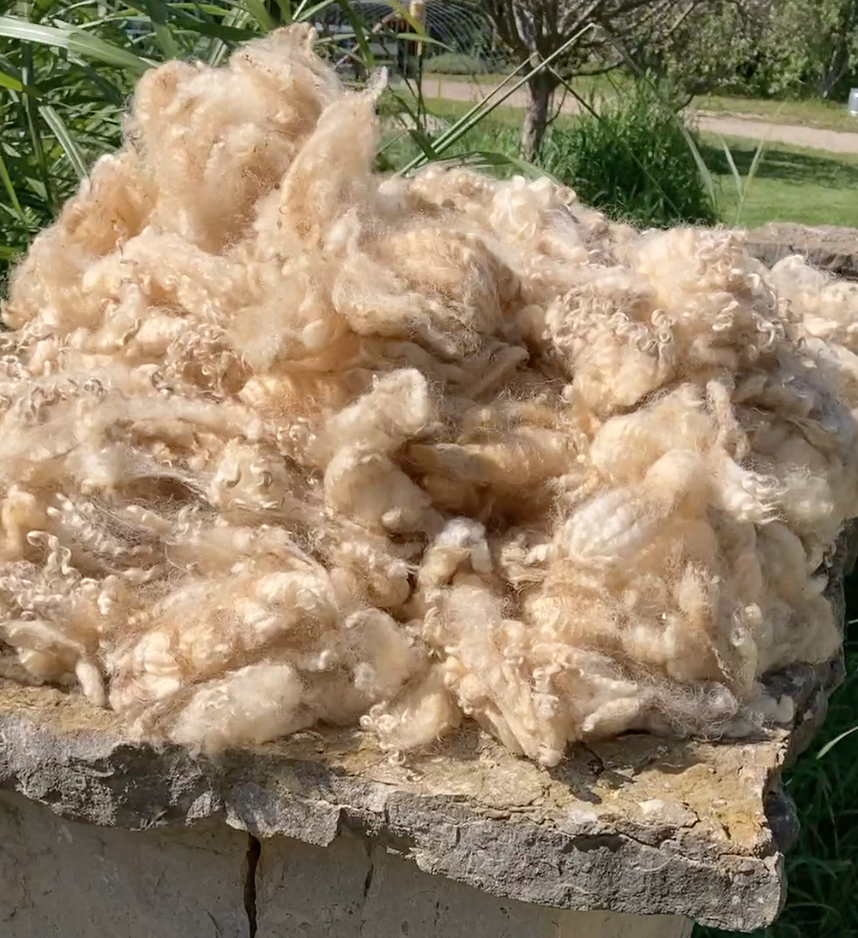
Turning wool into Woollets
Raw fleece
Notes:
K4 Our company turns wool into Woollets wool pellets
We source our wool from Wisconsin sheep farmers, paying them a fair price and adding revenue to their farm and families.
We divert that wool from the waste stream. We use raw wool straight off the sheep.

Slide 5
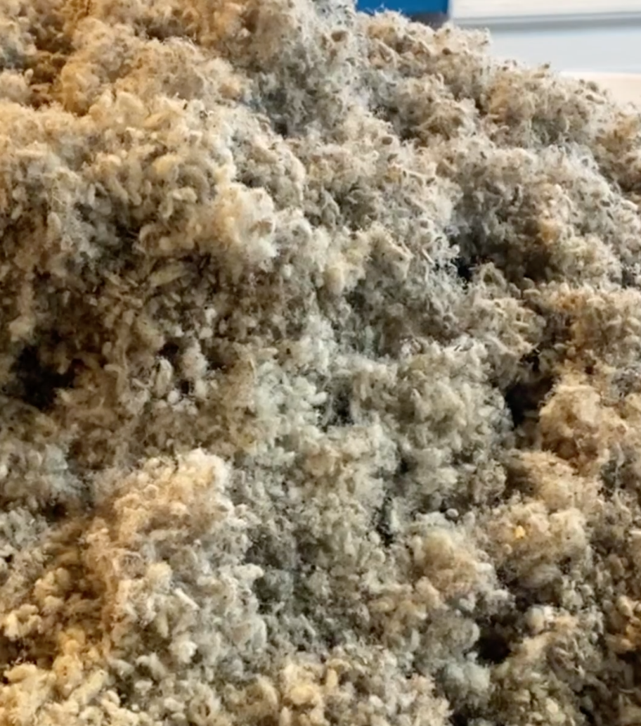
Turning wool into Woollets
Raw fleece
Shredded wool
Notes:
K5 Our company turns wool into Woollets wool pellets
We shred it in a machine which has 9 whirling blades of death, which turns the wool into tiny pieces.

Slide 6
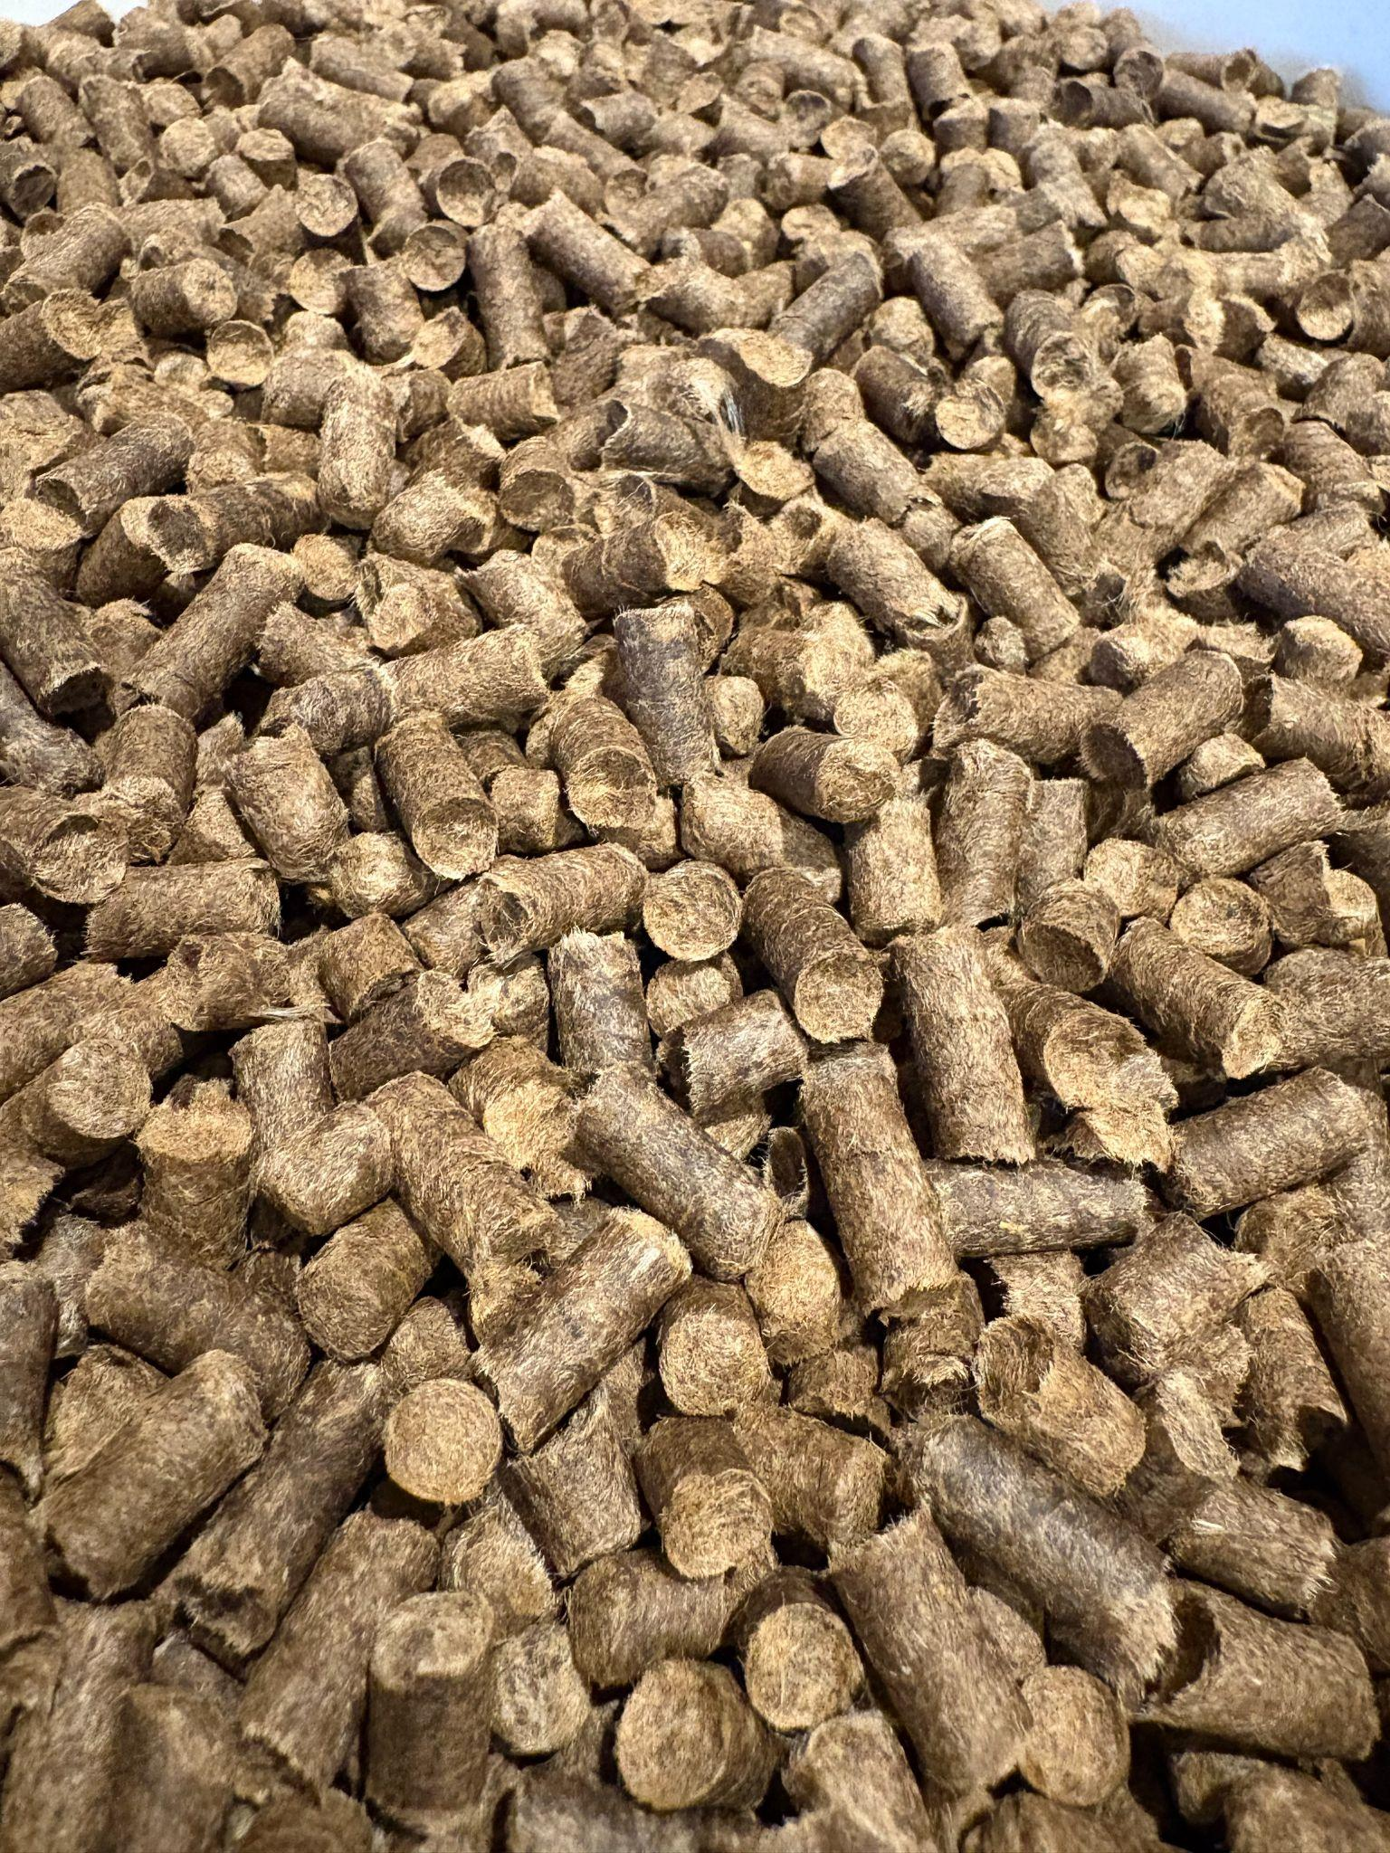
Turning wool into Woollets
Raw fleece
Shredded wool
Woollets wool pellets
Notes:
K6 Our company turns wool into Woollets wool pellets
Then pelletize it using heat and pressure, which sterilizes weed seeds.
Wool pellets are a sustainable alternative to peat for moisture retention and wool, unlike peat, provides nutrients to the soil.
The wool pellets are easy and more convenient to use and store than whole fleeces, and switching to wool is great for your plants and your planet.

Slide 7

In our first year… we have some things to celebrate
Woollets has diverted 18,000 pounds of wool from landfills.
Photo: Google Image
Notes:
E 7 We have a few things to celebrate in our first year…
*** We have been able to divert 18,000 pounds of wool from the waste stream or from being burned.

Slide 8

In our first year… we have some things to celebrate
We have provided Wisconsin shepherds a new market for their wool.
Photo: Google Image
Notes:
E 8 We have created a market for shepherds and have paid Wisconsin sheep farmers for 18,000 pounds of wool!

Slide 9
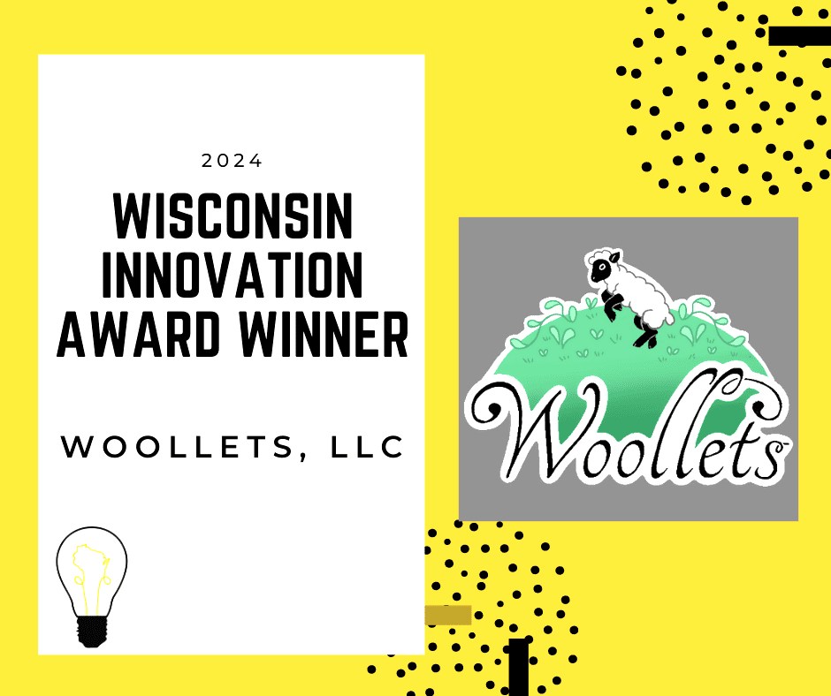
In our first year… we have some things to celebrate
2024 Wisconsin Innovation Award winner
Photo: Wisconsin Innovation Awards
Notes:
E 9 And our 3rd reason to celebrate… Woollets was nominated And won a Wisconsin Innovation Award for Agriculture this past fall.

Slide 10
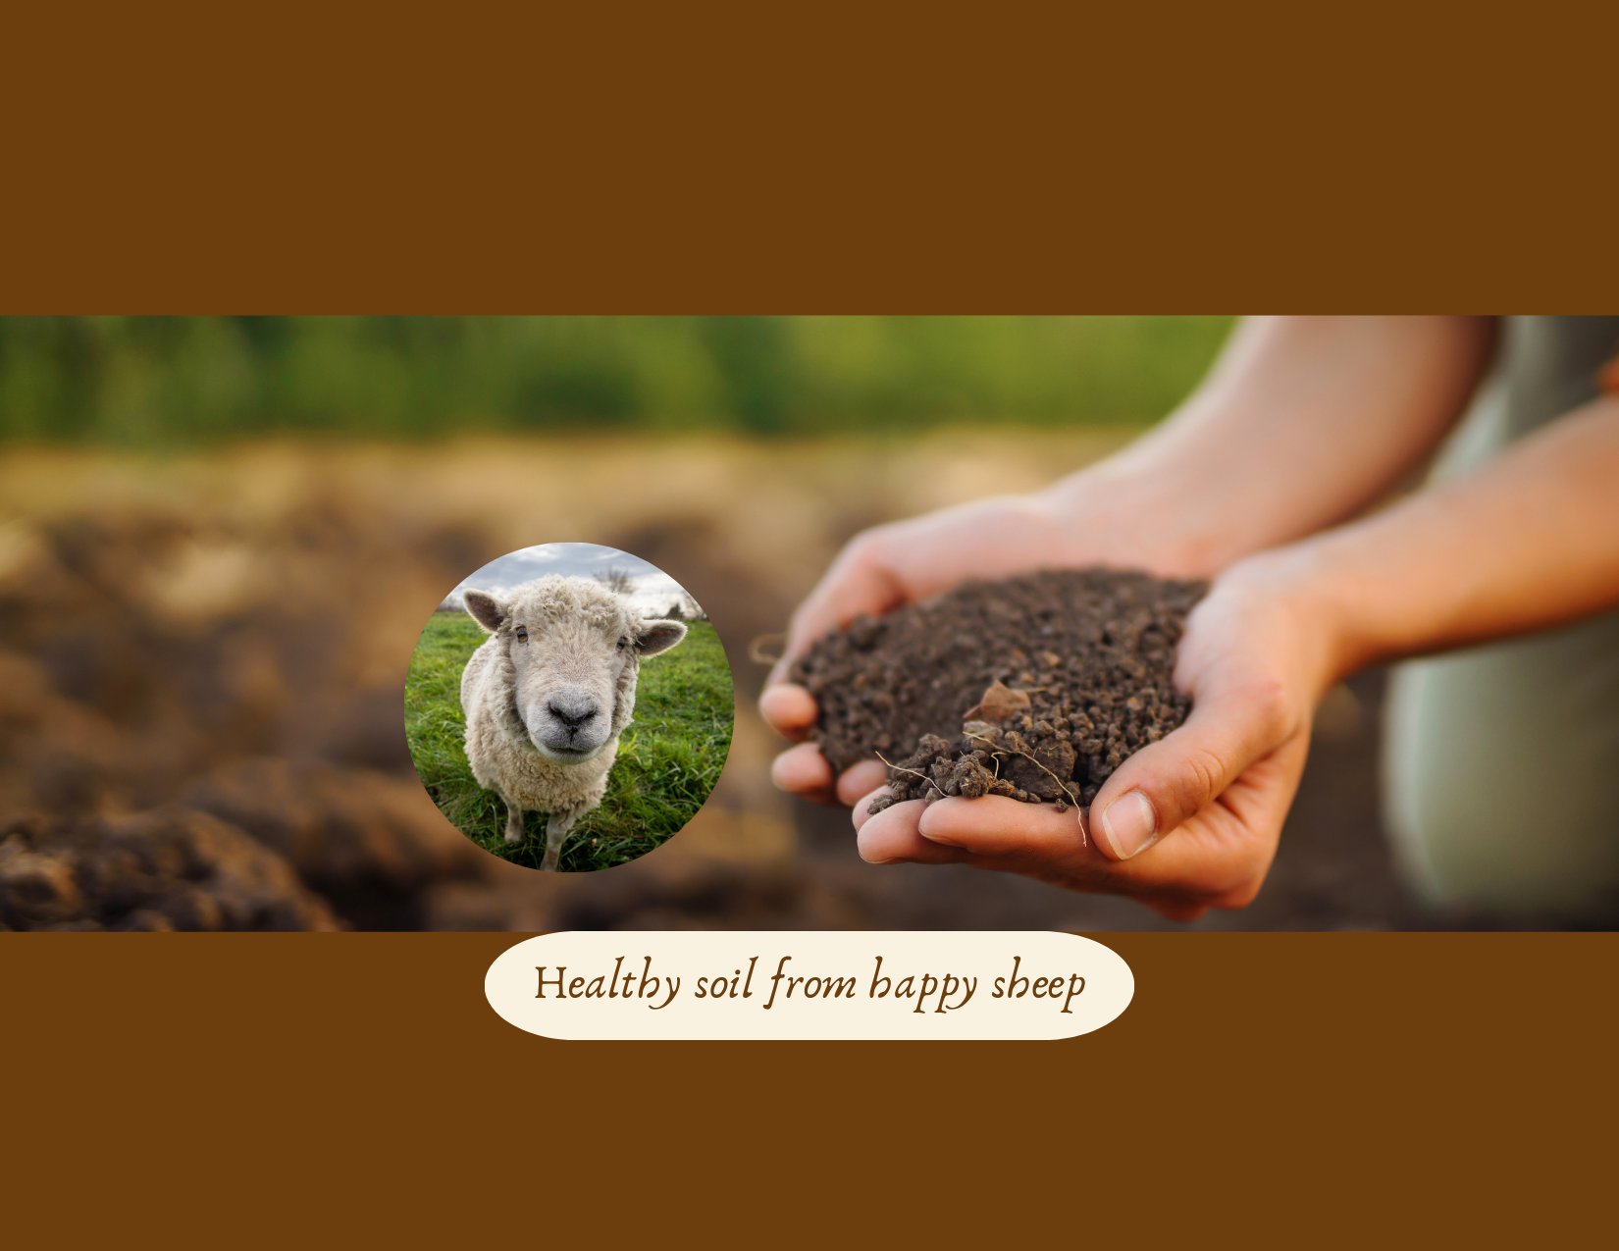
Overview
Peat
Nutrients
Soil Life
Moisture Balancing
Aeration
Use in each season
Notes:
E10 Overview
So today, We’re here to talk to you about the benefits of using wool in your gardens.
First we’ll discuss peat and the need for using sustainable alternatives due to peat’s important function as a carbon sink.
Next we’ll focus on the Nutrients wool can provide for your vegetables
Both Macro nutrients which plants need in larger quantities as well as
Micronutrients which plants need in small quantities
Soil Life - which plays a very important role in the health of your plants and quality of the vegetables you grow.
We’ll talk about the Moisture Balancing property of wool,
Aeration, and
Different Ways to use wool throughout each season.

Slide 11
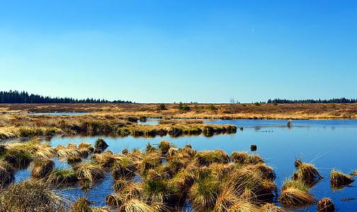
Peat Bogs
World’s largest carbon sink
Use is Unsustainable
Photo: Google image
Notes:
E 11 Peat Bogs
In our overview we mentioned peat bogs. Let me explain about the peat bogs, which are one of the world’s largest carbon sinks. Carbon sinks hold and store or sequester carbon in the ground, keeping it out of the atmosphere.
Carbon emissions drive extreme weather. According to the National Oceanic Atmospheric Administration CO2 is responsible for 76% of the greenhouse gas emissions. Some of our largest and best carbon sinks are the oceans, forests, and peatlands. Peatlands are fantastic for absorbing carbon because there’s no limit on the amount of absorption. Peatlands store more carbon than the rainforests!
Digging up peat bogs releases their stored carbon into the atmosphere, contributes to warming temperatures and accelerates climate change. Peat rebuilds at a rate of 1/16th an inch each year. These bogs are formed over thousands of years taking centuries to develop. Peat consumption is far greater than peat creation, making it unsustainable. Peat is also harvested using large equipment powered by fossil fuels.The main benefit of peat is its use as a moisture retaining medium. Peat is devoid of nutrients and is mostly used as a filler in potting soils. Unlike other organic materials such as manure or compost, peat moss, being devoid of nutrients, doesn’t contain any helpful microbes. So that means you can use peat as an amendment to acidify the soil and retain some moisture, but you cannot use it alone and expect the plants will grow strongly and properly.
Peat is effectively unsustainable for our garden use since we desperately need it to sequester carbon.
Let me share with you a startling fact: Peat bogs cover only 3% of the earth but store 33% of the world's soil carbon. So we obviously need to stop digging up the peat bogs and instead, let them be the carbon sink our world so desperately needs.
Now some of you may have heard about Canadian peat bogs being sustainable - and I know they have a fantastic management program with regards to their peat harvesting. Currently they indicate they are in balance with consumption. But that means consumption can not increase AND they are still harvesting an incredibly important carbon sink.
My take on this is… Why harvest a distinct ecosystem when we have a by-product, which is not only natural, but sustainable, renewable,and has a multitude of other benefits?
WOOL.
Wool has been found to be superior to peat for amending the soil. K Wool is also a carbon sink -
Up to fifty percent of the weight of wool is carbon. When wool fleece is incorporated into the soil, that carbon stays sequestered in the ground, instead of the atmosphere. Wool, unlike peat, grows quickly, is readily available, must be sheared every year and is completely sustainable, eco-friendly, and natural. Wool sheep grow between 5 and 15 lbs of wool every year! I can attest that my sheep do nothing all day but eat, poop and grow wool. That’s their job!

Slide 12
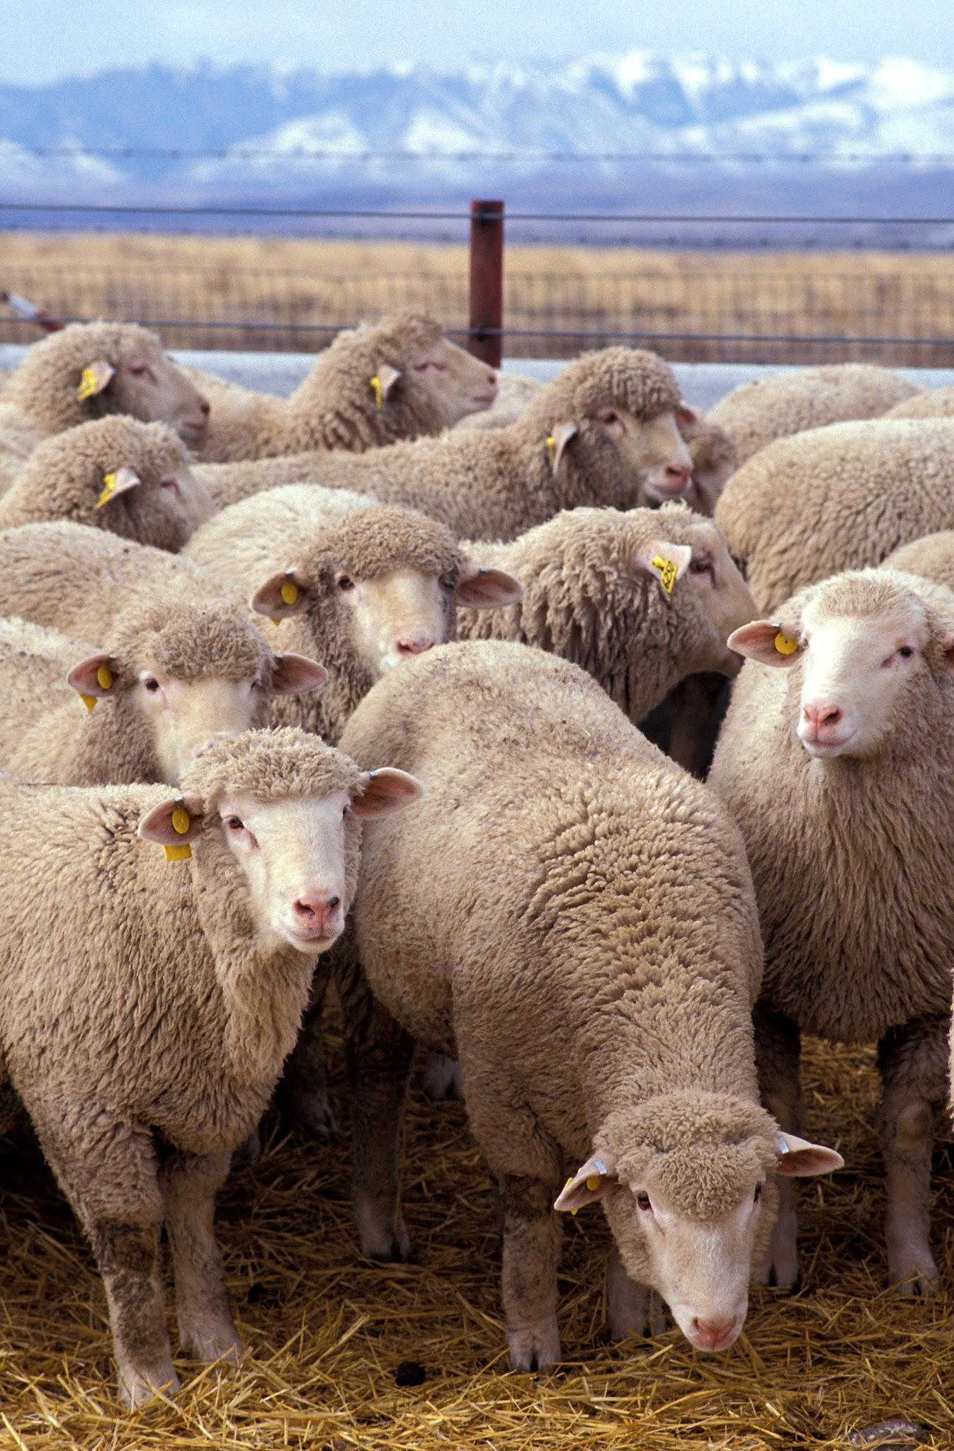
Nutrients
The Macros
Nitrogen
Phosphorus
Potassium
The Micros
Calcium
Iron
Zinc
Sulfur
Copper
Folic Acid
Pyridoxine
Selenium
Photo: Google Image
Notes:
K 12 Nutrients- Macros
Wool is a natural protein ﬁber that grows from the follicles of the sheep’s skin. It is like human hair in that it is composed of keratin-type protein. Chemically these proteins contain 5 elements: carbon, hydrogen, oxygen, nitrogen and sulfur. These 5 elements are further combined into 19 amino acids.
Analysis of wool pellets reveals an NPK profile average of 9-0-2. Let’s break it down.
Nitrogen - the first number of an NPK rating—grows big plants with lots of leaves. The nitrogen in wool slowly releases due to the physical properties of the fibrous wool and slow breakdown. For many vegetable growers, the generous nitrogen, virtually no phosphorus and small amounts of potassium are an ideal combination for their soil.
By comparison
Compost gives only 1-2% nitrogen
Poultry manure gives 3-4% nitrogen
Cow manure and Pig manure give 3% nitrogen
But these manures also contain urine and ammonia, which can burn plants. Called “hot fertilizers “ they must be composted before using.
But, wool gives 9-14% nitrogen, without the urine and ammonia, so it will never burn your plants. Wool is considered a “cold” fertilizer, safe for all plants at all times.
Now, Phosphorus—the middle number—is best known as the nutrient that produces more flowers and fruits, but it's also essential for strong root growth early in the season. However, with farmers putting manure on soils year after year, what’s known as “legacy phosphorus” has become a problem. Too much phosphorus is in the ground and it binds to the sediment. It can cause sickly plants. Too much phosphorus also makes its way into our water, causing water quality problems. (Remember the quote at the beginning of our talk? Everything is interconnected).
Potassium—the third number—helps plants process all nutrients more efficiently, improves the quality of fruits, and helps plants resist stress.
CLICK
MICROS
- People often only talk about the macronutrients that are required in large amounts for plant growth and development, but we don’t hear a lot about micronutrients, which are needed in small amounts for healthy growth, development and disease prevention. The following are some, but not all, of the micronutrients in wool.
Calcium: a mineral important for Cell structure, stress response, and disease resistance. Calcium activates enzymes involved in germination and other processes. It also improves water penetration into the plant. Calcium helps maintain pH levels, stimulates root growth, which improves conditions for other nutrients and finally, it helps with Nitrogen fixation.
Iron: Is involved in Chlorophyll, Enzyme and Protein production, as well as energy transfer, receiving oxygen, and overall plant development.
Zinc: A mineral that is important for the metabolism of plants, enzyme function, and ion transport (moving proteins across the membrane for energy production and cellular communication).
Sulfur: Sulfur is especially important for growth functions including protein production and chlorophyll formation.
Copper: one of eight essential plant micronutrients. Copper is required for many enzymatic activities in plants and for chlorophyll and seed production. Deficiency of copper can lead to increased susceptibility to diseases.
Folic acid: A nutrient that is important for seed germination, stress tolerance, and the formation of chlorophyll.
Pyridoxine: A nutrient that is important for root development and stress tolerance.
Selenium: While not essential - it’s beneficial. Protects against abiotic stresses: Selenium can help plants tolerate cold, drought, and desiccation, helps improve photosynthesis capacity, can reduce oxidative stress in plants and helps to maintain cell structures.

Slide 13
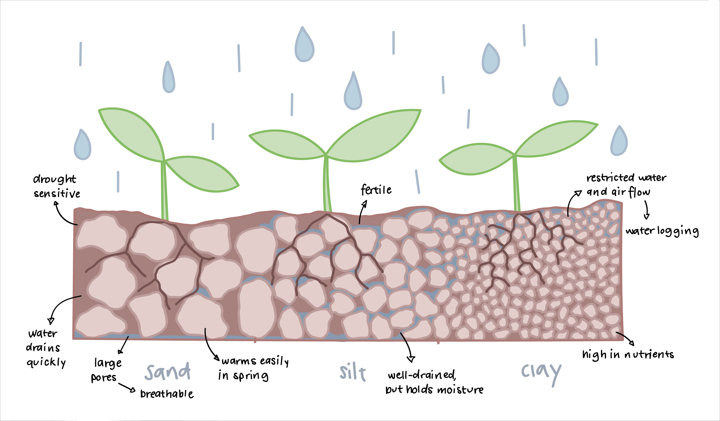
Soil Life
Google Image
Notes:
K13 Soil Life
Soil life makes nutrients available to plants. High levels of organic matter in your soil are vital to feed the soil microorganisms which leads to healthy growth of all plants. So all fertilization plans should begin with an inch of high-quality compost applied to the soil and then mixing in wool to boost the soil life. Overusing synthetic fertilizers can also harm soil structure and reduce the population of beneficial microorganisms, negatively impacting the soil's fertility and long-term health, making it less productive for future plant growth. A natural fertilizer like wool supports soil health and fertility as well as increasing the actual soil structure. Together, soil texture and soil structure have the greatest influence on pore space in soil, and how easily air, water, and roots can move through a soil.

Slide 14
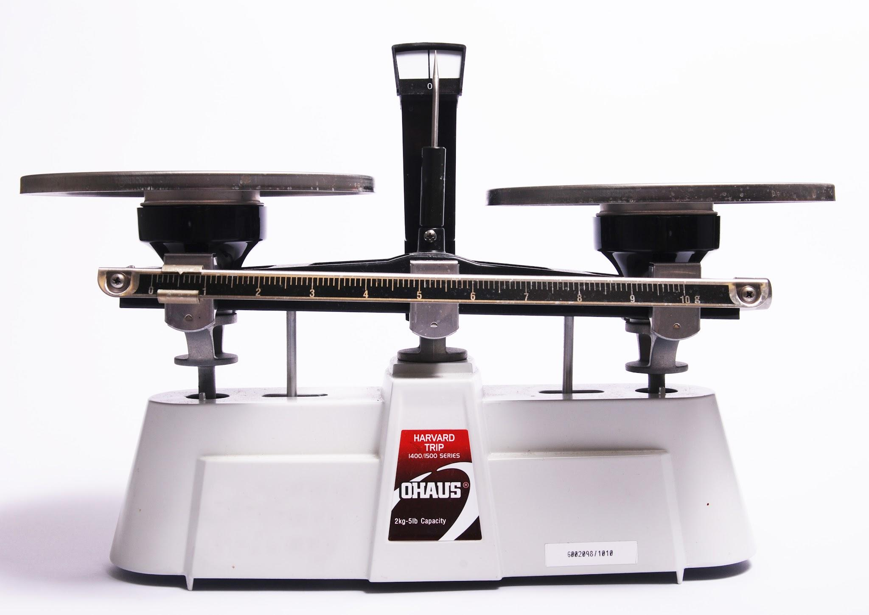
Moisture Balancing
Hygroscopic
Hydrophobic
Photo: Google Image
Notes:
E 14 Moisture Balancing
Wool is a hygroscopic ﬁber. That means it takes up moisture in vapor form. Tiny pores in the epicuticle make the ﬁber semi-permeable, allowing vapor to pass through to the heart of the ﬁber. Wool can easily absorb up to 30 times its weight in moisture without feeling damp or clammy.
Wool is also hydrophobic, repelling water…Wool always absorbs moisture from the atmosphere of greater humidity and releases it to the drier environment as it creates a balance in moisture conditions. As you know, extreme weather has been creating both too much water at times and not enough water at other times. By using wool, you’ll be providing better protection for your plants because the wool has the ability to better handle wild swings in precipitation. It can absorb, hold and release moisture as well as nutrients, over time. Think of our recent droughts as well as torrential downpours... How much more protected would your plants have been with the wool in the soil?!
The HYGROSCOPIC and HYDROPHOBIC characteristics of wool are what makes it so magical for the garden.

Slide 15
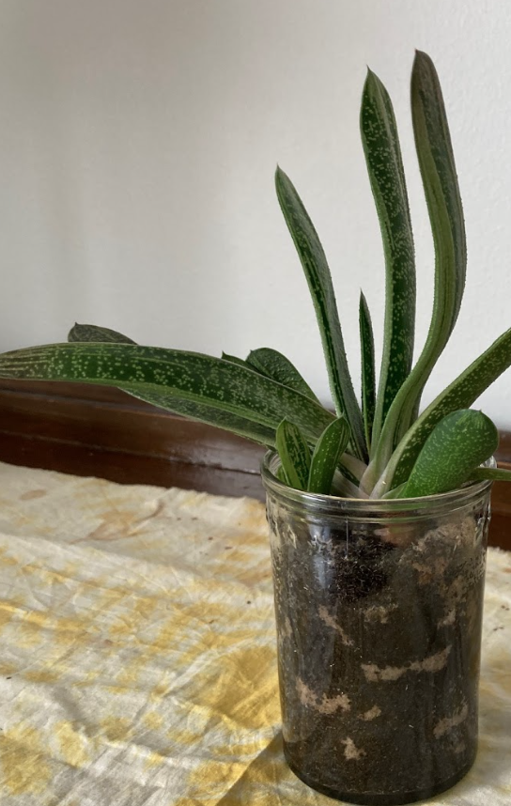
Aeration
Root growth
Nutrients
Water
Improved soil texture and soil structure
Notes:
E 15 Aeration
Roots need space to grow. When soil is compacted, the roots struggle to obtain the nutrients they need for proper growth, water has a difficult time getting to the roots, and roots are pushing against the compaction to expand.
By using pelleted wool, the pellets create air pockets in the soil, allowing space for water, nutrients and root growth thereby boosting the structure of the soil. Soil structure is an important physical property that influences water and nutrient flow, aeration to plants and microbes, and resistance to soil erosion and compaction, which all affect plant growth. Wool releases nutrients, holds and releases water, all while breaking down.
As it's breaking down, it's creating the space and pathways for nutrient and water flow that plants need. Wool pellets take about 6 months to a year to break down completely in the soil, so you’re giving your plants better soil structure and immense potential for growth with the aid of wool pellets yearly.

Slide 16
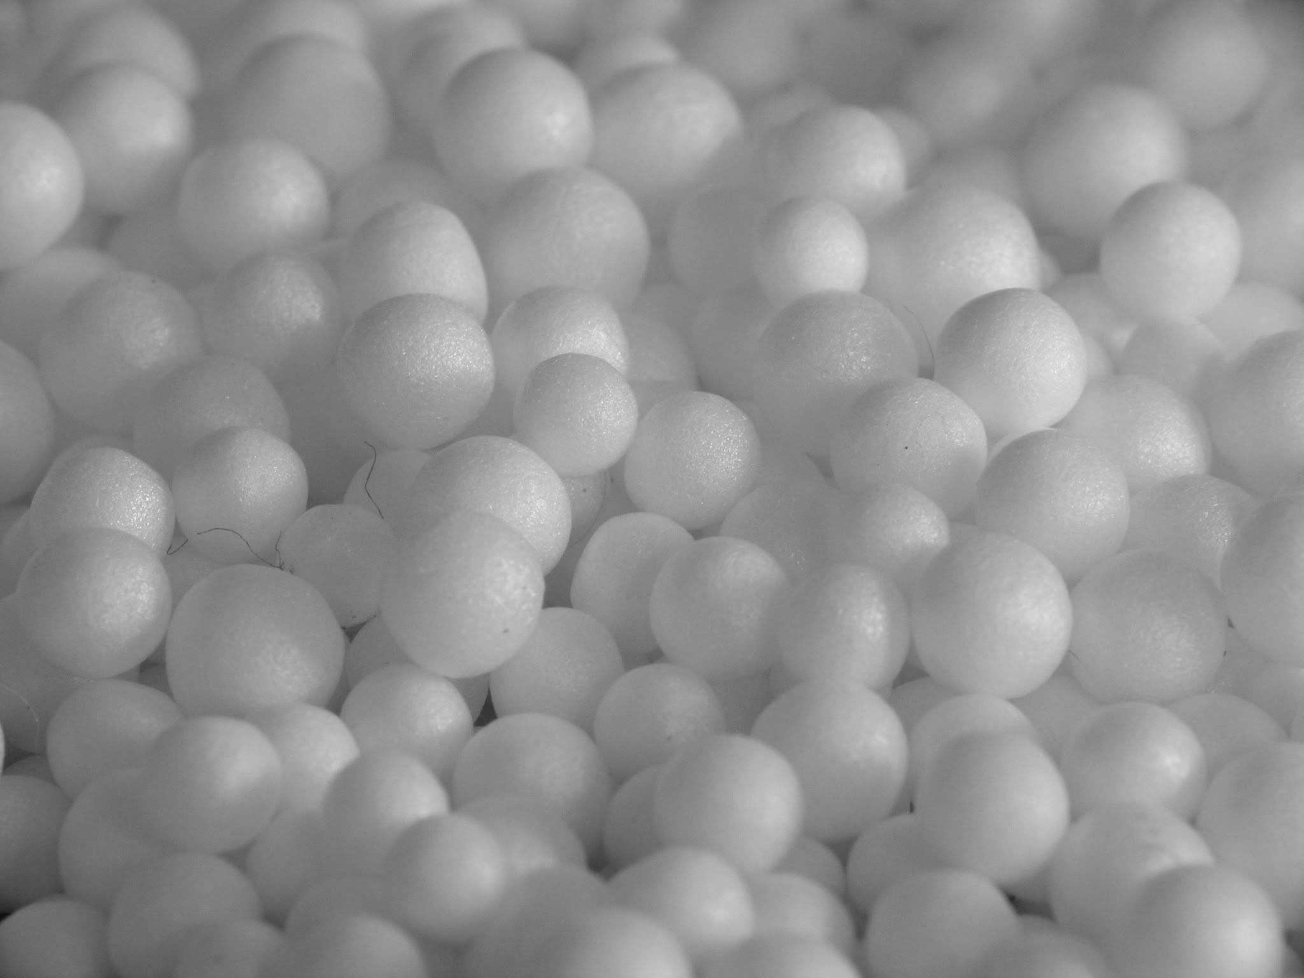
No more oil in your soil - polybeads
Effectiveness
Synthetic
Not naturally biodegradable
Photo: Google Image
Notes:
E 16 No more oil in your soil
There are many reasons why people garden, growing their own vegetables. Many people like the fresh flavor. Others enjoy spending time in nature. Another reason many of us grow our own food is that we want to know where our food comes from and what goes into it. We want to put good food into our bodies.
Polybeads (or what you might know as hydrogels) are those little colored balls we find in our starter plant packs and potting mixes from stores. These polybeads soak up to 500 times their weight in water, then gradually release it. Sounds great to hold and release that much water- right? That’s something we’ve been talking about here today - the ability to hold and release water during extreme weather… yes? That sounds great right?
Well, not so great. First, there is conflicting research indicating that their effectiveness is not as great as is stated; different factors like soil conditions, presence of fertilizer and other factors affect its ability to retain and release moisture.
Secondly, these synthetic products are made of a substance called polyacrylamide, which is considered nontoxic when intact, but it’s also biodegradable in a non-environmentally friendly way. That’s where polybeads become a problem. You see, polyacrylamide is built from a bunch of molecules of acrylamide — and acrylamide is a known neurotoxin and probable carcinogen. Some experts believe that degrading polyacrylamides could pose a risk to the health of humans (and all animals) as they biodegrade. They also take years to biodegrade completely, so that’s years your plants may be intaking that from the soil!
Some fertilizers also have synthetic resins in them. Synthetic resin is a bonding agent and is the main component in plastic. It not only bonds together its own structure, but also bonds other materials together tightly and firmly. I’m not sure why we need that in our fertilizer.
Wool, on the other hand, is a completely natural way to feed your plants as well as hold moisture. It biodegrades in a natural way in 6-12 months in pellet form, enriching the soil safely and increasing soil life.

Slide 17
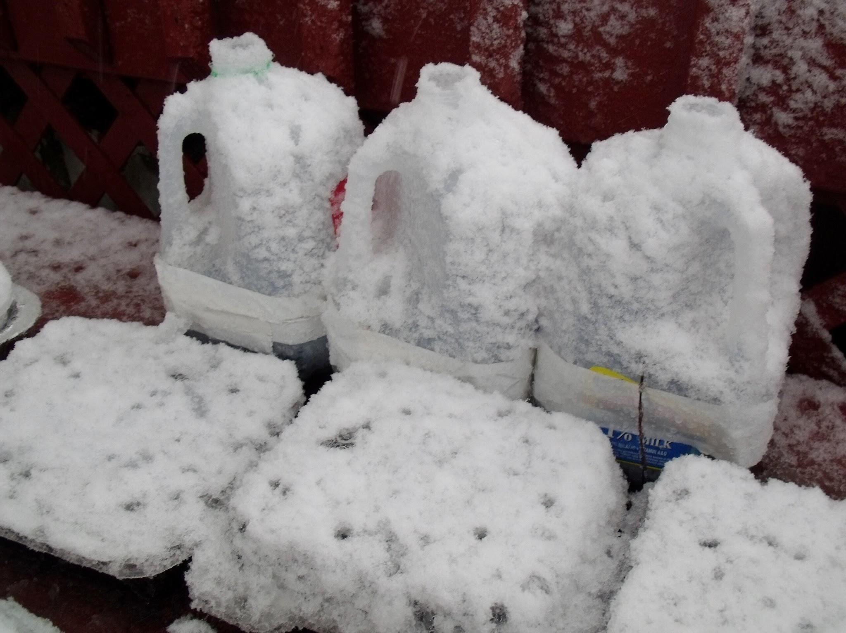
Winter
Winter sowing
Photo: Google Image
Notes:
K 17 In the Winter Garden: Let’s move on to the down & dirty of ways to use wool in your garden.(did you see what I did there?)
Winter sowing- Have you heard of winter sowing? That’s a technique where you plant seeds in milk jug mini greenhouses, set them out in the snow for the winter and you get rewarded with plants in the spring!
I like to winter sow in January and February, winter sowing perennial seeds that need stratification which is the freeze/thaw cycling that enables hard seed coats to crack open so the seeds can germinate. Adding wool to your seed starting mix when planting your milk jugs helps keep the soil consistently moist for stratification, prevents drying out and killing the newly sprouted seeds, and releases nutrients for the new seedlings even after transplanting out into the garden.

Slide 18
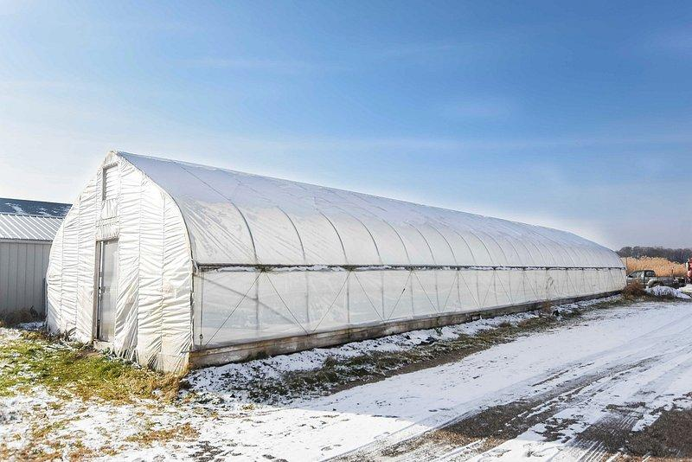
Winter
Winter sowing
Greenhouses
Photo: Google Image
Notes:
K 18
Greenhouses
seed starting in greenhouses- mix into potting mix to hold moisture. ⅓ -½ cup wool pellets to 1 gal of potting mix. That’s enough to keep the mix consistently moist longer.

Slide 19
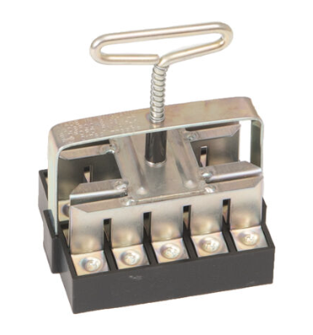
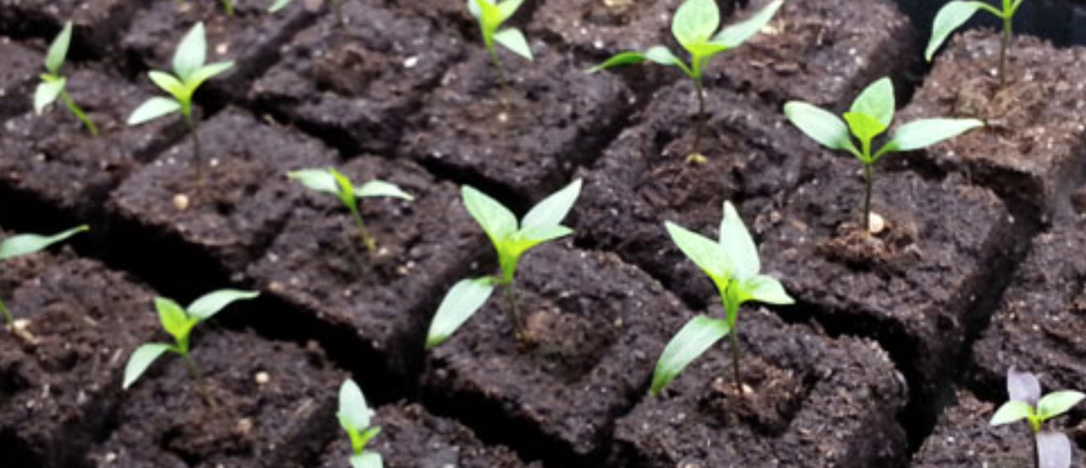
Winter
Winter sowing
Greenhouses
Soil blocking
Photos: Google Image
Notes:
K 19
Wool for soil blocking using soil “forms” instead of plastic containers to start plants -
wool can be used as a binder to hold the soil together
wool is a great replacement for peat when making soil blocks for starting seeds. Soil blocks make it possible to transplant your plants without them having transplant shock. Also, plant roots naturally ‘air prune” by having no plastic container. Instead of the roots growing longer and longer and circling around and around, the roots stop at the edge of the soil block and instead start branching out smaller roots within the block. The more roots the plants make, the greater amount of nutrients they can take up and, the sturdier and healthier the plant is. Adding wool to the potting mix helps hold the soil block together, keeps it moist longer and fertilizes the new plants. Use a ratio of 4 parts peat free potting soil like CocoLoco or Pittmoss to 1 part wool pellets.

Slide 20
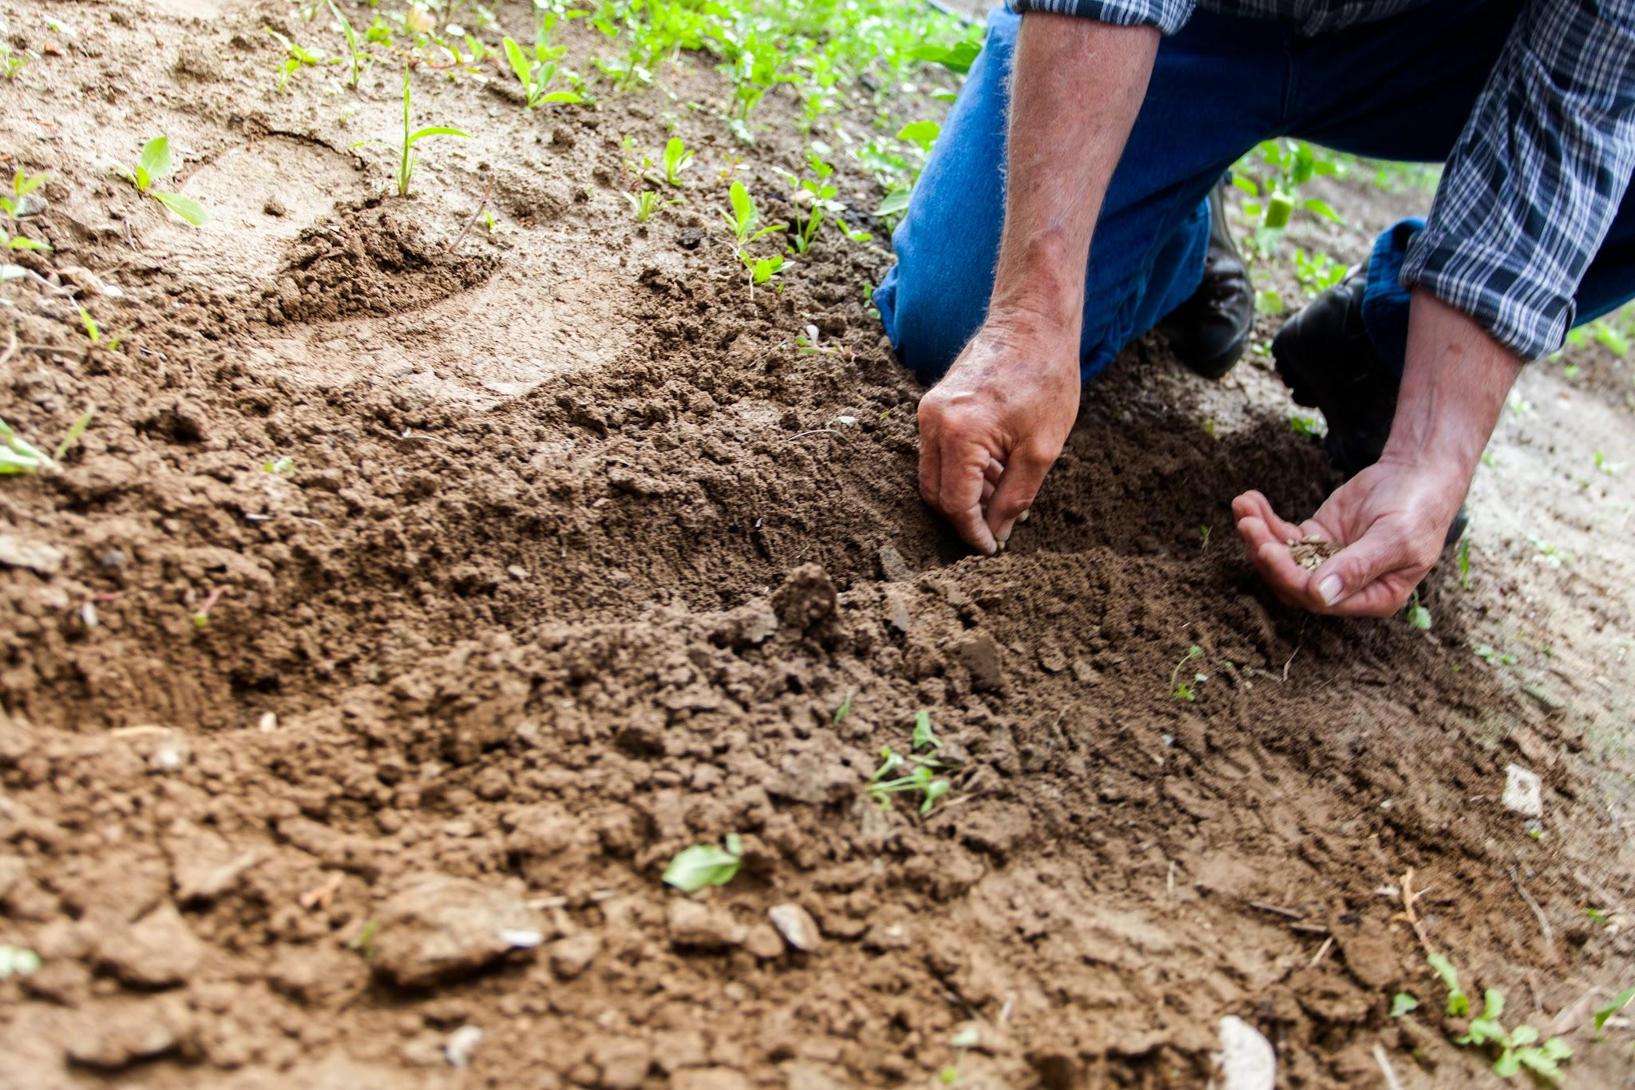
Spring
Direct sowing
Photo: Google Image
Notes:
E 20 In the Spring Garden
You can add wool directly into your garden when you are sowing the seeds. Just sprinkle it in! The wool will help with germination rates! Planting seeds directly with wool helps seedlings establish by keeping them consistently moist for good germination and early growth, plus nutrients. No more dried up seedlings because you missed a day of checking on them and watering.

Slide 21
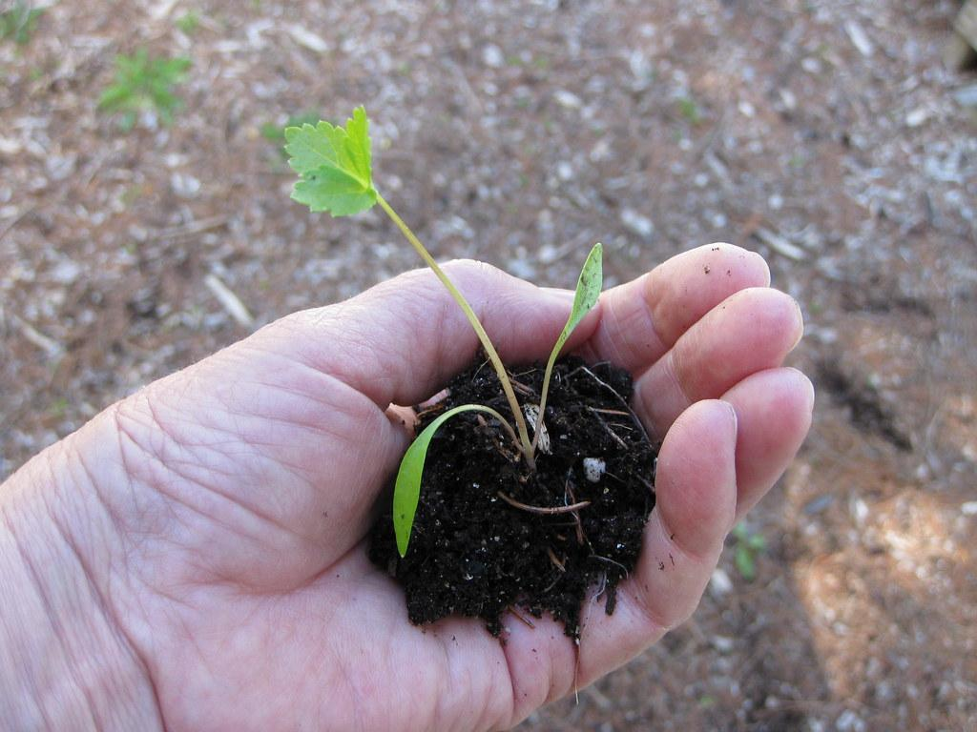
Spring
Direct sowing
Transplanting your
starter plants
Photo: Google Image
Notes:
E 21
You can mix wool in your soil when you’re transplanting to help transplants get off to a great start with nutrients and moisture retention, reducing transplant shock with the help of those micronutrients Selenium and Folic acid. When wool is put into the Root zone of the plants - the nutrients are going immediately to where the plant can take up those nutrients. Calcium is going to help stimulate root growth too. So make sure you are putting the pellets in with the roots to get the biggest bang for your buck.

Slide 22
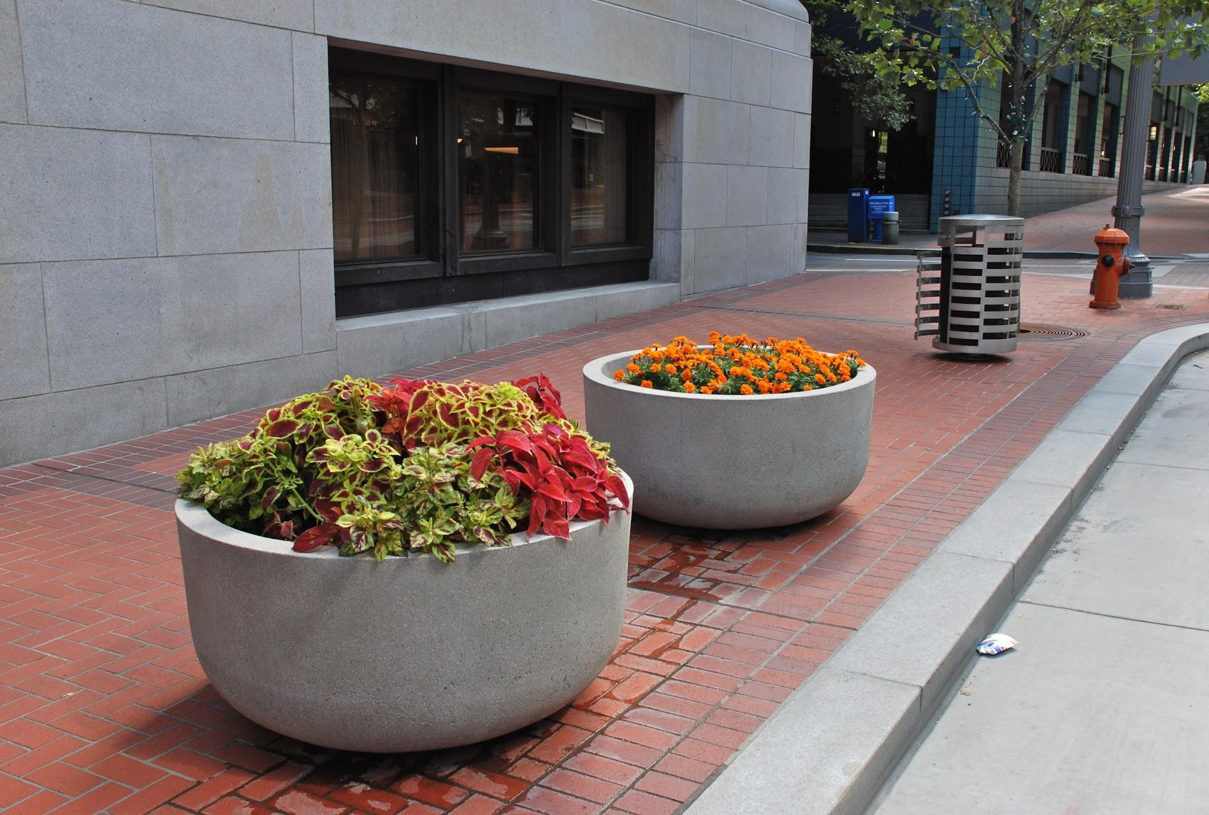
Spring
Direct sowing
Transplanting your
starter plants
Planters
Photo: Google Image
Notes:
E 22
Another way to use wool in the springtime is by adding a thin layer of wool at the bottom of your planters to hold more moisture and prevent the soil from running out. We’ve had a couple cities use our product to reduce the amount of watering they need to do on a large scale.

Slide 23
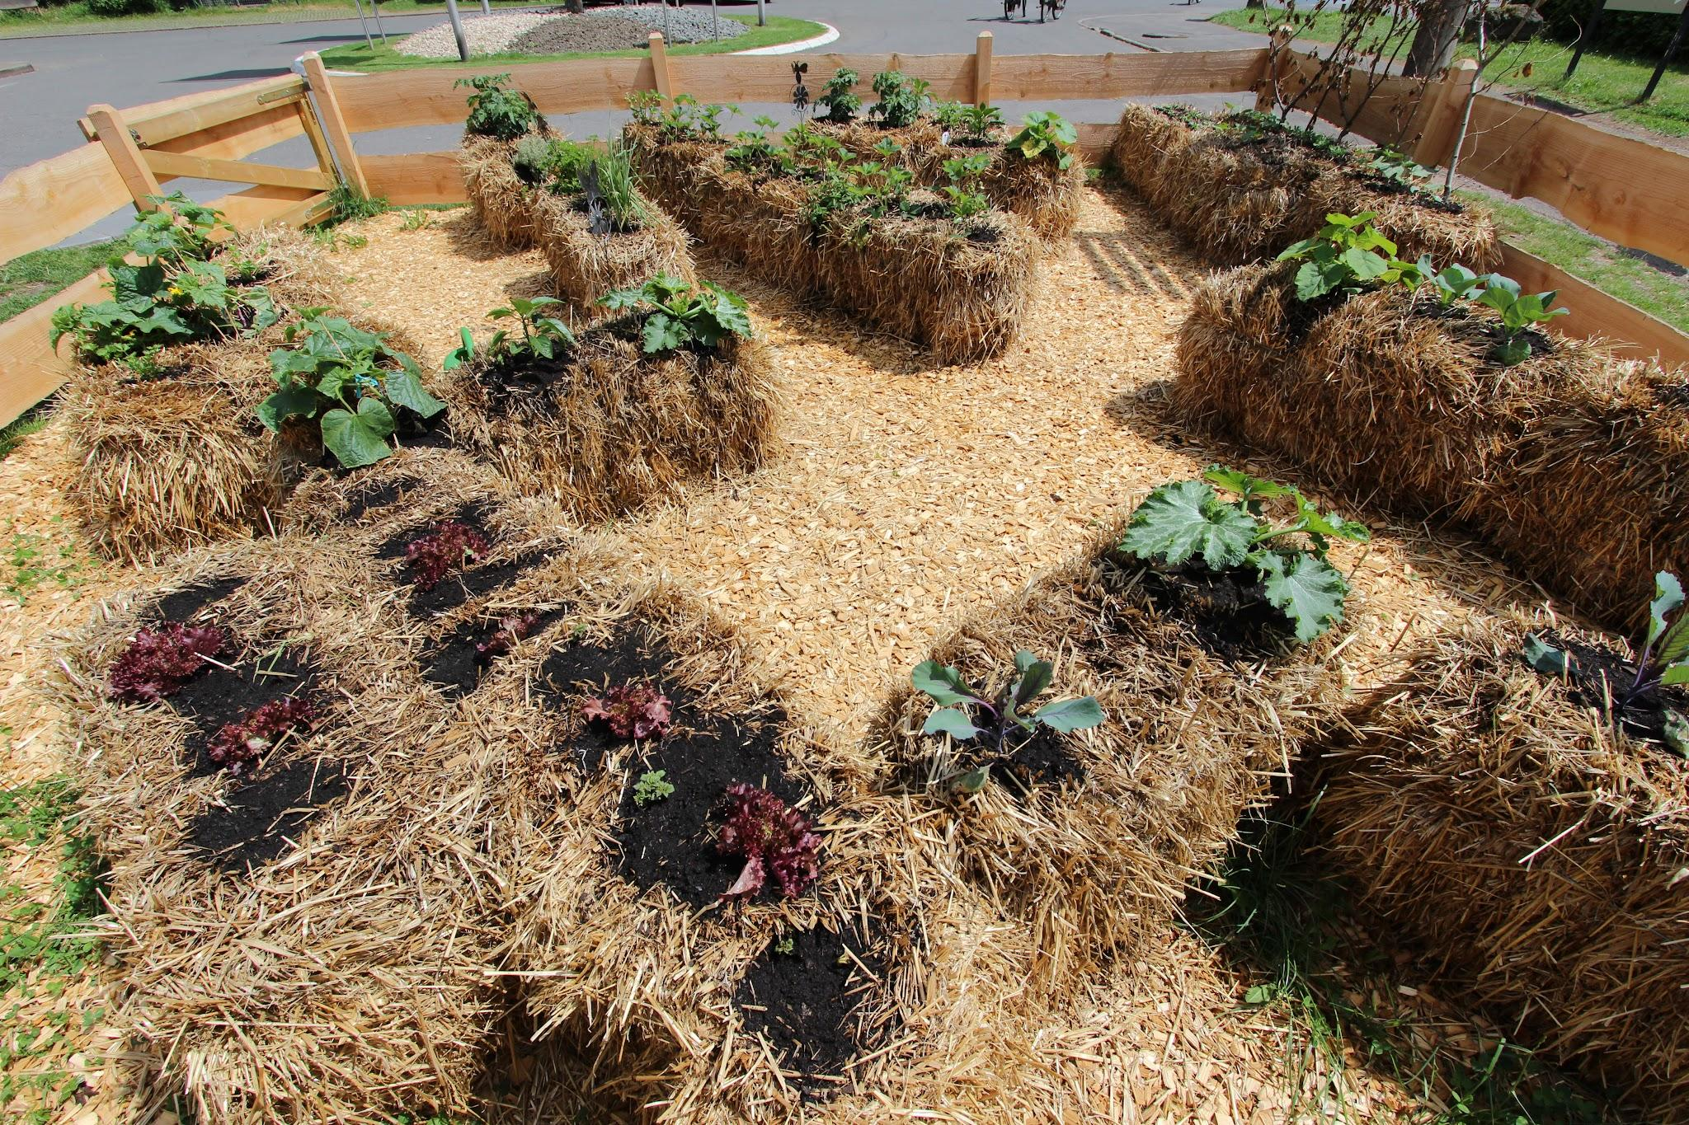
Spring
Straw Bales
Photo: Google Image
Notes:
E 23
If you’re a fan of straw bale gardening, add a scant handful of wool pellets in with your starter plants when you plant into the straw bale. - you’ll notice your plants will stay moist for longer periods, reducing your water usage.
If you’re planting seeds into your straw bale, place a pellet in with each seed to help with germination (remember the micronutrients of calcium and folic acid for germination?) , and you can even use fleece mulch around your vegetable plants to help retain more moisture.

Slide 24
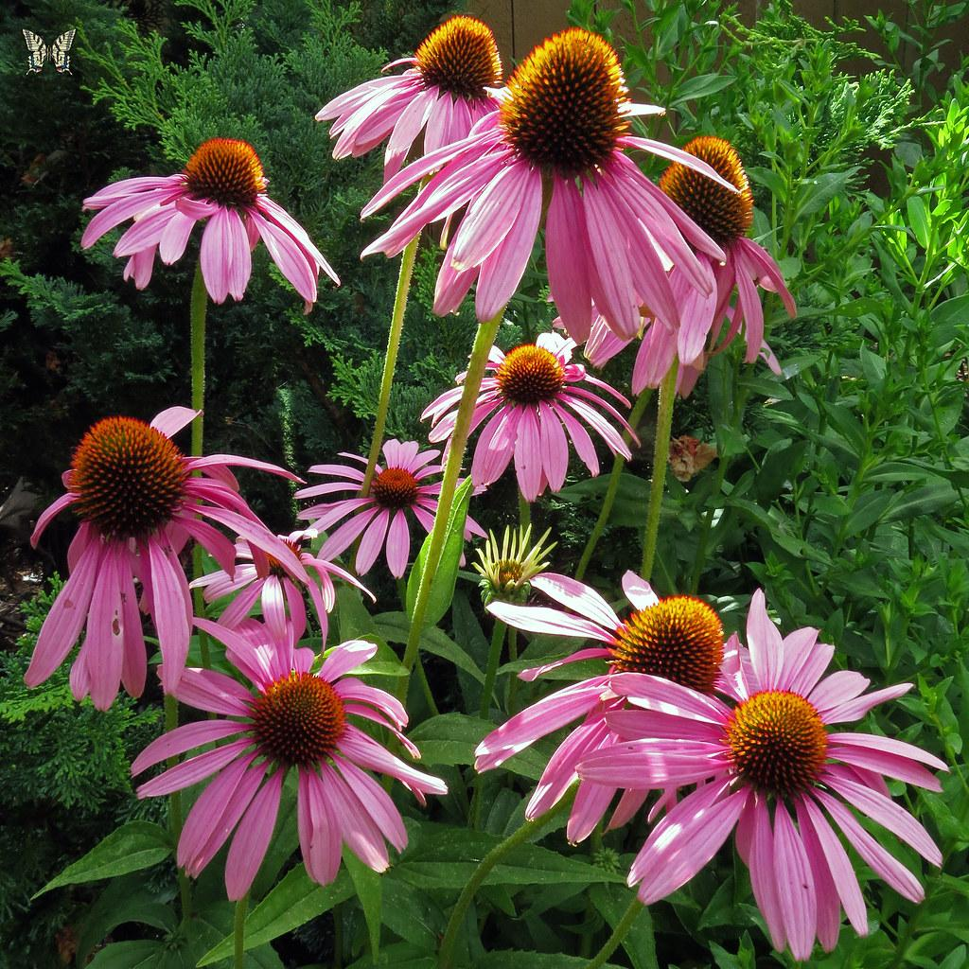
Spring
Straw Bales
Perennials
Photo: Google Image
Notes:
E 24
Already established Perennial plantings can benefit from a top dressing of wool pellets mixed in around the base as slow release fertilizer. In addition you can also Mulch around already established plants with raw fleece to maintain soil temperature, shade the roots and provide moisture retention. Just remember that wool insulates, so if you want the soil to heat up - allow the sun to do its work before you lay the mulch down.

Slide 25
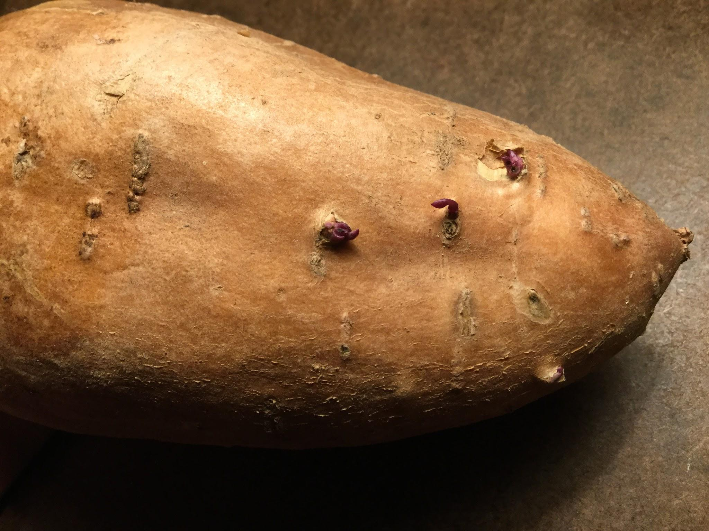
Spring
Straw Bales
Perennials
Sweet Potato slips
Photo: Google Image
Notes:
E 25
You could also use wool pellets to begin sweet potato slips. Since sweet potatoes love moist humid conditions, wool is perfect for keeping those conditions just right.

Slide 26
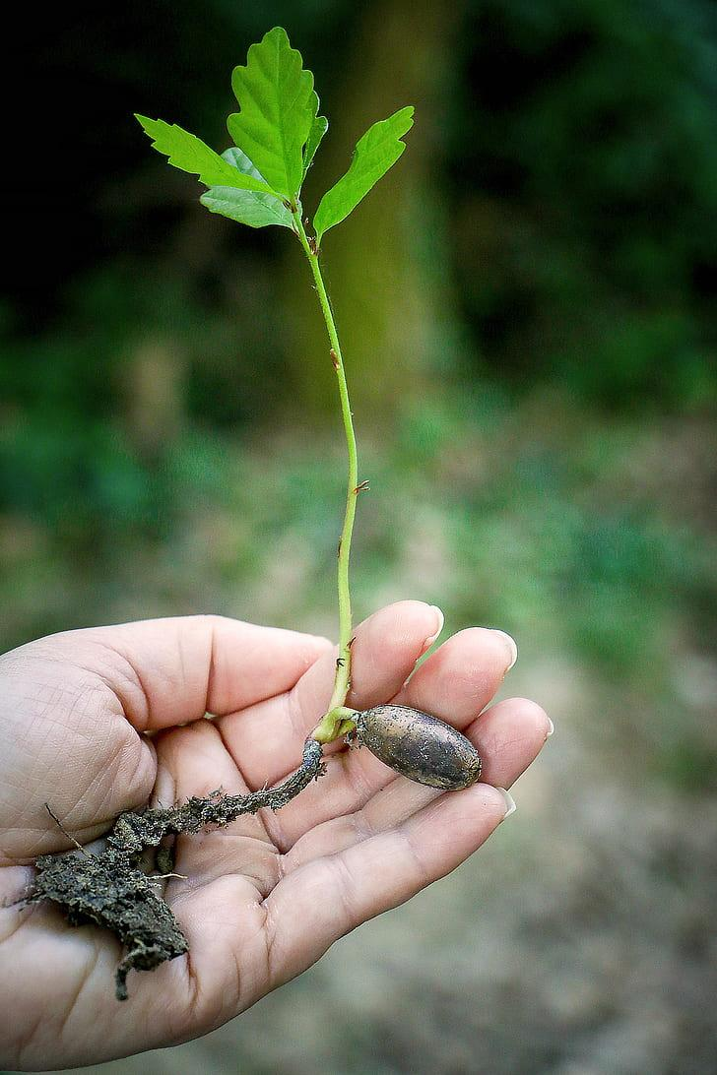
Spring
Straw Bales
Perennials
Sweet Potato slips
Trees
Photo: Google Image
Notes:
E 26
When transplanting trees, add wool into the transplant hole with the saplings. It gets those baby trees off to a great start, providing consistent moisture and slow release nutrients.

Slide 27
Summer
Garden plants
Photo: Google Image
Notes:
K 27 In the Summer Garden
By now, your garden plants are off to a great start and growing well. Laying some raw wool around your plants as mulch will shade the roots, keep the soil from drying out and protect tender plants from slug and snail damage. Unshredded raw wool on top of the ground as mulch will generally last a couple of years before breaking down if you leave it on the garden. You can take it up at the end of the growing season and store it to reuse the next year. Or mix it into your compost pile to break down faster. If you do leave it on the garden, be aware that it will really tangle up in your rototiller tines later. Also, you will have some weed seeds in your wool, but any that sprout in the mulch layer are easy to pull out.

Slide 28
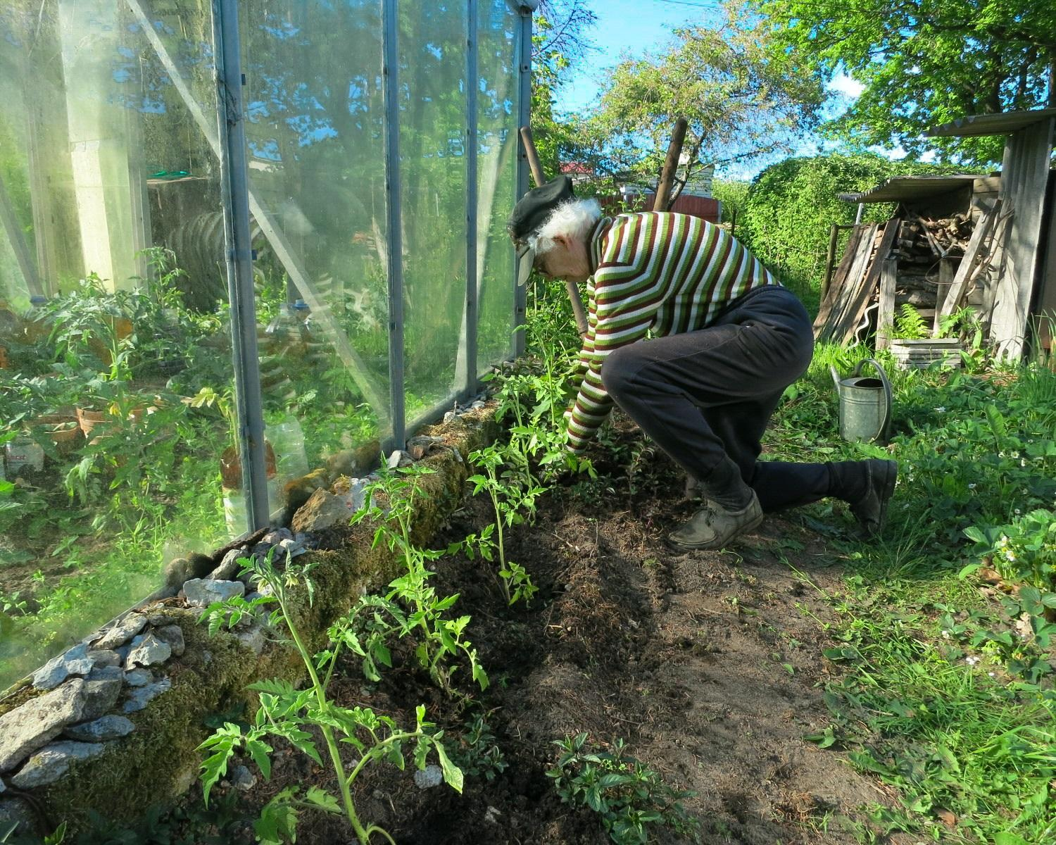
Summer
Garden plants
Succession planting
Photo: Google Image
Notes:
K 28
Continue sprinkling wool pellets with your succession plantings of summer and fall vegetable seeds. Even more important at this time of year.

Slide 29
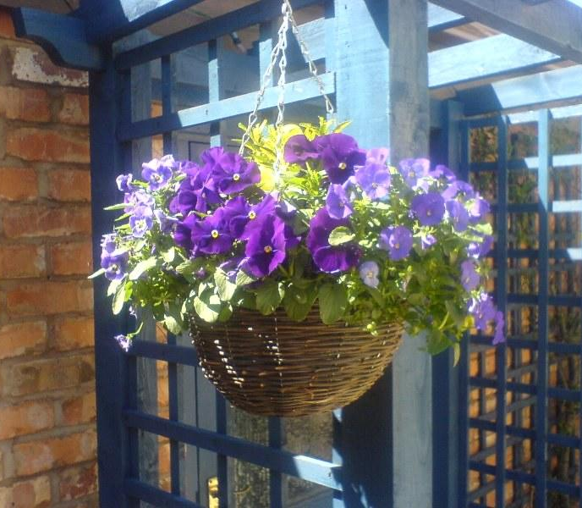
Summer
Garden plants
Succession planting
Hanging baskets
Photo: Google Image
Notes:
K 29
Hanging baskets-during a hot, dry spell, you have to water most hanging baskets and pots a couple times daily. Mixing some wool into the soil will make a big difference in the amount of water needed to keep your plants happy and stress free. In addition, as the wool breaks down, it aerates the soil giving the potted plants more room to grow and feeds them as well.

Slide 30
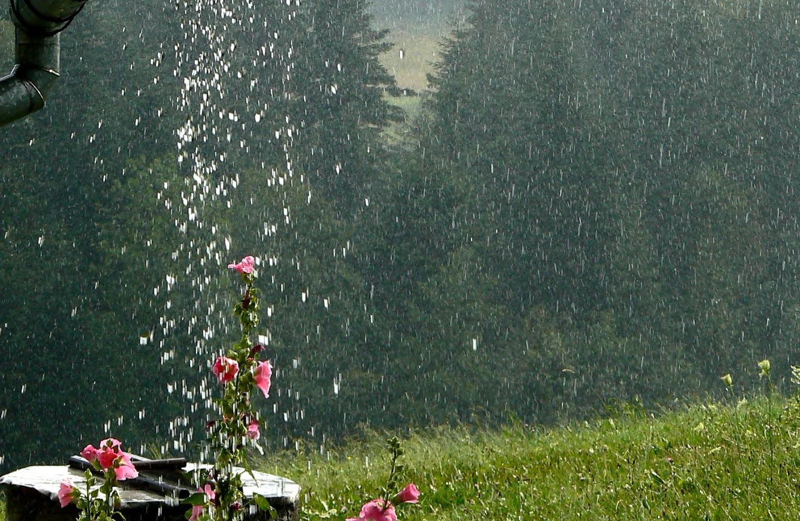
Summer
Garden plants
Succession planting
Hanging baskets
Safer in downpours
Photo: Google Image
Notes:
K 30
Hanging baskets-during a hot, dry spell, you have to water most hanging baskets and pots a couple times daily. Mixing some wool into the soil will make a big difference in the amount of water needed to keep your plants happy and stress free. In addition, as the wool breaks down, it aerates the soil giving the potted plants more room to grow and feeds them as well.
Remember that wool gathers moisture? It also can keep your plants from getting waterlogged during heavy rains. Wool pulls the water away from the roots so they can still breathe, releasing it back to the soil as the pot dries out.

Slide 31
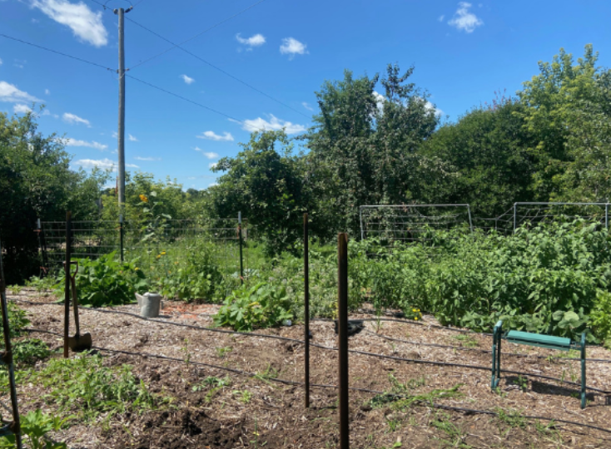
Inadvertent garden experiment
Notes:
K31 Inadvertent Summer garden Experiment
I inadvertently conducted an experiment in my vegetable garden. Half the garden was planted with wool mixed in with the transplants and half the garden was planted without wool. (Notoriously lazy waterer here). As you can see from the photo, there’s drip tape laid out, but it didn’t get hooked up. The big beautiful plants you see are the ones planted with wool. The mostly bare half of the garden is where the plants without wool were planted. They all died a tragic death by mid July and had to be pulled out.

Slide 32
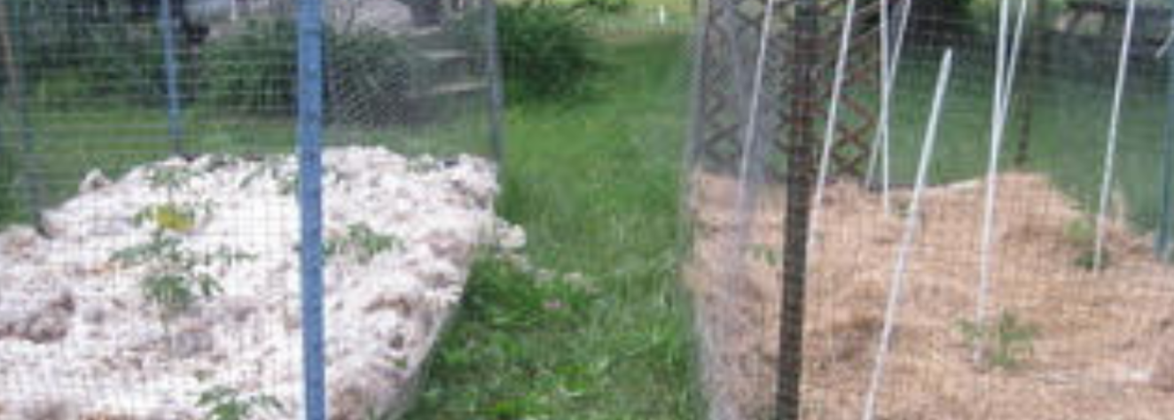
Tomato garden experiment
Notes:
K 32 Tomato Wool Experiment
Some shepherds in Minnesota conducted their own experiment as well. They planted 2 identical beds of tomato plants, but mulched one with a layer of their sheep wool and mulched the other with newspaper and straw. They sent us pictures of the results. The wool bed plants were bigger and darker green than the newspaper straw bed as the plants grew.

Slide 33
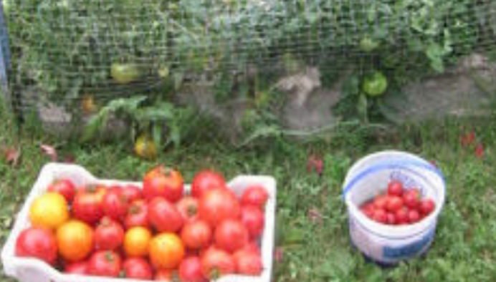
Tomato garden experiment
Wool garden harvest
Straw garden harvest
Notes:
K 33 When harvest time came in early September, the wool mulch clearly outperformed the newspaper and straw.

Slide 34
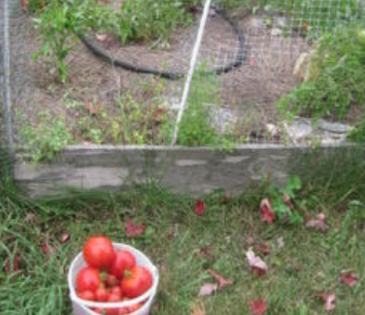
Tomato garden experiment
No September harvest from straw garden
Late September Wool garden harvest
Notes:
K 34 The Wool bed was still producing tomatoes at the end of September, while the newspaper straw bed had already finished 2 weeks before.

Slide 35
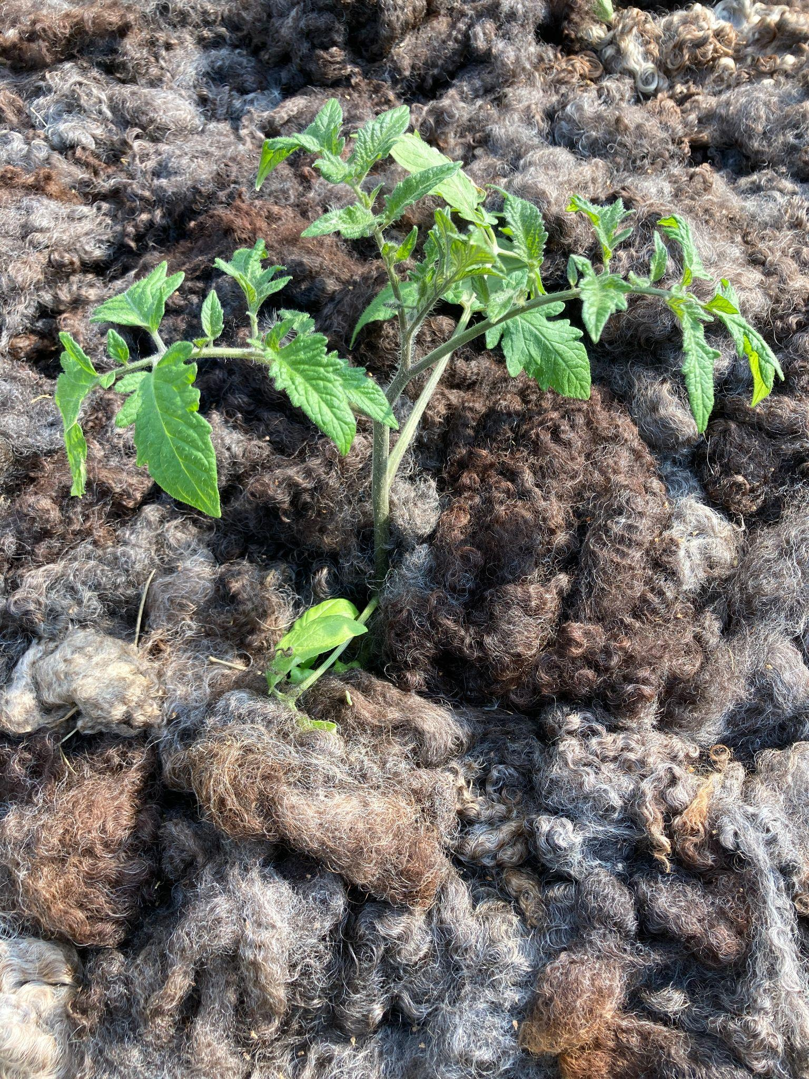
Fall
Mulch for protection
Photo: Google Image
Notes:
E 35
Wool offers benefits for the fall garden too!
Mulching around your perennials with wool protects them from winter damage. Just like a wool sweater keeps you warm and insulated, a layer of wool mulch around plants helps insulate them too.

Slide 36
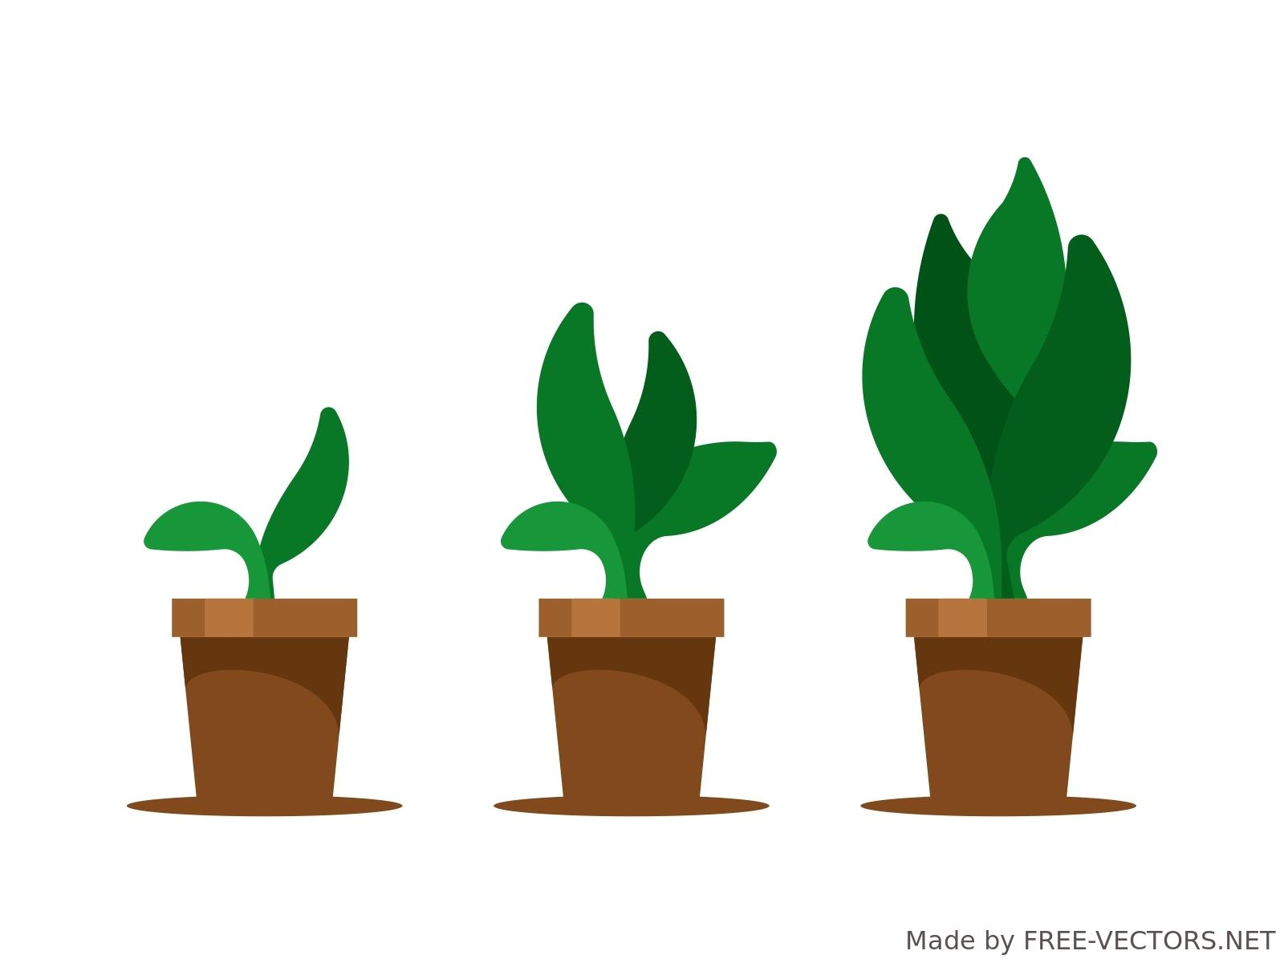
Fall
Mulch for protection
Nutrient boost
Notes:
E 37
Mixing in wool pellets or shreds around established perennials in the Fall gives the soil a boost of nutrients that will be available in time for spring growth.

Slide 37
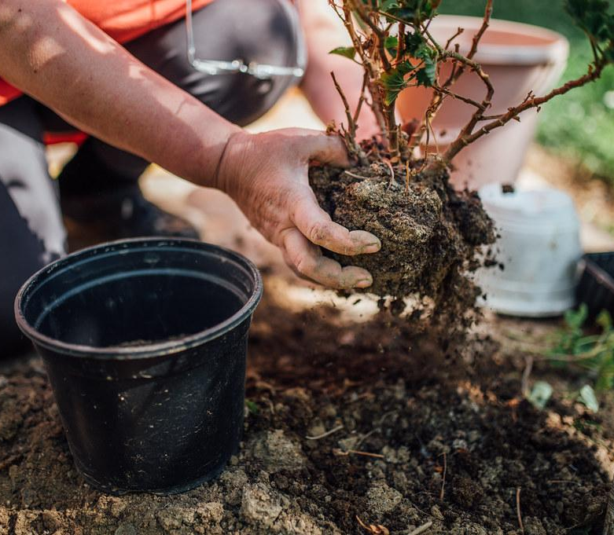
Fall
Mulch for protection
Nutrient boost
Transplanting
Photo: Google Image
Notes:
E 37
When transplanting divided perennials, remember to mix wool in around them just like in spring.

Slide 38
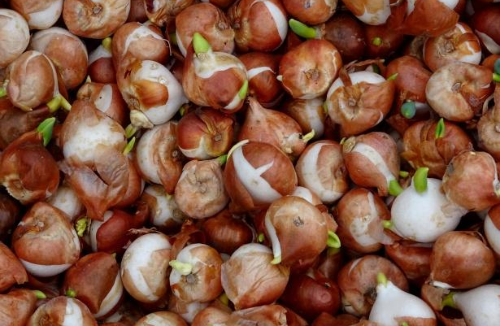
Fall
Mulch for protection
Nutrient boost
Transplanting
Bulbs
Photo: Google Image
Notes:
E 38
And you can add wool along with the bulbs that you have ready to plant in the Fall.
If there are any plants you like to bring indoors for the winter - maybe some herbs or favorite plants - (My husband’s grandfather had a lemon tree in Illinois: Every Spring he’d roll it outside and every fall roll it back INSIDE - And it produced lemons - imagine the harvest he would have had if he used wool with that tree.)
And finally - for those who like to mulch with leaves… those can blow away unless they are wet and matted down. Wool - won’t blow away.
If you don’t like the aesthetic of wool, you can always add a light layer of wood chips mulch to cover it.

Slide 39
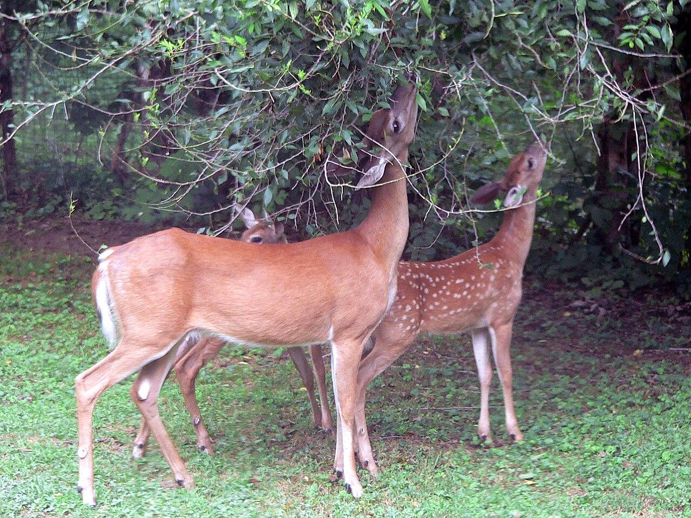
Repellent
Deer
Photo: Google Image
Notes:
E 39 Wool As a Repellent
Sheep produce not only wool, but a greasy or waxy substance called lanolin which protects their wool and skin from harsh environmental conditions. We can use the lanolin in the wool to our advantage - as a repellent - since some animals don’t like the smell of lanolin. Using wool around plants will deter deer since they are one of the animals that don’t like the lanolin.

Slide 40
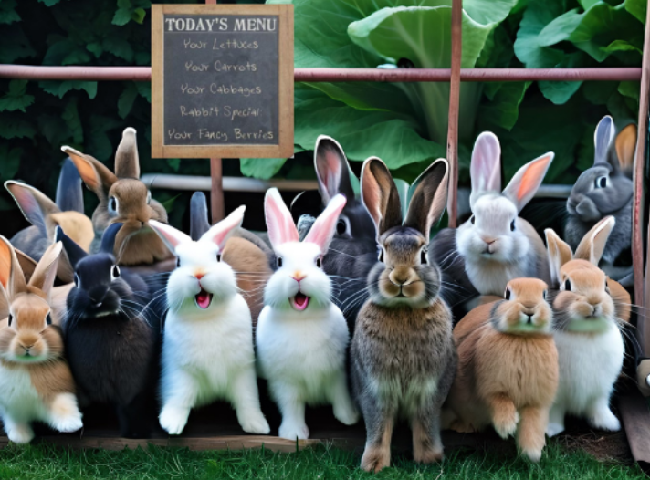
Repellent
Deer
Rabbits
Image: Carolyn Zilinski
Notes:
E 40
Rabbits are another garden pest that will be deterred when wool is used in the garden.

Slide 41
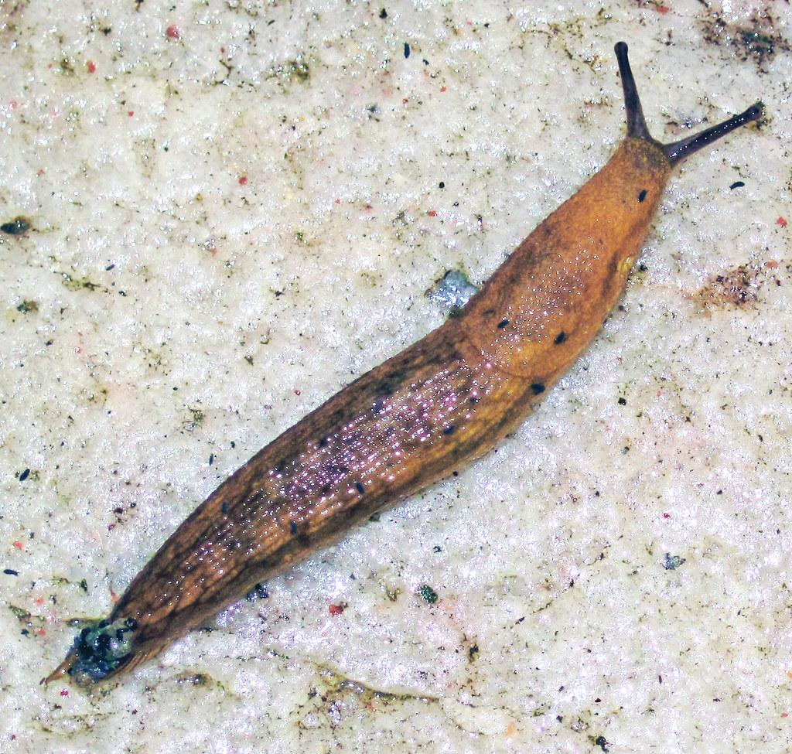
Repellent
Deer
Rabbits
Slugs
Photo: Google Image
Notes:
E 41
And finally, if you have a problem with slugs and snails, the lanolin AND the barbed structure of the wool fibers irritates them. So tuck some wool around your shrubs, potato plants, hostas and arborvitae to help protect your plants from being snacked on.

Slide 42
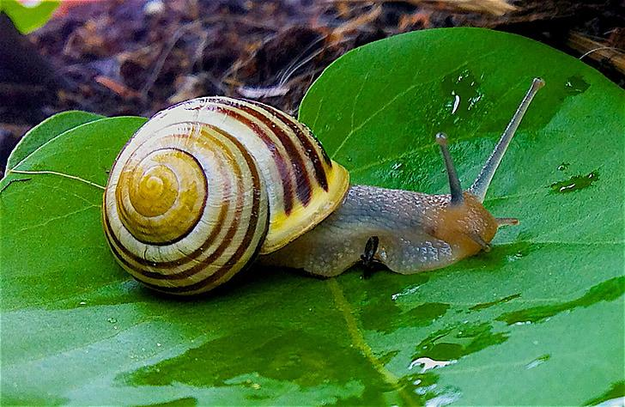
Repellent
Deer
Rabbits
Slugs
Snails
Photo: Google Image
Notes:
E 42
There’s a new lanolin based deer repellent spray now available in Europe. My take on this is why purchase something that’s been refined when you could have the real McCoy using raw wool.
Another advantage of using wool instead of spray repellents is that you won’t need to keep reapplying every time it rains. The lanolin stays on the wool and keeps working.

Slide 43
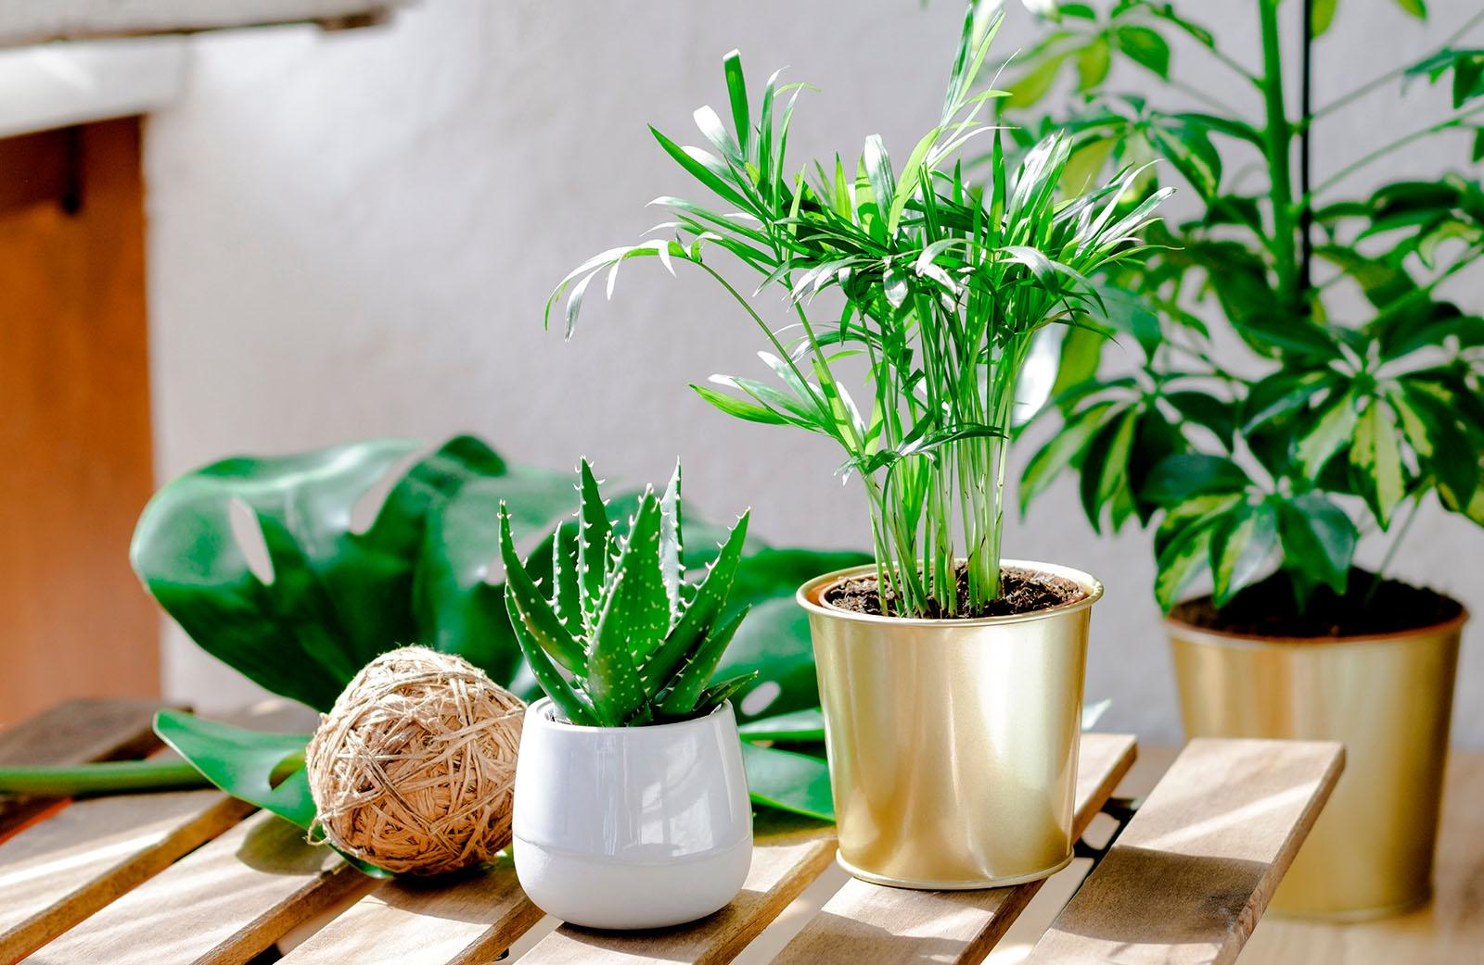
Houseplants
Repotting
Top dressing
Aeration
Photo: Google Image
Notes:
E 43
When repotting houseplants, mix wool into the soil for slow release of nitrogen and micronutrients to ease the transition stress.
If you aren’t going to repot, you can simply use a pencil or chopstick to create divots around the houseplant, inserting a wool pellet into each divot and covering again with the medium.
Houseplants give us a much needed boost during the long winter, but our houseplants can suffer from overly dry indoor heat or suffer at the hands of a forgetful waterer.
Adding wool to the soil maintains soil moisture longer so you can water less but the plants don’t dry out.
Also, adding wool on top of the soil adds to the humidity around the plant because wool attracts and gathers water from the air; remember how wool is hygroscopic?
Aeration is also a benefit to houseplants when you use wool pellets. Houseplants tend to become root bound - so wool pellets will give the much needed space that roots need for growth and nutrient/water paths, bringing your soil to life.
That moves us into a couple of very specific house plants: African Violets and Orchids Karen?

Slide 44
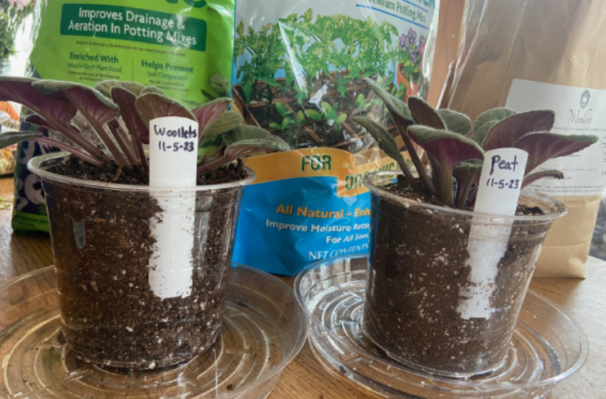
African Violet
Similar plants
WOOLLETS
PEAT
Notes:
K 44 African violet Experiment
African Violets: they need bottom watering but don’t like to sit in soggy soil. Peat moss takes a long time to rehydrate once it dries out. That means a peat based potting soil for African violets is really hard to get fully moistened again by bottom watering.

Slide 45
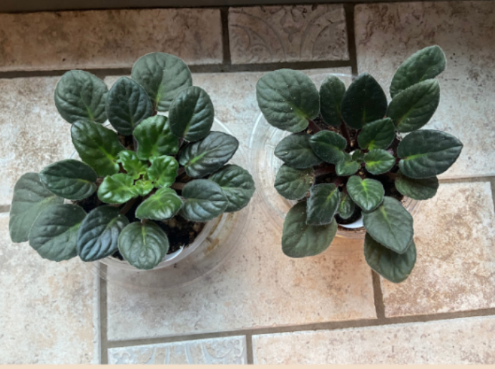
African Violet
Similar plants
After 8 weeks
WOOLLETS
PEAT
Photo: Google Image
Notes:
K 45 African violet Experiment
But if you add wool to the soil of your African Violets - especially towards the bottom - it will give the moisture when the violet needs it. The peat vs wool comparison trials we have done with African Violets showed wool increased new growth of leaves and reduced the frequency of watering needed.

Slide 46

Orchids
Consistent moisture
Stress management
Photo: Google Image
Notes:
K 46
Orchids also love moisture but can’t be left too wet or the roots will rot. Adding 1 TBS of wool pellets into your orchid media will keep them consistently moist. Orchids can be temperamental, dropping blooms at the least amount of stress. Adding wool helps them handle stress without losing their blossoms.

Slide 47
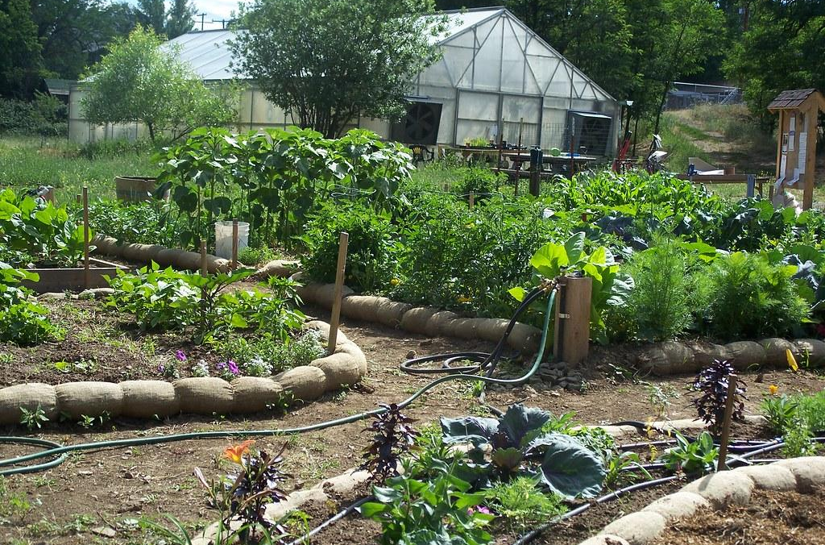
Wool is right for All gardening situations
Home gardens
Photo: Google Image
Photo: Google Image
Notes:
E47 Wool is right for all gardening situations
All the information we have given today has been directed towards the home gardener - but the real truth is that wool is the answer for all plants - all growing situations.

Slide 48
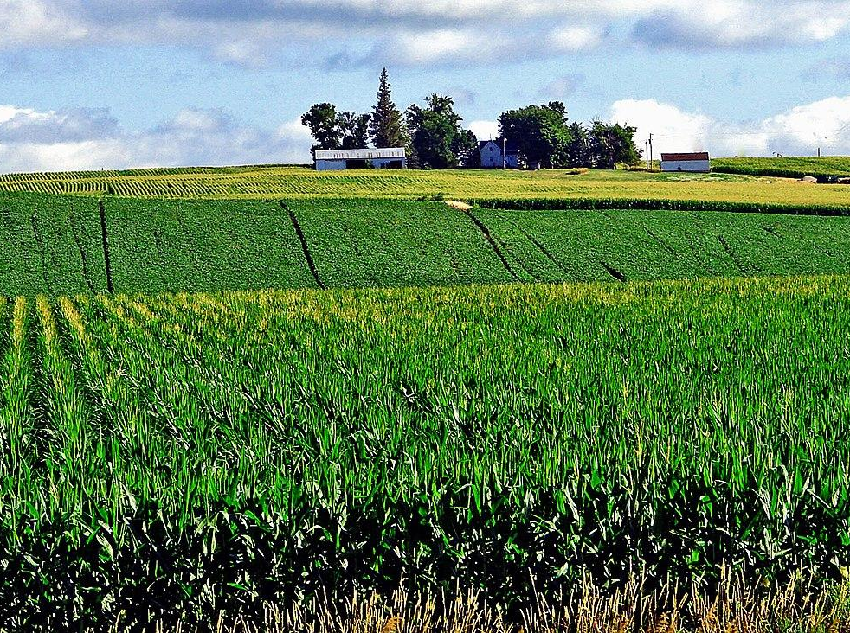
Wool is right for All gardening situations
Home gardens
Large Scale Farming
Photo: Google Image
Photo: Google Image
Notes:
E48
Whether you’re a home gardener or a large scale farmer, wool is for you. Wool is a natural fertilizer.

Slide 49

Wool is right for All gardening situations
Home gardens
Large Scale Farming
Sustainable
Renewable
Organic
Photo: Google Image
Notes:
E49
It’s sustainable and renewable. It sequesters carbon, it can help with any legacy phosphorus problems since it has virtually no phosphorus, it’s moisture-retaining AND drought resistant. It improves soil structure and fertility.
It can replace peat AND has been certified for organic growers.

Slide 50
Wool is right for All gardening situations
Trial run with 1000 pounds of Woollets, wool pellets on Brussels Sprouts and Kale.
“I liked the product, it was easy to spread. We used a spinner spreader and applied all the Woollets to the first planting of brussels sprouts three weeks after transplanting. Then came back 10 to 14 days later and cultivated with the Danish tine. I would use the product again.”
Kyle R. Commercial Grower
Photo: Google Image
Photo: Google Image
Notes:
E50
This past year we had a large scale farm operation purchase 1000 pounds to try on their brassica fields. They were pleased with the results and here is what the farm specialist had to say. “I liked the product, it was easy to spread. We used a spinner spreader and applied all the Woollets to the first planting of brussels sprouts three weeks after transplanting. Then came back 10 to 14 days later and cultivated with the Danish tine. I would use the product again

Slide 51
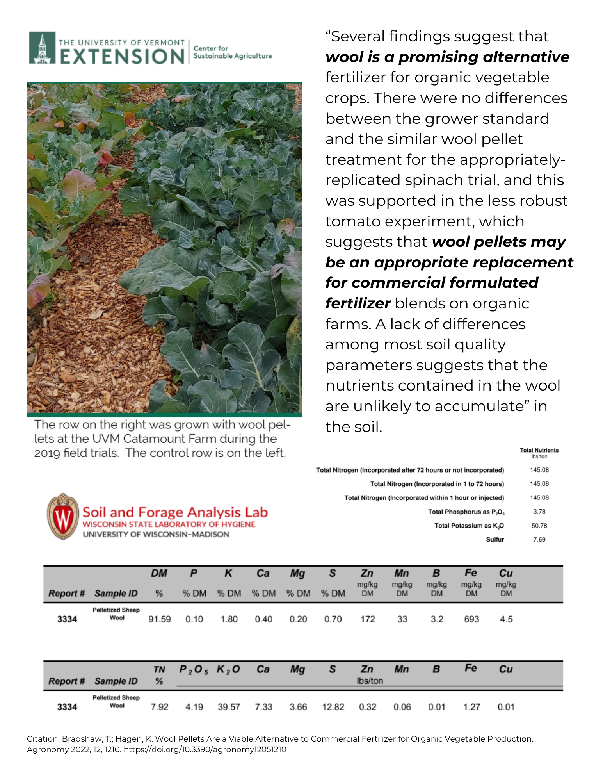
Research
The University of Vermont
Photo: Google Image
Photo: The University of Vermont
Notes:
E 51 research supports wool for horticulture.
Research supports using wool as a fertilizer and soil amendment. Univ of Vermont study, The Ohio State University as well as the Journal of Ecological Engineering all indicate the same thing.
And there have been a number of published scientific papers in Europe showing the benefits of wool on soil fertility compared to traditional chemical fertilizers.
Let’s take the Vermont study first. The University of Vermont Extension Center for Sustainable Agriculture found that wool could replace commercial fertilizers for organic growers. As you can see from this photo, the right side, grown with wool, is much healthier than the control group, which used the farm’s usual fertilizer protocol. Yields were also ready earlier.

Slide 52
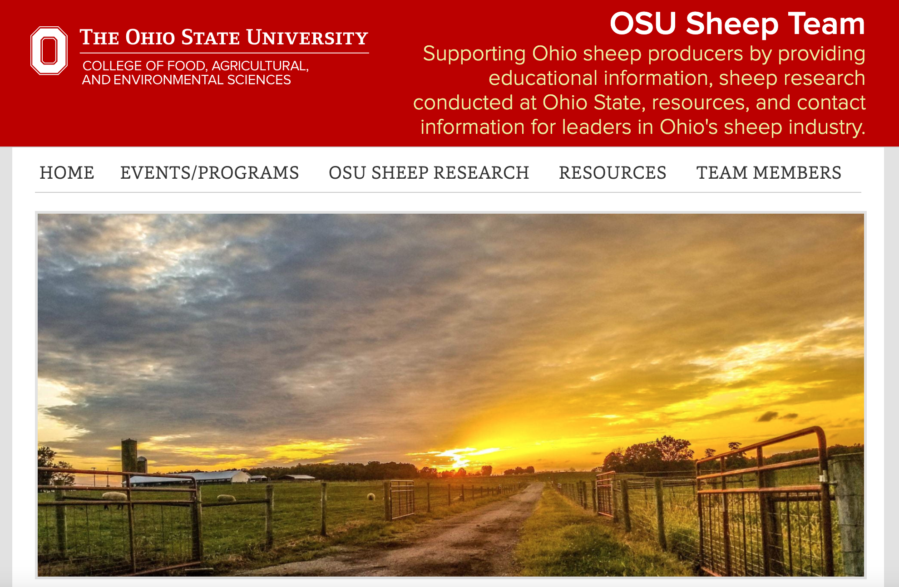
Research
The Ohio State University
Seed to market ready in
76 days w/ traditional
vs
38 days using wool
Photo: Google Image
Notes:
E 52
Ohio State University
Next, the Ohio State University research indicated
“With sheep’s wool, you’re getting between 9.3% – 14% Nitrogen. When the researcher and his team starting testing the impact of such high Nitrogen numbers, they found that with typical fertilizer, Greenhouses could bring organic tomatoes from seed to market-ready in about 76 days, but with wool pellets and their Nitrogen punch, you could bring tomatoes market-ready in as little as 38 days!”
Ohio State also discovered that wool:
Reduced grow time for vegetables
Water savings
Softens hard clay soils
Pest control - including aphids
All-natural/organic properties
Markets for waste wool

Slide 53
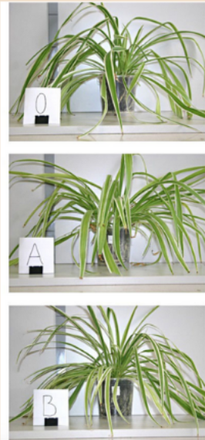
Research
The Journal of Ecological Engineering Volume 23, Issue 6, 2022
Photo: Google Image
Photo:The Journal of Ecological Engineering
Notes:
E 53 research supports wool for horticulture.
And finally, the Journal for Ecological Engineering - In this research, the wool was introduced into the soil in two ways in houseplants: in the form of a compact layer on the bottom of the pot (sample A) and in the form of an even mixture incorporated into soil (sample B), and of course the control (sample 0) with no wool. The research focused on the impact of the wool and method of its deployment on soil humidity and root growth.
Here are the results:
Group 0 (soil only) developed fine roots in the entirety of the root ball, with a few thicker roots at the bottom.
Group A (wool at the bottom) developed the same fine roots in the entirety of the root ball, with a much higher number of thicker roots at the bottom.
Group B (wool throughout) developed thick roots in the entire volume of the pot. Long roots which grew quickly and attained considerable length. Their main function is to provide the plant with fixation in the substrate and to transport substances taken up by short roots. Thus, the structure of the root system from research group B proves the presence of water (and nutrients) and its access to the entire volume of soil. Moreover, it was observed that the outer layer of the soil in the pots containing the plants from groups 0 and A behaved similarly, was moist immediately after watering, and then it dried quickly (1–2 days). The outer layer of soil in the B (wool throughout) pots, on the other hand, retained moisture for 2–5 days.

Slide 54

How to add wool to your soil
Find a local shepherd
Photo: Google Image
Notes:
K54 How to add wool to soil? We shared all the benefits and uses of wool for your plants, so how can you get some to try it yourself?
Find a local sheep farmer for raw whole sheared fleeces for mulching.

Slide 55
How to add wool to your soil
Find a local shepherd
Buy raw shredded wool
Photo: Google Image
Notes:
K55 How to add wool to soil?
Buy raw shredded wool. You can find it here and online though it is less common than whole fleeces. Remember that you want RAW wool with the lanolin still in it, not washed wool. Washed wool is pretty but loses the slug, pest and varmint deterrent properties.

Slide 56

How to add wool to your soil
Find a local shepherd
Buy raw shredded wool
Easiest way…
Woollets!
Photo: Google Image
Notes:
K56 How to add wool to soil?
The easiest way to add wool to your garden: Wool pellets, which we call “WOOLLETS! You can find all these forms of wool online at our website Woollets.net or today at our booth.

Slide 57
Wonderful Wool:
For Your Plants and Your Planet!
Questions and Answers
THANK YOU
Photo: Google Image
Notes:
WE HAVE A FEW MINUTES FOR QUESTIONS…
That’s all the time we have for today. If you have questions, please stop by our booth. We’d be happy to chat with you.
Thank you for joining us today. We appreciate the opportunity to share our passion with you! The Garden Expo would love it if you fill out the QR code survey today - Thank you

