Slide 1
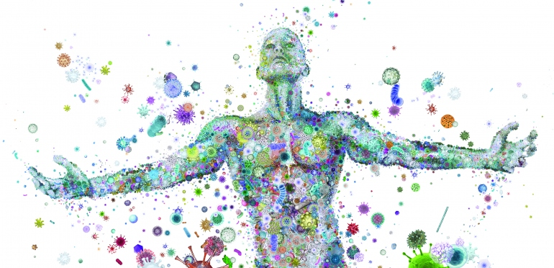
Gut Instincts - Microbes, Addiction, and Immunity
Illustration by Charis Tsevis

Slide 2
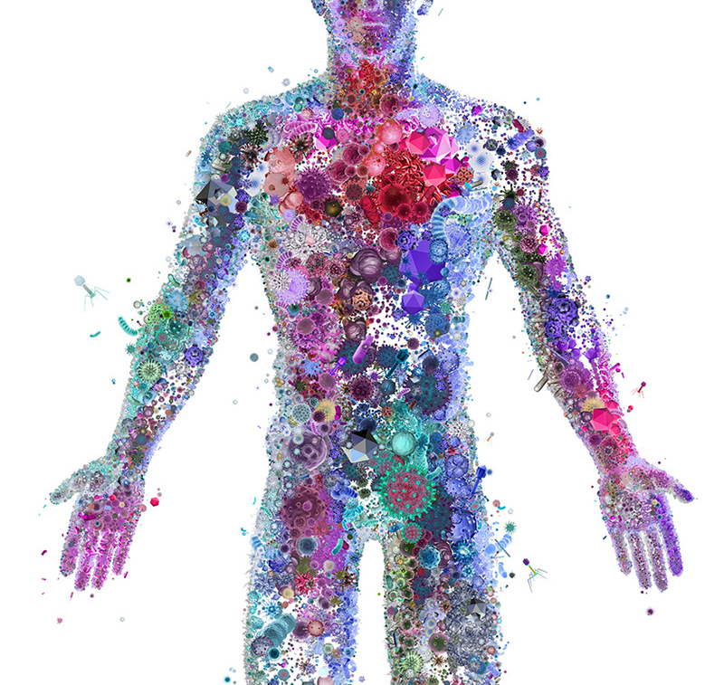
So many of us!
Nobody sees us,
Stops us, betrays us;
The small grains make room…
We
Diet on water,
On crumbs of shadow,
Bland-mannered, asking
Little or nothing.
So many of us!
So many of us!
- Sylvia Plath
Mushrooms Excerpt
Illustration by Charis Tsevis
Notes:
1 trillion microbes in and on us! Highest numbers in the gut
Who:
Bacteria
Virus
Fungus
Multicellular eukaryotes (helminths) – not usually in US

Slide 3
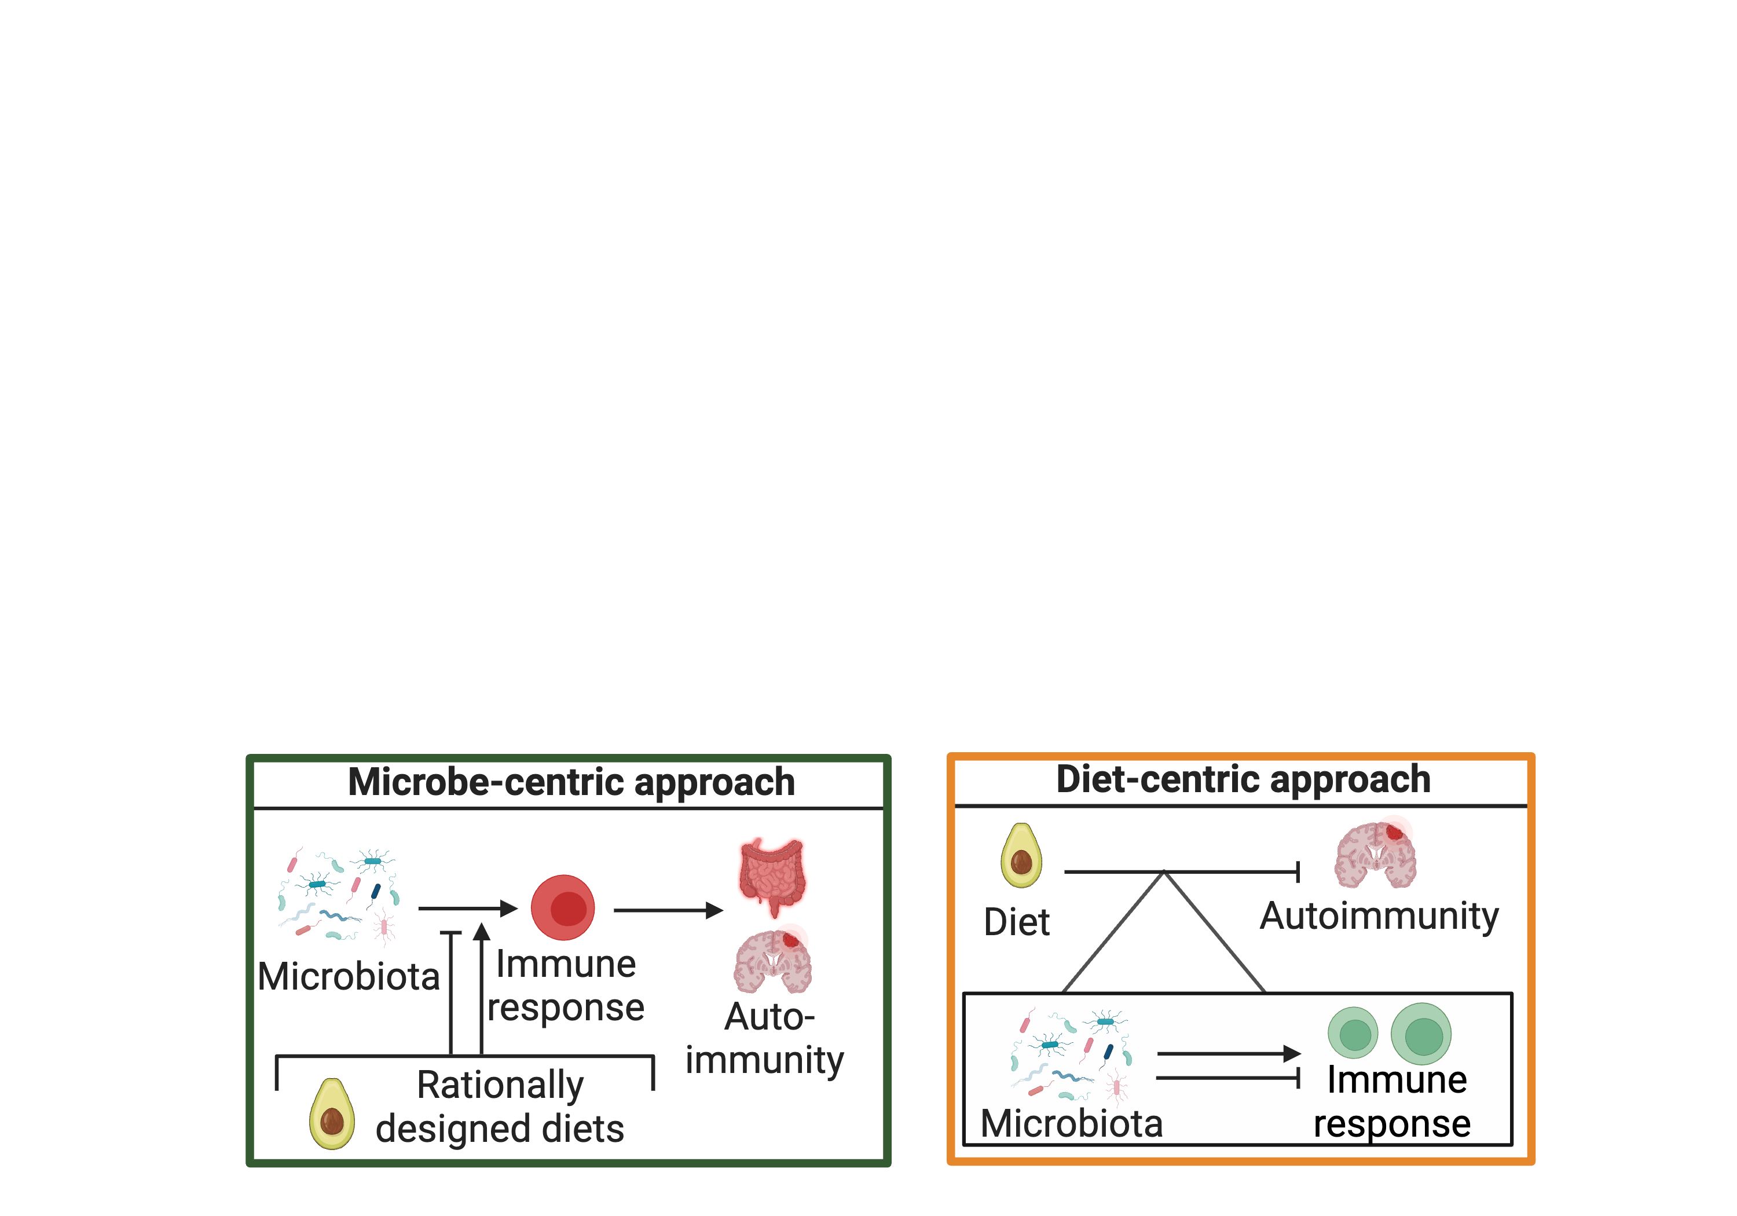
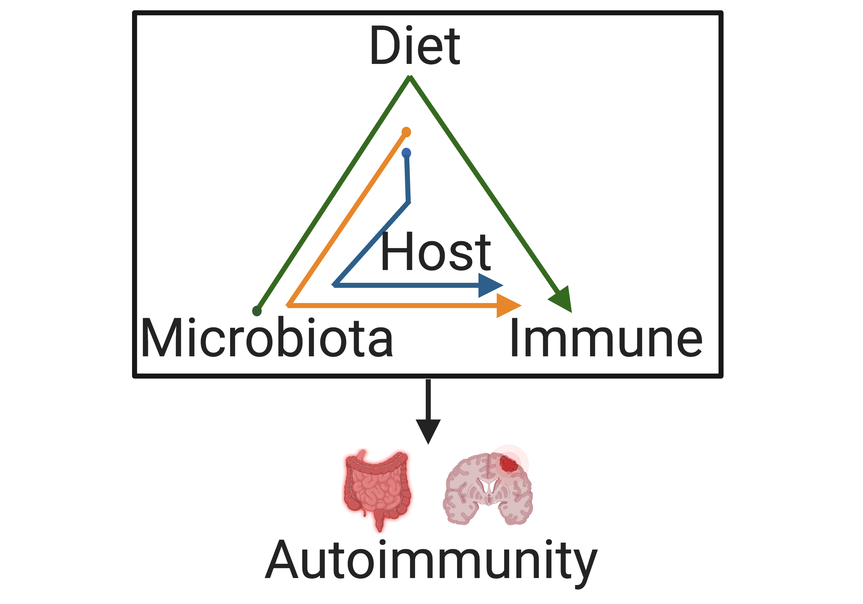
Our research: Mechanisms of diet-microbiota-immune interactions

Slide 4
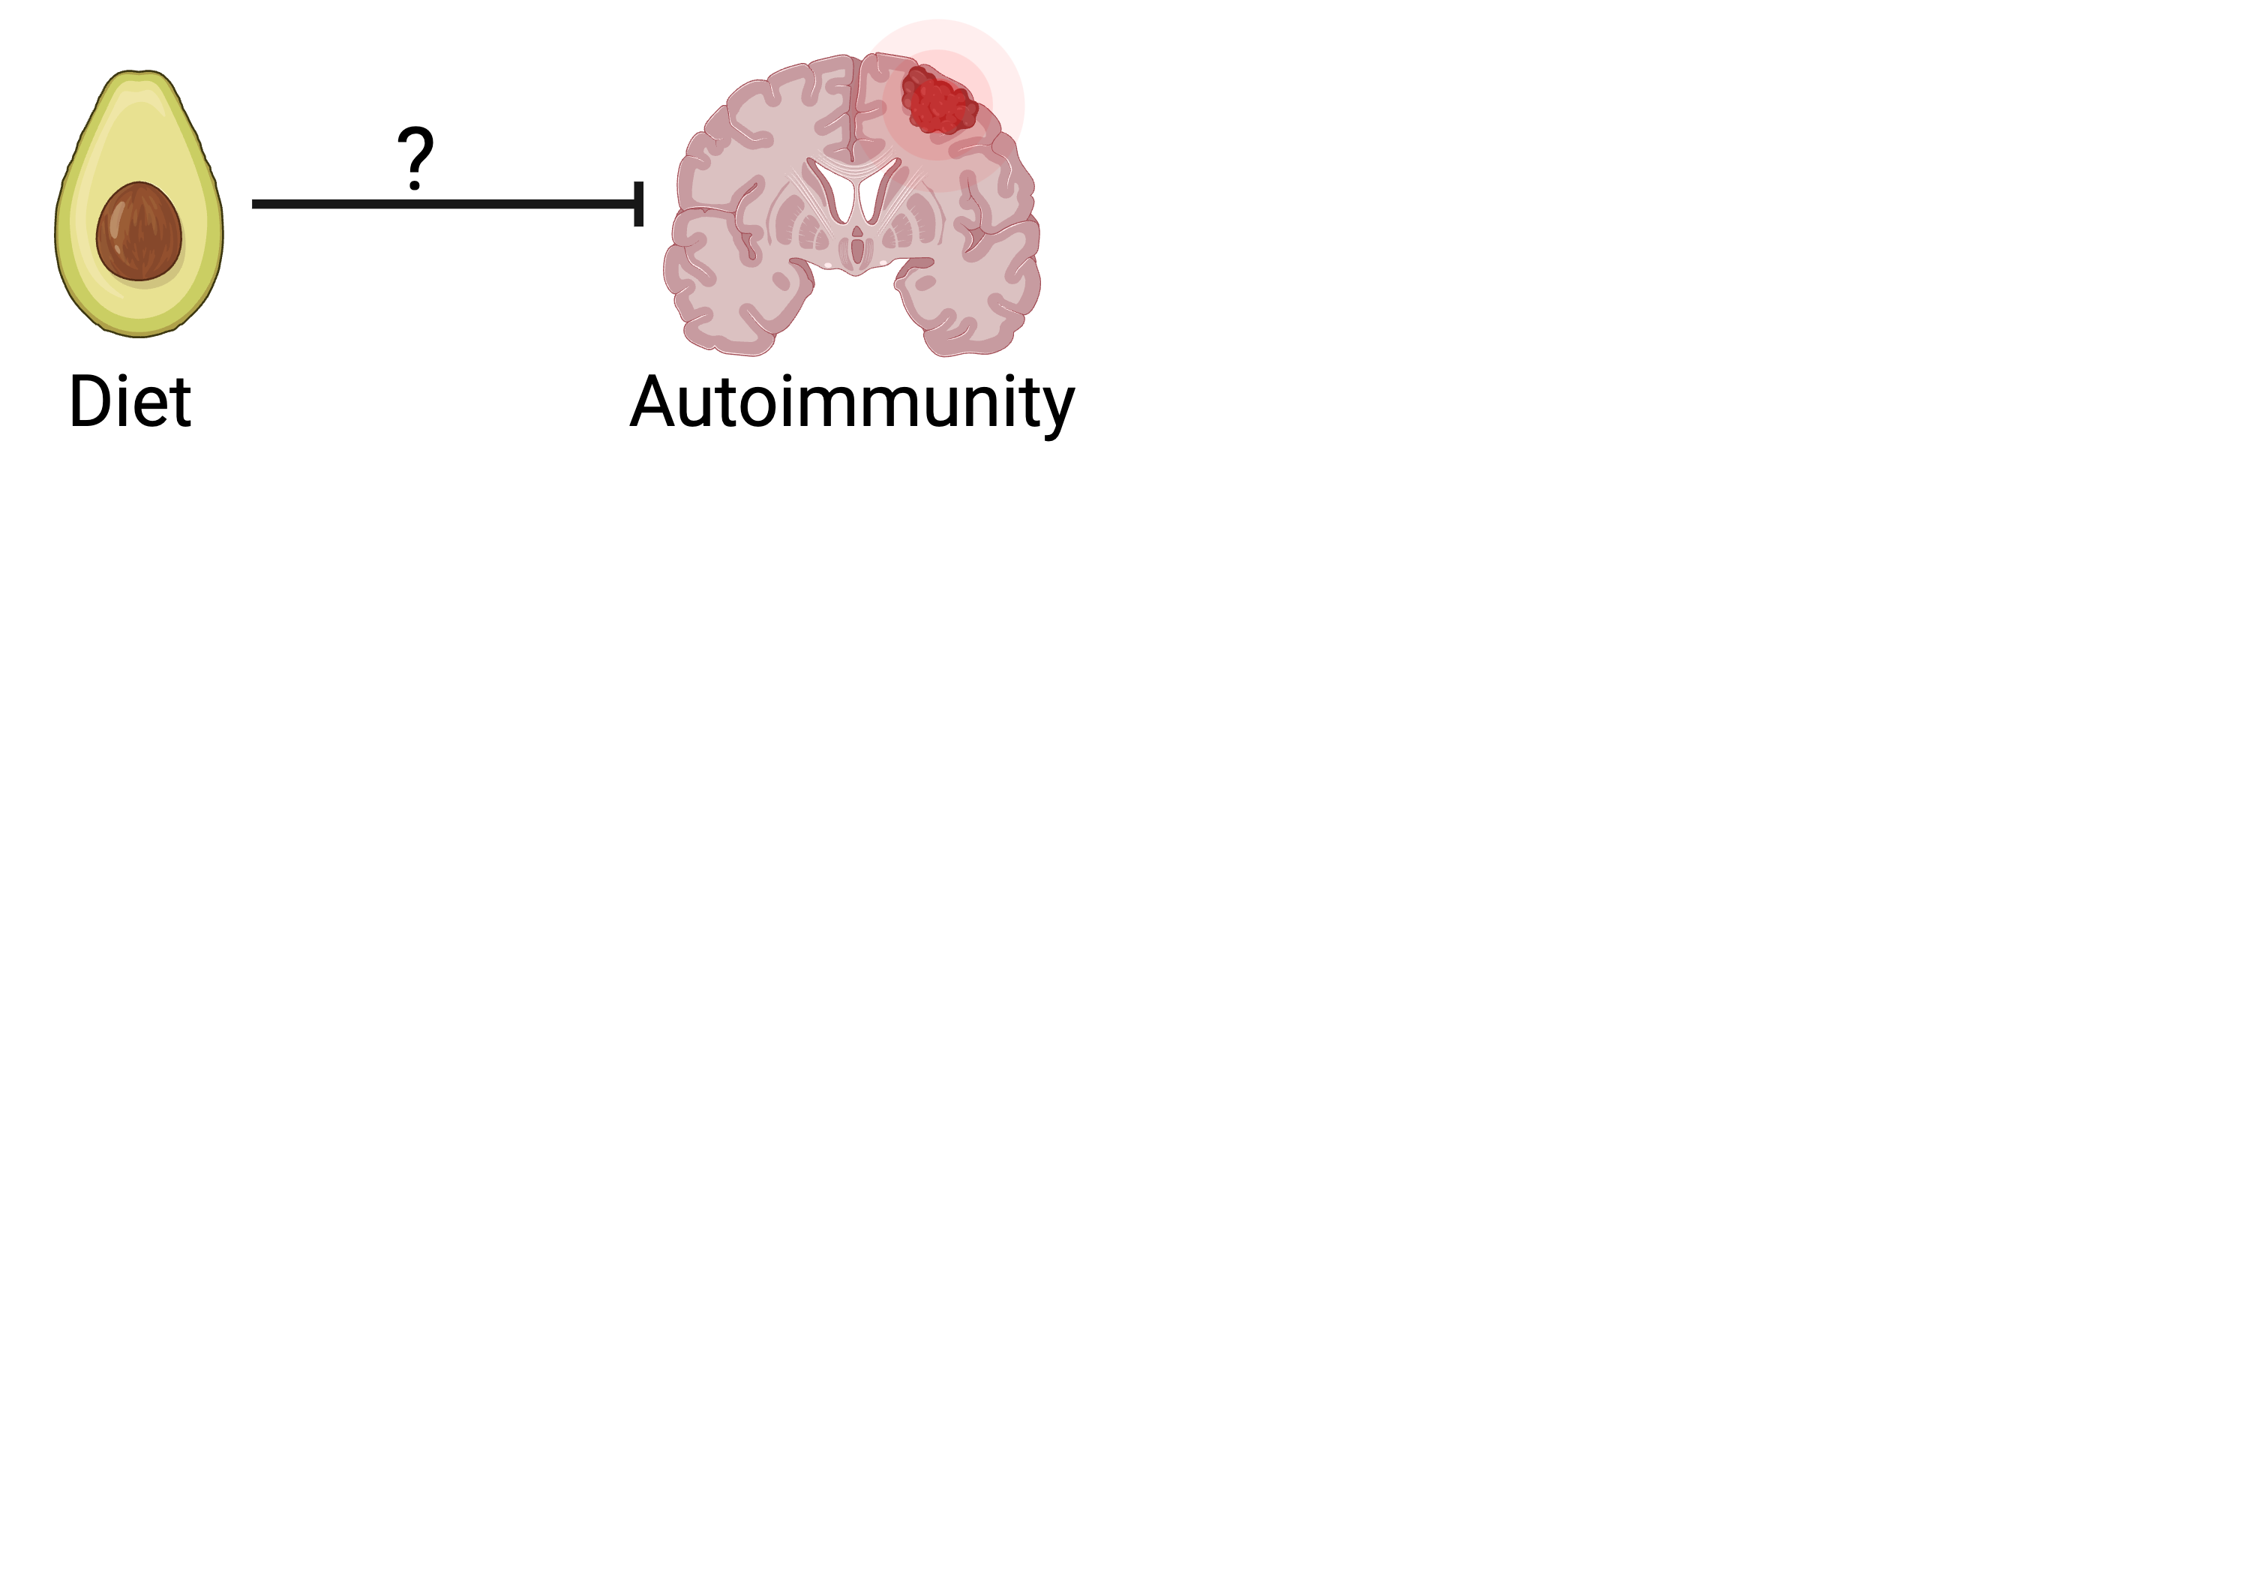
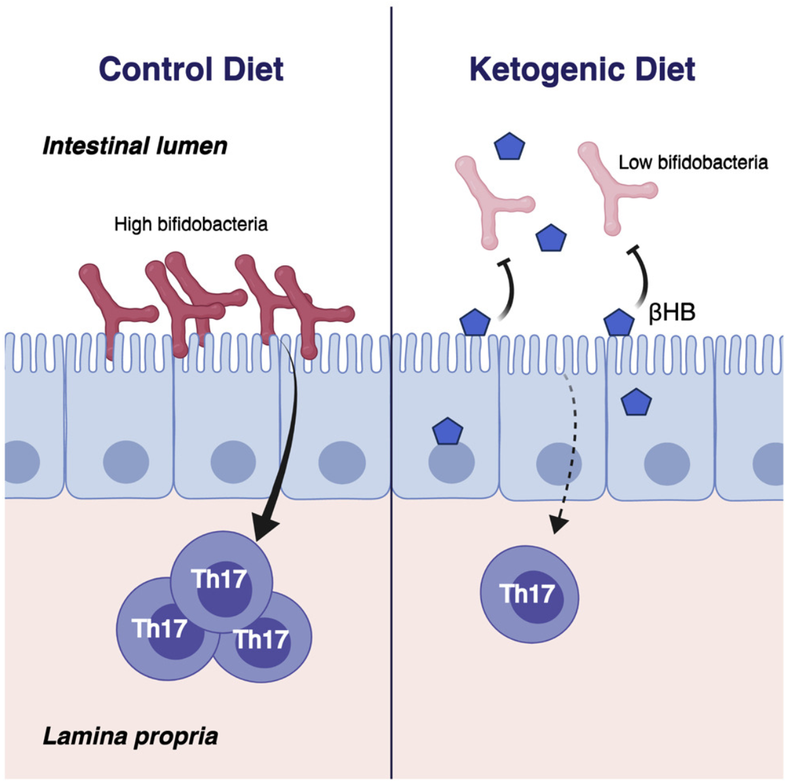
  How do our diets impact autoimmune diseases?
Qi Yan Ang!

Slide 5
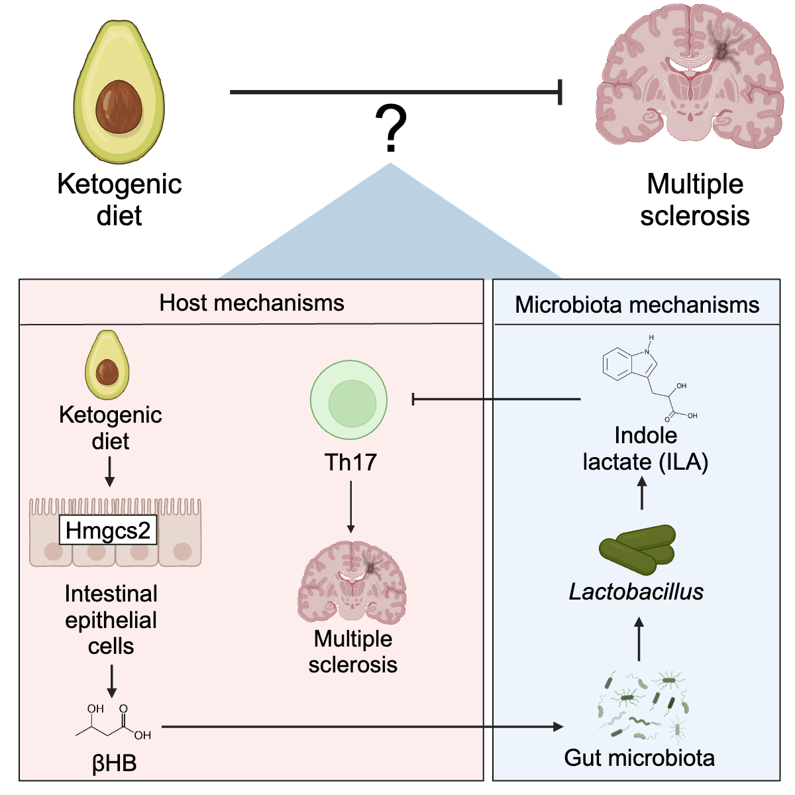
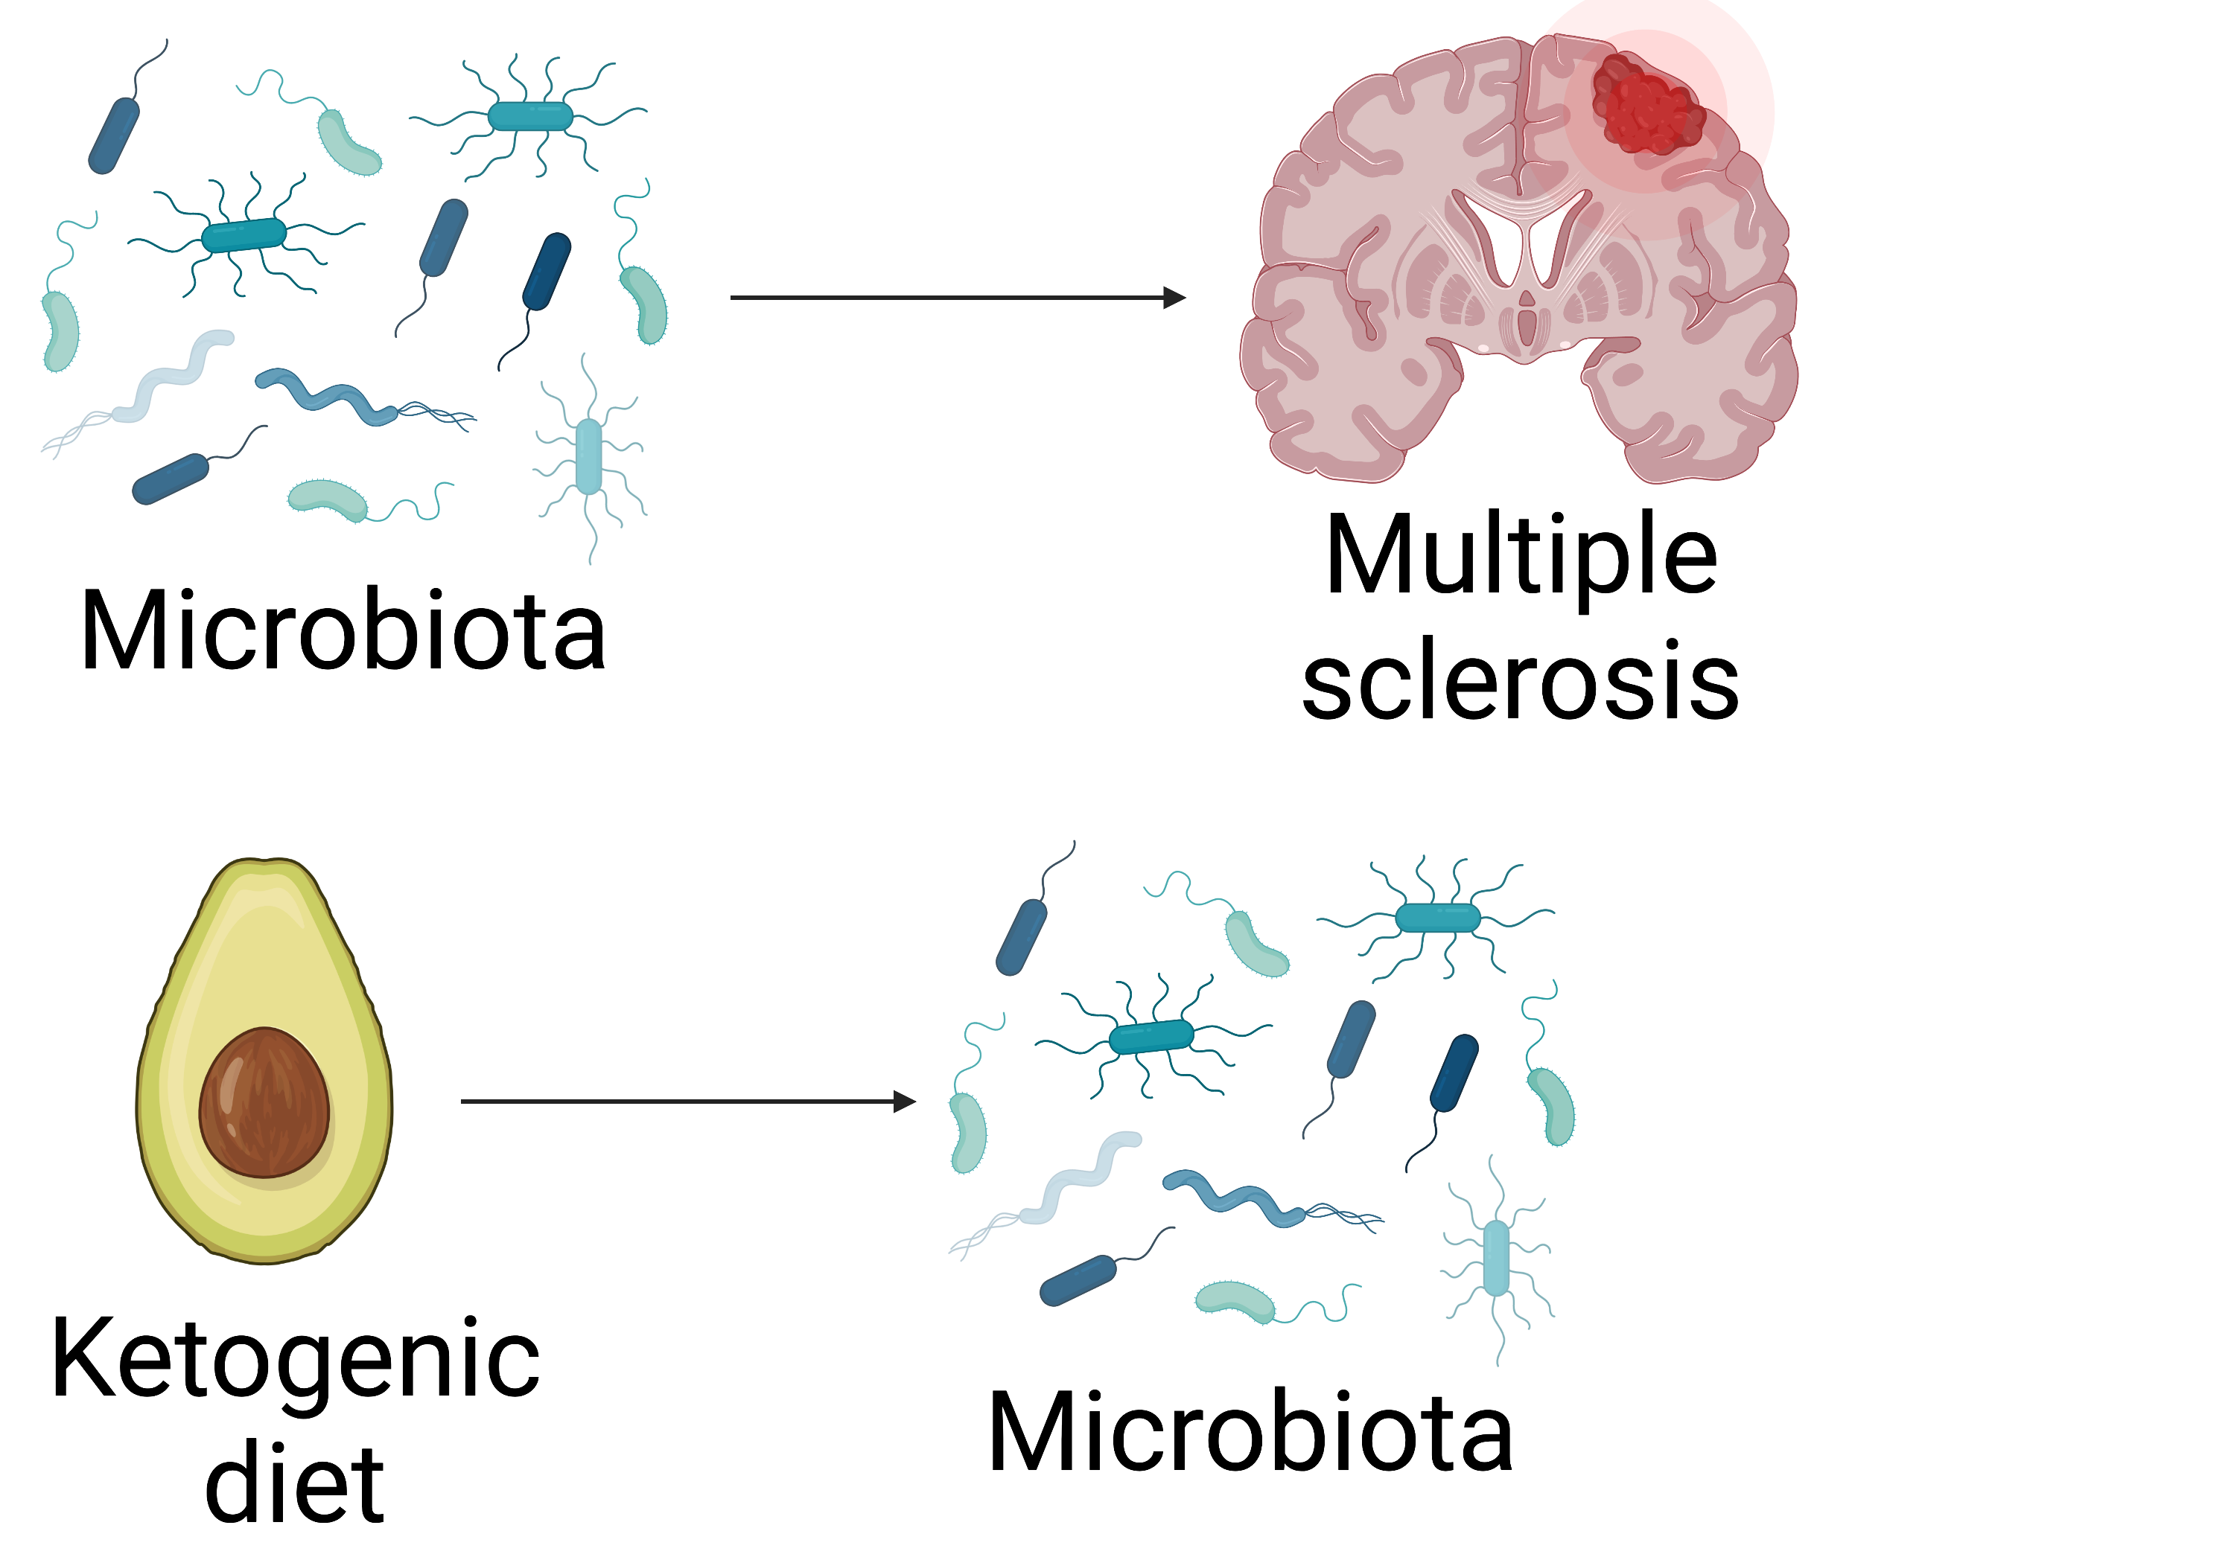
How is a ketogenic diet protective during multiple sclerosis?
Cekanaviciute et al., 2017
Correale et al., 2022
Ang, Alexander et al. 2020
Notes:
So my major question was how is a KD protective during MS?
Based on a previous project in the lab in collaboration with a talented graduate student Qi yan ang we know that a KD shape the composition and function of the microbiota
and additionally, previous literature has shown a strong connection between the microbiota and autoimmunity

Slide 6
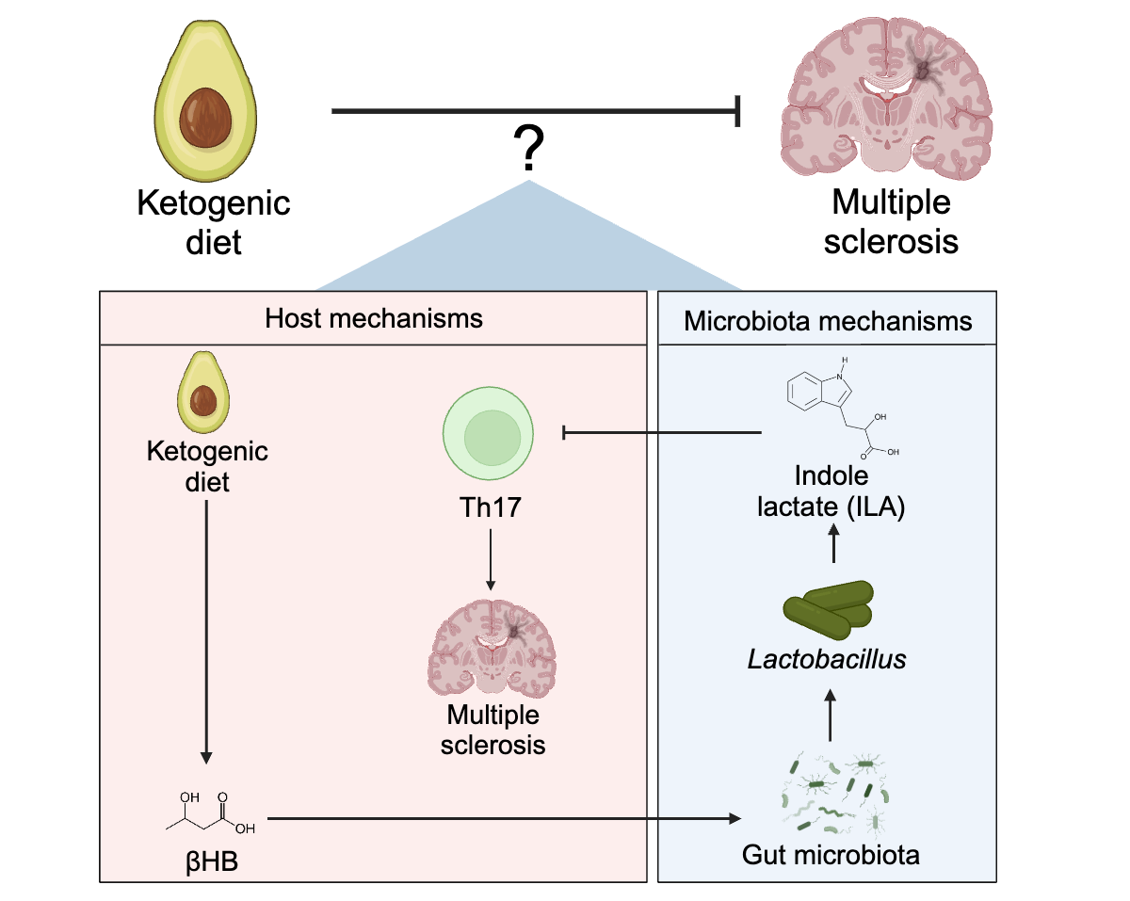
How is a ketogenic diet protective during multiple sclerosis?

Slide 7
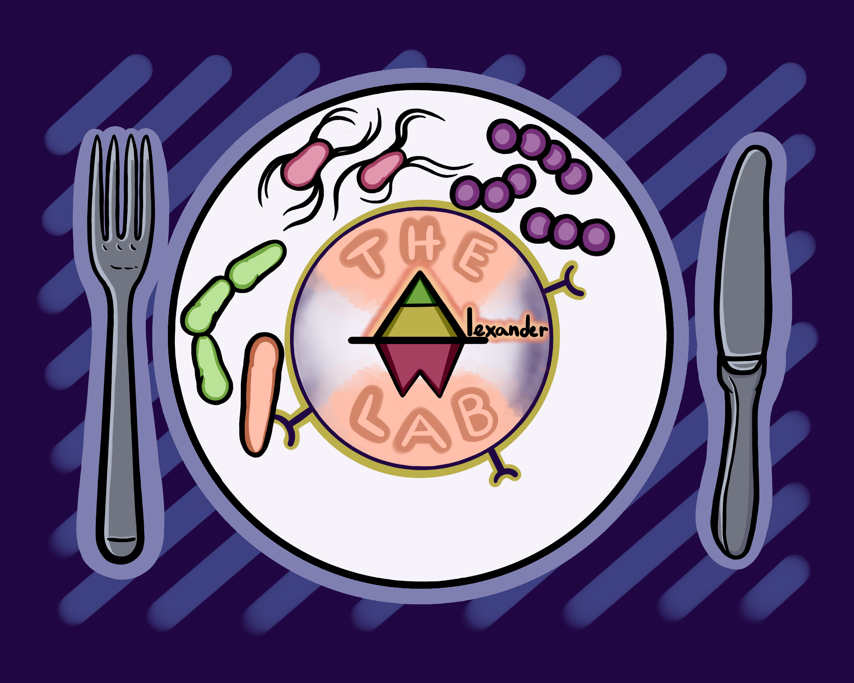
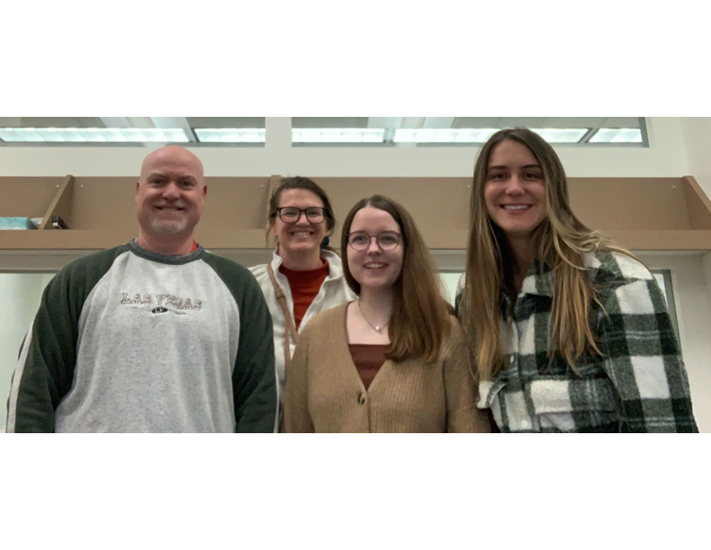
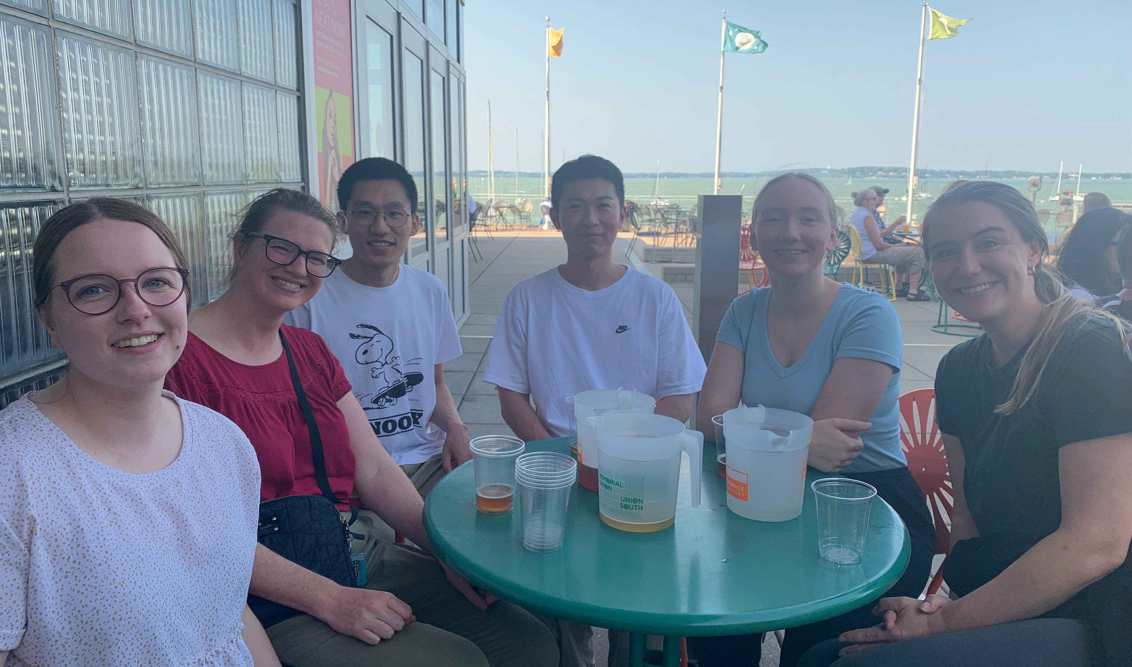
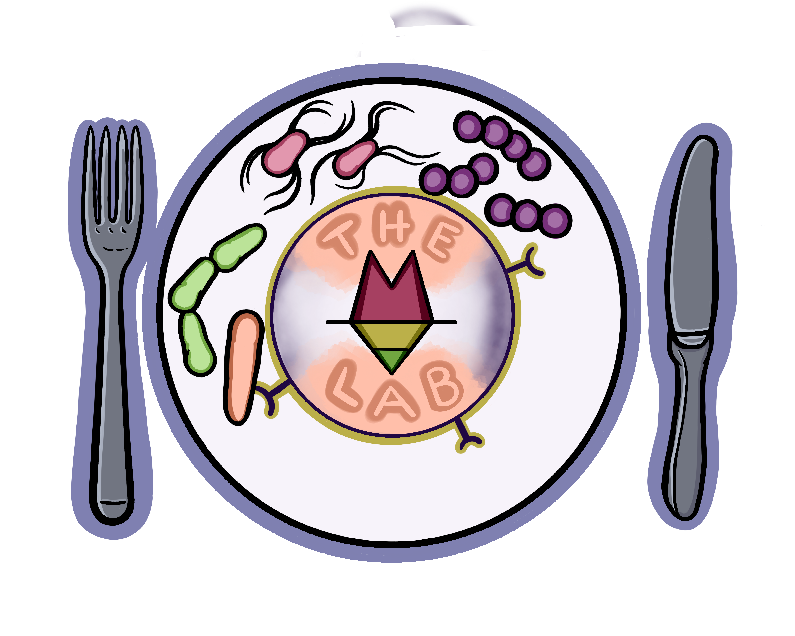
Acknowledgements
Alexander Lab:
Kevin Schwartz
Gillian Hughes (MDTP)
Kate Stack (genetics undergraduate)
Wenxuan Dong (Biophysics)
Chi Yan – Felix (Postdoc)
Bethany Korwin-Mihavics (Postdoc)
Theodora Osborne (MSTP summer student)
Turnbaugh Lab UCSF
John Newman Lab (Buck)
Peter Crawford Lab (UMN)
Andrew Patterson Lab (PSU)
UCSF Gnotobiotics Core
Funding:
NIH/NIAID K99/R00
NIH/NIAID F32
UW- Madison startup funds
Model figures made with Biorender.com
Alexander Lab
Thank you!

