Slide 1
Flourishing in a Culture of Belonging
Tony Chambers
Center for Healthy Minds
UW - Madison

Slide 2

Sawubana – “I see you”
Sikhona – “I am here to be seen”

Slide 3


Belonging
BBBBB

Slide 4
Take aways:
Our primary focus is on social and public belonging.
Belonging impacts well-being psychologically, emotionally, physically, and socially.
Belonging is not diversity, equity, and inclusion.
Belonging is not consistent across all human experiences at any given moment.
Belonging is not necessarily a good thing.
Belonging does not mean “fitting in”.
“Experiencing Belonging” is not the same as “A Sense of Belonging”.
That to which you want to belong, must want you to belong to it. Belonging is a recipricating experience.
Belonging is at the center of all human conflicts and joy.

Slide 5
Small group discussion….
A time when you experienced belonging? What was it about that experience that you remember?
A time when you experienced not belonging? What was it about that experience that you remember?

Slide 6
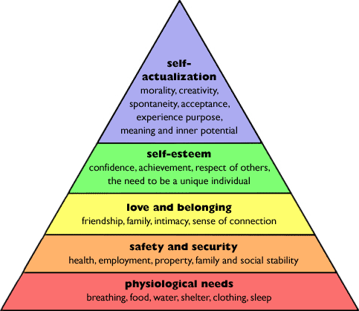

Maslow’s Hierarchy of Needs…..

Slide 7

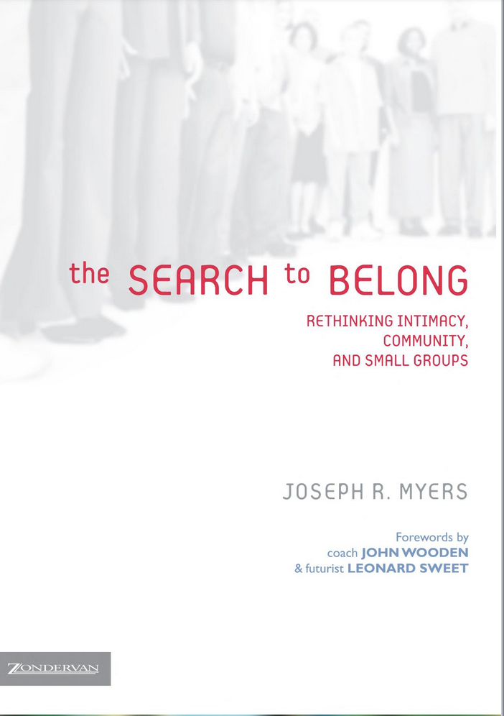
Four Levels of Belonging
Intimate Belonging – Described as as “naked and unashamed.” We don’t keep any secrets from those with whom we experience intimate belonging. Usually with best friend or spouse.
Personal Belonging - The kind of belonging we experience with our families and close friends. We have mutually disclosed information that is personal and assumes a high level of trust.
Social Belonging - The kind of belonging we experience with people whom we recognize but may not yet know very well. It is important for our identity formation. In settings for social belonging, we often self-select those with whom we want to experience personal or even intimate belonging.
Public Belonging - The kind of belonging we experience with those whom we may not know personally but with whom we are connected through some external commonality. We experience public belonging as fans of the same sports team, as worshipers in the same faith or institution, or live of the same town.

Slide 8
Potential Impacts of isolation, loneliness, and not belonging….
Impact performance, persistence, and subsequent engagement.
Can Cause ‘Cravings’ for Companionship as Strong as Hunger or Thirst
May Make Us More Pessimistic
May Make Us Less Likely to Trust Others
May Contribute to Cognitive difficulties
Can impact mental, physical, and emotional well-being.

Slide 9
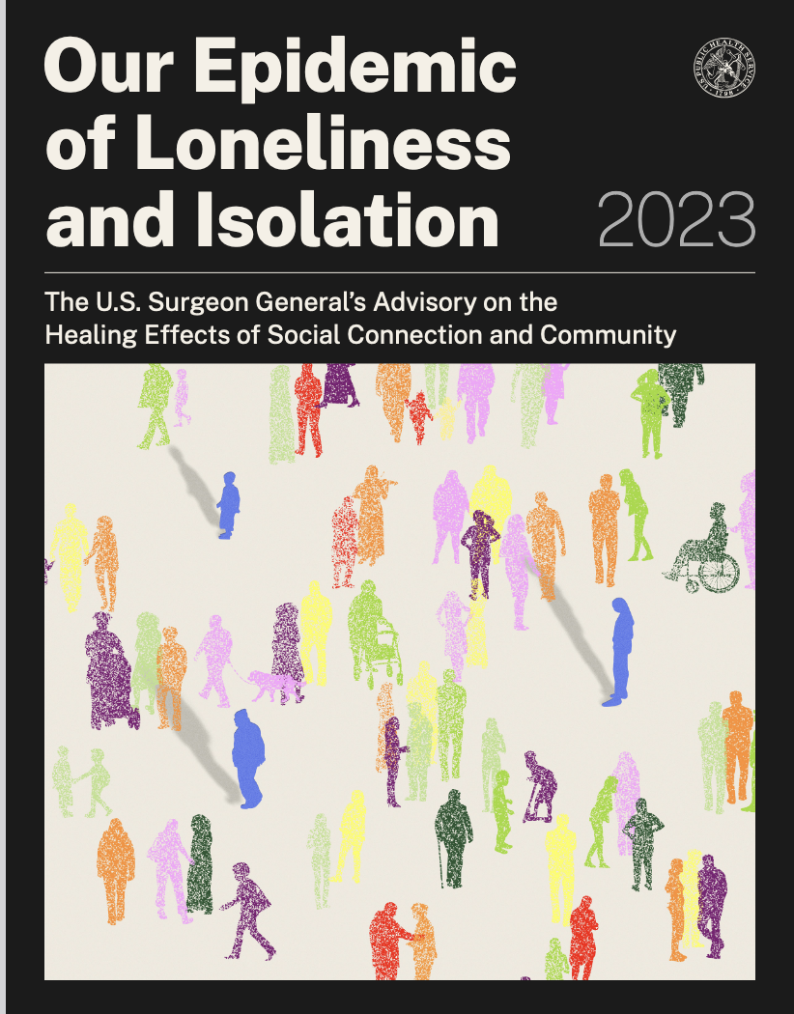
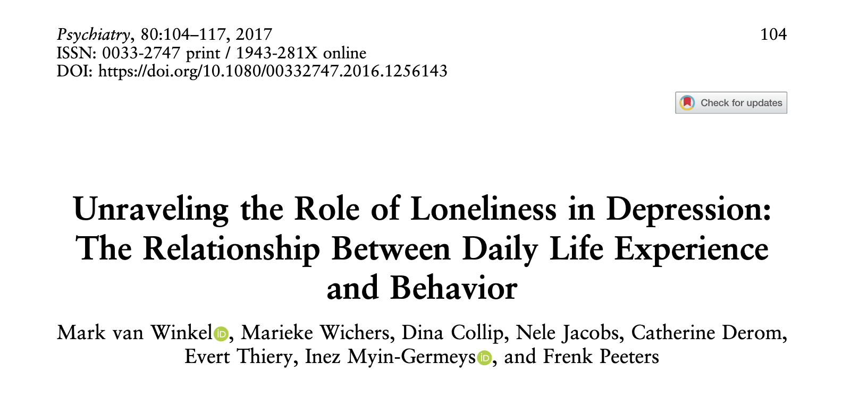
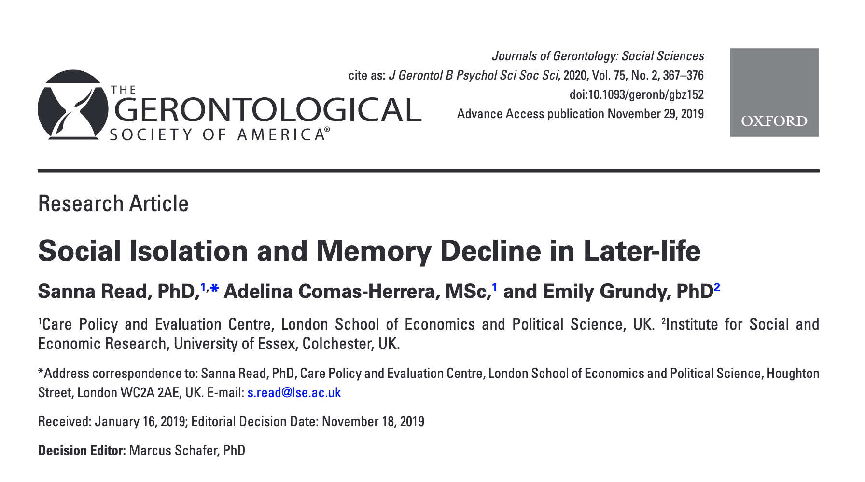

Slide 10
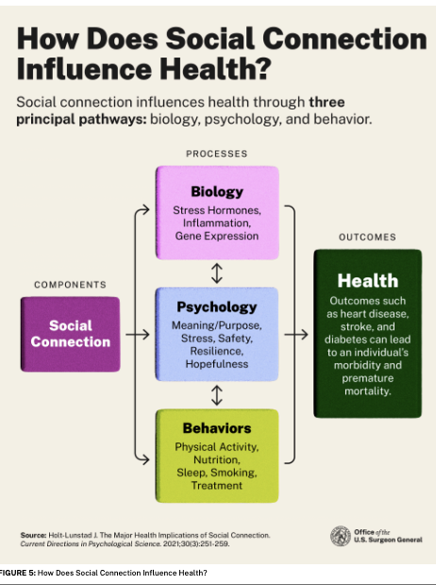

Slide 11
Necessary dimensions for Belonging to be present:
Subjective Experience
Objective Efforts & Outcomes
Agency
Strength of social networks

Slide 12
What are the feelings that you have when you belong, and you want to belong?
What are the feelings that you have when you don’t belong, but you want to belong?

Slide 13

Subjective Experience?
…a feeling or an experience?
“Belonging describes more than a feeling of inclusion or welcome. Its full power is as a strategic framework for addressing ongoing structural and systemic othering, made visible, for example, in the wide disparities in outcomes found across a variety of sectors and identity groups.”
john powell, Center for Belonging and Othering,
UC Berkley

Slide 14
Dynamics of Belonging for Marginalized Groups:
Belonging Uncertainty
Attributional Ambiguity

Slide 15
Other necessary dimensions for Belonging to be present:
Objective Efforts & Outcomes
(Policies, practices, symbols, resources, physical structures (places), recognitions and celebrations)
Agency
(The abilities and opportunities to impact their environments to create an experience of Belonging)

Slide 16
The Paradox of Belonging
The Strength of Social Networks
The other side of belonging.

Slide 17
Strength of Social networks and Belonging…..
The degree of belonging in an environment is associated with (…or depends on) the strength of the social connections one has, and the value of those connections to getting what’s necessary to flourish.
Factors impacting the strength of connections in network:
Frequency of contact
Quality of contact
Alignment of contact

Slide 18
Strength of Social Networks
Greater
Belonging
Lesser
Social Connection Strength
Tony Chambers

Slide 19
Strength of Social Networks
Greater
What does this mean for us and our students?
Belonging
Lesser
Social Connection Strength
Tony Chambers

Slide 20
The Other Side of Belonging
Inclusion and Exclusion - In Group and Out Group
For someone to belong, someone else cannot belong.
The “Myth of Superiority”
Belonging has a “value” attached to it; not belonging also has a value attached to it. Belonging is not neutral or value-free.
Identity Formation and Belonging
Sometimes we become the thing to which we belong.

Slide 21
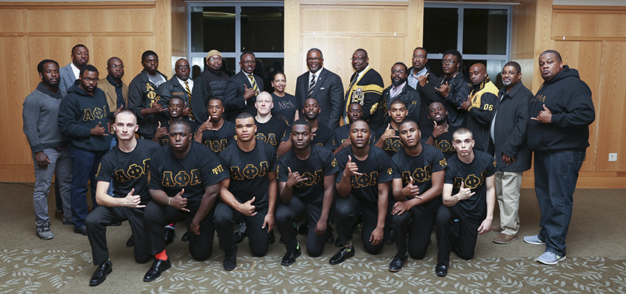
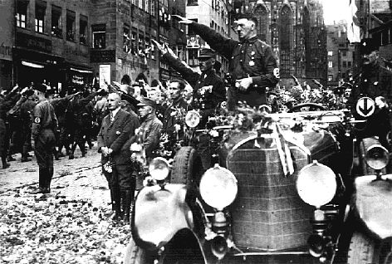
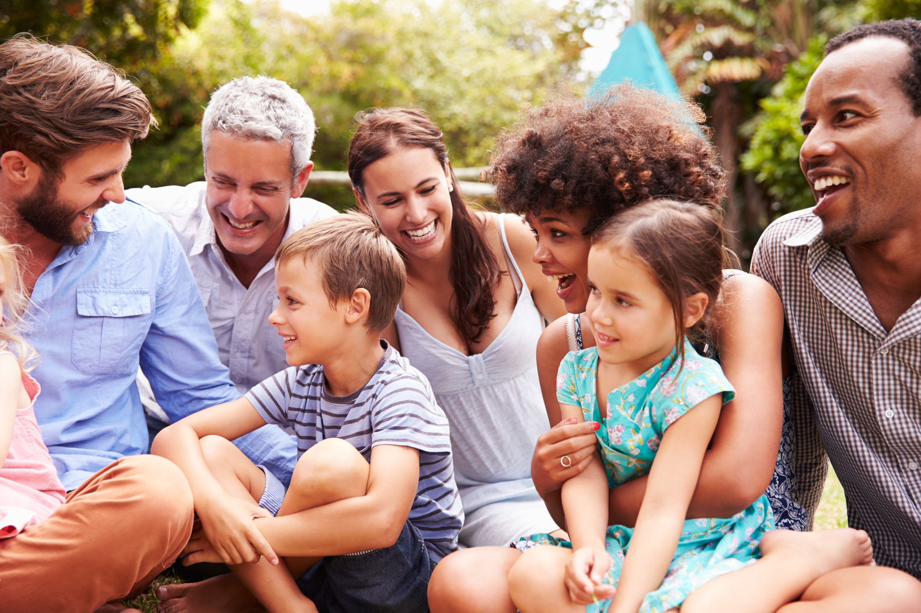
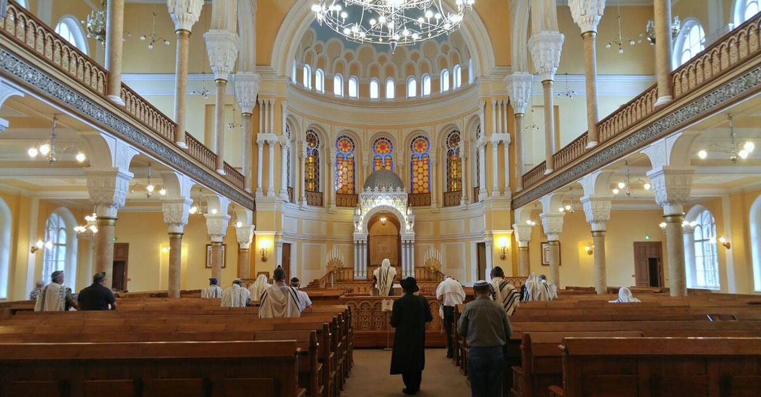
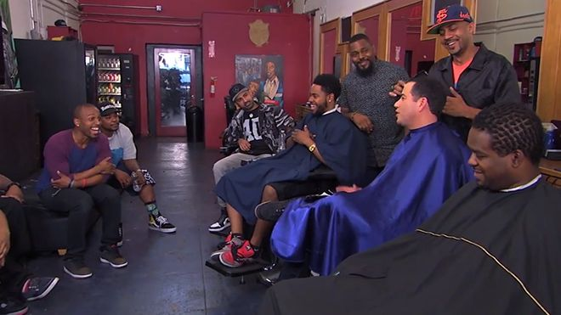
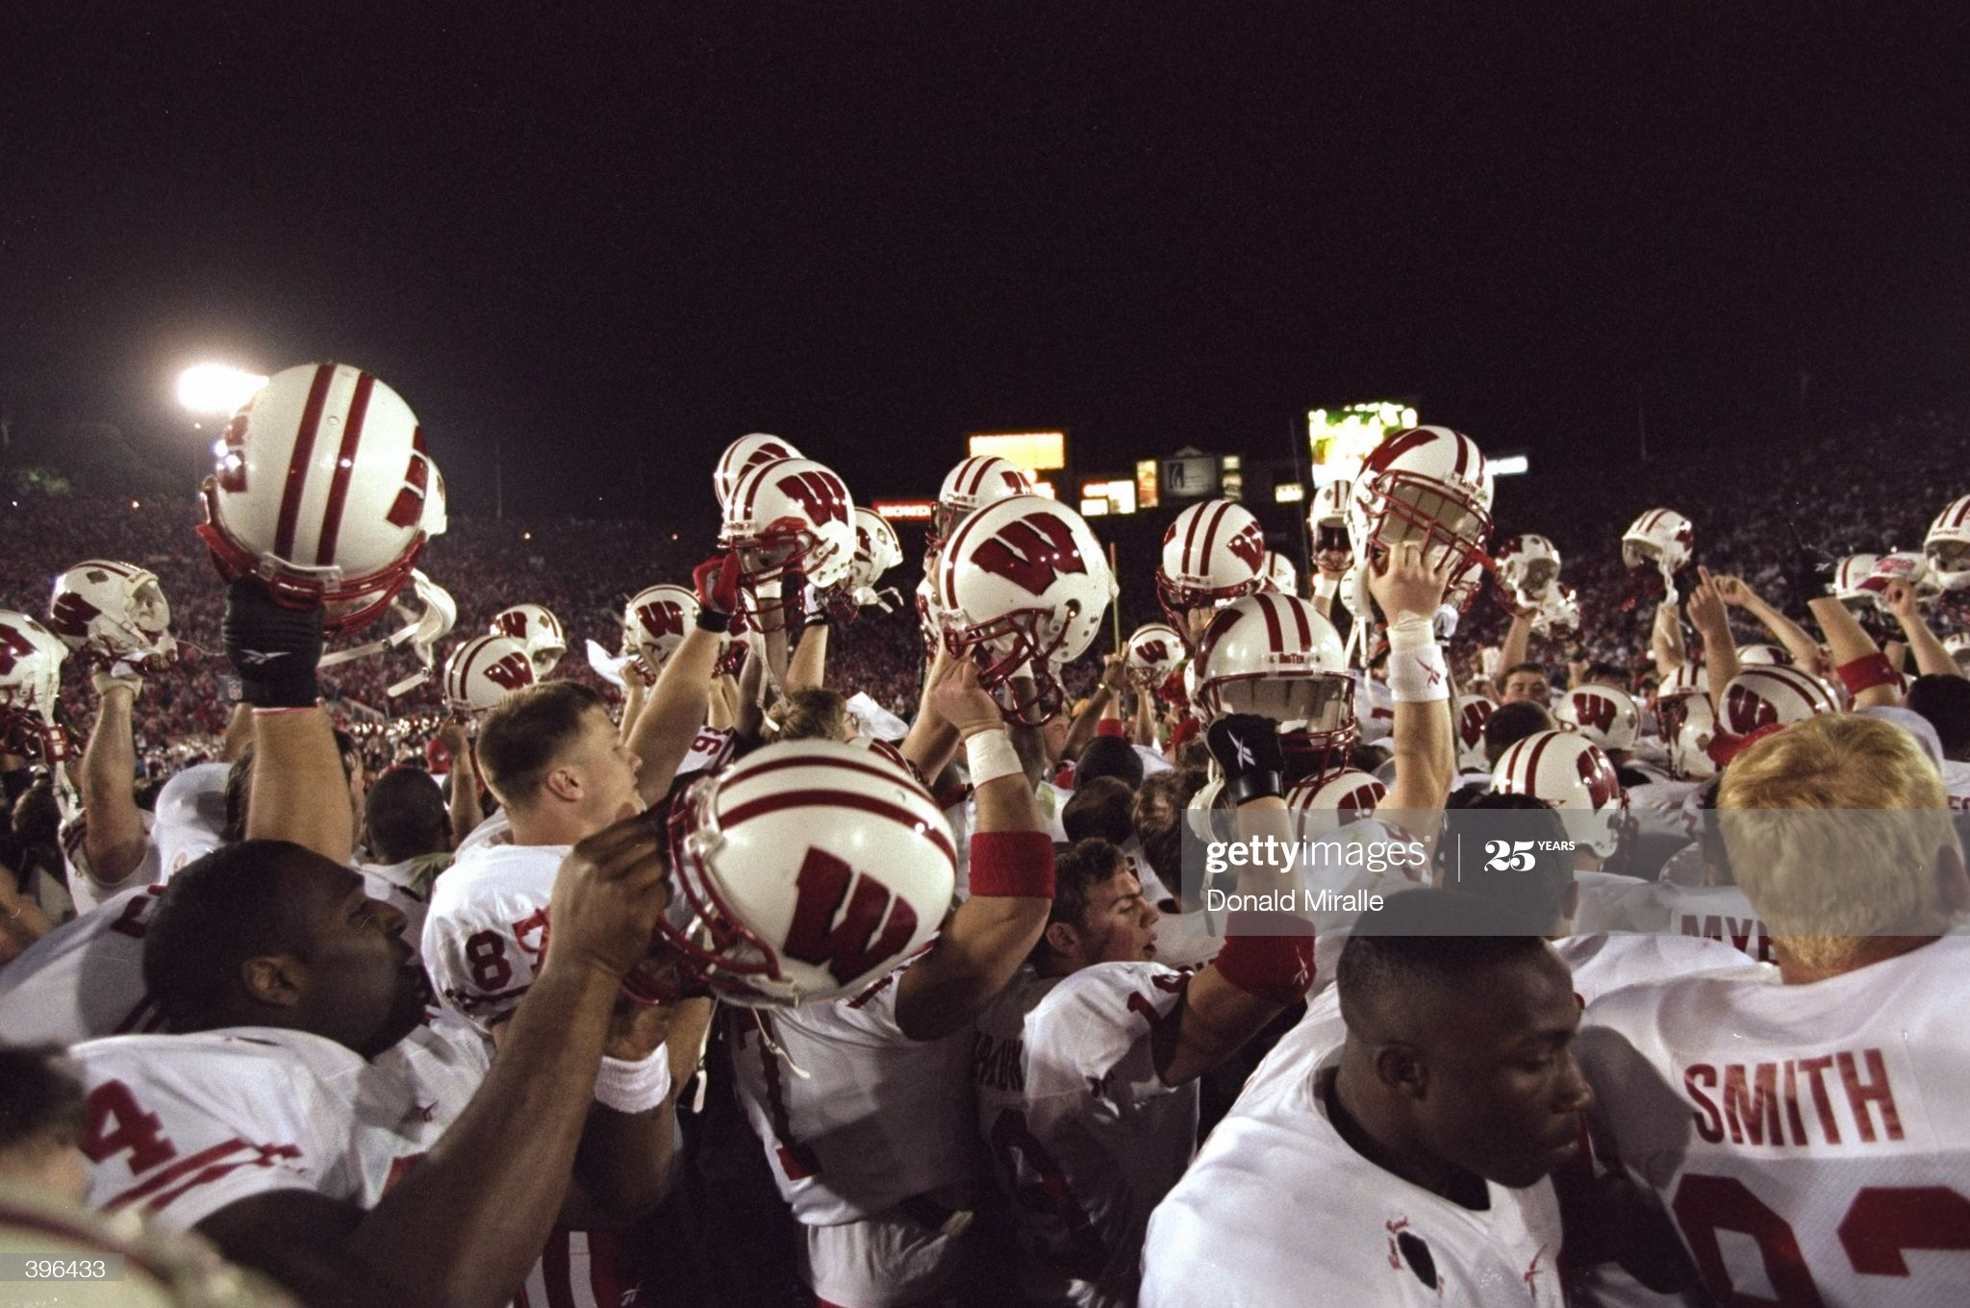
The Other Side of Belonging…
Nazi Party Rally

Slide 22
The Other Side of Belonging…
Nazi Party Rally
Inclusion and Exclusion - In Group and Out Group
The “Myth of Superiority”
Identity Formation and Belonging

Slide 23
What can we do to promote belongingness
Understand the power of social connection and the consequences of social disconnection
Invest time in nurturing your relationships
Minimize distraction during conversations
Seek out opportunities to serve and support others.
Be responsive, supportive, and practice gratitude.
Actively engage with people of different backgrounds and experiences.
Participate in social and community groups.
Reduce practices that lead to feelings of disconnection from others.
Seek help during times of struggle.
Be open with your health care providers.
Reflect the core values of connection in how you approach others.

Slide 24
Last words about Belonging….
?

