Slide 1
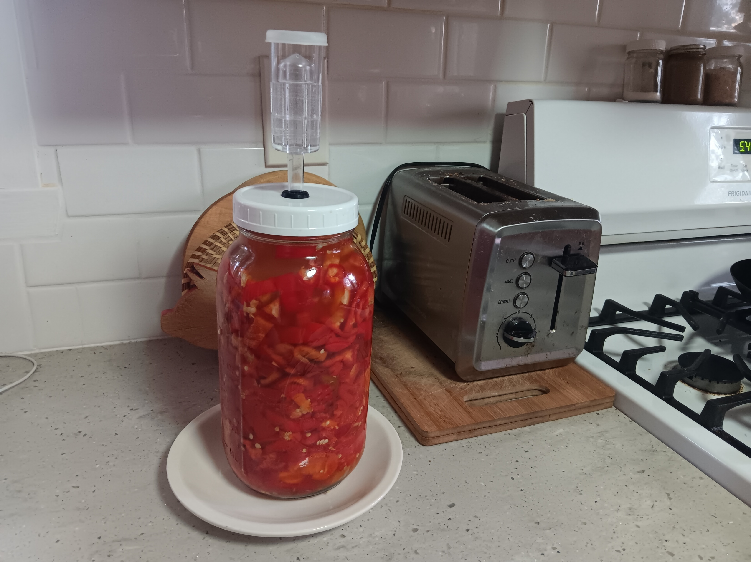
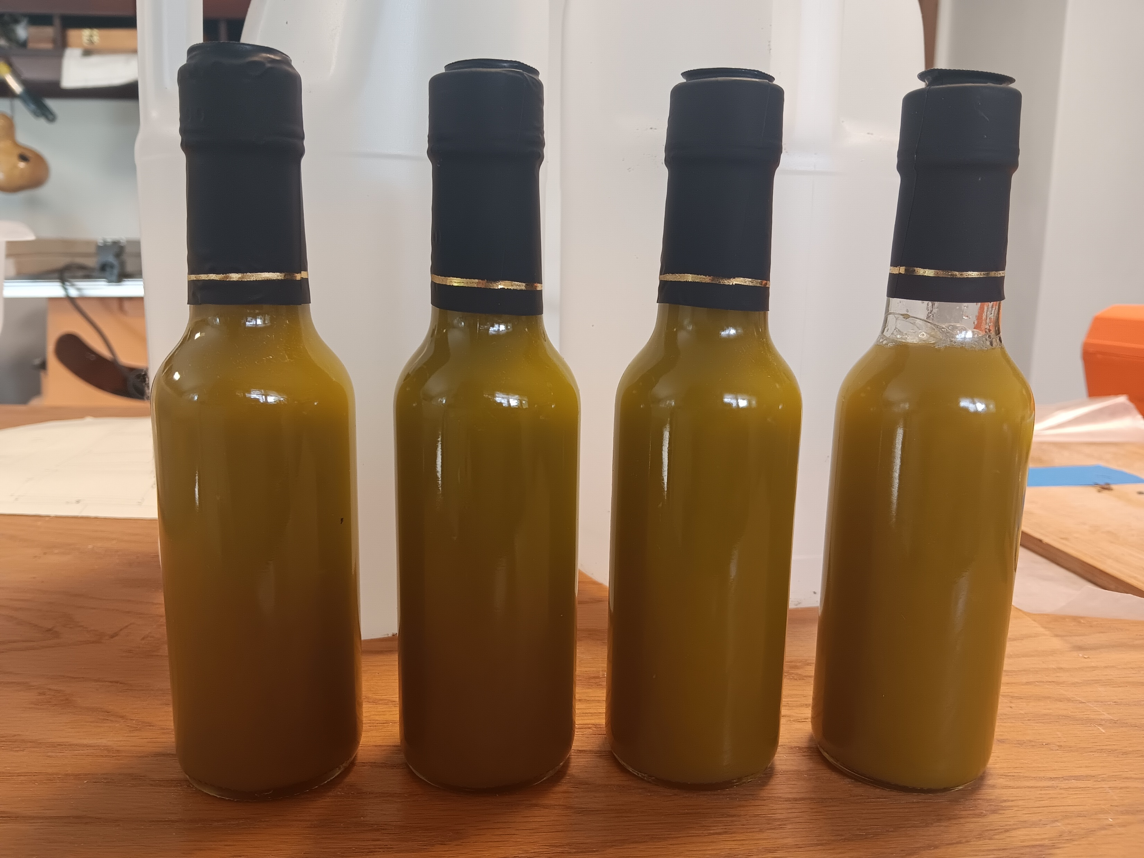
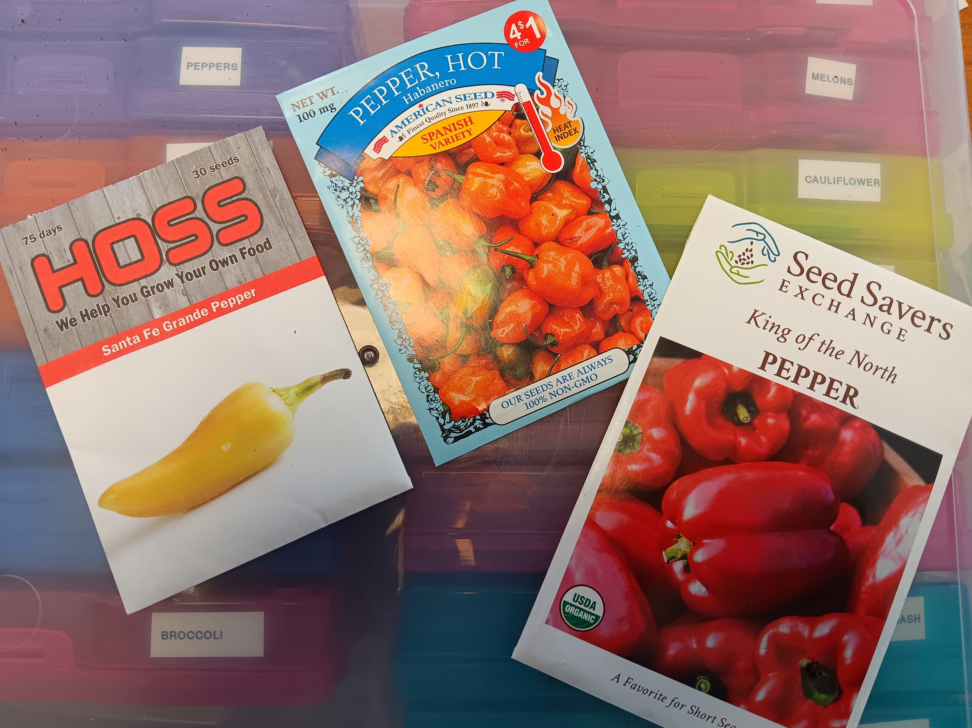
From Seed to Spicy – Create your own Hot Pepper Sauce
Ed Buc
Blackhammer Acres

Slide 2
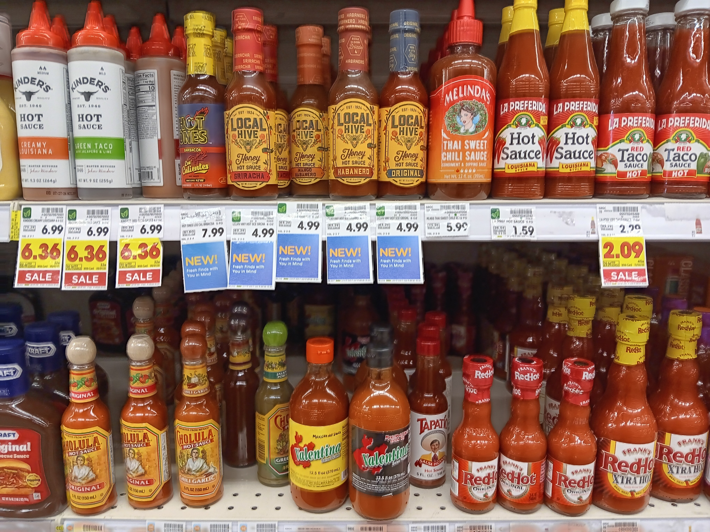
Why Make Your Own Hot Pepper Sauce?
Spice up Gardening Skills
Spice up Preservation Skills
Create the Next Sriracha
Why wouldn’t you want to create your own hot pepper sauce?

Slide 3
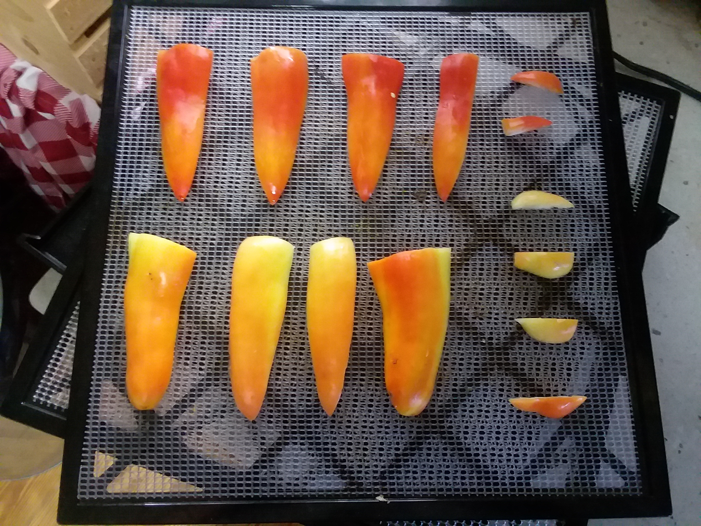
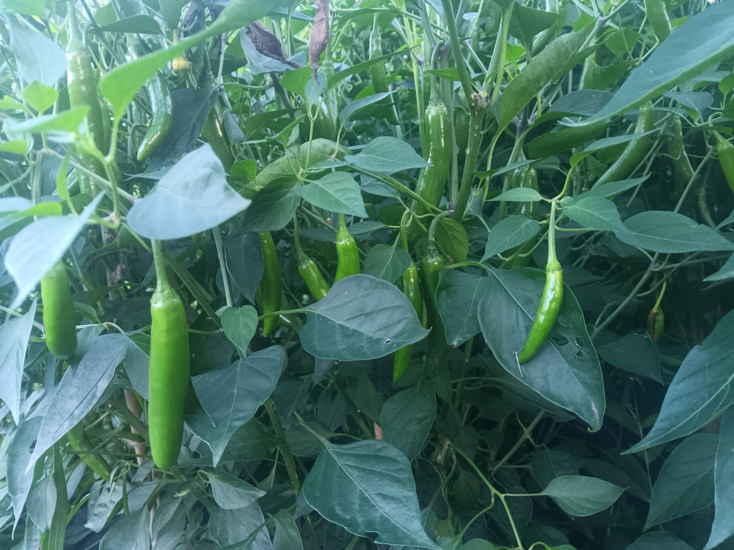
Outline
Who We Are…
Hot Sauce Design
The Growing Part
The Sauce Part
Resources
Questions

Slide 4
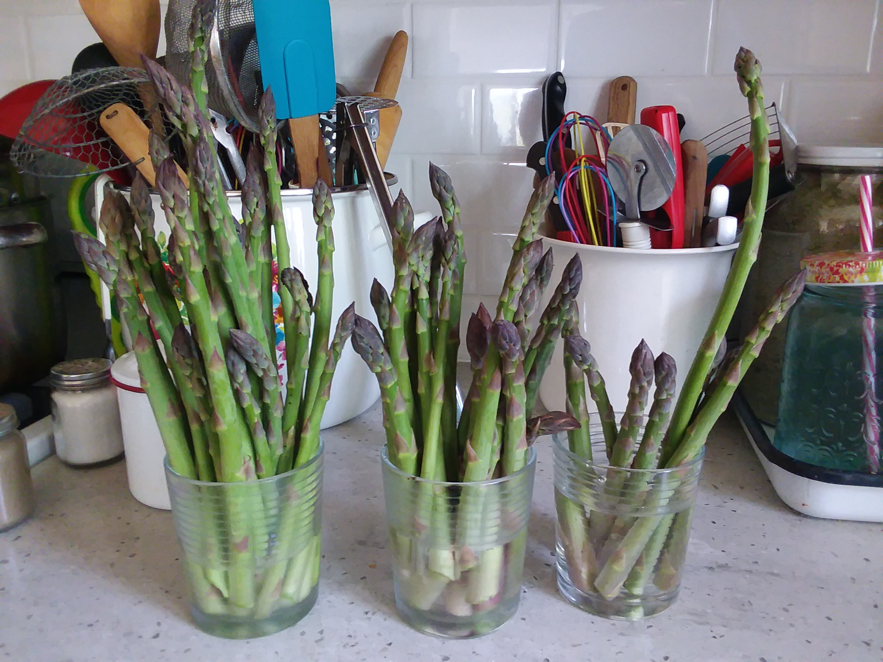
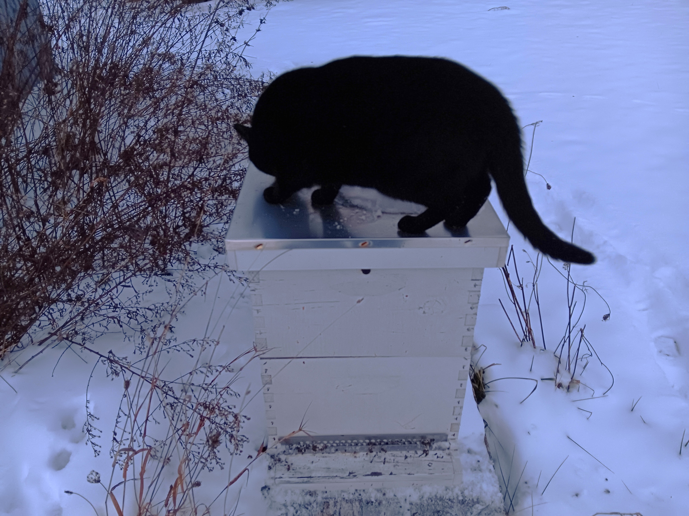
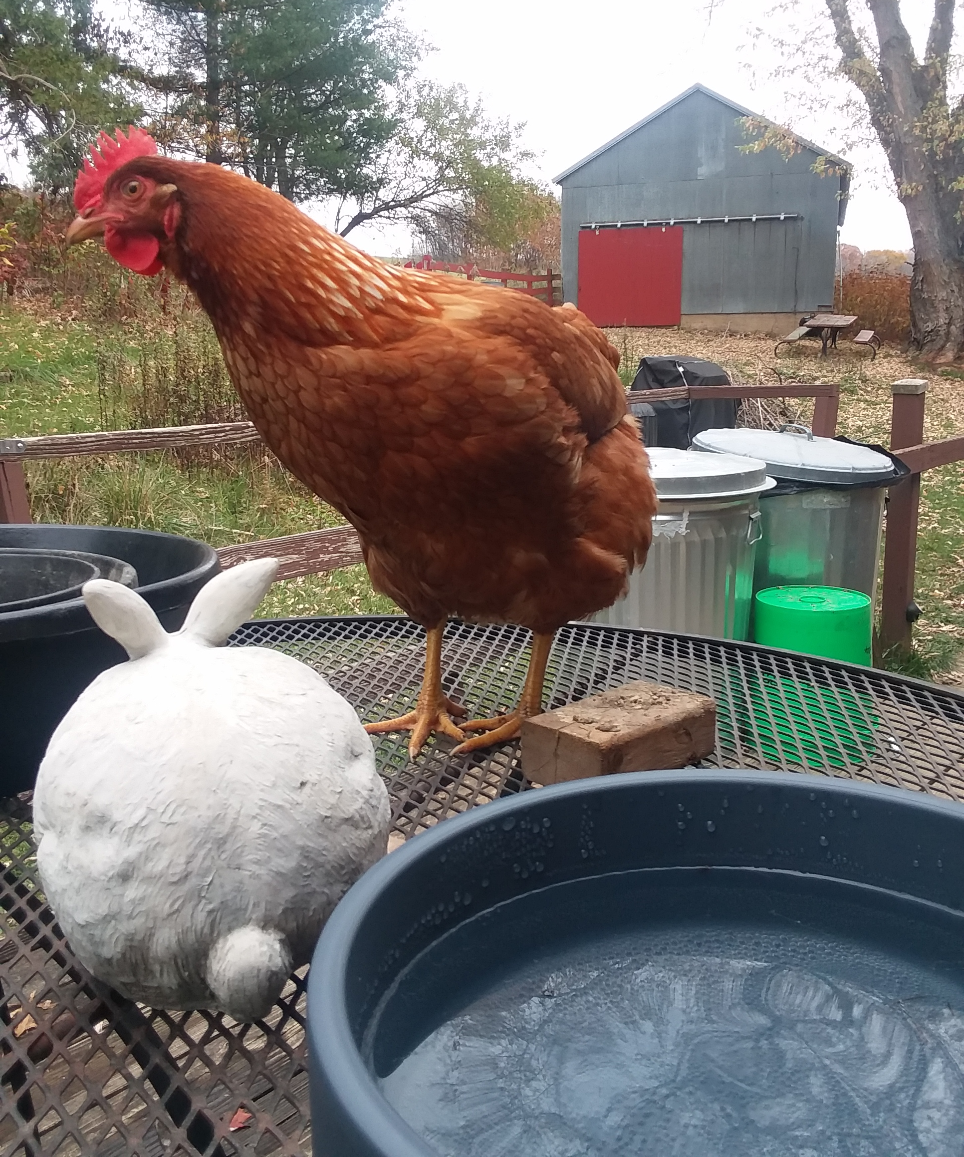
Who We Are…
Homesteaders, working towards self-sufficiency
Located in Driftless Area
  Large Garden
  Small Orchard
  Food Preservation
  Woodlot
  Maple Syrup
  Mushrooms
  Chickens
  Bees

Slide 5


Hot Sauce Design
One Note/One Pepper
Recipe
Excess Peppers
Design Yourself
  Base/Filler Pepper
  Heat
  Flavor Profile (Fruity/Smokey/Hot)

Slide 6
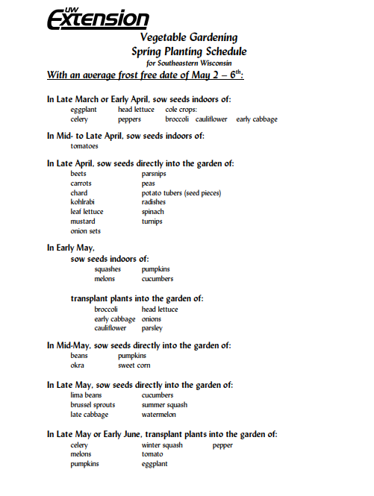
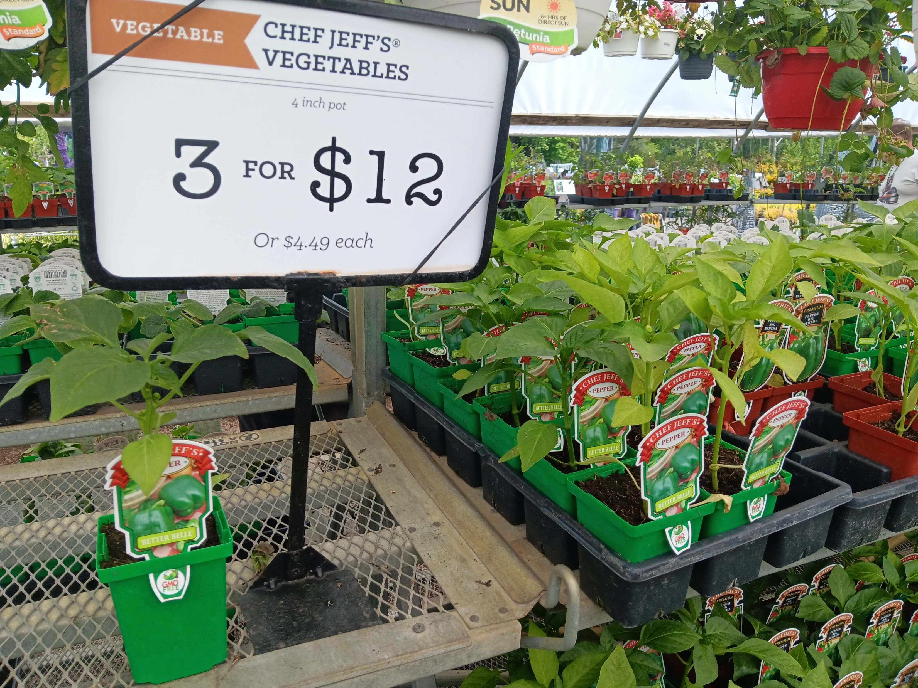
Growing Peppers

Slide 7
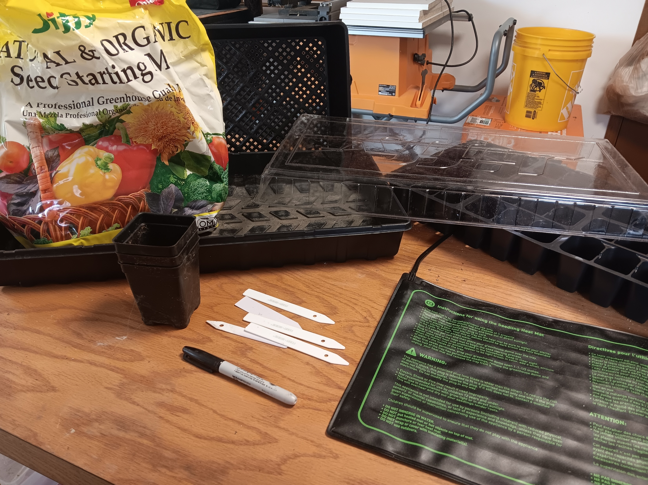
Seed Starting Supplies
Seeds
Pots
Dome
Seed Starting Mix
Labels
Heating Mat
Grow Light
Potting Soil
Fertilizer
Spray Bottle

Slide 8
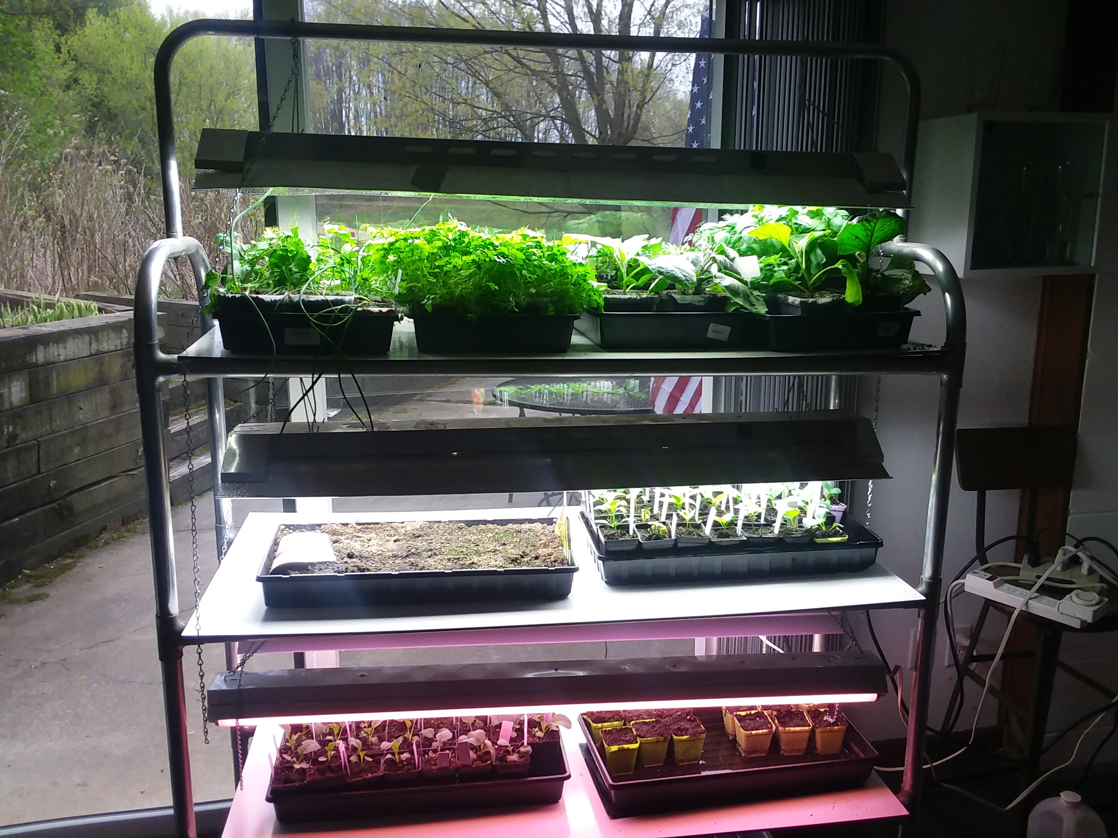

Slide 9
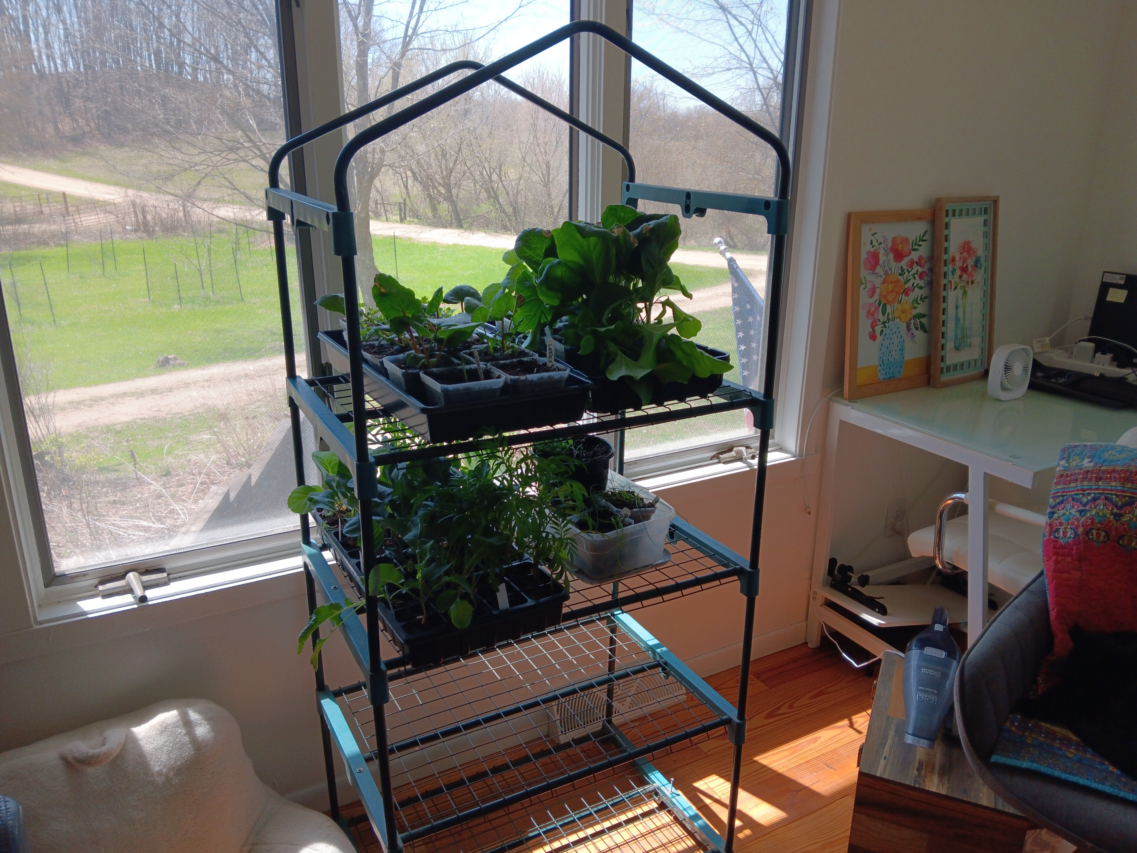
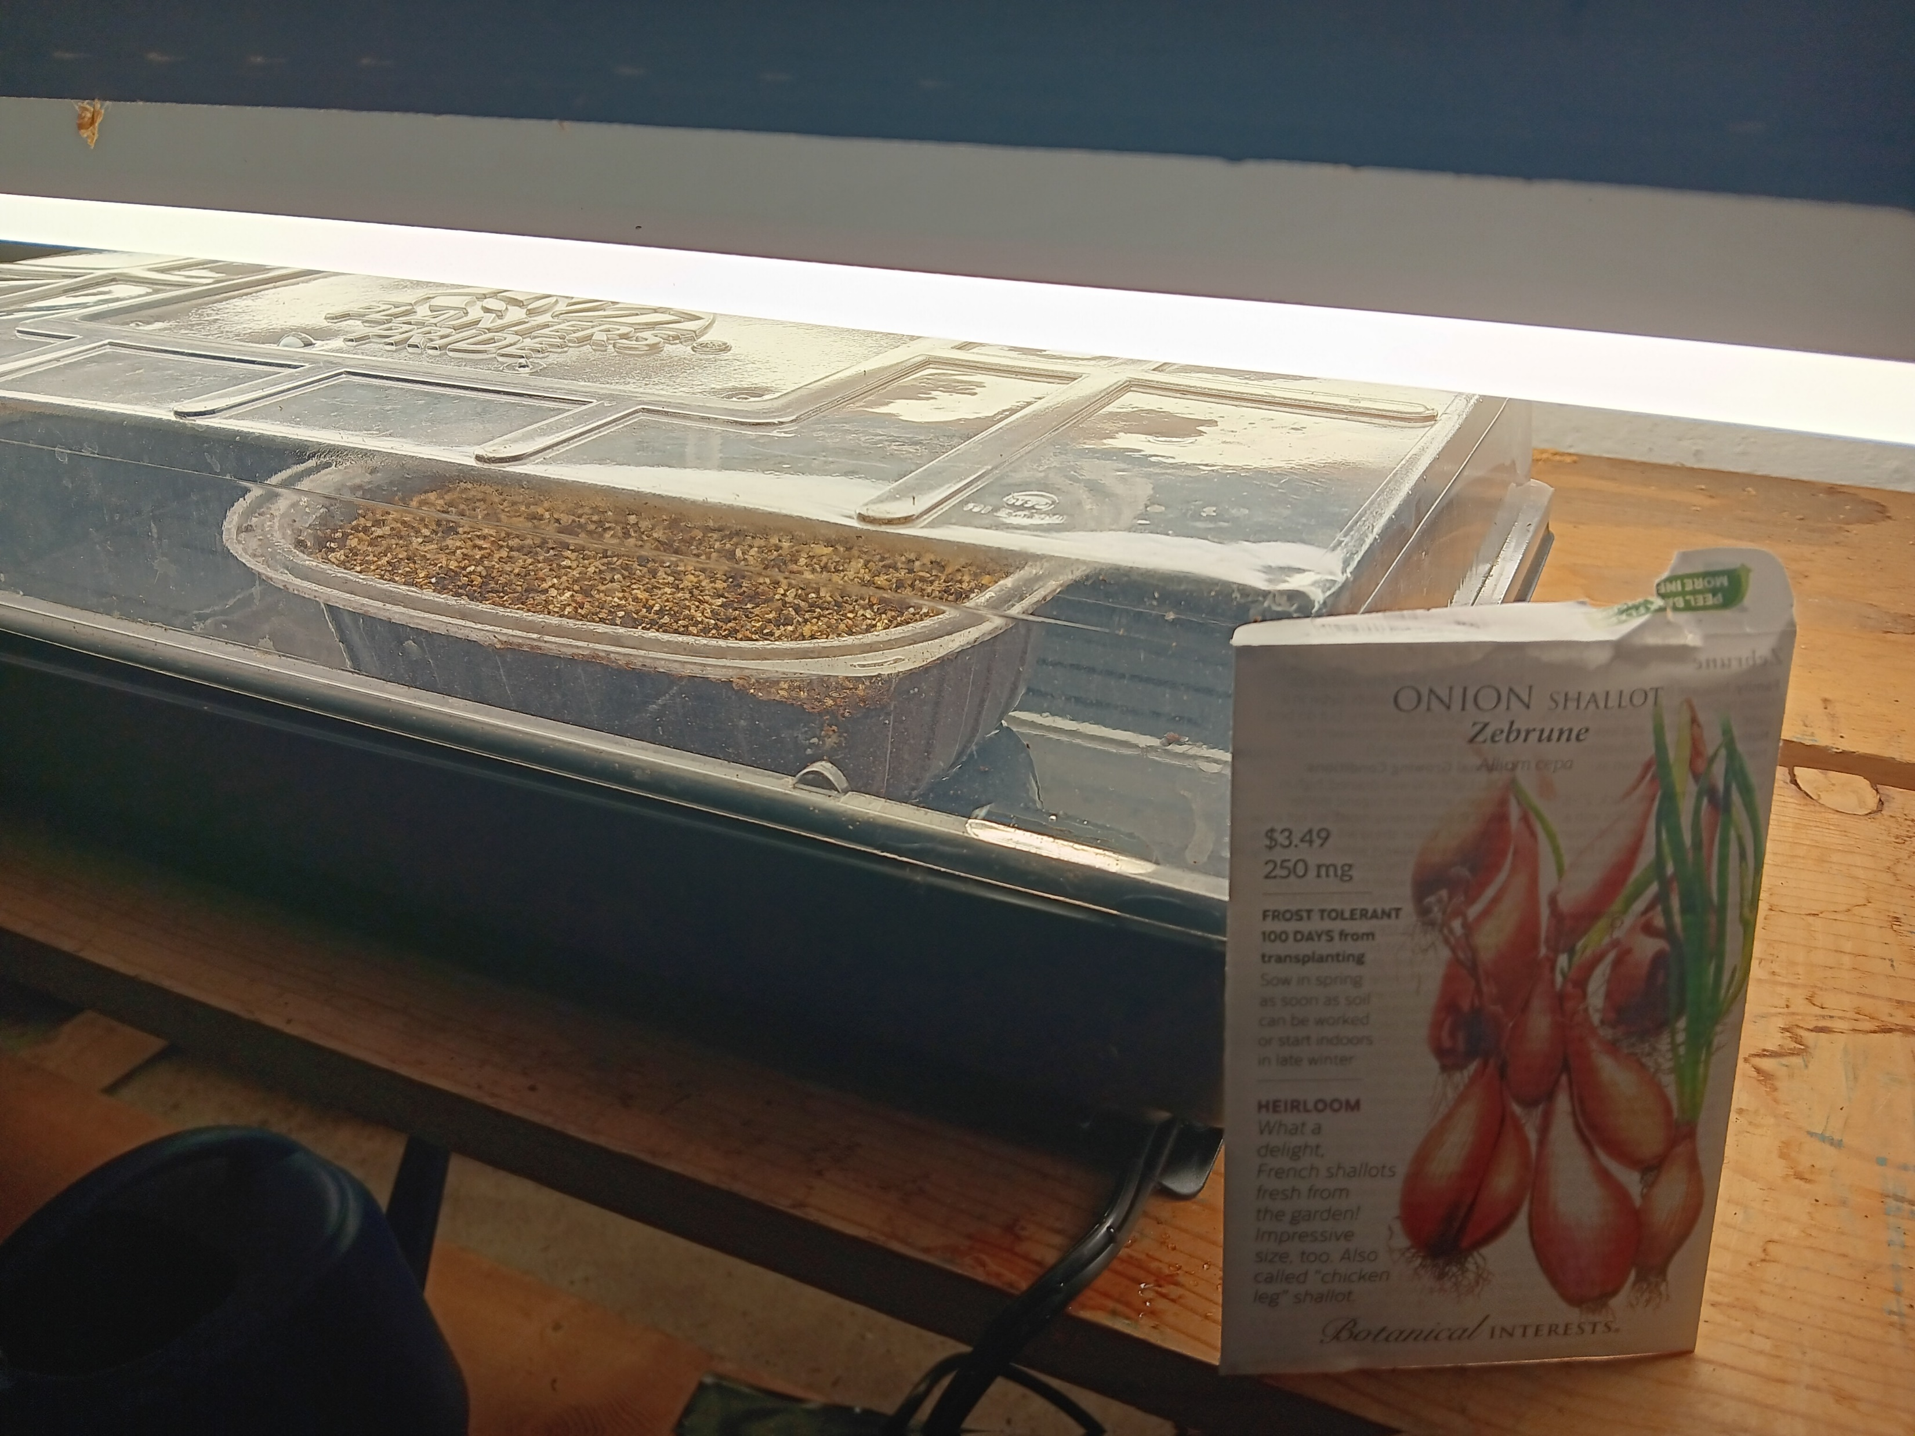

Slide 10
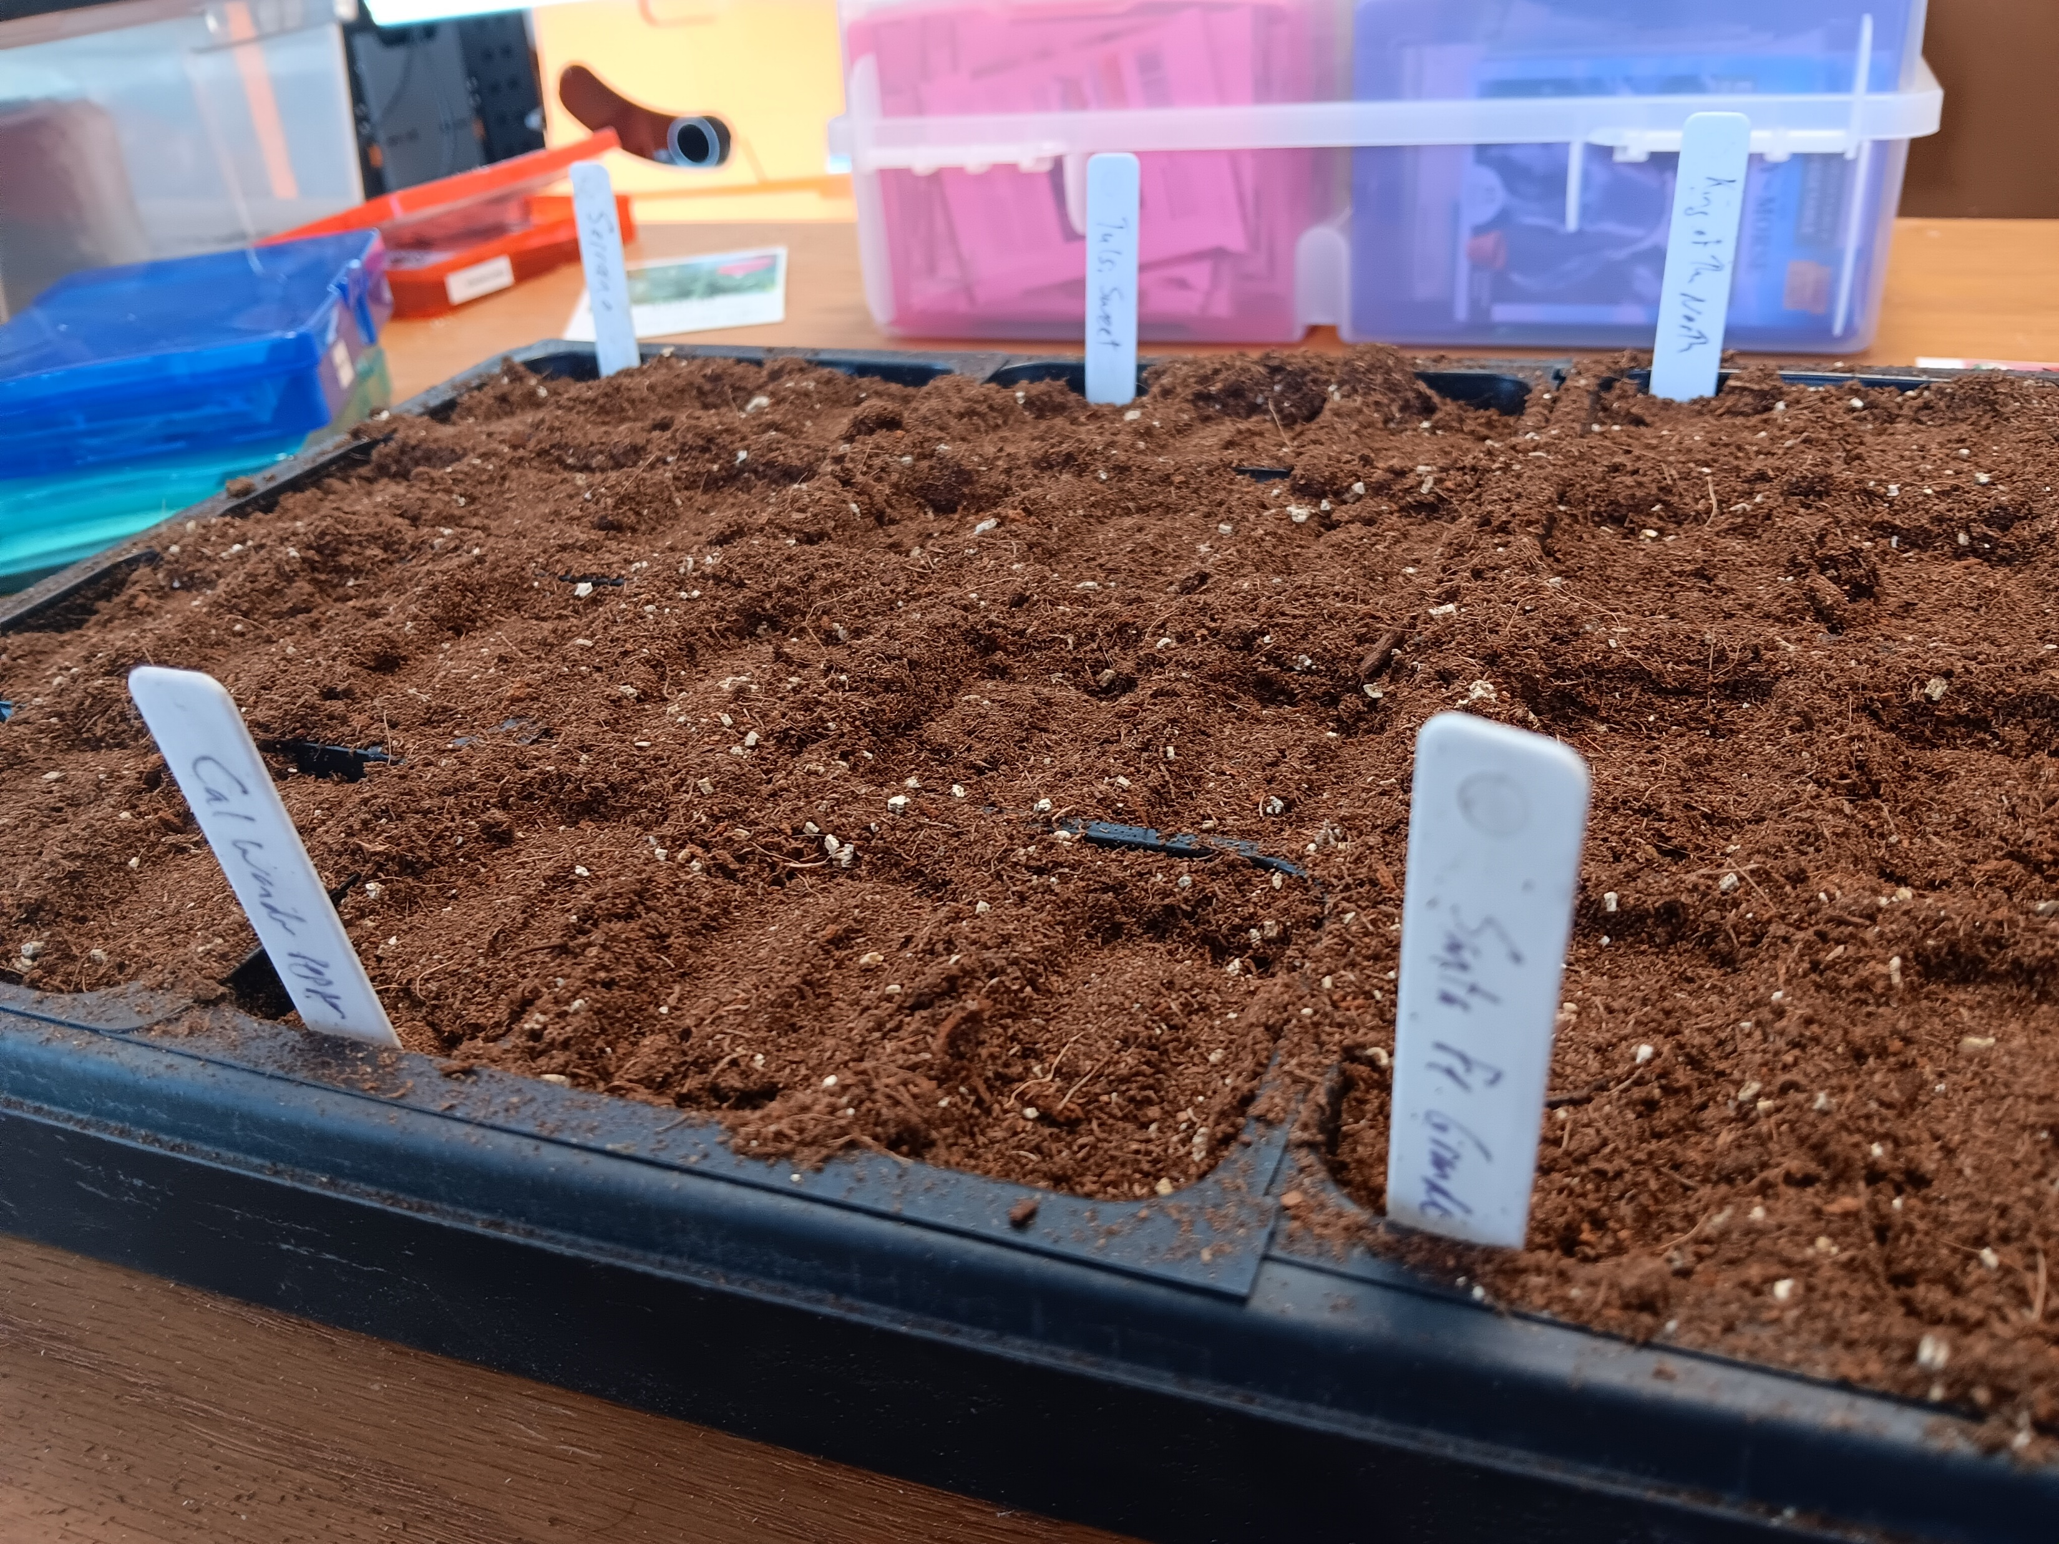
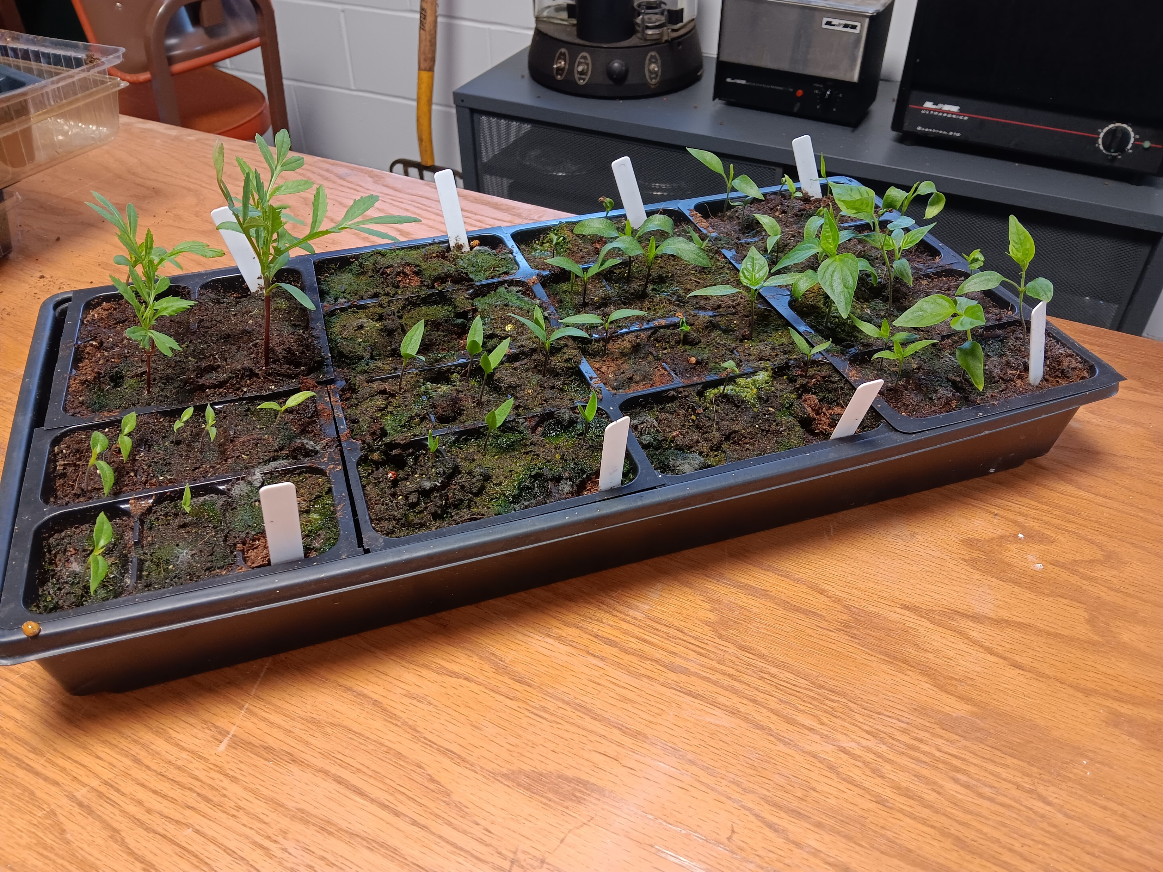
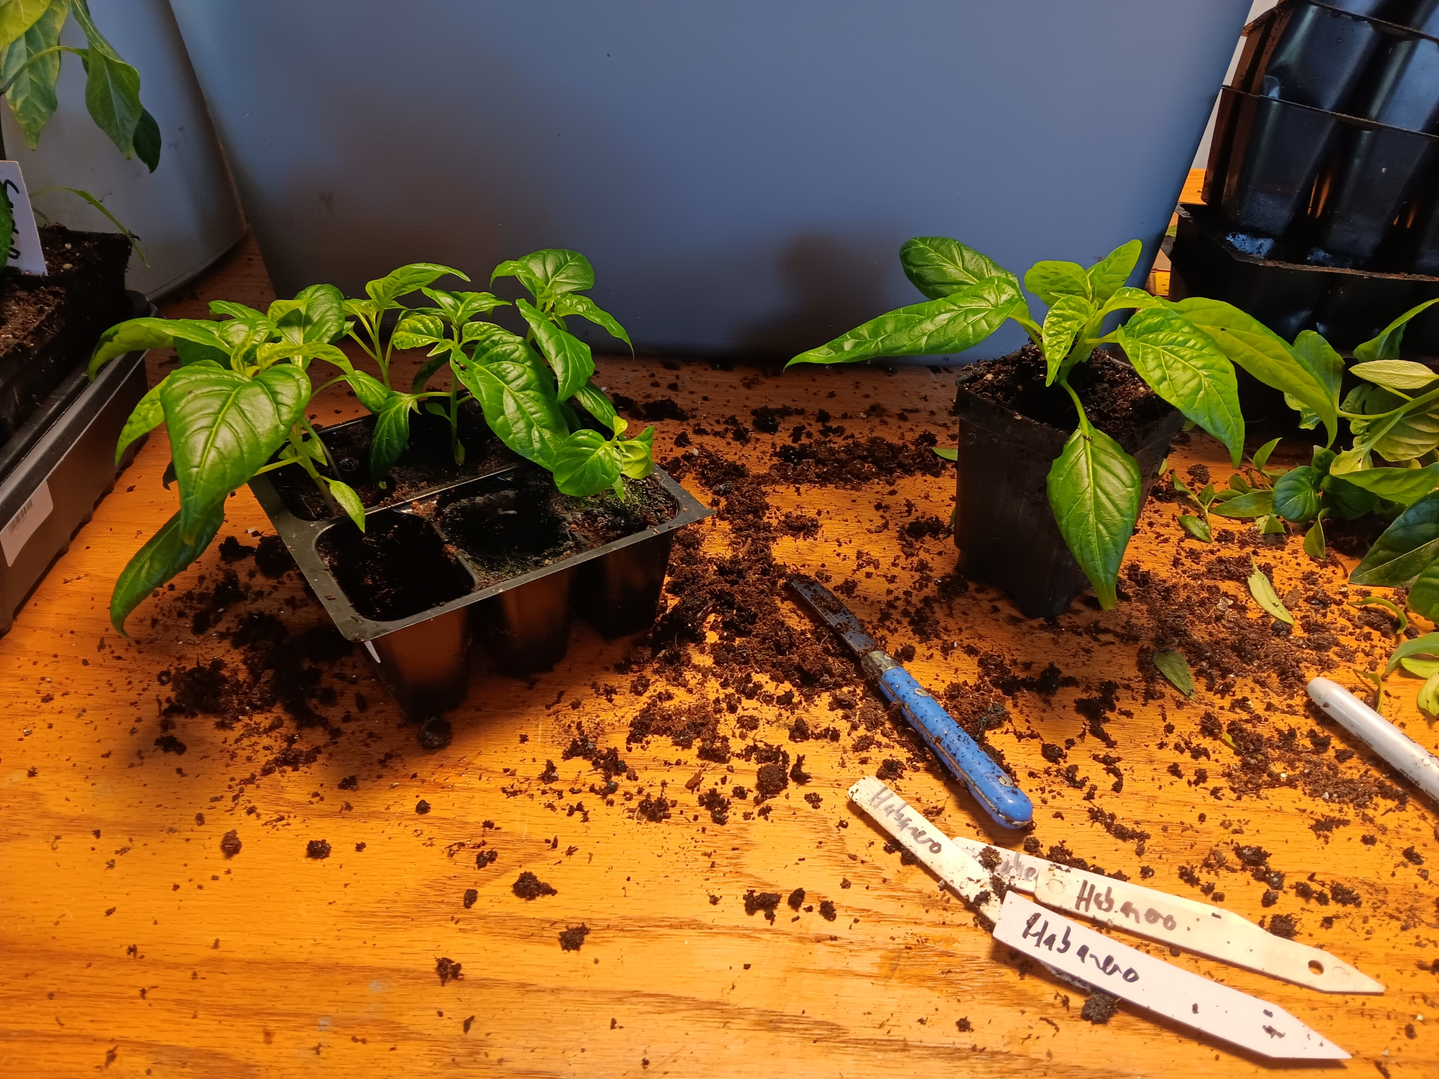

Slide 11
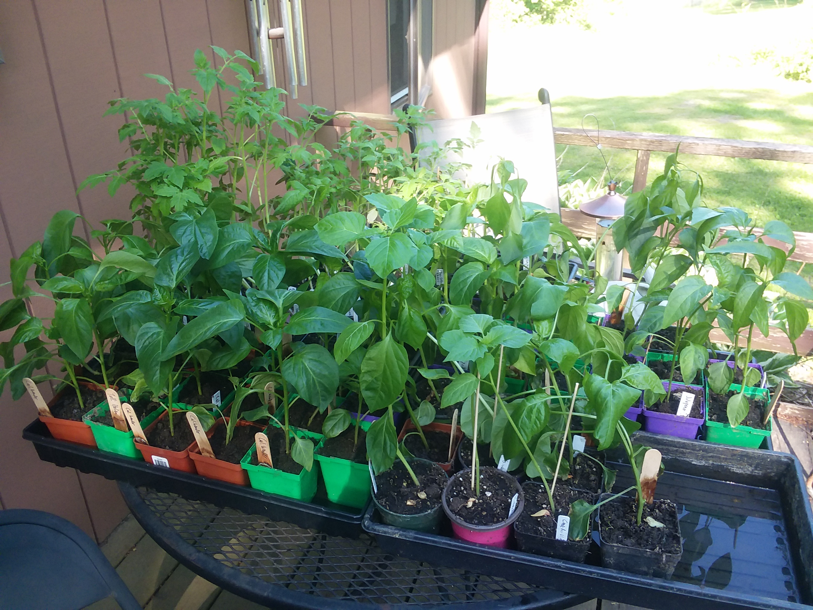
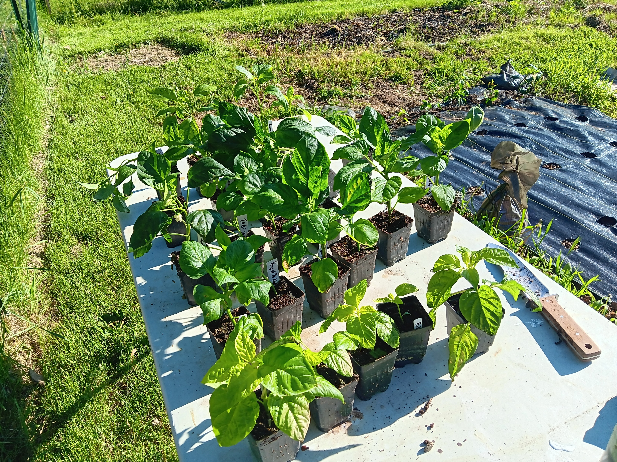

Slide 12
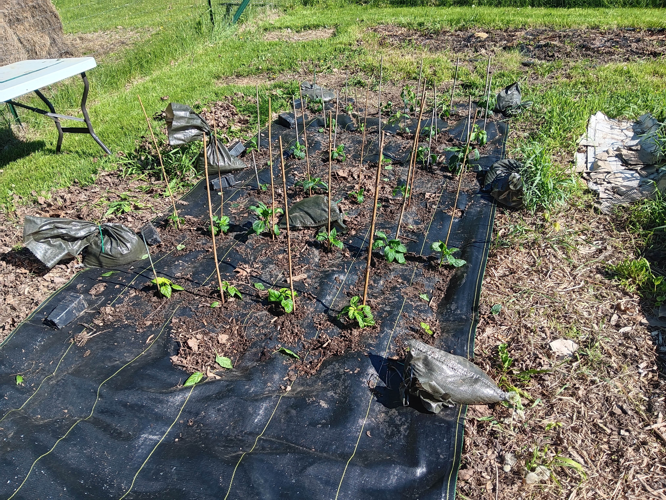

Slide 13
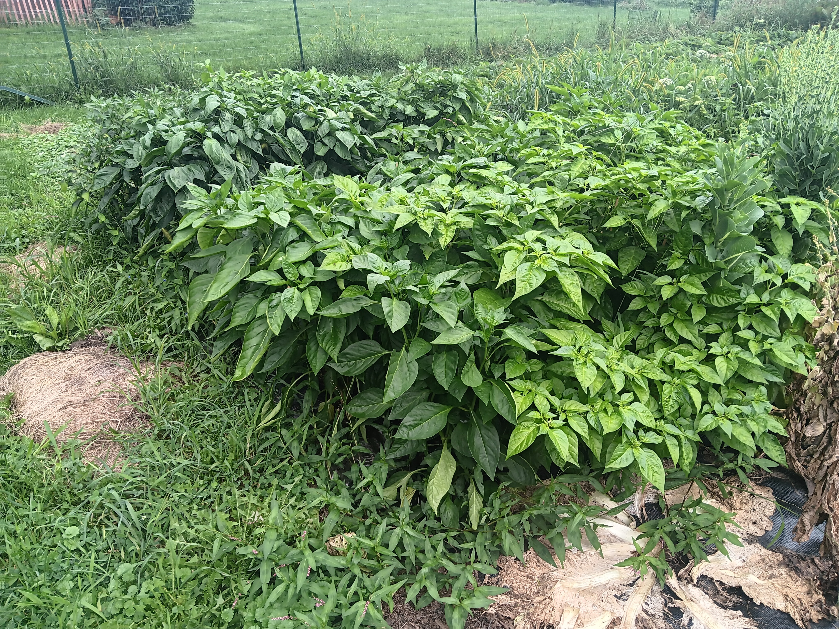
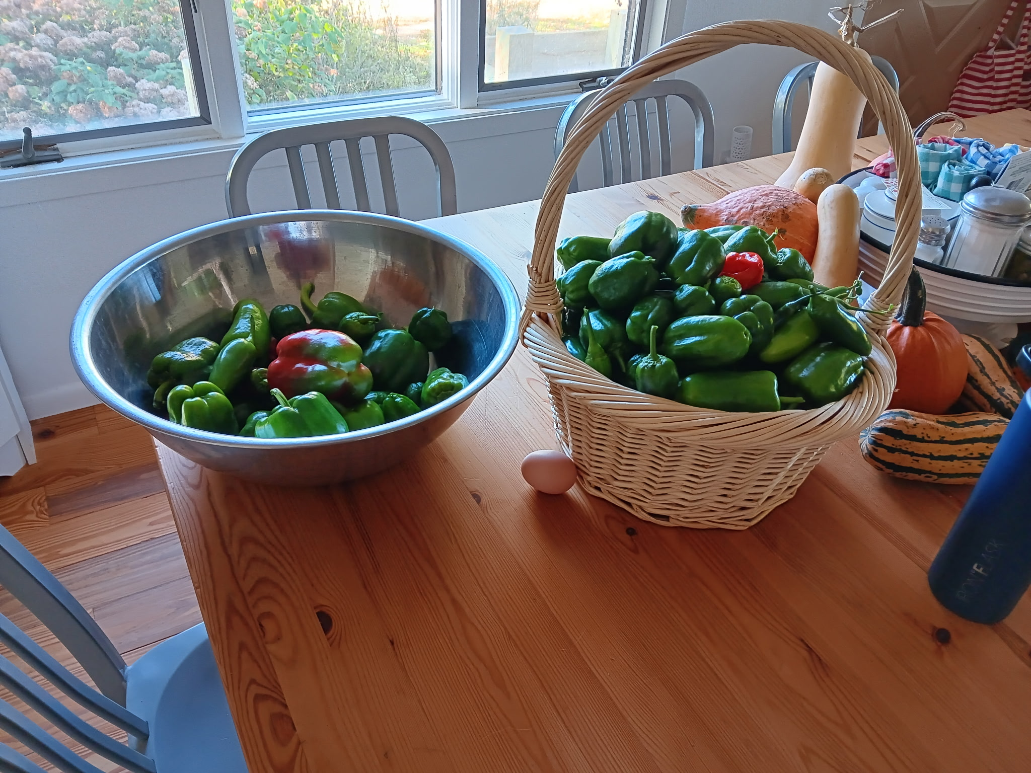

Slide 14
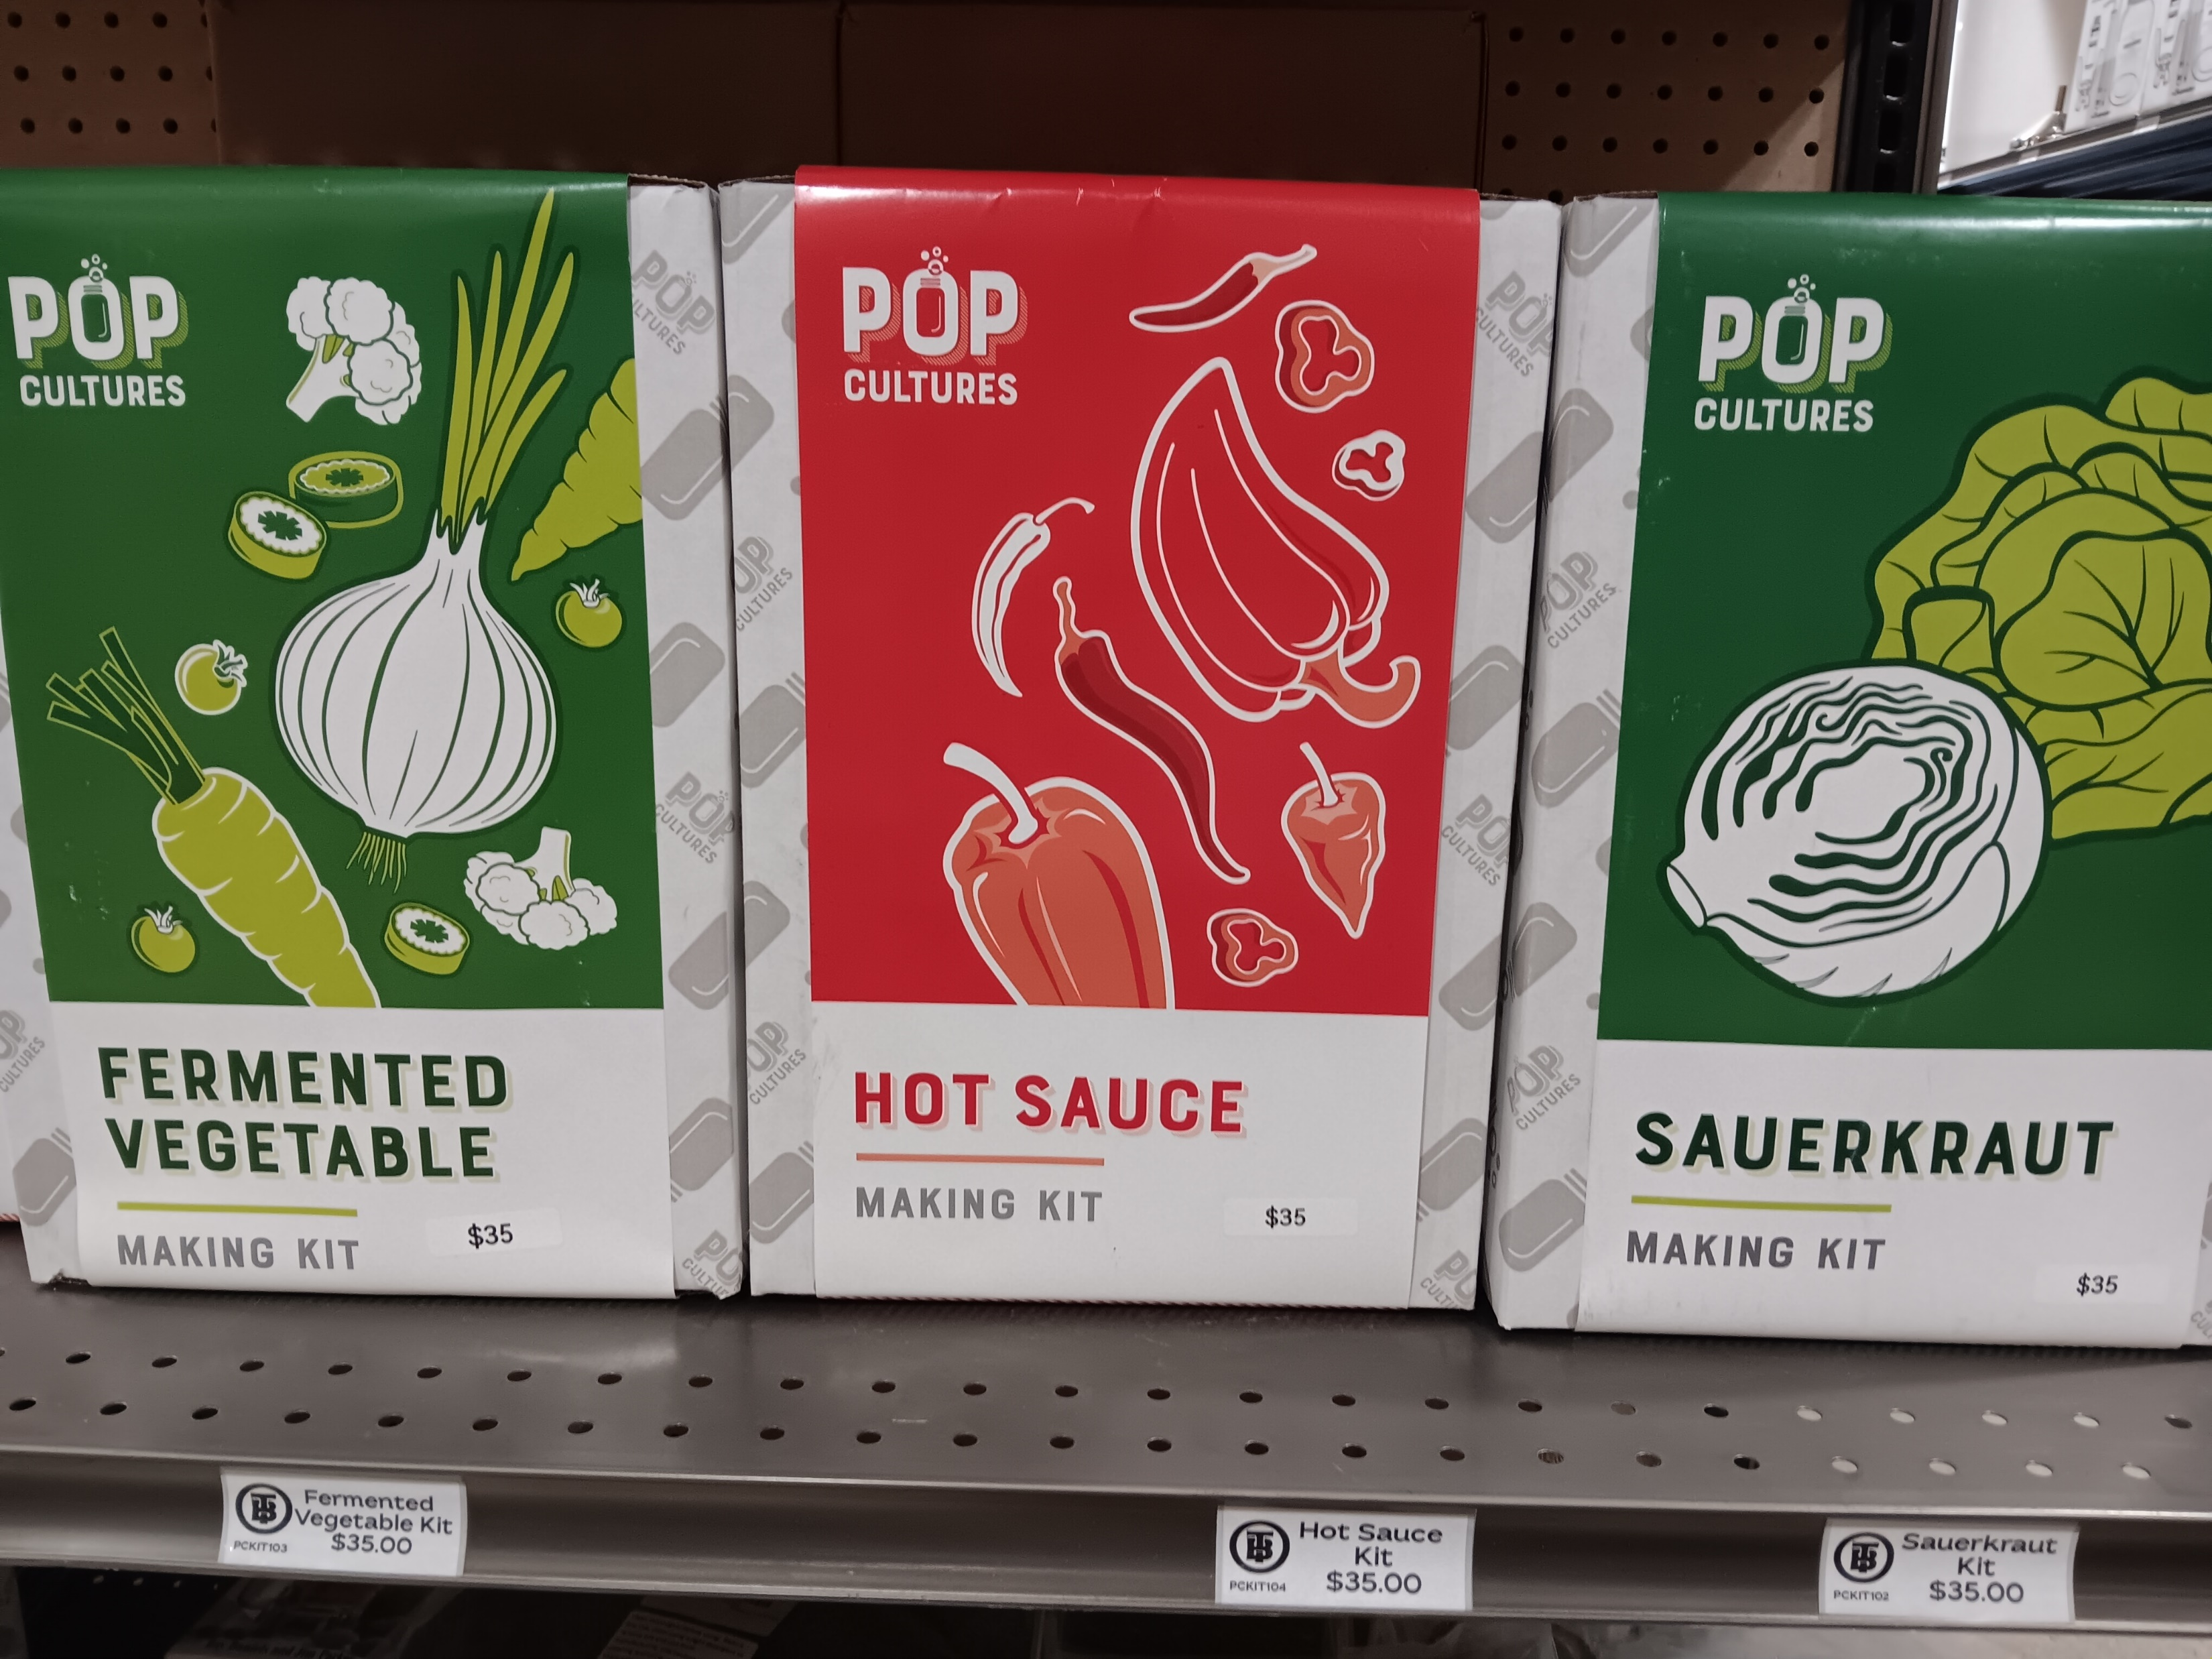
Making Sauce
Disclaimers
  This Presentation is an Overview
  Practice Good Food Safety and Sanitation
  Hot Sauce Preservation Relies on pH
  Consider the Volume of Sauce You are Making
  Feel Free to Buy Peppers!

Slide 15
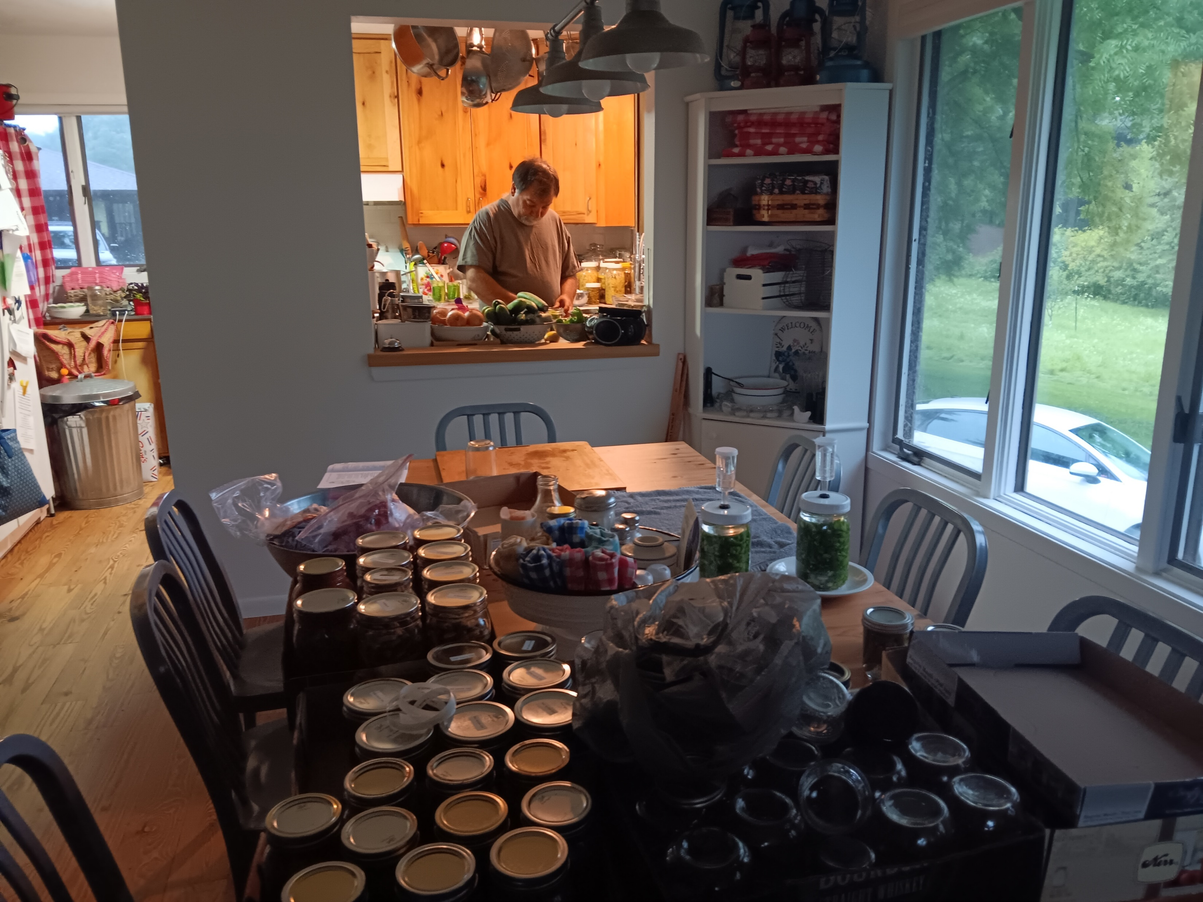
Methods of Preservation
Water Bath Canning
  Tons of Resources Available
  Great for First-Time Makers
  Shelf Stable
  Usually includes Vinegar (acid)
  BH&G: Fire-Roasted Tomato-Ancho Taco Sauce Recipe
Pressure Canning – Not Needed
Fermentation
  Biological Process
  Anaerobically Converts Food to other Food; Creates Acid
  Process that creates Cheese, Beer, Sauerkraut, Kimchi, Commercial Pepper Sauces

Slide 16
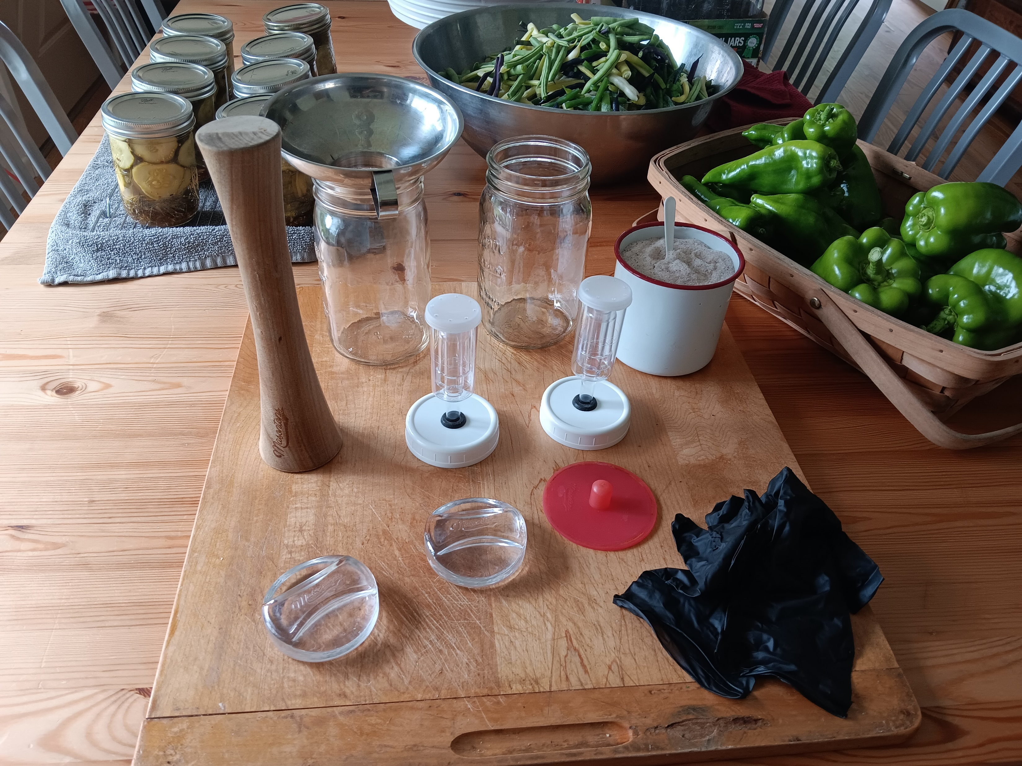
Fermentation Supplies
Peppers
Canning Jars – Quart
Fermentation Weights
Air Locks
Salt (Not Iodized)
Water (Not Tap)
Gloves
pH Paper
Strainer/Funnel
Immersion Blender
Jars for Finished Product

Slide 17
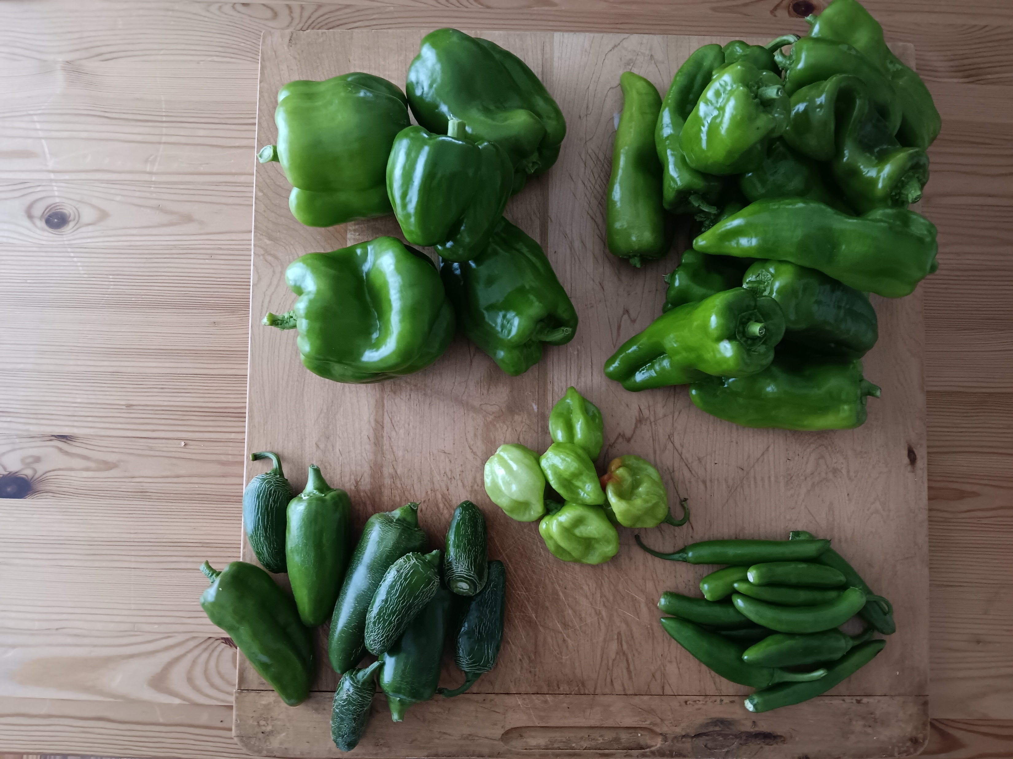
Numbers to Know
Salt to Water Ratio = 2-5%
  1 qt = 946 mL = 946 g
  1% = 9.46 g
  3 tbsp quart per quart (3%)
  ~28 g salt per quart (3%)
pH
  Target pH <4.6
  (Utah State University Extension)

Slide 18
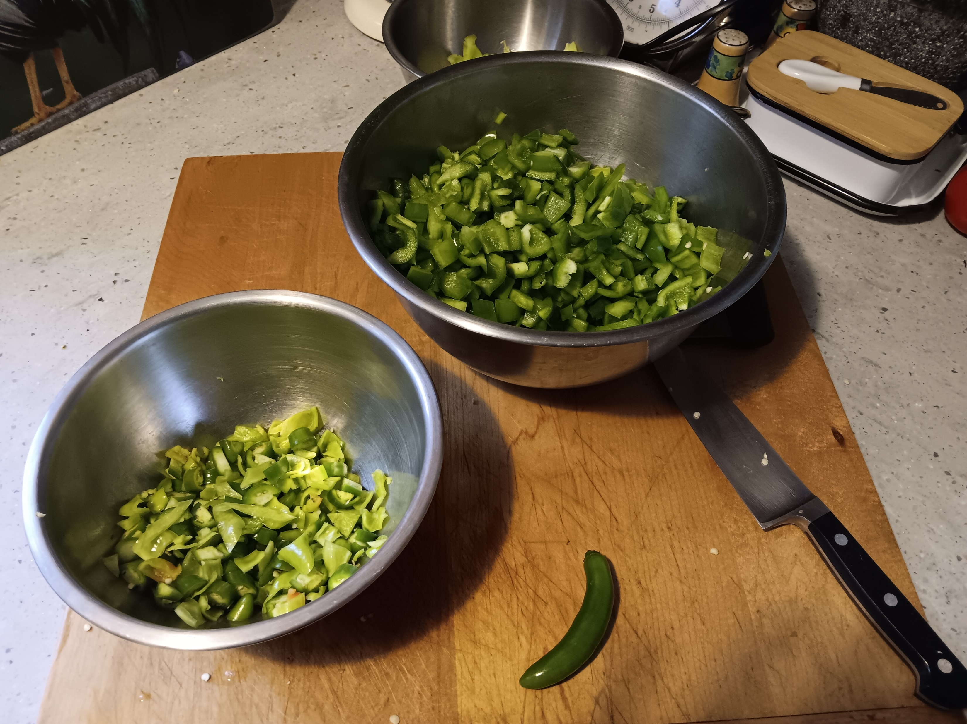
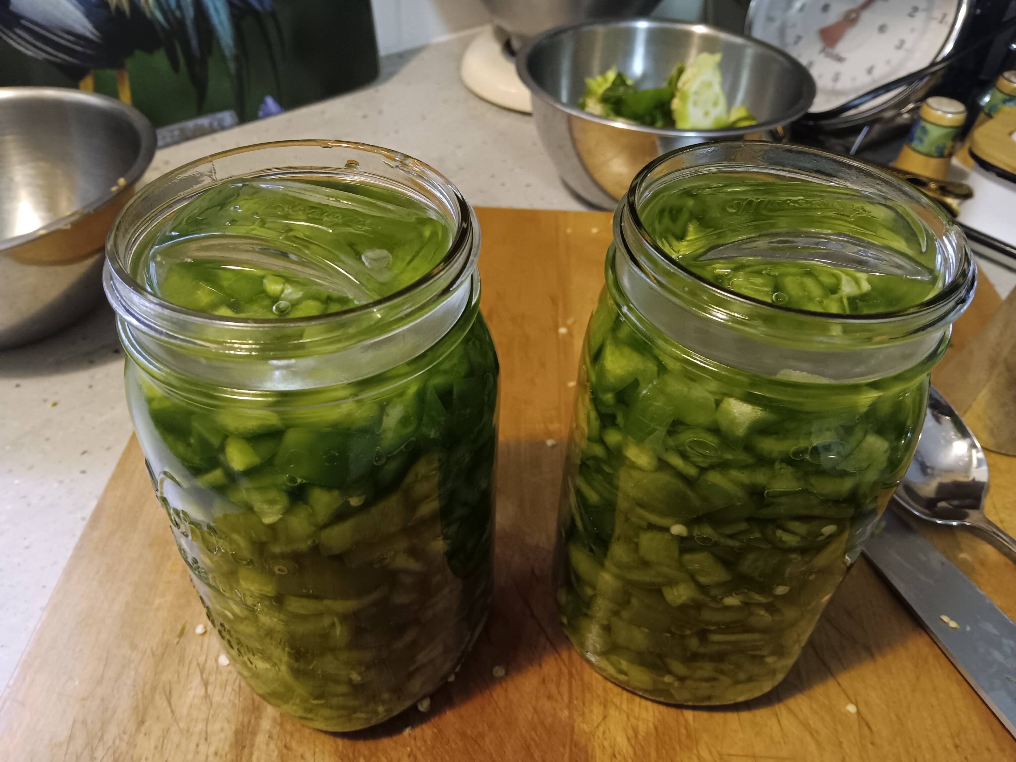
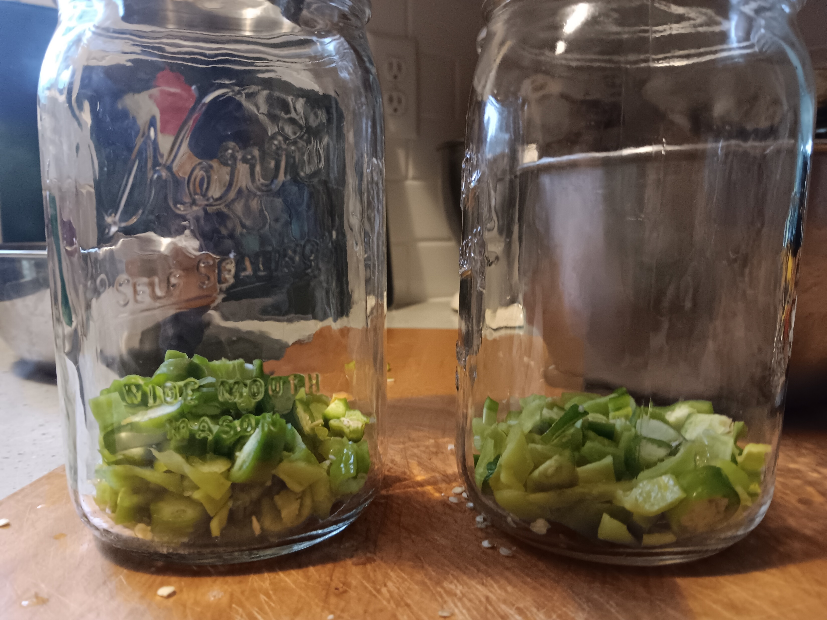
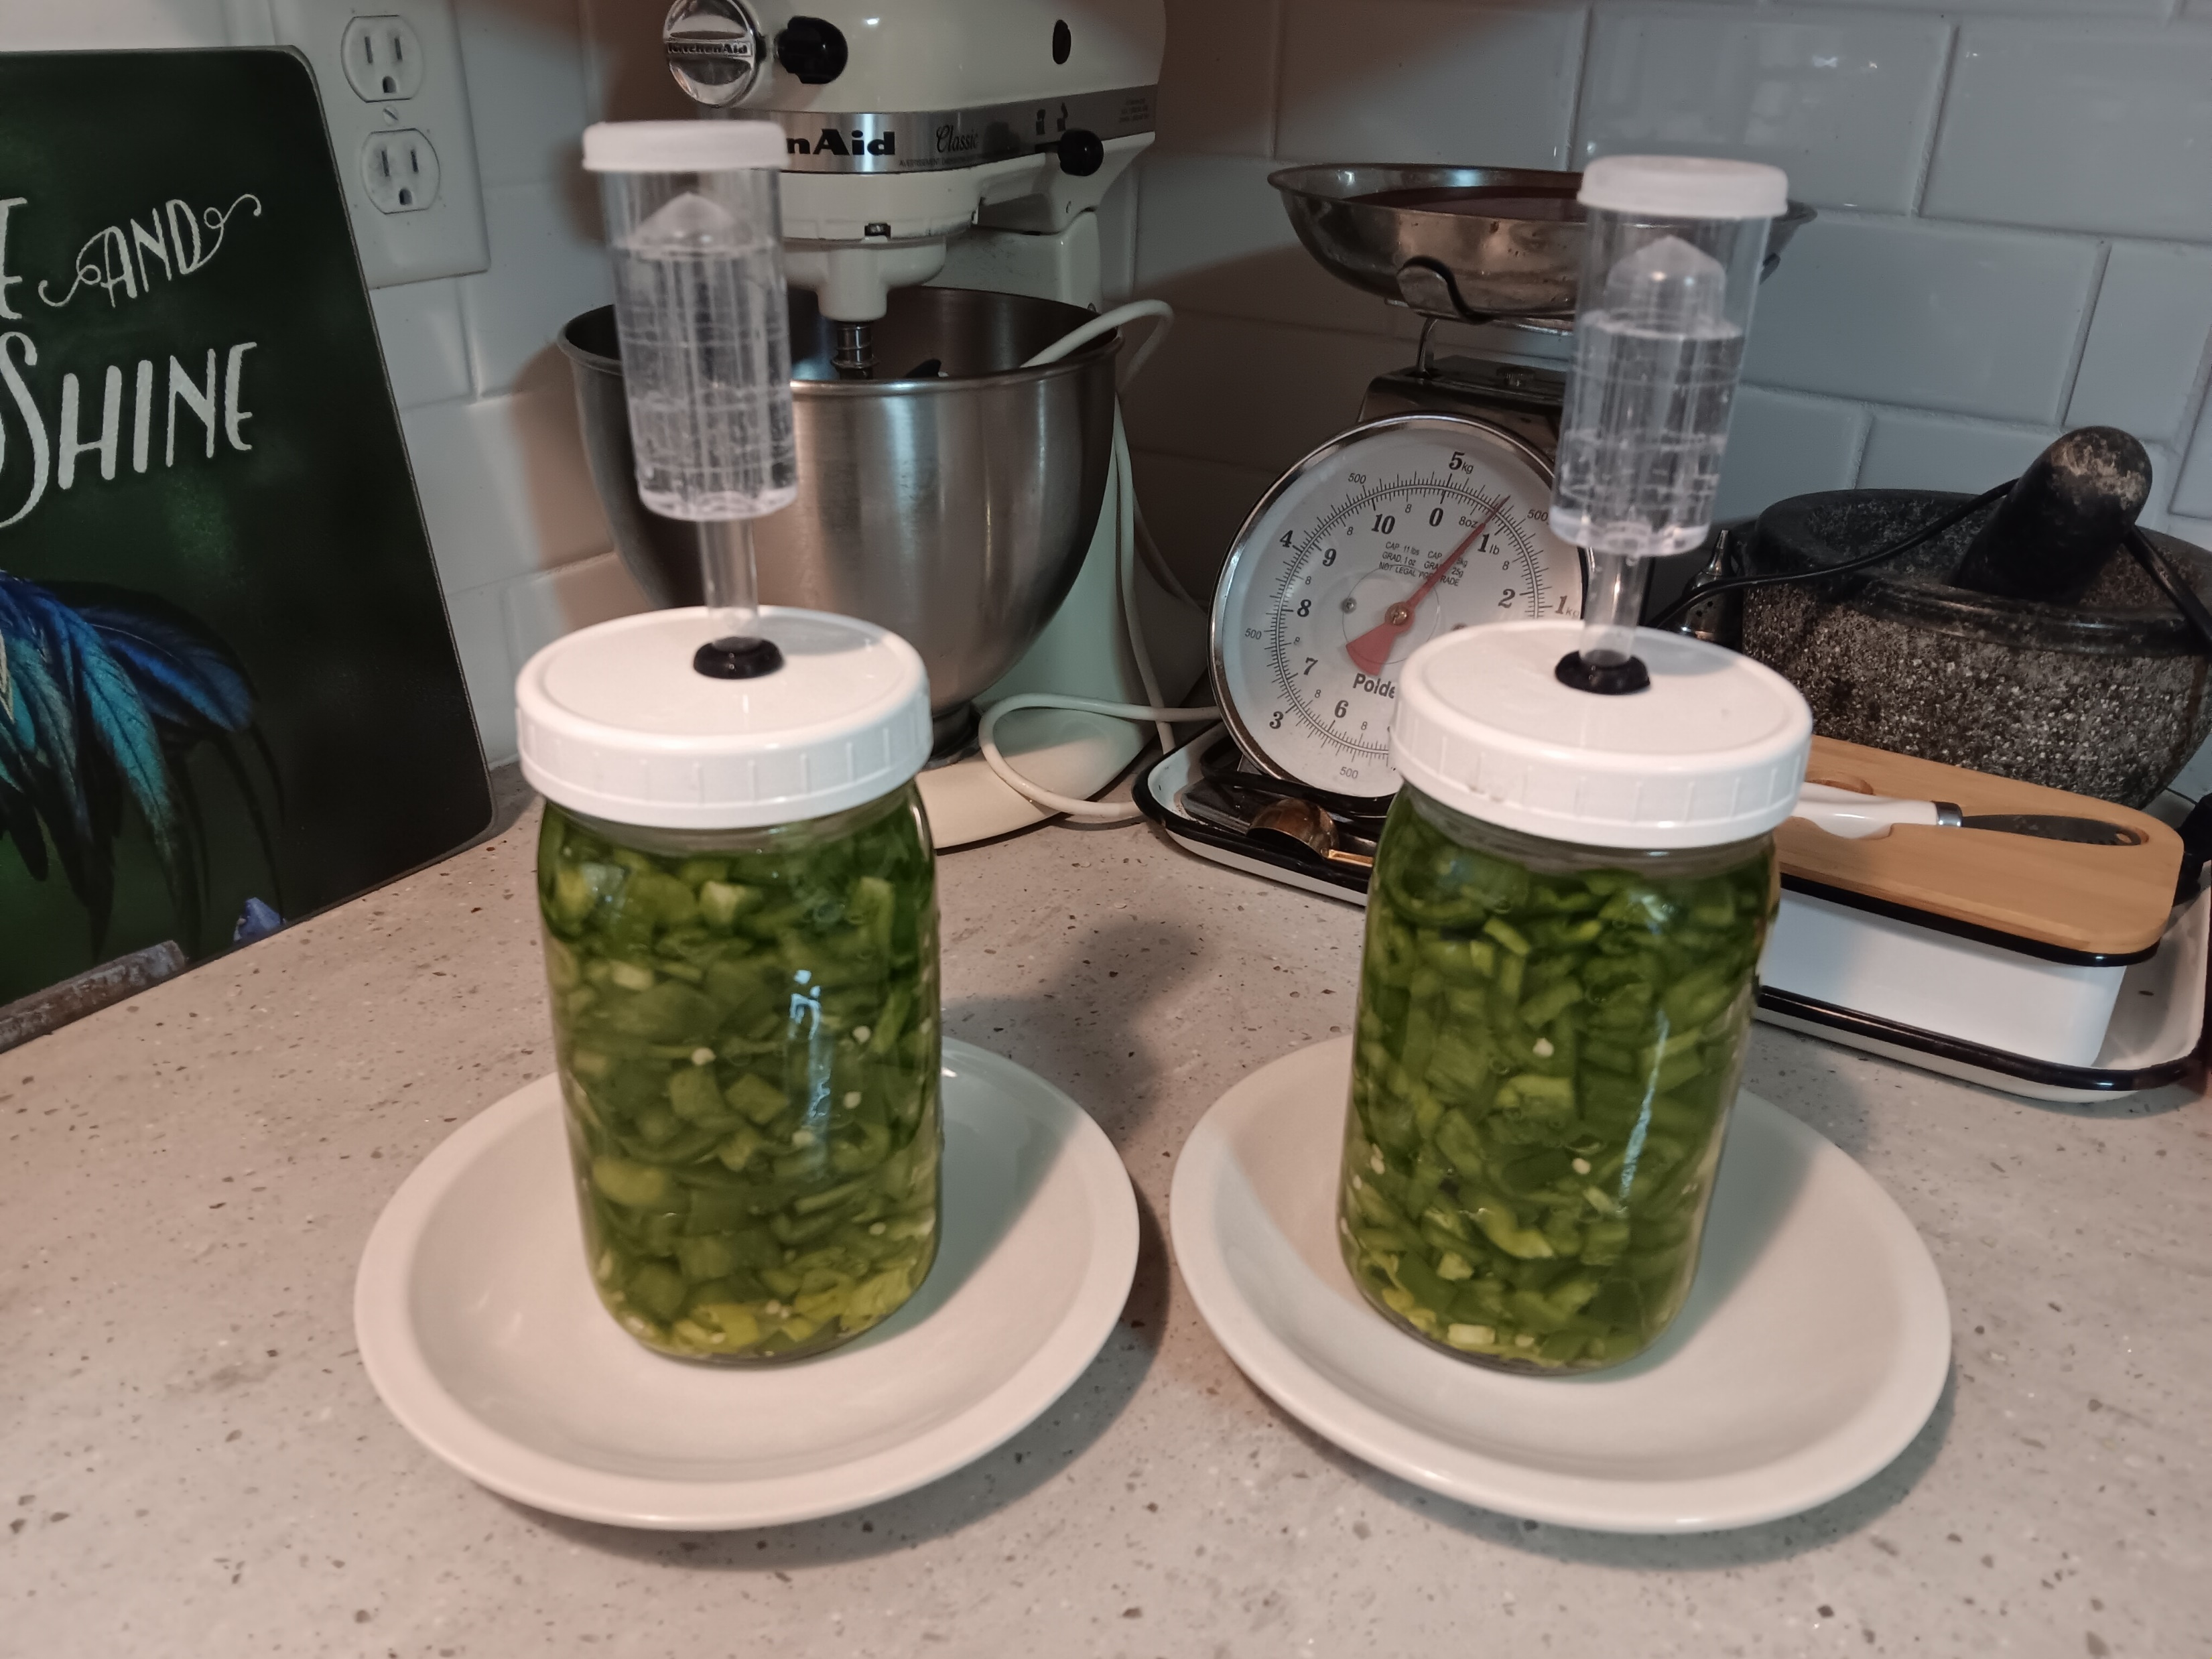
Starting your Ferment

Slide 19
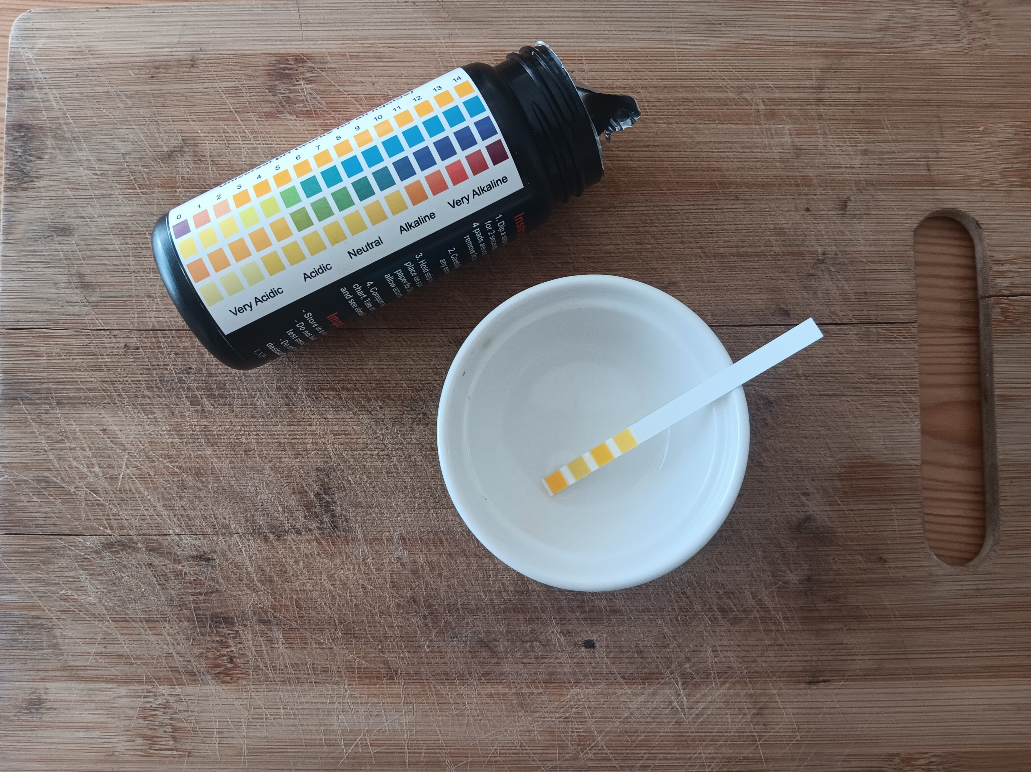
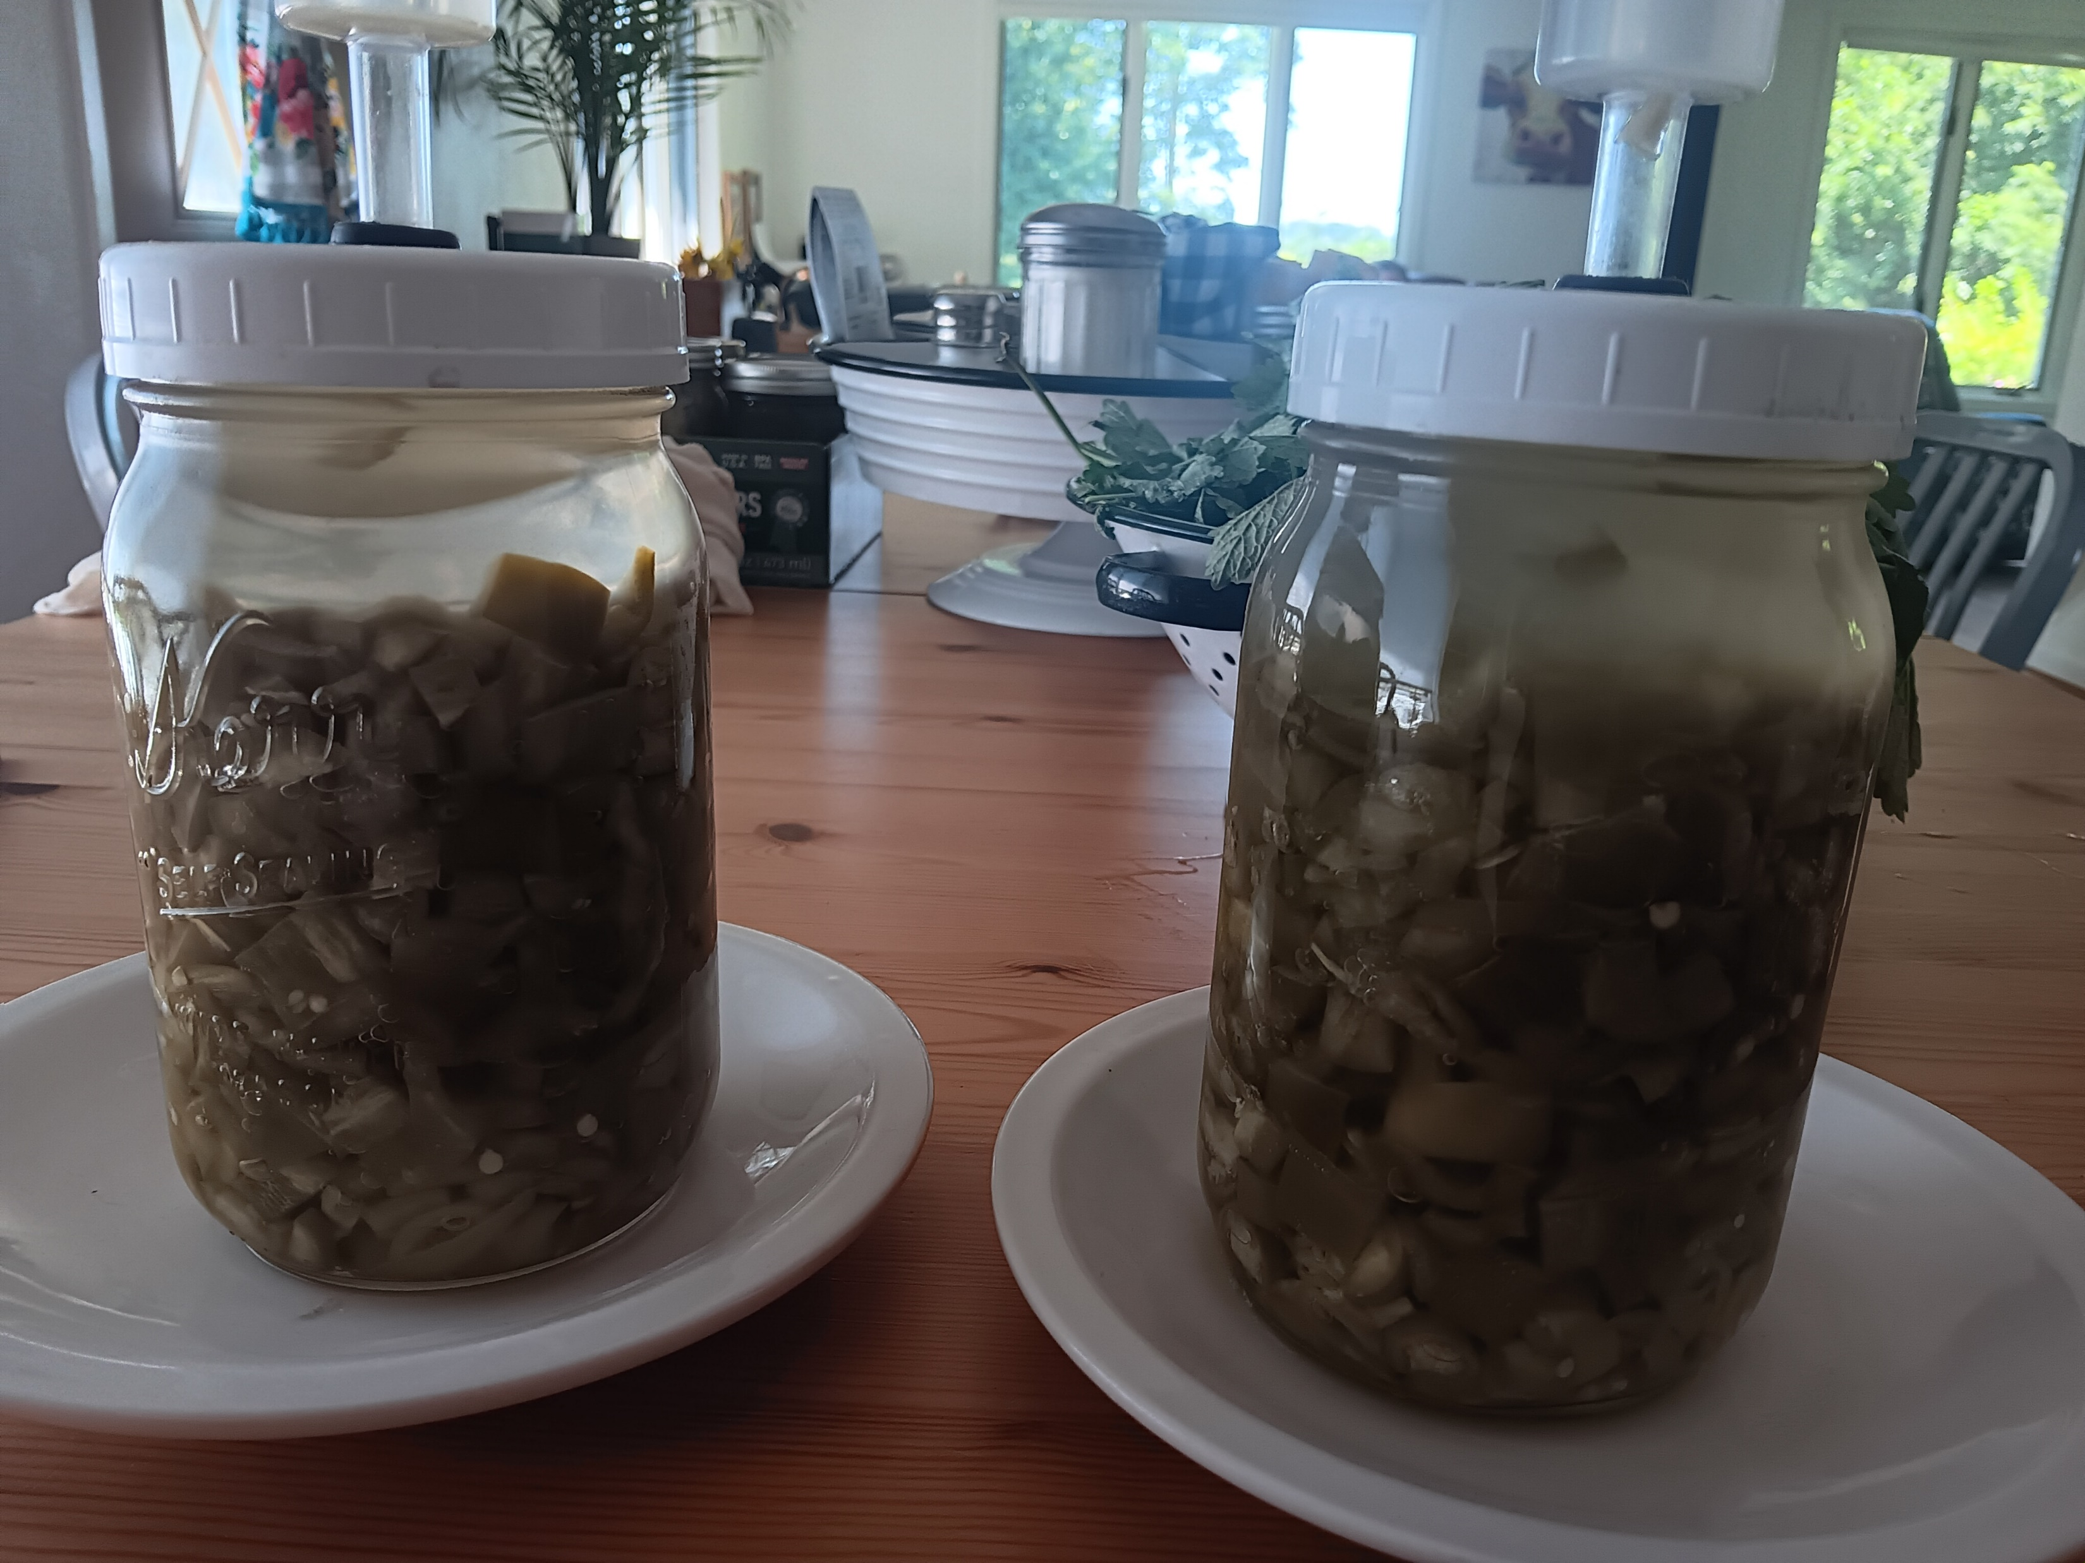
When is it Done?
Can take 1 to 3 weeks
  Temperature-dependent
  Follow recipe, and/or
  Check pH, and/or
  Taste
Flavors get more complex over time

Slide 20
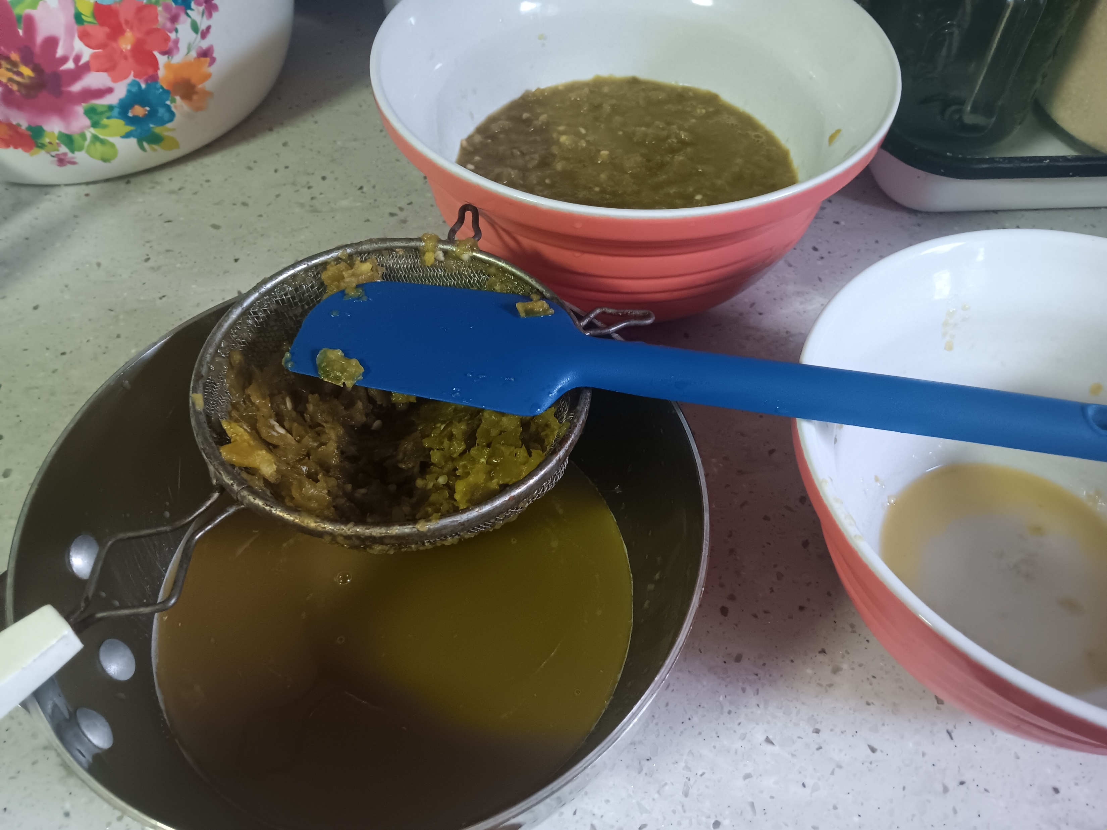
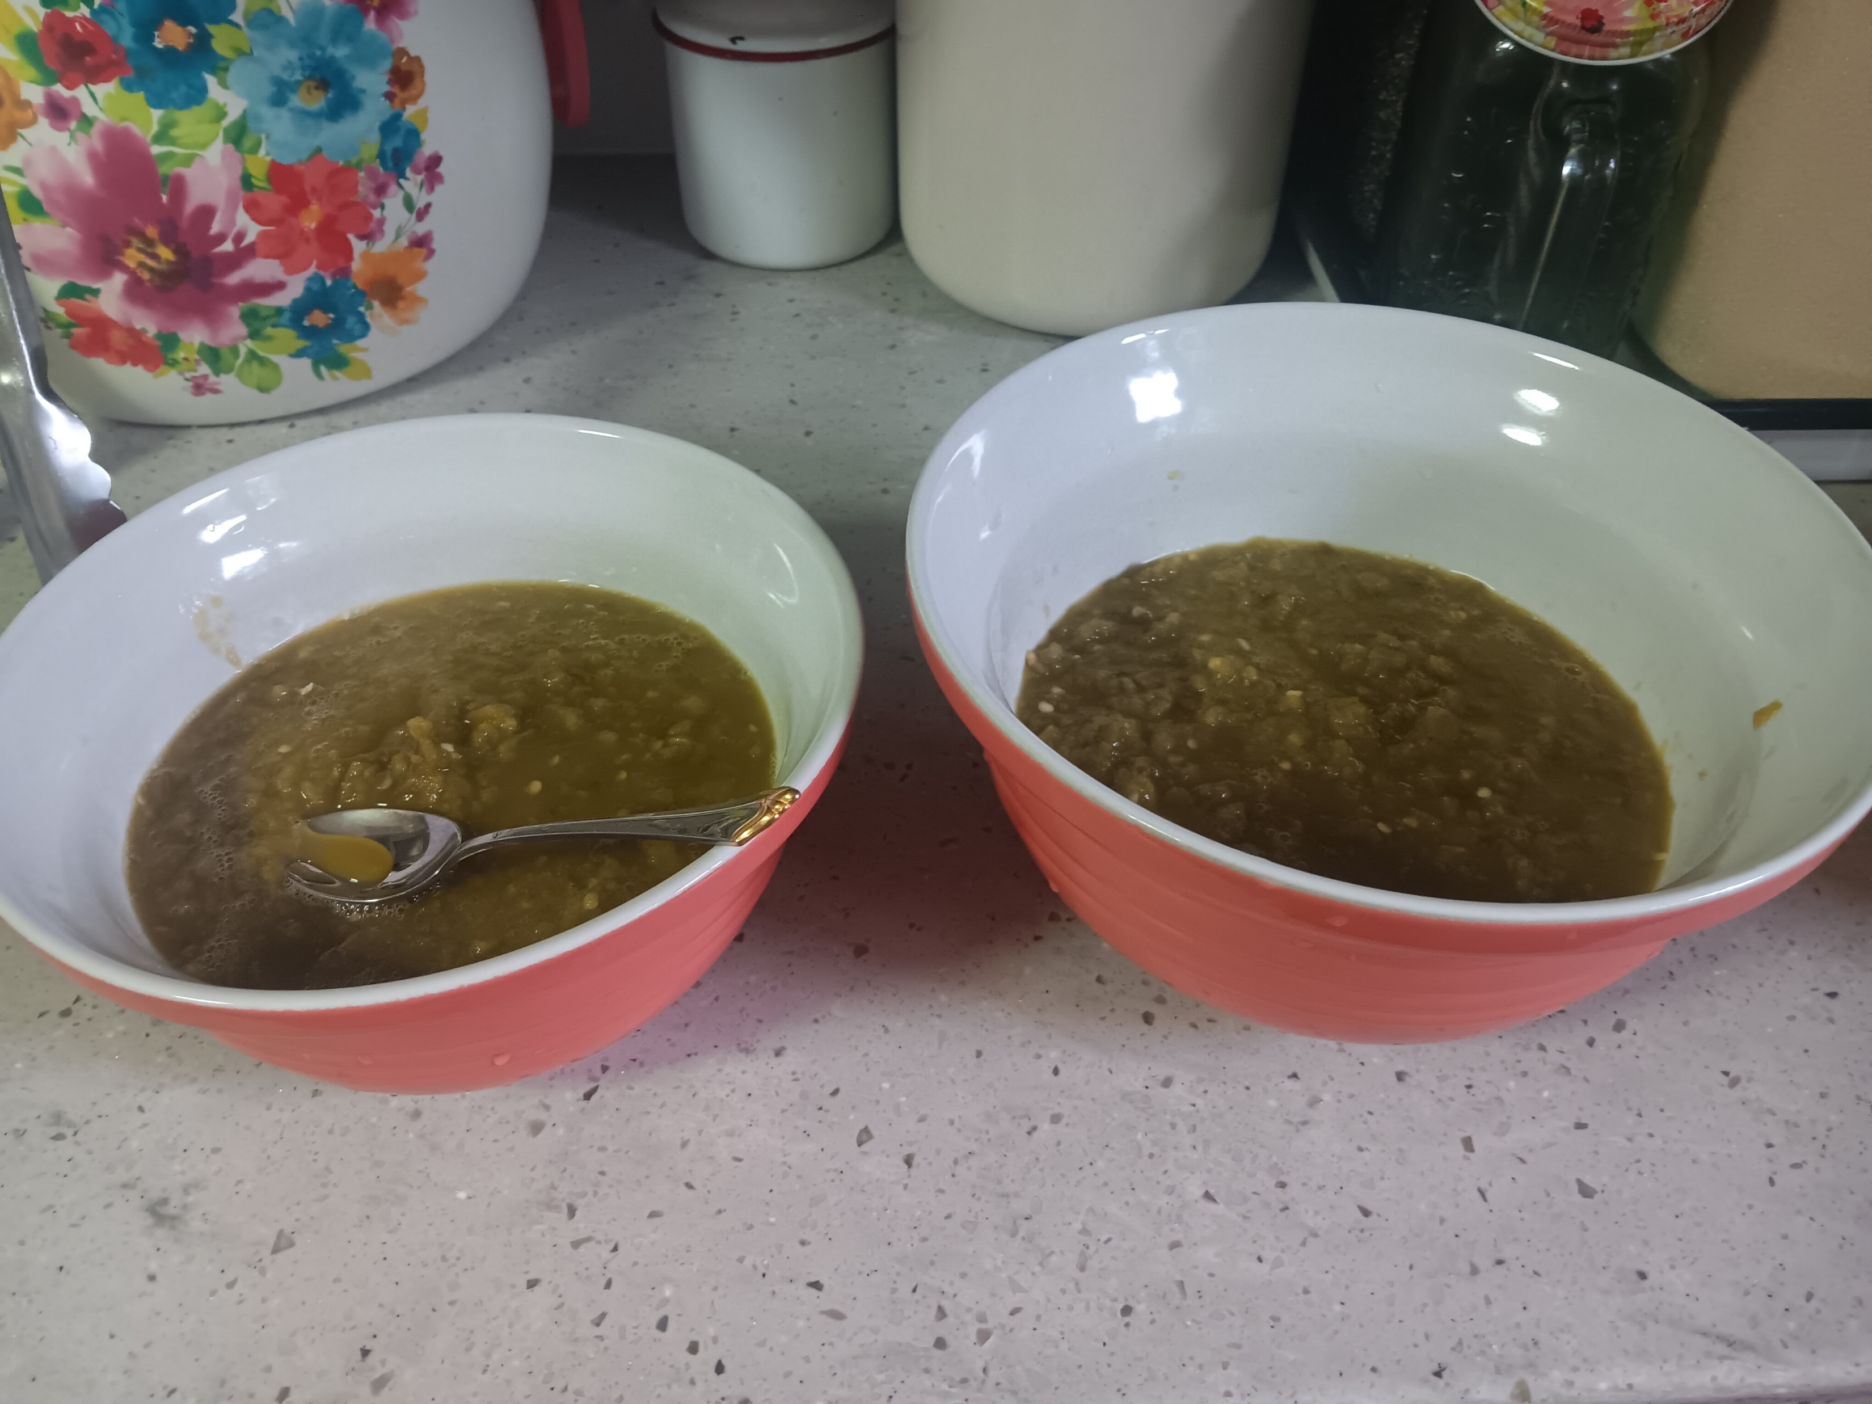
Finishing Your Fermented Sauce
Prepare Sauce
  Strain off brine
  Taste/Blend
  Add some brine back
  Strain out solids

Slide 21
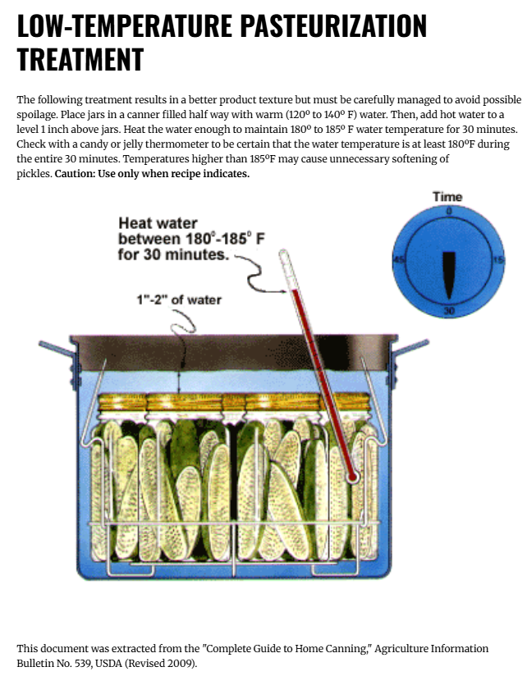
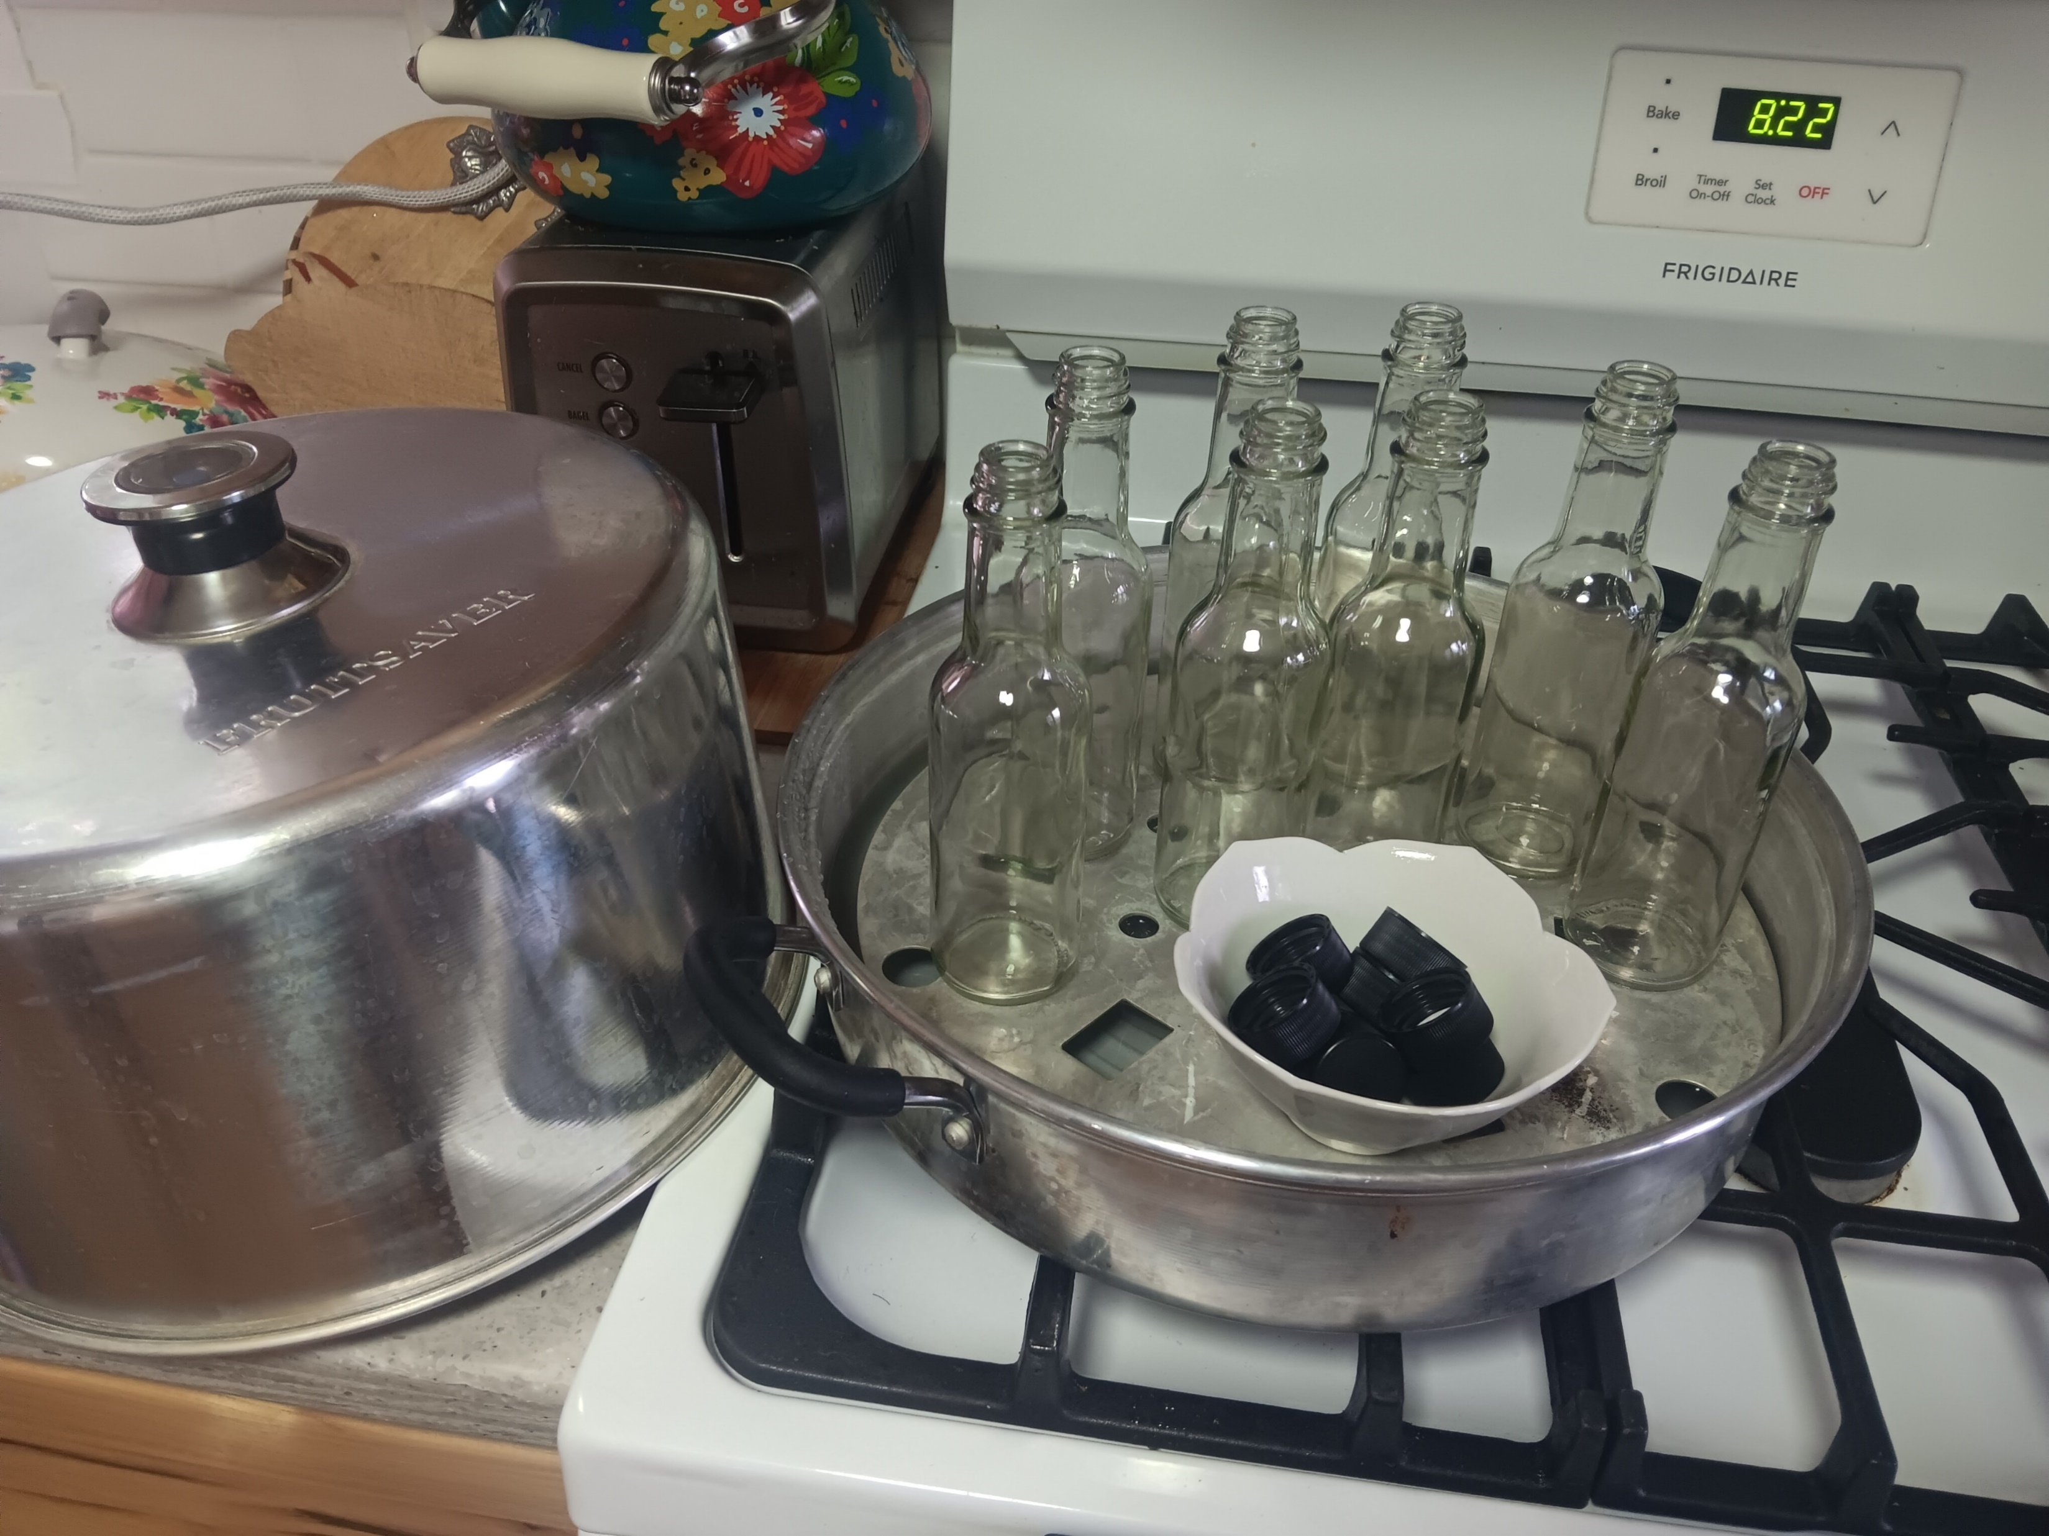
Finishing Your Fermented Sauce
Preserve
  Option A – Store in Refrigerator
  Option B – Water Bath
  Can
  Option C – Pasteurize

Slide 22
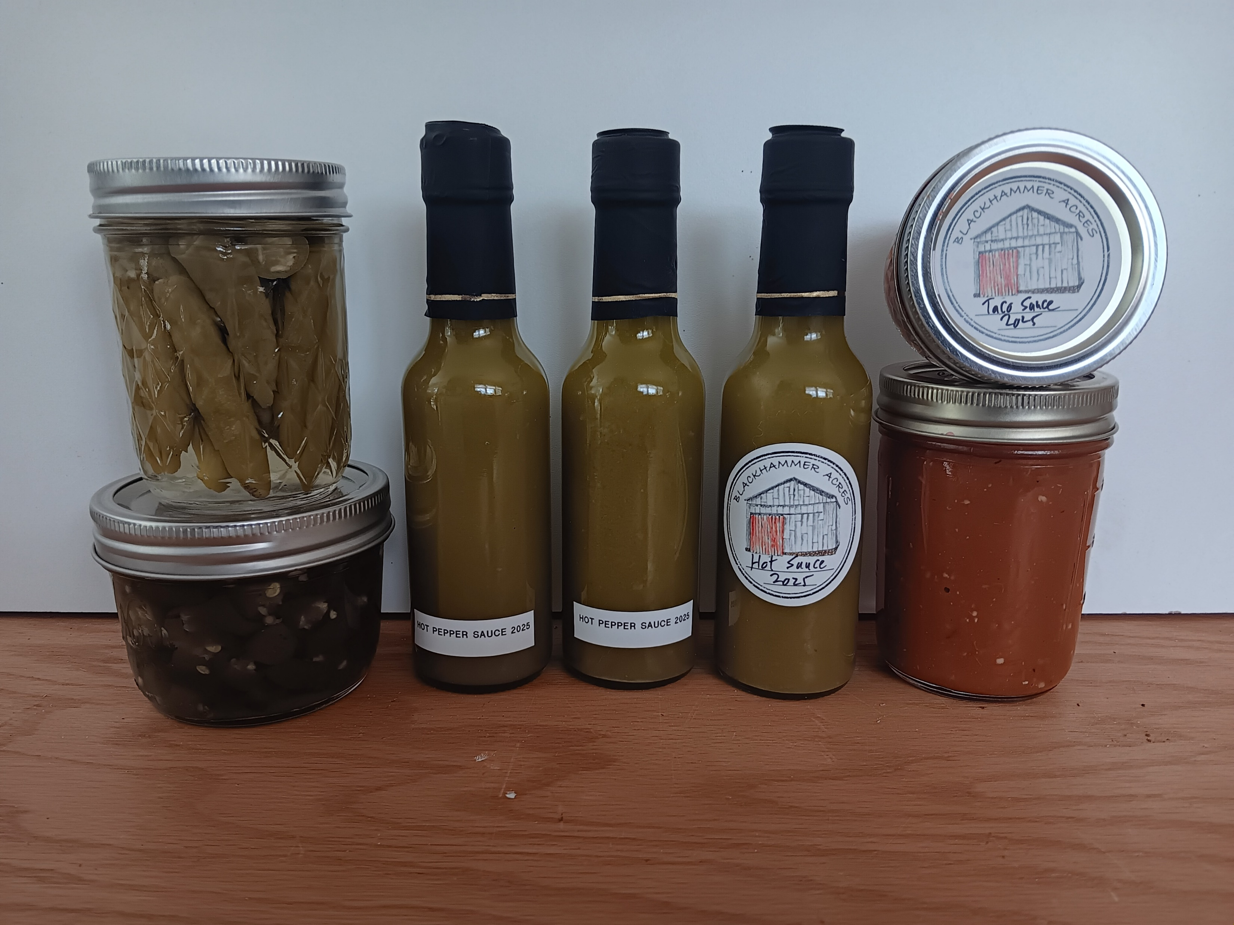
Finishing Your Fermented Sauce
Label and Enjoy!

Slide 23
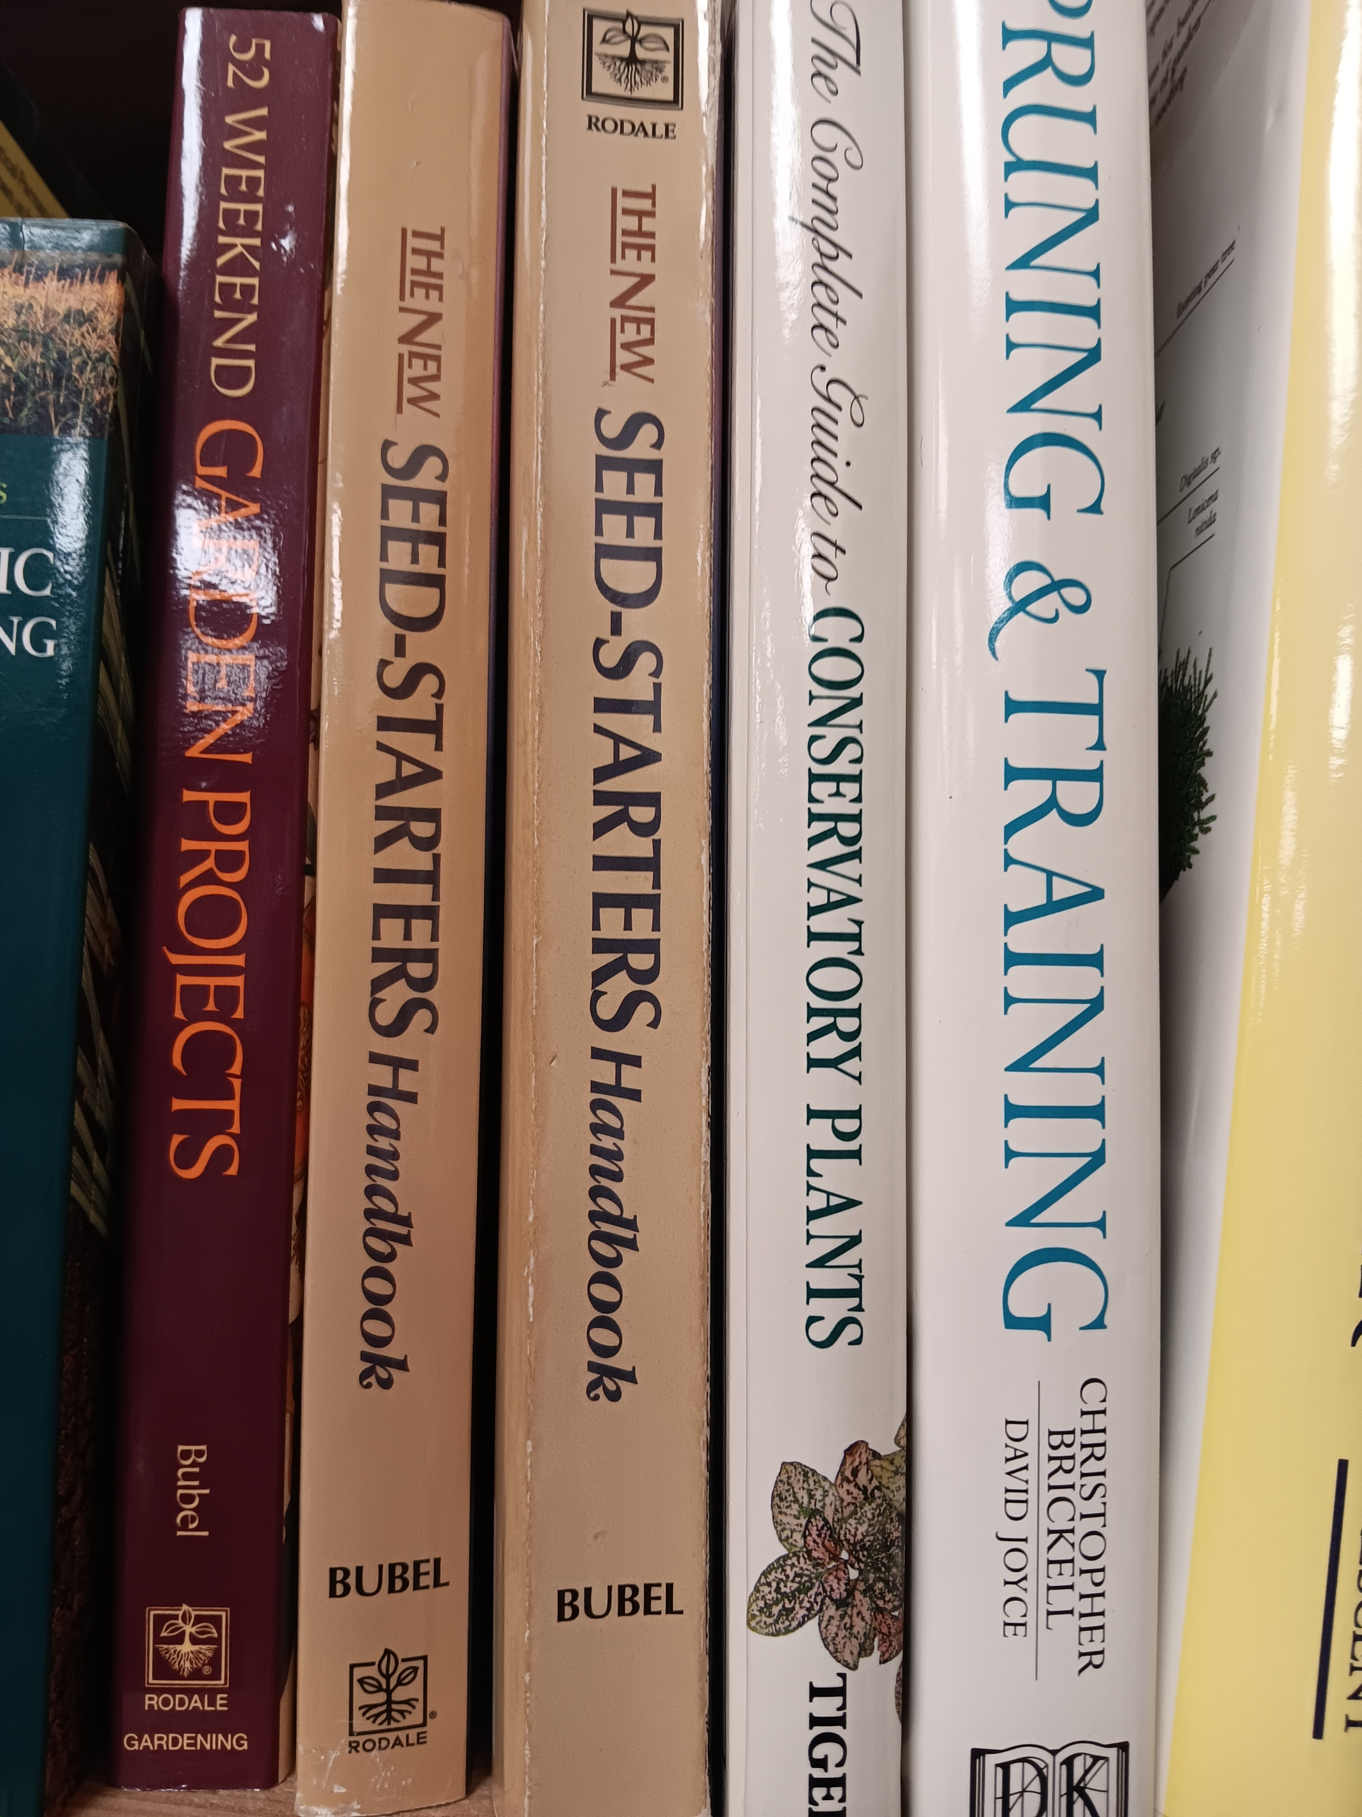

Resources
Gardening
  “The New Seed Starters Handbook” – Nancy Bubel
  “The Vegetable Gardener’s Bible” – Edwards Smith
  “Growing Tomatoes, Peppers, and Eggplant in Wisconsin: A Guide for Fresh Market Growers” – UW Extension Publication A3687
Canning
  Ball “Blue Books”
  USDA Complete Guide to Home Canning
  Better Homes & Garden “Can It!”
Fermenting
  “Fiery Ferments” – Christopher and Kirsten Shockey
  “The Art of Fermentation” – Sandor Katz
  Hobby Farms Magazine Nov/Dec 2025 issue

Slide 24


Thank You!
Questions? www.blackhammeracres.com

