Slide 1
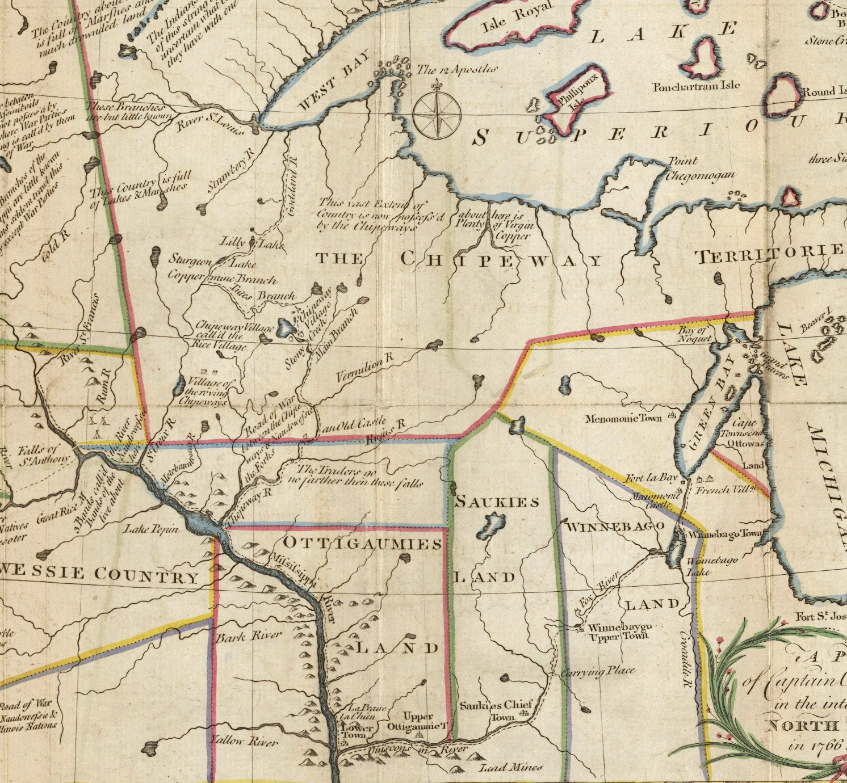
Residents of “Wisconsin”
in the American Revolution

Slide 2
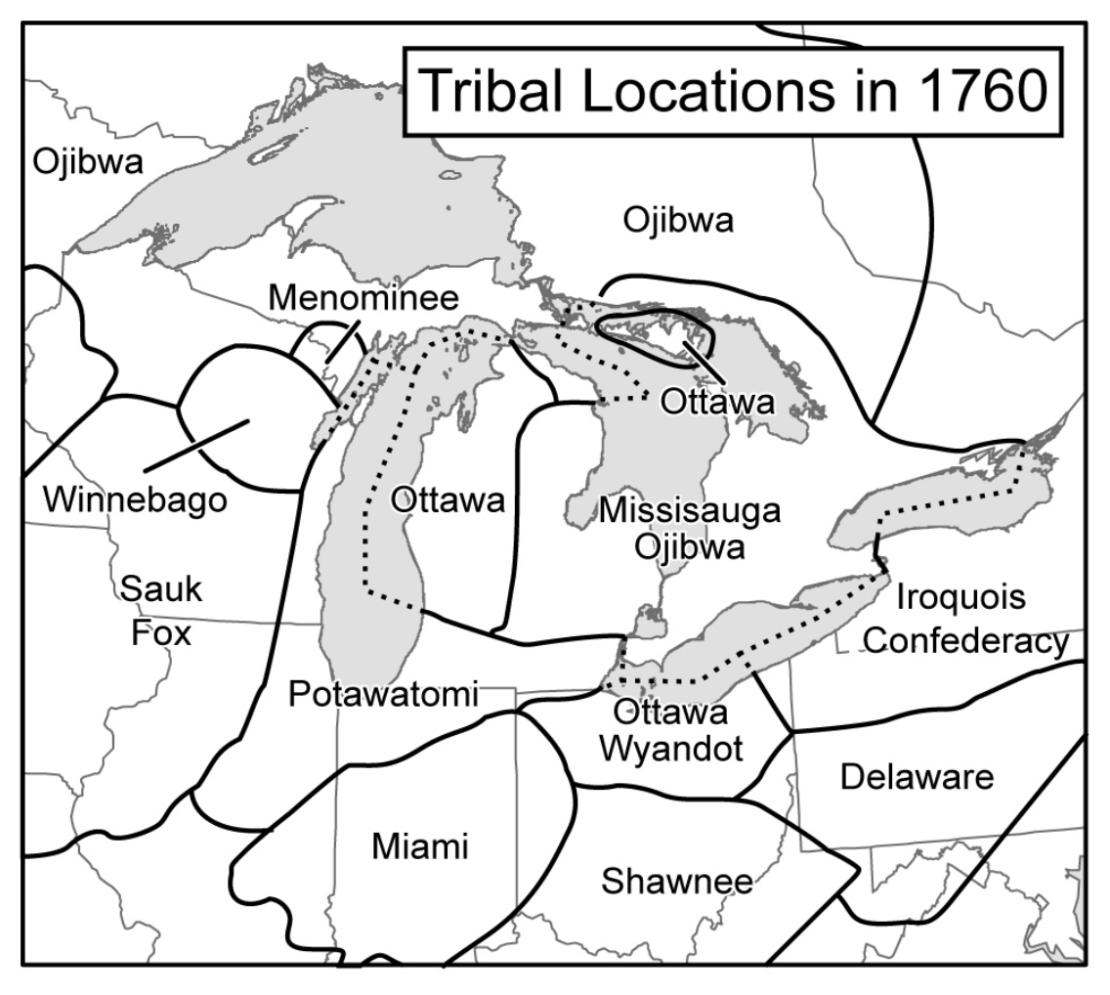
Pays d’en haut
Indian Country

Slide 3
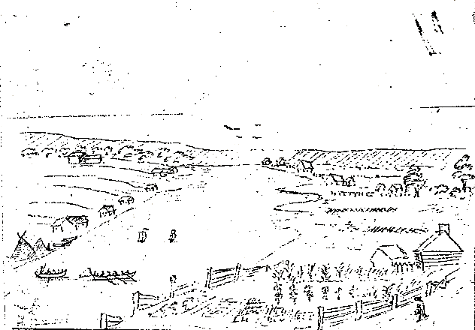
la Baie

Slide 4
Prairie du Chien

Slide 5
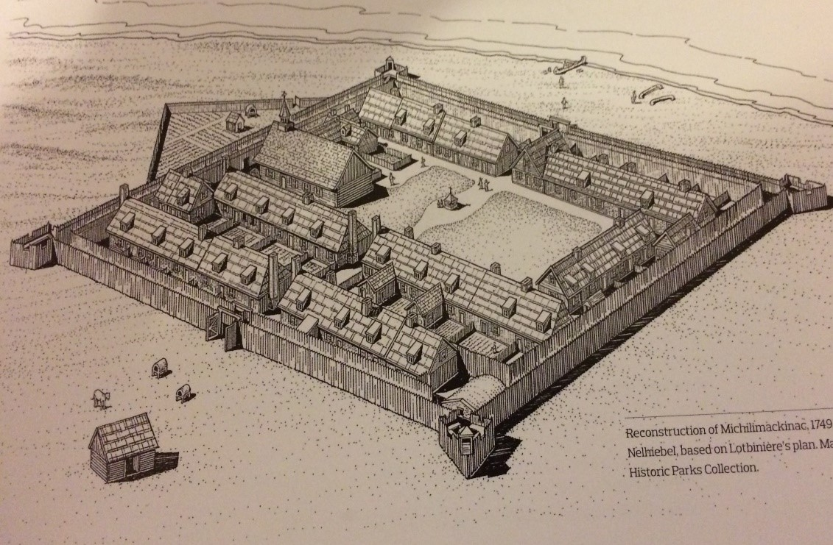
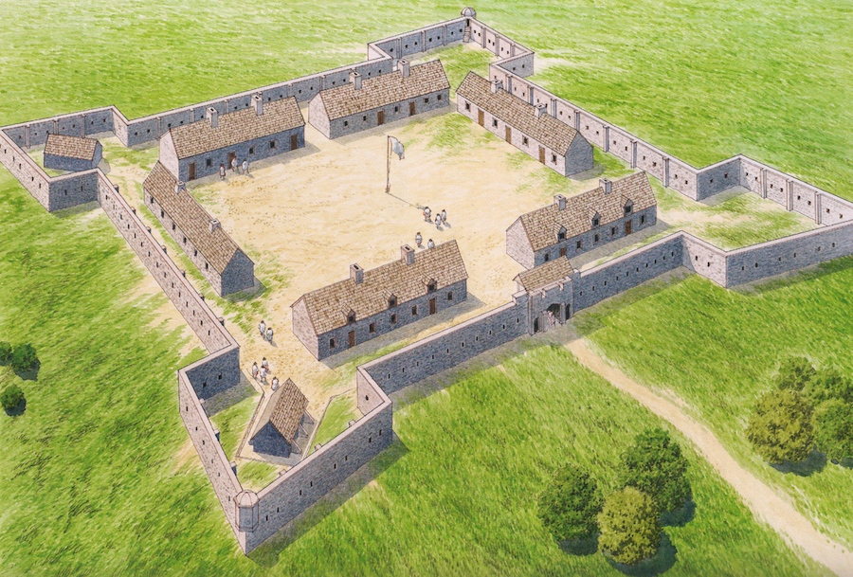
Fort Detroit 1701
Fort Michilimackinac 1714
Fort de Chartres 1720

Slide 6
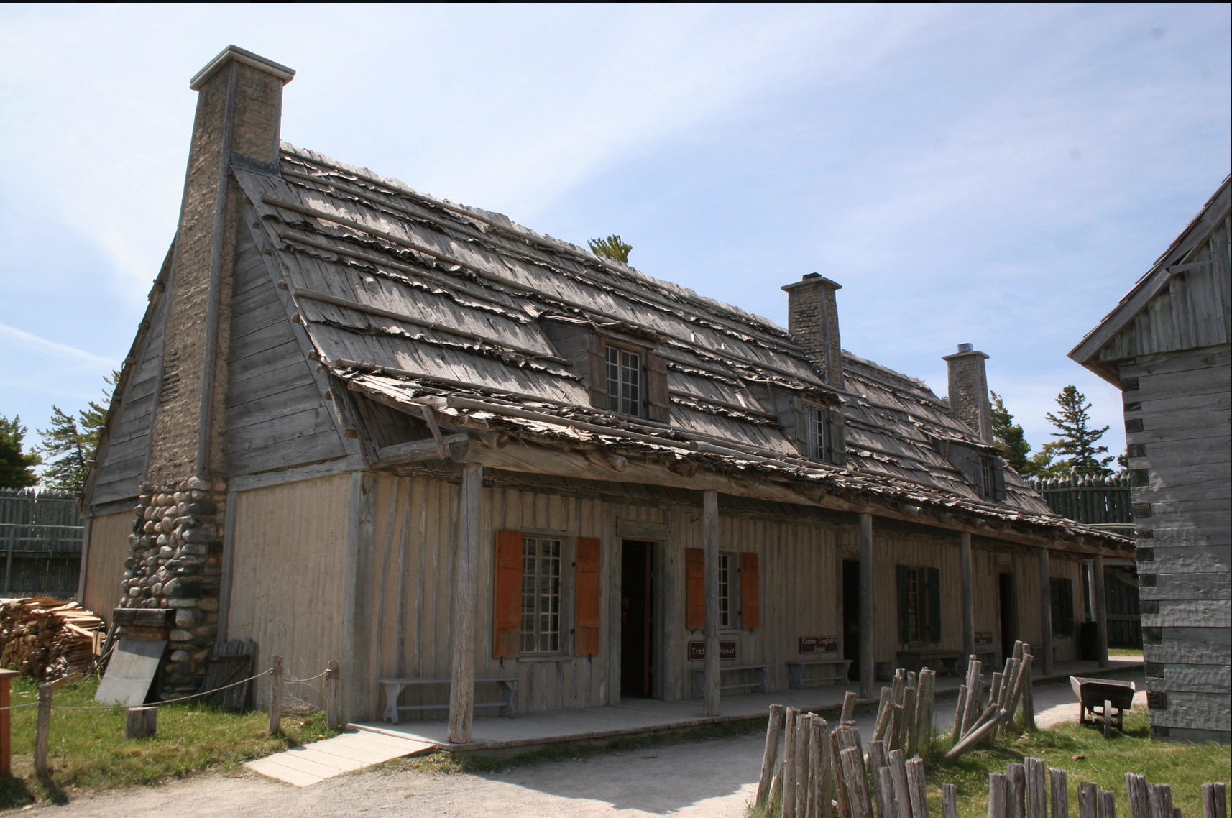
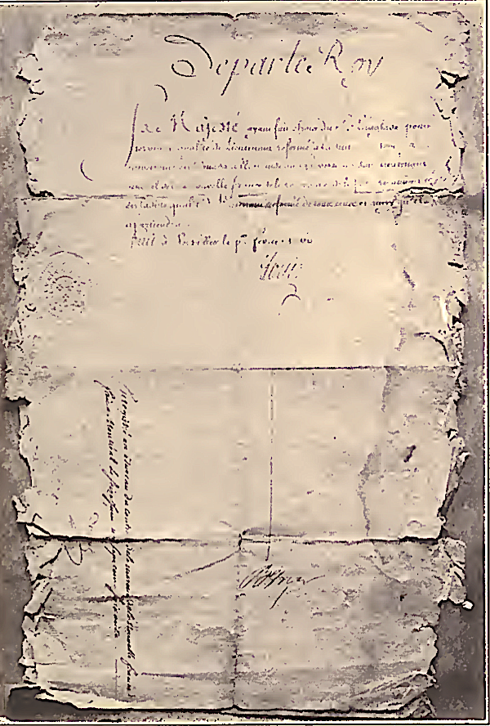
Charles Michel de Langlade
Fur Trader
Officer French colonial regulars

Slide 7
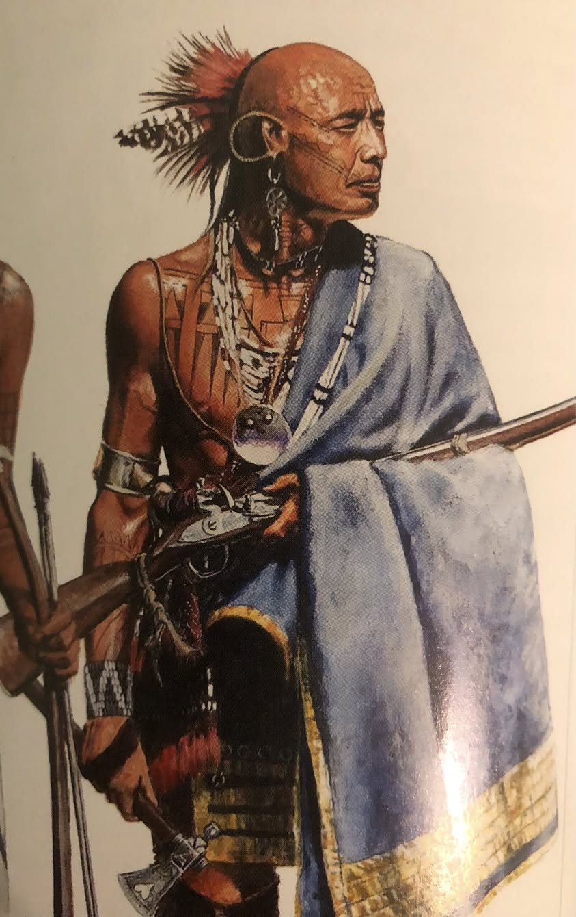
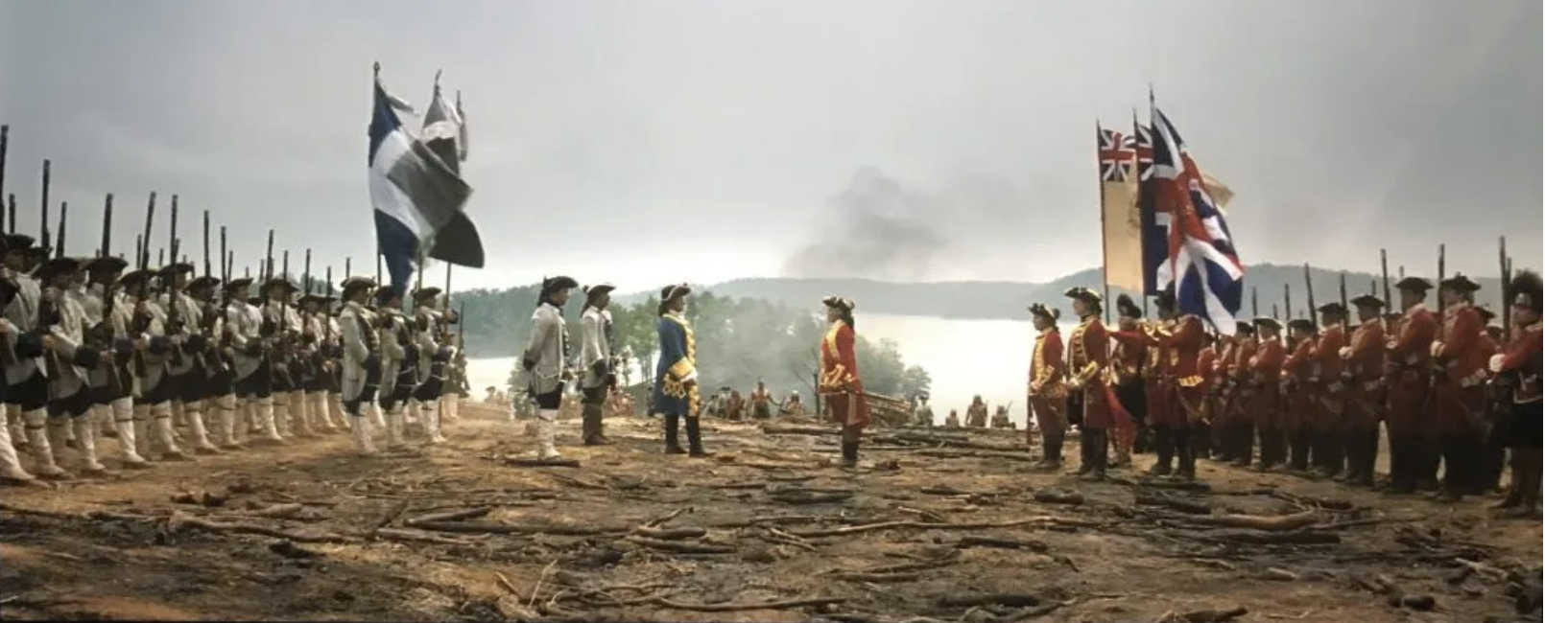
French and Indian War
Pickawillany 1752 – led Odawa, Potawatomi, Ojibwe
Defeat of General Braddock, Fort Duquesne March 1755
Led Three Fires Confederacy
Nephew – Charles Gautier de Vierville
Ambushed Robert Rogers, Rogers Rangers January 1757
Battle of Lake George September 1757
Second in Command at Fort Michilimackinac 1757
Led Ottawa at Plains of Abraham in defense of Quebec1759
Charles Gautier
Promoted to Lieutenant 1760
Surrendered Fort Michilimackinac to the British, 1761

Slide 8
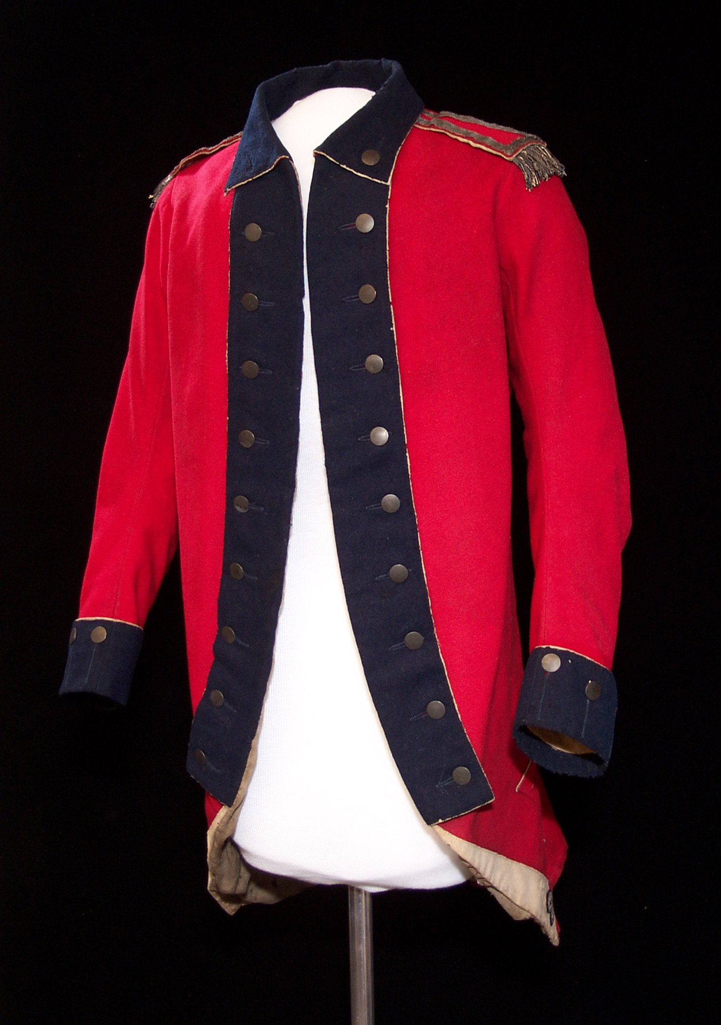
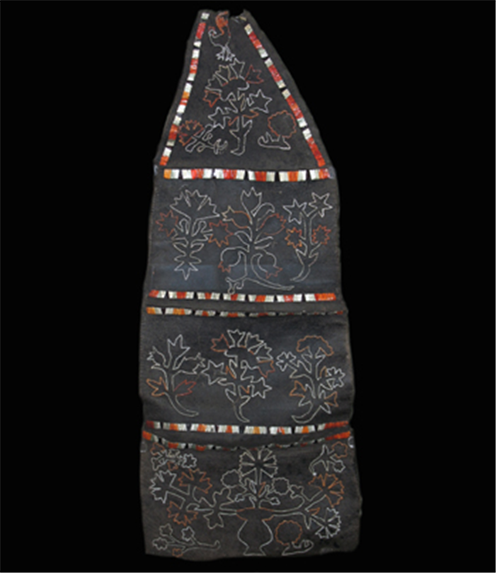
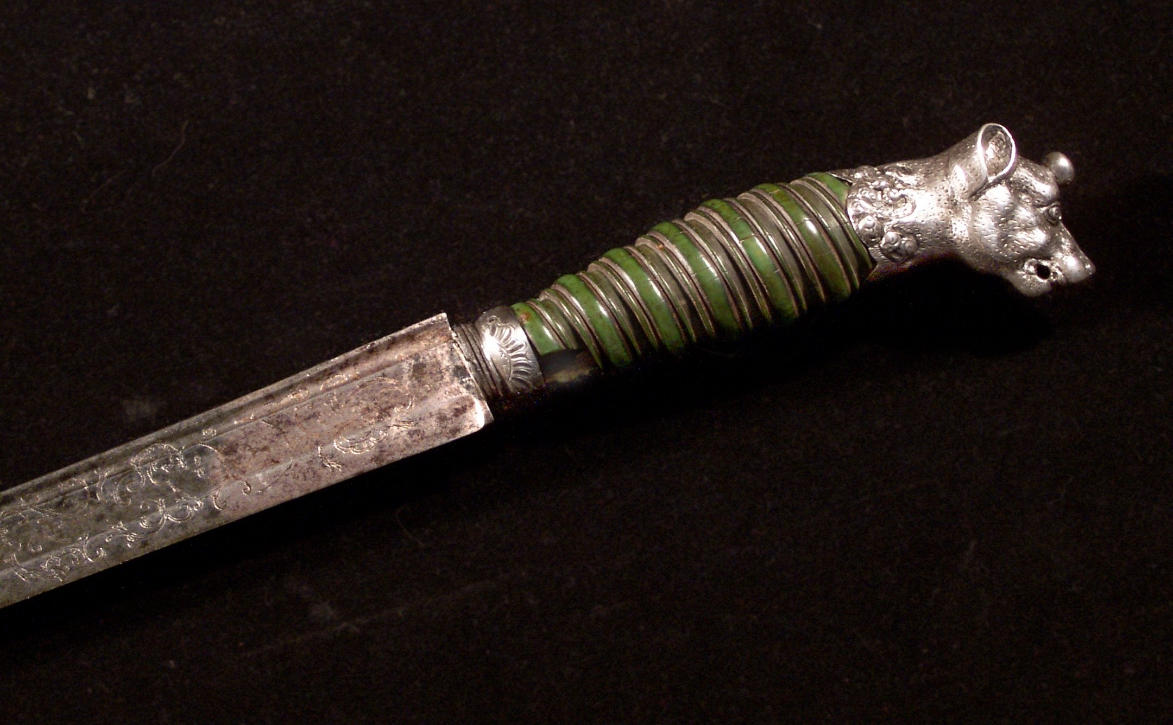
Commanded Fort Michilimackinac for the British
until 1763.
Commission Lieutenant in British Indian Department

Slide 9
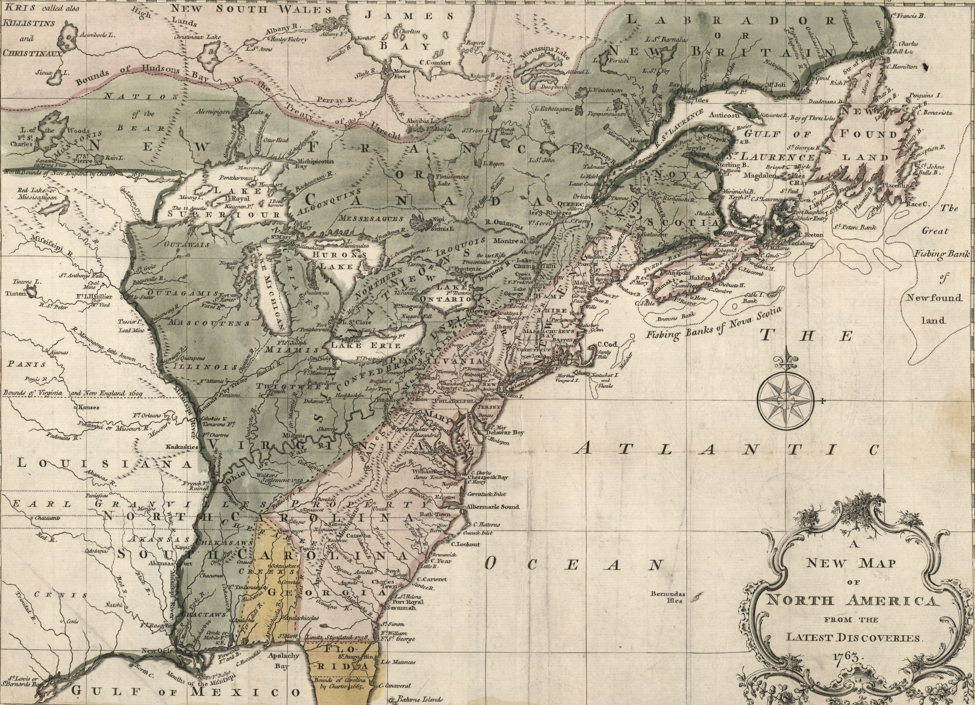
Royal Proclamation 1763

Slide 10
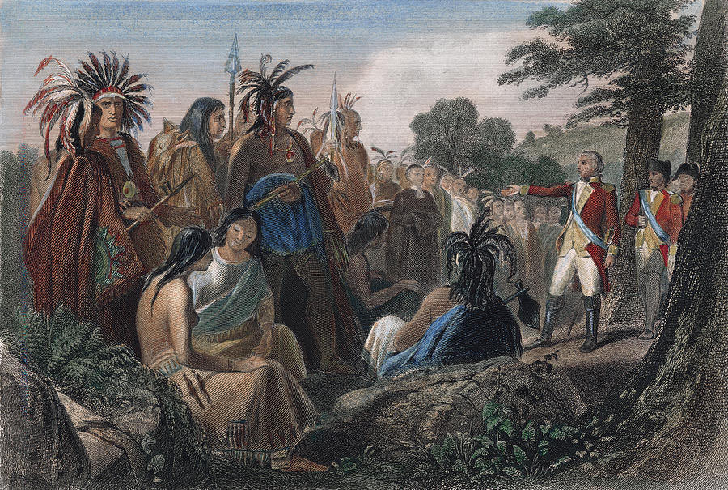

Slide 11
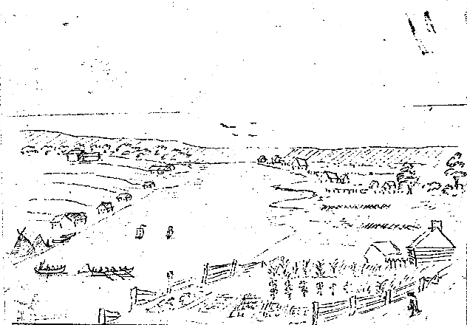
April 19, 1775

Slide 12
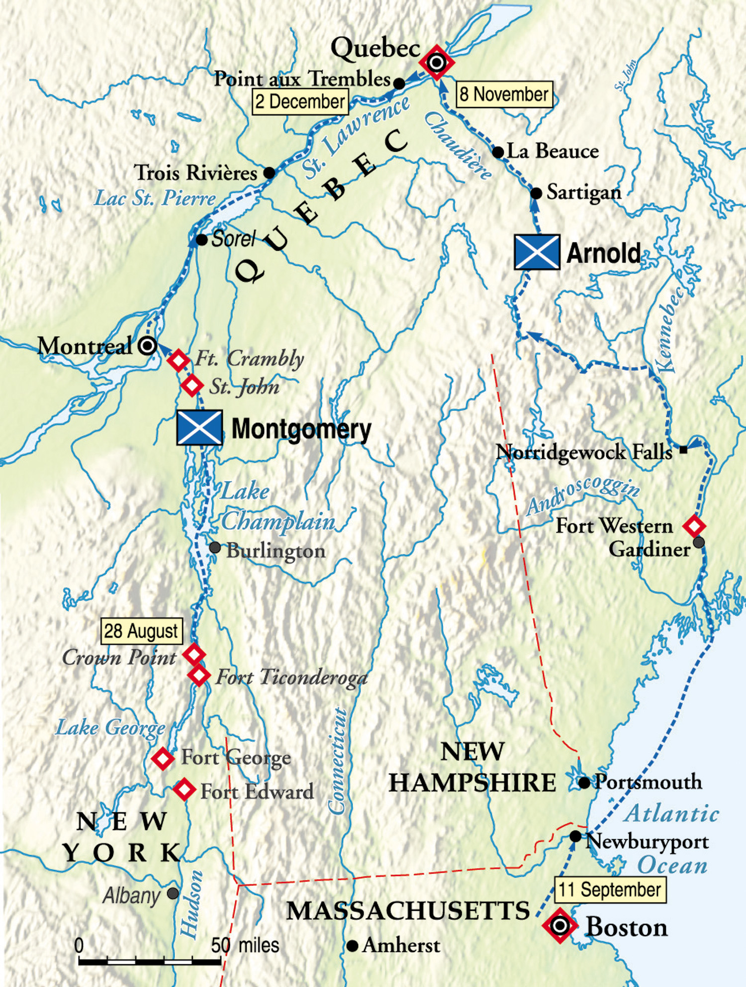
Invasion of Quebec
1775-1776
Langlade - “a man I have had every reason to be very much satisfied with and who from his influence among the Indians of that district may be very much use.”
Gov. Guy Carlton

Slide 13
Captain Arent de Peyster, Command Fort Michilimackinac
Raise force of 150 Ottawa and Ojibwe,
interpreter Joseph-Louis Ainsse
July 1775, requested Langlade “to beat up for
Indian volunteers.”
Several hundred Menominee, Ho-Chunk,
Sauk, Meskwaki, and Dakota
“You will do your best to harass the Rebels
wherever you may encounter them and in
all matters you will conduct yourself with
your customary prudence and humanity”
Langlade and the Native warriors he led secured
Montreal for British in 1776

Slide 14
Declaration of Independence – July 1776
27 Grievances
”He has endeavored to prevent the population of these States;…refusing to pass others to encourage their migrations hither,
and raising the conditions of new Appropriations of Lands.”
”He has forbidding his Governors to pass Laws of immediate and
pressing importance,….”
“He has kept among us, in times of peace, Standing Armies without the Consent of our legislatures.”
”He has…endeavoring to bring on the inhabitants of our frontiers,
the merciless Indian Savages, whose known rule of warfare, is an undistinguished destruction of all ages, sexes, and conditions."

Slide 15
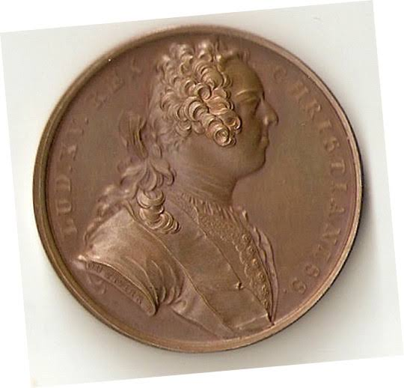
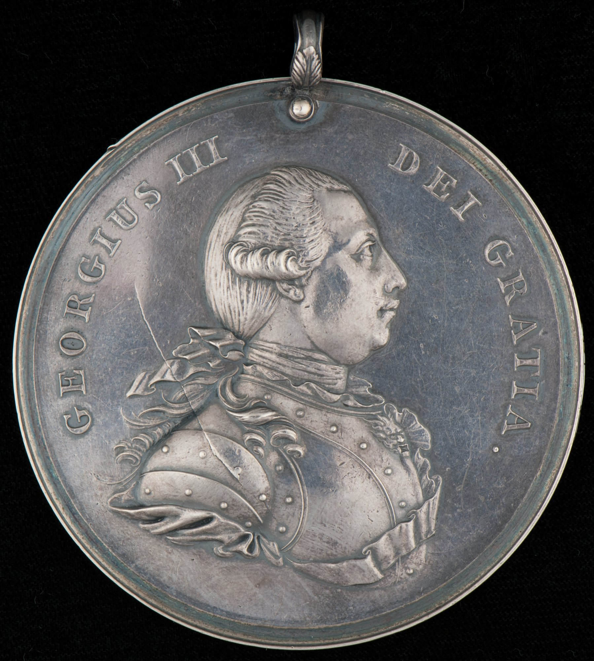
1776
General John Burgoyne enrolled Charles Langlade and Charles Gautier in the Quebec Indian Department, 1776
Wabasha and another Dakota chief presented to Governor Guy Carlton. The interpreter was Joseph Roc.
I have heard "your summons addressed to the whole world" and had come from "the most distant of your children” to offer the services of 15,000 warriors to the British.
Wabasha pledged: "I will therefore return, when it is thy pleasure, to my own people, and tell them of the happiness I had in speaking with the Father of the world.”

Slide 16
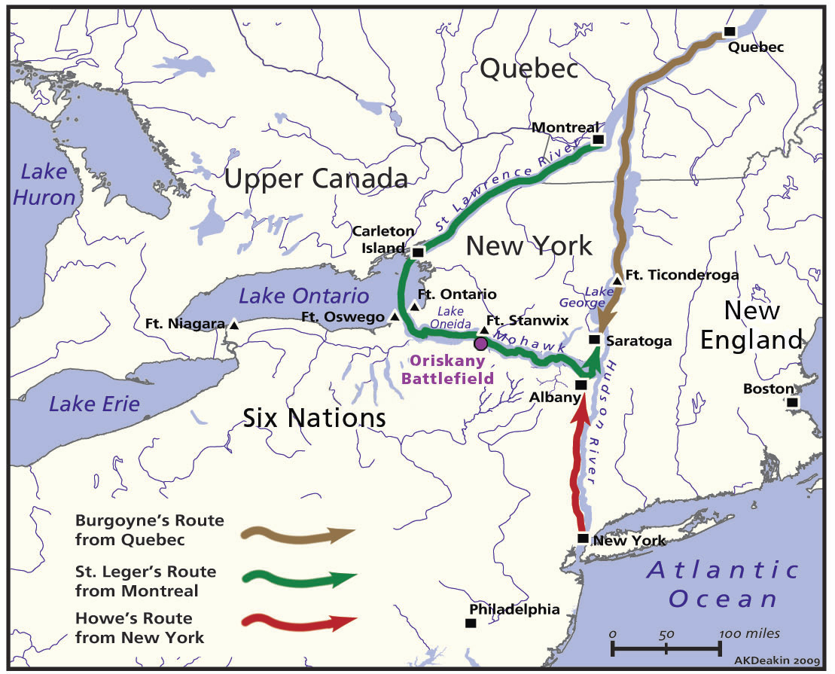
1777 – British Plan to Win the War

Slide 17
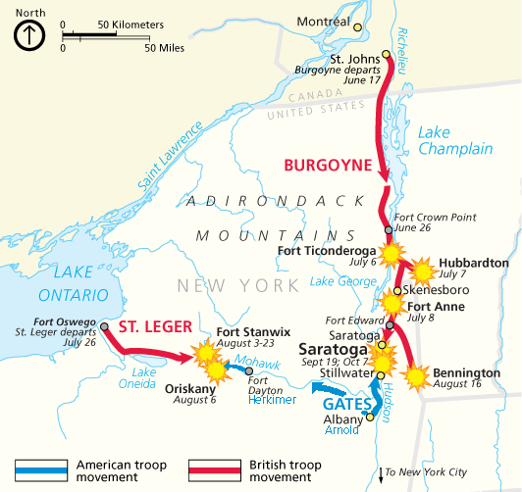
Campaign of General Burgoyne, summer 1777
Battle of Saratoga
Langlade – Menominee, Ottawa
Gautier – Sauk and Meskwaki
Langlade second in command of “Burgoyne’s Indians”
Fought with Ottawa until Battle of Bennington

Slide 18
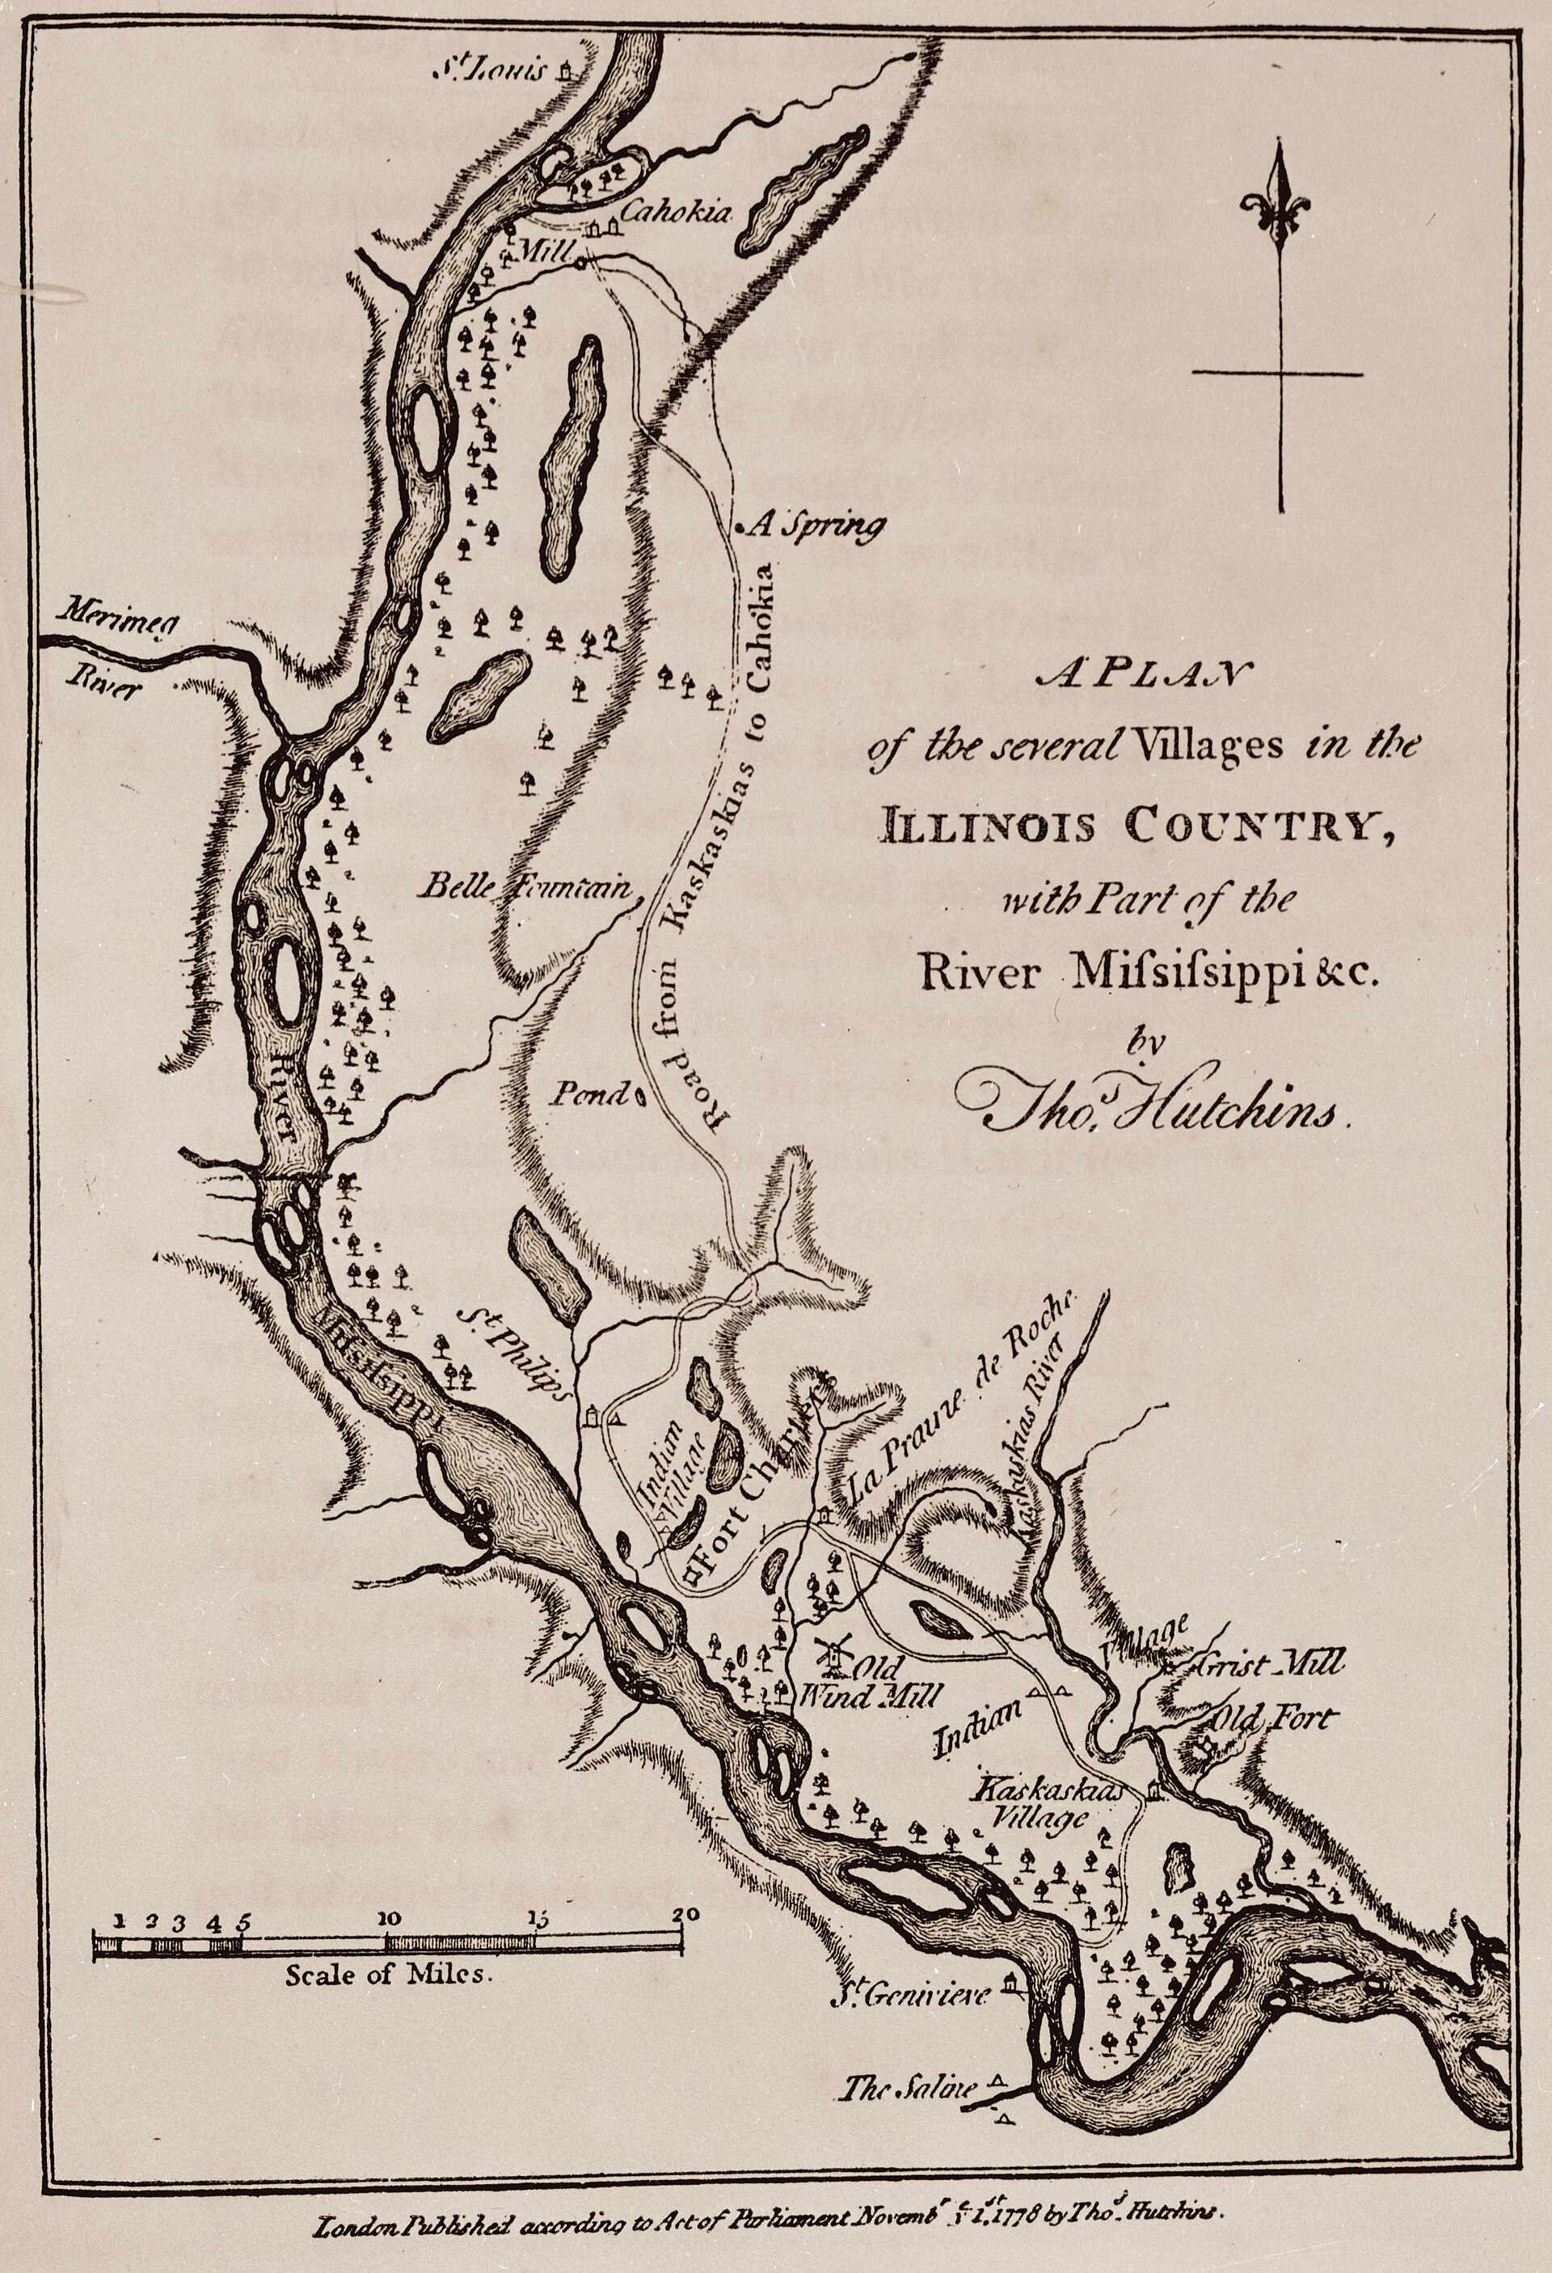
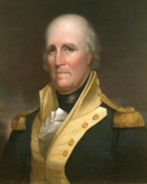
George Rogers Clark – Illinois Country 1778

Slide 19
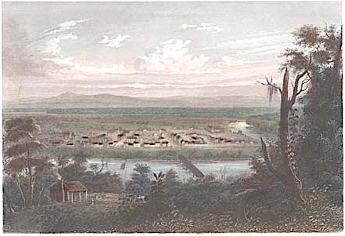
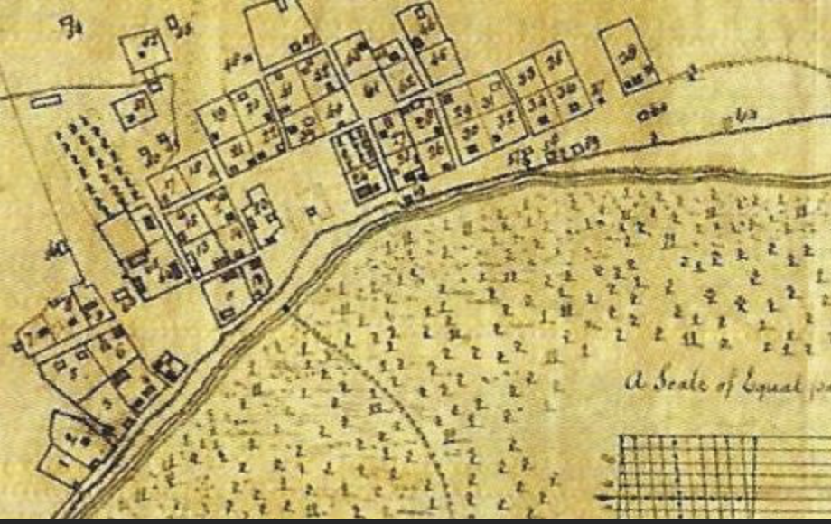
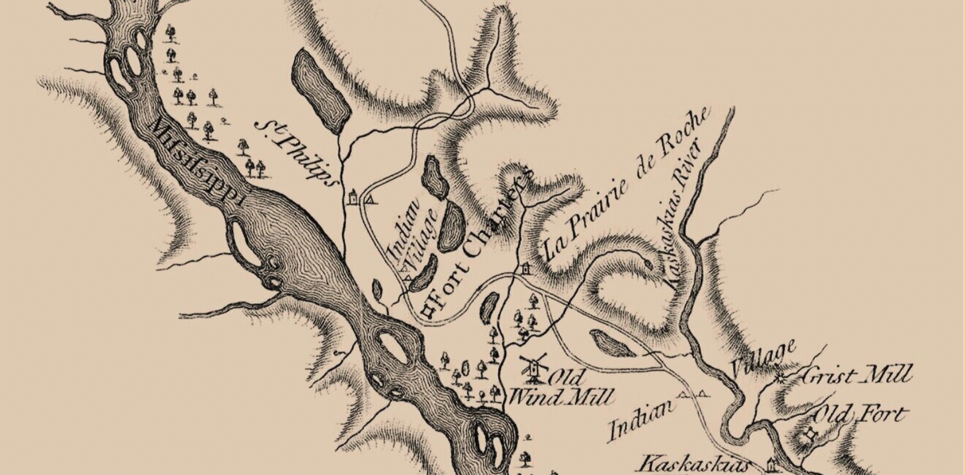
Cahokia
Kaskaskia
“Illinois Regiment of Virginia”
Prairie du Roche

Slide 20
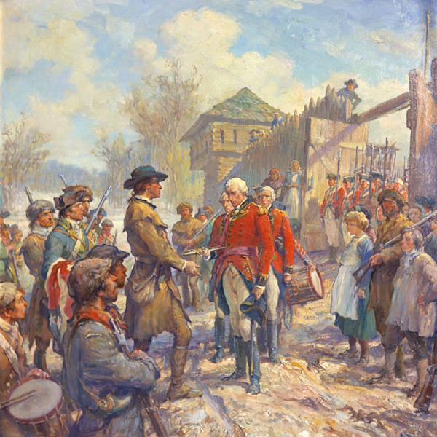
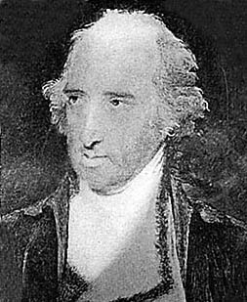
Lt. Governor Henry Hamiliton
Battle Fort Vincennes 1778

Slide 21
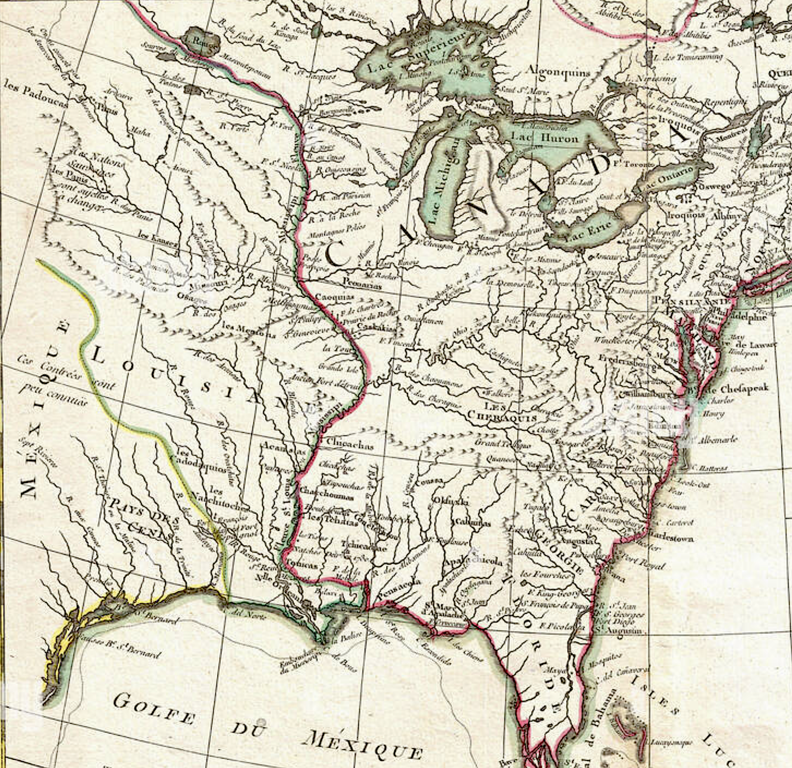
Spanish Louisiana
St. Louis 1764 – Precour
Spain joins as an ally of France June1779

Slide 22
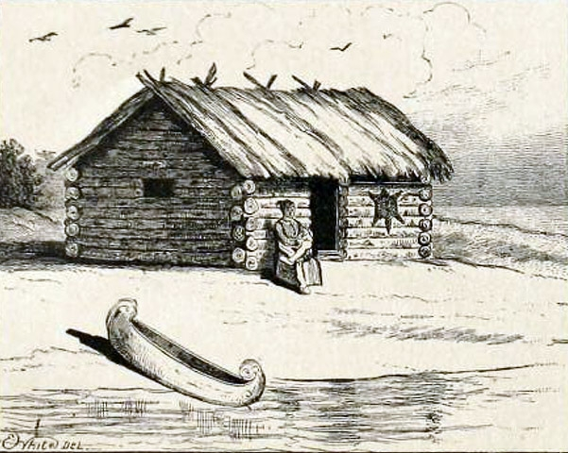
Rumor – Rogers’ forces building boats at Chicago

Slide 23
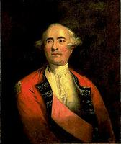
1780 Three-pronged attacked planned
Campbell at Pensacola ordered to attack New Orleans
de Peyster at Detroit attack Vincennes
Commander at Fort Pitt to prevent US forces to go to Kaskaskia and Cahokia
Sinclair at Michilimackinac to gather Prairie du Chien and descend Mississippi and attack St. Louis and Cahokia
Sir Frederick Haldimand, Governor Canada

Slide 24
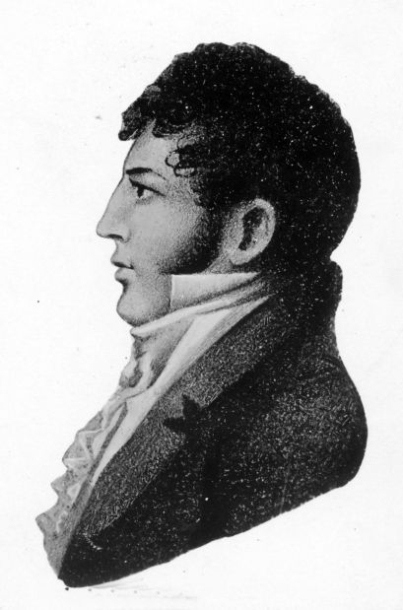
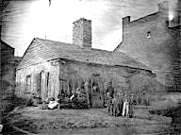
Charles Gratiot
Cahokia Illinois Country

Slide 25
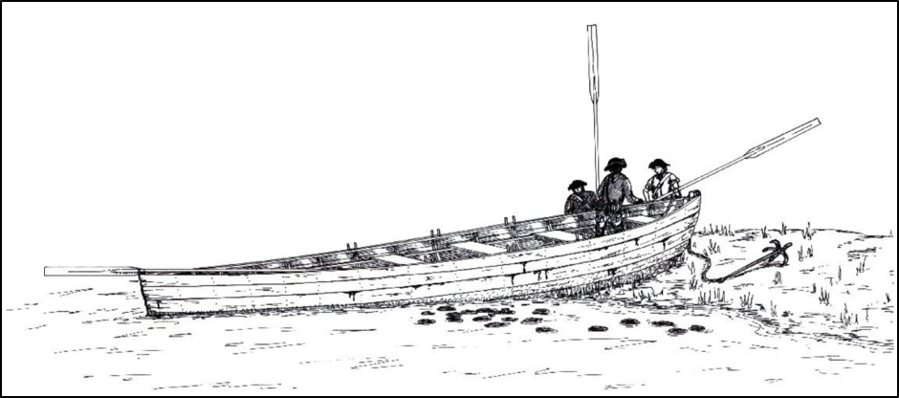
Jean Baptiste Cardinal

Slide 26
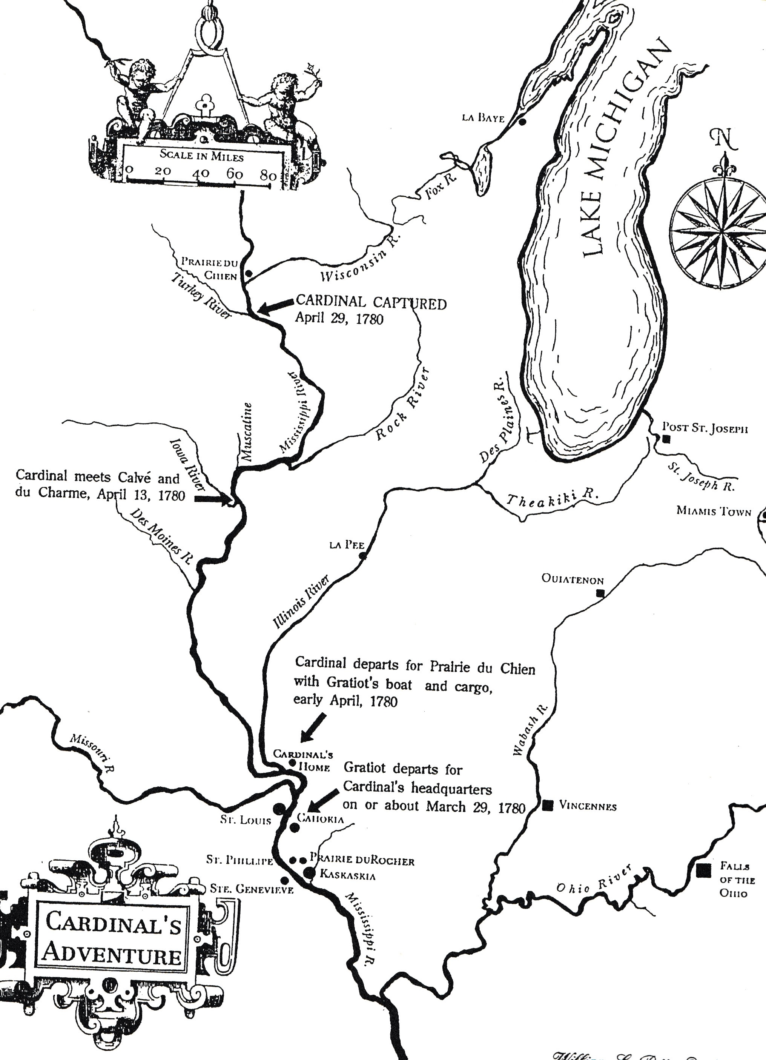
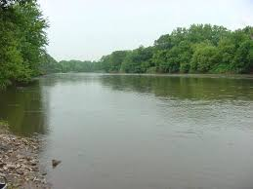
April 13, 1780
Iowa River
Joseph Calvè
Jean-Marie DuCharme

Slide 27
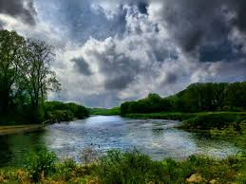
April 29, 1780
Turkey River

Slide 28
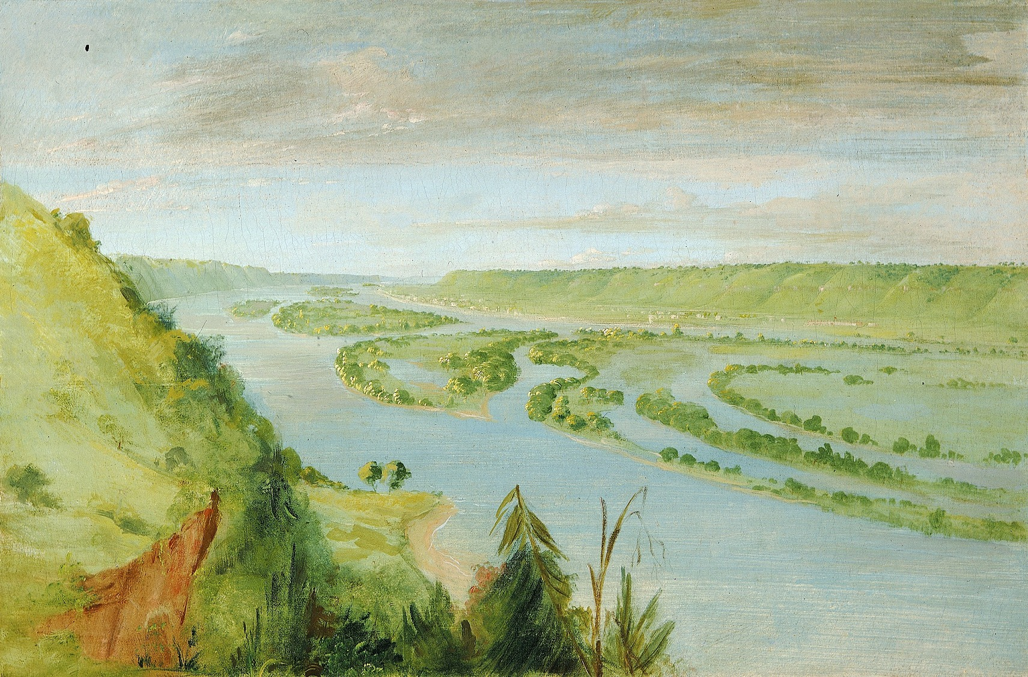
Prairie du Chien

Slide 29
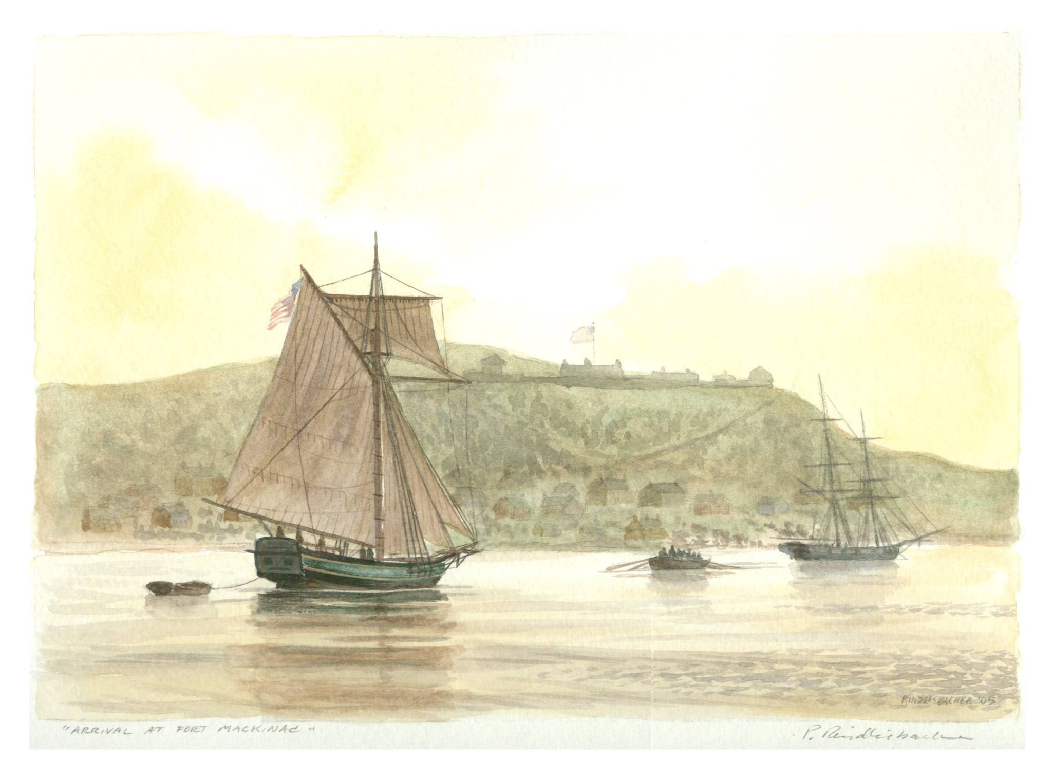
Lt. Governor Patrick Sinclair
order “reduce the Spanish posts in the Illinois.”

Slide 30
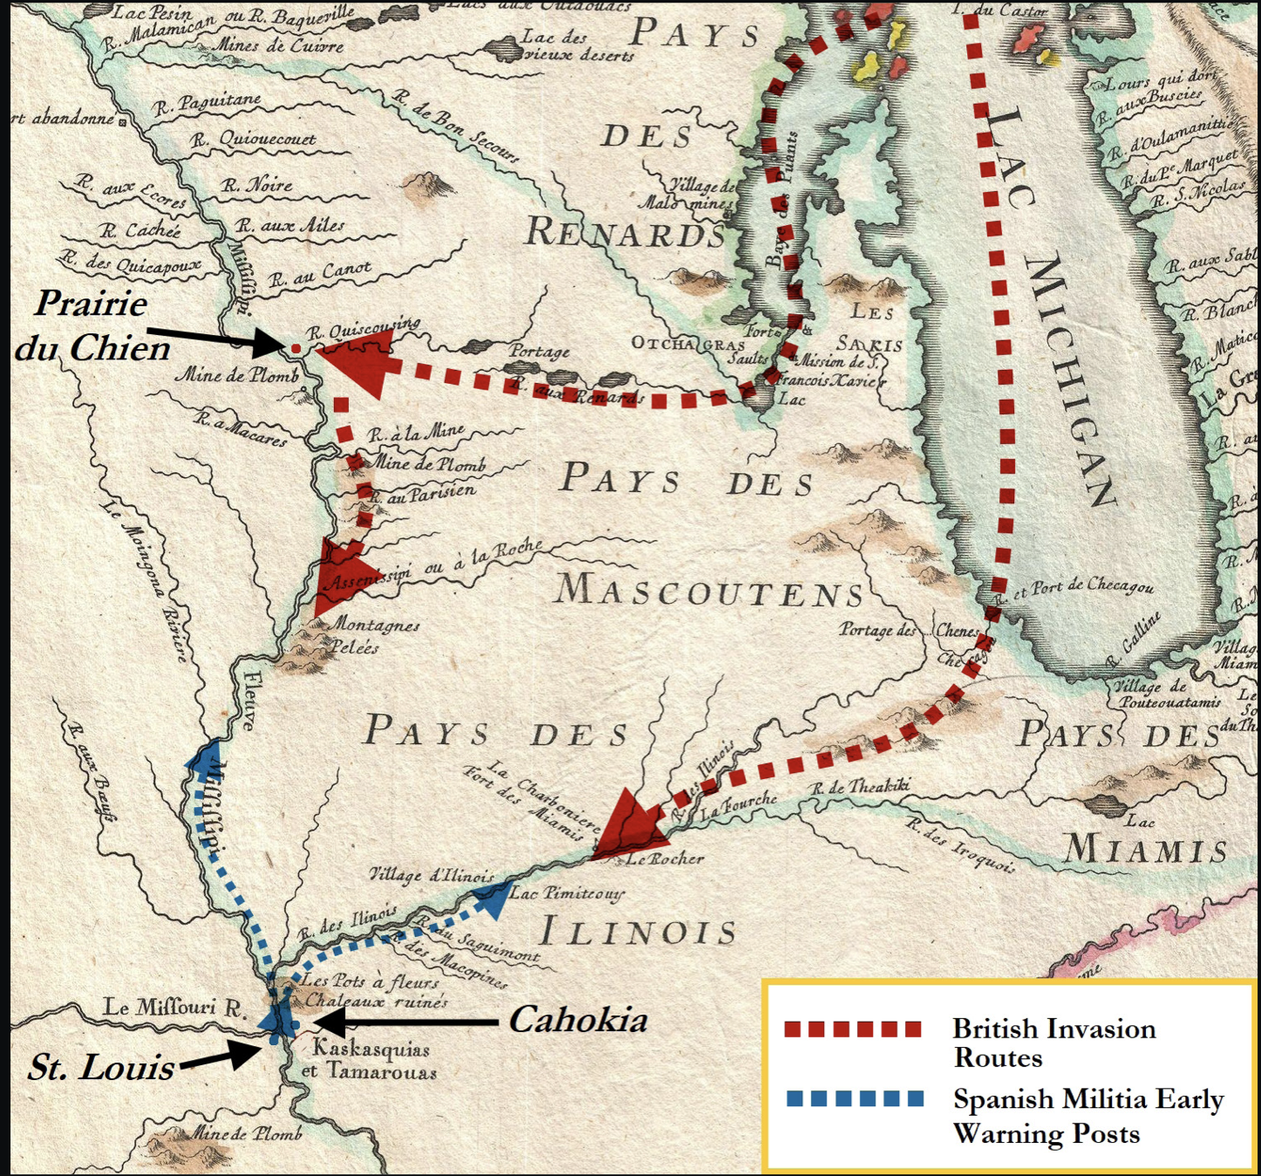

Slide 31
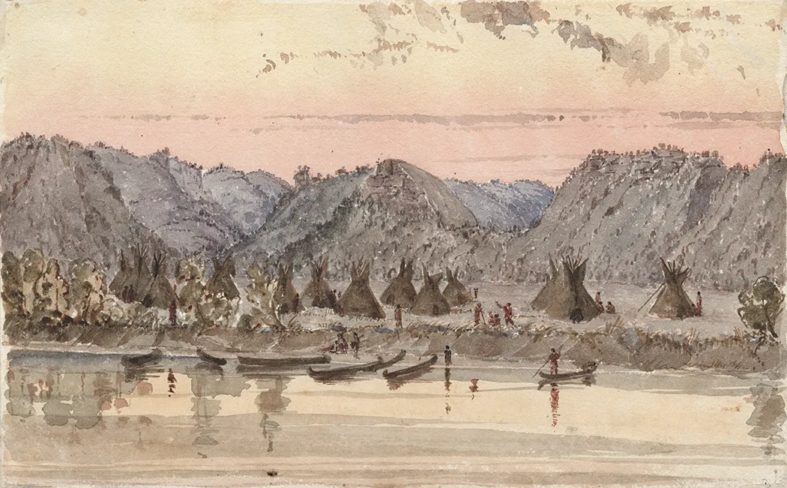
Mississippi River Expedition 1780
Joseph Roc/Roque - “The King’s Interpreter”
Key – English interpreter and commissary
Wapasha
“The zeal he has manifested warrants our attention.”
Governor Haldimand
April 1780, commissioned a British general.
A chief “of very singular & uncommon abilities, generously attached to His Majesty’s Interests.”
Patrick Sinclair

Slide 32
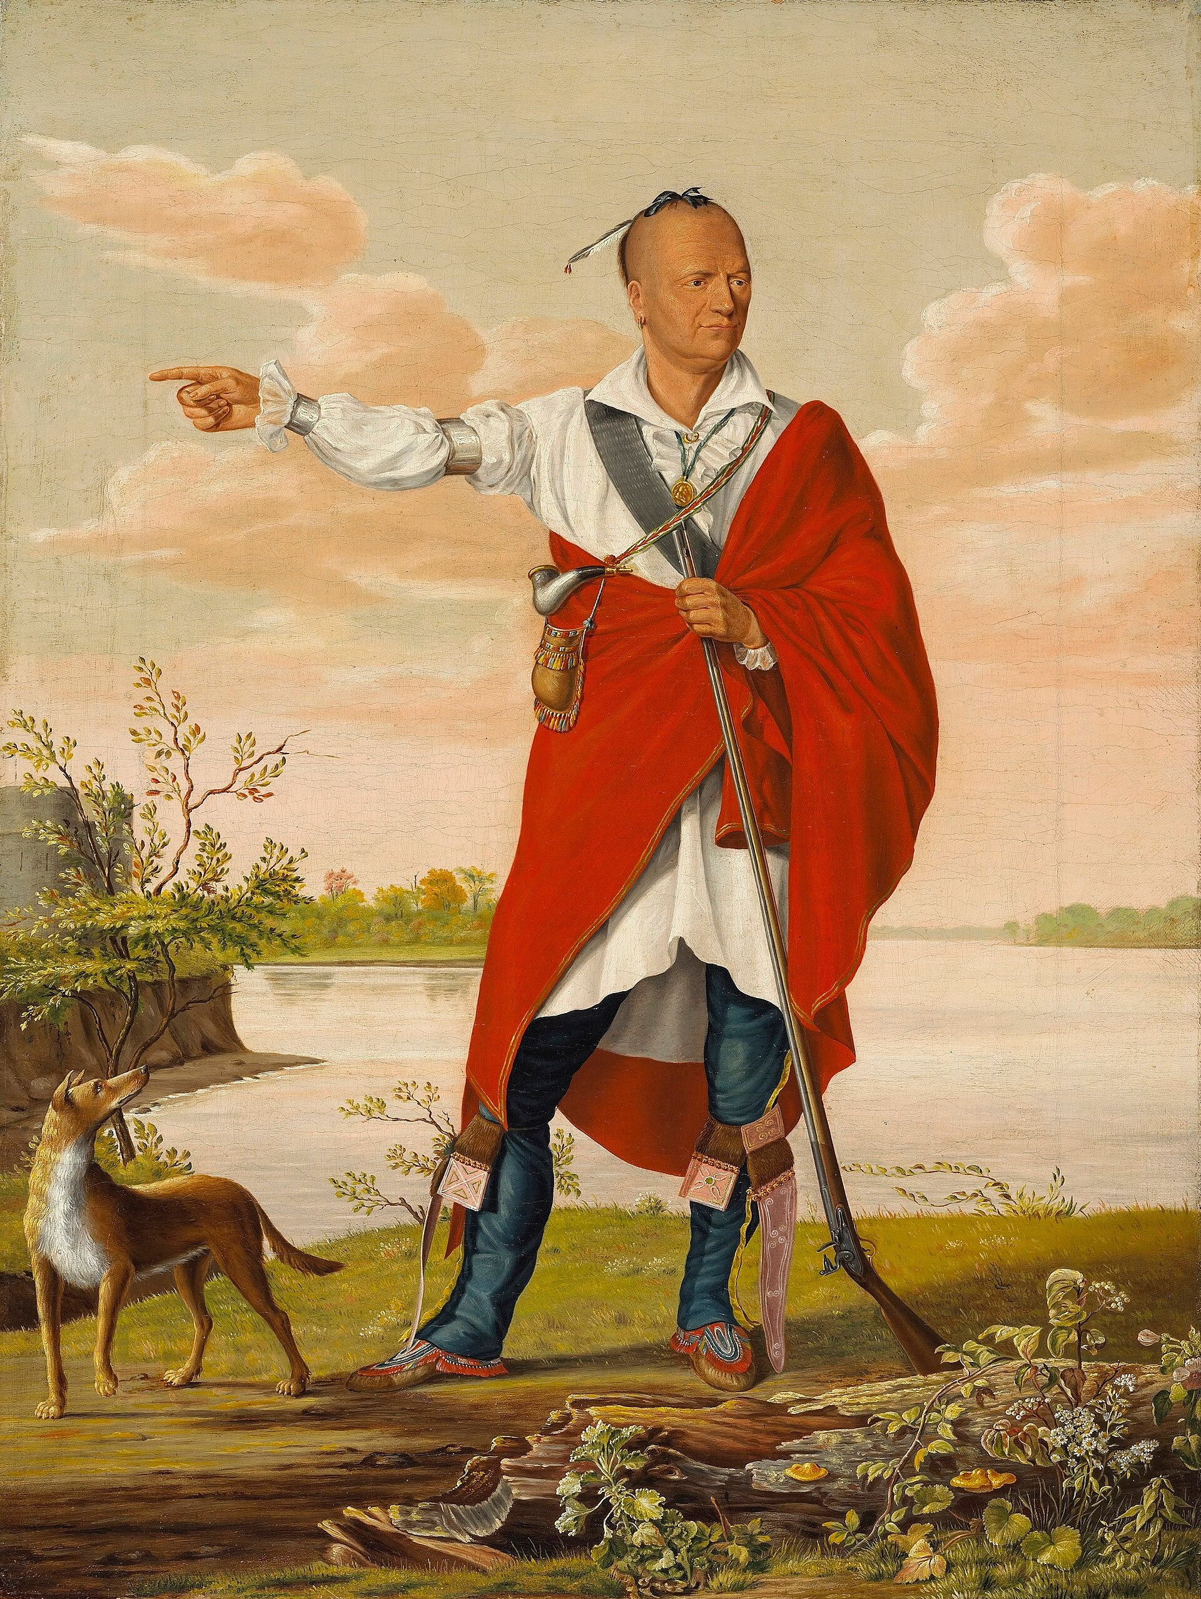
Emmanuel Hesse
Ojibwe, Ho-Chunk, Menominee
Sauk, Meskwaki

Slide 33
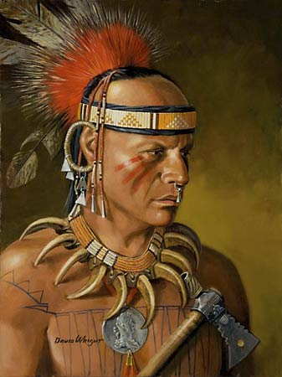
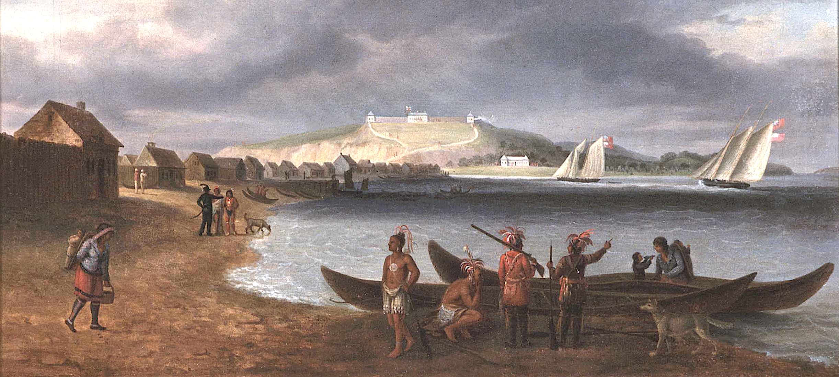
Sergeant J. F. Phillips of 8th Regiment
Matchekewis and Ojibwe

Slide 34
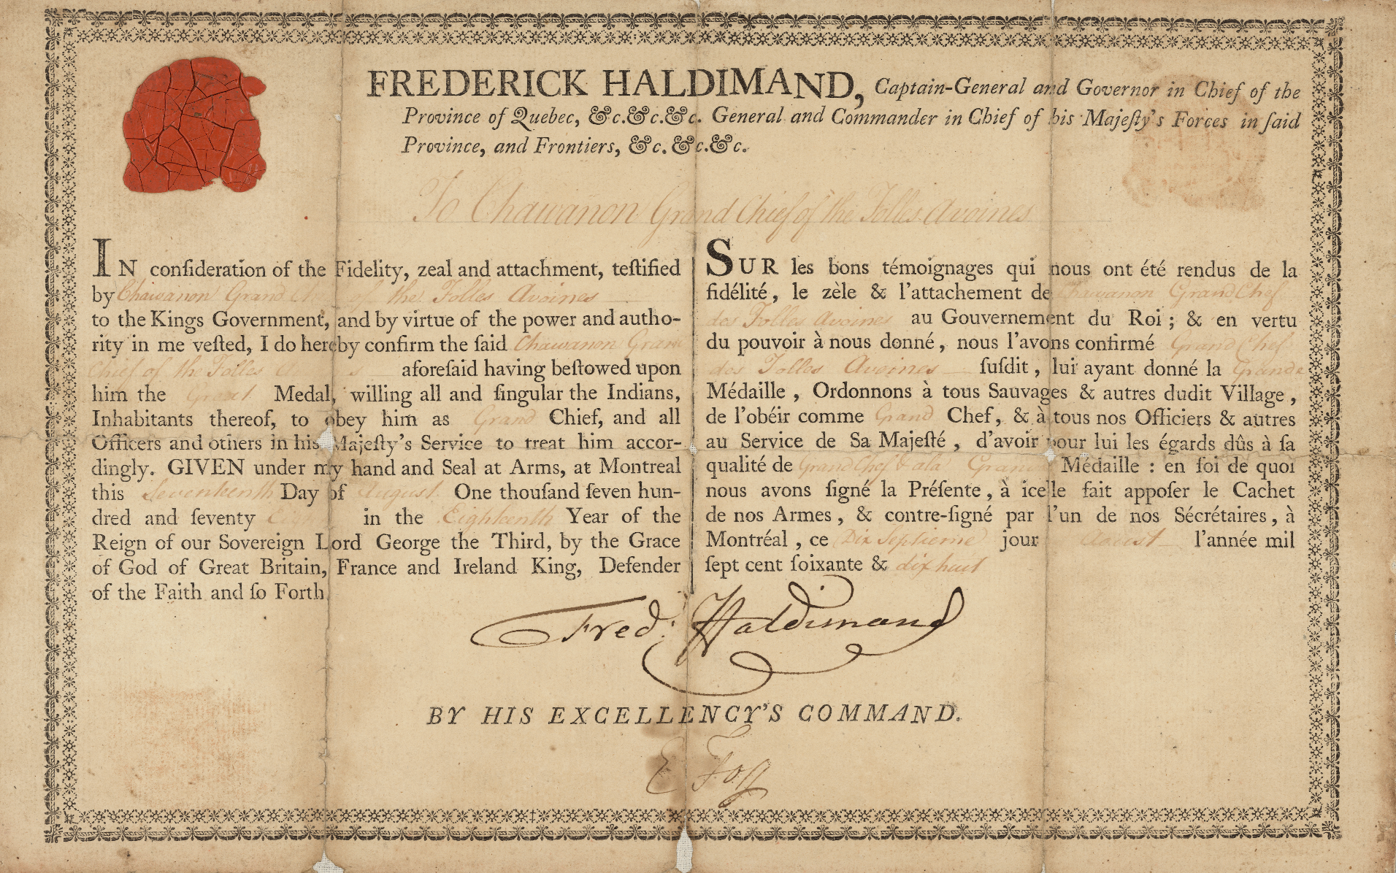
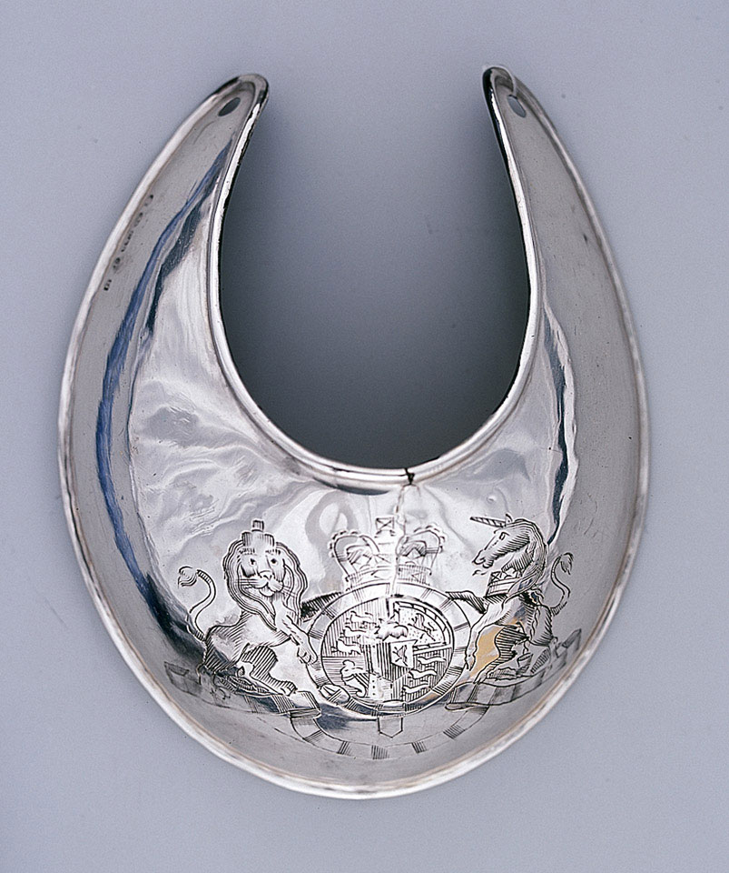
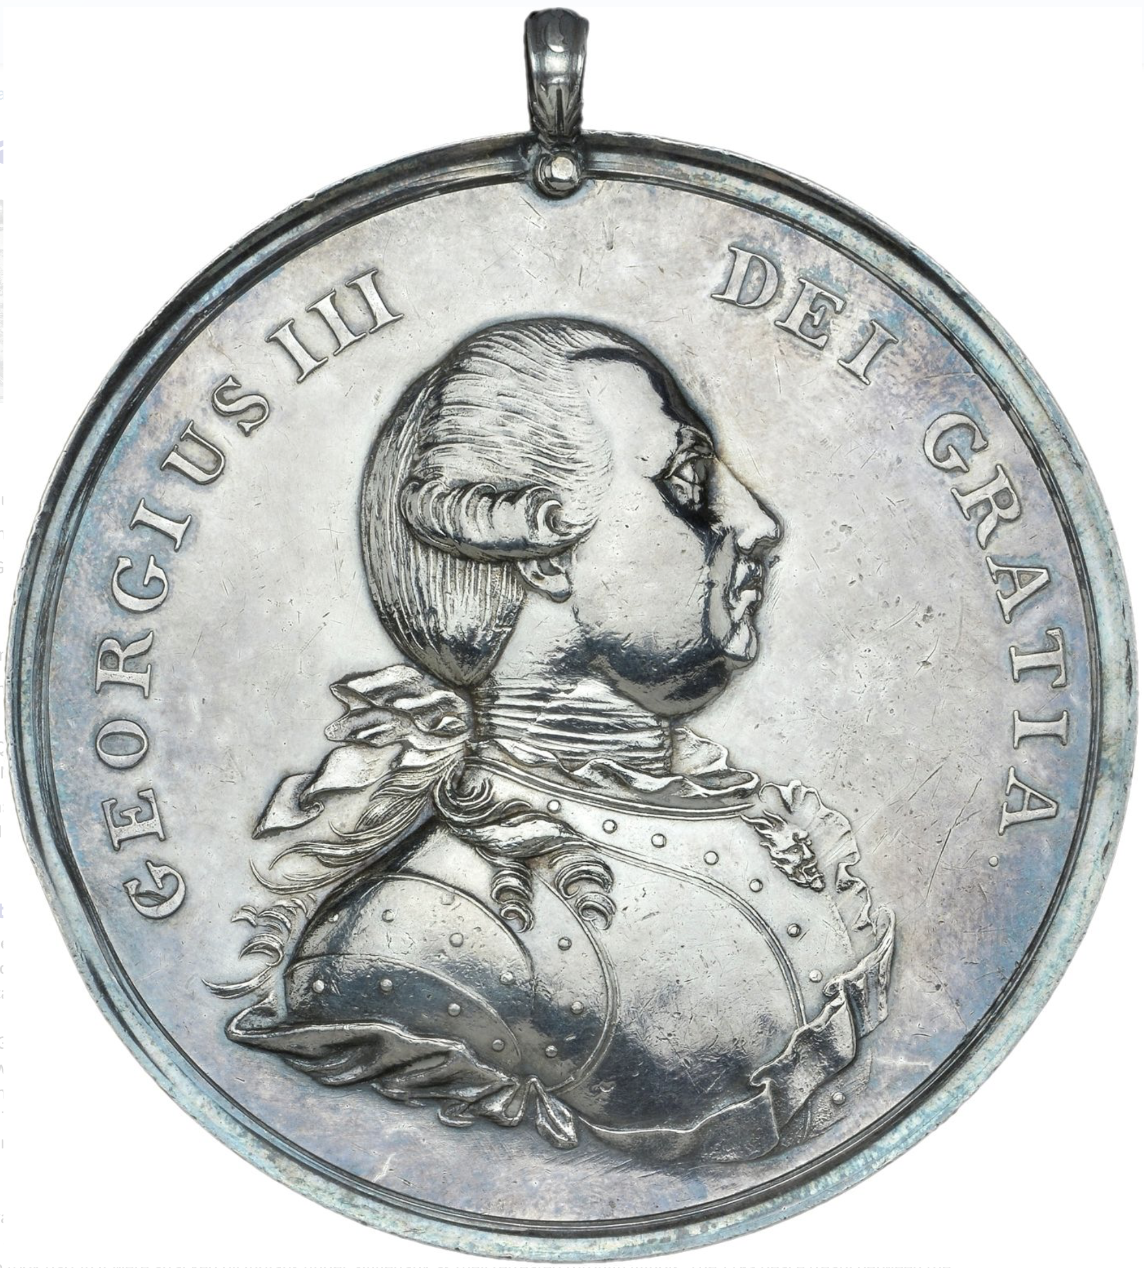
Chanawon

Slide 35
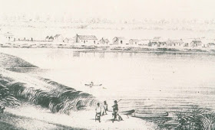
Illinois River Expedition, 1780
Charles Langlade, Charles Gautier, and Pierre Durand as guide
Ottawa, Odawa, Potawatomi, and Canadians

Slide 36
May 1780
750 – 1000 Native Americans (Dakota, Ho-Chunk, Menominee, Sauk), Traders, and Servants left Prairie du Chien

Slide 37
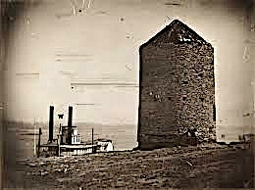
Fort San Carlos St. Louis
Regular Army – 29 men
Local militia – 168
French Militia - 155

Slide 38
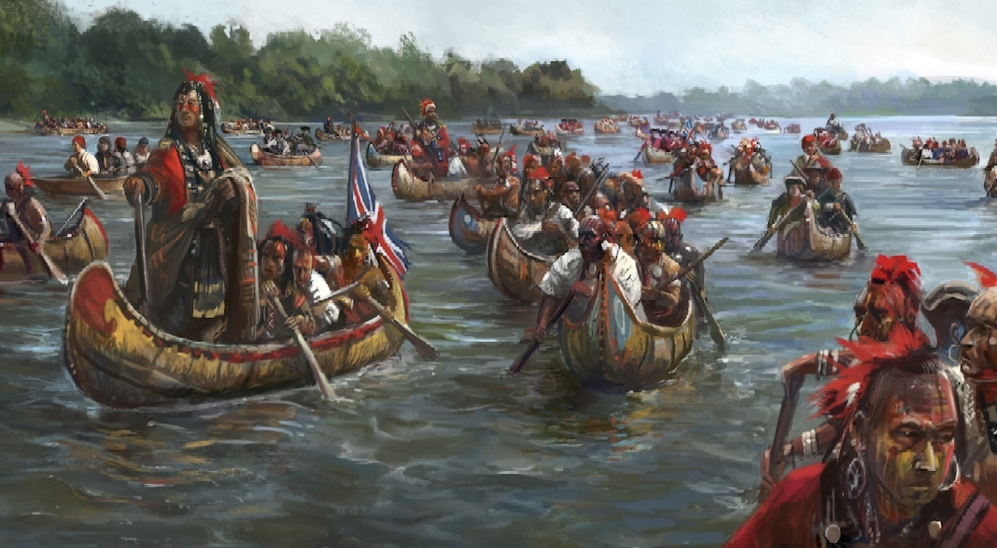
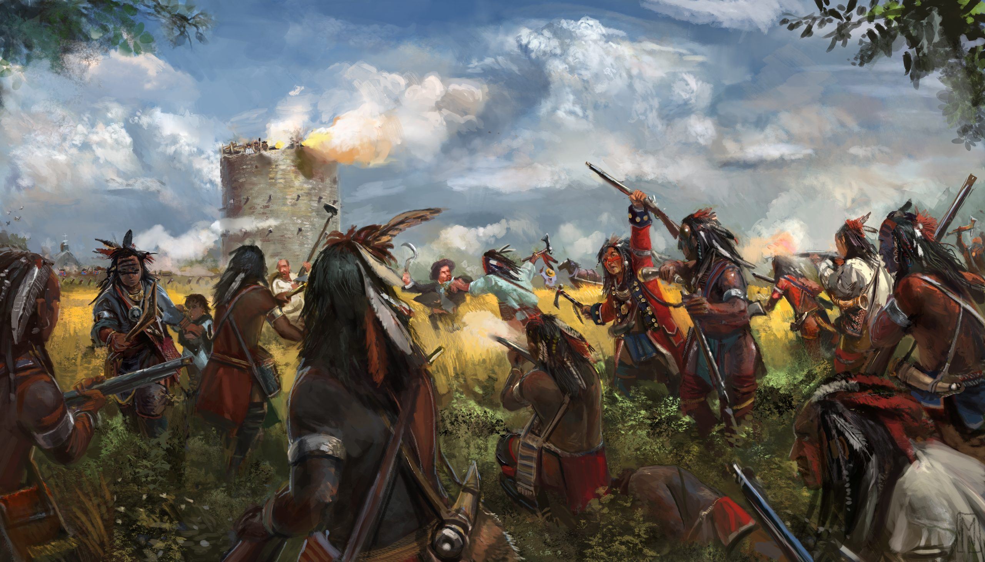
May 23 - Force from Prairie du Chien landed canoes and coming overland
May 26 – Jean-Marie DuCharme and Ojibwe cross river to attack Cahokia - 250
  Dakota, Ho-Chunk lead attack on St. Louis with Sauk and Meskwaki
  Unable to take Fort Don Carlos, Hesse calls troops back, leave, and head north
American force led by George Rogers Clark repulse DuCharme
Langlade force stopped enroute

Slide 39
1781 at Michilimackinac
Treaty signed. Native Nations grant land to residents Mackinac Island,
Green Bay, and Prairie du Chien

Slide 40

Residents of “Wisconsin” in the American Revolution
Wabasha and Dakota
Madjeckewiss and Ojibwe
Chanawon and Menominee
Sauk and Meskwaki
Charles Michel de Langlade
Joseph Roc
Maurice Blondeau
Jean Baptiste Cardinal Marie Anne Souligny
Pierre Lafleur
Pierre Pelletier
Louis Tesson Honoré

Slide 41

October 19, 1781

Slide 42

May 1783 Council at Prairie du Chien
Sioux, Ho-Chunk, Menominee, Sauk, Meskwaki

Slide 43

Treaty of Paris 1783

Slide 44


Slide 45


Lt. Zebulon M. Pike 1804-1805

Slide 46




Slide 47


