Slide 1
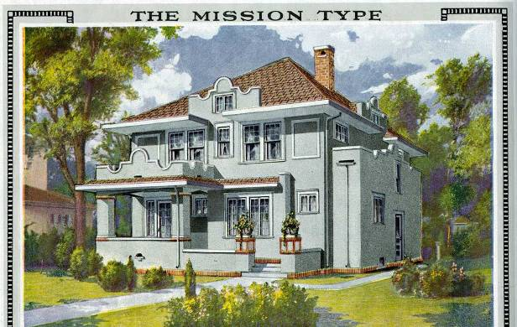
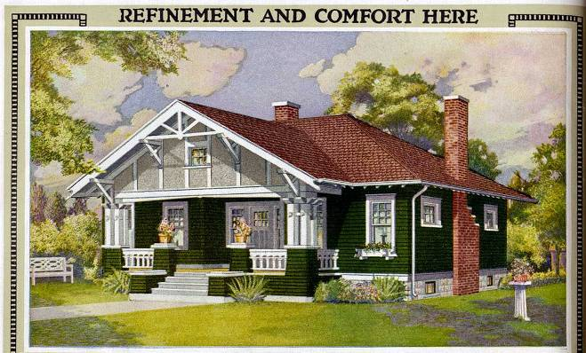
Postal Perfect Architecture
Jim Draeger

Slide 2
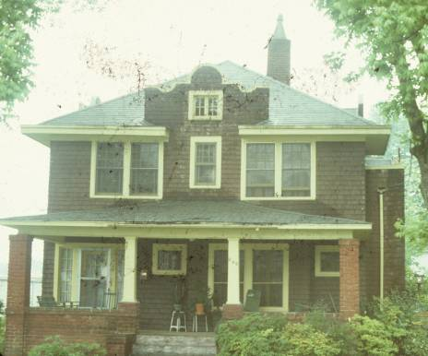
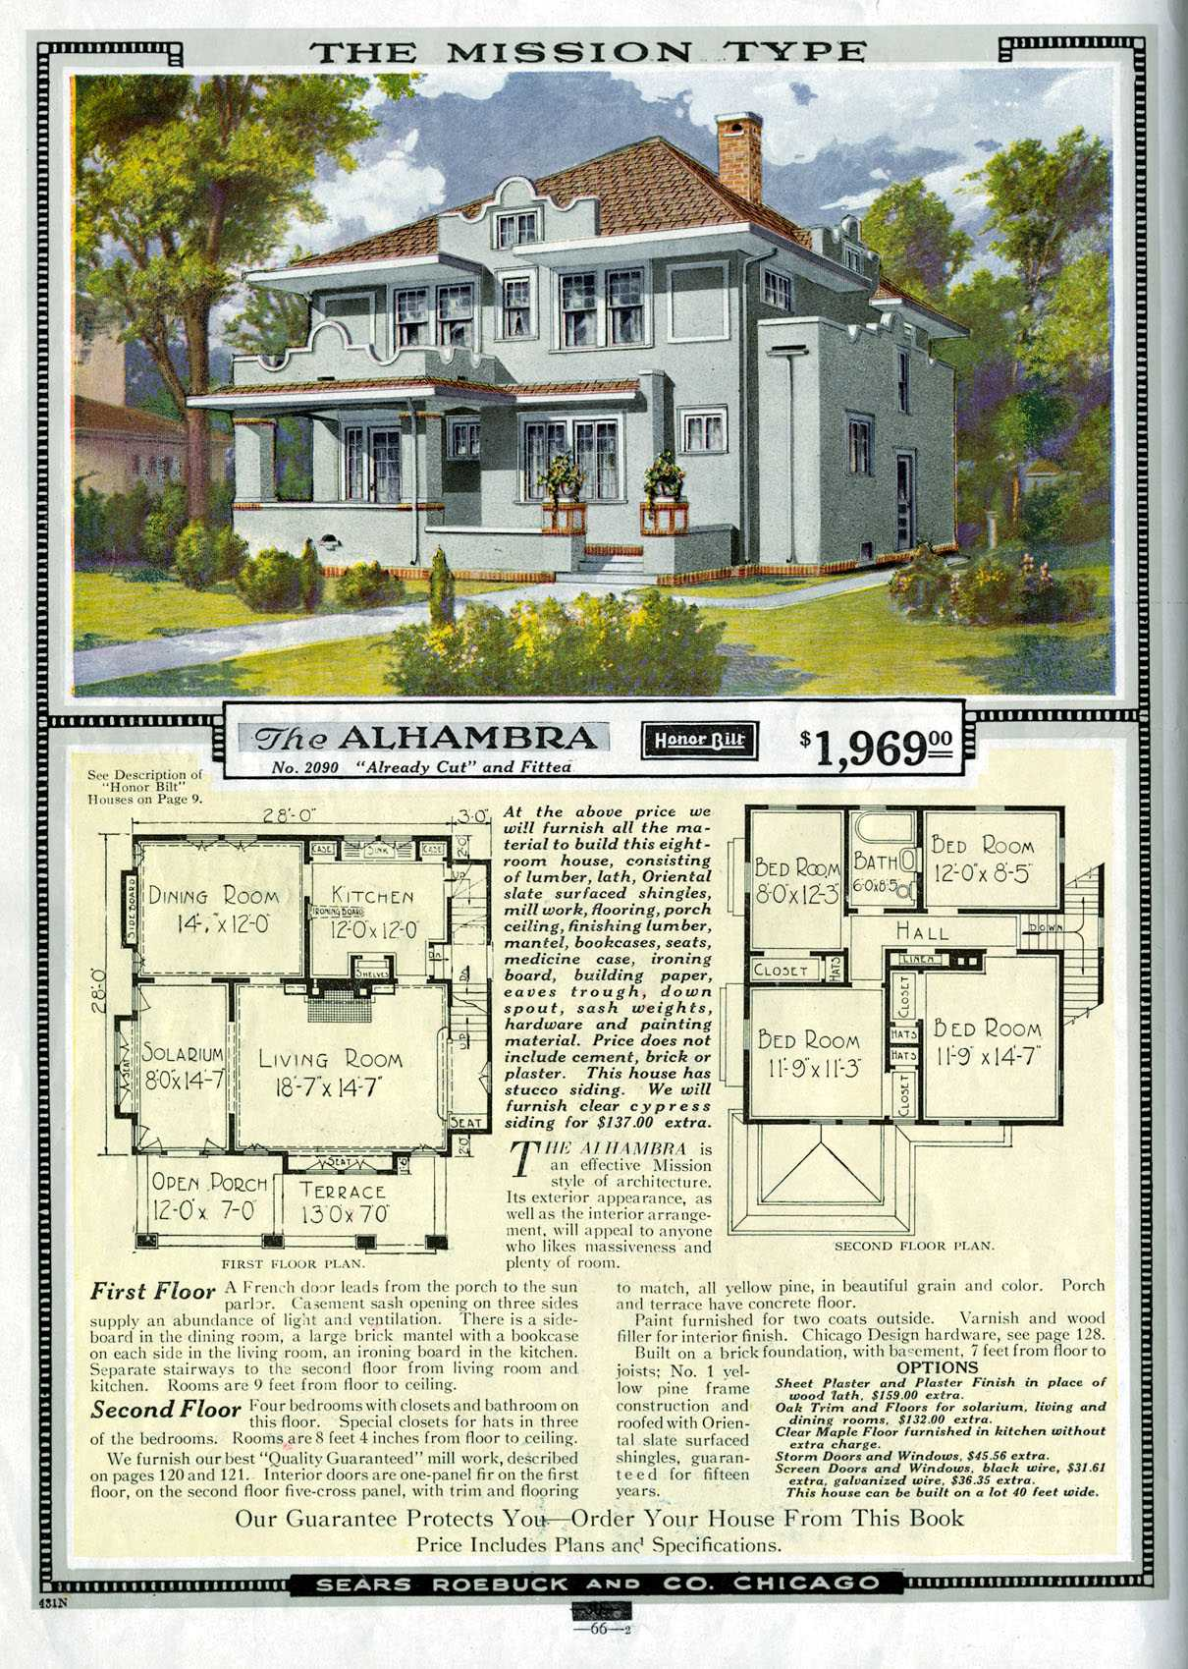
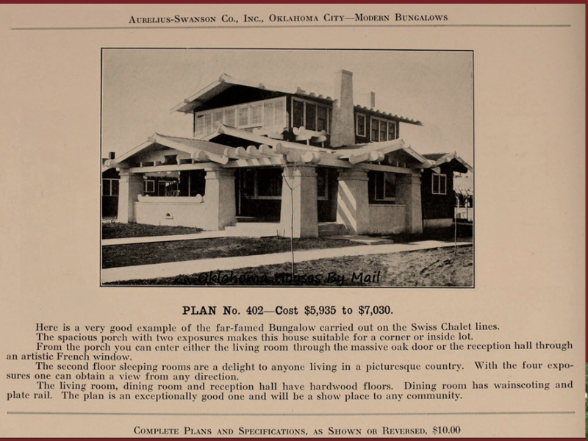
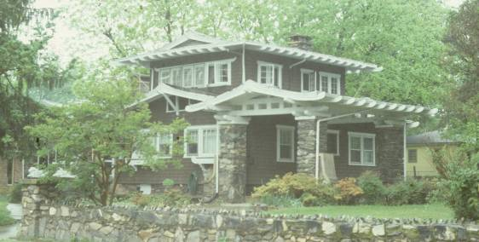
Notes:
[West Meadow, Gaffney, SC] [S. Limestone, Gaffney, SC]
In Gaffney, I discovered my first mail-order house, an Alhambra. The slide on the bottom right I confidently labeled “Sears and Roebuck House” on the basis of the owner's assertion. 42 years later, I finally identified the design from an Aurelius Swanson Company catalog. My next experience was in Old Hickory, Dupontonia, and Rayon City, TN. Company town, etc.

Slide 3
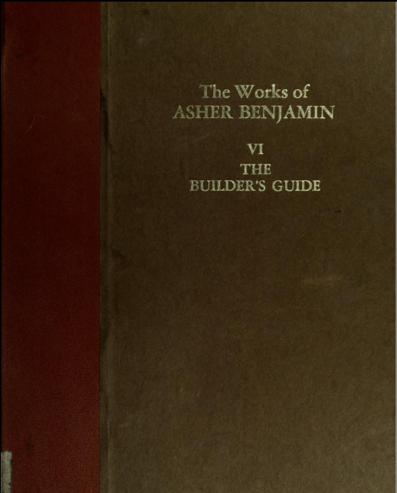
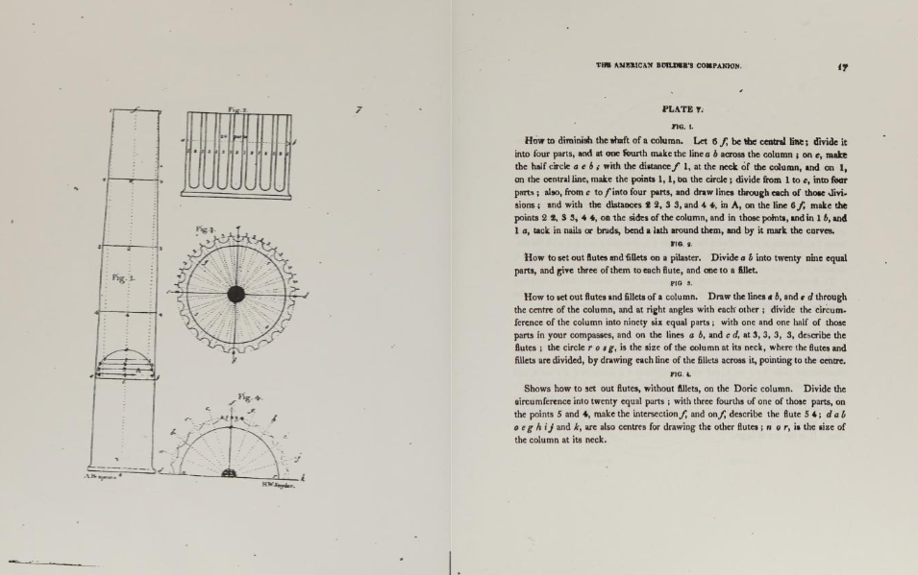
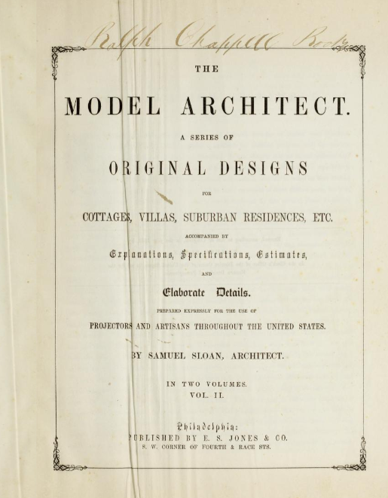
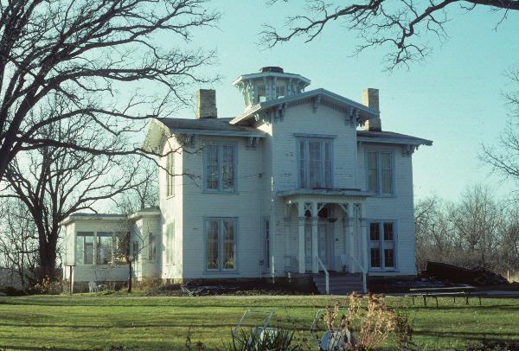
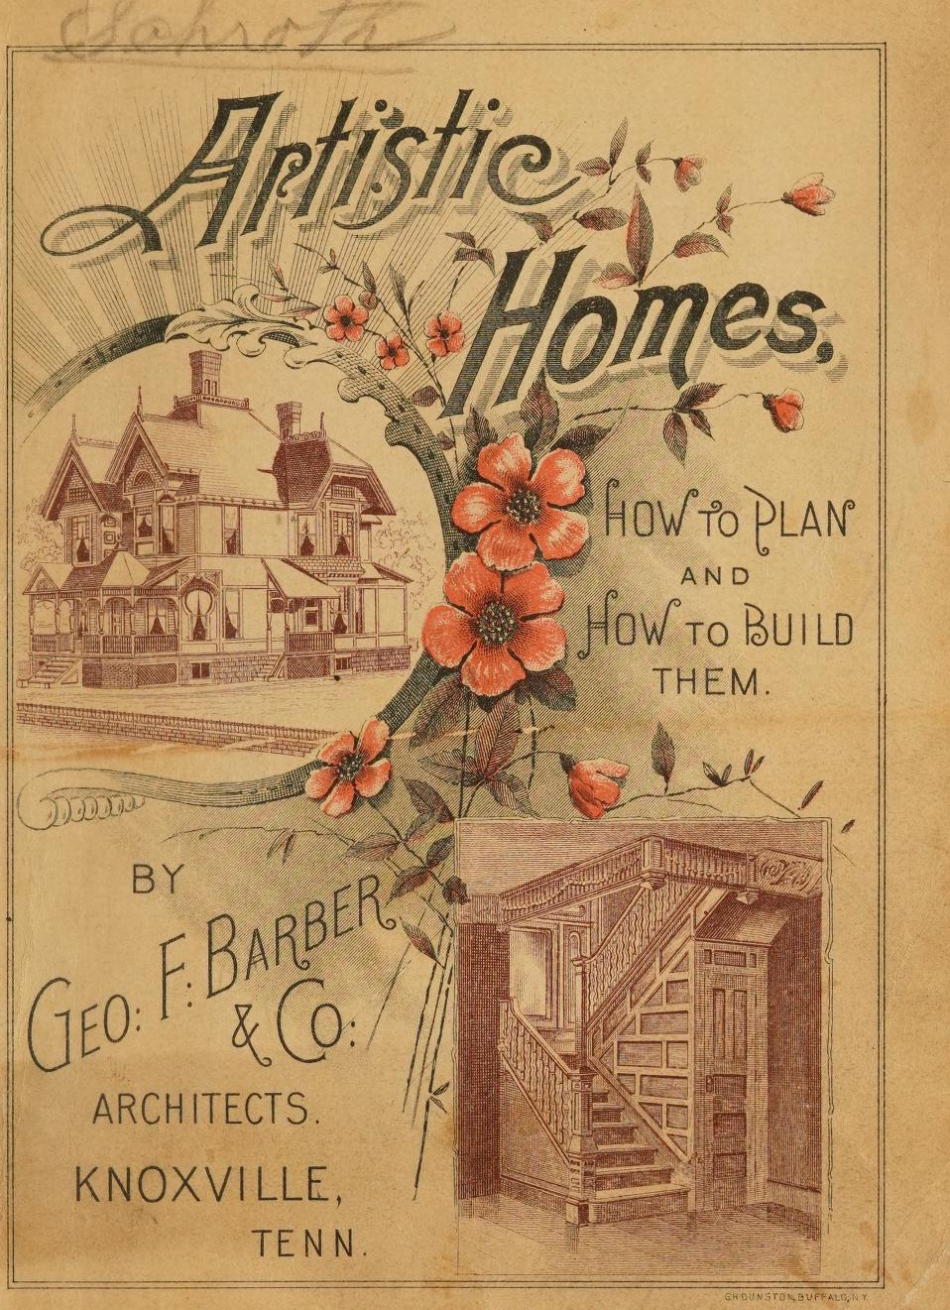
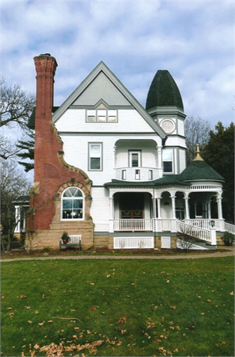
Notes:
[Asher Benjamin builder’s guide] [Samuel Sloan Model Architect] [ George Barber Artistic Homes]
Sears did not discover something new.
Carpenter’s manual to design ideas to full blueprints

Slide 4
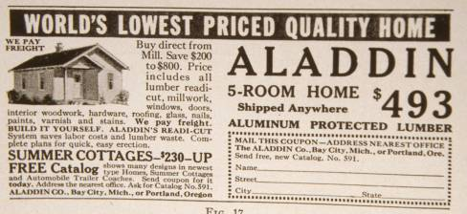
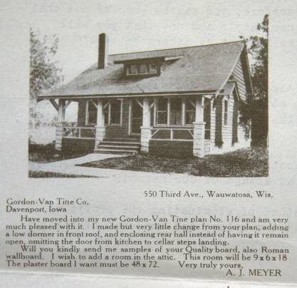
Notes:
[Gordon Van Tine testimonial] [Aladdin Homes frontispiece 1919]
The Aladdin Company of Bay City, Michigan was the first to offer complete mail order build-it-yourself house in 1904 and quickly became the largest manufacturer of mail order houses in America. In 1918 Aladdin’s sales accounted for 2.37% of the country’s housing starts. In its peak year of 1926, it sold 3, 650 houses.
Gordon Van Tine of Davenport, IA was instrumental in the development of mail-order houses. The company began as a millwork firm selling components specified in its mail order plans. Stock building elements had been available for a long period of time, the success of Gordon Van Tine was in packaging components such as stairs, windows, and doors with blueprints. This eventually became full-blown mail-order homes business. (Periodicals marketed these companies)

Slide 5
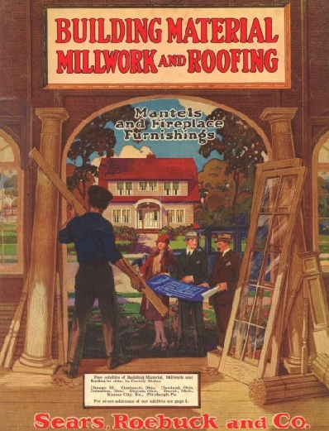
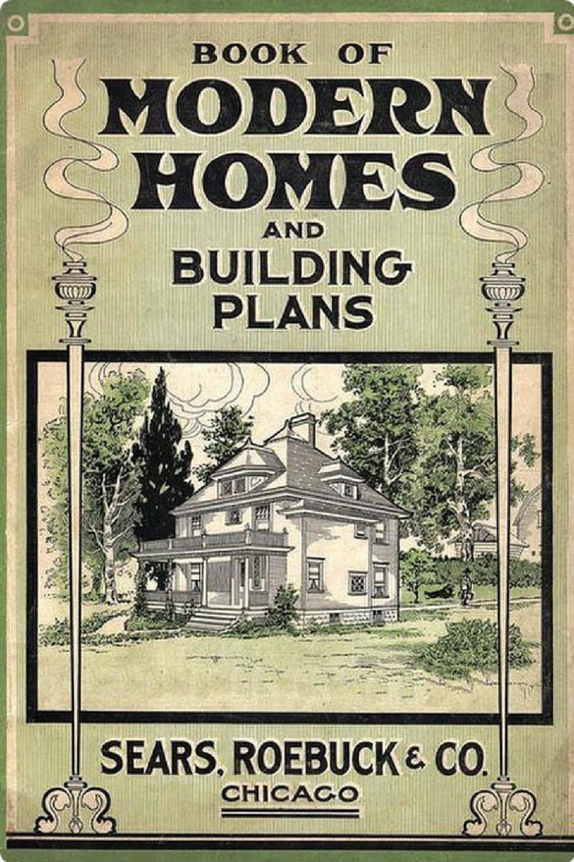
Notes:
[Sears and Roebuck building material catalog] [1908 catalog]
Sears and Roebuck was founded in 1886 as a general merchandise mail-order business. It began selling millwork and plans in 1895 and entered the catalog home business in 1908. the beginnings of its mail-order houses ironically grew out of the transfer of a new manager into the unprofitable millwork division to shut it down. Sears and Roebuck eventually became the largest supplier in the U.S.

Slide 6
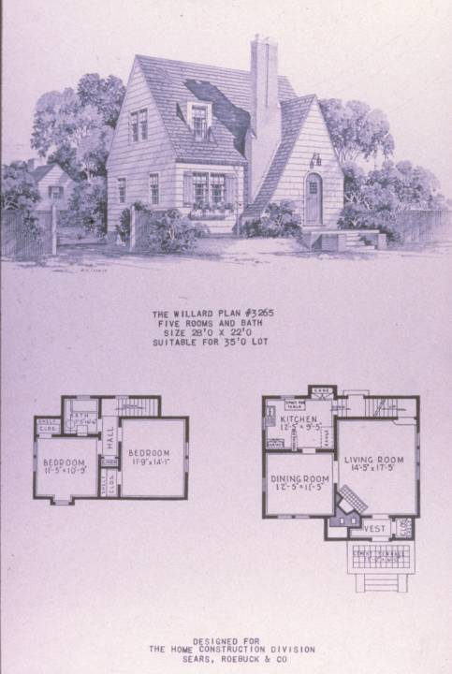
Notes:
[Willard illus.]
No records remain of Sears home sales so, total numbers are difficult to determine. Sears also operated a separated Home Construction Division that would build from Sears plans or the plans of others.

Slide 7
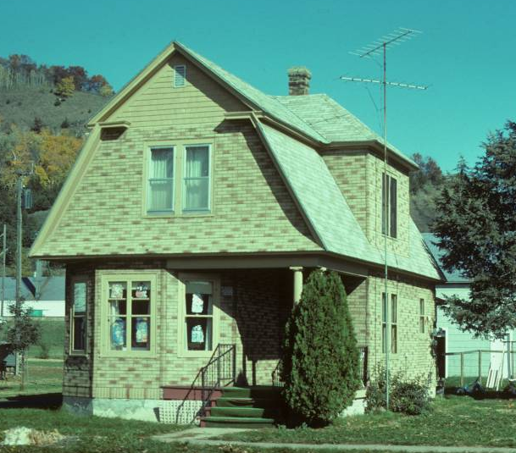
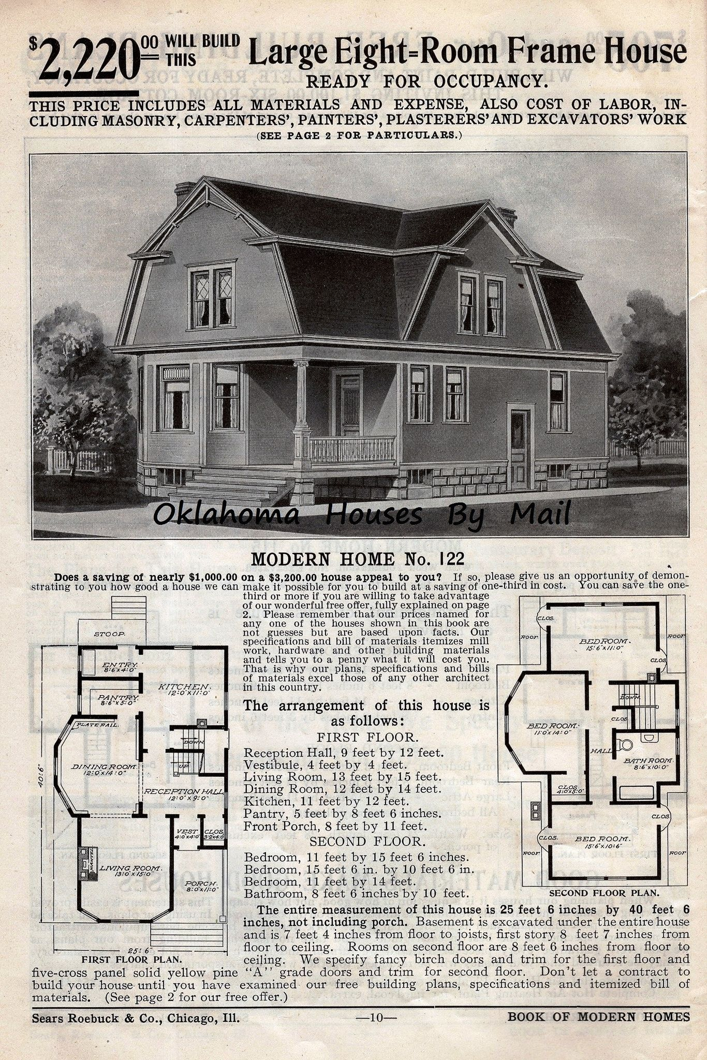
Notes:
[#122 Cochrane, WI]
First home catalog in 1908 offered 22 models, early plans were identified by number. After the mid-teens romantic or picturesque names were used as part of the promotional schemes for these houses. Sears also promoted their houses on the basis of cost, quality, and quick delivery. Mail order houses were advertised in the Sears and Roebuck catalog as well as popular publications such as House Beautiful.

Slide 8
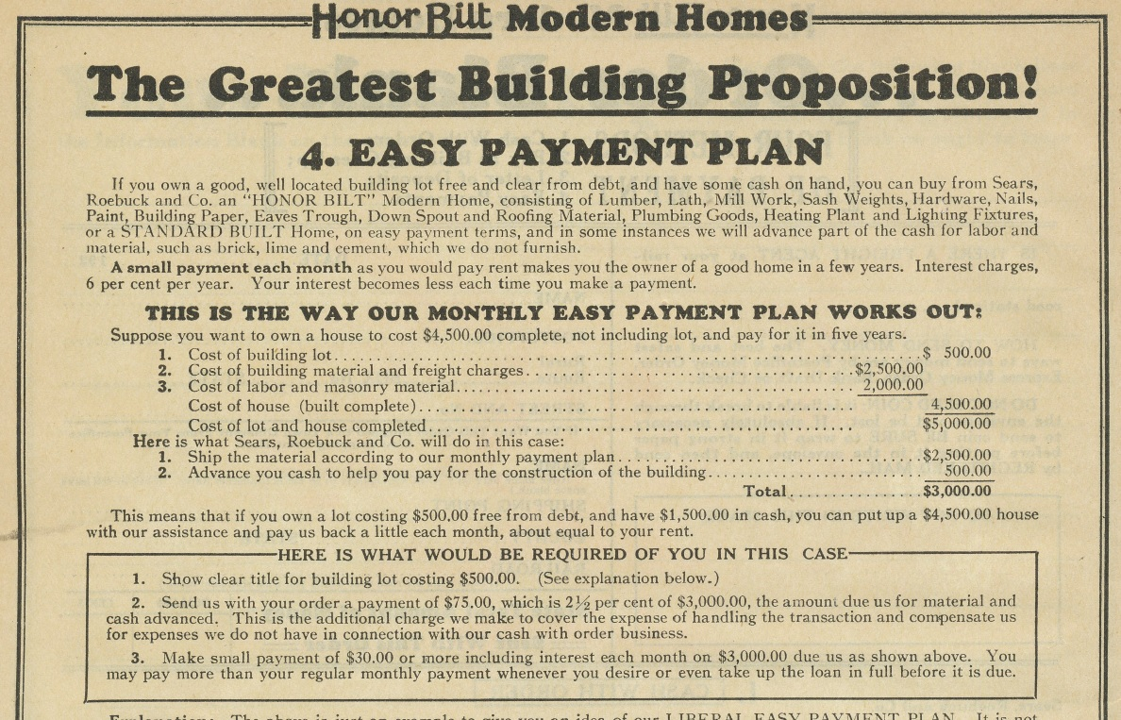
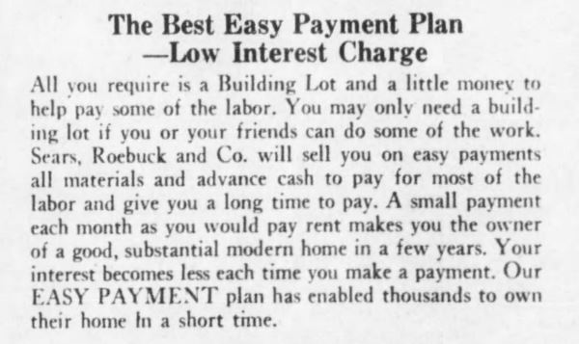
Notes:
[advertisement]
Sears offered home financing beginning in 1911, at a time when long term mordgages were rare. Payment plans included cash, payment as the building was built, and “easy payments.” the payment plan was 2½% down and one percent a month. Mortgages could extend as long as 15 years and could include the cost of the lot. This may have significantly boosted sales during the boom years of the 1920s, but hurt the company badly when the depression forced Sears into the dilemma of having to foreclose on mortgages of loyal customers.

Slide 9
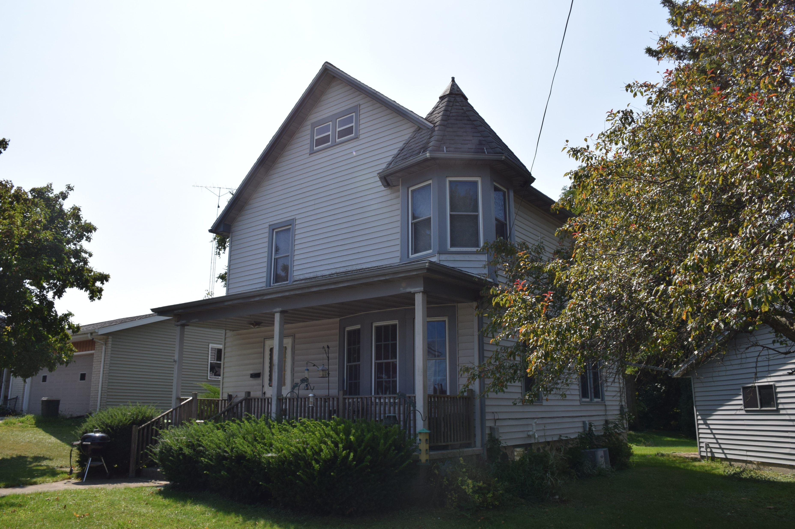
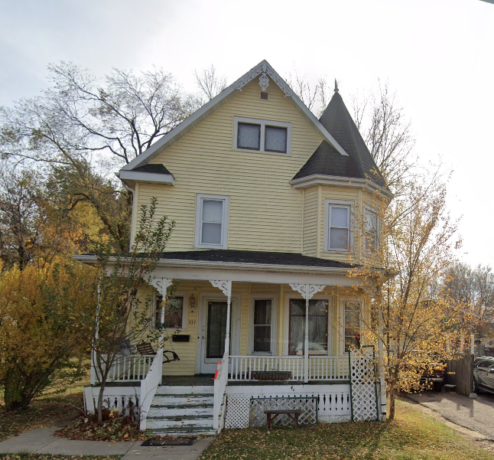
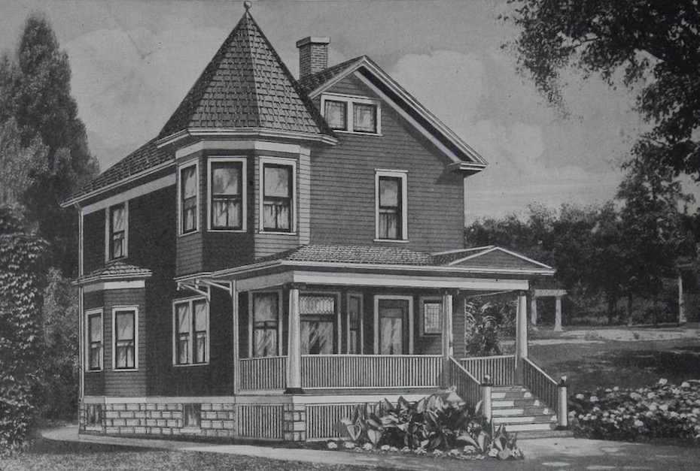
Notes:
[Maytown, 103 Columbus, Chilton] [Maytown, 337 WI-33, Reedsburg]
Sears houses reflected popular tastes of the time with designs that were often simple, austere and slightly dated.

Slide 10
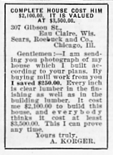
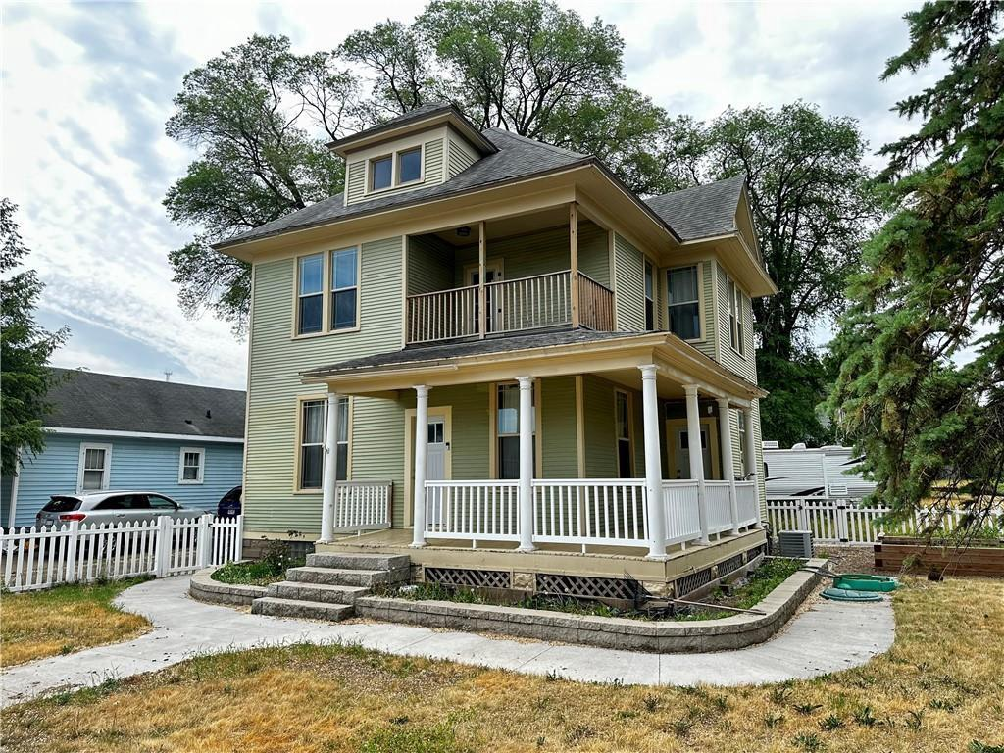
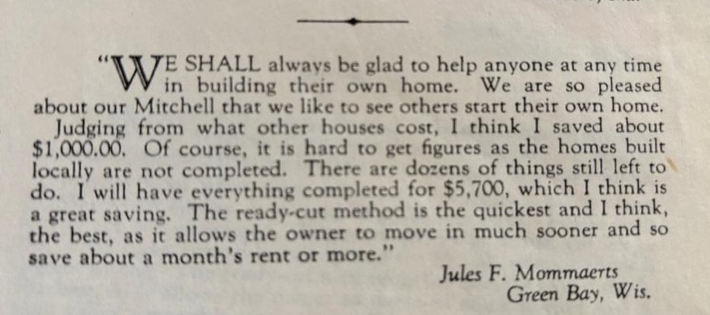
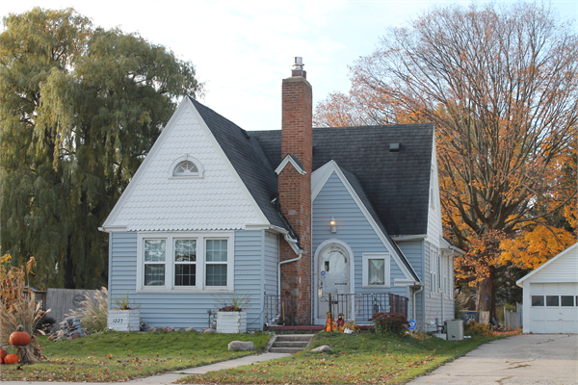
Notes:
Testimonials and guarantees

Slide 11
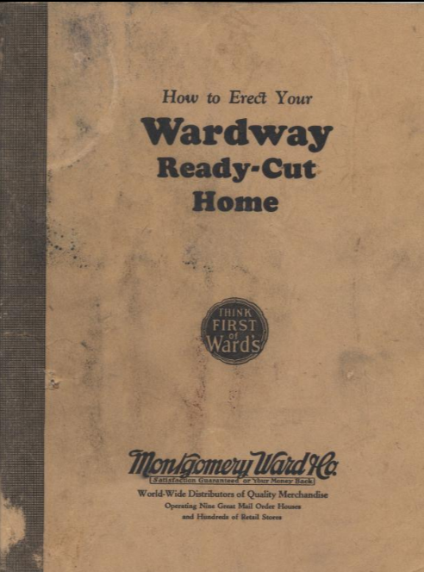
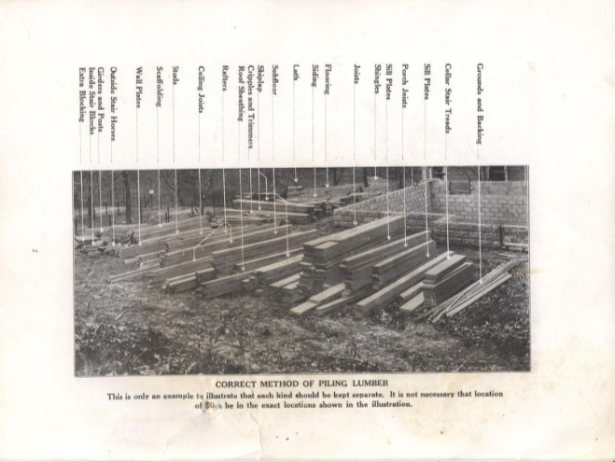
Notes:
[Elsmore, Pepin]
Precut houses were designed for ease of erection. Each piece was numbered and keyed to a set of blueprints. Sears houses came with a 77 page construction manual and were designed for construction by novices. The largest numbers of examples have been found in industrial communities that boomed during the heyday of catalog architecture in the 1910s and 20s.

Slide 12
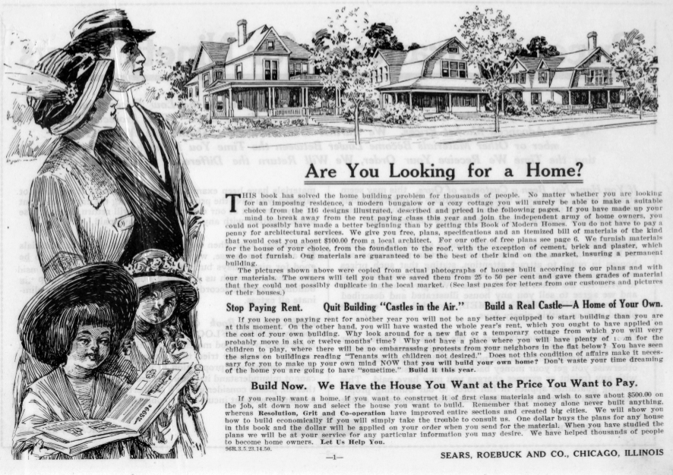
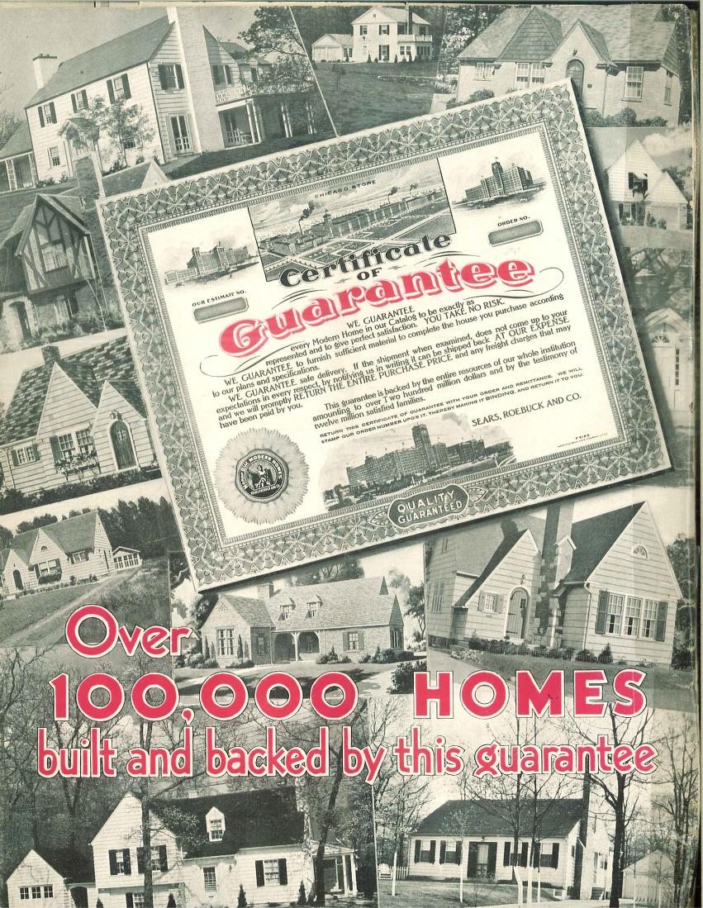
Notes:
So what do they guarantee?
Lumber and Millwork as represented
Meets or exceeded standard lumber grades
Immediate shipment
Can return for refund at Sears expense
Will replace any damaged items

Slide 13
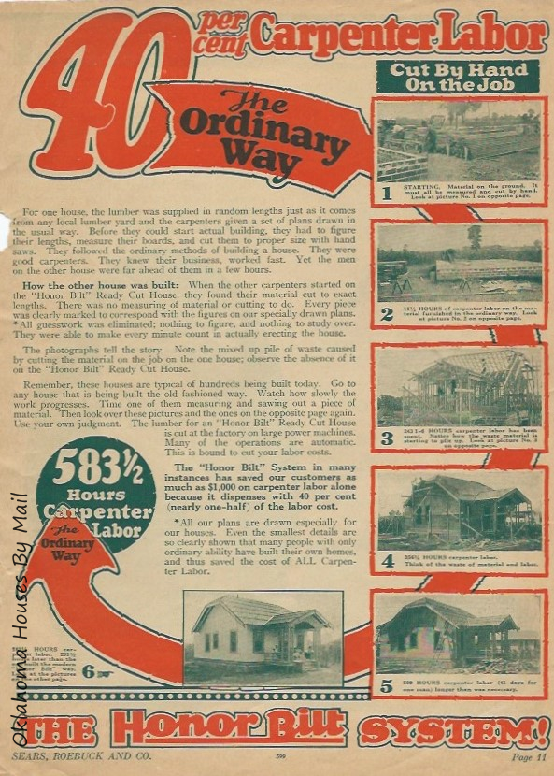
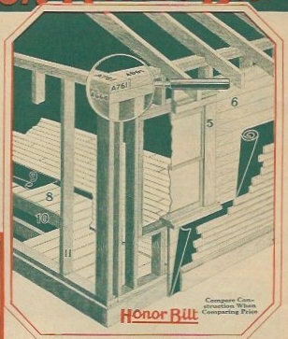
Notes:
In two months time, a single carpenter could erect a Sears house due to simplified assembly.

Slide 14
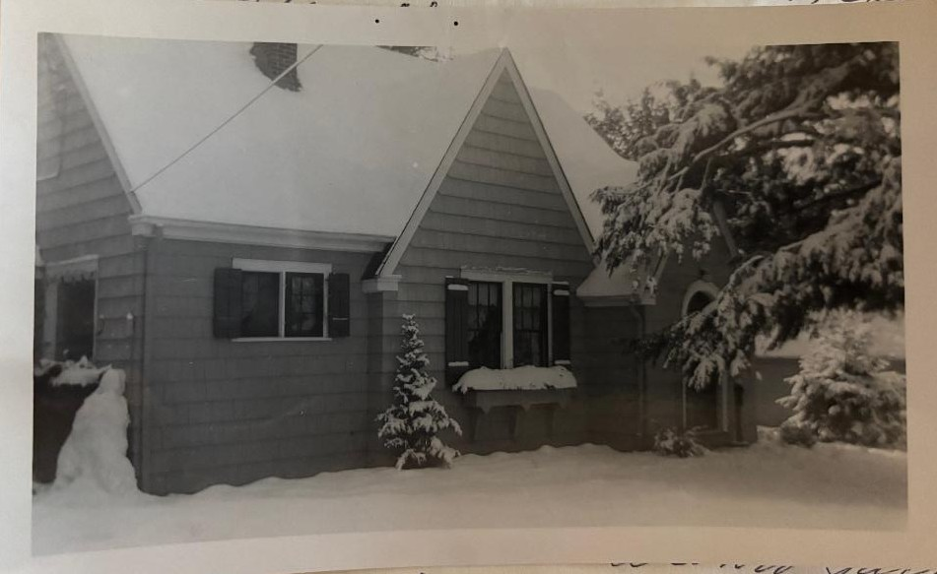
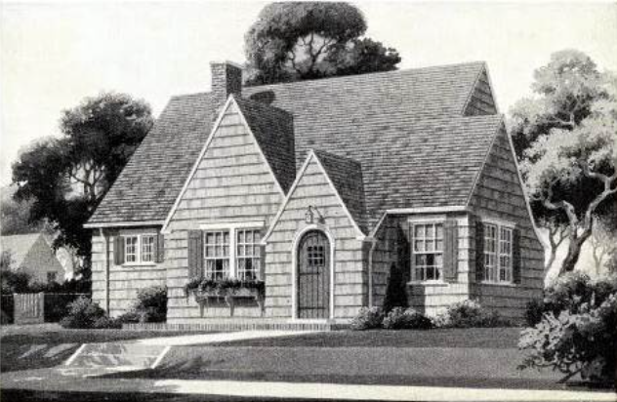
Notes:
Wilmore AHI:N Spencer & Sylvia Nelson, 120 B Old Camp Road,Washington Island DO, 1939.
Imagine you are newlyweds, Spencer & Sylvia Nelson and you want to build a new home for your life together. Imagine you live on an island off the tip of Door County. All your building materials and workers need to be ferried to the island. Spencer bought a Sears Wilmore and paid a local carpenter to nail the kit together.

Slide 15
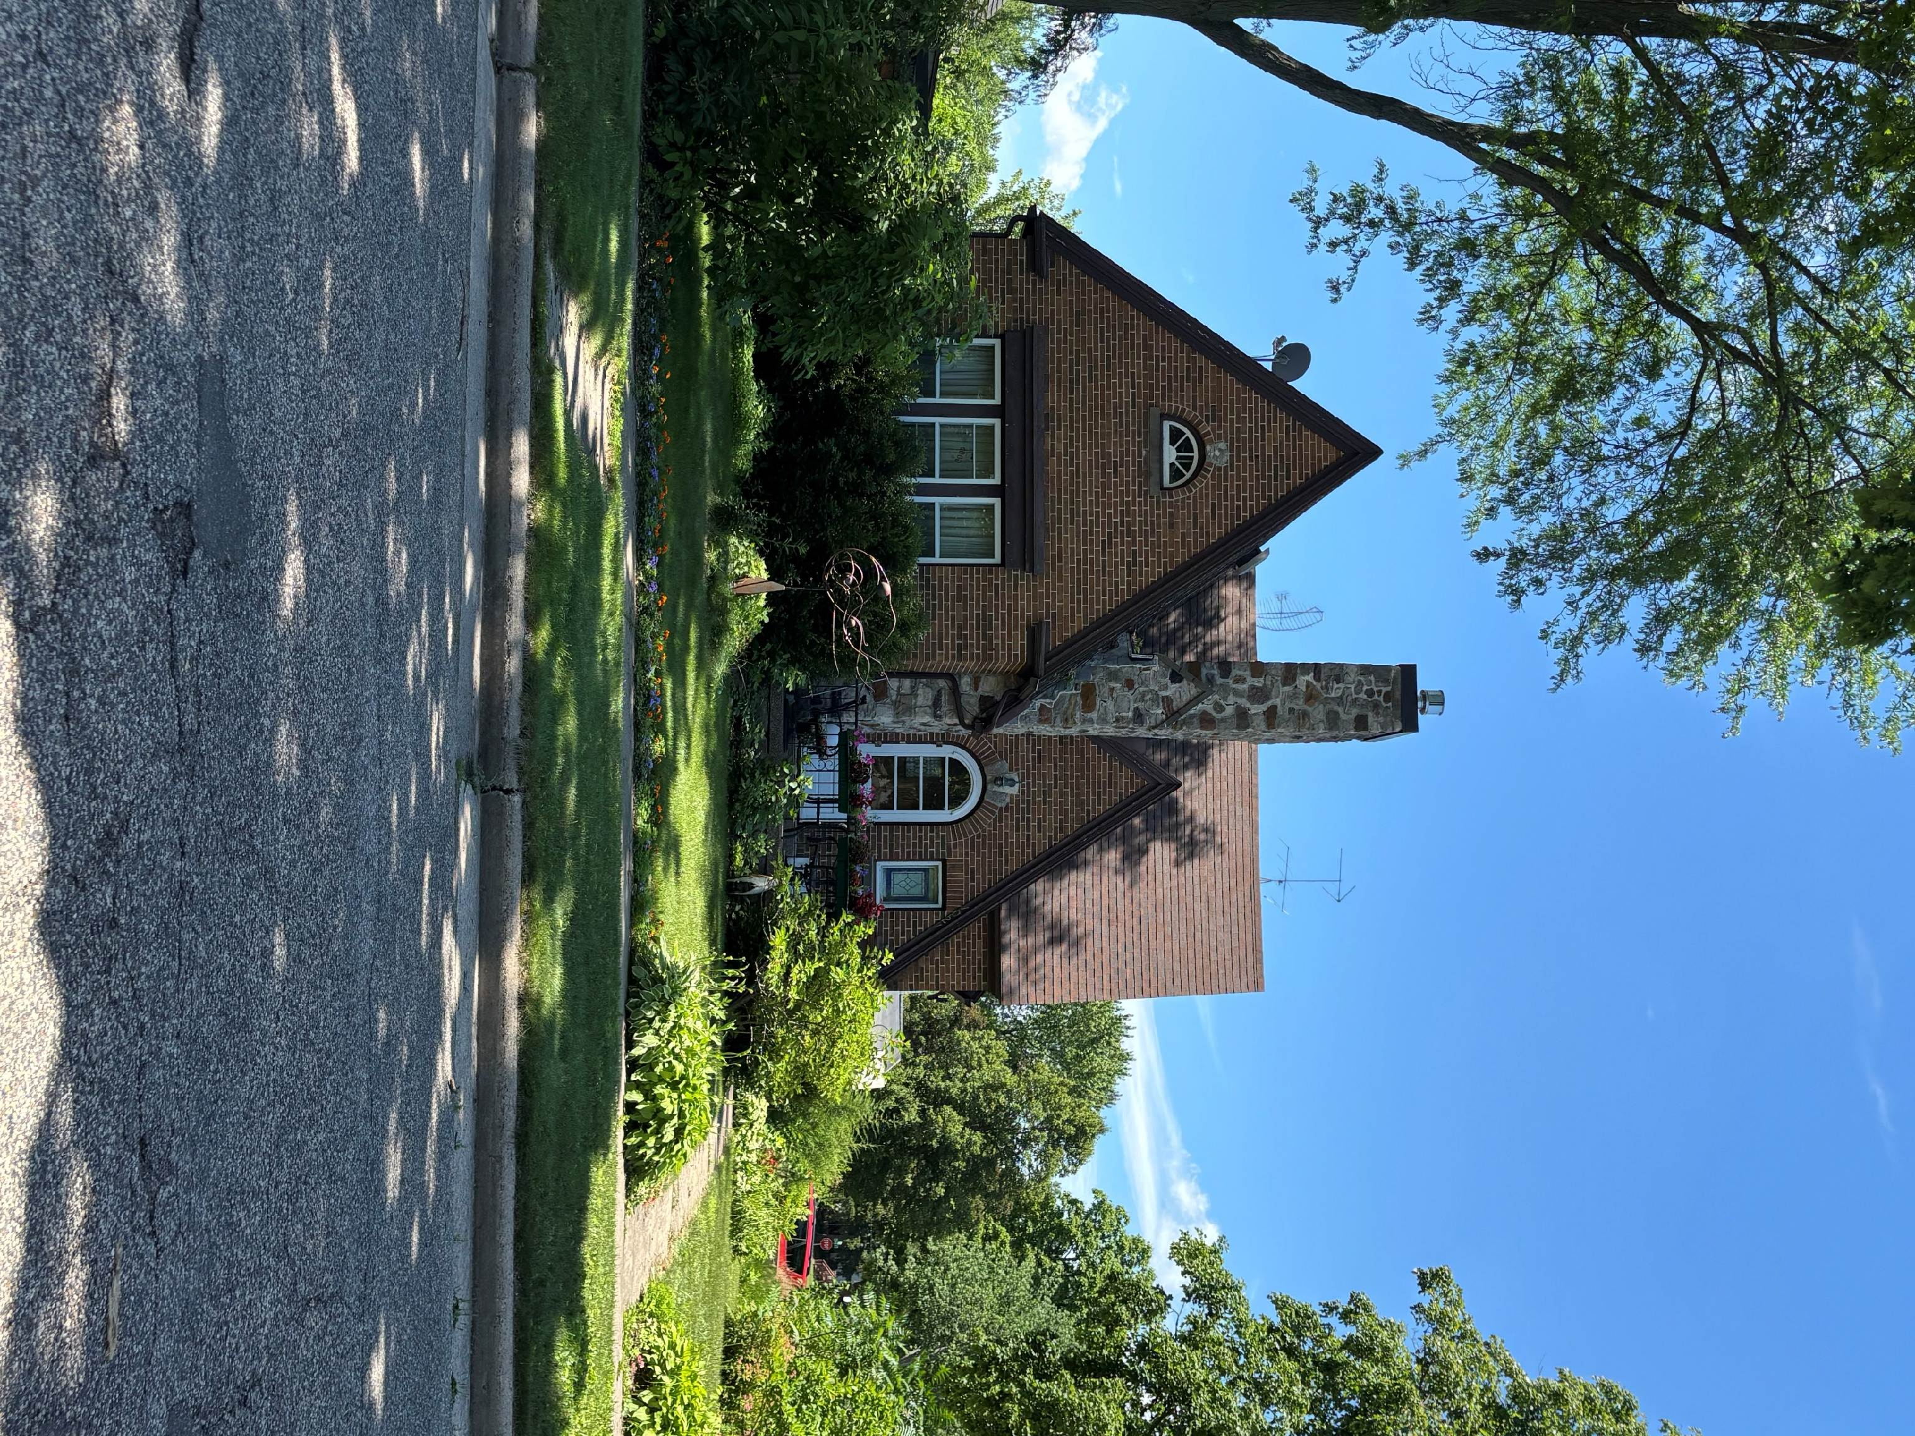
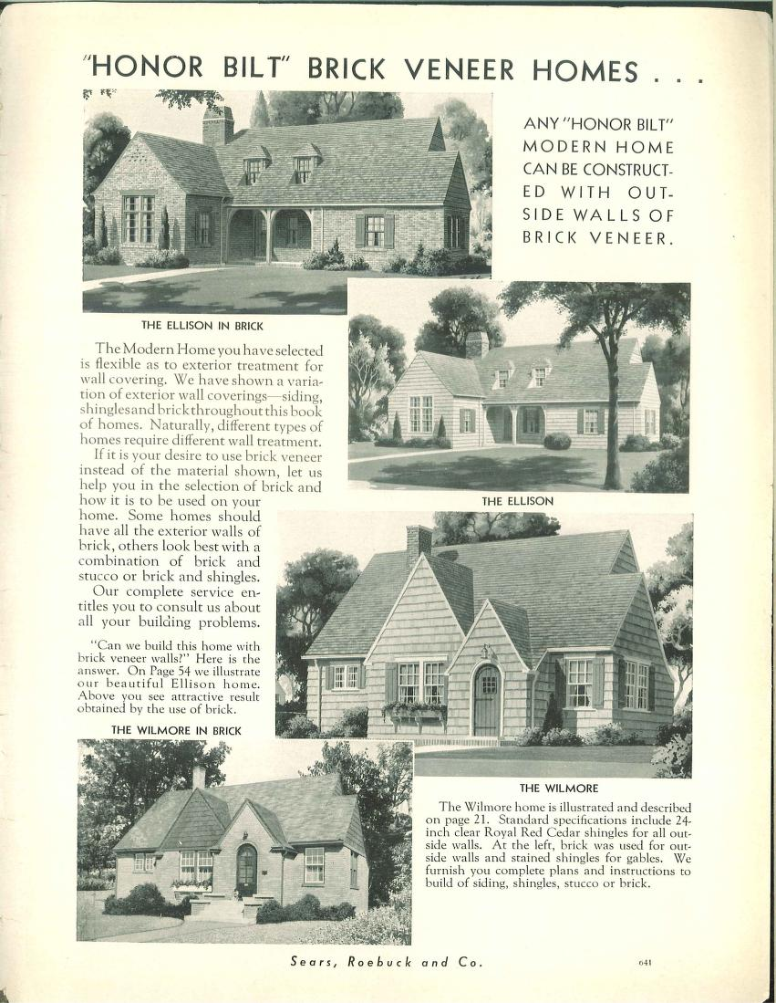
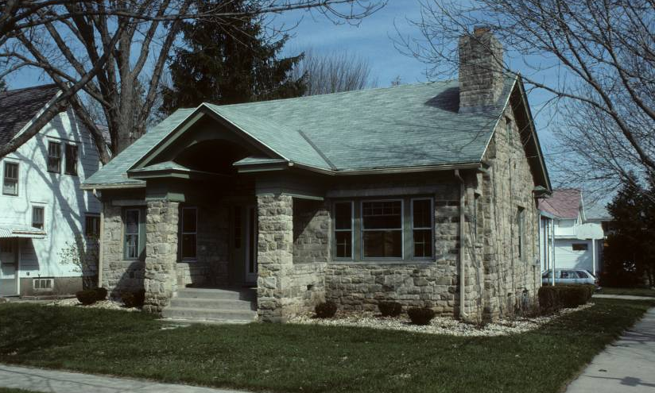
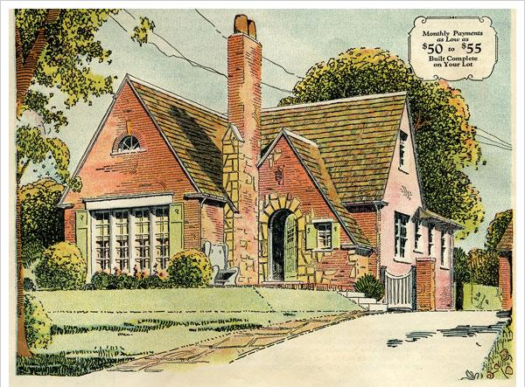
Notes:
[Stratfort, 1021 Ash St, Baraboo 1932] [Crescent, 702 Emertson, Madison 1927]
Sears allowed for construction of masonry versions of their houses.

Slide 16
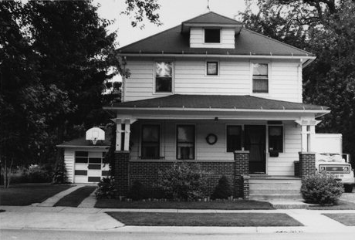
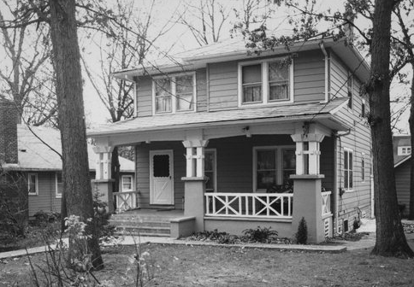
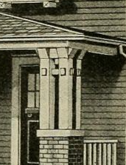
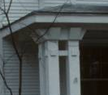
Notes:
[Woodland 317 N TERRACE ST, Janesville, RO 1921] [Americus AHI: 83118 18 LINCOLN PARKWAY, Williams Bay, WL]
[porch post Haven]
Many designs shared millwork and other standard components so that greater diversity was possible. Over two dozen plans featured this distinctive porch post. During Sears’ three decades in the housing business, 447 models were offered. Most house designs were only offered for a few years before being replaced by newer designs. An exception to this are perennially popular designs such as the Westly, which was sold from 1912 to 1940.

Slide 17
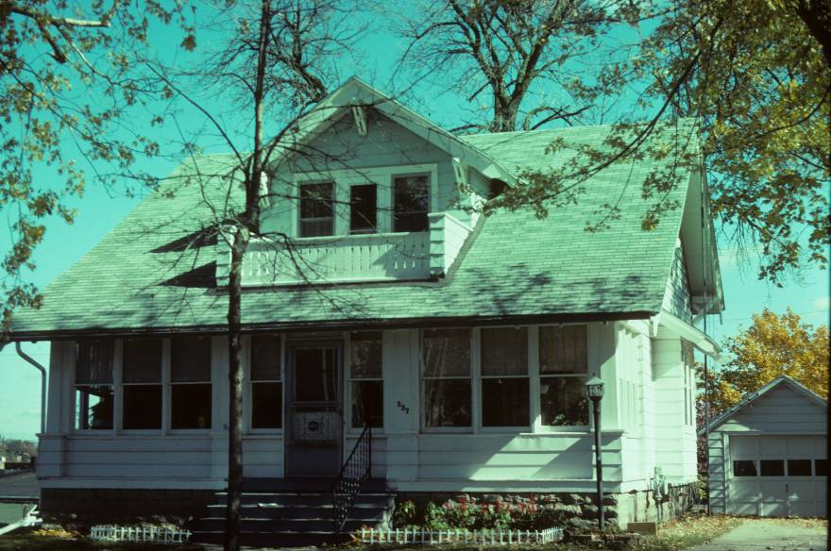
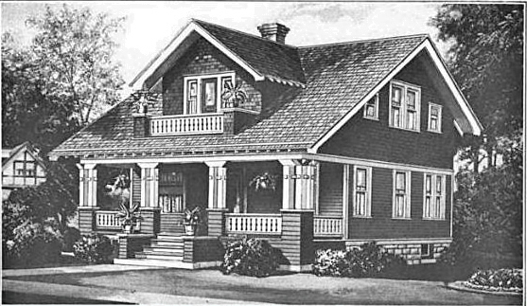
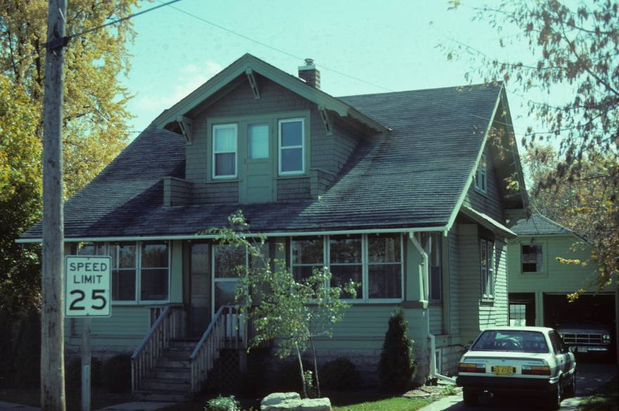
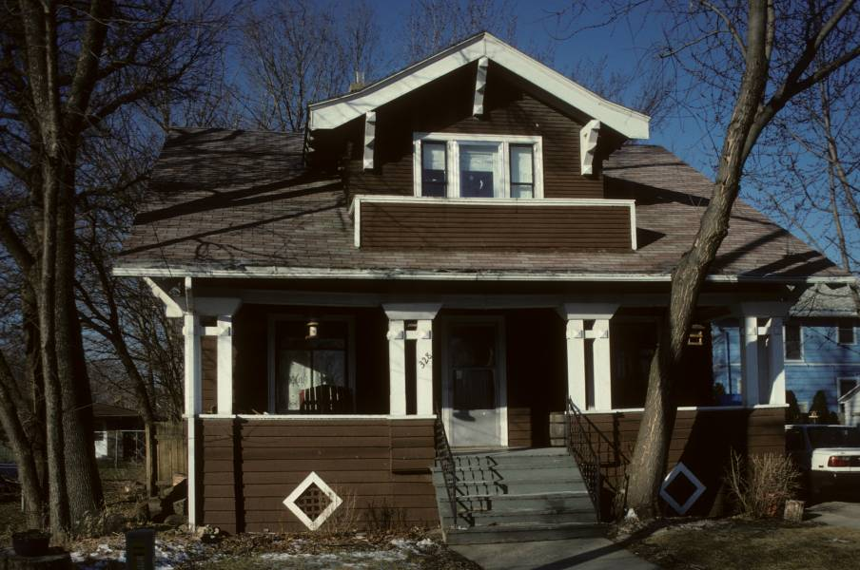
Notes:
[Westly, 227 Ransom St., Ripon] [Westly, 221 E. Fond du Lac, Ripon] [Westly, 518 North Baldwin, Madison]
Popular styles like the Westly stayed in the Sears catalog for many years, while lack of demands doomed other designs in a few years. The Westly was introduced in 1913 and lasted until 1929 for a run of 16 years.

Slide 18
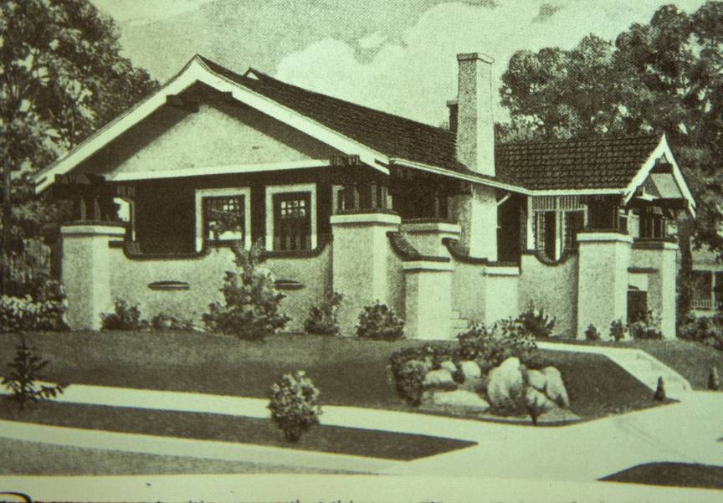
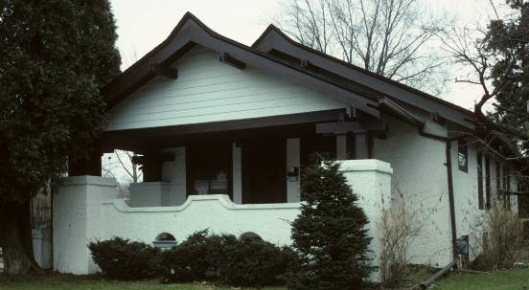
Notes:
[Osborn catalog illustration] HARRY H. & EVA SCHAEVE HOUSE1924 Wauwatosa
Catalog text emphasized design and construction quality, comport and beauty, value and mainstream appeal. Quoting from the ad copy for the Osborn:“Bungalow authorities agree that this type or architecture has come to stay. They claim that as years go by the bungalow will be even more in demand than at the present time, and should one wish to sell he will have little difficulty in finding a buyer. While the Osborn is neither extreme nor extravagant, it has all the earmarks of a cozy well-planned, artistic home”

Slide 19







Notes:
[Osborn, 419 W. Third Street, Beaver Dam]
Despite its unusual Japanese bungalow design, the house appears to have been popular.
I have documented 15 examples of this design in WI

Slide 20


Notes:
[The Fairy, 831 Summit, Manitowoc]
Sears designers created houses for every market from tiny garages and summer cottages to affluent homes. Designs ranged from this modest $993 dollar house TO

Slide 21

Notes:
[Glen Falls, 1033 Geneva Street, Lake Geneva]
Substantial upper middle class houses like this Glen Falls designed located in Lake Geneva.
Note the masonry construction

Slide 22


Notes:
[Clyde, 921 Beacon, Madison]
Most popular designs were bungalows. This Clyde has the most popular bungalow floor plan with a LDR/BBathB arrangement. This efficient plan was popularized in plan books and spread across the country.

Slide 23


Notes:
Walter T. Ramlow House 7329 W North Avenue Wauwatosa 1921

Slide 24



Notes:
[Hazelton, 2310 West Lawn]
[Hazelton, 4202 Mandan Crescent]

Slide 25


Notes:
[Willard, Janesville]
Returning service men from WWII built houses based on European historic styles they witness marching through Europe. This design is loosely influenced by English cottages.

Slide 26


Notes:
[Belmont, 2634 Park Place, Madison]

Slide 27





Notes:
[2841 Regent St, Madison, DA 1915] [1129 N. Washington, Janesville, RO] [2226 ERIE AVE Sheboygan 1929] [503 Madison, Beaver Dam] [Crescent, East Bristol, Dane Co.]
[Sears Honor Bilt Catalog, 1926]
Colonial-derived and European revival designs were popular among buyers. This appears to have been Sears most popular homes.
I have documented 20 of this Crescent design.

Slide 28

Notes:
Louis O. & Ella Stauff 7933 W STICKNEY AVE Wauwatosa 1923
Wall dormer an unusual treatment. Mix of Colonial and French Provincial

Slide 29

Alhambra
Notes:
Alhambra AHI: 5929 John Brickson House, 408 N PAGE ST, Stoughton, DA 1922
A few mediterranean house designs were offered,

Slide 30

Notes:
[Aladdin home loaded in railcar, ca. 1950]
Shipped by railroad boxcar, and then usually trucked to a home site, the average Sears Modern Home kit had about 25 tons of materials, with more than 30,000 parts. Plumbing, electrical fixtures, and heating systems were options that could be ordered at additional cost; they were many families' first steps to modern HVAC systems, kitchens, and bathrooms.

Slide 31


Notes:
Sales peaked in 1929, just before the Great Depression. While financing through Sears helped many homeowners purchase homes, a number of those purchasers defaulted during the ensuing Great Depression. The company was forced to liquidate $11 million in defaulted debt. The mortgage program was also a public relations disaster, as many of the families Sears foreclosed upon refused to do further business with the company.
Sears stopped offering mortgages at the end of 1933. In 1935, some newspaper reports stated that Sears had "discontinued" the "modern homes department". However, Sears continued selling homes and it continued to issue a new "Modern Homes" catalog until 1942. Despite home sales slowly recovering as the United States emerged from the Great Depression, Sears exited the business.

Slide 32

Notes:
[Houses by Mail 1995]
Identifying Sears Homes has become a pastime among history enthusiasts because of their sturdy structure, the do-it-yourself nature of construction, and the popular architectural design concepts

Slide 33


Notes:
[Ardara, 1205 Williams, Lake Geneva]
Primacy of façade

Slide 34



Notes:
[Elsmore, Pepin]
Modest houses with distinctive details

Slide 35



Notes:
[ No. 264P138 AHI: 75319 Ernest Kirsh House, 2129 KENDALL AVE, Madison.] Clyde AHI: 67752 1117 WILLIAMS ST, Lake Geneva, WL ]
There is a kit of parts that through experience allows for identification of many models.
Brackets, gable brace, shaped rafter ends

Slide 36

Notes:
Roanoke AHI:N F.A. Larson, 103 W Spirit, Tomahawk, LI
Owner found shipping label on board in wall.

Slide 37



Notes:
[Standard Homes Cornell AHI: 239284 513 Main St, Pewaukee, WK]
[Bowes, C.L. Design No. 12032 AHI:97241 434 E 2ND ST, Richland Center, RI ] [
Look-alikes
National and regional competitors in the catalog and kit house market included Aladdin, Bennett, Gordon-Van Tine, Harris Brothers, Lewis, Pacific Ready Cut Homes, Sterling and Montgomery Ward (Wardway) Homes.

Slide 38


Notes:
Gordon Van Tine Cabot/Stratford and Wardway “Mount Vernon” are identical designs both produced by Gordon Van Tine Company.

Slide 39

Notes:
[San Jose, 2326 Madison, La Crosse]
After WWII dramatic social and economic change meant pattern books and their mail order offspring were a thing of the past. Over the more than 3 decades of operation, Sears and Roebuck claims to have sold over 100,000 homes.

Slide 40
How did Sears house business influence American housing?
Nationalization of architectural tastes
Standardization of floor plans
Standardization of fabrication
Democracy of good design and good construction
Expanded range of housing choices
Anticipated the establishment of standard home mortgages in the 30s
Created a DIY homebuilding culture
Notes:
How did Sears house business influence American housing?

Slide 41



Thank You!

Slide 43


Notes:
[Glen Falls, Janesville]

