Slide 1

is a global network of students and instructors who are “studentsourcing” antibiotics from soil bacteria
(mostly college)
Notes:
Hi, and thanks for having me. I’m Sarah Miller, Executive Director of Tiny Earth, which is housed here at WID.
Tiny Earth is a global network of college students who are crowdsourcing, or we say “studentsourcing,” antibiotics from soil bacteria.

Slide 2

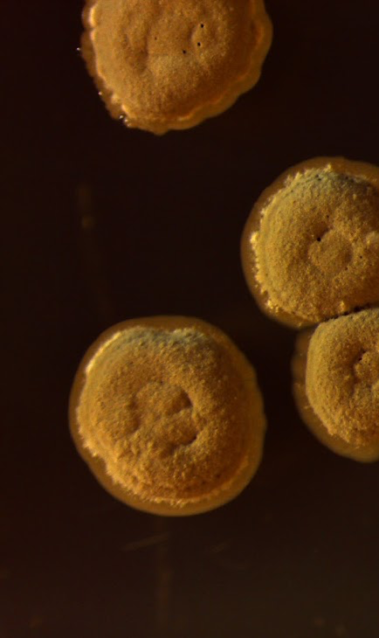
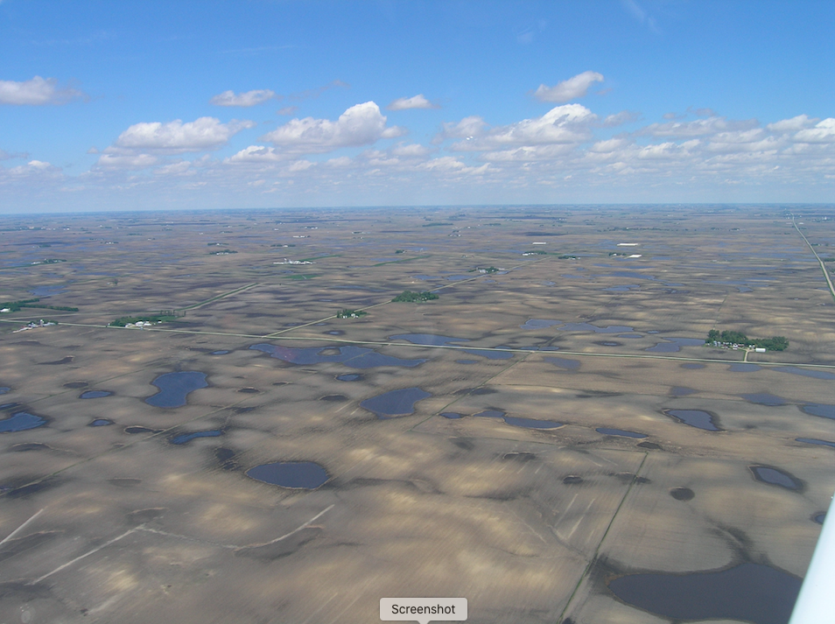
We face pressing global challenges
Increasing opportunity gaps in STEM higher education
Increasing antibiotic
resistance
Increasing soil erosion
Theobald et al 2022; Bensimon 2005
Silver 2011; O’Neill 2014
U.S. Global Change ​2018
Notes:
We face pressing global challenges: increasing gaps with respect to achievement and access to science experiences in college, increasing antibiotic resistance, and increasing soil erosion. Each of these constitutes a global crisis, which the Tiny Earth initiative is designed to address.

Slide 3
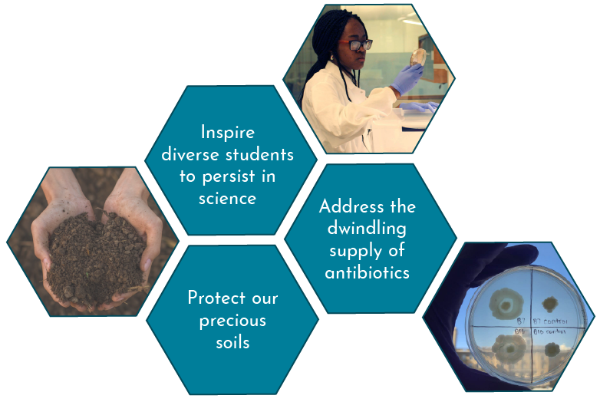
Tiny Earth addresses global challenges via three goals
1
2
3
Notes:
Tiny Earth’s three goals, therefore, are to inspire diverse students to have access to and persist in STEM, to address the dwindling supply of antibiotics, and to protect our precious soils. I’ll unpack the first two in this talk.

Slide 4
Goal 1: Inspire diverse students to persist in science
Opportunity gaps between overrepresented and underrepresented students have been called “one of the most urgent and intractable problems in higher education.”
Theobald et al 2022; Bensimon 2005
Notes:
First, let’s start with the goal of inspiring diverse students to persist in science. There are two problems here: students leave science in college, and there is a stubborn gap in performance. Nearly 600,000 students leave STEM majors each year, citing poor teaching methods as the primary reason. Worse, women, students of color, and all underrepresented groups leave at higher rates than majority students. In addition, the gap in performance between underrepresented and overrepresented students, as measured by exams and grades, has been called “one of the most urgent and intractable problems in higher education.” In order to have a diverse STEM workforce, students need to access scientific opportunities, environments designed for success, and to feel like they belong. Colleges are often falling short, relying largely on didactic lectures, despite overwhelming evidence in support of active and inclusive learning strategies.

Slide 5
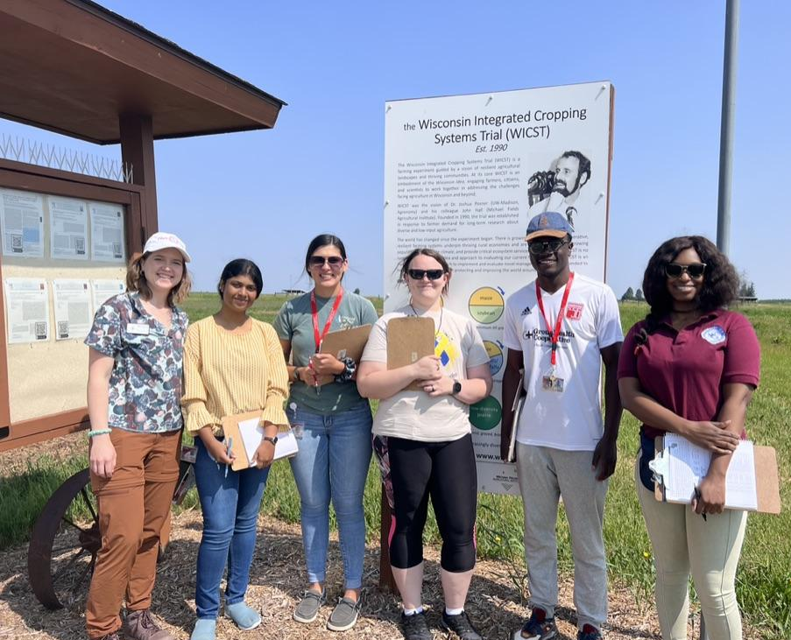
Tiny Earth is a CURE
Course-based Undergraduate Research Experience
Hallmarks of a CURE
Authenticity
Iteration
Ownership
Relevance
Discovery
Dissemination
Notes:
Tiny Earth provides students with access and opportunity to do real scientific research. Tiny Earth is a CURE, a course-based undergraduate research experience. Students engage in a full semester of authentic science research, designing their own experiments, working collaboratively, failing, troubleshooting, collecting and analyzing data, trying again, all while building the lab skills needed to be part of the STEM workforce – or simply to be well-informed citizens who are able to think critically about scientific issues by weighing evidence.

Slide 6
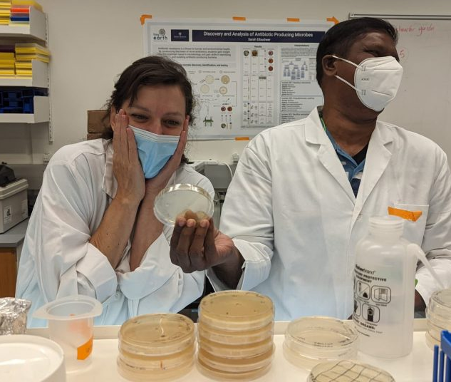
CUREs promote student learning
CUREs increase:
Research skills and project ownership
Confidence, self-efficacy, and belonging in science
Retention in science
CUREs provide access:
Research experiences at scale
All types of colleges
Just one CURE in college can increase persistence in science
Buchanan and Fisher 2022 10.1187/cbe.22-04-0069
Notes:
CUREs have been shown again and again to promote student learning. They increase research skills and project ownership, they boost confidence, self-efficacy, and belonging in science, and they lead to retention in science. They focus on relevant problems and lead to new discoveries. Students who take a CURE like Tiny Earth are less likely to leave science: Just one CURE in college can increase persistence in science, and the positive effect is greater for students from groups historically excluded from STEM.
CUREs also provide access to research experiences at scale because they are taught as courses that enroll tens or hundreds of students simultaneously, rather than a more traditional 1:1 faculty-student research experience in a lab, where the math ain’t mathin’. Better yet, CUREs can be (and are!) taught at all types of colleges: technical colleges, community colleges, tribal colleges – not just research universities.

Slide 7
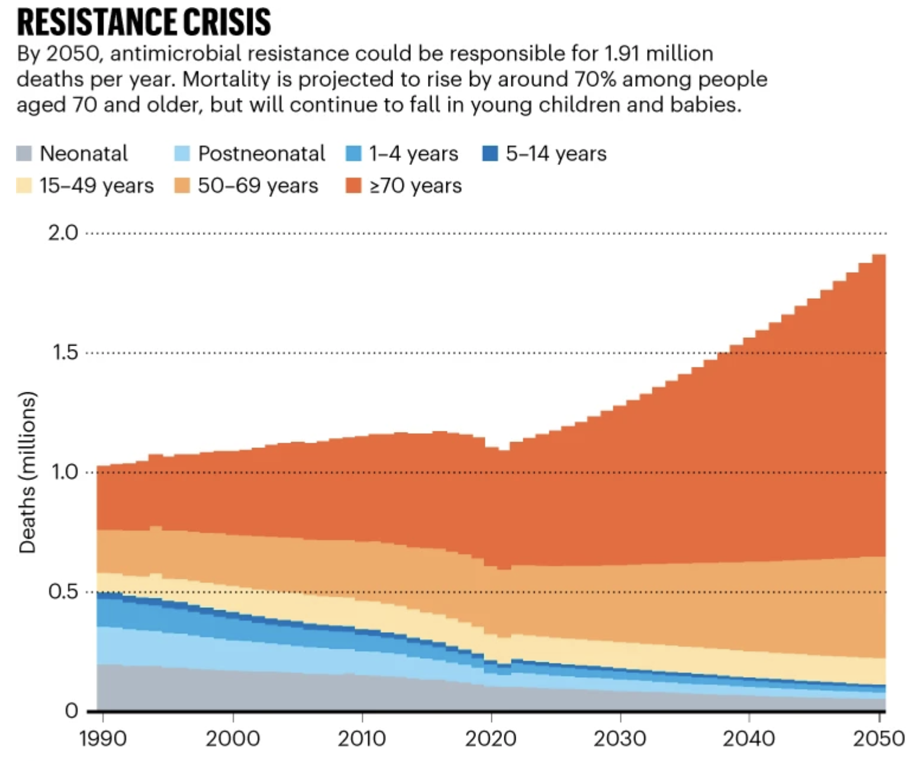
Goal 2. Address the dwindling supply of antibiotics
Antibiotic resistance is on the rise
Naddaf, 2024
Notes:
OK, so we have established that CUREs provide access to and support for students to engage in research. But what are the students doing research on? In Tiny Earth, the answer is the dwindling supply of antibiotics. Antibiotics are the medicines we take to cure bacterial infections. They are also used in other applications, like in veterinary clinics, on farms, or on crops. However, largely due to overuse, bacteria are becoming increasingly resistant to antibiotics, rendering them useless. You can see here that antibiotic resistance has risen sharply this century, especially for seniors.

Slide 8
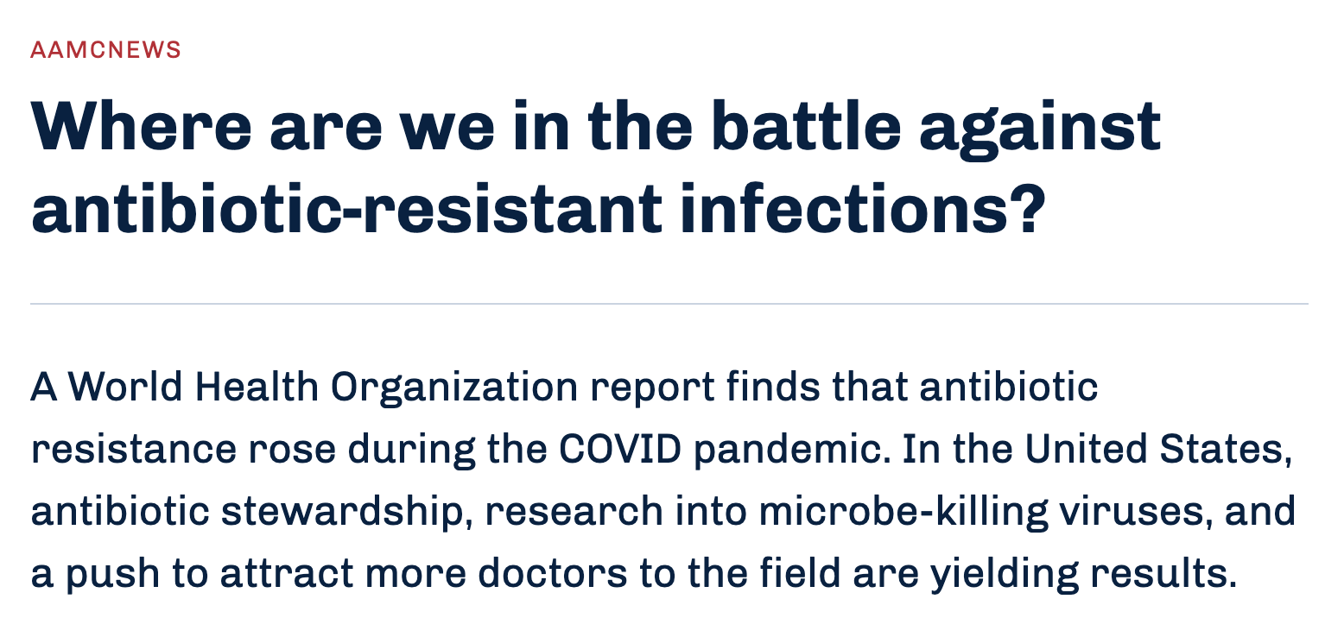
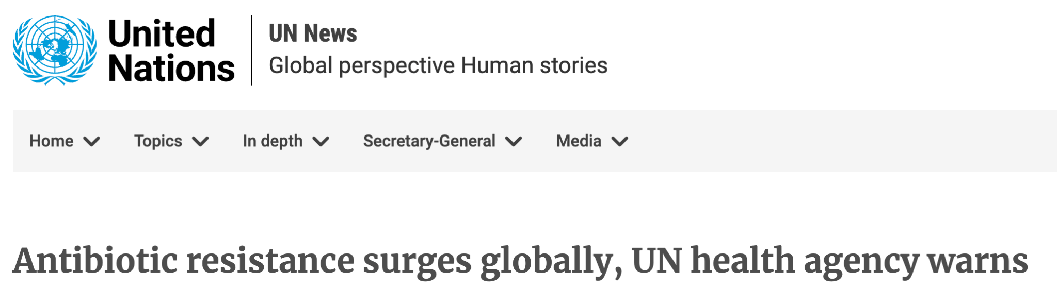
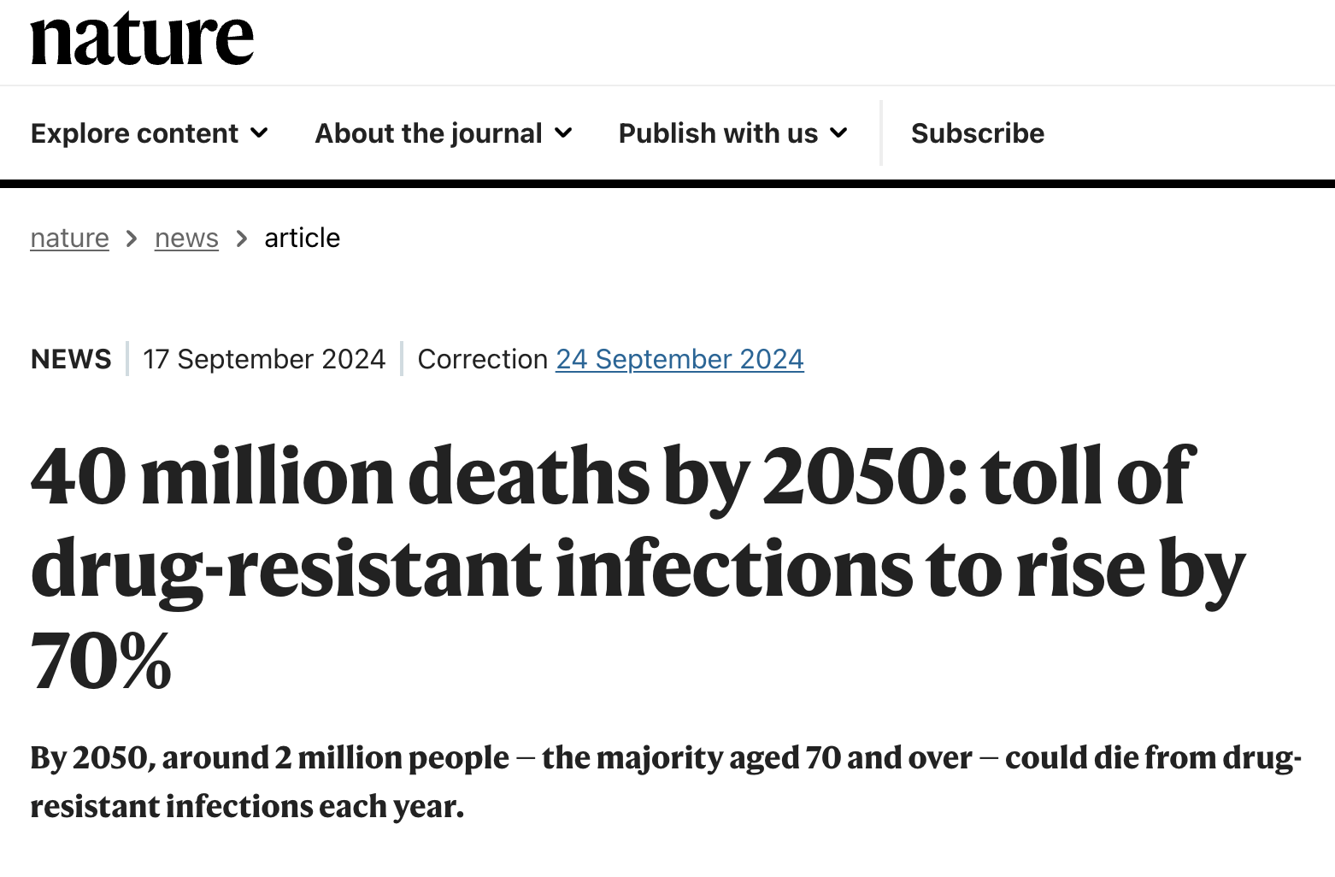
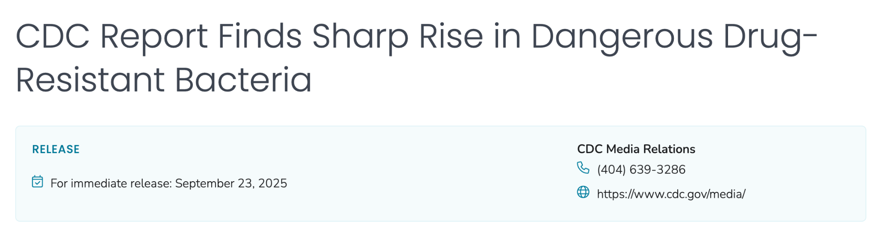
Scientists are warning of a looming crisis
Notes:
Scientists worldwide are warning of a looming crisis, as antibiotic resistance surges globally, predicting 40 million deaths by 2050.

Slide 9
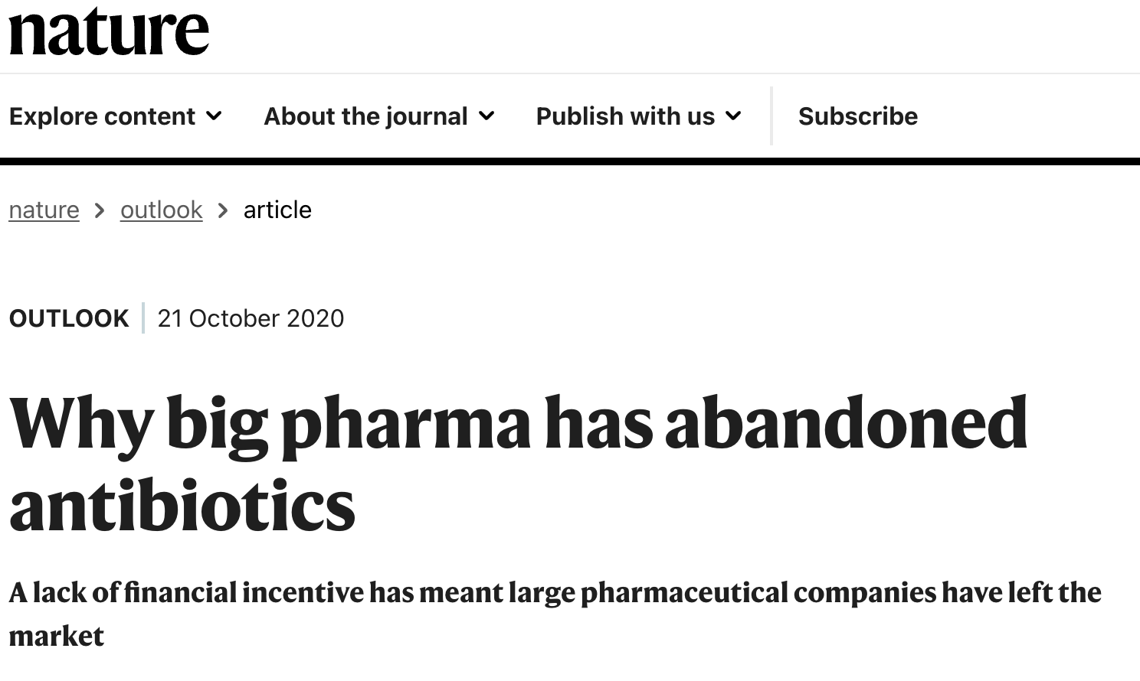
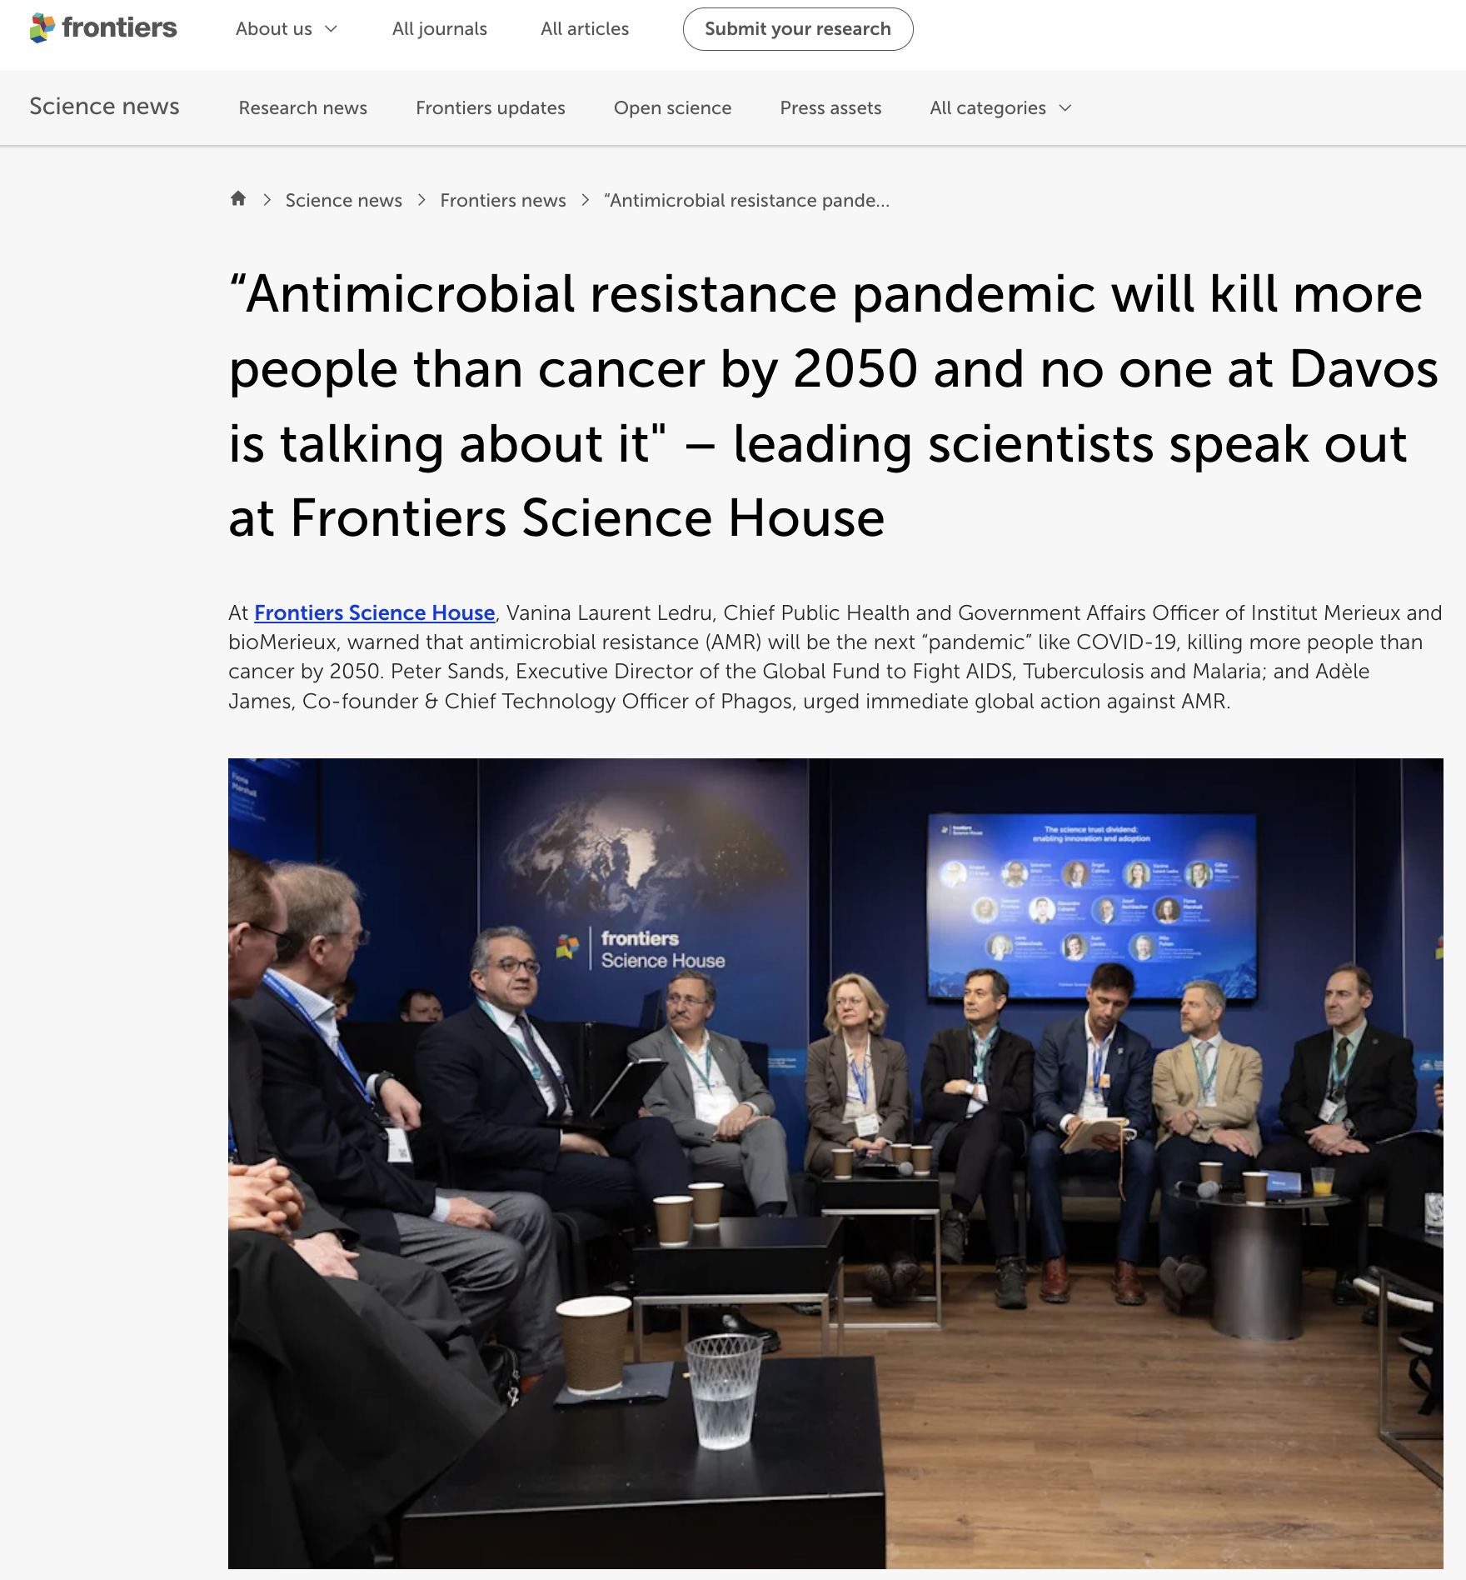
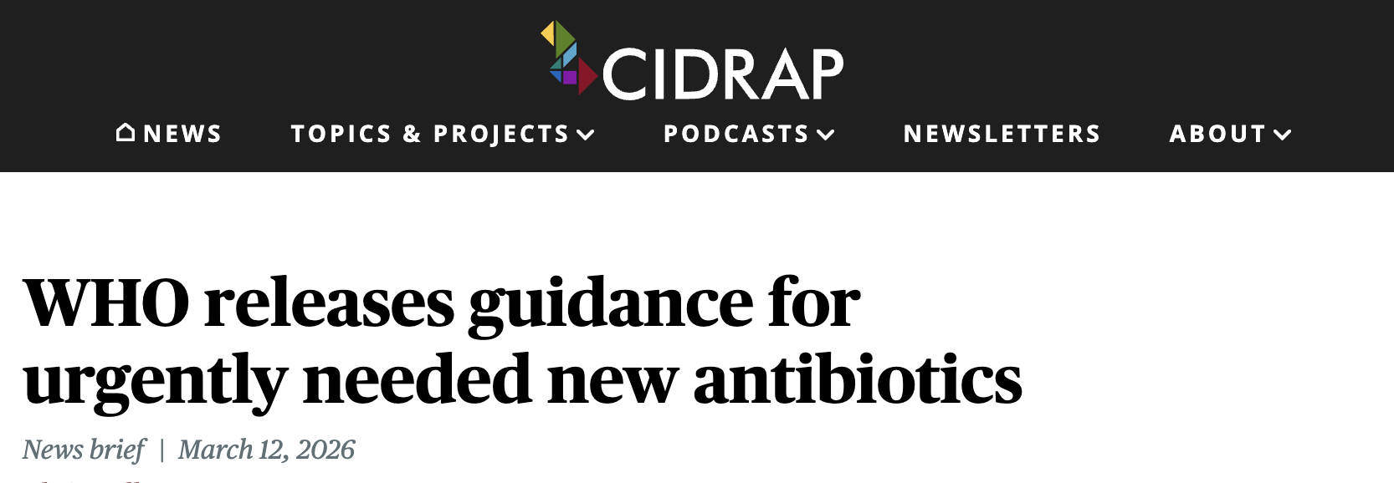
Yet antibiotic discovery has been largely abandoned
Notes:
Yet pharmaceutical companies have largely abandoned antibiotic discovery. Why you may ask? It’s simply not that lucrative. It takes a billion or billions of dollars to move a new drug from discovery to market, but then you the consumer only takes it for 5-10 days, in contrast to other drugs that are taken for much longer, like statins or SSRIs – which we often take for life and therefore are more lucrative.

Slide 10
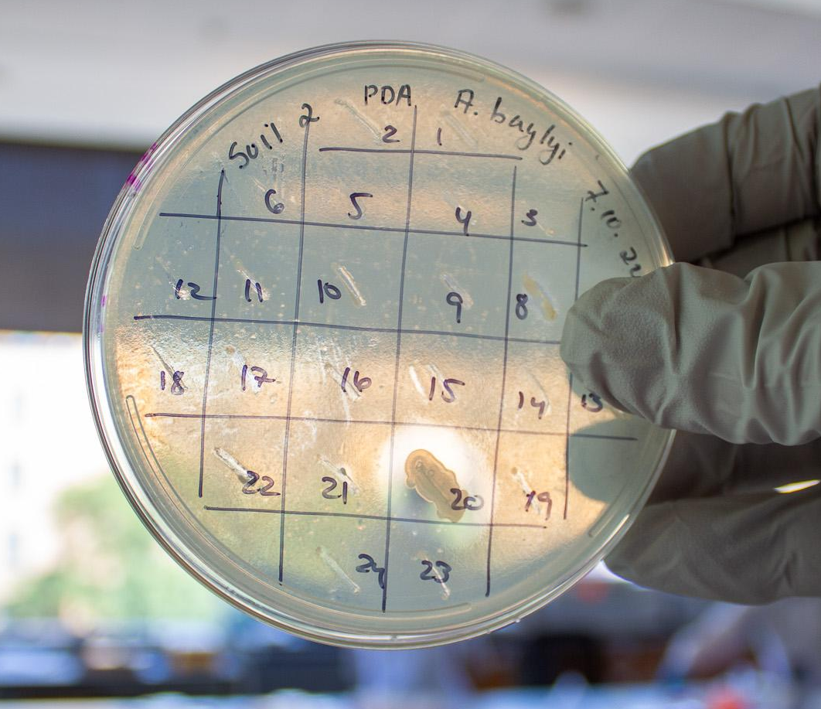
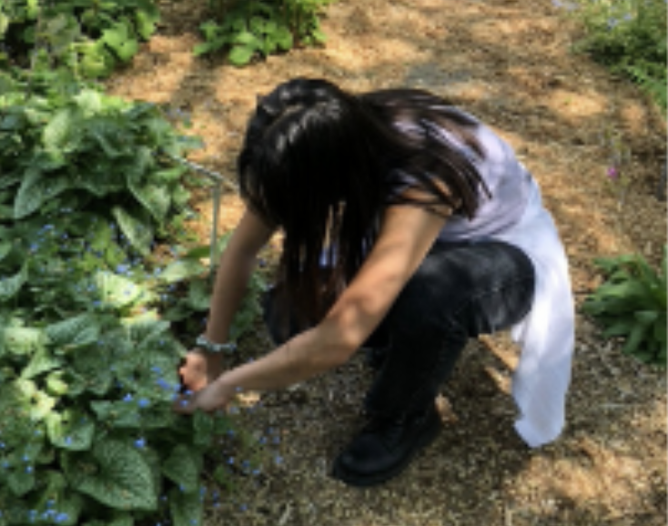
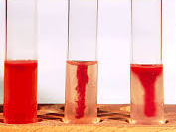

Goal 2: Address the dwindling supply of antibiotics
Tiny Earth’s college students look for new antibiotics in soil bacteria worldwide
MODULE I
Isolate bacteria from soil
MODULE II
Screen isolates for
antibiotic production
MODULE III
Characterize antibiotic-
producing bacterial isolates
MODULE IV
Elucidate antibiotic
compounds
Notes:
Enter Tiny Earth again. Tiny Earth’s students turn to the soil – a rich repository of bacteria where many of our medicines come from. Tiny Earth students spend a semester working on this problem. First they collect a soil sample, just a teaspoon or so, from a soil of their choosing. It could be from their backyard, their campus, or a local park or field. They dilute their soil in sterile water, then inoculate petri plates with the soil dilutions, and wait a few days to see what grows. This is the first discovery: students see how alive the soil is when their plates are covered with bacteria!
Next, they choose a few bacteria to screen for antibiotic activity by growing them with the safe relatives of known pathogens. They do not use the actual antibiotic-resistant pathogens in the course! The experiments usually result in several isolates showing a “zone of inhibition” where the soil bacteria stopped the pathogen in its tracks. See the clear area here on this plate. Discovering an antibiotic producer is the second discovery!
At this point, students don’t know what their bacteria are, but they are hooked on sorting it out, which leads to countless more discoveries. The next step is to try a battery of classic microbiology tests and genomic applications to characterize and possibly even identify the soil bacteria that have shown inhibitory activity. Some Tiny Earth courses even take it a step further to elucidate what molecules the bacteria are making that have antibiotic activity.

Slide 11
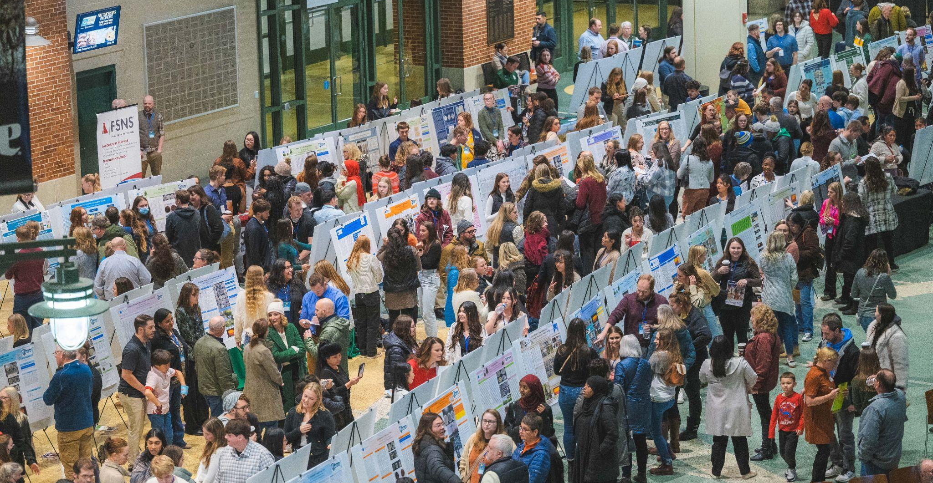
Students disseminate their research findings
Notes:
Students usually write up their results in class, but they can also present their research findings at a symposium. Shown here is our annual Tiny Earth in Titletown event at Lambeau Field. Last December, 200 students presented their research to 350 of their family, friends, and community members. Students from several UW System schools presented along with College of Menominee Nation, Northeast Wisconsin Technical College, and several 4-year colleges such as Beloit College and St. Norbert.

Slide 12
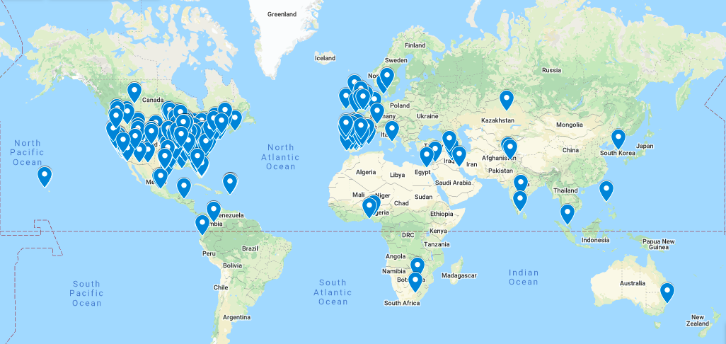
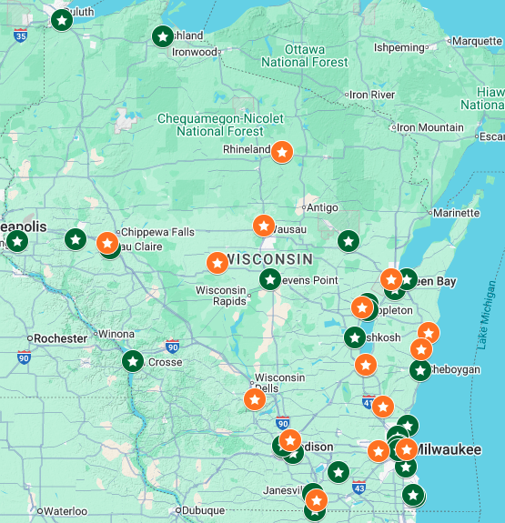
Tiny Earth is a network
of more than 900 instructors in 33 countries who teach more than 18,000 students per year
Tiny Earth Wisconsin
Notes:
The problem of antibiotic resistance is massive, so it requires a massive, crowdsourced effort. We have trained more than 900 instructors – mostly college faculty – to teach Tiny Earth. Estimating conservatively if you imagine on average they each teach 20 students per year, that means 18,000 students have access to a Tiny Earth CURE research experience every single year.

Slide 13
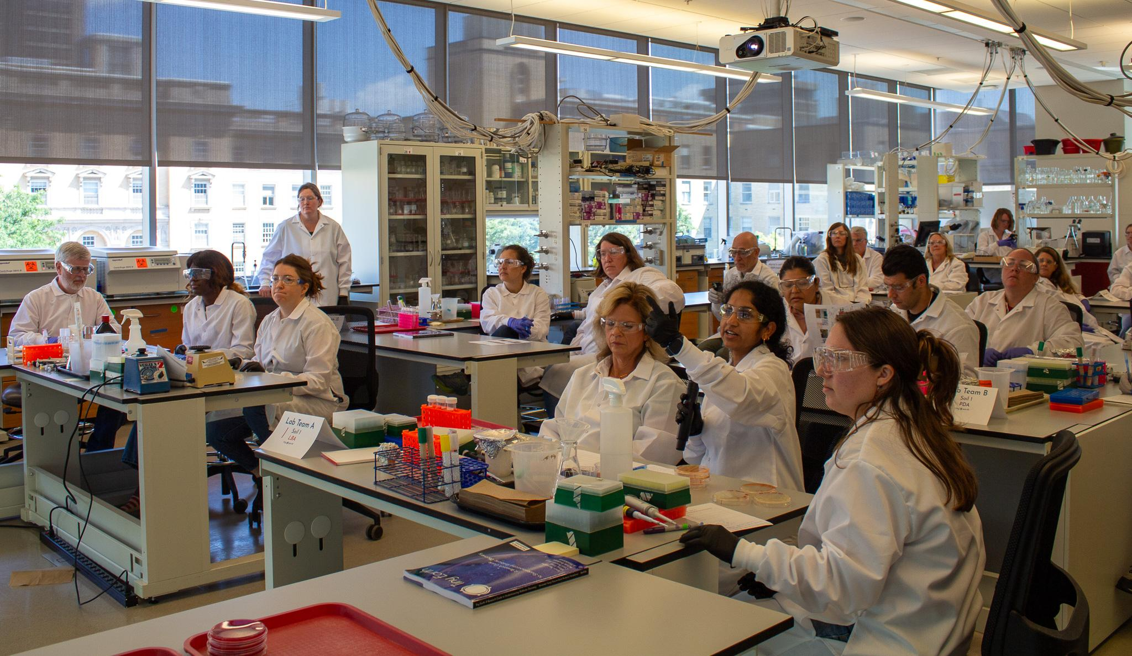
Our main expansion tool is TEPI* Training
Which are based on:
Scientific Teaching
Entering Mentoring
*Tiny Earth Partner Instructor
Notes:
And this is where Tiny Earth is really clever – and how we get around the overwhelming numbers game. Our main expansion tool is the Tiny Earth Partner Instructor Training, or TEPI Training. It’s a week-long immersive summer camp for faculty to learn how to teach Tiny Earth. It’s based on evidence-based pedagogical and peer mentoring practices.

Slide 14
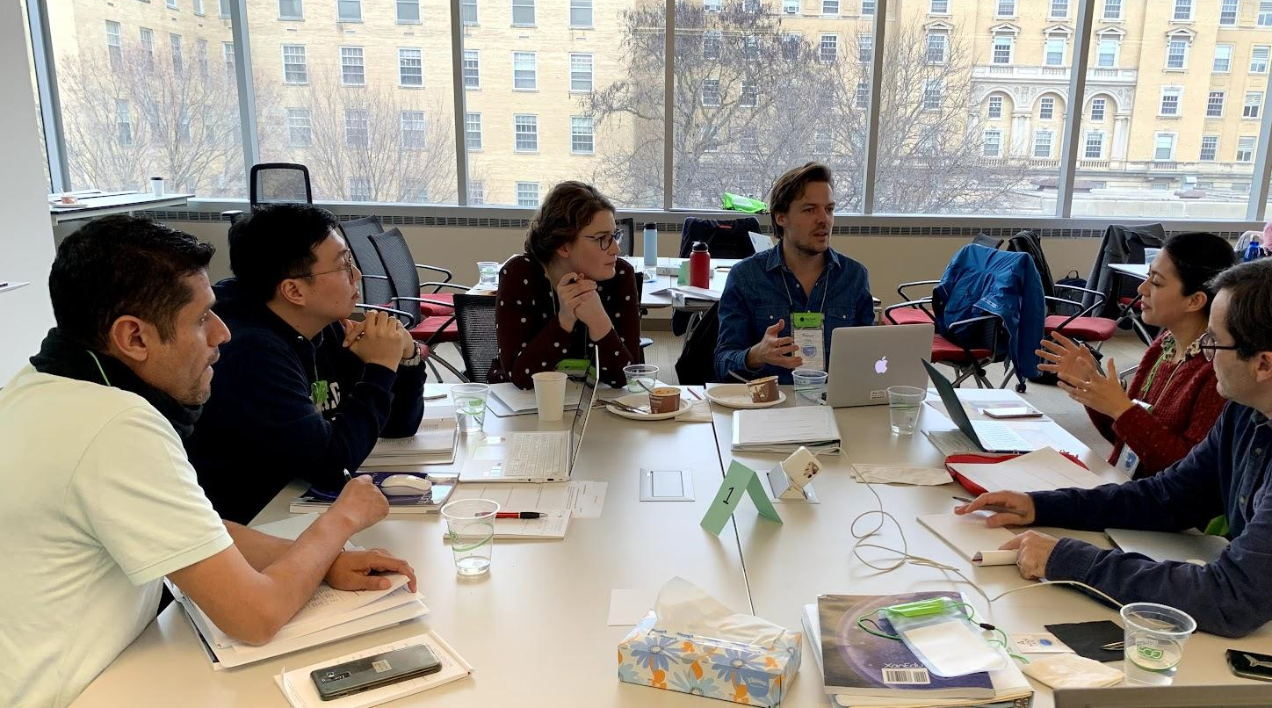
TEPIs work in facilitated groups during the training
Notes:
During the week, TEPIs work in facilitated groups to adapt the curriculum for their particular students and their particular version of Tiny Earth.

Slide 15
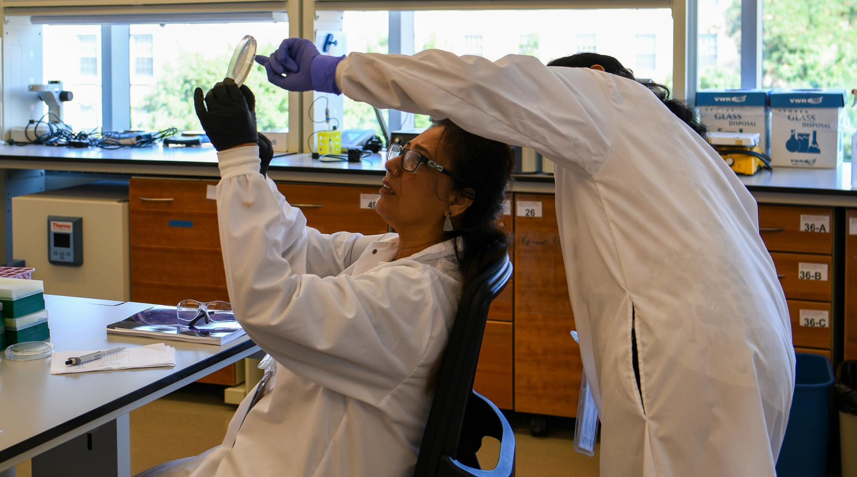
TEPIs learn scientific teaching principles
Notes:
They learn scientific teaching principles, such as course design, active learning, and inclusive learning, and apply them to the development of their Tiny Earth course.

Slide 16
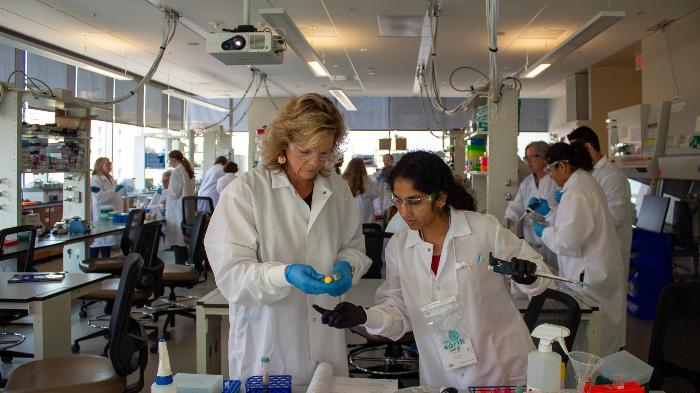
TEPIs go through all the lab research and protocols
Notes:
And they go through all the lab protocols along the way.

Slide 17
Tiny Earth is an antibiotic-discovery pipeline
…that aims to discover novel antibiotics
🧑‍🏫 Instructors | 900+ Instructors Worldwide | ↓ Worldwide network of instructors teach evidence-based hands-on science | 50-100 Trained Yearly | 25%+ Historically Excluded Groups
🧑‍🎓 Students | 18,000+ Students per Year | ↓ Students study microbes from local soils with interactive research | 540 Institutions
🌐 Database | 26,000+ Total Isolates | ↓ Pathogen-inhibiting isolates are recorded in the global Tiny Earth Database and shared | 1,600+ Isolates from Outside the U.S.
🧪 Chemistry Hub | 4,300+ Isolates in the Collection | ↓ Students share samples with the Chemistry Hub scientists for genomic and metabolomic analysis. | 291 Complete Genome Sequences | 22 High-priority Isolates
💉 Antibiotic Structures | 28 Known bioactive structures identified | ↓ Identifying antibiotic compounds to combat the resistance crisis | Coming Soon: Novel Antibiotic Structures
Notes:
Bringing this all together, Tiny Earth is an antibiotic-discovery pipeline that starts with training instructors but really focuses on students engaging in authentic research for a full semester. Students enter their data into the Tiny Earth database and can send any interesting antibiotic-producing bacteria they find to the Tiny Earth Chemistry Hub here at WID, which is upstairs in Prof. Jo Handelsman’s lab. Today, we have more than 4,300 isolates in the collection, with several of interest that we are pursuing further.

Slide 18










Thanks to our sponsors
Special thanks to:
Jo Handelsman, Tiny Earth Founder
Tiny Earth students, instructors, and staff
Notes:
Thank you to you all, and to our sponsors, and in particular Dr. Jo Handelsman, the founder of Tiny Earth.

