Slide 1


Slide 2


Slide 3

15-25, 2026

Slide 4












SUPPORT OUR PROGRAMS

Slide 5
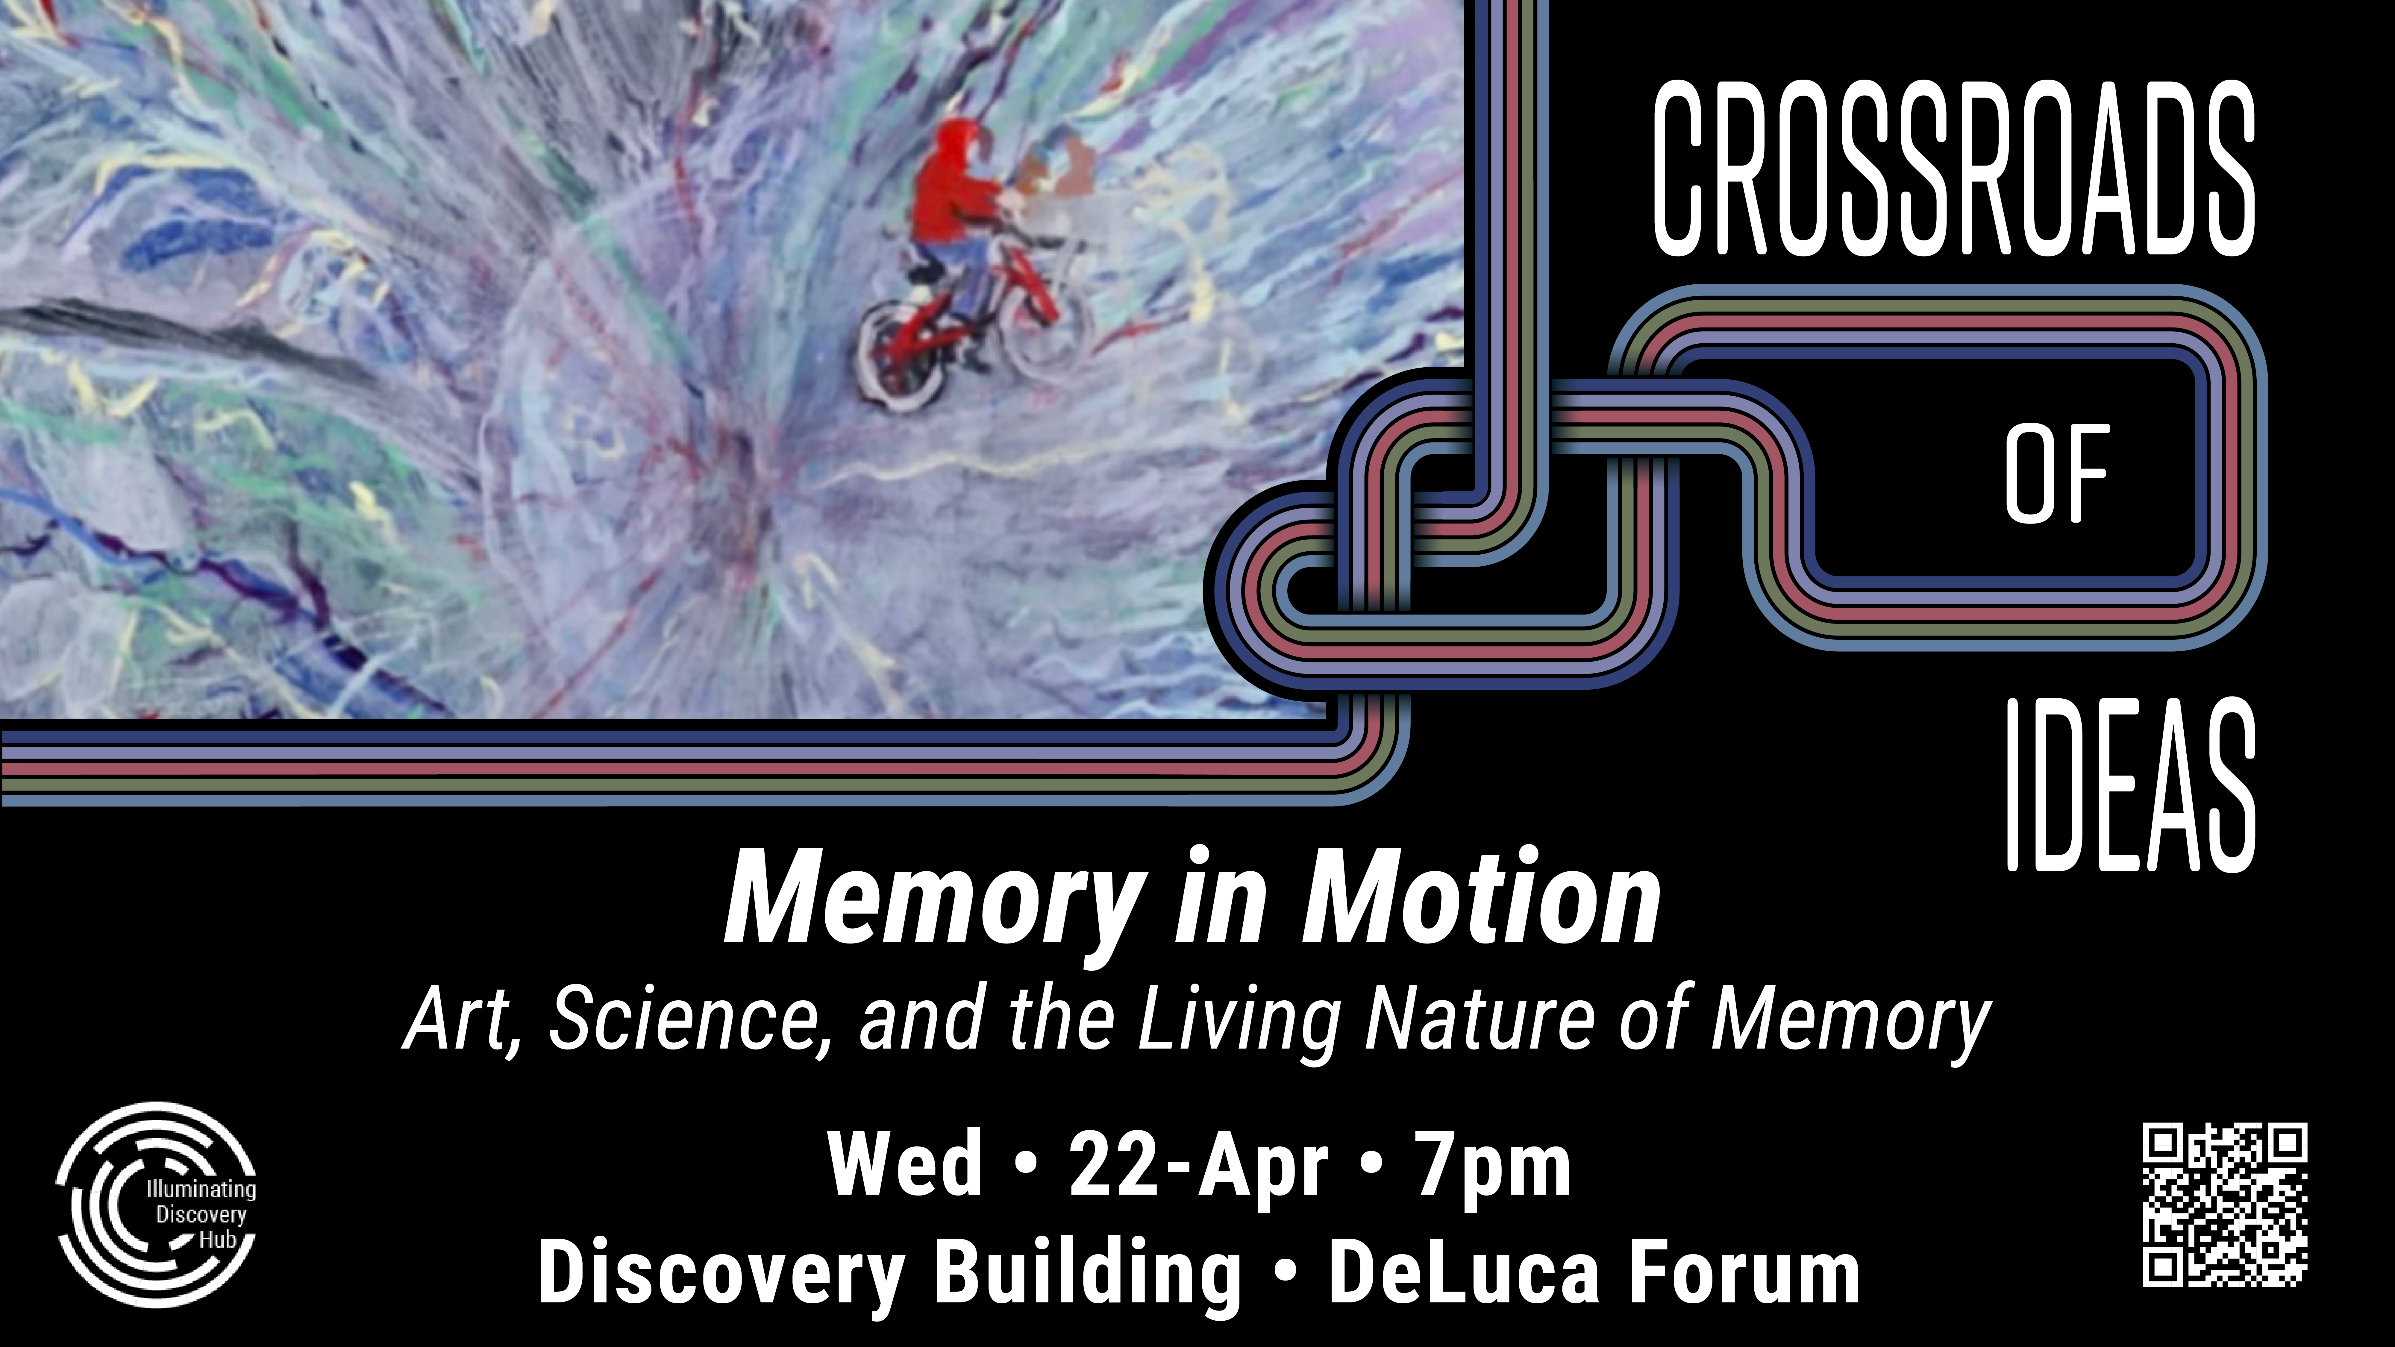

Slide 6
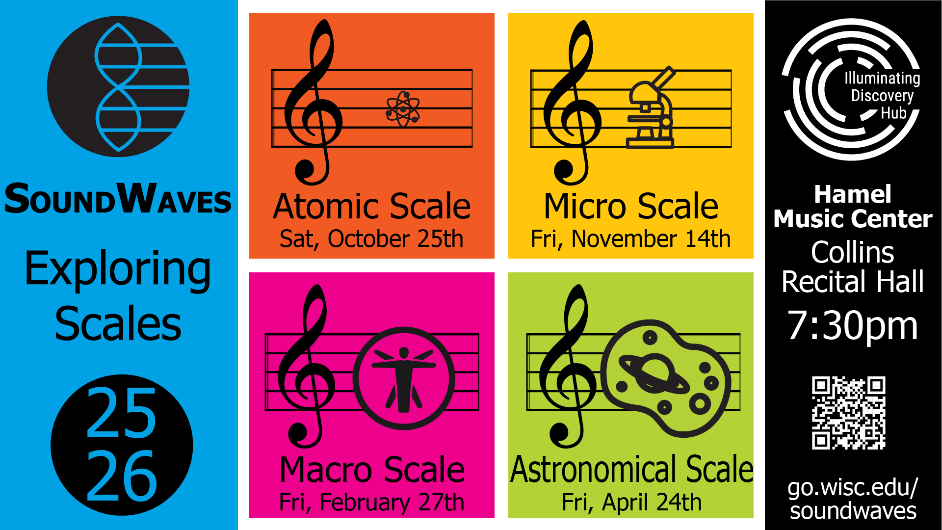

Slide 7
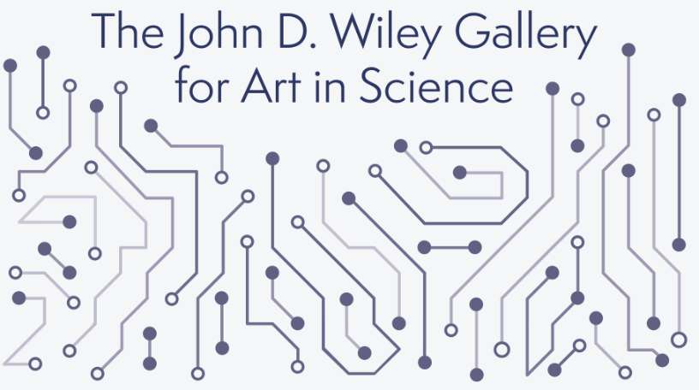

NOW
OPEN!
Located in the Northwest corner of the Discovery Building, the John D. Wiley Gallery for Art in Science is a unique space where art meets science, sparking curiosity and wonder in every visitor.
Available Hours: Mon–Fri, 7 a.m.–8 p.m. Sat, 9 a.m.–8 p.m.

Slide 8


Slide 9


Slide 10



