Slide 1
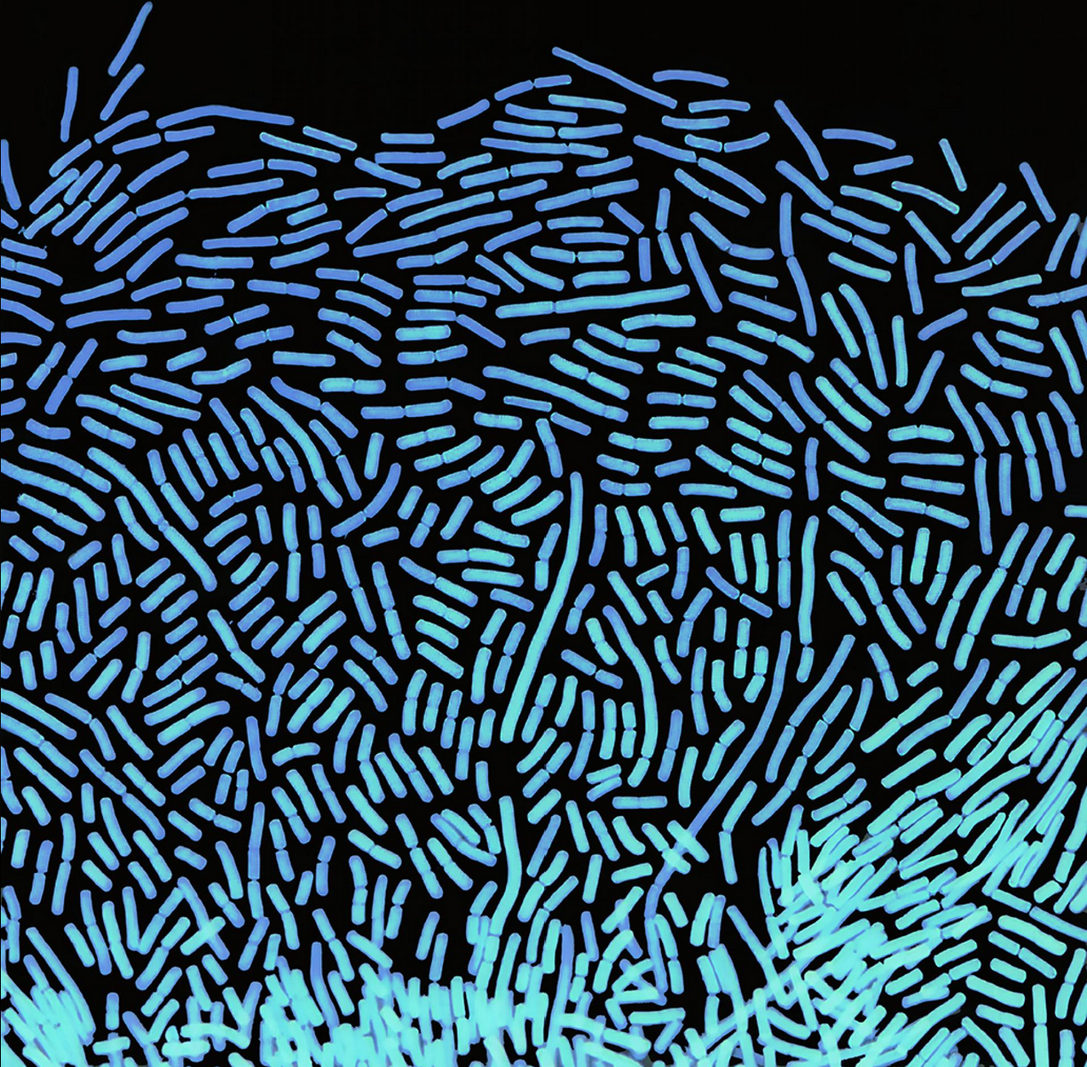
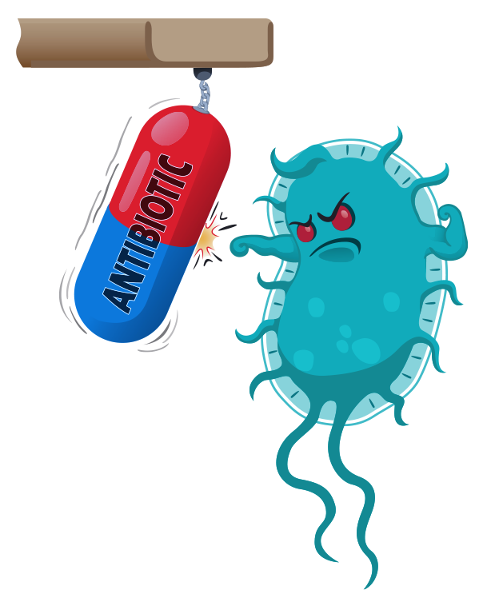


When Antibiotics Fail
Marc G Chevrette, PhD
Crossroads of Ideas 2026-03-18

Slide 2
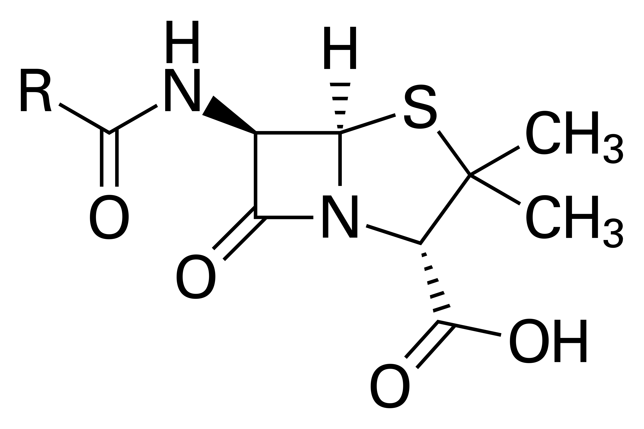
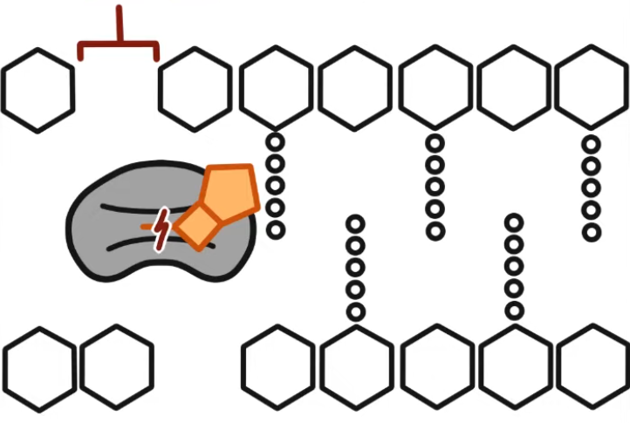
What are antibiotics?
Chemicals often used to treat infections
  “cidal”: the kill switch
  “static”: the pause button
Cell wall synthesis blocked, bacteria die
Penicillin

Slide 3
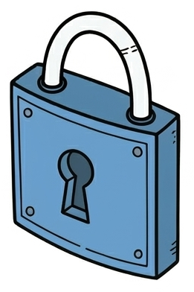
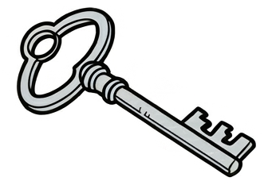


What are antibiotics?
Antibiotic
Chemicals often used to treat infections
  “cidal”: the kill switch
  “static”: the pause button
Antibiotics are specialized tools,
not “all-purpose” medicines
  Different germs require
  different weapons
  Can be anti-bacterial
  and/or anti-fungal
Antibiotics do nothing against viruses
  Viruses lack the machinery that antibiotics target
Bacterium
Different keys for different locks
(bacteria/fungi)
Viruses…
No key hole

Slide 4
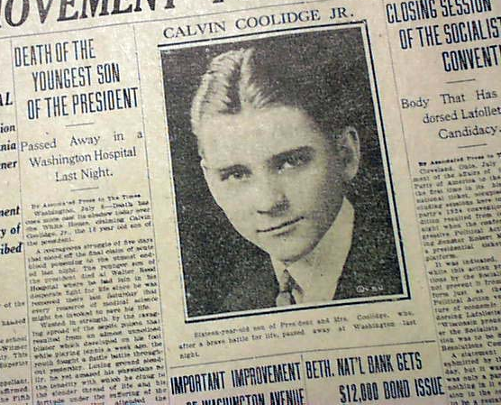
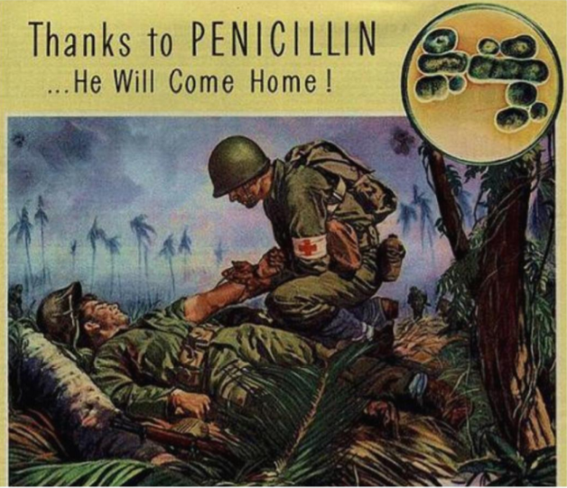
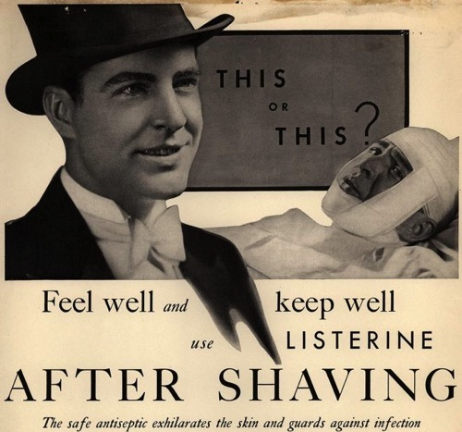
Bethlehem Times (1924)
Schenley Labs (1944)
Listerine (1930)

Slide 5
How do we use antibiotics?
Antibiotics are used…
to treat human infections caused by bacteria and fungi
in parallel with other (sometimes life-saving) treatments
  Cancer, organ transplants, surgeries, routine dental cleanings
in agriculture
  Crop & livestock bacterial/fungal diseases, sometimes as prophylaxis or to promote growth of food animals
    different countries have different regulations
  Of all antibiotics sold in the United States, ~80% are for animal agriculture; and ~70% of these are from classes important to human medicine.
US Abx Sales
Human
Health
Agriculture
Martin et al. 2015. Am J Public Health.

Slide 6
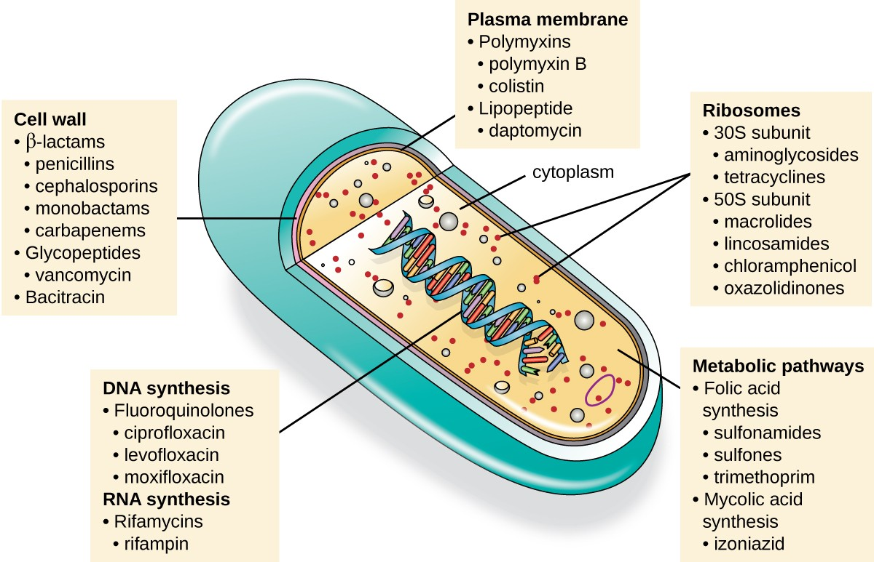
How do antibiotics work?
SUNY Microbiology.

Slide 7
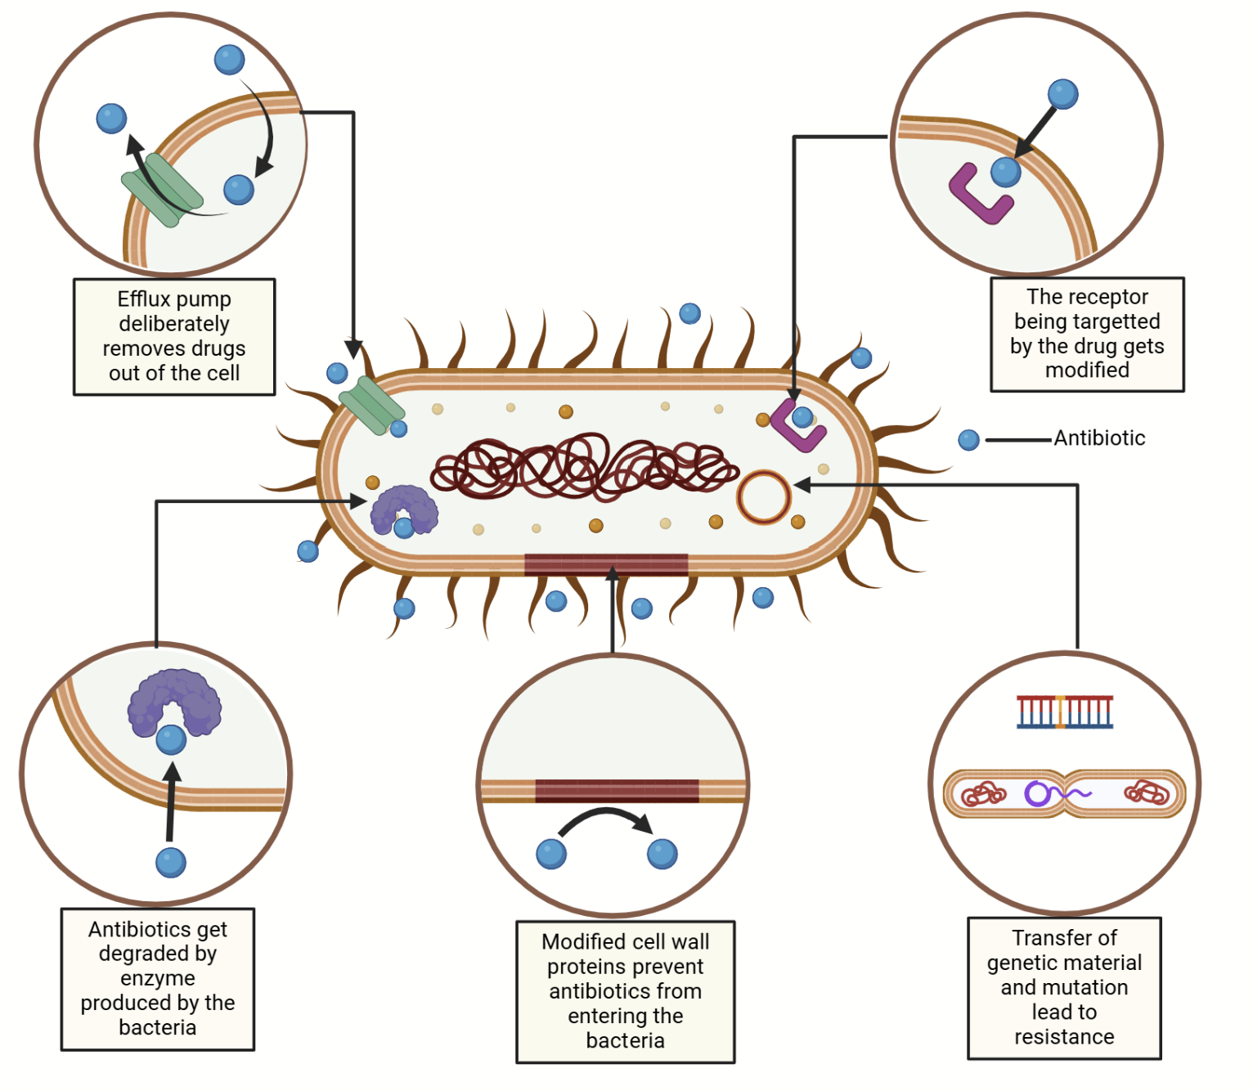
How do antibiotics fail? (i.e. resistance)
Pumps remove antibiotics from the cell
The target of the antibiotic is modified
Antibiotic
Degradation by specialized enzymes
Modified cell wall prevents antibiotics from entering
Transfer of genetic material and/or mutations
Khushi Kiran.

Slide 8
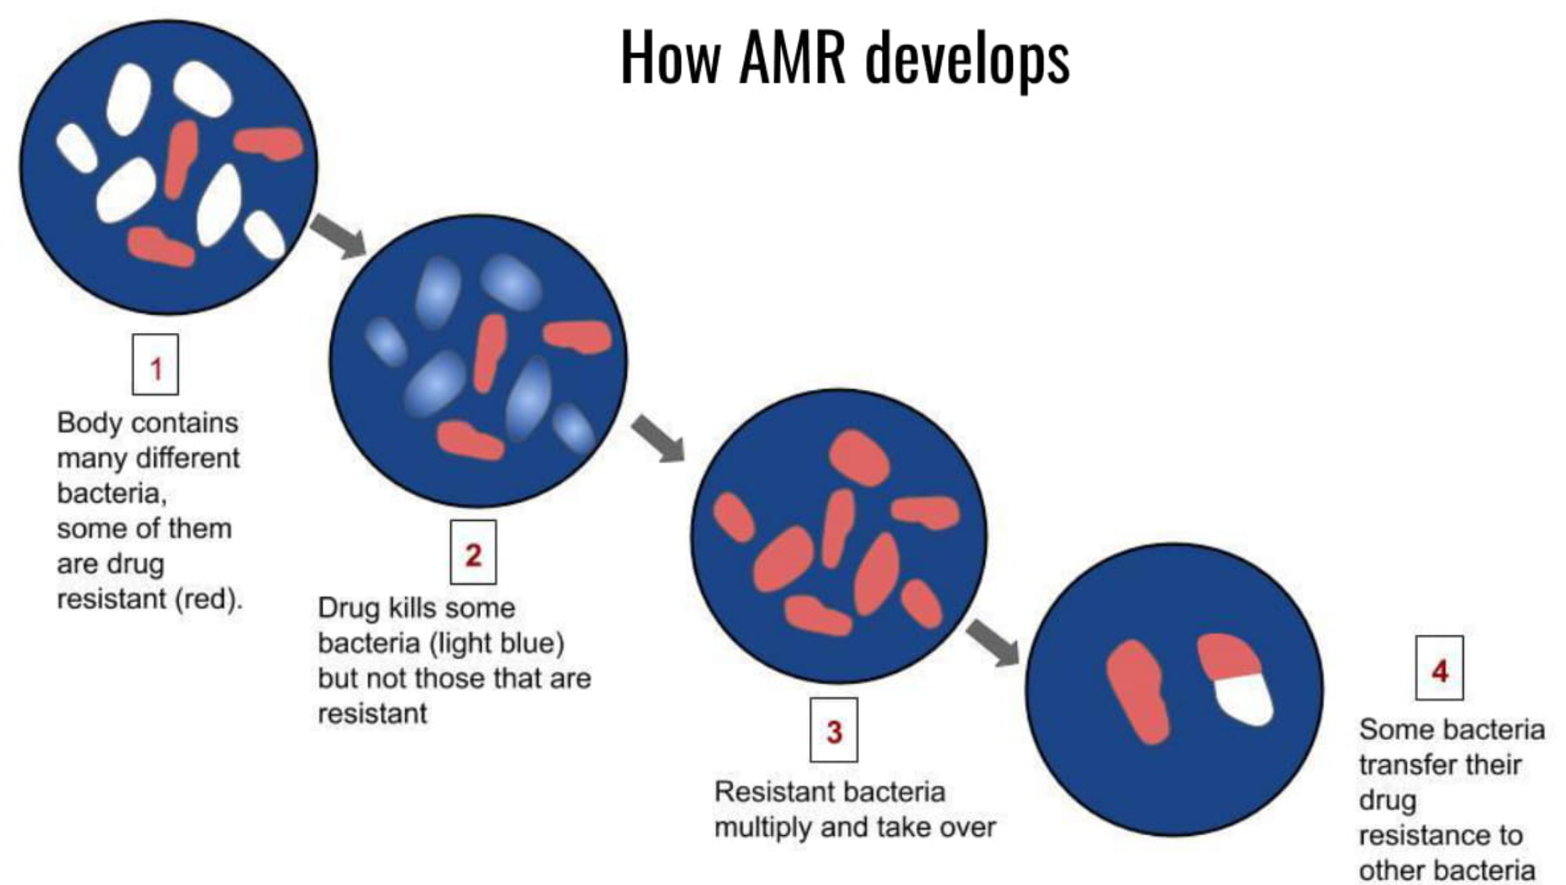
How do antibiotics fail? (i.e. resistance)
How resistance develops
An infection contains many different bacteria, some of them are drug resistant
Antibiotic kills some bacteria but not those that are resistant
Some bacteria transfer their resistance to others
Resistant bacteria multiply and take over
whatisbiotechnology.org

Slide 9
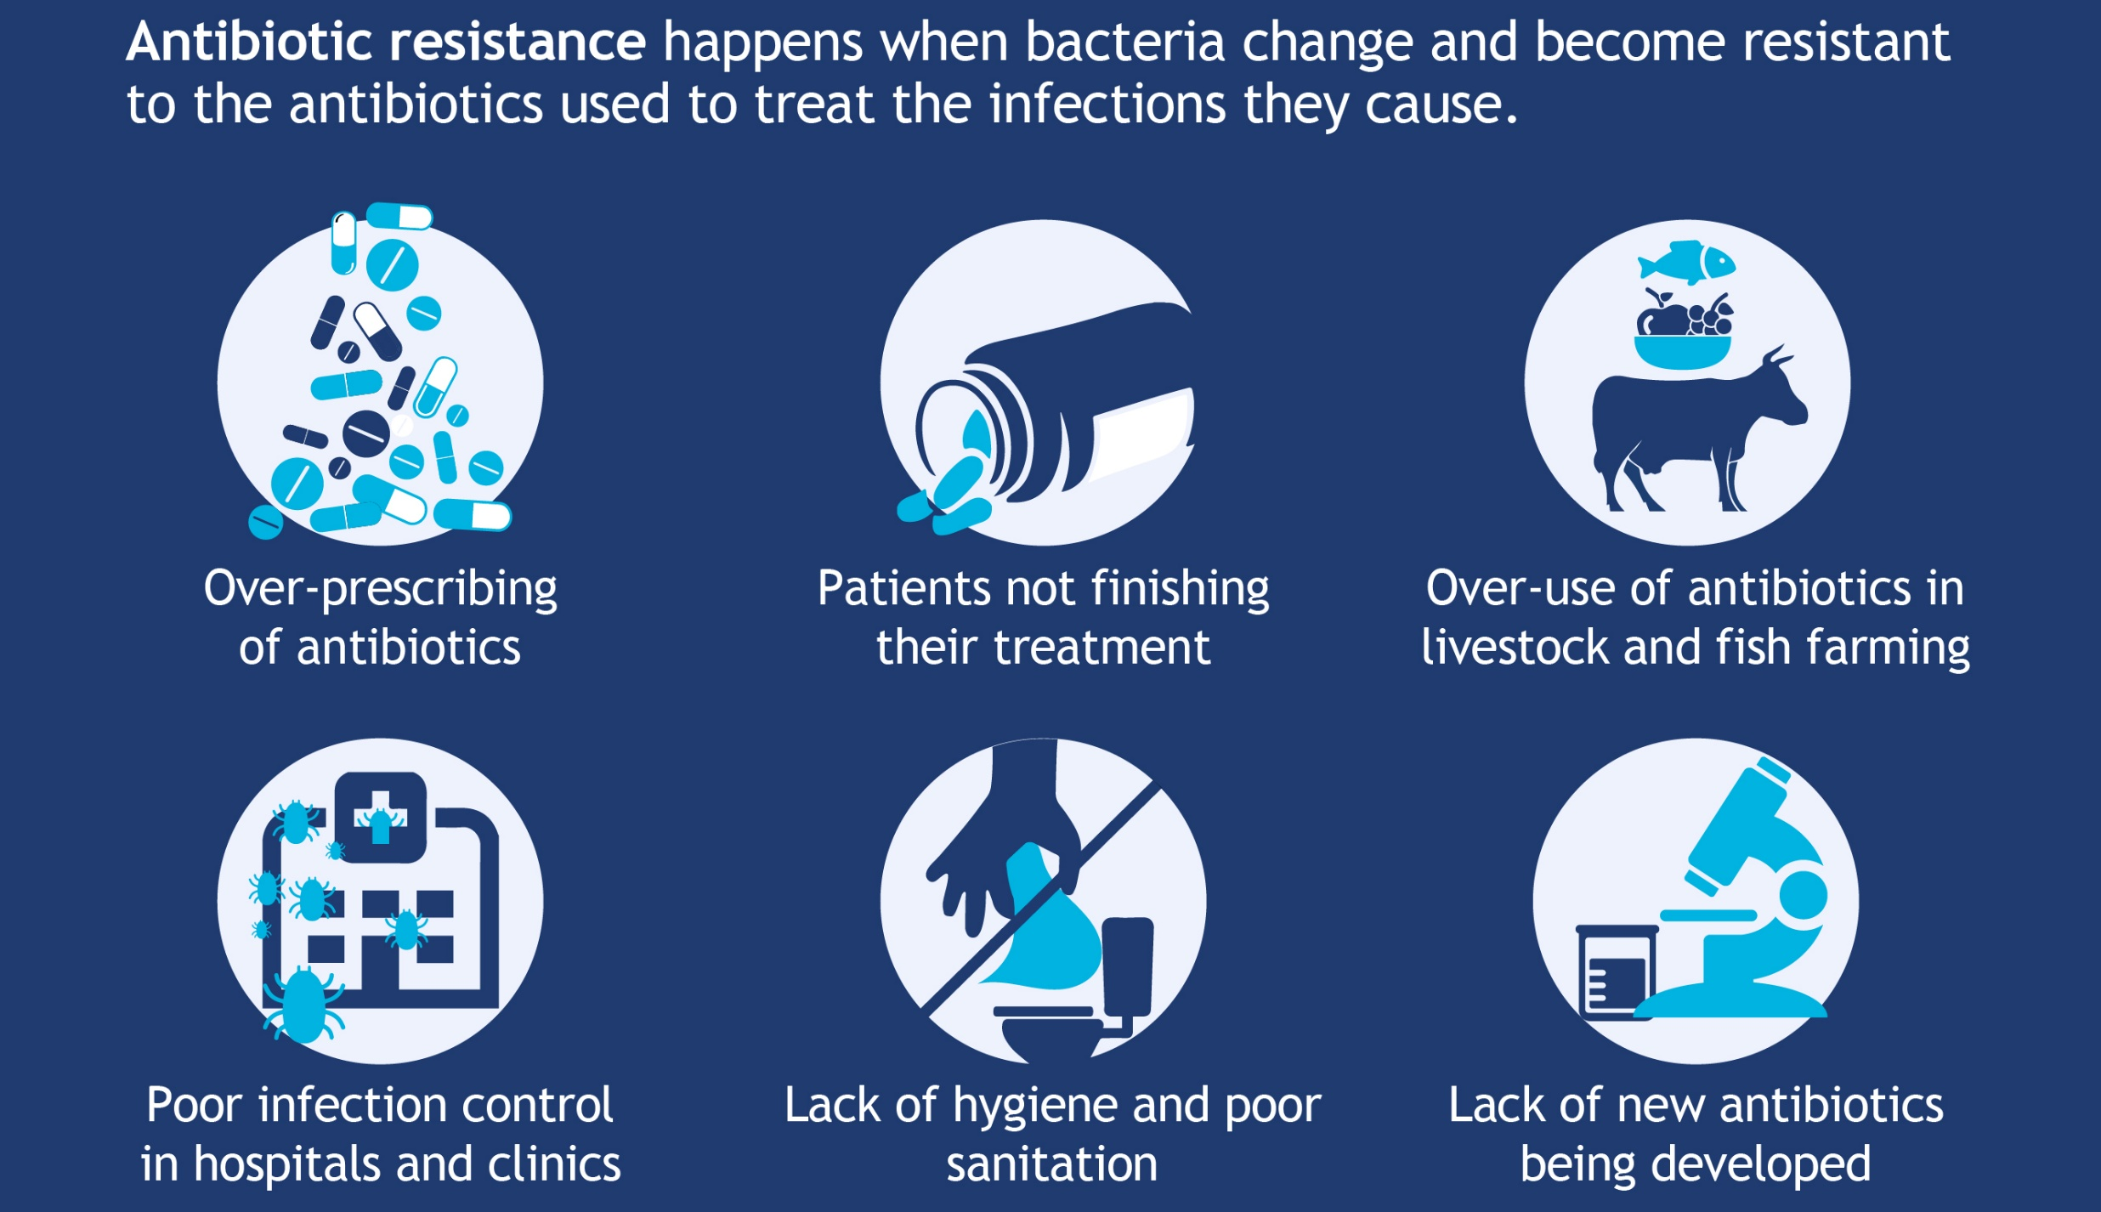
Causes
World Health Organization.

Slide 10
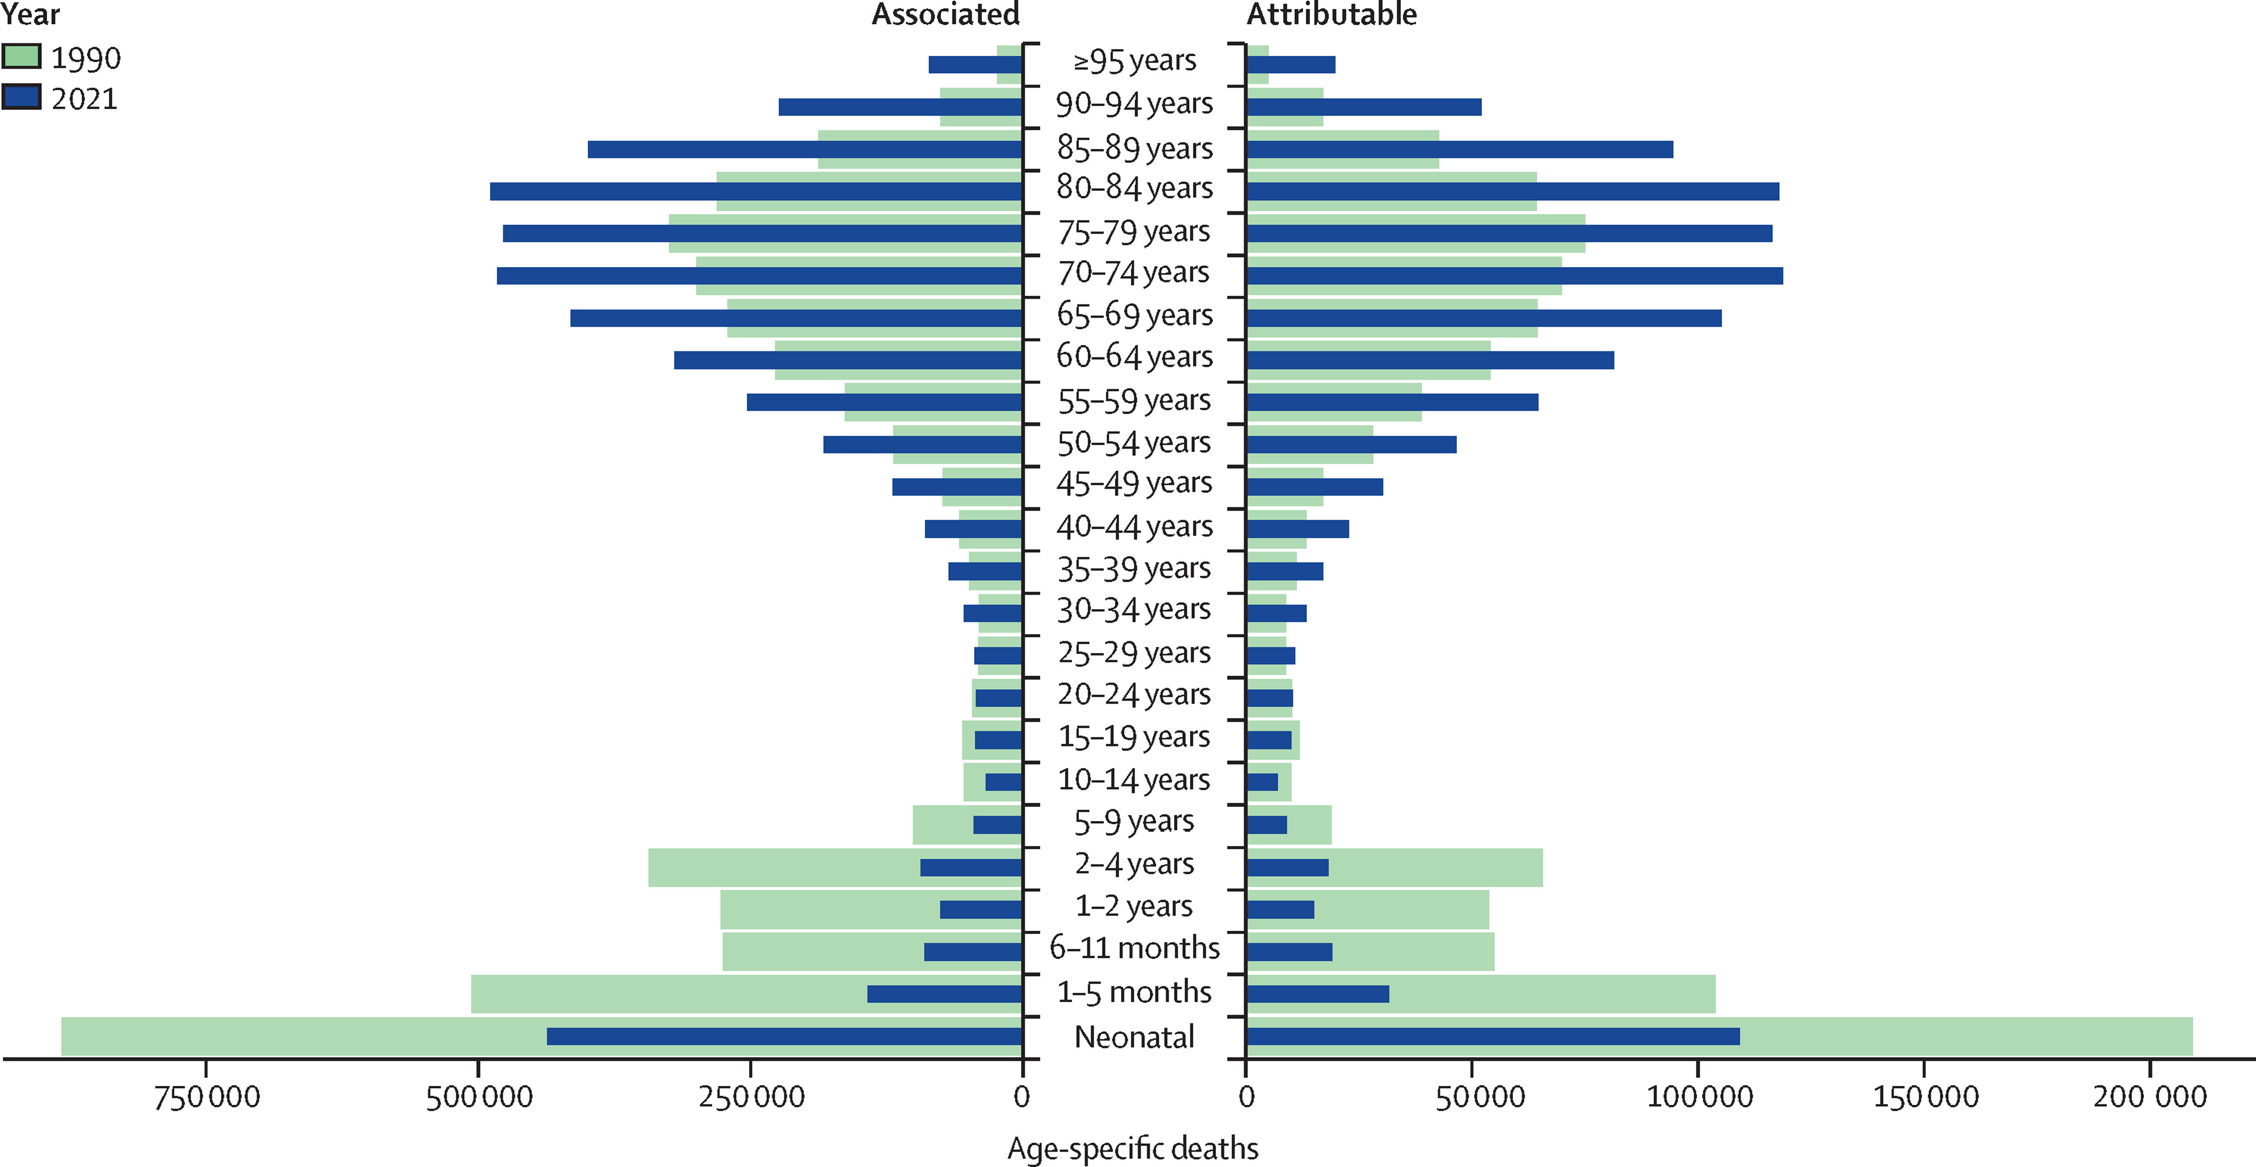
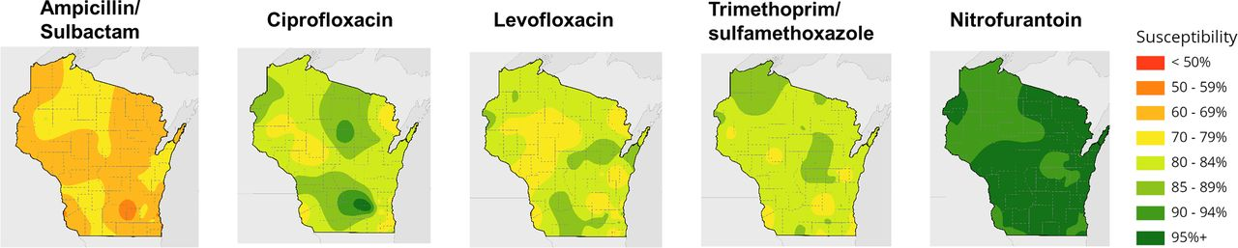
Resistance in human health
“In the US alone, more than 2,000,000 infections a year are caused by bacteria that are resistant to at least first-line antibiotic treatments, costing the US health system $20 billion USD in excess costs each year.”
1990
2021
Associated Deaths/Yr (Global)
O’Neill. 2016. Review on Antimicrobial Resistance.
GBD 2021 Antimicrobial Resistance Collaborators. Lancet.
Legenza et al. 2019. Antimicrobial Agents and Chemotherapy.

Slide 11

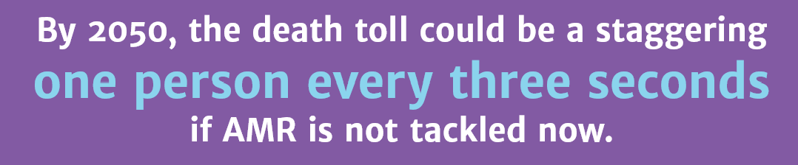
Resistance in human health
“In the US alone, more than 2,000,000 infections a year are caused by bacteria that are resistant to at least first-line antibiotic treatments, costing the US health system $20 billion USD in excess costs each year.”
1990
2021
Associated Deaths/Yr (Global)
O’Neill. 2016. Review on Antimicrobial Resistance.
GBD 2021 Antimicrobial Resistance Collaborators. Lancet.
Legenza et al. 2019. Antimicrobial Agents and Chemotherapy.

Slide 12
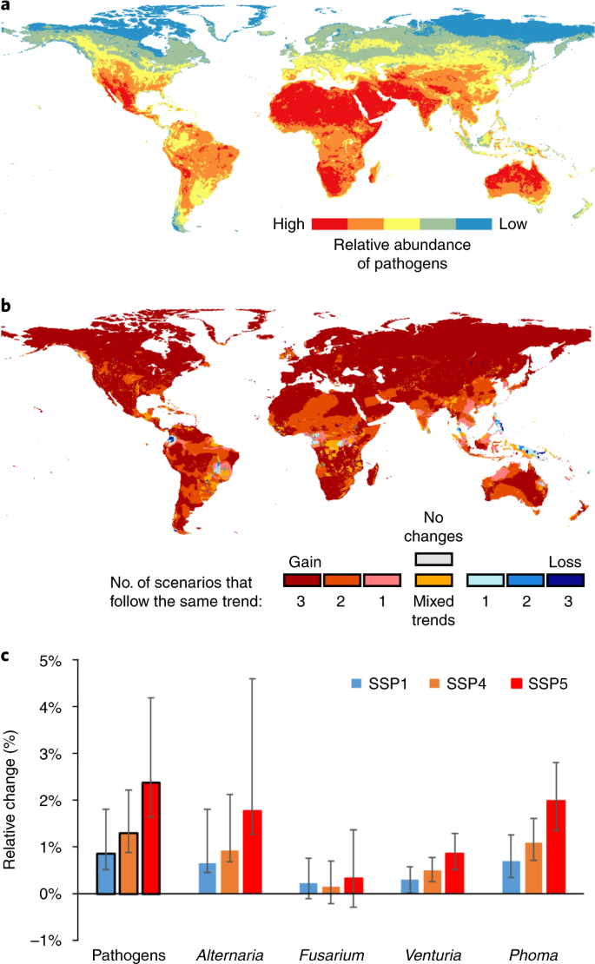
Infectious disease in agriculture
Relative Abundance of Plant Pathogens
2020
“Plant pathogens and pests are documented to cause up to
40% yield losses in major crops including maize, rice, and wheat…resulting in annual worldwide economic losses of approx. $220 billion USD.”
2050 (projection)
Savary et al. 2019. Nat Ecol Evol.
Delgado-Baquerizo et al. 2020. Nat Clim Change.

Slide 13
Strategies for when antibiotics fail
Implement better use practices and stewardship
Discover new antibiotics that work in new ways
Develop non-antibiotic treatments

Slide 14
Where do we find new antibiotics?
Nature offers the most promising new antibiotics.
Bacteria and fungi have evolved over millions of years to live in competitive environments.
  Some of these cause disease, but many microbes are beneficial to humans, plants, and other organisms.
  They often make their own antibiotics to compete and give them a survival advantage over other microbes.

Slide 15
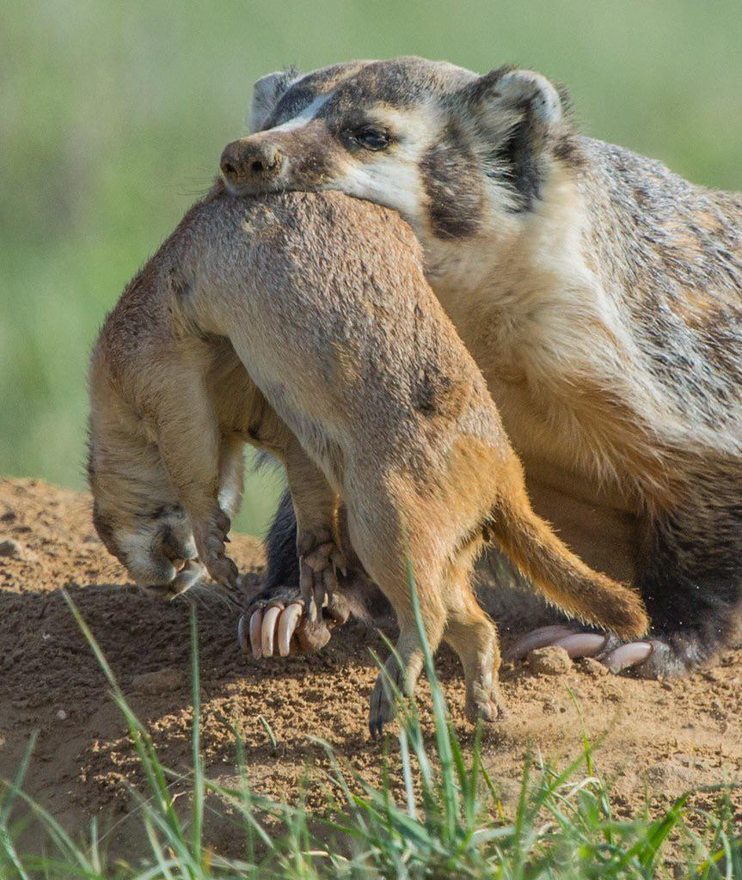
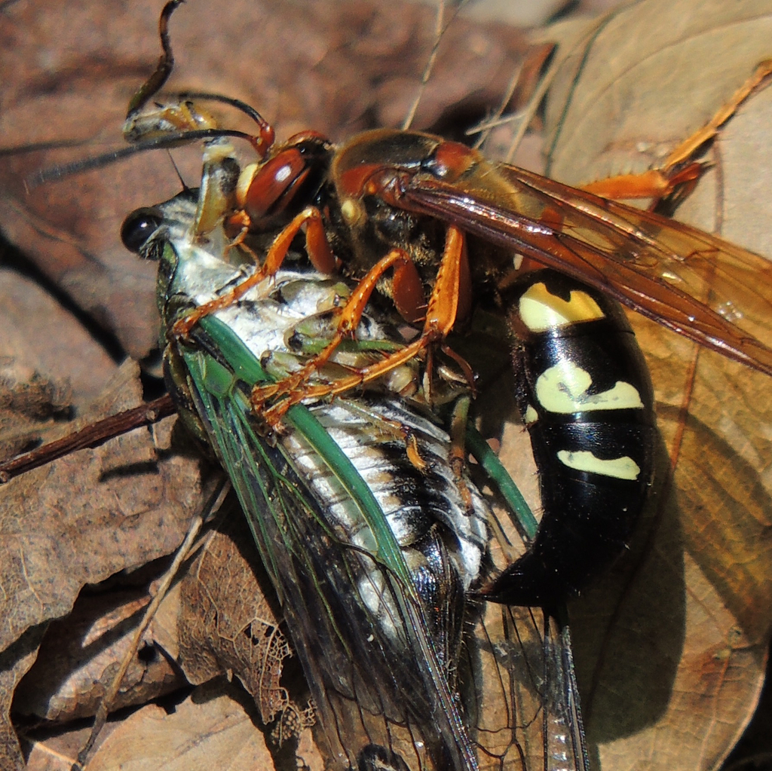
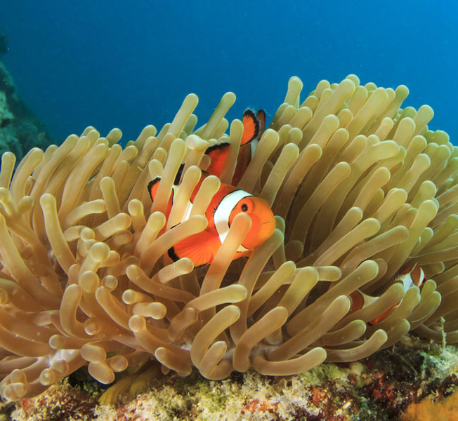
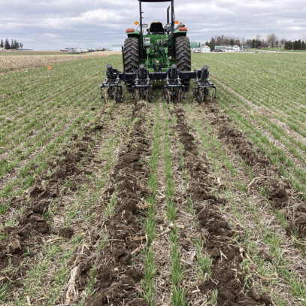
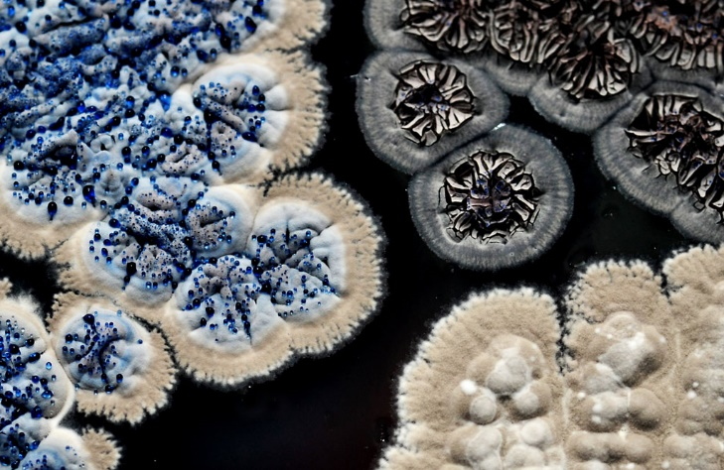
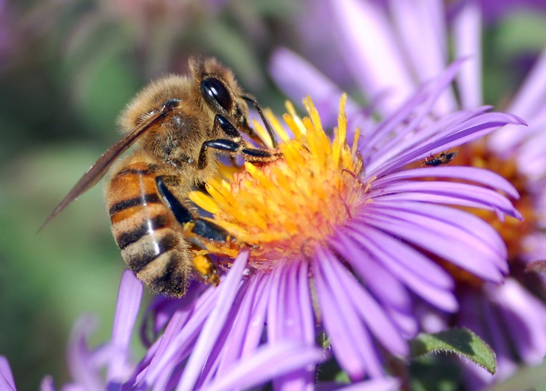
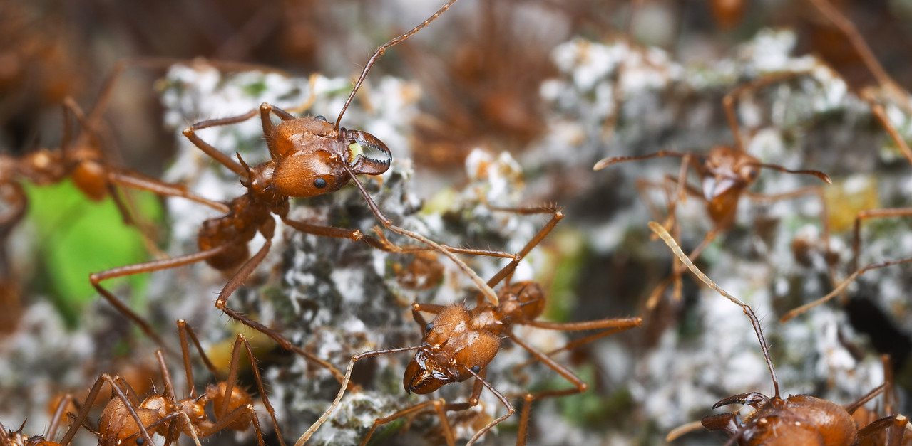
Complex Interactions Between Species Shape the Diversity of Life

Slide 16
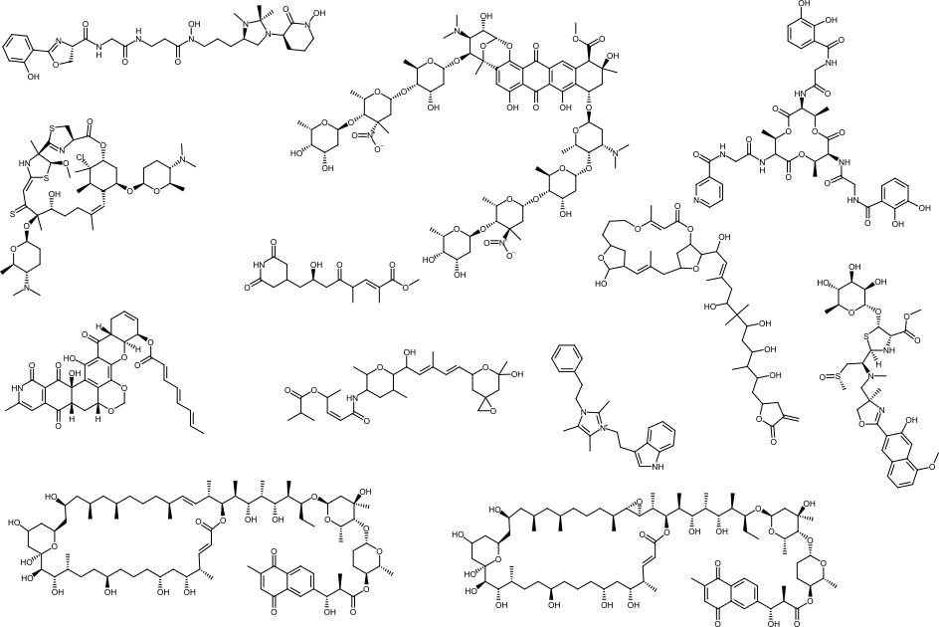
Diverse Chemistry Mediates Microbial Interactions
Antibacterial
Antifungal
Anti-oomycete
Anti-leishmania
Host-microbe interaction (e.g., virulence)
Resource competition
Bacillibactin E
J Nat Prod. 2021.
Madurastatin D2
Org Lett. 2019.
Keyicin
ACS Chem Biol. 2017.
Forazoline A
Org Lett. 2020.
Secimide
Nature Comm. 2021.
Gynuellalide
Nature Comm. 2021.
Turbinmicin
Science. 2020.
Spliceostatin M
Nature Comm. 2021.
Bacillimidazole
Marine Drugs. 2022.
Ecteinamine
JACS. 2022.
Cyphomycin Nature Comm. 2020.
Caniferolide C Bioorg Med Chem. 2021.
In collaboration with UW-Madison: C Currie, T Bugni, D Andes, F Zhang, J Wu, J Yan, M Thomas;
ETH Zurich: E Helfrich, J Piel; U de São Paulo: H Ortega, M Pupo

Slide 17
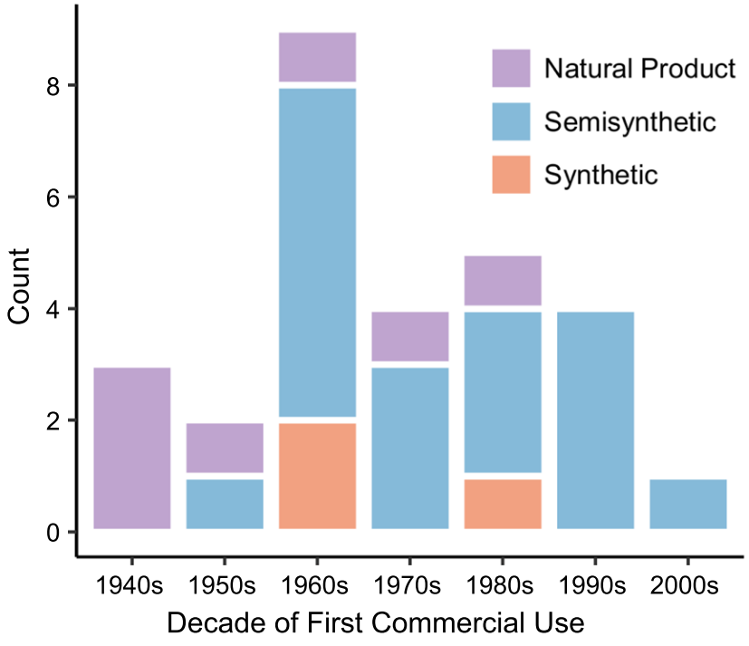
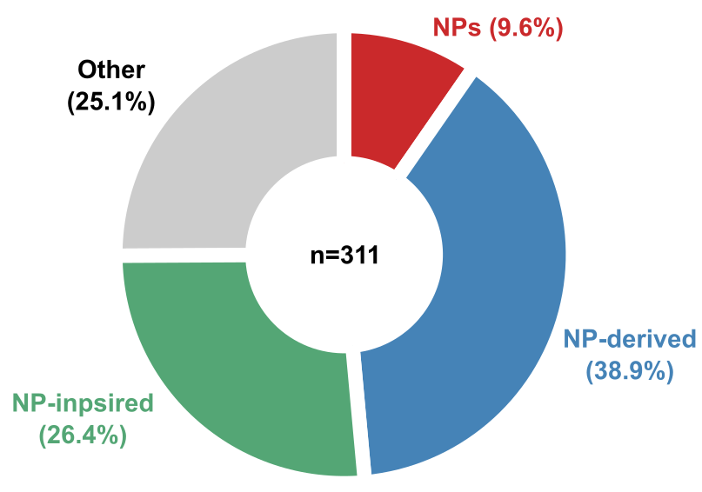
Antibiotics made by bacteria and fungi are a major source of new drugs
FDA-approved Small Molecule
Antibiotics & Anticancer Drugs (1981-2019)
WHO “key access” antibiotics
Directly from Nature (9.6%)
Directly from Nature
Other
(25.1%)
Nature-derived
Synthetic
Nature-derived
(38.9%)
Nature-inspired
(26.4%)
Newman & Cragg. 2020. J Nat Prod.
Chevrette & Currie. 2018. J Ind Microbiol Biot.

Slide 18


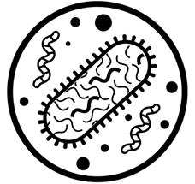
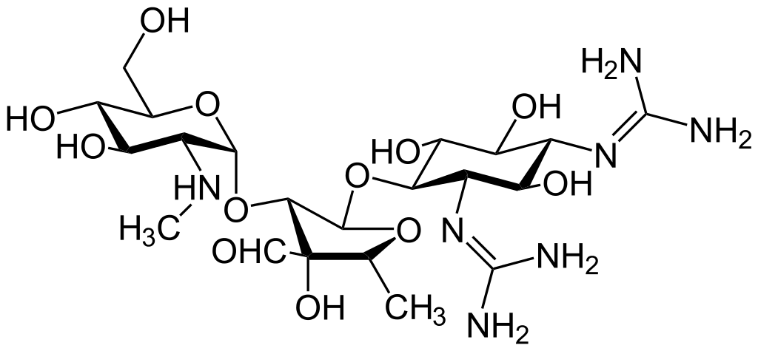
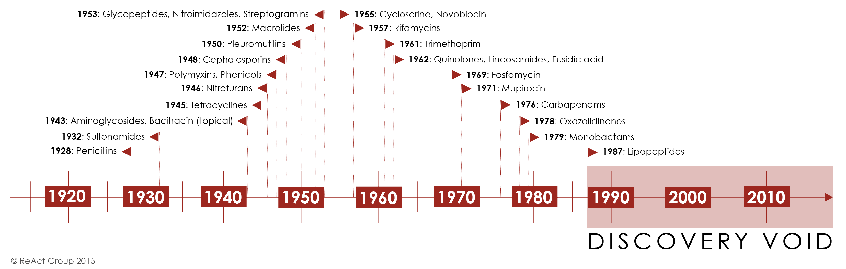
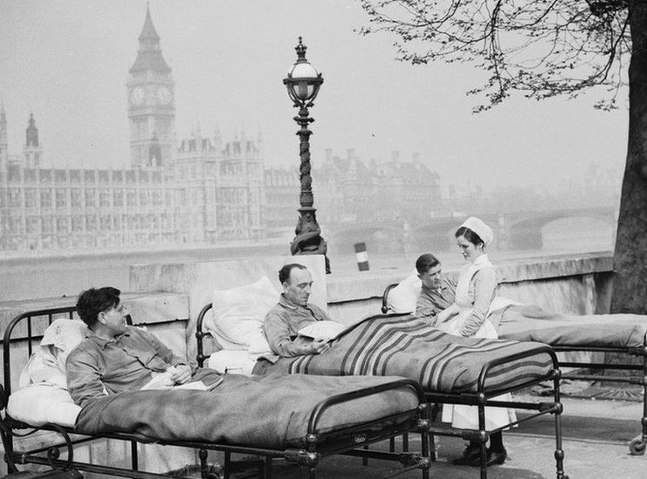
Where have we looked for new antibiotics?
Discovery
Soil
Isolate bacteria
Screen for activity
Streptomycin, discovered 1943
Tuberculosis mortality decreased by over 85% from 1940 to 1960

Slide 19
Where have we looked for new antibiotics?
Discovery
Soil
Isolate bacteria
Screen for activity
Rediscovery

Slide 20
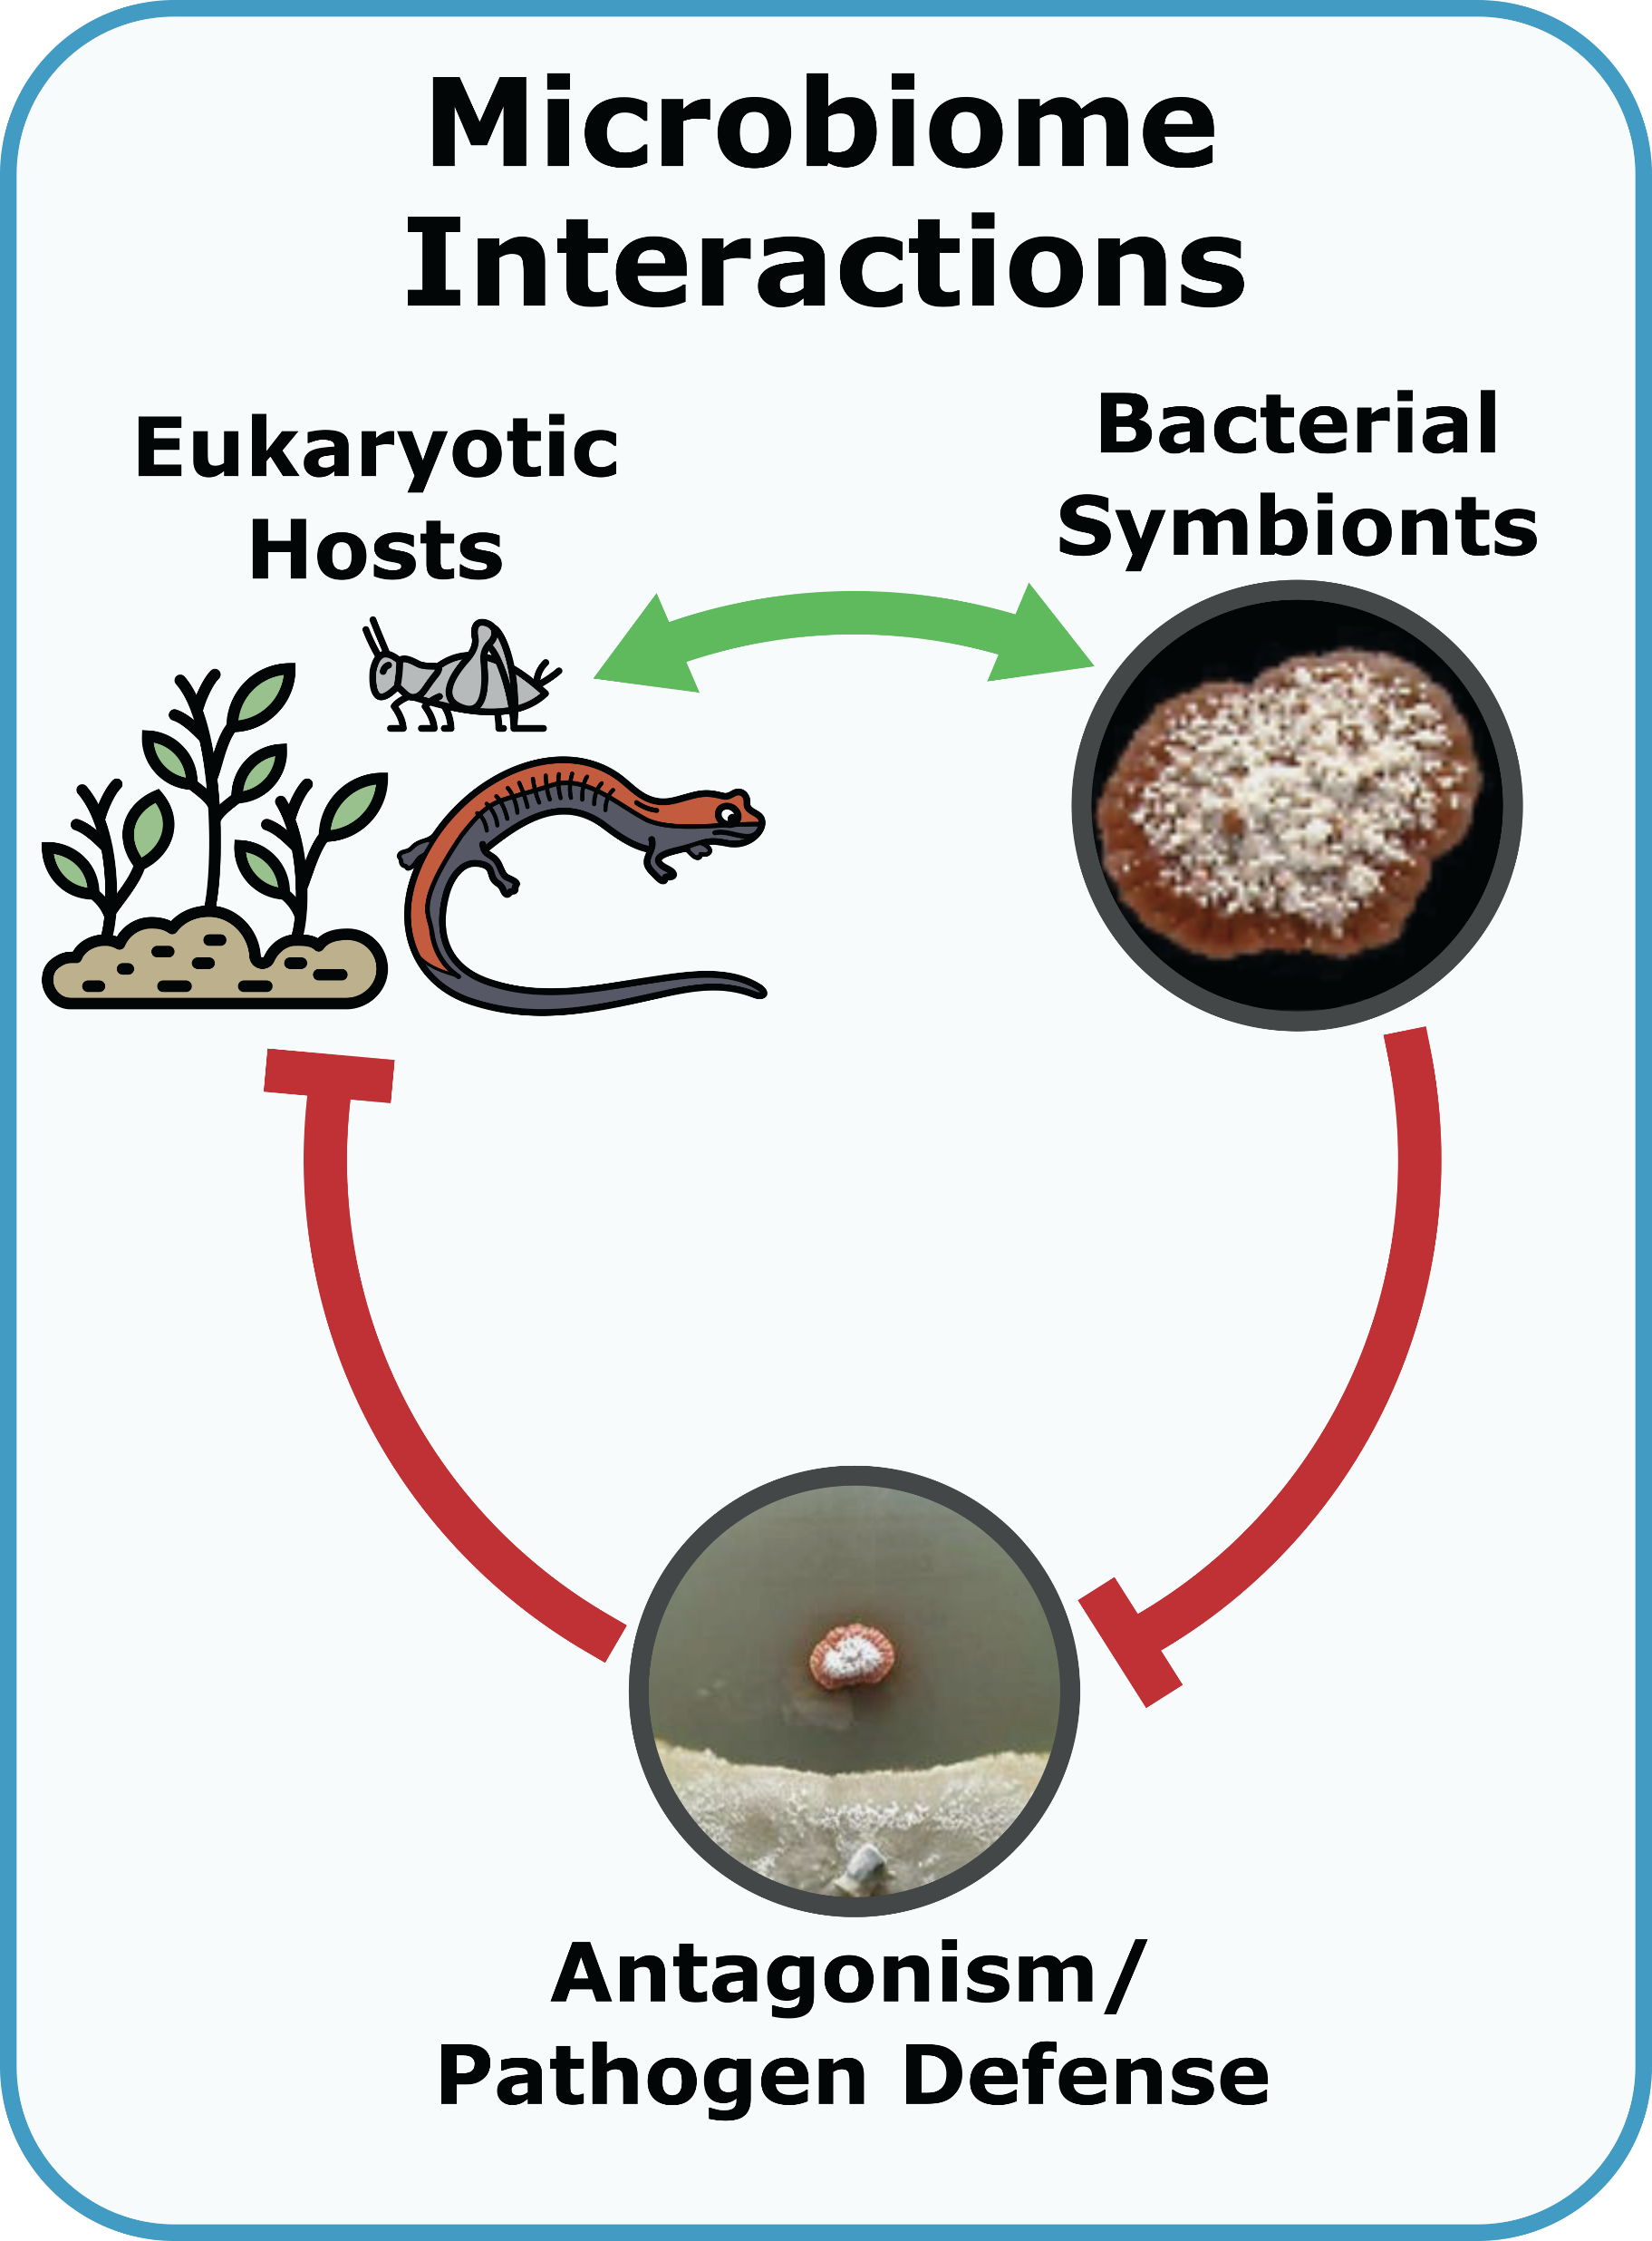
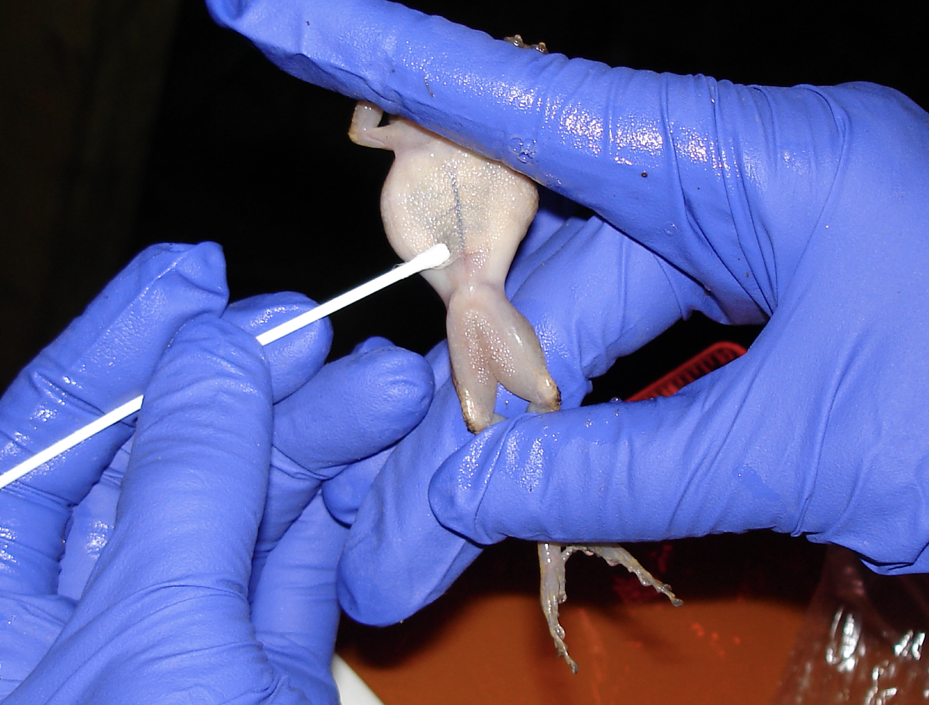
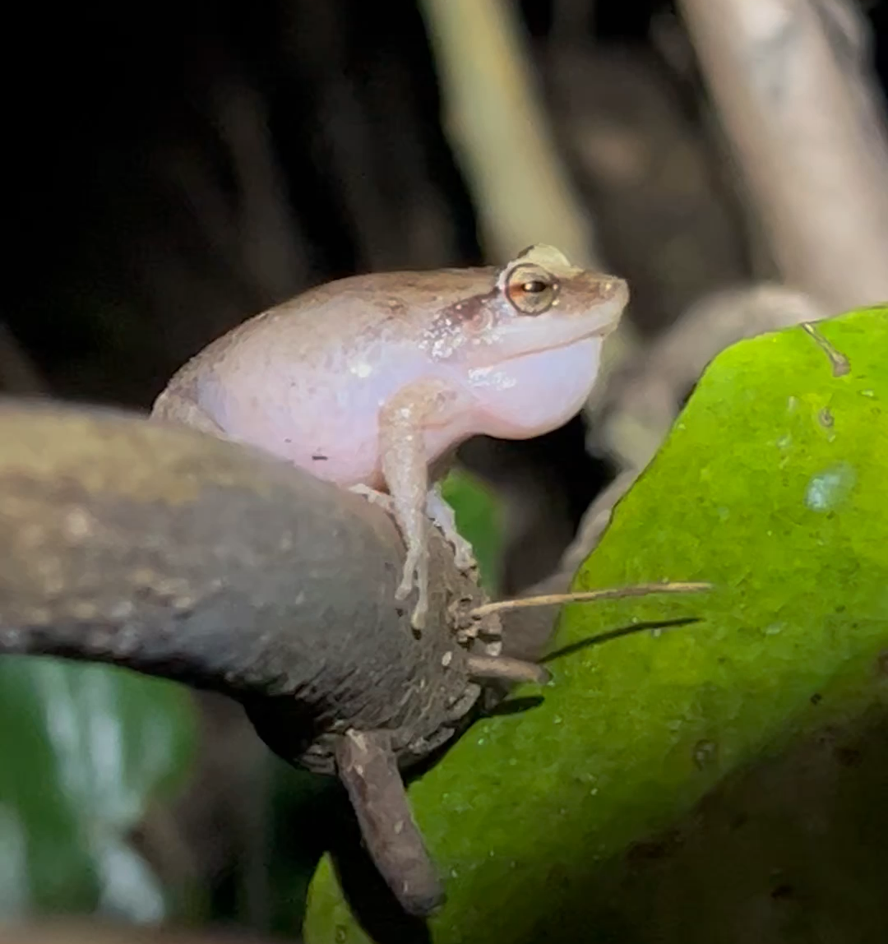
Where else can we look for new antibiotics?
Herptiles with (fungal) disease burden
  Frogs, salamanders, snakes
Plant/crop systems
  General: Rhizosphere
  Targeted: Disease burden
    e.g. rice blast and other crop diseases
Insects from underexplored environments
  Cockroaches, termites
  Butterflies, moths
Ana Longo, University of Florida

Slide 21
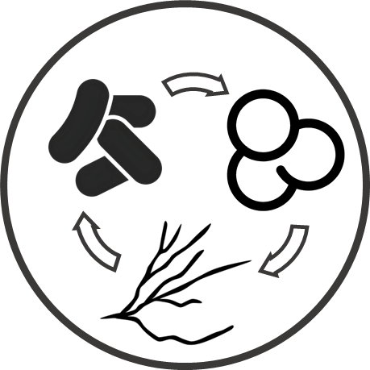

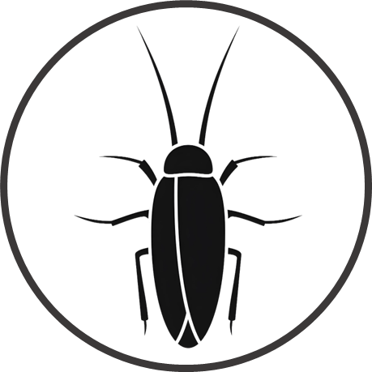
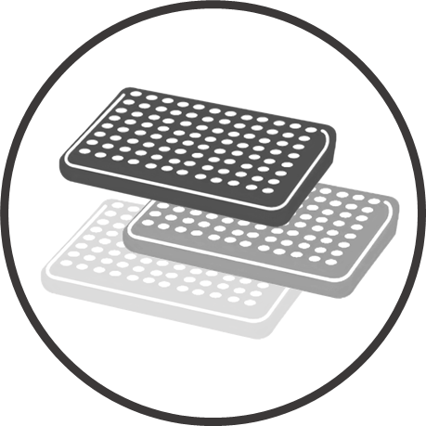
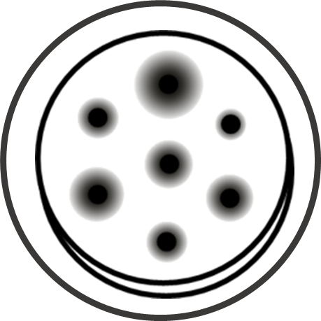


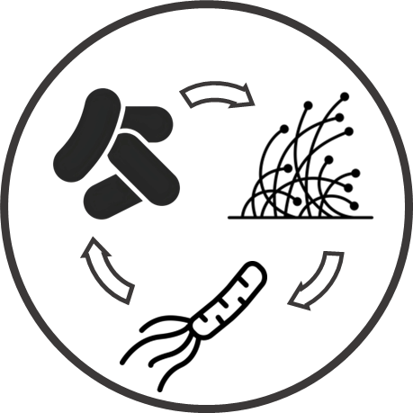
Metabolomics
Transcriptomics
Environmental bacteria interactions
High-throughput elicitation experiments
Antimicrobial activity against
pathogens
Host-associated culture collections
Environmental bacteria - pathogen interactions

Slide 22
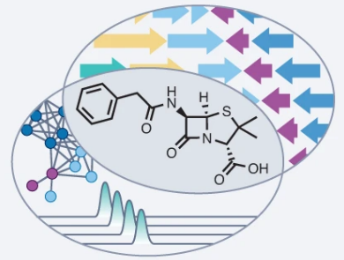
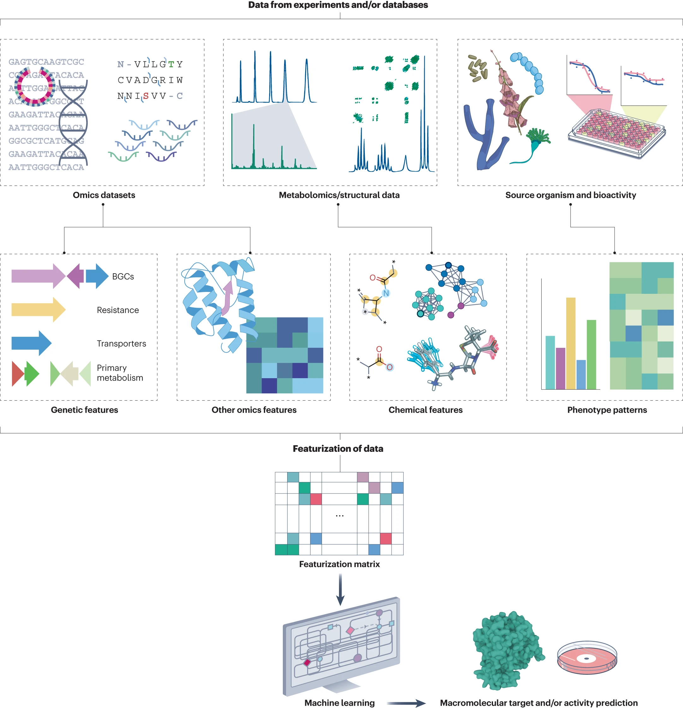
New methods for new discoveries
Mullowney, et al. 2023. Nat Rev Drug Disc.

Slide 23
Challenges and opportunities; Chevrette lab @ UW
Finding new, useful antibiotic molecules
  High “rediscovery” rates with traditional methods
  ‘Omics/AI to mine for new chemistry & study its evolution
Producing them and understanding their regulation
  Most bacterial chemistry is “silent” under lab conditions
  Synthetic biology tools & high-throughput elicitation
Understanding the ecological roles of antibiotics
  Little known is about this chemistry in complex communities
  Synthetic & natural communities, microbiomes

Slide 24
Summary
Antibiotics enable modern medicine and are our major defense against bacterial and fungal diseases
Most of the antibiotics we use are originally made by bacteria and fungi in nature
Resistance threatens their effectiveness
Research at UW-Madison and across the globe is aimed at developing new strategies for combating resistance, including discovering new antibiotics

Slide 25
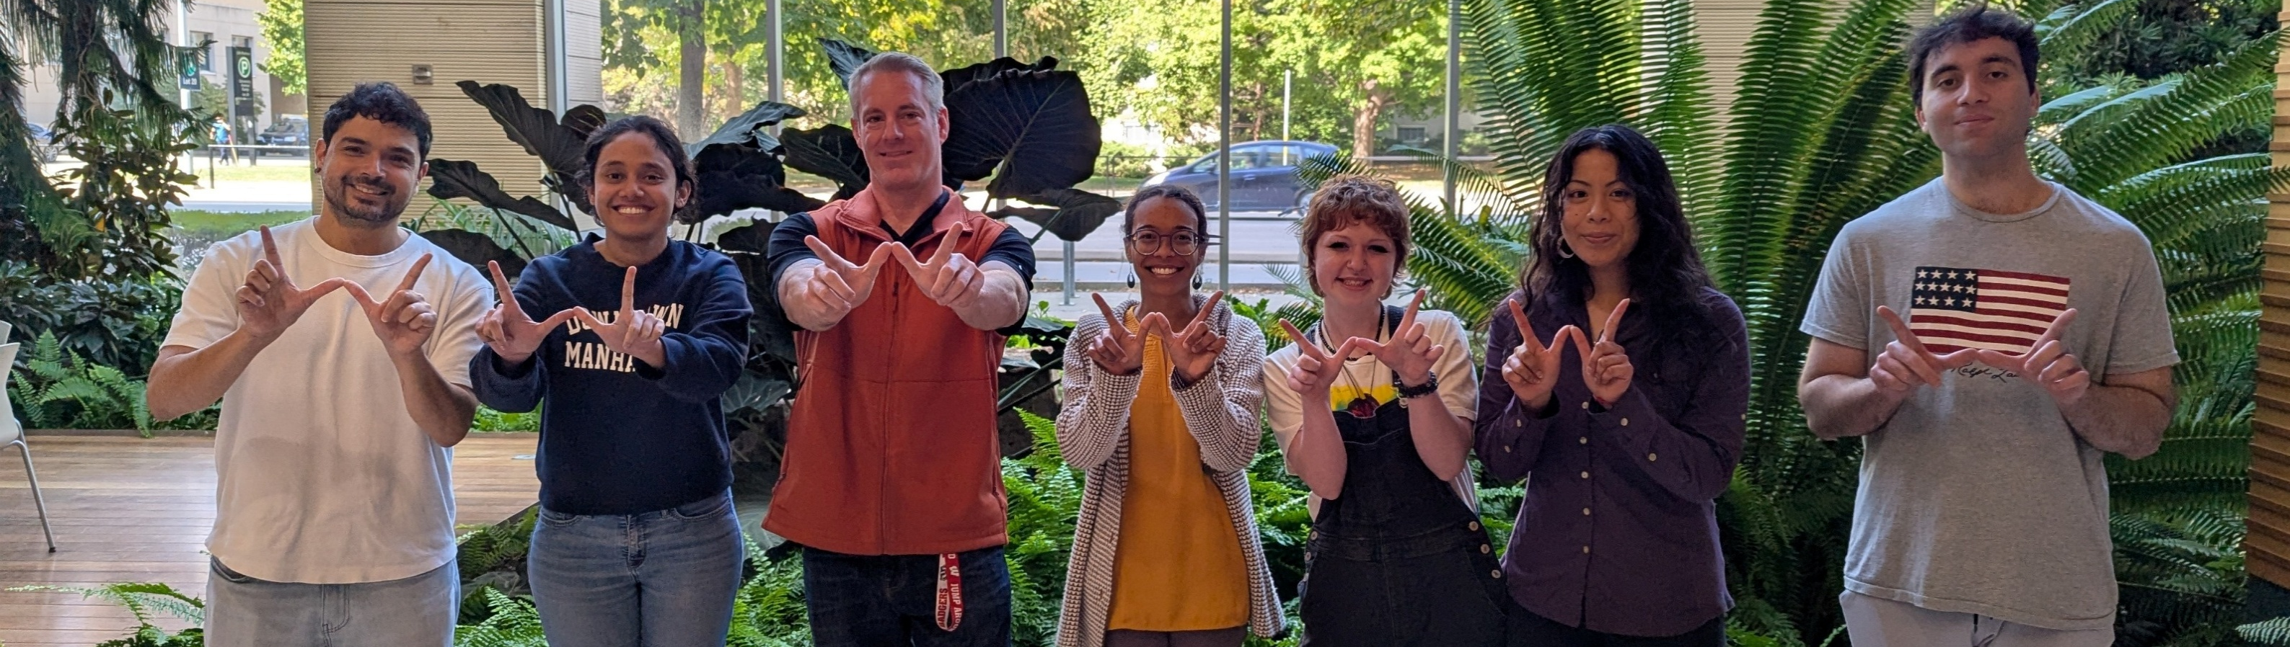





Chevrette Lab
Dr. Julia Nepper
Willow Ungaro
Murrel Saldanha
Dr. Andrés Cumsille
Socorro Palmon
Zachary Ammar
Not Pictured
Ava Clark
Marielle Martin
Sydney McCauslin
Josephine Putnam
Stella North

