Slide 1
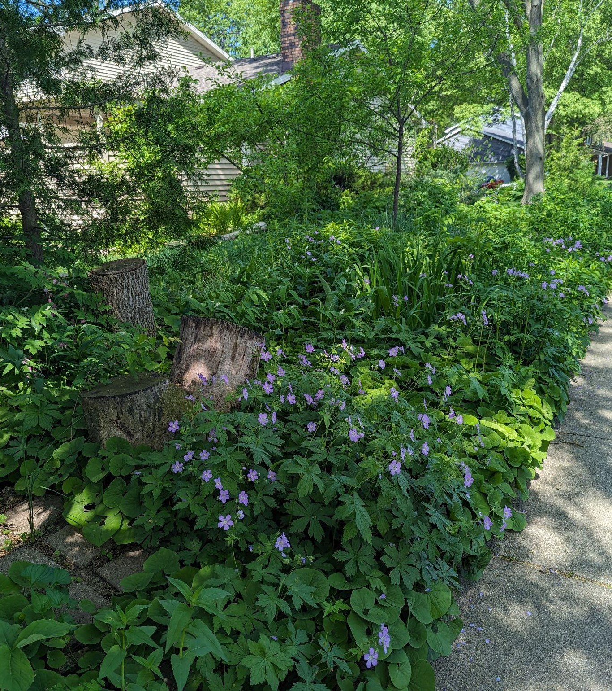
Native Plants for Shady Spaces
Melissa Apland Bee Balm Wildscapes
And lessons learned from my own yard

Slide 2
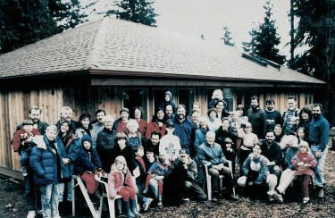
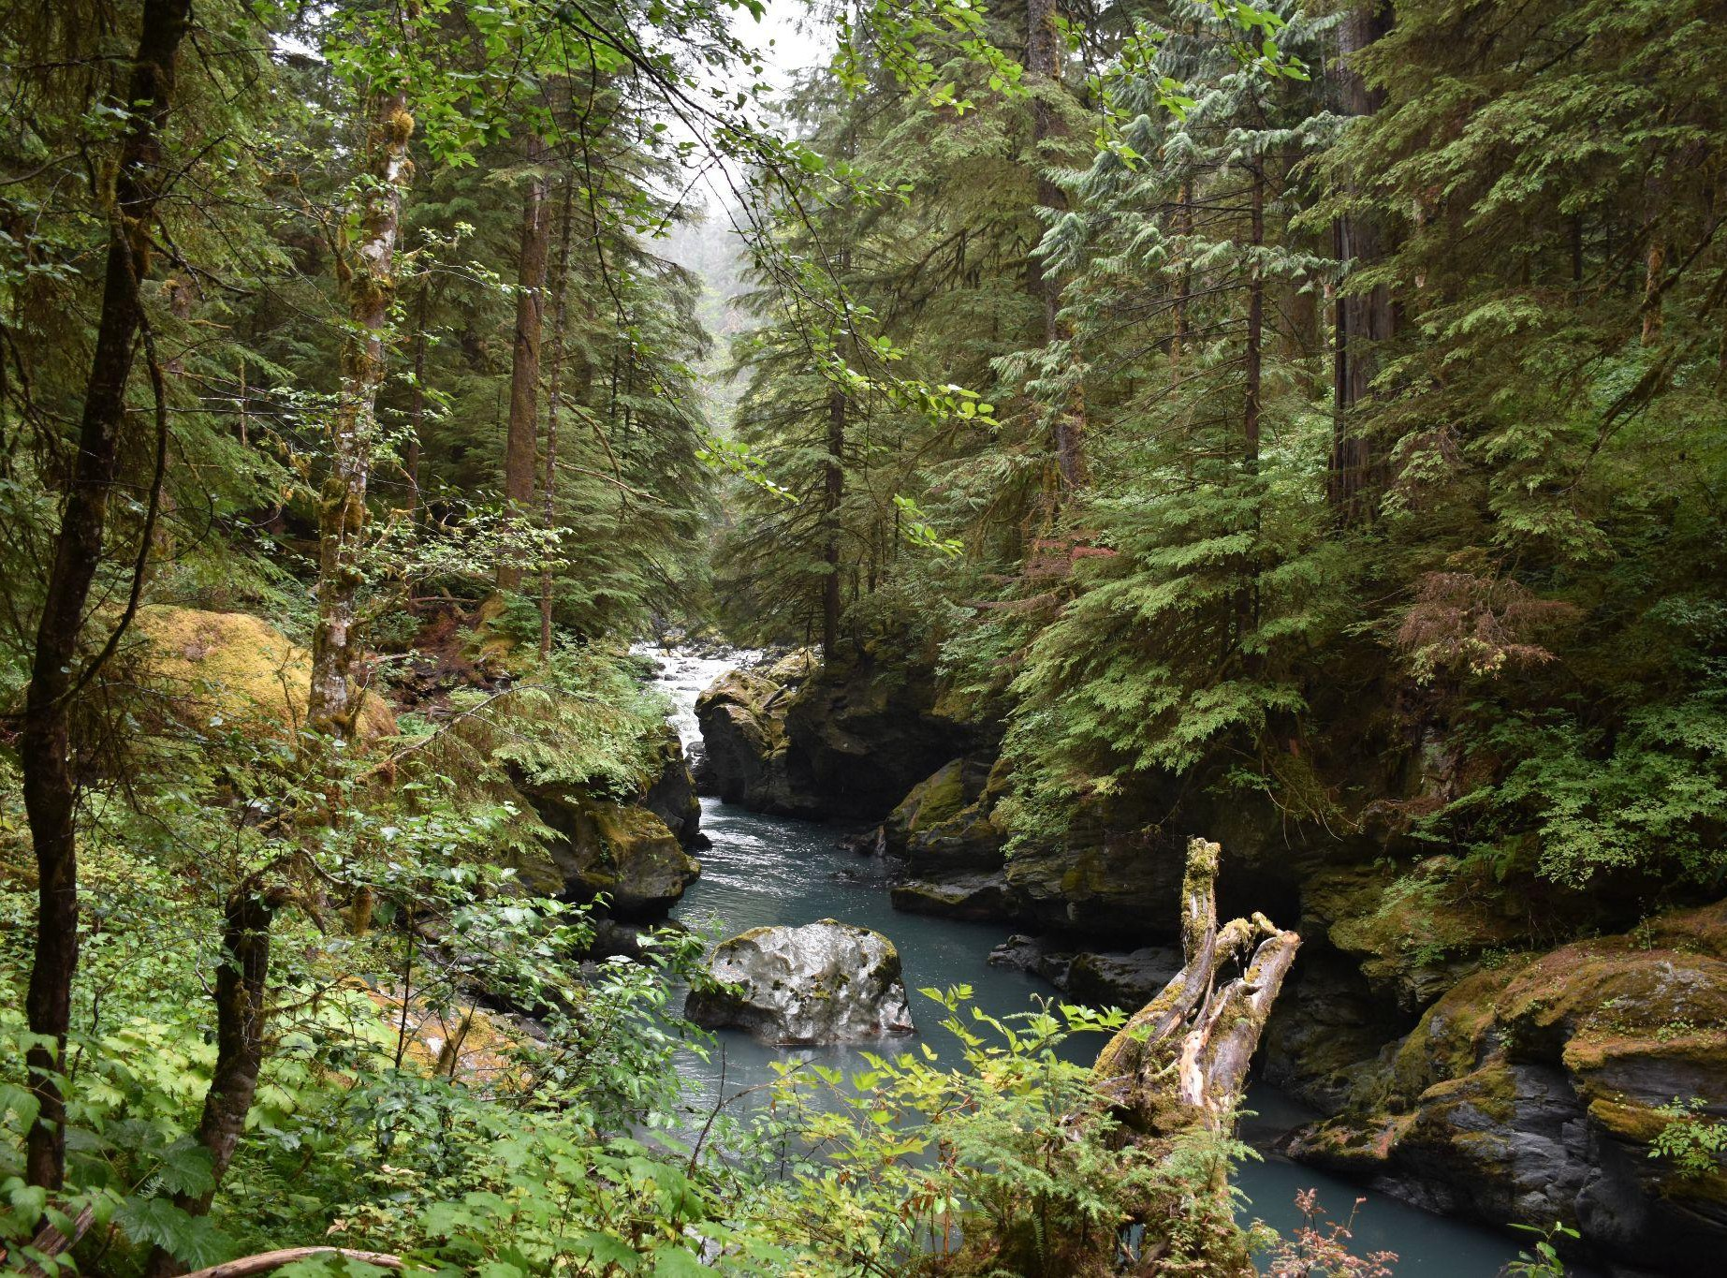
About Me
Bee Balm Wildscapes
2

Slide 3
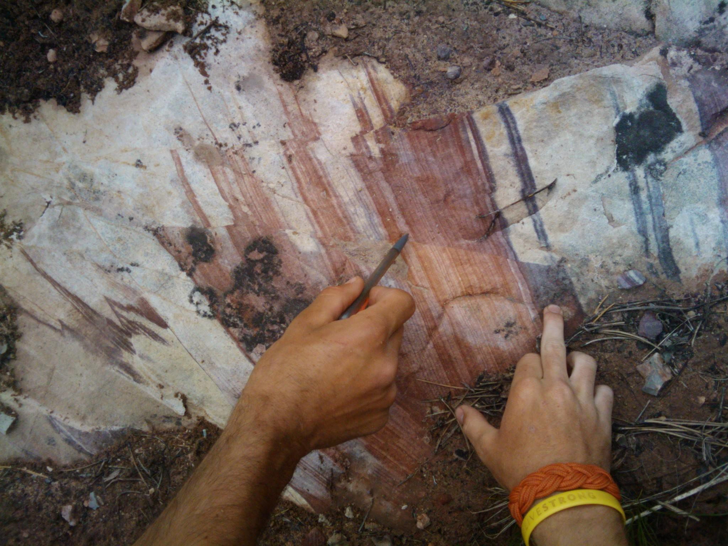
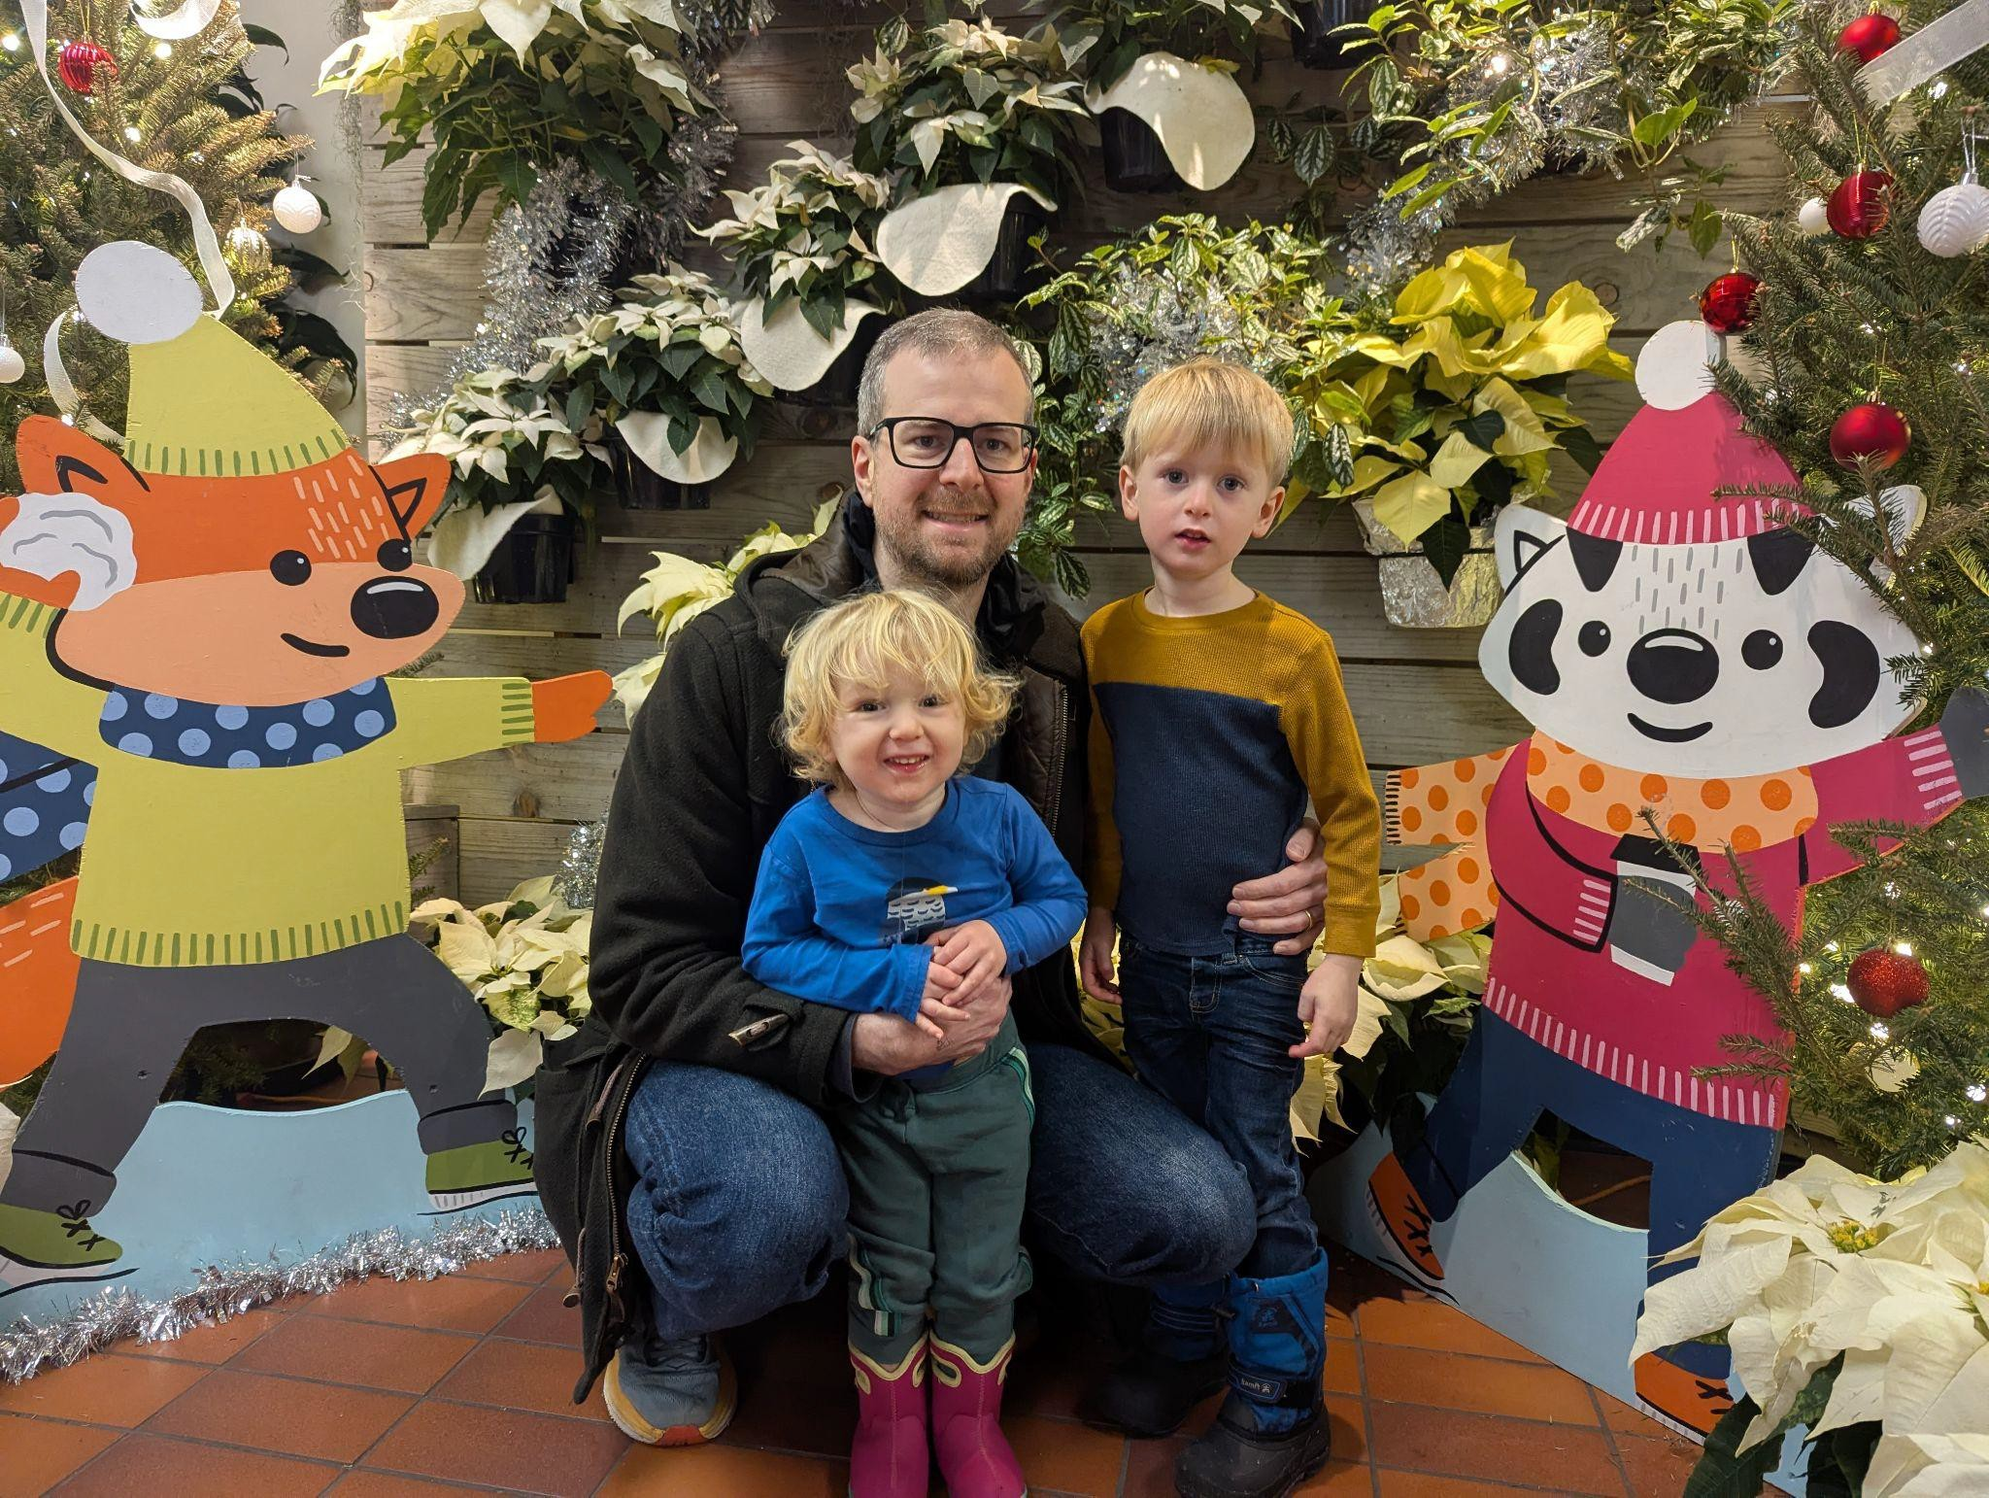
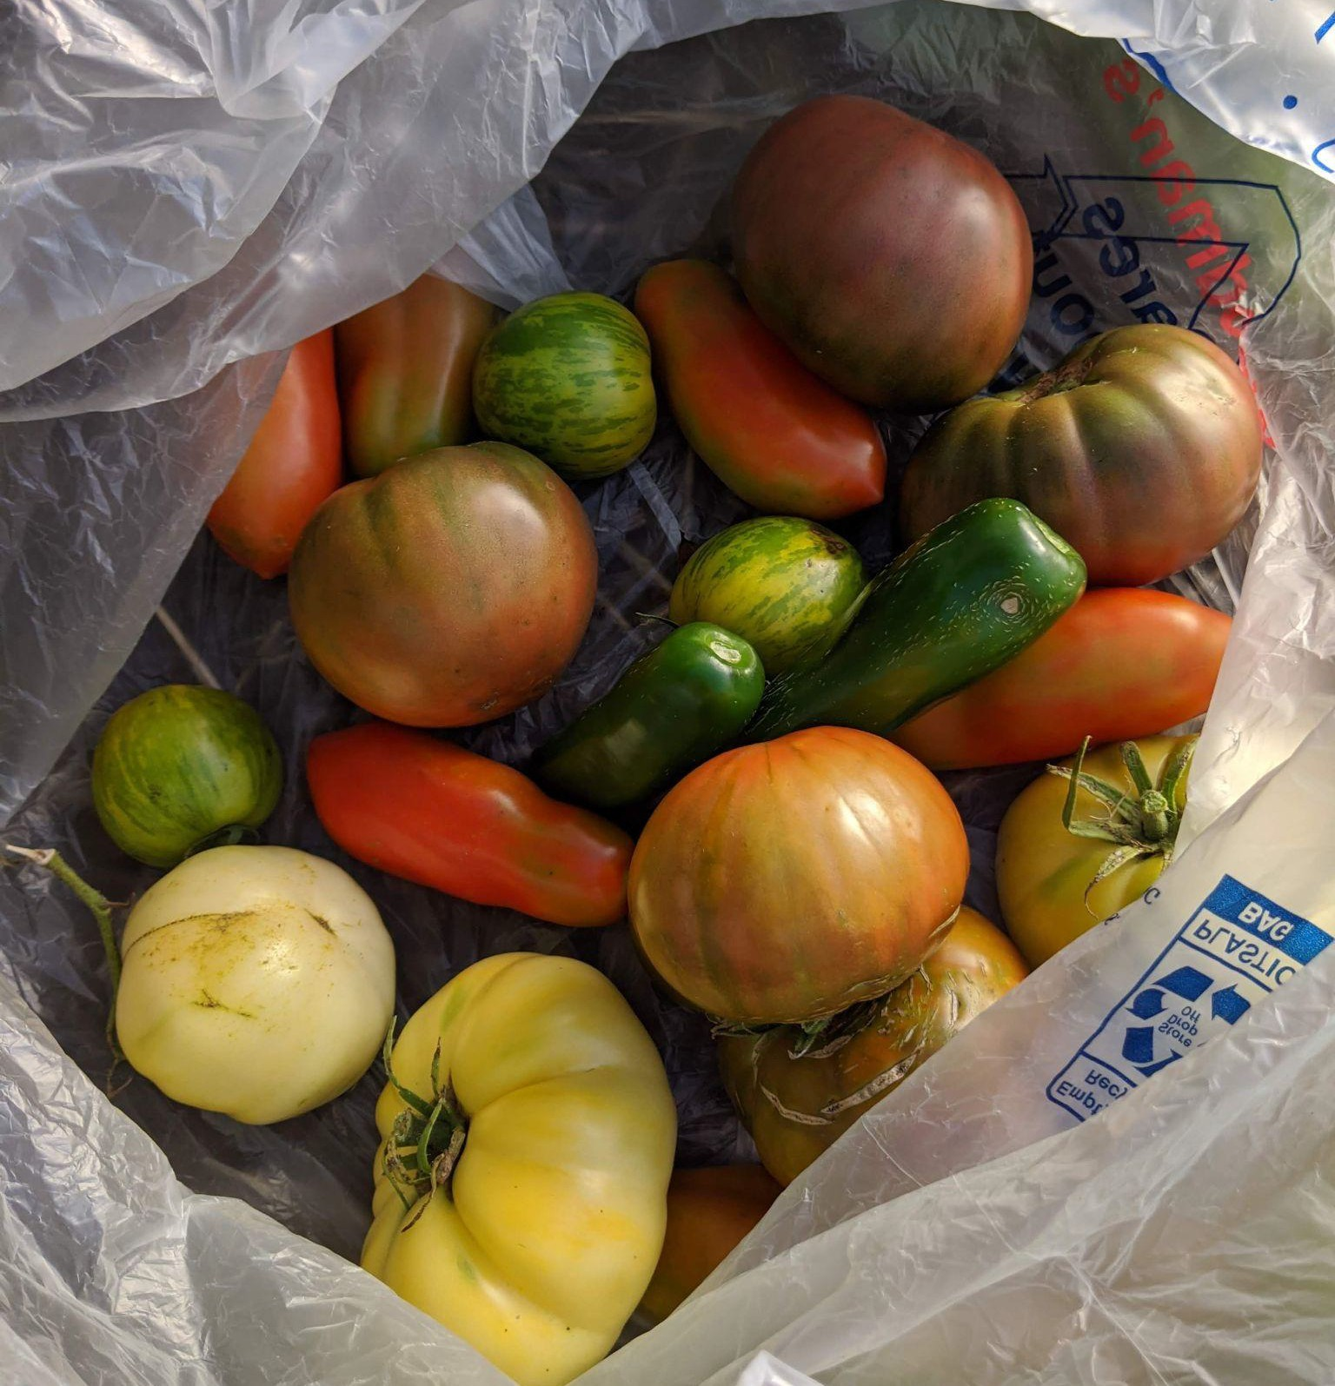
About Me
Bee Balm Wildscapes
3

Slide 4
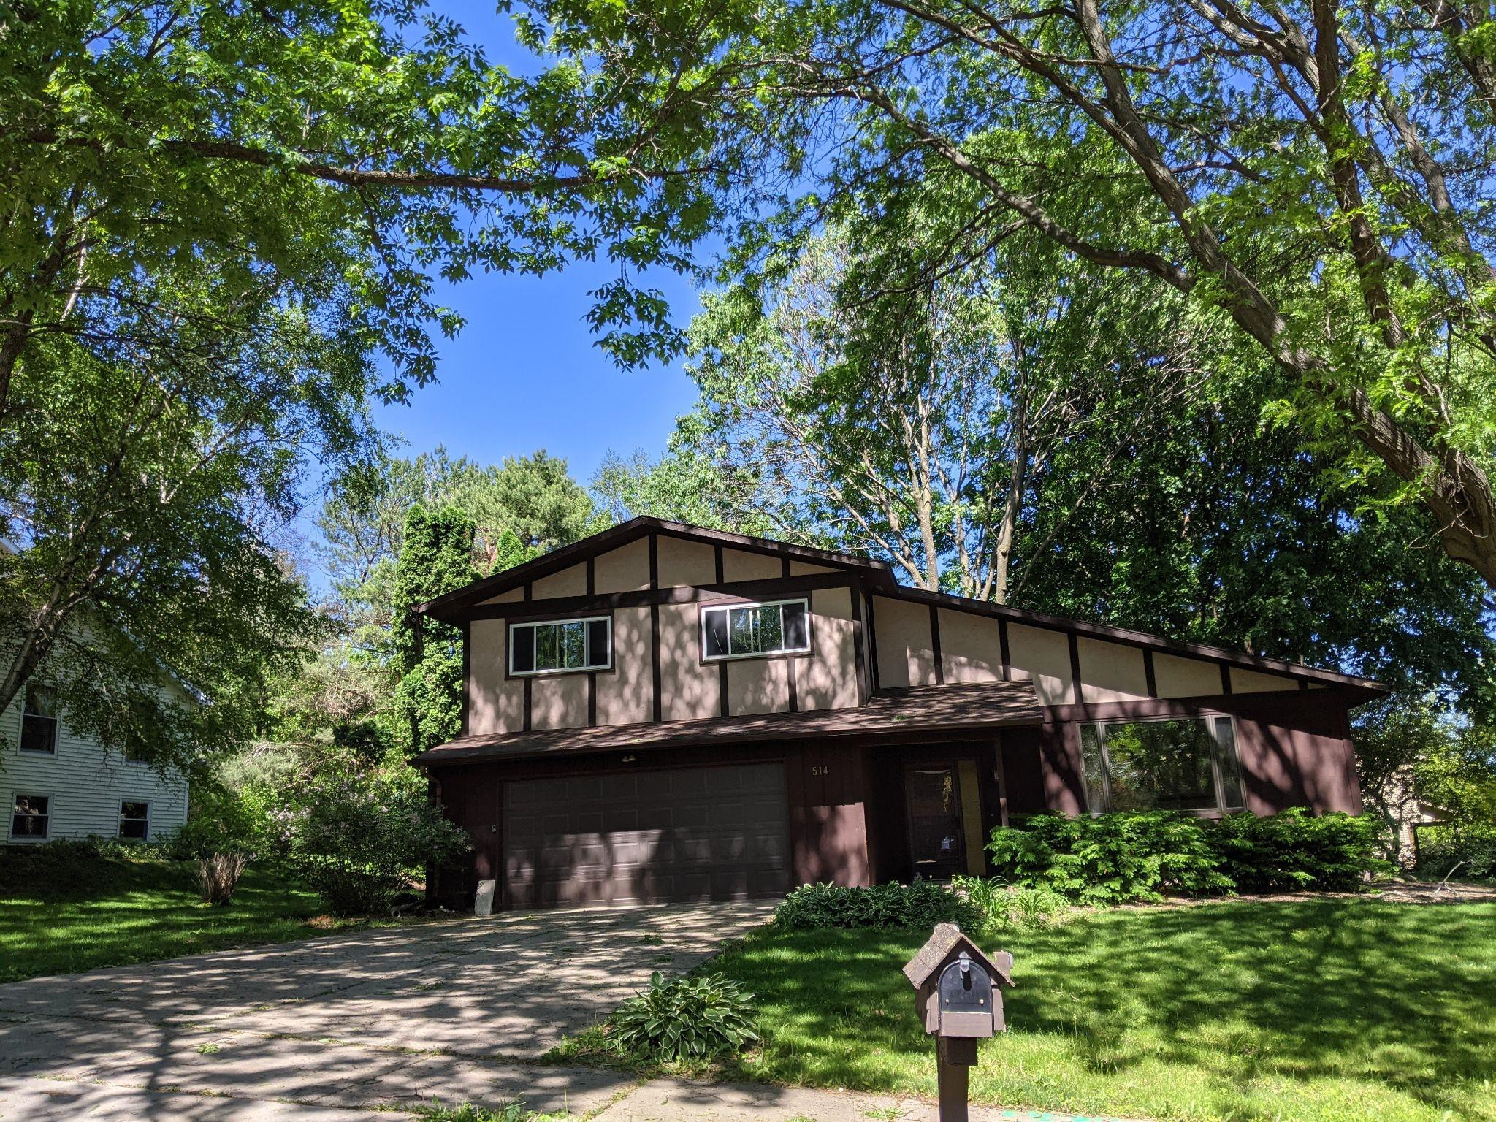
Bee Balm Wildscapes
4

Slide 5
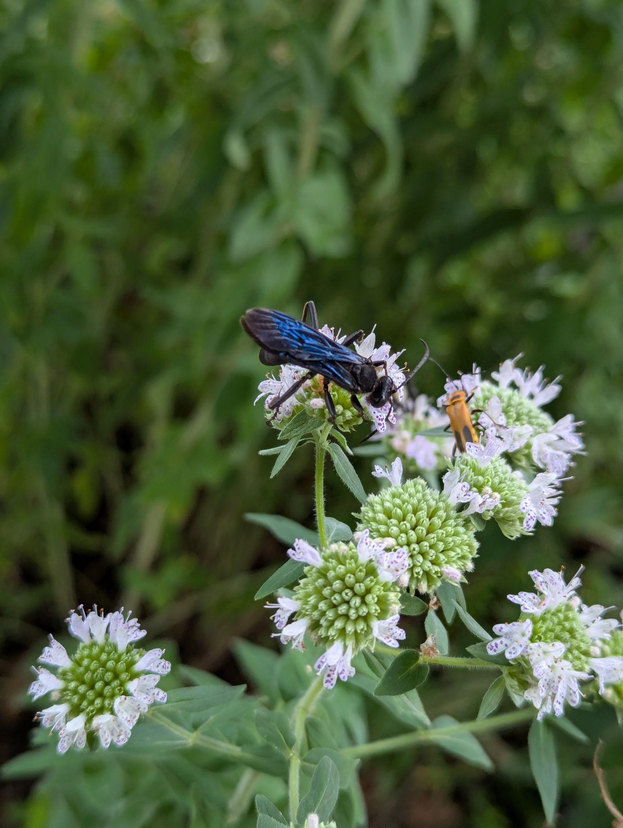
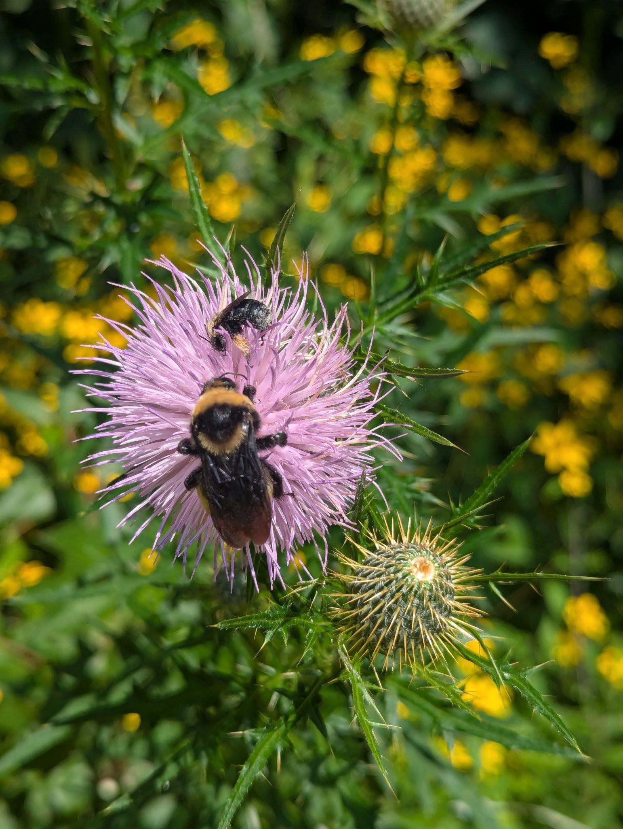
Bee Balm Wildscapes
5

Slide 6
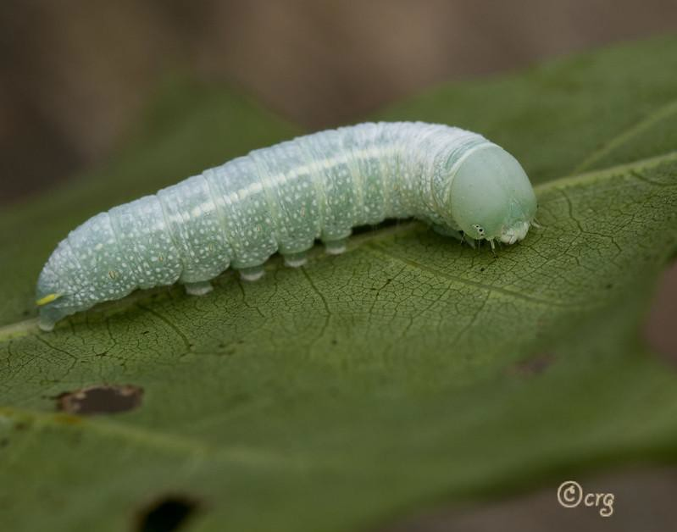
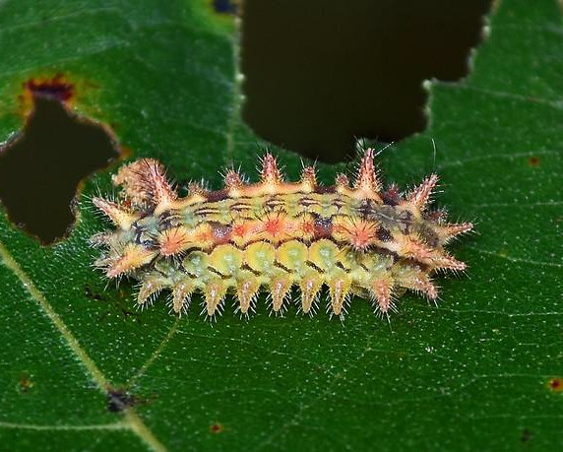
Bee Balm Wildscapes
6
Eacles imperialis
Photo taken by Colin Gillette, accessed via Flickr
Euclea delphinii
Photo taken by Brody J, accessed via Flickr

Slide 7
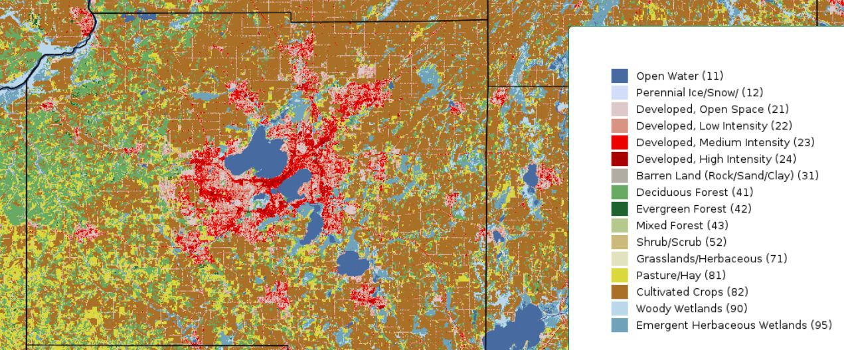
Bee Balm Wildscapes
7

Slide 8
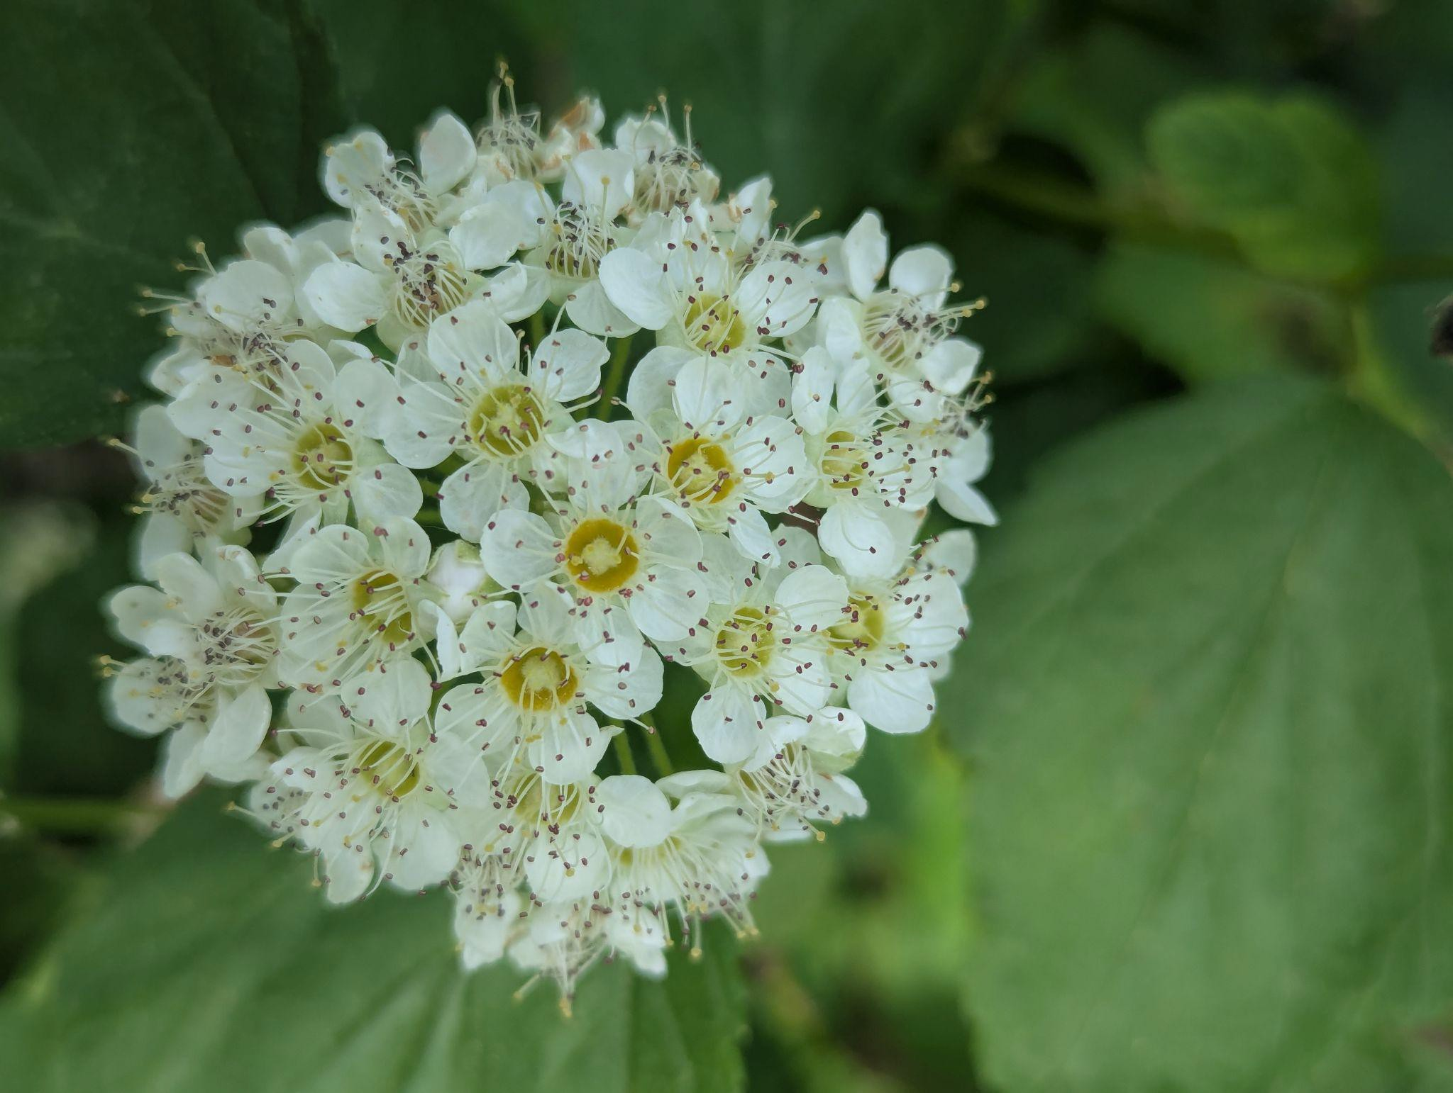
Bee Balm Wildscapes
8

Slide 9
Shade Garden Positives
Bee Balm Wildscapes
9
Adds life to an often empty space!
Flowers earlier in season than prairie plants Less weed competition
Fewer plants to choose from = easier choices!

Slide 10
What is a native plant?
Bee Balm Wildscapes
10
A species of plant that was present before European settlement
Prairiemoon.com source for range maps

Slide 11
Lessons Learned: Check that it’s native!
11
Even a ‘native plant sale’ may include non-native plants Be extra careful at any large nursery!
Trust latin names only - NOT common names From seed - “wildﬂower” = NOT NATIVE

Slide 12
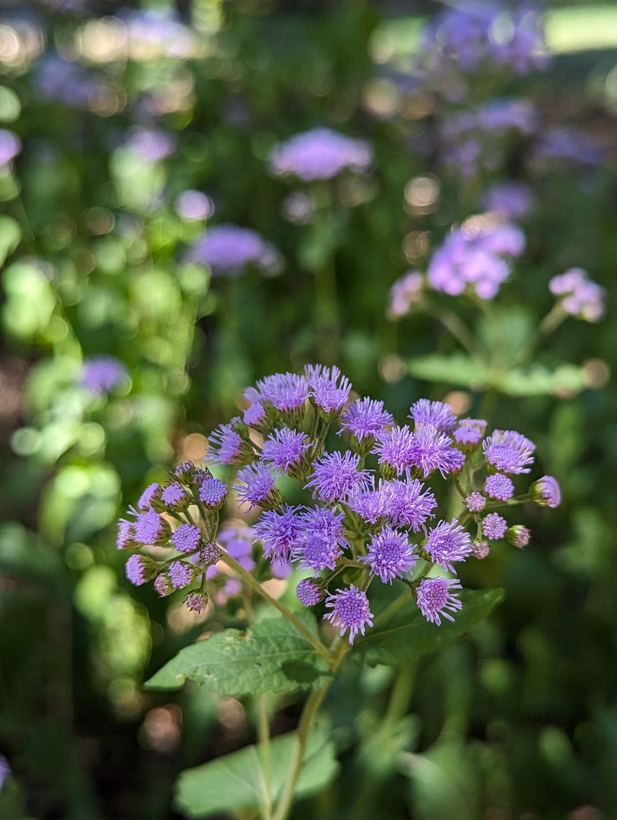
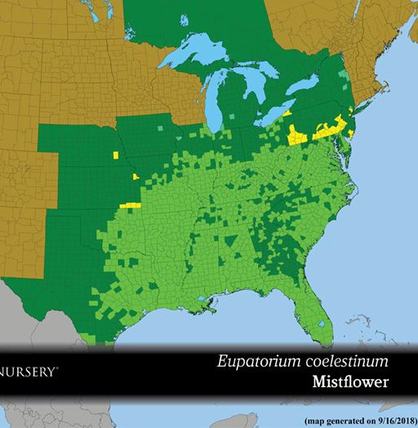
Bee Balm Wildscapes
12
Source: Prairie Moon Nursery

Slide 13
Cultivars
Bee Balm Wildscapes
13
A cultivar is a selection of a plant species that changes a characteristic of the plant
Changes to ﬂower, foliage color likely reduce insect use Changes to ﬂower period, bloom density, overall stature
= likely less eﬀects on insects
May be cultivar of non-native species

Slide 14
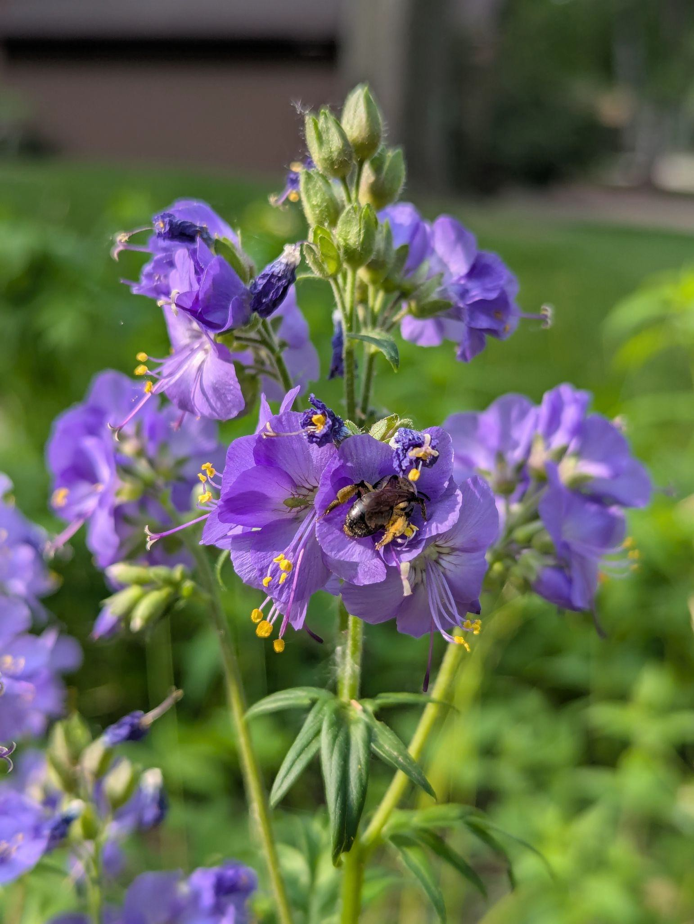
Bee Balm Wildscapes
14
Purchased as a “Jacob’s Ladder” cultivar - but this is a cultivar of Polemonium caeruleum, not the native Polemonium reptans
Yes it is gorgeous, do you want it

Slide 15
Matching Plants to Your Site
Bee Balm Wildscapes
15
Traditional advice: 6+ hours of sun = full sun 4-6 hours = part sun
Under 4 hours = shade
Heliophily ratings from North Carolina Botanical Garden https://fsus.ncbg.unc.edu/main.php?pg=index.php
Also consider soil moisture

Slide 16
How to Structure Planting?
Bee Balm Wildscapes
16
Include trees, shrubs, ﬂowers AND grasses Background of grasses/sedges
Shorter overall height will look more organized Spring through fall blooms
Include one aster, goldenrod

Slide 17
How to Choose Native Plants
Bee Balm Wildscapes
17
Pre made kits are a great place to start!
Prairie Moon’s website a great resource
“Native Plants of the Midwest” by Alan Branhagen Local, specialized nurseries can provide recommendations

Slide 18
Where to get native plants?
Bee Balm Wildscapes
18
You will be best served by a specialist grower
WI DNR maintains list of native plant growers
https://dnr.wisconsin.gov/topic/endangeredresources/nati veplants
Agrecol in Edgerton
Johnson’s Nursery in Milwaukee Bare Root orders

Slide 19
How to organize planting
Bee Balm Wildscapes
19
Plant lots of plants! One per square foot Spread grasses/sedges throughout
Tall in back/middle, short in front Choose a ‘palette’ of species and plant in clumps of 3/5/7/9

Slide 20
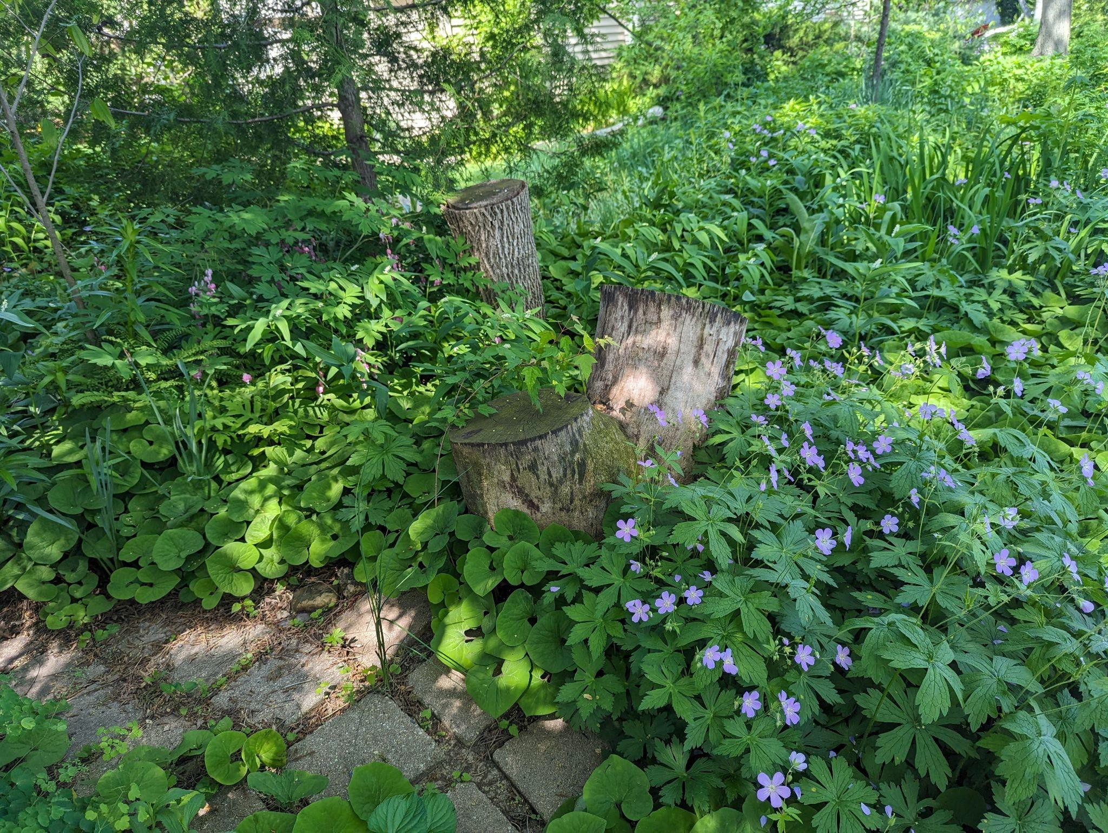
Picture slide
20

Slide 21
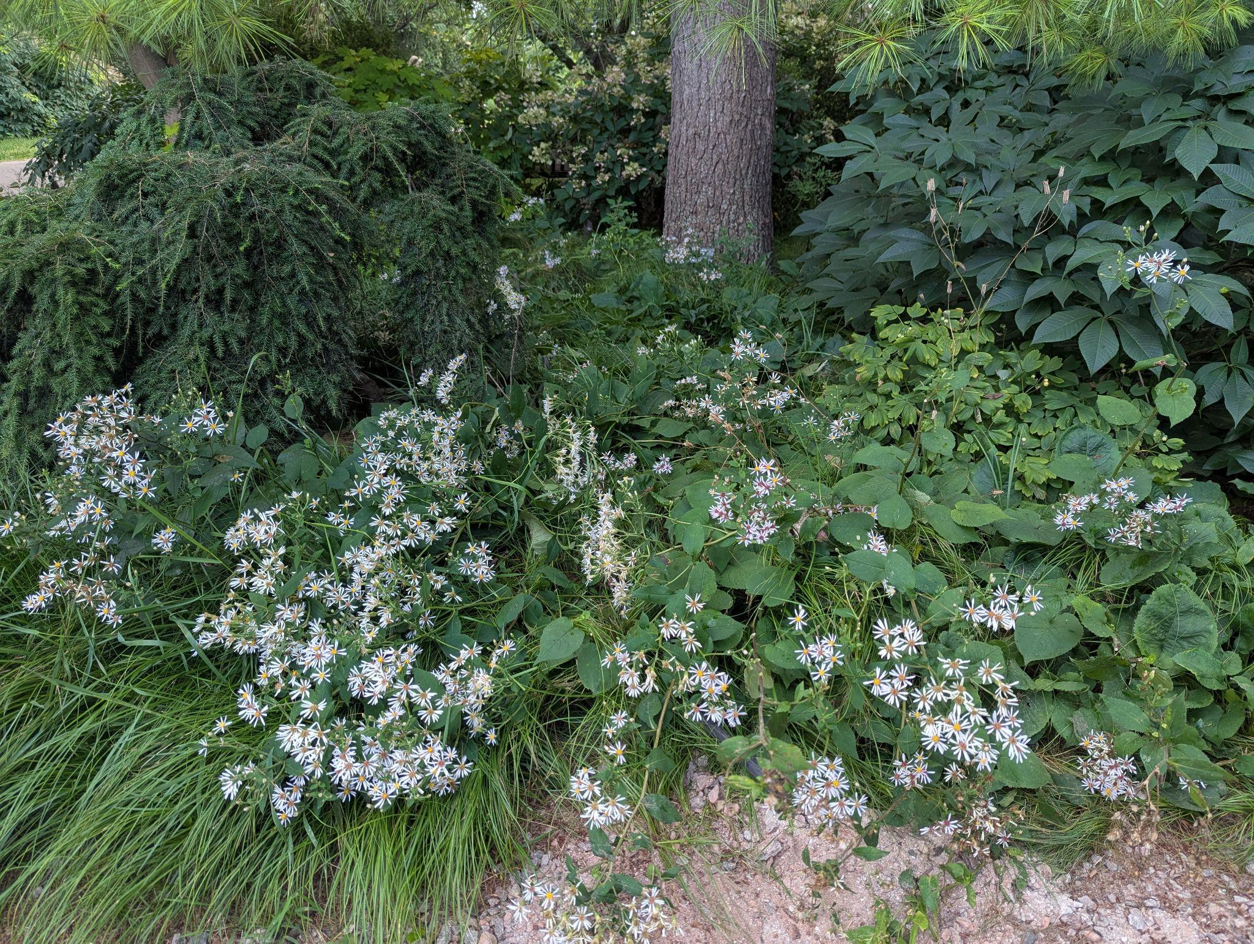
Bee Balm Wildscapes
21

Slide 22
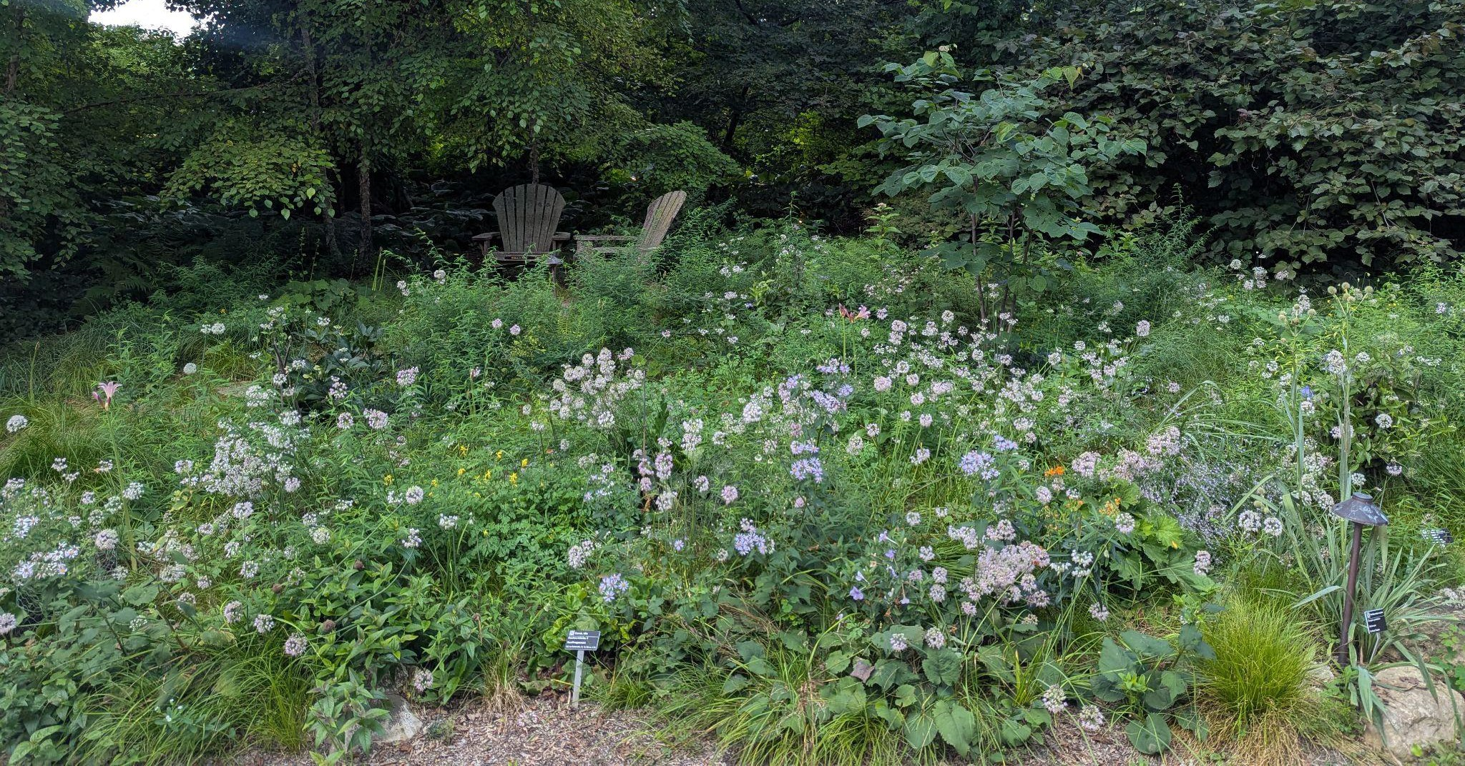
Bee Balm Wildscapes
22

Slide 23
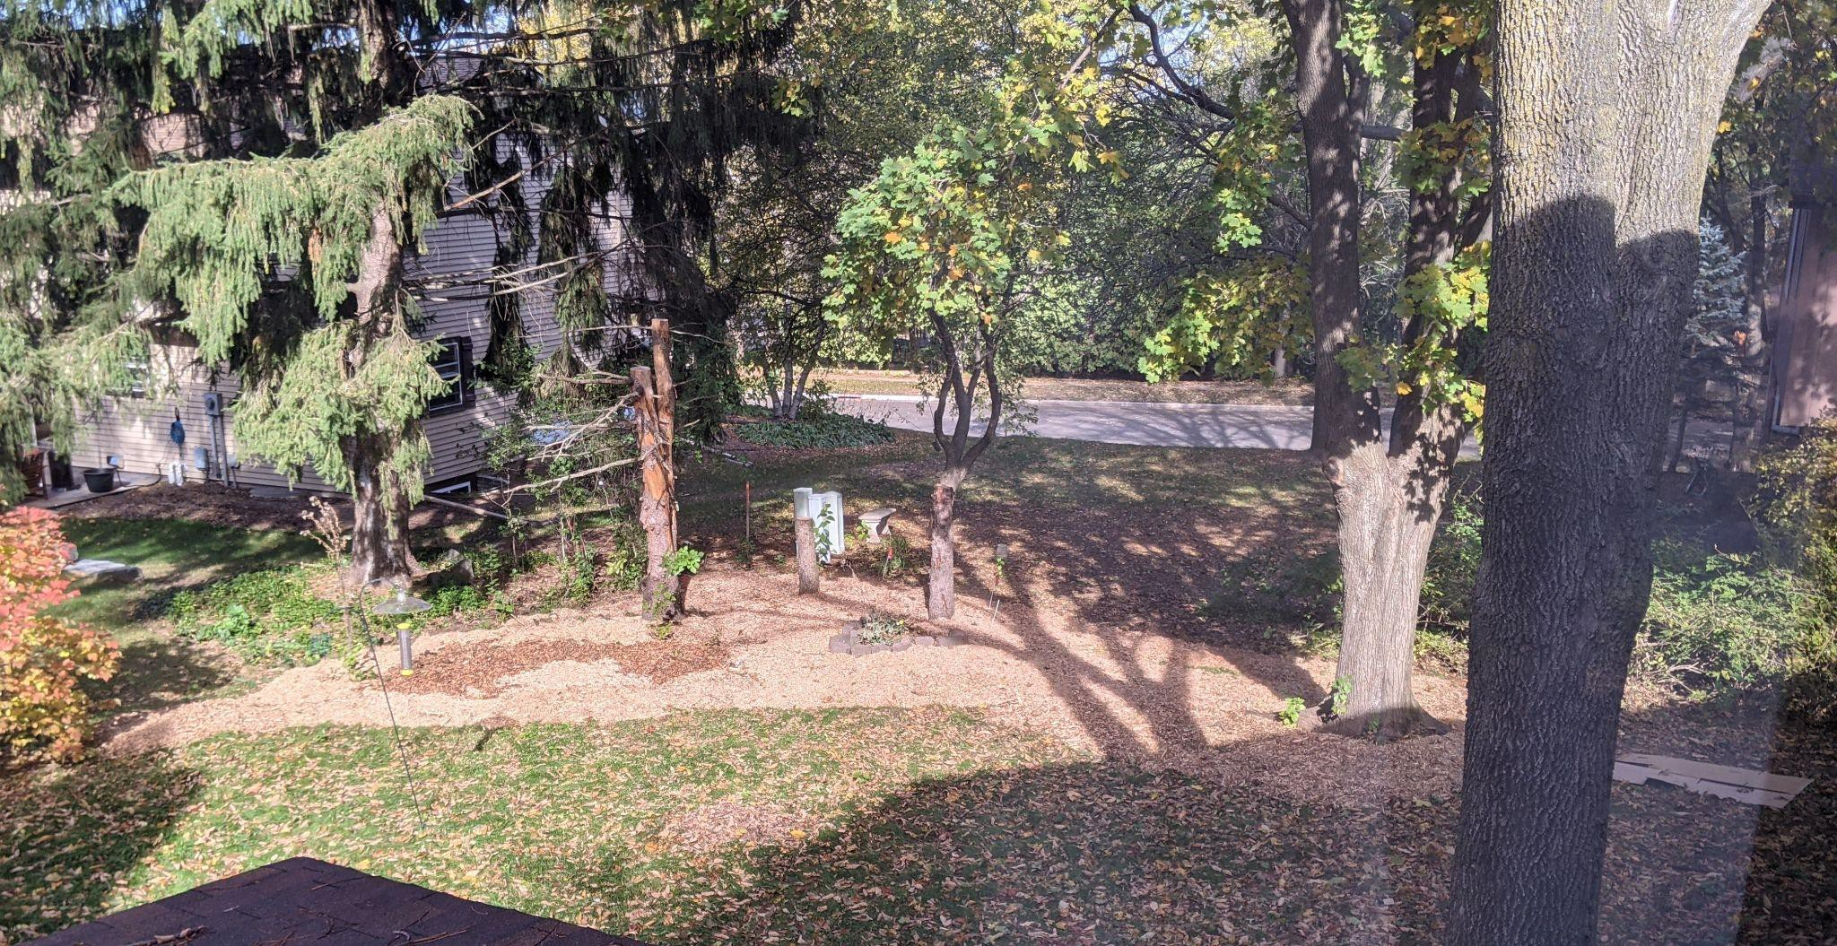
Bee Balm Wildscapes
23

Slide 24
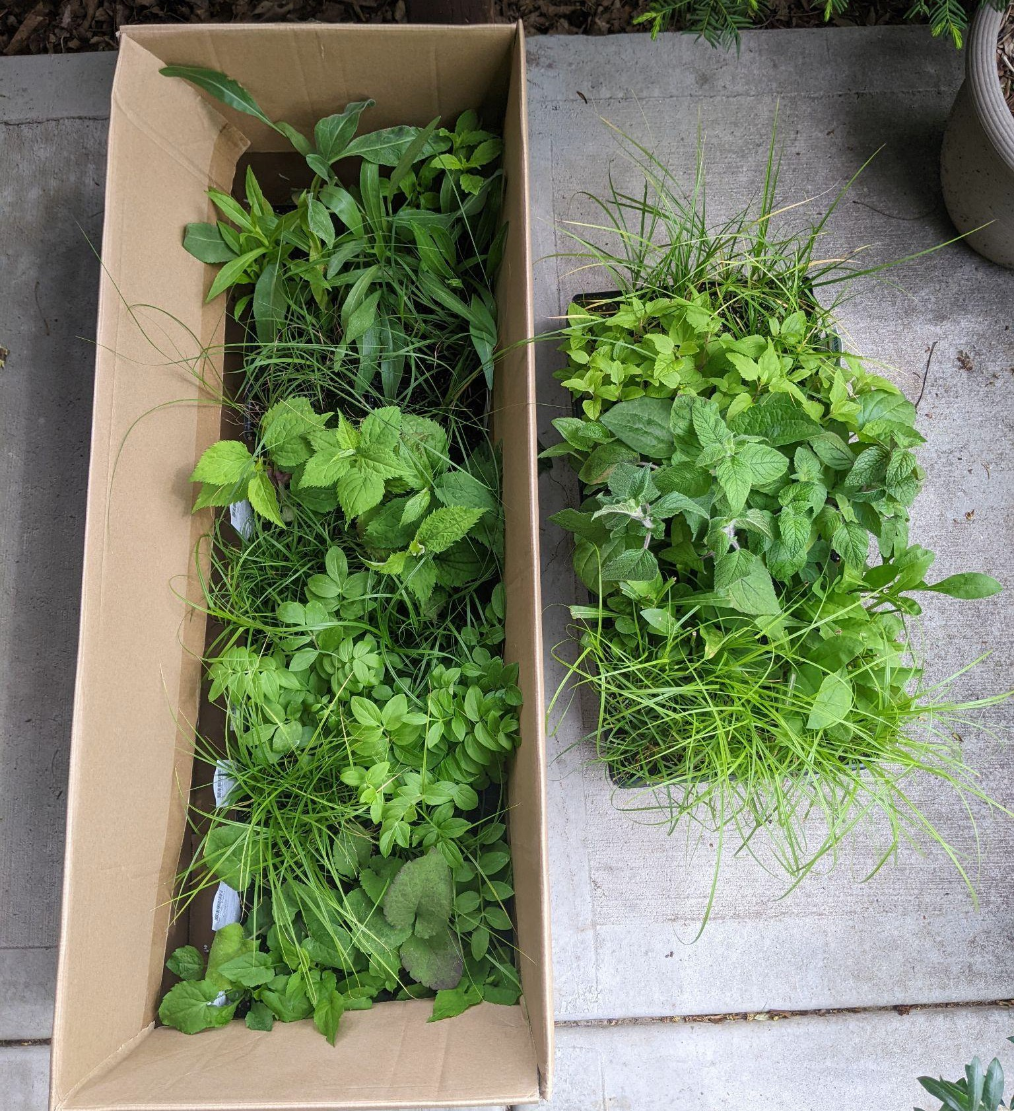
Bee Balm Wildscapes
24

Slide 25
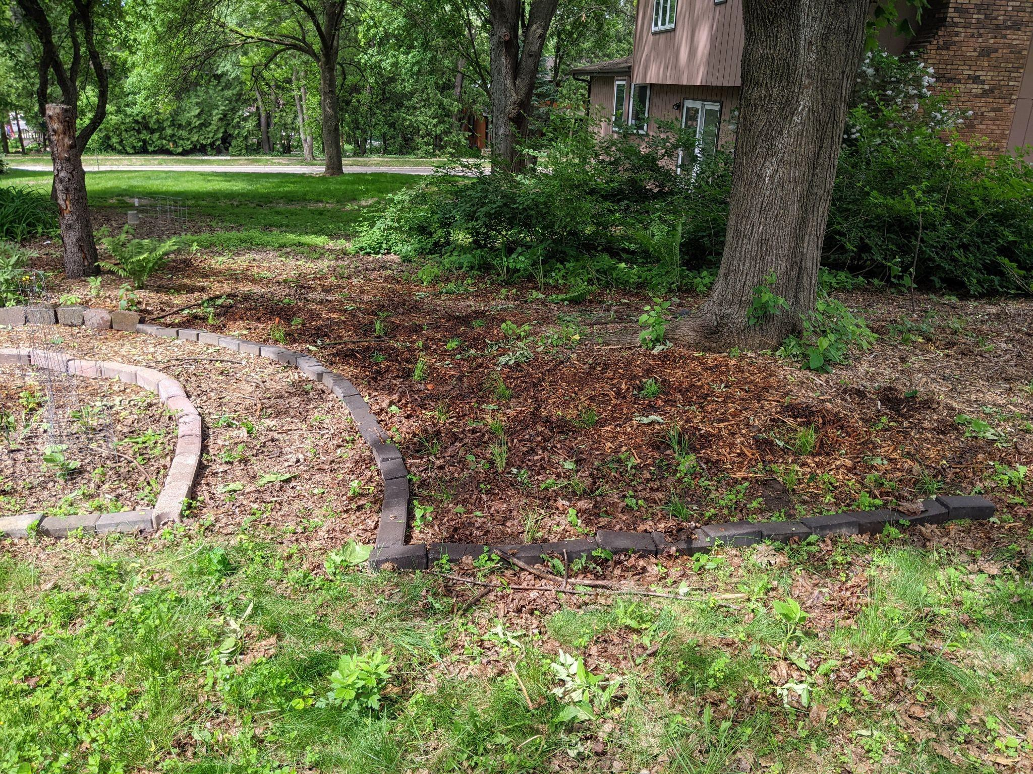
Bee Balm Wildscapes
25
May 2022:
Planted 24
sedges, 3 species

Slide 26
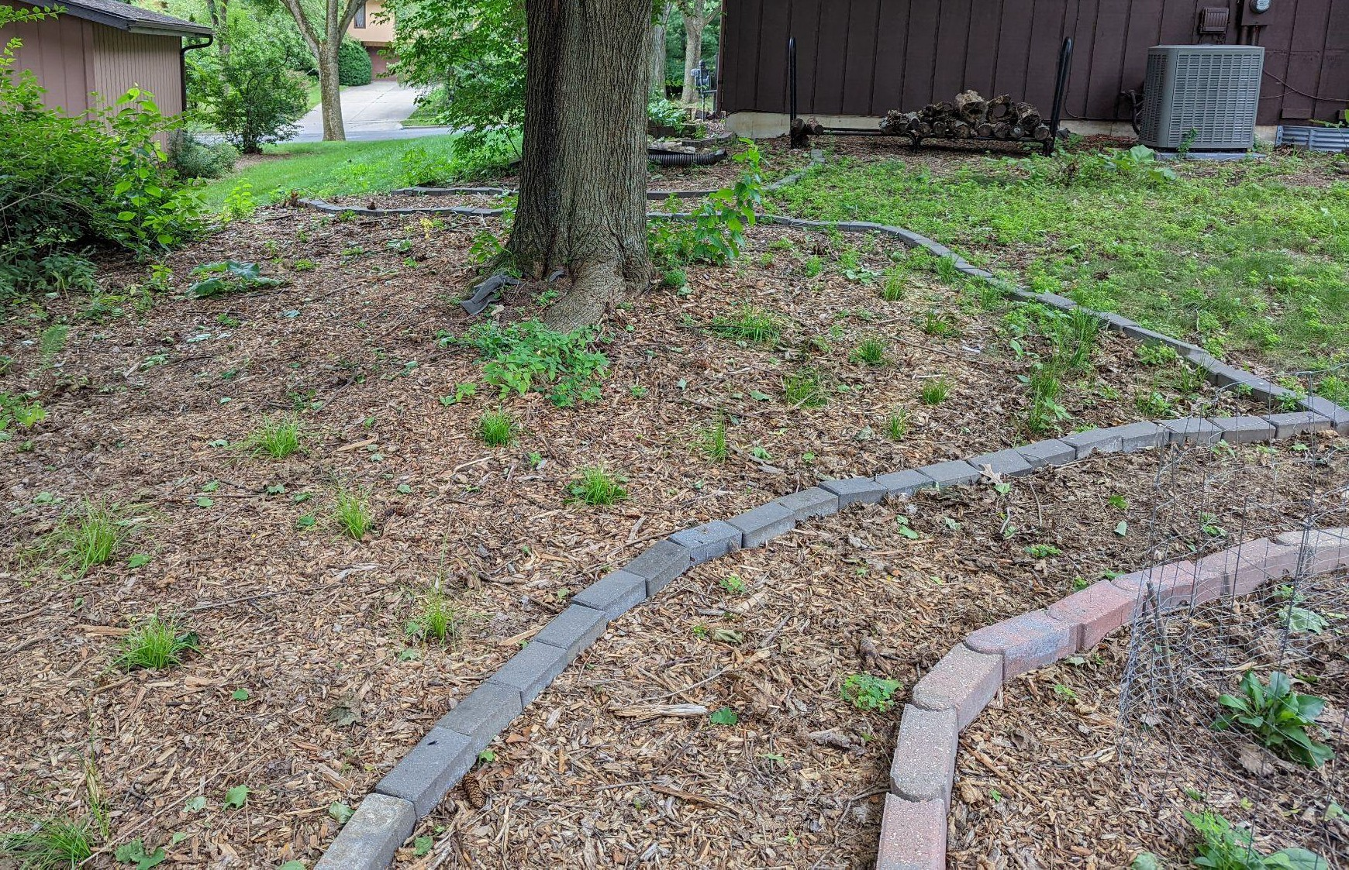
Bee Balm Wildscapes
26
August 2022

Slide 27
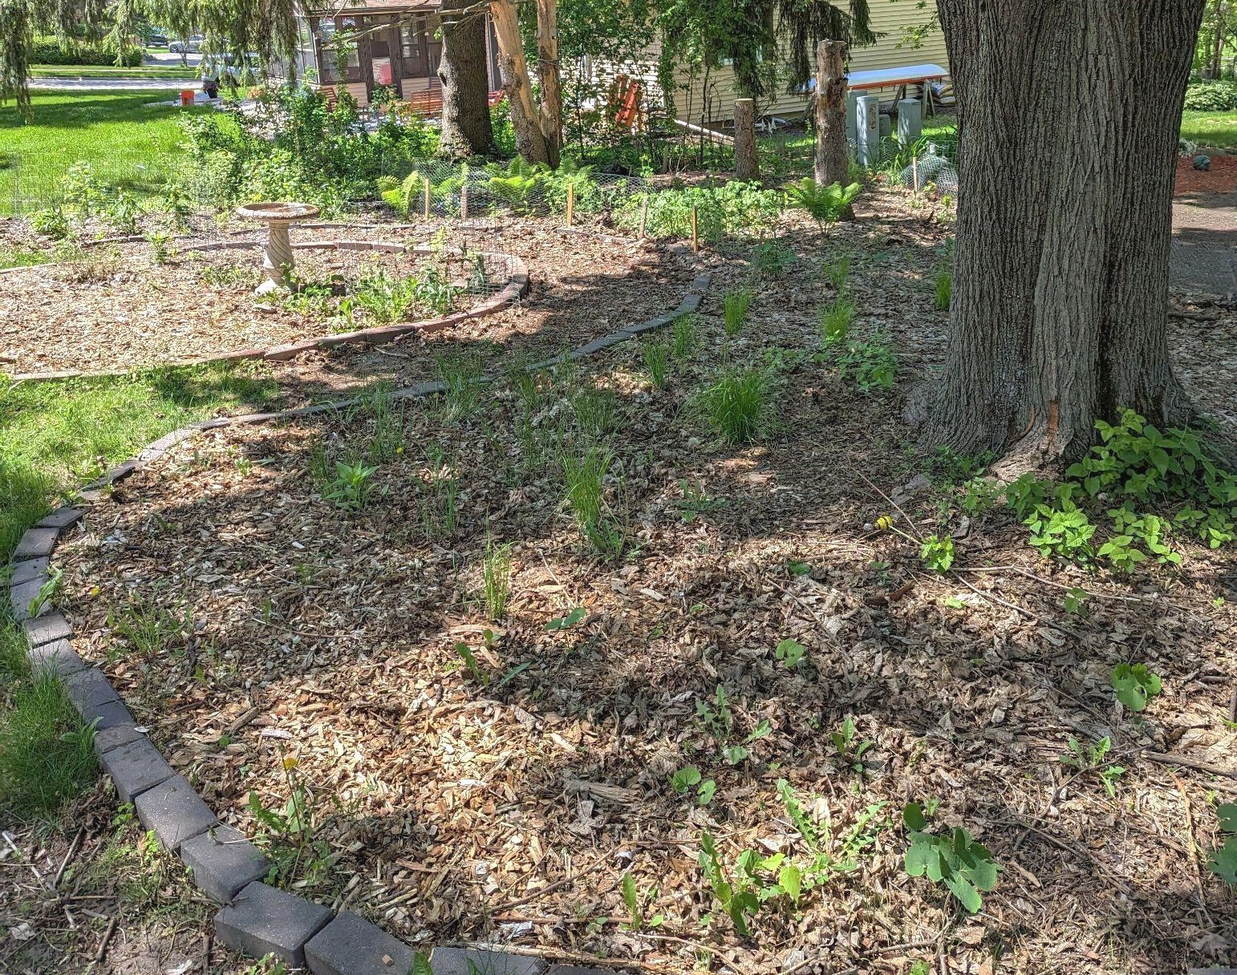
Bee Balm Wildscapes
27
May 2023

Slide 28
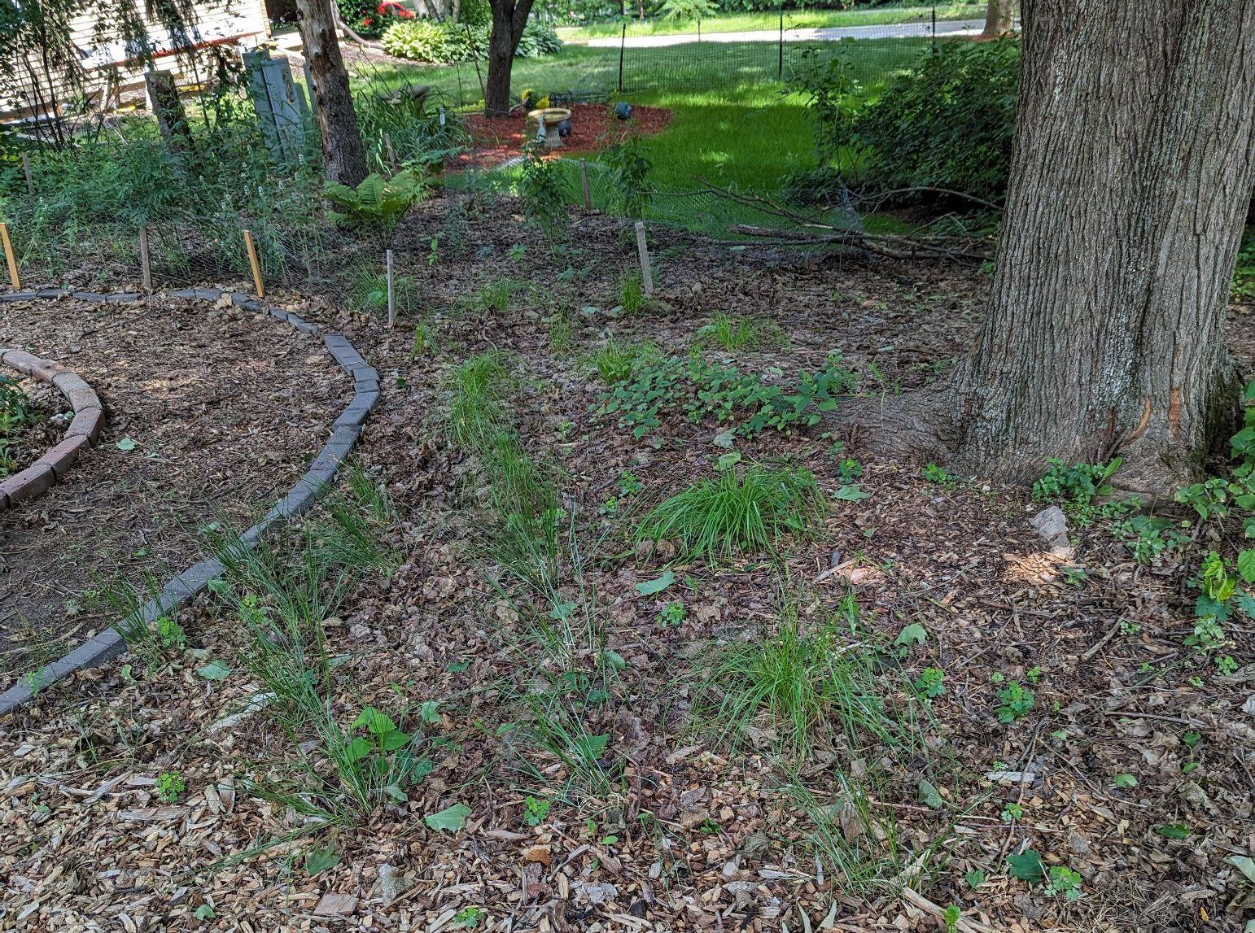
Bee Balm Wildscapes
28
July 2023

Slide 29
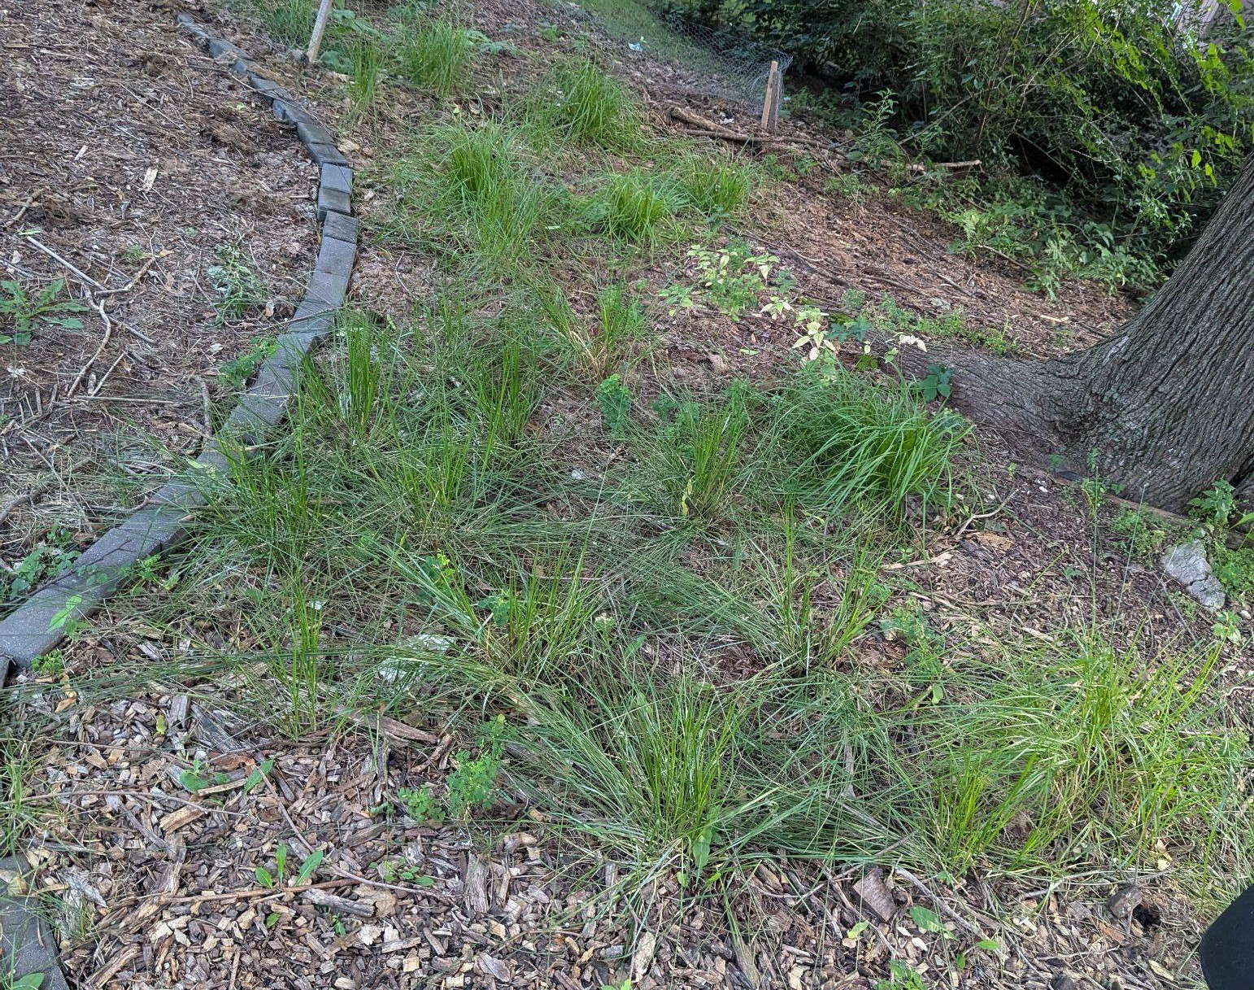
Bee Balm Wildscapes
29
July 2024

Slide 30
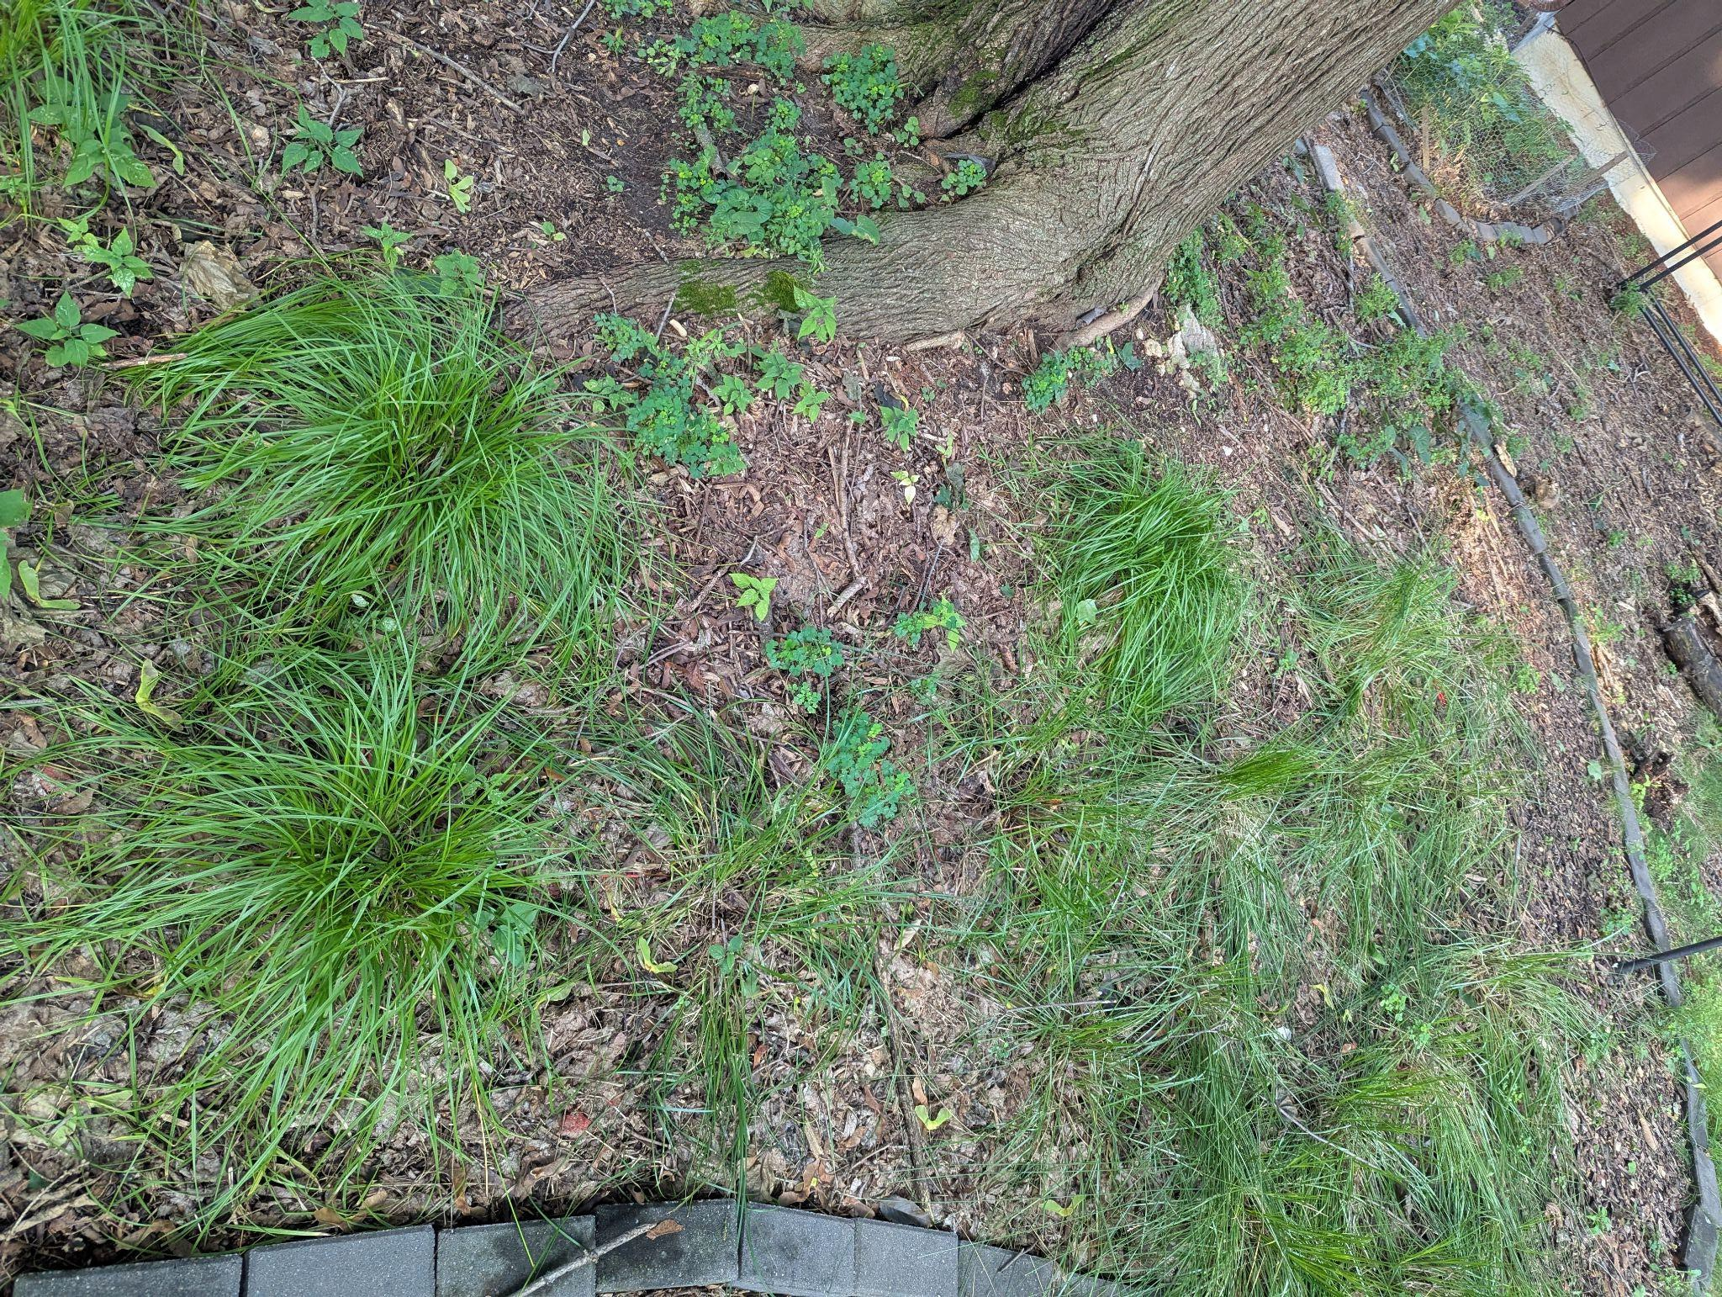
Bee Balm Wildscapes
30
August 2025

Slide 31
Site Prep: Cardboard & Mulch
Bee Balm Wildscapes
31
Materials easy and cheap or free to source Cuts down on weed pressure in disturbed site Not adding chemicals to soil
More labor/time intensive
Prevents plants from reseeding in ﬁrst few years Have to plant pre-grown plants

Slide 32
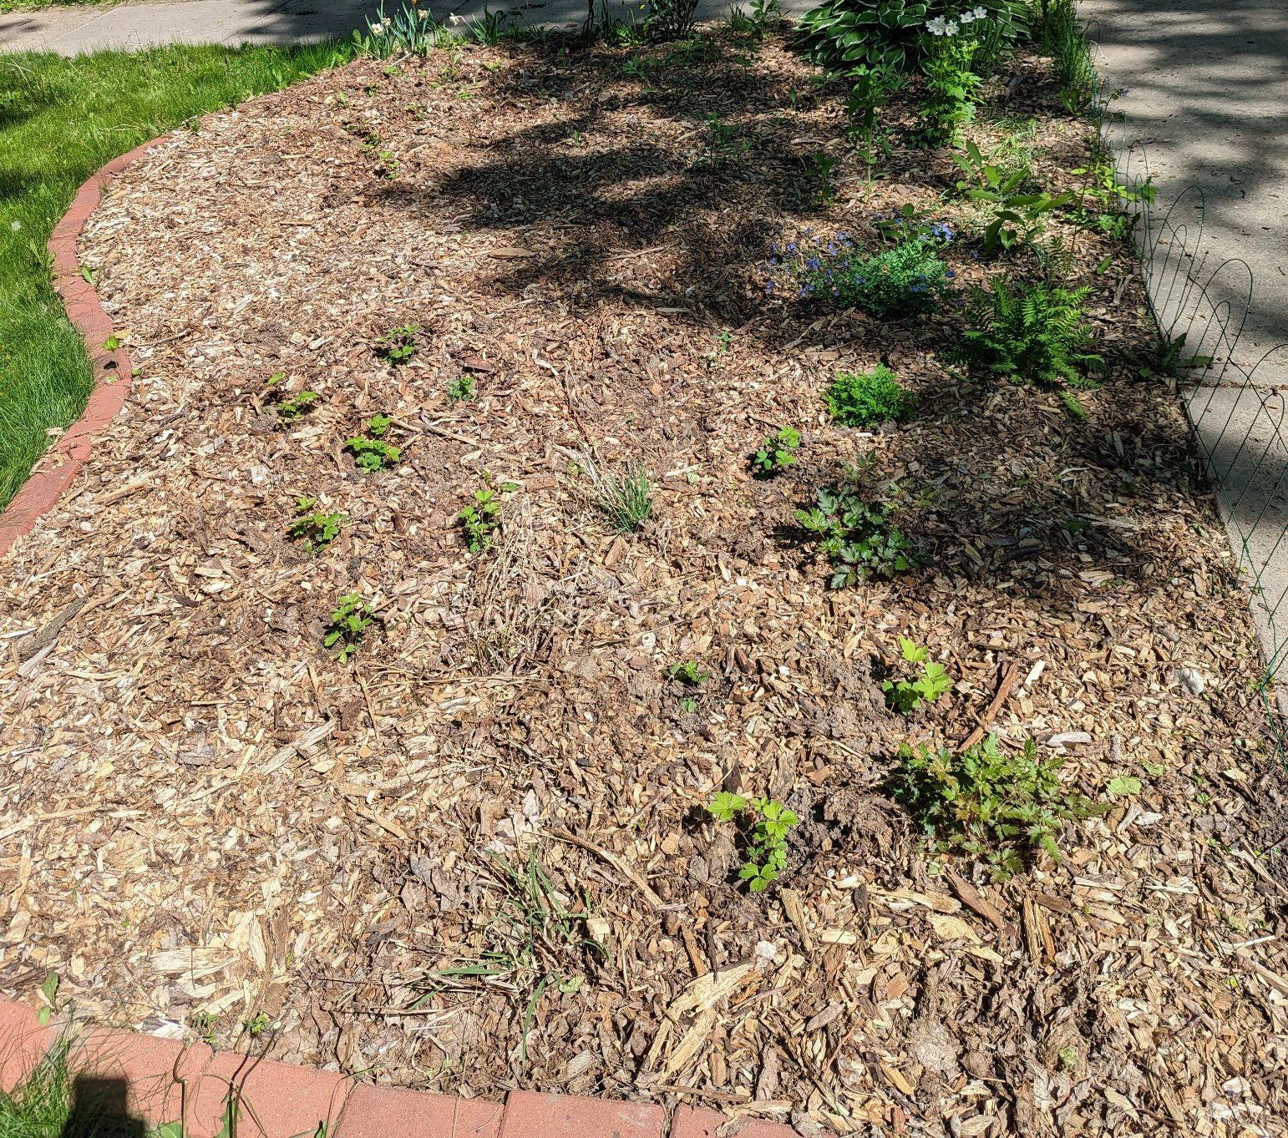
Bee Balm Wildscapes
32
May 2023

Slide 33
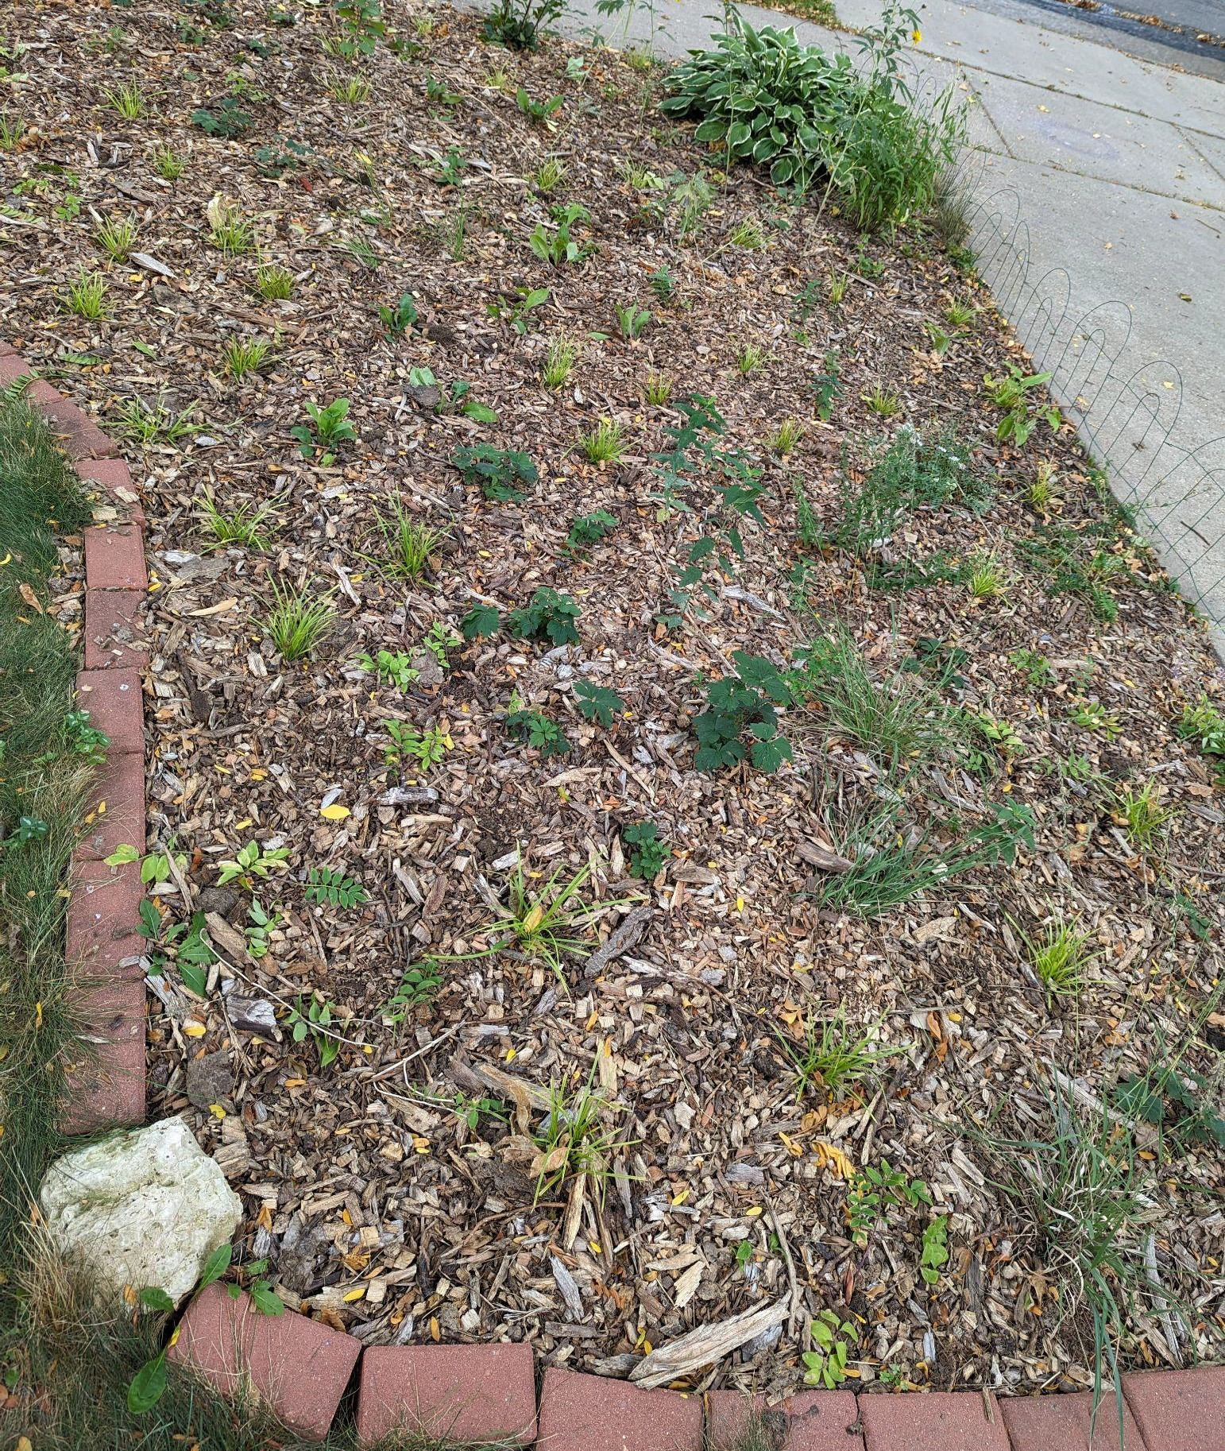
Bee Balm Wildscapes
33
September 2023

Slide 34
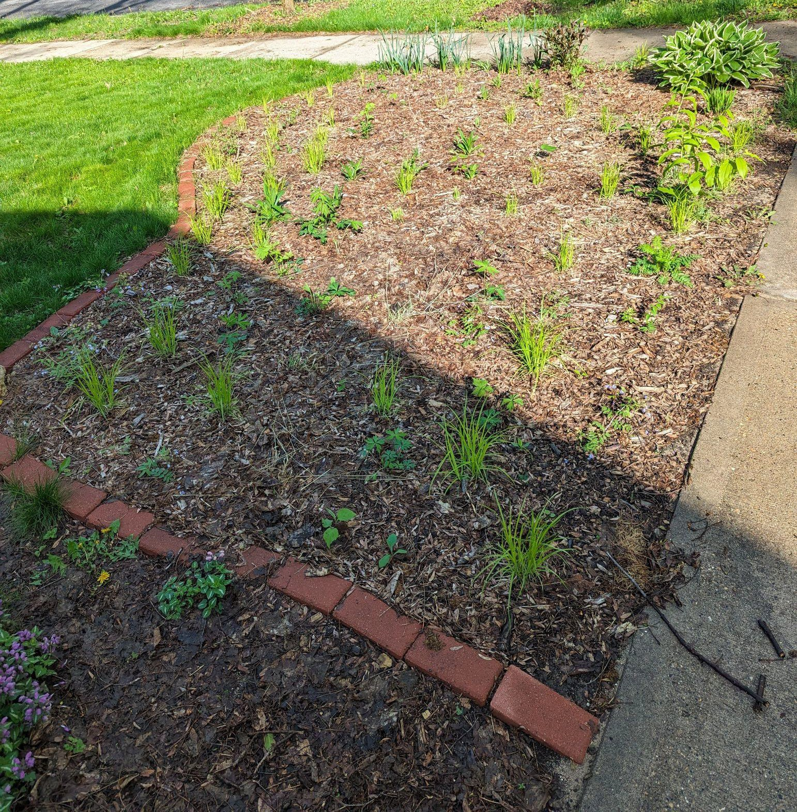
Bee Balm Wildscapes
34
May 2024

Slide 35
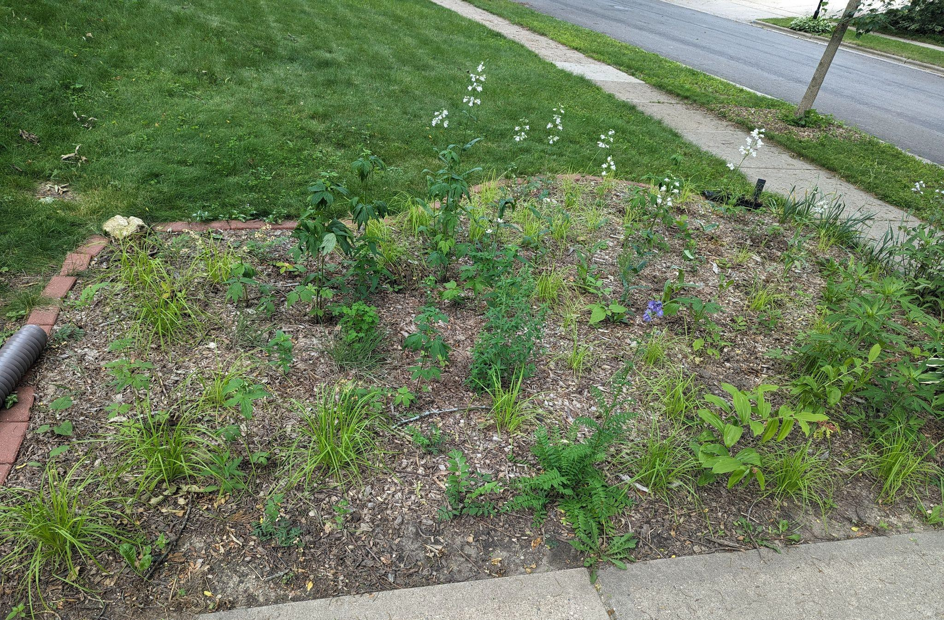
Bee Balm Wildscapes
35
June 2024

Slide 36
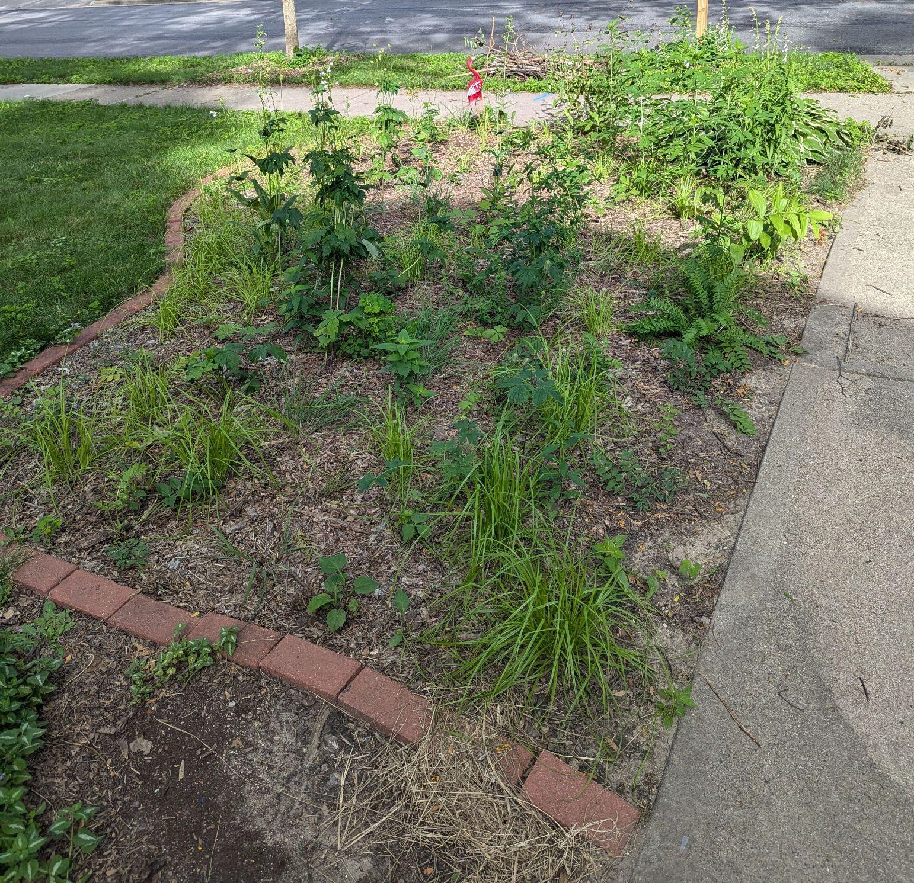
Bee Balm Wildscapes
36
July 2024

Slide 37
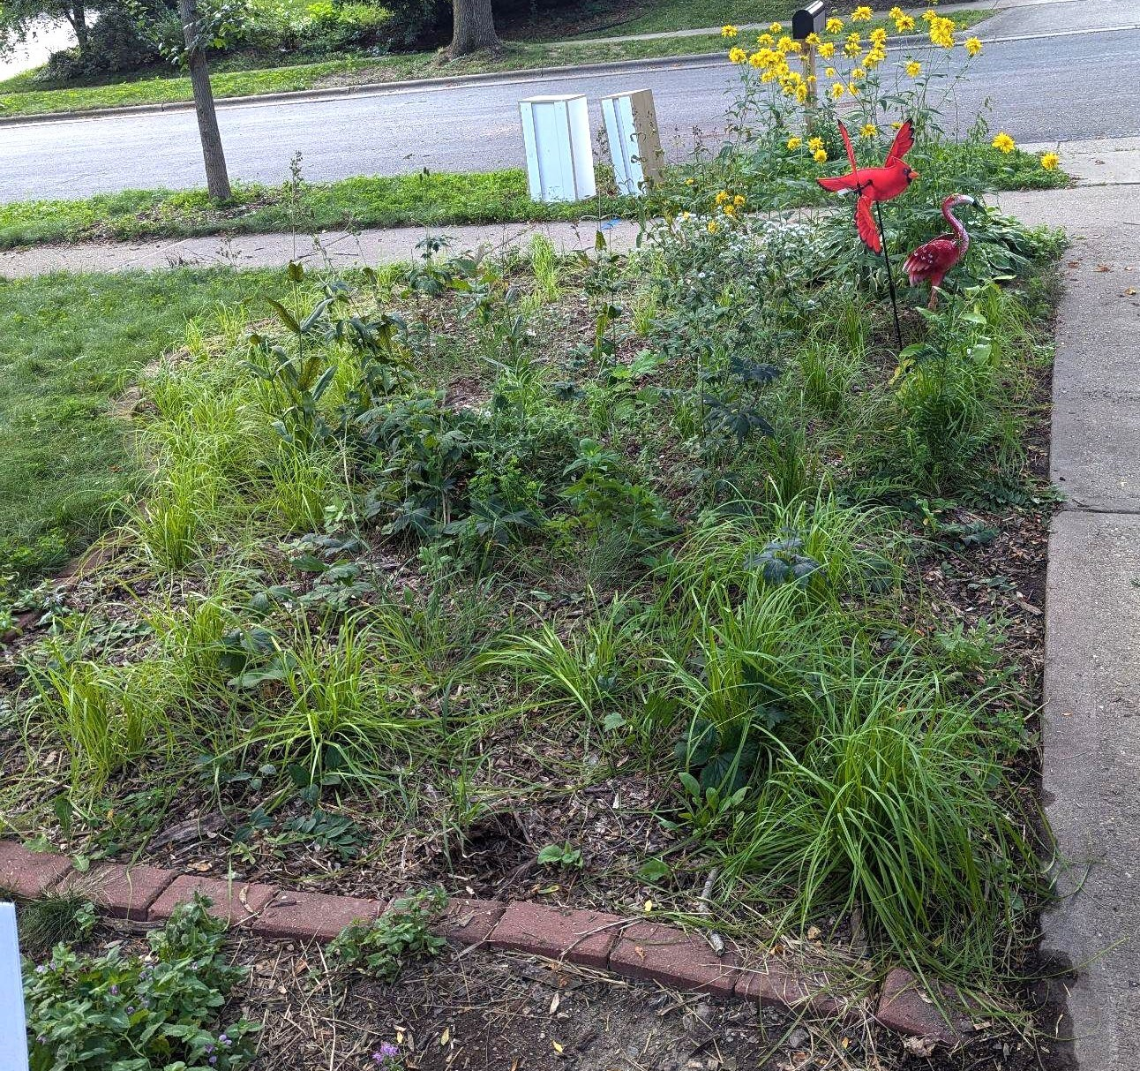
Bee Balm Wildscapes
37
August 2024

Slide 38
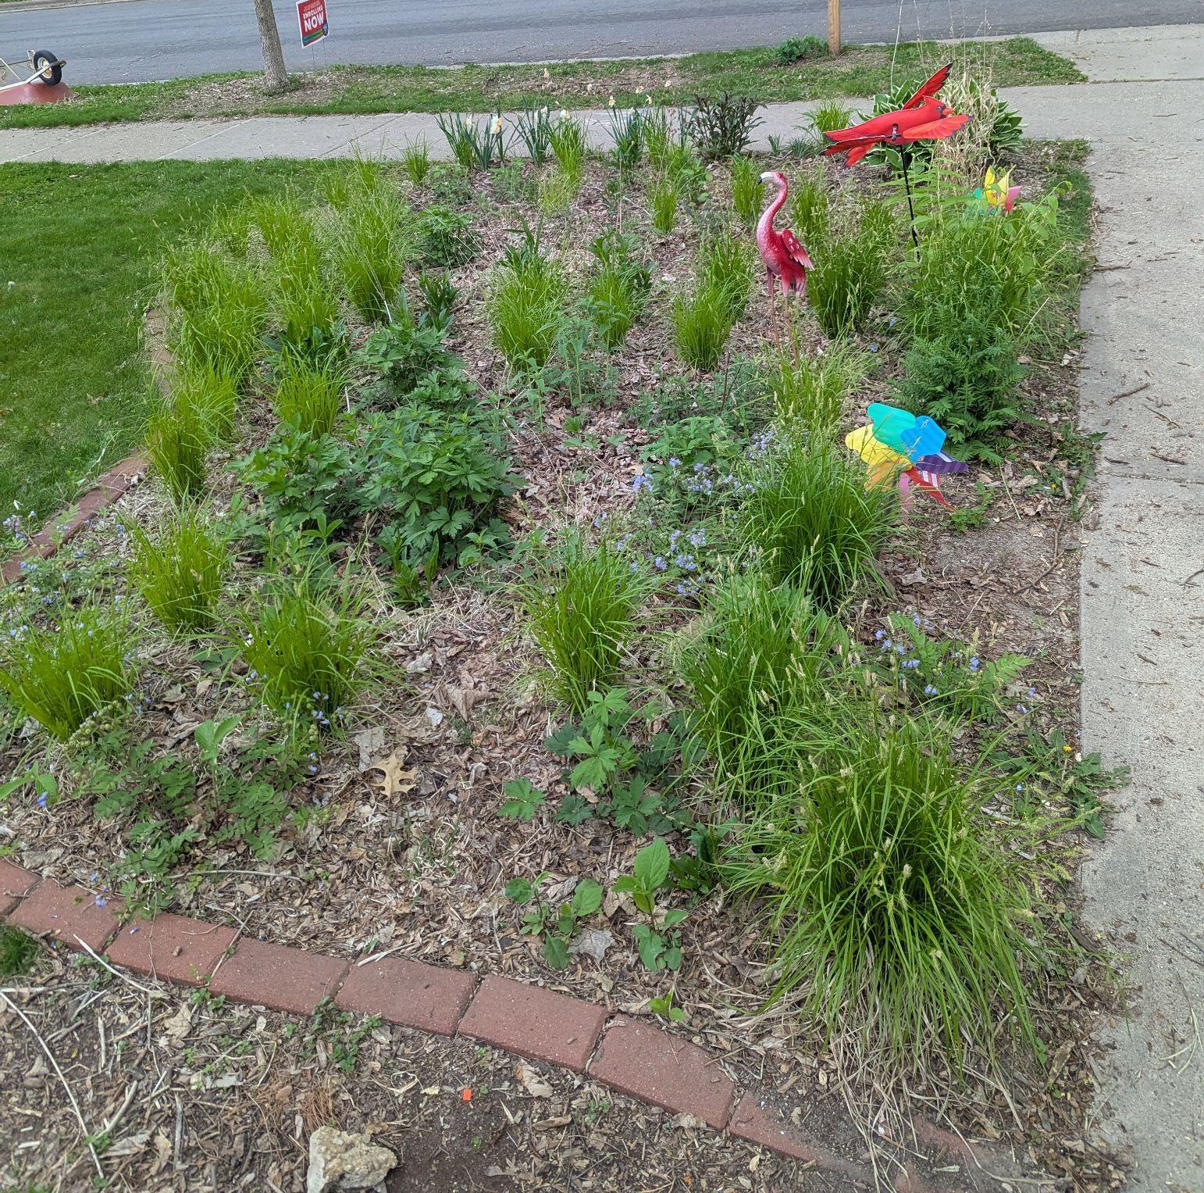
Bee Balm Wildscapes
38
May 2025

Slide 39
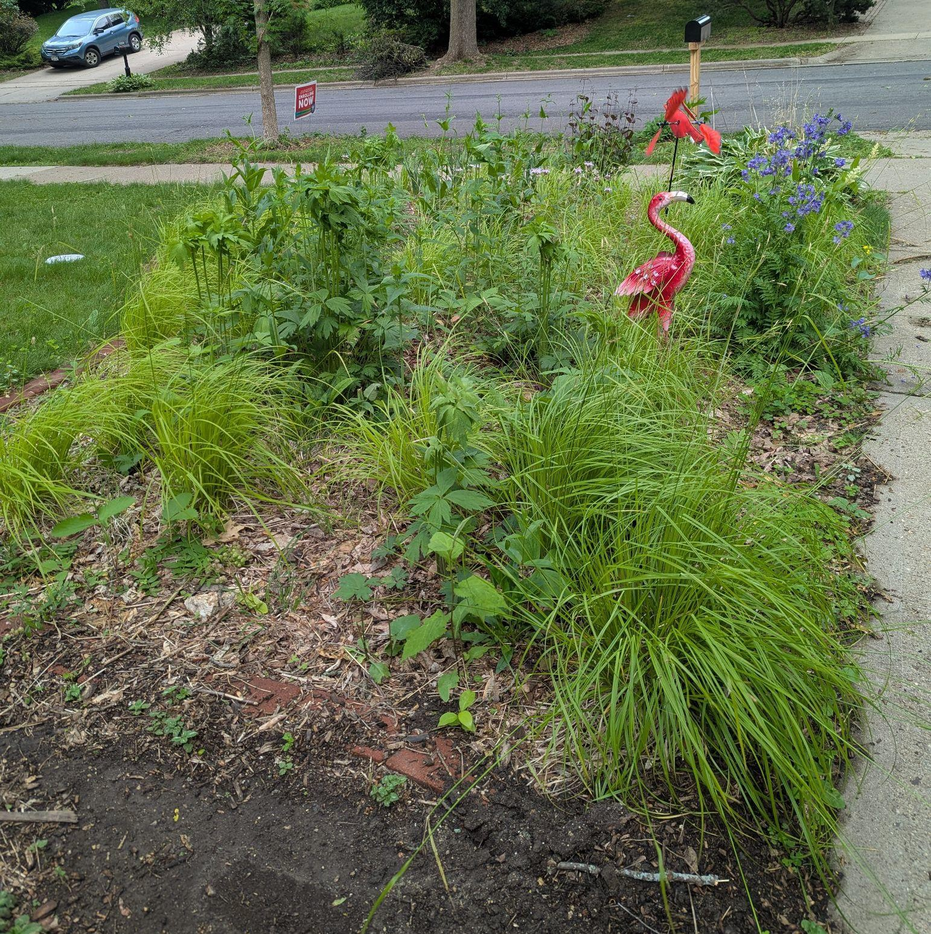
Bee Balm Wildscapes
39
June 2025

Slide 40
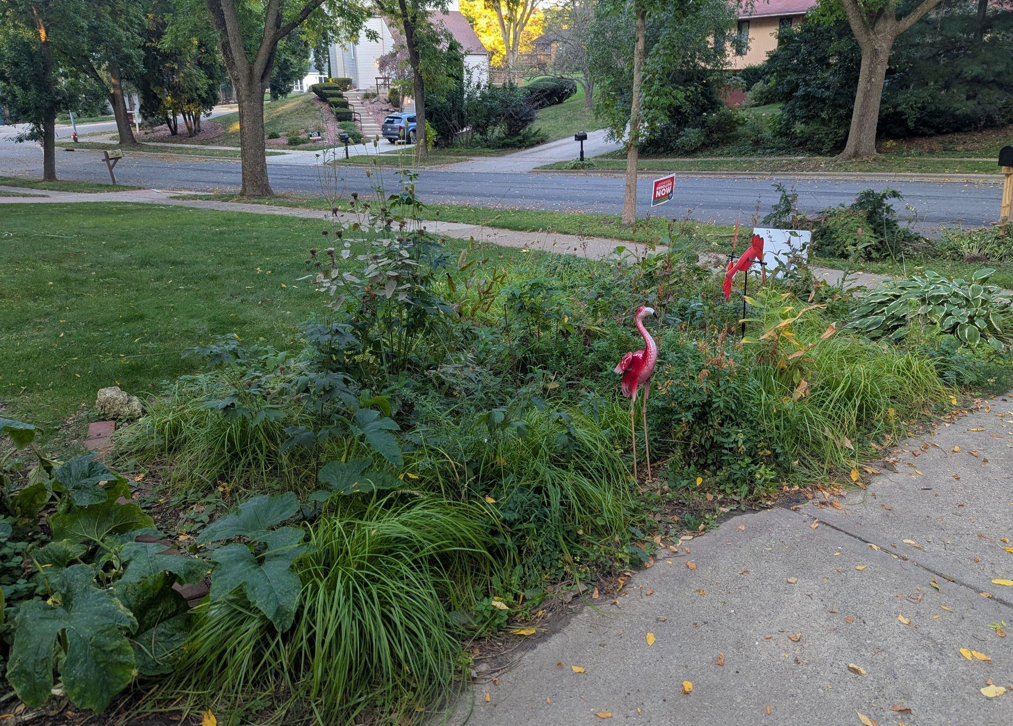
Bee Balm Wildscapes
40
September 2025

Slide 41
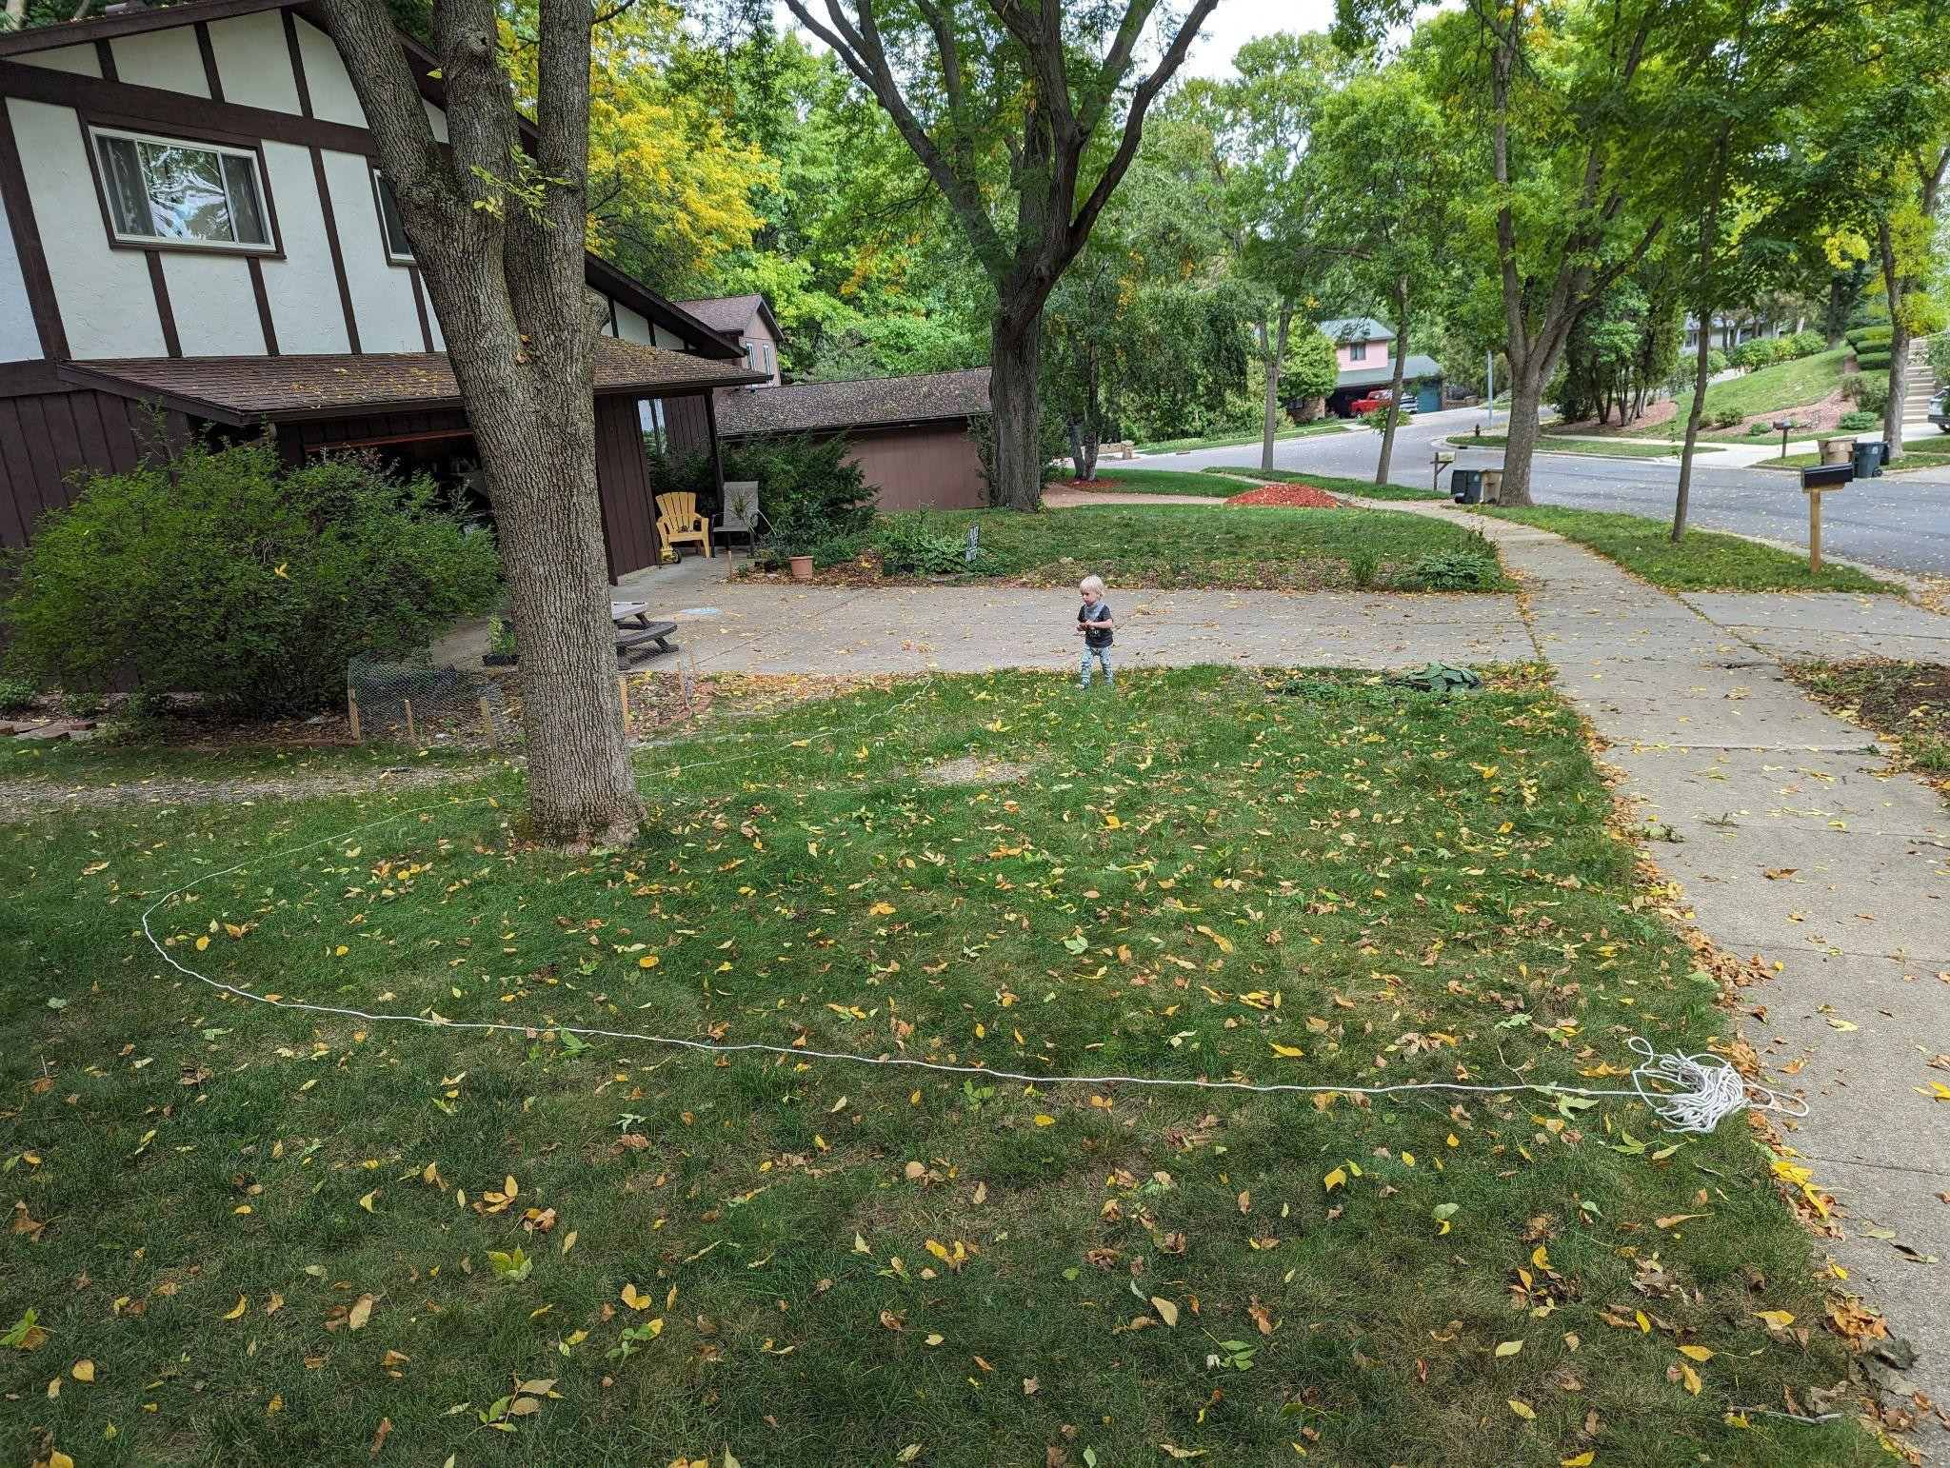
Bee Balm Wildscapes
41
September 2023

Slide 42
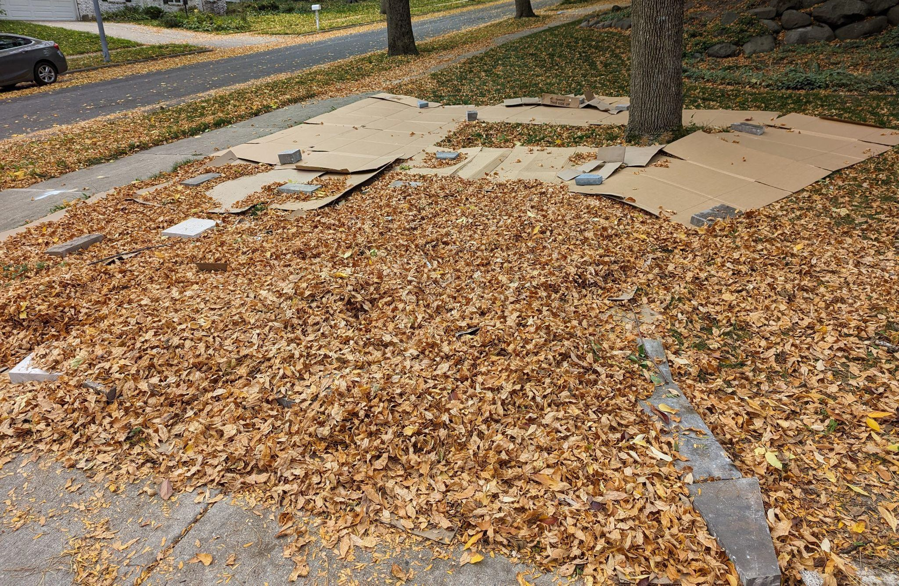
Bee Balm Wildscapes
42
October 2023

Slide 43

Bee Balm Wildscapes
43

Slide 44
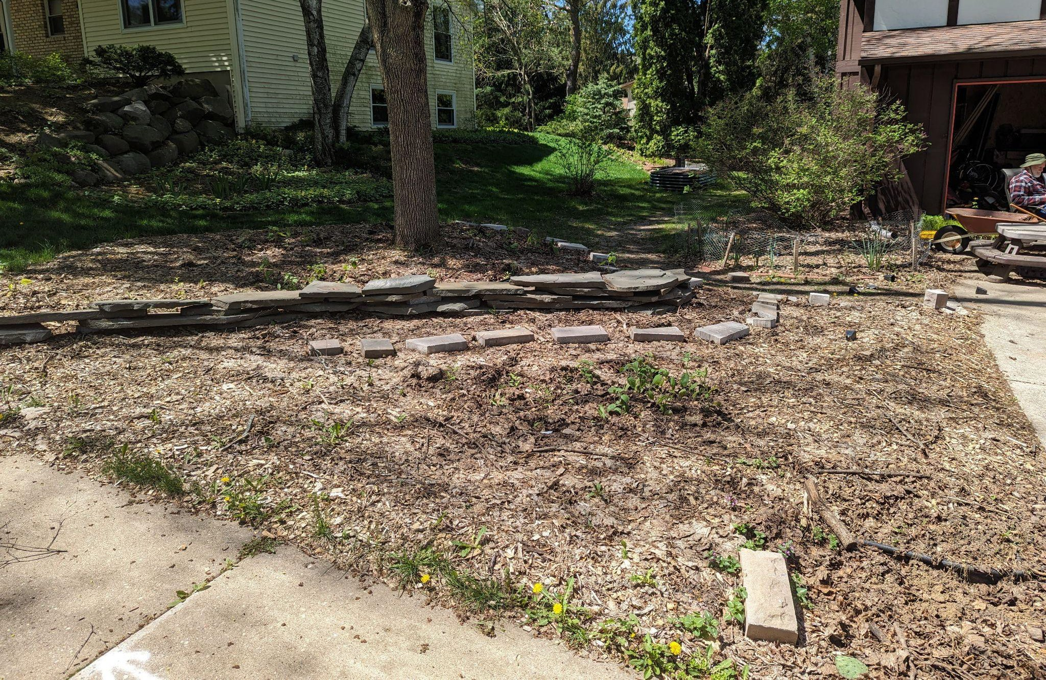
Bee Balm Wildscapes
44
May 2024

Slide 45
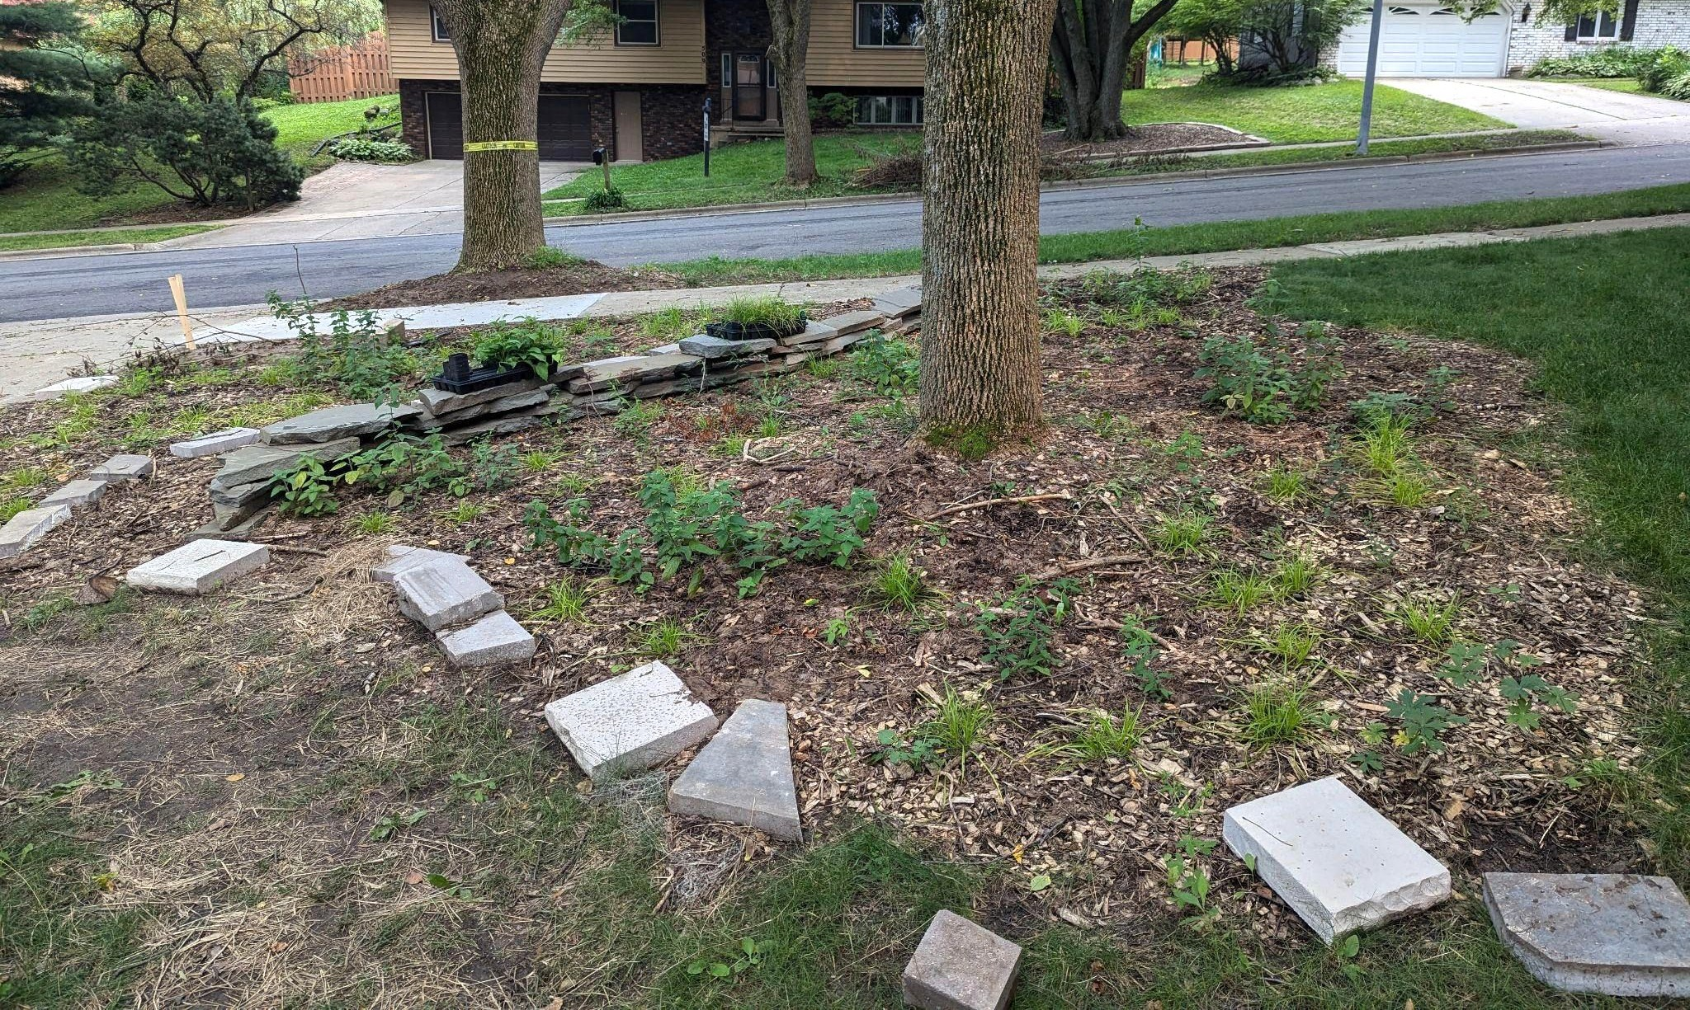
Bee Balm Wildscapes
45
July 2024

Slide 46
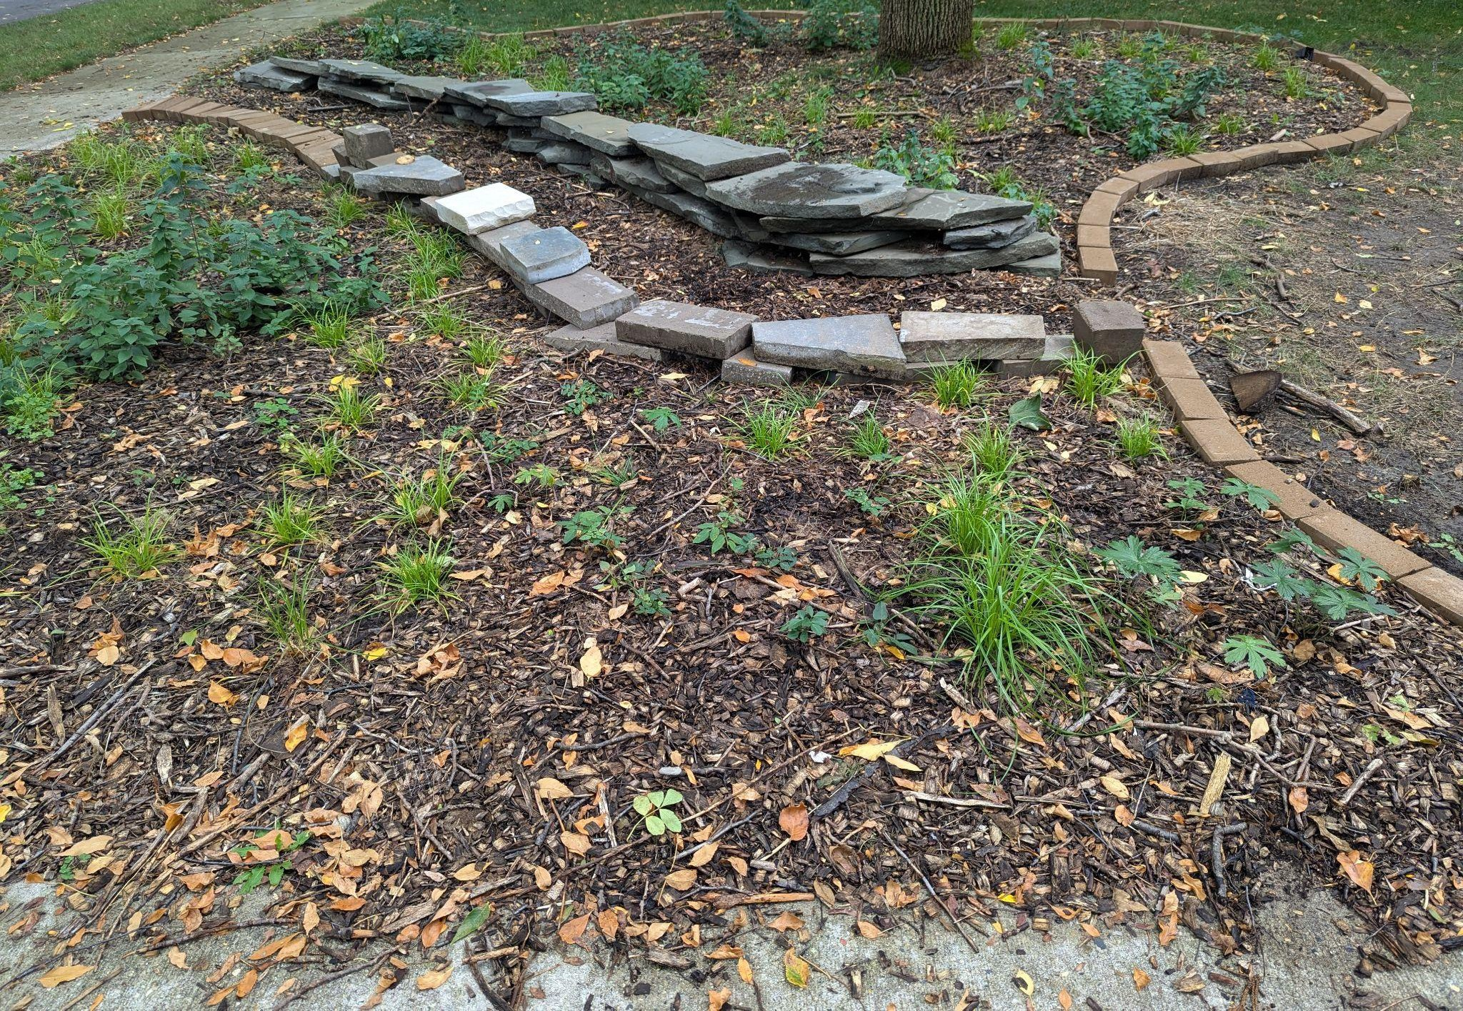
Bee Balm Wildscapes
46
August 2024

Slide 47
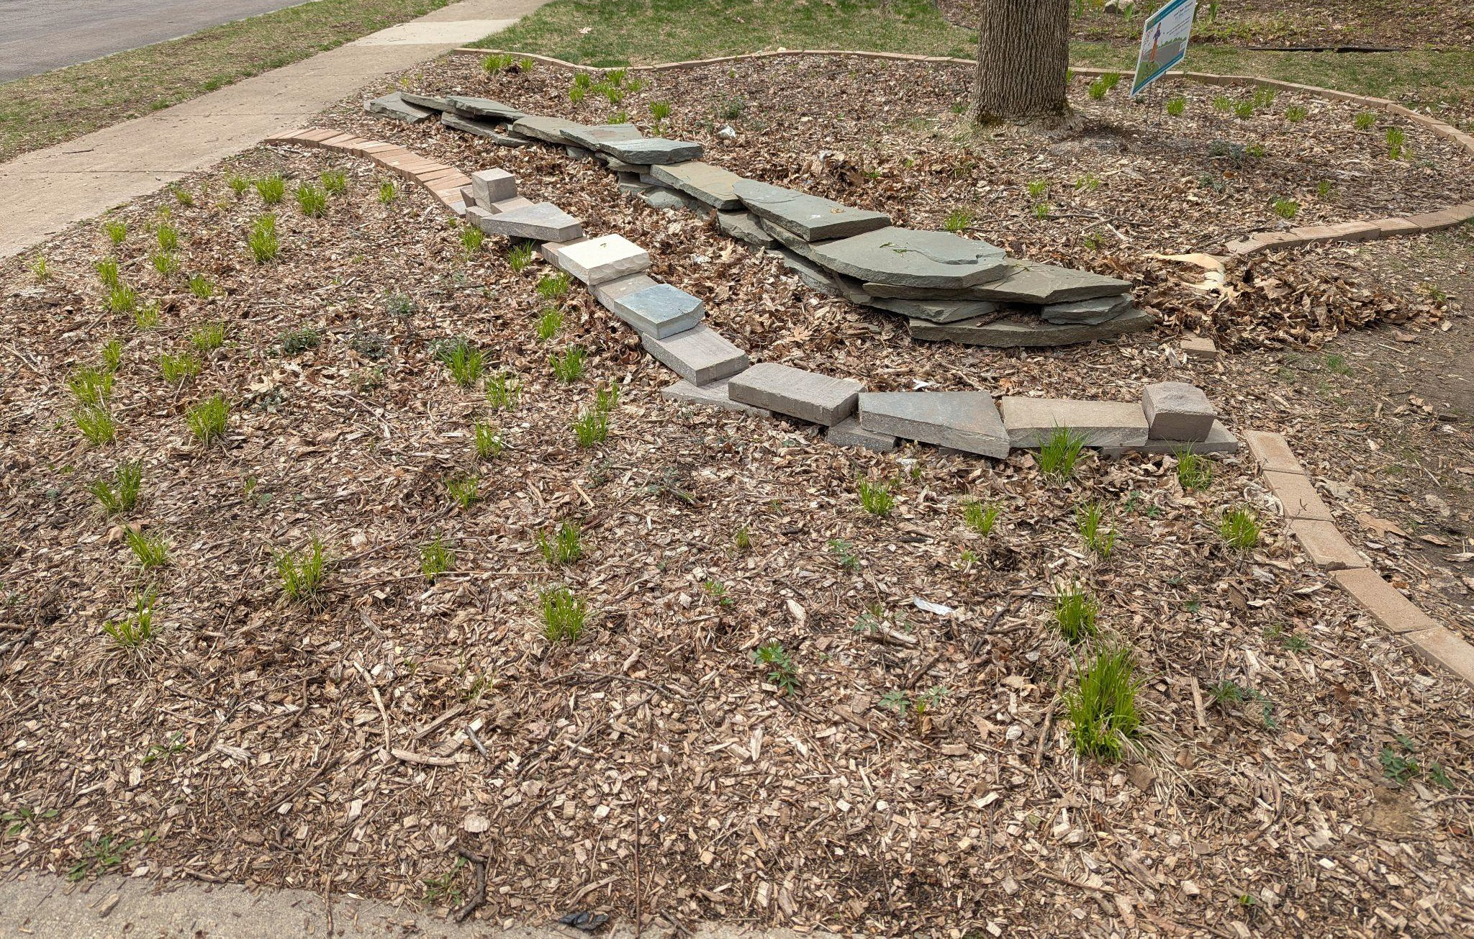
Bee Balm Wildscapes
47
April 2025

Slide 48
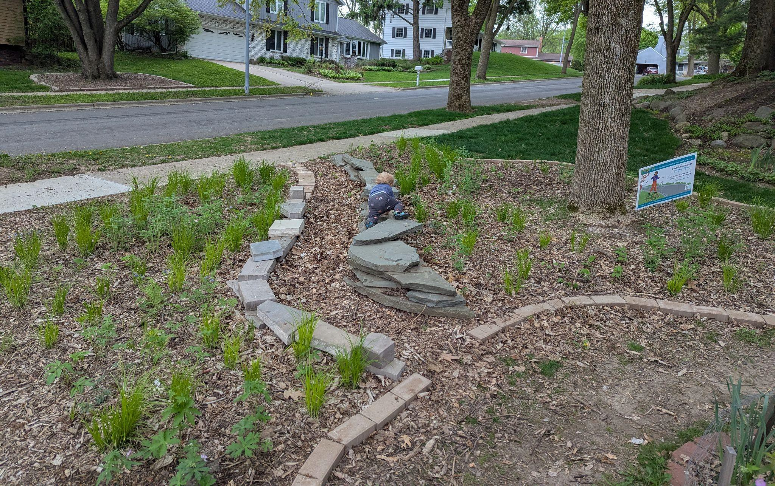
Bee Balm Wildscapes
48
May 2025

Slide 49
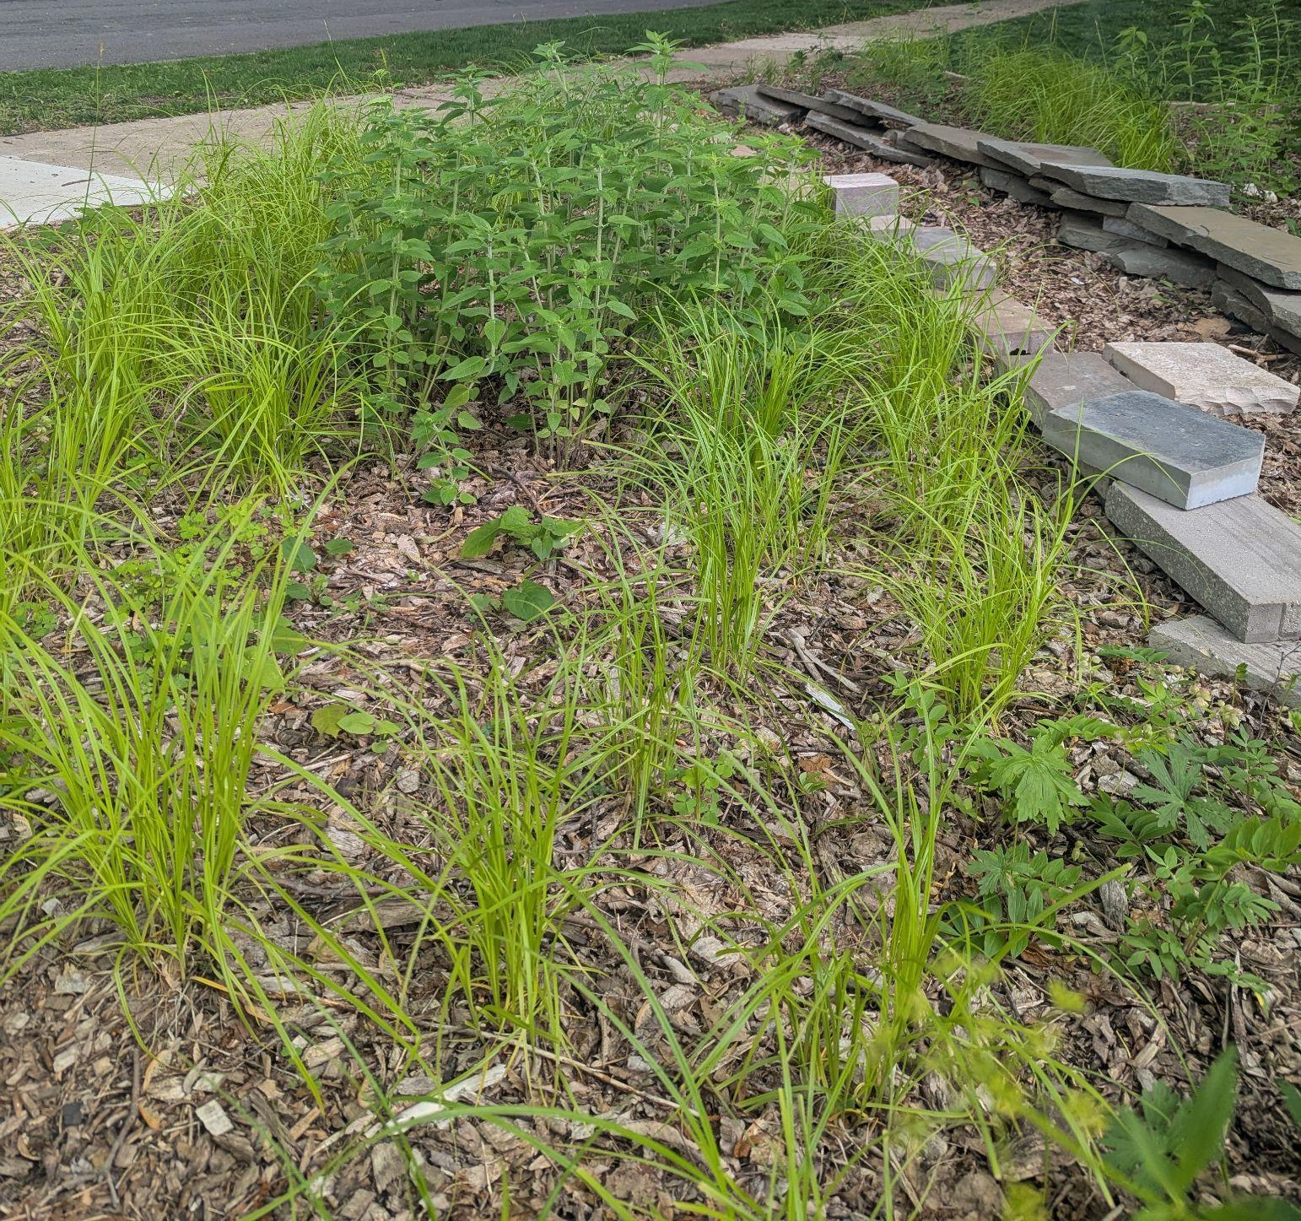
Bee Balm Wildscapes
49
June 2025

Slide 50
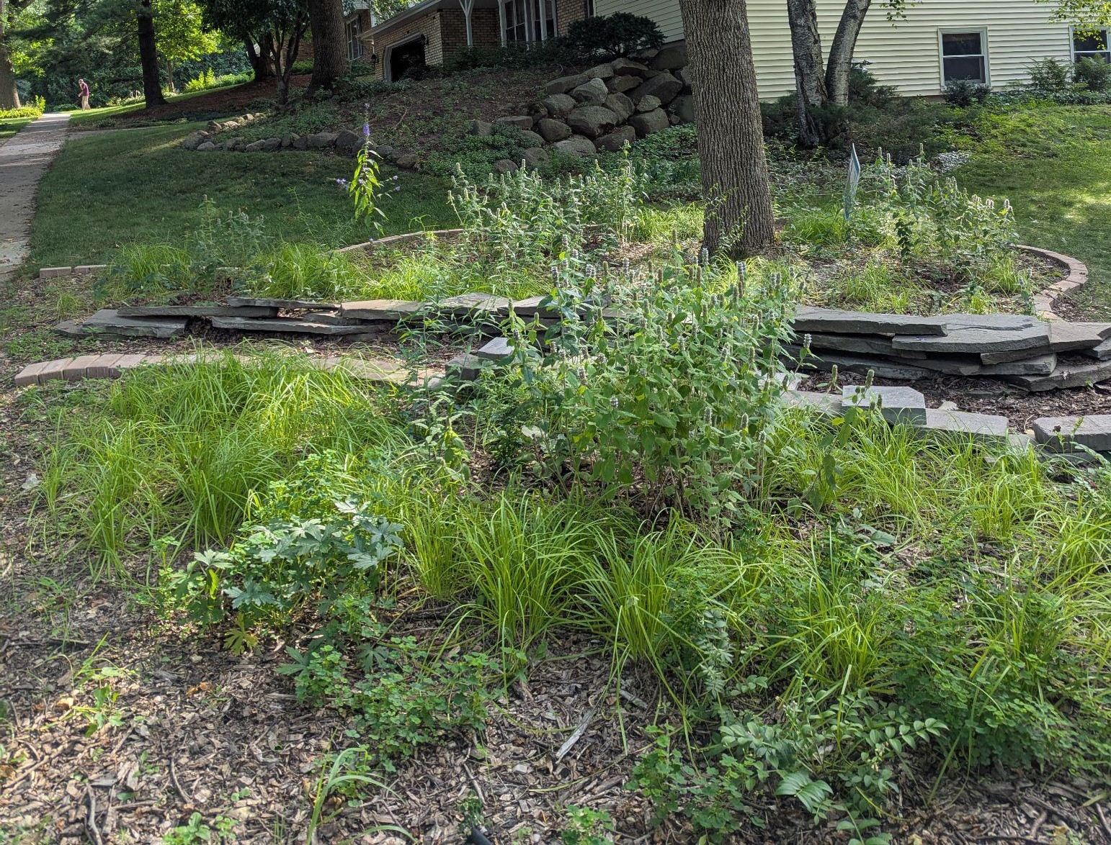
Bee Balm Wildscapes
50
July 2025

Slide 51
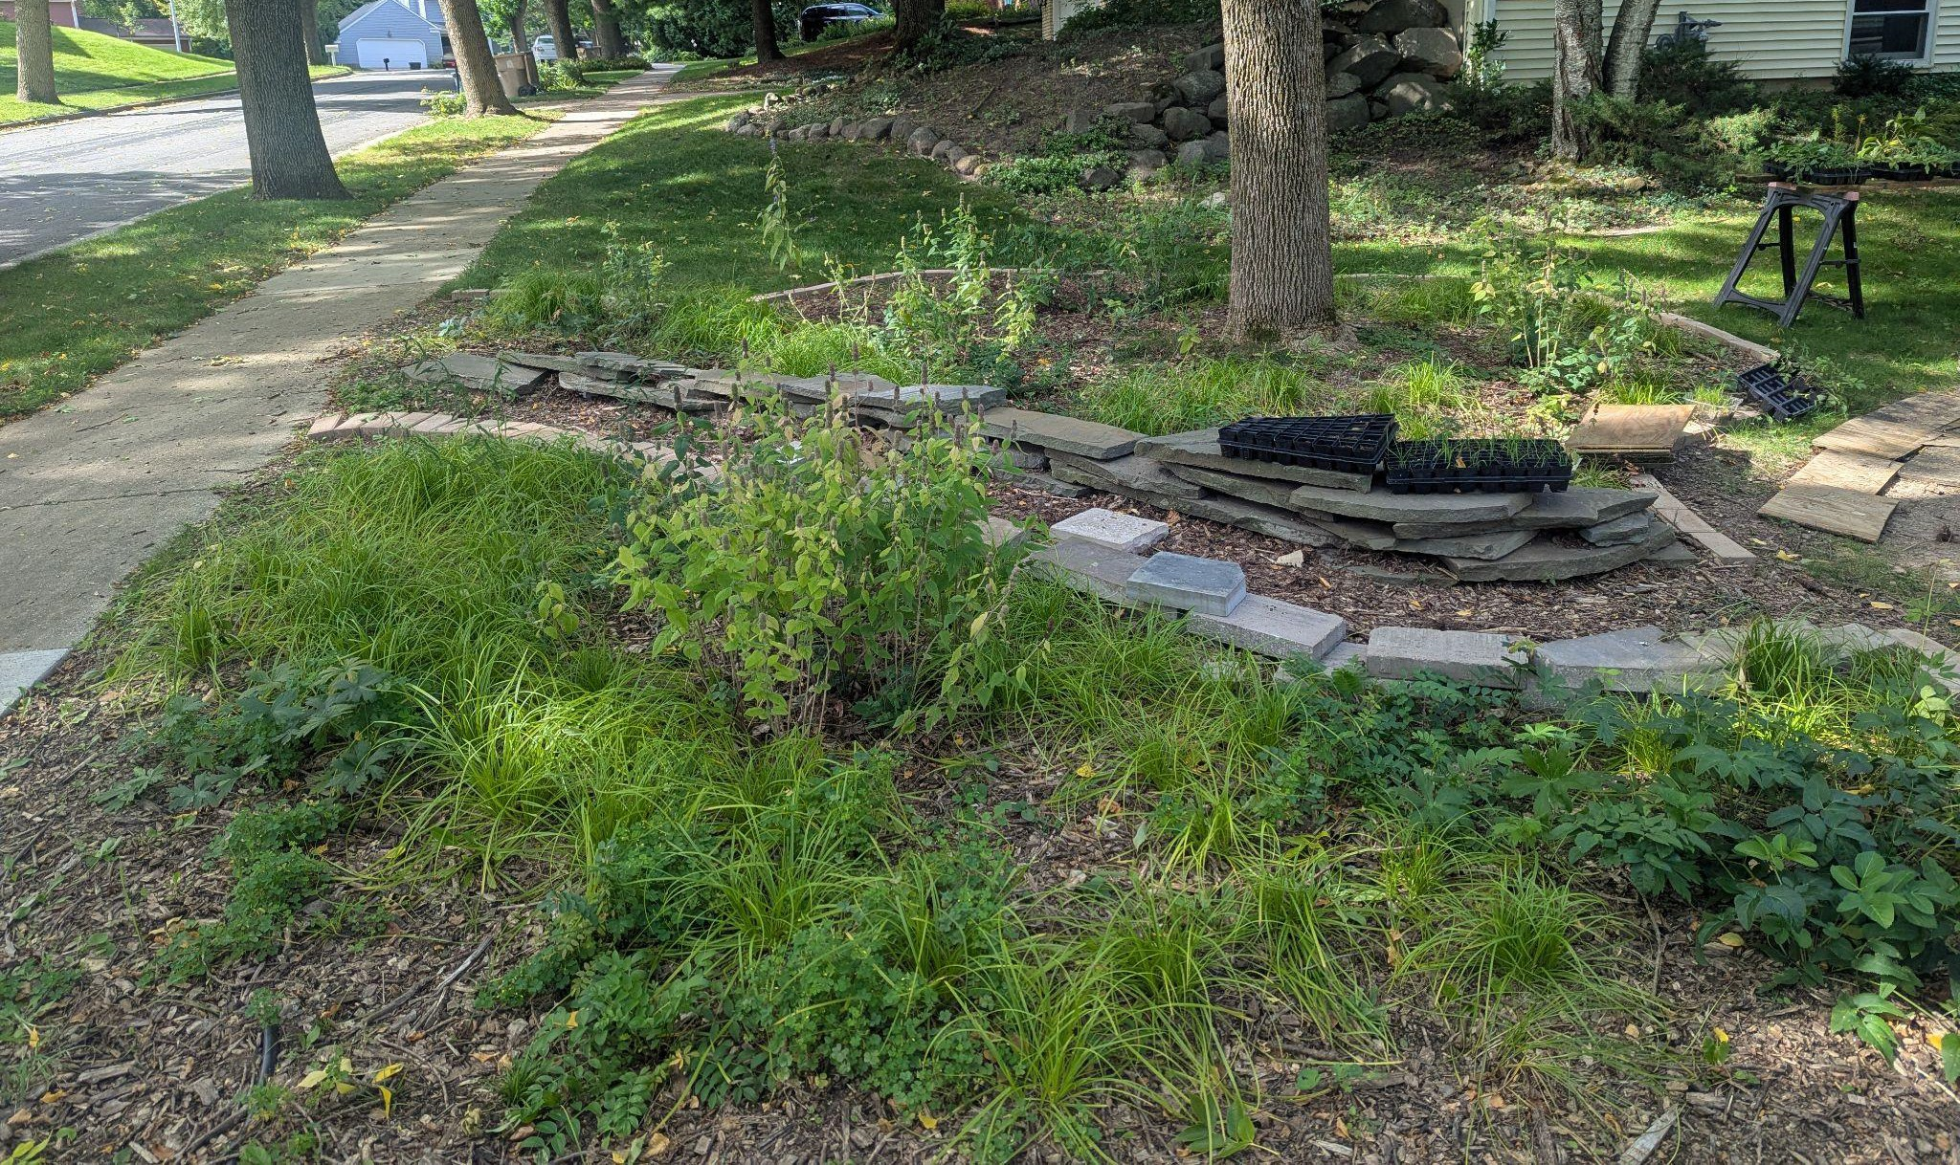
Bee Balm Wildscapes
51
September 2025

Slide 52
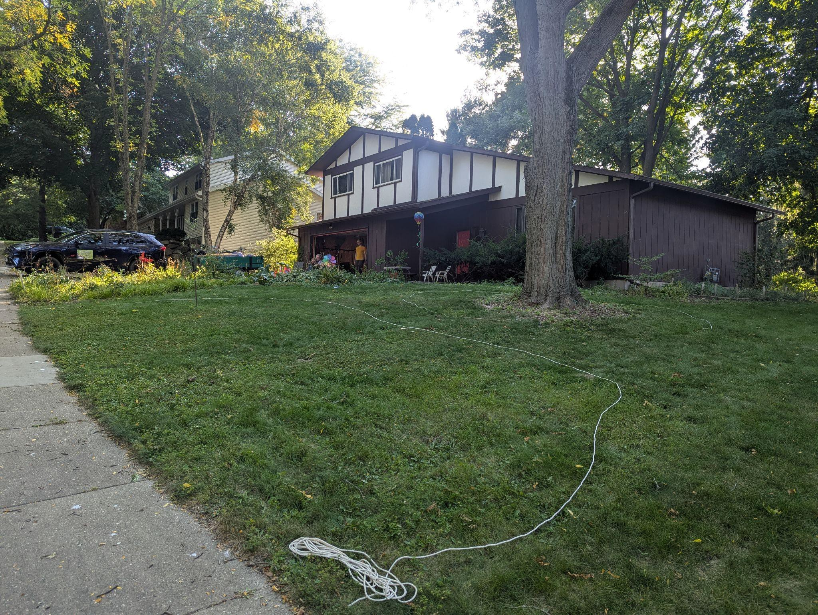
Bee Balm Wildscapes
52
September 2025… the next adventure

Slide 53
Site Prep: Herbicide
Bee Balm Wildscapes
53
Easy, cheap, quick, eﬀective
Can seed in to killed grass or plant plugs May only need one or two applications
Recommend looking for a product with one active ingredient so that you can understand risks
Concerns over environmental toxicity

Slide 54
Growing from Seed Mixes
Bee Balm Wildscapes
54
“Wildﬂower” is NOT native
May be hard to ﬁnd native seed mix that meets aesthetic criteria
Slower to establish, but may still get ﬁrst year ﬂowers

Slide 55
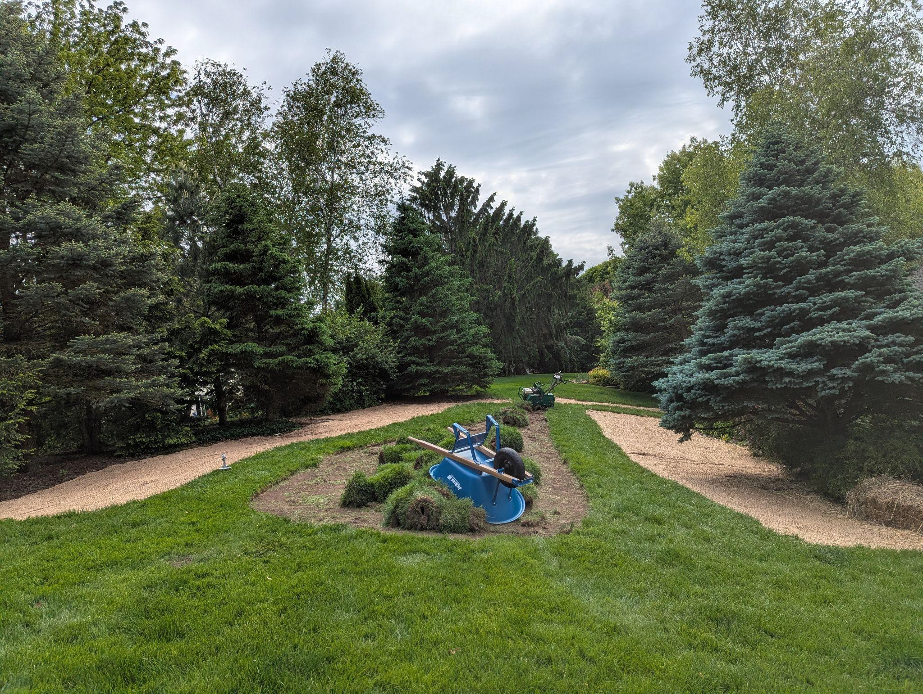
Bee Balm Wildscapes
55

Slide 56
Site Prep: Sod Cutter
Bee Balm Wildscapes
56
Prepares site quickly
I found manual sod cutter easy to use Can seed in to exposed soil
No chemicals added to soil
Removes organic material Have to dispose of cut sod
Exposes seed bank & doesn’t remove all grass roots

Slide 57
Site Prep: Plastic Sheeting
Bee Balm Wildscapes
57
Not labor intensive
Can seed in to exposed soil
No chemicals added to soil… Maybe
Takes an entire growing season to prep site Concerns about microplastics
May not work as well in shady sites Kills soil life

Slide 58
Contact
Bee Balm Wildscapes
58
www.BeeBalmWildscapes.com
contact@beebalmwildscapes.com 608-960-8358

