Slide 1
Environmentally Conscious Lighting
Restoring the Night for People, Wildlife, and the Stars
Samantha Saeger, President, DarkSky WI
Scott Lind, President, Kickapoo Valley Dark Sky Initiative

Slide 2

Notes:
Hello everyone, thank you so much for being here today. My name is Sam Saeger and I am the president of DarkSky WI.

Slide 3
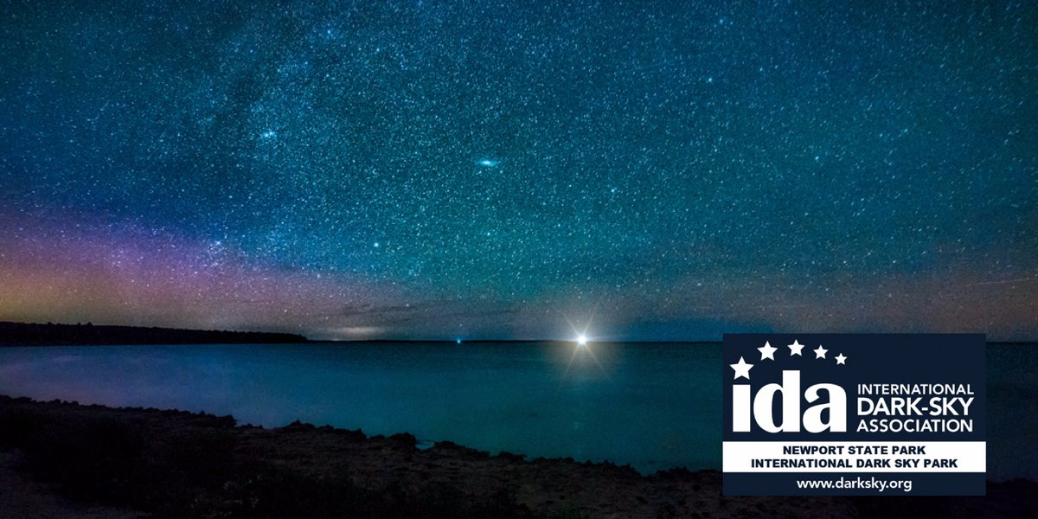
Photography by Denny Moutray
Notes:
My connection to the dark sky began when I visited Newport State Park in Door County–it is the moment I truly understood the power of the night sky when I was standing under a star filled sky.
Newport State Park is the only dark sky designed park in Wisconsin.

Slide 4
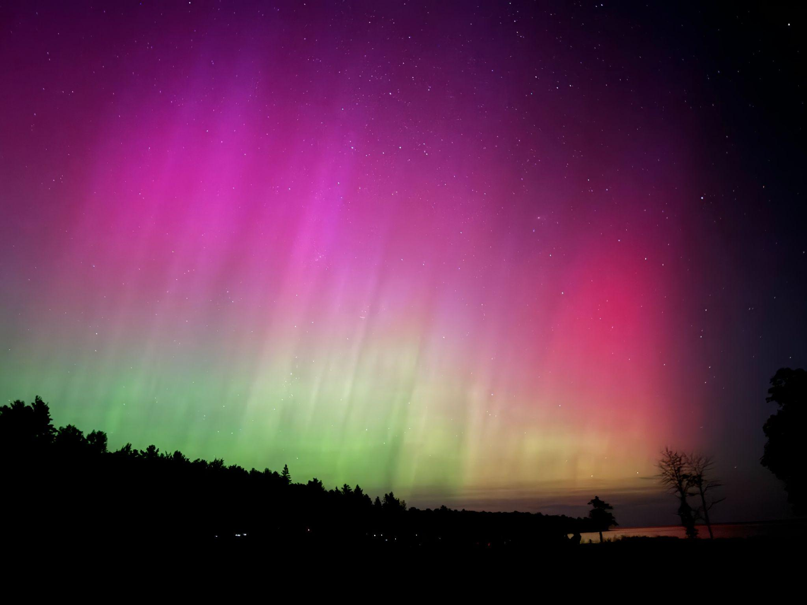
Notes:
And while taking in the northern lights.
I’m fortunate to be joined by a co-presenter who brings additional expertise and perspective, and I’ll turn it over so he can introduce himself.

Slide 5

Notes:
Scott introduces himself.

Slide 6
Why Are We Here?
Light pollution is increasing
The impacts are real
The solutions are practical
Action starts locally
Notes:
What I realized that night in Newport State Park is that many of us have slowly lost the experience of true darkness — not because we intended to, but because of how we light our communities.
This has caused an increase in light pollution, so much so that it is increasing 10 percent per year and doubling every 8 years. We’ve seen even faster jumps in areas of Wisconsin.
The Impacts of light pollution are well-documented and measurable but the good news is that it is solvable and reversible, which is a hopeful problem.
The solutions are straightforward and often inexpensive and
Change happens locally — at homes, area businesses, and communities
We’re here to create awareness, not to place blame — and to show that reversing light pollution is practical, not extreme.

Slide 7
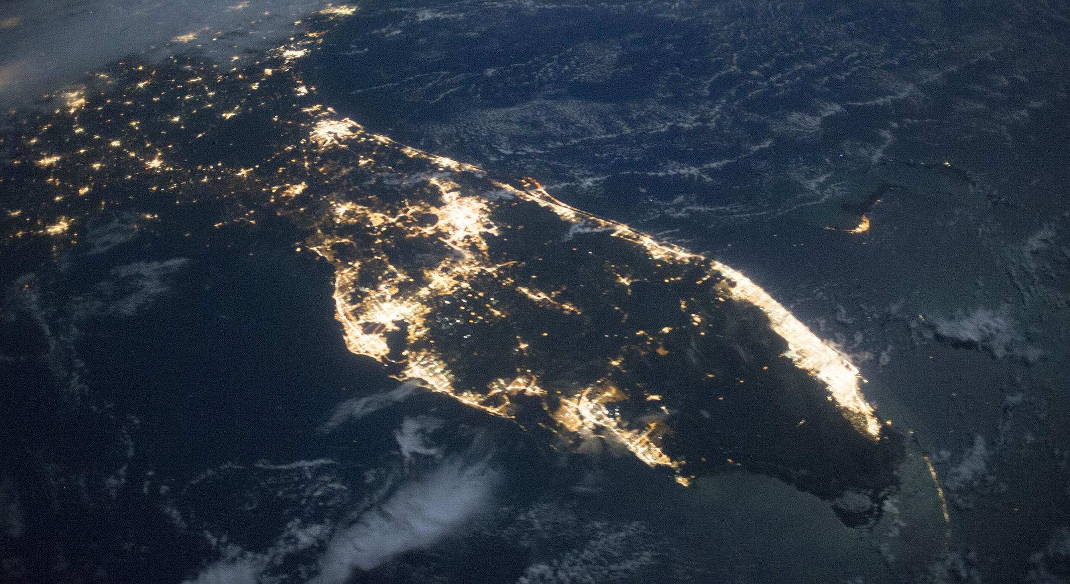
Light Pollution is Bad and Getting Worse
Global satellite data indicates ALAN has increased by at least 2% each year over 25 years
Citizen science data indicates that ALAN is growing by about 10% each year over 10 years
Artificial Light at Night is causing negative ecological impacts
Notes:
Why are we here talking about outdoor lighting? Here’s a startling fact: A child born today that can see 250 stars, will only be able to see 100 of those stars when they turn 18 because world-wide light pollution is increasing by nearly 10% every year. We’ve seen even faster jumps in my area of Wisconsin and have the measurements to prove it. In the next few minutes, we’re going to discover what’s happened, why it’s happening, why you should care about it and how you can create an ordinance to help reverse the trend.

Slide 8
What Is Light Pollution?
Excessive or misdirected artificial light at night
Light that shines where it’s not needed, when it’s not needed, or brighter than necessary
Notes:
Light pollution isn’t just “a lot of light.”
Many people assume it’s only a big-city issue — something that only affects downtown skylines or major metro areas.
But it’s actually a growing environmental issue worldwide.
At its core, light pollution is simply light used where it isn’t needed, or when it isn’t needed.
And most of the time, people contribute to it unintentionally.
In fact, you’ve probably seen examples in your own neighborhood.

Slide 9
Types of Light Pollution
Skyglow – brightening of the night sky
Glare – excessive brightness causing visual discomfort
Light trespass – light spilling onto unwanted areas
Clutter – excessive grouping of bright lights
Notes:
There are four main types of light pollution.
The first is skyglow — that bright dome you see over communities at night.
And it doesn’t just affect big cities. Even small towns create skyglow.
Then there’s glare.
Glare doesn’t just cause discomfort — it actually reduces visibility. When light is too bright or poorly shielded, it decreases contrast and makes it harder to see clearly.
The third type is light trespass — and this is one of the most common neighbor complaints.
It’s simply light shining where it doesn’t belong, like into a bedroom window.
And finally, there’s clutter — too many bright light sources grouped together.
Clutter creates visual chaos, increases distraction, and can actually reduce safety instead of improving it.

Slide 10
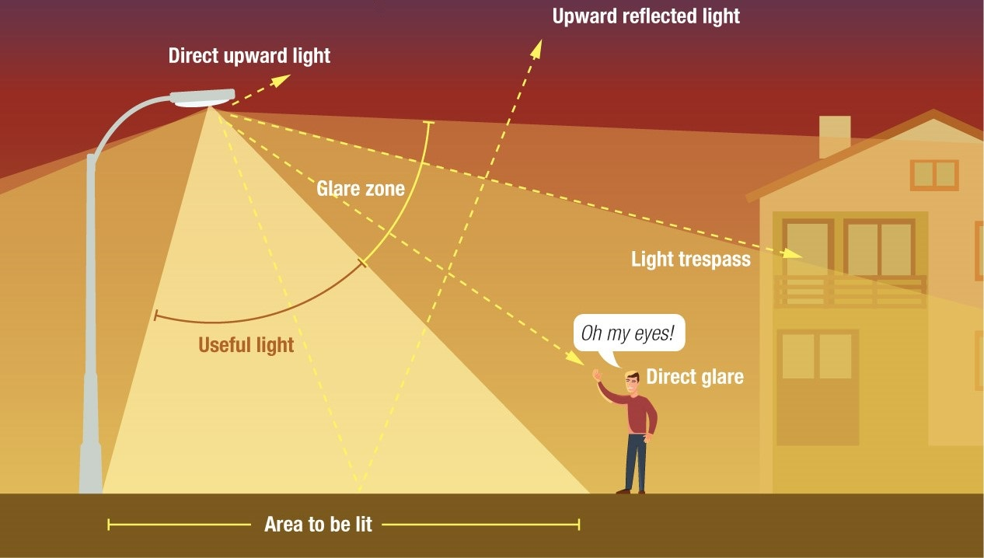
Image by Anezka Gocova
Useful Light vs. Total Light
Notes:
This image emphasizes misdirection and overuse of light creating glare, light trespass and visua discomfort

Slide 11
Why the Night Matters
Natural day–night cycles regulate life on Earth
Darkness is as important as daylight
All species evolved under dark skies
Notes:
Before we go any further, I want to reframe something.
The night is natural. It is not bad. It is not inherently unsafe. It is essential for life on Earth.
Darkness is not an absence of something — it is a natural condition. Life on this planet evolved under predictable light–dark cycles. For billions of years, there was day… and there was night.
When we use artificial light at night, especially in ways that are excessive or misdirected, we begin to disrupt that natural rhythm.
And that disruption doesn’t just affect the stars. It affects wildlife. It affects ecosystems. And it affects us.
Darkness is biological. Humans evolved under dark skies. Our sleep cycles, our hormones, even our mental health are tied to natural patterns of light and dark.
So when we talk about environmentally conscious lighting, we’re not talking about eliminating light. We’re talking about preserving the natural night — and using light in ways that respect it.

Slide 12
More than half of the world’s species are nocturnal
“We too quickly forget we don’t perceive the world in the same way as other species, and consequently, we ignore the impacts that we shouldn’t.”
– Travis Longcore
Notes:
More than half of the world’s species are nocturnal!
I really appreciate this quote from Travis Longcore. He says, “We too quickly forget we don’t perceive the world in the same way as other species, and consequently, we ignore the impacts that we shouldn’t.”
What this reminds us is that we tend to design the world based on how we experience it — and we forget that other species experience light very differently.
Wildlife doesn’t get a vote in how we light our communities.
Modern lighting has largely been designed for human convenience. And humans are the only species that assumes night should look like day.

Slide 13
Impacts on Wildlife
Disrupts migration, feeding, and reproduction
Confuses nocturnal animals
Affects insects, birds, amphibians, and mammals
Notes:
When we change the night, we’re not just changing the sky — we’re affecting a huge portion of life on this planet.
Many of these impacts are invisible to us, but they ripple through entire ecosystems.
Artificial light at night disrupts feeding, migration, and reproduction. It interferes with natural circadian rhythms — not just for animals, but for plants as well.
Insects are especially vulnerable. Both nocturnal and diurnal insects are negatively affected by artificial light. You’ve probably seen this yourself — insects trapped, circling endlessly around bright fixtures. That behavior isn’t harmless. It exhausts them, makes them easy prey, and disrupts pollination patterns.

Slide 14
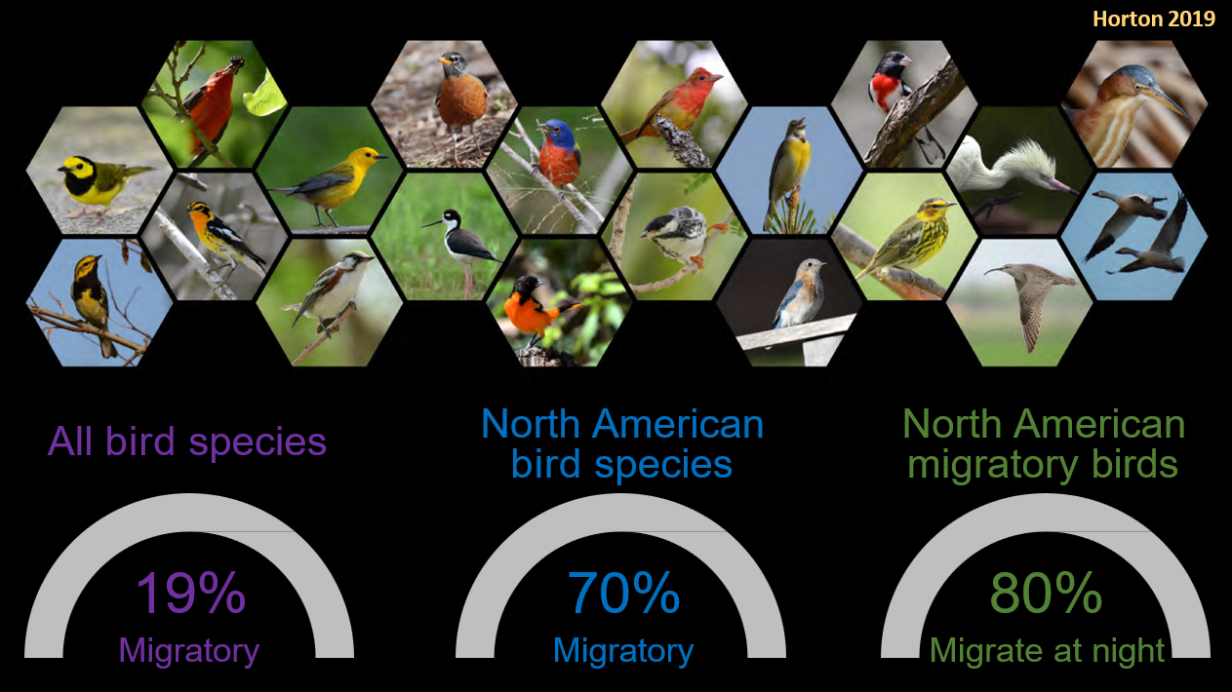
Notes:
Birds are another major example, particularly during peak migration seasons of being affected by light pollution. Many species navigate using the stars and the moon. When bright city lights draw them off course, it can lead to disorientation and fatal collisions with buildings.
And it doesn’t stop there. Sea turtles, frogs, pollinators — many species experience light very differently than we do. Even subtle changes in nighttime brightness can alter their behavior in ways we may never see, but that still matter deeply.

Slide 15
Impact on the Environment
Wasted money and energy
Notes:
Light pollution isn’t just about losing the stars — it has real environmental consequences.
In the United States alone, wasted outdoor lighting costs an estimated $7 billion in energy every year. That wasted light results in the release of about 66 million tons of carbon dioxide annually.
Those emissions aren’t coming from lighting that’s improving safety or visibility — they’re coming from light that is misdirected, excessive, or simply unnecessary.
In other words, these carbon emissions are a direct result of wasted light.

Slide 16
Impacts on Human Health
Disrupts circadian rhythms
Affects sleep quality
Linked to increased stress and health risks
Blue-rich light at night is especially disruptive
Notes:
Just as light pollution affects wildlife and the environment, it affects us as well.
Our bodies depend on natural light–dark cycles. Circadian rhythms — the internal clocks that regulate sleep, hormones, and overall health — rely on darkness at night.
Blue-rich light, especially from electronics and certain outdoor lighting, is particularly disruptive after sunset. It can interfere with melatonin production, impact sleep quality, and increase stress over time.
And this is important: we are not separate from nature. The same biological systems that guide wildlife also guide us.
This conversation isn’t about fear. It’s about awareness. When we choose smarter lighting — we’re offering practical solutions that protect the health of people, wildlife, and our environment.

Slide 17
Losing the Night Sky
Fewer people can see the Milky Way
Loss of cultural, scientific, and emotional connection
Night skies inspire curiosity, wonder, and stewardship
Notes:
Losing the night sky isn’t just an environmental issue — it’s a cultural, emotional, and scientific loss.
Today, about one-third of humanity — and nearly 80 percent of people in the United States — can no longer see the Milky Way from where they live.
For most of human history, the night sky was a shared experience. It shaped navigation, storytelling, science, and our understanding of our place in the universe.
Darkness inspires curiosity. It sparks wonder. It encourages stewardship.
When we lose the night sky, we’re not just losing stars — we’re losing a source of perspective, imagination, and connection that has guided humanity for thousands of years.

Slide 18
Light Pollution Is a Community Issue
One light can affect many people and habitats
Collective action matters
Communities can protect darkness while staying safe
Notes:
One important thing to remember is that light doesn’t stay contained to one property. It crosses property lines.
A single poorly aimed or overly bright fixture can impact neighbors, wildlife, and even the night sky itself.
That’s why this isn’t about individual perfection — it’s about collective awareness.
When communities work together and adopt thoughtful lighting practices, the impact is far greater than any one person acting alone.
And the good news is this: communities can protect darkness while still maintaining visibility and safety. Smart lighting allows us to do both.

Slide 19
A Different Perspective on Outdoor Lighting
Outdoor lighting beyond basic safety needs is optional
Darkness is a natural and valuable resource
The most environmentally responsible option is often no light at all
Notes:
When we talk about good lighting design, sometimes the best design choice is choosing not to light something at all.
For example, choosing not to uplight a tree or architectural feature on your property.
That can feel counterintuitive. We’re used to thinking that adding light enhances beauty or improves a space. And for many people, the idea that not lighting something is a valid design choice can be the hardest concept to accept.
But in many cases, restraint is the most environmentally responsible option. It recognizes that darkness isn’t something to eliminate — it has intrinsic value.

Slide 20
Rethinking What Outdoor Lighting Signals
Lighting choices send signals about values
More light does not always mean better design
Thoughtful restraint can communicate care and confidence
Notes:
So what does it actually mean to not use light beyond what’s needed for safety?
It means being intentional. It means lighting for a purpose — not lighting simply because we can.
In many communities, the most respected and beautiful properties aren’t the brightest ones. They’re the most thoughtfully designed.
Choosing not to use excess light doesn’t mean neglect — it means you’ve considered what’s truly necessary.
Lighting choices have always communicated values. In the past, more light was often associated with status or success. But today, we understand that excess light doesn’t equal quality.
Thoughtful lighting — light that is purposeful and limited to what’s needed — reflects a community that values both safety and stewardship.

Slide 21
Lighting & Safety: Clearing Up Myths
More light ≠ more safety
Glare can reduce visibility
Well-designed lighting improves safety and comfort
Notes:
There’s a common belief that more lighting automatically means more safety.
But we now know that isn’t necessarily true. Brightness alone does not equal safety.
And safety isn’t about flooding an area with light — it’s about using well-designed lighting that improves visibility without creating visual discomfort, the glare that we talked about
With well-designed lighting we can improve safety.

Slide 22
Why Do We Think Brighter Means Safer?
For decades, more light meant more visibility
Bright lighting became associated with safety
That belief made sense at the time
Notes:
The idea that brighter is safer isn’t a bad assumption — it’s just an old one.
When lighting and security technology were more limited, increasing brightness was often the simplest and most effective solution. Historically, that made sense.
Our perceptions of safety were shaped by those technological limitations.

Slide 23
Bright ≠ Better Visibility
Too Much Light Can Reduce Safety
Glare reduces contrast and detail
Harsh lighting creates deep shadows
Overlighting can hide, not reveal, activity
Notes:
So today, that leaves us with brighter does not mean safer, does not mean better vision
In fact, excessive brightness can create glare, which reduces contrast and limits our ability to see clearly.
Harsh lighting creates shadows
Overlighting can have the opposite affect and make areas feel unsafe because of the glares produced by overlighting

Slide 24
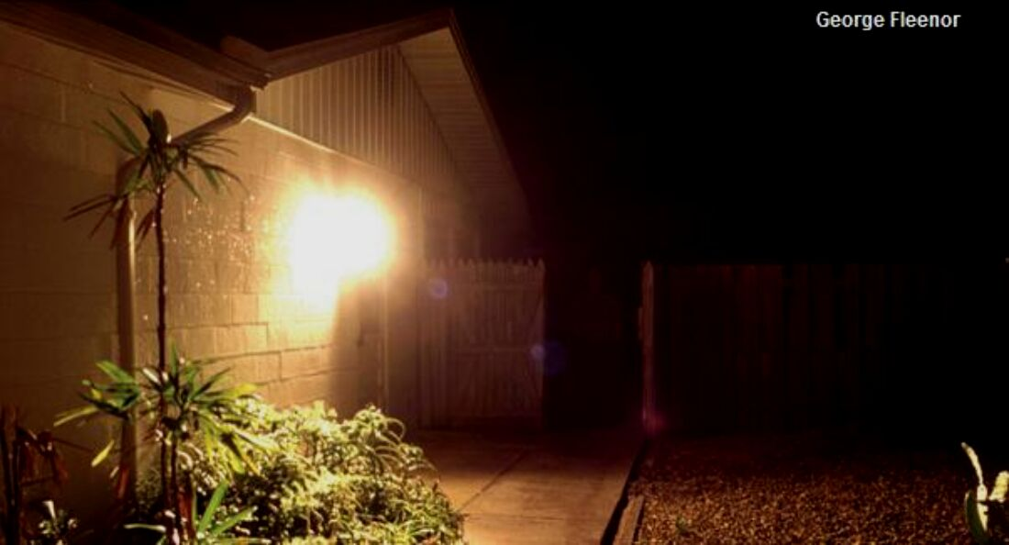
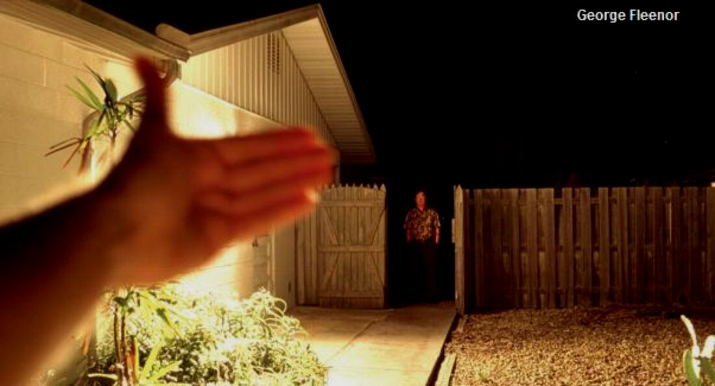
Myth
More light is safer
Reality
Glare is dangerous Uniformity and proper contrast are the keys to safety
International Dark-Sky Association | 2019
Notes:
Here’s an example of glare reducing safety and hiding details
There is a person standing at the gate in both photos. We just can’t see him in the first photo because of the glare. By shielding the fixture with the hand, the lack of intense glare means you can see him in the bottom photo.

Slide 25
Technology Has Evolved
Lighting is now controllable and precise
Cameras perform better in lower and even light
We no longer need constant brightness
Modern LEDs provide better visibility at lower light levels
Notes:
Technology has changed.
We now have better fixture design, full shielding, adaptive controls, motion sensors, and dramatically improved camera systems.
The tools are different now.
Modern cameras no longer require overlighting to function well — which changes the equation. Security no longer depends on constant brightness.
LEDs allow precise control — of direction, intensity, timing, and color temperature.
We’ve moved from a mindset of “light everything” to “light what matters.”
The rules have evolved — and it’s time for our assumptions to evolve with them.

Slide 26
A New Way to Think About Safety
Safety comes from control, not brightness
Right light
Right place
Right time
Notes:
This is the pivot.
We’re not removing light — we’re using it intentionally.
Darkness doesn’t mean unmonitored.
Darkness can be designed — with the right light, in the right place, at the right time.

Slide 27
Best Practice is Less, Not More
Modern Safety Standard
Safety comes from visibility, not brightness
Comfort comes from consistency, not glare
Confidence comes from intentional design, not excess
Darkness and safety can coexist
Notes:
The mindset shift we’re inviting is not a fear of darkness, but confidence in smarter lighting. We can rethink old habits without sacrificing safety and security.
This is a new way of thinking of safety. Instead of thinking we need brightness to feel safe:
Safety comes from consistency and creating visibility where it matters most, with even lighting that improves clarity instead of glare.
Confidence comes from intentional design
And the understanding that darkness and safety are compatible
Security today doesn’t come from floodlights.
It comes from visibility, control, and intelligence.

Slide 28
Having “The Talk”
Start with curiosity, not criticism
Focus on light impacts, not personal choices
Share how the lighting affects you
Offer simple alternatives, not demands
Keep the conversation friendly and low-pressure
Notes:
When a neighbor believes that “more light is better,” one of the most common questions I hear is:
What do I do if their light is shining into my window all night?
The first step is to assume good intent.
Most lighting issues are unintentional — and often very easy to fix.
Instead of focusing on judgment, focus on impact.
You might mention sleep disruption, glare, or even effects on wildlife — rather than implying someone is doing something wrong.
It can sound as simple as:
“I recently learned a bit about outdoor lighting, and I noticed some light from your fixture is shining into our yard at night. I was wondering if you’d be open to adjusting it or maybe using a warmer bulb?”
If they seem unsure, you could add:
“I completely understand — this was new information to me too. Even a small adjustment, or turning it off a little later at night, would make a big difference for us.”
And you can always ease pressure by saying:
“There’s no rush at all. I just wanted to share the information in case it’s something you’d consider.”
It’s not about confrontation.
It’s about conversation.
The good news? Most fixes are simple. And Scott is going to walk you through the practical solutions.

Slide 29
What Is Environmentally Conscious Lighting?
Lighting that is:
Used only when needed
Shielded
Warm in color
Appropriately bright
Notes:
Now that Sam has explained what light pollution is, and why it matters we hope you’re ready to help change things. So I’ll share what we can all do to achieve more environmentally conscious lighting..
This is not anti-light
It’s about using light thoughtfully and only when needed
Emphasize intention and restraint
These principles scale from one house to a city
This is where solutions begin to feel manageable

Slide 30
Definitions
Zero Uplight
A fixture with no light shining above the bottom edge.
Lumens
The total visible light produced by a bulb or fixture.
Color Temperature (CCT)
The color of light, measured in Kelvin (K).
Notes:
This will not be technical deep dive
Emphasize downward light, appropriate brightness, warm color
These terms will come up again

Slide 31
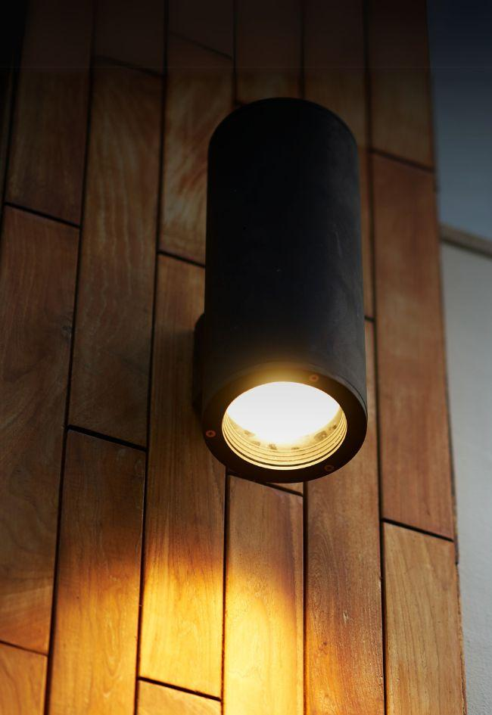
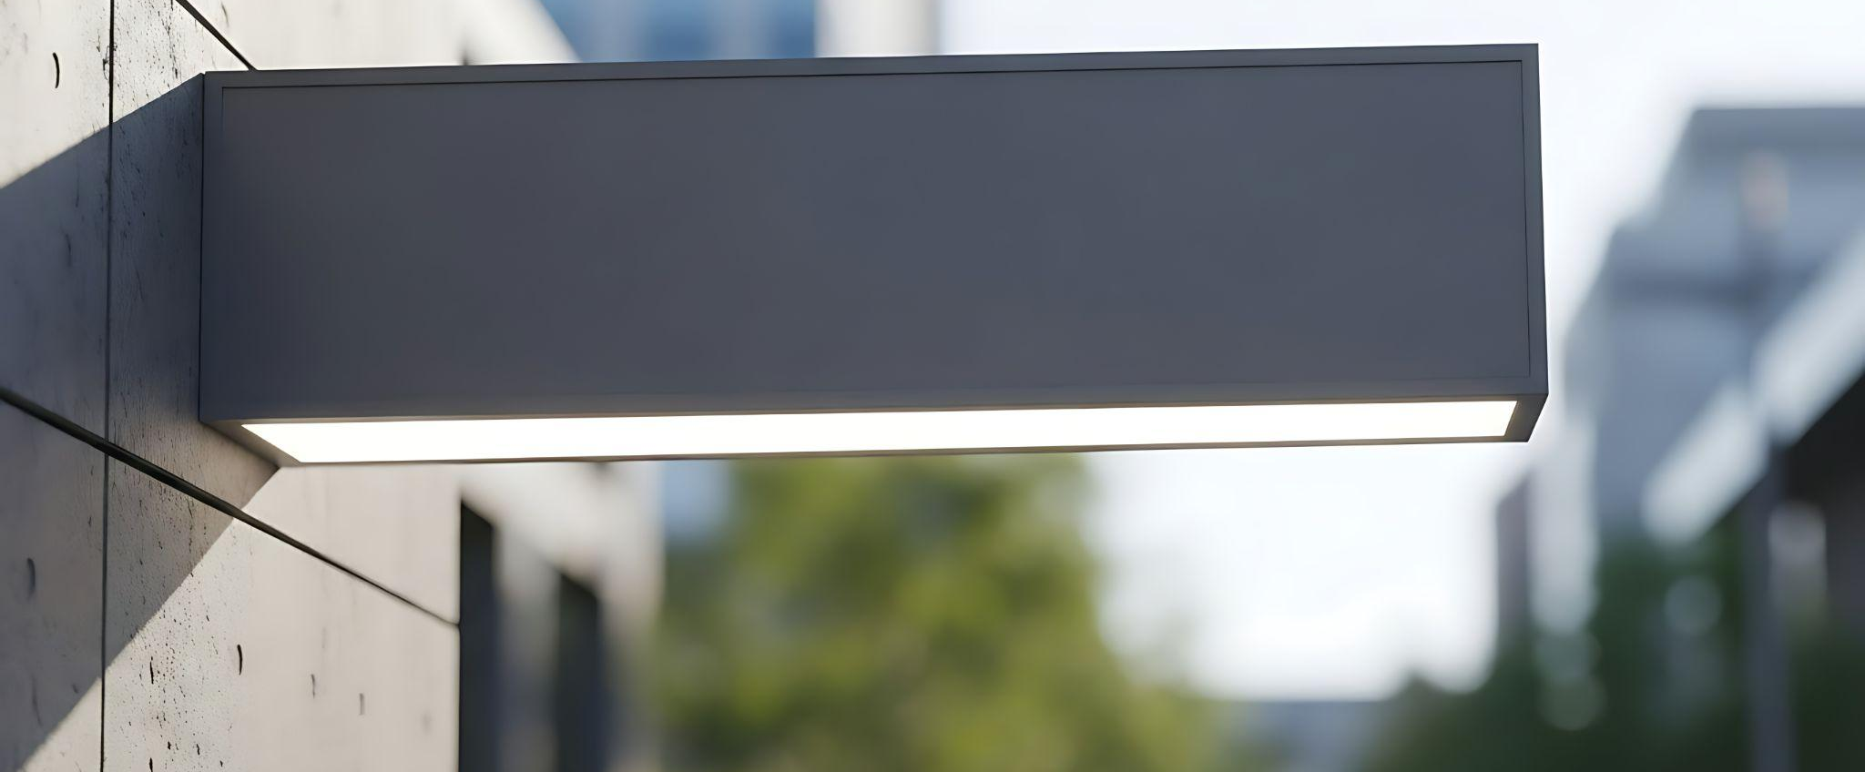
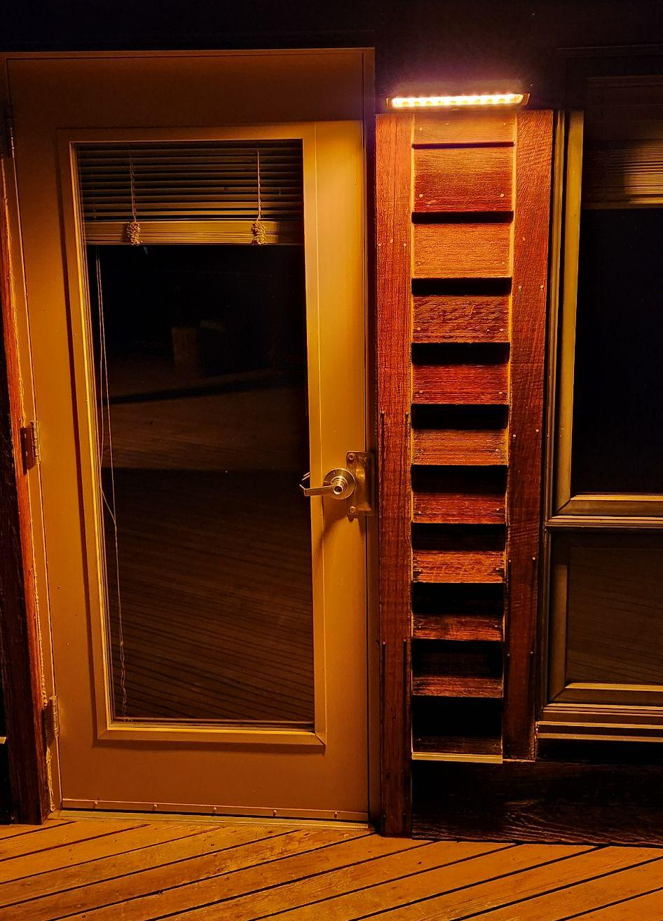
Zero Uplight Fixtures
DarkSky.org , Tatik Listiani - Vecteezy.com
Notes:
Shielding directs light where it’s needed

Slide 32
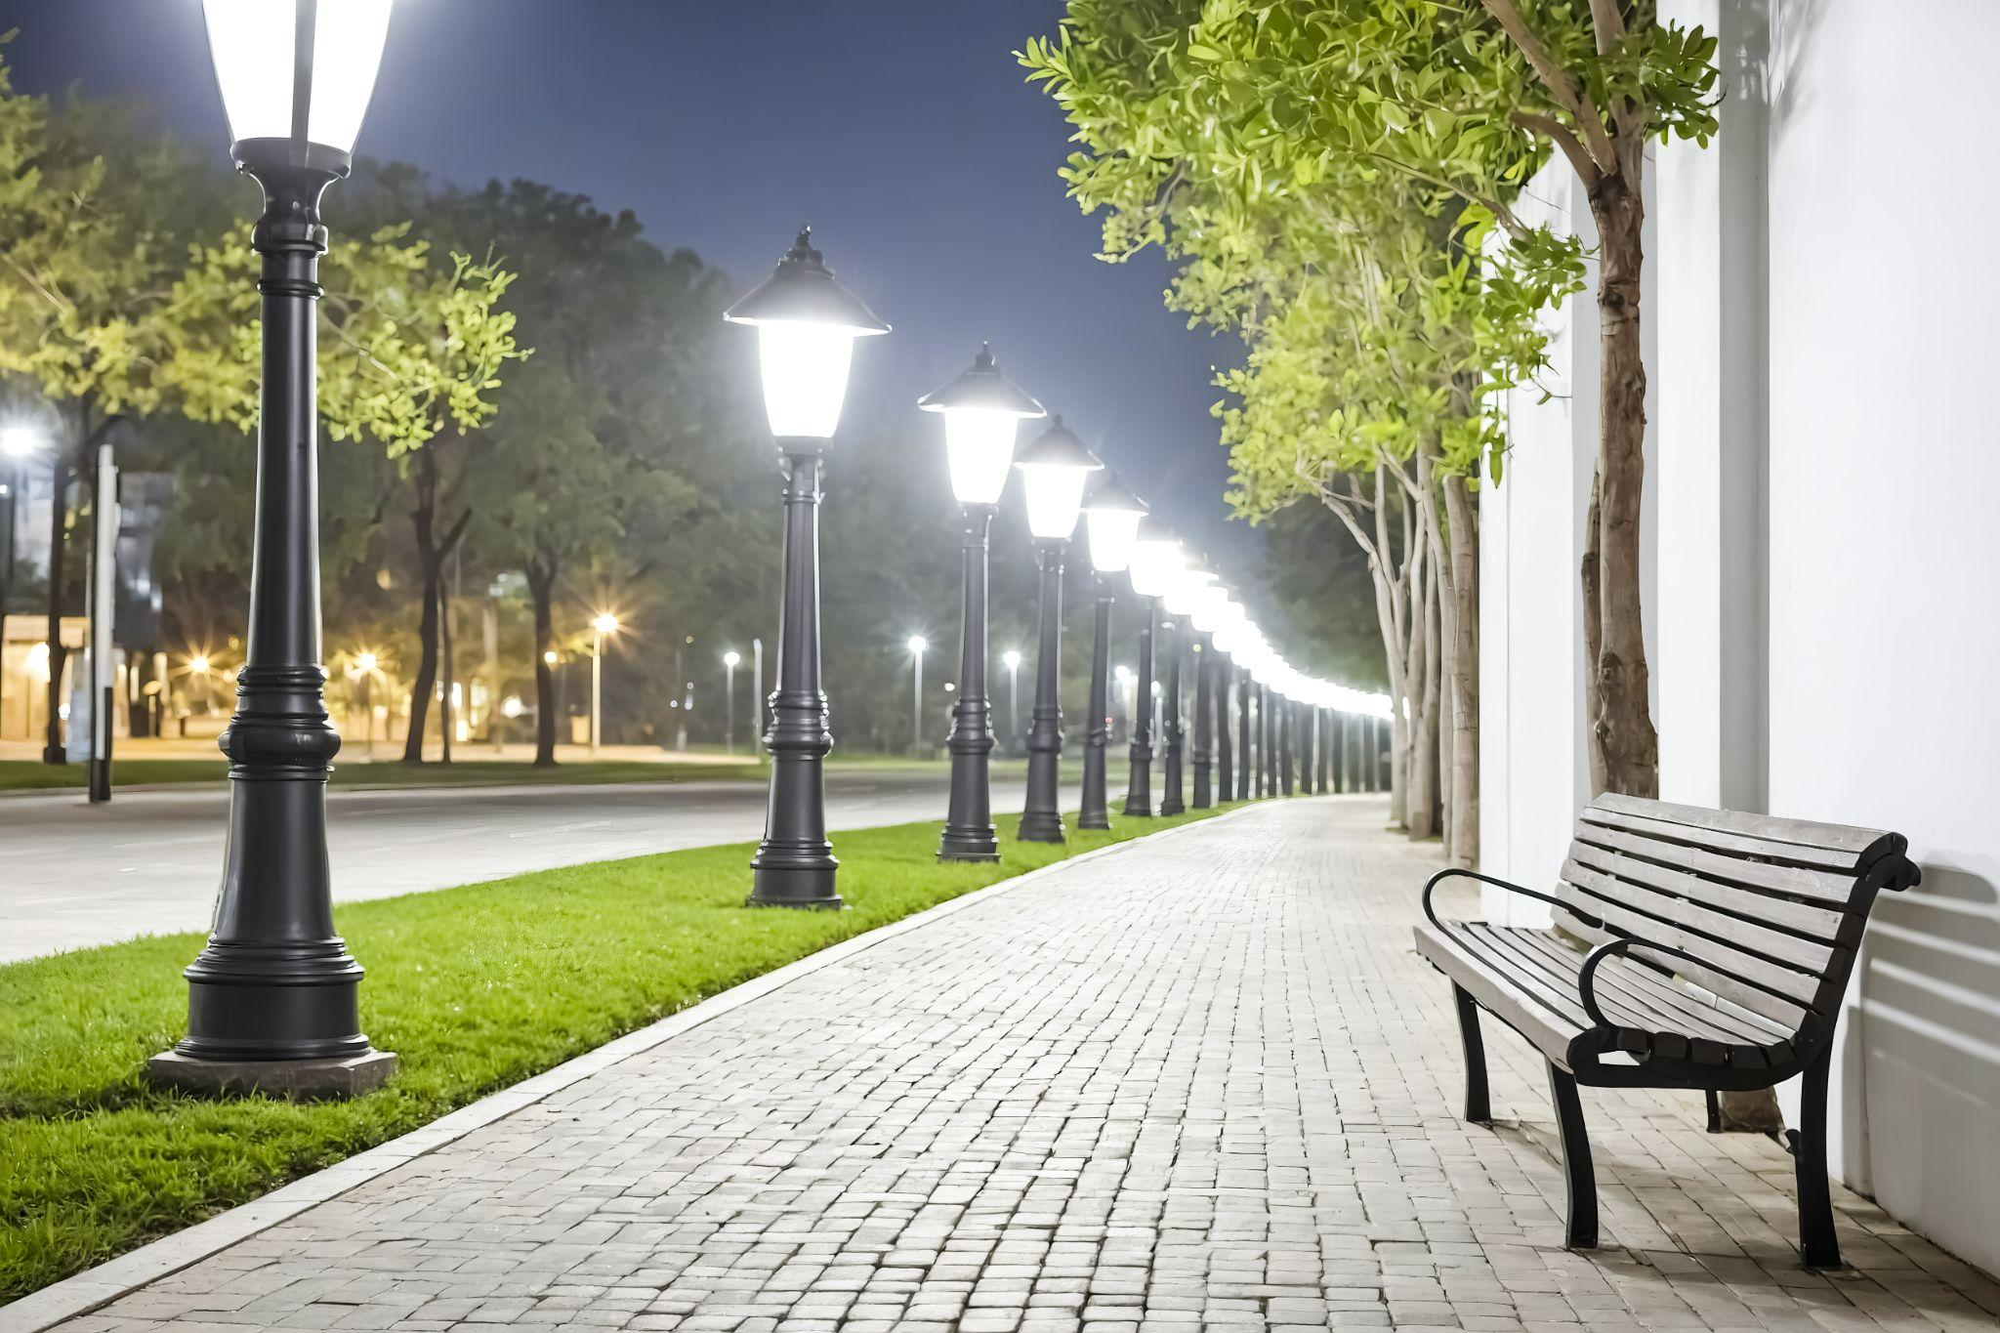
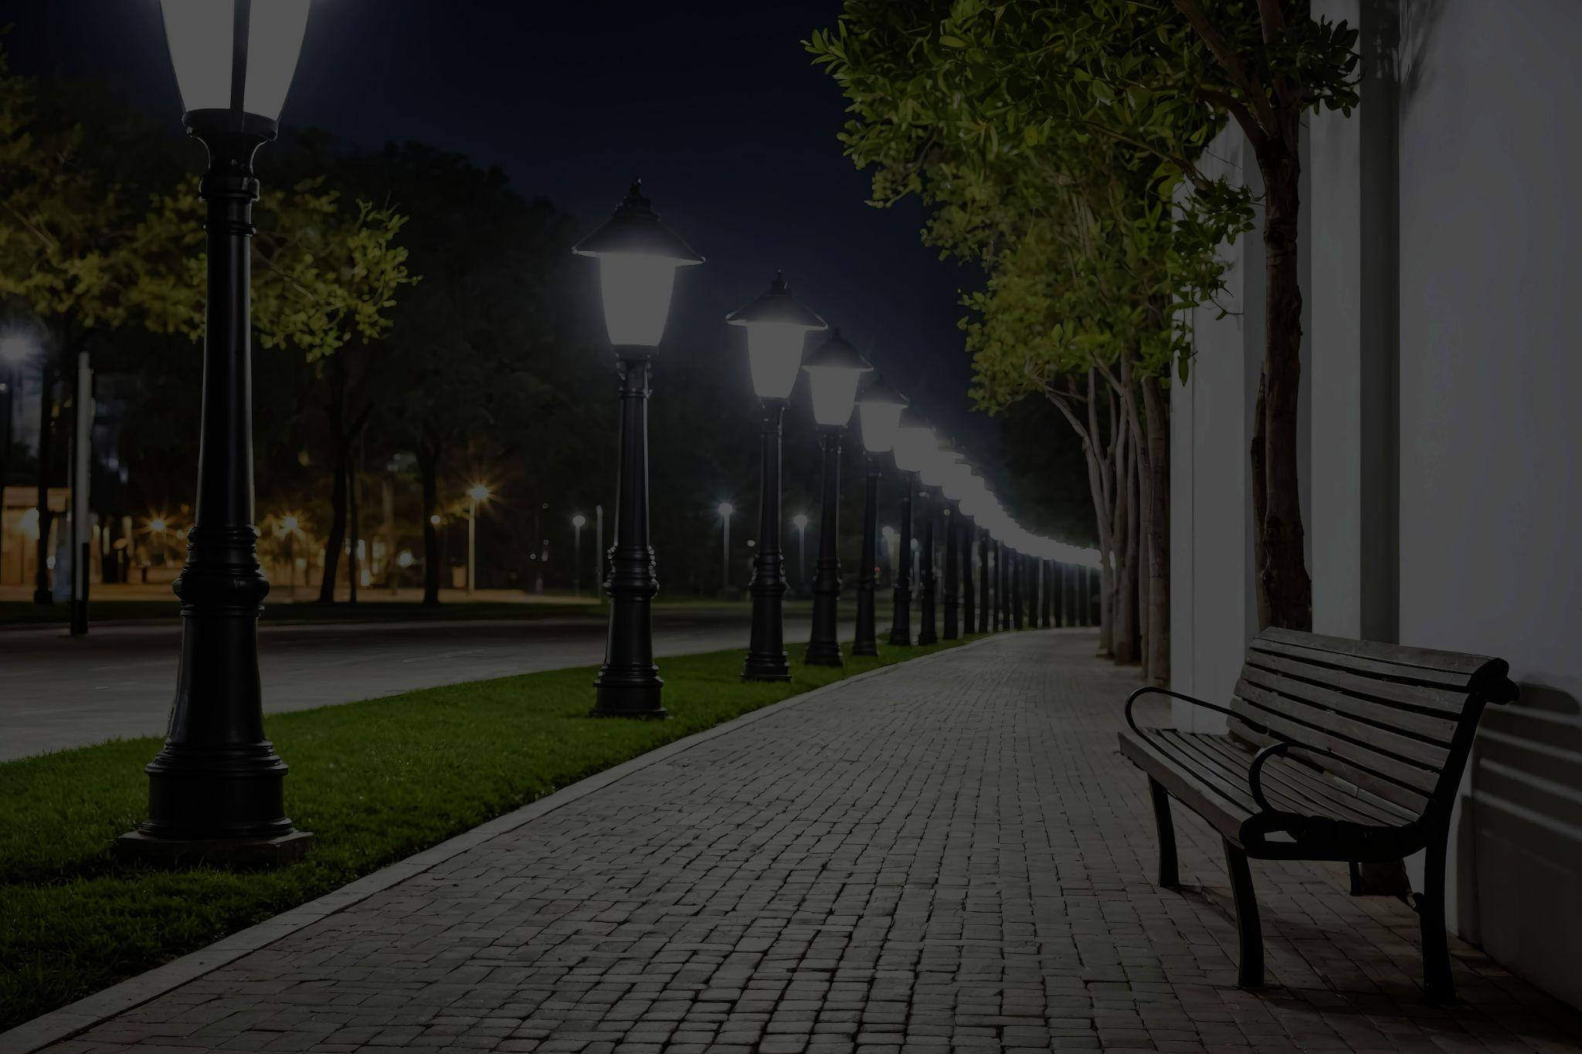
Lumens = quantity
Anton Rysak - Vecteezy.com

Slide 33
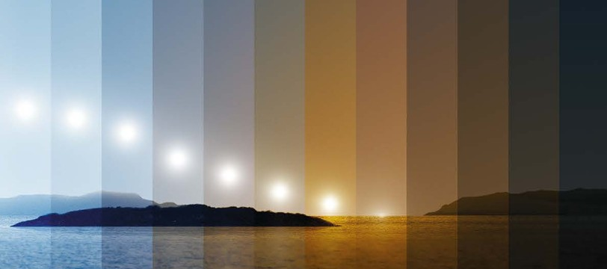
CCT of Natural Day and Dusk
Zumtobel Lighting - 2016
6000K
5000K
4000K
3000K
2700K
2200K
1900K
1800K
Zumtobel Lighting 2016
Notes:
Humans evolved with warm light before nightfall
High CCT lighting introduces blue light - signals daytime
Emphasize: color ≠ brightness
Warm light still supports visibility but reduces impact

Slide 34
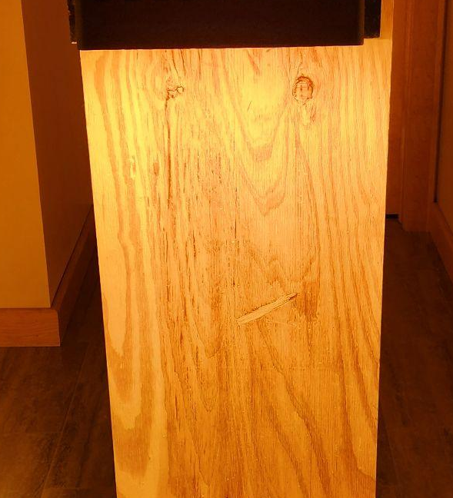
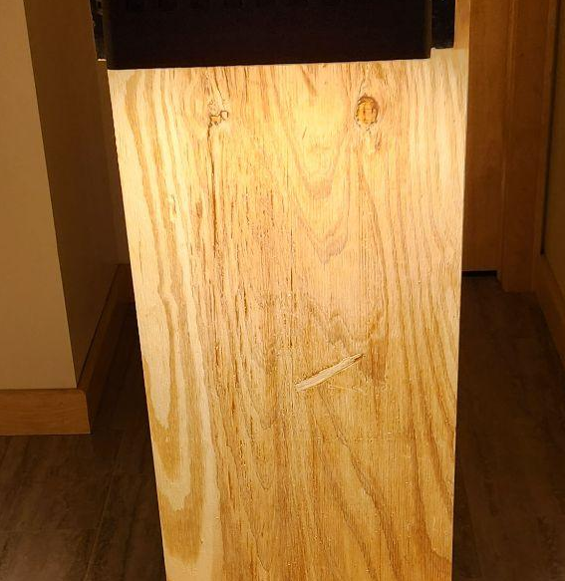
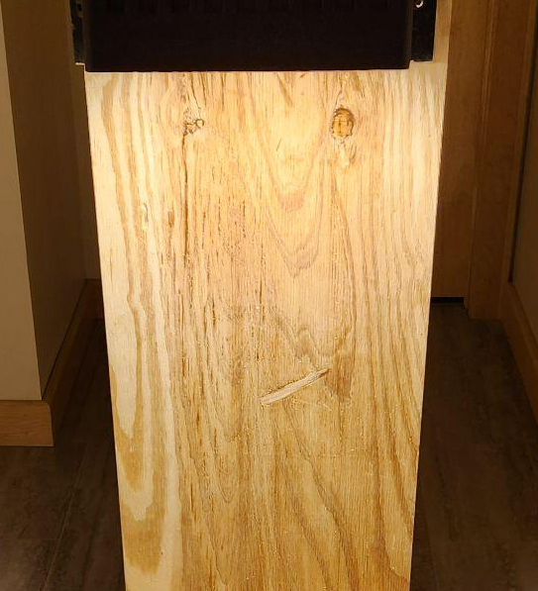
CCT = Color
1800K
2200K
2700K

Slide 35
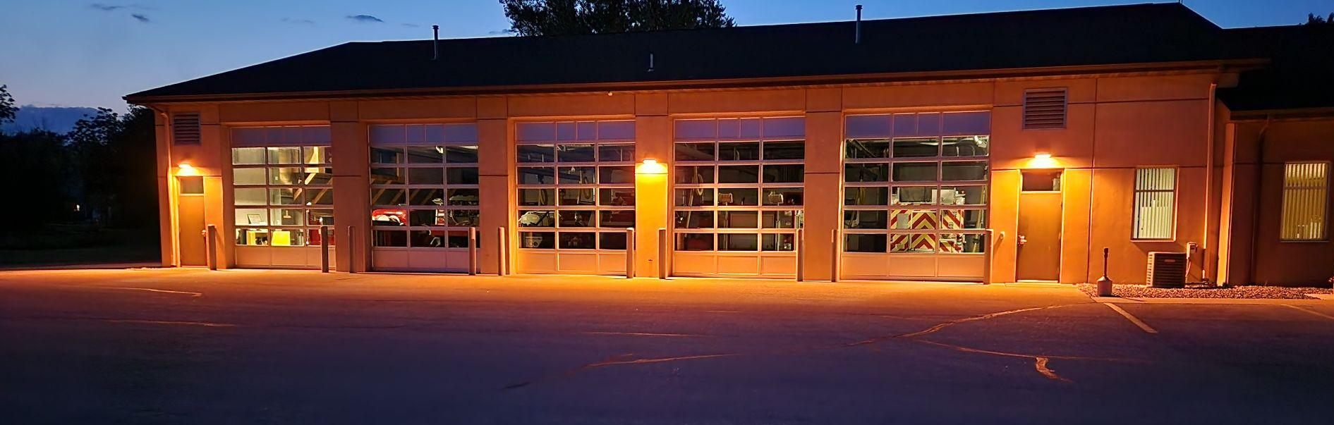
Warm in Color

Slide 36
Why Focus on Color (CCT) ?
Higher CCT = more scatter = more skyglow and glare
Species are sensitive to light CCT in different ways
Higher CCT = more blue spectrum which impacts sleep
Notes:
Changing CCT doesn’t reduce visibility
Blue light scatters more in the atmosphere
Color is one of the easiest changes

Slide 37
Light Pollution Increases With CCT
2200°K
2700°K
3000°K
4000°K
5000°K
Notes:
Higher CCT increases skyglow even at the same brightness
Color matters independently from lumens

Slide 38
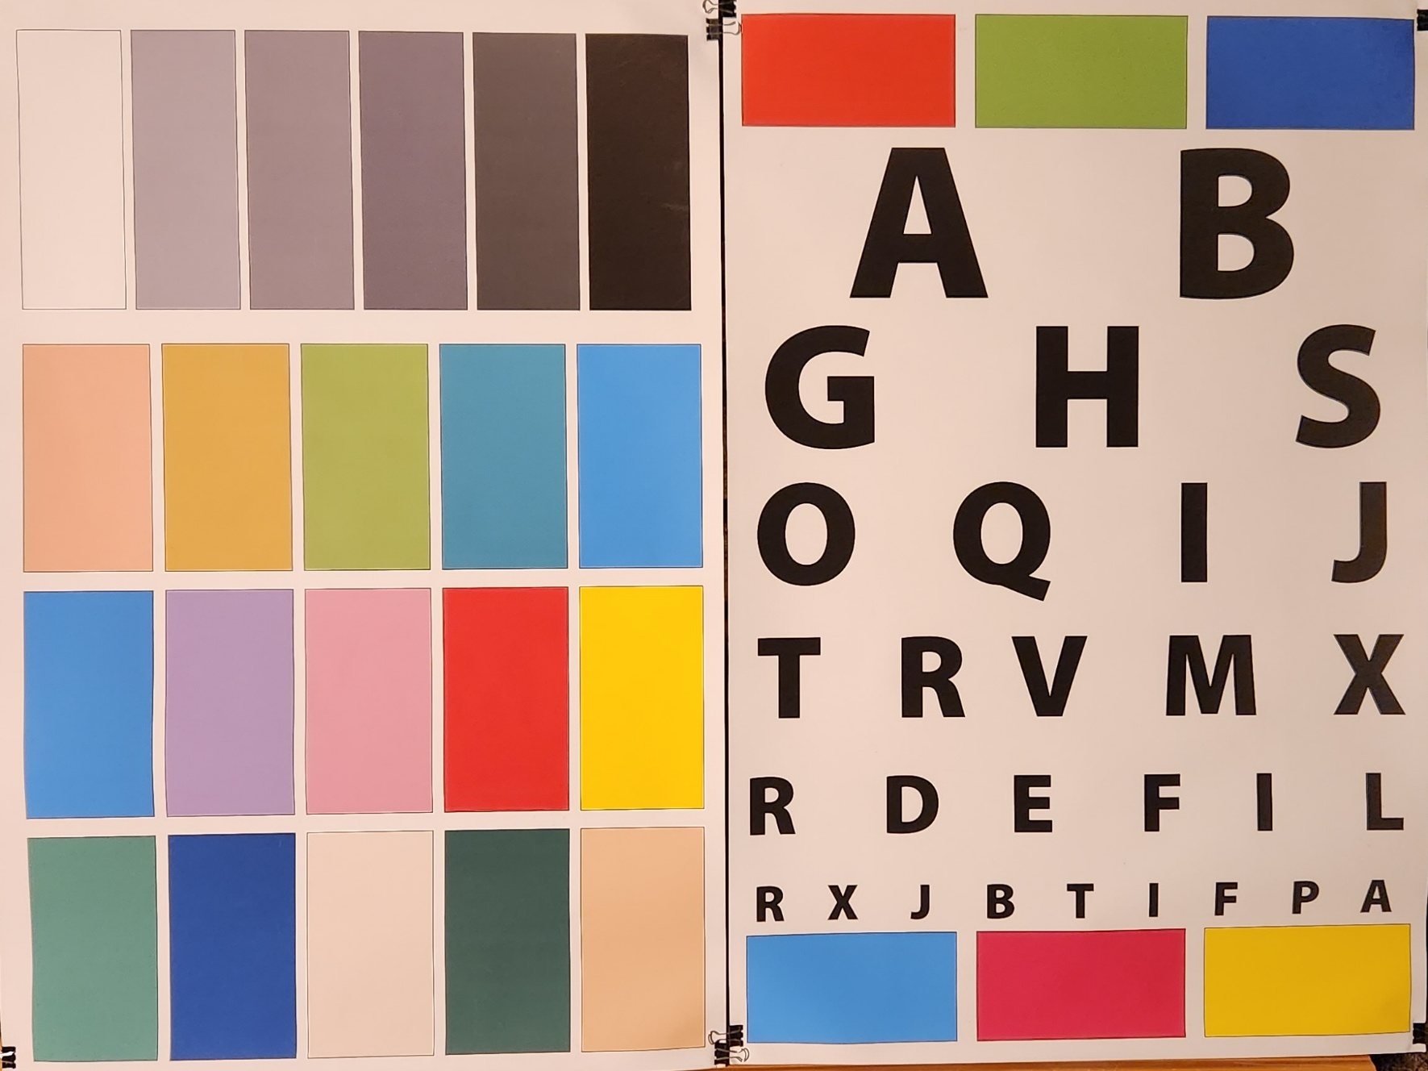
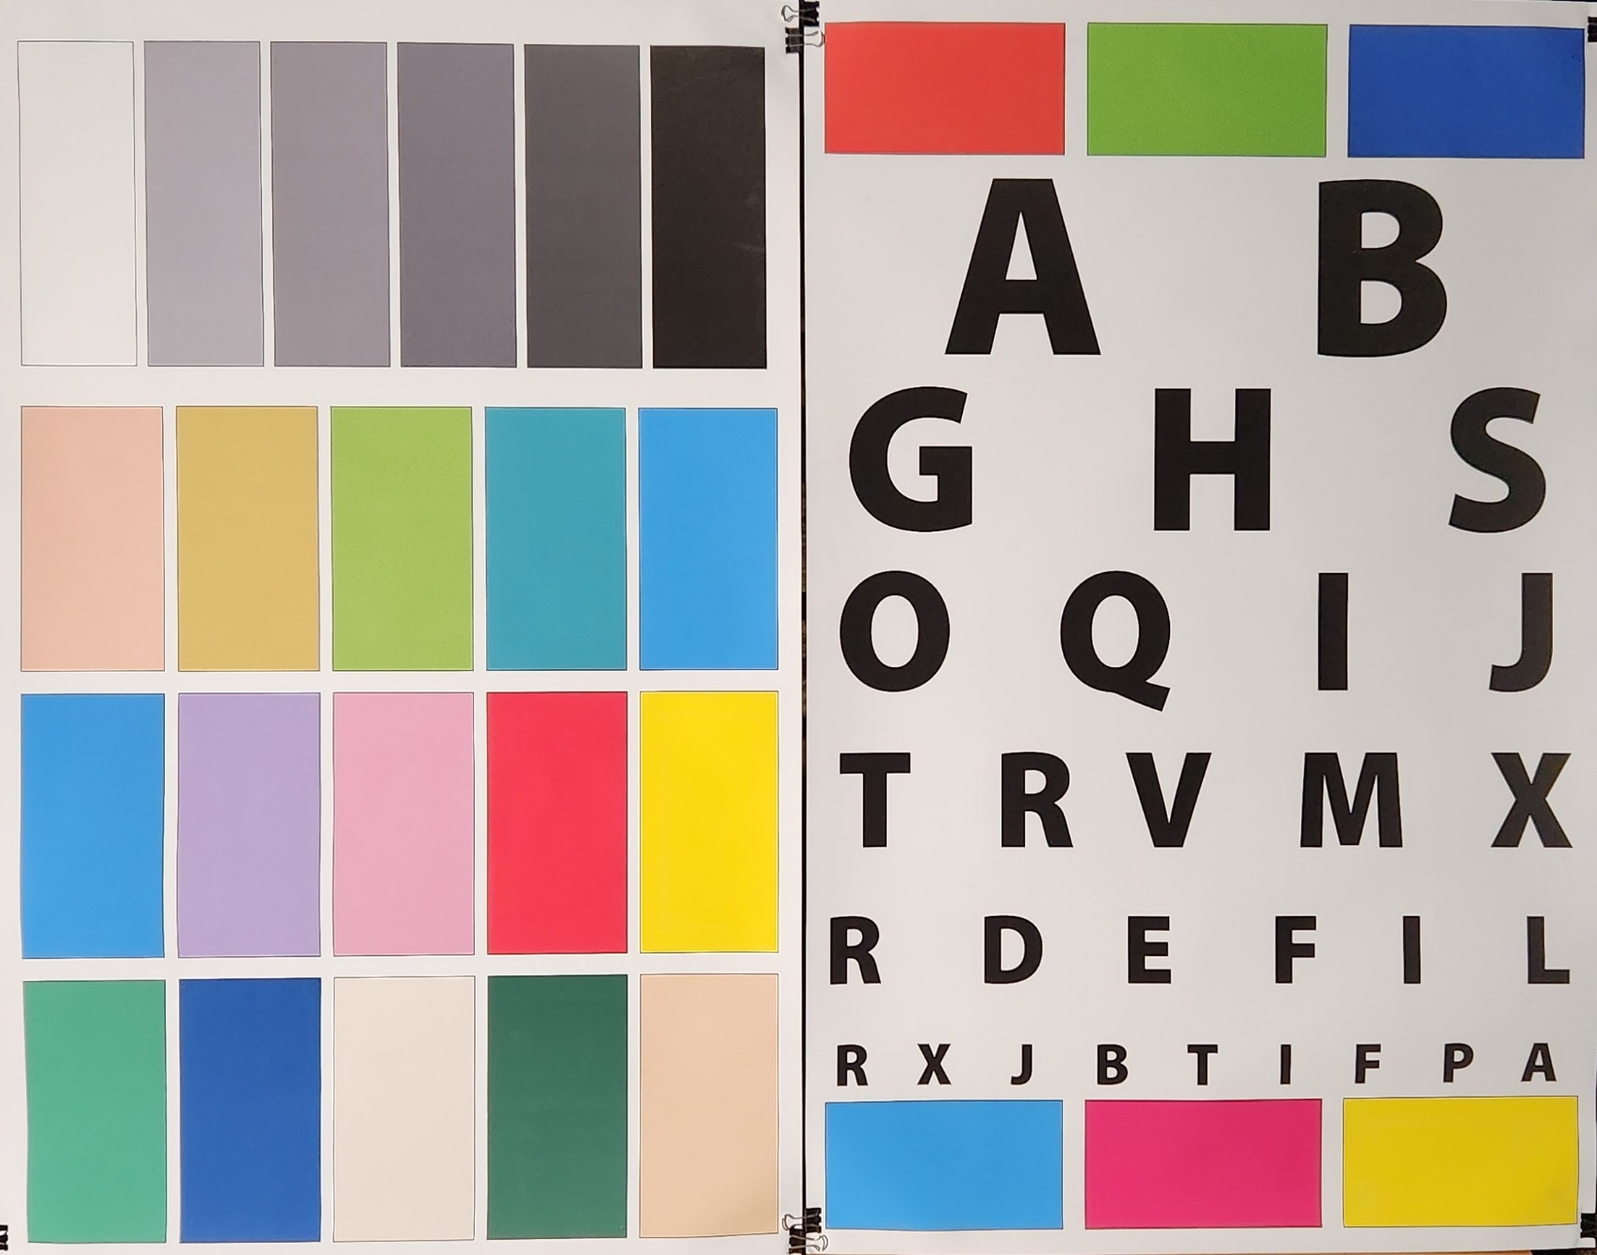
CCT, Light Pollution and Color Appearance
2200K LED
4000K LED 78% more skyglow

Slide 39
Principles of Responsible Lighting
Zero uplight fixtures
2700K or lower (2200K or 1800K are much better)
Motion sensor controlled / Off when not needed
Lower intensity and dimmable
Notes:
These principles work together
Controls matter as much as fixtures
Turning lights off is a valid solution

Slide 40

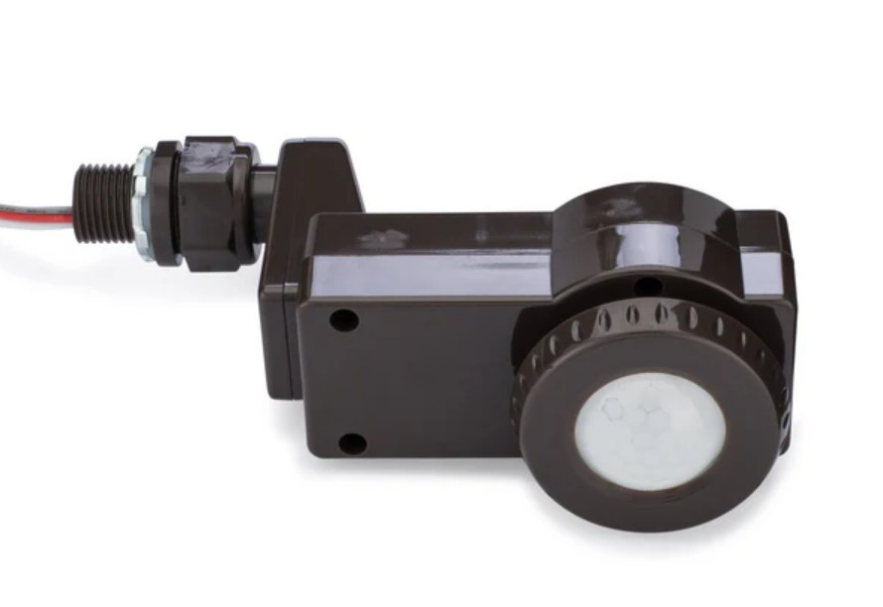
Controlled
Motion Sensors
Timers

Slide 41
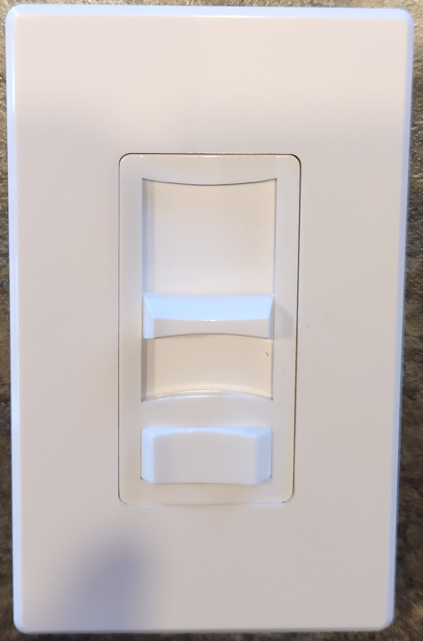
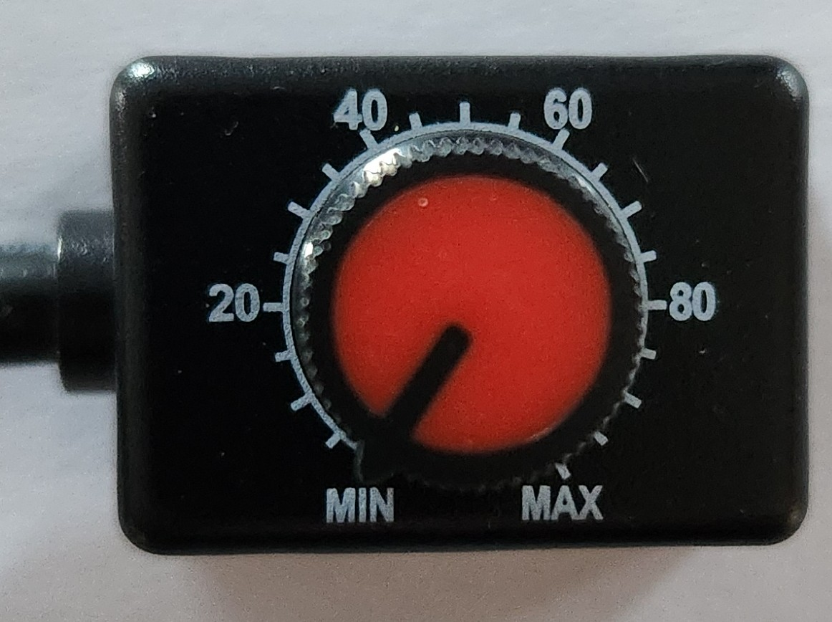
Dimmed

Slide 42
Simple Actions at Home
Use zero uplight fixtures
Choose lower Kelvin CCT light
Use motion sensors or timers to turn off lights
Avoid decorative and landscape lighting, except for special occasions and short timeframes
Close blinds at night
Notes:
Most solutions require no major investment
Decorative lighting is optional, not required
Encourage starting with one change
Emphasize affordability and ease—no major renovations required.

Slide 43
What Communities Can Do
Lead by example with public lighting
Adopt thoughtful outdoor lighting standards
Educate residents and businesses

Slide 44
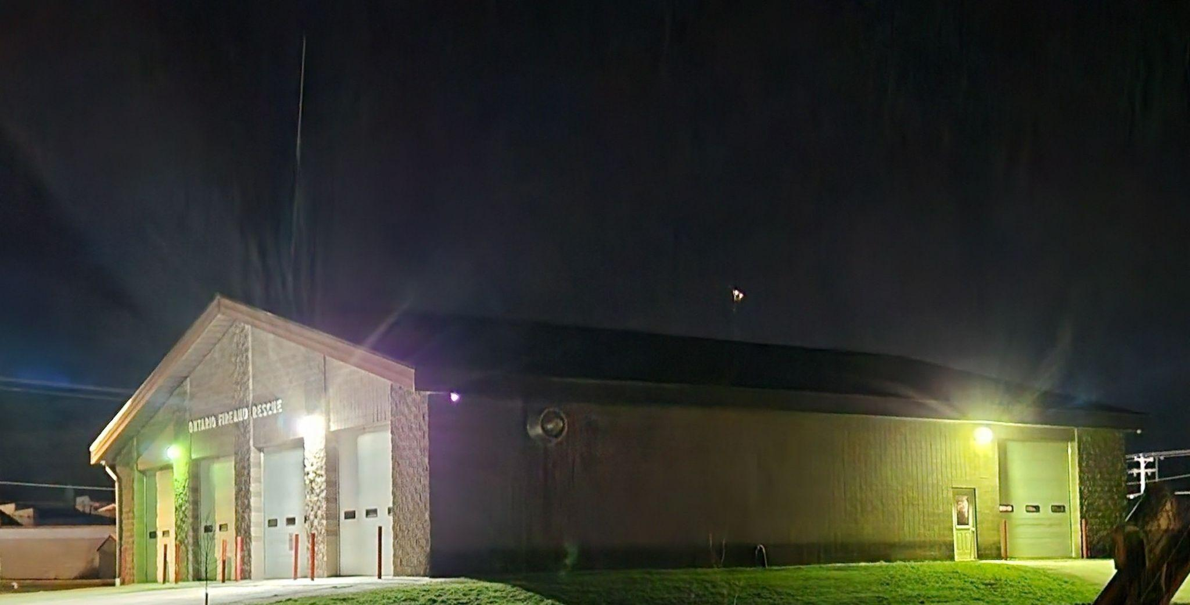
In Practice - Before

Slide 45
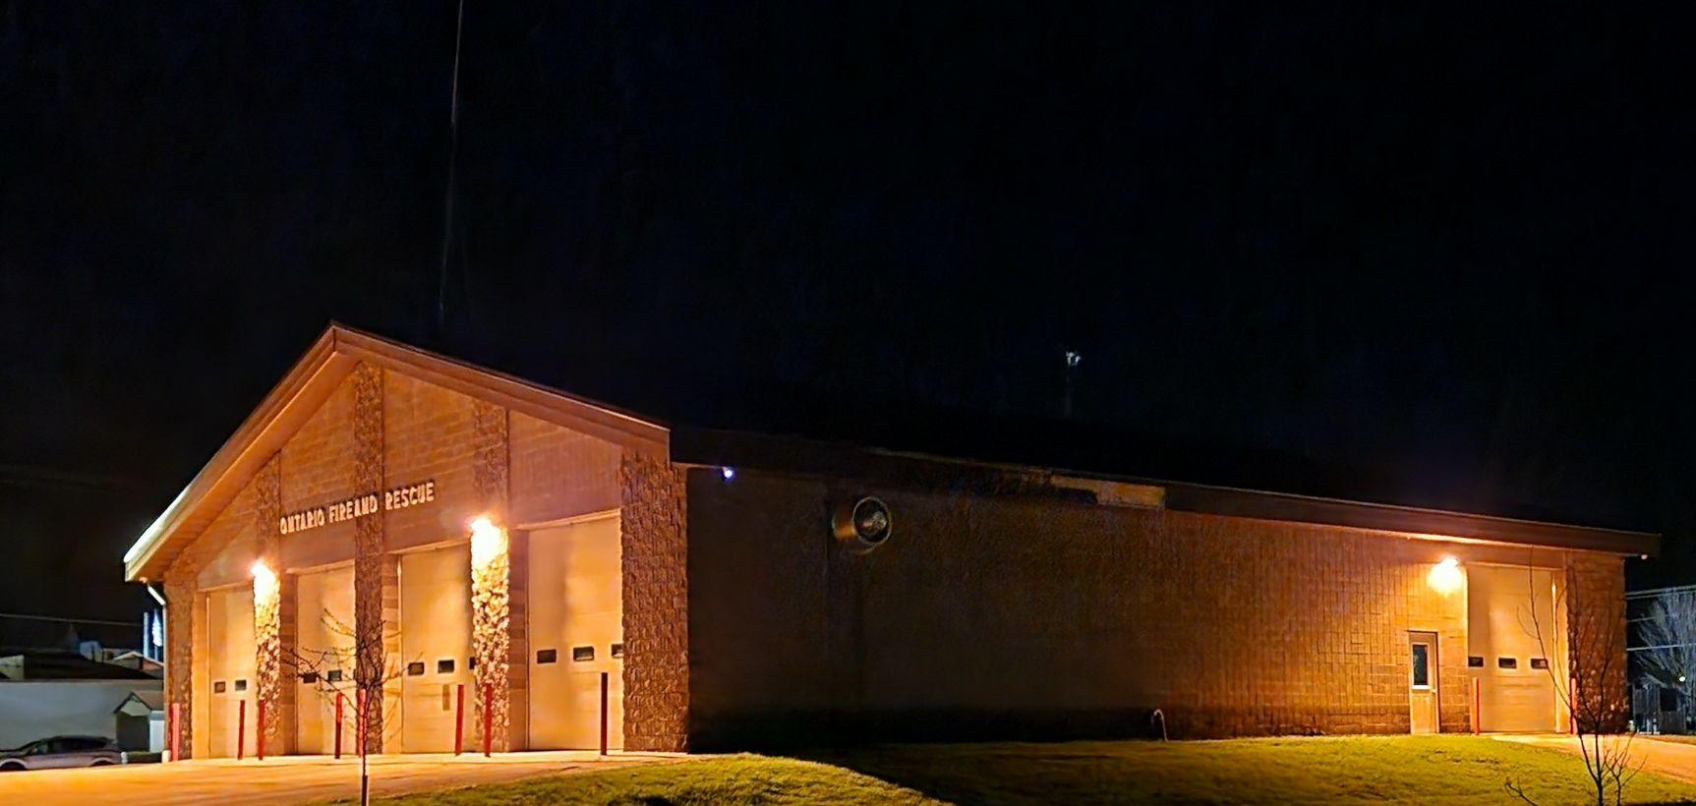
In Practice - After
Reduced energy use by 75% and skyglow by 90%

Slide 46
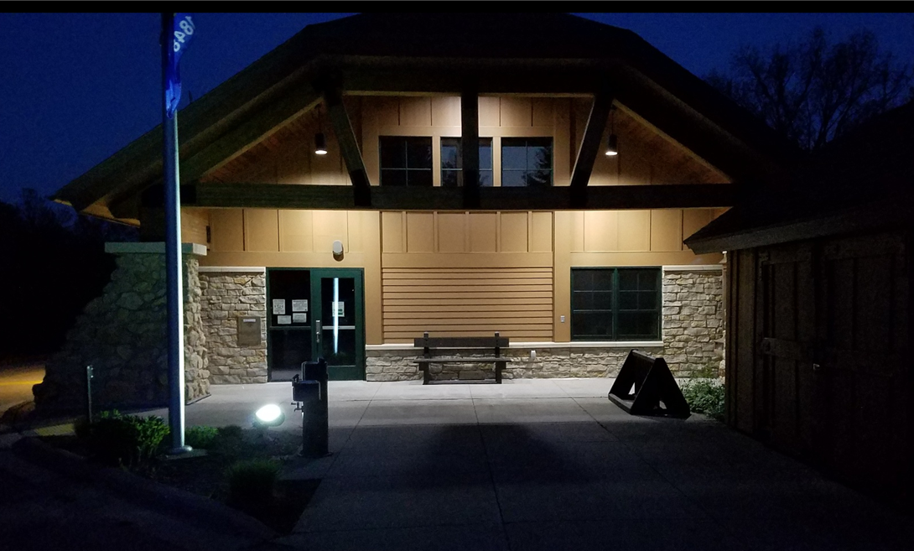
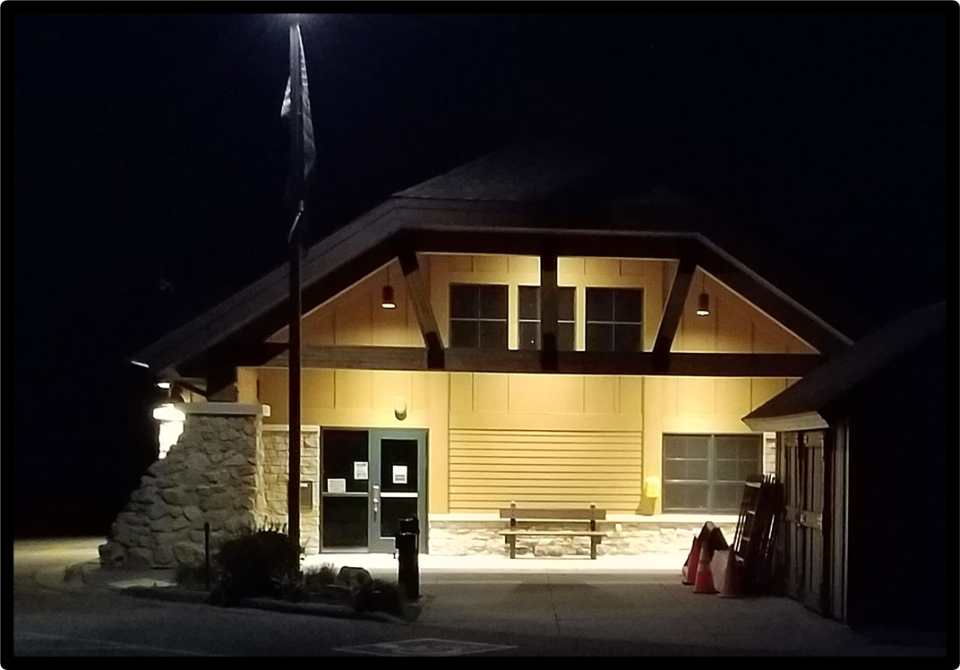
Interim Changes at Wildcat Mountain
5000K to 2700K - less skyglow - and top lit flag

Slide 47
Benefits Beyond Darkness
Energy savings
Lower utility costs
Reduced carbon emissions
Better nighttime visibility
Healthier ecosystems

Slide 48
How You Can Get Involved
Make small changes at home
Talk with neighbors and community leaders
Initiate local dark-sky efforts
Share what you’ve learned

Slide 49
Darkness is not lost forever
With simple, thoughtful choices, we can restore the night -
for ourselves and all other species

Slide 50
Thank you!
Questions?

Slide 51



Slide 52
