Slide 1
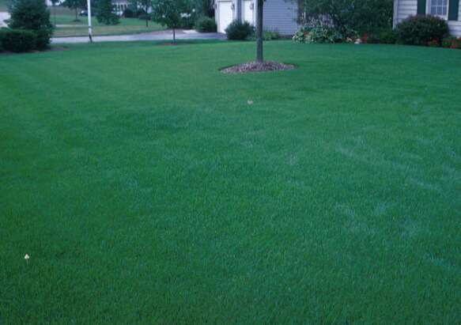
Wisconsin Lawn Care Calendar
hort.extension.wisc.edu
Bruce Spangenberg, Statewide Horticulture Outreach Specialist
UW-Madison Division of Extension Horticulture Program

Slide 2
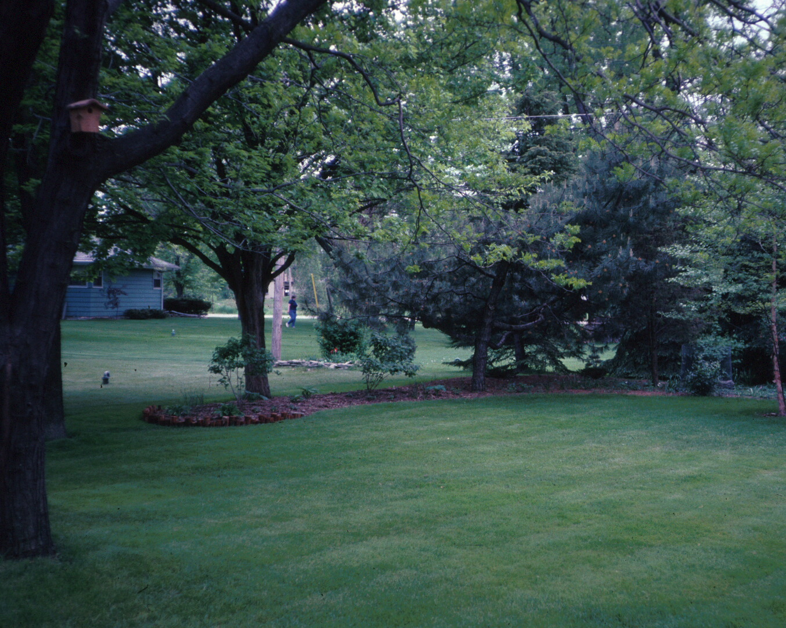
Wisconsin Lawn Care Calendar
Cool-season Grasses
Accurate Timing Based on Needs
Minimal Use of Chemicals
Bruce Spangenberg, Statewide Horticulture Outreach Specialist
UW-Madison Division of Extension Horticulture Program

Slide 3
Lawn Scheduling Considerations
Not all practices discussed here are suggested to be done on any one lawn in a single season
Conflict when managing overseeded established turf:
herbicide use, fertilizer use, watering schedule
Weather may alter scheduled plans:
drought, prolonged rainfall, unusual temperatures
Wisconsin Lawn Care Calendar

Slide 4
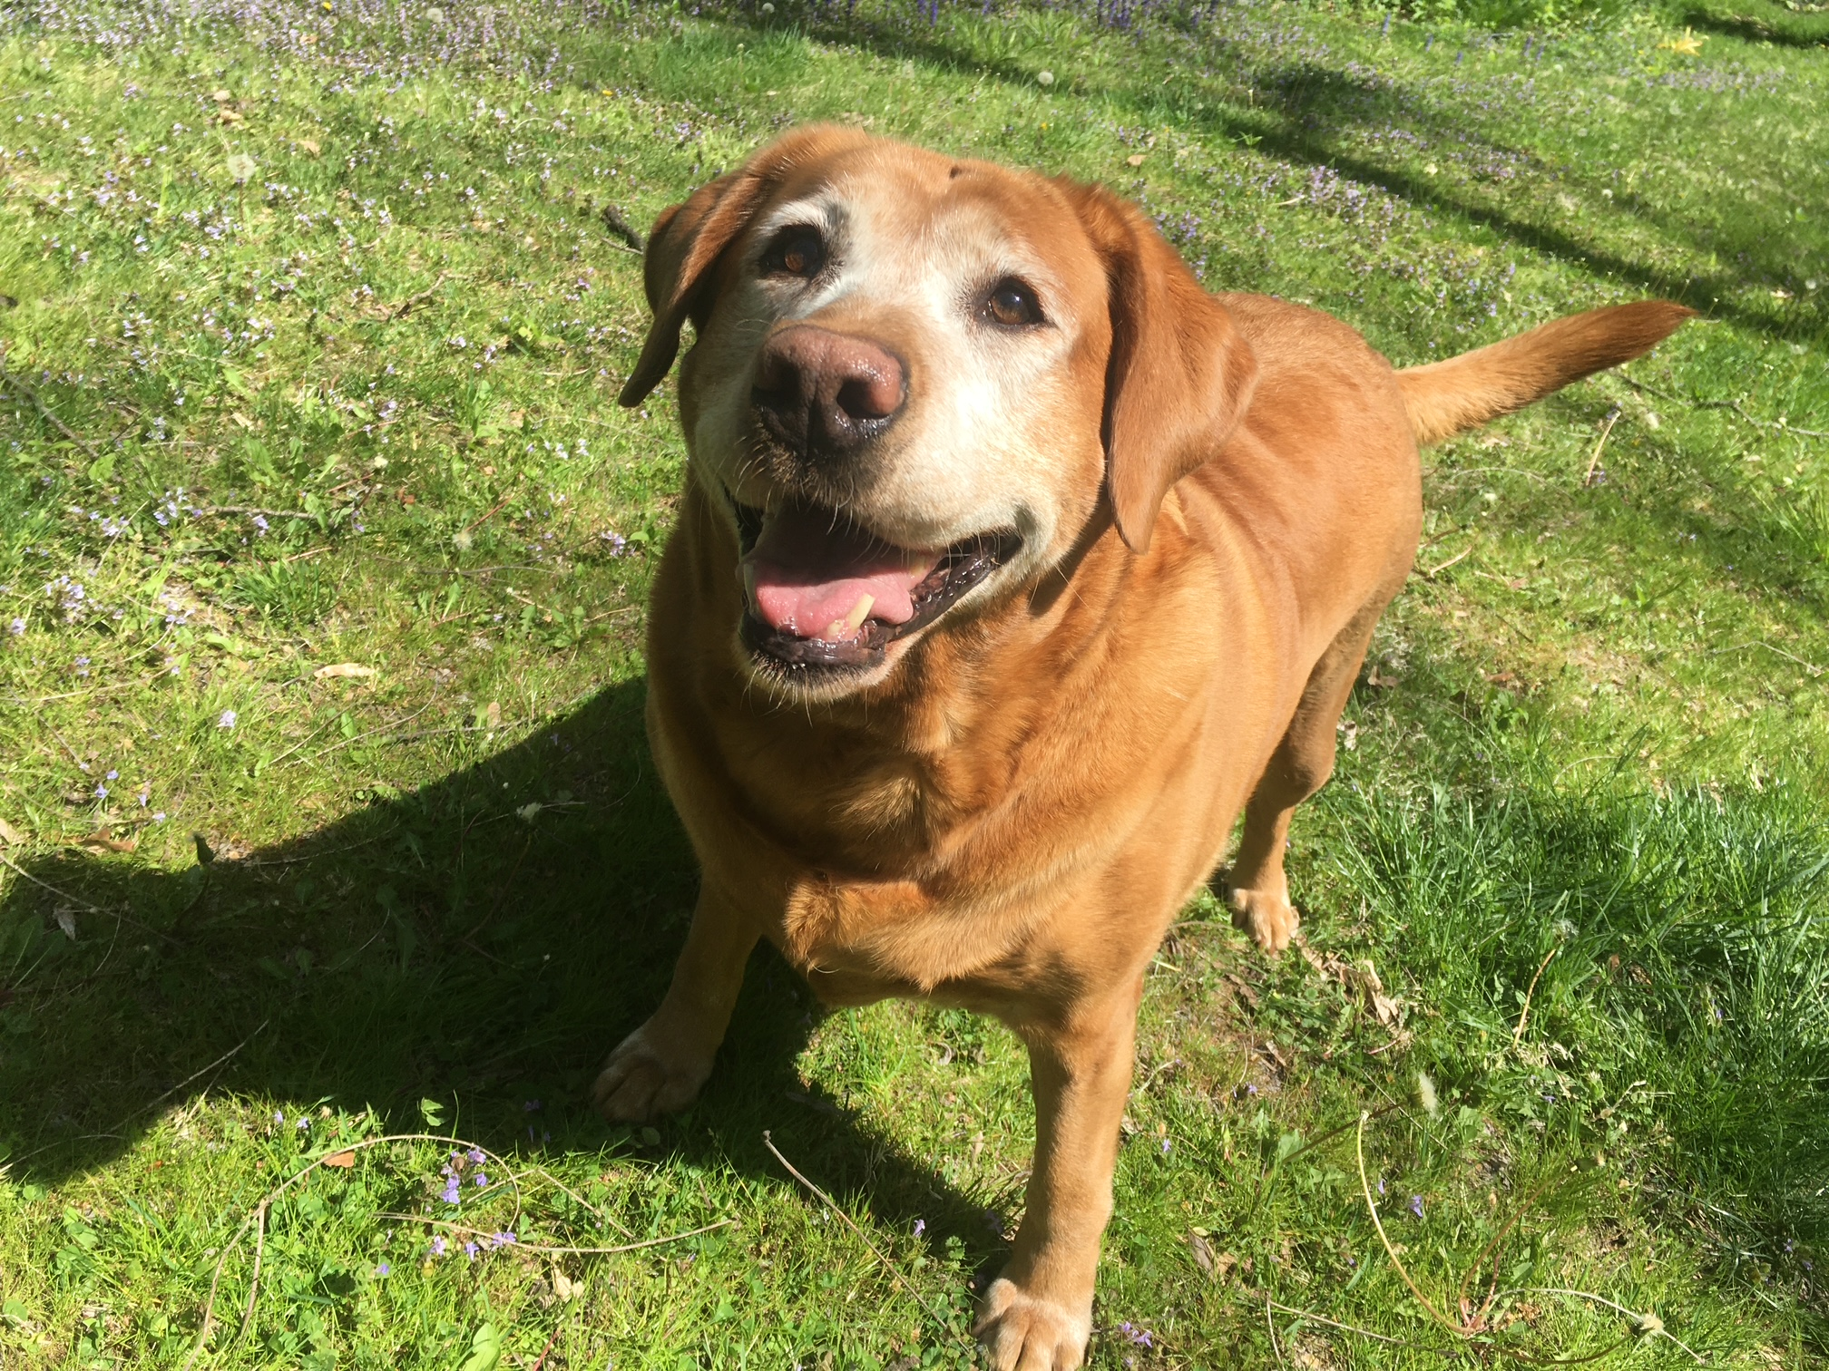
Spring
Important Time for
Development of Grasses:
Set Stage for Season
Wait for Lawn to Resume Growth
e
t

Slide 5
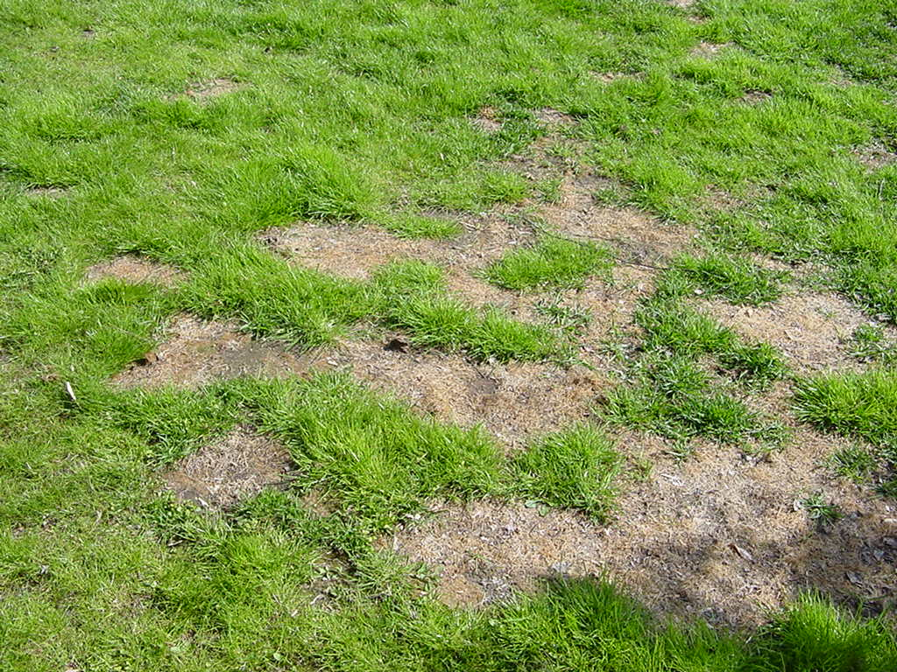
Lawn Care Calendar
SPRING (April/May)
Clean up Debris
Mowing
Crabgrass Control
Fertilization
Core Aerating
Establishment
Overseeding
Broadleaf Weed Control
Wisconsin Lawn Care Calendar

Slide 6
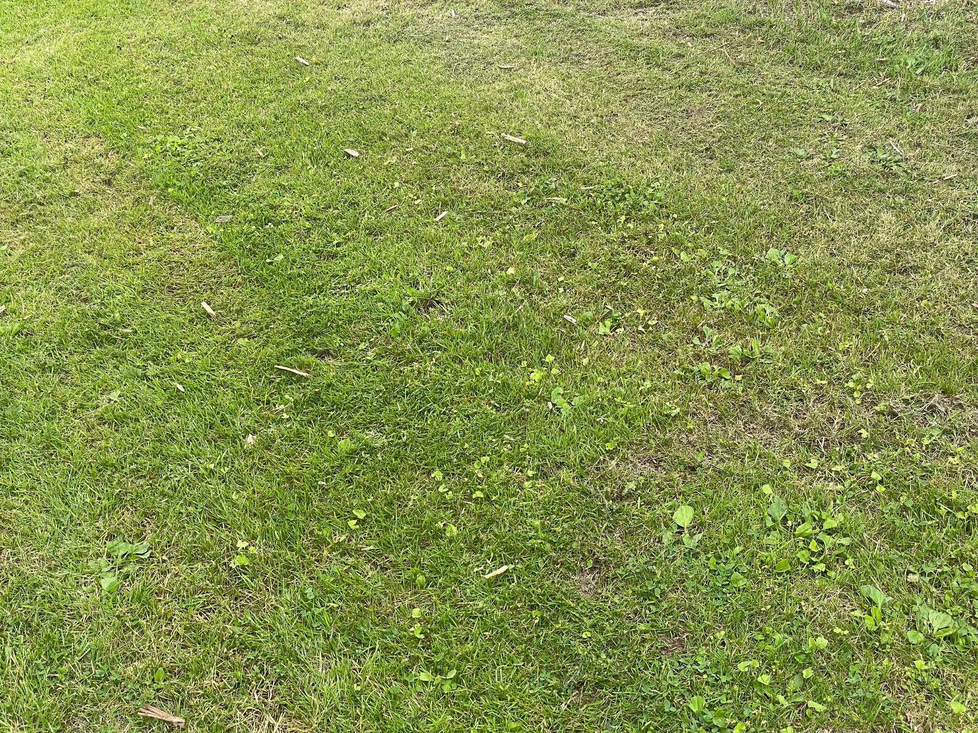
Thin & stressed lawn due to short mowing height
Increased weeds & problems likely
Easily corrected -major positive impact
Wisconsin Lawn Care Calendar

Slide 7
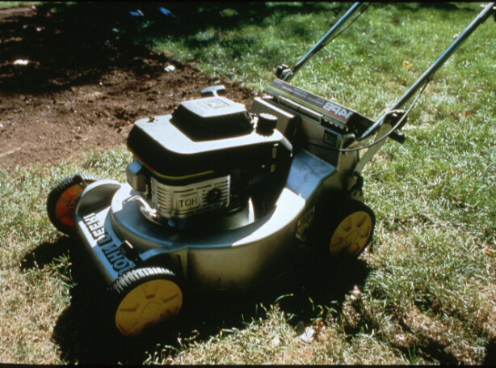
Lawn Mowing Guidelines
Mow based on grass growth rate;
Follow Rule of One-third
Mow as high as site factors allow;
3-inch range for most lawns
Return clippings
Recycles nitrogen = fertilize less
Wisconsin Lawn Care Calendar

Slide 8
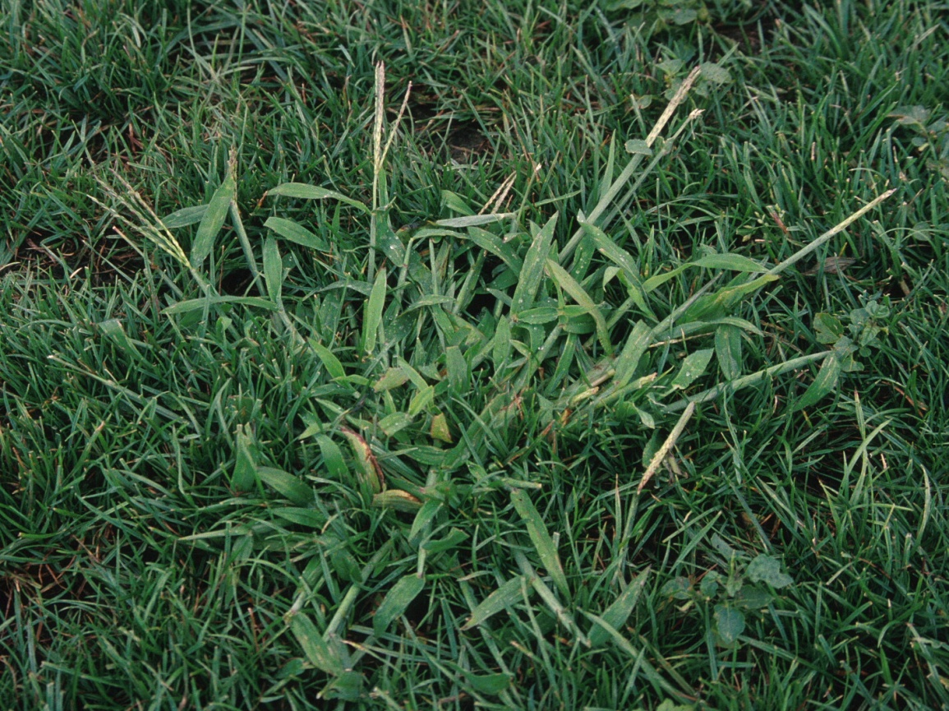
Crabgrass in Lawns
Warm-season annual
Prefers full sun, open or
thin lawns, moisture
Germinates as soil temperatures reach 60 degrees for several consecutive days
Wisconsin Lawn Care Calendar

Slide 9
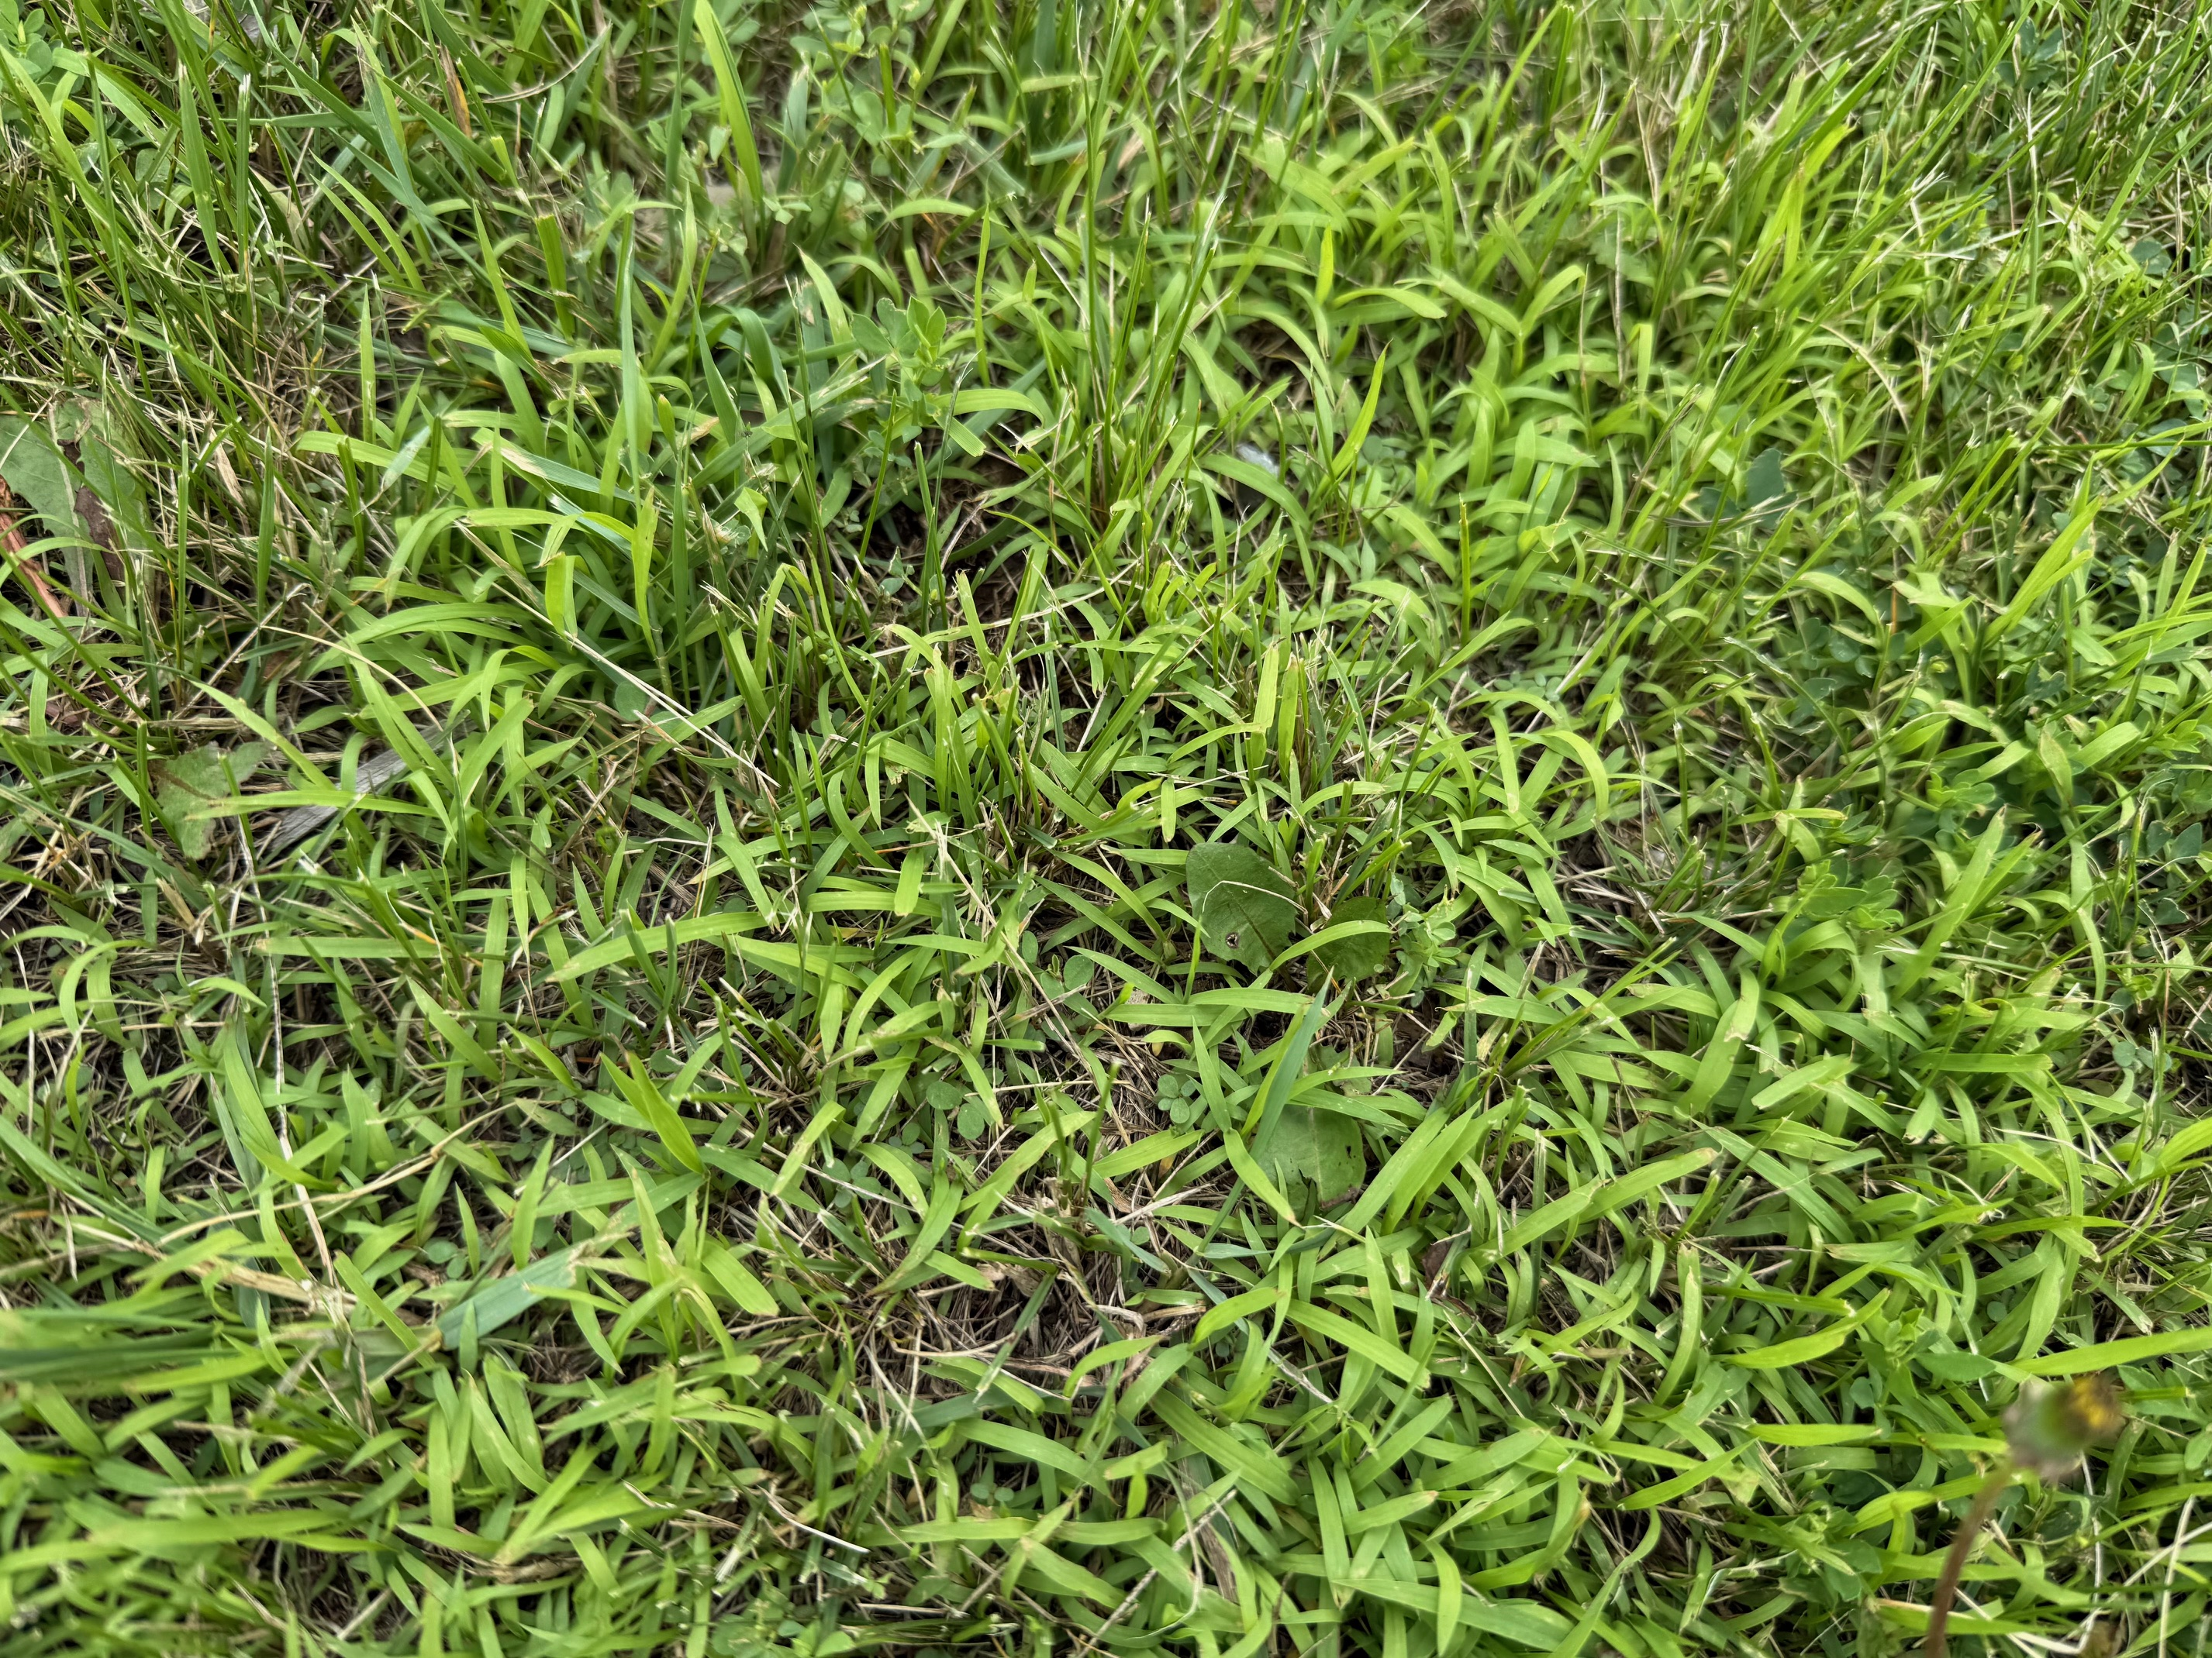
Crabgrass invasion
in thin lawn due
to excessively
short mowing
Wisconsin Lawn Care Calendar

Slide 10
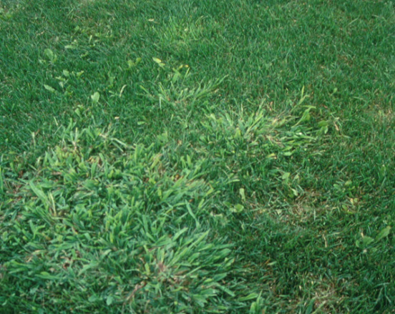
Crabgrass Management
Mow lawn higher
Avoid cultivation in summer
Sound irrigation & fertilization
Preemergence herbicides
(combined with fertilizer)
(Forsythia bloom)
Postemergence herbicides
Wisconsin Lawn Care Calendar

Slide 11
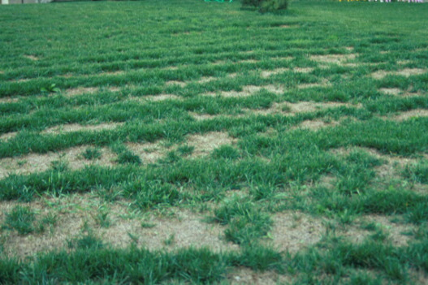
Spring Lawn Fertilization
Wisconsin Lawn Care Calendar

Slide 12
Lawn Fertilizer Program Components
Type of Nitrogen to Use
  fast or controlled release
  organic or synthetic
Rate of Fertilizer– How Much to Apply
  can often be reduced (clippings recycle nitrogen)
  shade lawns need less nitrogen than full sun lawns
Timing of Application– When to Apply
  match to grass growth cycles; spring & early fall key times
Wisconsin Lawn Care Calendar

Slide 13
Nitrogen Fertilizers for Lawns
Fast-release
urea
ammonium nitrate
ammonium sulfate
Controlled-release (slow release, slowly available)
ureaform
sulfur-coated & polymer-coated urea
IBDU (isobutylidene diurea)
activated sewage sludge (Milorganite)
most organic fertilizers
water insoluble nitrogen (WIN)
Wisconsin Lawn Care Calendar

Slide 14
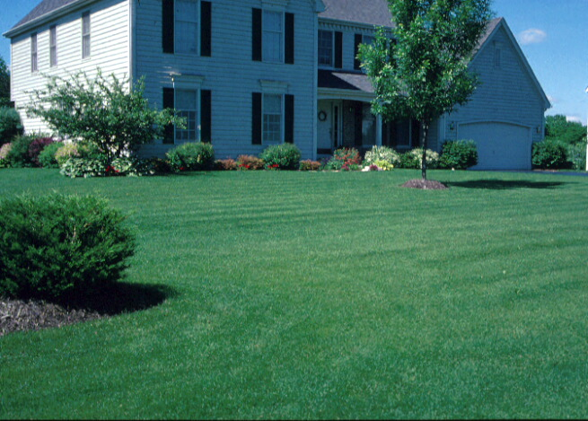
Spring Lawn Fertilization Guidelines
Wait Until 2nd Mowing
Use controlled-release nitrogen fertilizers
Apply about 1 pound of nitrogen per 1,000 square feet of lawn area
Wisconsin Lawn Care Calendar

Slide 15
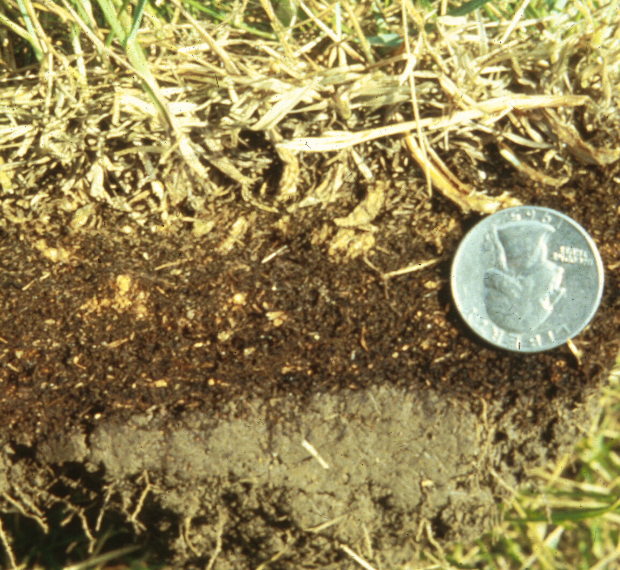
Thatch Problems in Lawns
Most common causes:
Poor soil conditions
(clay, compaction)
Overwatering
Overfertilizing
Sodded lawns with soil issues
Management should correct cause of thatch
Wisconsin Lawn Care Calendar

Slide 16
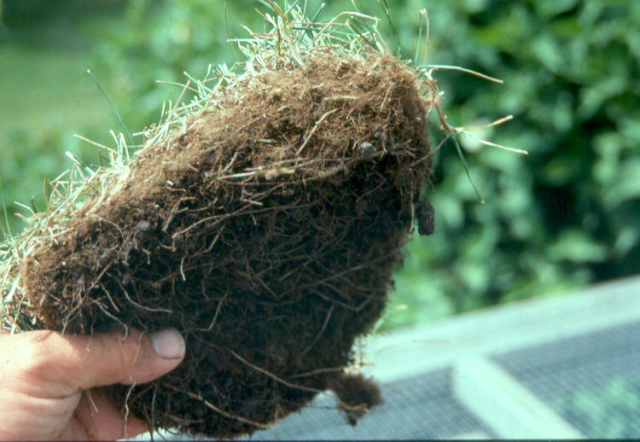
Excessive thatch
Sodded lawn
Heavy clay soil
Overwatered
Overfertilized
Wisconsin Lawn Care Calendar

Slide 17
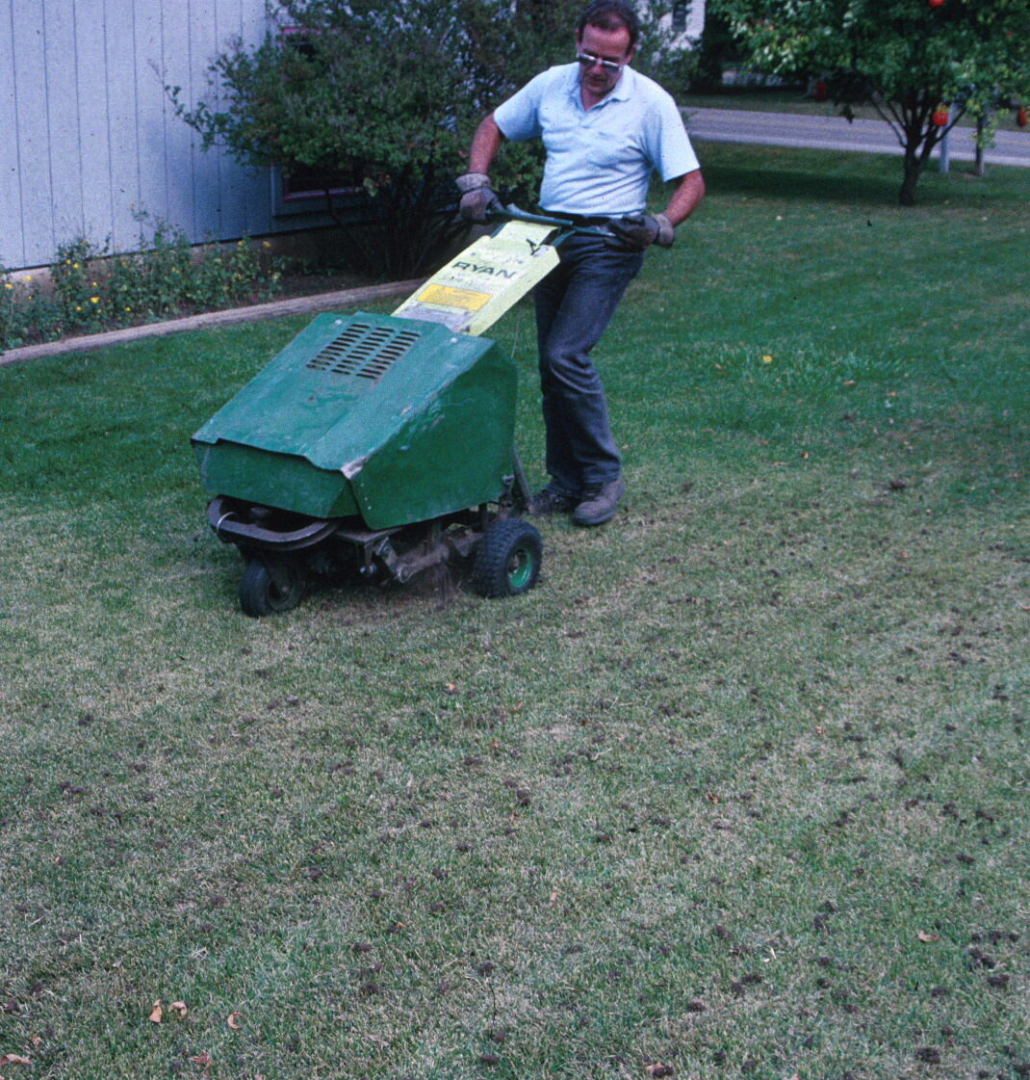
Core Aerating Lawns
Correct soil issues
Reduce thatch
Spring & Fall Good Times
  adequate soil moisture
  actively growing turf
Soil building/improvement for long-term success
Wisconsin Lawn Care Calendar

Slide 18
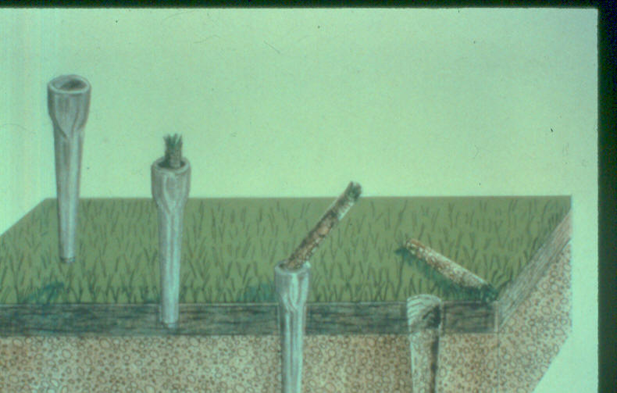
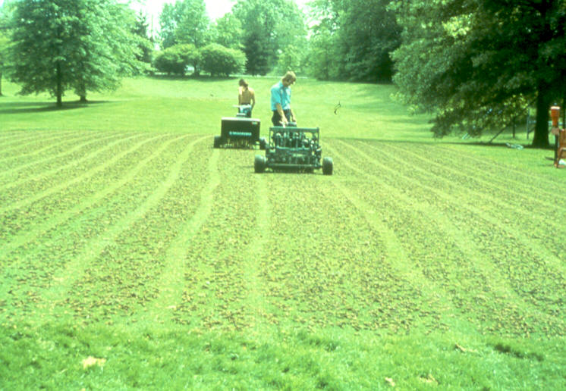
Core Aerating Process
Wisconsin Lawn Care Calendar

Slide 19
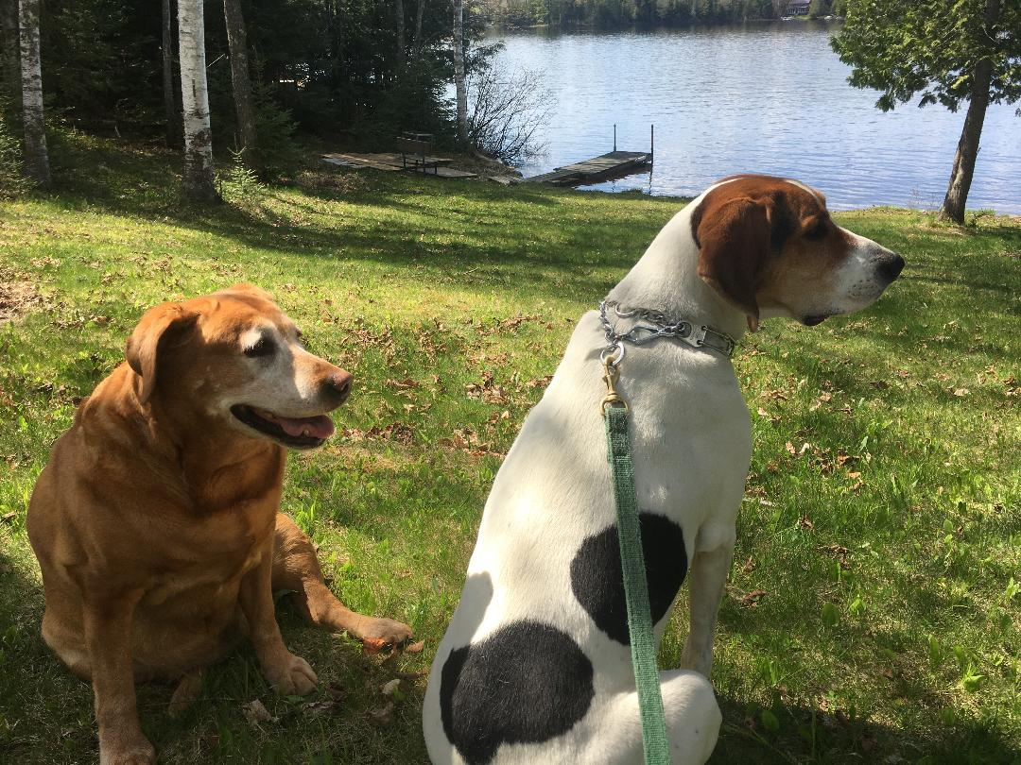
Summer
Grass Growth Naturally Slows
Avoid Most Cultural Practices
Late Summer - Prepare for Early Fall Cultural Practices
use
Drought or prolonged rainfall
Unusual temperature extremes

Slide 20
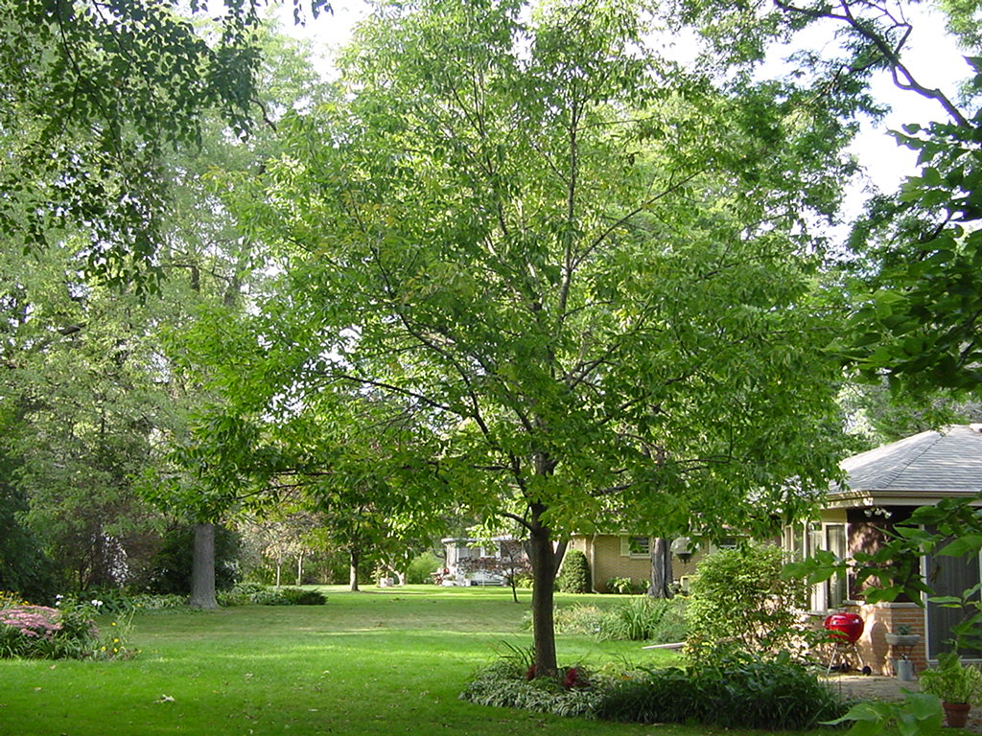
Lawn Care Calendar
SUMMER (June - early August)
Irrigation
Mowing
Scout for insects or diseases
Broadleaf Weed Control?
Fertilization?
Wisconsin Lawn Care Calendar

Slide 21
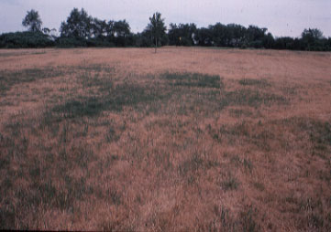
Lawn Watering Guidelines
Water to depth of root system
Water early in day
“Foot printing”
Duller, darker color to grass
Don’t bounce back & forth between dormancy & green
Decide to water or not
Wisconsin Lawn Care Calendar

Slide 22
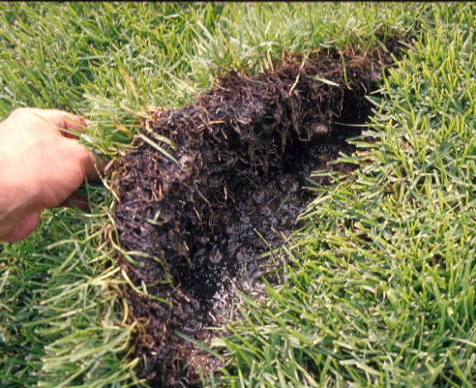
Sodded lawn with
saturated root zone
due to overwatering
Wisconsin Lawn Care Calendar

Slide 23
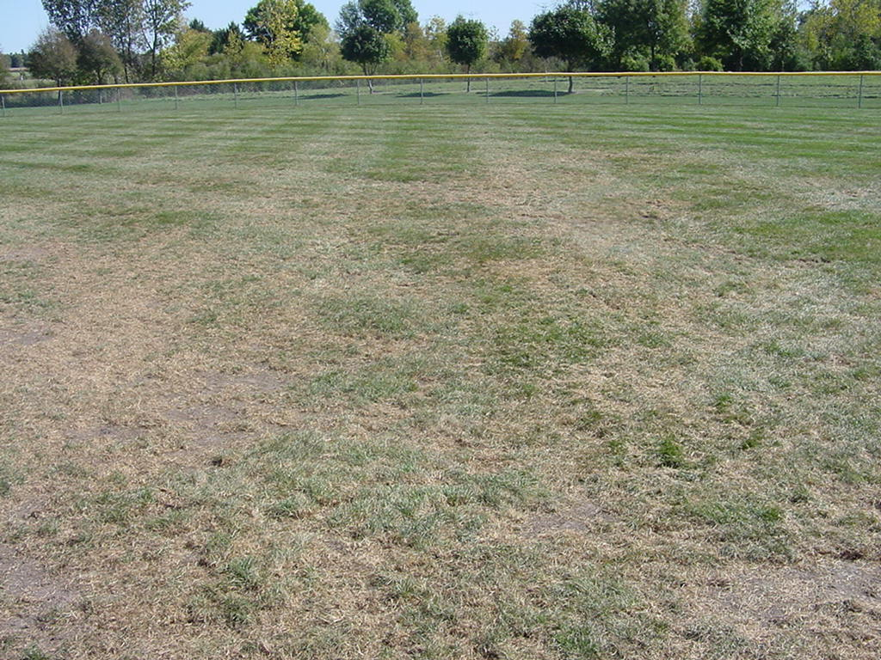
Scouting for White Grubs
Full sun
Moist soil
Wisconsin Lawn Care Calendar

Slide 24
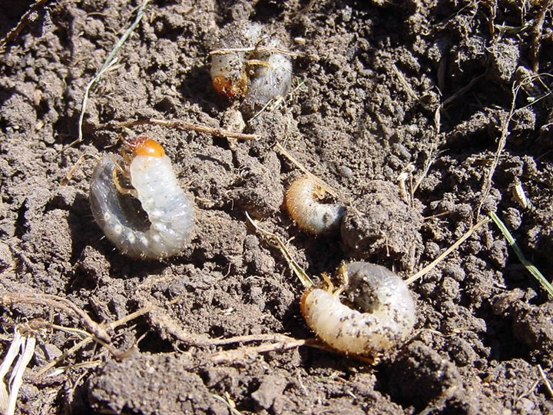
White Grubs in Lawns
Check root zone for grubs
Brown/Green grass
Assess grub population
Consider time of year
Consider insecticide characteristics
Read product labels
Monitor results
Wisconsin Lawn Care Calendar

Slide 25
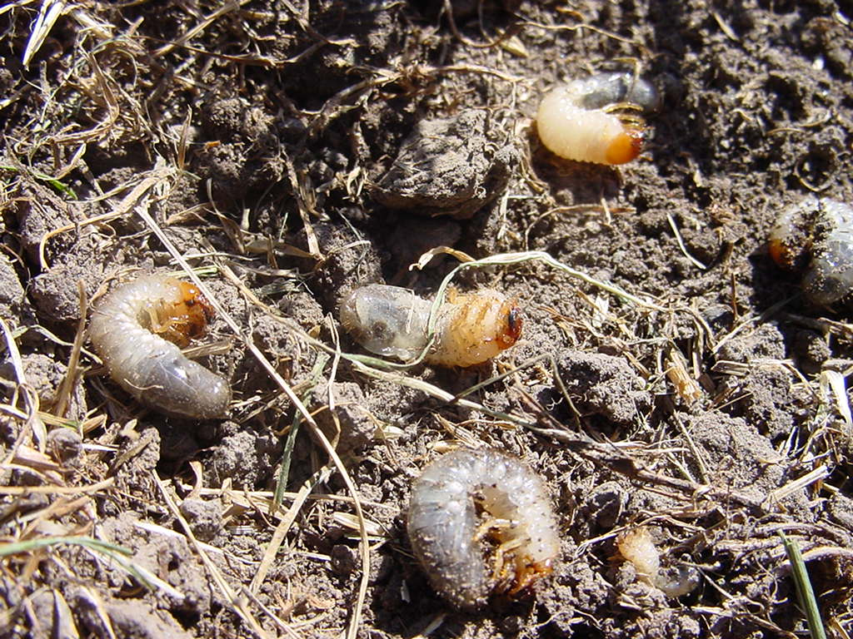
Selected White Grub Insecticides
Synthetic
Trichlorfon (Dylox)
Organic/Biological
Heterorhabditis bacteriophora (Hb)
parasitic nematodes
Bacillus thuringiensis (BT) galleriae (GrubGone)
Wisconsin Lawn Care Calendar

Slide 26
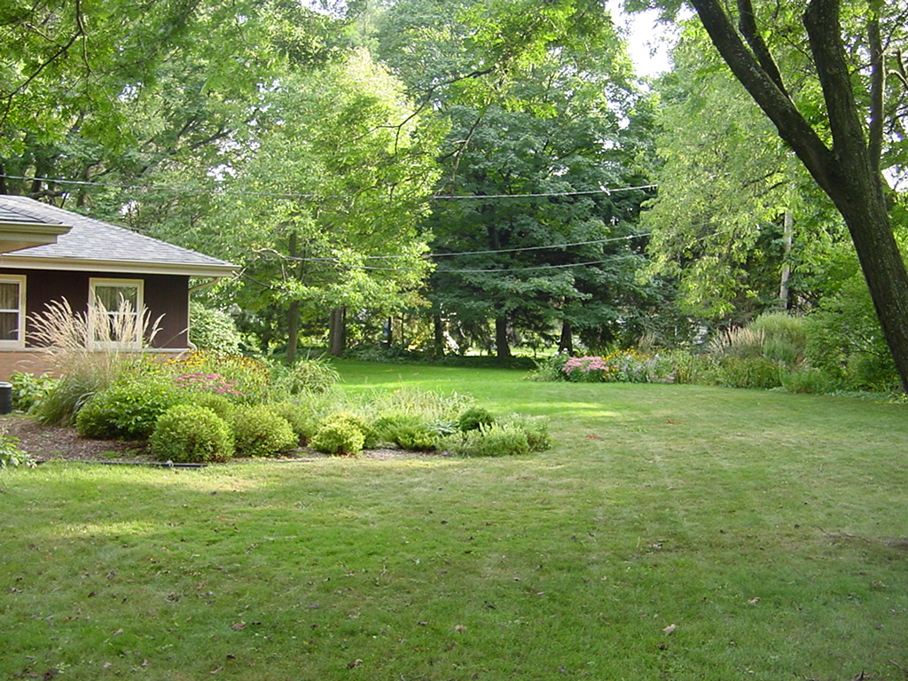
Lawn Care Calendar
LATE SUMMER (2nd half August)
Perennial Grass Weed Control
Prep for Renovation &
Establishing New Lawns
Irrigation
White Grub Control (if needed)
Wisconsin Lawn Care Calendar

Slide 27
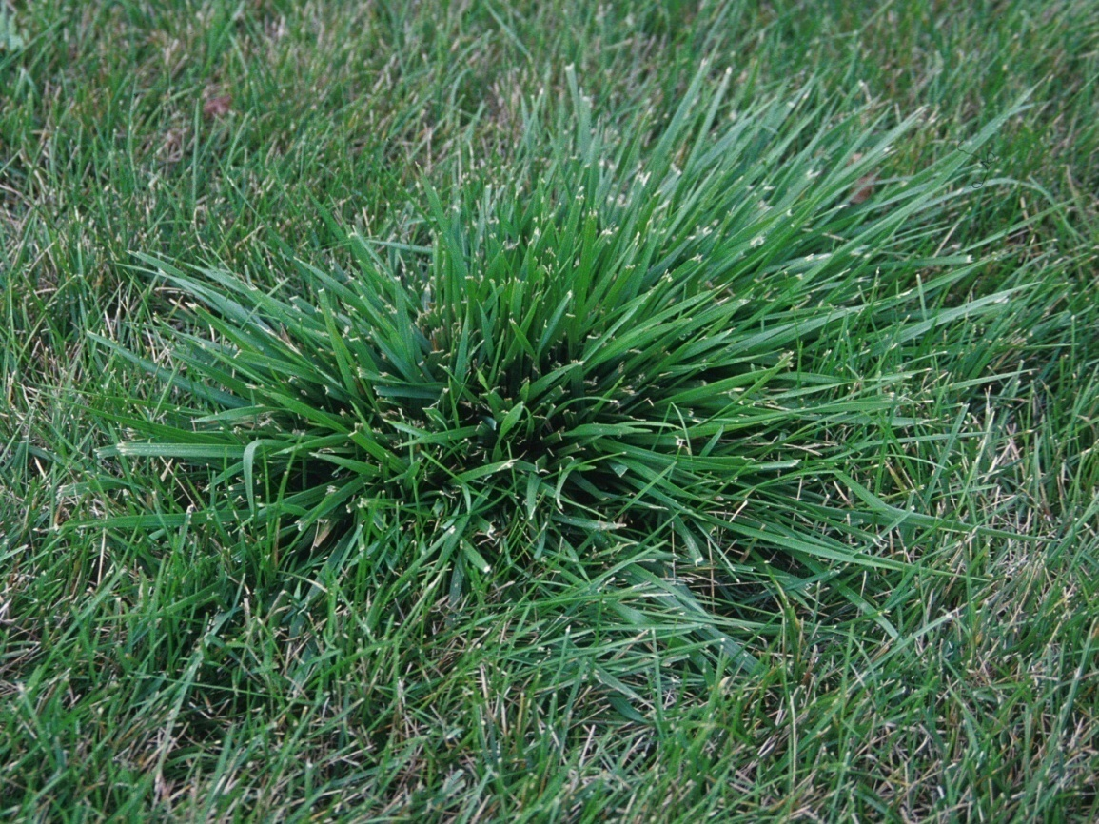
Perennial Weed Grass -Tall Fescue
Cool-season perennial
Very coarse leaf blade
Often grows higher than surrounding turf
Drought tolerant
Bunch type growth
Present all season
(versus crabgrass)
Wisconsin Lawn Care Calendar

Slide 28
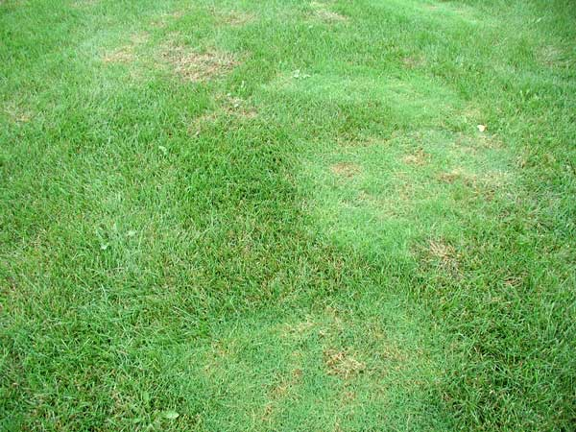
Perennial Weed Grass-Creeping Bentgrass
Cool-season perennial
Shallow rooted- easily
uprooted by rotary
mowers
Spreads via stolons
Prefers higher nitrogen and moist soils
Wisconsin Lawn Care Calendar

Slide 29
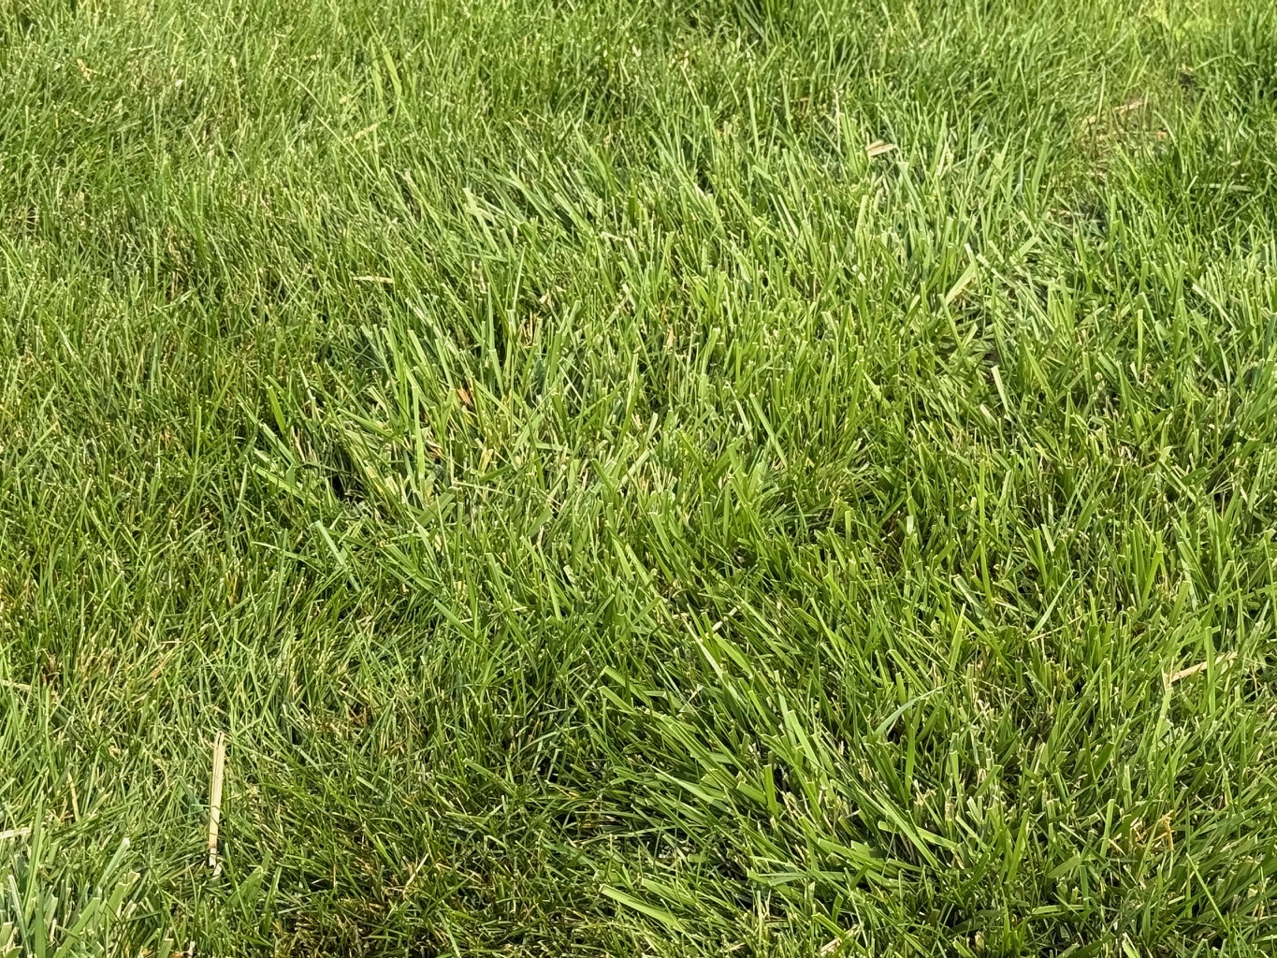
Perennial Grass Weed Management
Hand-pull or dig out
Limited herbicide options; primarily nonselective herbicides
Late summer ideal timing
Reseed areas afterwards
Wisconsin Lawn Care Calendar

Slide 30
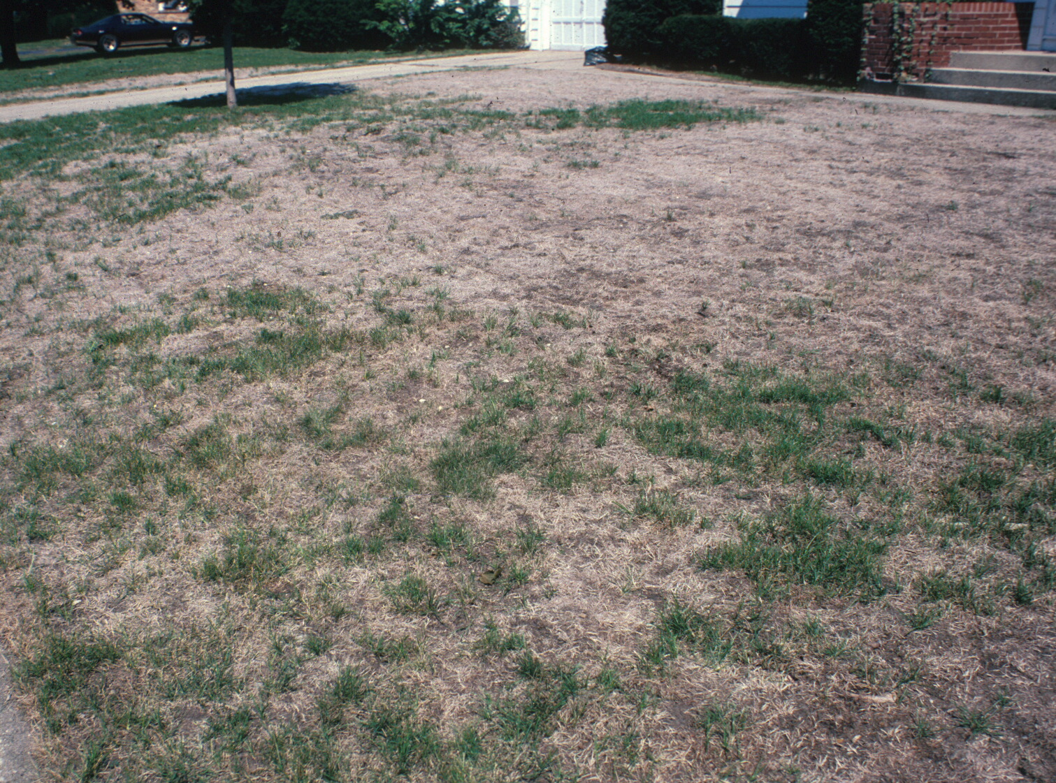
Assessing Lawns Prior to Renovation
Lawn Grasses Present
Overseeding
Remove existing vegetation
Underlying Soil Conditions
Open surface for overseeding
Core aerate
Tillage & amendments
Wisconsin Lawn Care Calendar

Slide 31
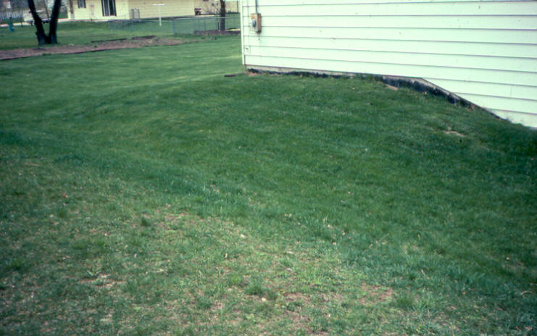
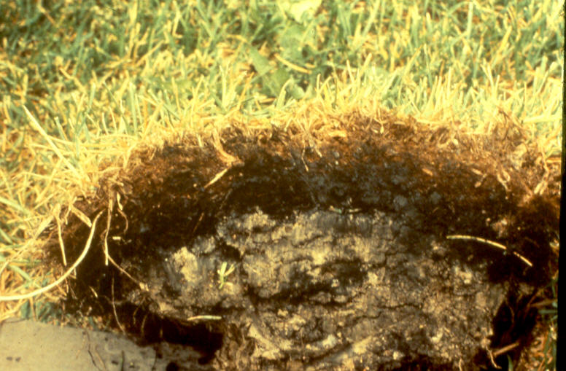
Underlying Soil & Interface Issues
Wisconsin Lawn Care Calendar

Slide 32
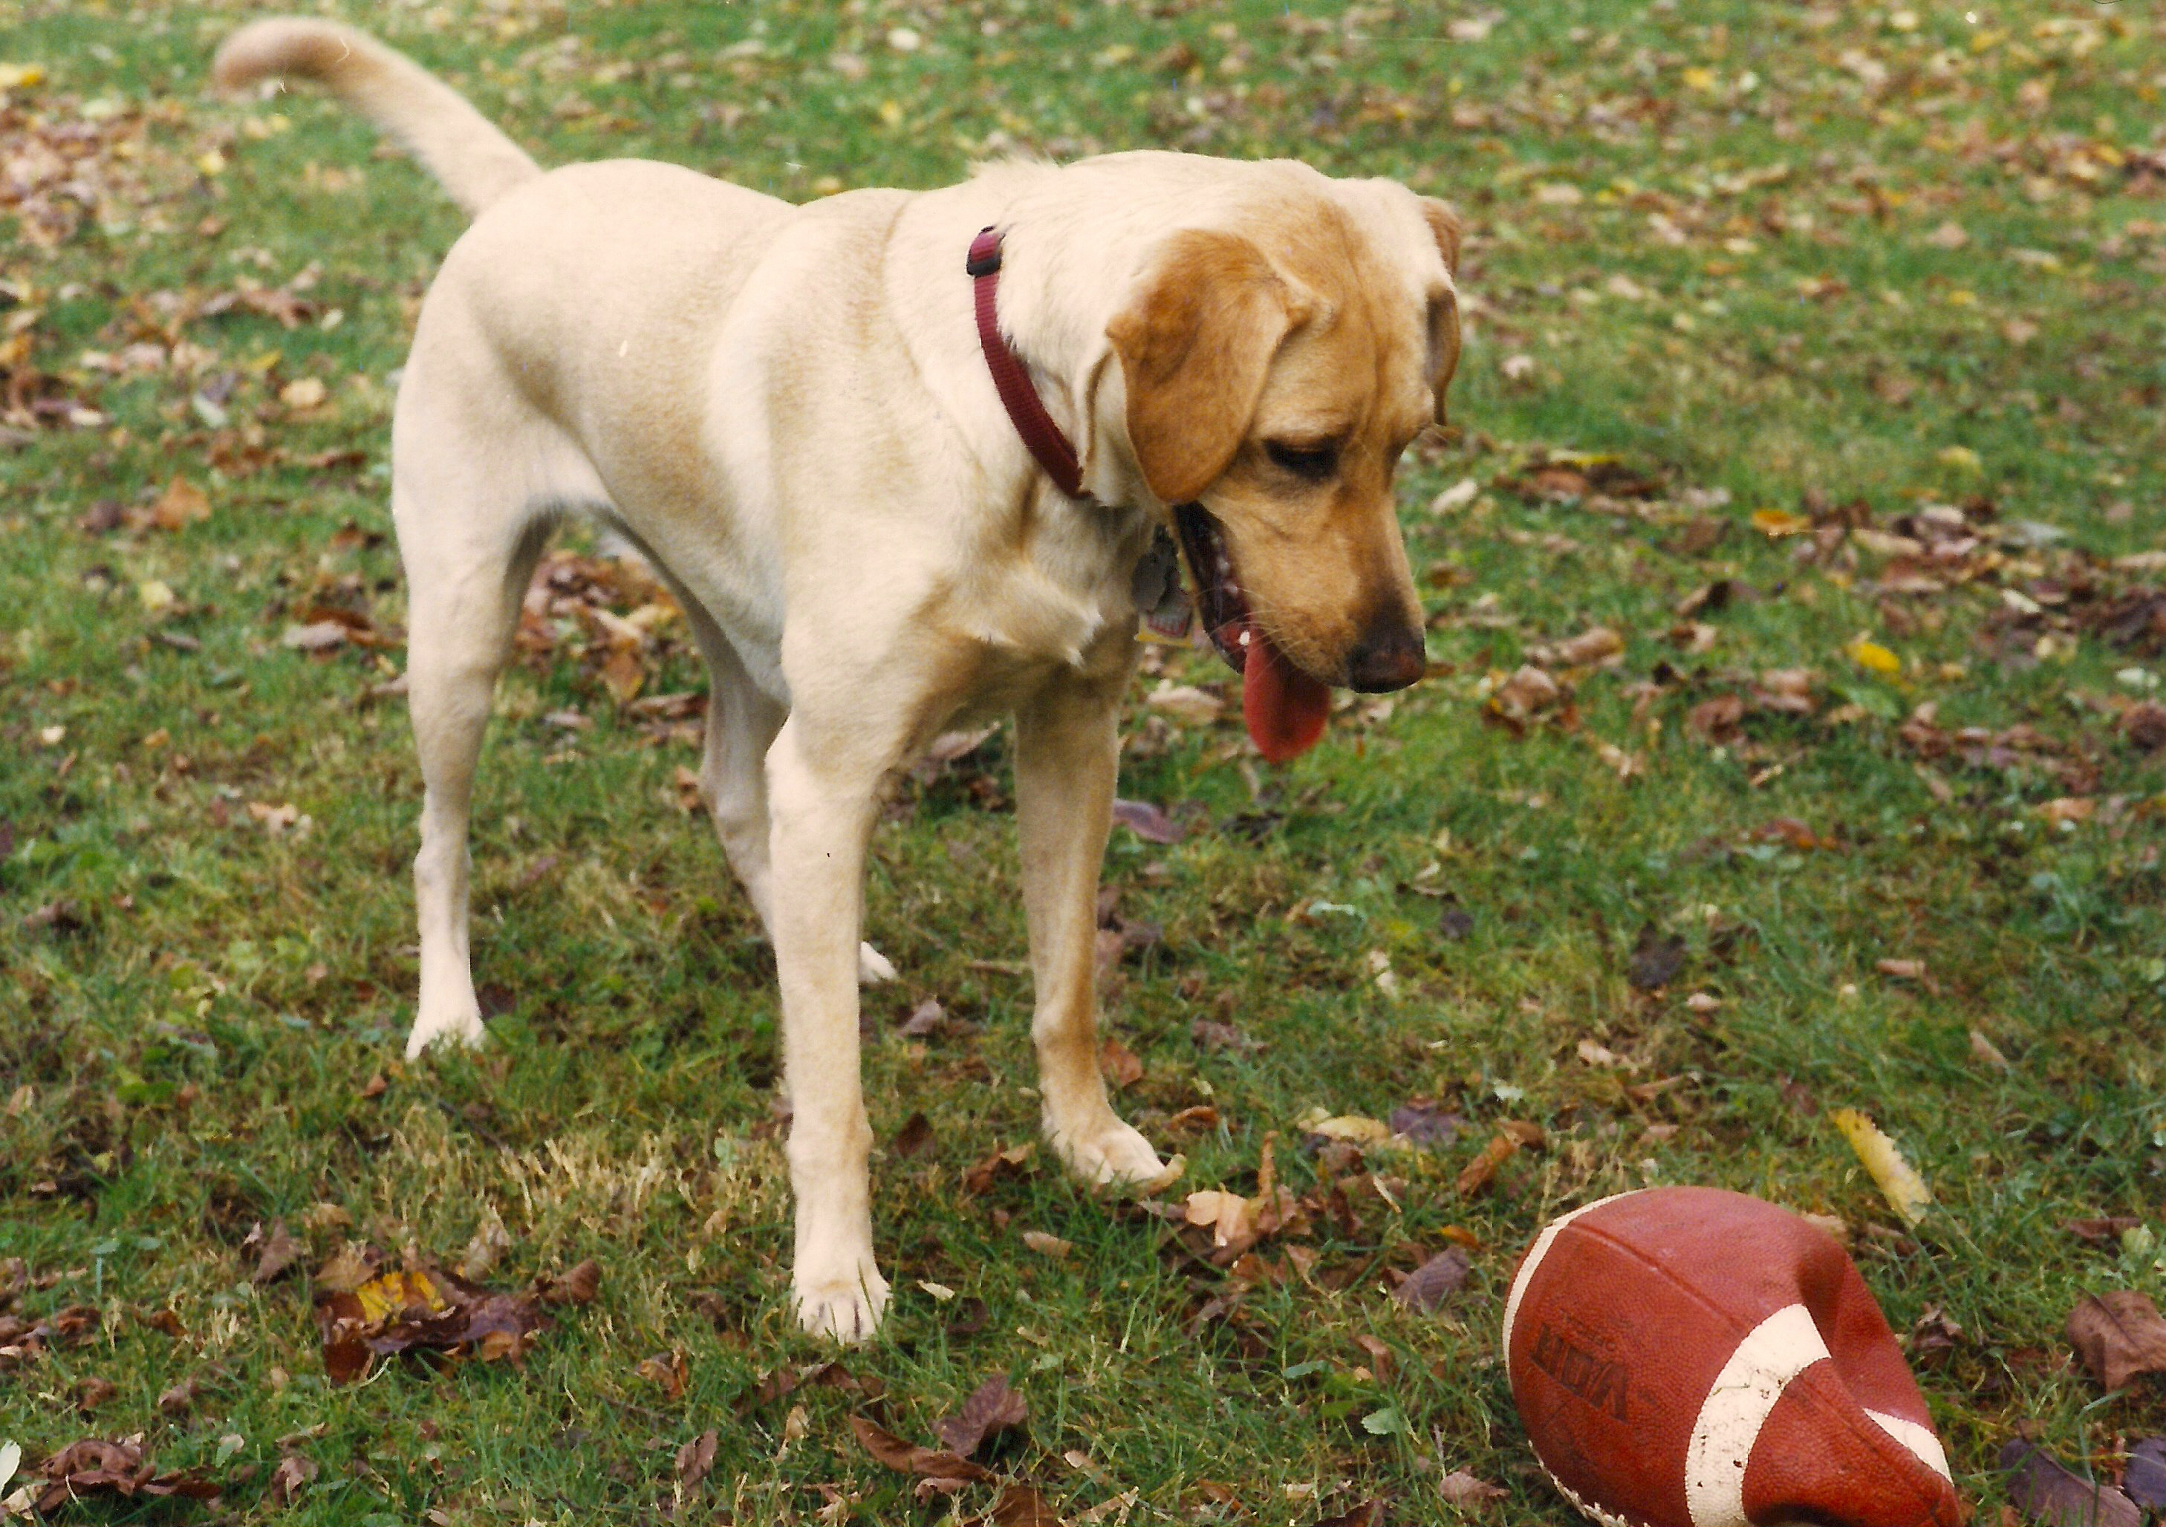
Fall
Key Time for Cultural Practices
Cool Weather Favors Grass Growth
Herbicide use
Fertilizer use
Watering schedule
Drought or prolonged rainfall
Unusual temperature extremes

Slide 33
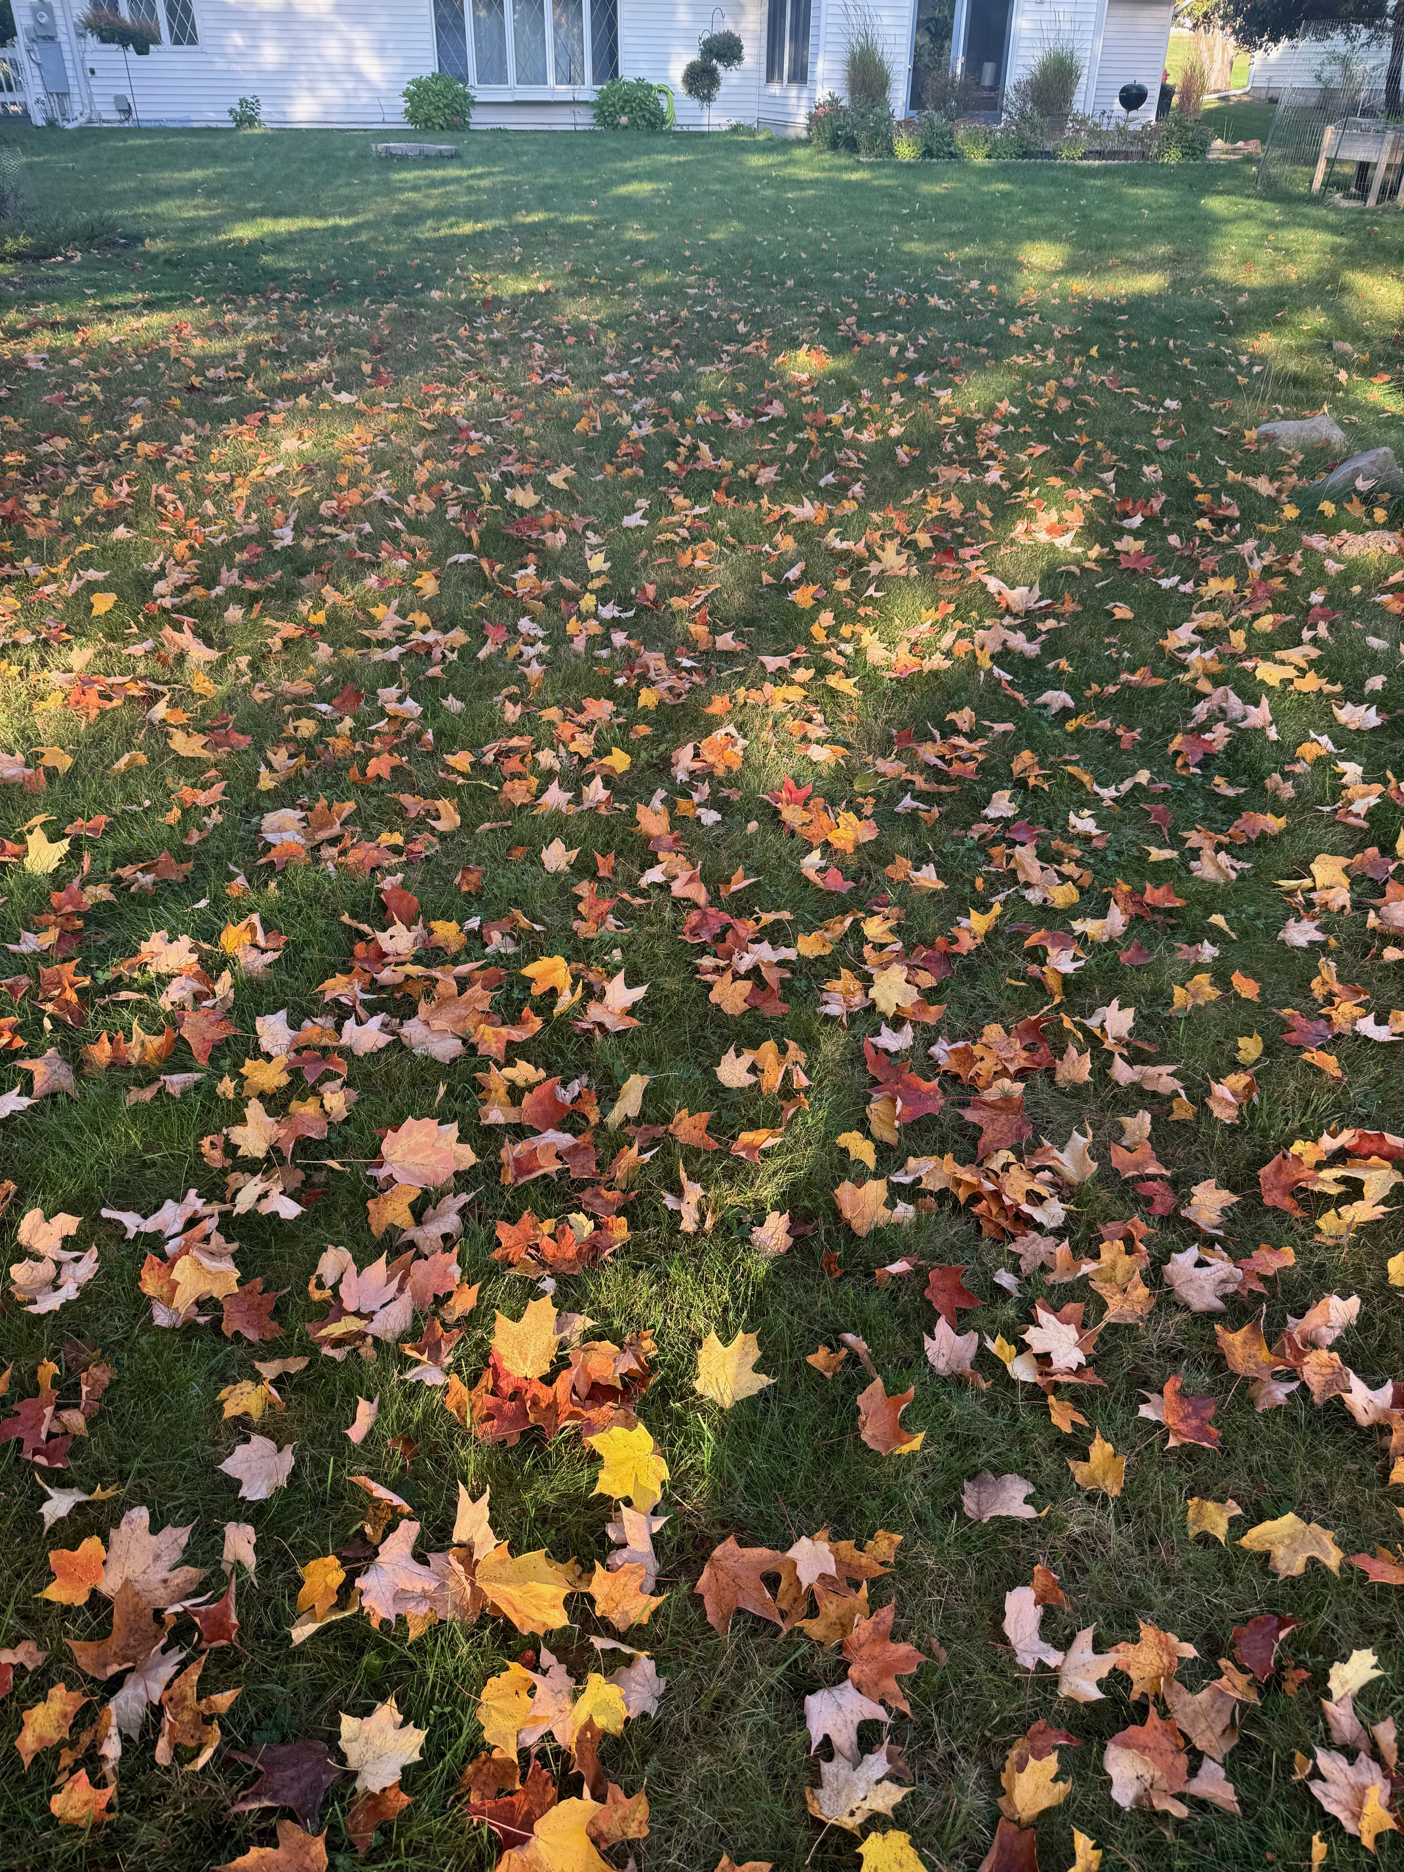
Lawn Care Calendar
EARLY FALL(September)
Establishing New Lawns
Renovate/Repair Thin Lawns
Fertilization
Broadleaf Weed Control
Core Aerating
Wisconsin Lawn Care Calendar

Slide 34
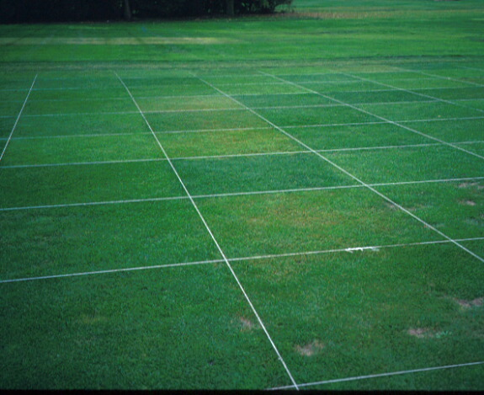
Choose Quality Lawn Grasses
Always Choose Named Cultivars in Seed Products
Mixtures & Blends
Genetically diverse lawns can withstand more problems & stress
NTEP
National Turfgrass Evaluation Program
Wisconsin Lawn Care Calendar

Slide 35
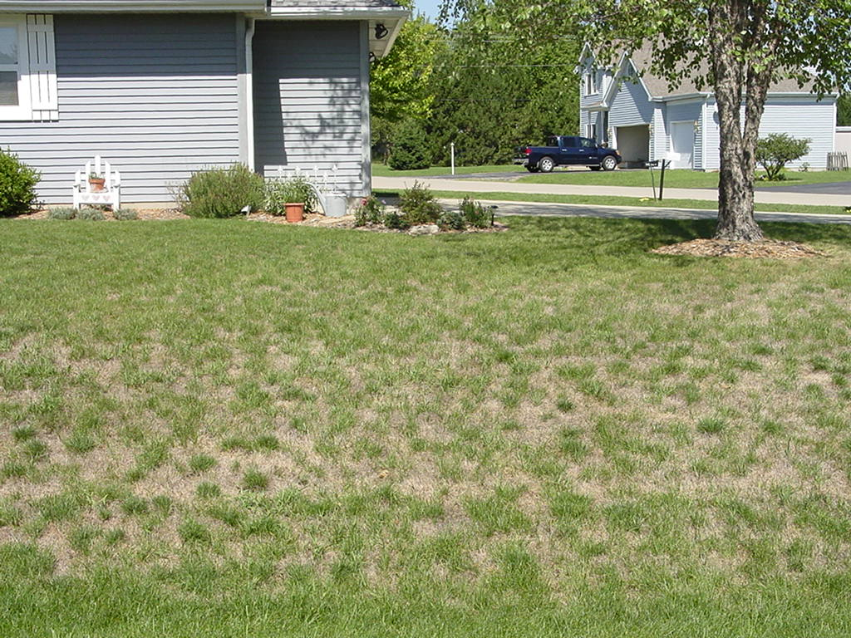
Overseeding Thin Lawns
Choose quality lawn grass seed to match site factors
Late August/early September best timing
Spring second choice
Good seed to soil contact
Wisconsin Lawn Care Calendar

Slide 36
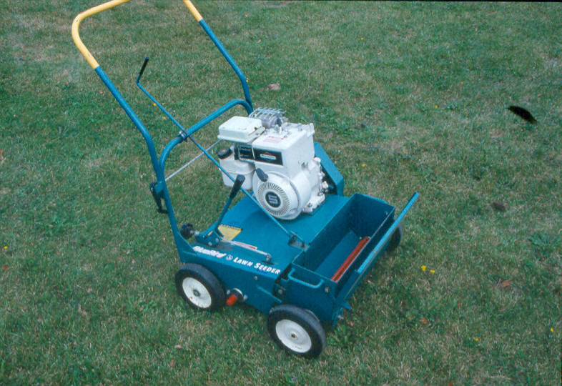
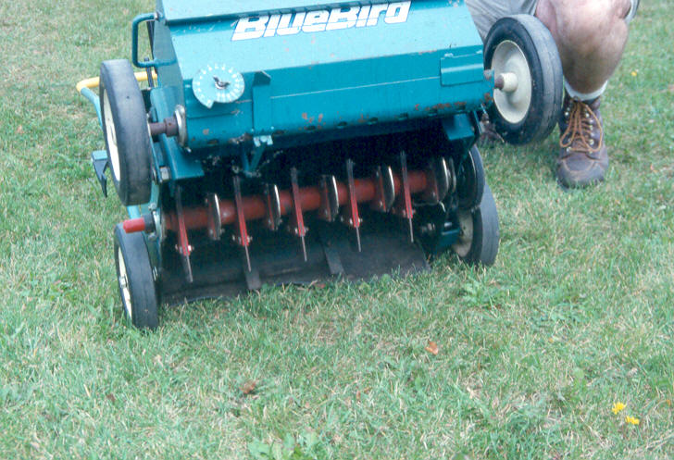
Slit-seeders for Overseeding Lawns
Wisconsin Lawn Care Calendar

Slide 37
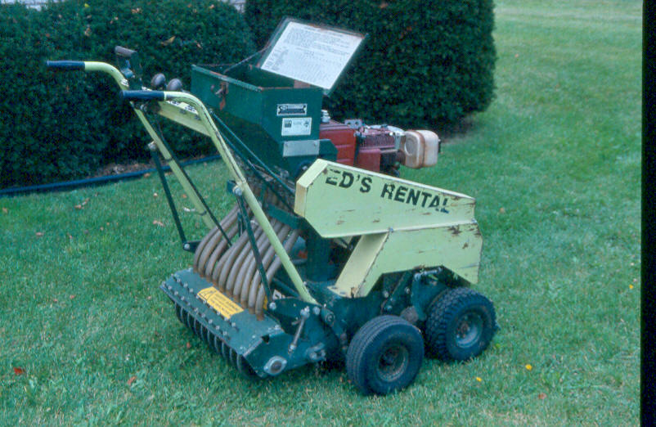
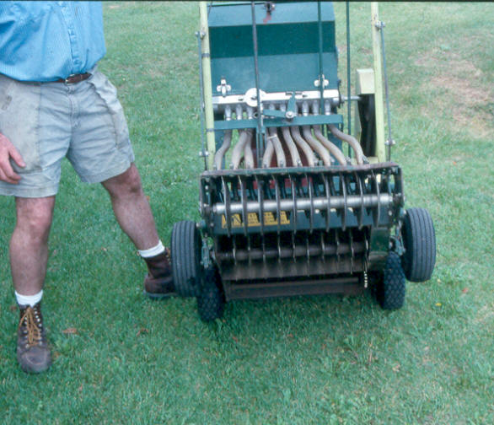
Slit-seeders for Overseeding Lawns
Wisconsin Lawn Care Calendar

Slide 38
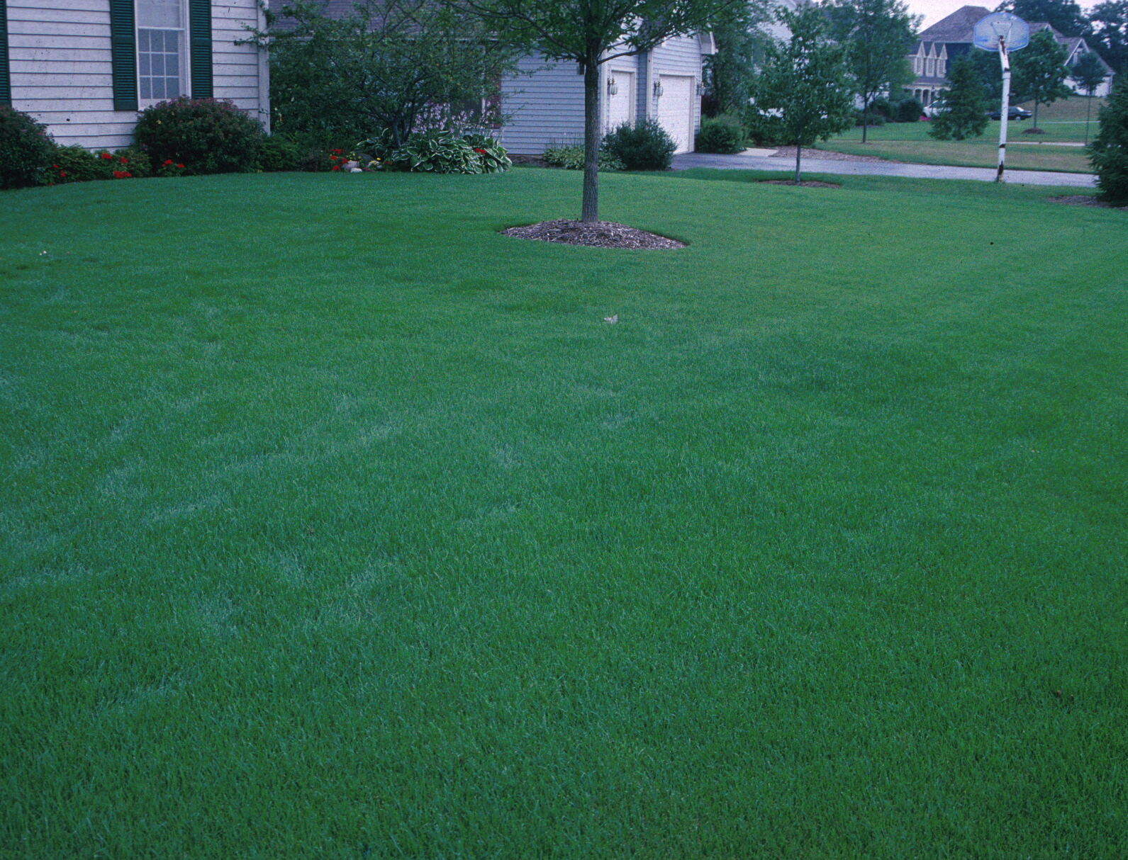
Fall Fertilization Guidelines
Key time for all lawns
Labor Day ideal timing
Use controlled-release nitrogen fertilizers
Apply about 1 pound of nitrogen per 1,000 square feet of lawn area
Wisconsin Lawn Care Calendar

Slide 39
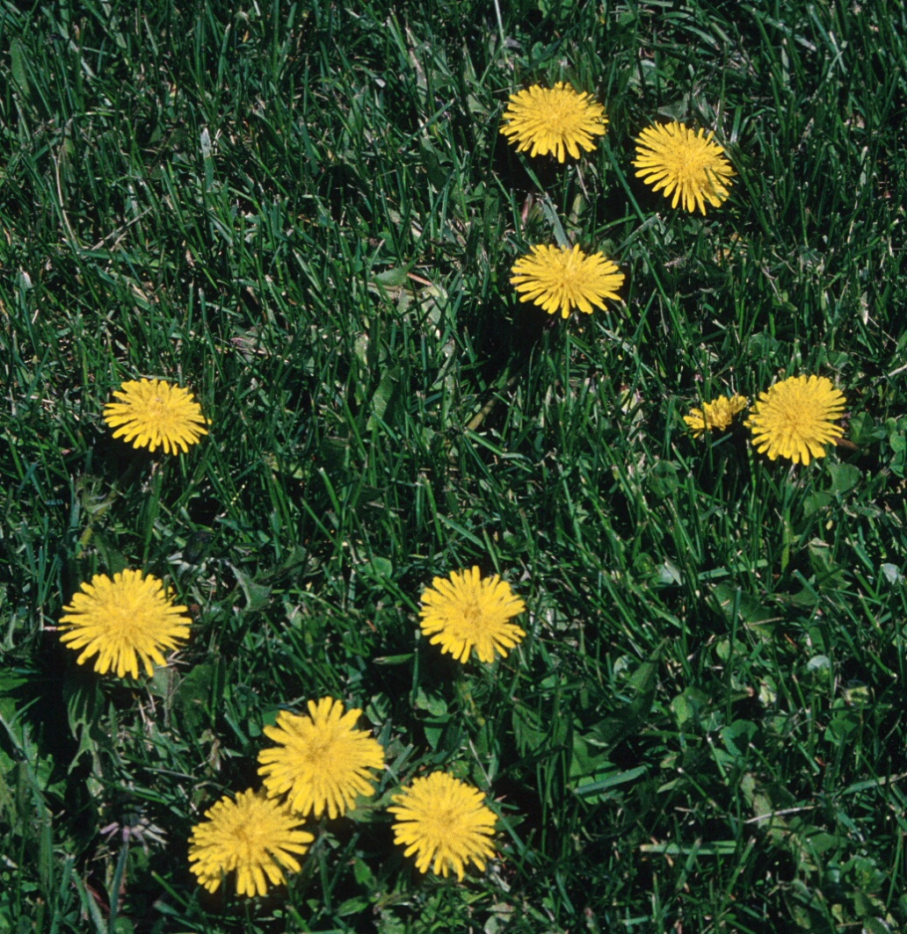
Broadleaf Weed Management
Hand-pull or dig out
Correct underlying causes
Sound Cultural Practices
Herbicide Use
  September/early October
  Spot treat with liquid products
  Read & Follow Label Directions
Wisconsin Lawn Care Calendar

Slide 40
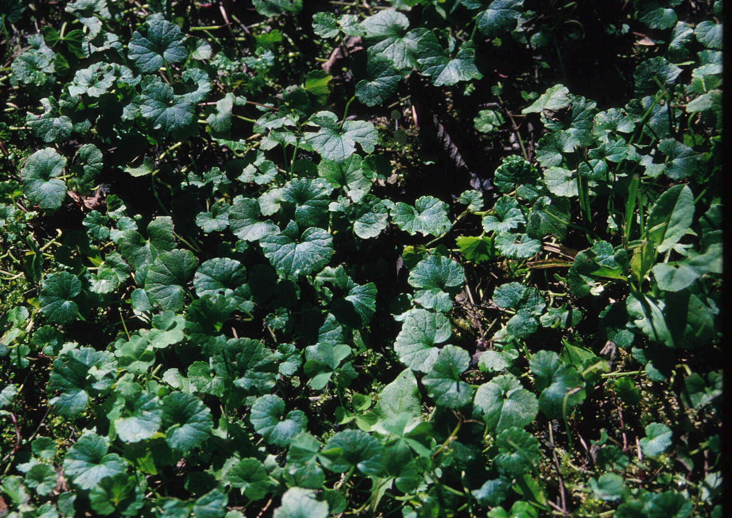
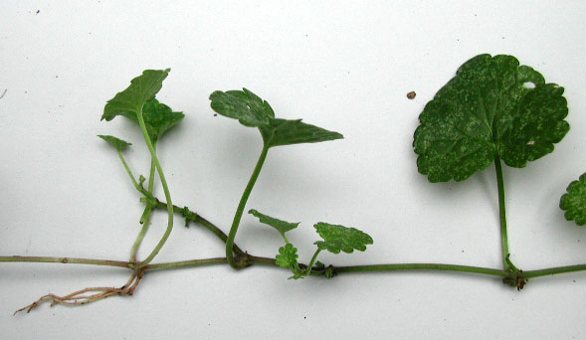
Ground Ivy Management
First frost & full bloom
Synthetic Herbicides
Triclopyr (numerous products)
Alternative
Iron Chelate (Fiesta)
Wisconsin Lawn Care Calendar

Slide 41
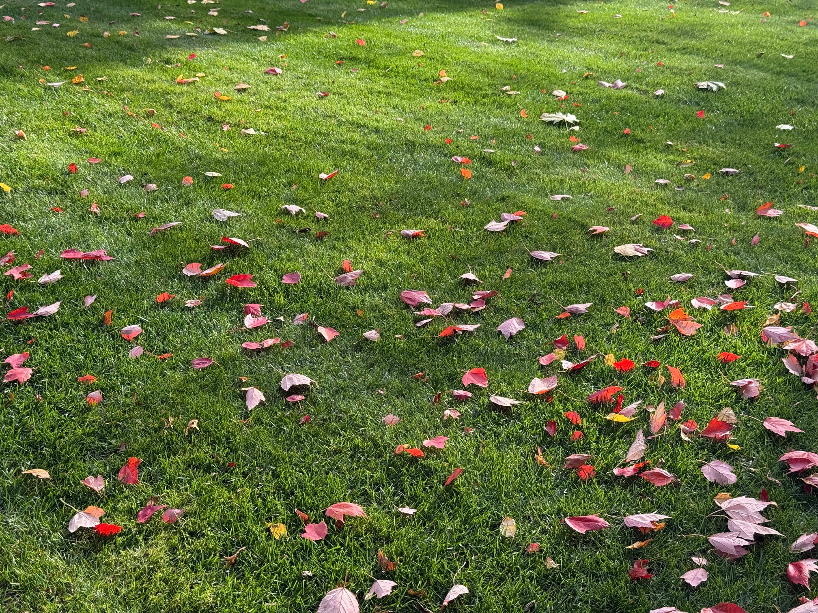
Lawn Care Calendar
LATE FALL
Mowing Until Dormant
Removal of Leaves
Fertilization
Dormant Seeding
Wisconsin Lawn Care Calendar

Slide 42

Wisconsin Lawn Care Calendar

