Slide 1
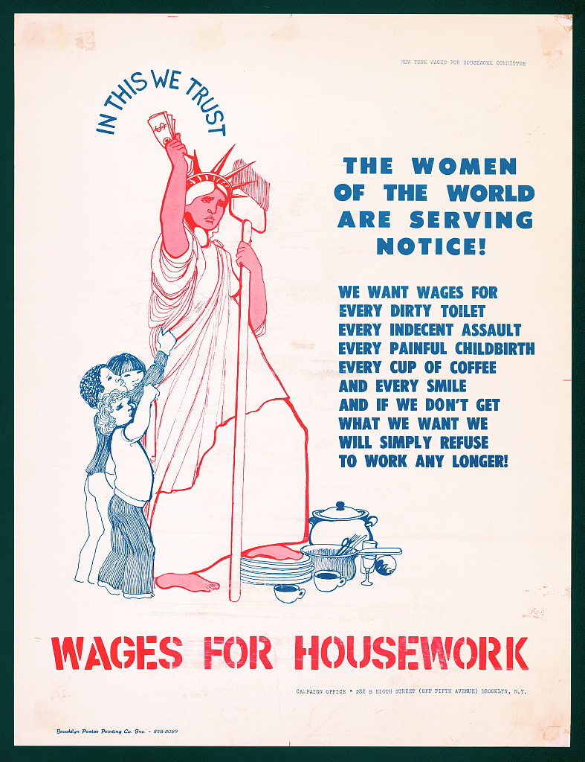
New York Wages for Housework Poster, Library of Congress
Notes:
Start with my personal story

Slide 2
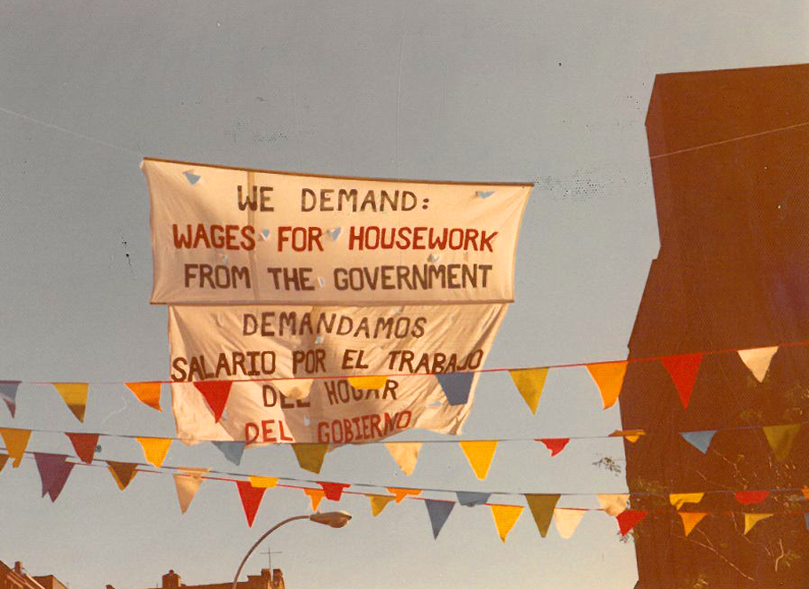
New York Wages for Housework Committee Banner, Silvia Federici Papers, Pembroke Feminist Theory Archives, Brown University
Notes:
Historical context: 1970s
What made them different

Slide 3
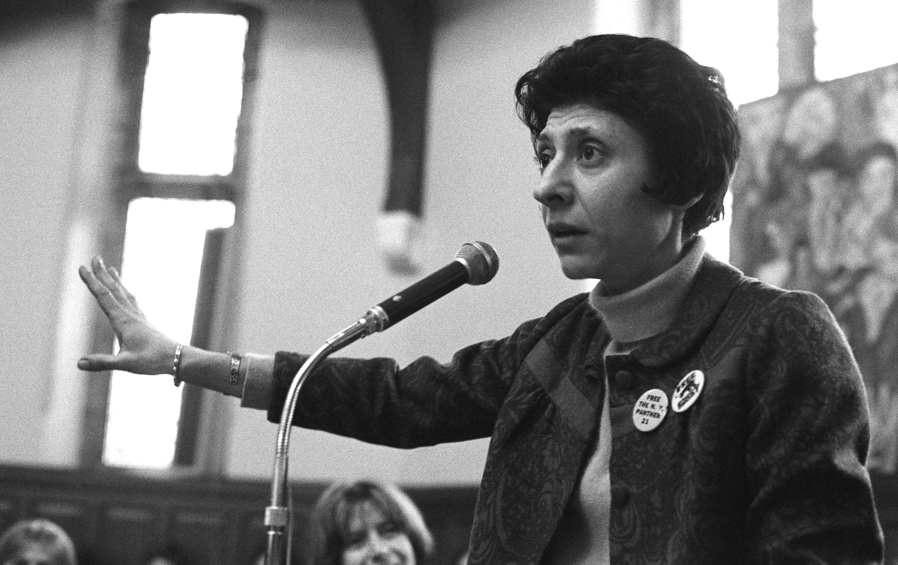
Selma James, 1970 © Chandan (Sally) Fraser

Slide 4
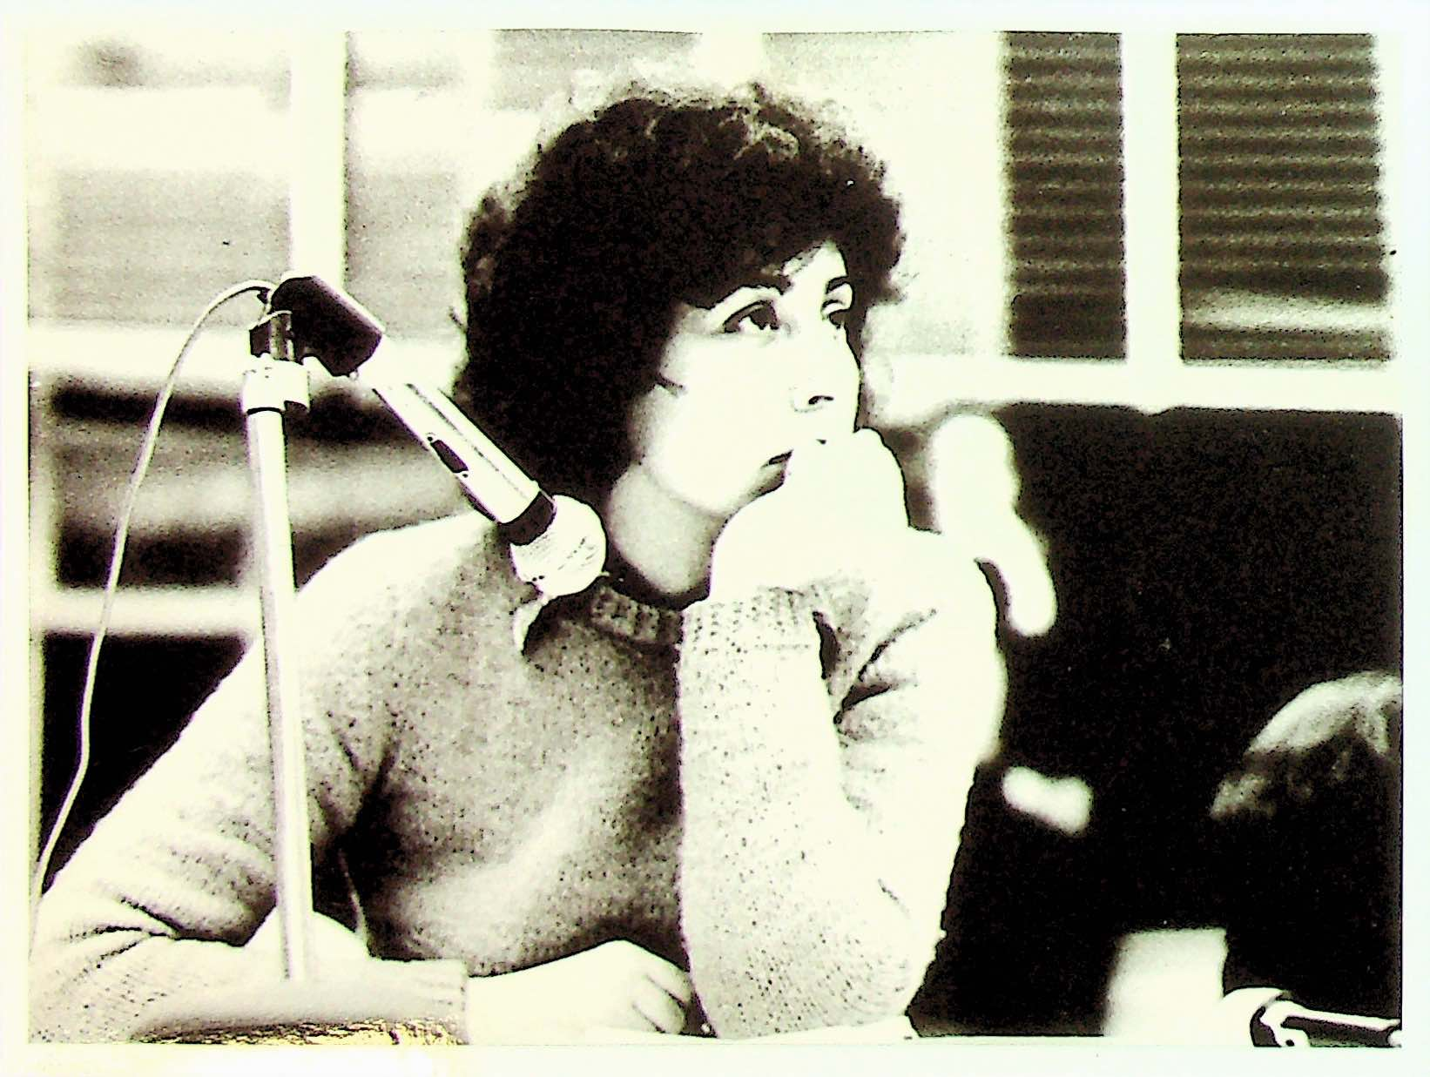
Mariarosa Dalla Costa, © Archivio Mariarosa Dalla Costa

Slide 5
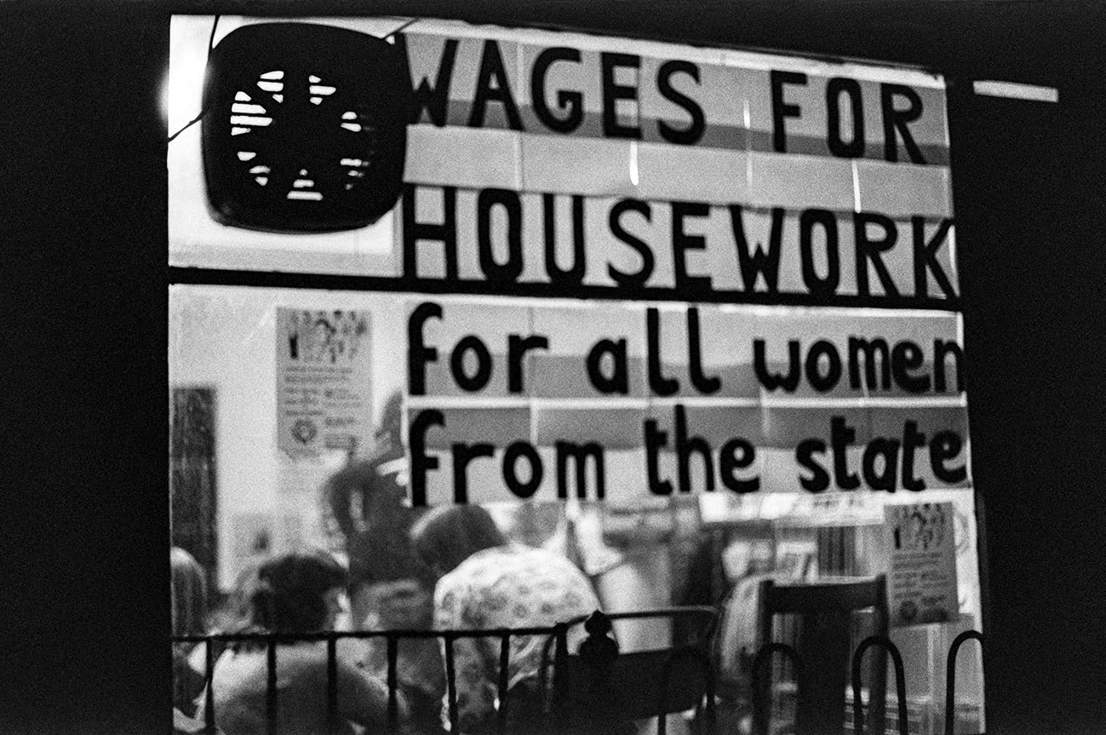
London Wages for Housework Women’s Center, © Linda Law

Slide 6
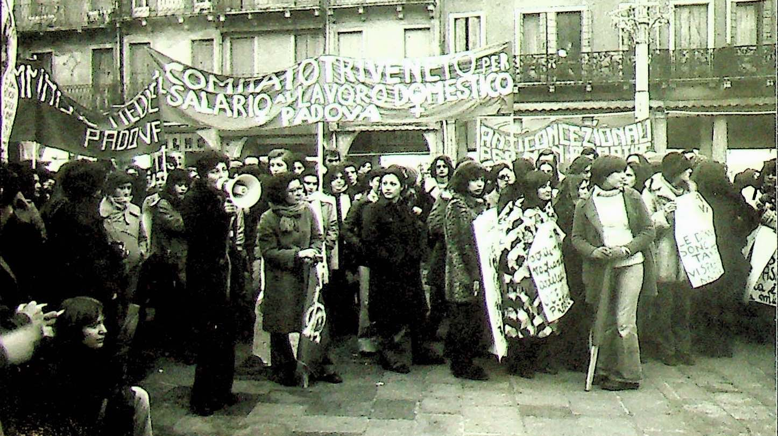
© Archivio Mariarosa Dalla Costa, Biblioteca Civica, Padova

Slide 7
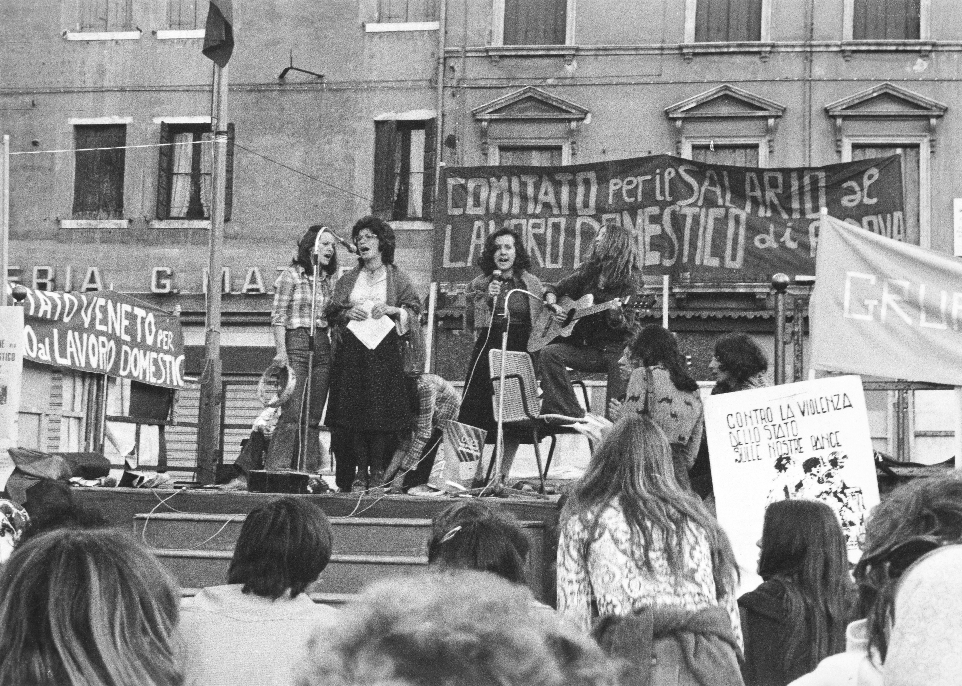
© Archivio Mariarosa Dalla Costa, Biblioteca Civica, Padova

Slide 8
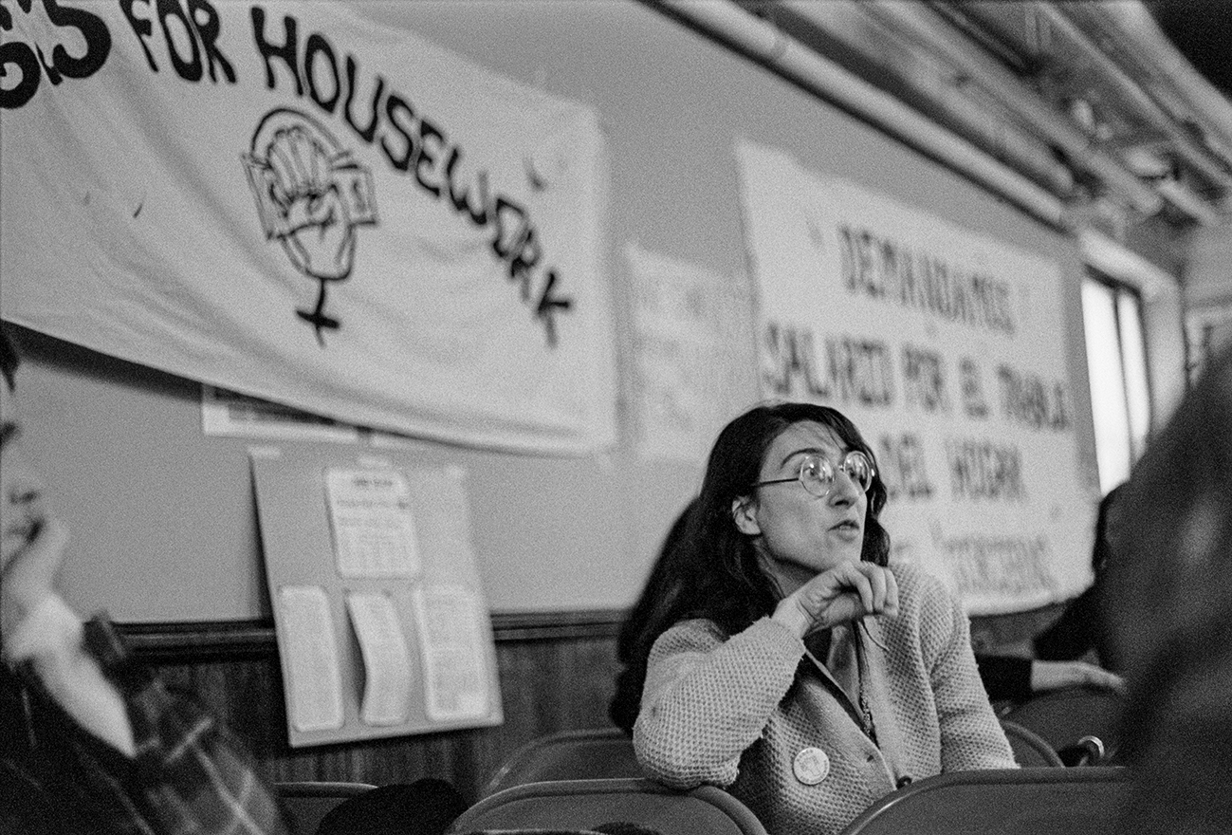
Silvia Federici, 1977 © Linda Law

Slide 9
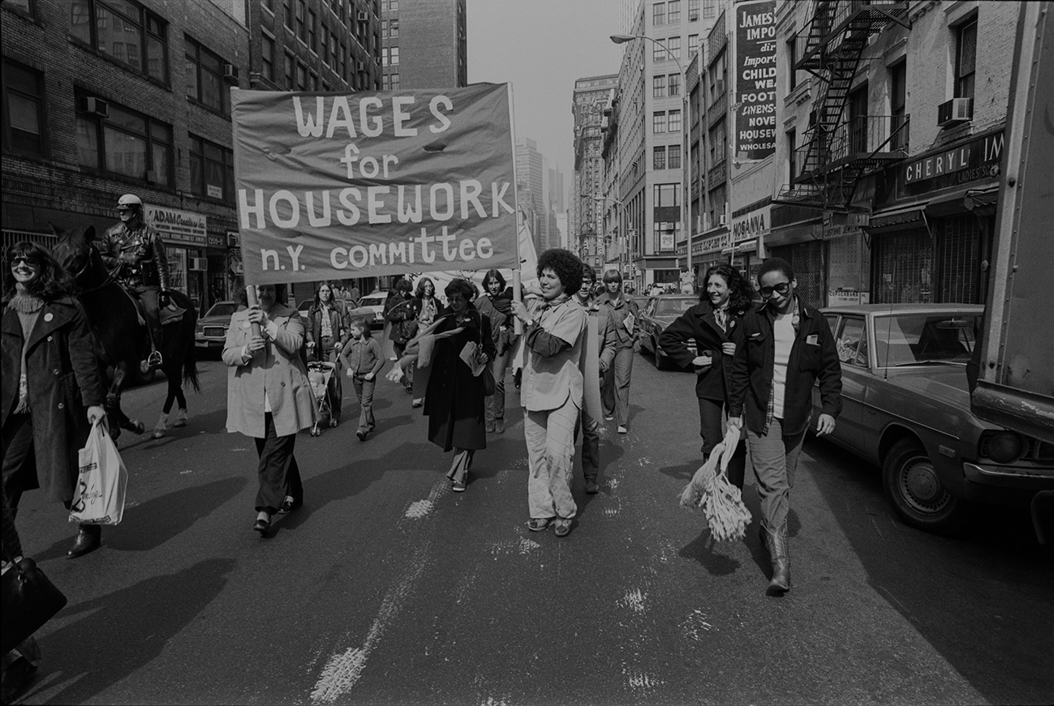
Wages for Housework demonstration, 1977 © Linda Law

Slide 10
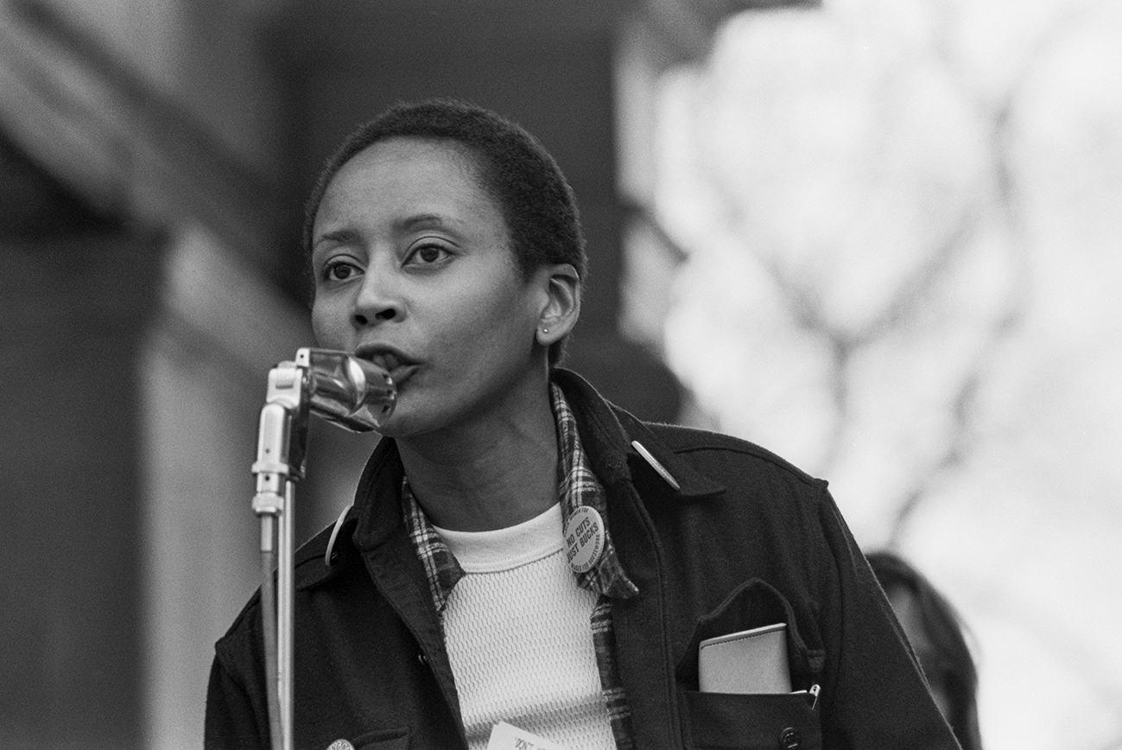
Wilmette Brown, 1977 © Linda Law

Slide 11
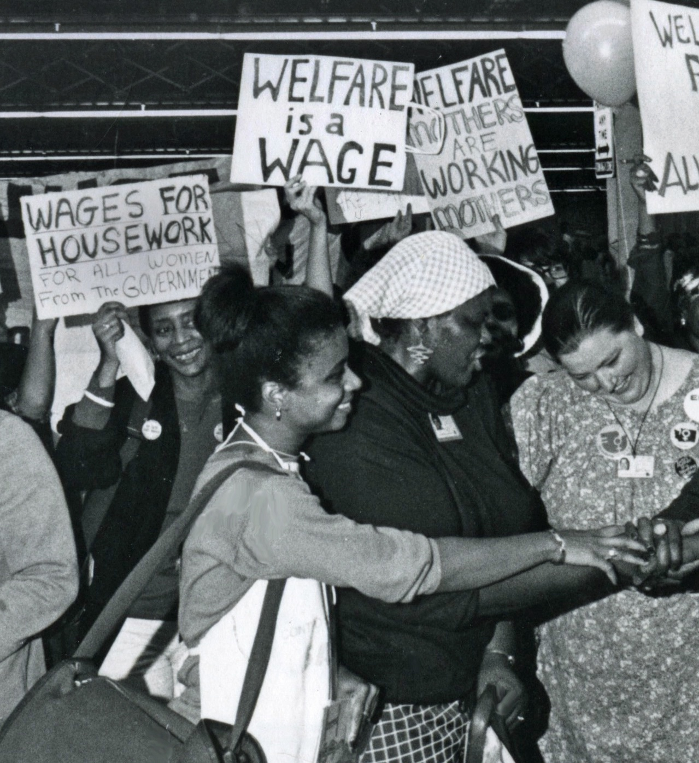
Margaret Prescod, ©Diana Mara Henry

Slide 12
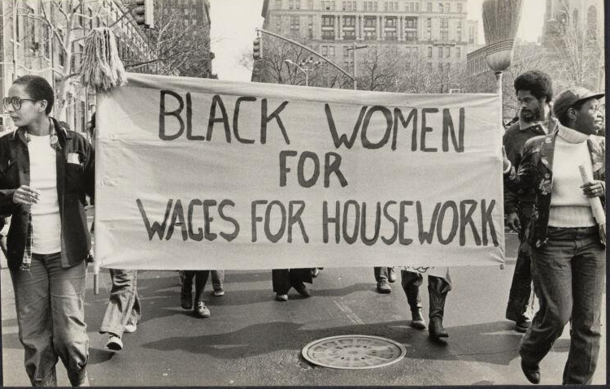
Black Women for Wages for Housework, Schlesinger Library Collection, © Bettye Lane

Slide 13
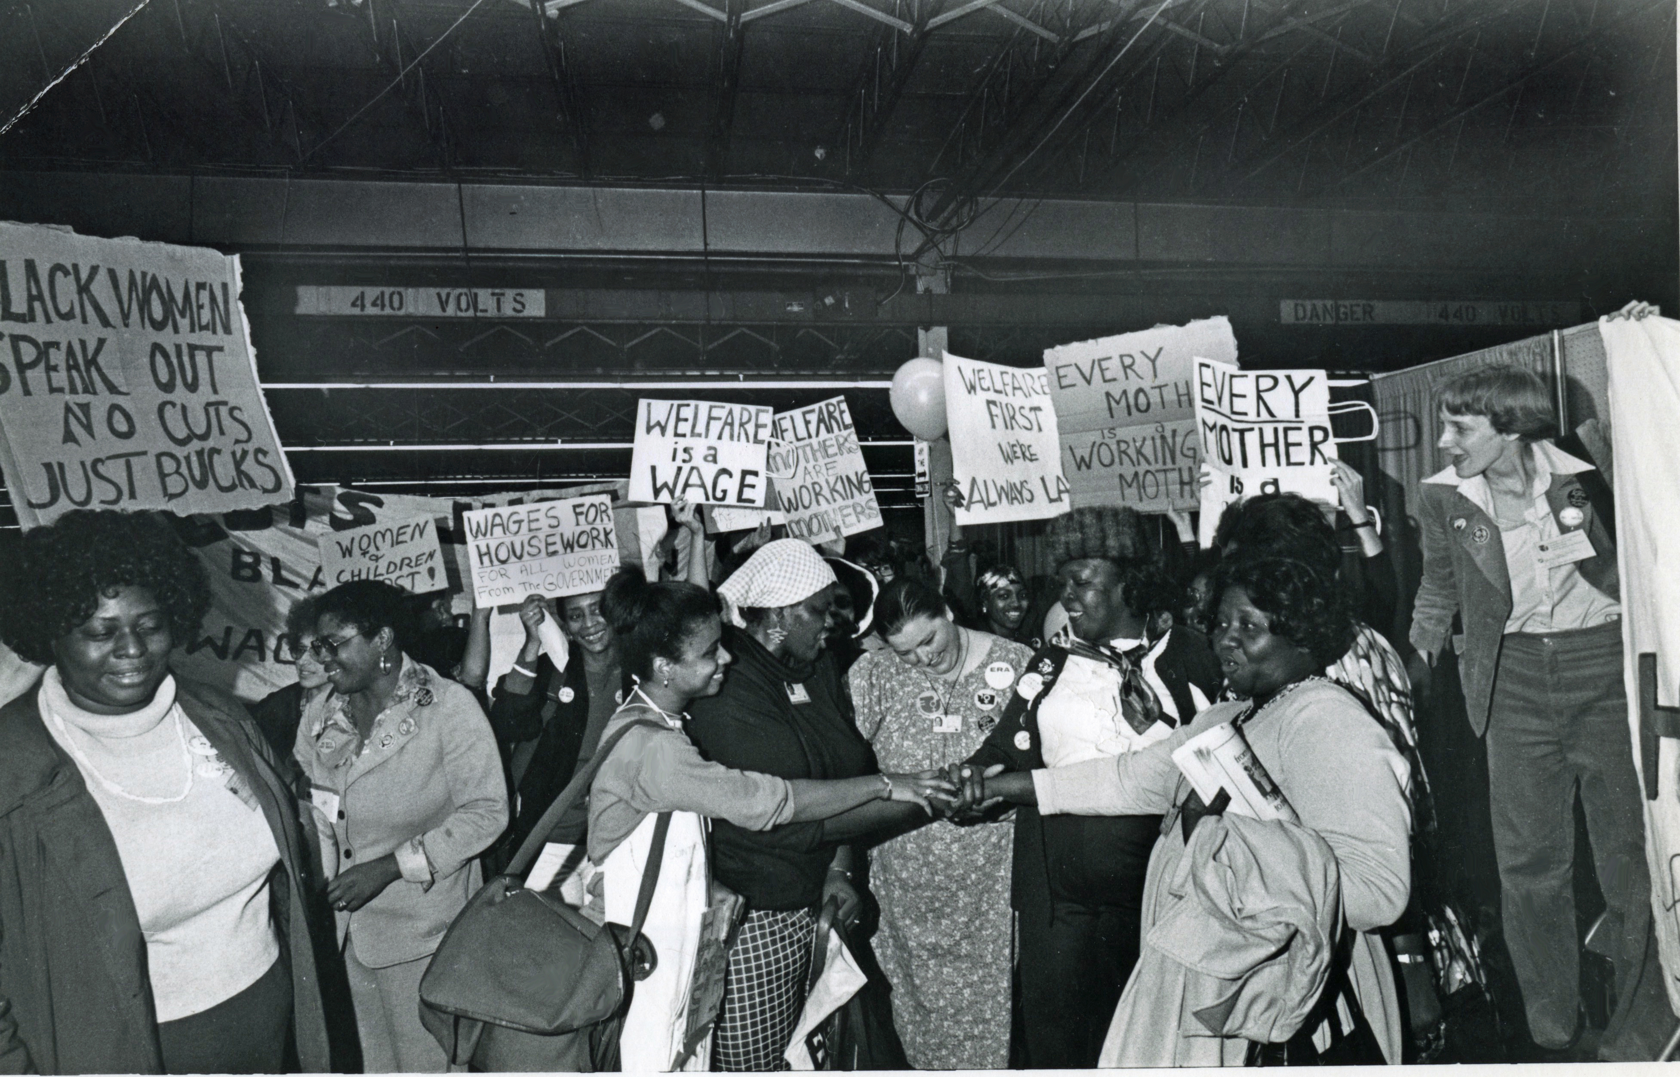
Margaret Prescod (center) at National Women’s Conference, Houston, 1977
© Diana Mara Henry

