Slide 1
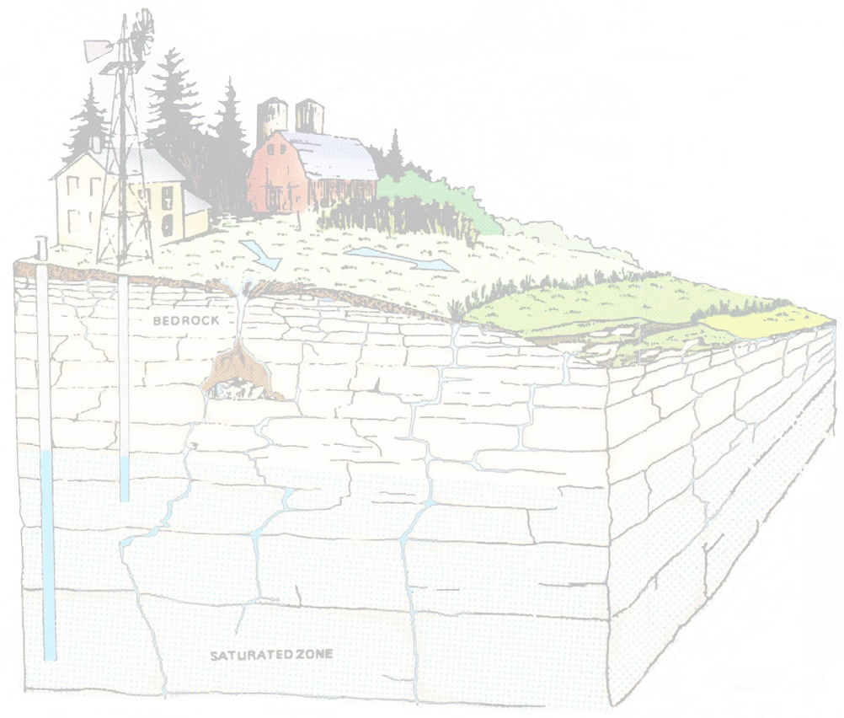

Wisconsin’s Karst Aquifers:
Productive but Vulnerable
Maureen Muldoon
Badger Talk
McCoy Public Library
8/5/2025

Slide 2
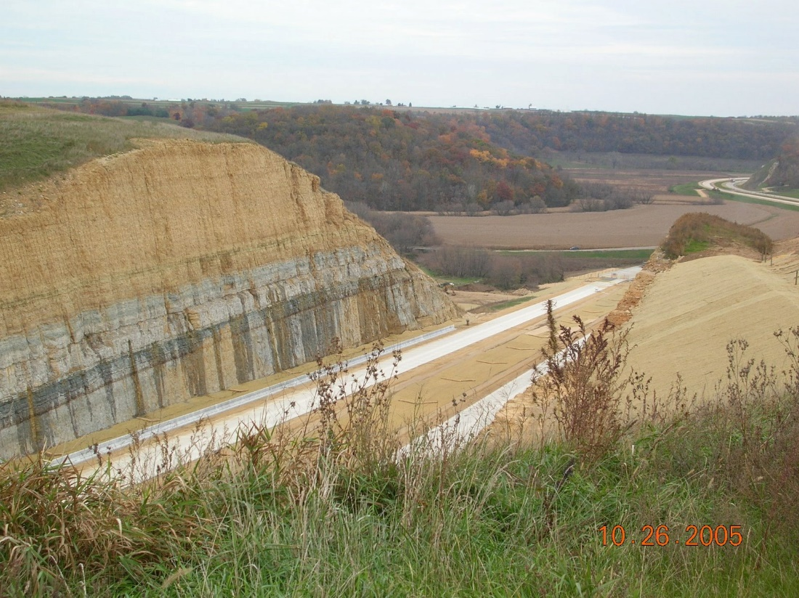
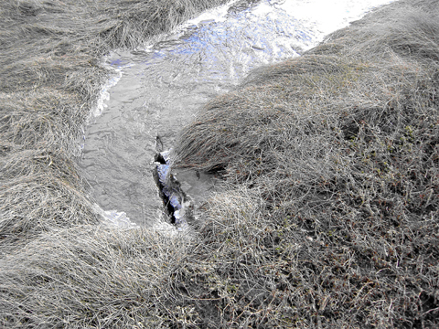
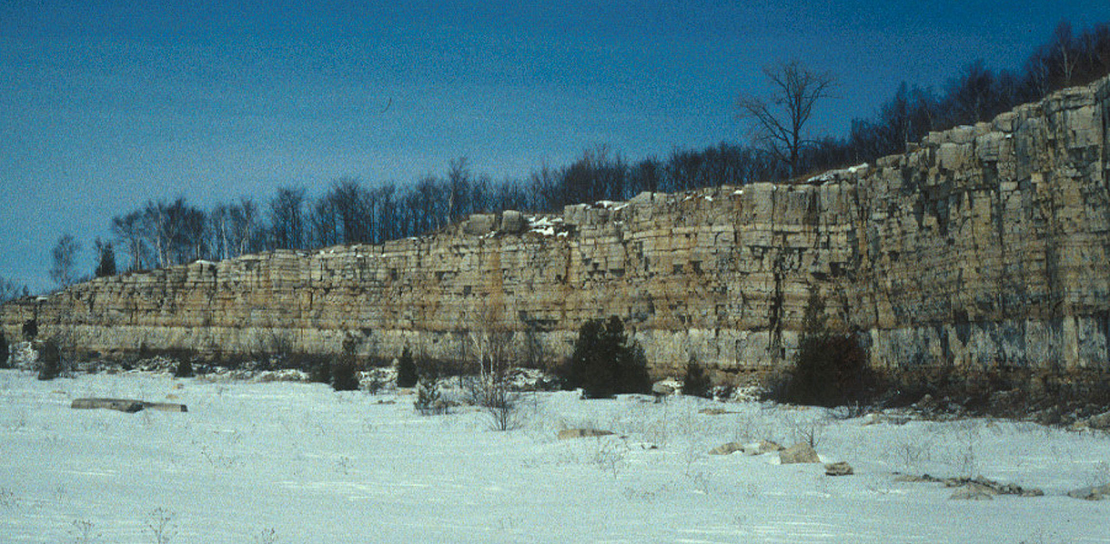
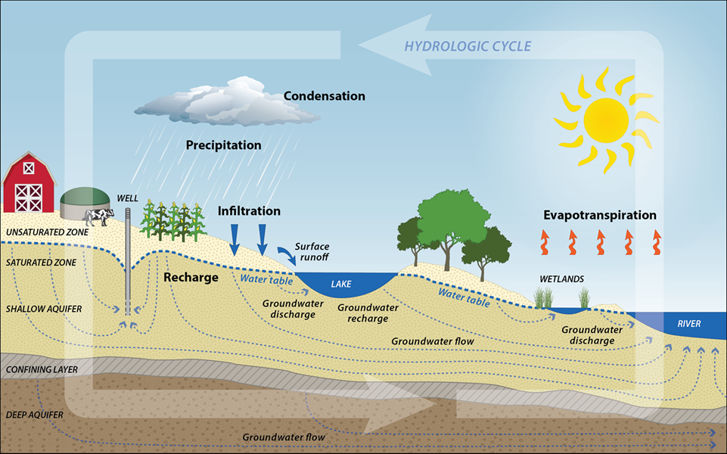
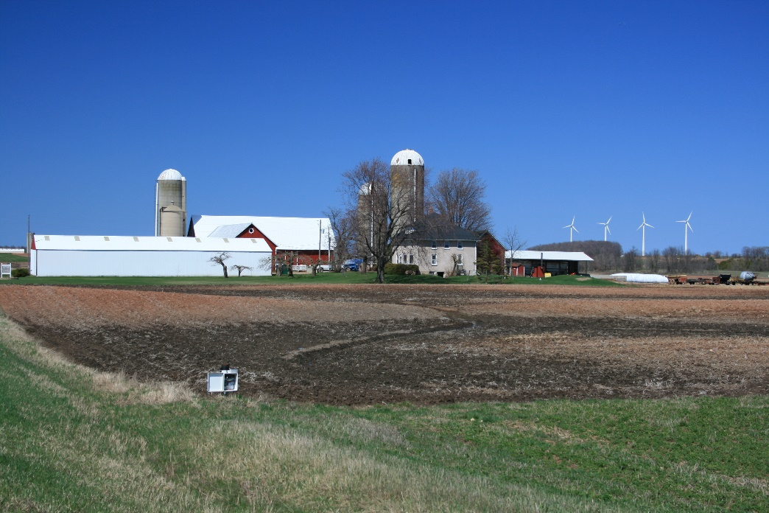
Bedrock Geology
Soil Type and Thickness
We rely on soil to filter and treat water as it moves from the ground surface to the groundwater system
Water Cycle
Land Use

Slide 3
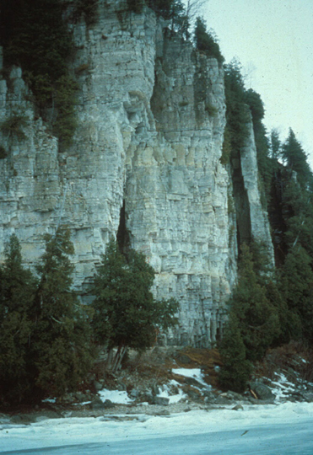
Outline
WI Geology & Karst
  Bedrock Geology
  Definition of Karst
  WI Karst Aquifers
Water Cycle & Groundwater Basics
Why worry about karst?
Soils & Water Quality
Recharge & Water Quality
Geology & Hydrogeology of SW WI
Take Away Points

Slide 4
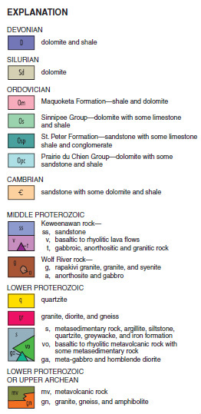
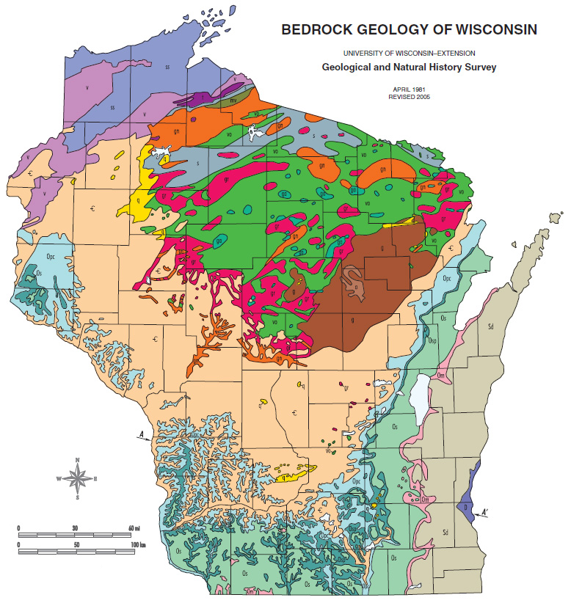
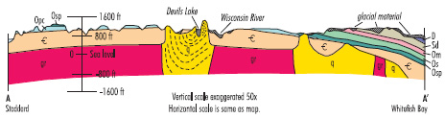
WI Bedrock Geology

Slide 5
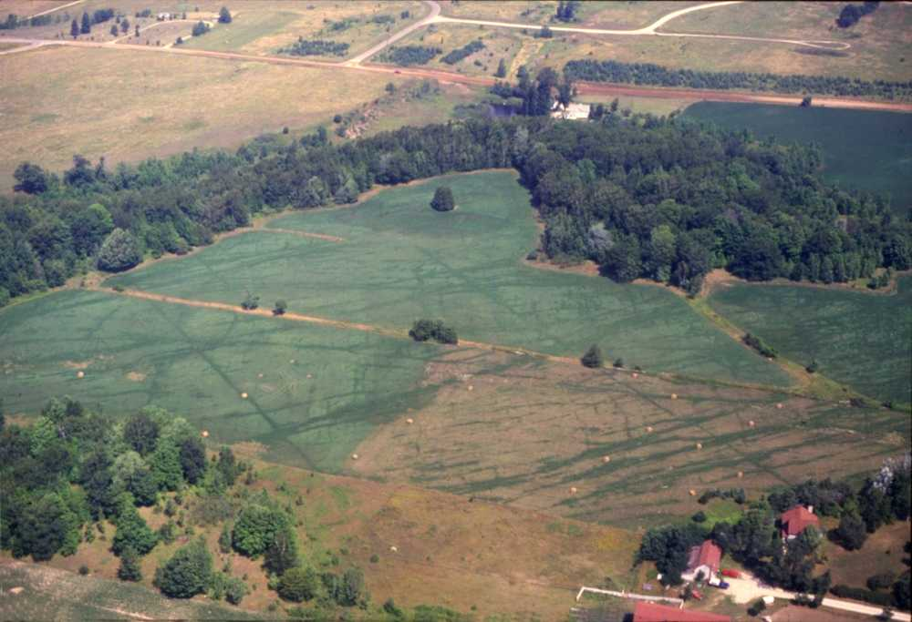
What is Karst?
A type of topography that is formed on limestone (& dolostone) gypsum, and other rocks, primarily by dissolution, and is characterized by sinkholes, caves, and underground drainage (Glossary of Geology)
Spectrum of landscapes -- Door Co. to tower karst of China
Significant land area - 20% of U.S., 40% of area east of Mississippi River

Slide 6
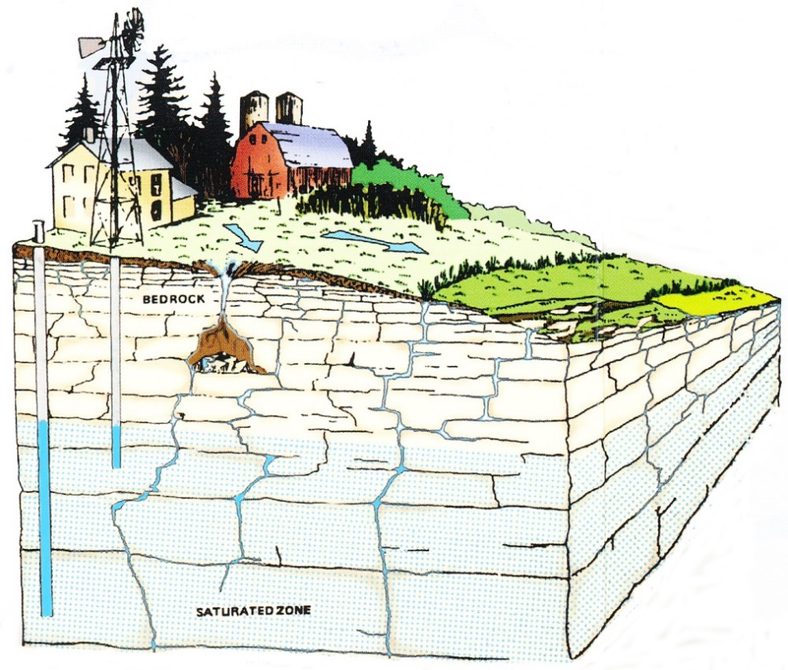
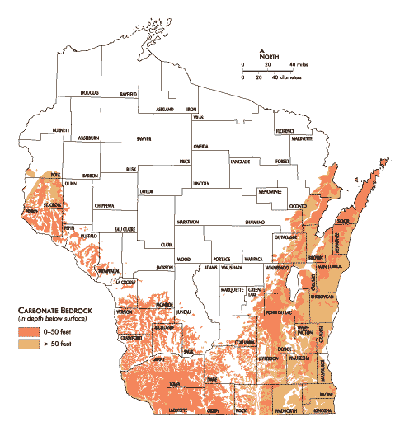
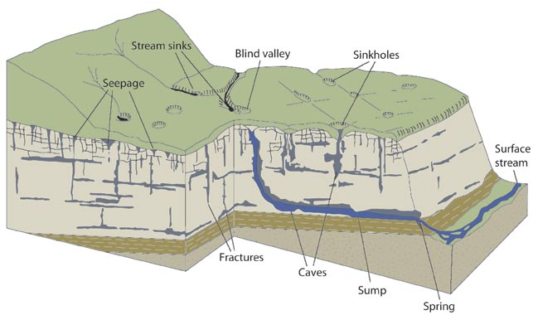
Wisconsin Karst
Image from Protect the Water You Drink: Tips for Homeowners of Rural and Agricultural Lands in Door County
Image courtesy of Tony Runkel, MN Geological Survey

Slide 7
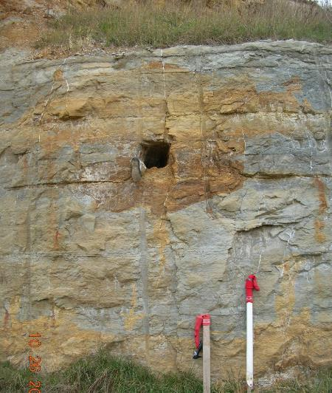
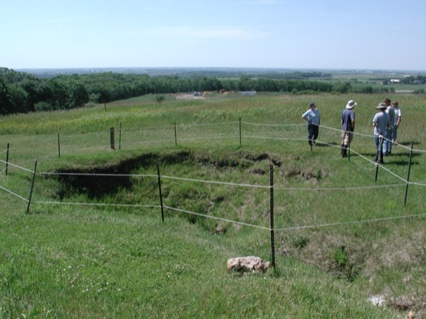
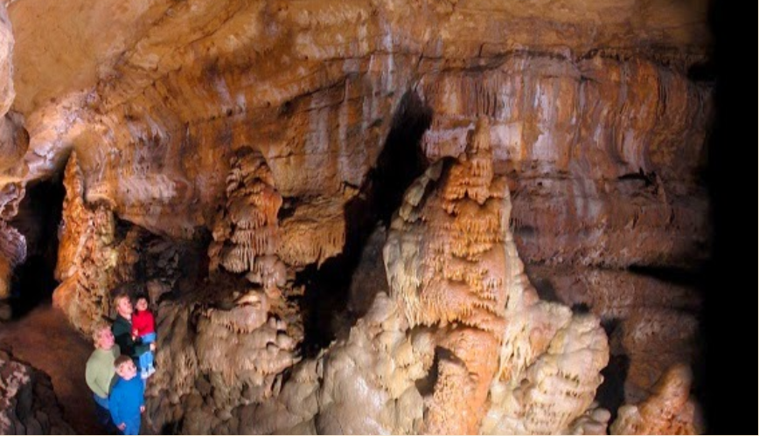
Southwest Wisconsin Karst
Conduit in 151 roadcut,
WiDOT photo
Karst features
  Sinkholes, conduits, caves
  Carbonates weather to produce red clay “terra rosa”
photo from Cave of the Mounds National Natural Landmark
Sinkhole near Blue Mounds, WGNHS photo

Slide 8
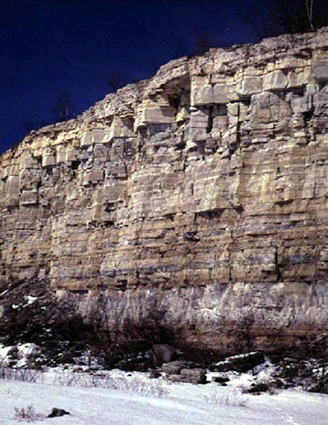
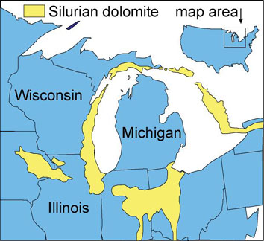
Northeastern Wisconsin Karst

Slide 9
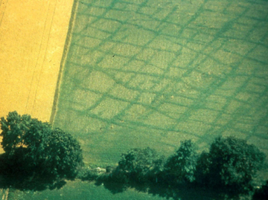
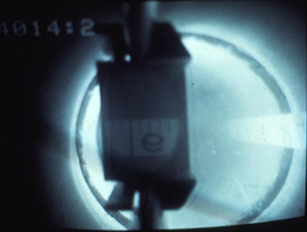
Northeastern Wisconsin Karst
Vertical Fractures are common
Bedding-plane fractures are also common
Characterized by a very well-connected network of fractures

Slide 10
Outline
WI Geology & Karst
Water Cycle & Groundwater Basics
  Groundwater 101
  Groundwater Recharge
Why worry about karst?
Soils & Water Quality
Recharge & Water Quality
Geology & Hydrogeology of SW WI
Summary & Take Away Points

Slide 11
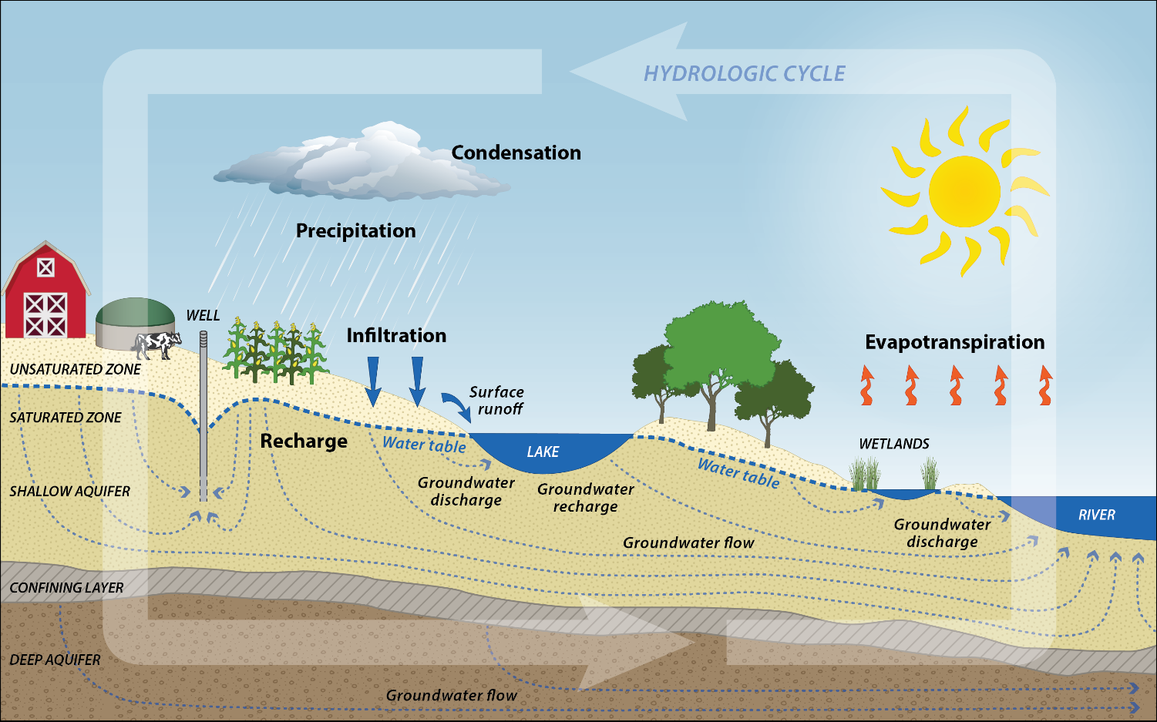
All water is part of the water cycle…

Slide 12
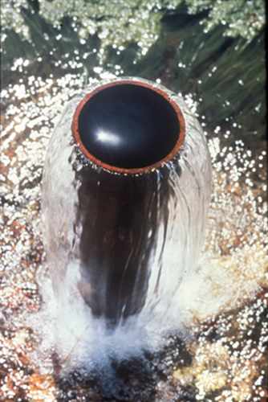
What is groundwater?
Groundwater is water filling pores, cracks, fractures, and other voids in geologic materials beneath the earth’s surface.
Groundwater is drinking water for ~70% of Wisconsin residents
Flowing Well, Door County, WI

Slide 13
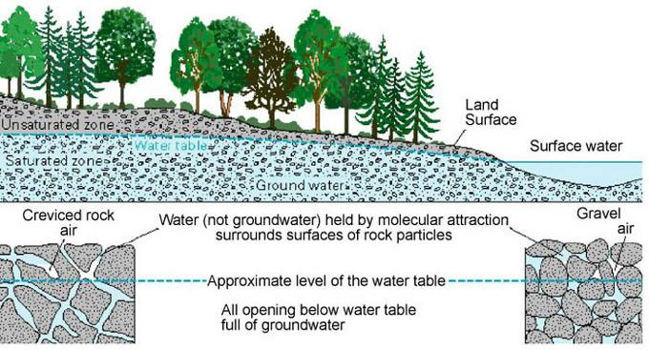
Aquifer – a geologic unit that can store and transmit usable quantities of water to a well
Water table is boundary between the unsaturated and saturated zones
  Unsaturated zone - pores spaces contain both air and water
  Saturated zone - pores spaces are filled with water
Groundwater Recharge -- water that seeps past the root zone and makes it to the water table (top of the saturated zone)

Slide 14
Seasonality of Recharge
WL measurements from 4 wells in NE WI for Sept 2007 –Aug 2008
Measured every 30 minutes
Soil thickness 7 to 18 ft
Fall Recharge
Snowmelt recharge
Large Summer recharge event

Slide 15
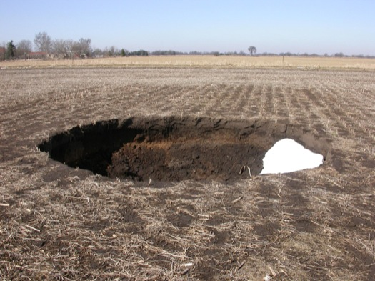
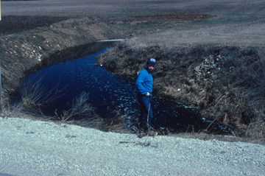
Outline
WI Geology & Karst
Water Cycle & Groundwater Basics
Why worry about karst?
  Solution Features
  Groundwater Vulnerability
Soils & Water Quality
Recharge & Water Quality
Geology & Hydrogeology of SW WI
Take Away Points
Sinkhole near Eagle, WI (Waukesha County)
WGNHS photo
C&M Sinkhole near Sturgeon Bay, WI

Slide 16
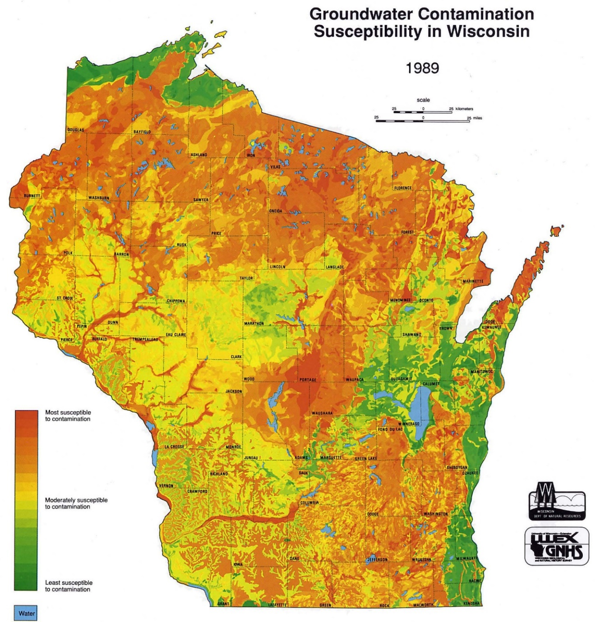
Aquifer Vulnerability
Five characteristics were used to generate this map:
Type of bedrock
Depth to bedrock
Depth to water-table
Soil Characteristics
Characteristics of surficial sediment

Slide 17
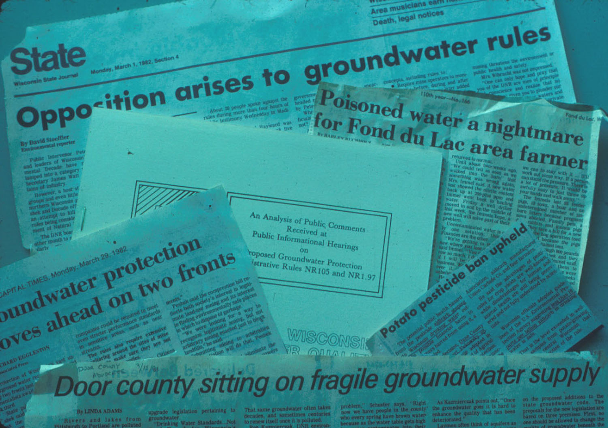
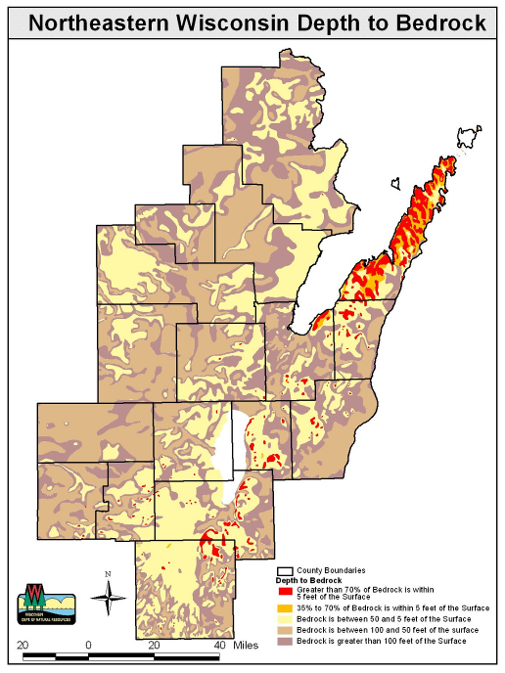
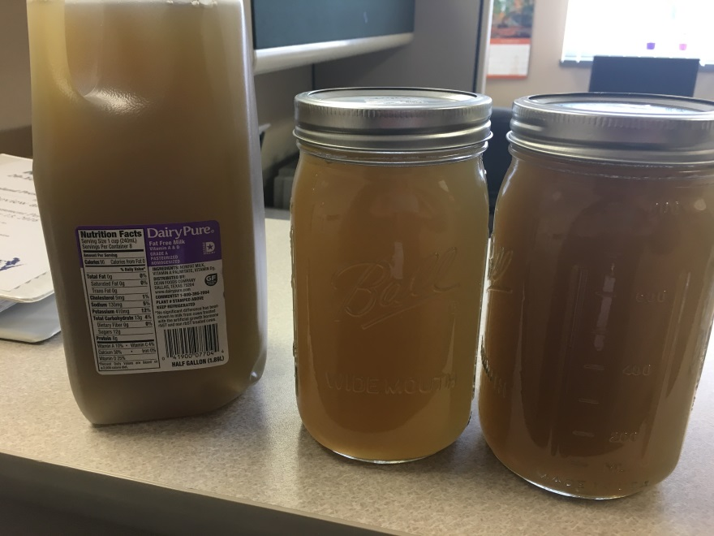
Historic Water-Quality Concerns
Long history of bacterial detections in NE WI
Occasional brown water events
Door County 2005
2 wells
Kewaunee County 2004
3 wells
Brown County 2005 10 wells
Manitowoc County 2005 11 wells
Calumet County 2002
9 wells
Brown Water, Kewaunee County, Oct 2016
Photo from Davina Bonness (Kewaunee LWCD)
Green Lake 2005
2 wells
Dodge County 2005
6 wells

Slide 18
Outline
Soil Type and Thickness
We rely on soil to filter and treat water as it moves from the ground surface to the groundwater system
WI Geology & Karst
Water Cycle & Groundwater Basics
Why worry about karst?
Soils & Water Quality
  What we want soils to do?
  Soils & Aquifer Vulnerability
  Soil Macropores
Recharge & Water Quality
Geology & Hydrogeology of SW WI
Take Away Points

Slide 19
Soils Treat & Filter Water

Slide 20
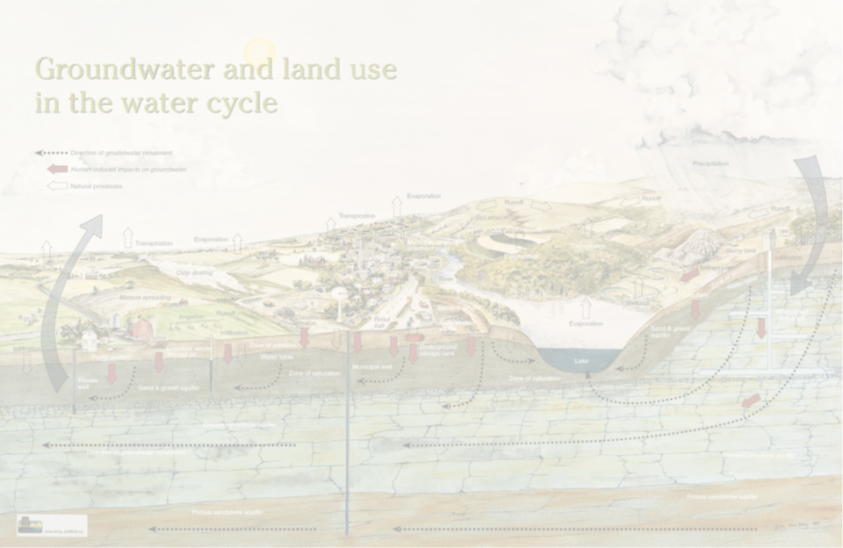
What We Want Soils To Do
Hold nutrients in root zone
Filter microbes out of recharging water (septic drain fields, land application of sewage sludge or manure)
Retard the movement of, or assist with, the breakdown of certain chemical contaminants (petroleum products, pesticides, etc)

Slide 21
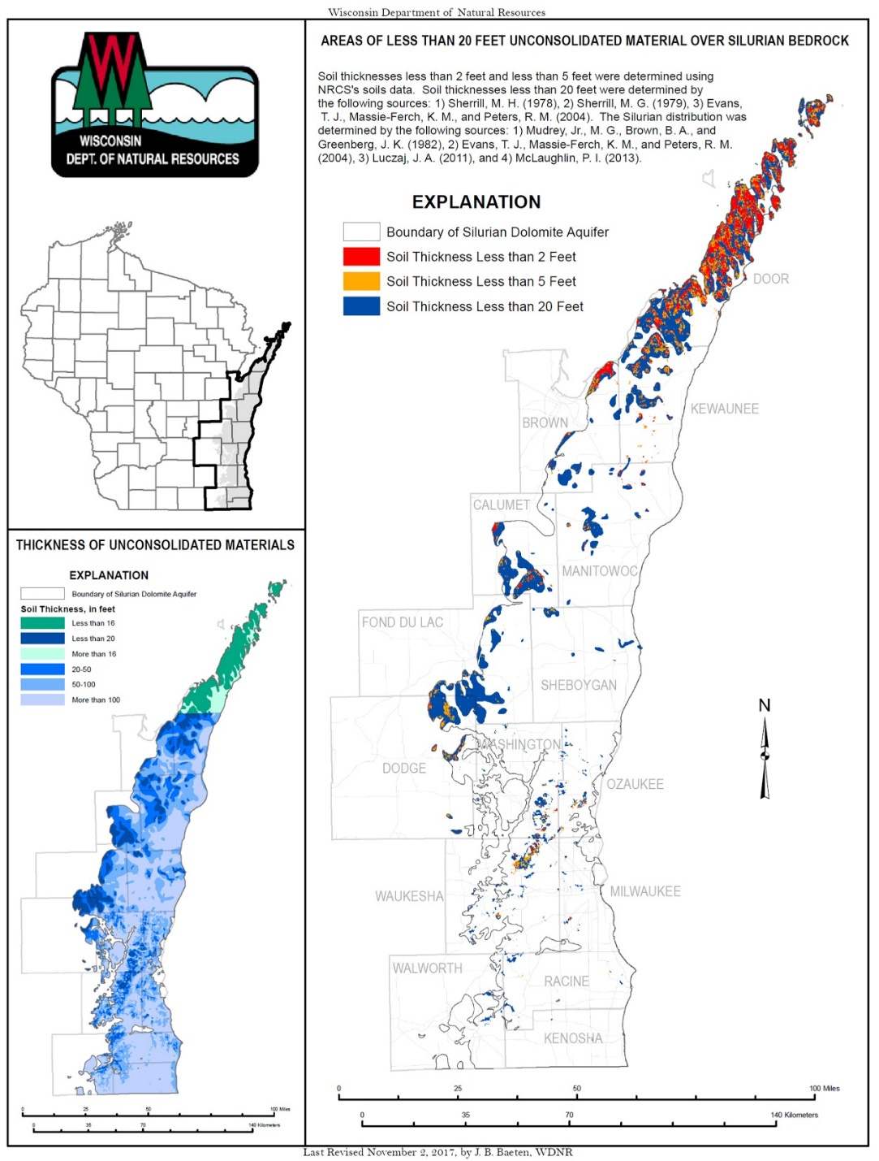
Soil Thickness
Thickness of surficial sediments is a major factor in predicting contamination potential for the eastern dolomite aquifer
Areas with thin soils and areas with coarse-textured soils are more vulnerable to contamination
Map on Lower Left: Contamination potential in the Silurian Dolomite aquifer, eastern Wisconsin. USGS Water-Resources Investigations Report 78-108 By: M.G. Sherrill

Slide 22
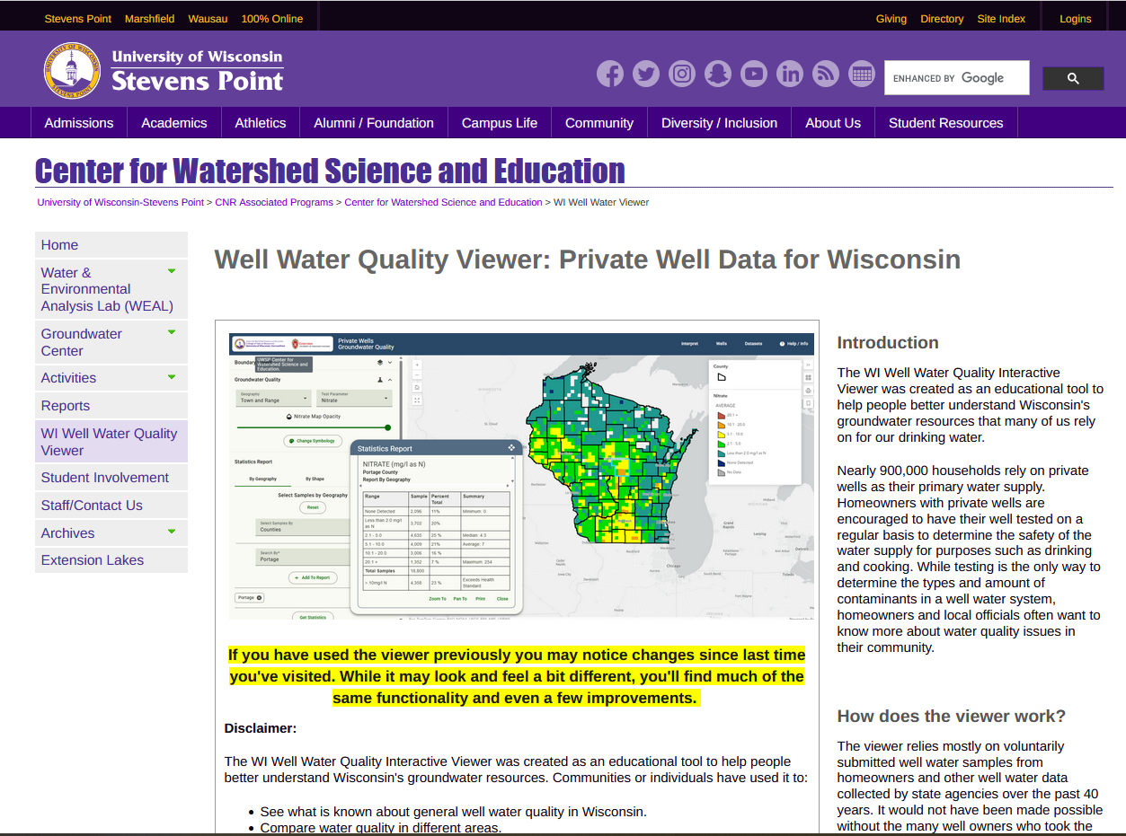
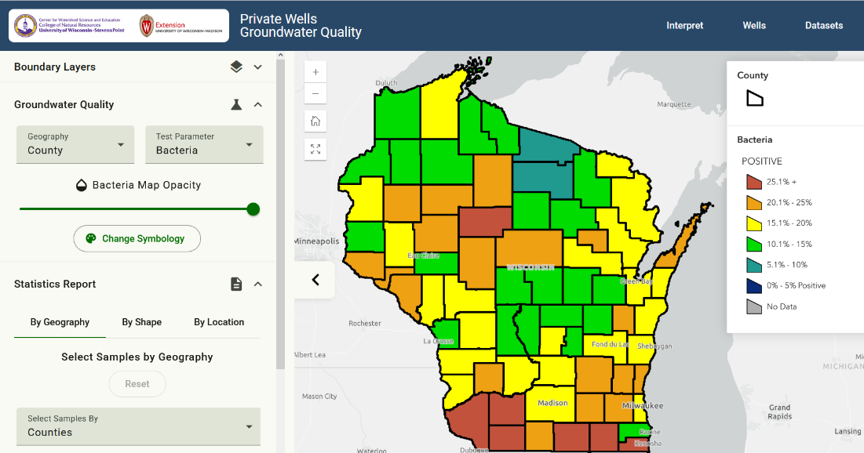
Private Well Data
UW Stevens Point Center for Watershed Science
  Interactive program that allows you to view groundwater quality data at a variety of scales
  Example percent of wells with coliform bacteria detections at county scale
  https://gissrv3.uwsp.edu/webapps/gwc/pri_wells/

Slide 23
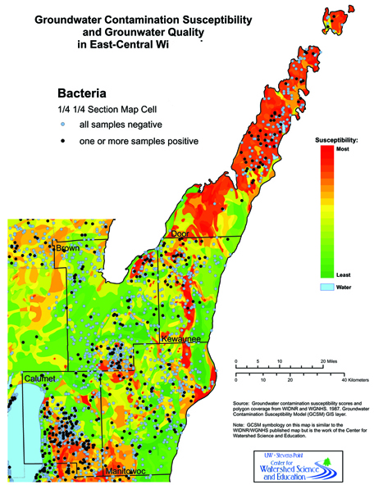
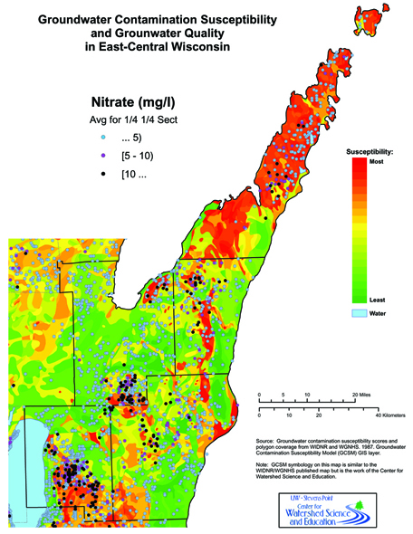
Regional WQ Data
Figures from NE WI Karst Task Force Report (2007)

Slide 24
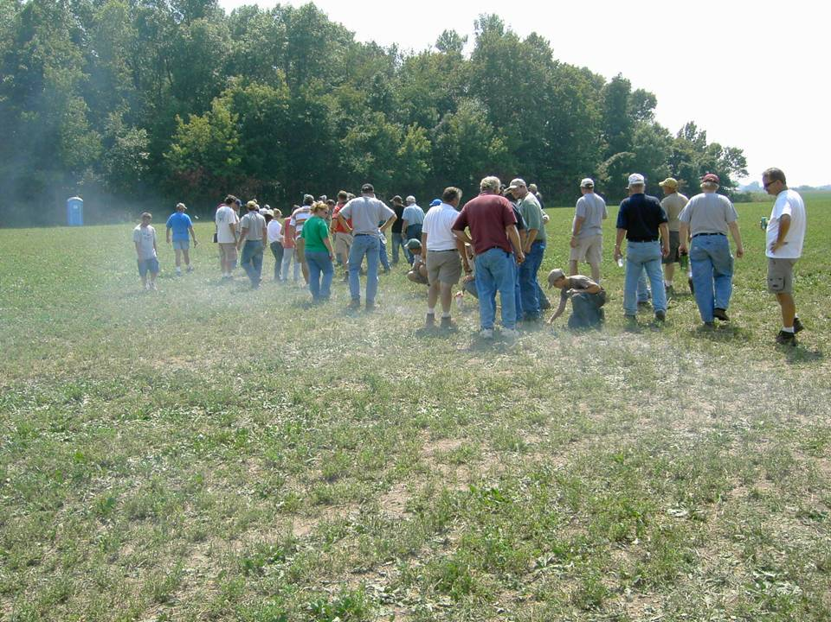
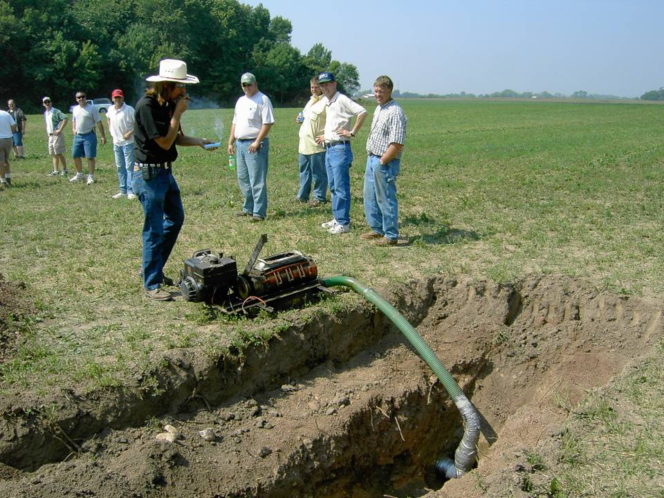
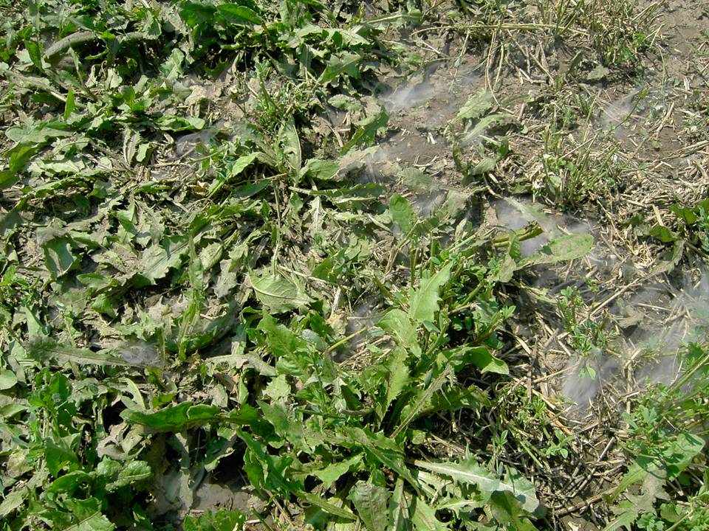
Soil Macropores
Adding smoke to tile drainage line
Photos from Fred Madison

Slide 25
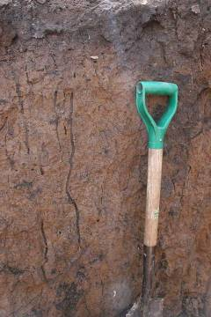
Soil Macropores & Recharge
Fine-grained, cohesive soils may contain fractures and macropores to significant depths
Dodge County: Manure through 15+ feet of clay via cracks and pathways

Slide 26
Outline
WI Geology & Karst
Water Cycle & Groundwater Basics
Why worry about karst?
Soils & Water Quality
Recharge & Water Quality
  Kewaunee County Example
Geology & Hydrogeology of SW WI
Take Away Points

Slide 27
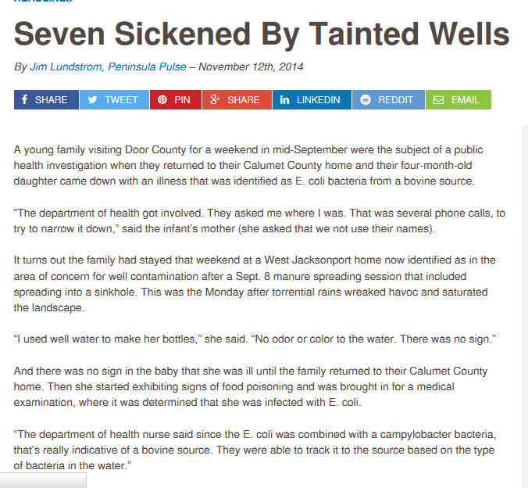
Objective 3
What is the timing of enteric pathogen contamination in relation to groundwater recharge?
  We hypothesize that pathogen arrival precedes “brown water” signal based on anecdotal evidence

Slide 28
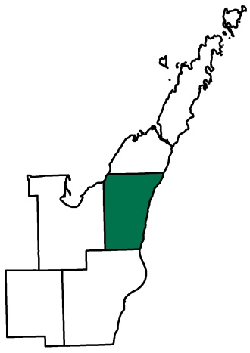
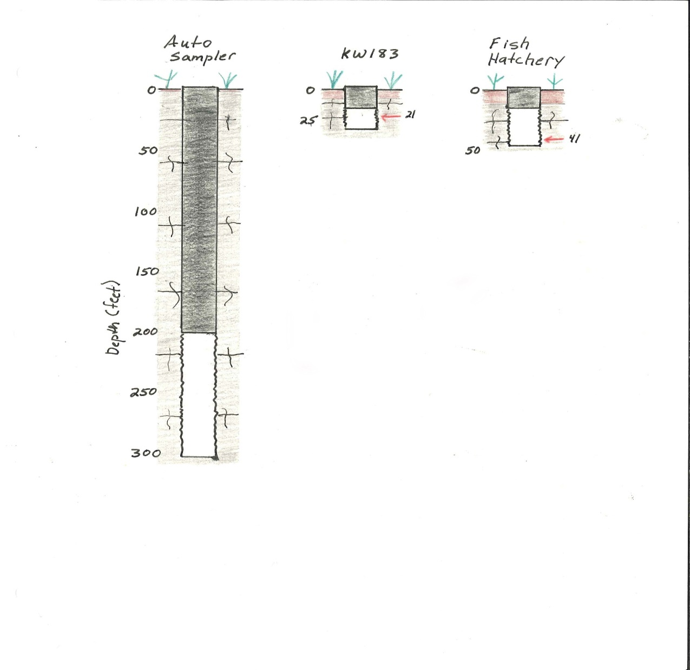
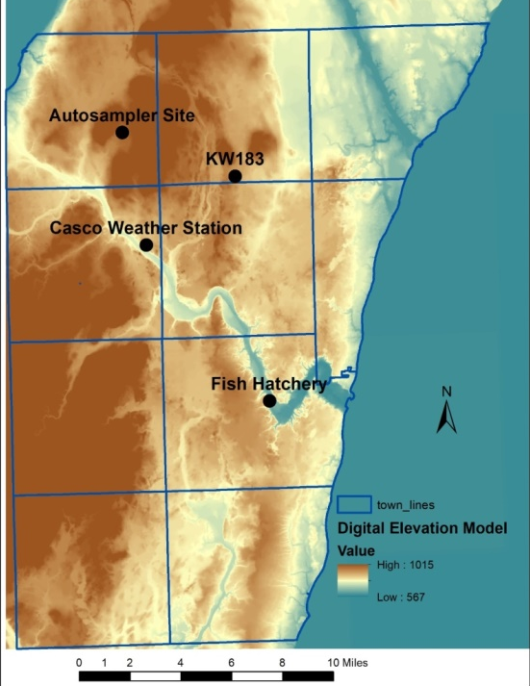
Recharge and Water-Quality Variation
Measured recharge indicators at two non-pumping monitoring wells
  Both water levels and water-quality parameters
Use automated samplers at domestic wells to collect samples during recharge events
Analyze samples by qPCR for microbial targets
Soil: 7 ft
Casing: 10 ft
Total depth: 33 ft
Soil: 11.5 ft
Casing: 15 ft
Total depth: 46 ft
Soil: 2 ft
Casing: 200 ft
Total depth: 303 ft

Slide 29
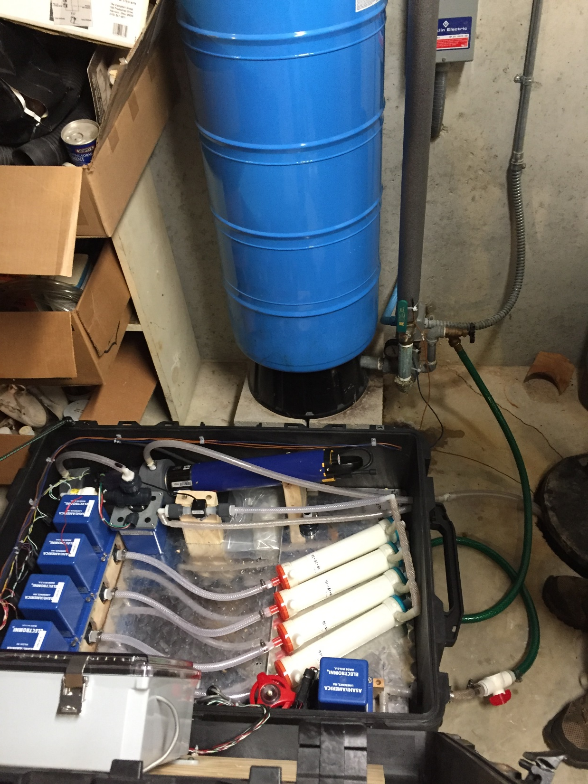

Slide 30
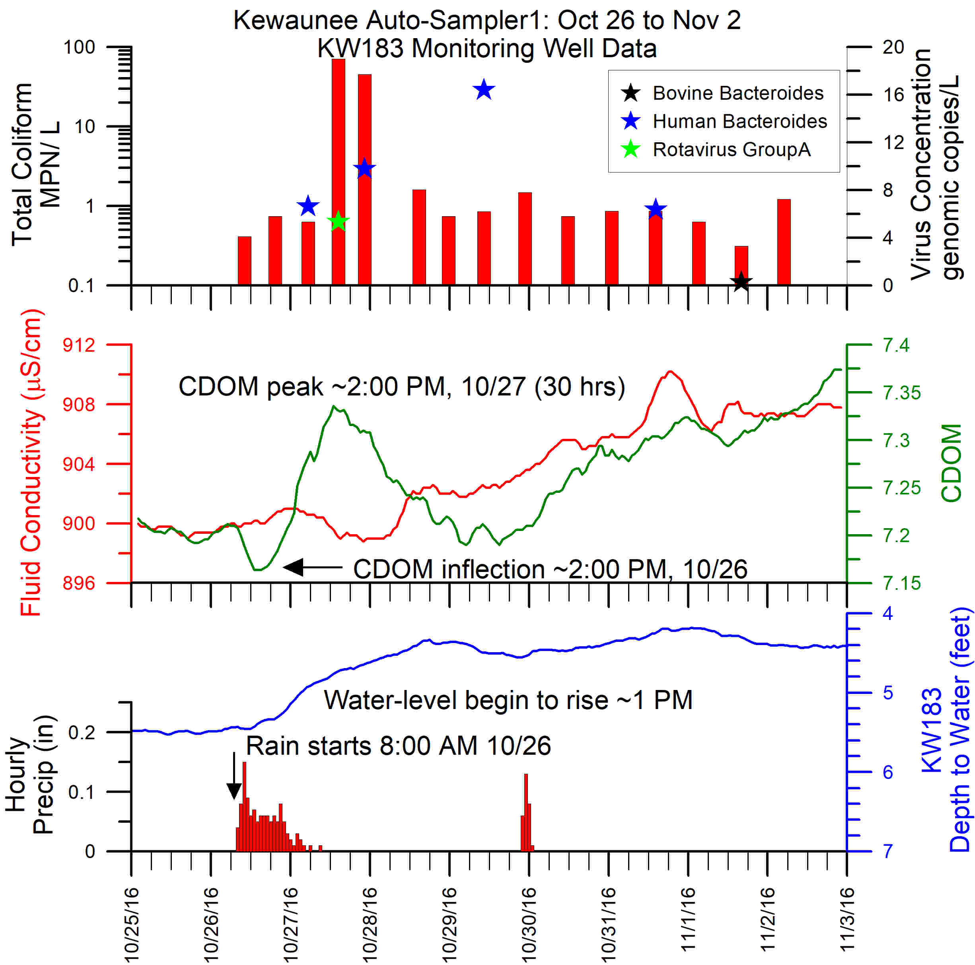
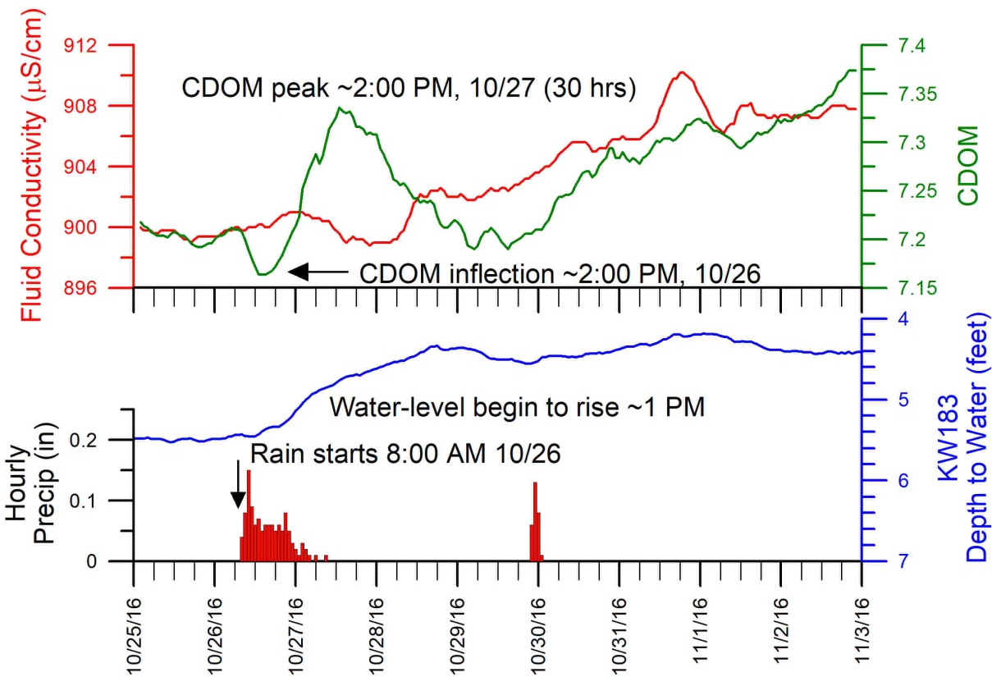
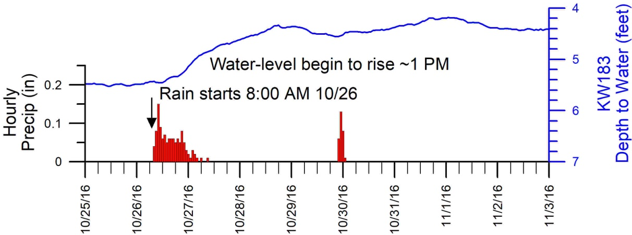
Recharge and Water-Quality Variation
Soil: 7 ft
Casing: 10 ft
Total depth: 33 ft
Soil: 2 ft
Casing: 200 ft
Total depth: 303 ft

Slide 31
Recharge and Water Quality Observations (NE WI)
Recharge is rapid and wells respond within 1 to 2 days of significant rain or melt events
The majority of recharge occurs in the early spring, however fall and winter can also contribute significant recharge. Are occasional summer recharge events
Total coliform counts in domestic wells can vary significantly across a recharge event
As recharge can rapidly penetrate 100’s of feet into the saturated zone, more deeply cased wells do not provide additional protection to the homeowner

Slide 32
Outline
WI Geology & Karst
Water Cycle & Groundwater Basics
Why worry about karst?
Soils & Water Quality
Recharge & Water Quality
Geology & Hydrogeology SW WI
  Bedrock Geology
  Surficial Geology
  Flow Patterns
  Multiple Aquifers
  Pioneer Farm
  SWIGG Results
Take Away Points
Image courtesy of Tony Runkel, MN Geological Survey

Slide 33
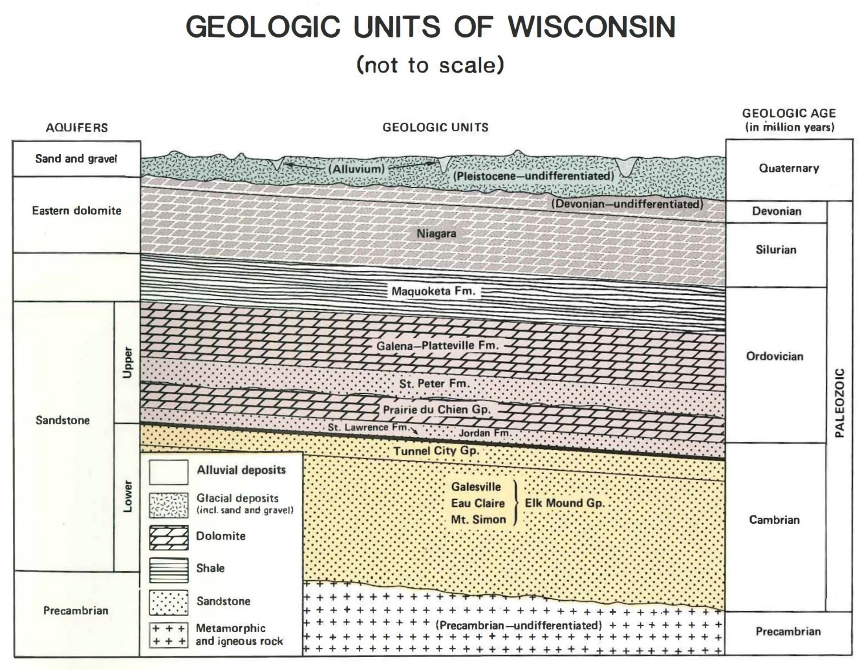
Stratigraphy and Aquifers
NE WI Aquifer
SW WI
Aquifers

Slide 34
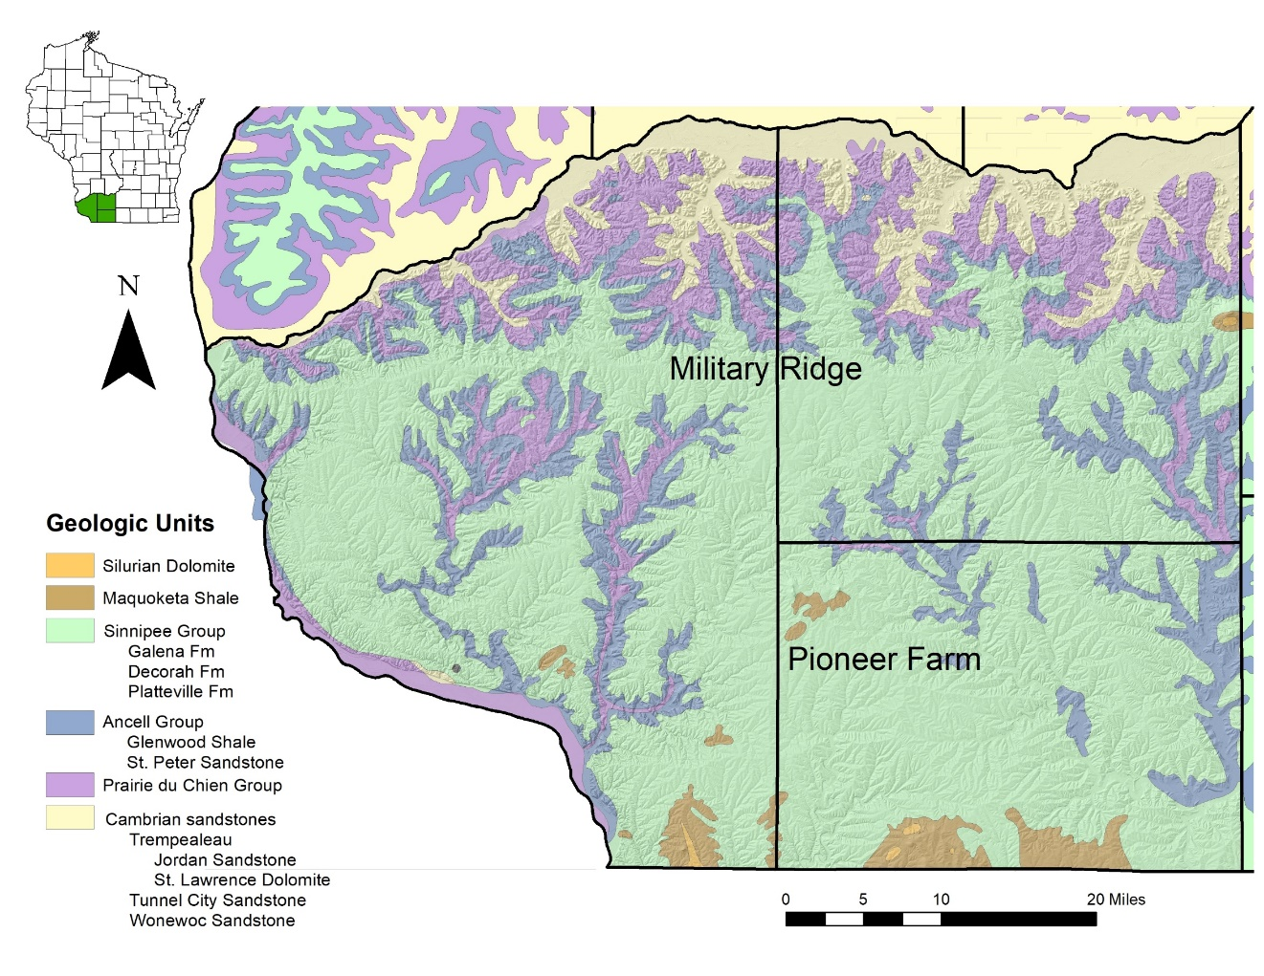

Southwest Wisconsin Bedrock Geology
Geology from Bedrock Geologic Map of Wisconsin.
Mudrey and others 1981
“Bedrock Stratigraphic Units of Wisconsin”
https://wgnhs.wisc.edu/catalog/publication/000200/resource/es051

Slide 35


Wisconsin’s Driftless Area
topography, isolated drift deposits
never glaciated, fluvial incision
From Carson and others, 2019

Slide 36

Surficial Geology
Surficial Geology
  Residuum –sediment from weathered carbonate bedrock, locally known as the ‘Rountree Formation’
  Aeolian – windblown sediment including sand and loess (silt-sized sediment)
  Colluvial Sediment – slope sediment from weathering of Paleozoic bedrock and windblown sediment. Moving downslope due to gravity
  Alluvial Sediment – deposited in stream valleys and on terraces in stream valleys
  Lacustrine – lake sediment
Photo by Eric Carson, WGNHS

Slide 37


1:250,000 Compilation of Surficial Geology of the Driftless Area
Eric Carson
Should be published within a year

Slide 38

Flow Patterns in Southwestern Wisconsin
  Short flow paths from ridgetop to adjacent creek or river
  Different rock layers can cause perching and significant lateral movement of water
  Springs common
Photo courtesy WiDOT
Note seepage locations
Galena
Decorah
Platteville
WGNHS Springs database
Hwy 151 near Dickeyville
Above is modified from “Bedrock Stratigraphic Units of Wisconsin”
https://wgnhs.wisc.edu/catalog/publication/000200/resource/es051

Slide 39

Multiple Aquifers in Southwestern WI
Upper Aquifer consists of the Sinnipee Group (Galena, Decorah, & Platteville Fm)
Separated from Lower Aquifer by the Glenwood Shale
Lower Aquifer includes the St Peter sandstone, Prairie du Chien dolomite and underlying Cambrian sandstones

Slide 40


Groundwater Investigations: Pioneer Farm
A’
B’
LF-465
C’
A
B
C
Pioneer Farm
*Top of Ridge
*Mid Slope
Avg Head
1011.09 ft
*Toe of Slope
Monitoring Network installed by George Kraft in ~2006
  13 monitoring locations, each with 2 to 4 small-diameter piezometers
  Measured water levels and collected water-quality samples
Avg Head
919.2 ft

Slide 41

Recharge Appears to Be Rapid
Top of Ridge
Mid Slope
Toe of Slope
Near Stream
St. Peter

Slide 42


SW WI Groundwater & Geology (SWIGG) Study
Initiated by Iowa, Grant and Lafayette Counties
  Initial funding from the three counties plus Lafayette Ag Stewardship Alliance
Researchers:
Dr. Ken Bradbury, Director and State Geologist, WI Geological & Natural History Survey
Dr. Mark Borchardt, Research Microbiologist, USDA Agricultural Research Service
Dr. Maureen Muldoon, Hydrogeologist, WI Geological & Natural History Survey
Joel Stokdyk, Biologist, U.S. Geological Survey
From UWSP Well Water Data Viewer

Slide 43
Study design & well selection
Objective 1. Determine contamination occurrence
Objective 2. Determine fecal source
Random selection
Random selection
301
126
16,092
35
34
529
147
34
35
Private wells in SWIGG counties
Wells tested for bacteria & nitrate
Wells with bacteria or high nitrate
Tested for pathogens & human, porcine, & bovine fecal markers

Slide 44
Total coliform, E. coli, & nitrate for two synoptic sampling rounds
 | Wells sampled | Total coliform | E. coli | High nitrate* | Total coliform or high nitrate
November 2018 | 301 | 34% | 4% | 16% | 42%
April 2019 | 539 | 16% | 2% | 15% | 27%
Statewide 1997ª | 534 | 23% | 3% | 7% | -
Statewide 2013^{b} | 3838 | 18% | - | 10% | -
Statewide 2017^{c} | 401 | - | - | 8% | -
*High nitrate is NO₃⁻-N > 10 mg/L
ª US General Accounting Office. June 1997.
^{b} Knobeloch L., Gorski P., Christenson M., and Anderson H. 2013.
^{c} Wisconsin Department of Agriculture, Trade, and Consumer Protection, 2017.

Slide 45

Objective 2: Approach
Sample collection
Random selection from wells positive for total coliforms, E. coli, or high nitrate
34 or 35 wells per season, 138 wells total
Objectives 2 & 3: Fecal sources & pathogens
Region:
16,000
wells (approx.)
Random selection
Tested:
816
wells
Positive coliforms or high nitrate wells
Random selection
Tested:
138
wells

Slide 46



Microbes specific to fecal sources
Fecal source | Fecal microbe
Human wastewater | Bacteroidales-like Hum M2
 | Cryptosporidium hominis
 | Human adenovirus groups A-F
 | Human enterovirus
 | Human polyomavirus
 | Norovirus genogroup I
 | Human Bacteroides
Cattle/ruminant manure | Bacteroidales-like cow M2
 | Bacteroidales-like cow M3
 | Bovine adenovirus
 | Bovine enterovirus
 | Bovine polyomavirus
 | Ruminant Bacteroides
Pig manure | Pig-1-Bacteroidales
 | Pig-2-Bacteroidales
 | Porcine adenovirus
 | Porcine epidemic diarrhea virus

Slide 47
Objective 2: Key findings
Human wastewater & livestock manure contribute to private well contamination, & human wastewater was more common.
Wells positive for fecal microbes (138 tested)
Fecal source | No. positive wells
Human wastewater | 64
Cattle/ruminant manure | 33
Pig manure | 13
26 wells were positive for multiple fecal sources.

Slide 48

Deep well,
deeply cased
Shallow well
Contaminant source
= water table
Shallow wells draw from the upper aquifer
Deep wells draw from the lower aquifer
upper aquifer
Glenwood Shale
lower aquifer

Slide 49






Geology and Nitrate
Nitrate results by Aquifer
Elevated nitrate is more common for wells in the Sinnipee and S&G aquifers
  These wells are typically shallow and older

Slide 50








Nitrate in SW Wisconsin Karst
A’
B’
C’
In SW WI
  Ten samples at Pioneer Farm from August 2020 to August 2021
  Work by Masarik & others (2007) that suggests that baseflow to the Upper Fever River accounts for 80% of the annual nitrate loss from croplands in the basin
  Elevated NO₃-N in streams; example from springs in Upper Fever River
A
B
C
Pioneer Farm

Slide 51


Well Construction is Important
Shallowly-cased wells are more vulnerable to contaminants originating at the land surface than deeply-cased wells.
Minnesota has well construction codes that prevent cross-connection between aquifers
Runkel and others, 2013. Minnesota Geological Survey, OpenFile Report 14-02

Slide 52
Take Away Messages
Karst aquifers form by dissolving carbonate rock (limestone and dolomite). Water can move quickly in the interconnected network of fractures and conduits
Soils are the “protective cover” over karst aquifers. Areas with thin soils or coarse-textured soils are more vulnerable to contamination. Macropores in cohesive soils also provide pathways for contaminants.
Recharge is the process that moves contaminants from the ground surface into the aquifer. Recharge varies seasonally. Aquifers are most vulnerable during recharge periods.
The karst flow systems in NE and SW Wisconsin are different.
In NE WI, areas with thin soils are more vulnerable to contamination.
In SW WI, geology and well construction are significant factors in predicting well contamination

Slide 53

Hydrogeologic Resources SW WI
Detailed 1:24,000 geologic maps for Lead-Zinc District
  Heyl, A.V. Jr, A. F. Agnew, E.J. Lyons, and C.H. Behre, Jr., 1959. The Geology of the Upper Mississippi Valley Zinc-Lead District, U.S.G.S. Professional Paper 309, 320 pages, 24 plates.
Iowa County Bedrock Map
  Bill Batten, 2010. WGNHS Open File Report,WOFR2010-01, Plate 1 is map, Plate 2 cross sections
Grant County Bedrock Map by Eric Stewart
Lafayette County Bedrock Map by Eric Stewart – expected Summer 2026
Surficial Geology Maps of Driftless counties, Eric Carson
  many counties mapped at 1:100,000 scale. 1:250,000 compilation within a year
Depth-to-bedrock Maps: in progress

Slide 54
Hydrogeologic Resources SW WI
Iowa County Water-table map
  Gotkowitz, 2010. WGNHS Open File Report, WOFR2010-03-plate01
  Water-table maps can be used to delineate capture zones
Grant County Water-table map
  Muldoon, in prep. Draft contours completed, hope it will be published within the year.
SWIGG Report to Counties
  Stokdyk and others, 2023. WGNHS Open File Report, WOFR2023-02
SWIGG Journal Article
  “Sources and risk factors for nitrate, pathogens, and fecal contamination of private wells in rural southwestern Wisconsin, USA” (Joel Stokdyk and others) was submitted to Water Research last month
Current Project “Risk from pathogens and exposure to antibiotic resistance genes in private wells in southwest WI” July 2023-June 2025

Slide 55

Information on Well Construction
Well construction reports (WCRs) contain information about private wells.
To find a well construction report visit the DNR website:
https://dnr.wi.gov/WellConstructionSearch/#!/PublicSearch/Index

Slide 56


Information on Groundwater Quality
UW Stevens Point Center for Watershed Science
  Interactive program that allows you to view groundwater quality data at a variety of scales
https://www3.uwsp.edu/cnr-ap/watershed/Pages/WellWaterViewer.aspx

Slide 57

Where to get help with your water
The WDNR has a variety of publications
https://dnr.wisconsin.gov/topic/Wells/homeowners.html

Slide 58


The Center for Watershed Science and Education at UW Stevens Point has numerous education resources about groundwater and wells
https://www3.uwsp.edu/cnr-ap/watershed/Pages/GWHome.aspx

Slide 59


The Wisconsin Geological and Natural History Survey provides maps, publications, and data about geology and groundwater
https://wgnhs.wisc.edu/

