Slide 1
The Security of AI
(what you need to know)
Badger Talks!
May 8, 2025 – Racine, WI
Patrick McDaniel, Tsun-Ming Shih Professor of Computer Sciences
UW-Madison School of Computer, Data & Information Sciences

Slide 2
Social disruption at scale …
Healthcare
Finance
Insurance
Marketing
Education
E-commerce
Manufacturing
Transportation
…
The Security of AI

Slide 3
The “security” and ”safety” questions?
In security, we ask two questions of any “new” technology
  Can the technology be abused by an adversary?
  Can the technology be used against us?
Hint 1: the answer is always yes.
Hint 2: we are still trying to figure out what “secure” means.
The Security of AI

Slide 4
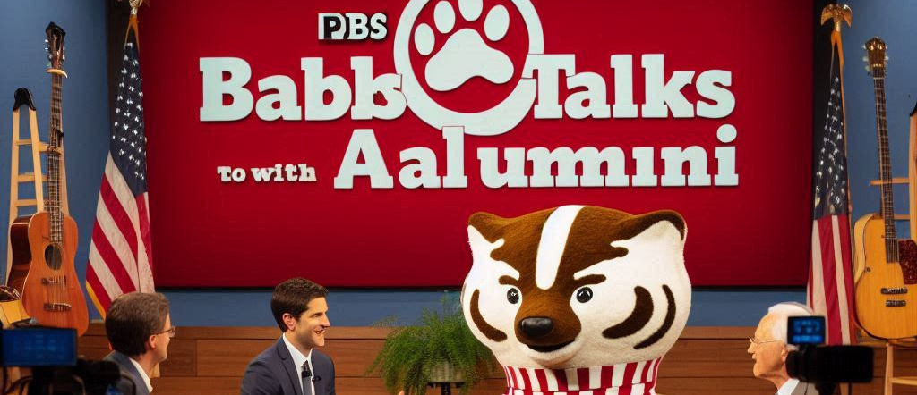
Ask AI: PBS Wisconsin hosts Badger Talks (to Alumni)
The Security of AI

Slide 5
What is AI*?
*Also known as machine learning

Slide 6
AI in 5 minutes ...
Note: the car is the system, and the ML is a component (which is wrong some of the time ~ statistical ML)
The Security of AI

Slide 7
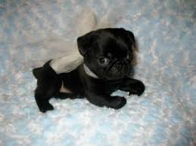
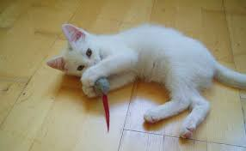
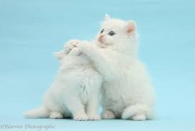
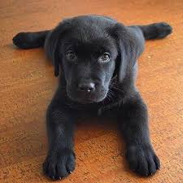
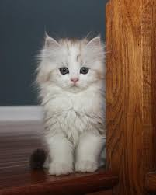
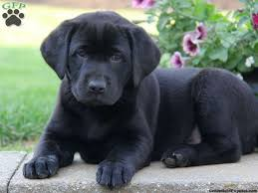
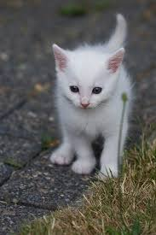
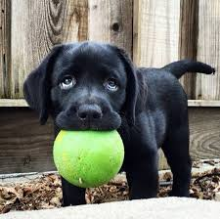
AI in 5 minutes ...
It's all about generalization ...
The Security of AI

Slide 8
AI in 5 minutes ...
The learning algorithm identifies the regions of the “feature space” that best represent the phenomenon …
The Security of AI

Slide 9
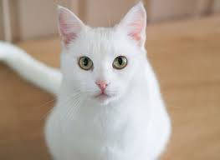
AI in 5 minutes ...
The learning algorithm identifies the regions of the “feature space” that best represent the phenomenon …
C
The Security of AI

Slide 10
AI in 5 minutes ...
The learning algorithm identifies the regions of the “feature space” that best represent the phenomenon …
?
Problem: the input is not like the data trained with
The Security of AI

Slide 11
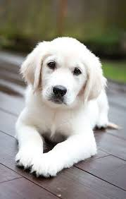
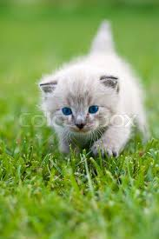
AI is not magic!
AI does not ”learn” reality, just mimics data it is given …
(Training data is often an infinitesimally small portion of phenomenon)
The Security of AI

Slide 12

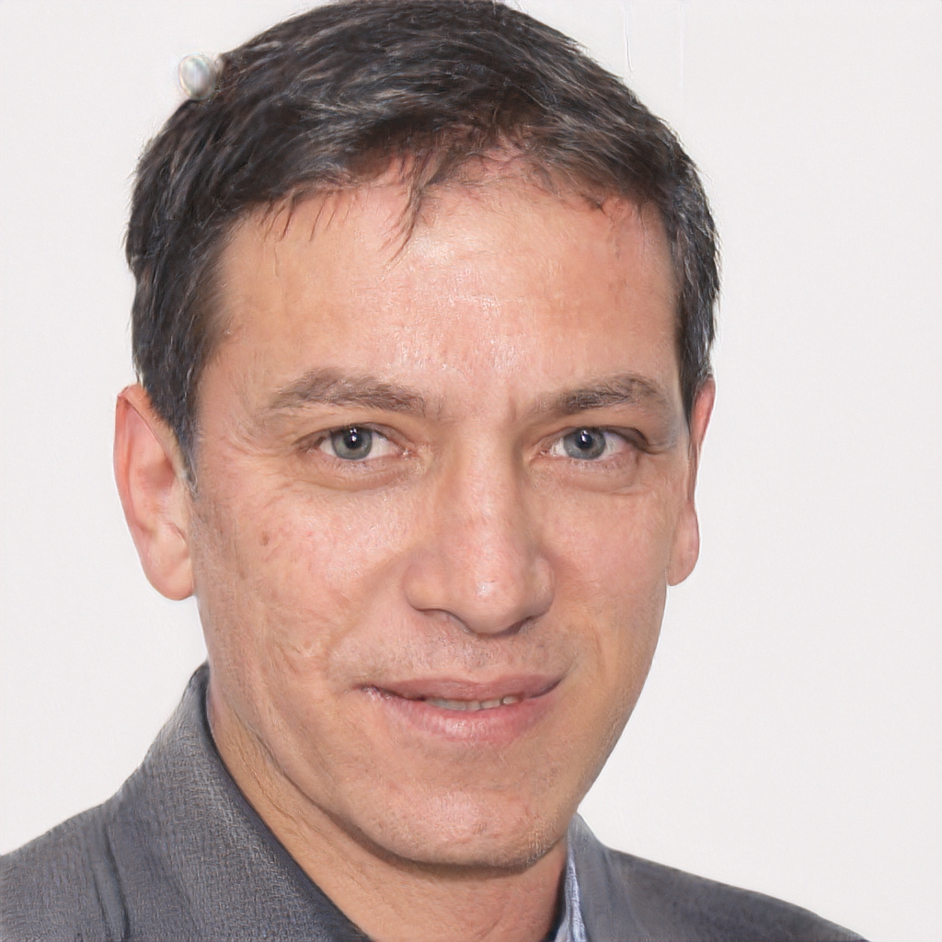

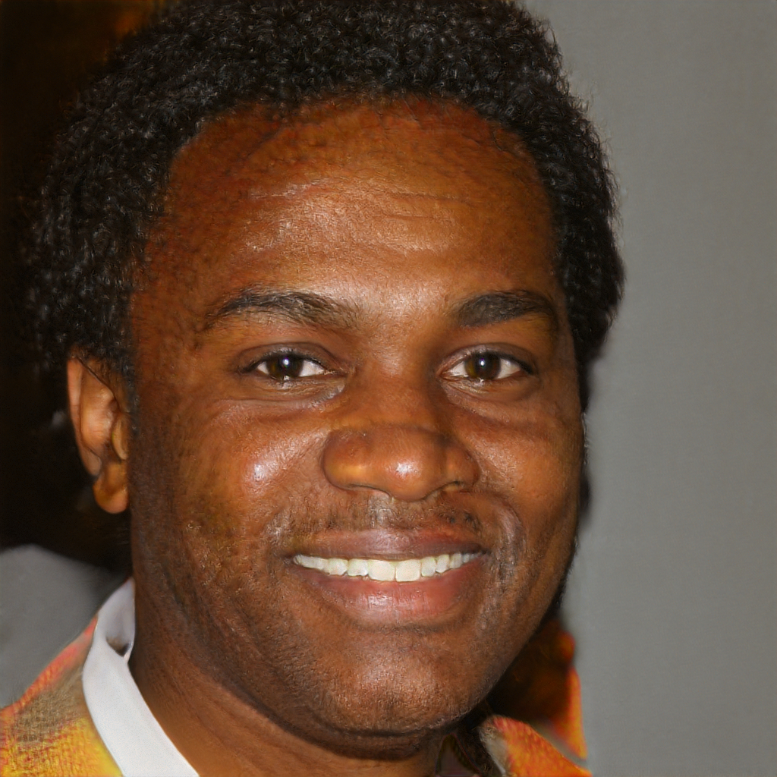
Synthetic reality
“I love this place. I have been going here
for years and it is a great place to hang
out with friends and family. I love the food
and service. I have never had a bad
experience when I am there.” (5 stars!)
“I had the grilled veggie burger with fries!!!! Ohhhh and
taste. Omgggg! Very flavorful! It was so delicious that
I didn’t spell it!!” (5 stars!)
“I was so excited to try this place out for the first time and the food was awful. I ordered the chicken sandwich and it was so salty that I could not eat it. I was so disappointed that I was so disappointed in the food. I was so disappointed that I was so disappointed with the service.” (1 star)
Source: https://arxiv.org/pdf/1708.08151.pdf, “Automated Crowdturfing Attacks and Defenses in Online Review Systems” (Yao et al.)
https://thispersondoesnotexist.com/
The Security of AI

Slide 13
How can AI be used against us?

Slide 14

Let's play a game ….
The Security of AI

Slide 15
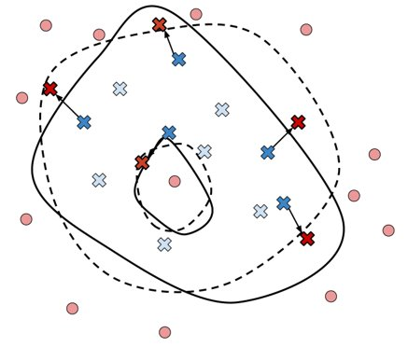
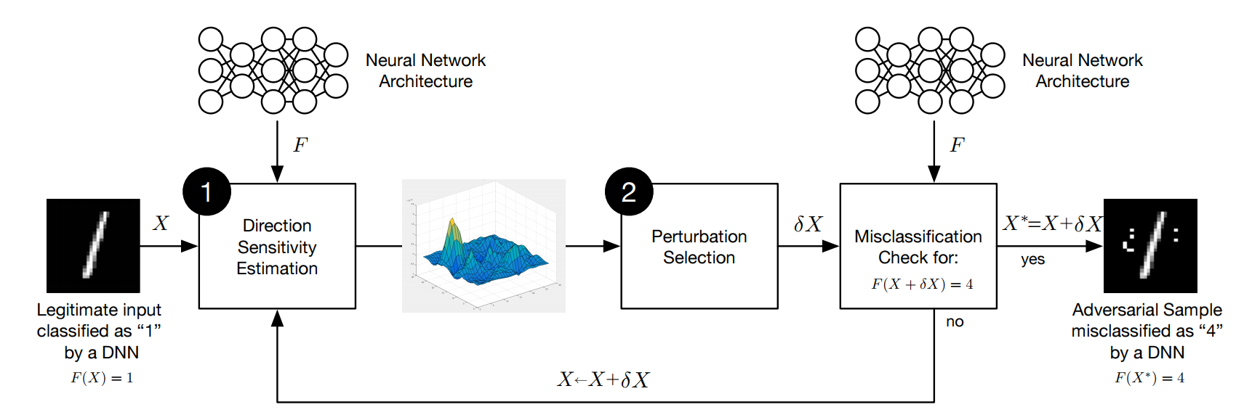
Attacking AI (for starters …)
Manipulating the "model"
  Adversarial inputs
    Force AI to make wrong/dangerous decisions
  Poisoning the training
    Make bad decisions
    Create "back door" inputs
Model theft/exposure
  Adversaries can extract the model
  Adversaries can extract the data that the model was trained on
The Security of AI

Slide 16






What happens when our data is “in” the AI?
Reconnaissance– you don’t have to know anything about AI, you just have to be able to access it.
Intellectual property – if your organization’s value is “in” a model, then it can be extracted (and duplicated and misused).
Privacy – the model can tell you a lot about the training data, e.g., patient data (membership queries).
The Security of AI

Slide 17
How will the use of ML
impact society?

Slide 18
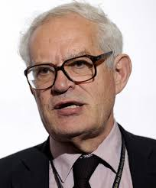
Goodhart’s Law and AI …
Economist Charles Goodhart posited in 1975 that …
This insight is very relevant today: the more our success
in life and carrying out of daily activities relies on
computational reasoning, the more we will have to
“satisfy” the models that make decisions for and about us.
Hence, a corollary to Goodhart’s law …
“when AI becomes the target, the target can be gamed”
“When a measure becomes a target, it ceases to be a good measure”​
The Security of AI

Slide 19
A synthetic universe …
Machine learning can now emulate human behavior, thought processes, and strategies to the pointer they have become indistinguishable from real humans …
The Security of AI

Slide 20
The digital human …
We are on the cusp of being faced with innumerable army of “fake” digital human beings who can wreak havoc on public discourse, politics, due process, commerce, and society at large.
Think of misinformation today …
The Security of AI

Slide 21
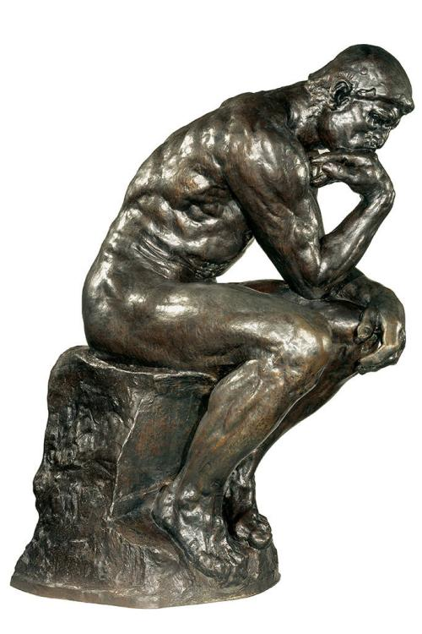
A call to think …
AI will alter life on this planet in ways that change the nature of existence (for good and ill)
The use cases will be compelling and may address things like hunger, disease and foster a renaissance in all areas of human endeavor.
However, we need to think about when and how we use AI
  Understand AI’s weaknesses, vulnerability and potential failures
  Negotiate norms, public policy, and law to protect people and society
We must act now …
The Security of AI

Slide 22
Contact: mcdaniel@cs.wisc.edu

