Slide 1
What Does AI Mean to Our Future? (what you need to know)
Badger Talks!
May 8, 2025 – Racine, WI
Patrick McDaniel, Tsun-Ming Shih Professor of Computer Sciences
UW-Madison School of Computer, Data & Information Sciences

Slide 2
Social disruption at scale …
Healthcare
Finance
Insurance
Marketing
Education
E-commerce
Manufacturing
Transportation
…
What Does AI Mean to Our Future?

Slide 3
The “security” and ”safety” questions?
In security, we ask two questions of any “new” technology
Can the technology be abused by an adversary?
Can the technology be used against us?
Hint 1: the answer is always yes.
Hint 2: we are still trying to figure out what “secure” means.
What Does AI Mean to Our Future?

Slide 4
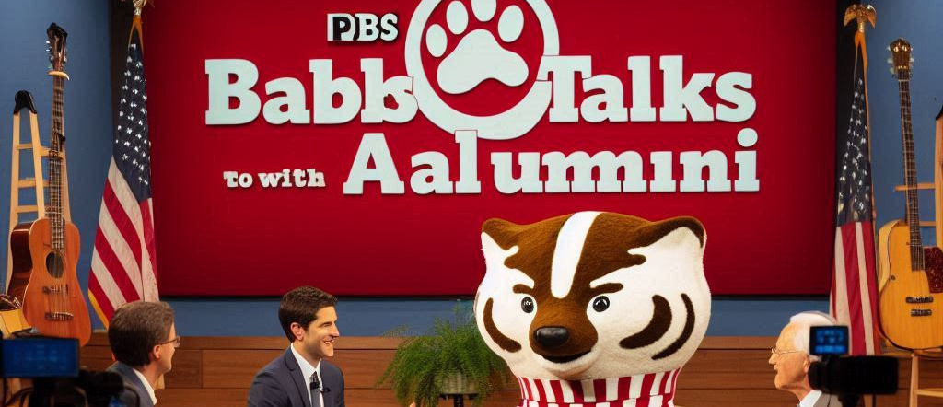
Ask AI: PBS Wisconsin hosts Badger Talks (to Alumni)
What Does AI Mean to Our Future?

Slide 5
What is AI*?
*Also known as machine learning

Slide 6
AI in 5 minutes ...
Note: the car is the system, and the ML is a component (which is wrong some of the time ~ statistical ML)
What Does AI Mean to Our Future?

Slide 7
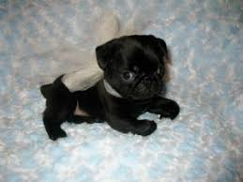
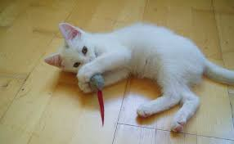
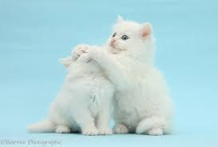
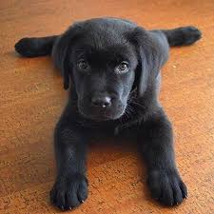
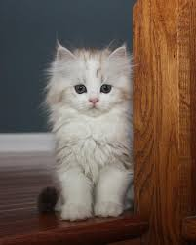
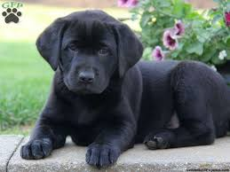
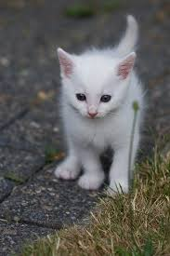
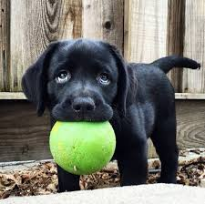
AI in 5 minutes ...
It's all about generalization ...
What Does AI Mean to Our Future?

Slide 8
AI in 5 minutes ...
The learning algorithm identifies the regions of the “feature space” that best represent the phenomenon …
What Does AI Mean to Our Future?

Slide 9
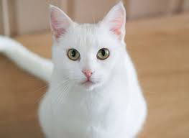
AI in 5 minutes ...
The learning algorithm identifies the regions of the “feature space” that best represent the phenomenon …
C
What Does AI Mean to Our Future?

Slide 10
AI in 5 minutes ...
The learning algorithm identifies the regions of the “feature space” that best represent the phenomenon …
?
Problem: the input is not like the data trained with
What Does AI Mean to Our Future?

Slide 11
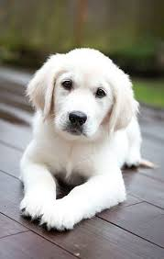
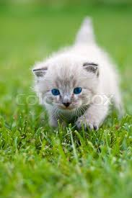
AI is not magic!
AI does not ”learn” reality, just mimics data it is given …
(Training data is often an infinitesimally small portion of phenomenon)
What Does AI Mean to Our Future?

Slide 12



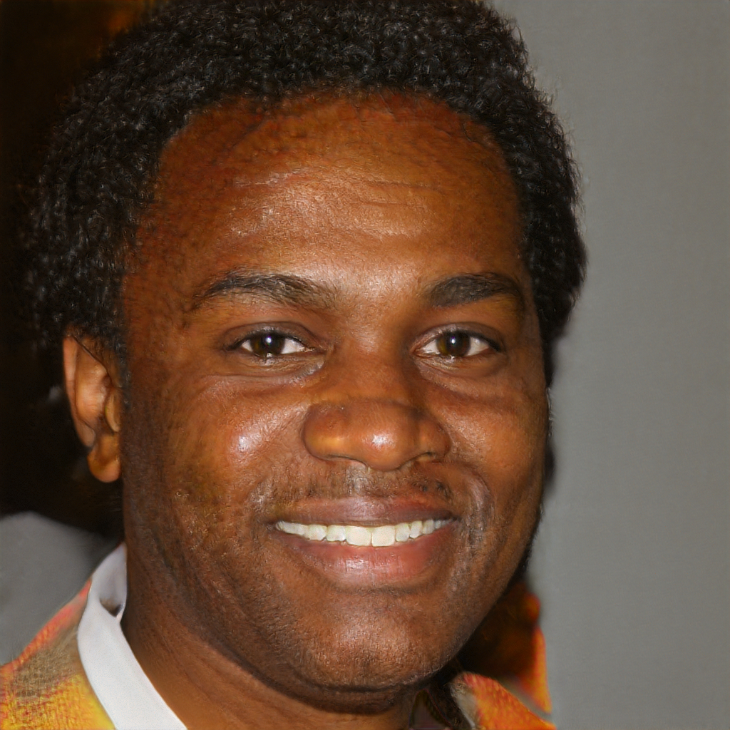
Synthetic reality
“I love this place. I have been going here for years and it is a great place to hang out with friends and family. I love the food and service. I have never had a bad experience when I am there.” (5 stars!)
“I had the grilled veggie burger with fries!!!! Ohhhh and taste. Omgggg! Very flavorful! It was so delicious that I didn’t spell it!!” (5 stars!)
“I was so excited to try this place out for the first time and the food was awful. I ordered the chicken sandwich and it was so salty that I could not eat it. I was so disappointed that I was so disappointed in the food. I was so disappointed that I was so disappointed with the service.” (1 star)
Source: https://arxiv.org/pdf/1708.08151.pdf, “Automated Crowdturfing Attacks and Defenses in Online Review Systems” (Yao et al.)
https://thispersondoesnotexist.com/
What Does AI Mean to Our Future?

Slide 13
How can AI be used against us?

Slide 14
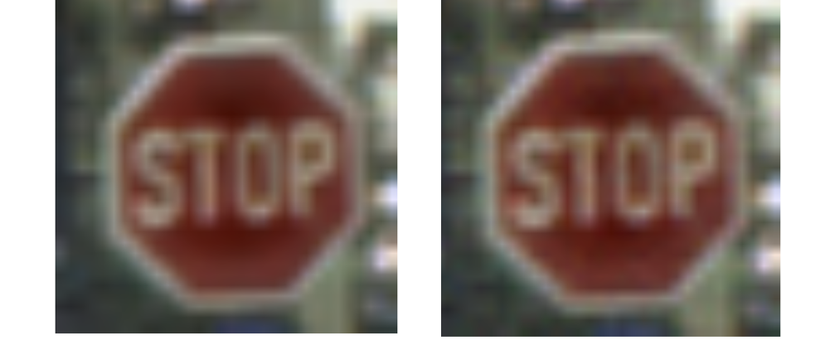
Let's play a game ….
What Does AI Mean to Our Future?

Slide 15
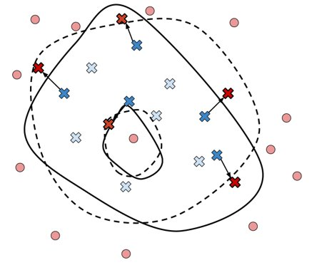
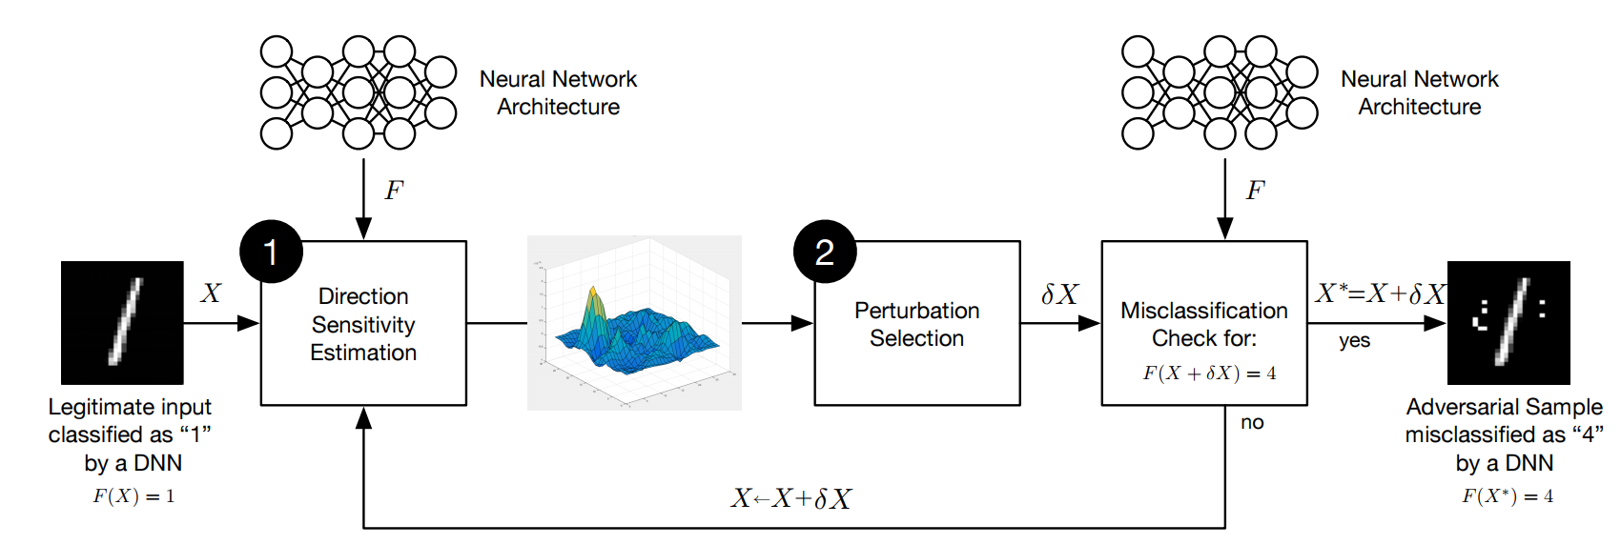
Attacking AI (for starters …)
Manipulating the "model"
Adversarial inputs
Force AI to make wrong/dangerous decisions
Poisoning the training
Make bad decisions
Create "back door" inputs
Model theft/exposure
Adversaries can extract the model
Adversaries can extract the data that the model was trained on
What Does AI Mean to Our Future?

Slide 16
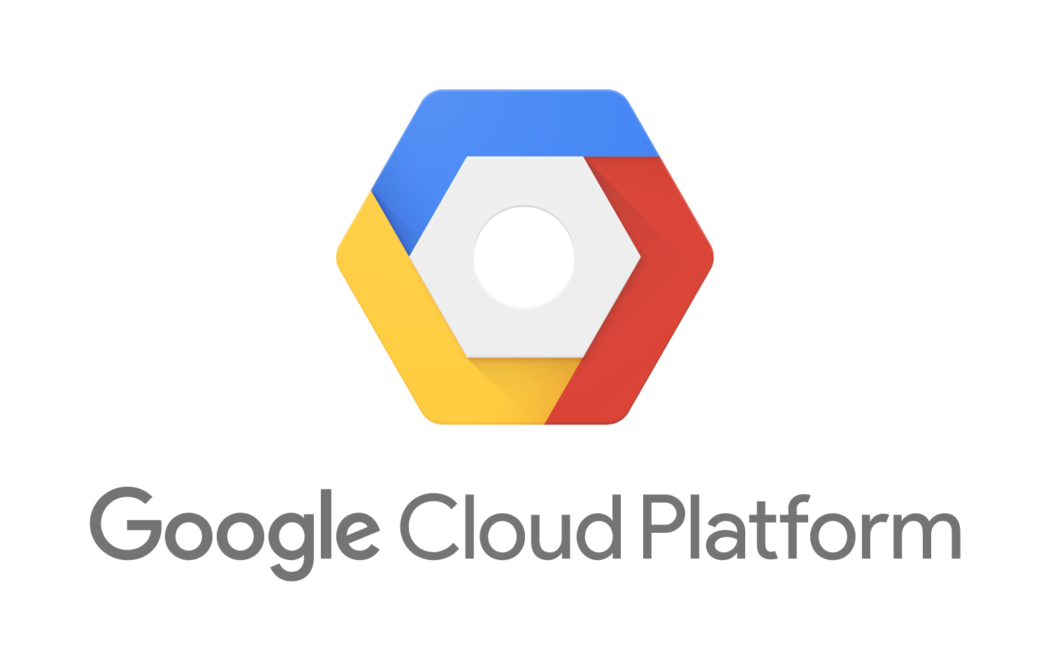





What happens when our data is “in” the AI?
Reconnaissance– you don’t have to know anything about AI, you just have to be able to access it.
Intellectual property – if your organization’s value is “in” a model, then it can be extracted (and duplicated and misused).
Privacy – the model can tell you a lot about the training data, e.g., patient data (membership queries).
What Does AI Mean to Our Future?

Slide 17
How will the use of ML impact society?

Slide 18
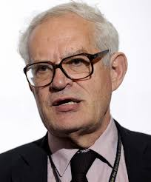
Goodhart’s Law and AI …
Economist Charles Goodhart posited in 1975 that …
This insight is very relevant today: the more our success in life and carrying out of daily activities relies on computational reasoning, the more we will have to “satisfy” the models that make decisions for and about us.
Hence, a corollary to Goodhart’s law …
“when AI becomes the target, the target can be gamed”
“When a measure becomes a target, it ceases to be a good measure”​
What Does AI Mean to Our Future?

Slide 19
A synthetic universe …
Machine learning can now emulate human behavior, thought processes, and strategies to the point they have become indistinguishable from real humans …
What Does AI Mean to Our Future?

Slide 20
The digital human …
We are on the cusp of being faced with innumerable army of “fake” digital human beings who can wreak havoc on public discourse, politics, due process, commerce, and society at large.
Think of misinformation today …
What Does AI Mean to Our Future?

Slide 21
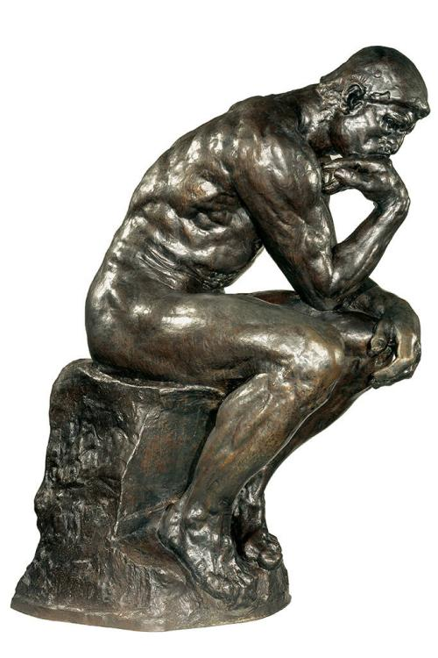
A call to think …
AI will alter life on this planet in ways that change the nature of existence (for good and ill)
The use cases will be compelling and may address things like hunger, disease and foster a renaissance in all areas of human endeavor.
However, we need to think about when and how we use AI
Understand AI’s weaknesses, vulnerability and potential failures
Negotiate norms, public policy, and law to protect people and society
We must act now …
What Does AI Mean to Our Future?

Slide 22
Contact: mcdaniel@cs.wisc.edu

