Slide 1

Microbiome in aging and health
Barbara Bendlin, PhD, Professor, Medicine
Director, Neuroscience & Public Policy Program
Deputy Director, Center for Health Disparities Research
REC Leader, Wisconsin ADRC
School of Medicine & Public Health, University of Wisconsin-Madison

Slide 2
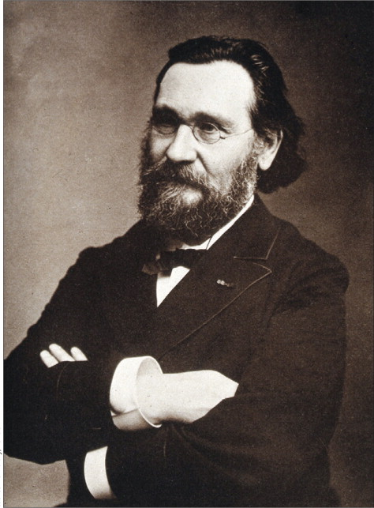
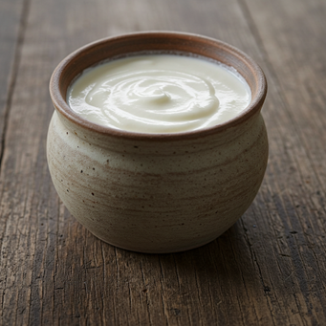
Élie Metchnikoff
Notes:
Eliya Metchnikoff was a Russian zoologist best known for his pioneering research in immunology
As a father of immunology - most notable discovery was that of “phagocytes,” bacteria-eating cells which he realized serve as protectors against infection
1908 he received Nobel Prize in Physiology or Medicine
foods and keen observer of the natural world. Noticed that there were unusually large number of centenarians in certain sections of Eastern Europe, and he began to develop his own scientific theories on how lifespan could be extended. He was particularly interested in fermented foods and noted that centenarians were consuming a lot of yogurt.
His interest in fermented foods linked to his interest in immunology, theorized that the bacteria in yogurt were important for crowding out other microbiota that cause disease. He even experimented on himself drinking sour milk every day, and also attempting to infect himself with cholera, and not becoming ill, and concluding that Cholera infection was due to differences in intestinal microbes, speculating that those who have plenty of beneficial ones would be healthier.

Slide 3

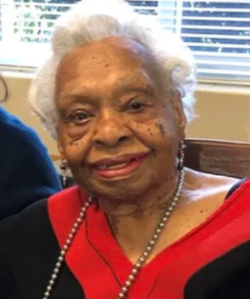
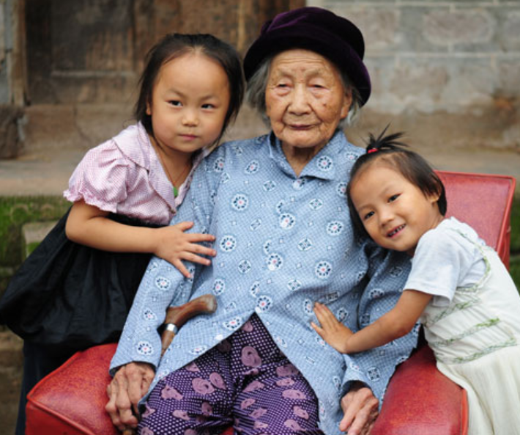
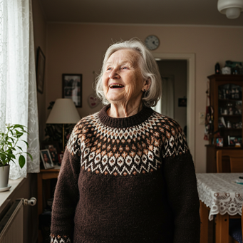
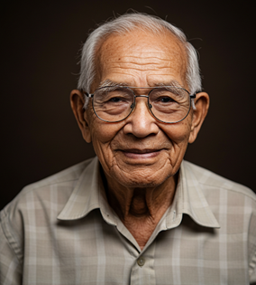
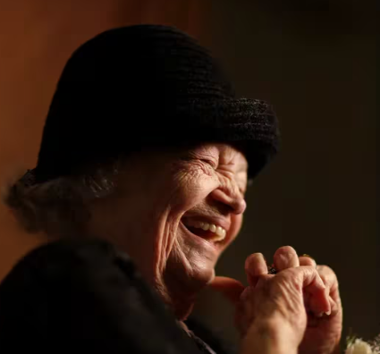
Notes:
Coined the term gerontology, was a pioneer in longevity, and promoted the idea of maintaining health in older age. Early on linked the ideas of probiotics, immune function, and aging.
Today in our discussion of aging, and Alzheimer’s disease, we’re revisiting the intersection of these ideas

Slide 4
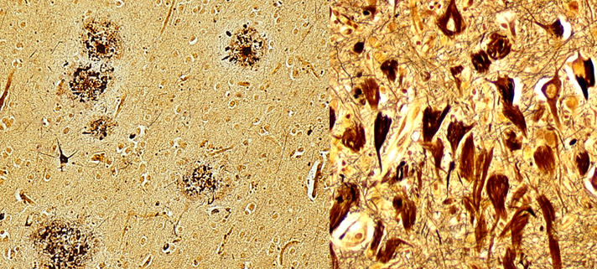
Courtesy of Dr. Shahriar Salamat
Notes:
Have spent a lot of my career working on understanding Alzheimer’s disease.
Understanding the impact of risk factors for AD, ie what influences the development of plaques and tangles as seen here on autopsy.
We can now see these in living people with brain imaging, CSF, and blood analysis.

Slide 5
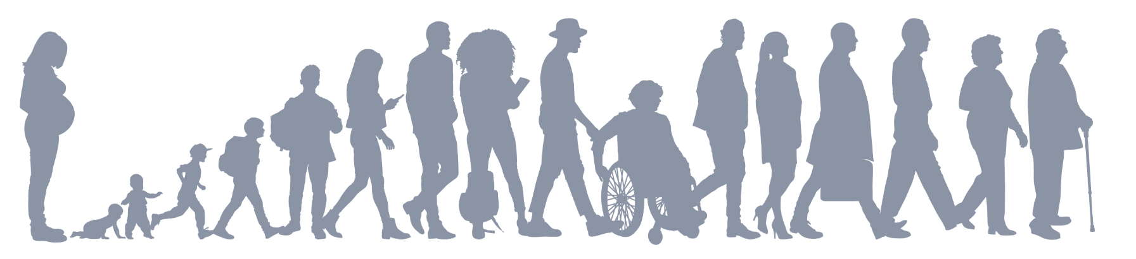
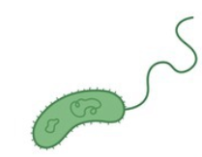
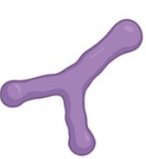
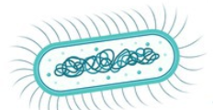
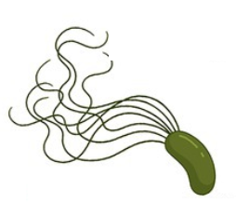
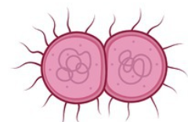
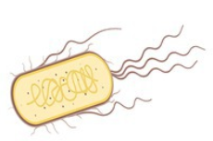
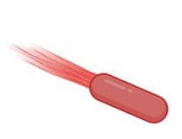

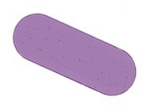







Notes:
We know that longevity, health span, and risk for neurodegenerative disease is impacted by genetics. However, exposures across the lifecourse also play a role. Even genetically identical twins can have many years of discrepancy in the onset of dementia.
One idea is that exposures, ie. some of the lifestyle factors impact disease risk.
Exposome includes microbiota we are exposed to over the life course,. Certain viral infections such as HSV-1 have been linked to potentially increased risk for dementia, the microbe that causes lyme disease, Corona virus as well.
The food we eat shapes our microbiome, which may in turn provide a pathway to health outcomes. Or working in an environment with pesticide exposure could actually deplete healthy microbes that colonize us.

Slide 6
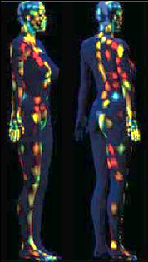
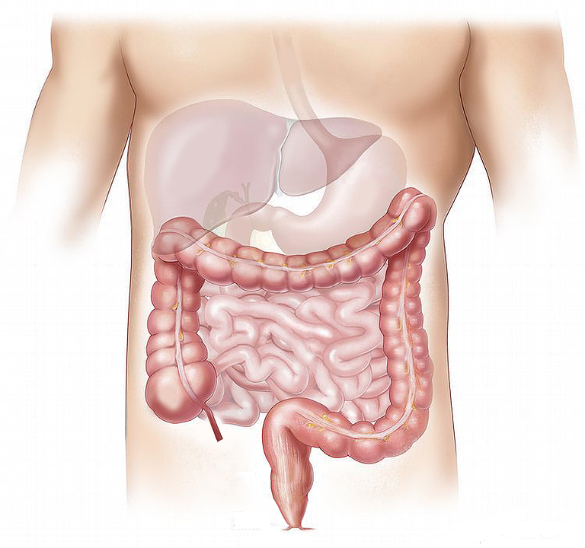
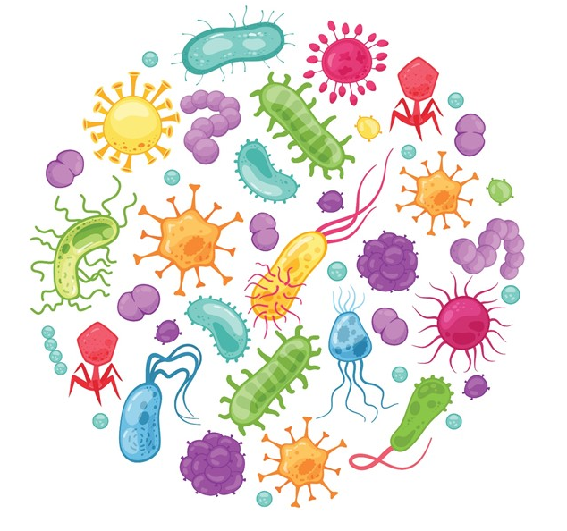
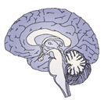
Human Microbiome
Some are pathogens but most are either benign or beneficial
In gut: play role in nutrition, immunity, barriers, toxins
Altered in disease
Proc. Natl Acad. Sci. USA (2015)
Notes:
Microbiota are not necessarily pathogenic.
We evolved with microbes and they play important roles in our health
Differences in composition have been shown in Gastrointestinal illnesses, Metabolic syndrome, Type 2 diabetes, Autoimmune disease, Allergy, Osteoarthritis, HIV complications, Cancer, Heart disease, Eczema/psoriasis, psychiatric diseases, and brain diseases.
Mental health/psychiatric conditions, Autism, Neurological and neurodegenerative diseases: Parkinson’s, ALS, Multiple Sclerosis, Stroke, Alzheimer’s

Slide 7
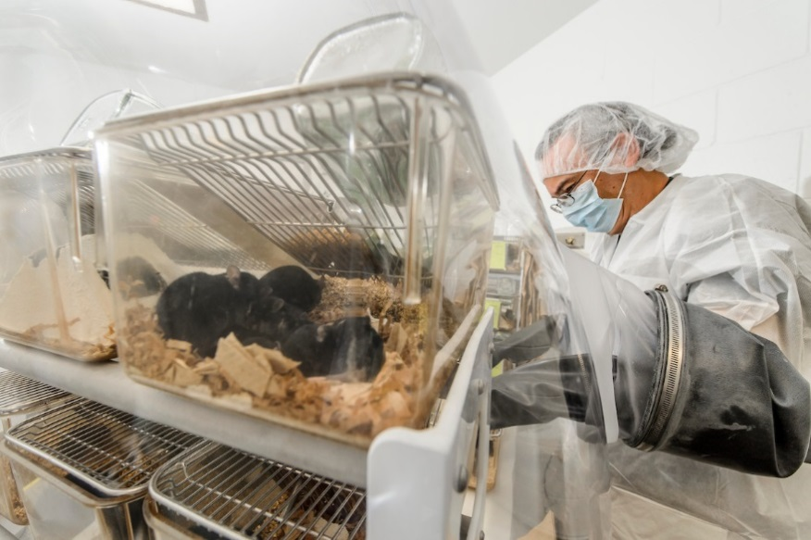
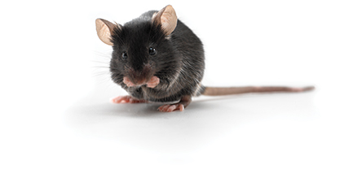

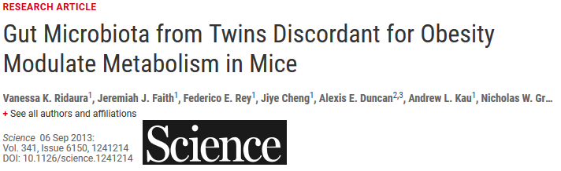
Gut microbiome and obesity
Federico Rey, PhD
Is the gut microbiome different in Alzheimer’s?
Notes:
Colleague Federico Rey
Began collaborating 10 years ago
Microbiota not only different between people with and without conditions, but microbiota may even promote the differences in health

Slide 8
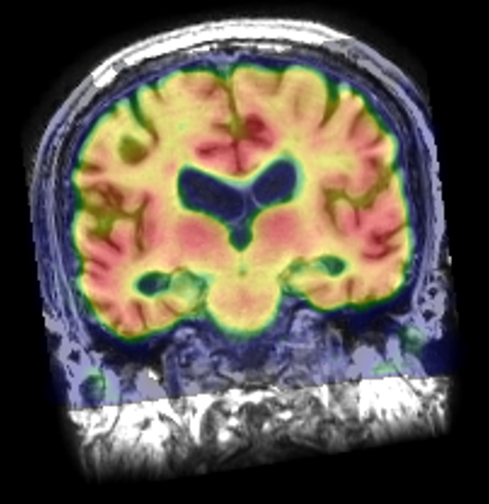
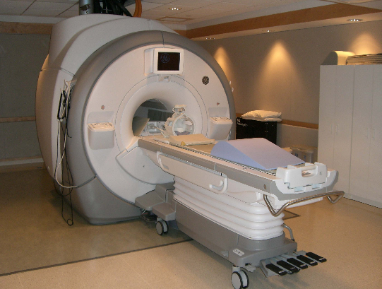
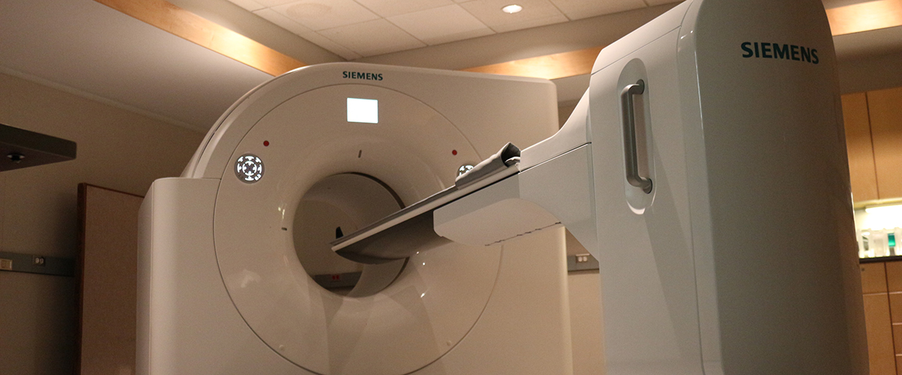
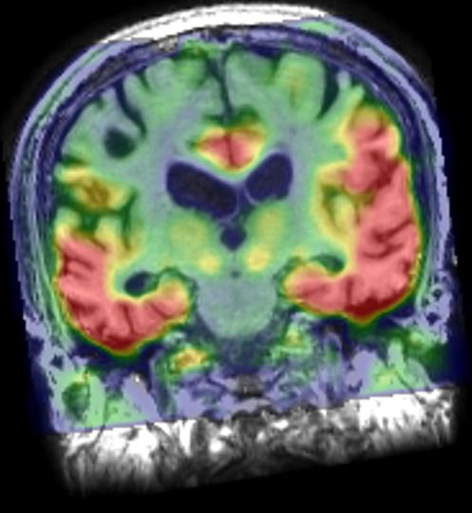
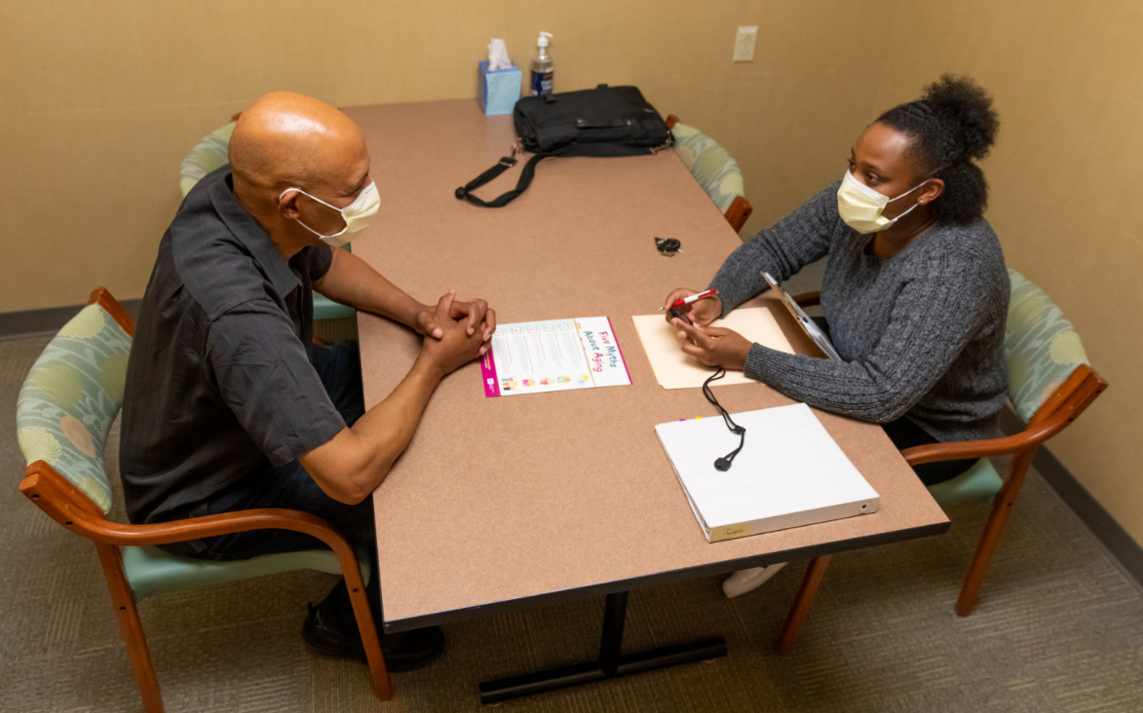
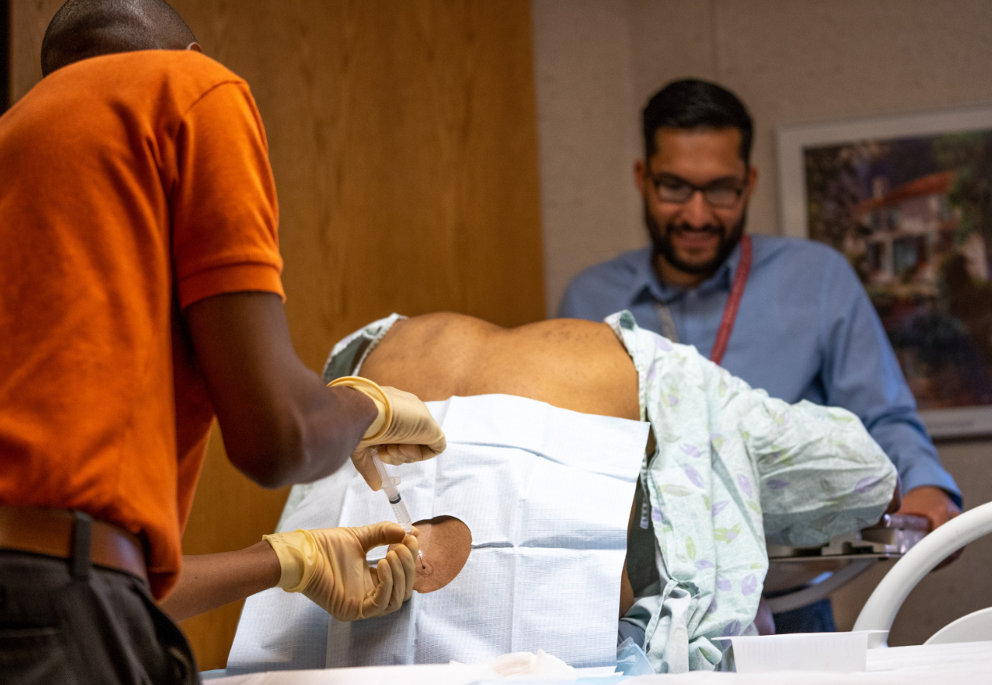
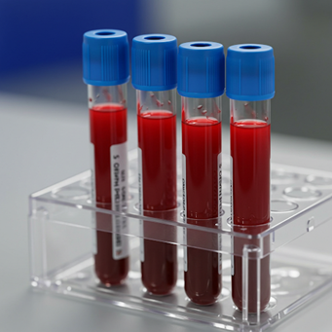
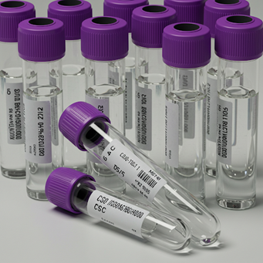
Notes:
Wisconsites – participants in long standing studies
MRI
PET
Cognitive testing
Lumbar puncture and blood draw

Slide 9


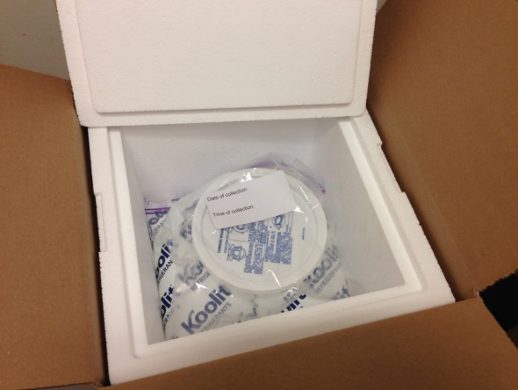
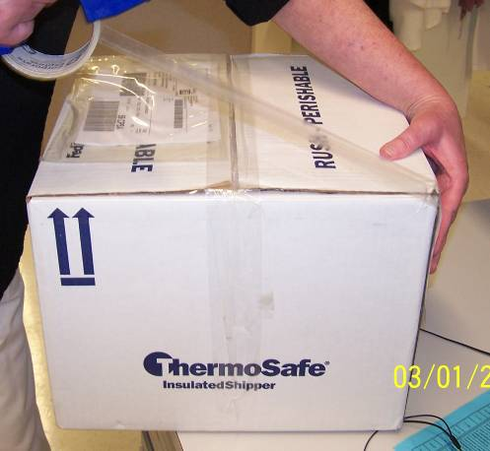


AGTC
16S ribosomal RNA
Mapping to reference catalogue
Metagenomics (function-based analysis)
Metabolomics, proteomics, lipodomics, foodomics
Notes:
Study gut microbiome by collecting stool sampls
Genetic analysis to identify microbes

Slide 10


AGTC
Performed bacterial 16S rRNA sequencing on DNA isolated from stool
Compared age- and sex-matched AD participants 1-to-1 with asymptomatic participants
Diversity and Abundance
Notes:
Compared people with and without AD dementia
People who were asymptomatic but starting to show brain changes
Diversity and abundance

Slide 11
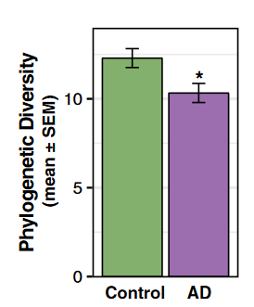
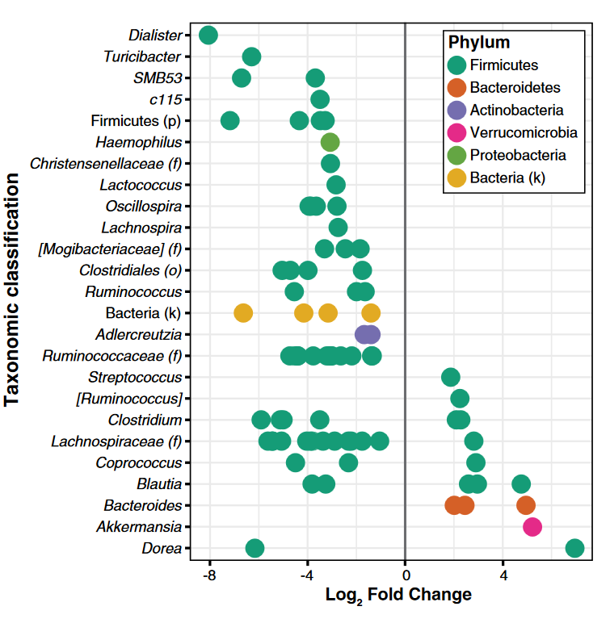

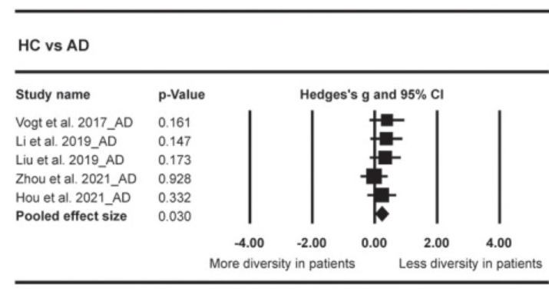
Increased Bacteroides and decreased Bifidobacterium
Vogt et al. Gut microbiome alterations in Alzheimer's disease. Sci Rep. 2017
Notes:
Lower diversity
Abundance of several microbiota in AD were decreased (68) And 14 increased
Decreased bifidobacterium, decreased firmicutes, and increased bacteroides at the phylum level
14 OTUs were increased and 68 OTUs were decreased in AD
Results replicated

Slide 12
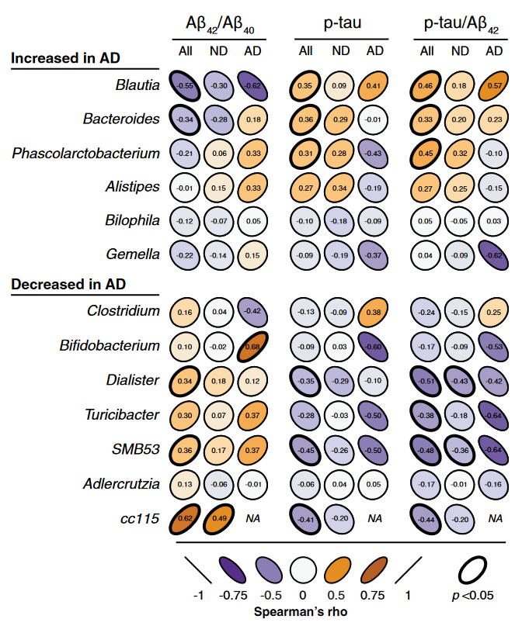
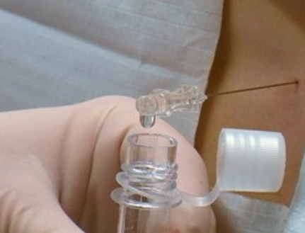

Vogt et al. Gut microbiome alterations in Alzheimer's disease. Sci Rep. 2017
Notes:
Abundance of bacteria were associated with biomarkers of Alzheimer’s among cognitively unimpaired participants.
Even among people with symptoms, abundance of bacteria linked to amount of pathology in brain

Slide 13
How do we change the gut microbiome?

Slide 14
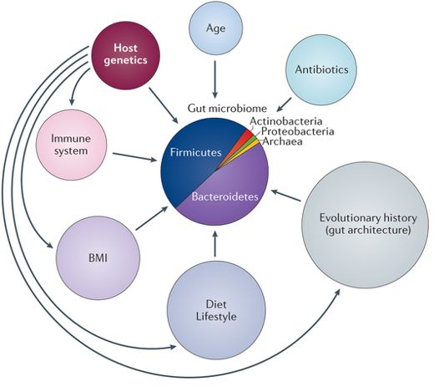
Modifiers of the gut microbiome
Genetics
Early life experiences
Age
Travel/Residence
Diet/Alcohol
Spouse/family members
Antibiotics
Probiotics
Gastric bypass
Disease
Pets
Nat. Rev. Microbiol. (2011)
Notes:
How do we change the gut?
The gut is influenced by early life, but changes throughout the life
Particularly interested in ways to increase diversity
Probiotics, or diet, or even microbial transplant

Slide 15
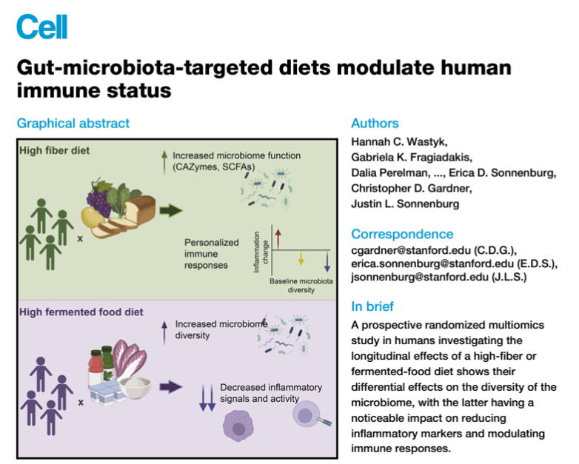


Notes:
Circling back to the theories of Elia Metchkinoff,
This study tested whether the gut microbiome and immune function can be modulated by a dietary intervention
Fermented foods increased diversity, not because the new microbes from the foods increased, but the fermented foods changed the gut to become more hospitable to a diversity of microbes. Even since Metchkinoff’s time, we have tools to better understand these early observations
gut microbiota play a direct role in modulating immune functions, influencing everything from inflammation to immune cell training.

Slide 16
Take aways
Gut microbiome plays a role in health outcomes, including brain and potentially longevity.
Opportunities for intervention.
Caveats: the gut microbiome is complex, we are only starting to learn how it might be modified for optimal health.

Slide 17


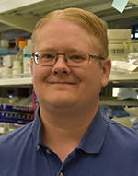




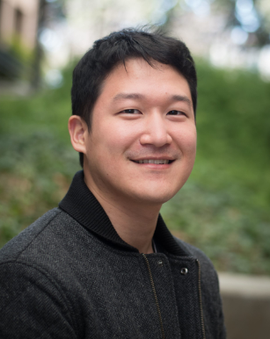








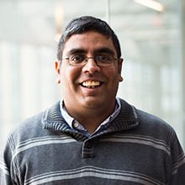


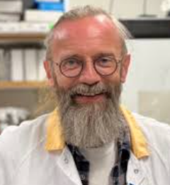








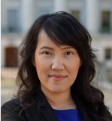

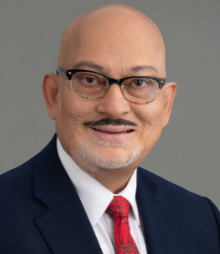

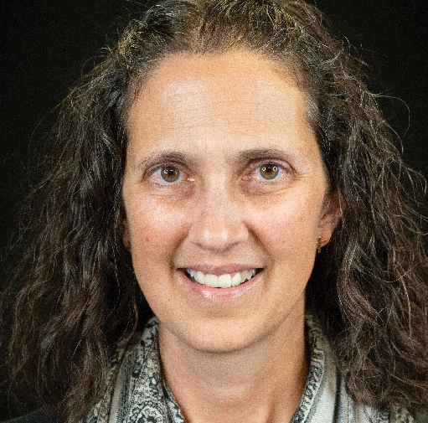



Thank you to our research participants and our funders!
Notes:
Acknowledgements
National Institute on Aging; Wisconsin Partnership Program; Microbiome Initiative; WRAP, Wisconsin ADRC; our participants!

