Slide 1
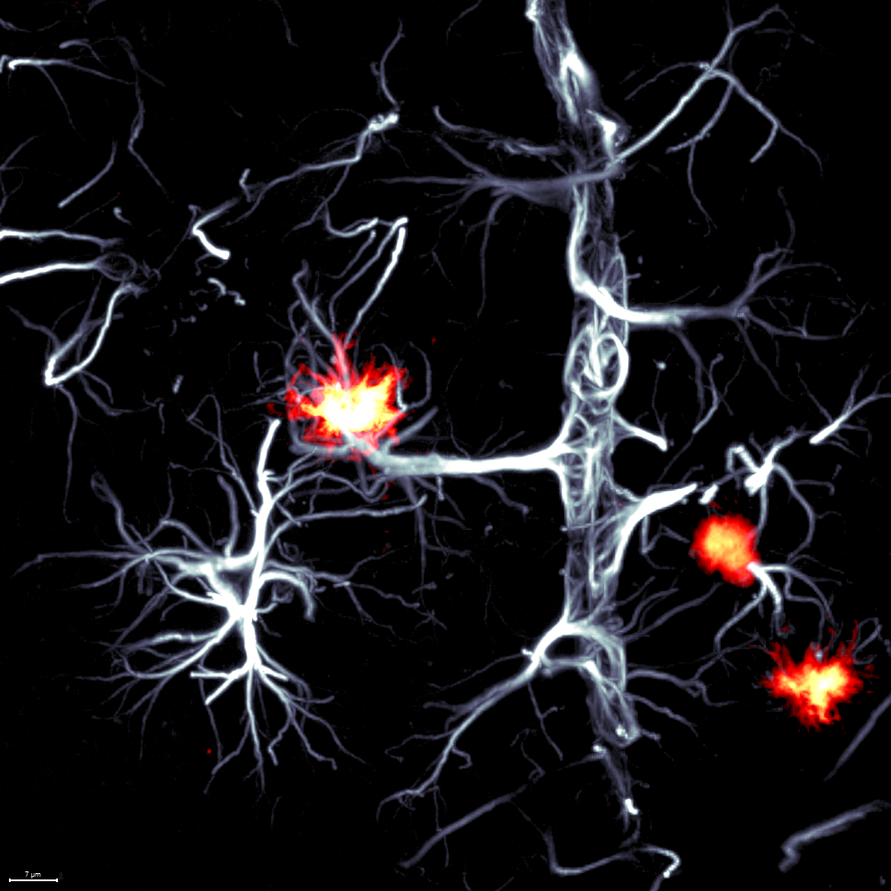
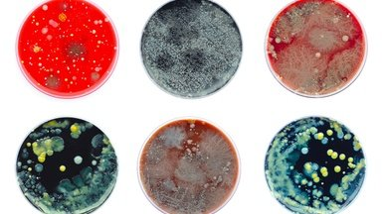
Gut Bacterial metabolism and Alzheimer's disease
Federico E. Rey, PhD
Departments of Bacteriology and Medical Microbiology and Immunology
University of Wisconsin
ferey@wisc.edu

Slide 2
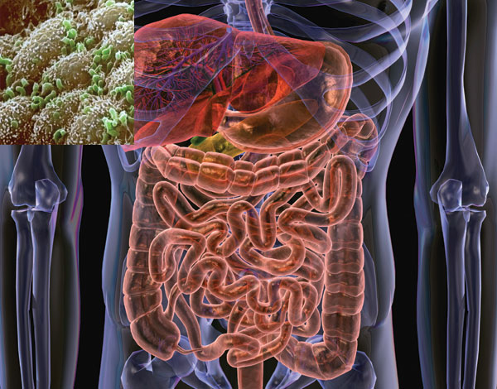
The gut microbiota
1x10¹¹ organisms per milliliter
~ 150 microbial species per individual (mostly bacterial, but archaea and eukaryotes are also present)
An enormous genetic repository (unique to each individual)
Distinct from our human genome in its origin, composition, and plasticity:
-Origin: at birth
-Content: Includes functions we did not have to evolve on our own (e.g. glycoside hydrolases)
-Plasticity: microbial community structure changes rapidly in response to diet
Notes:
Highly individual, modifiable

Slide 3
Microbiota stability
~60% of microbial strains harbored in each adult’s intestine are retained over the course of 5-8 year sampling periods
Notes:
stable

Slide 4
What are the consequences of our gut microbial differences?
Thousands of species capable of gut colonization; Each of us harbors a unique collection of 100-200 species of bacteria
How our microbial differences influence the metabolism of the food we consume? How this affects our health?
Hypothesis: The gut microbiome is a key determinant of how we respond to diet
Notes:
Lab question
Transition: think about your favorite food, this is my favorite meal

Slide 5
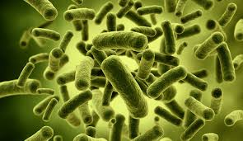
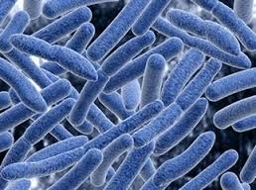
Gut bacteria produce metabolites that influence host biology
Flavonoids
( e.g.,anthocyanins)
Complex plant polysaccharides
3,4-Dihydroxybenzoic acid and other phenolic acids
-Prevents atherosclerosis
Short Chain Fatty Acids:
(e.g., acetate, propionate, butyrate)
Epigenetic regulation
Immunomodulatory properties
Modulate intestinal motility
Modulate insulin sensitivity
Regulate blood pressure
Choline/carnitine/histidine
TMAO, ImP
Detrimental effects in CMD
Cao et. al 2023; Kasahara et al 2019; Haș IM, 2023;
Notes:
Each component of this meal, and basically anything can be ,etabolized by microbes and converted

Slide 6
How does bacterial metabolism influence AD? Correlation to causation
[Disease models]
5xFAD mice (Amyloid- β)
PS19P301S (h-Tau)
Primary brain endothelial cells
[Hypothesis generation]
[Validation]
Metabolite/ bacterial culture
Identification and isolation
Dosage
Toxicology
[Associations]
AD Biomarkers, bacterial taxa,
Neuroimaging etc
[Mechanistic studies]
BBB permeability
Histopathology
Notes:
So we are interest

Slide 7
Higher blood levels of imidazole propionate (ImP) are associated with cognitive decline
ImP
ImP
ImP
Score Cognitive test 1
Score Cognitive test 2
Score Cognitive test 3
The abundance of bacteria capable of ImP production are positively associated with markers of neuronal damage
Notes:
Patients with higher recorded ImP levels display lowered neurocognitive health outcomes
Memory: Recall, recognition, and sequencing
Language: Understanding, speaking, and writing
Attention: Focus, concentration, and switching tasks
Visuospatial abilities: Perception, navigation, and drawing
Executive function: Planning, problem-solving, and decision-making

Slide 8
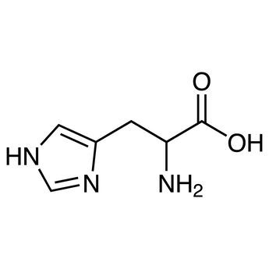
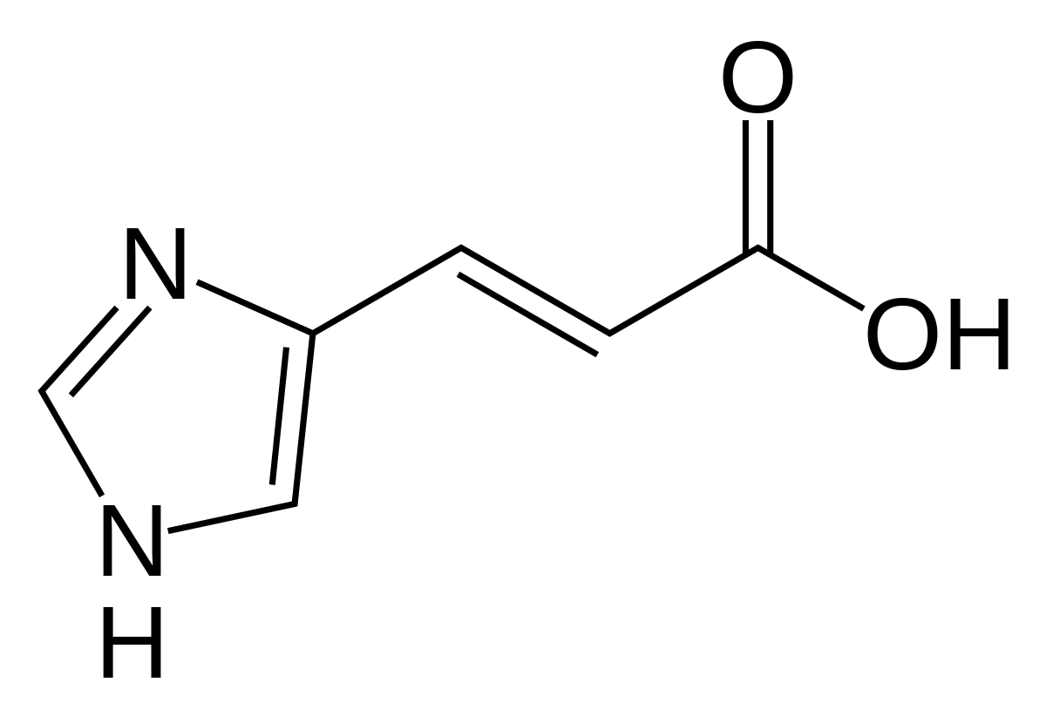
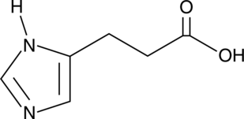
Imidazole propionate (ImP) is a bacterial metabolite derived from histidine
Histidine ammonia lyase
Urocanate Reductase
Histidine
(Host and gut-bacterial)
Urocanate
(Exclusively gut-bacterial)
Imidazole Propionate
(ImP)
Notes:
Dietary histidine

Slide 9
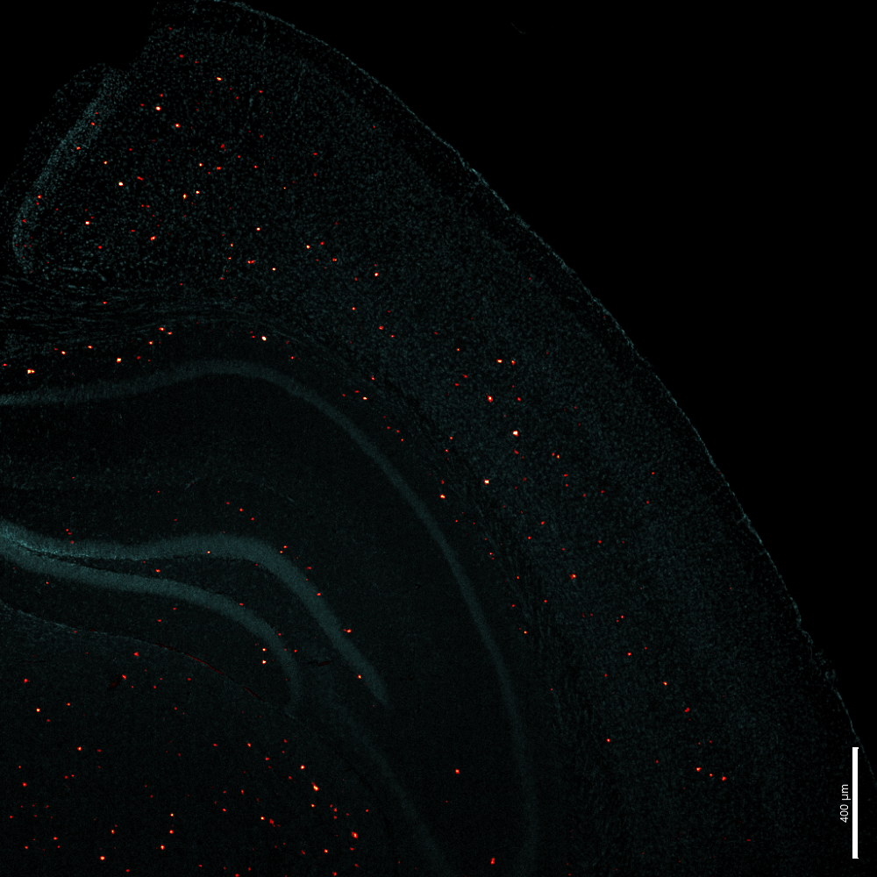
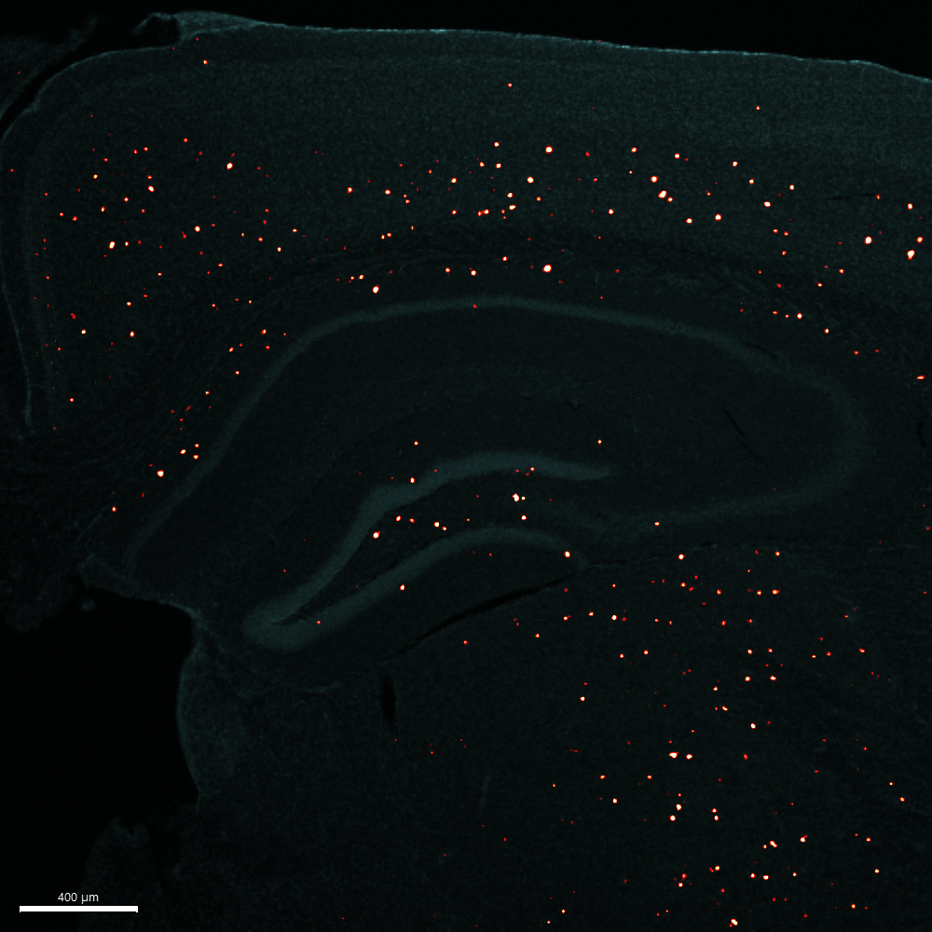
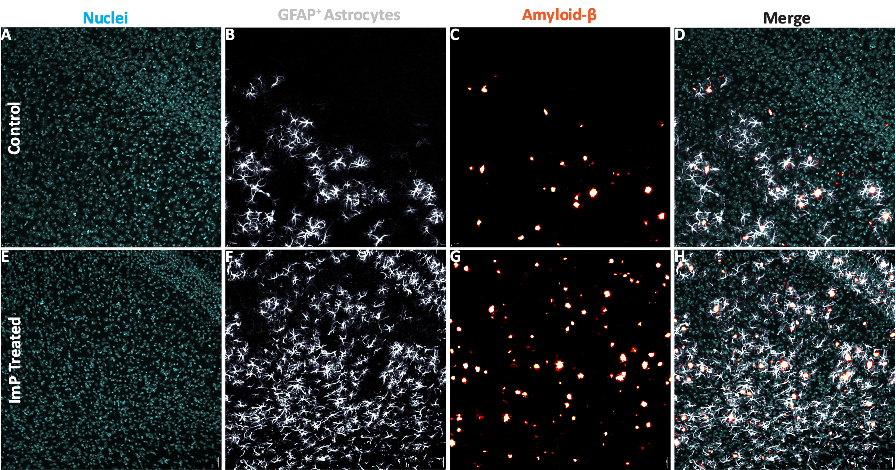
Chronic ImP exposure exacerbates Alzheimer’s disease neuropathology in mice
Notes:
Exacerbated cortical neuropathology – describe histology
40um sections – MethoxyX04 for Abeta
10x objective 4x objective

Slide 10
Pre-clinical studies support the idea that SCFA may slow down AD pathology
AD mice supplemented with butyrate show decreased levels of amyloid and proinflammatory cytokines in the brain
Butyrate and propionate protect brain endothelial cells from LPS-induced barrier permeability
Butyrate and acetate downregulate LPS-induced proinflammatory cytokine production by microglia
Jiang et al. 2021, Knox et al. 2022, Caetano-Silva et al. 2023,
Notes:
I told you about a potentially bad metabolites, they are bacterial metabolites that may be good

Slide 11
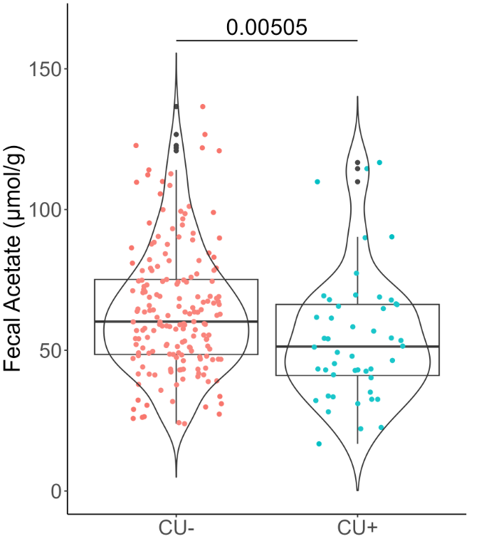
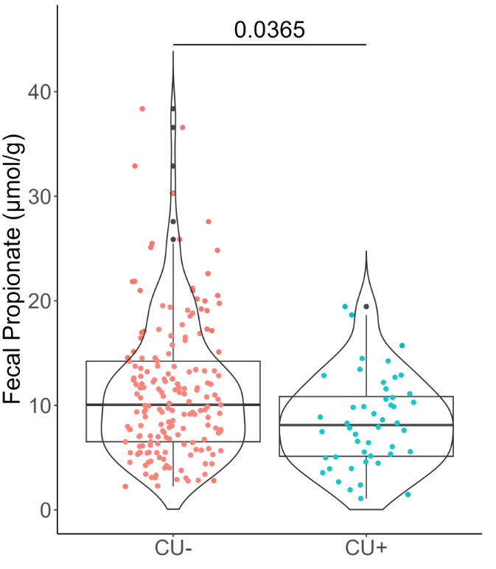
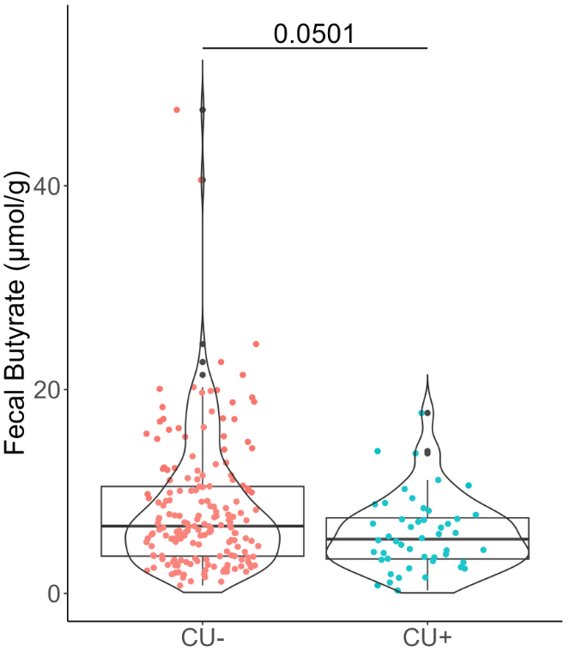
Short Chain Fatty Acids (SCFAs) levels are reduced in amyloid positive participants compared to healthy controls
Amyloid
negative
Amyloid
Positive
Amyloid
negative
Amyloid
Positive
Amyloid
negative
Amyloid
Positive
Butyrate and propionate-producing bacteria have reduced relative abundance in participants with amyloid positive status (n=315)
created with Biorender.com

Slide 12
Take-home message
Associations between the abundance of gut bacteria and their metabolites with AD pathology in humans.
Mouse studies support a causal role of bacteria or bacteria-derived metabolites (disease trajectory).
Many microbial metabolites likely affect disease progression. More research is needed.

Slide 13
Microbiome-centered interventions
Dietary fiber
Fermented foods
Probiotics

Slide 14
Microbiome-centered interventions
Dietary fiber
Fermented foods
Probiotics

Slide 15
Microbiome-centered interventions
Dietary fiber
Fermented foods
Probiotics
Fecal Microbiota Transplants
Live biotherapeutic products: Rationally designed, defined bacterial consortia to treat a variety of diseases (Medicinal Ecology)
Drugging the microbiome

Slide 16
Collaborators:
Barbara Bendlin, Tyler Ulland, Alan Attie, John Denu, Daniel Amador-Noguez (UW-Madison)
Fredrik Bäckhed (U of Gothenburg)
Jake Lusis (UCLA)
Stan Hazen (Cleveland Clinic)

Slide 17
Image: Bryce Richter
Gnotobiotic mouse models are useful to dissect interactions between specific bacterial pathways and components of the diet.

