Slide 1
The 2024 CHARLOTTE ZOLOTOW LECTURE

Slide 2
WELCOME
Tessa Michaelson Schmidt Director Cooperative Children’s Book Center

Slide 3
INTRODUCTION
Francesca Rodriquez Manager of Strategic Initiatives Dean’s Office, School of Education University of Wisconsin-Madison

Slide 4
MEG MEDINA The 2024 Charlotte Zolotow Lecture

Slide 5
WRITING THE TRUTH IN CONTENTIOUS TIMES
MEG MEDINA
2024 Charlotte Zolotow Lecture

Slide 7
How

Slide 9
How have you used books across all stages of your life?

Slide 20
A Writer’s Clave
GIRLS, CULTURE, GROWING UP AND FAMILY

Slide 23
Top 10 most challenged books 2023
Source ALA Freedom to Read

Slide 25
Remittances
Writing letters to home country
Longing for connection/family

Slide 26
Dear Aunt Eloy,
Your niece, Lidia is at my house with my mother and I am with my grandmother. Lili sends kisses and I send kisses, too. My uncle taught me how to write in Spanish. Tell Adita to write to me. Kisses from Lili and Margaret

Slide 27
Different family structures
Spectrum of Latine identities
Moving/separation

Slide 34
Connect with Meg
www.megmedina.com for Sobremesa newsletter
MEGMEDINABOOKS
Let’s Talk Books on
the Library of Congress/ YouTube

Slide 35
THANK YOU!

Slide 37
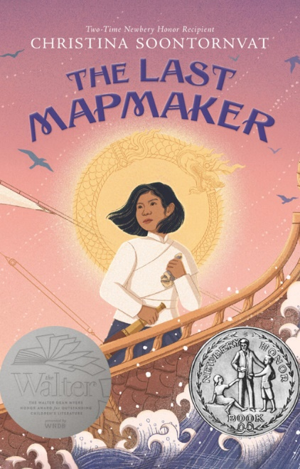
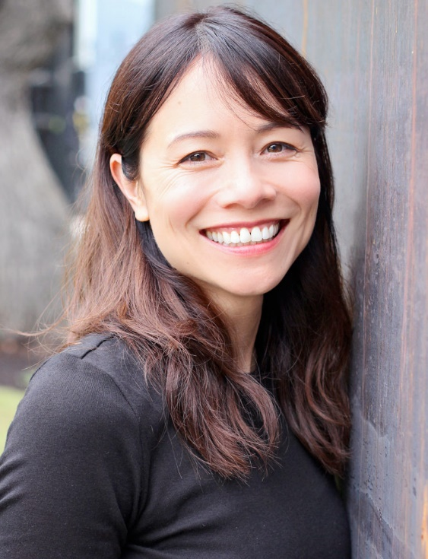
2025 Charlotte Zolotow Lecturer
Christina Soontornvat
Photo: Sam Bond Photography

Slide 38
Save the date for next year’s Charlotte Zolotow Lecture!
October 16, 2025

