Slide 1
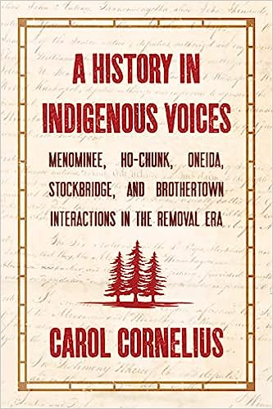

Slide 2
INDIGENOUS VOICES
I’ve read many books on our history written by others. They quote a sentence or two from our ancestors and that’s it. I wanted to hear the voices of our ancestors. Thank goodness for footnotes!
I call myself a gatherer because I spent 10 years searching historic documents to find the voices of the Indigenous Nations involved in these treaties.

Slide 3
“LAND, LAND IT’S ALL ABOUT LAND”
Indian Nation to Indian Nation treaties were made in 1821 and 1822, 1825
and after these treaties - all treaties were made with the United States.
Major treaties from 1821 – 1838
In Treaty after Treaty Indigenous Nations lands were taken.
- LORETTA METOXEN, ONEIDA HISTORIAN

Slide 4
UNITED STATES CONSTITUTION
ARTICLE VI, second paragraph
“The Constitution, and the Laws of the United States which shall be made in Pursuance, thereof;
and all Treaties made, or which shall be made, under the Authority of the United States,
Shall be the supreme law of land;”

Slide 5
UNITED STATES INDIAN REMOVAL POLICY
In 1830 the Indian Removal Act was passed. The goal was to remove all Indians from the East to beyond the Mississippi River to land that would be called Indian Territory.
Removal of the Oneida, Stockbridge and Brothertown from New York to Wisconsin had already started in the 1820’s.
The United States continued trying to remove the Menominee, Winnebago, Oneida, Stockbridge, Brothertown well into the 1850’s removal treaties.

Slide 6
INDIGENOUS LANDS IN WISCONSIN

Slide 8
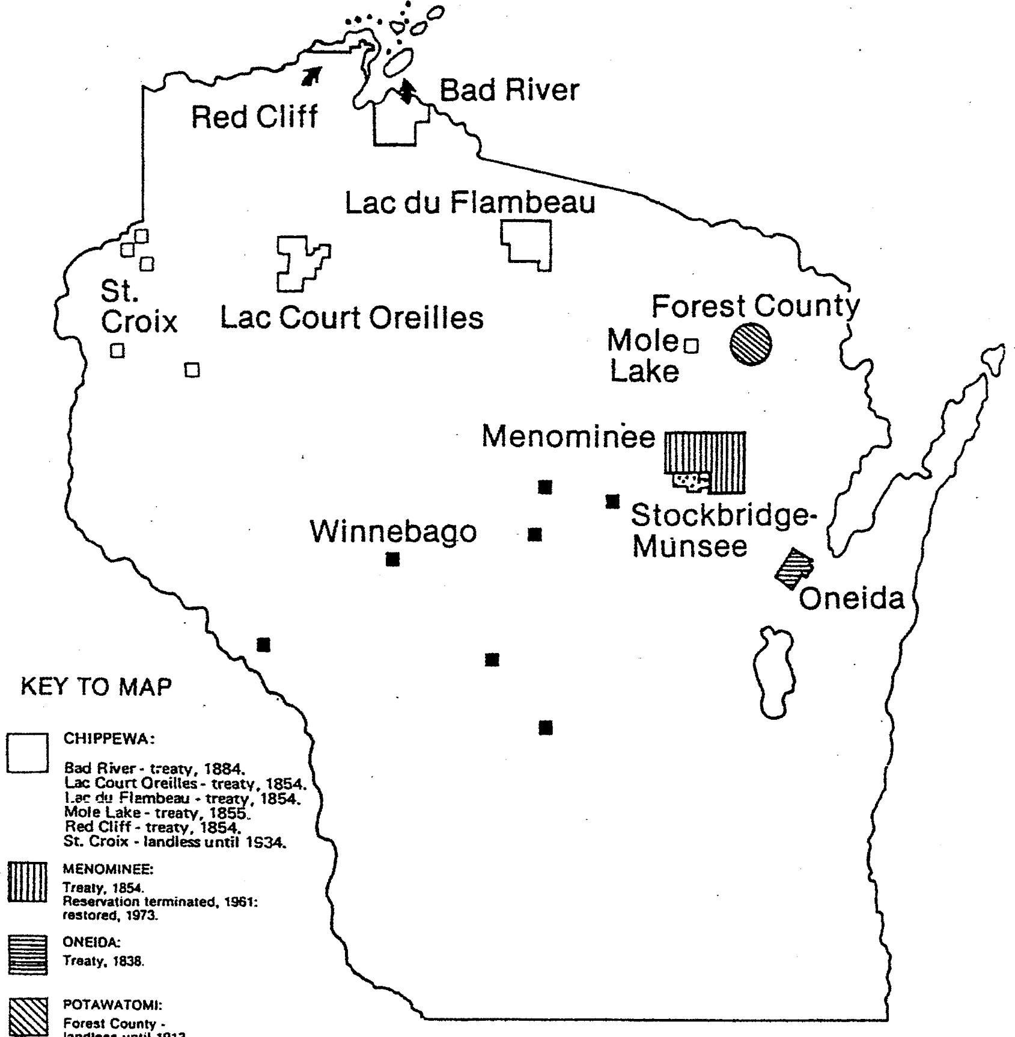
landless
until
1913

Slide 9
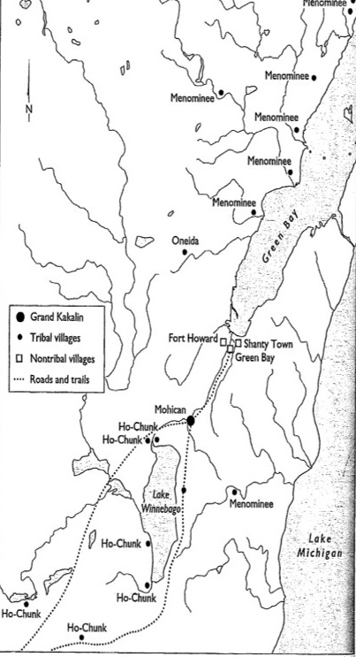
MENOMINEE VILLAGES 1820

Slide 10
Indian Nation to Indian Nation Treaties
1821 Treaty of Green Bay with Menominee, Winnebago, and New York Indians
1822 Treaty with New York Indians and Menominee
1824-25 New York Indians Treaty with the Brothertown
Indian Nation to Indian Nation treaties were not subject to Congressional approval
because they were treaties between Indian Nations and did not involve the United States,
therefore, President Monroe signed his approval of both the 1821 and 1822 treaties.

Slide 11
MENOMINEE STATEMENT 1820
“We disapprove of what has been done by the Agent, and of the conduct of those of our nation, who treated with him, and sold our lands without our consent.”
They were informed that Mr. Williams, with a number of the Chiefs of the Six Nations, were on their way to Green Bay, to look out for a place of settlement for themselves, and such others of their tribes, as might be disposed to migrate and settle with them. Should they be pleased with the country, they were asked, will you sell, or give them lands on which they may settle?
Father, In regard to the Delegates from the Six Nations, we Menominee have no enemies. We are ready to give them our hand. But in regard to a piece of land to give them, we know not what to say, our Territory is so small.
Father, I listen always to what the white people say, but I do not want to do as some of our foolish people have done. I do not want to take on myself, or to have those with me of the disposition, to steal a piece of land (*alluding to the sale of a large tract of their land, by a minority of the nation, in opposition to the will of the majority.) but if all our nation were together, we would know what to do.

Slide 12
New York Indians reply:
Our Great Father, The President of the United States gave to the Six Nations his consent that they should move to the west, if they could obtain lands from their brothers there.
We have been informed on good authority that the lands at Green Bay, which we hope to obtain, have been purchased by the Great Father’s Agent at that place.
We shall expect that you Father, and our Great Father the President of the United States, will remove these obstacles out of the way, that your children may get quiet possession of the land which they have been encouraged to expect.
Father, We wish peace — we wish to obtain a place to get our foot on peaceably, and to live in friendship with our brothers of the west, and our Great Father, the President.

Slide 13
Indian Nation to Indian Nation 1821 Treaty
Treaty of Green Bay between the Menominee and Winnebago Nations
and the Brothertown, Munsee, Oneida, Stockbridge and Other New York Indian Nations
August 18, 1821

Slide 14
Boundaries and Usage in 1821 Treaty
Beginning at the Foot of the Rapid of the Fox River, usually called the Grand Kakalin, thence up said River to the Rapids at Winnebago Lake, and from the River extending back in this width on each side, to the Northwest and to the Northeast equi-distant with the lands claimed by the said Menomine and Winnebago Nations of Indians.
Article 2 Menominies and Winnebagoes shall reserve to themselves the right to occupy a necessary proportion of the Lands hereby ceded, for the purpose of hunting, and also the right of fishing”

Slide 15
Articles of a Treaty September 23, 1822
Lists for each Nation names of those present, many names are in Indigenous language
Mucheconnuk or Stockbridge nation or tribe of Indians (4)
Oneida first Christian party Oneida Nation (2)
Tuscarora nation or tribe of Indians (1)
Eleazor Williams to represent St. Regis (1)
Munsee nationone representative (1)
and the chiefs and head men of the Menominee nation of Indians (10)

Slide 16
Articles of a Treaty September 23, 1822
Article II
“The Stockbridge, Oneida, Tuscarora, St. Regis and Munsee nations aforesaid, do promise and agree to and with the said Menominies, that they, the said Menominies, shall have the free permission and privilege of occupying and residing upon the lands hereby ceded in common with them…”
This tract covered at least 4 or 5 million acres

Slide 17
THE CONTROVERSY
THE MENOMINEE THOUGHT THEY SIGNED A TREATY TO SHARE LAND IN COMMON WITH THE NEW YORK INDIANS.
THE NEW YORK INDIANS THOUGHT THEY HAD PURCHASED THE LAND.
The Indian Nation to Indian Treaties signed by President Monroe 1821 and 1822 were disputed throughout the treaties from 1825-1838

Slide 18
MENOMINEE PROTEST 1824
To the secretary of war June 16, 1824 - The Memorial and petition of the undersigned chiefs and principal men of the Menomine nation of Indians, residing with the Michigan Territory, represents:
“That when the New York Indians, or Nautoways, first came to this country they asked the Menomonies to sell to them a small piece of their lands. That the Menomines replied to them, they had no land to sell; that their country was already too small for their numbers, and that they were themselves compelled to hunt upon other Indians’ lands. That, notwithstanding this answer, the Nautoways held a treaty with some of the men of the Menominie nation, at which none of the principal chiefs attended, and purchased, or pretended to purchase, a part of the Menomonies’ country, the boundaries of which they knew nothing about.”

Slide 19
TREATIES WITH THE UNITED STATES
1825 The United States entered into a treaty with the Chippewa, Sac and Fox, Menominee, Ioway, Sioux, Winnebago, and a portion of the Ottawa, Chippewa, and Pottawatomie tribes to define their boundaries.
1827 “The representatives of the Menominies not being sufficiently acquainted with their proper boundaries, to settle the same definitively, and some uncertainty existing in consequence of the cession made by that tribe upon Fox River and Green Bay, to the New York Indians.” Therefore, the final decision on land for the New York Indians was assigned to the President.

Slide 20
NEW YORK INDIANS
The 1827 treaty at Butte des Morts was an astonishment and a grievance because the same lands they bought in the 1821 and 1822 treaties were being sold to the United States.
“This purchase of our lands was made, not only without our consent and contrary to our most earnest wishes, but also without even consulting us at all! We were not allowed a hearing nor even asked whether we would consent to sell or not.”

Slide 21
1829 PETITION BY NEW YORK INDIANS
A petition was signed by John Metoxen and Austin Quinney (Stockbridge), as representatives of the New York Indians:
“A second permission was obtained of the President of the United States to make a second treaty (1822) to purchase land, and we purchased of the Menominie Indians a large tract of land lying on both sides of the Fox River and Green Bay, to be occupied in common with us, they have the right to settle thereon, wherever it should be agreeable, not interfering with our settlements.
But how great was our surprise and sorrow, when at the late treaty held by Excellency Gov. L. Cass, and Colonel Thos. L. McKenney, at the Little Butte de Morts (in 1827) , our lands were purchased by them as Commissioners of the U.S. and thus our hopes of security in this last refuge destroyed.”

Slide 22
1830 The Three U.S. Commissioners
According to the 1827 Treaty, the decision on lands for the New York Indian was left to the discretion of the President. He assigned three commissioners to meet in council with the Menominee, Winnebago, and New York Indians (Oneida, Brothertown, Stockbridge, St. Regis and Munsee.) AUGUST 24, - SEPTEMBER 1, 1830
John Quinney Stockbridge presented a sophisticated document outlining the New York Indians legal understanding and claims.
Potential boundaries for the New York Indians land were presented by U.S. Commissioners, Menominee and Winnebago, and New York Indians. Discussion went back and forth, but agreement could not be reached.

Slide 23
Evidence presented by New York Indians to support their claims
PRESUMPTIVE Quinney provides a sophisticated discussion on the doctrine of discovery and the precepts of western civilization. Presumptive means supposed presumptions made about civilized and barbarous peoples. He asks if it is presumed the New York Indians would leave their climate in New York State in exchange “for an insecure abode in this inhospitable region.”
CIRCUMSTANTIAL refers to the circumstances surrounding the treaties. Menominee “that when a white man puts his fingers upon our lands, he had long nails, & they go deep, and is hard to get them out. You have had sad experiences that this is true. You have told us, the white people have got your lands. And you have come to seek an asylum among us. For which we are glad, that you thought of us.” “a tenancy in common was agreed upon between the parties.
DOCUMENTARY refers to the conditions surrounding the making of treaties. Ie. Who signed – valid Chiefs or appointed by U.S.; French interference; treaties signed by the President disregarded; U.S. wanted the land

Slide 24
1831 and 1832 Menominee Treaties
Menominee go to Washington, write letters to the President,
In the 1831 treaty 500,00 acres was identified for the New York Indians, Menominee lose millions of acres.
The 1831 treaty designated two townships for the Stockbridge, and one township for the Brothertown
The issue that was controversial was the New York Indians request to exchange 200,000 acres of the colder northern land for 200,000, for better agricultural land on the south end of the 500,000 acres.
The 1832 settled the controversy be exchanging the 200,000 acres.

Slide 25
REMOVAL POLICY OF U.S. CONTINUES
Despite opposition, the U.S. continues making treaties to remove the New York Indians to the West.

Slide 26
Treaties continue, threats of removal
Oneida treaties
1836 Suydam treaties with Stockbridge and Oneida for removal to the West, never ratified.
1838 Buffalo Creek planned to remove of all Six Nations to the West
1838 Oneida, Feb. 3, 1838 Oneida, WI final treaty for 65,400 acres

Slide 27
Menominee Treaties
The approximately 10 million acres of Menominee land was reduced through treaties from 1821 to 1856.
1821 and 1822 treaties with New York Indians, boundaries defined but changed by the President and it remained unsettled what lands would be designated for the New York Indians
1825 and 1827 Treaties ceded one million acres of land lying between Lake Winnebago and Green Bay to the U.S.
1831 and 1832 treaties, 500,000 acres for New York Indians, two townships for Stockbridge and one township for the Brothertown. 2.5 million acres ceded to U.S.
1836 Treaty of the Cedars ceded about 4 million acres most of their land in northeastern Wisconsin and a small strip along the Wisconsin River.
1848 Treaty of Lake Poygan was designed to remove the Menominee to the west to Minnesota. They didn’t move.
1854 Treaty Lands on the Wolf River, 270,000 acres.
1856 Treaty for two townships for the Stockbridge.

Slide 28
Stockbridge Treaties
1831, two townships on the east side of Winnebago Lake.
1839 Treaty with U.S. ceded land, and two divisions came about as some Stockbridge wanted to stay in Wisconsin, and some Stockbridge removed to Indian Territory (Kansas and Oklahoma)
1843 “An Act for the relived of the Stockbridge tribe on Indians in the Territory Wisconsin” allotted their land , changed their government to an elected system, made them citizens, and they were terminated!
1846 The above Act was repealed and they “were restored to their ancient form of government, will all powers, rights, and privileges, held and exercised by them under their customs and usages…”
1848 Treaty to remove the Stockbridge to the West. Indian Party and the Citizen Party disagreed on removal. They were to cede all their lands on the east side of Lake Winnebago.
1855 unratified treaty
1856 Treaty relinquish all lands east of Lake Winnebago and were to receive two townships of land near the southern boundary of the Menominee reservation.
1934 Indian Reorganization Act government changed to elected system. Some land repurchased.

Slide 29
HoChunk (Winnebago) Treaties
The history of the Ho-Chunk Nation tells of many, many removals, resistance, and their survival as an Indigenous Nation in Wisconsin. In historical documents they are identified as the Winnebago, and in 1994 they return to their original name.
“The Ho-Chunk Nation’s ten million acres of ancestral land, between the Mississippi and Rock Rivers, were recognized in treaties with the United States,“ as told by Andy Thundercloud. Lead miners invaded their lands and the U.S. wanted their lands.
1825 and 1827 treaties to establish boundaries between Indigenous Nations in Wisconsin
1829 Treaty Prairie du Chien. The original treaty had a Wampum String attached to the top, and Winnebago cede land with promise of $18,000 yearly for 30 years.
1832 Fort Armstrong, Rock Island, Illinois the Winnebago cede all their lands east of the Mississippi and south of Wisconsin river., and removed to the Neutral Ground west of the Mississippi and included lands in southeastern Minnesota and Northeast Iowa.
They were told to remove by 1833 and they could no longer plant, fish, or hunt in the ceded territory. Provisions were to be provided, but they had to sign the treaty, and only those who signed the treaty would receive the provisions.

Slide 30
1837 and 1846 Treaties ceded their lands and relocated them to Long Prairie Minnesota. They are heart wrenching accounts of the removal and being loaded onto wagons and railroad cars.
1855 Treaty, yet another removal from Minnesota
1846 Treaty Winnebago cede all their inlands including the Neutral ground from the 1832 Treaty for lands in Blue Earth Minnesota.
1859 Treaty allotment of their lands to individuals
1863 Moved to Crow Creek, South Dakota and many perished, or fled to the Omaha reservation in Nebraska.
1862 U.S. Homestaead Act, those who resisted removal were able to acquire homestead scattered throughout southwestern Wisconsin
1881 Congressional legislation allowed them 40 acres for homesteads again scattered in Wisconsin
1963 The Winnebago Consitution was ratifed which ensured federal recognment.
1974 The Winnebago won $4.6 million through the Indian Claims Commission to “compensate the tribe for its lands lost through fraudulent treaties.”
Today, land base includes 3, 535 acres of trust lands, and 5,328 acres of fee simple.

Slide 31
Brothertown Nation
1831 and 1832 Treaties with the Menominee and U.S., they had one township on the east side of lake Winnebago. However, under threat of further removal to Kansas, the decision was made to become citizens of the United States which ended their recognition as a Nation by the United States.
However, they continue to meet as the Brothertown Nation and have sought to be recognized by the U.S. for many, many years. The battle continues.

Slide 32
STAMBAUGH STATEMENT
“I believe the Menomonie tribe of Indians have been most shamefully deceived both by the agents of the New York Indians and by their own agents and advisers.
I believe the New York Indians have been duped and deceived by their own agents,
and I am sorry to say the Government appears to have participated in the deception.”
Office of the Indian Agent, S.C. Stambaugh to President Jackson,
September 8, 1830
The Indian Removal Act was passed by Congress in 1830

